Slide 1
Enabling Efficient SpMM for Sparse Attention on GEMM-Optimized Hardware with Block Aggregation
Presenter: | Tianchu Ji
Authors: | Tianchu Ji Niranjan Balasubramanian Michael Ferdman Peter Milder

Slide 2
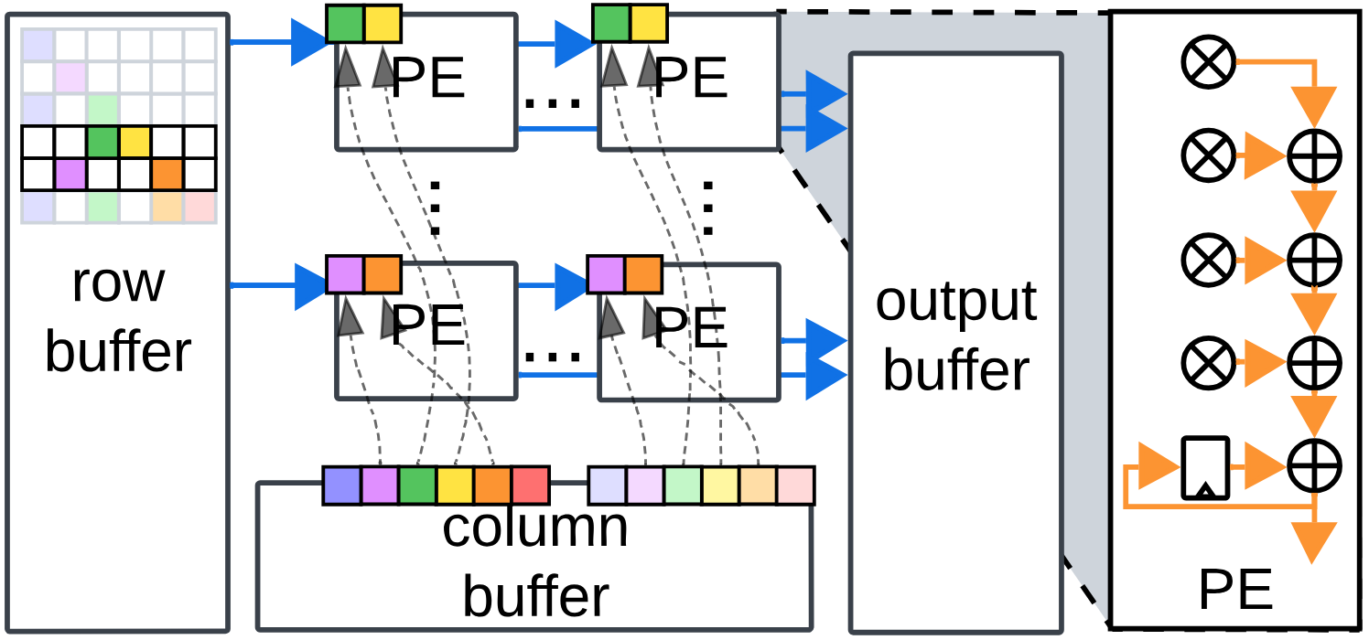
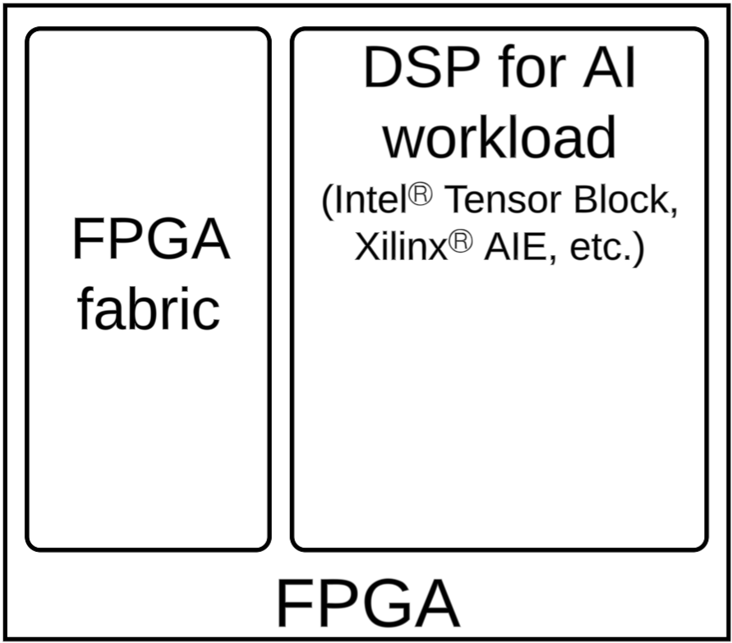
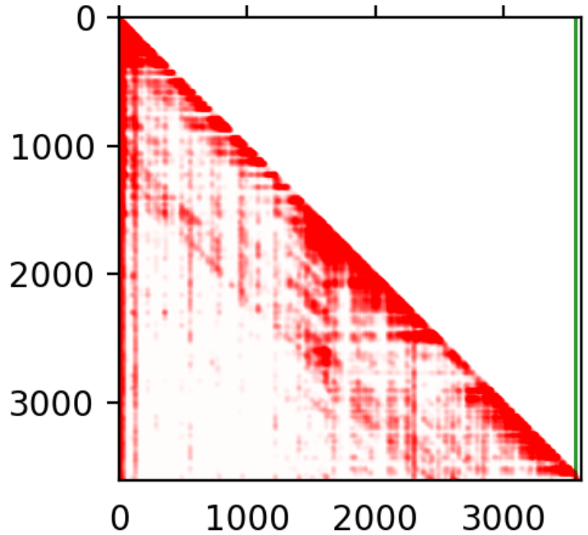

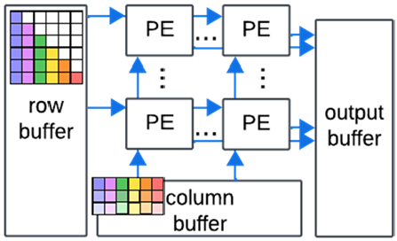

Overview
KV
SpMM => GEMM tiles
Q
Random data access breaks rigid paths
sparse attention
Background
GEMM-optimized hardware requires rigid data flow for best efficiency
Problem & Motivation
Sparse attention helps speed up LLMs, but leads to hardware inefficiency
Method
Block aggregation: preserve rigid data flow by transforming SpMM to GEMM
Notes:
Our work starts on making a key observation that sparse attention computation in the LLM contradicts with the rigid data path in the existing hardware;
This conflict potentially undermines the frequency, dynamic utilization and throughput of the LLM accelerator.
Our method, named as block aggregation, solves this problem by dynamically collects and aggregates the dense vlues to form small GEMM tiles.
By doing so, the hardware executes SpMM just like computing small tiles of GEMM, thus re-enabling the efficiency of the rigid data path.
Our experiment shows our block aggregation technique achieves higher frequency, throughput and scalability compared to the existing works.

Slide 3
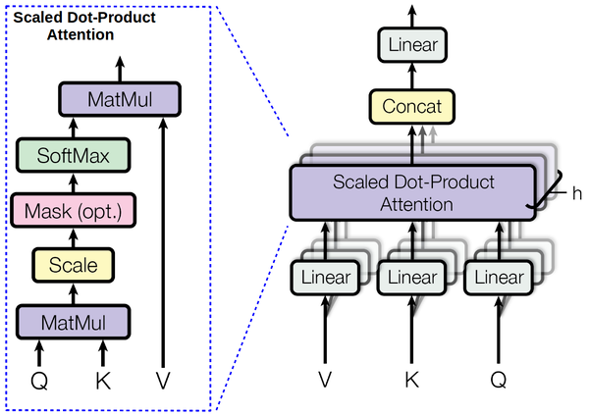
Intro
Problem: attention is compute-intensive
O(n²) complexity
relative to context length
LLMs use increasingly longer context lengths
… leading to much higher computational complexity
Self-attention pipeline
(Vaswani et al. 2017)
Notes:
Large Language Models have shown their eye-catching capability on many Natural Language Processing tasks including Machine Translation, Summarization, etc.
To further improve such a capability, recent LLMs intend to support longer context lengths so it can get a broader view of the inputs.
However, this strategy also increases the computational complexity of the LLM.
The main reason is that, the self-attention has a compute intensive GEMM operation.
The runtime of this operation increase quadratically as the context length n grows and finally dominates the runtime of the entire pipeline.
It is vital to optimize this computation to alleviate the computational complexity.

Slide 4
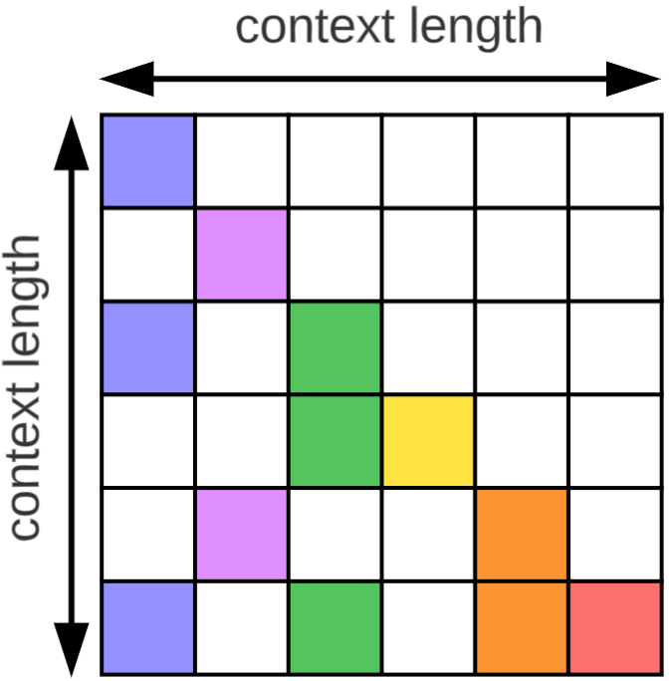
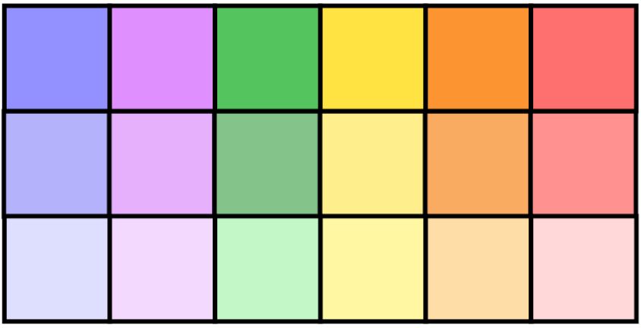




Background & Motivation
Sparse attention’s hardware dilemma
Sparse attention requires hardware for Sparse-Dense Matrix Multiplication (SpMM)
FPGAs can support irregular data access by their customizable logic
But SpMM suffers from inefficiency with GEMM-optimized hardware on FPGA
GEMM-optimized hardware is
inefficient for SpMM
$$×$$
map to
$$A_{sparse}$$
$$V$$
$$H=A_{sparse}×V$$
(elements with similar colors belong to same dot-product)
Notes:
A well-known technique to optimize the attention computation is to sparsify it.
It has been proven that the attention matrix is moderately sparse, and 80%~90% of its elements can be skipped to save the runtime.
However, it also transform the attention-related computation from GEMM to SpMM and forms irregular data access.
FPGA thus becomes a suitable platform for the sparse attention to efficiently computes irregular SpMM by its customizable logic.
Recent FPGAs begin to equip with special DSPs optimized for GEMM operation, challenging the existing customized SpMM solutions.

Slide 5
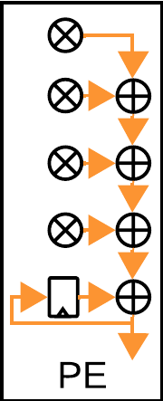
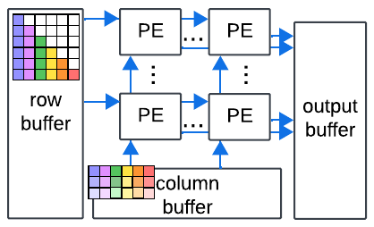

Background & Motivation
GEMM-optimized Hardware on FPGA
Each PE computes a vector dot-product
GEMM-optimized hardware features
A large cloud of PEs for faster computation
Achieves high bandwidth by data broadcast
Grouped AI data format (e.g., Intel Block Float, Nvidia Block Scaling)
Different PEs share
inputs for data reuse
GEMM-Optimized Hardware with Processing Element (PE) Array
Notes:
As is shown in this figure, GEMM-optimized hardware often contains a large cloud of processing elements (PEs), with each finishing a vector dot-product operation.
Examples can be systolic array such as TPU, or PE array with multi-cycle NoC such as Xilinx AI Engine, and Intel Tensor Blocks.
Such a kind of spatial structure amplifies the input bandwidth (in blue), and requires a highly efficient data path to distribute the matrix elements.
Recent AI hardware also requires sending a block-level scaling factor into the PEs, which further increases the input word size, and eventually the bandwidth of the PEs as well.
To fulfill with large bandwidth requirements, GEMM-optimized hardware tends to reuse and broadcast the data when possible, across the rows and columns of the PE cloud.

Slide 6
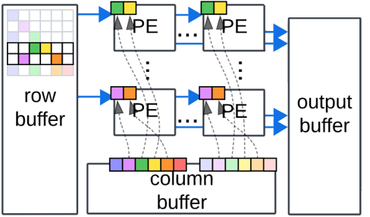
Background & Motivation
Sparsity is hard on GEMM-optimized Hardware
The PE array prevents the random access by SpMM:
Rigid data path conflicts with random pattern
GEMM-Optimized Hardware with Processing Element (PE) Array
Notes:
Unfortunately, sparse matrix multiplication owns a data access pattern which naturally mismatches with rigid data path, due to 2 major features of the GEMM-optimized hardware:
First, the skipped elements forms a random data access pattern from each PE to the data buffer, and precludes the reusable data access to different PEs.
Second, grouping the elements inside each PE challenges the zero-skipping on the element level.

Slide 7
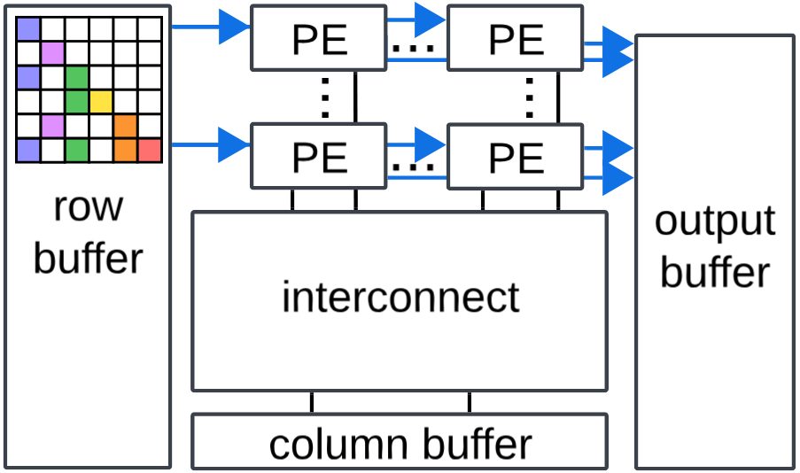
Background & Motivation
Sparsity is hard on GEMM-optimized Hardware
Flexible routing becomes cost-ineffective because:
PE array is so large
(e.g., 237,600 MACs on Intel Stratix® 10 NX)
Grouped inputs are too wide
(e.g., 88-bit word on Intel Stratix® 10 NX)
GEMM-Optimized Hardware with Processing Element (PE) Array
Notes:
Conventional effort to overcome these conflicts is to add flexible data access component to the hardware (in the figure, we use crossbar as an example).
However, since the PE array can scale up to really large, and the grouped inputs grows to many bits, flexible data access can become too complex and finally causes unacceptable frequency degradation or even routing failure.
As a result, on the GEMM-optimized hardware, the existing SpMM solutions become invalid.

Slide 8
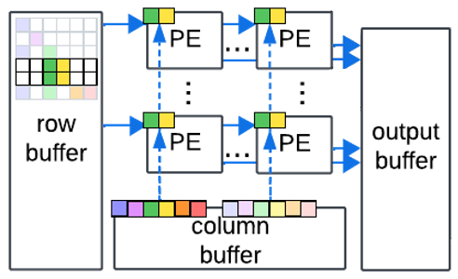
OUR APPROACH keep the data path, regularize the data flow
Find GEMM-like tiles in SpMM
GEMM-Optimized Hardware with Processing Element (PE) Array
Notes:
Our observation implies that, the shared data path must be remained to maintain the routability and the frequency of the design.
Instead of adding the cost-inefficient routing logic, we turn to regularize the data flow that can make use of the shared paths.

Slide 9

Method
Block aggregation: transform SpMM to tiny GEMM
KV
Existence of locally aggregated attention
Dense attention values form small clusters
Dynamically aggregate the blocks to form GEMM tiles
Aggregate separated blocks
Q
$$A_{sparse}$$
Notes:
Our method to regularize the data flow, is to reconstruct the data access manner of the GEMM for sparse attention computation.
The left figure shows an attention matrix, with dense values (in red) forming vertical and rectangular clusters.
Such a locally aggregated pattern is due to the nature of the attention mechanism.
Based on this, we adopt a new approach by dynamically aggregating the small pieces of the dense attention values into GEMM-like tiles.

Slide 10
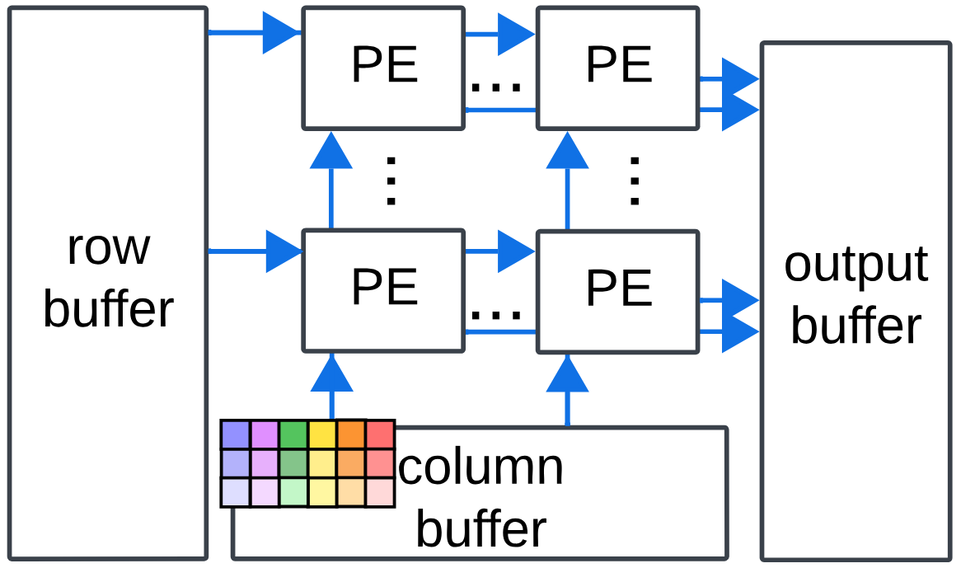
Method
Block aggregation: transform SpMM to tiny GEMM
recovers shared paths
KV
Dense attention values form small clusters
Dynamically aggregate the blocks to form GEMM tiles
Compute the GEMM tiles like a dense matrix
Q
GEMM-optimized hardware
$$A_{sparse}$$
Notes:
Our solution to this problem, is to reconstruct the data access manner of the GEMM for sparse attention computation.
The left figure shows an attention matrix, with dense values (in red) forming vertical and rectangular clusters.
Such a locally aggregated pattern is due to the nature of the attention mechanism.
Based on this, we adopt a new approach by dynamically aggregating the small pieces of the dense attention values into GEMM-like tiles.

Slide 11
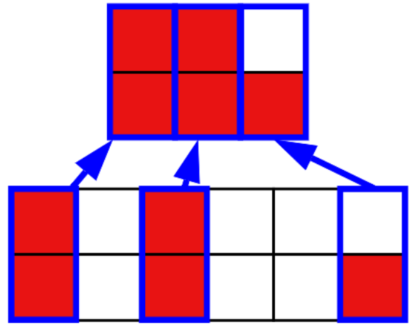
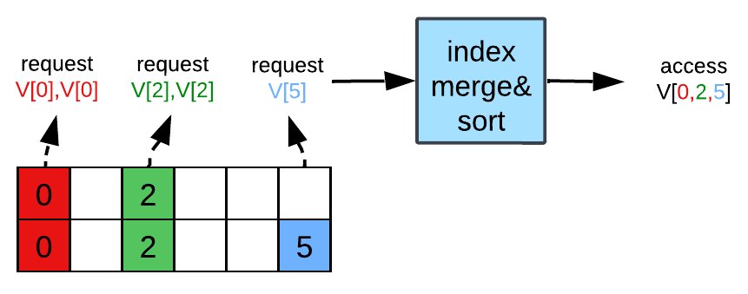
Method
Block aggregation: uniquify the data requests
Combine and uniquify the different data requests from aggregated blocks
Implemented as merge and sort tree in hardware
Aggregated blocks in sparse attention
Notes:
Our solution to this problem, is to reconstruct the data access manner of the GEMM for sparse attention computation.
The left figure shows an attention matrix, with dense values (in red) forming vertical and rectangular clusters.
Such a locally aggregated pattern is due to the nature of the attention mechanism.
Based on this, we adopt a new approach by dynamically aggregating the small pieces of the dense attention values into GEMM-like tiles.

Slide 12
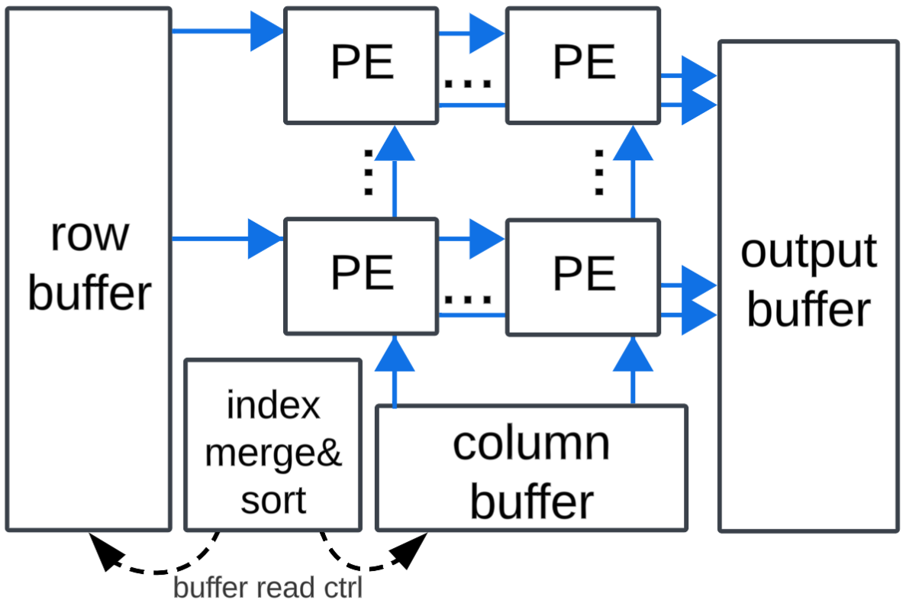
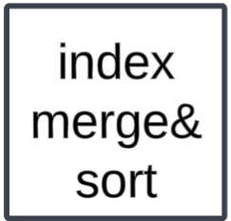
Architecture
Sparse Attention Core
Keeping the rigid data path
Only add an index generator to control data feeding
Hardware scale:
Up to 138,240 MACs with 288 PEs
480 MACs in each PE
Platform: Intel Stratix® 10 NX with Tensor Blocks
Notes:
Then we proposed our architecture based on a PE array.
The Tensor Block Chain array, in the center of the figure, is the compute core of our hardware.
The PEs inside this array is connected by the broadcast data paths from buffers, exactly the same to the data path organization of the GEMM-optimized hardware.
On top of this GEMM-optimized structure, the only change is that we add the index merging and sorting tree on the upper left, to aggregate the blocks in the sparse attention.

Slide 13
Architecture
Sparse Attention Core: Pipeline
③ Multiply the dense matrix blocks
②
③
①
②
② Fetch associated rows from matrix V by indices
① Aggregate the blocks in attention matrix
Notes:
The computation pipeline is finished in 3 steps.
First the index merging and sorting tree aggregates the blocks by their column indices, and provide the indices to serve matrix V fetching
Second, the attention matrix and Value matrix buffer fetches the aggregated block and loads them into the PE array in the center.
Finally the matrix multiplication is performed in the exactly same manner as GEMM computation by the PE array.
We implemented this design on Intel Stratix 10 NX with Tenser Blocks, and evaluated it by the real attention.Value computation from three LLMs on Longbench dataset.

Slide 14
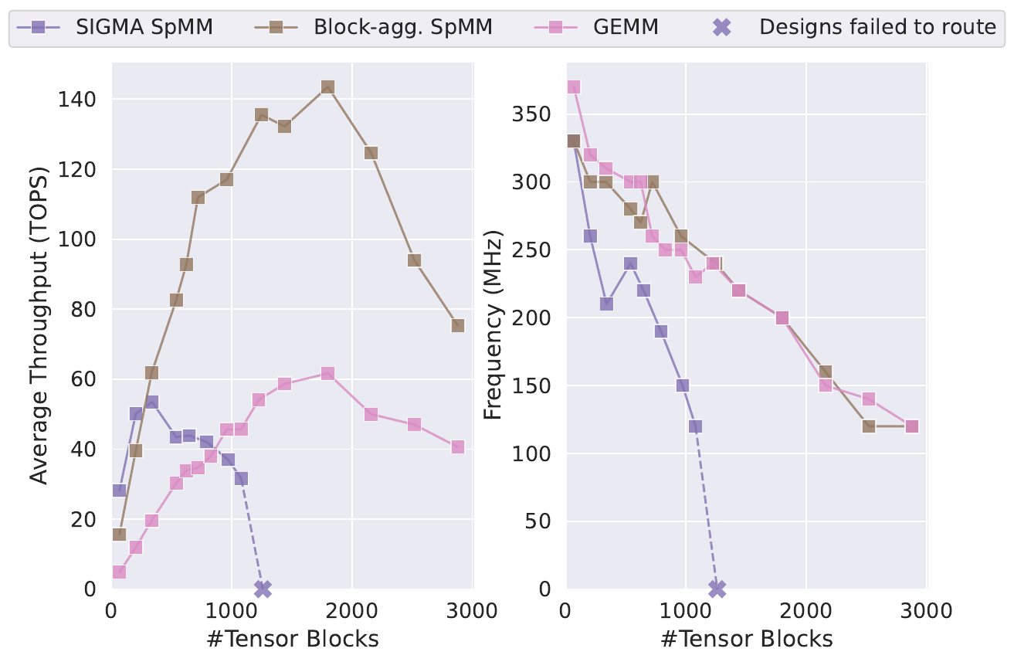
Results
Higher scalability and frequency
ours
Block aggregation achieves:
  Better scalability
  Higher frequency
than existing SpMM implementation
SIGMA SpMM
(Qin et al. 2020)
Throughput/Frequency compared
with existing SpMM and GEMM hardware
Notes:
To evaluate the effectiveness of the block aggregation, we first compare the scalability of our design with GEMM design and an existing SpMM design with complex data routing network.
The figure shows the average throughput on the left, and the frequency on the right, of different PE array size on the x axis, respectively.
The throughput comparison on the left shows block aggregation method (in brown) outperforms the GEMM computation (in pink) in terms of the throughput, since it skips the unnecessary computation in the attention.
Compared to the SpMM design which has flexible data routing network, block aggregation method shows a higher throughput, and also manages to extends to a larger scale of PE array.
The right figure shows that usage of the data routing network severely suffers from frequency degradation as the PE array size grows,
while the block aggregation design can keep the same frequency as the dense design, as they are using the same structure of the shared data path.

Slide 15
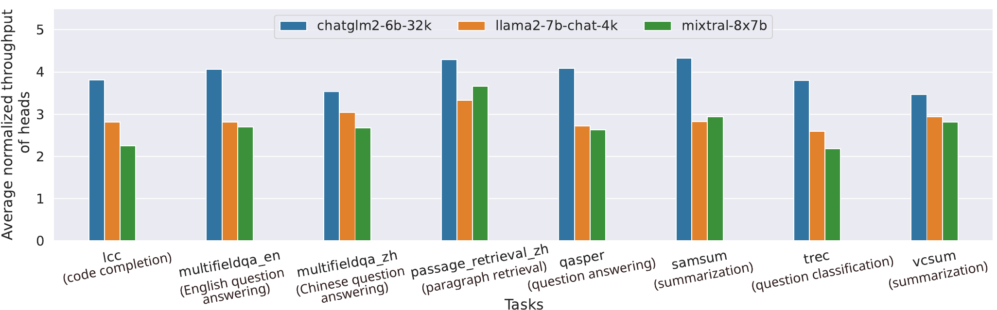
Results
Average speedup of 3.13x
Average throughput on different models and LongBench (Bai et al. 2024) tasks
(normalized to GEMM on the same hardware and frequency)
Notes:
We picked our design with 720 Tensor Blocks and evaluates its throughput normalized to the GEMM, shown in this figure, with eight different tasks on three LLMs.
The average throughput speed up of 2.66x to 3.89x on different models.
Some models, like chatglm2, exhibits a higher throughput than others.

Slide 16

Conclusion
KV
SpMM => GEMM tiles
SOURCE CODE
Q
Random data access breaks rigid paths
sparse attention
Problem
Sparse attention leads to hardware inefficiency on GEMM-optimized hardware
Method
Block aggregation: creates GEMM-like tiles from inherently aggregated attentions
Result
3x throughput to GEMM
2.6x throughput to other SpMM and better scalability
Notes:
Our work starts on making a key observation that sparse attention computation in the LLM contradicts with the rigid data path in the existing hardware;
This conflict potentially undermines the frequency, dynamic utilization and throughput of the LLM accelerator.
Our method, named as block aggregation, solves this problem by dynamically collects and aggregates the dense vlues to form small GEMM tiles.
By doing so, the hardware executes SpMM just like computing small tiles of GEMM, thus re-enabling the efficiency of the rigid data path.
Our experiment shows our block aggregation technique achieves higher frequency, throughput and scalability compared to the existing works.

Slide 17
Thank you

Slide 18
Appendix 1
Block Aggregation Explanation

Slide 19
Block Aggregation
Aggregating Dense Values into Small Blocks
KV
Observation: Locally aggregated non-zero values as dense “sub-matrix blocks” - block aggregation
  Reason: some “important” words need attention from other neighboring words:
“What country…?” -> “US”
Compute the matrix multiply of these blocks just like dense matrices
  Why it matters?
Existence of locally aggregated attention
Q
Notes:
We can see there is some aggregation pattern in it, vertical-slash pattern is the most common one.
Why such localization can help data flow mapping

Slide 20
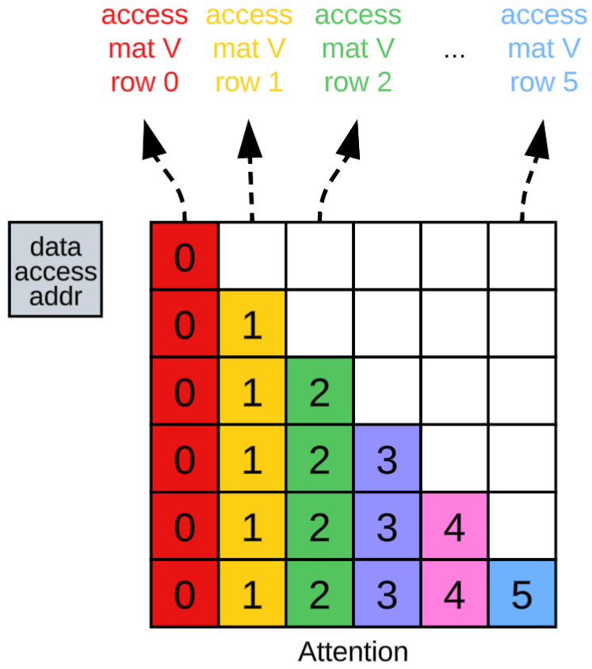
Block Aggregation
Data Access Pattern: Starting from Dense
Column index defines data access

Slide 21
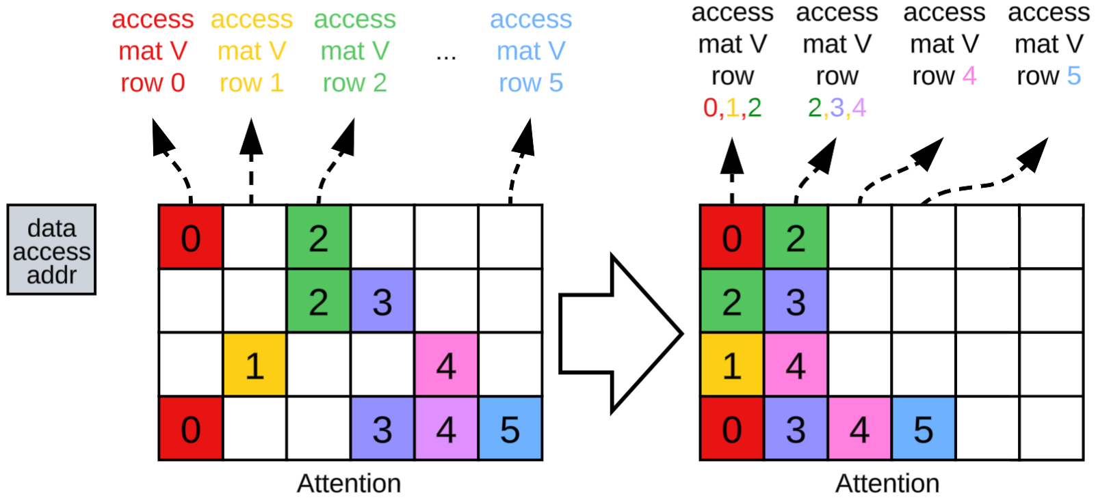
Block Aggregation
Data Access Pattern: A “Bad” Sparse Matrix
Sparsity creates irregular data access pattern

Slide 22
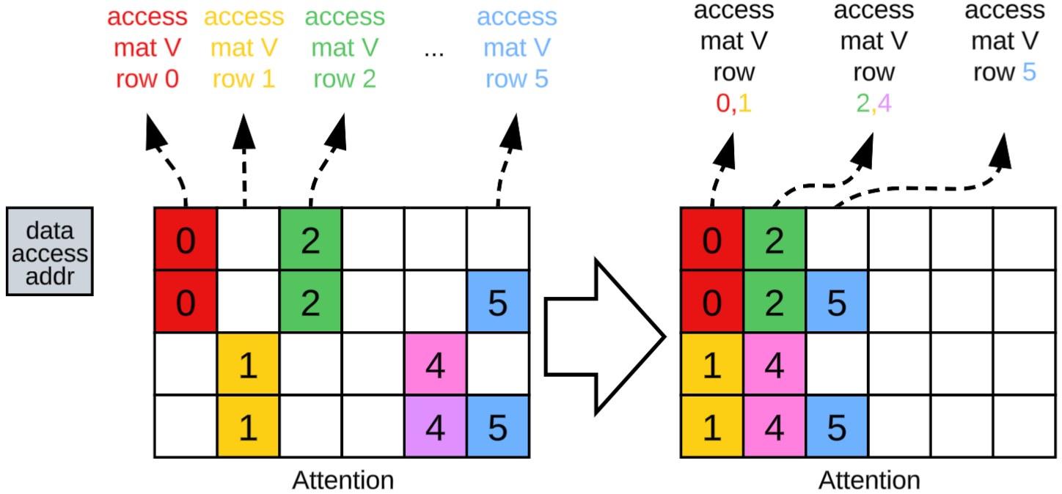
Block Aggregation
Data Access Pattern: A “Good” Sparse Matrix
More aggregated blocks creates regular access

Slide 23
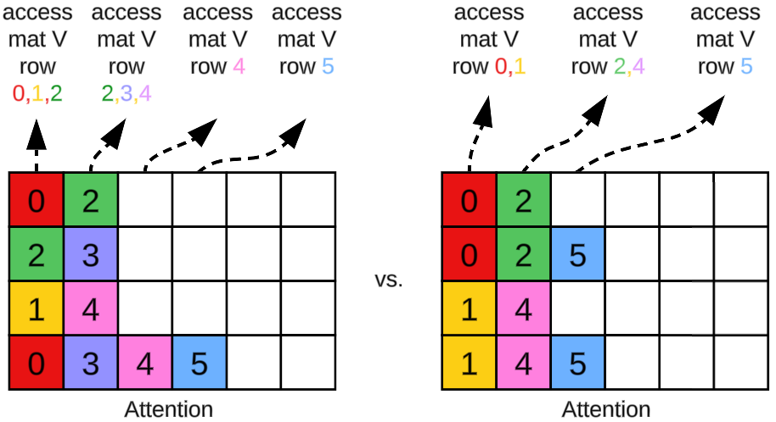
Block Aggregation
More Aggregation = Less Data Access
More aggregated blocks
= more identical data access
= more shared data path
= high bandwidth utilization

Slide 24
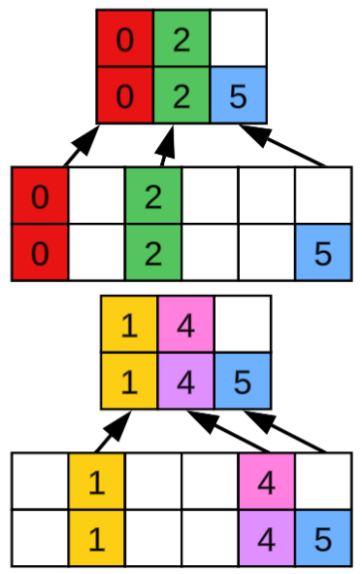
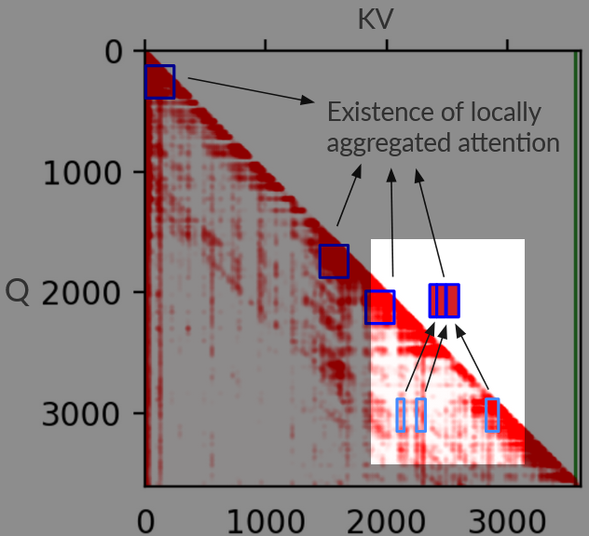
Block Aggregation
Block Aggregation in Real Attention
=
More aggregated blocks
= high bandwidth utilization

Slide 25
Block Aggregation
Block Aggregation in Real Attention
“Bubbles” to regularize the data flow
It only matters if bubbles are a lot
(which is not true!)

Slide 26
Block Aggregation
Block Aggregation in Real Attention
Effective sparsity: Treat this whole sub-block as dense
Quantitatively analyze sparsity after aggregation

Slide 27
Block Aggregation
Trade-off: sparsity vs. hardware efficiency
sparsity: 43%~77%
Efficiently organizing data flow is more important on GEMM-optimized hardware for better throughput
sparsity: 80%~90%
Throughput/Frequency compared
with existing SpMM and GEMM hardware
Notes:
As discussed before, aggregated blocks in the sparse attention sometimes require bubble insertion to match with the rigid data path, thus leading to lower sparsity.
We evaluated the sparsity degradation caused by the block aggregation.
Although the effective sparsity decreased to 43~77% in average, the speedup it gains from better frequency is still high enough to compensate for that.
Furthermore, allowing such sparsity greatly increases the supported hardware scale.

Slide 28
Appendix 2
Architecture Details

Slide 29
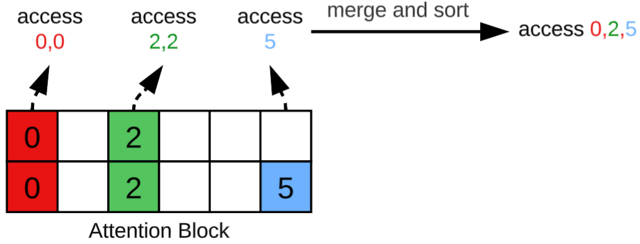
Architecture
Dataflow Mapping: Aggregation
Step 1: find column index of aggregated blocks by merge&sort, load them into PEs
Col indices are merged and sorted

Slide 30
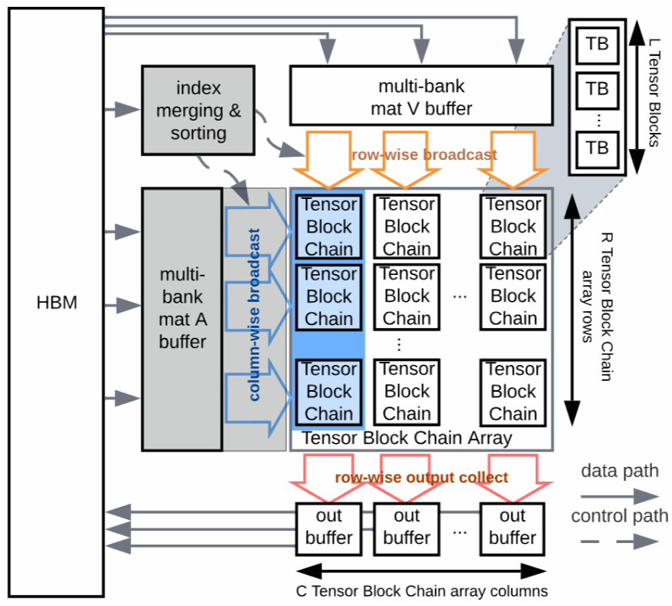
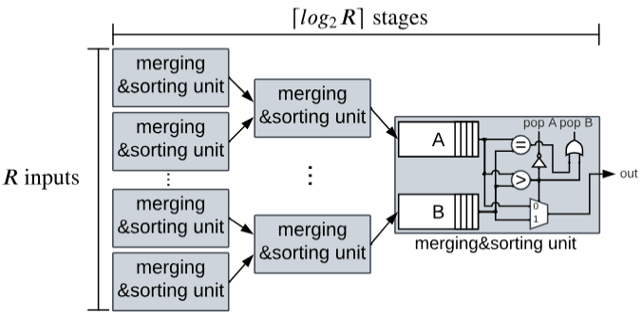
Architecture
Dataflow Mapping: Aggregation
Step 1: find column index of aggregated blocks by merge&sort, load them into PEs

Slide 31
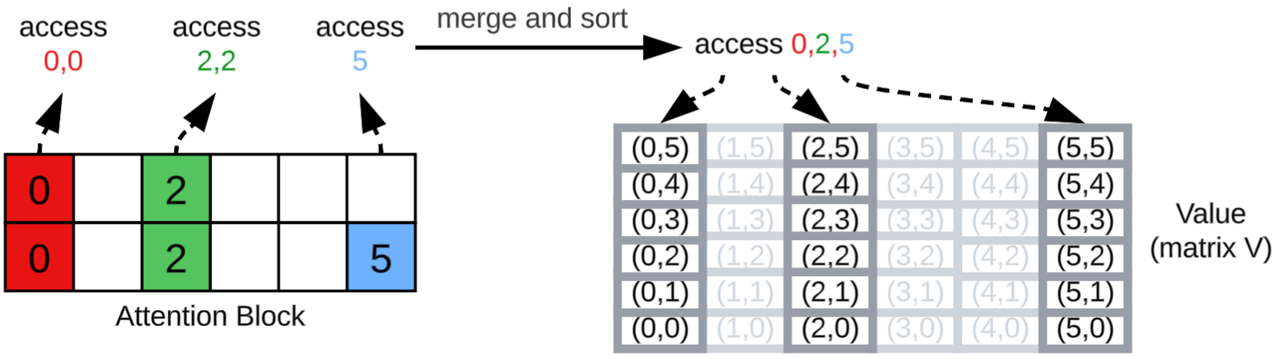
Architecture
Dataflow Mapping: Fetching
Step 2: find associated row from matrix V column index

Slide 32
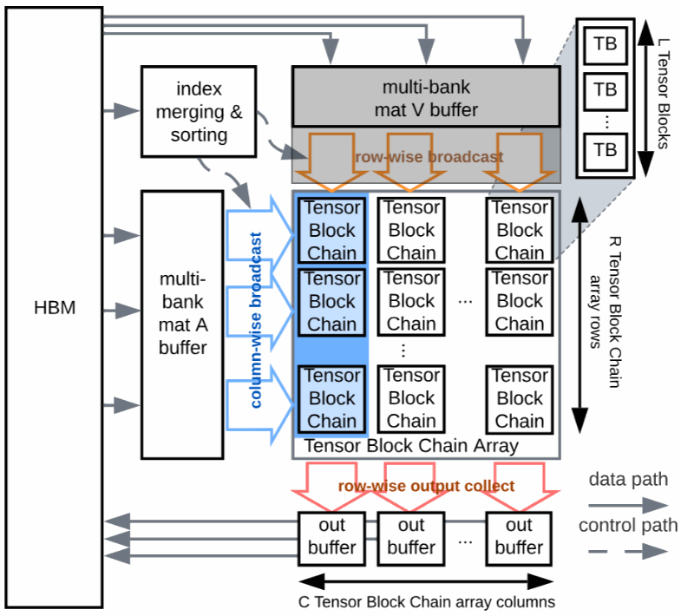
Architecture
Dataflow Mapping: Fetching
Step 2: find associated row from matrix V column index

Slide 33
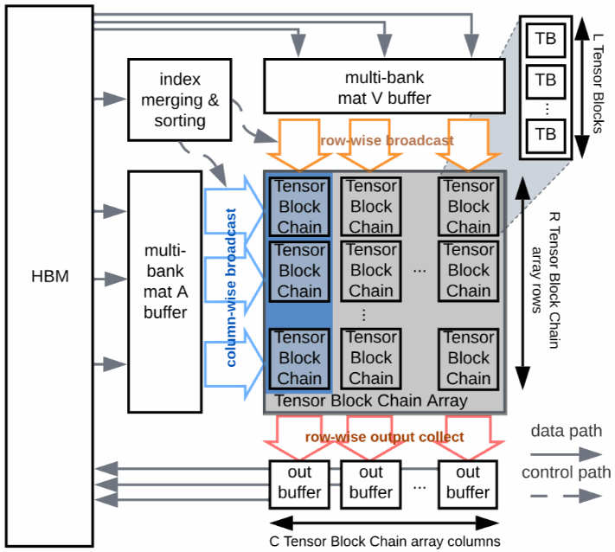
Architecture
Dataflow Mapping: Execution
Step 3: dot-product of loaded Attention blocks and V rows

Slide 34
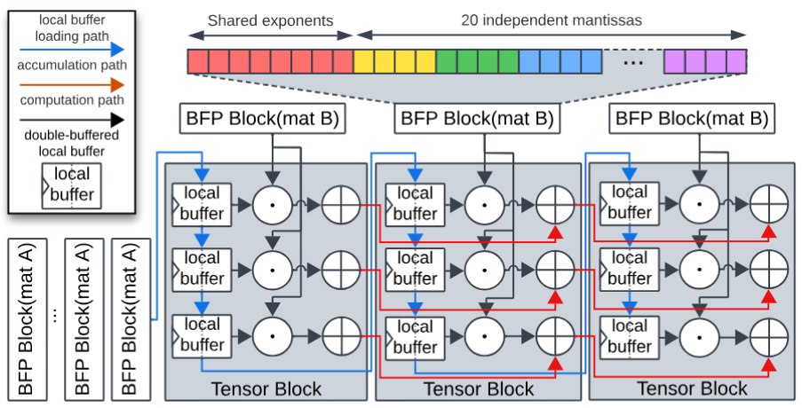
Architecture
Dataflow Mapping: Execution
Step 3: dot-product of loaded Attention blocks and V rows

Slide 35
Results
Recap: Bubbles After Aggregation
“Bubbles” to regularize the data flow
43%–77% average effective sparsity after block aggregation (details in result section)

Slide 36
Q: Can it be done on ASIC/GPU?
ASIC - Sure!
GPU - Depending on different memory hierarchy level
  Inside Stream Multiprocessor: need special hardware support
  On Shared Memory level: “shared data paths” becomes “shared memory”
  On system level: might be too coarse grained (less benefit on finding localized data)

