Slide 1
An Introduction to Efinix
A new breed of FPGA company
Jay Schleicher, Senior Vice President Software Engineering
Copyright © 2026. All rights reserved. Efinix, the Efinix logo, Efinity, Quantum, Titanium, Topaz, and Trion are trademarks of Efinix, Inc. All other trademarks and service marks are the property of their respective owners. All specifications are subject to change without notice.

Slide 2
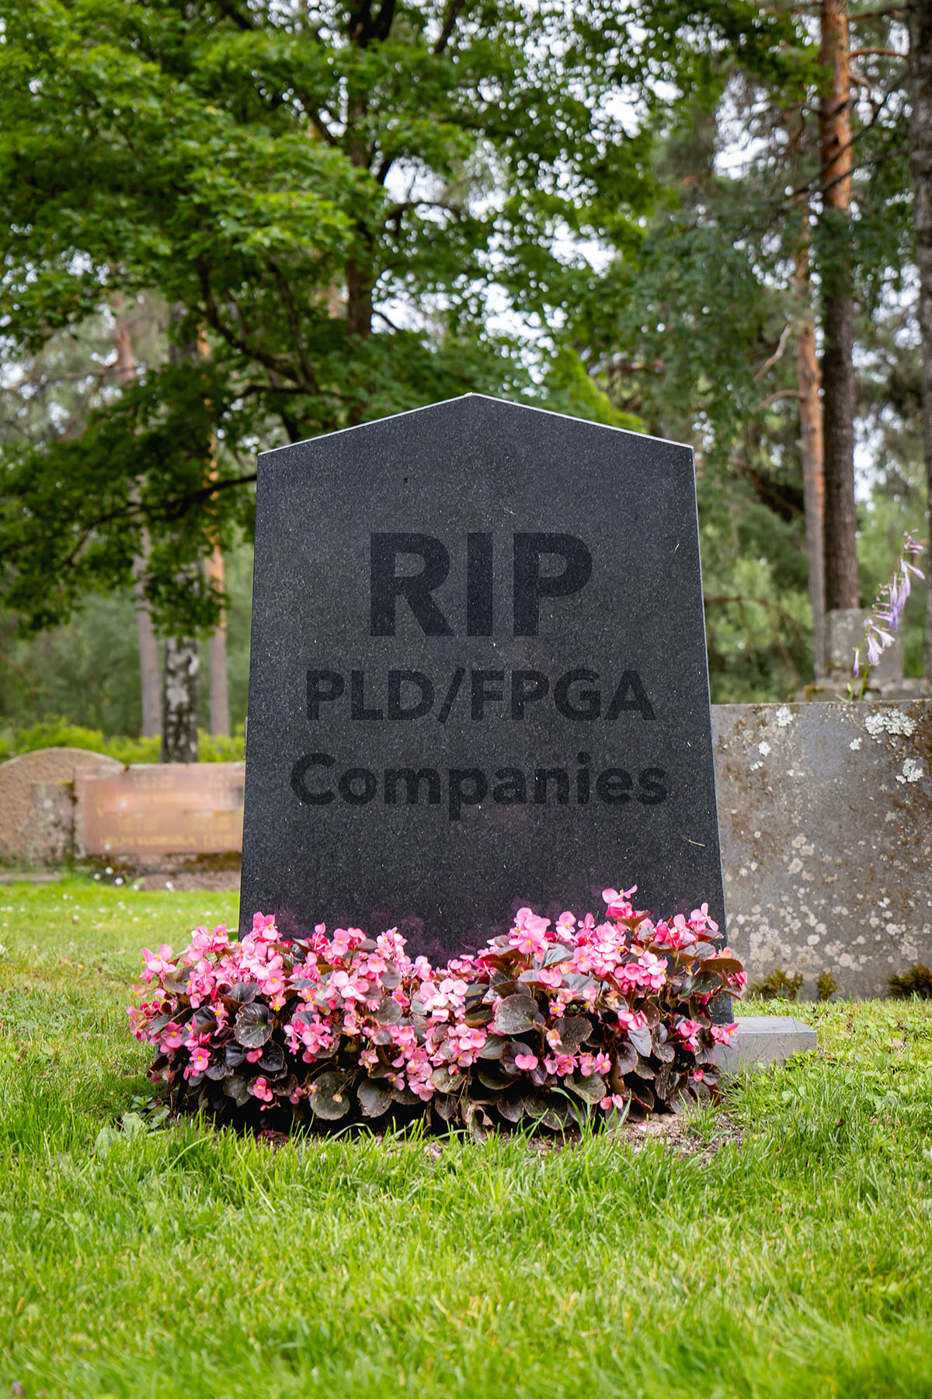
A Troubled History
The problem with FPGAs:
Costly to develop
Have entrenched competition
Require success in multiple disciplines
Have a long design cycle
Require complex tools
Cypress
MMI
VLSI
Vantis
Philipps
Texas Instruments
National Semiconductor
SEEQ
AT&T
Plus Logic
Samsung
SGS
Concurrent Logic
Crosspoint Solutions
Toshiba
Dynachip
IBM
Motorola
Gatefield
Lucent
Vantis
Velogix
Silicon Spice
MorphICs
VariCore
Chameleon
Leopard Logic
Tabula
SiliconBlue
M2000
Tier Logic
Flex Logix
To name a few…
February 2026

Slide 3
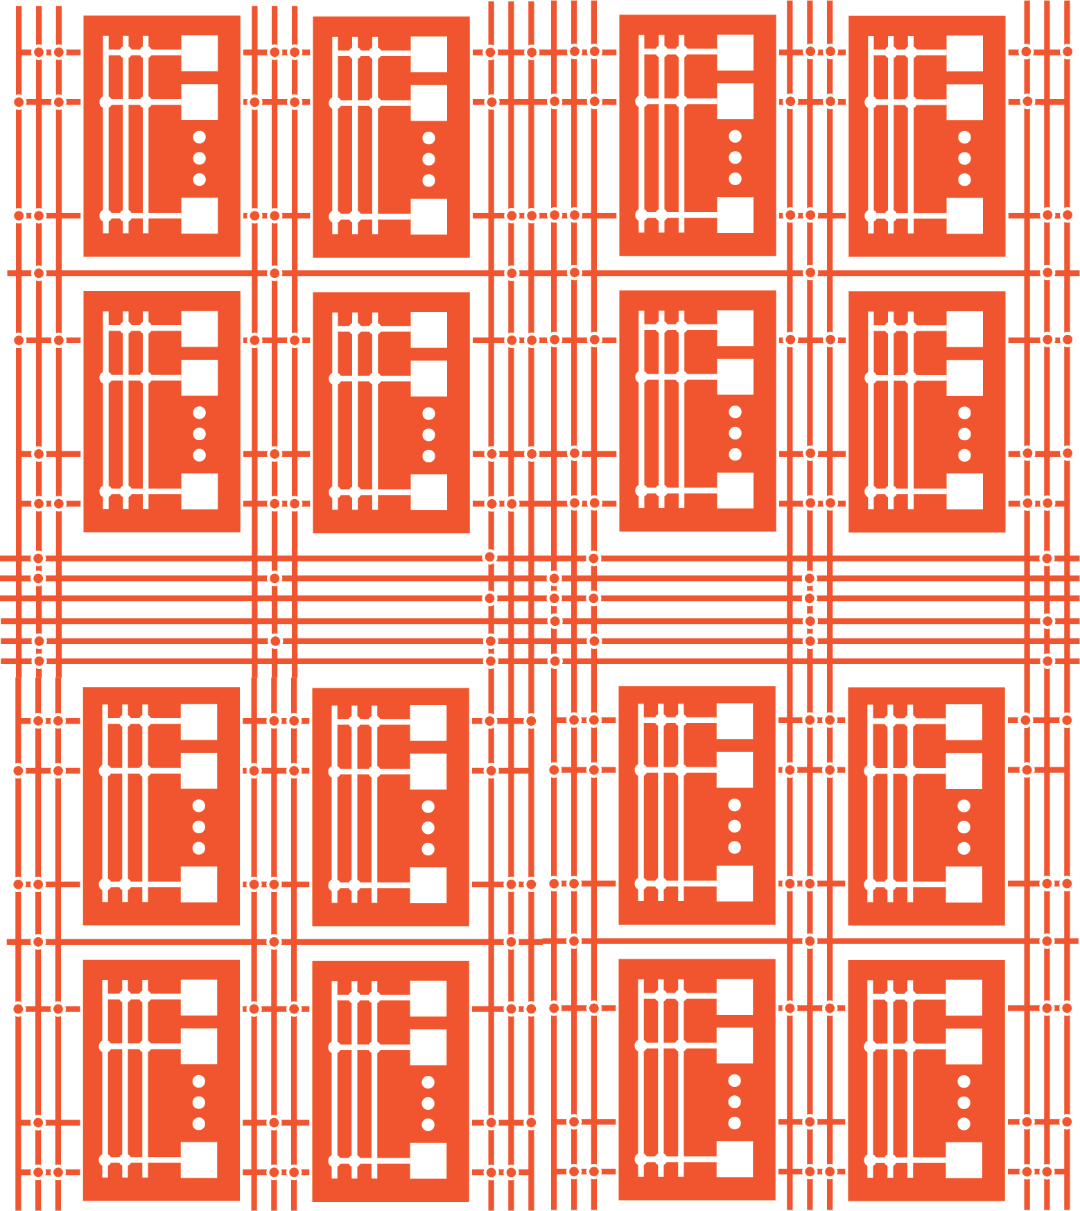



Disruptive FPGA Architecture for Rapid Innovation
Traditional FPGAs
eXchangable Logic and Routing: XLR Cell
Extensive and Expensive Development Times
FIXED routing and logic custom designed
for EACH family member
Expensive to scale up/down
Rapid, Capital-Efficient Development Times
3 Generations in 4 years
400+ Ordering codes
Easily scalable to higher densities and smaller process nodes
Inefficient
Too much logic,
no routing to connect
Smaller Sizes,
Lower Power
2x Lower power
Half the die size
Hard to
Scale
Expensive
Too much routing,
wasted silicon area
Easily
Scalable
Universal Cell
Larger device, more cells
Fixed Wire/Routing Dominant
Creates Inefficiencies
Flexible Wire/Logic Allocation
Adaptative to Design Requirements

Slide 4
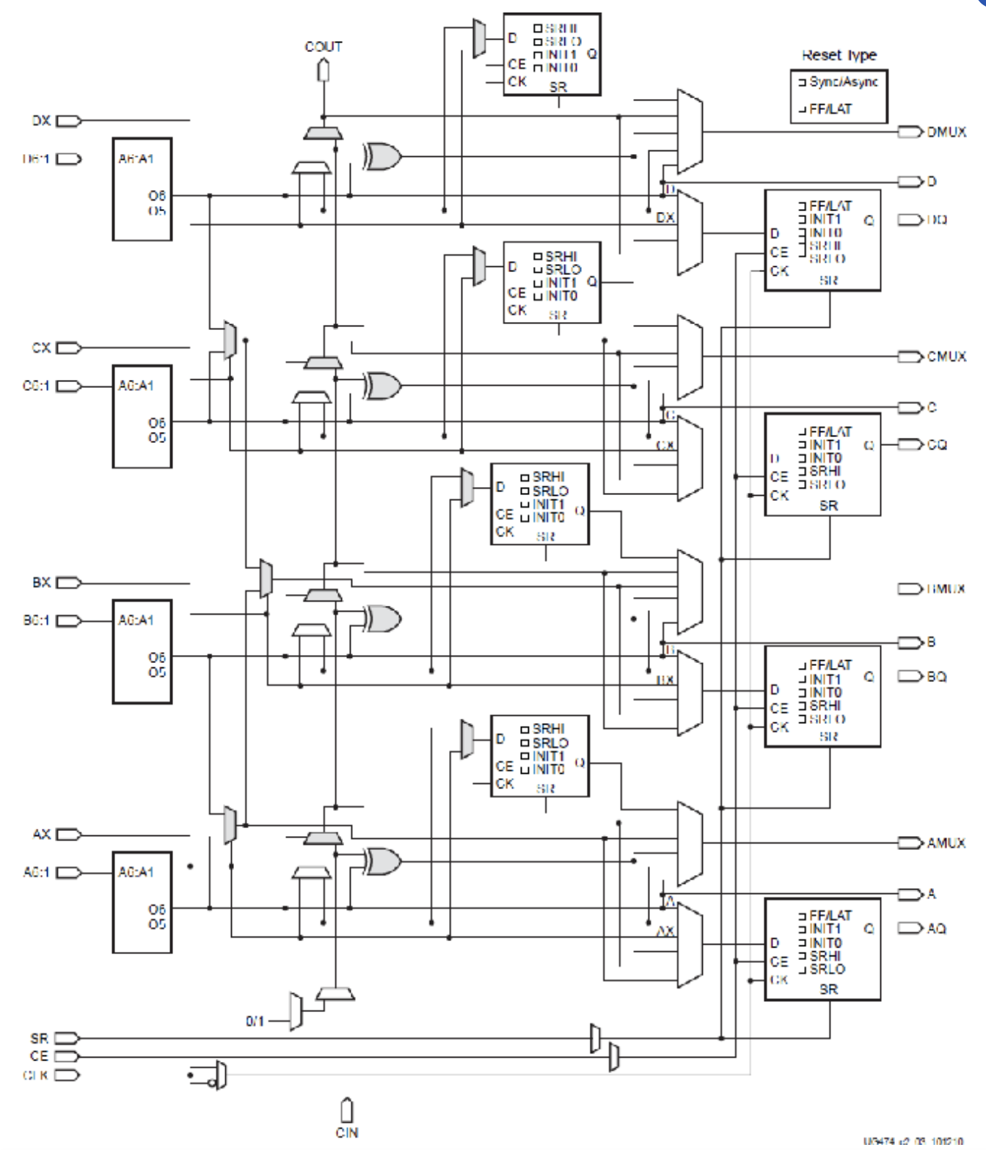

Myth: Bigger is Better
Logic is expensive so you want to use it all
But then you need more routing to address the worst case
Bigger FPGAs mean bigger logic clusters
Which requires more routing
Resulting in ever more complex tools
Source: Chandrakar, Shant, Dinesh D. Gaitonde and Trevor Bauer. “Enhancements in UltraScale CLB Architecture.” Proceedings of the 2015 ACM/SIGDA International Symposium on Field-Programmable Gate Arrays (2015): n. pag.
February 2026
Copyright © Efinix, Inc.

Slide 5
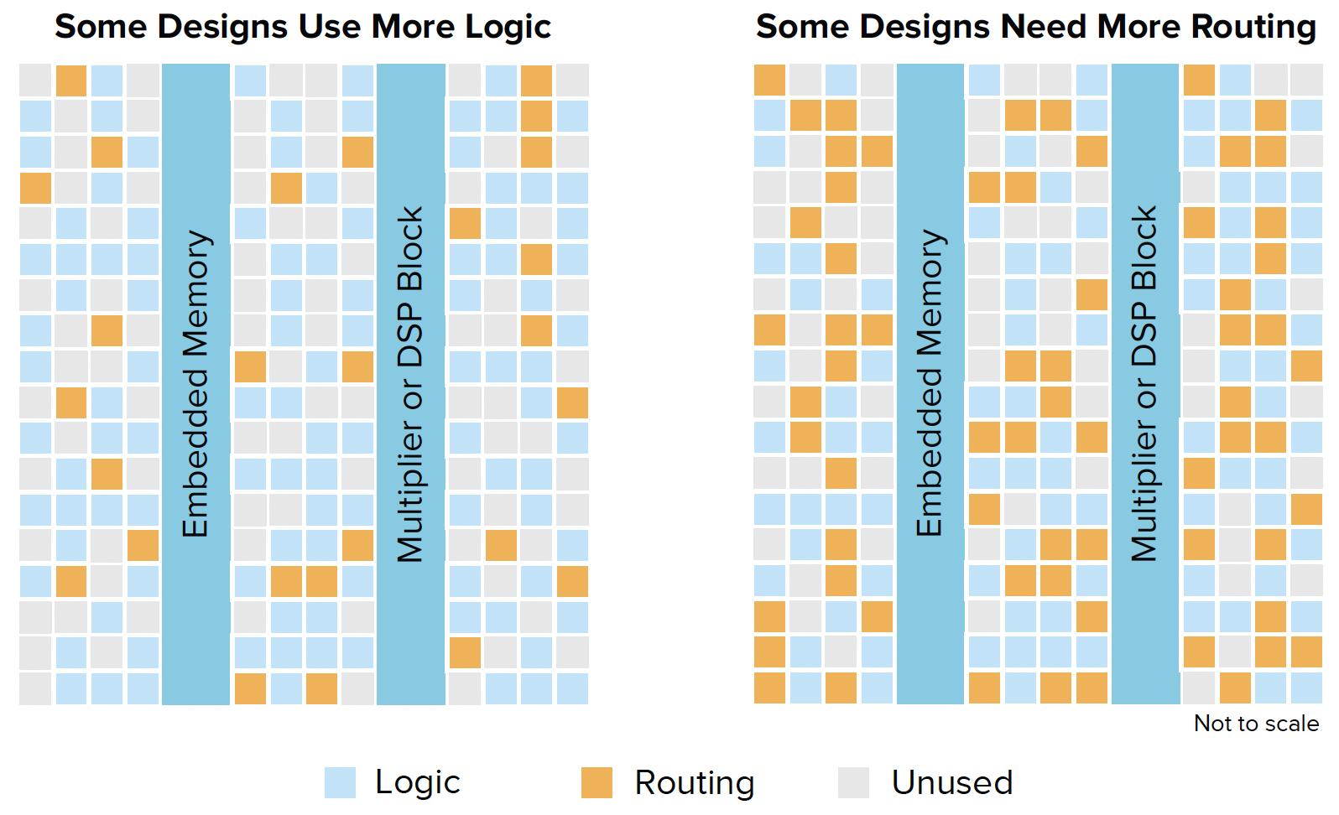
Busting the Myth
XLR cell, uniform grid of fine-grained tiles
  Small, simple structure
  4-input LUT plus flipflop
  Compute functions (adder, shift register)
Used for logic AND routing
Software decides the best composition
  Heuristics estimate how many XLRs needed for routing
  Routing XLRs can be used for logic
  You can use every XLR
February 2026

Slide 6
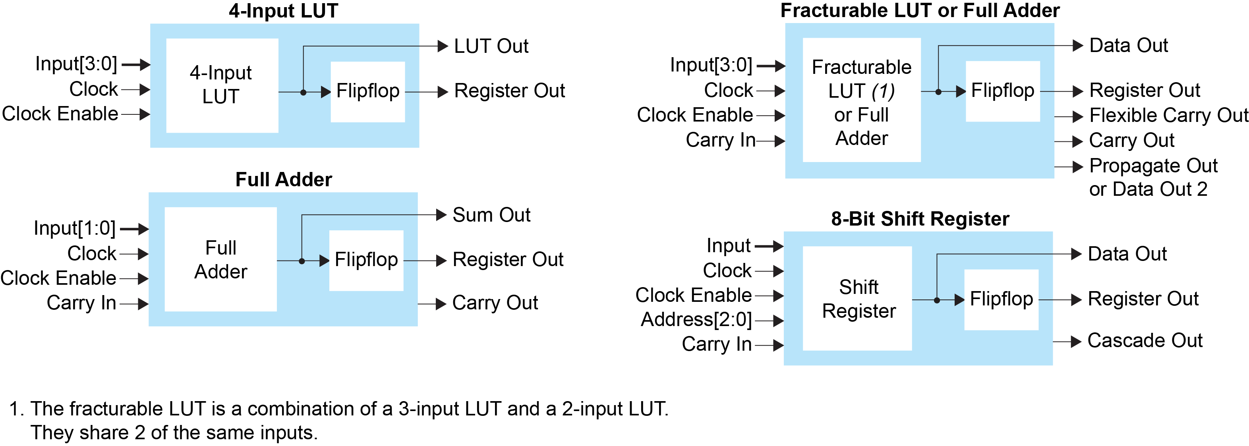
XLR Cell
February 2026
Copyright © Efinix, Inc.

Slide 7
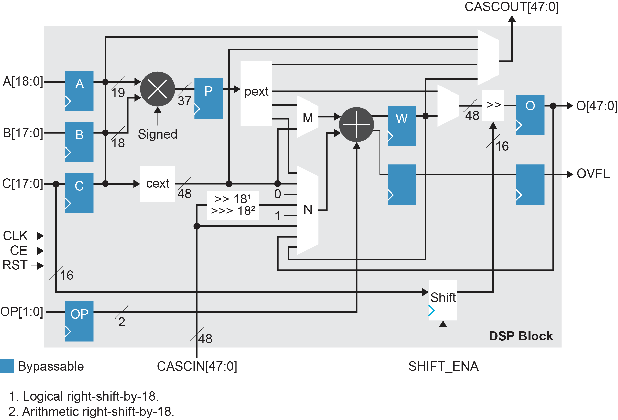
DSP Block

Slide 8

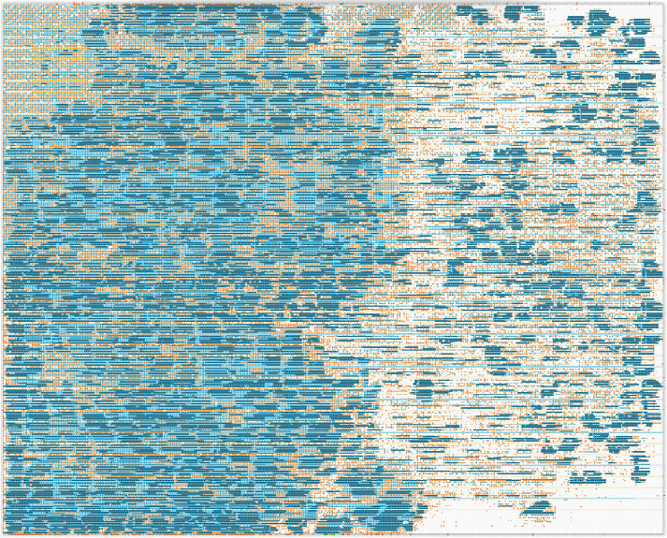
Solving Routing Congestion
Traditional FPGA
Interchangeable logic and routing solves worst-case congestion
No overbuilding routing overhead
Software configurable
Hybrid place-and-route algorithms
Two-thirds of delay is routing; metal dominated by the Manhattan distance
Hot
Spots
XLR Architecture
More Routing
More Logic
February 2026

Slide 9
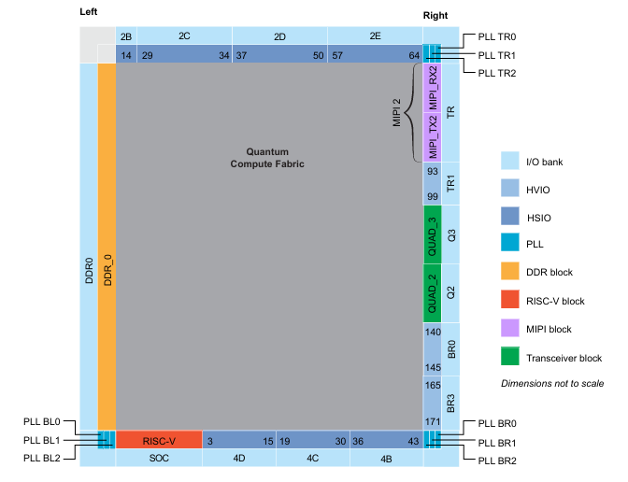
Build It Like an SoC
Strict separation of core and periphery
Hardware: Periphery design team develops it as an SoC with an eFPGA core
Software: Synthesis, PnR, and Assembler only see the homogeneous core logic fabric
Interface Designer used to configure the periphery and pass constraints to the core

Slide 10
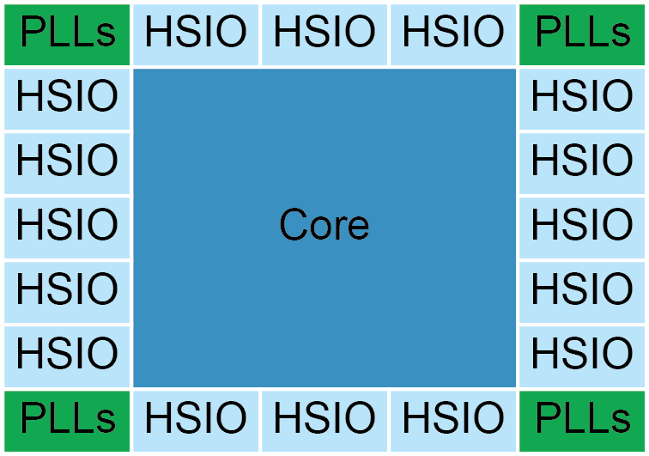
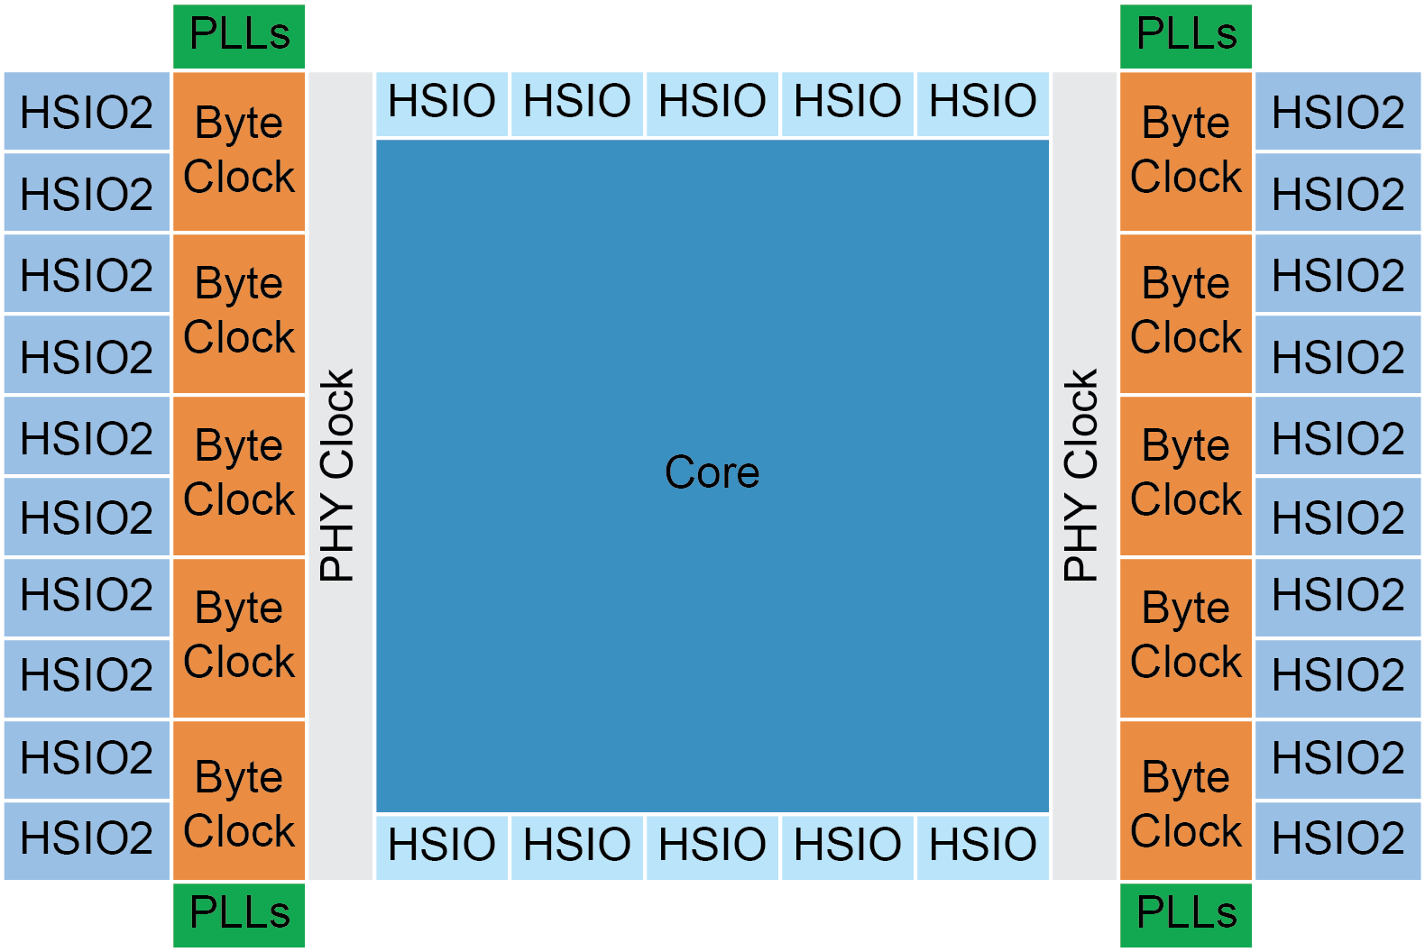
Interface Designer Advantage
Ti60 F225
Avoid passing the complexity of standard interfaces onto the user
Users start design at the system level
Core design becomes the configurable function inside
No need to freeze the interface design to meet timing
Any interface works with any core
Periphery can be updated without recompiling the core
Easily migrate to another device
Core design is the same
Ti125 F225
February 2026

Slide 11
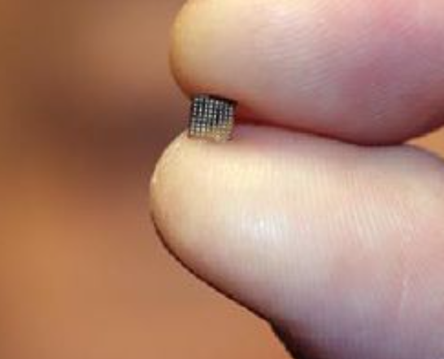
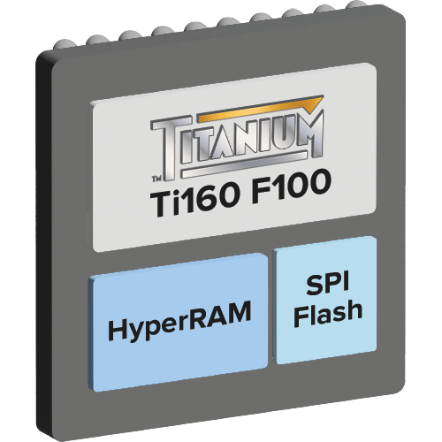
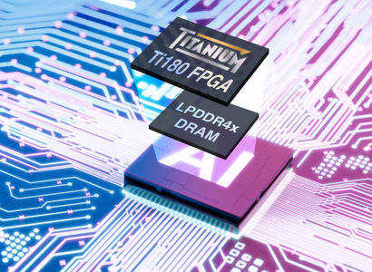
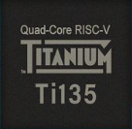
Small Form Factor
Low power advantage enables Efinix to lead in small form factor options
Ti60W64
3.5 x 3.4 mm
0.5 mm ball pitch
WLCSP package
Ti60F100S3F2 (SiP)
5.5 x 5.5 mm
0.5 mm ball pitch
256 Mb HyperRAM
16 Mb Flash
Ti180J484D1 (SiP)
15 x 15 mm
0.65 mm ball pitch
2 Gb LPDDR4x
3,000 Mbps
Ti135N441
11 x 11 mm
0.5 mm ball pitch
8x Transceivers
PCIe Gen4x4
11 mm
Sensing
10GE
PCIe x4
PMA Direct
11 mm
LPDDR4x

Slide 12
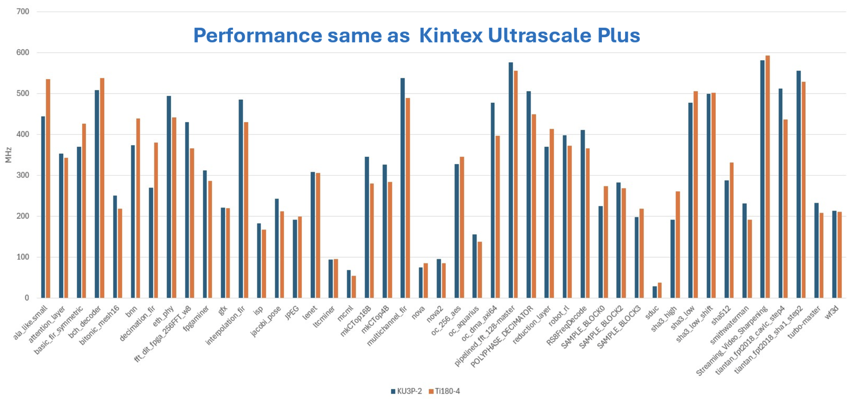
Core Performance Benchmark

Slide 13
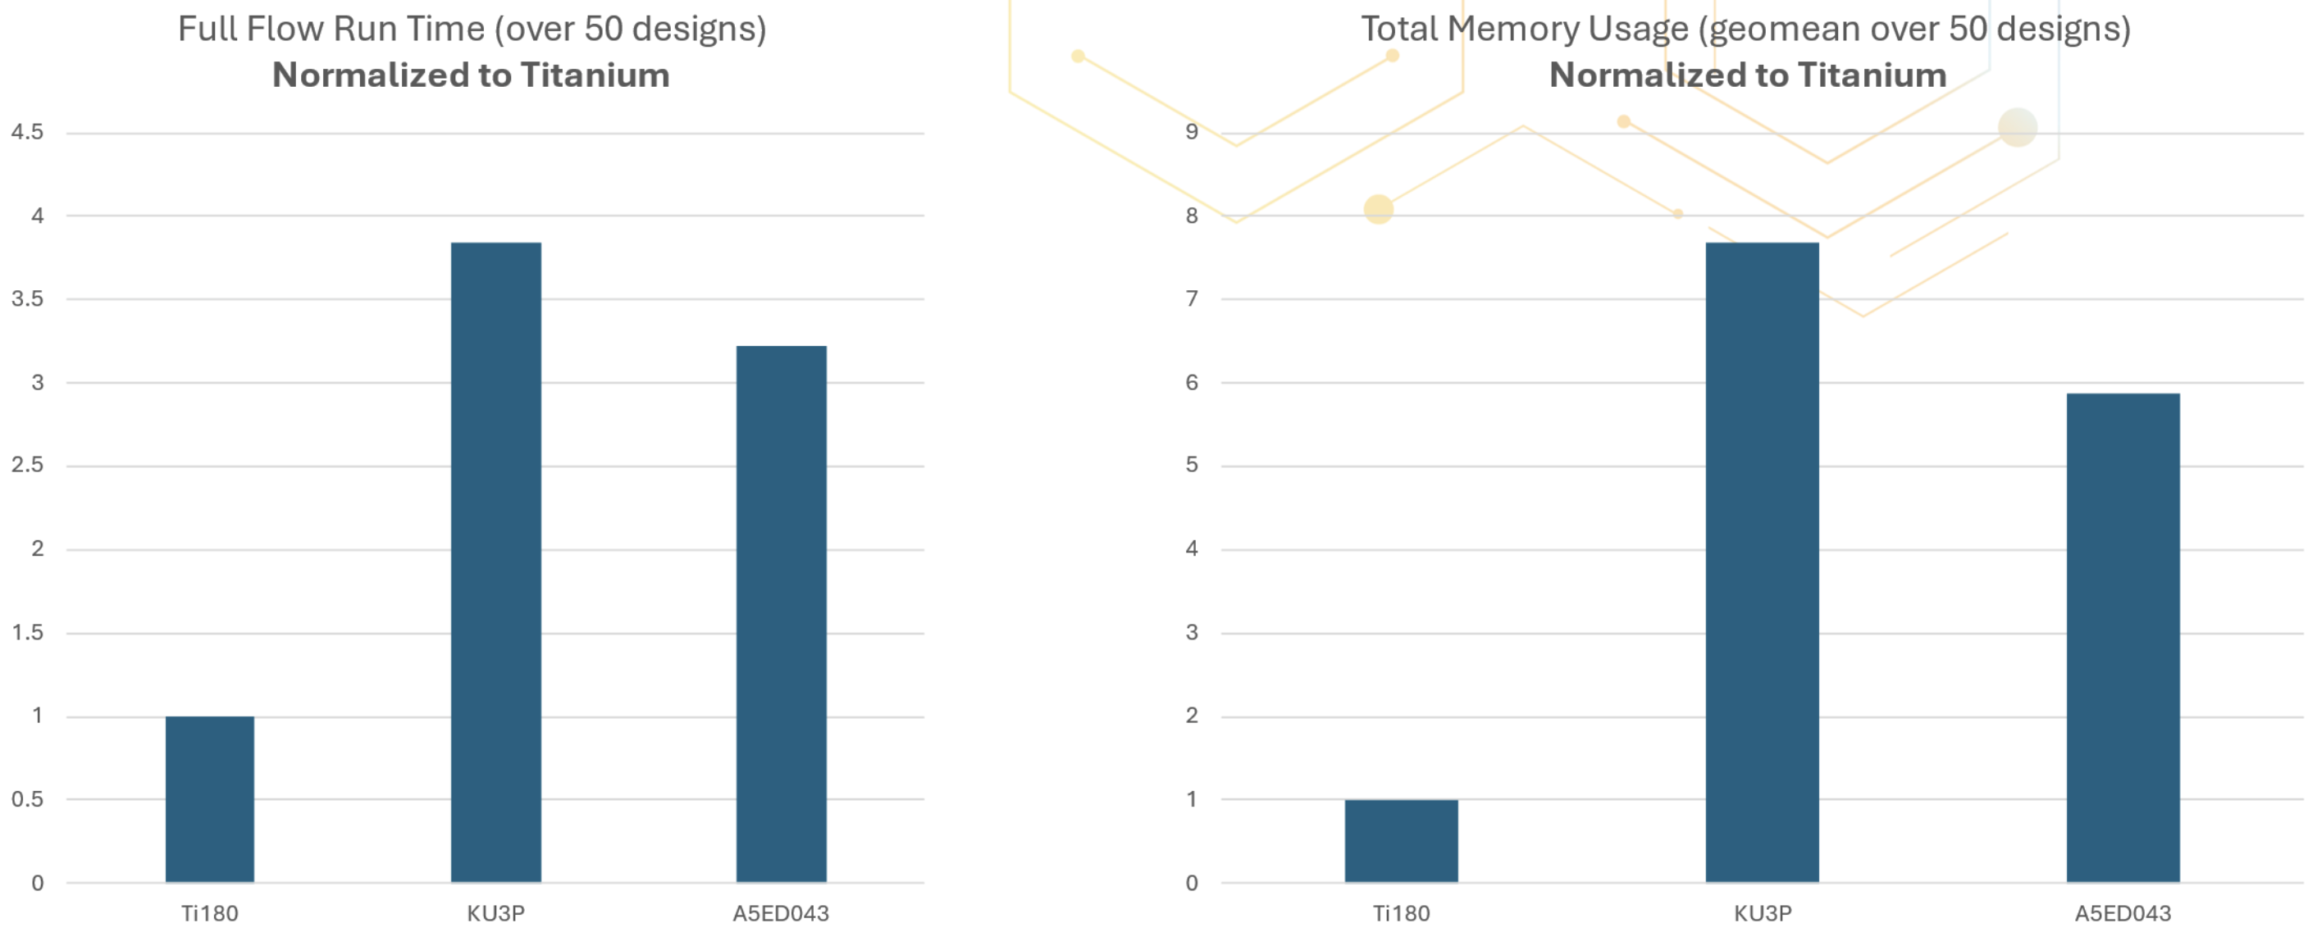
Software Efficiency

Slide 14
















Efinity Software
Simple, Easy-to-Use Toolflow
The Efinity® software provides a complete RTL-to-bitstream flow with a simple, easy to use GUI interface and command-line scripting support. The software runs on the Windows, Ubuntu, and Red Hat Enterprise operating systems.
Software Highlights
Projects
Dashboard
Language Support
Interface Designer
Project management to keep your design files organized
Easy-to-use dashboard to run the tool flow automatically or manually
Verilog HDL, SystemVerilog, and VHDL
Constrain logic and assign pins to blocks in the device periphery
IP Manager
Floorplan Viewer
Netlist Viewer
Timing Browser
Configure and add building blocks to your project
Browse through your design's logic and routing placement
Displays and analyzes your design's netlist
Browse timing and perform static timing analysis
Simulation
BRAM Initial
Content Updater
Python API
Package Planner
Supports simulation flows using the ModelSim, NCSim, or free iVerilog simulators
Use scripts to build your design's interface
Assign logic to package pins and view the pinout graphically
Update initial BRAM without performing a full compile
Hardware Debugger
Programmer
JTAG SVF Player
Bitstream Authentication and Encryption
Integrated hardware Debugger with Logic Analyzer and Virtual I/O debug cores
GUI and command-line Programmer to configure your FPGA
Sends JTAG command to an FPGA
Sign and/or encrypt bitstreams

Slide 15
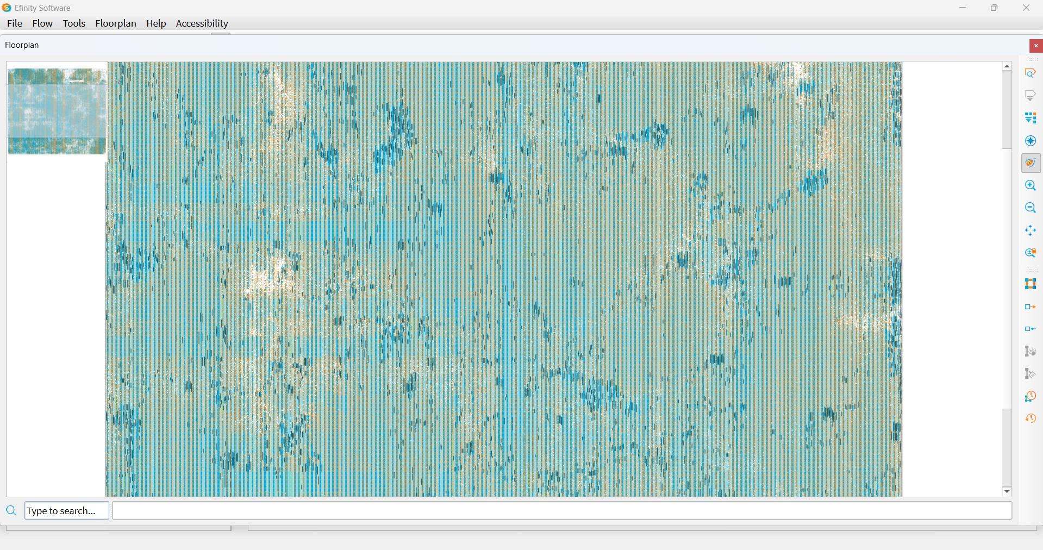
Scalability

Slide 16
Company Overview

Slide 17






At-A-Glance
Disruptive FPGA Company
Proven FPGA
Superiority
SDK Accelerates
Time-to-Market
SoC Solutions for AI and Control Acceleration
Efinity SDK
Sapphire SoC
Founded: 2012 in Silicon Valley
Employees: 200+
Global Footprint
Diversified customer base
TAM: $25B by 2033
2025E Revenue: $77M
XLR scalability enabled 3 generations of FPGAs
Highest performance
Lowest power
Cost effective
4x more efficient* than competitors
Full featured Software Development Kit (SDK)
Rapid RTL-to-bitstream design flow
4x faster compile times
C/C++ and AI models-to-bitstream flow
Suite of RISC-V Processors
Soft and hard IP options
Extension instructions for AI acceleration
>1,500 Customers Worldwide
> 50M Units
Shipped
>10,000 Efinity
SDK Users
>10M Deployed Processors
* Measured by effective logic per watt per mm² for similar process technologies

Slide 18

A Silicon Valley Company with an International Footprint
Munich
HQ in Cupertino, California, U.S.A.
200+ Employees Worldwide
Cupertino
Toronto
Tokyo
Shenzhen
Hong Kong
Penang

Slide 19




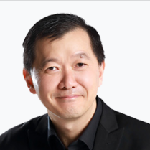

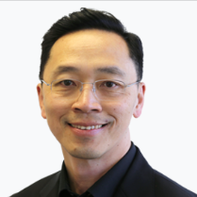













Seasoned Executive Team
Sammy Cheung
Founder, Chairman,
President and CEO
Ming Ng
COO, Sr. VP Operations
and Applications
Jay Schleicher
Sr. VP Software
Engineering
Tony Ngai
Founder, CTO and
Co-President
Bob Beachler
CVP Marketing and Corporate Development
Ching-Lun Yan
VP Business and Solutions
Cathy Lewis
VP Finance
Created many of the most successful PLD/FPGAs and software tools in the industry

Slide 20


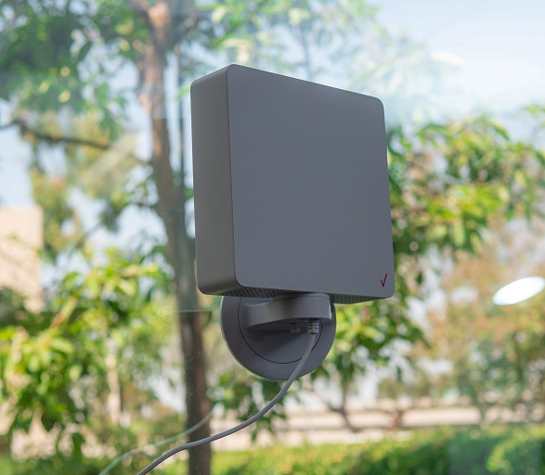
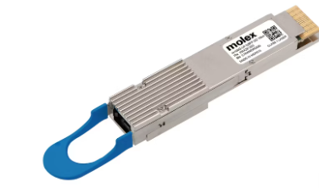

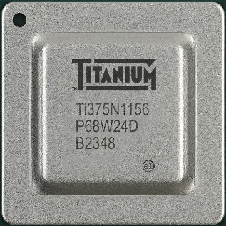

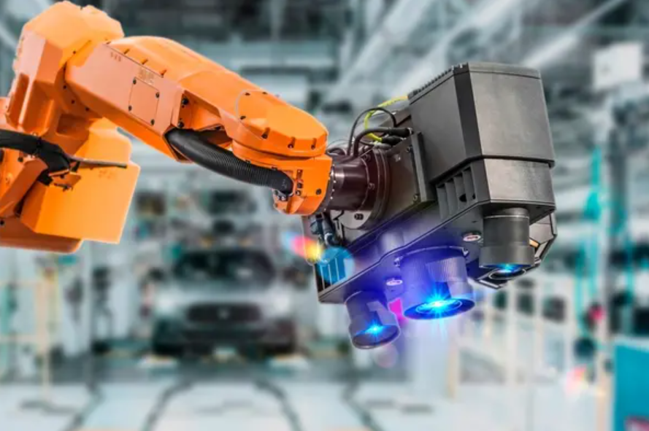
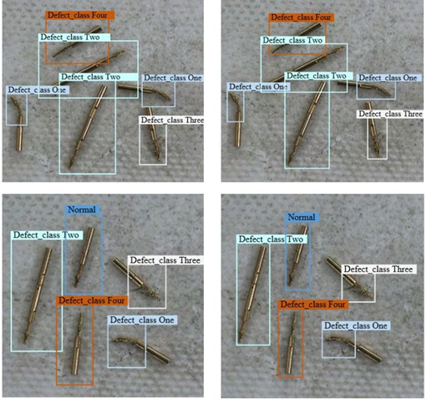

Accelerating Edge AI Innovation
Consumer
Efinix is at the
Heart of AI Innovation
Infrastructure
Sensor signal processing/fusion
AI acceleration
Communication
Servo/motor control
Telemetry
AV and Entertainment
AR/VR Glasses
Humanoid Robotics
Wireless Backhaul
Networking
Cloud Compute
Broadcast
Industrial and Automotive
Vision Guided Robotics
Smart City/Retail
Machine Inspection
Thermal Imaging
ATE
Medical imaging
Endoscopy
Ultrasound
ADAS/AV
In-Vehicle Infotainment

Slide 21





Keys to Success
Challenge existing assumptions
Don't re-invent the wheel
Make your customers' lives better
Innovate where it makes a difference
February 2026

Slide 22
Thank you!
Copyright © Efinix, Inc.

Slide 23
Accelerating Edge AI Innovation
Edge AI Requires Low-Latency, Low-Power, High-Performance Processing, Control, and Communication for Rapidly Changing Applications
Sensor Suites, Acoustic, Vision, Lidar, Radar, Pressure
Efinix FPGA
CPU/GPU
Cloud
Sensor processing
Sensor fusion
AI acceleration
Communication
Servo/motor control
Telemetry
Control, Servo, Stepper
Efinix Scalable, Low-Power Solutions Enable
Differentiation from Standard SoCs

