Slide 1
Bridging the Gap:
A Module-Context Modeling Methodology for Hyperscale FPGA Applications
Madison N Emas*
Senior Hardware Engineer
Microsoft Corporation
Austin Baylis*
Senior Hardware Engineer
Microsoft Corporation
*Both authors contributed equally to this research
Greg Stitt
Adjunct Professor of ECE
University of Florida

Slide 2
Overview
FPGA Hyperscale design development is challenging
  Ex. Long compilation times or need to make progress without access to the full design
    Common practices and vendor tools for addressing these complexities are often insufficient or impractical due to inherent tradeoffs and assumptions based on more ideal conditions
  Engineers may work on isolated parts out of convenience or necessity
    Allows forward progress to be made but comes with its own sets of challenges
      Isolation techniques sacrifice physical context and may fail to perform as expected when integrated in full design
Presenting: A Module-Context Modeling Methodology
  Synthetic context used to achieve performance goals in isolation
    Case study 1: Optimizing Microsoft Project Brainwave NPU
      Applying synthetic context from the full design to isolated module development enabled timing optimization with 2% accuracy while achieving 2.5× faster compilation compared to the full design
    Case study 2: Modeling Fan-out Mitigation Strategies
      Applying synthetic context to characterize mitigation strategies prior to full design availability
Notes:
I’m going to tell you about some problems we have, a bit about why we don’t have a clear solution to those problems, and then about a methodology that can help mitigate these challenges, and

Slide 3
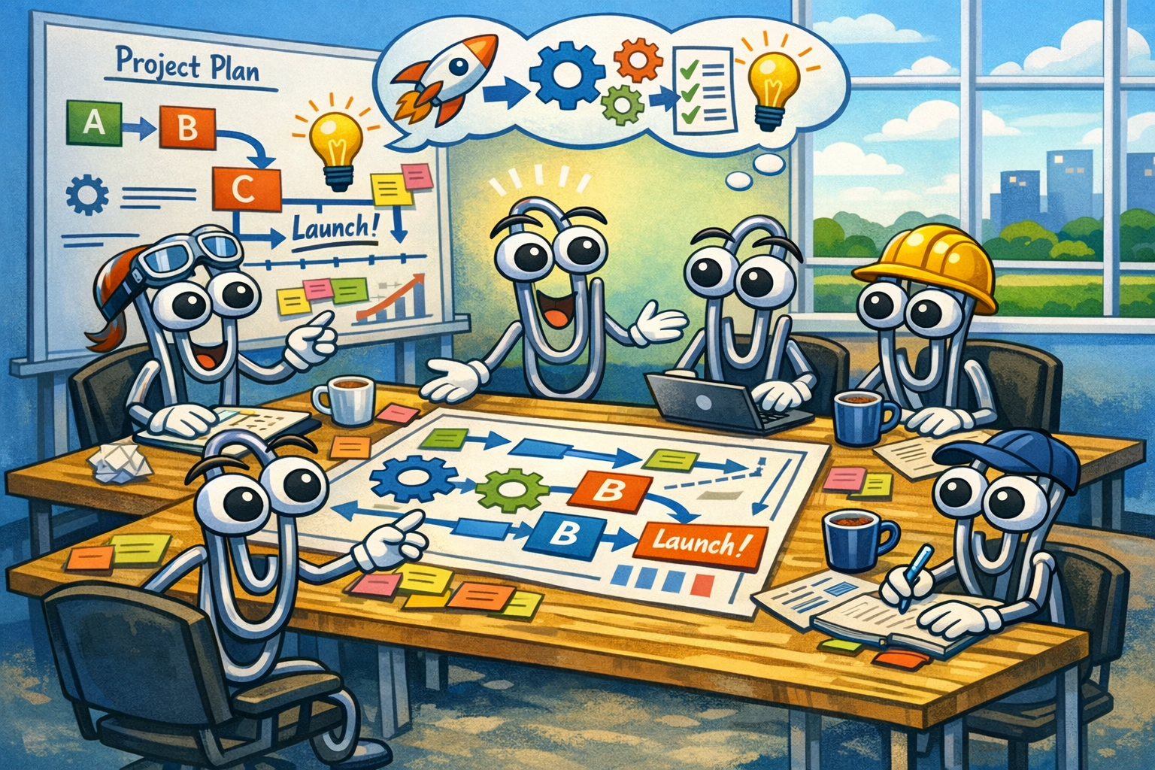
FPGA Development: Ideal
In ideal world conditions, development follows a top-down methodology
Engineers make high level decisions based on known end product such as:
  Device selection
  Architecture
  Features and deployment schedule
  Performance and quality requirements
Common practices and vendor
recommendations easier to used or
applied easier when the design is
stable and there exists a complete
design context
Notes:
Minimizing time to market, make intelligent choices and work in isolation without being fully involved with full design

Slide 4
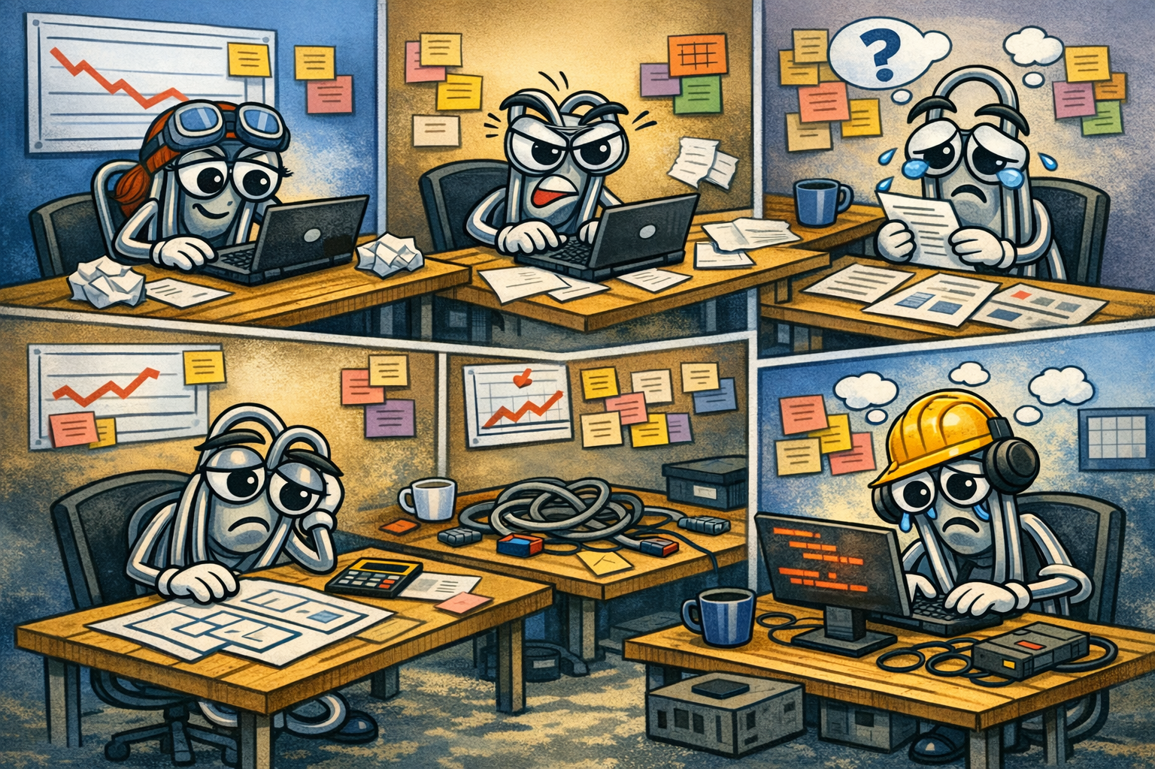
Decisions in Isolation Necessity
Hyperscale industry development realities can make this difficult
The need to commit critical architecture decisions compounds challenges
  New hardware deployments in Azure can
  be a long and expensive process
    Programs Target devices in development
    May pivot to use available older device in Azure
    May switch to a new vendor between iterations
  Engineers try to achieve a general
  understanding of how isolated decisions
  will affect the product as a whole
  Full context may not be available when
  base architectural decisions are made
  Rearchitecting when they prove wrong
  is costly in time and budget.
Notes:
Ex. Feature ownership, program schedule, module interfaces, and clocking strategies based on limited information or rough projections
Timing failures, routing congestion, and resource shortages surface late in the full design, making rearchitecture costly under schedule and budget pressure
Switching vendors makes it hard to maintain a shared code base

Slide 5
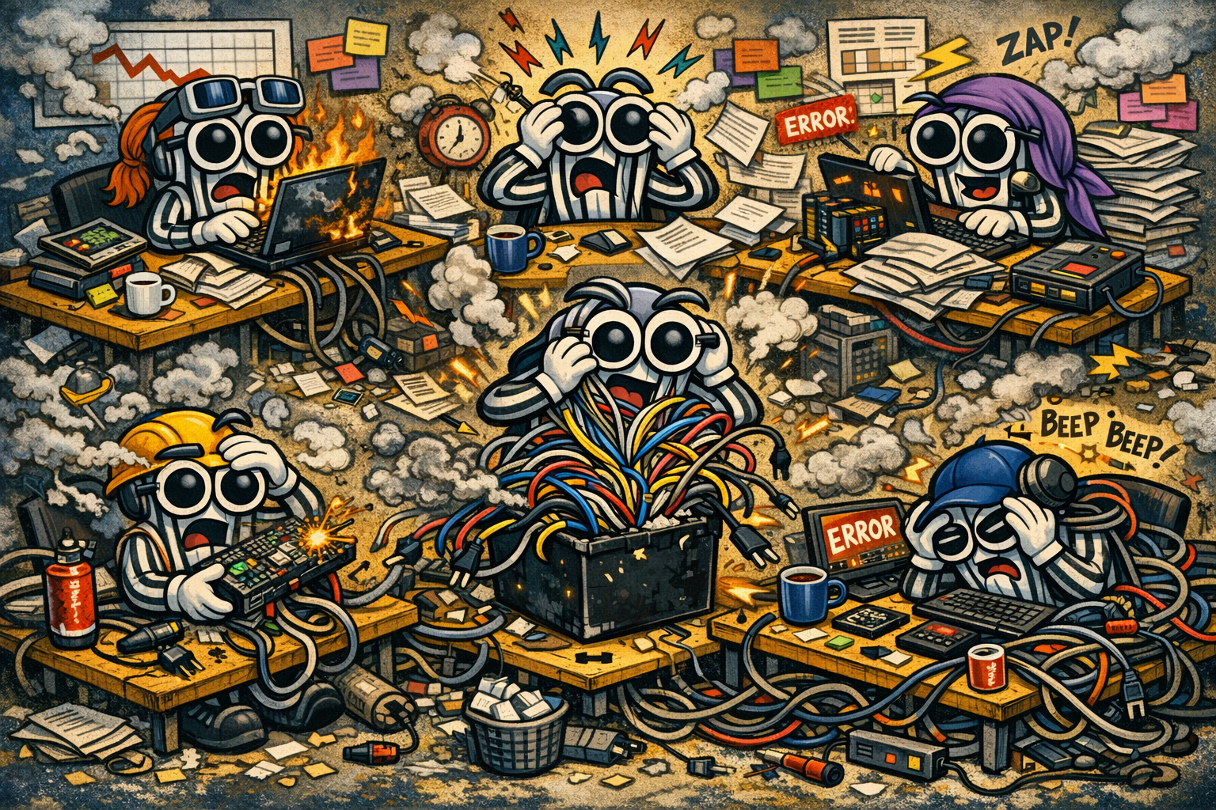
FPGA Development: Reality
Living design requirements change or may be deployed in stages
  May be deployed as soon once the minimum viable product with new features coming later
Developers from software or ASIC
backgrounds may lack FPGA-specific
optimization experience
Geographically distributed teams limit
planning and coordination
Teams inherit HDL patched over
multiple generations of programs
  Multi-vendor legacy codebase
Full Builds may not compile within a
single work day
Notes:
Minimizing time to market, make intelligent choices and work in isolation without being fully involved with full design

Slide 6
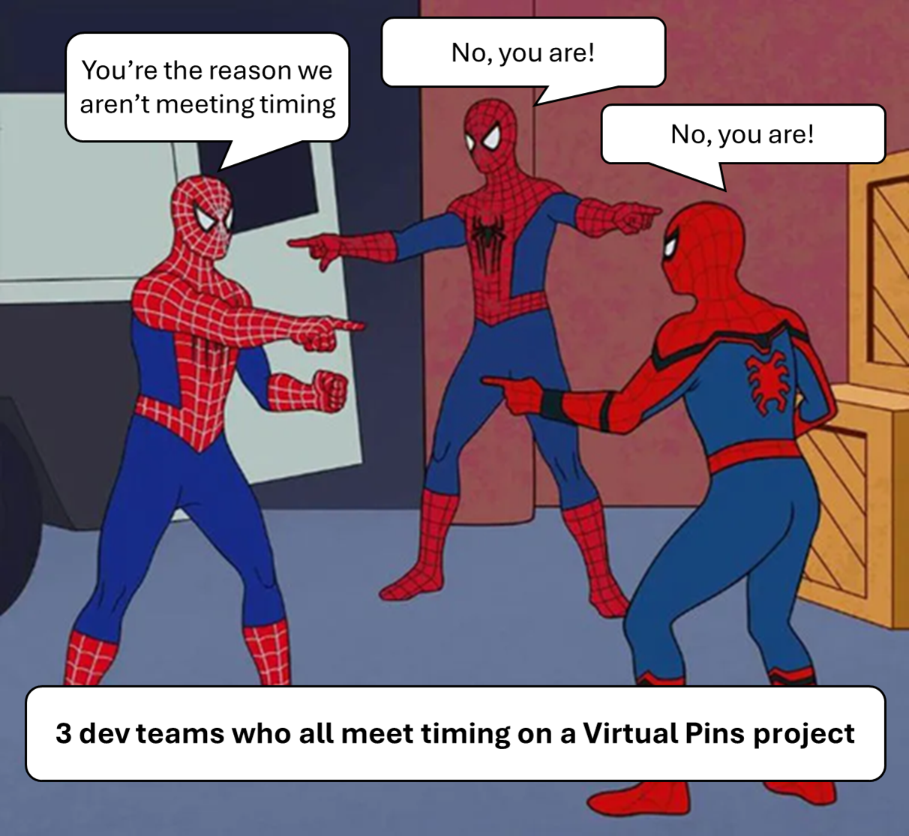
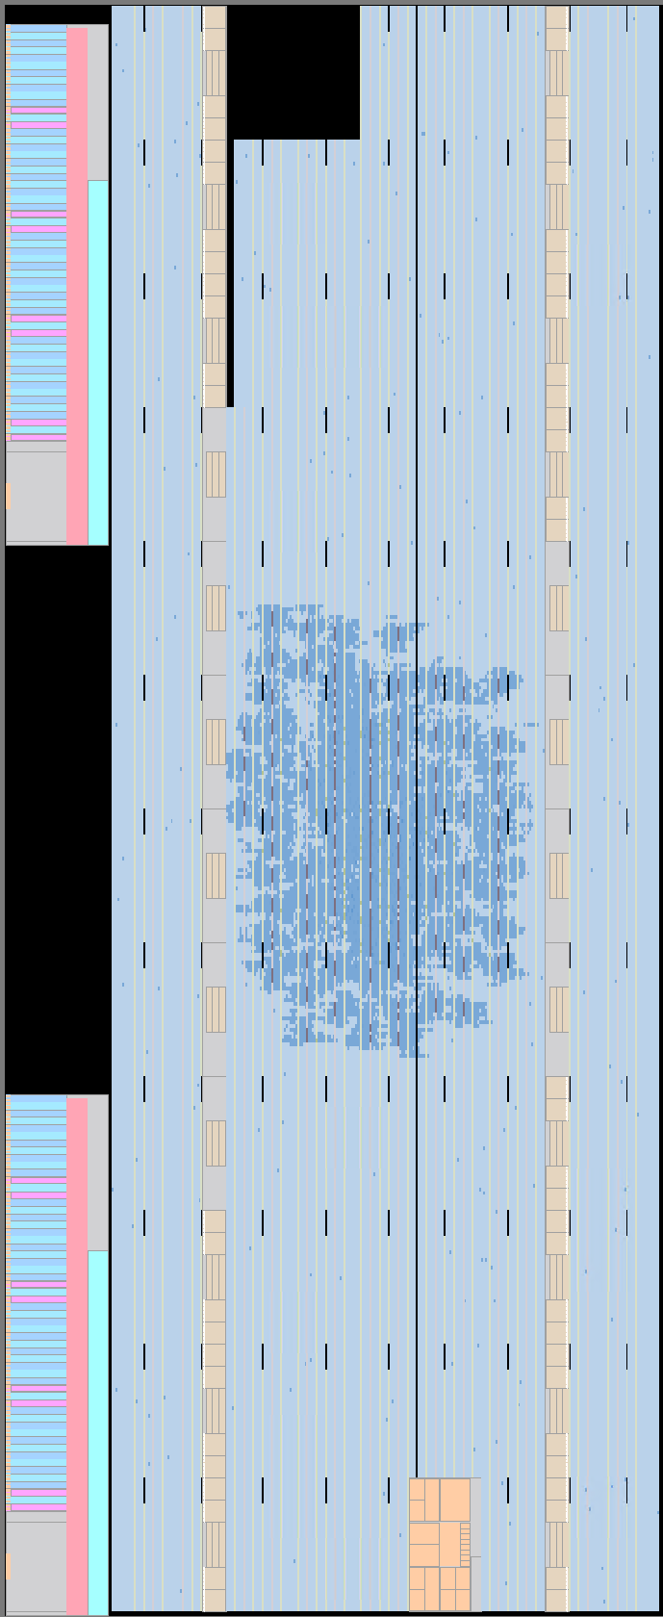
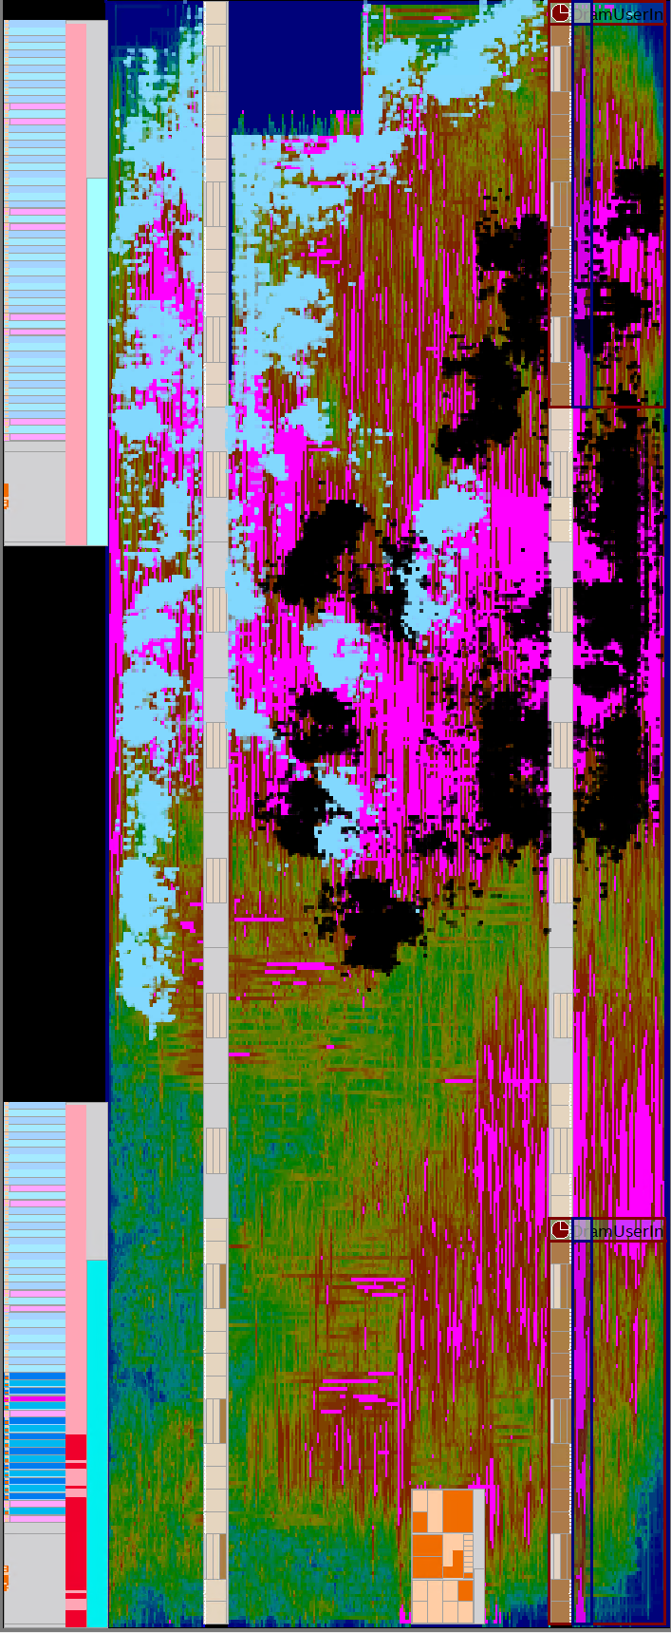
Development in Isolation Necessity
In practice, a bottom-up methodology often emerges in fast-paced industry environments
  Teams work on isolated parts
    Isolated modules allow for iterations
    with fewer compilation hours
  Teams develop entire modules
  in isolation with limited context
    Enables parallel development and
    early validation of functionality
  However, without system-level
  visibility, tools make choices
  based on isolated module placement and resource availability
  Results creates false confidence when isolated modules meet
  timing but problems only surface when integrated in full design
    Optimizations applied in isolation may increase congestion in full design
Module Instance 1
(Blue)
VPP Module In Isolation
Module Instance 2
(Black)

Slide 7
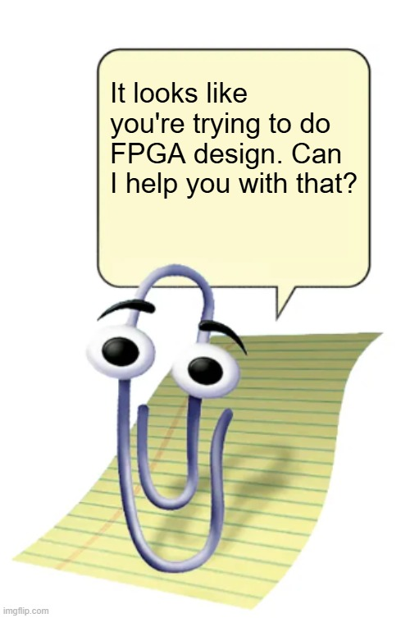
Existing Tooling/Research have Tradeoffs
Existing Tooling and Research have limitations that either don’t give the content modules need or require tradeoffs that were not accepted
  Paper dives more into details on both Altera and AMD tooling and recommendations
    Ex. Vivado’s Incremental Compilation and Quartus’s Rapid Recompile, Vivado’s OOC and Quartus’s VPP, Vivado’s LogicLock and Quartus’s Pblock, Vivado’s Hierarchical Design and Quartus’s, etc
  Vendor Tooling and Recommendations are complementary to the
  methodology but have tradeoffs that don’t suit large scale hyperscale
  development of living designs such as:
    Restrictions include narrow edit scope (<5%), complex infra to support tools in cloud
    systems, no preservation of I/O placement, no restriction of routing or placement to achieve
    realistic behavior outside isolation, and/or requirement stable design
  Related research complementary but doesn’t fully address needs
    Restrictions include requirement of a more top down environment with fixed end goals,
    fixed partion boundaries, rigid interface constraints, significant design overhead,
    requires commit of open source tooling and language

Slide 8

Module-Context Modeling Methodology
To address the limitations of existing techniques while accounting for industry developer complexities, this Module-Context Methodology was developed
  Preserves or creates a “good enough” amount of application context (i.e. synthetic context) during isolated module compilation
    Simple, repeatable, adaptable to various projects
  Excessive resources overhead avoided
  via module I/O Decoupling
    Altera’s virtual pins consuming entire ALMs and
    allows logic packing for remaining overhead
  Area constrains used to specify allowable
  place and route of modules and I/Os
Synthetic Context allows for more
effective isolation iteration

Slide 9
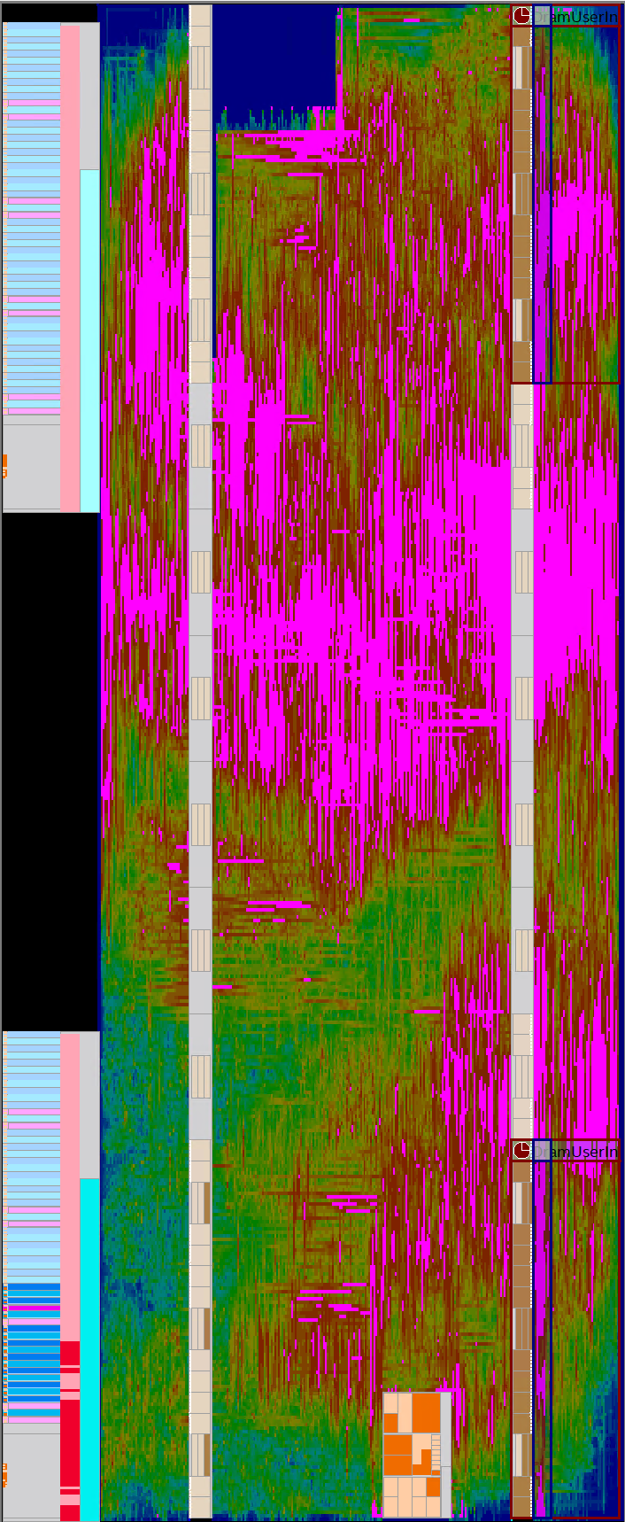
Case Study 1: Optimizing Brainwave
Microsoft’s Project Brainwave is a scalable FPGA-powered DNN Servicing Platform for Bing that uses scalable Neural Processing Units (NPUs) on FPGAs to for pre-trained DNN models
  This case study on a pre-production Stratix 10 implementation
  CI/CD Infra exists to run sweeps of builds and save key files/data
    Simple python scripts scrape information and store it in a dashboard for analysis
Problem: Brainwave was not meeting their timing goal
  Developers struggling to identify root causes and full compilation iterations took 15 hours
  Need to iterate on isolated modules instead
    Want to quickly identify root(s) of timing/congestion and fix it
Full build congestion

Slide 10
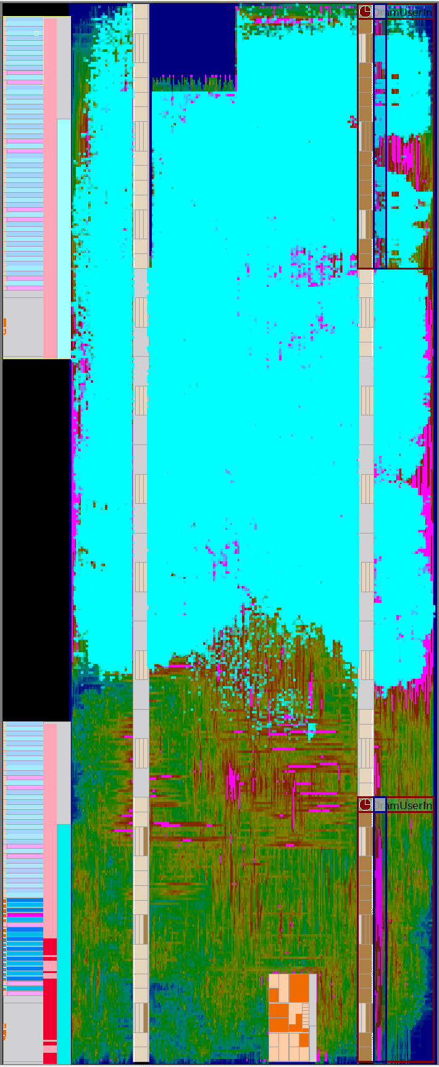
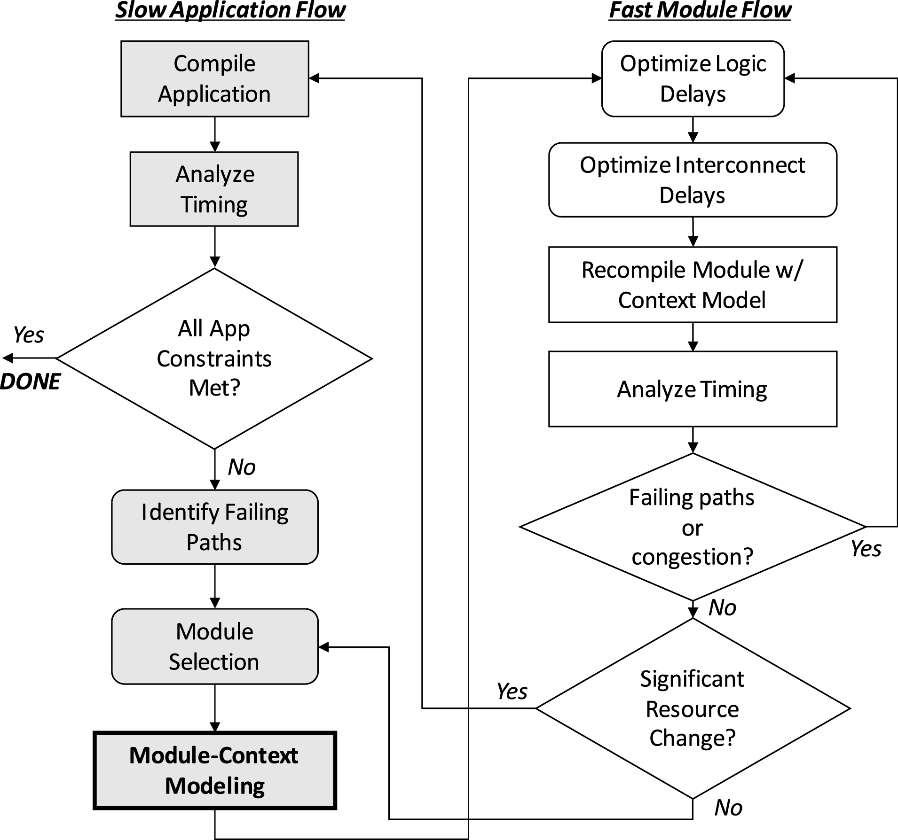
Identify Failing Paths and Module Selection
Tile Engine Array (TEA) likely a good candidate for optimizations
  TEA directly overlaps with congested area
  88% of long and short wire demand being consumed by resources related to TEA
  TEA frequently among worst paths across sweeps
  TEA picked over single Tile
  Engine (TE) due to irregular placement of TE and distribution of paths to all TEs
TEA in full build
(turquise)
Notes:
Timing reports showed 88% of the long and short wire demandfor the entire build being associated with the TEA, as well as themodule including 3 of the 10 worst paths. The problematic timingpaths were distributed across multiple tile engines rather than isolated to a single one, making optimization of an individual tile engine impractical and motivating the decision to optimize the TEA module as a whole.

Slide 11
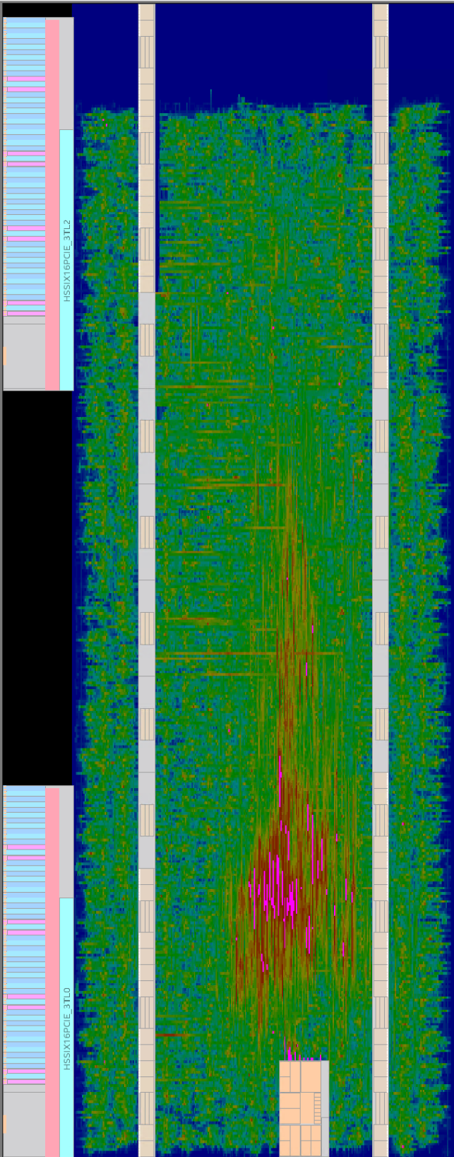
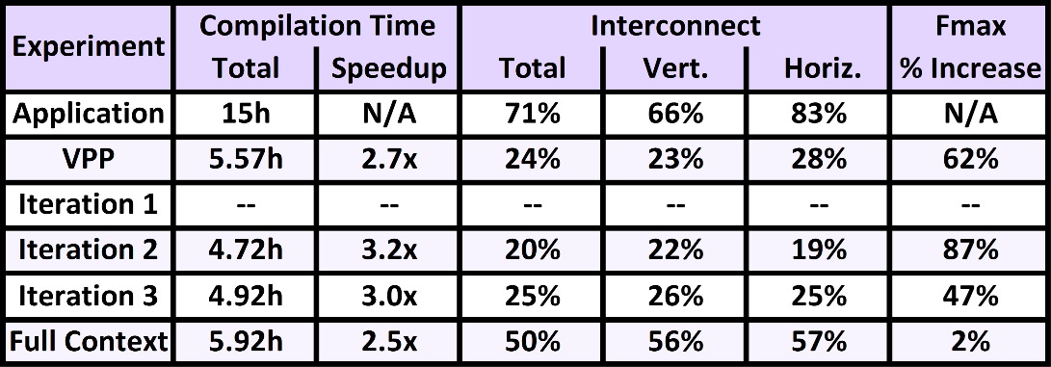
Vendor Tool Isolation: VPP
Full build
TEA VPP In Isolation
Attempted to compile TEA in isolation via Altera’s VPP flow
  Placement, Congestion, Fmax, Interconnect Use, Wire Use, etc. very different from full build
  Not representative enough of full build
  Can’t view problem in isolation with more accurate context
TEA in full build
(turquise)
Notes:
Next slide talks about inputs and outputs

Slide 12
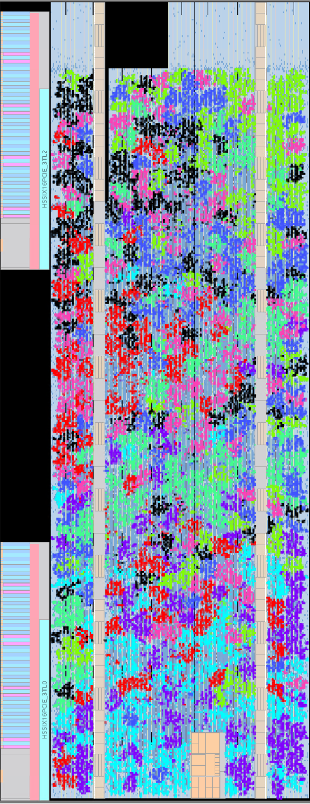
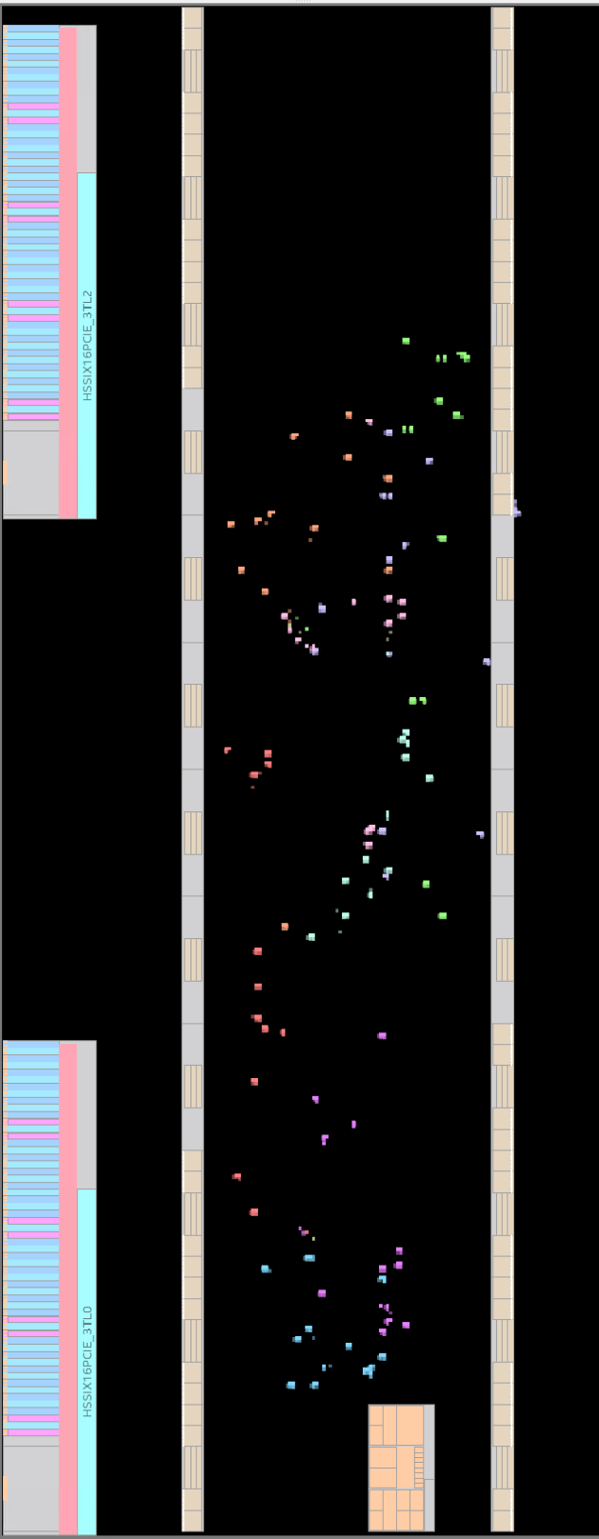
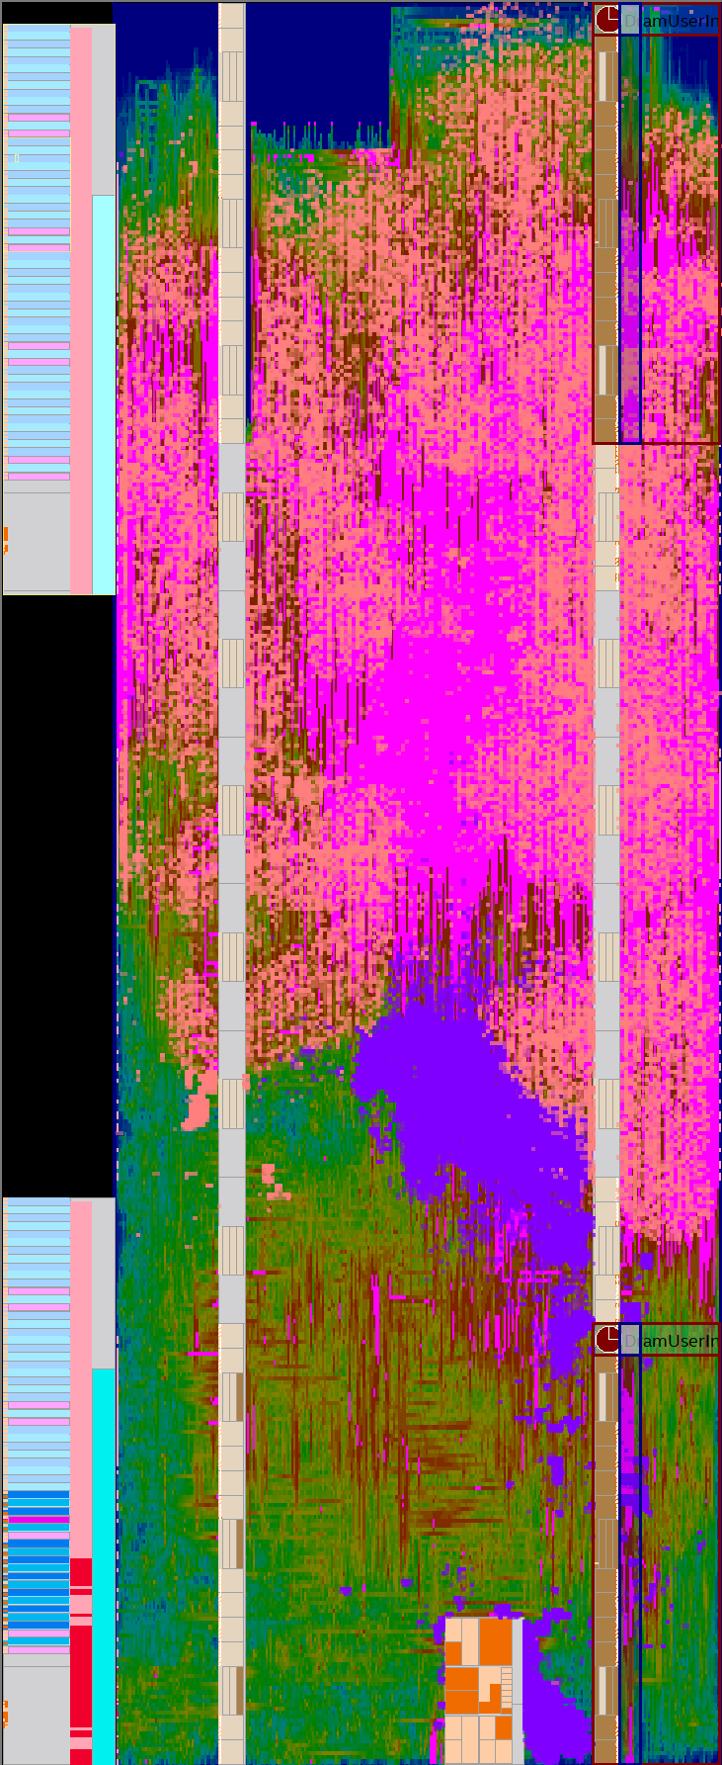
Vendor Tool Isolation: VPP
Inputs of TEA VPP
Input Buffers in TEA
(orange)
Attempted to compile TEA in isolation via Altera’s VPP flow
  Investigating further shows difference in I/O placement
  Full Build I/O wrap around sides and top, formatting a ring
    Full Build: Inputs in horseshoe shape around top and sides and data flows downward to the Outputs at the bottom
    VPP: evenly distributes the inputs across the device with outputs being clustered towards the center
Outputs of TEA VPP
TEA in full build
(turquise)
Output Buffer in TEA
(purple)

Slide 13
Path to Module-Context (Iterations)
Iteration 1: Synthetic Context added to design by constraining TEA to top Logic Lock used to restrict placement and routing to top half of device
  TEA failed to compile and was killed after getting stuck in place and route over 2 days
    Not useful even if it did finish compiling eventually since it took longer than full design
    Investigation showed overhead of Quartus’s virtual pins too high (12% of ALMs in entire device used for virtual pins)
  Need to reduce overhead
Iteration 2: Reduced resource overhead by removing virtual pins
  Ground input registers, leave outputs danging, apply no prune to registers
Iteration 3: Combine TEA constraining with
reduced resource overhead
    Closer but still not representative enough of full build
    Can’t view problem in isolation with more accurate context
Notes:
Each virtual pin consumes a full ALM, resulting in needing 12% of the ALMs of the entire device for the pins alone
This overhead was present in first VPP build but since TEA was spread out, overhead amortized across large area. Necessary register wrapper also contributed to overhead, but significantly less
Register packing of up to four wrapper register per ALM

Slide 14
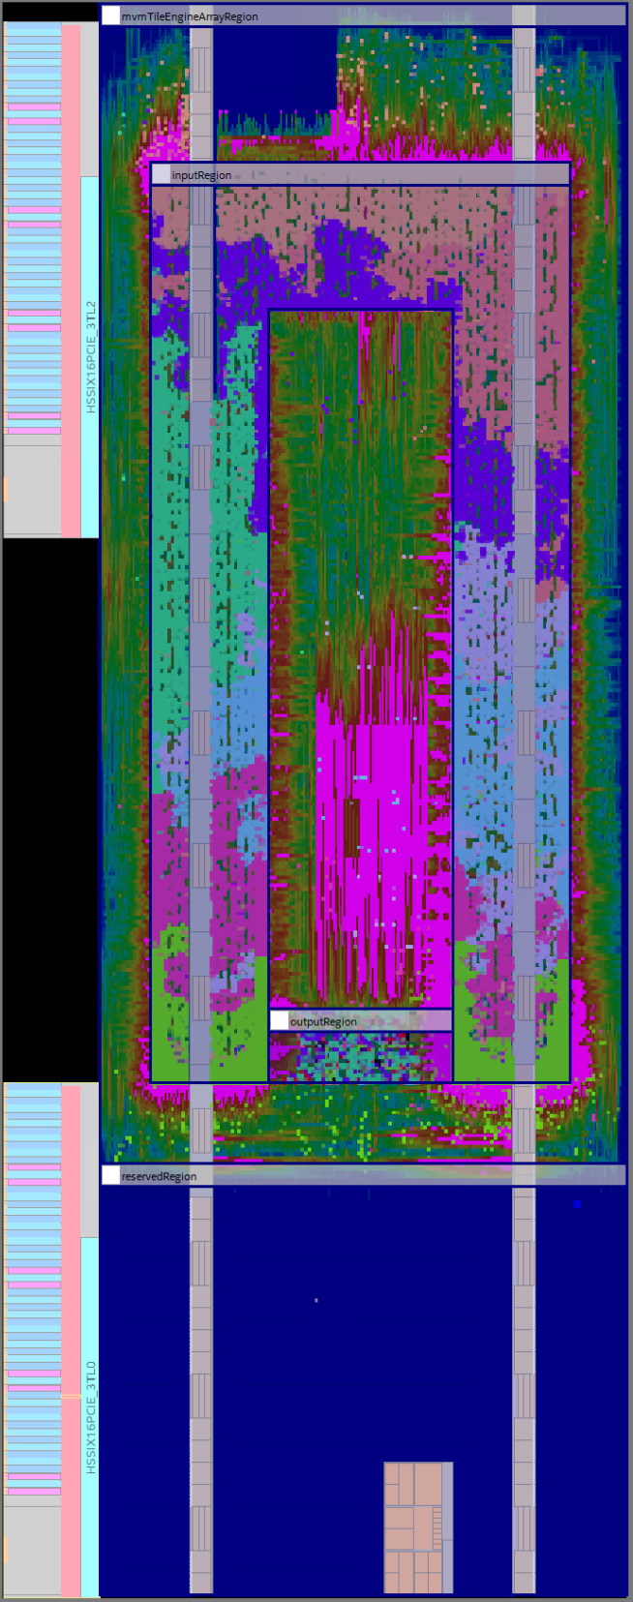
Path to Module-Context (Using Methodology)
Input Buffers in TEA
(orange)
Input register placement
(horseshoe shape)
Added I/O Placement Constraints
  Inputs and Outputs registers restricted to same general region as full design
  Fmax within 2% of Fmax of full design
  Tile Engines Array component distribution and congestion similar to full design
  Interconnect usage closer to full design
Ready to do analysis and iterate
Output Buffer in TEA
(purple)
Output Register placement
(bottom)

Slide 15
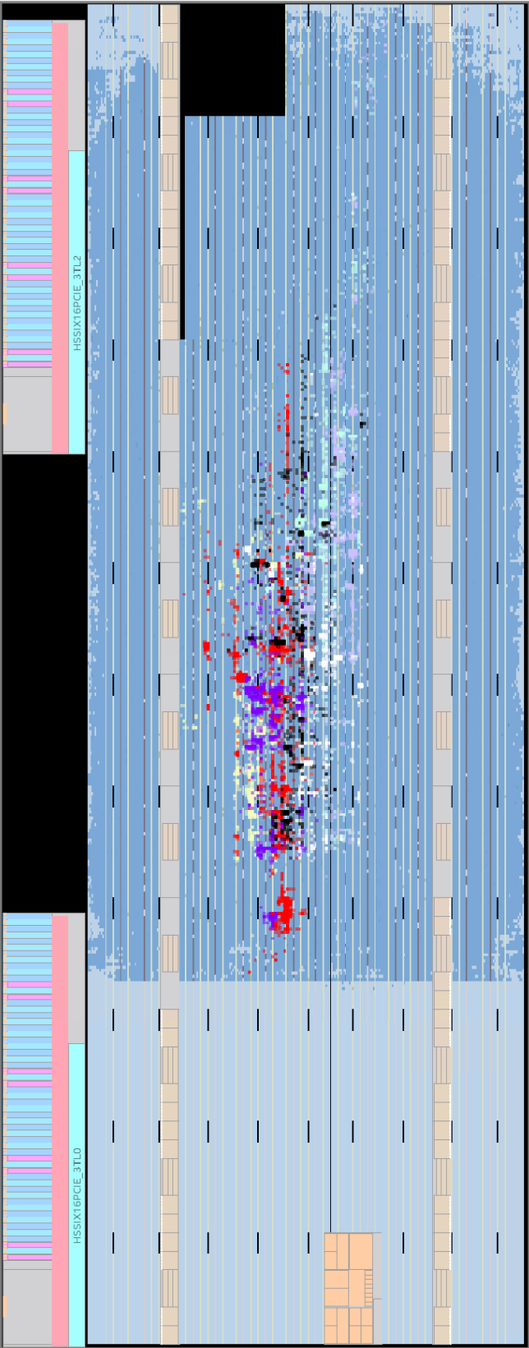
Module-Context Module Methodology
Issues revealed and fixed in isolation
Congestion without co-located modules occurs at output
buffer interface
  Improvements made in isolation to remove congestion and increase fmax carried over to full design
  Faster and easier to iterate in isolation
Input register placement
(horseshoe shape)
Output Register placement
(bottom)
Output buffer
Notes:
Talk about retrospective. What does it mean to be good enough? Problem was with output buffer.

Slide 16
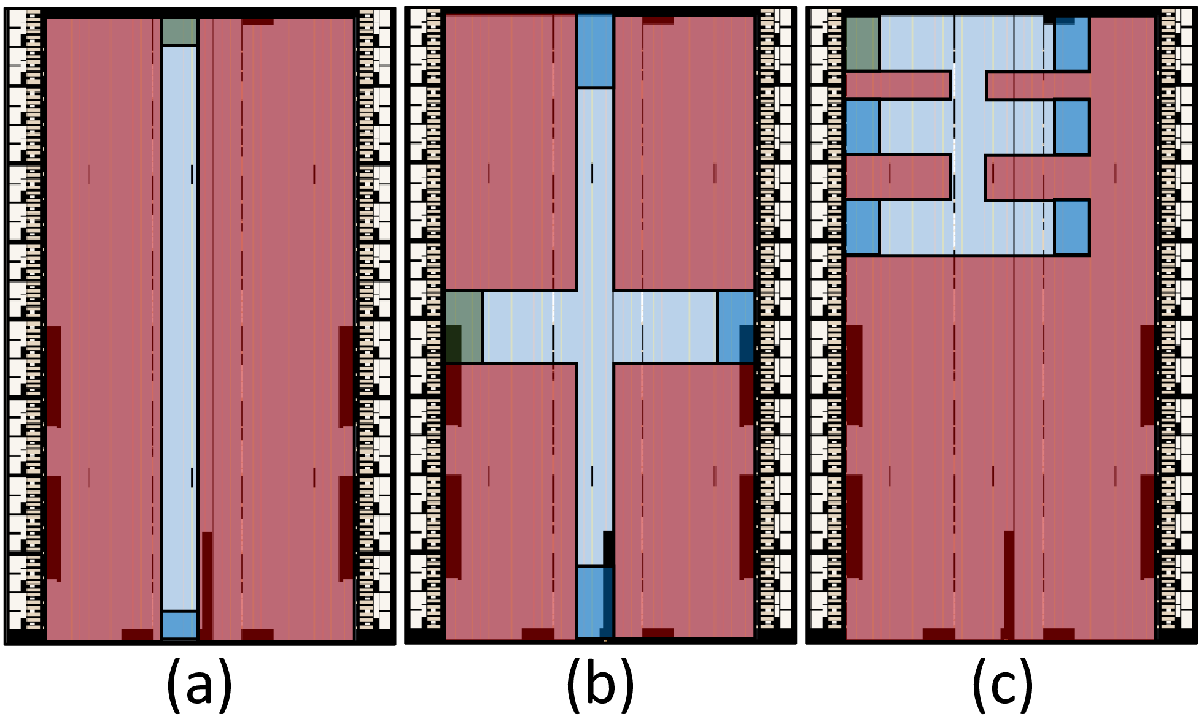
Case Study 2: Fan-out Characterization
Applying synthetic contexts spanning various realistic constraints to characterize fanout mitigation strategies prior to full design availability
  Case study characterizes fanout strategies of register duplication and hierarchical duplication
  Similar tool setup to Brainwave case study
  For synthetic context, swept across 9
  different sets of shapes (Combos of
  destination placements) and sizes
  (Critical path lengths from source to sinks)
  For Fanout characterization, swept across
  different Data Widths (8-128 bits), Number
  of outputs (8-64), and Maximum fan-outs
  per node (2-64)
Ran over 4k variations
Notes:
Each virtual pin consumes a full ALM, resulting in needing 12% of the ALMs of the entire device for the pins alone
This overhead was present in first VPP build but since TEA was spread out, overhead amortized across large area. Necessary register wrapper also contributed to overhead, but significantly less
Register packing of up to four wrapper register per ALM

Slide 17
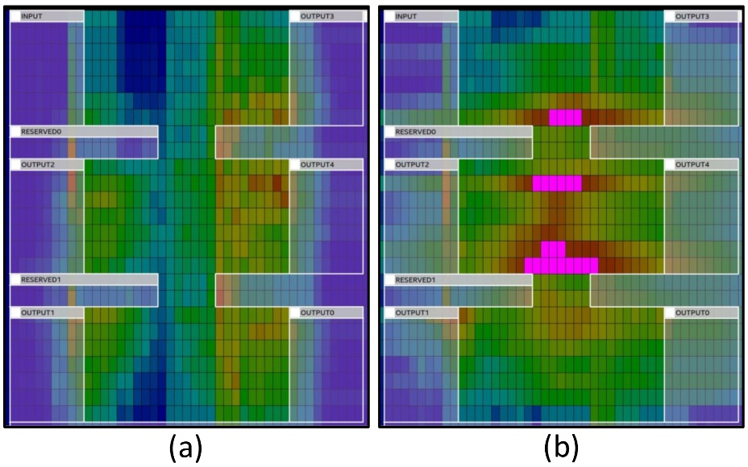
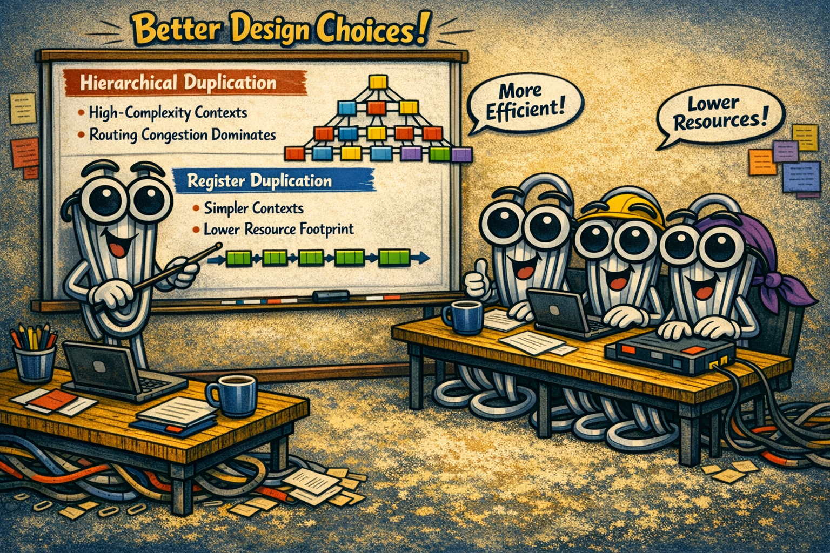
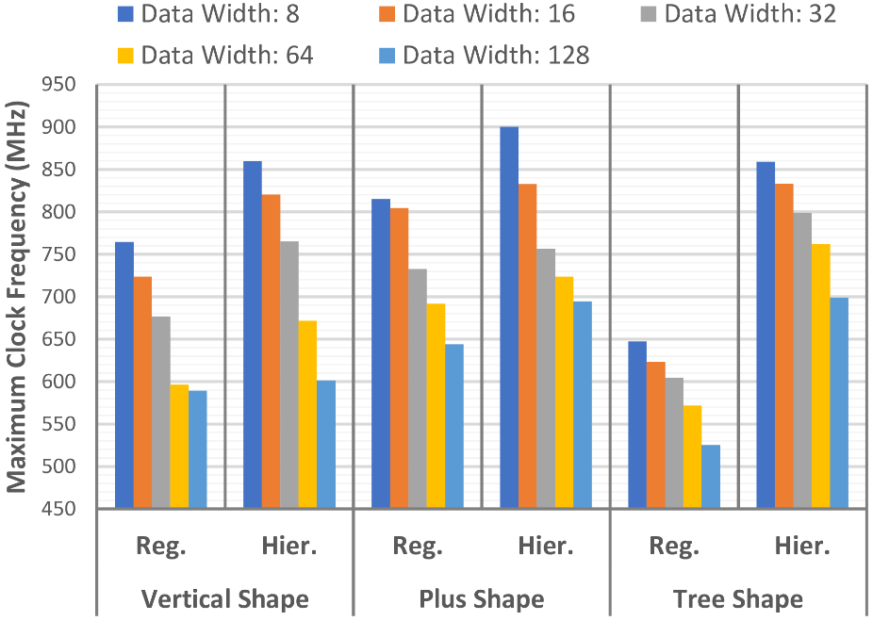
Case Study 2: Fan-out Characterization
Model Context Modeling Methodology allowed developers to get a “good enough” understanding of which fanout strategy to use
  Characterization led to concrete recommendation
  Teams can make decisions grounded in empirical data
Notes:
Each virtual pin consumes a full ALM, resulting in needing 12% of the ALMs of the entire device for the pins alone
This overhead was present in first VPP build but since TEA was spread out, overhead amortized across large area. Necessary register wrapper also contributed to overhead, but significantly less
Register packing of up to four wrapper register per ALM

Slide 18

Conclusion and Take Aways
Case studies demonstrate how to create “good enough” amount of application context (i.e. synthetic context) for isolated module compilation using module I/O decoupling and placement constraints
  Enables developers to develop, optimize, and
  characterize modules in isolation in a simple,
  easy to follow, repeatable, and adaptable way
Methodology can be expanded upon:
  Ex. Model routing congestion from neighboring
  modules, cross-module timing paths, etc
  Controlled, context-rich data via synthetic
  context could be as training data for
  automated design space exploration
Shows need for future research and vendor tools that account for industry realities

