Slide 1
Hyperscale FPGA Engineering Systems at Microsoft
Rob Rydberg, Madison N. Emas, John Demme,
Ana Ibarra, Kara Kagi, Brandon Klouchek, Abhijeet Lawande, Todd Massengill, David J. Powers, Andrew Putnam
Microsoft Corporation
ISFPGA ’26, Seaside, CA, USA

Slide 2
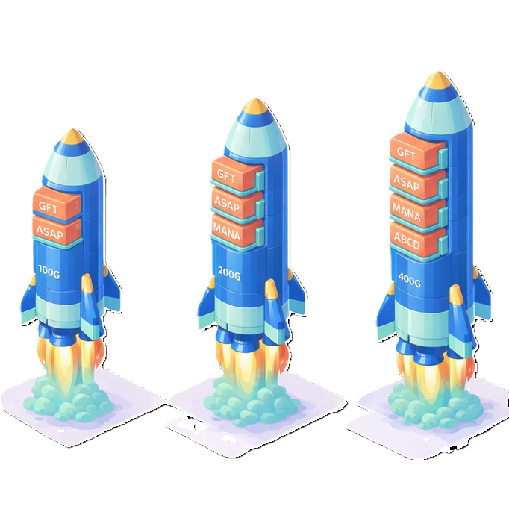
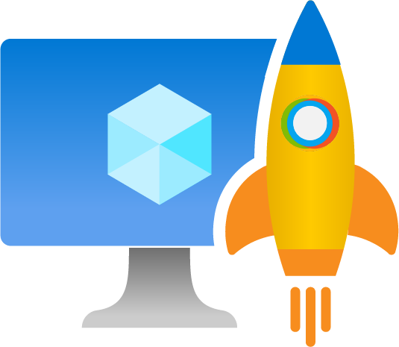
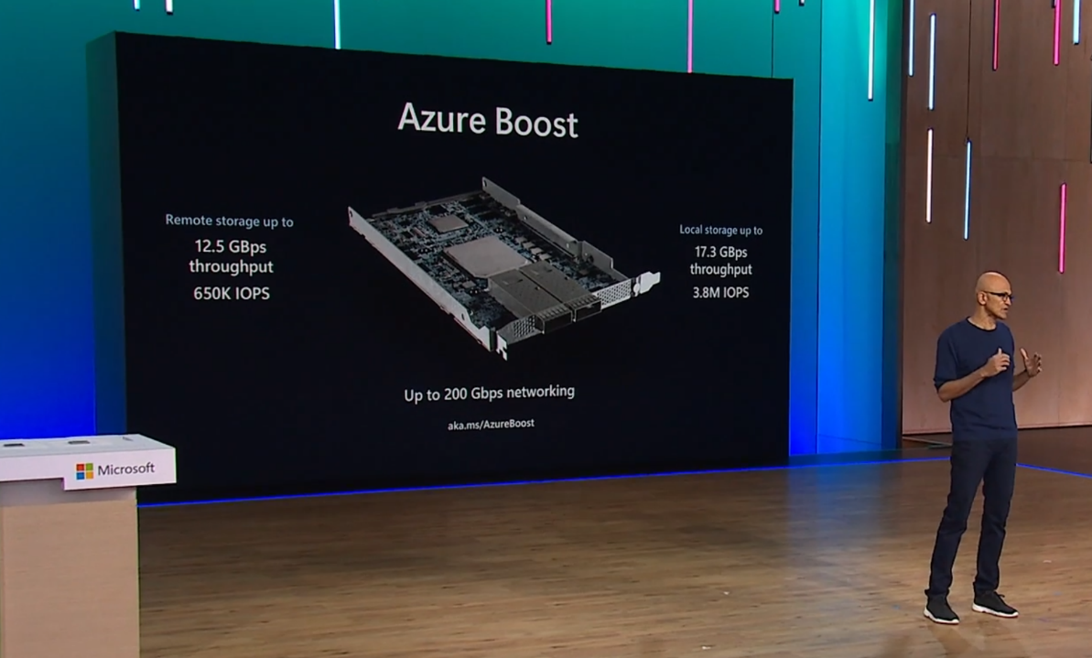
Azure Boost
SW Defined Networking – GFT
Storage – ASAP
NIC – MANA
Confidential – ABCD

Slide 3
FPGA Engineering Systems at Microsoft
Tools & Infrastructure we use
  Dev Environment
    OS env, Licenses*
  Version Control (git)
    Branch strategy, change management
  IDE (vscode)
    LLM (copilot)
  EDA Tools*
  CI/CD (i.e. build & test flow - ADO)
  Compute Platform (Azure)
  Report Platform (data gather, store, display)
  Test (lab, Test-in-Production)
Good ones are invisible
  Dependable
  Reliable
  Repeatable
  Flexible
  Modular
  Automated
  Documented
* - FPGA-specific parts

Slide 4
Azure Boost Development Flow
HW Development
SW Development
Design
Code
Unit Test - DV
Role Simulation - DV
Build
Lab – Val <= This is where SW starts
Design
Code
Unit Test
Lab – Requires FPGA Build

Slide 5
Azure Boost Build Flow
Source Assembly & Project Creation
Initiate the process by creating the source assembly and setting up the project.
Run Build
Compile and build the project to generate the necessary binaries.
Collect Reports & Logs
Gather build reports and logs for analysis and documentation.
Report, Analyze, & Sign
Review the reports, analyze the results, and sign off on the build.
Trigger Lab & TiP Tests
Start the Lab and TiP tests to validate the build.

Slide 6
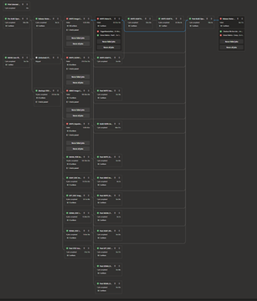
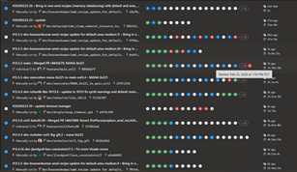
Example Build Pipeline

Slide 7
Evolution of the Build System
If it ain’t broke, don’t fix it
  But seriously, stop using TCL
Rebuild pieces continuously
Modularity is Key
Laptop → Cloud CI/CD
  From GUI + Tcl on laptops to Azure VMs + DevOps Pipelines
Tcl → Python:
  Thin EDA wrapper; Python for scalable, testable orchestration
Rebuilt every 2–3 yrs: Continuous infra redesign to maintain velocity
Layered abstractions: Serve casual users and power users
AI emerging: Copilot helps navigate massive, evolving HDL codebases

Slide 8
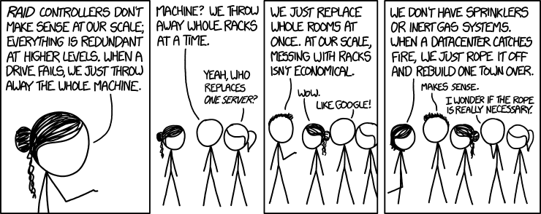
What’s Truly Unique at Hyperscale?
https://xkcd.com/1737

Slide 9
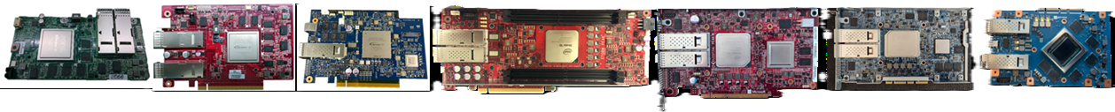
What’s Truly Unique at Hyperscale?
Cloud-scale synthesis (100k+ cores, 1 PB DRAM, 4½ PB storage)
Automation is a pre-requisite & a method of survival
DRI – FPGA Engineers support the Production Fleet
1-in-1Million problems happen multiple times a day
6+ Generations in production today, 1M++ device, active support
70-90% code re-use between programs or generations

Slide 10
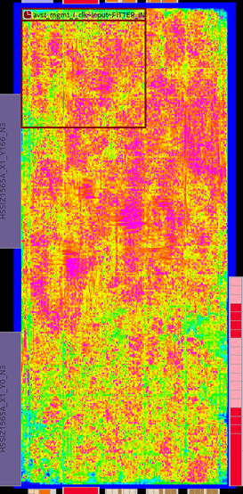
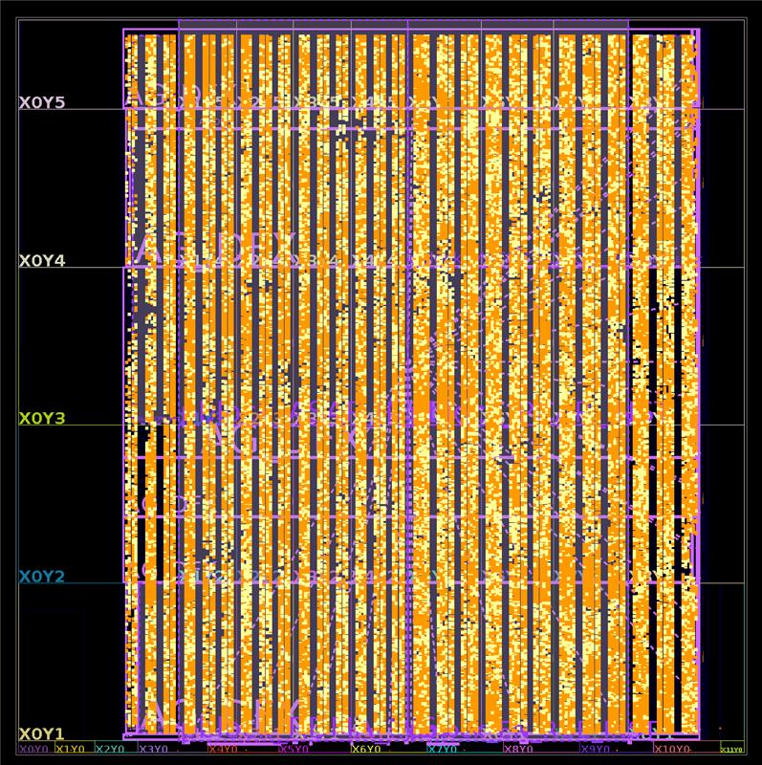
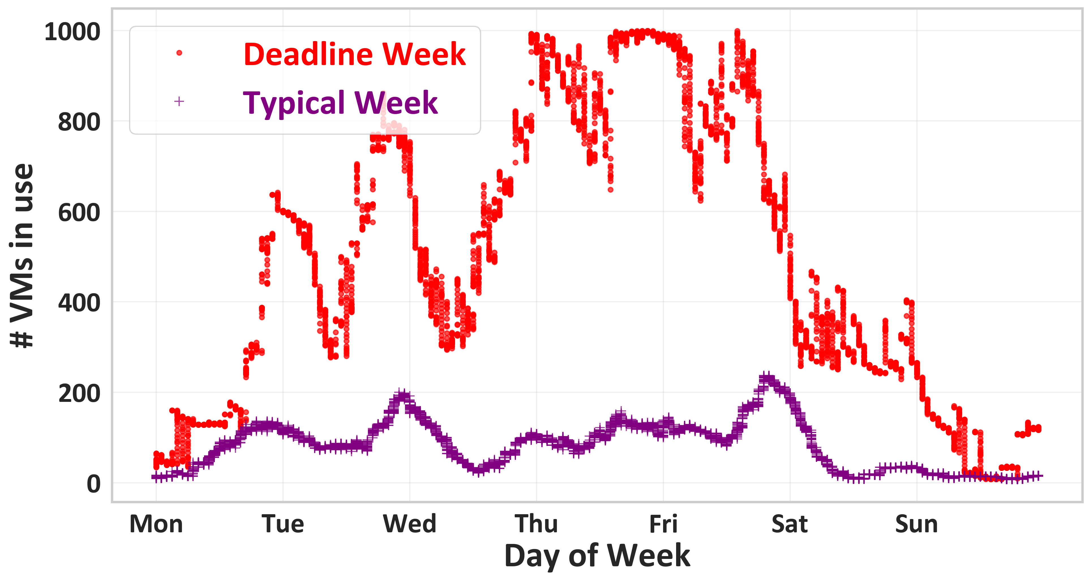
Azure Boost Design Scale Challenges
Platform | Logic % | RAM % | Run Time (Hrs) | Vars Run | % Passing | # Warnings
100G | 86 | 66 | 6 | 20 | 40 | 24.2K
200G | 93 | 85 | 16 | 50 | 20 | 79.6K
400G | 83 | 82 | 30+30 | 170+ | <1 | 2.6K

Slide 11
Making Sure it Works
Traditional Validation & Verification Still Applies
FPGA is just one component in a massive SW/HW ecosystem
Validate “enough” and follow safe deployment practices
Deployment (Joint HW & SW)
Debug
Lab Validation (1s)
Test In Production (1s)
Dev Cluster (10s)
Canary Cluster (100 – 1K)
Single Region (10k+)
Multi Region (10k – 1M+)
Constant streaming logs & telemetry
  Limited ability to store that data
Automated recovery on failure
No JTAG / interactive debug
You only have the breadcrumbs you drop

Slide 12
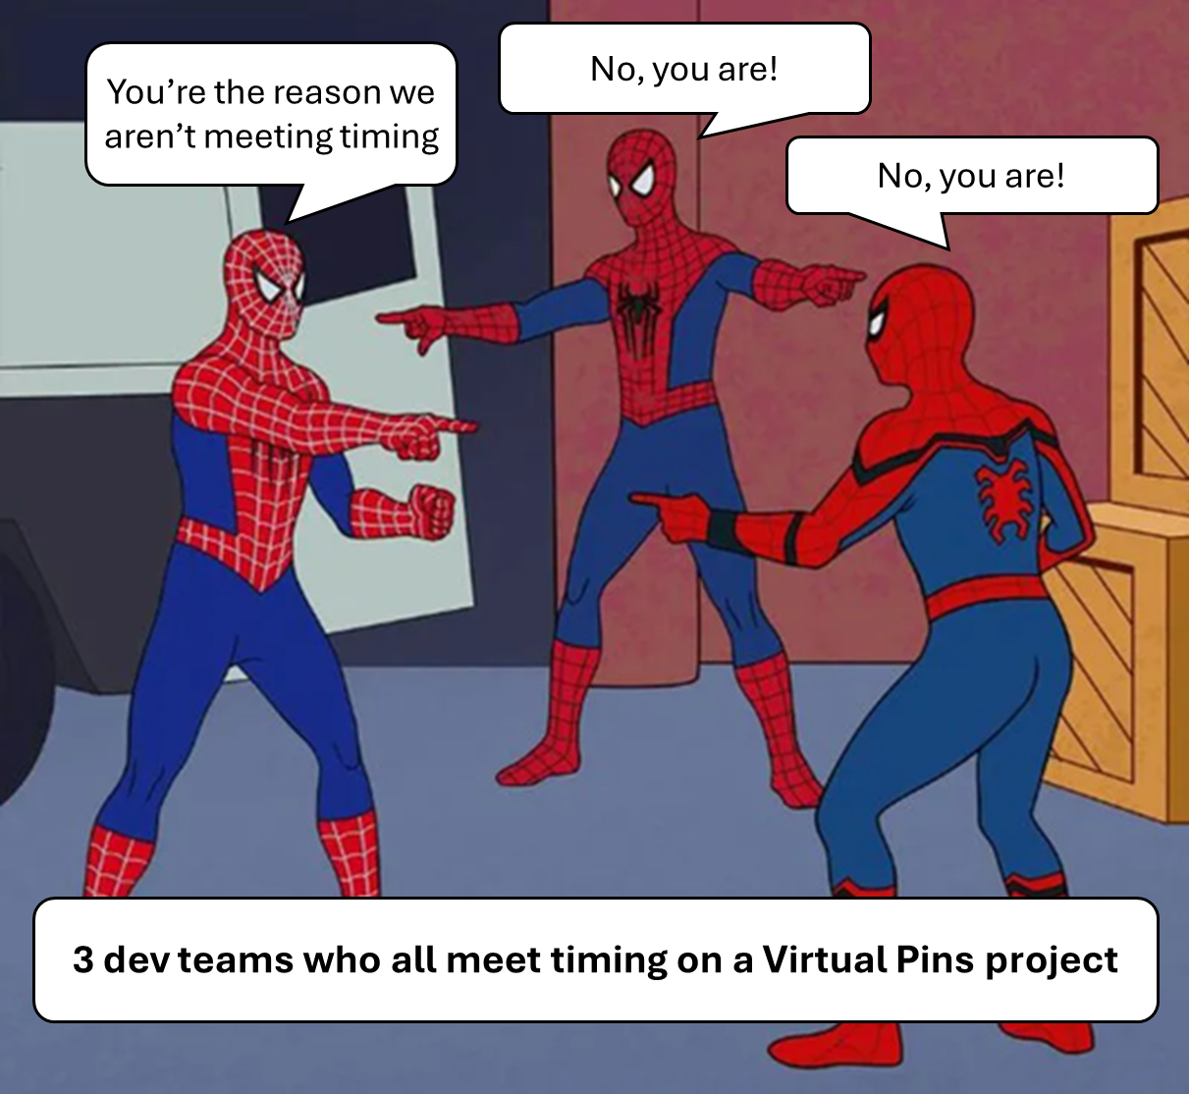
People & Teams at Cloud Scale
HW embedded in SW teams
  A few hundred devs
  <30% write FPGA code
Geographically and Organizationally diverse
  10s of Git Repos
Resource contention across applications far more challenging than in SW

Slide 13


Hopes & Dreams
No more TCL
Never fail for a license again
Reduce warnings to < 79.6k
First-class Python APIs
Run-over-run learning
More software-like integration
  Partial Reconfiguration?
Tape Out Every Day

Slide 14
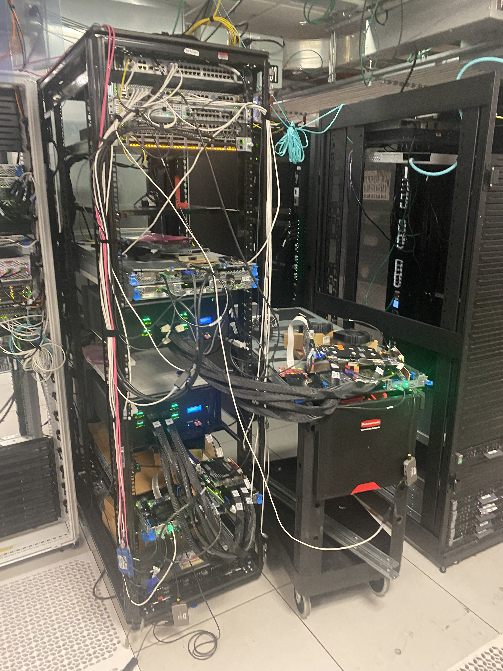

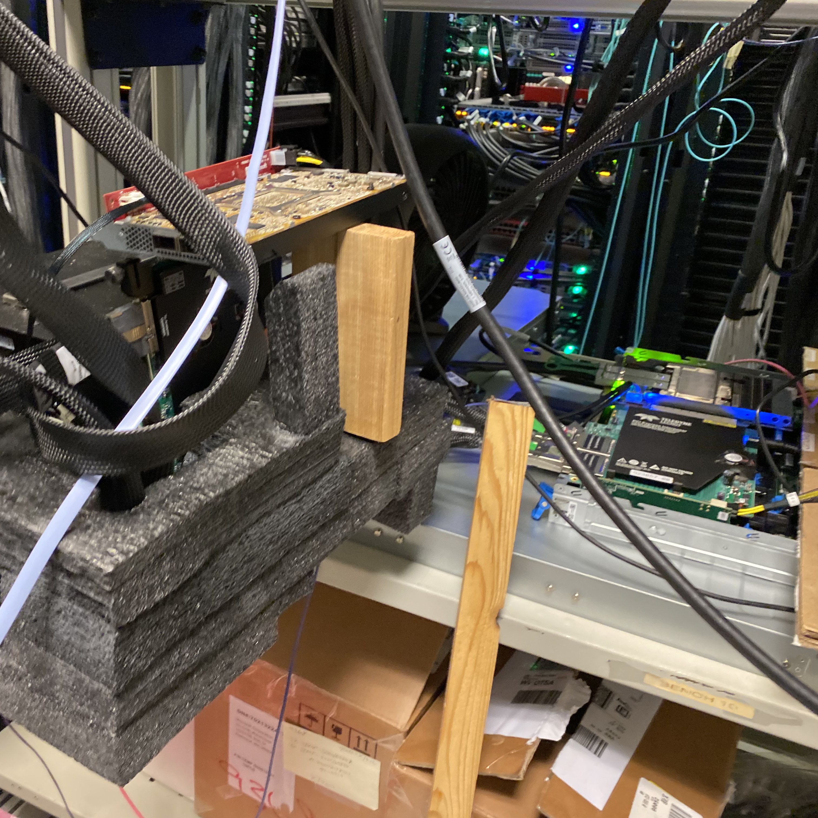
Thank you!

Slide 15
Questions

Slide 16

Azure Boost Scale Challenges
Device Utilization
Build Time
Compute Needs
Team size, background, & charter
Data Analysis
Design Quality
Developer inner loop

Slide 17
Talk Outline
What is Azure Boost?
Background on FPGA Engineering Systems at Microsoft
Build & Design
Integration
Deployment
Debug

