Slide 1
HiLFS: FPGA-Orchestrated File System for High-Level Synthesis
YoungSeok Na*, Linus Y. Wong*, André DeHon, Jing (Jane) Li
University of Pennsylvania
* Both authors contributed equally to the paper
Notes:
Today, I will be presenting the work HiLFS: FPGA-Orchestarted File System for High-Level Synthesis. This work is done in close collaboration with my colleague Linus Wong, and under the guidance of Professor Andre DeHon and Jing Li

Slide 2
Rise of Data- and I/O-intensive Applications
Large Storage Demand
DeepSeek R1
SSD
LlaMa 3.1
weights
BLOOM
LlaMa2-70B
AlexNet
VGG16
YOLOv1
WideResNet
BERT
GPT2
ViT
OPT-6.7B
LlaMa2-7B
Mamba-2
Notes:
Modern applications have been marked with an exponential growth in model size and becoming more data- and I/O-intensive, with parameter counts easily reaching hundreds of billions.
These model parameters like model weights are distributed in multiple files with various sizes, and consume significant amount of storage space, driving a demand for high-capacity SSDs.

Slide 3
Complexity of Sparse Mixture-of-Expert Models
Large Storage Demand
AND Data-dependent Access
DeepSeek R1
SSD
LlaMa 3.1
Input A
Input B
BLOOM
LlaMa2-70B
AlexNet
VGG16
YOLOv1
WideResNet
BERT
GPT2
ViT
OPT-6.7B
LlaMa2-7B
Mamba-2
Notes:
New paradigm named Sparse Mixture-of-Experts, exemplified by models like DeepSeek R1, brings a storage access pattern that depends dynamically on different input.
For instance, the accessed storage region for input A may be different from input B.
This data-dependent access further complicates the storage logic needed to be specified by developers when programming large applications.

Slide 4
Growing Gap between FPGA and GPU
DeepSeek R1
LlaMa 3.1
BLOOM
100x Gap
LlaMa2-70B
AlexNet
VGG16
YOLOv1
WideResNet
BERT
GPT2
ViT
OPT-6.7B
LlaMa2-7B
Mamba-2
Notes:
While both FPGA and GPU have been able to support earlier models, we see growing gap between models supported by the two platforms on recent ones.
We ask the question, why does this gap exist?

Slide 5
Outline
Current Storage Strategies
Our Solution
Evaluation
Conclusion
Notes:
To answer this, we will first debunk strategies GPUs and FPGAs have employed in tackling this trend.
Then, we propose our solution that aim to address the limitations of FPGA in supporting modern models like GPU does.
We demonstrate the effectiveness of our design through evaluation result and conclude the presentation.

Slide 6
Outline
Current Storage Strategies
Our Solution
Evaluation
Conclusion

Slide 7
Current Strategies: GPUDirect Storage (GDS)
Control Path
Data Path
CPU DRAM
CPU DRAM
CPU Host
CPU Host
1
1
PCIe Switch
2
PCIe Switch
2
4
3
4
3
GPU
SSD
GPU
SSD
GPU DRAM
GPU DRAM
GDS
Increased performance with direct data path
Notes:
When GPUs need data from storage, it has to rely on the host CPU to first migrate the data from storage to host memory, and then to the GPU memory.
This intermediary copy degrades performance, especially troublesome for storage-dependent models. To alleviate this, modern GPU and NVMe SSD support GPUDirect Storage technology (abbreviated as GDS) that enables a direct transfer of data between the two.

Slide 8
Current Strategies: GPU Software File System (cuFile)
Control Path
Data Path
CPU DRAM
Host
CUDA
1
CPU Host
Suspend
int fd = open();
2
cuFileDriverOpen();
cuFileBufRegister();
cuFileRead();
1
3
PCIe Switch
2
4
3
4
CUDA Launch
Algorithm
GPU
SSD
GPU DRAM
GDS
Simple software interface
Host-dependent, slow file logic
Notes:
To provide a software support for GPU devices with GDS, GPU’s software file system support like cuFile enables storage-aware programming in GPU through simple library calls.
When the GPU kernel needs data from storage, the kernel first suspends its operation, allowing file access APIs to setup and read data from storage, before resuming the algorithm on the kernel.
Despite the simplified view of storage access, the cost of halting the kernel and traversing OS storage stack becomes a bottleneck for storage-dependent design.

Slide 9
Current Strategies: GPU File System (GDS + GeminiFS)
Control Path
Data Path
CPU DRAM
Host
CUDA
Metadata
CPU Host
1
Suspend
2
dev_fd fd = G_open();
3
1
4
PCIe Switch
2
CUDA Launch
4
3
int bytes = G_read(fd);
Algorithm
GPU
SSD
GPU DRAM
GDS
File-level interface on GPU
Bypassing CPU only within same files
GeminiFS: A Companion File System for GPUs (FAST ’25)
Notes:
Recently, approaches like GeminiFS provides a file-level API for GPU, accelerating the file access by attempting to bypass CPU.
However, dynamically opening and closing a file still requires CPU involvement, as the metadata need to be fetched from the host OS.
Similar to before, the kernel needs to halt, hand over the control to host to fetch appropriate file metadata, before the kernel can independently work with storage data.
Though some file-level APIs are available for GPU to bypass CPU within same file access, adapting the design to use new files incur overhead.

Slide 10
Summary of GPU Strategies
Improved datapath through GDS
Simple file abstraction available on the host and GPU
CPU DRAM
CPU Host
G_open
cuFile
G_read
PCIe Switch
GPU
SSD
GPU DRAM
GDS
Notes:
To summarize, we have seen GDS providing a direct datapath between storage and GPU memory, and creation of a simple file abstractions to the host and GPU so that the developers can better utilize the benefit of direct storage access. This provides a rich environment for developers to work on large storage-aware designs easily.

Slide 11
Current Strategies: FPGA Peer-to-Peer (P2P)
Control Path
Data Path
Non-P2P
P2P
CPU DRAM
CPU DRAM
CPU Host
CPU Host
1
PCIe Switch
1
2
PCIe Switch
2
4
3
4
3
FPGA
SSD
FPGA
SSD
FPGA DRAM
FPGA DRAM
Direct data path from SSD to FPGA DRAM
Notes:
FPGAs have also made an effort in improving support for this storage demand.
Identifying that the migration of data from SSD to FPGA also relies on host DRAM as an intermediary buffer, PCIe Peer-to-Peer technology enables a direct migration of data from storage to FPGA memory. I will term the designs that has Peer-to-Peer disabled and enabled as Non-P2P and P2P, respectively.

Slide 12
Current Strategies: FPGA Software File System
Control Path
Data Path
Host
HLS
CPU DRAM
CPU Host
1
Suspend
2
int fd = open(“fname”, …);
3
1
int bytes = pread(fd, …);
PCIe Switch
2
4
HLS resume
4
3
Algorithm
FPGA
SSD
FPGA DRAM
Simple software interface
Host-dependent file logic
Notes:
To describe the migration of data, developers rely on software file system interface in CPU to interact with storage. Though the interface is simple, the host-dependent logic requires frequent suspension of HLS kernel for each storage request, degrading performance.

Slide 13
Current Strategies: DONGLE
Control Path
Data Path
CPU DRAM
HLS
CPU Host
ap_uint<512> x =
ssd[4 * OFFSET_LAYER + \
2 * OFFSET_EXPERT + \
OFFSET_WEIGHT];
PCIe Switch
Algorithm
FPGA
SSD
FPGA DRAM
FPGA-initiated storage control
Cumbersome raw block-level addressing
DONGLE: Direct FPGA-Orchestrated NVMe Storage for HLS (FPGA ’23)
Notes:
Works like DONGLE allow FPGAs to be the direct agent to both orchestrate and migrate data from/to SSD. This greatly reduces the programming complexity by allowing unified HLS code with both control and data logic. However, the exposed API to developers are at a block-level granularity, which makes development of large storage-dependent application cumbersome and error-prone.

Slide 14
Tradeoff: Abstraction versus Performance
Control Path
Data Path
CPU DRAM
Either:
  Simple interface like File System
    Host-mediated access
  Performant access
    Direct path between FPGA and SSD
    Low-level block programming
CPU Host
PCIe Switch
FPGA
SSD
FPGA DRAM
Notes:
In sum, the current FPGA storage programming methodologies either rely on simple file system interface available in CPU, creating a host-mediated access, or focus on performance through direct connection, at a cost of using low-level block programming.

Slide 15
Outline
Current Storage Strategies
Our Solution
Evaluation
Conclusion
Notes:
Thus, we propose a solution to tackle this tradeoff.

Slide 16
HiLFS Design Goals
Better usability for HLS developers
  Low-level block access is cumbersome and error-prone
Efficient management of storage space
  Performant means to orchestrate data
  Bypass CPU OS storage stack
Notes:
To target complex storage-dependent applications,
We first need to have a better interface to develop HLS code than low-level block access, as it is cumbersome and error-prone to use for designing large models.
Also, the management of storage data must be efficient to orchestrate the data by bypassing CPU OS storage stack on control plane

Slide 17
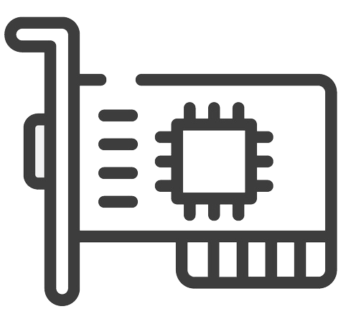
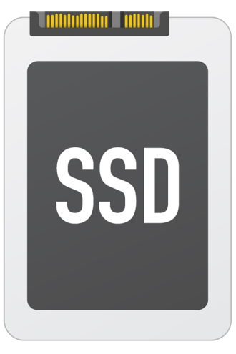
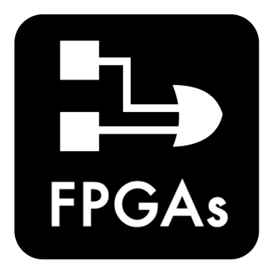
HiLFS Overview
A fully FPGA-offloaded file system for HLS developers
  Usability: File-level interface for storage like software
  Performant: Direct storage management, bypassing CPU
file
Software
HLS
Setup
Setup
Storage access
≈
Storage access
Algorithm
Algorithm
Notes:
To this end, we propose HiLFS. HiLFS is a fully FPGA-offloaded file system for HLS developers that gives
A file-level interface similar to software, providing better usability for storage-based designs
And a performant means for FPGA to manage storage, bypassing CPU

Slide 18
File-level Access to Storage like Software
FPGA
HLS App
hilfs_open
hilfs_close
HiLFS Library
hilfs_read
hilfs_write
hilfs_lseek
HLS App
HiLFS File System
HiLFS Library
HiLFS Block I/O
SSD
Notes:
Employing HiLFS enables HLS applications to directly interact with HiLFS library layer that provides a similar interface as POSIX call (like open and close) to access storage.

Slide 19
File-level Access to Storage like Software
FPGA
HLS App
HiLFS Library
hilfs_open
HLS App
HiLFS File System
HiLFS Library
identifier
property
fd
lseek_pos
HiLFS Block I/O
structure
inode
SSD
Notes:
Similar to software, API calls like hilfs_open get translated to set of requests that allocate a new identifier (like file descriptor), set the property of the file (starting position for reading/writing), and construct the file data structure (referred to as inodes) if it has not yet constructed.
This request will then be communicated to the downstream file system layer for actual data management.

Slide 20
Direct Storage Management
hilfs_read
FPGA
File Walker
HLS App
1
HiLFS Library
file
Metadata Loader
4
HiLFS File System
HiLFS File System
5
HiLFS Block I/O
2
Block Reader
Block Writer
HiLFS Block I/O
3
Block Driver
(using DONGLE)
SSD
3
Notes:
The file system and block-level I/O modules of HiLFS translates the requests sent by the library layer to metadata and data operations.
For instance, upon a read request, the metadata corresponding to the requested file is communicated to the metadata loader that gets translated to the appropriate block containing the file. The metadata loader then parses out the file inode containing the structure of the file, and passes onto the file walker to determine physical addresses to read by parsing out logical-to-physical block mappings.
The set of addresses will then be communicated to the block I/O to fetch directly the content requested by the application.
Similar story holds for writes.

Slide 21
Optimizing HiLFS
Eliminate frequent pointer-chasing in storage
  Minimal metadata storage access for each data block
Safety/Resilience to faults
  Marking/notifying incorrect access to files
  Periodic metadata backup through snapshot
Notes:
In efforts to optimize performance and functionality, we fine-tune our design in two aspects.
First, we want to eliminate frequent pointer-chasing done on storage to have a minimal metadata access for each data block.
Also, we need storage management to be performed safely and in a resilient manner, by notifying developers of incorrect access to files, and performing metadata backups using periodic snapshot.

Slide 22
Fast Metadata Lookup through Metadata Cache
hilfs_read
FPGA
File Walker
HLS App
HiLFS Library
Metadata Loader
file
HiLFS File System
Metadata Cache
HiLFS File System
HiLFS Block I/O
Block Reader
Block Writer
HiLFS Block I/O
Block Driver
(using DONGLE)
SSD
Notes:
To accelerate file access, HiLFS maintains a cache of file inodes on the on-chip memory. The cache can be configured to be of different capacity, and entries are replaced when the queried file is not found in the cache.

Slide 23
Secured Access through Integrity Checks
hilfs_read
FPGA
Integrity Checker
File Walker
HLS App
HiLFS Library
Metadata Loader
file
Integrity Checker
HiLFS File System
Metadata Cache
HiLFS File System
HiLFS Block I/O
Block Reader
Block Writer
HiLFS Block I/O
Block Driver
(using DONGLE)
SSD
Notes:
As with POSIX, the request to access invalid files (i.e., incorrect file descriptors) are checked by integrity checkers placed on logics dependent on metadata.
In case of a failure, an error value is notified to the developer for handling.

Slide 24
Periodic Metadata Backup
Metadata Cache
FPGA
HLS App
HiLFS Library
HiLFS File System
Metadata Blocks
Data Blocks
HiLFS Block I/O
SSD
Notes:
Finally, the on-chip metadata changes are reflected to be periodically backed up by taking its snapshot and saving it to appropriate blocks of reserved blocks inside the storage.

Slide 25
Outline
Current Storage Strategies
Our Solution
Evaluation
Conclusion

Slide 26
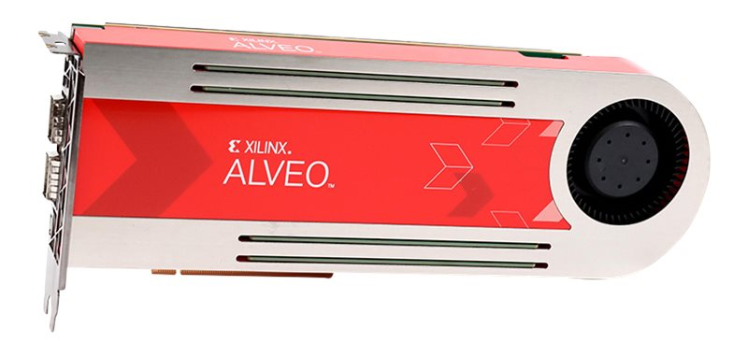
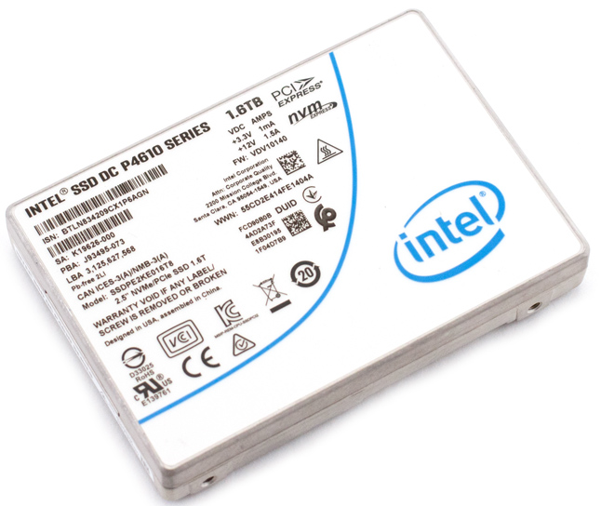
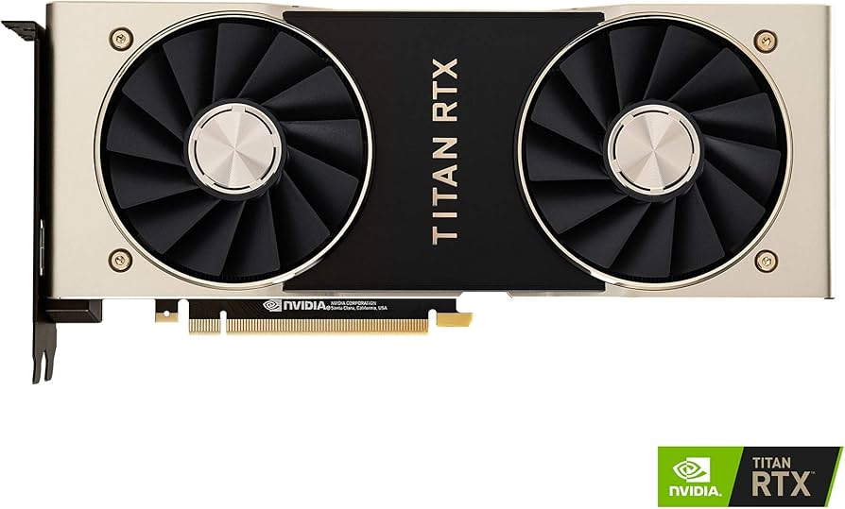
Evaluation Setup
Evaluation Hardware
FPGA | AMD/Xilinx Alveo U200
SSD | Solidigm DC P4610 1.6TB
HLS Compiler | Vitis HLS 2024.2
Implementation Tool | Vivado 2020.2
GPU | NVIDIA Titan RTX
Evaluation Benchmarks
Bandwidth | Sequential Read
Sequential Write | Sequential Write
Latency | Random Update
Database | Merge-Join
Large-Language Model | Mixtral 8x7B
Mixtral
8x7B
Notes:
We prototype HiLFS using Alveo U200 FPGA and Solidigm SSD using Vitis HLS 2024.2. We evaluate the design on synthetic and realistic benchmarks, covering database and large-language model, Mixtral 8x7B.

Slide 27
Programmability Results
Notes:
On all benchmarks, we see an improvement in programmability by HiLFS, compared to Non-P2P/P2P case and DONGLE case.

Slide 28
Programmability Results
5.3x less
1.5x less
Notes:
On geomean, HiLFS achieves a 1.5x and 5.3x improvement compared to Non-P2P/P2P and DONGLE, respectively. These improvements highlight the benefit of bypassing host-tethered logic of P2P and providing an abstraction for manual address management required by DONGLE.

Slide 29
Performance Results
Maximum SSD BW
Notes:
For performance, we normalize the results across the maximum SSD bandwidth, and compute the geomean with best-performing result on all benchmarks. More detailed evaluation can be found in the full manuscript.

Slide 30
Performance Results
Maximum SSD BW
-14%
+18%
+30%
Notes:
Compared to the two baseline models (Non-P2P and P2P), HiLFS shows a net increase in performance, showcasing the benefit of having bypassed CPU completely. But note that there is a slight performance degradation compared against DONGLE. This mainly originates from the translation logic added on top of raw block-level access.

Slide 31
Performance Results
Maximum SSD BW
GPU + GDS
+8%
GPU
+19%
Notes:
We also compare our Mixtral benchmark against GPU without and with considering GDS. For both, we see that HiLFS is able to generate a more performant result.
HiLFS yields 3x better performance-per-Watt than GPU + GDS and even larger benefit with GPU-only.

Slide 32
Outline
Current Storage Strategies
Our Solution
Evaluation
Conclusion

Slide 33
Closing the Gap with HiLFS
Sparse Mixture-of-Experts models
DeepSeek R1
LlaMa 3.1
Grok-1
DeepSeek v2
BLOOM
LlaMa2-70B
Mixtral 8x7B
AlexNet
VGG16
YOLOv1
WideResNet
BERT
GPT2
ViT
OPT-6.7B
LlaMa2-7B
Mamba-2
Notes:
To conclude, we see that by allowing FPGA to also have better usability through software-like interface, HLS developers can explore domains that were previously not easily explorable, in particular due to inefficient storage management capability. Through HiLFS, we will be able to close the gap between the two platforms when considering modern data- and I/O-intensive models with complex storage requirement like Sparse Mixture-of-Experts model.
(Tune the parameters)

Slide 34
Thank you!
Notes:
With that, thank you for listening and I will be happy to answer any questions.

