Slide 1


HACE: HLS-Tool-Agnostic CDFG Extraction from RTL Designs
Carmine Rizzi, Sebastian Pfeiler, and Lana Josipović
February 2026

Slide 2
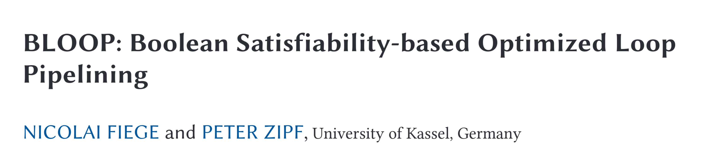
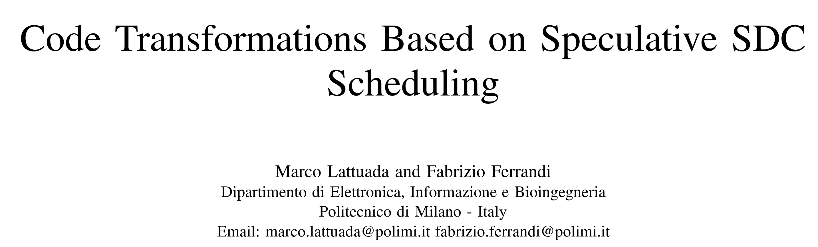
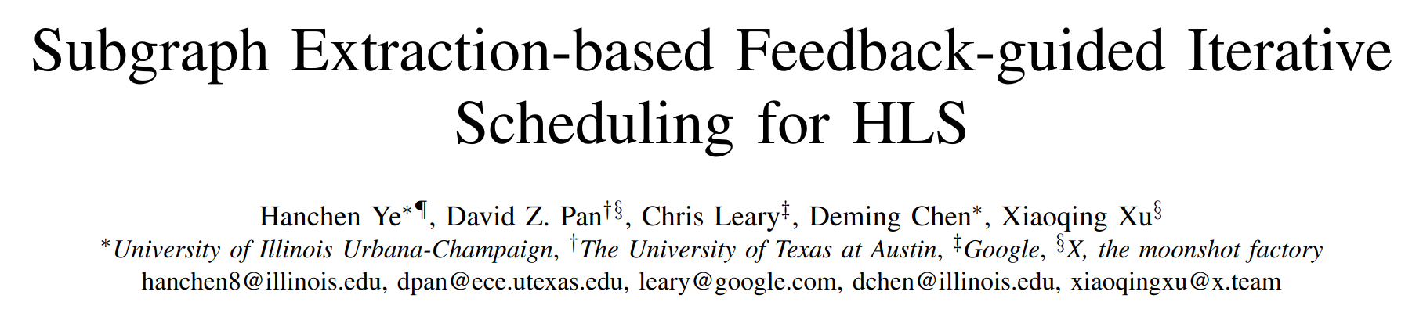

How to Compare Schedulers of HLS Tools?
C/C++ code
HLS Tool A
Frontend A
CDFG A
Scheduler A
RTL code
Is it fair to compare the schedulers using an end-to-end evaluation of different HLS tools?
HLS = High-Level Synthesis
CDFG = Control-Data Flow Graph

Slide 3
How to Compare Schedulers of HLS Tools?
sum = 0;
for(i=0; i<10; i++){
sum += A[i]; }
C/C++ code
C/C++ code
HLS Tool A
B0
0
0
Frontend A
br
CDFG A
B1
Scheduler A
10
ɸ
ɸ
==
+
+
CDFG
RTL code
br
1
load_A
B2
ret
HLS = High-Level Synthesis
CDFG = Control-Data Flow Graph

Slide 4
How to Compare Schedulers of HLS Tools?
sum = 0;
for(i=0; i<10; i++){
sum += A[i]; }
C/C++ code
C/C++ code
HLS Tool A
B0
0
0
Frontend A
br
CDFG A
B1
Scheduler A
10
ɸ
ɸ
Basic
Block
==
+
+
CDFG
RTL code
br
1
load_A
B2
ret
HLS = High-Level Synthesis
CDFG = Control-Data Flow Graph

Slide 5
How to Compare Schedulers of HLS Tools?
sum = 0;
for(i=0; i<10; i++){
sum += A[i]; }
C/C++ code
C/C++ code
HLS Tool A
B0
0
0
Frontend A
br
CDFG A
B1
Scheduler A
10
ɸ
ɸ
Basic
Block
==
+
+
CDFG
RTL code
br
1
load_A
Control
edge
B2
ret
HLS = High-Level Synthesis
CDFG = Control-Data Flow Graph

Slide 6
How to Compare Schedulers of HLS Tools?
sum = 0;
for(i=0; i<10; i++){
sum += A[i]; }
C/C++ code
C/C++ code
HLS Tool B
B0
br
0
0
Frontend B
CDFG B
B1
load_A
ɸ
10
ɸ
+
Scheduler A
+
+
CDFG
==
+
1
br
1
load_A
RTL code
B2
ret
HLS = High-Level Synthesis
CDFG = Control-Data Flow Graph
Different HLS tools may produce different CDFGs

Slide 7
How to Compare Schedulers of HLS Tools?
covariance
covariance
LegUp
Bambu
Frontend LegUp
Frontend Bambu
CDFG A
CDFG B
Scheduler LegUp
Scheduler Bambu
RTL code
RTL code

Slide 8
How to Compare Schedulers of HLS Tools?
covariance
covariance
LegUp
Bambu
Frontend LegUp
Frontend Bambu
CDFG A
CDFG B
Scheduler LegUp
Scheduler Bambu
RTL code
RTL code
1026 LUTs
1824 LUTs (+78%)
Does the difference in frontend affect the scheduler comparison?

Slide 9
How to Compare Schedulers of HLS Tools?
covariance
covariance
covariance
LegUp
Bambu
Frontend LegUp
Frontend Bambu
Frontend LegUp
CDFG A
CDFG B
CDFG A
Scheduler LegUp
Scheduler Bambu
Scheduler Bambu
RTL code
RTL code
RTL code
1026 LUTs
1824 LUTs (+78%)

Slide 10
How to Compare Schedulers of HLS Tools?
covariance
covariance
covariance
LegUp
Bambu
Frontend LegUp
Frontend Bambu
Frontend LegUp
CDFG A
CDFG B
CDFG A
Scheduler LegUp
Scheduler Bambu
Scheduler Bambu
RTL code
RTL code
RTL code
1026 LUTs
1824 LUTs (+78%)
1138 LUTs (+11%)
Comparing end-to-end does not determine the better scheduler

Slide 11
How to Compare Schedulers of HLS Tools?
covariance
covariance
covariance
LegUp
Bambu
Frontend LegUp
Frontend Bambu
Frontend Bambu
CDFG A
CDFG B
CDFG A
Scheduler LegUp
Scheduler Bambu
Scheduler LegUp
RTL code
RTL code
RTL code
1026 LUTs
1824 LUTs (+78%)

Slide 12
How to Compare Schedulers of HLS Tools?
covariance
covariance
covariance
LegUp
Bambu
Frontend LegUp
Frontend Bambu
Frontend Bambu
CDFG A
CDFG B
CDFG A
Scheduler LegUp
Scheduler Bambu
Scheduler LegUp
RTL code
RTL code
RTL code
1026 LUTs
1824 LUTs (+78%)
It is not possible to use only the frontend or backend of all HLS tools

Slide 13
How to Compare Schedulers of HLS Tools?
C/C++ code
C/C++ code
HLS Tool A
HLS Tool B
Frontend A
Frontend B
CDFG A
CDFG B
Scheduler A
Scheduler B
CDFG A
RTL code
HACE
RTL code
HACE: an HLS-tool-agnostic framework for CDFG extraction from HLS-produced RTL netlists
HLS = High-Level Synthesis
CDFG = Control-Data Flow Graph

Slide 14
HACE’s Perspective
HLS
Tool A
HLS Tool A
HLS Tool B
HLS
Tool B
CDFG B
Fair HLS comparison
Fast RTL Simulation
RTL analysis
HACE: an HLS-tool-agnostic framework for CDFG extraction from HLS-produced RTL netlists
HLS = High-Level Synthesis
CDFG = Control-Data Flow Graph

Slide 15
CDFG Extraction
CDFG
RTL code
Control edge
Data edge
B0
if (state == S0) {
sum = 1 + data_A; }
if (state == S1) {
i = sum + 1; }
if (state == S0) {
state = S1; }
if (state == S1){
if (i <= 5) {
state = S1;
} else {
state = S2; }
data_A
+
1
HACE
+
1
<=
5
B1

Slide 16
CDFG Extraction
RTL code
How to distinguish the datapath from the control?
How to identify the FSM?
How to extract the CFG?
if (state == S0) {
sum = 1 + data_A; }
if (state == S1) {
i = sum + 1; }
if (state == S0) {
state = S1; }
if (state == S1){
if (i <= 5) {
state = S1;
} else {
state = S2; }

Slide 17
How to identify the datapath inside the RTL?
CDFG
RTL code
Control edge
Data edge
if (state == S0) {
sum = 1 + data_A; }
if (state == S1) {
i = sum + 1; }
if (state == S0) {
state = S1; }
if (state == S1){
if (i <= 5) {
state = S1;
} else {
state = S2; }
HACE

Slide 18
How to identify the datapath inside the RTL?
CDFG
RTL code
Control edge
Data edge
if (state == S0) {
sum = 1 + data_A; }
if (state == S1) {
i = sum + 1; }
if (state == S0) {
state = S1; }
if (state == S1){
if (i <= 5) {
state = S1;
} else {
state = S2; }
HACE
HACE traverses data paths from data/memory input and output ports

Slide 19
How to identify the datapath inside the RTL?
CDFG
RTL code
Control edge
Data edge
if (state == S0) {
sum = 1 + data_A; }
if (state == S1) {
i = sum + 1; }
if (state == S0) {
state = S1; }
if (state == S1){
if (i <= 5) {
state = S1;
} else {
state = S2; }
data_A
HACE
HACE traverses data paths from data/memory input and output ports

Slide 20
How to identify the datapath inside the RTL?
CDFG
RTL code
Control edge
Data edge
if (state == S0) {
sum = 1 + data_A; }
if (state == S1) {
i = sum + 1; }
if (state == S0) {
state = S1; }
if (state == S1){
if (i <= 5) {
state = S1;
} else {
state = S2; }
data_A
+
1
HACE
HACE traverses data paths from data/memory input and output ports

Slide 21
How to identify the datapath inside the RTL?
CDFG
RTL code
Control edge
Data edge
if (state == S0) {
sum = 1 + data_A; }
if (state == S1) {
i = sum + 1; }
if (state == S0) {
state = S1; }
if (state == S1){
if (i <= 5) {
state = S1;
} else {
state = S2; }
data_A
sum = 1 + data_A; }
+
1
HACE
+
1
HACE traverses data paths from data/memory input and output ports

Slide 22
How to identify the datapath inside the RTL?
CDFG
RTL code
Control edge
Data edge
if (state == S0) {
sum = 1 + data_A; }
if (state == S1) {
i = sum + 1; }
if (state == S0) {
state = S1; }
if (state == S1){
if (i <= 5) {
state = S1;
} else {
state = S2; }
data_A
sum = 1 + data_A; }
+
1
i = sum + 1; }
HACE
+
1
<=
5
HACE traverses data paths from data/memory input and output ports

Slide 23
How to identify the datapath inside the RTL?
CDFG
RTL code
Control edge
Data edge
if (state == S0) {
sum = 1 + data_A; }
if (state == S1) {
i = sum + 1; }
if (state == S0) {
state = S1; }
if (state == S1){
if (i <= 5) {
state = S1;
} else {
state = S2; }
data_A
sum = 1 + data_A; }
+
1
i = sum + 1; }
HACE
+
1
if (i <= 5) {
<=
5

Slide 24
How to identify the datapath inside the RTL?
CDFG
RTL code
Control edge
Data edge
if (state == S0) {
sum = 1 + data_A; }
if (state == S1) {
i = sum + 1; }
if (state == S0) {
state = S1; }
if (state == S1){
if (i <= 5) {
state = S1;
} else {
state = S2; }
data_A
sum = 1 + data_A; }
+
1
i = sum + 1; }
HACE
+
1
if (i <= 5) {
<=
5
HACE labels all the constructs that are not data path as control flow constructs

Slide 25
How to identify the datapath inside the RTL?
CDFG
RTL code
Control edge
Data edge
if (state == S0) {
sum = 1 + data_A; }
if (state == S1) {
i = sum + 1; }
if (state == S0) {
state = S1; }
if (state == S1){
if (i <= 5) {
state = S1;
} else {
state = S2; }
data_A
sum = 1 + data_A; }
+
1
i = sum + 1; }
HACE
+
1
if (i <= 5) {
<=
5
HACE labels all the constructs that are not data path as control flow constructs

Slide 26
How to extract the FSM?
CDFG
RTL code
Control edge
How to identify the FSM in the control constructs?
Data edge
if (state == S0) {
sum = 1 + data_A; }
if (state == S1) {
i = sum + 1; }
if (state == S0) {
state = S1; }
if (state == S1){
if (i <= 5) {
state = S1;
} else {
state = S2; }
data_A
sum = 1 + data_A; }
+
1
i = sum + 1; }
HACE
+
1
if (i <= 5) {
<=
5

Slide 27
How to extract the FSM?
FSM
RTL code
Control edge
How to identify the FSM in the control constructs?
Data edge
if (state == S0) {
sum = 1 + data_A; }
if (state == S1) {
i = sum + 1; }
if (state == S0) {
state = S1; }
if (state == S1){
if (i <= 5) {
state = S1;
} else {
state = S2; }
sum = 1 + data_A; }
S0
S1
S2
i = sum + 1; }
Datapath
if (i <= 5) {
Next
state
FF
Current
state

Slide 28
How to extract the FSM?
FSM
RTL code
Control edge
Data edge
How to identify the FSM in the control constructs?
Identify the FSM state variable
if (state == S0) {
sum = 1 + data_A; }
if (state == S1) {
i = sum + 1; }
if (state == S0) {
state = S1; }
if (state == S1){
if (i <= 5) {
state = S1;
} else {
state = S2; }
sum = 1 + data_A; }
S0
S1
S2
i = sum + 1; }
Datapath
if (i <= 5) {
Next
state
FF
Current
state

Slide 29
How to extract the FSM?
CDFG
RTL code
Control edge
Data edge
How to identify the FSM in the control constructs?
Identify the FSM state variable
if (state == S0) {
sum = 1 + data_A; }
if (state == S1) {
i = sum + 1; }
if (state == S0) {
state = S1; }
if (state == S1){
if (i <= 5) {
state = S1;
} else {
state = S2; }
data_A
sum = 1 + data_A; }
+
1
i = sum + 1; }
HACE
+
1
if (i <= 5) {
<=
5
FSM state variable: a control-flow variable that governs the dataflow and itself, and is assigned constant values

Slide 30
How to extract the FSM?
CDFG
RTL code
Control edge
Data edge
How to identify the FSM in the control constructs?
Identify the FSM state variable
if (state == S0) {
sum = 1 + data_A; }
if (state == S1) {
i = sum + 1; }
if (state == S0) {
state = S1; }
if (state == S1){
if (i <= 5) {
state = S1;
} else {
state = S2; }
data_A
sum = 1 + data_A; }
+
1
i = sum + 1; }
HACE
+
1
if (i <= 5) {
<=
5
FSM state variable: a control-flow variable that governs the dataflow and itself, and is assigned constant values

Slide 31
How to extract the FSM?
CDFG
RTL code
Control edge
Data edge
How to identify the FSM in the control constructs?
Identify the FSM state variable
if (state == S0) {
sum = 1 + data_A; }
if (state == S1) {
i = sum + 1; }
if (state == S0) {
state = S1; }
if (state == S1){
if (i <= 5) {
state = S1;
} else {
state = S2; }
data_A
sum = 1 + data_A; }
S0
+
1
i = sum + 1; }
HACE
S1
+
1
if (i <= 5) {
S2
<=
5
FSM state variable: a control-flow variable that governs the dataflow and itself, and is assigned constant values

Slide 32
How to extract the FSM?
CDFG
RTL code
Control edge
Data edge
if (state == S0) {
sum = 1 + data_A; }
if (state == S1) {
i = sum + 1; }
if (state == S0) {
state = S1; }
if (state == S1){
if (i <= 5) {
state = S1;
} else {
state = S2; }
data_A
How to identify the FSM in the control constructs?
Identify the FSM state variable
Identify the FSM transitions
sum = 1 + data_A; }
S0
+
1
i = sum + 1; }
HACE
S1
+
1
if (i <= 5) {
S2
<=
5

Slide 33
How to extract the FSM?
FSM
RTL code
Control edge
Data edge
if (state == S0) {
sum = 1 + data_A; }
if (state == S1) {
i = sum + 1; }
if (state == S0) {
state = S1; }
if (state == S1){
if (i <= 5) {
state = S1;
} else {
state = S2; }
How to identify the FSM in the control constructs?
Identify the FSM state variable
Identify the FSM transitions
sum = 1 + data_A; }
S0
S1
S2
i = sum + 1; }
Datapath
if (i <= 5) {
Next
state
FF
Current
state

Slide 34
How to extract the FSM?
CDFG
RTL code
Control edge
Data edge
if (state == S0) {
sum = 1 + data_A; }
if (state == S1) {
i = sum + 1; }
if (state == S0) {
state = S1; }
if (state == S1){
if (i <= 5) {
state = S1;
} else {
state = S2; }
data_A
How to identify the FSM in the control constructs?
Identify the FSM state variable
Identify the FSM transitions
sum = 1 + data_A; }
S0
+
1
i = sum + 1; }
HACE
S1
+
1
if (i <= 5) {
S2
<=
5
FSM transitions: conditional assignments to the FSM state variable

Slide 35
How to extract the FSM?
CDFG
RTL code
Control edge
Data edge
if (state == S0) {
sum = 1 + data_A; }
if (state == S1) {
i = sum + 1; }
if (state == S0) {
state = S1; }
if (state == S1){
if (i <= 5) {
state = S1;
} else {
state = S2; }
data_A
How to identify the FSM in the control constructs?
Identify the FSM state variable
Identify the FSM transitions
sum = 1 + data_A; }
S0
+
1
i = sum + 1; }
HACE
S1
+
1
if (i <= 5) {
S2
<=
5
FSM transitions: conditional assignments to the FSM state variable

Slide 36
How to extract the FSM?
CDFG
RTL code
Control edge
Data edge
if (state == S0) {
sum = 1 + data_A; }
if (state == S1) {
i = sum + 1; }
if (state == S0) {
state = S1; }
if (state == S1){
if (i <= 5) {
state = S1;
} else {
state = S2; }
data_A
How to identify the FSM in the control constructs?
Identify the FSM state variable
Identify the FSM transitions
sum = 1 + data_A; }
S0
+
1
i = sum + 1; }
HACE
S1
Cond
+
1
if (i <= 5) {
!Cond
S2
<=
5
FSM transitions: conditional assignments to the FSM state variable

Slide 37
How to extract the control flow graph?
CDFG
RTL code
Control edge
Data edge
if (state == S0) {
sum = 1 + data_A; }
if (state == S1) {
i = sum + 1; }
if (state == S0) {
state = S1; }
if (state == S1){
if (i <= 5) {
state = S1;
} else {
state = S2; }
data_A
sum = 1 + data_A; }
S0
+
1
i = sum + 1; }
HACE
S1
Cond
+
1
if (i <= 5) {
!Cond
S2
<=
5

Slide 38
How to extract the control flow graph?
CDFG
RTL code
Control edge
Data edge
if (state == S0) {
sum = 1 + data_A; }
if (state == S1) {
i = sum + 1; }
if (state == S0) {
state = S1; }
if (state == S1){
if (i <= 5) {
state = S1;
} else {
state = S2; }
data_A
sum = 1 + data_A; }
S0
+
1
i = sum + 1; }
How to transform an FSM into a CFG?
HACE
S1
Cond
+
1
if (i <= 5) {
!Cond
S2
<=
5

Slide 39
How to extract the control flow graph?
CDFG
RTL code
Control edge
Data edge
if (state == S0) {
sum = 1 + data_A; }
if (state == S1) {
i = sum + 1; }
if (state == S0) {
state = S1; }
if (state == S1){
if (i <= 5) {
state = S1;
} else {
state = S2; }
data_A
sum = 1 + data_A; }
S0
+
1
i = sum + 1; }
How to transform an FSM into a CFG?
HACE
S1
Cond
+
1
if (i <= 5) {
!Cond
S2
<=
5
HACE merges sequences of unconditionally executing states into BBs

Slide 40
How to extract the control flow graph?
CDFG
RTL code
Control edge
Data edge
if (state == S0) {
sum = 1 + data_A; }
if (state == S1) {
i = sum + 1; }
if (state == S0) {
state = S1; }
if (state == S1){
if (i <= 5) {
state = S1;
} else {
state = S2; }
data_A
B0
sum = 1 + data_A; }
S0
+
1
i = sum + 1; }
How to transform an FSM into a CFG?
HACE
S1
Cond
+
1
if (i <= 5) {
!Cond
S2
<=
5
HACE merges sequences of unconditionally executing states into BBs

Slide 41
How to extract the control flow graph?
CDFG
RTL code
Control edge
Data edge
if (state == S0) {
sum = 1 + data_A; }
if (state == S1) {
i = sum + 1; }
if (state == S0) {
state = S1; }
if (state == S1){
if (i <= 5) {
state = S1;
} else {
state = S2; }
data_A
B0
sum = 1 + data_A; }
S0
+
1
i = sum + 1; }
How to transform an FSM into a CFG?
HACE
S1
Cond
+
1
if (i <= 5) {
!Cond
B1
S2
<=
5
HACE merges sequences of unconditionally executing states into BBs

Slide 42
How to extract the control flow graph?
CDFG
RTL code
Control edge
Data edge
if (state == S0) {
sum = 1 + data_A; }
if (state == S1) {
i = sum + 1; }
if (state == S0) {
state = S1; }
if (state == S1){
if (i <= 5) {
state = S1;
} else {
state = S2; }
data_A
B0
sum = 1 + data_A; }
S0
+
1
i = sum + 1; }
How to group operations into BBs?
HACE
S1
Cond
+
1
if (i <= 5) {
!Cond
B1
S2
<=
5

Slide 43
How to extract the control flow graph?
CDFG
RTL code
Control edge
Data edge
if (state == S0) {
sum = 1 + data_A; }
if (state == S1) {
i = sum + 1; }
if (state == S0) {
state = S1; }
if (state == S1){
if (i <= 5) {
state = S1;
} else {
state = S2; }
data_A
B0
sum = 1 + data_A; }
S0
+
1
i = sum + 1; }
How to group operations into BBs?
Assign states to nodes
HACE
S1
Cond
+
1
if (i <= 5) {
!Cond
B1
S2
<=
5

Slide 44
How to extract the control flow graph?
CDFG
RTL code
Control edge
Data edge
if (state == S0) {
sum = 1 + data_A; }
if (state == S1) {
i = sum + 1; }
if (state == S0) {
state = S1; }
if (state == S1){
if (i <= 5) {
state = S1;
} else {
state = S2; }
data_A
B0
sum = 1 + data_A; }
S0
+
1
i = sum + 1; }
How to group operations into BBs?
Assign states to nodes
HACE
S1
Cond
+
1
if (i <= 5) {
!Cond
B1
S2
<=
5
HACE determines FSM state that controls each conditional assignment in the datapath

Slide 45
How to extract the control flow graph?
CDFG
RTL code
Control edge
Data edge
if (state == S0) {
sum = 1 + data_A; }
if (state == S1) {
i = sum + 1; }
if (state == S0) {
state = S1; }
if (state == S1){
if (i <= 5) {
state = S1;
} else {
state = S2; }
data_A
B0
sum = 1 + data_A; }
S0
S0
+
1
i = sum + 1; }
How to group operations into BBs?
Assign states to nodes
HACE
S1
Cond
+
1
if (i <= 5) {
!Cond
B1
S2
<=
5
HACE determines FSM state that controls each conditional assignment in the datapath

Slide 46
How to extract the control flow graph?
CDFG
RTL code
Control edge
Data edge
if (state == S0) {
sum = 1 + data_A; }
if (state == S1) {
i = sum + 1; }
if (state == S0) {
state = S1; }
if (state == S1){
if (i <= 5) {
state = S1;
} else {
state = S2; }
data_A
B0
sum = 1 + data_A; }
S0
S0
+
1
i = sum + 1; }
How to group operations into BBs?
Assign states to nodes
HACE
S1
Cond
+
1
S1
if (i <= 5) {
!Cond
B1
S2
<=
5
HACE determines FSM state that controls each conditional assignment in the datapath

Slide 47
How to extract the control flow graph?
CDFG
RTL code
Control edge
Data edge
if (state == S0) {
sum = 1 + data_A; }
if (state == S1) {
i = sum + 1; }
if (state == S0) {
state = S1; }
if (state == S1){
if (i <= 5) {
state = S1;
} else {
state = S2; }
data_A
B0
sum = 1 + data_A; }
S0
S0
+
1
i = sum + 1; }
How to group operations into BBs?
Assign states to nodes
Assign BBs to nodes
HACE
S1
Cond
+
1
S1
if (i <= 5) {
!Cond
B1
S2
<=
5

Slide 48
How to extract the control flow graph?
CDFG
RTL code
Control edge
Data edge
if (state == S0) {
sum = 1 + data_A; }
if (state == S1) {
i = sum + 1; }
if (state == S0) {
state = S1; }
if (state == S1){
if (i <= 5) {
state = S1;
} else {
state = S2; }
data_A
B0
sum = 1 + data_A; }
S0
S0
+
1
i = sum + 1; }
How to group operations into BBs?
Assign states to nodes
Assign BBs to nodes
HACE
S1
Cond
+
1
S1
if (i <= 5) {
!Cond
B1
S2
<=
5
HACE uses state-BB mapping to assign BBs to nodes

Slide 49
How to extract the control flow graph?
CDFG
RTL code
Control edge
Data edge
B0
if (state == S0) {
sum = 1 + data_A; }
if (state == S1) {
i = sum + 1; }
if (state == S0) {
state = S1; }
if (state == S1){
if (i <= 5) {
state = S1;
} else {
state = S2; }
data_A
B0
sum = 1 + data_A; }
S0
S0
+
1
i = sum + 1; }
How to group operations into BBs?
Assign states to nodes
Assign BBs to nodes
HACE
S1
Cond
+
1
S1
if (i <= 5) {
!Cond
B1
S2
<=
5
HACE uses state-BB mapping to assign BBs to nodes

Slide 50
How to extract the control flow graph?
CDFG
RTL code
Control edge
Data edge
B0
if (state == S0) {
sum = 1 + data_A; }
if (state == S1) {
i = sum + 1; }
if (state == S0) {
state = S1; }
if (state == S1){
if (i <= 5) {
state = S1;
} else {
state = S2; }
data_A
B0
sum = 1 + data_A; }
S0
+
1
i = sum + 1; }
How to group operations into BBs?
Assign states to nodes
Assign BBs to nodes
HACE
S1
Cond
+
1
if (i <= 5) {
!Cond
B1
S2
<=
5
B1
HACE uses state-BB mapping to assign BBs to nodes

Slide 51
How to extract the control flow graph?
CDFG
RTL code
Control edge
Data edge
B0
if (state == S0) {
sum = 1 + data_A; }
if (state == S1) {
i = sum + 1; }
if (state == S0) {
state = S1; }
if (state == S1){
if (i <= 5) {
state = S1;
} else {
state = S2; }
data_A
B0
sum = 1 + data_A; }
S0
+
1
i = sum + 1; }
How to connect BBs?
HACE
S1
Cond
+
1
if (i <= 5) {
!Cond
B1
S2
<=
5
B1

Slide 52
How to extract the control flow graph?
CDFG
RTL code
Control edge
Data edge
B0
if (state == S0) {
sum = 1 + data_A; }
if (state == S1) {
i = sum + 1; }
if (state == S0) {
state = S1; }
if (state == S1){
if (i <= 5) {
state = S1;
} else {
state = S2; }
data_A
B0
sum = 1 + data_A; }
S0
+
1
i = sum + 1; }
How to connect BBs?
HACE
S1
Cond
+
1
if (i <= 5) {
!Cond
B1
S2
<=
5
B1
HACE replicates the CFG edges for the CDFG

Slide 53
How to extract the control flow graph?
CDFG
RTL code
Control edge
Data edge
B0
if (state == S0) {
sum = 1 + data_A; }
if (state == S1) {
i = sum + 1; }
if (state == S0) {
state = S1; }
if (state == S1){
if (i <= 5) {
state = S1;
} else {
state = S2; }
data_A
B0
sum = 1 + data_A; }
S0
+
1
i = sum + 1; }
How to connect BBs?
HACE
S1
Cond
+
1
if (i <= 5) {
!Cond
B1
S2
<=
5
B1
HACE encodes CDFGs in MLIR IR, an open-source format compatible with LLVM or MLIR tools
HACE replicates the CFG edges for the CDFG

Slide 54
Results: Functional Equivalence
We have evaluated the functional correctness of the MLIR IR generated by HACE comparing them with the initial C code with 10K input sets.
LegUp/
Vivado HLS
C/C++ code
HLS tool
RTL
HACE
MLIR IR
MLIR
LLVM IR
Differential execution
Equivalent?
clang
LLVM IR
Across all benchmarks, the extracted CDFGs match the behavior of the original C code, demonstrating the correctness of HACE

Slide 55
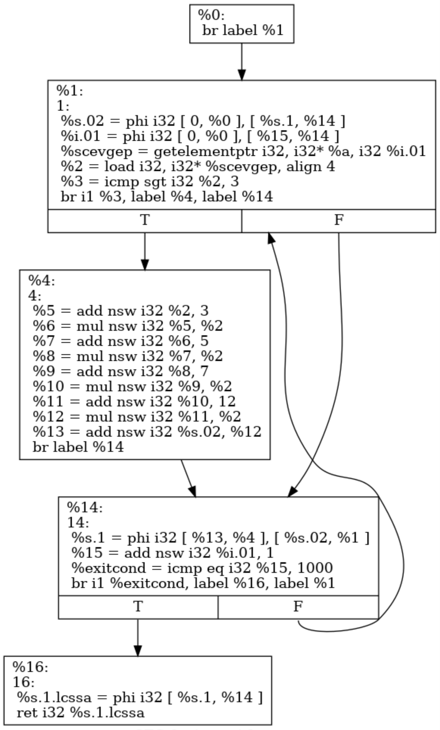
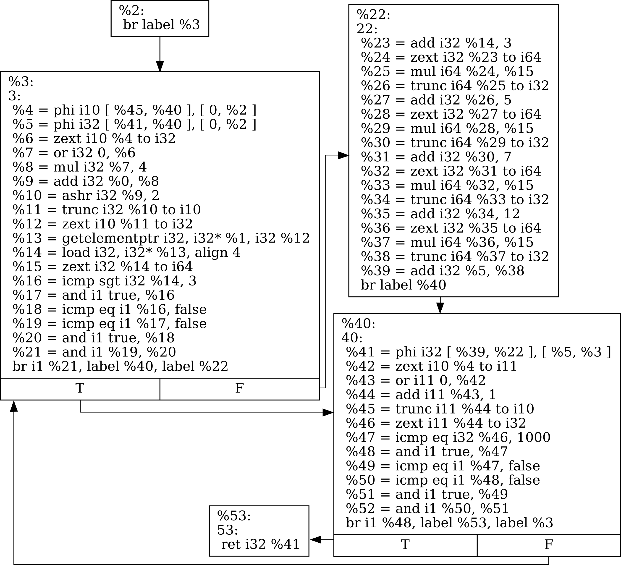
Results: Structural Equivalence
We have extracted the LLVM IR from LegUp to compare its structural equivalence with the IR generated by HACE. The following example shows the IRs from the gsum benchmark.
In the HACE open-source repository, you can visually compare the CDFGs
LegUp IR
HACE IR

Slide 56
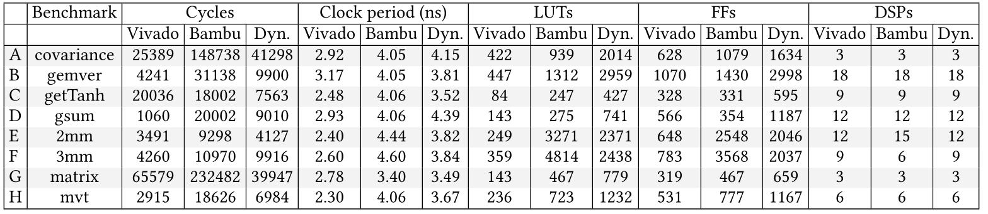
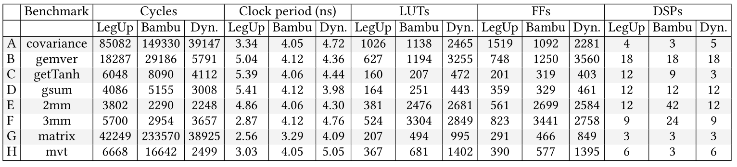
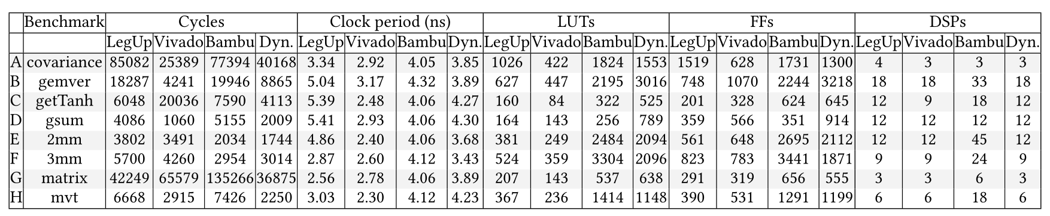
Results: Comparing HLS Tools
We have used four different HLS tools for evaluation: Bambu [2], Dynamatic [3], LegUp [4], and Vivado HLS 2019.1 [5].
Bambu
RTL
C/C++ code
LegUp
RTL
HACE
MLIR IR
Dynamatic
RTL
Bambu
RTL
C/C++ code
Vivado HLS
RTL
HACE
MLIR IR
Dynamatic
RTL
We have evaluated the RTL designs with Vivado 2024.2 [6] and Modelsim [7].

Slide 57
Results: Comparing HLS Tools
LegUp Frontend
LegUp Backend
Bambu Backend
C/C++ code
RTL
HACE
MLIR IR
RTL
Bambu Frontend
Bambu Backend
RTL

Slide 58
Results: Comparing HLS Tools
LegUp Frontend
LegUp Backend
Bambu Backend
C/C++ code
RTL
HACE
MLIR IR
RTL
1
Bambu Frontend
Bambu Backend
RTL

Slide 59
Results: Comparing HLS Tools
LegUp Frontend
LegUp Backend
Bambu Backend
C/C++ code
RTL
HACE
MLIR IR
RTL
1
Bambu Frontend
Bambu Backend
RTL
2

Slide 60
Results: Comparing HLS Tools
LegUp Frontend
LegUp Backend
Bambu Backend
C/C++ code
RTL
HACE
MLIR IR
RTL
1
3
Bambu Frontend
Bambu Backend
RTL
2

Slide 61
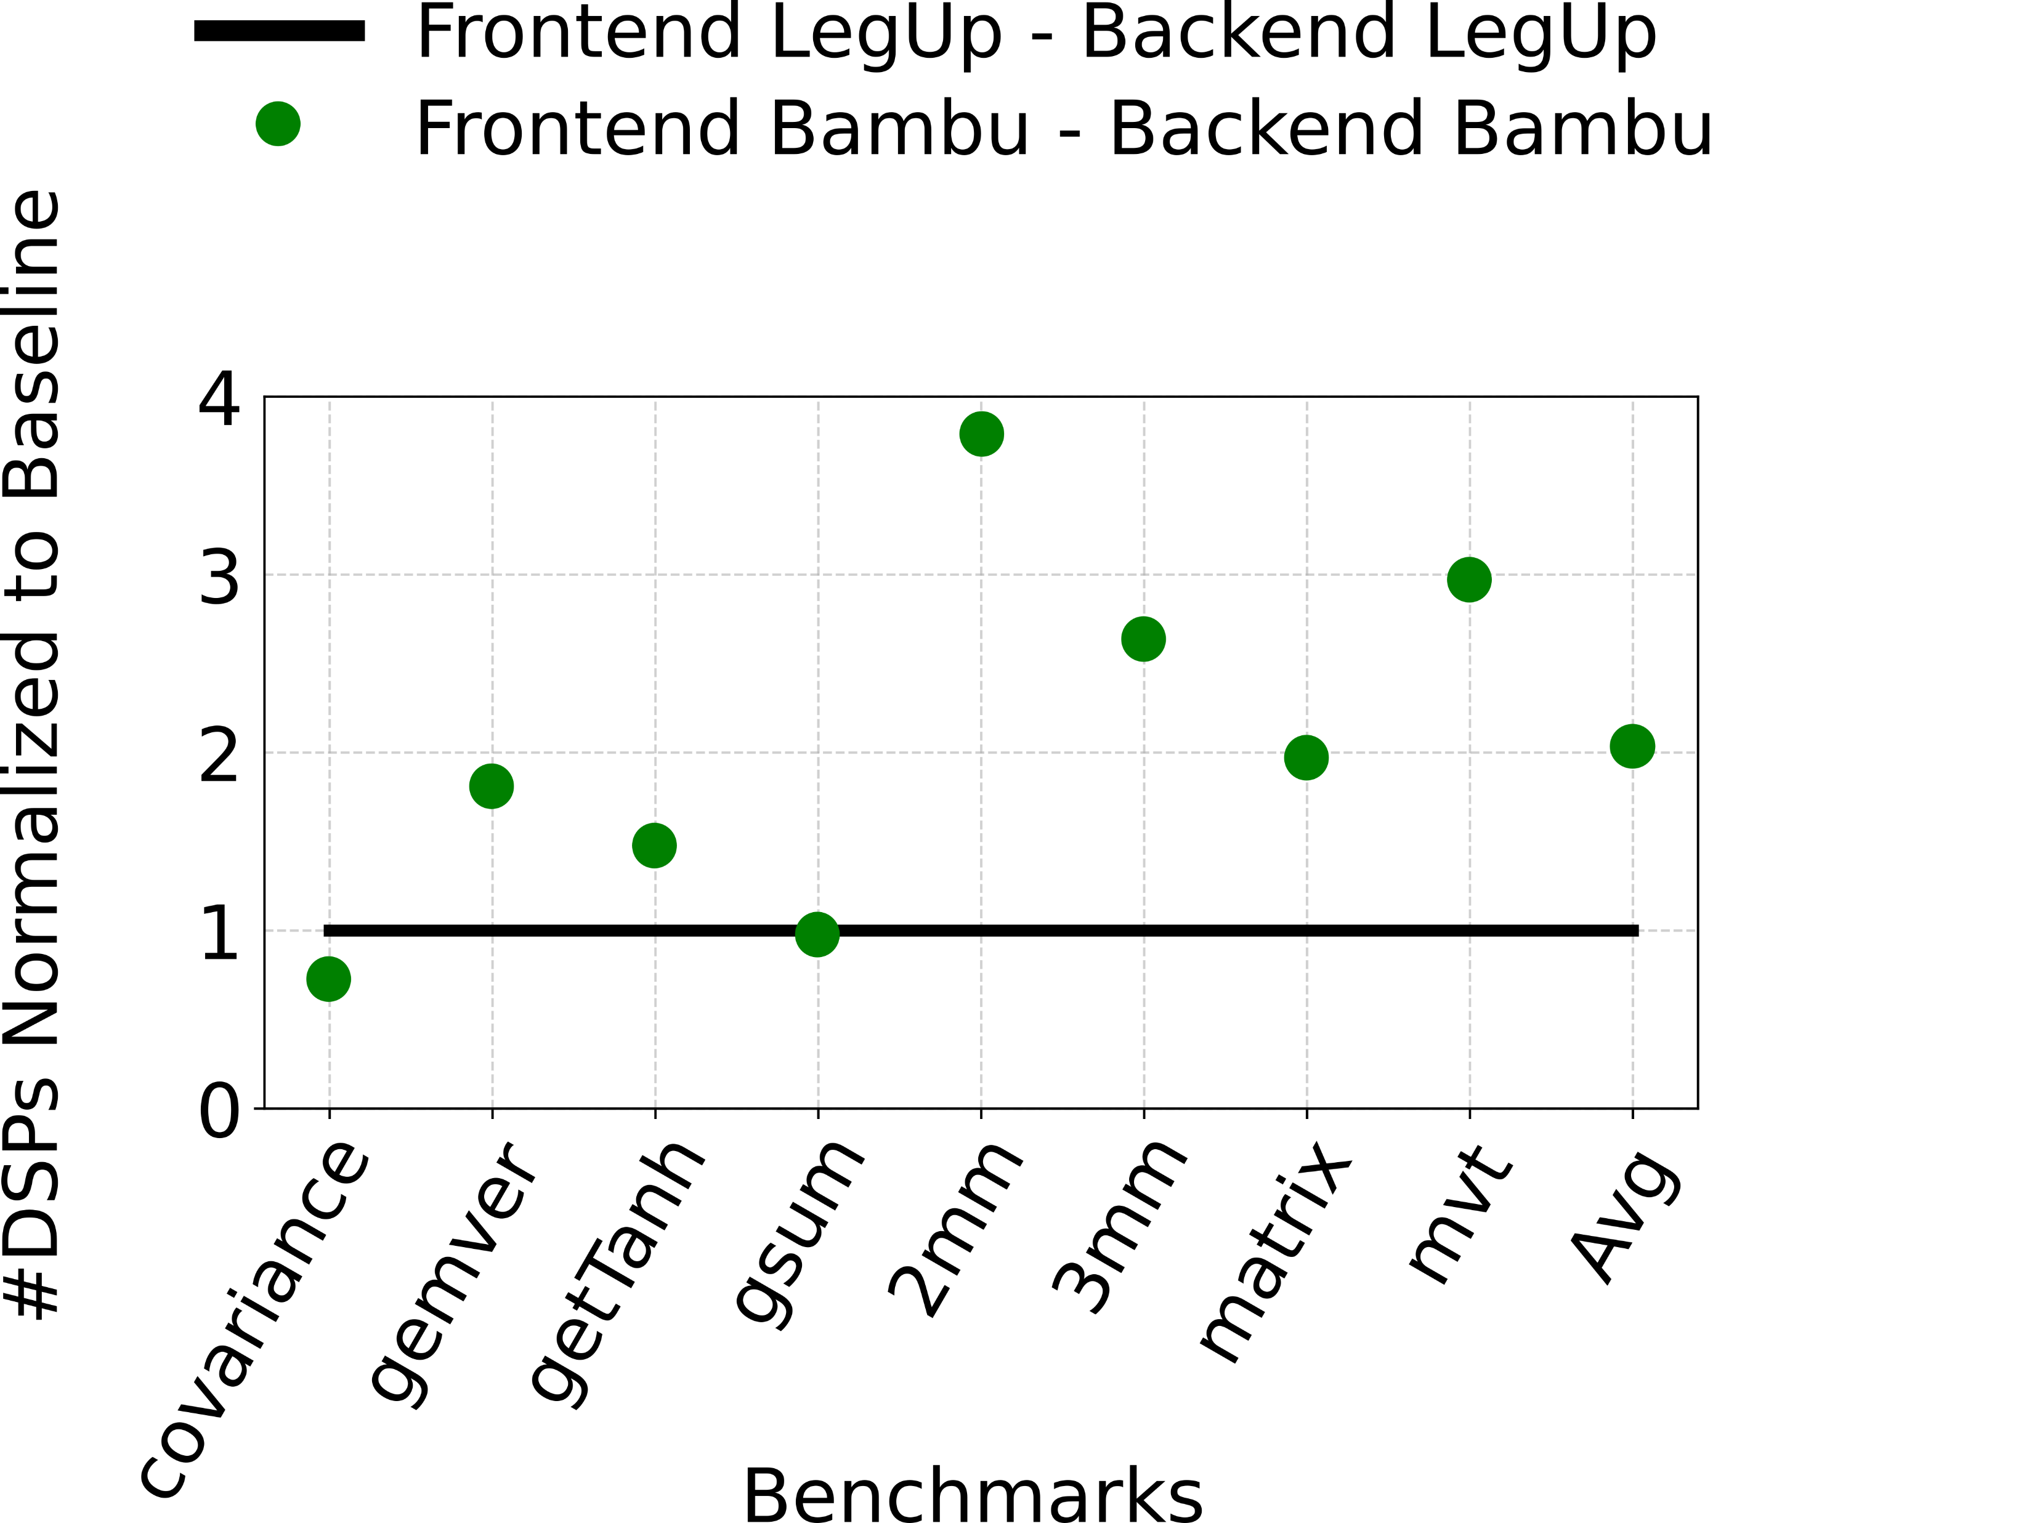
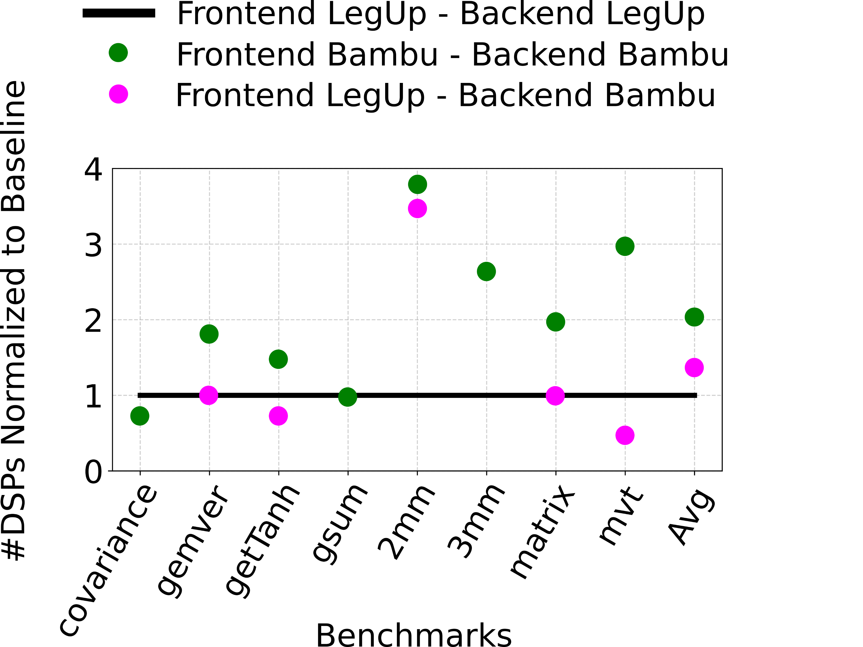
Results: Comparing HLS Tools
LegUp Frontend
LegUp Backend
Bambu Backend
C/C++ code
RTL
HACE
MLIR IR
RTL
1
3
Bambu Frontend
Bambu Backend
RTL
2
HACE allowed us to identify Bambu’s frontend optimizations that were not specified by the user

Slide 62
Results: HACE’s Findings Across Different HLS Tools
End-to-End Observation: Dynamatic and Vivado circuits achieve similar performance
Possible Conclusion: Dynamatic and Vivado schedulers have similar scheduling quality
HACE’s Finding: Vivado's frontend optimizations are tailored to its own scheduler
End-to-End Observation: Bambu uses more DSPs than LegUp and Vivado HLS
Possible Conclusion: Bambu scheduler overuses DSPs
HACE’s Finding: Bambu’s frontend is responsible for the large DSP count due to unrolling
End-to-End Observation: Bambu uses the same number of FFs as Dynamatic
Possible Conclusion: Bambu’s backend employs the same FFs as Dynamatic one
HACE’s Finding: Bambu's backend is better in FF usage than Dynamatic
HACE facilitates experimentation across different HLS compilers and enables fair comparisons of HLS frontends and scheduling strategies

Slide 63


HACE’s Perspective
HLS
Tool A
HLS
Tool B
Fair HLS comparison
Fast RTL Simulation
RTL analysis
Check out the open-source code!

Slide 64
References
[1] Google, “honggfuzz,” https://github.com/google/honggfuzz, 2015.
[2] F. Ferrandi, et al. , “Bambu: an open-source research framework for the high-level synthesis of complex applications,” in Proceedings of the 58th ACM/IEEE Design Automation Conference.
[3] L. Josipović, et al., “Dynamatic: From C/C++ to dynamically scheduled circuits,” in Proceedings of the 28th ACM/SIGDA International Symposium on Field Programmable Gate Arrays.
[4] A. Canis, et al., “Legup: high-level synthesis for fpga-based processor/accelerator systems,” in Proceedings of the 19th ACM/SIGDA International Symposium on Field Programmable Gate Arrays.
[5] Vivado High-Level Synthesis, Xilinx Inc., 2018. [Online]. Available: http://www.xilinx.com/products/design-tools/vivado/integration/esl-design.html .
[6] Vivado Design Suite, Xilinx Inc., 2020. [Online]. Available: https://docs.xilinx.com/v/u/2019.2-English/ug901-vivado-synthesis .
[7] Intel, “ModelSim,” 2021. [Online]. Available: https://www.intel.com/

Slide 65
HACE Overview
RTL code
HACE
CDFG

Slide 66
How to identify the datapath inside the RTL?
CDFG
RTL code
Control edge
Data edge
if (state == S0) {
sum = 1 + data_A; }
if (state == S1) {
i = sum + 1; }
if (state == S0) {
state = S1; }
if (state == S1){
if (i <= 5) {
state = S1;
} else {
state = S2; }
HACE
We have no distinction between data and control constructs in the RTL

Slide 67
How to extract the FSM?
CDFG
RTL code
Control edge
Data edge
How to identify the FSM in the RTL?
Identify the FSM state variable
if (xyz == S0) {
sum = 1 + data_A; }
if (xyz == S1) {
i = sum + 1; }
if (xyz == S0) {
xyz = S1; }
if (xyz == S1){
if (i <= 5) {
xyz = S1;
} else {
xyz = S2; }
data_A
sum = 1 + data_A; }
+
1
i = sum + 1; }
HACE
+
1
if (i <= 5) {
<=
5
Name-based FSM identification is not general enough

Slide 68
How to Compare Schedulers of HLS Tools?
C/C++ code
C/C++ code
HLS Tool A
HLS Tool B
Frontend A
Frontend B
CDFG A
CDFG B
Scheduler A
Scheduler B
RTL code
CDFG A ≠ CDFG B
RTL code
HLS = High-Level Synthesis
CDFG = Control-Data Flow Graph

Slide 69
HACE Overview
HACE
if (state == S0) {
sum = 1 + data_A; }
if (state == S1) {
i = sum + 1; }
CDFG
RTL code
RTL code
HACE
CDFG

Slide 70
HACE Overview
HACE
Assignment Graph
It is a directed graph that makes dataflow and control information explicit
if (state == S0) {
sum = 1 + data_A; }
if (state == S1) {
i = sum + 1; }
CDFG
RTL code
RTL code
HACE
CDFG

Slide 71
HACE Overview
HACE
Control edge
Data edge
FSM
Assignment Graph
It is a directed graph that makes dataflow and control information explicit
S0
if (state == S0) {
sum = 1 + data_A; }
if (state == S1) {
i = sum + 1; }
CDFG
S1
RTL code
FSM-Datapath Graph
RTL code
HACE
CDFG

Slide 72
HACE Overview
HACE
Control edge
Data edge
Datapath
FSM
data_A
Assignment Graph
It is a directed graph that makes dataflow and control information explicit
S0
if (state == S0) {
sum = 1 + data_A; }
if (state == S1) {
i = sum + 1; }
+
1
CDFG
=
S1
+
1
RTL code
=
FSM-Datapath Graph
RTL code
HACE
CDFG

Slide 73
HACE Overview
HACE
Control edge
Data edge
Datapath
FSM
data_A
Assignment Graph
It is a directed graph that makes dataflow and control information explicit
S0
if (state == S0) {
sum = 1 + data_A; }
if (state == S1) {
i = sum + 1; }
+
1
CDFG
=
S1
+
1
RTL code
=
FSM-Datapath Graph
RTL code
HACE
CDFG

Slide 74
HACE Overview
HACE
Control edge
Data edge
Datapath
FSM
data_A
Assignment Graph
It is a directed graph that makes dataflow and control information explicit
S0
if (state == S0) {
sum = 1 + data_A; }
if (state == S1) {
i = sum + 1; }
+
1
CDFG
=
S1
+
1
RTL code
=
FSM-Datapath Graph
RTL code
HACE
CDFG

Slide 75
From RTL to Assignment Graph
Assignment graph
Control edge
Data edge
RTL code (simplified)
if (state == S0) {
sum = 1 + data_A; }
Any RTL code is composed by a list of conditional assignments

Slide 76
From RTL to Assignment Graph
Assignment graph
Control edge
Data edge
RTL code (simplified)
if (state == S0) {
sum = 1 + data_A; }
1
S0
Constant nodes

Slide 77
From RTL to Assignment Graph
Assignment graph
Control edge
Data edge
data_A
RTL code (simplified)
if (state == S0) {
sum = 1 + data_A; }
1
S0
Port nodes

Slide 78
From RTL to Assignment Graph
Assignment graph
Control edge
Data edge
data_A
RTL code (simplified)
if (state == S0) {
sum = 1 + data_A; }
+
1
S0
==
Operator nodes

Slide 79
From RTL to Assignment Graph
Assignment graph
Control edge
Data edge
data_A
RTL code (simplified)
if (state == S0) {
sum = 1 + data_A; }
=
+
1
S0
==
Assignment nodes

Slide 80
From RTL to Assignment Graph
Assignment graph
Control edge
Data edge
data_A
RTL code (simplified)
if (state == S0) {
sum = 1 + data_A; }
=
+
1
S0
==
=

Slide 81
From RTL to Assignment Graph
Assignment graph
Control edge
Data edge
data_A
RTL code (simplified)
if (state == S0) {
sum = 1 + data_A; }
=
+
1
S0
==
=

Slide 82
From RTL to Assignment Graph
Assignment graph
Control edge
Data edge
RTL code (simplified)
data_A
if (state == S0) {
sum = 1 + data_A; }
if (state == S1) {
i = sum + 1; }
=
+
1
S0
==
=

Slide 83
From RTL to Assignment Graph
Assignment graph
Control edge
Data edge
RTL code (simplified)
data_A
if (state == S0) {
sum = 1 + data_A; }
if (state == S1) {
i = sum + 1; }
=
+
1
S0
==
=
+
1
S1
==
=

Slide 84
From RTL to Assignment Graph
Assignment graph
Control edge
Data edge
RTL code (simplified)
data_A
if (state == S0) {
sum = 1 + data_A; }
if (state == S1) {
i = sum + 1; }
=
+
1
S0
==
=
+
1
S1
==
=
The assignment graph makes dataflow and control information explicit

Slide 85
HACE Overview
HACE
Control edge
Data edge
Datapath
FSM
data_A
Assignment Graph
It is a directed graph that makes dataflow and control information explicit
S0
if (state == S0) {
sum = 1 + data_A; }
if (state == S1) {
i = sum + 1; }
+
1
CDFG
=
S1
+
1
RTL code
=
FSM-Datapath Graph
RTL code
HACE
CDFG

Slide 86
From Assignment Graph to FSM-Datapath Graph
Assignment graph
Control edge
Data edge
data_A
=
+
1
S0
==
=
+
1
S1
==
=

Slide 87
From Assignment Graph to FSM-Datapath Graph
Assignment graph
Control edge
Data edge
data_A
S1
=
+
1
S0
==
=
+
1
S1
==
=

Slide 88
From Assignment Graph to FSM-Datapath Graph
Assignment graph
Control edge
Data edge
data_A
S1
S0
=
+
1
S0
==
=
+
1
S1
==
=
&&
==
5

Slide 89
From Assignment Graph to FSM-Datapath Graph
Assignment graph
Control edge
Data edge
data_A
S1
S0
=
+
1
S0
==
=
+
1
S1
==
=
&&
==
5

Slide 90
From Assignment Graph to FSM-Datapath Graph
Assignment graph
Control edge
Separate control and data flow graphs
  Traverse the assignment graph from data and memory ports backward and forward along data edges
  All the traversed nodes are data flow nodes
Data edge
data_A
S1
S0
=
+
1
S0
==
=
+
1
S1
==
=
&&
==
5

Slide 91
From Assignment Graph to FSM-Datapath Graph
Assignment graph
Control edge
Separate control and data flow graphs
  Traverse the assignment graph from data and memory ports backward and forward along data edges
  All the traversed nodes are data flow nodes
Data edge
data_A
S1
S0
=
+
1
S0
==
=
+
1
S1
==
=
&&
==
5

Slide 92
From Assignment Graph to FSM-Datapath Graph
Assignment graph
Control edge
Separate control and data flow graphs
  Traverse the assignment graph from data and memory ports backward and forward along data edges
  All the traversed nodes are data flow nodes
Data edge
data_A
S1
S0
=
+
1
S0
==
=
+
1
S1
==
=
&&
==
5
The datapath is refined through resource sharing reversal, memory node creation, and phi identification

Slide 93
From Assignment Graph to FSM-Datapath Graph
Assignment graph
Control edge
Separate control and data flow graphs
Create FSM from control flow graph
Data edge
data_A
S1
S0
=
+
1
S0
==
=
+
1
S1
==
=
&&
==
5
HACE considers only single and centralized FSMs

Slide 94
From Assignment Graph to FSM-Datapath Graph
Assignment graph with only control flow nodes
Control edge
Data edge
S1
S0
=
S0
==
S1
==
&&

Slide 95
From Assignment Graph to FSM-Datapath Graph
Assignment graph with only control flow nodes
Control edge
Data edge
S1
S0
=
S0
==
Cond1
S1
==
Cond2
&&
Cond3

Slide 96
From Assignment Graph to FSM-Datapath Graph
Assignment graph with only control flow nodes
Identify FSM state node
  FSM state node is the variable holding the state of the FSM
Control edge
Data edge
S1
S0
=
S0
==
Cond1
S1
==
Cond2
&&
Cond3

Slide 97
From Assignment Graph to FSM-Datapath Graph
Assignment graph with only control flow nodes
Identify FSM state node
  FSM state node is the variable holding the state of the FSM
Control edge
Data edge
S1
S0
=
S0
==
Cond1
S1
==
Cond2
&&
Cond3

Slide 98
From Assignment Graph to FSM-Datapath Graph
Assignment graph with only control flow nodes
FSM
Identify FSM state node
Design FSM from the FSM state node
  Inputs of the FSM state node represent FSM transitions
  The assigned value is the next state
  The condition encodes the current state
Control edge
Data edge
S1
S0
=
S0
==
Cond1
S1
==
Cond2
&&
Cond3

Slide 99
From Assignment Graph to FSM-Datapath Graph
Assignment graph with only control flow nodes
FSM
Identify FSM state node
Design FSM from the FSM state node
  Inputs of the FSM state node represent FSM transitions
  The assigned value is the next state
  The condition encodes the current state
Control edge
Data edge
S1
S0
=
S0
==
Cond1
S1
==
Cond2
&&
Cond3

Slide 100
From Assignment Graph to FSM-Datapath Graph
Assignment graph with only control flow nodes
FSM
Identify FSM state node
Design FSM from the FSM state node
  Inputs of the FSM state node represent FSM transitions
  The assigned value is the next state
  The condition encodes the current state
Control edge
Data edge
S1
=
S0
==
if (state == S0) {
state = S1; }

Slide 101
From Assignment Graph to FSM-Datapath Graph
Assignment graph with only control flow nodes
FSM
Identify FSM state node
Design FSM from the FSM state node
  Inputs of the FSM state node represent FSM transitions
  The assigned value is the next state
  The condition encodes the current state
Control edge
Data edge
S1
S0
=
S0
==
S1
if (state == S0) {
state = S1; }

Slide 102
From Assignment Graph to FSM-Datapath Graph
Assignment graph with only control flow nodes
FSM
Identify FSM state node
Design FSM from the FSM state node
  Inputs of the FSM state node represent FSM transitions
  The assigned value is the next state
  The condition encodes the current state
Control edge
Data edge
S1
S0
S0
=
S0
==
Cond1
S1
S1
==
Cond2
&&
Cond3

Slide 103
From Assignment Graph to FSM-Datapath Graph
Assignment graph with only control flow nodes
FSM
Identify FSM state node
Design FSM from the FSM state node
  Inputs of the FSM state node represent FSM transitions
  The assigned value is the next state
  The condition encodes the current state
Control edge
Data edge
S0
S0
=
S1
S1
==
&&
Cond3
if ( Cond3 && (state == S1) {
state = S0; }

Slide 104
From Assignment Graph to FSM-Datapath Graph
Assignment graph with only control flow nodes
FSM
Identify FSM state node
Design FSM from the FSM state node
  Inputs of the FSM state node represent FSM transitions
  The assigned value is the next state
  The condition encodes the current state
Control edge
Data edge
S0
S0
=
S1
Cond3
S1
==
&&
Cond3
if ( Cond3 && (state == S1) {
state = S0; }

Slide 105
HACE Overview
HACE
Control edge
Data edge
Datapath
FSM
data_A
Assignment Graph
It is a directed graph that makes dataflow and control information explicit
S0
if (state == S0) {
sum = 1 + data_A; }
if (state == S1) {
i = sum + 1; }
+
1
CDFG
=
S1
+
1
RTL code
=
FSM-Datapath Graph
RTL code
HACE
CDFG

Slide 106
From FSM-Datapath Graph to CDFG
FSM-datapath graph
Control edge
Data edge
data_A
S0
+
1
S0
=
S1
+
1
Cond
S1
=
Cond
==
5

Slide 107
From FSM-Datapath Graph to CDFG
FSM-datapath graph
Control edge
Data edge
data_A
S0
+
1
S0
=
S1
+
1
Cond
S1
=
!Cond
S2
Cond
==
5

Slide 108
From FSM-Datapath Graph to CDFG
FSM-datapath graph
Construct the CFG
  HACE merges straight sequences of FSM states into basic blocks
Control edge
Data edge
data_A
S0
+
1
S0
=
S1
+
1
Cond
S1
=
!Cond
S2
Cond
==
5

Slide 109
From FSM-Datapath Graph to CDFG
FSM-datapath graph
Construct the CFG
  HACE merges straight sequences of FSM states into basic blocks
Control edge
Data edge
data_A
B0
S0
+
1
S0
=
S1
+
1
Cond
S1
=
!Cond
B1
S2
Cond
==
5

Slide 110
From FSM-Datapath Graph to CDFG
FSM-datapath graph
Construct the CFG
Associate operations with BBs
  HACE labels operations with assigned states with their corresponding BBs
Control edge
Data edge
data_A
B0
S0
+
1
S0
=
S1
+
1
Cond
S1
=
!Cond
B1
S2
Cond
==
5

Slide 111
From FSM-Datapath Graph to CDFG
FSM-datapath graph
Construct the CFG
Associate operations with BBs
  HACE labels operations with assigned states with their corresponding BBs
Control edge
Data edge
B0
data_A
B0
S0
+
1
=
S1
+
1
Cond
!Cond
=
B1
S2
Cond
B1
==
5

Slide 112
From FSM-Datapath Graph to CDFG
FSM-datapath graph
Construct the CFG
Associate operations with BBs
Generate branches
  HACE generates a branch for each BB
  If the BB has no successors, it is a return
  If the BB has a single successor, it is an unconditional branch
  Otherwise, it is a conditional branch
Control edge
Data edge
B0
data_A
B0
S0
+
1
=
S1
+
1
Cond
!Cond
=
B1
S2
Cond
B1
==
5

Slide 113
From FSM-Datapath Graph to CDFG
FSM-datapath graph
Construct the CFG
Associate operations with BBs
Generate branches
  HACE generates a branch for each BB
  If the BB has no successors, it is a return
  If the BB has a single successor, it is an unconditional branch
  Otherwise, it is a conditional branch
Control edge
Data edge
B0
data_A
B0
S0
+
1
=
S1
+
1
Cond
!Cond
=
B1
S2
br
B1
==
5
ret

Slide 114
From FSM-Datapath Graph to CDFG
FSM-datapath graph
Construct the CFG
Associate operations with BBs
Generate branches
Generate MLIR IR
  Convert all operations into MLIR dialects
Control edge
Data edge
B0
data_A
B0
S0
+
1
=
S1
+
1
Cond
!Cond
=
B1
S2
br
B1
==
5
ret
HACE encodes CDFGs in a standard open-source format which works directly with any LLVM or MLIR tool

Slide 115
Backup slides

Slide 116
CDFG Extraction
CDFG
RTL code
Control edge
Data edge
if (state == S0) {
sum = 1 + data_A; }
if (state == S1) {
i = sum + 1; }
if (state == S0) {
state = S1; }
if (state == S1){
if (i <= 5) {
state = S1;
} else {
state = S2; }
B0
data_A
+
1
=
HACE
+
1
=
br
<=
5
B1
ret

Slide 117
CDFG Extraction
CDFG
RTL code
Control edge
Data edge
if (state == S0) {
sum = 1 + data_A; }
if (state == S1) {
i = sum + 1; }
if (state == S0) {
state = S1; }
if (state == S1){
if (i <= 5) {
state = S1;
} else {
state = S2; }
B0
data_A
+
1
=
HACE
+
1
=
br
<=
5
B1
ret
How do we know which nodes belong to a BB?

Slide 118
CDFG Extraction
CDFG
RTL code
Control edge
Data edge
if (state == S0) {
sum = 1 + data_A; }
if (state == S1) {
i = sum + 1; }
if (state == S0) {
state = S1; }
if (state == S1){
if (i <= 5) {
state = S1;
} else {
state = S2; }
B0
data_A
B0
S0
+
1
=
HACE
S1
Cond
+
1
!Cond
=
B1
S2
br
<=
5
B1
ret

Slide 119
CDFG Extraction
CDFG
RTL code
Control edge
Data edge
if (state == S0) {
sum = 1 + data_A; }
if (state == S1) {
i = sum + 1; }
if (state == S0) {
state = S1; }
if (state == S1){
if (i <= 5) {
state = S1;
} else {
state = S2; }
B0
data_A
B0
S0
+
1
S0
=
HACE
S1
Cond
+
1
!Cond
S1
=
B1
S2
br
<=
5
B1
ret
We need an FSM-datapath graph to obtain a CDFG

Slide 120
FSM-Datapath Graph Extraction
FSM-datapath graph
RTL code
Control edge
Data edge
if (state == S0) {
sum = 1 + data_A; }
if (state == S1) {
i = sum + 1; }
if (state == S0) {
state = S1; }
if (state == S1){
if (i <= 5) {
state = S1;
} else {
state = S2; }
data_A
S0
+
1
S0
=
CDFG
S1
Cond
+
1
!Cond
S1
=
S2
Cond
<=
5
HACE
How to convert RTL into FSM-datapath graph?

Slide 121
FSM-Datapath Graph Extraction
FSM-datapath graph
RTL code
Control edge
How to identify the FSM in the RTL?
Data edge
if (state == S0) {
sum = 1 + data_A; }
if (state == S1) {
i = sum + 1; }
if (state == S0) {
state = S1; }
if (state == S1){
if (i <= 5) {
state = S1;
} else {
state = S2; }
data_A
S0
+
1
S0
=
CDFG
S1
Cond
+
1
!Cond
S1
=
S2
Cond
<=
5
HACE

Slide 122
FSM-Datapath Graph Extraction
FSM-datapath graph
RTL code
Control edge
How to identify the FSM in the RTL?
Data edge
if (xyz == S0) {
sum = 1 + data_A; }
if (xyz == S1) {
i = sum + 1; }
if (xyz == S0) {
xyz = S1; }
if (xyz == S1){
if (i <= 5) {
xyz = S1;
} else {
xyz = S2; }
data_A
S0
+
1
S0
=
CDFG
S1
Cond
+
1
!Cond
S1
=
S2
Cond
<=
5
HACE
FSM identification through name-based approaches are not general enough

Slide 123
FSM-Datapath Graph Extraction
FSM-datapath graph
RTL code
Control edge
How to identify the FSM in the RTL?
Identify the FSM state variable
Data edge
if (state == S0) {
sum = 1 + data_A; }
if (state == S1) {
i = sum + 1; }
if (state == S0) {
state = S1; }
if (state == S1){
if (i <= 5) {
state = S1;
} else {
state = S2; }
data_A
S0
+
1
S0
=
CDFG
S1
Cond
+
1
!Cond
S1
=
S2
Cond
<=
5
HACE

Slide 124
FSM-Datapath Graph Extraction
FSM-datapath graph
RTL code
Control edge
How to identify the FSM in the RTL?
Identify the FSM state variable
Identify the FSM transitions
Data edge
if (state == S0) {
sum = 1 + data_A; }
if (state == S1) {
i = sum + 1; }
if (state == S0) {
state = S1; }
if (state == S1){
if (i <= 5) {
state = S1;
} else {
state = S2; }
data_A
S0
+
1
S0
=
CDFG
S1
Cond
+
1
!Cond
S1
=
S2
Cond
<=
5
HACE

Slide 125
FSM-Datapath Graph Extraction
FSM-datapath graph
RTL code
Control edge
How to identify the FSM in the RTL?
Identify the FSM state variable
Identify the FSM transitions
Data edge
if (state == S0) {
sum = 1 + data_A; }
if (state == S1) {
i = sum + 1; }
if (state == S0) {
state = S1; }
if (state == S1){
if (i <= 5) {
state = S1;
} else {
state = S2; }
data_A
S0
+
1
S0
=
CDFG
S1
Cond
+
1
!Cond
S1
=
S2
Cond
<=
5
HACE

Slide 126
FSM-Datapath Graph Extraction
FSM-datapath graph
RTL code
Control edge
How to extract the datapath?
Data edge
if (state == S0) {
sum = 1 + data_A; }
if (state == S1) {
i = sum + 1; }
if (state == S0) {
state = S1; }
if (state == S1){
if (i <= 5) {
state = S1;
} else {
state = S2; }
data_A
S0
+
1
S0
=
CDFG
S1
Cond
+
1
!Cond
S1
=
S2
Cond
<=
5
HACE

Slide 127
FSM-Datapath Graph Extraction
FSM-datapath graph
RTL code
Control edge
How to extract the datapath?
Separate data and control
Data edge
if (state == S0) {
sum = 1 + data_A; }
if (state == S1) {
i = sum + 1; }
if (state == S0) {
state = S1; }
if (state == S1){
if (i <= 5) {
state = S1;
} else {
state = S2; }
data_A
S0
+
1
S0
=
CDFG
S1
Cond
+
1
!Cond
S1
=
S2
Cond
<=
5
HACE

Slide 128
FSM-Datapath Graph Extraction
FSM-datapath graph
RTL code
Control edge
How to extract the datapath?
Separate data and control
Create memory operations
Data edge
if (state == S0) {
sum = 1 + data_A; }
if (state == S1) {
i = sum + 1; }
if (state == S0) {
state = S1; }
if (state == S1){
if (i <= 5) {
state = S1;
} else {
state = S2; }
data_A
S0
+
1
S0
=
CDFG
S1
Cond
+
1
!Cond
S1
=
S2
Cond
<=
5
HACE

Slide 129
FSM-Datapath Graph Extraction
FSM-datapath graph
RTL code
Control edge
How to extract the datapath?
Separate data and control
Create memory operations
Separate shared resources
Data edge
if (state == S0) {
sum = 1 + data_A; }
if (state == S1) {
i = sum + 1; }
if (state == S0) {
state = S1; }
if (state == S1){
if (i <= 5) {
state = S1;
} else {
state = S2; }
data_A
S0
+
1
S0
=
CDFG
S1
Cond
+
1
!Cond
S1
=
S2
Cond
<=
5
HACE
HACE raises the RTL code into an FSM-Datapath graph for CDFG extraction

Slide 130
SMT formulation
These two graphs are graphically different but functional equivalent.
For both of them, the condition checks if FSM state == S0.
In order to extract the state that satisfies the conditions, we encode the condition expression as SMT formulation.
Control edge
Control edge
Data edge
Data edge
S1
S1
=
=
S0
&&
==
S0
==
0xFFFFFFFF
if (state == S0) {
state = S1; }
if (state == (S0 && 0XFFFFFFFF)) {
state = S1; }

Slide 131
Related Work
Tool | Data/Control Separation | FSM Extraction | Operation Scheduling Info | Basic Block Identification
PyVerilog | X | name based | X | X
R2C | X | X | X | X
Yosys | X | loop based | X | X
FastSim | V | unspecified | X | X
VeriIntel2C | X | X | X | X
MIRROR | X | case-statement based | hash based | X
HACE | V | V | V | V

Slide 132
Outline
HACE
Abstract Syntax Tree (AST)
Assignment
Graph
FSM-Datapath
Graph
RTL code
CDFG
From RTL to Assignment Graph
From Assignment Graph to FSM-Datapath Graph
From FSM-Datapath Graph to CDFG
Results

Slide 133
From RTL to Assignment Graph
HACE
RTL code (simplified)
Datapath and FSM abstraction
if (state == S0) {
sum = 0; i = 0;
} else if (state == S1) {
read_A = 1;
addr_A = i;
sum = sum + data_A;
i = i + 1;}
if (state == S0)
state = S1;
else if (state == S1 && i < 10)
state = S1;
else
state = S2;
Start
Data Inputs
FSM
S1
S2
Memory Inputs/Outputs
???
???
CDFG
S1
S2
Datapath
End
Data Outputs
How can we derive a graphical representation of the RTL code?

Slide 134
From Assignment Graph to FSM-Datapath Graph
Assignment graph with separated data and control flow
Control edge
Data edge
1
=
read_A
Datapath node
!
!
S0Cond
addr_A
S1Cond
Datapath and FSM abstraction
&&
S1
S2
10
0
=
0
=
&&
==
=
=
==
==
+
+
S0Cond
S0
S1
S1Cond
1
data_A
S0Cond
The next step is to derive the FSM abstraction from the control flow.

Slide 135
From RTL to Assignment Graph
RTL code (simplified)
Abstract Syntax Tree (AST)
if (state == S0) {
sum = 0;
i = 0;
} else if (state == S1) {
read_A = 1;
addr_A = i;
sum = sum + data_A;
i = i + 1;}
if (state == S0)
state = S1;
else if (state == S1 && i < 10)
state = S1;
else
state = S2;
Assignment graph is a directed graph with four node types:
operator nodes (e.g., add, mul),
assignment nodes,
port nodes for circuit I/Os,
constants,
and two types of edges:
data edges,
control edges.
state
==
if
S0
sum
=
0
AST of code portion
if (state == S0)
sum = 0;

Slide 136
From RTL to Assignment Graph
RTL code (simplified)
Assignment graph of the entire RTL code
Abstract Syntax Tree (AST)
if (state == S0) {
sum = 0;
i = 0;
} else if (state == S1) {
read_A = 1;
addr_A = i;
sum = sum + data_A;
i = i + 1;}
if (state == S0)
state = S1;
else if (state == S1 && i < 10)
state = S1;
else
state = S2;
Control edge
Data edge
1
=
read_A
state
==
if
!
!
S0Cond
addr_A
S1Cond
S0
&&
S1
S2
10
0
=
0
sum
=
=
&&
==
=
=
0
==
==
+
+
S0Cond
AST of code portion
S0
S1
S1Cond
1
data_A
S0Cond
The assignment graph serves as a starting point for HACE’s analyses and transformations.

Slide 137
From Assignment Graph to FSM-Datapath Graph
Assignment graph
FSM-datapath graph
Control edge
Control edge
Data edge
1
=
read_A
Data edge
1
=
read_A
S0
FSM
Datapath
!
!
S0Cond
addr_A
S1Cond
addr_A
Data Cond
S0
S1
S1
S2
10
0
=
0
S0
&&
10
0
=
0
=
S1
=
&&
==
=
==
=
=
==
==
+
+
S1
+
+
S0Cond
!Data Cond
S1
S0
S0
S1
S1Cond
1
data_A
S2
Data Cond
1
data_A
S0Cond
Datapath nodes are connected only by data edges, both to each other and to the circuit I/Os.

Slide 138
From FSM-Datapath Graph to CDFG
FSM-datapath graph
Create memory nodes
HACE interprets the values assigned to the memory ports.
Depending on the execution states, it generates corresponding load or store operation.
Control edge
Data edge
1
=
read_A
S0
S0
addr_A
S1
S0
Data Cond
10
0
=
0
S1
==
=
=
!Data Cond
Data Cond
+
+
S1
S0
S2
S1
1
data_A

Slide 139
From FSM-Datapath Graph to CDFG
FSM-datapath graph
Create memory nodes
HACE interprets the values assigned to the memory ports.
Depending on the execution states, it generates corresponding load or store operation.
Control edge
Data edge
load_A
S0
S0
S1
S0
Data Cond
10
0
=
0
S1
==
=
=
!Data Cond
Data Cond
+
+
S1
S0
S2
S1
1

Slide 140
From FSM-Datapath Graph to CDFG
FSM-datapath graph
Create memory nodes
Construct the CFG
HACE merges straight sequences of FSM states into basic blocks.
Control edge
Data edge
load_A
S0
S0
S1
S0
Data Cond
10
0
=
0
S1
==
=
=
!Data Cond
Data Cond
+
+
S1
S0
S2
S1
1

Slide 141
From FSM-Datapath Graph to CDFG
FSM-datapath graph
Create memory nodes
Construct the CFG
HACE merges straight sequences of FSM states into basic blocks.
Leave CFG and assignment
Keep slides as backups
Control edge
Data edge
load_A
B0
S0
S1
S0
Data Cond
10
0
=
0
B1
==
=
=
!Data Cond
Data Cond
+
+
S1
S0
B2
S1
1

Slide 142
From FSM-Datapath Graph to CDFG
FSM-datapath graph
Create memory nodes
Construct the CFG
Create phi nodes
HACE identifies conditional assignments marked with states belonging to different basic blocks as phis.
Control edge
Data edge
load_A
B0
S0
S1
S0
Data Cond
10
0
=
0
B1
==
=
=
!Data Cond
Data Cond
+
+
S1
S0
B2
S1
1

Slide 143
From FSM-Datapath Graph to CDFG
FSM-datapath graph
Create memory nodes
Construct the CFG
Create phi nodes
HACE identifies conditional assignments marked with states belonging to different basic blocks as phis.
Control edge
Data edge
load_A
B0
S0
S1
S0
Data Cond
10
0
=
0
B1
==
ɸ
ɸ
!Data Cond
Data Cond
+
+
S1
S0
B2
S1
1

Slide 144
From FSM-Datapath Graph to CDFG
FSM-datapath graph
Create memory nodes
Construct the CFG
Create phi nodes
Associate operations with BBs
HACE labels operations with assigned states with their corresponding BBs, then assigns all remaining nodes using an ASAP-like procedure.
Control edge
Data edge
load_A
B0
S0
S1
S0
Data Cond
10
0
=
0
B1
==
ɸ
ɸ
!Data Cond
Data Cond
+
+
S1
S0
B2
S1
1

Slide 145
From FSM-Datapath Graph to CDFG
FSM-datapath graph
Create memory nodes
Construct the CFG
Create phi nodes
Associate operations with BBs
HACE labels operations with assigned states with their corresponding BBs, then assigns all remaining nodes using an ASAP-like procedure.
Control edge
B0
Data edge
0
0
B0
B1
S0
Data Cond
10
ɸ
ɸ
B1
==
+
+
!Data Cond
Data Cond
1
load_A
S1
B2
B2

Slide 146
From FSM-Datapath Graph to CDFG
FSM-datapath graph
Create memory nodes
Construct the CFG
Create phi nodes
Associate operations with BBs
Generate branches
HACE generates a branch for each BB.
If the BB has no successors, it is a return operation.
If the BB has a single successor, it is unconditional branch.
Otherwise, it is a conditional branch.
Control edge
B0
Data edge
0
0
B0
B1
S0
Data Cond
10
ɸ
ɸ
B1
==
+
+
!Data Cond
Data Cond
1
load_A
S1
B2
B2

Slide 147
From FSM-Datapath Graph to CDFG
FSM-datapath graph
Create memory nodes
Construct the CFG
Create phi nodes
Associate operations with BBs
Generate branches
HACE generates a branch for each BB.
If the BB has no successors, it is a return operation.
If the BB has a single successor, it is unconditional branch.
Otherwise, it is a conditional branch.
Control edge
B0
Data edge
0
0
br
B0
B1
S0
Data Cond
10
ɸ
ɸ
B1
==
+
+
!Data Cond
br
1
load_A
S1
B2
B2
ret

Slide 148
From FSM-Datapath Graph to CDFG
FSM-datapath graph
Create memory nodes
Construct the CFG
Create phi nodes
Associate operations with BBs
Generate branches
Generate MLIR CF IR
Convert all operations into CF dialect or other MLIR dialects (e.g. arith).
Control edge
B0
Data edge
0
0
br
B0
B1
S0
Data Cond
10
ɸ
ɸ
B1
==
+
+
!Data Cond
br
1
load_A
S1
B2
B2
ret
HACE encodes the CDFG with a known open-source format facilitating experiments with other LLVM- or MLIR-based frameworks.

Slide 149
From RTL to Assignment Graph
Abstract Syntax Tree (AST)
RTL code (simplified)
state
==
if
if (state == S0) {
sum = 0;
i = 0;
} else if (state == S1) {
read_A = 1;
addr_A = i;
sum = sum + data_A;
i = i + 1;}
if (state == S0)
state = S1;
else if (state == S1 && i < 10)
state = S1;
else
state = S2;
S0
sum
=
0
state
==
if
S1
sum
=
sum
+
data_A
AST of code portion

Slide 150
From RTL to Assignment Graph
Abstract Syntax Tree (AST)
RTL code (simplified)
Assignment graph of the entire RTL code
state
==
if
if (state == S0) {
sum = 0;
i = 0;
} else if (state == S1) {
read_A = 1;
addr_A = i;
sum = sum + data_A;
i = i + 1;}
if (state == S0)
state = S1;
else if (state == S1 && i < 10)
state = S1;
else
state = S2;
Control edge
S0
Data edge
sum
=
0
state
==
if
S1
sum
=
sum
+
data_A
AST of code portion

Slide 151
From RTL to Assignment Graph
Abstract Syntax Tree (AST)
RTL code (simplified)
Assignment graph of the entire RTL code
state
==
if
if (state == S0) {
sum = 0;
i = 0;
} else if (state == S1) {
read_A = 1;
addr_A = i;
sum = sum + data_A;
i = i + 1;}
if (state == S0)
state = S1;
else if (state == S1 && i < 10)
state = S1;
else
state = S2;
Control edge
S0
Data edge
sum
=
0
state
==
if
0
S1
sum
=
sum
+
S0
S1
data_A
AST of code portion
Constant nodes

Slide 152
From RTL to Assignment Graph
Abstract Syntax Tree (AST)
RTL code (simplified)
Assignment graph of the entire RTL code
state
==
if
if (state == S0) {
sum = 0;
i = 0;
} else if (state == S1) {
read_A = 1;
addr_A = i;
sum = sum + data_A;
i = i + 1;}
if (state == S0)
state = S1;
else if (state == S1 && i < 10)
state = S1;
else
state = S2;
Control edge
S0
Data edge
sum
=
0
state
==
if
0
S1
sum
=
sum
+
S0
S1
data_A
data_A
AST of code portion
Port nodes

Slide 153
From RTL to Assignment Graph
Abstract Syntax Tree (AST)
RTL code (simplified)
Assignment graph of the entire RTL code
state
==
if
if (state == S0) {
sum = 0;
i = 0;
} else if (state == S1) {
read_A = 1;
addr_A = i;
sum = sum + data_A;
i = i + 1;}
if (state == S0)
state = S1;
else if (state == S1 && i < 10)
state = S1;
else
state = S2;
Control edge
S0
Data edge
sum
=
0
state
==
if
0
S1
sum
=
+
==
==
sum
+
S0
S1
data_A
data_A
AST of code portion
Operator nodes

Slide 154
From RTL to Assignment Graph
Abstract Syntax Tree (AST)
RTL code (simplified)
Assignment graph of the entire RTL code
state
==
if
if (state == S0) {
sum = 0;
i = 0;
} else if (state == S1) {
read_A = 1;
addr_A = i;
sum = sum + data_A;
i = i + 1;}
if (state == S0)
state = S1;
else if (state == S1 && i < 10)
state = S1;
else
state = S2;
Control edge
S0
Data edge
sum
=
0
state
==
if
0
S1
=
sum
=
+
==
==
sum
+
S0
S1
data_A
data_A
AST of code portion
Assignment nodes

Slide 155
From RTL to Assignment Graph
Abstract Syntax Tree (AST)
RTL code (simplified)
Assignment graph of the entire RTL code
state
==
if
if (state == S0) {
sum = 0;
i = 0;
} else if (state == S1) {
read_A = 1;
addr_A = i;
sum = sum + data_A;
i = i + 1;}
if (state == S0)
state = S1;
else if (state == S1 && i < 10)
state = S1;
else
state = S2;
Control edge
S0
Data edge
sum
=
0
state
==
if
0
S1
=
=
sum
=
+
==
==
sum
+
S0
S1
data_A
data_A
AST of code portion
Assignment nodes

Slide 156
From RTL to Assignment Graph
Abstract Syntax Tree (AST)
RTL code (simplified)
Assignment graph of the entire RTL code
state
==
if
if (state == S0) {
sum = 0;
i = 0;
} else if (state == S1) {
read_A = 1;
addr_A = i;
sum = sum + data_A;
i = i + 1;}
if (state == S0)
state = S1;
else if (state == S1 && i < 10)
state = S1;
else
state = S2;
Control edge
S0
Data edge
sum
=
0
state
==
if
0
S1
=
=
sum
=
+
==
==
S0Cond
sum
+
S0
S1
data_A
S0Cond
data_A
AST of code portion

Slide 157
From RTL to Assignment Graph
Abstract Syntax Tree (AST)
RTL code (simplified)
Assignment graph of the entire RTL code
state
==
if
if (state == S0) {
sum = 0;
i = 0;
} else if (state == S1) {
read_A = 1;
addr_A = i;
sum = sum + data_A;
i = i + 1;}
if (state == S0)
state = S1;
else if (state == S1 && i < 10)
state = S1;
else
state = S2;
Control edge
S0
Data edge
sum
=
0
state
==
if
0
S1
=
=
sum
=
+
==
==
S0Cond
sum
+
S0
S1
data_A
S0Cond
data_A
AST of code portion

Slide 158
From RTL to Assignment Graph
Abstract Syntax Tree (AST)
RTL code (simplified)
Assignment graph of the entire RTL code
state
==
if
if (state == S0) {
sum = 0;
i = 0;
} else if (state == S1) {
read_A = 1;
addr_A = i;
sum = sum + data_A;
i = i + 1;}
if (state == S0)
state = S1;
else if (state == S1 && i < 10)
state = S1;
else
state = S2;
Control edge
S0
Data edge
sum
=
0
state
==
if
0
S1
=
=
sum
=
+
==
==
S0Cond
sum
+
S0
S1
data_A
S0Cond
data_A
AST of code portion

Slide 159
From RTL to Assignment Graph
Abstract Syntax Tree (AST)
RTL code (simplified)
Assignment graph of the entire RTL code
state
==
if
if (state == S0) {
sum = 0;
i = 0;
} else if (state == S1) {
read_A = 1;
addr_A = i;
sum = sum + data_A;
i = i + 1;}
if (state == S0)
state = S1;
else if (state == S1 && i < 10)
state = S1;
else
state = S2;
Control edge
S0
Data edge
sum
=
0
S1Cond
state
==
if
0
S1
=
=
sum
=
+
==
==
S0Cond
sum
+
S1Cond
S0
S1
data_A
S0Cond
data_A
AST of code portion

Slide 160
From RTL to Assignment Graph
Abstract Syntax Tree (AST)
RTL code (simplified)
Assignment graph of the entire RTL code
state
==
if
if (state == S0) {
sum = 0;
i = 0;
} else if (state == S1) {
read_A = 1;
addr_A = i;
sum = sum + data_A;
i = i + 1;}
if (state == S0)
state = S1;
else if (state == S1 && i < 10)
state = S1;
else
state = S2;
Control edge
S0
Data edge
1
=
read_A
sum
=
!
0
!
S0Cond
addr_A
S1Cond
state
==
if
&&
S1
S2
10
0
=
0
S1
=
&&
==
=
=
sum
=
+
+
==
==
S0Cond
sum
+
S1Cond
S0
S1
1
data_A
S0Cond
data_A
The assignment graph serves as a starting point for HACE’s analyses and transformations.
AST of code portion

Slide 161
HACE Overview
HACE
state
==
if
Control edge
Data edge
1
=
read_A
S0
FSM
S0
Datapath
sum
=
S0
addr_A
S1
0
Data Cond
S0
RTL code
???
10
0
=
0
CDFG
state
==
if
S1
==
=
=
S1
S1
!Data Cond
+
+
sum
=
S0
S1
S2
1
data_A
sum
+
Data Cond
data_A
FSM-Datapath Graph
Abstract Syntax Tree (AST)

Slide 162
HACE Overview
HACE
state
==
if
Control edge
Data edge
1
=
read_A
S0
FSM
S0
Datapath
sum
=
S0
addr_A
S1
0
Data Cond
S0
RTL code
???
10
0
=
0
CDFG
state
==
if
S1
==
=
=
S1
S1
!Data Cond
+
+
sum
=
S0
S1
S2
1
data_A
sum
+
Data Cond
data_A
FSM-Datapath Graph
Abstract Syntax Tree (AST)

Slide 163
HACE Overview
HACE
state
==
if
Control edge
Data edge
1
=
read_A
S0
FSM
S0
Datapath
sum
=
S0
addr_A
S1
0
Data Cond
S0
RTL code
???
10
0
=
0
CDFG
state
==
if
S1
==
=
=
S1
S1
!Data Cond
+
+
sum
=
S0
S1
S2
1
data_A
sum
+
Data Cond
data_A
FSM-Datapath Graph
Abstract Syntax Tree (AST)

Slide 164
HACE Overview
HACE
state
==
if
Control edge
Data edge
1
=
read_A
S0
FSM
S0
Datapath
sum
=
S0
addr_A
S1
0
Data Cond
S0
Assignment Graph
RTL code
10
0
=
0
CDFG
state
==
if
S1
==
=
=
S1
S1
!Data Cond
+
+
sum
=
S0
S1
S2
1
data_A
sum
+
Data Cond
data_A
FSM-Datapath Graph
Abstract Syntax Tree (AST)

Slide 165
HACE Overview
HACE
state
==
if
Control edge
Data edge
1
=
read_A
S0
FSM
S0
Datapath
sum
=
S0
addr_A
S1
0
Data Cond
S0
Assignment Graph
RTL code
10
0
=
0
CDFG
state
==
if
S1
==
=
=
S1
S1
!Data Cond
+
+
sum
=
S0
S1
S2
1
data_A
sum
+
Data Cond
data_A
FSM-Datapath Graph
Abstract Syntax Tree (AST)

Slide 166
From Assignment Graph to FSM-Datapath Graph
Assignment graph with separated data and control flow
Assignment graph
Control edge
Control edge
Data edge
1
=
read_A
Data edge
1
=
read_A
Datapath node
!
!
!
S0Cond
addr_A
S1Cond
!
S0Cond
addr_A
S1Cond
&&
S1
S2
10
0
=
0
&&
S1
S2
10
0
=
0
=
&&
==
=
=
=
&&
==
=
=
==
==
+
+
==
==
+
+
S0Cond
S0Cond
S0
S1
S1Cond
1
data_A
S0
S1
S1Cond
1
data_A
S0Cond
S0Cond
The remaining datapath modifications (e.g., separating shared resources) are discussed in more detail in the paper.

Slide 167
From Assignment Graph to FSM-Datapath Graph
Assignment graph with separated data and control flow
Control edge
Data edge
1
=
read_A
Datapath node
!
!
S0Cond
addr_A
S1Cond
&&
S1
S2
10
0
=
0
FSM-datapath graph
=
&&
==
=
=
==
==
+
+
S0Cond
S0
S1
S1Cond
1
data_A
S0Cond
HACE assumes that the FSM is single and centralized.

Slide 168
From Assignment Graph to FSM-Datapath Graph
Assignment graph with separated data and control flow
Assignment graph
Control edge
Control edge
Data edge
Data edge
Datapath node
data_A
data_A
=
+
1
=
+
1
S0
==
=
S0
==
=

Slide 169
From Assignment Graph to FSM-Datapath Graph
Assignment graph with separated data and control flow
Assignment graph
Control edge
Control edge
Data edge
Data edge
Datapath node
data_A
data_A
=
+
1
=
+
1
S0
==
=
S0
==
=

Slide 170
From Assignment Graph to FSM-Datapath Graph
Assignment graph with separated data and control flow
Assignment graph
Control edge
Control edge
Data edge
Data edge
Datapath node
data_A
data_A
=
+
1
=
+
1
S0
==
=
S0
==
=
The remaining datapath modifications (e.g., separating shared resources) are discussed in more detail in the paper

Slide 171
From Assignment Graph to FSM-Datapath Graph
Assignment graph with separated data and control flow
Control edge
Data edge
Datapath node
data_A
FSM-datapath graph
=
+
1
S0
==
=

Slide 172
From Assignment Graph to FSM-Datapath Graph
Assignment graph with separated data and control flow
Control edge
Data edge
Datapath node
data_A
FSM-datapath graph
=
+
1
S0
==
=
HACE assumes that the FSM is single and centralized.

Slide 173
From Assignment Graph to FSM-Datapath Graph
Assignment graph with separated data and control flow
Assignment graph
Control edge
Control edge
Data edge
1
=
read_A
Data edge
1
=
read_A
Datapath node
!
!
!
S0Cond
addr_A
S1Cond
!
S0Cond
addr_A
S1Cond
&&
S1
S2
10
0
=
0
&&
S1
S2
10
0
=
0
=
&&
==
=
=
=
&&
==
=
=
==
==
+
+
==
==
+
+
S0Cond
S0Cond
S0
S1
S1Cond
1
data_A
S0
S1
S1Cond
1
data_A
S0Cond
S0Cond

Slide 174
From Assignment Graph to FSM-Datapath Graph
Assignment graph with separated data and control flow
Assignment graph
Control edge
Control edge
Data edge
1
=
read_A
Data edge
1
=
read_A
Datapath node
!
!
!
S0Cond
addr_A
S1Cond
!
S0Cond
addr_A
S1Cond
&&
S1
S2
10
0
=
0
&&
S1
S2
10
0
=
0
=
&&
==
=
=
=
&&
==
=
=
==
==
+
+
==
==
+
+
S0Cond
S0Cond
S0
S1
S1Cond
1
data_A
S0
S1
S1Cond
1
data_A
S0Cond
S0Cond

Slide 175
From Assignment Graph to FSM-Datapath Graph
Assignment graph with separated data and control flow
Assignment graph
Control edge
Control edge
Data edge
1
=
read_A
Data edge
1
=
read_A
Datapath node
!
!
!
S0Cond
addr_A
S1Cond
!
S0Cond
addr_A
S1Cond
&&
S1
S2
10
0
=
0
&&
S1
S2
10
0
=
0
=
&&
==
=
=
=
&&
==
=
=
==
==
+
+
==
==
+
+
S0Cond
S0Cond
S0
S1
S1Cond
1
data_A
S0
S1
S1Cond
1
data_A
S0Cond
S0Cond
The remaining datapath modifications (e.g., separating shared resources) are discussed in more detail in the paper.

Slide 176
From Assignment Graph to FSM-Datapath Graph
Assignment graph with separated data and control flow
Control edge
Data edge
1
=
read_A
Datapath node
!
!
S0Cond
addr_A
S1Cond
&&
S1
S2
10
0
=
0
FSM-datapath graph
=
&&
==
=
=
==
==
+
+
S0Cond
S0
S1
S1Cond
1
data_A
S0Cond
HACE assumes that the FSM is single and centralized.

