Slide 1
EagerlyElastic:
Correct-by-Construction Eager Execution
in Dynamically-Scheduled HLS
Shun Katsumi*, Emmet Murphy* and Lana Josipović
February 2026
∗Both authors contributed equally to this research
Notes:
Hello everyone, this is my ICCAD’24 presentation on Balor, a HLS source code evaluator.

Slide 2
What is Eager Execution?
Eager execution is a powerful and simple
form of speculation:
Speculatively execute
both sides of a branch in parallel

Slide 3
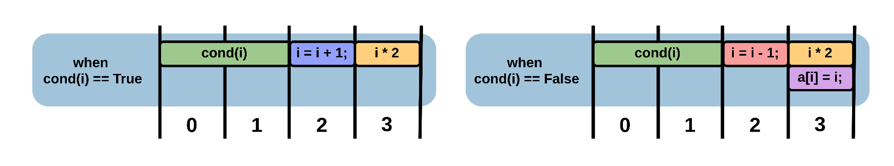
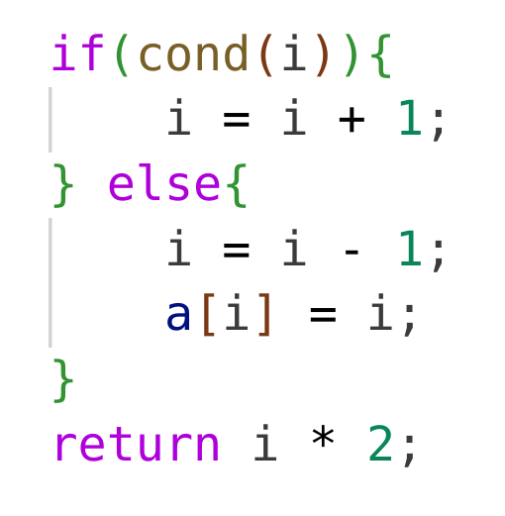
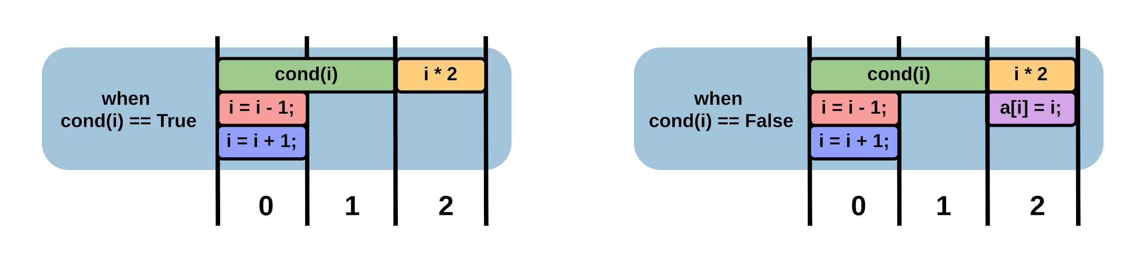
What is Eager Execution?
Standard Schedule
cond(i)
i = i + 1;
i = i - 1;
a[i] = i;
Eager Execution Schedule
i * 2

Slide 4
Speculation in Processors
In a processor:
1) Eager execution is expensive:
Each parallel execution requires a duplicated pipeline
2) Eager execution is unnecessary:
Branch prediction and compiler optimizations
(such as predication and if-conversion)
offer near-equivalent performance
Riseman and Foster. The Inhibition of Potential Parallelism by Conditional Jumps. IEEE Trans. Computers 1972.
Šilc, Robič, and Ungerer. Processor Architecture: From Dataflow to Superscalar and Beyond. Springer 1999.
Moll and Hack. Partial Control-Flow Linearization. PLDI 2018.

Slide 5
Speculation in Processors
In processors,
branch prediction is a better choice than eager execution

Slide 6
Speculation in Accelerators
In an accelerator:
1) Branch prediction underutilizes data paths:
Both data paths already exist in the circuit
With branch prediction, only one executes speculatively
The other waits for the condition
2) Branch prediction is more complex:
With eager execution, one of the executed paths must be correct
But branch prediction requires state rollback after misprediction,
which is both expensive and difficult to implement

Slide 7
Speculation in Accelerators
In an accelerator:
1) Branch prediction underutilizes data paths:
Both data paths already exist in the circuit
With branch prediction, only one executes speculatively
The other waits for the condition
We therefore propose:
Eager execution
is the natural choice for speculation in accelerators
2) Branch prediction is more complex:
With eager execution, one of the executed paths must be correct
But branch prediction requires state rollback,
which is both expensive and difficult to implement

Slide 8
EagerlyElastic:
Correct-by-Construction Eager Execution
in Dynamically-Scheduled HLS
We enable the performance benefits of eager execution
without any additional computational units
We enable eager execution using circuit rewrites: incremental, targeted, local transformations
The approach scales to large and complex designs
We are correct-by-construction,
as our circuit rewrites are formally verified:
Circuit correctness is guaranteed at every stage

Slide 9
EagerlyElastic:
Correct-by-Construction Eager Execution
in Dynamically-Scheduled HLS
How do we add eager execution to
dynamically-scheduled HLS?
1)
Why should we use correct-by-construction
circuit rewrites?
2)

Slide 10
Dynamically-Scheduled High-Level Synthesis
High-level synthesis enables circuit generation
directly from high-level languages
Dynamically-scheduled high-level synthesis uses
Fine-grained data-flow units
connected with elastic channels
Elastic circuits are flexible, modular, and runtime-adaptable:
Eager execution is a natural extension
Josipović, Ghosal, and Ienne. Dynamically Scheduled High-level Synthesis. FPGA 2018.
Notes:
Design space exploration for high level synthesis
High level synthesis allows us to generate circuits directly from high-level languages, primarily for use on FPGAs. And although it raises the level of abstraction, it does not free us from many of the hardware decisions that must be made.

Slide 11
Elastic Circuit:
If Statement
cond(i)
i = i + 1;
i = i - 1;
a[i] = i;
i * 2
Elakhras, Guerrieri, Josipović, and Ienne. Unleashing Parallelism in Elastic Circuits with Faster Token Delivery. FPL 2022

Slide 12
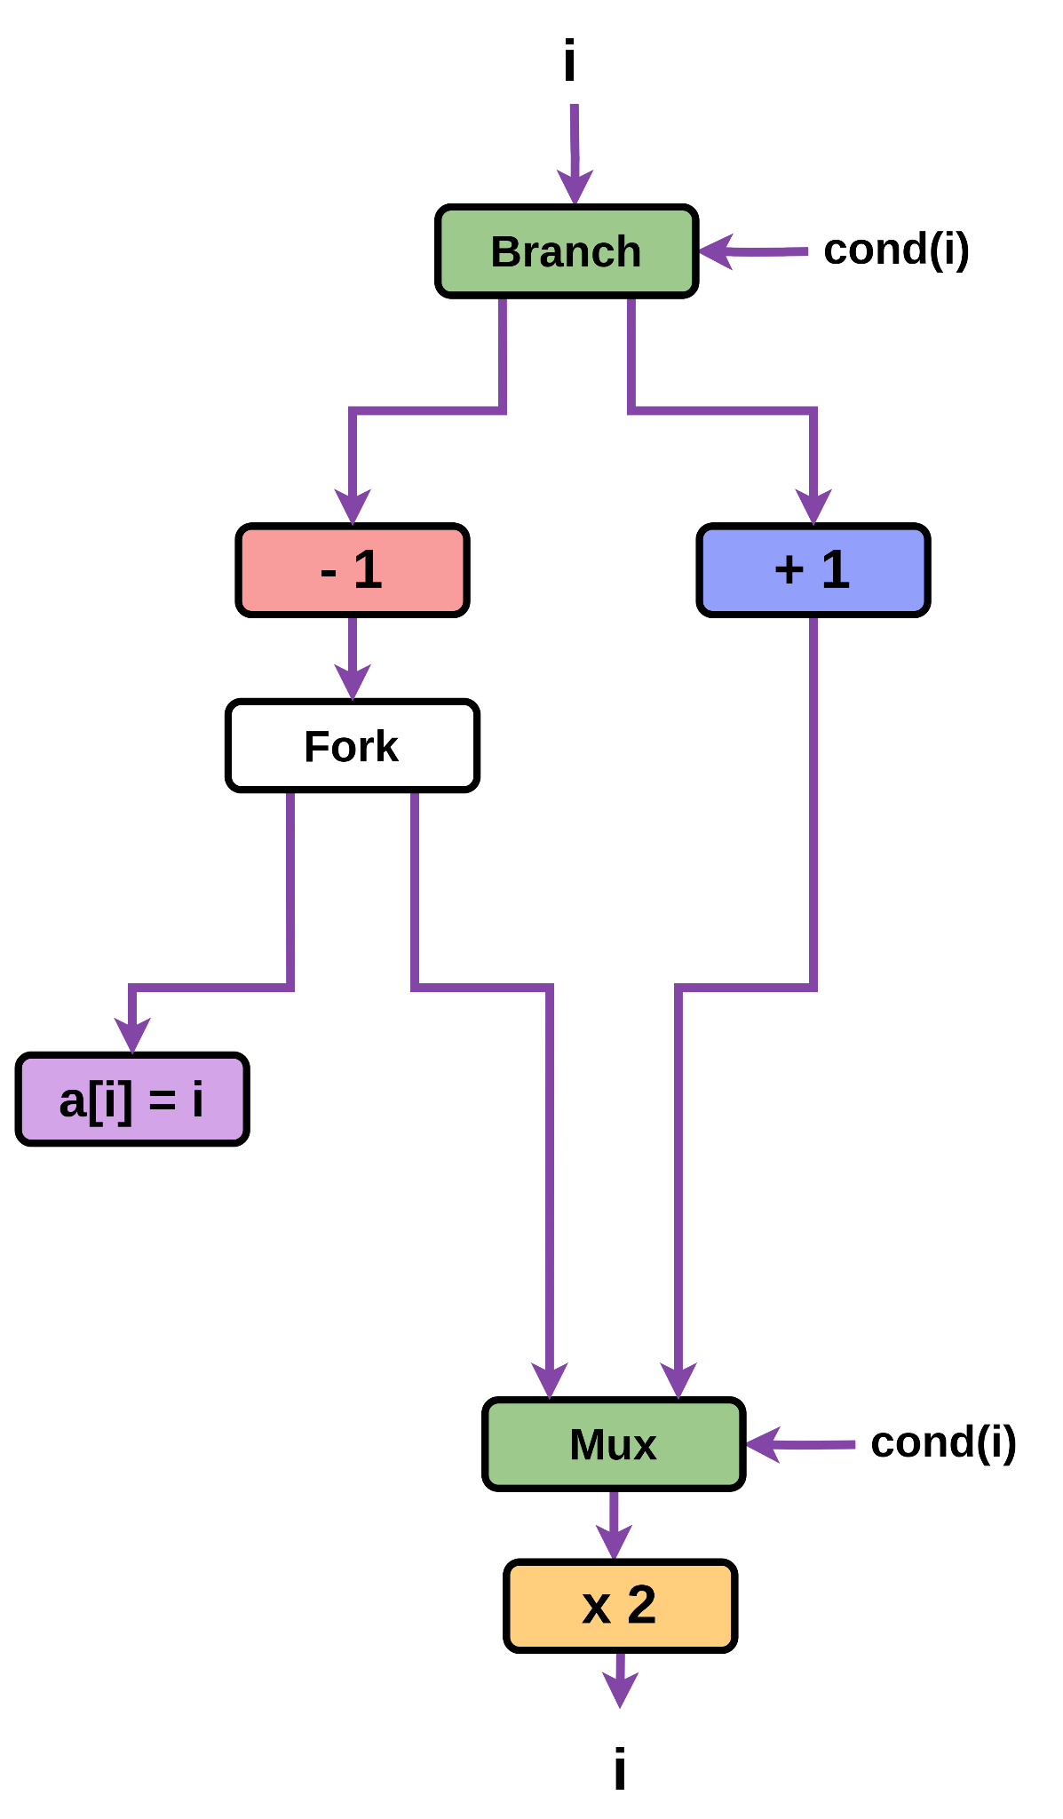
Elastic Circuit:
If Statement
cond(i)
i = i + 1;
i = i - 1;
a[i] = i;
i * 2
Elakhras, Guerrieri, Josipović, and Ienne. Unleashing Parallelism in Elastic Circuits with Faster Token Delivery. FPL 2022

Slide 13
Elastic Circuit:
If Statement
cond(i)
i = i + 1;
i = i - 1;
a[i] = i;
i * 2
Elakhras, Guerrieri, Josipović, and Ienne. Unleashing Parallelism in Elastic Circuits with Faster Token Delivery. FPL 2022

Slide 14
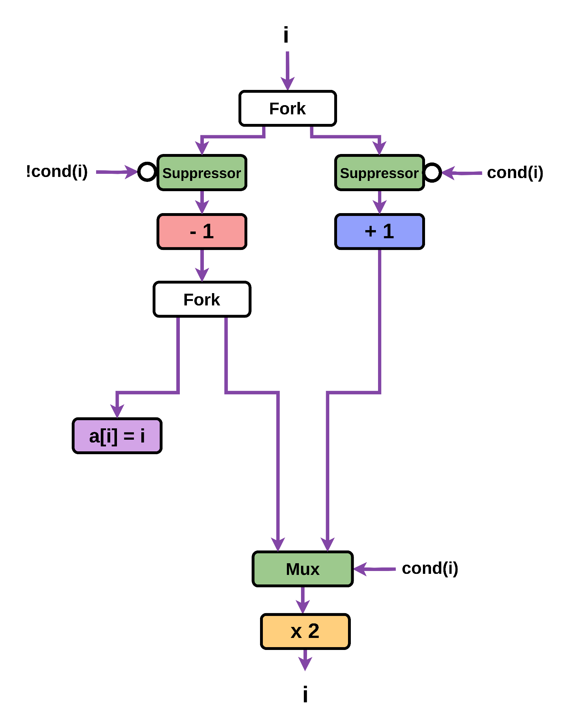
Elastic Circuit:
If Statement
cond(i)
i = i + 1;
i = i - 1;
a[i] = i;
i * 2
Elakhras, Guerrieri, Josipović, and Ienne. Unleashing Parallelism in Elastic Circuits with Faster Token Delivery. FPL 2022

Slide 15
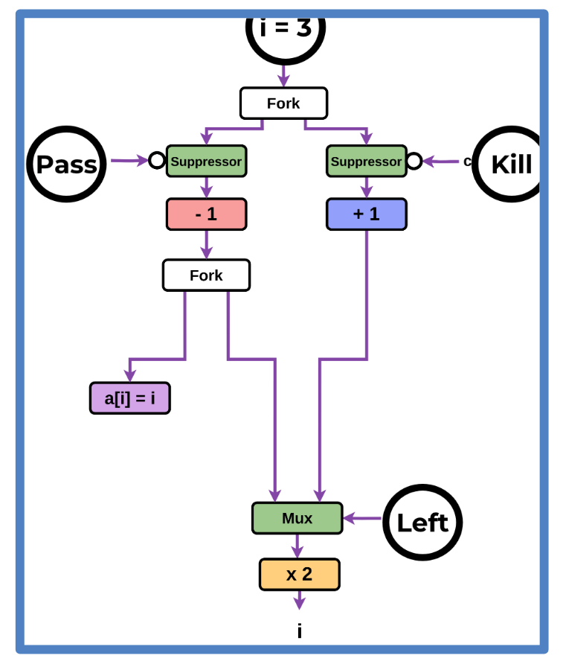
Elastic Circuit:
If Statement
cond(i)
i = i + 1;
i = i - 1;
a[i] = i;
i * 2
Elakhras, Guerrieri, Josipović, and Ienne. Unleashing Parallelism in Elastic Circuits with Faster Token Delivery. FPL 2022

Slide 16
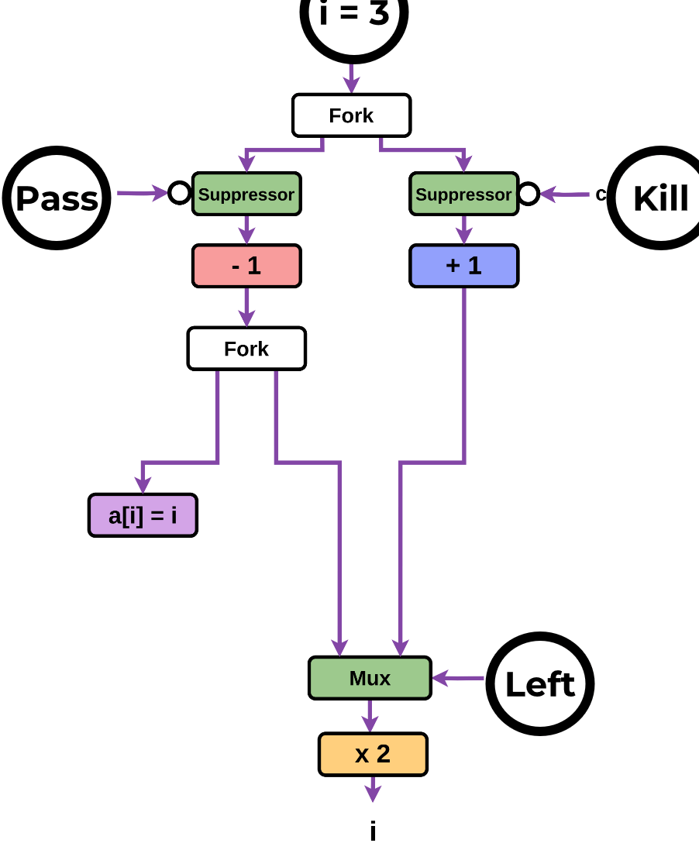
Elastic Circuit:
If Statement
cond(i)
i = i + 1;
i = i - 1;
a[i] = i;
i * 2
Elakhras, Guerrieri, Josipović, and Ienne. Unleashing Parallelism in Elastic Circuits with Faster Token Delivery. FPL 2022
Notes:
animation made faster

Slide 17
Elastic Circuit:
If Statement
cond(i)
i = i + 1;
i = i - 1;
a[i] = i;
i * 2
Elakhras, Guerrieri, Josipović, and Ienne. Unleashing Parallelism in Elastic Circuits with Faster Token Delivery. FPL 2022

Slide 18
Elastic Circuit:
If Statement
cond(i)
i = i + 1;
Suppressor units independently
control which computations occur
i = i - 1;
a[i] = i;
i * 2
Elakhras, Guerrieri, Josipović, and Ienne. Unleashing Parallelism in Elastic Circuits with Faster Token Delivery. FPL 2022

Slide 19
First Contribution:
How Do We Enable Eager Execution

Slide 20
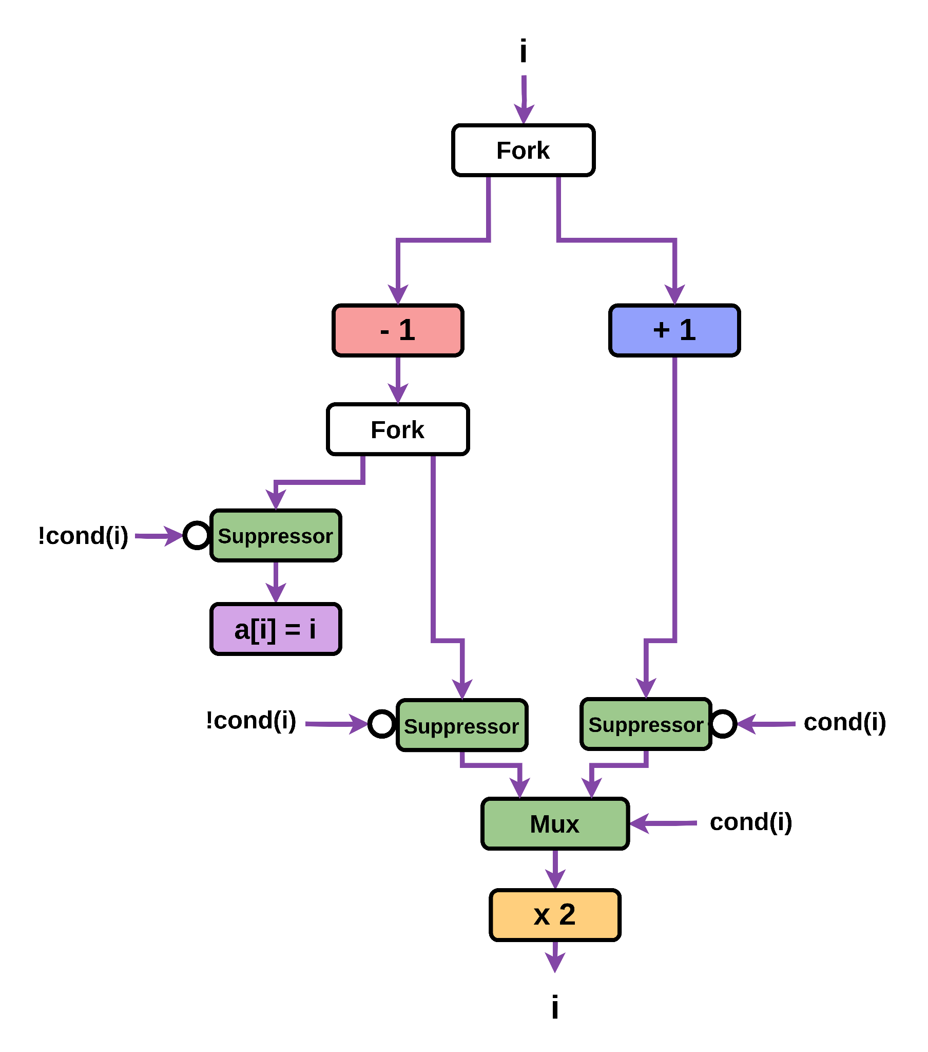
How Do We Add Eager Execution:
If Statement

Slide 21
How Do We Add Eager Execution:
If Statement

Slide 22
How Do We Add Eager Execution:
If Statement

Slide 23
How Do We Add Eager Execution:
If Statement

Slide 24
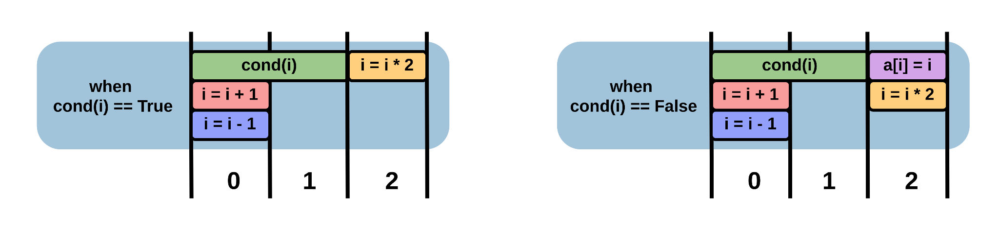
How Do We Add Eager Execution:
If Statement
Eager Execution Schedule

Slide 25
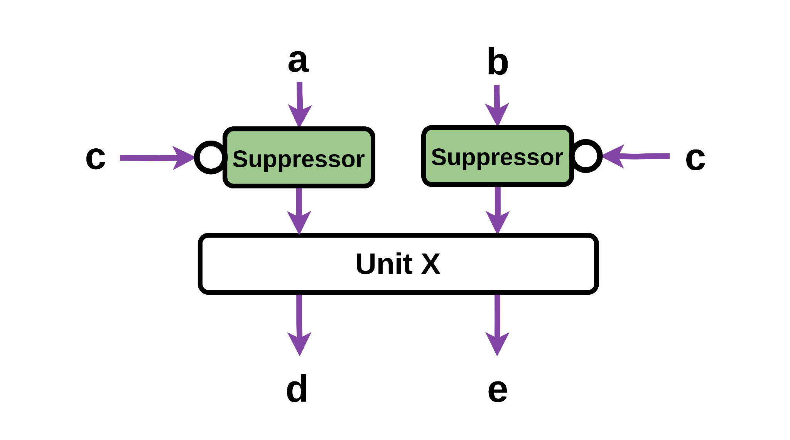
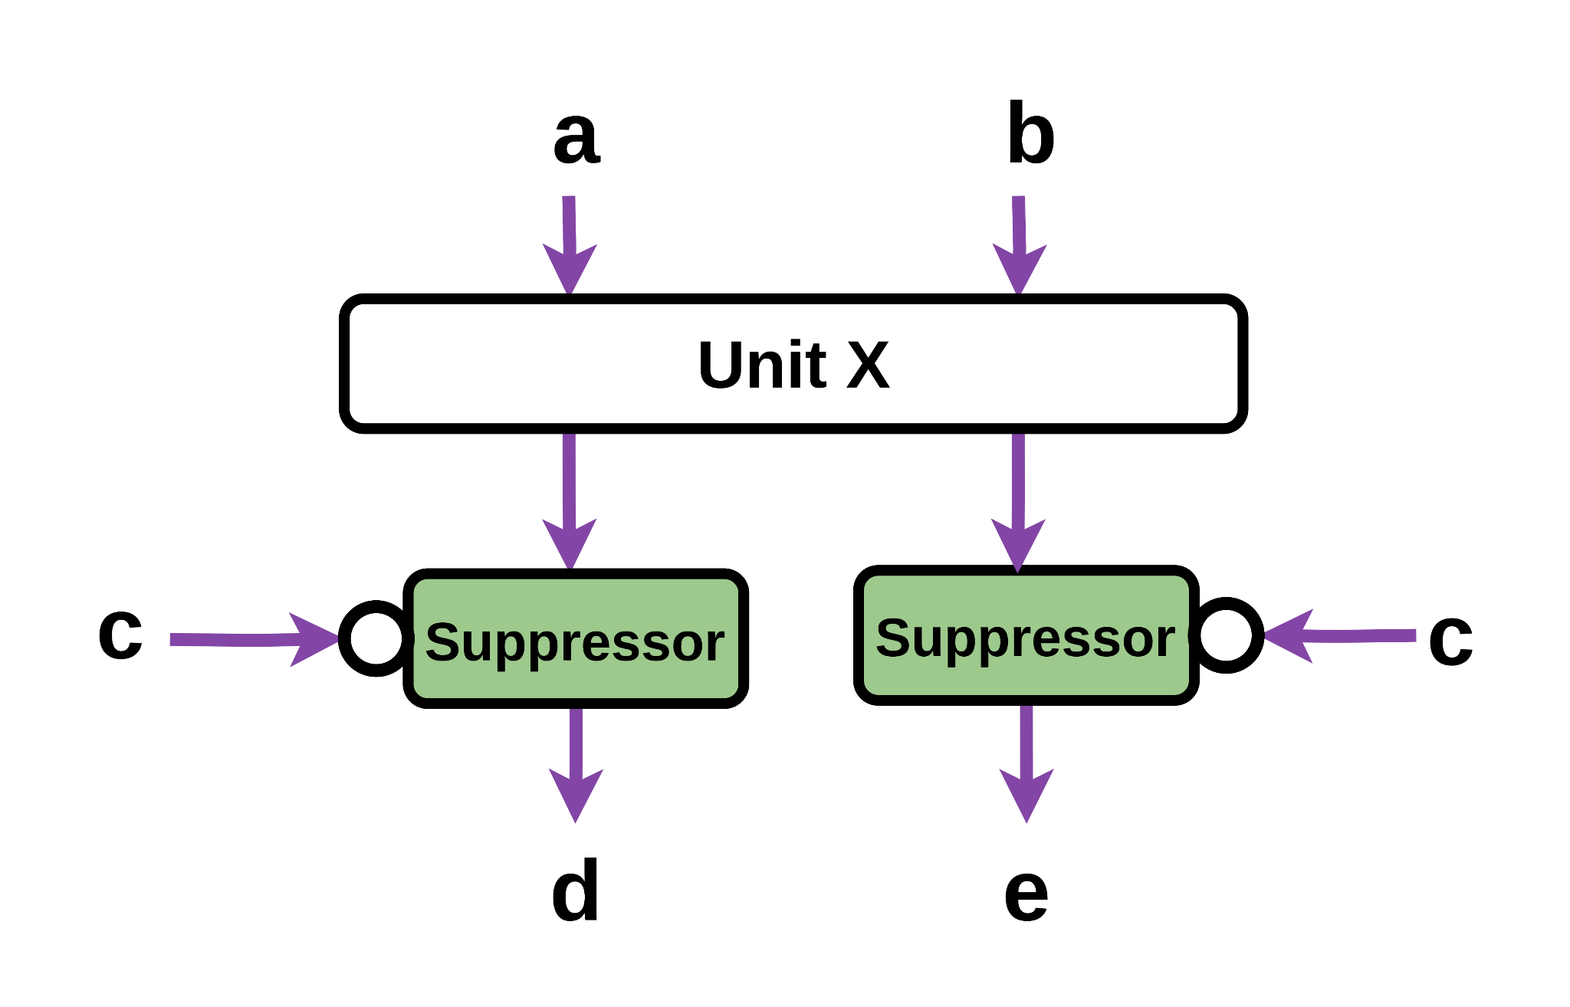
How Do We Add Eager Execution
Key Insight:
To enable eager execution, we wish to
move suppressor units below computational units

Slide 26
EagerlyElastic:
Correct-by-Construction Eager Execution
in Dynamically-Scheduled HLS
How do we add eager execution to dynamically-scheduled HLS?
1)
Why should we use correct-by-construction
circuit rewrites?
2)

Slide 27
Local Circuit Rewrites
A local circuit rewrite takes an input circuit,
and transforms it to
an equivalent but desirable output circuit
Rewrite A

Slide 28
Local Circuit Rewrites
A local circuit rewrite takes an input circuit,
and transforms it to
an equivalent but desirable output circuit
Our core local circuit rewrite,
Rewrite A,
allows us to eagerly execute on straight data paths
Rewrite A

Slide 29
Local Circuit Rewrites
Due to their small size,
the equivalence of the two circuits can be formally proven
1)
Their local nature is efficient and reliable on complex designs:
If the small input circuit is found, the rewrite can be applied
2)
3)
By applying many rewrites, one at a time,
circuits can still be drastically transformed

Slide 30
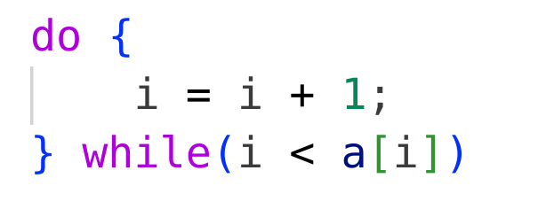
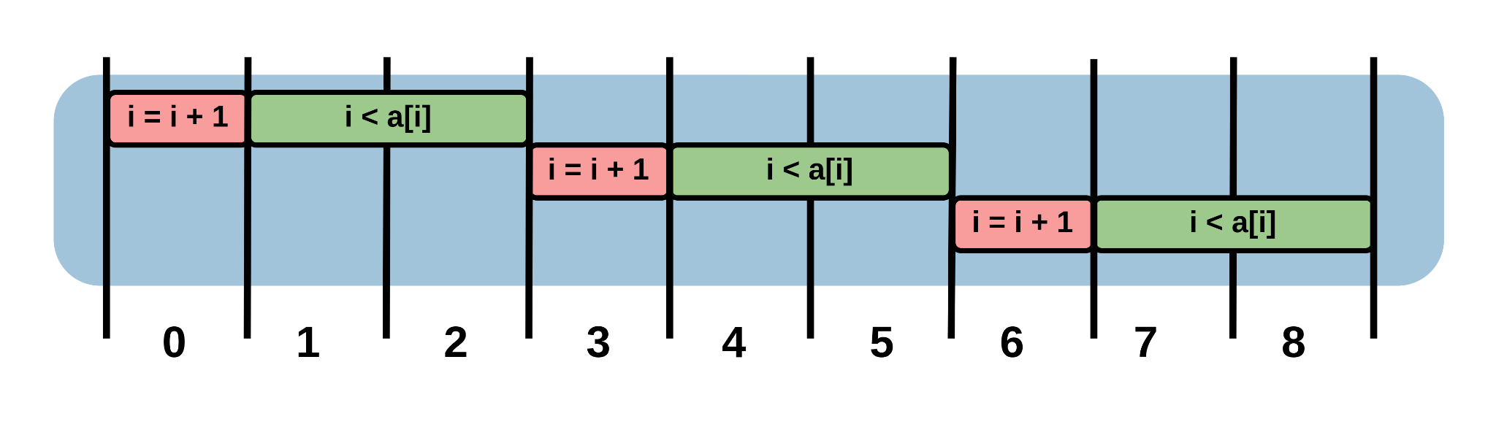
Motivating Example 2:
Eager Re-Entry of a Do-While Loop
For the sake of example:
Loop finishes after 3 iterations
Standard Schedule
Every 3 cycles, an iteration begins. Throughput: 1/3

Slide 31
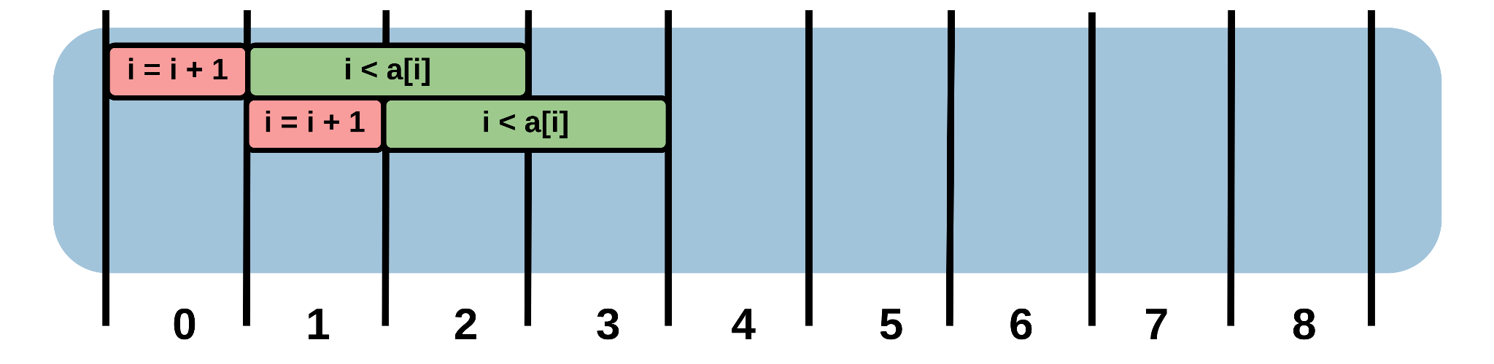
Motivating Example 2:
Eager Re-Entry of a Do-While Loop
Eagerly executing a do-while loop branch: One loop iteration eagerly executes at a time
If an eagerly executing iteration is confirmed?
A new iteration can eagerly execute
One Iteration Eagerly Executing

Slide 32
Motivating Example 2:
Eager Re-Entry of a Do-While Loop
Eagerly executing a do-while loop branch: One loop iteration eagerly executes at a time
If an eagerly executing iteration is confirmed?
A new iteration can eagerly execute
One Iteration Eagerly Executing

Slide 33
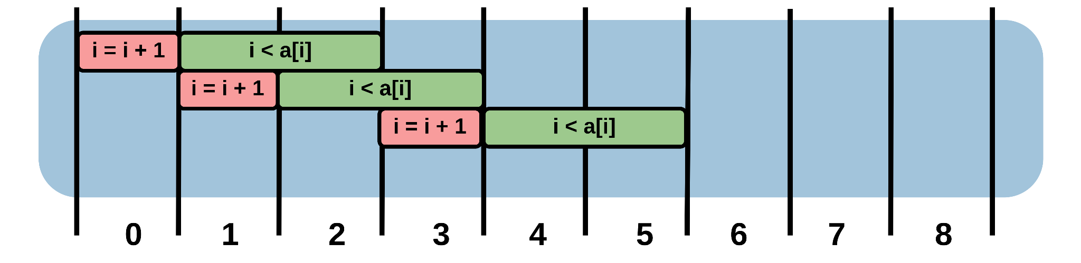
Motivating Example 2:
Eager Re-Entry of a Do-While Loop
Eagerly executing a do-while loop branch: One loop iteration eagerly executes at a time
If an eagerly executing iteration is confirmed?
A new iteration can eagerly execute
One Iteration Eagerly Executing

Slide 34
Motivating Example 2:
Eager Re-Entry of a Do-While Loop
Eagerly executing a do-while loop branch: One loop iteration eagerly executes at a time
If an eagerly executing iteration is confirmed?
A new iteration can eagerly execute
One Iteration Eagerly Executing

Slide 35
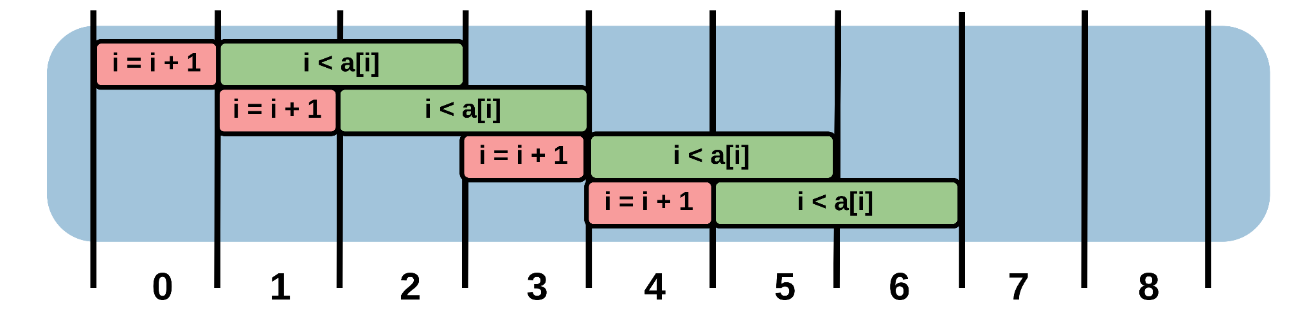
Motivating Example 2:
Eager Re-Entry of a Do-While Loop
Eagerly executing a do-while loop branch: One loop iteration eagerly executes at a time
If an eagerly executing iteration is confirmed?
A new iteration can eagerly execute
One Iteration Eagerly Executing

Slide 36
Motivating Example 2:
Eager Re-Entry of a Do-While Loop
Eagerly executing a do-while loop branch: One loop iteration eagerly executes at a time
If an eagerly executing iteration is confirmed?
A new iteration can eagerly execute
One Iteration Eagerly Executing

Slide 37
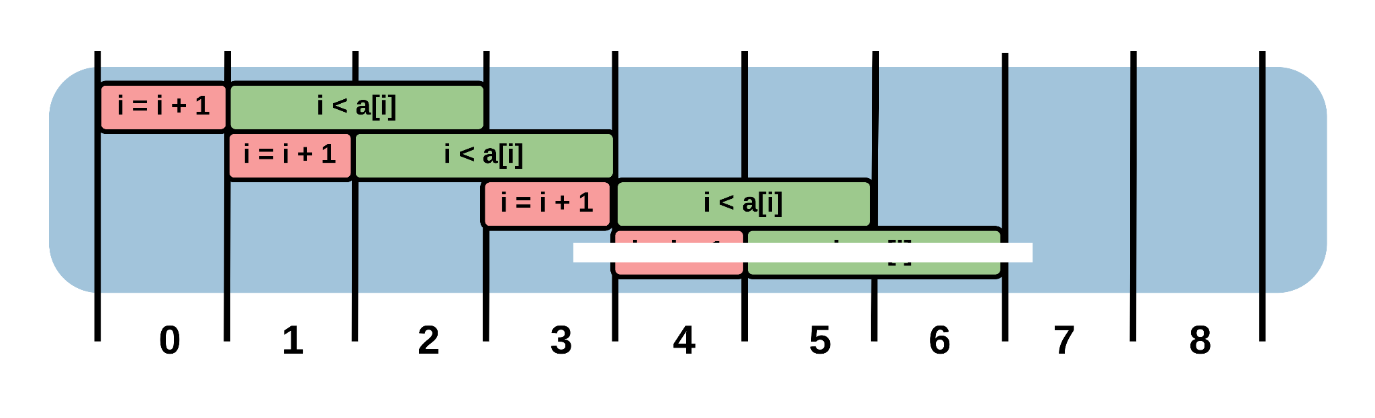
Motivating Example 2:
Eager Re-Entry of a Do-While Loop
Eagerly executing a do-while loop branch: One loop iteration eagerly executes at a time
If an eagerly executing iteration is confirmed?
A new iteration can eagerly execute
One Iteration Eagerly Executing
Every 3 cycles, 2 iterations begin. Throughput: 2/3

Slide 38
Motivating Example 2:
Eager Re-Entry of a Do-While Loop
Standard Schedule
Throughput: 1/3

Slide 39
Motivating Example 2:
Eager Re-Entry of a Do-While Loop
Standard Schedule
Throughput: 1/3
One Iteration Eagerly Executing
Throughput: 2/3
Throughput is doubled:

Slide 40
Motivating Example 2:
Eager Re-Entry of a Do-While Loop
Standard Schedule
Throughput: 1/3
Eagerly executing one iteration
can double throughput
One Iteration Eagerly Executing
Throughput: 2/3
Throughput is doubled:

Slide 41
Motivating Example 2:
Eager Re-Entry of a Do-While Loop
Standard Schedule
Throughput: 1/3
Eagerly executing one iteration
can double throughput
Can we improve throughput further?
Yes: more eager execution
One Iteration Eagerly Executing
Throughput: 2/3
Throughput is doubled:

Slide 42
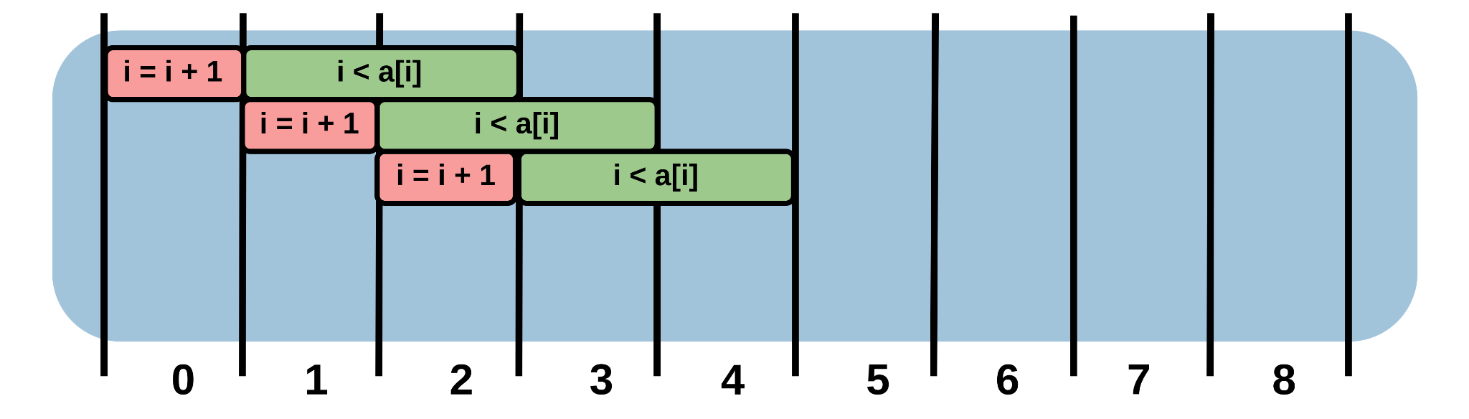
Motivating Example 2:
Eager Re-Entry of a Do-While Loop
Two Iterations Eagerly Executing

Slide 43
Motivating Example 2:
Eager Re-Entry of a Do-While Loop
Two Iterations Eagerly Executing

Slide 44
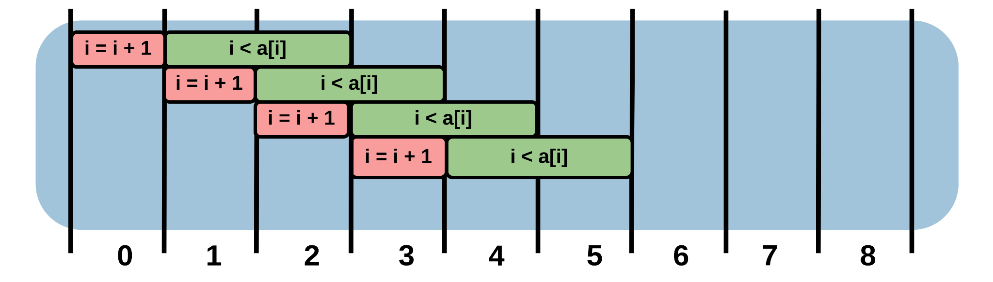
Motivating Example 2:
Eager Re-Entry of a Do-While Loop
Two Iterations Eagerly Executing

Slide 45
Motivating Example 2:
Eager Re-Entry of a Do-While Loop
Two Iterations Eagerly Executing

Slide 46
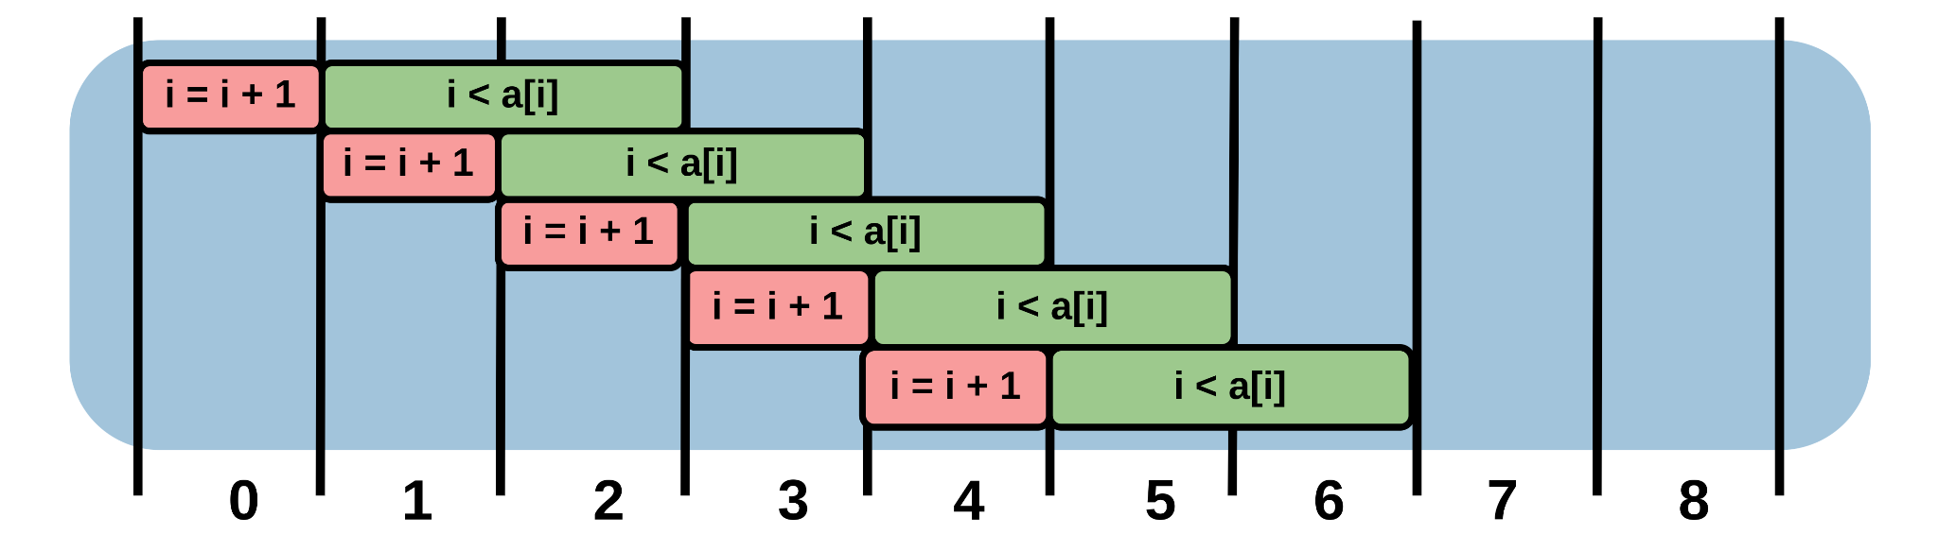
Motivating Example 2:
Eager Re-Entry of a Do-While Loop
Two Iterations Eagerly Executing

Slide 47
Motivating Example 2:
Eager Re-Entry of a Do-While Loop
Two Iterations Eagerly Executing

Slide 48
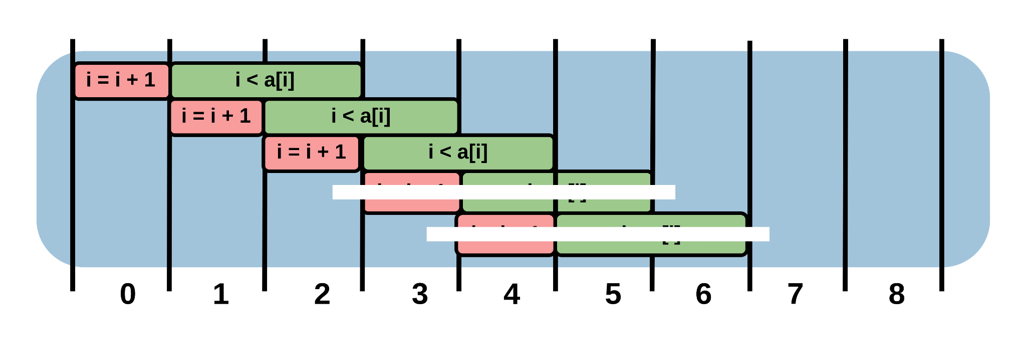
Motivating Example 2:
Eager Re-Entry of a Do-While Loop
Two Iterations Eagerly Executing
Every cycle, an iteration begins. Throughput: 1

Slide 49
Motivating Example 2:
Eager Re-Entry of a Do-While Loop
Standard Schedule
Throughput: 1/3
Two Iterations Eagerly Executing
Throughput: 1
Throughput is tripled:

Slide 50
Motivating Example 2:
Eager Re-Entry of a Do-While Loop
Standard Schedule
Throughput: 1/3
Eagerly re-entering a loop n times
can multiply loop throughput by (n + 1)
Two Iterations Eagerly Executing
Throughput: 1
Throughput is tripled:

Slide 51
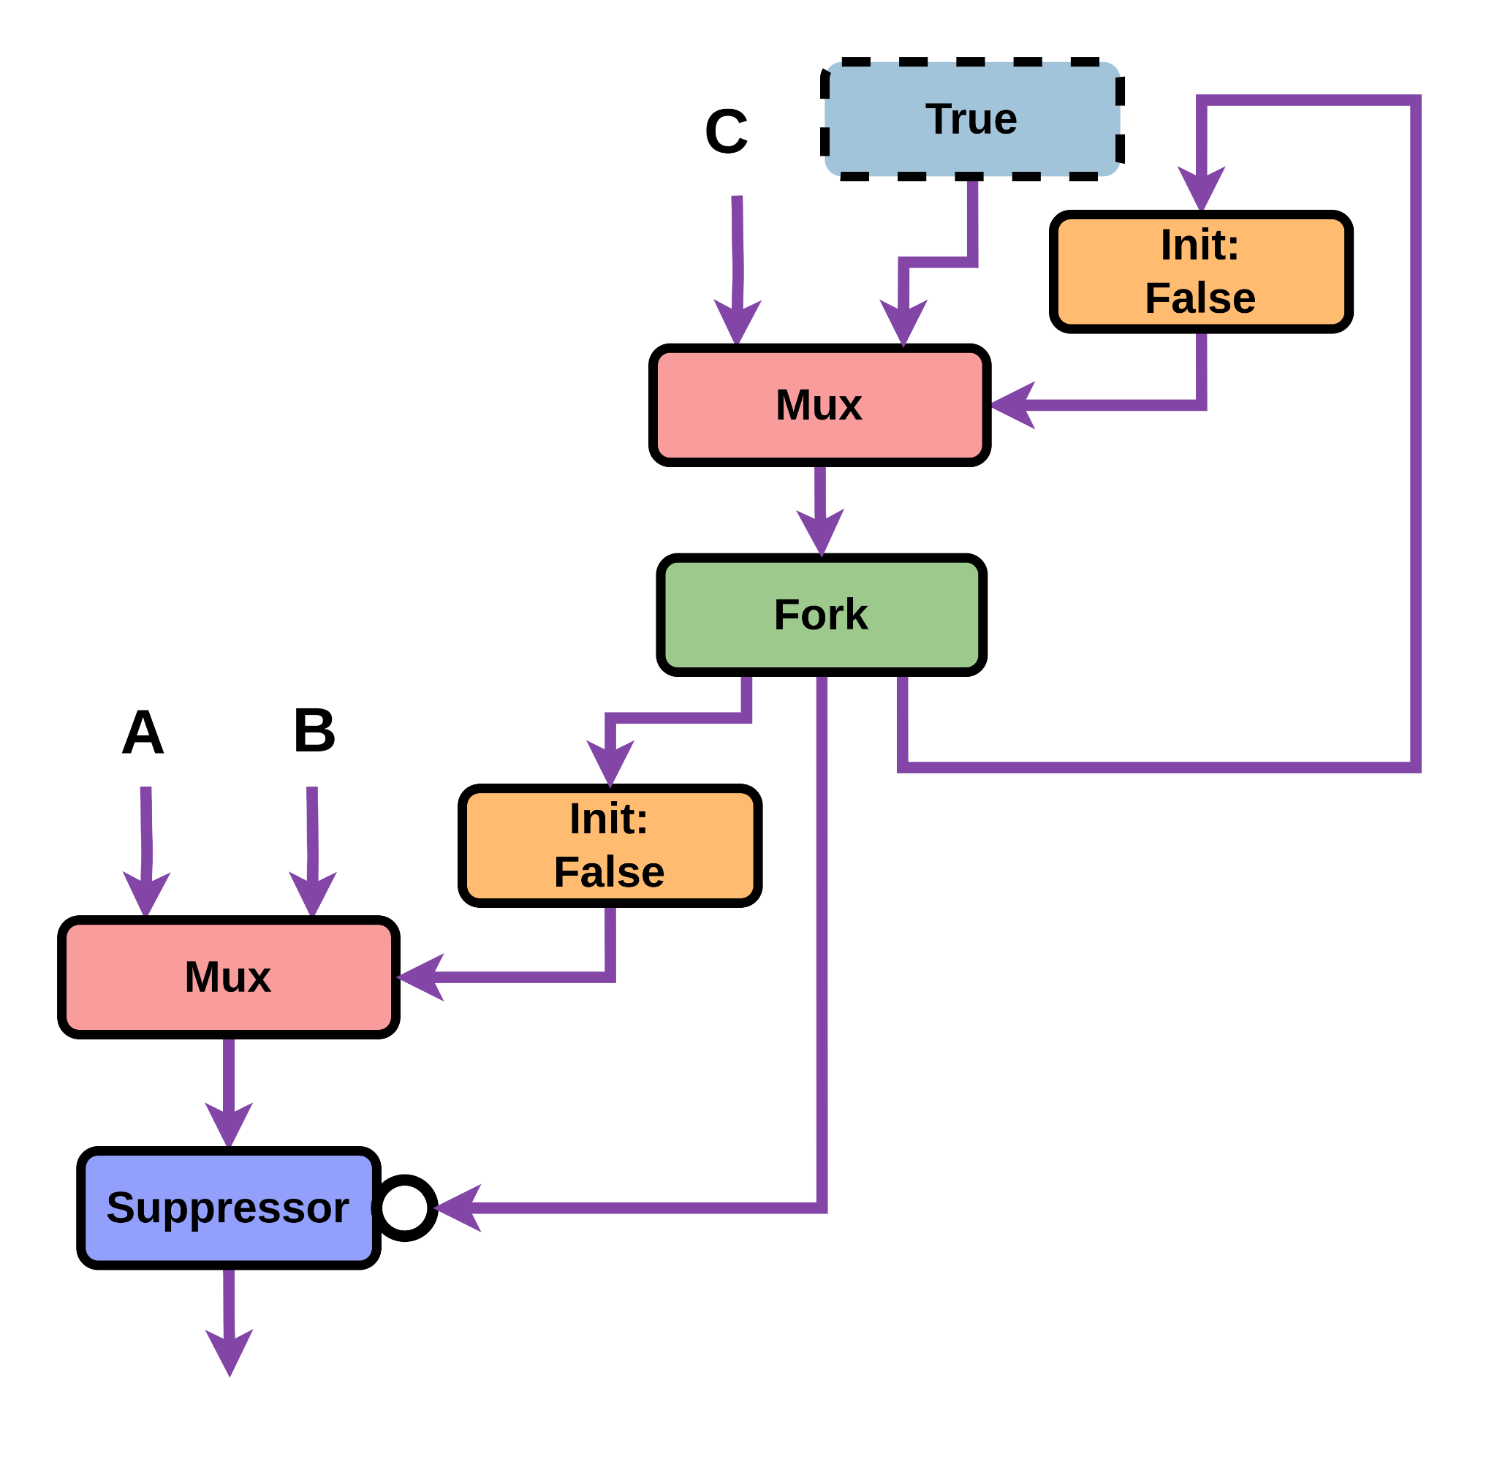
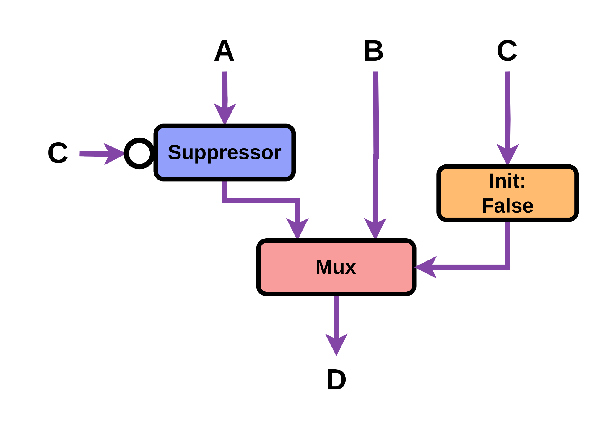
Rewrite D:
Eager Re-Entry of a Do-While Loop
Our rewrite to enable this is called Rewrite D

Slide 52
Rewrite D:
Eager Re-Entry of a Do-While Loop
Our rewrite to enable this is called Rewrite D

Slide 53
Rewrite D:
Eager Re-Entry of a Do-While Loop
Our rewrite to enable this is called Rewrite D

Slide 54
Rewrite D:
Eager Re-Entry of a Do-While Loop
Rewrite D enables us to eagerly execute one iteration,
and double the loop throughput
However, to multiply throughput further,
we would need to apply Rewrite D multiple times

Slide 55
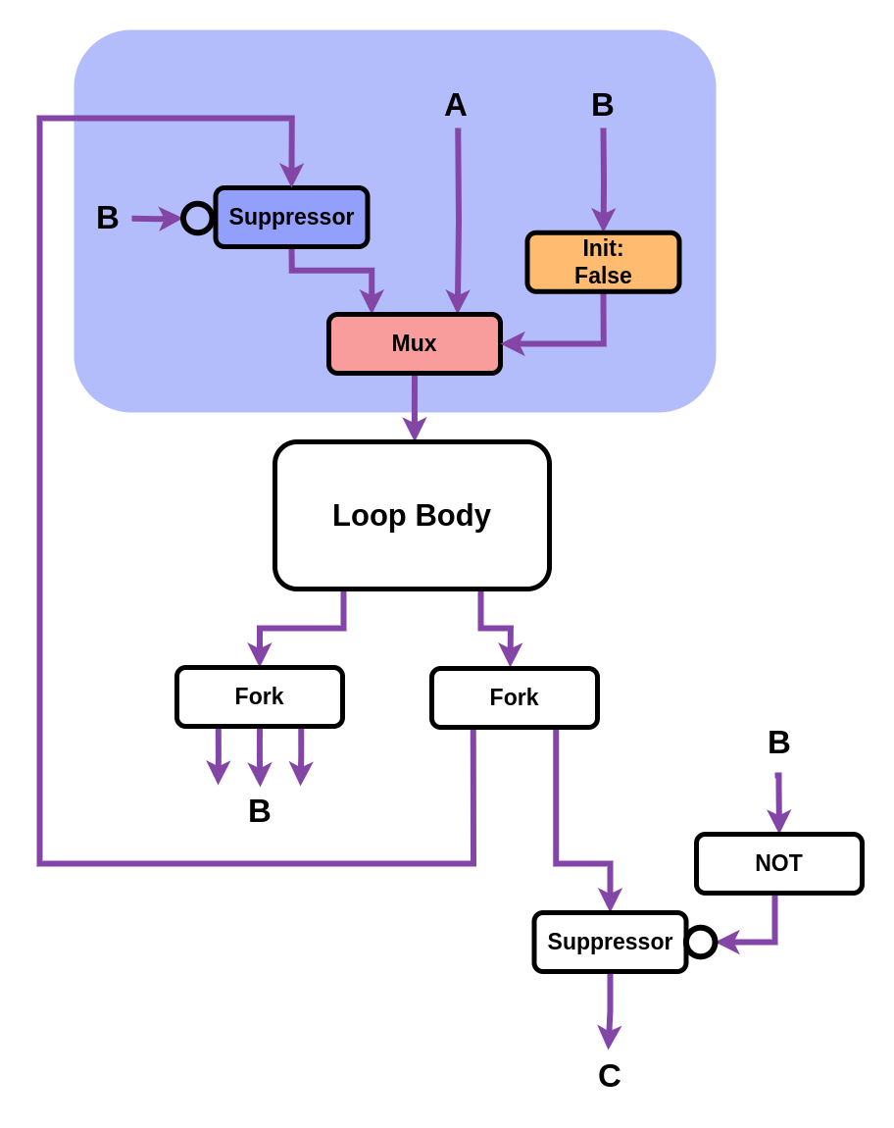
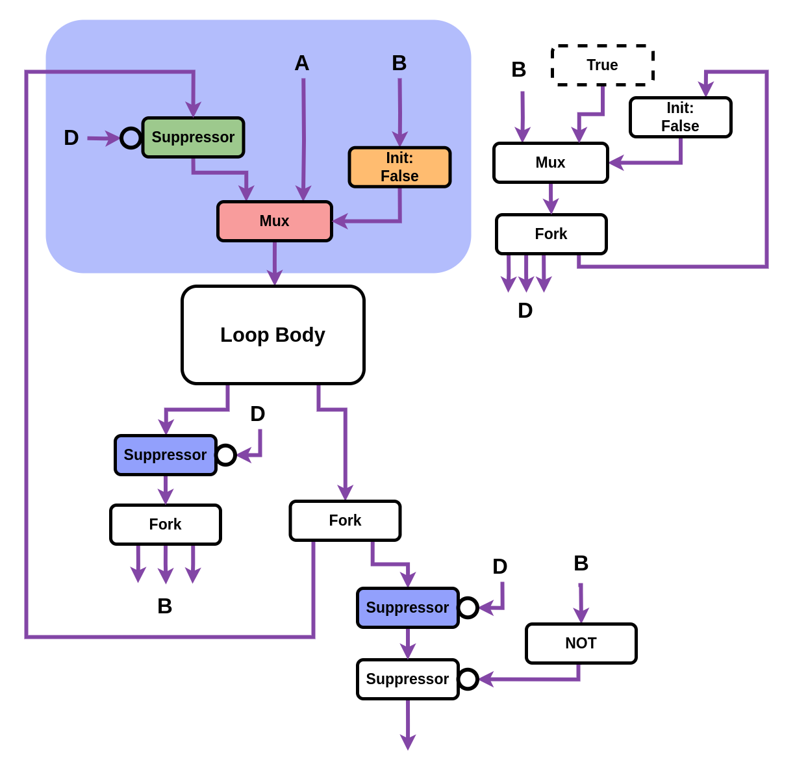
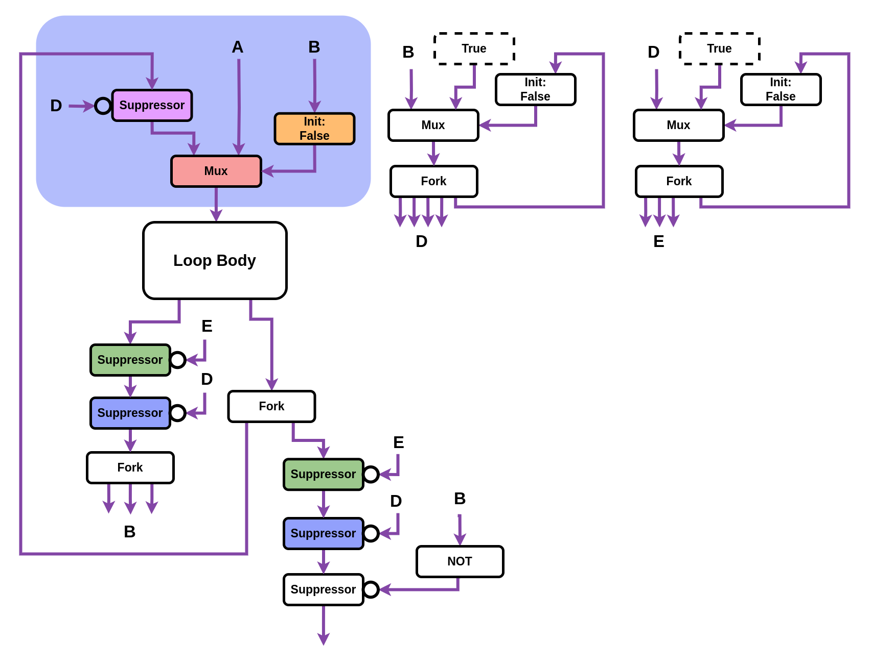
Rewrite D:
Eager Re-Entry of a Do-While Loop
Fortunately, Rewrite D has a beautiful (and unique) property:
It is infinitely re-applicable
Standard
Do-While Loop
One Iteration Eagerly Executing
Do-While Loop
Two Iterations Eagerly Executing
Do-While Loop

Slide 56
Rewrite D:
Eager Re-Entry of a Do-While Loop
Fortunately, Rewrite D has a beautiful (and unique) property:
It is infinitely re-applicable
As Rewrite D is infinitely re-applicable,
EagerlyElastic is able to
completely eliminate branch conditions
as a bottleneck on loop pipelining
Standard
Do-While Loop
One Iteration Eagerly Executing
Do-While Loop
Two Iterations Eagerly Executing
Do-While Loop

Slide 57
EagerlyElastic Rewrites
Our paper discusses 8 rewrites in detail

Slide 58
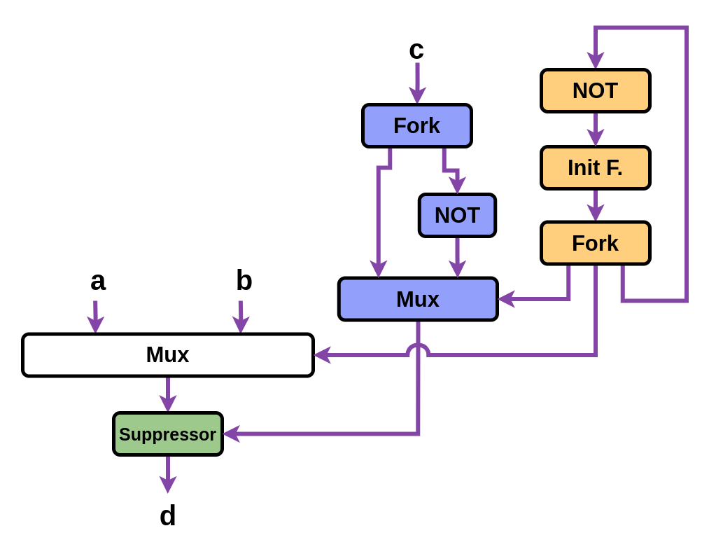
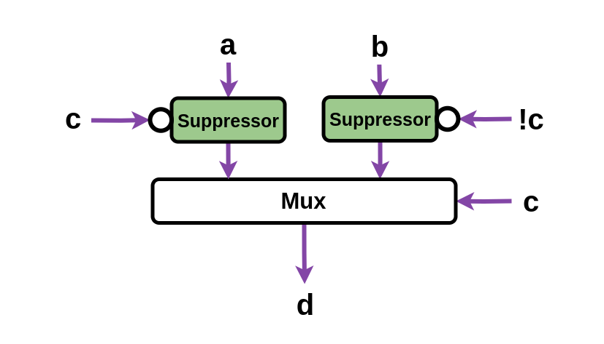
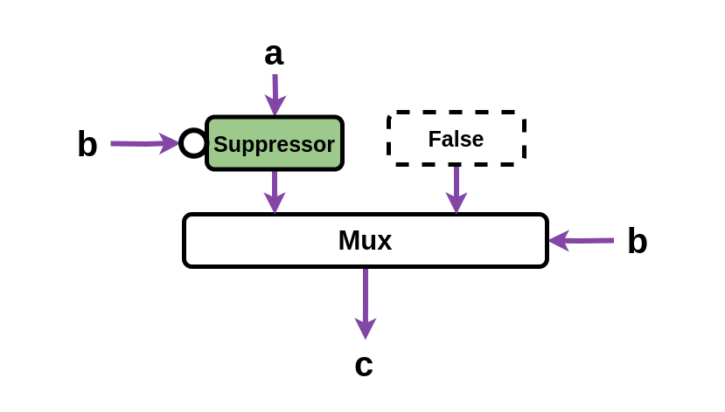
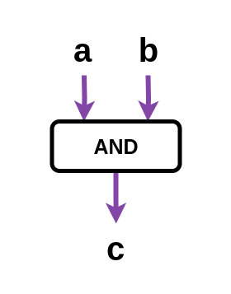
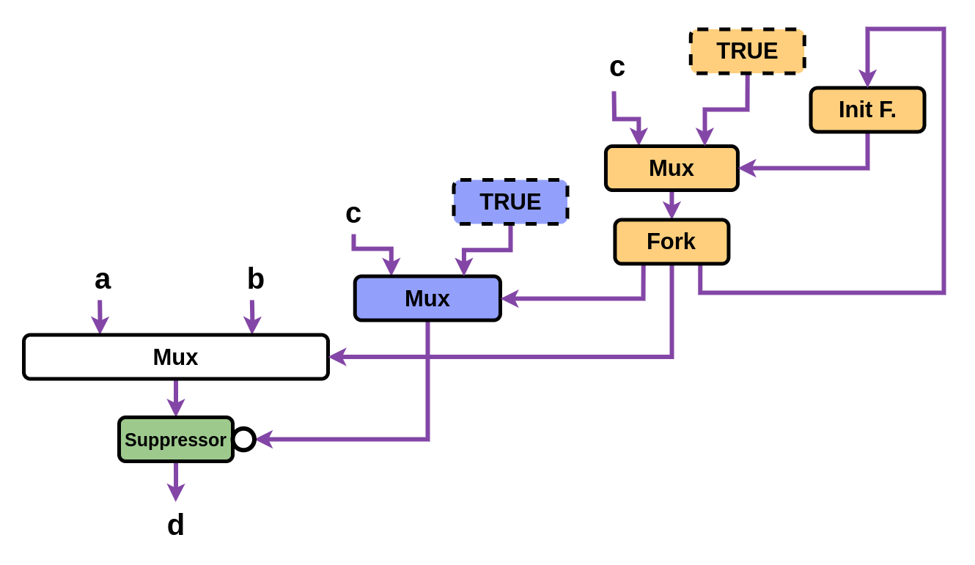
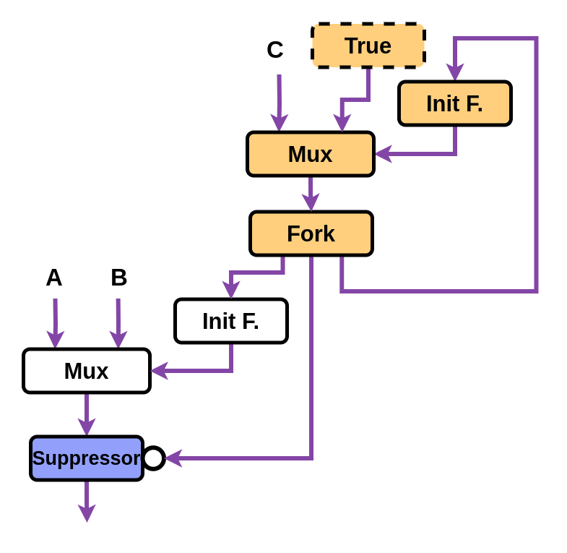
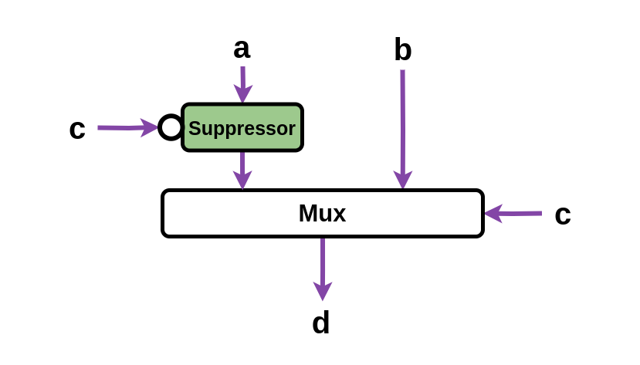
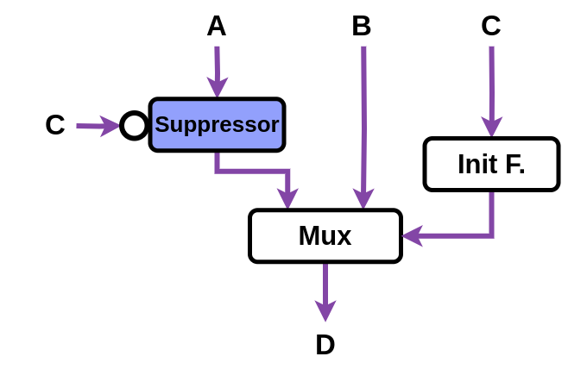
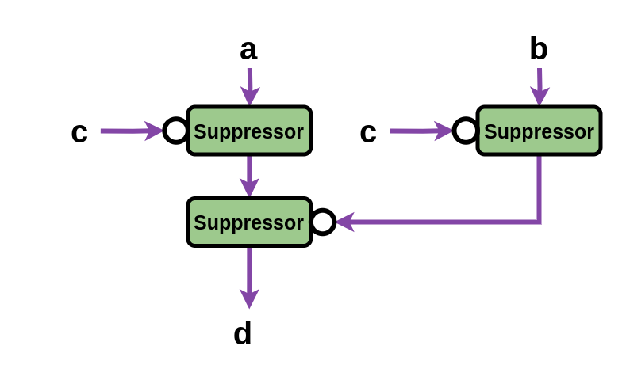
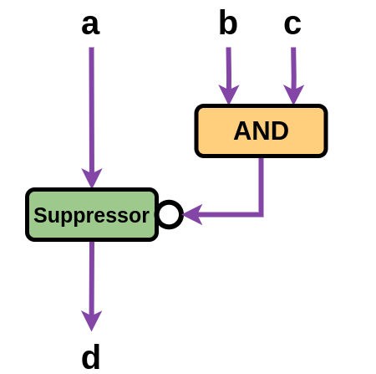
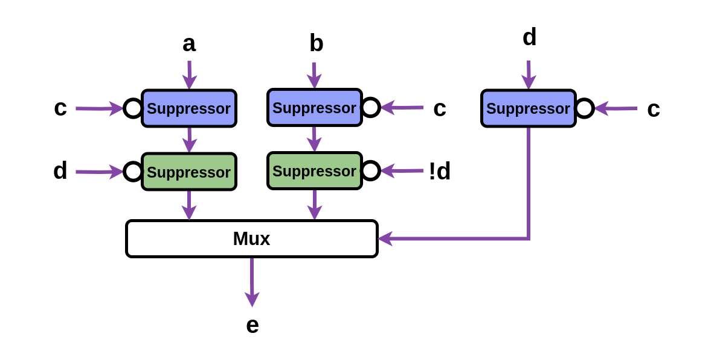
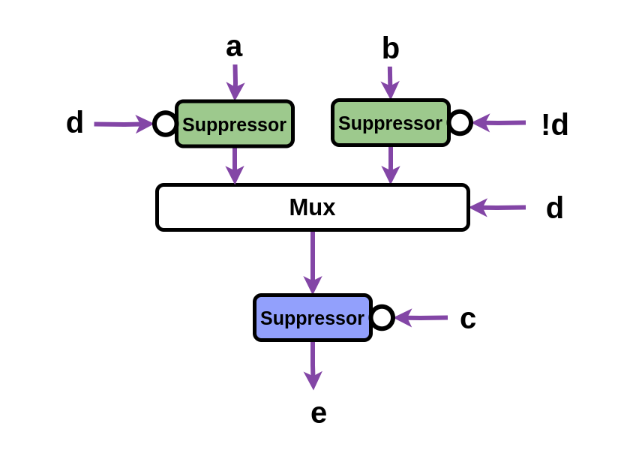
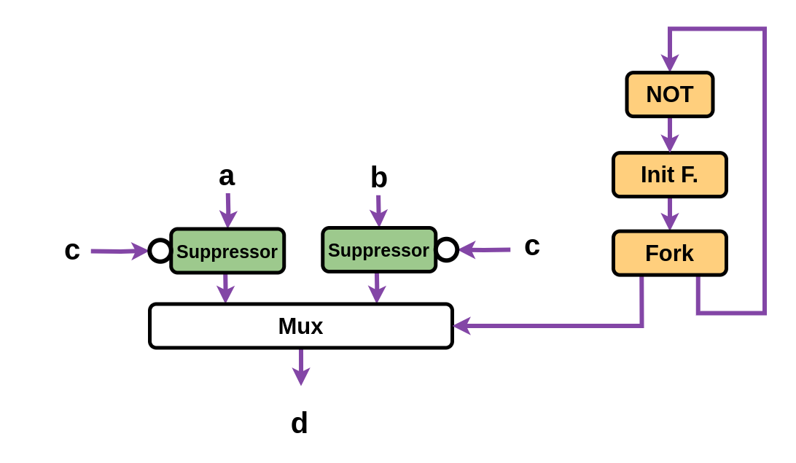
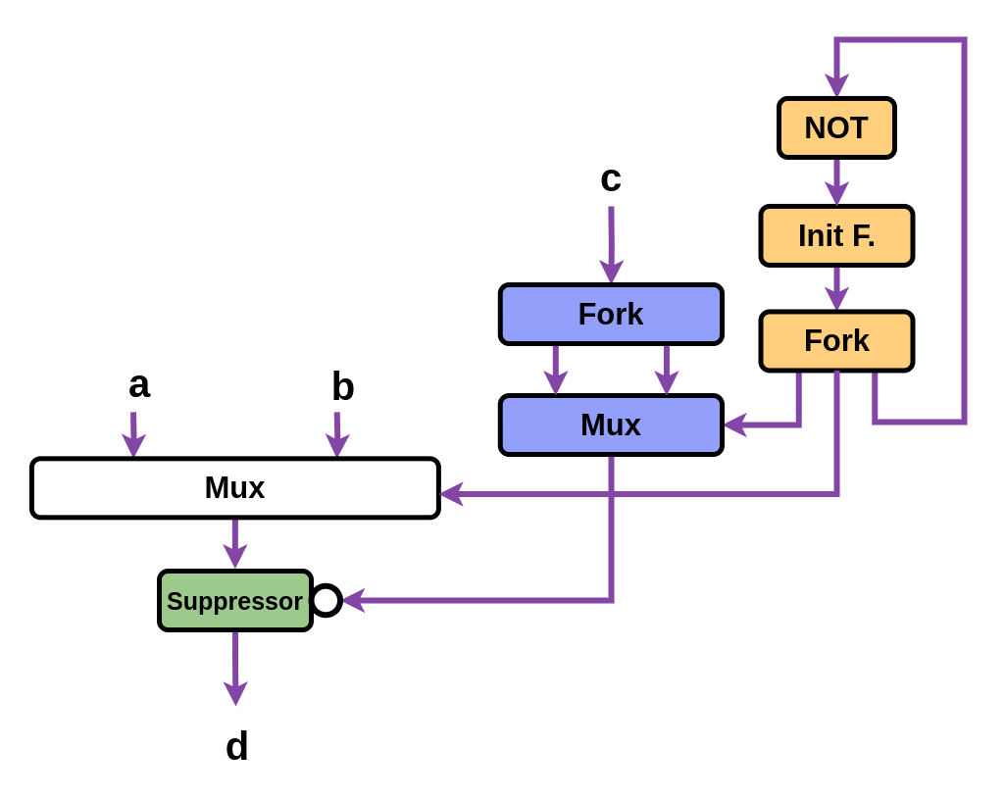
EagerlyElastic Rewrites
Our paper discusses 8 rewrites in detail
Rewrite A
Rewrite B
Rewrite E
Rewrite C
Rewrite D
Rewrite F
Rewrite G
Rewrite H

Slide 59
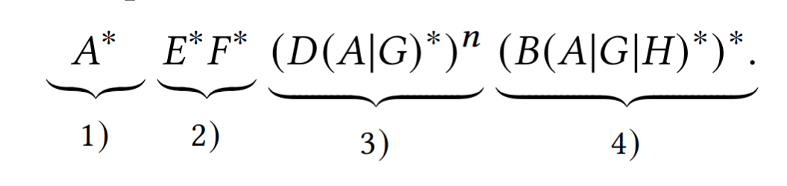
EagerlyElastic Rewrites
We use the rewrite sequence:
1)
2)
3)
4)
* = Apply sub-pattern repeatedly
| = Apply any with no priority
This naively maximizes eager execution throughout the circuit

Slide 60
EagerlyElastic Rewrites
We use the rewrite sequence:
1)
2)
3)
4)
* = Apply sub-pattern repeatedly
| = Apply any with no priority
This naively maximizes eager execution throughout the circuit
1)
Straight Data Paths
Do-While Loops
3)
Preprocess Do-While Loops
with Multiple Exits
2)
If Statements
4)

Slide 61
EagerlyElastic Rewrites
We use the rewrite sequence:
1)
2)
3)
4)

Slide 62
EagerlyElastic Rewrites
We use the rewrite sequence:
1)
2)
3)
4)
n is an per-loop input parameter
=
How many times to eagerly re-enter the loop
As n increases, both performance and resource cost increase

Slide 63
EagerlyElastic Rewrites
We use the rewrite sequence:
EagerlyElastic
offers a new Pareto frontier
based on the desired extent of eager execution
1)
2)
3)
4)
n is an per-loop input parameter
=
How many times to eagerly re-enter the loop
As n increases, both performance and resource cost increase

Slide 64
Results

Slide 65
Formal Verification
ElasticMiter: (ASPLOS ‘25)
Existing tool to prove equivalence of two elastic circuits
We prove each rewrite maintains correctness
only once
No formal verification happens during HLS
Elakhras, Xu, Erhart, Ienne, and Josipović. ElasticMiter: Formally Verified Dataflow Circuit Rewrites. ASPLOS 2025.

Slide 66
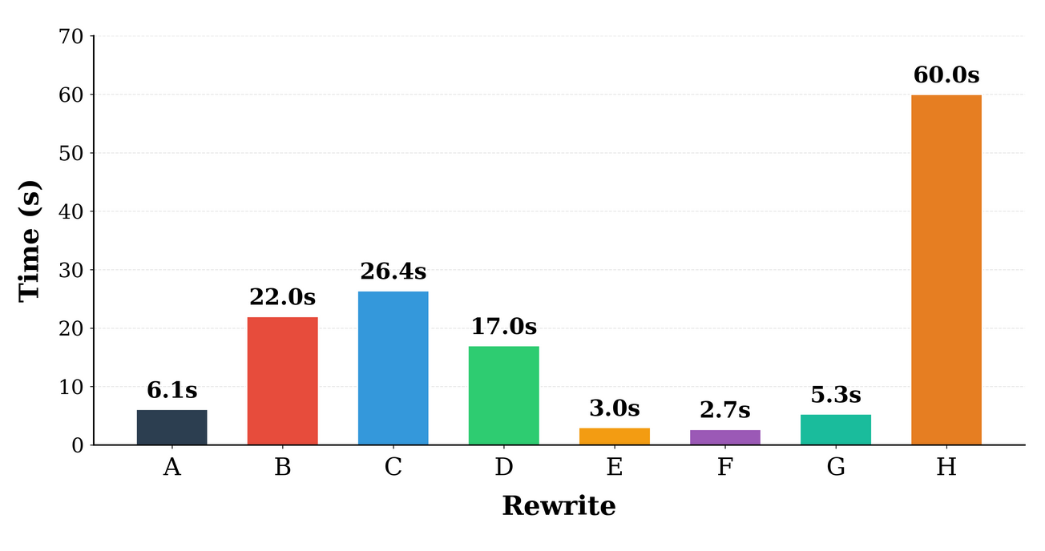
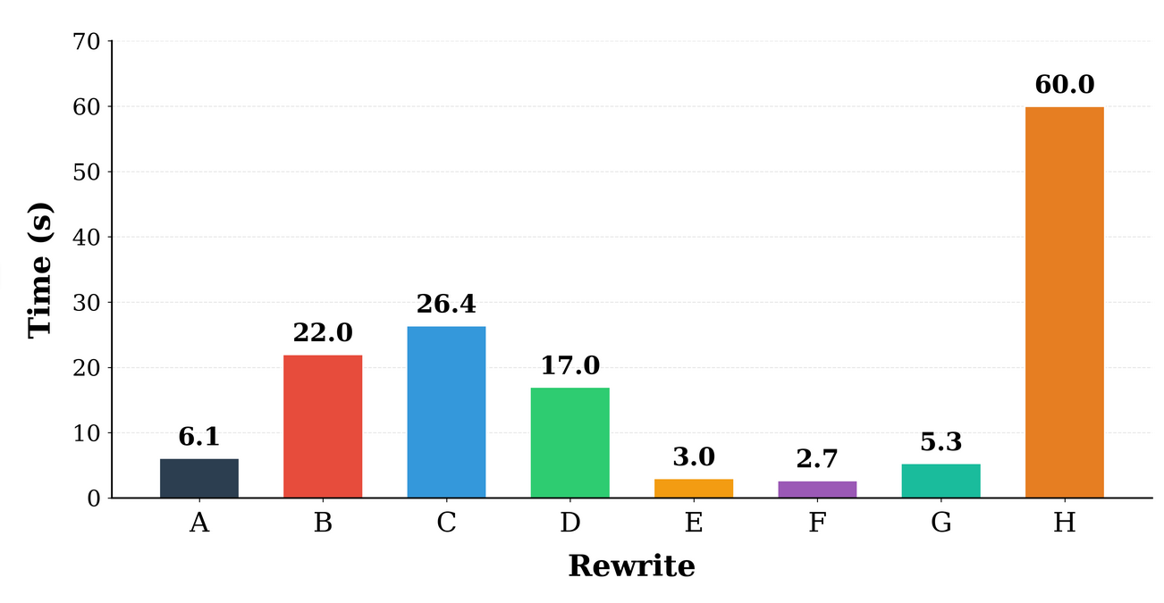
Rewrite Rule Equivalence Proof Time

Slide 67
Evaluation
For our baseline, we compare to Dynamatic,
an open-source dynamically-scheduled HLS compiler
We also compare to an prior work (FPGA ‘19)
which implements branch prediction in Dynamatic
Josipović, Guerrieri, and Ienne. Speculative Dataflow Circuits. FPGA 2019.
Dynamatic HLS Compiler. 2022. https://dynamatic.epfl.ch/

Slide 68
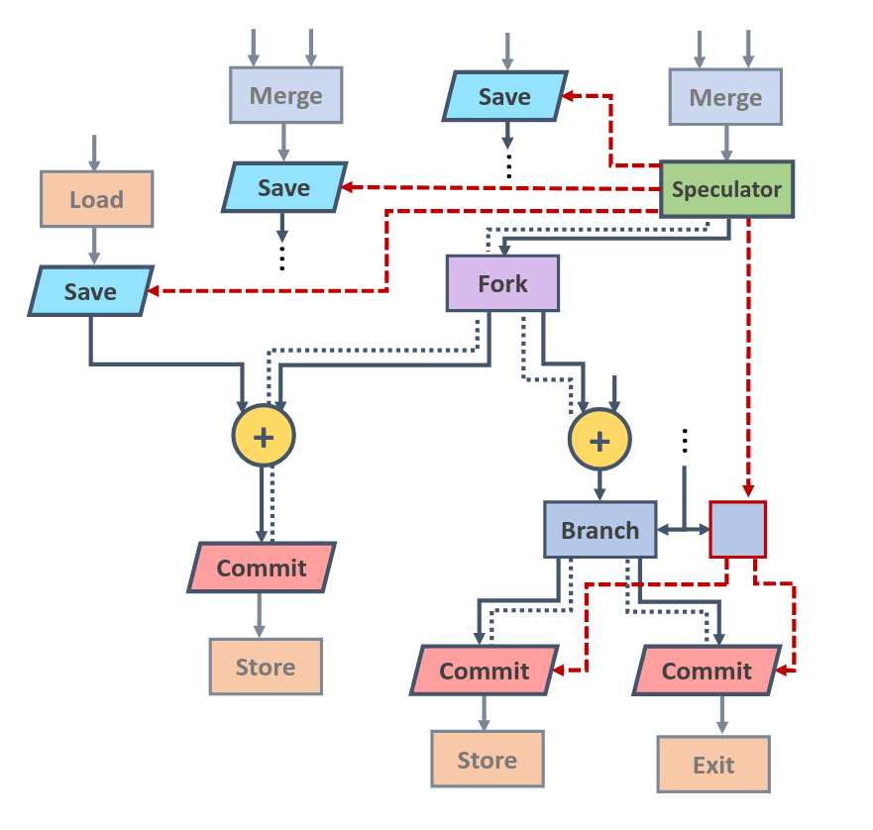
Prior Work: Branch Prediction
Weakness 1:
The approach is not correct-by-construction
Weakness 2:
Implementation is global and complex,
which causes frequency degradation
Weakness 3:
State rollback consumes resources and power
Josipović, Guerrieri, and Ienne. Speculative Dataflow Circuits. FPGA 2019.

Slide 69
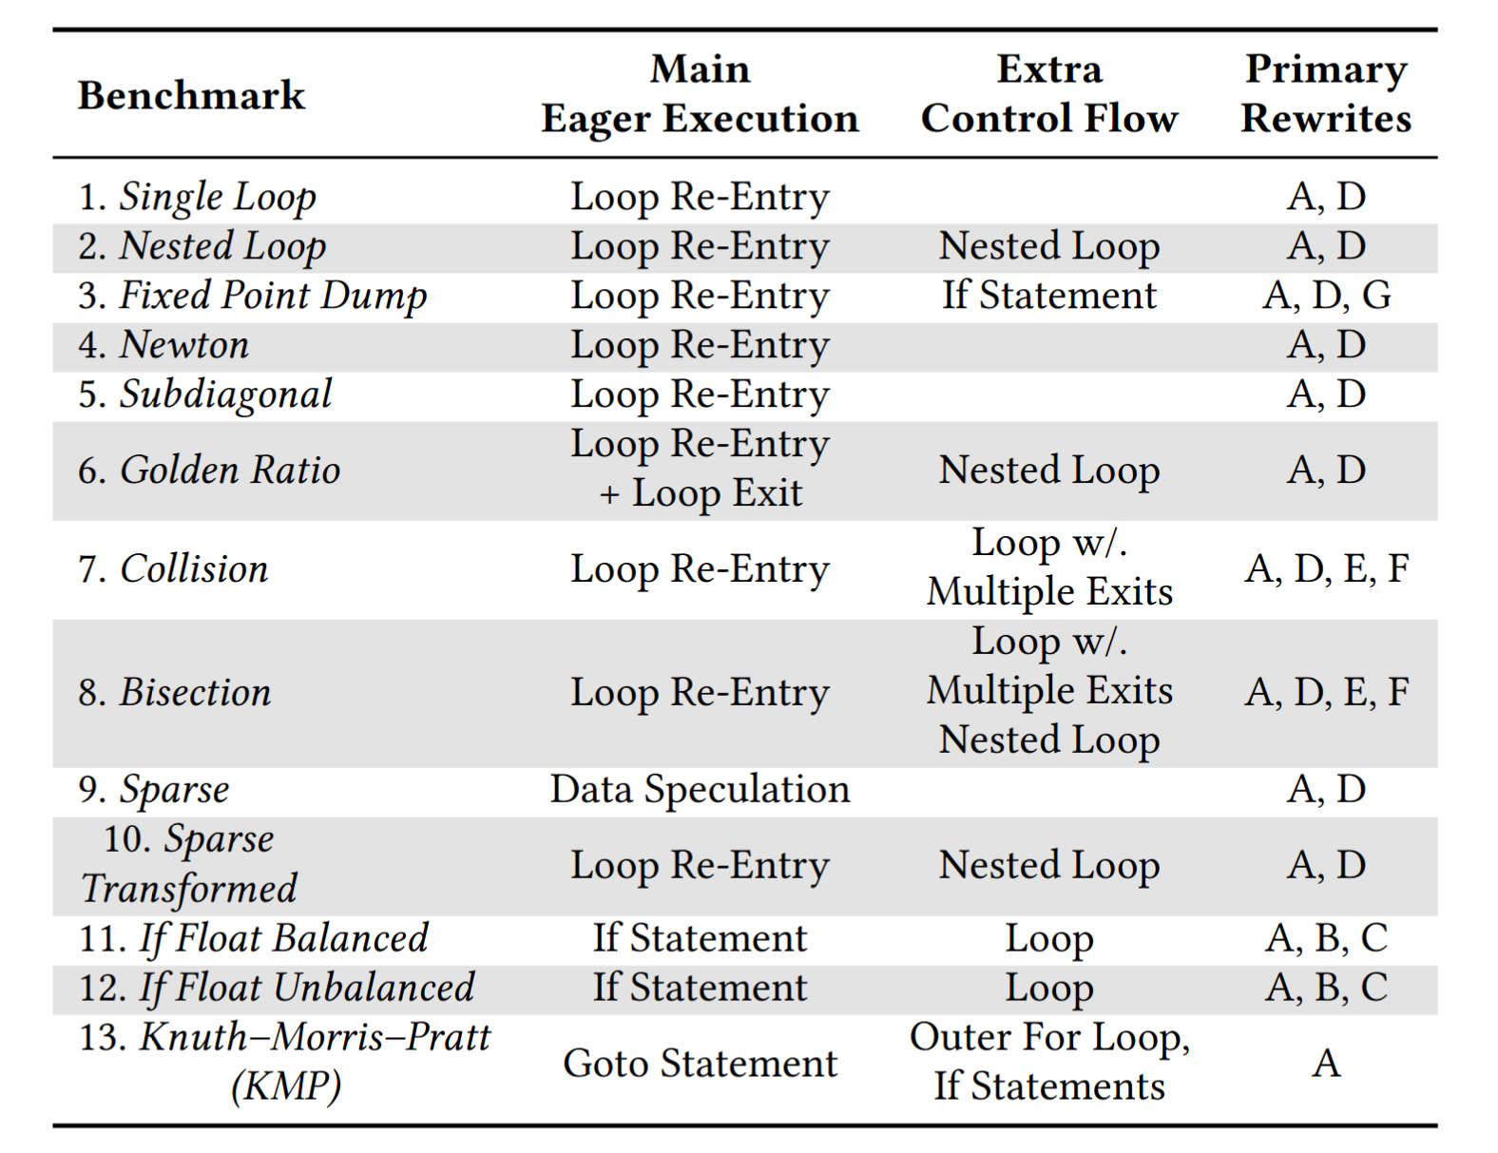
Evaluation
We evaluate on 13 benchmarks
pulled from HLS target workloads,
using post-implementation results for a Kintex-7 Xilinx FPGA
12 kernels
1 full unrolled application (KMP)
We additionally unroll 2 of the kernels
(single loop and bisection)
to demonstrate scalability

Slide 70
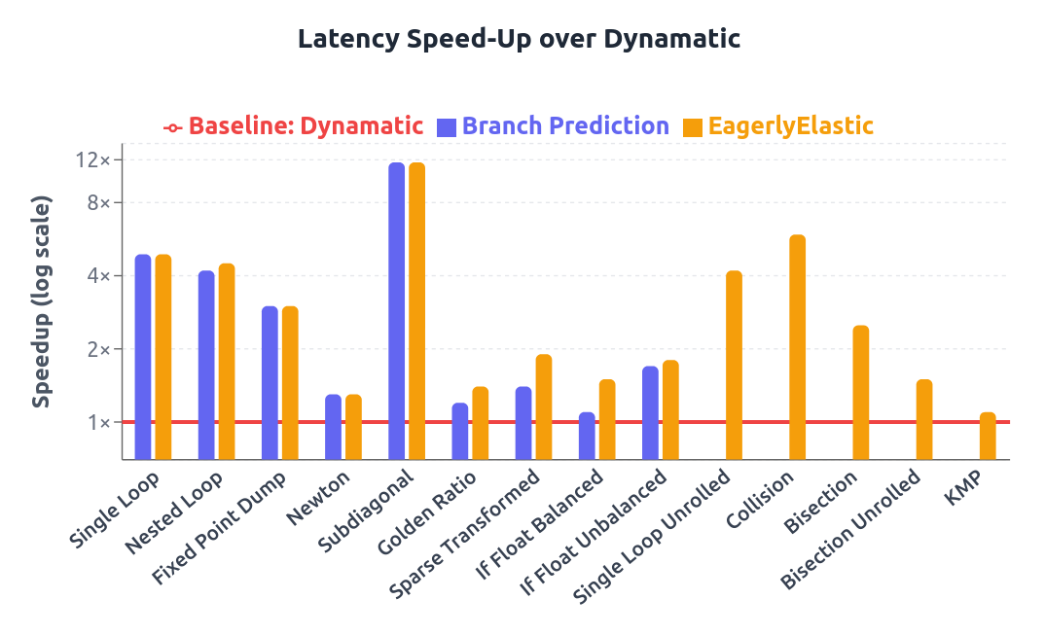
Evaluation: Latency in Clock Cycles
EagerlyElastic offers
strong speed-ups:
up to 10.4x
2. We outperform branch prediction on nested loops,
due to their pipeline emptying cost
3. We outperform branch prediction when prediction is hard,
as we avoid misprediction costs
4. Both are academically general but:
Our implementation is already usable across a wider variety of control flow

Slide 71
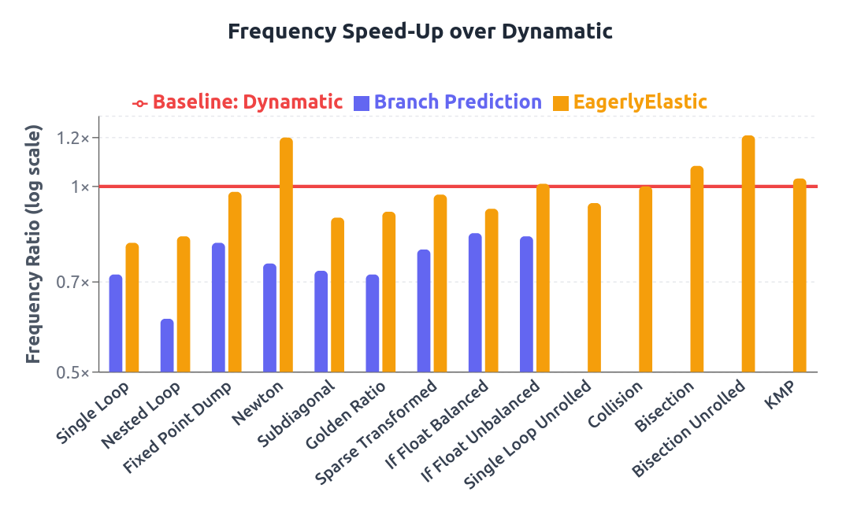
Evaluation: Frequency
Heuristic buffering introduces variation into achieved frequency
But the branch prediction approach causes clear frequency issues:
Reduces their achieved speed-up

Slide 72
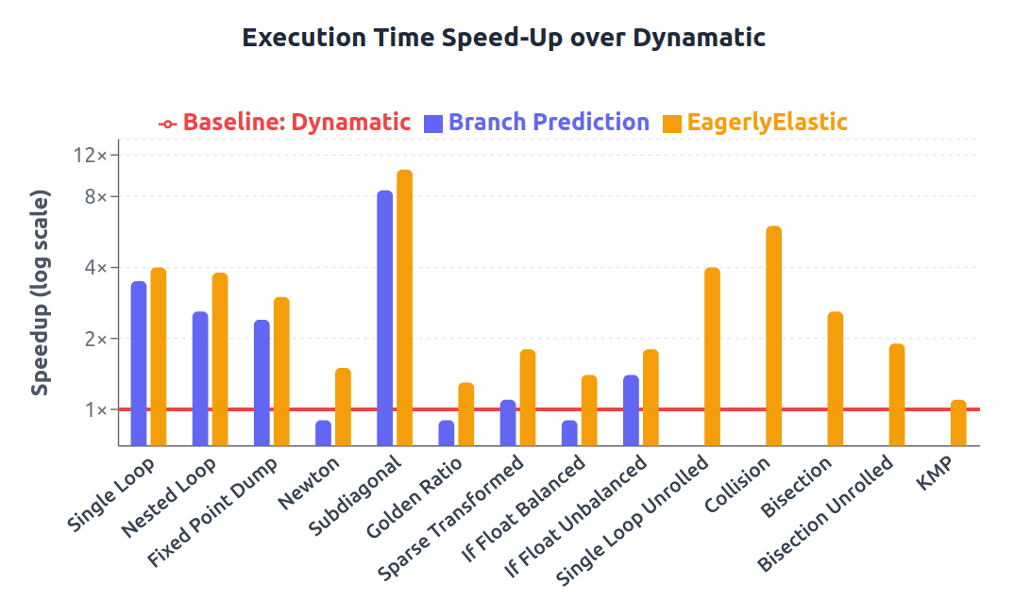
Evaluation: Execution Time in Seconds
EagerlyElastic therefore achieves the best performance
across all benchmarks

Slide 73
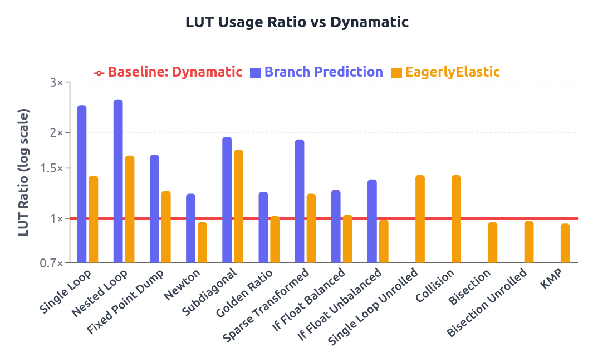
Evaluation: Look-Up Table Usage
Branch Prediction:
1.7x avg. increase in LUT cost
EagerlyElastic:
1.2x avg. increase in LUT cost

Slide 74
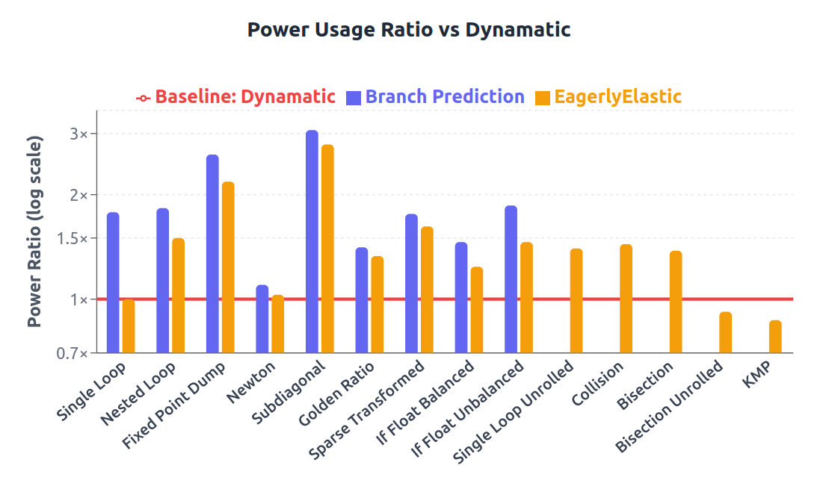
Evaluation: Power Usage
EagerlyElastic has
a reduced power cost
compared to branch prediction

Slide 75

Evaluation: Energy Usage
The performance improvements from EagerlyElastic
compensate for the power increase,
and so the energy cost is reduced

Slide 76
Evaluation
On our benchmarks,
EagerlyElastic achieved a max speed-up of 10.4x,
and an average speed-up of 3.2x
On our benchmarks,
EagerlyElastic has a average resource cost of 1.3x
Compared to branch prediction, EagerlyElastic provides
more speed-up at a lower resource cost,
while using less power
Compared to branch prediction,
EagerlyElastic offers safety through being correct-by-construction

Slide 77


EagerlyElastic:
Correct-by-Construction Eager Execution
in Dynamically-Scheduled HLS
We enable the performance benefits of eager execution
without any additional computational units
We enable eager execution using circuit rewrites: incremental, targeted, local transformations
The approach scales to large and complex designs
dynamo.ethz.ch
We are correct-by-construction,
as our circuit rewrites are formally verified:
Circuit correctness is guaranteed at every stage
Zenodo

Slide 78

Evaluation: Pareto Frontier

