Slide 1



TeLLMe: An Efficient End-to-End Ternary LLM Prefill and Decode Accelerator with Table-Lookup MatMul on Edge FPGAs
FPGA 2026
Ye Qiao*, Zhiheng Chen*, Yifan Zhang, Yian Wang, and Sitao Huang
(* Equal contributions)
EECS, University of California, Irvine, USA
Contact: sitaoh@uci.edu
https://github.com/UCI-CORSA/
TeLLMe_FPGA_2026
Acknowledgment: the authors would like to thank the support from NSF (Award No. 2443992) and AMD.
Compiler
Optimizations
Reconfigurable
Scalable
Architectures
Research Lab @UCI

Slide 2
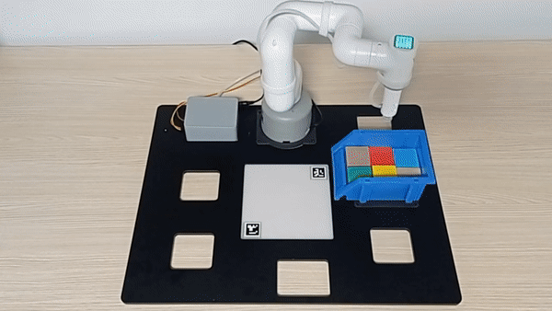
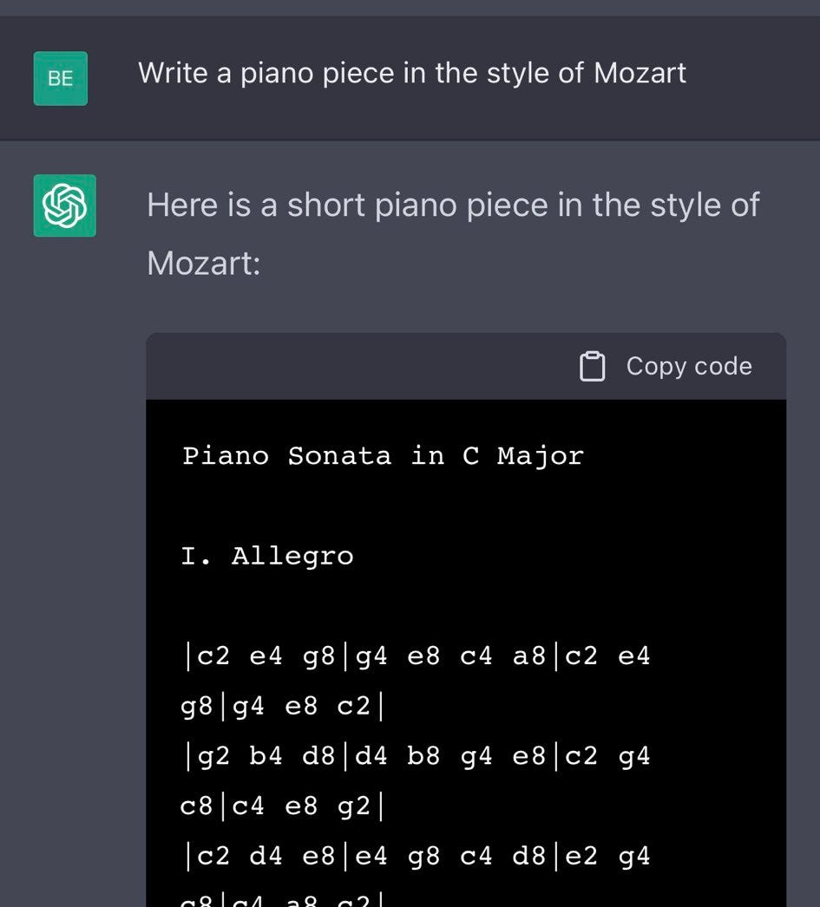
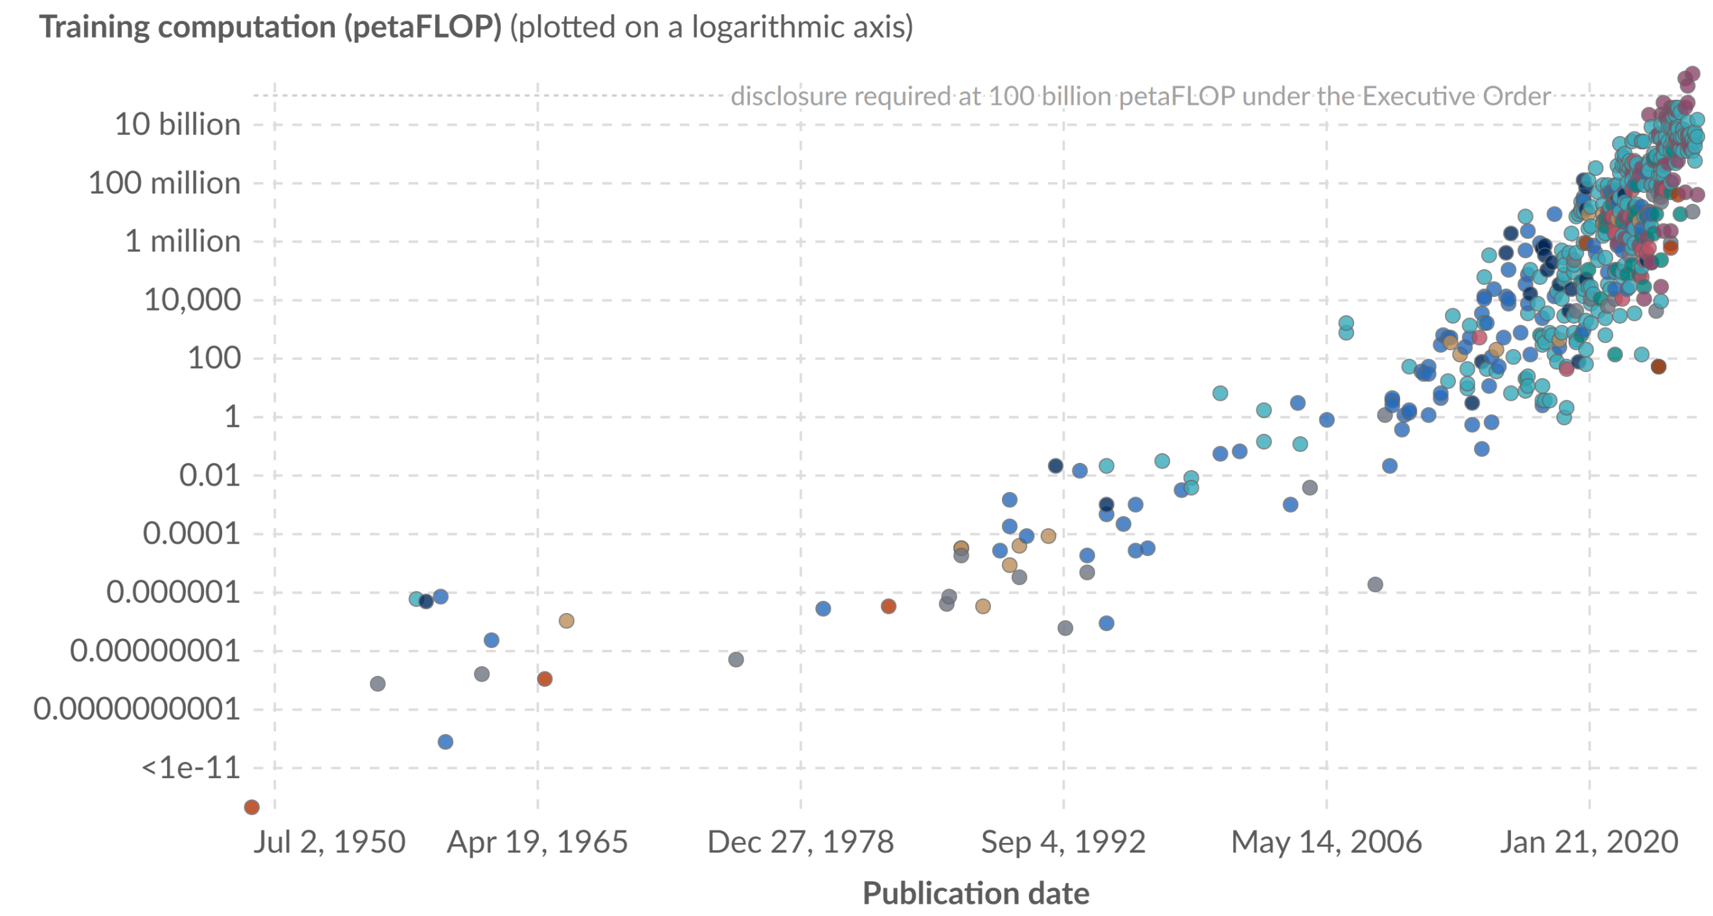





Challenges in Running LLMs at the Edge
Large language models (LLMs) have redefined what's possible with AI.
LLMs are very intensive in computation and memory demands.
Grok 4 (July 9, 2025)
500 billion petaFLOP
Source: OurWorldInData.org/artificial-intelligence
Edge devices are pervasive, featuring security, privacy, and latency advantages.
Can we bring real-time end-to-end LLM inference to edge devices?
AR/VR
Robots
Autonomous Vehicles
Yes!
TeLLMe is our answer!
Notes:
To understand why we built TeLLMe, we first need to look at the scale of modern transformers. On the left, you can see how rapidly LLMs have evolved in just a few short years. But this scaling comes at a massive cost. As the graph on the right shows, the demand for computation and memory has absolutely skyrocketed.
Now, think about edge devices—robots, AR glasses, or autonomous cars. We want LLMs running locally on these devices because it preserves user privacy, eliminates network latency, and enables true autonomy. But edge hardware has very strict limits on power, compute, and memory capacity.
This brings us to the core question of our research: Is it actually possible to run real-time, end-to-end LLM inference directly on the edge under a tight power budget? We believe the answer is yes, and TeLLMe is our solution.

Slide 3

Prefill and Decode Have Different Computational Patterns
Observation 1
Sequence of Tokens
KV-cache
Sequence of Tokens
…
…
…
Q
Process Tokens in Parallel
Compute
Heavy
Prefill
Decode
New
Sequential Token-by-Token Prediction
Memory Traffic Heavy
KV-cache
Prefill
Compute-bound
(GEMM-like)
Decode
Memory-bound
(GEMV-like)
Notes:
But prefill is completely different—it needs to process the entire prompt in parallel to actually build the KV-cache in the first place. If you force the prefill phase to process token-by-token, you are drastically underutilizing your hardware. It leads to terrible throughput and a frustratingly long wait before the model even starts talking. We realized that to fix this, we needed an architecture that respects the distinct computational needs of both stages.

Slide 4
Previous Accelerators Did NOT Exploit the Difference
Observation 1
Sequence of Tokens
KV-cache
Sequence of Tokens
…
…
…
Prefill
Q
Process Tokens in Parallel
New
Decode
KV-cache
Sequential Token-by-Token Prediction
Prefill
Compute-bound
(GEMM-like)
Decode
Memory-bound
(GEMV-like)
GEMV-like
Processing Element
“One-for-Both” PE is suboptimal!
Notes:
But prefill is completely different—it needs to process the entire prompt in parallel to actually build the KV-cache in the first place. If you force the prefill phase to process token-by-token, you are drastically underutilizing your hardware. It leads to terrible throughput and a frustratingly long wait before the model even starts talking. We realized that to fix this, we needed an architecture that respects the distinct computational needs of both stages.
Forcing the Prefill phase to follow a Decoding-like execution pattern results in low throughput.

Slide 5
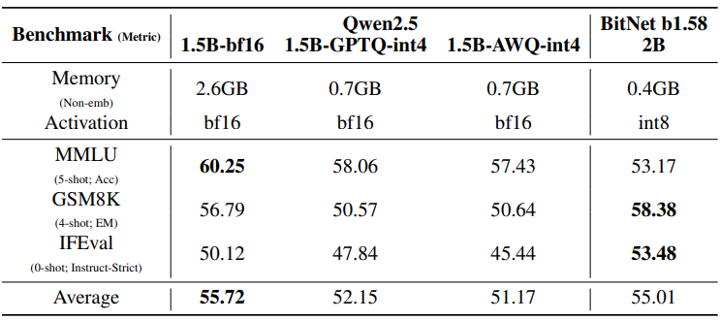
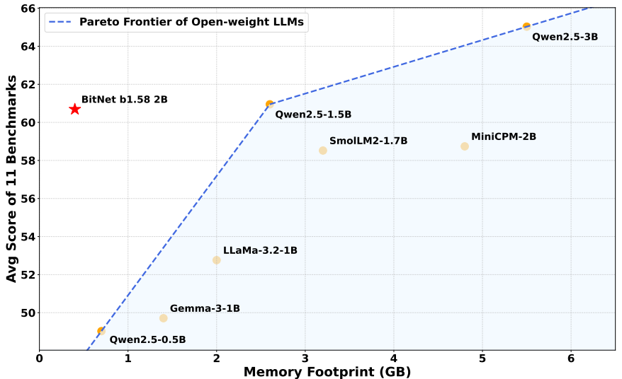
Ternary LLMs Mitigate Memory and Compute Pressure
Observation 2
Good Accuracy: 1.58-bit weights deliver near-FP16 accuracy performance
Small Memory Footprint: more than 10× smaller memory footprint
Efficient Compute: More multiplications with same amount of resource
*Ma, Shuming, et al. "BitNet b1. 58 2B4T Technical Report."
Notes:
So, how do we fit these massive LLMs onto a tiny, bandwidth-limited edge FPGA? The secret lies in our algorithmic foundation: Ternary LLMs.By aggressively quantizing the weights to just 1.58 bits—using only -1, 0, or +1—BitNet achieves something incredible. First, we get near-FP16 quality. Second, shrinking the weight storage by more than 10x directly solves the DRAM bandwidth nightmare. And third, it allows us to use an FPGA-friendly Matrix Multiplication engine. Because the weights are ternary, we don't need heavy DSP multipliers; we simply precompute our activations and run the whole network using table lookups and accumulations."

Slide 6
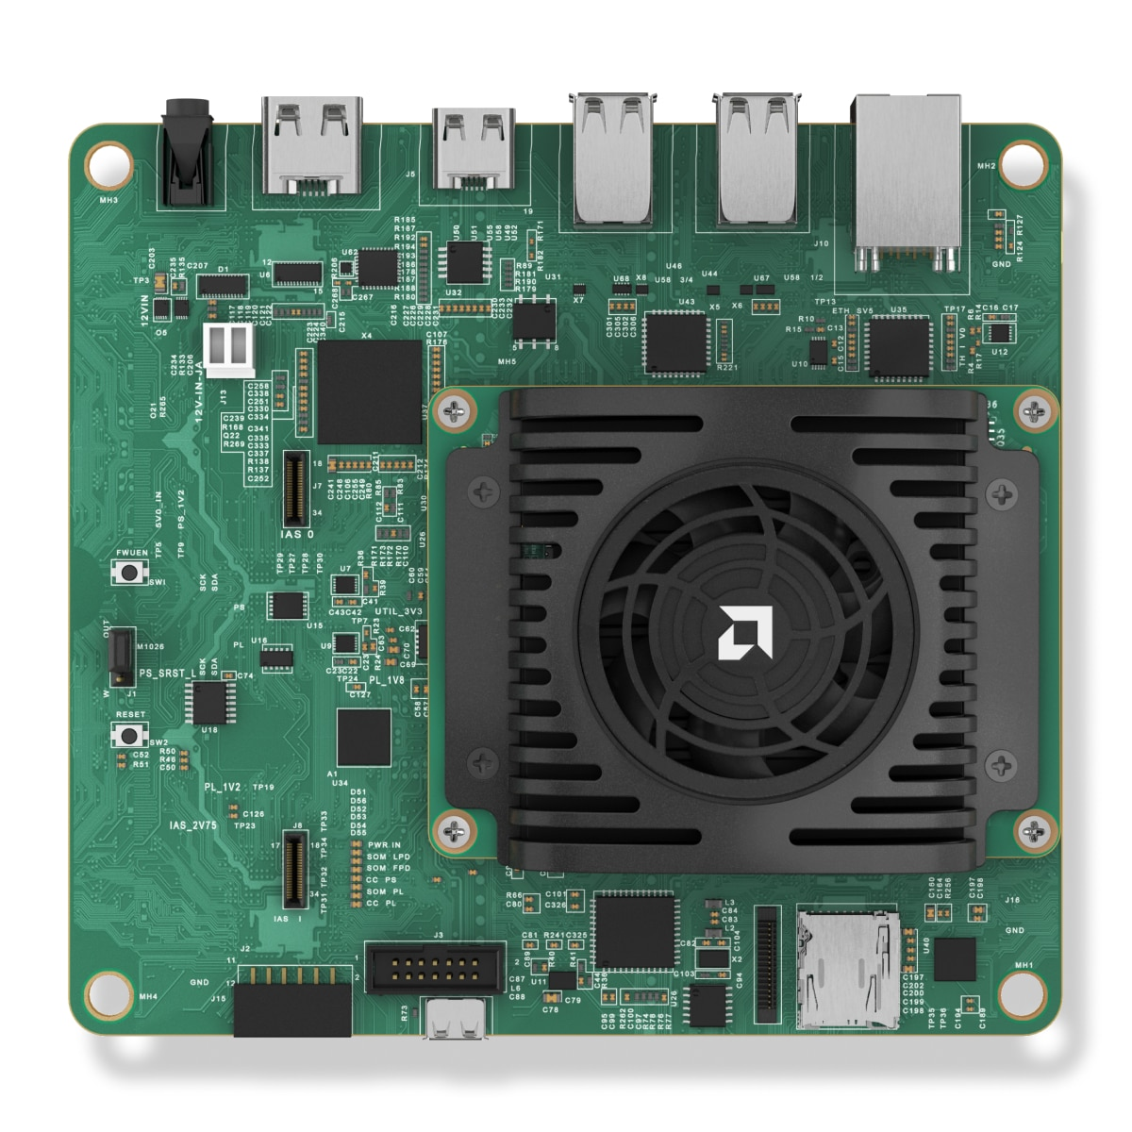
TeLLMe: Ternary LLM Accelerator on Edge FPGAs
URAM-aware Weight Management
Fine-grain buffering +
Analytic Management
Sequence of Tokens
KV-cache
…
Sequence of Tokens
…
…
Q
Prefill
TLMM-FUSE
Table-lookup ternary matmul
for QKV + FFN fused with FP DeQ ↔ INT ops ↔ Quant
+ Elemwise (residual/RoPE/...)
Decode
New
Prefill Attention
Reversed + fully fused
minimizes DDR traffic
Decode Attention
On-chip SoftMax cache
avoids DDR reloads
Platform: AMD Kria KV 260
< 6 W
Max Soc Power
143 tokens/s
Prefill throughput
25 tokens/s
Decode throughput
Notes:
So, how do we turn these ternary benefits of Lower Computational Complexity and Less Memory Traffic Requirement into actual hardware performance? This slide outlines our four main contributions.
The heart of our design is the TLMM-FUSE unit, which replaces standard multipliers with table lookups and fuses them directly with necessary floating-point operations. We feed this engine using a smart URAM Weight Management system. For the attention layers, we decoupled the architecture: our Prefill Attention Unit uses a reversed and fused design to cut down off-chip traffic, while our Decode Attention Unit caches SoftMax scores on-chip to prevent slow memory reloads.
The bottom line is the performance: running on a standard KV260 board, we hit up to 143 prefill tokens and 25 decoding tokens per second, consuming less than 6 watts of power.

Slide 7
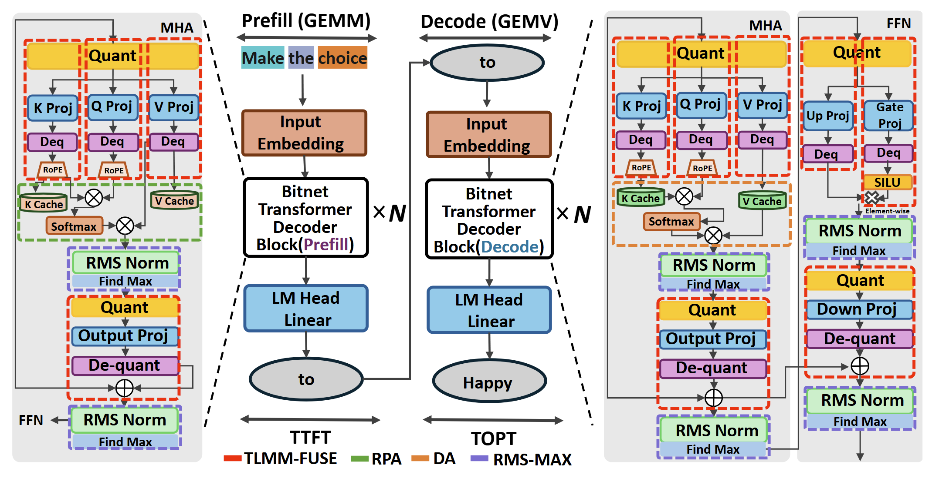
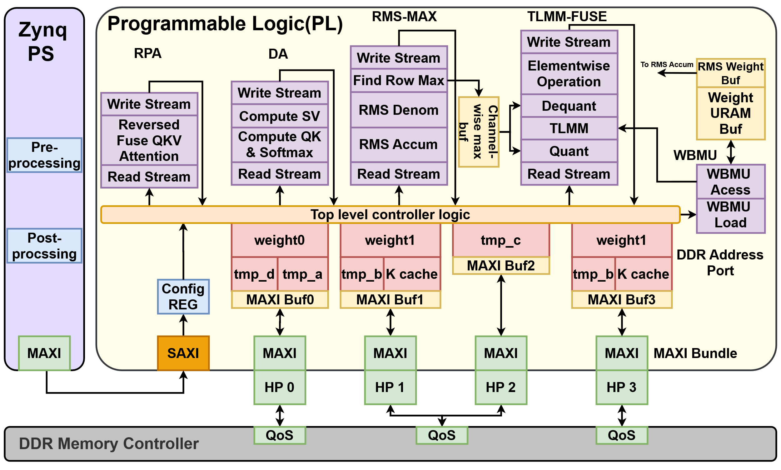
Contribution 1
TLMM-FUSE Unit: Table-lookup MatMul + Fused Dataflow
Supports 6 different patterns of computation
TLMM-FUSE
Table-lookup ternary matmul
for QKV + FFN fused with FP DeQ ↔ INT ops ↔ Quant
+ Elemwise (residual/RoPE/...)
URAM-aware Weight Management
Fine-grain buffering +
Analytic Management
Prefill Attention
Reversed + fully fused
minimizes DDR traffic
Decode Attention
On-chip SoftMax score buffer
avoids DDR reloads
TLMM-FUSE Unit in TeLLMe Accelerator
Notes:
Moving on to our TLMM-FUSE unit. You might be wondering: why not just use a standard approach for ternary matmul? Well, a straightforward implementation actually introduces significant hardware bottlenecks.
Think about it: our weights only have three states: -1, 0, and 1. In large matrices, these exact same patterns repeat over and over again. A standard 'select and accumulate' architecture isn't smart enough to recognize this; it treats every operation as brand new, wasting precious LUT resources by re-computing identical partial sums.
+2
On top of that, if we try to map this to DSP slices, we are drastically underutilizing our hardware. We are essentially taking complex DSPs built for high-precision math and using them for basic addition and negation—which is a huge architectural waste. That's exactly why we shifted to the Table-Lookup method illustrated on the left side of this slide.“
Straight forward implematation of ternary matmul has according challenge and
Limited States, Repetitive Patterns: With only 3 states (-1, 0, +1), weight patterns repeat frequently across large matrices.
Re-computation: Standard "Select & Accumulate" logic treats every operation as unique, repeatedly burning LUT resources to calculate identical partial sums for these repeating patterns.
DSP Underutilization: Using high-precision DSP slices for simple negation/addition is architecturally inefficient.

Slide 8
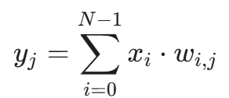
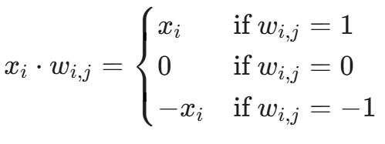
Limitations of Naive Ternary MatMul Implementation
Contribution 1
Redundant computation in standard “Select & Accumulate”
  Limited States {-1, 0, 1}, repetitive patterns
DSP Underutilization
  Typical DSP: P (48bit) = A (27bit)* B (18bit) + C (48*bit)
  Bit-packing is not efficient: imbalanced operand bitwidths: 1.58bit & 8bit
Notes:
Moving on to our TLMM-FUSE unit. You might be wondering: why not just use a standard approach for ternary matmul? Well, a straightforward implementation actually introduces significant hardware bottlenecks.
Think about it: our weights only have three states: -1, 0, and 1. In large matrices, these exact same patterns repeat over and over again. A standard 'select and accumulate' architecture isn't smart enough to recognize this; it treats every operation as brand new, wasting precious LUT resources by re-computing identical partial sums.
+2
On top of that, if we try to map this to DSP slices, we are drastically underutilizing our hardware. We are essentially taking complex DSPs built for high-precision math and using them for basic addition and negation—which is a huge architectural waste. That's exactly why we shifted to the Table-Lookup method illustrated on the left side of this slide.“
Straight forward implematation of ternary matmul has according challenge and
Limited States, Repetitive Patterns: With only 3 states (-1, 0, +1), weight patterns repeat frequently across large matrices.
Re-computation: Standard "Select & Accumulate" logic treats every operation as unique, repeatedly burning LUT resources to calculate identical partial sums for these repeating patterns.
DSP Underutilization: Using high-precision DSP slices for simple negation/addition is architecturally inefficient.

Slide 9
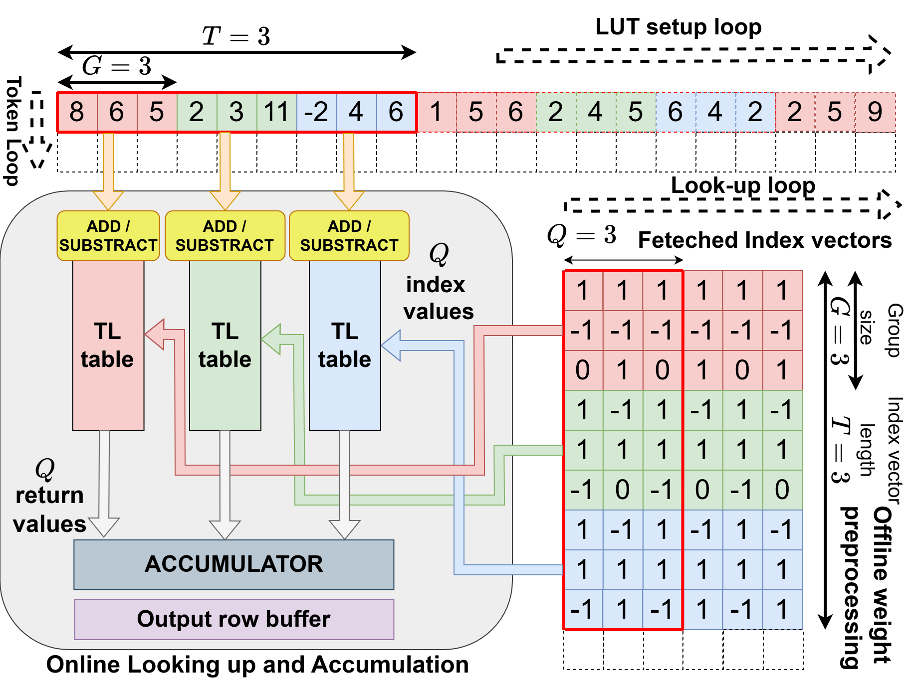
Contribution 1
TLMM: Table-lookup MatMul
Our Solution: Custom hardware architecture of
Table Lookup based MatMul Unit (TLMM)
Parameter for TLMM
  G (Group Size = 3):
    Number of input activations grouped together.
  T (Number of TL table= 3):
    Number of parallel tables maintained in hardware.
  Q (Lookup Parallelism = 3):
    Enables simultaneous looking up and accumulation.
TL = Table Lookup
LUT = LUT unit on FPGA
Notes:
The whole idea can be concluded to this: compute the math once, and then just reuse that answer multiple times.Just to clear up any acronym confusion early on: when we say 'TL', we mean the Table-Lookup structures we are generating. When we say 'LUT', we are talking about the actual physical Look-Up Table resources on the FPGA.To make this work, we defined three main parameters. $G$ is our Group Size, meaning how many input activations we group together. $T$ is the number of parallel TL tables we keep running in the hardware. And $Q$ represents our Lookup Parallelism, which allows us to do multiple look-ups and accumulations at the exact same time

Slide 10
TLMM: Computation Steps
Contribution 1
(1) Set up TL table
8 6 5
TL Table (1WQR)
Input Activation Entries
0
Adder & Subtractor Tree
8 6 5
14 2 13
3 11 1
19 9 7 3
8 6 5
14 2 11 1 13 3
19 9 7 3
Original Val
-8 -6 -5
-14 -2 -13
-3 -11 -1
-19 -9 -7 -3
Negation Unit
Negated Val
Adder & Subtractor Tree
2 3 11
TL Table
Adder & Subtractor Tree
-2 4 6
TL Table
Notes:
First, we dynamically set up our TL tables by precomputing the partial sums for our activations.

Slide 11
TLMM: Computation Steps
Contribution 1
(2) Parallel Lookup and Accumulation
1
-1
0
1
-1
1
1
-1
0
TL Table
(1WQR)
+
Offline Preprocessing
5 12 5
Index Vector
1
1
-1
-1
-1
0
1
1
-1
TL Table
(1WQR)
+
Offline Preprocessing
Accumulator
9 15 9
Index Vector
1
1
-1
-1
1
1
1
1
-1
TL Table
(1WQR)
+
Offline Preprocessing
9 13 9
Index Vector
Notes:
Notice that our ternary weights have already been encoded into compact indices offline. So, instead of calculating, we simply use those indices to look up the values in parallel and accumulate them.

Slide 12
TLMM: Computation Steps
Contribution 1
(3) Fetch Next Weight Index Vector
Notes:
We sweep through the rest of the weight index vectors for that row.

Slide 13
TLMM: Computation Steps
Contribution 1
(3) Fetch Next Weight Index Vector

Slide 14
TLMM: Computation Steps
Contribution 1
(4) Set up new TL table with next group of activation
Notes:
After that, we grab the next pair of activation and index vectors to keep building our result.

Slide 15
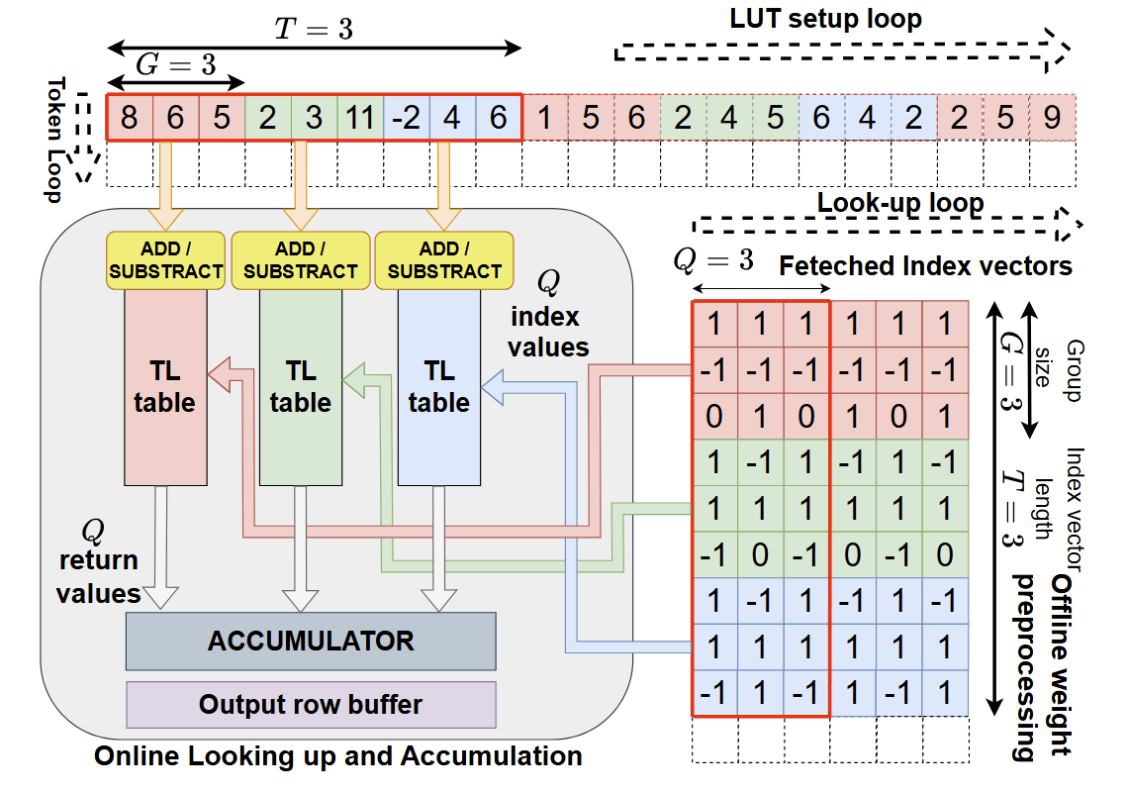
TLMM: Computation Steps
Contribution 1
(5) Output Current Token’s Projection to to Stream Channel
Notes:
Once the entire row finishes execution, that output is pushed straight into the stream FIFO channel for the next kernel.

Slide 16
TLMM: Computation Steps
Contribution 1
(6) Start Next Token Iteration
Notes:
Then, we just fetch the next token's vector, seamlessly supporting full GEMM execution if it is prefill.

Slide 17
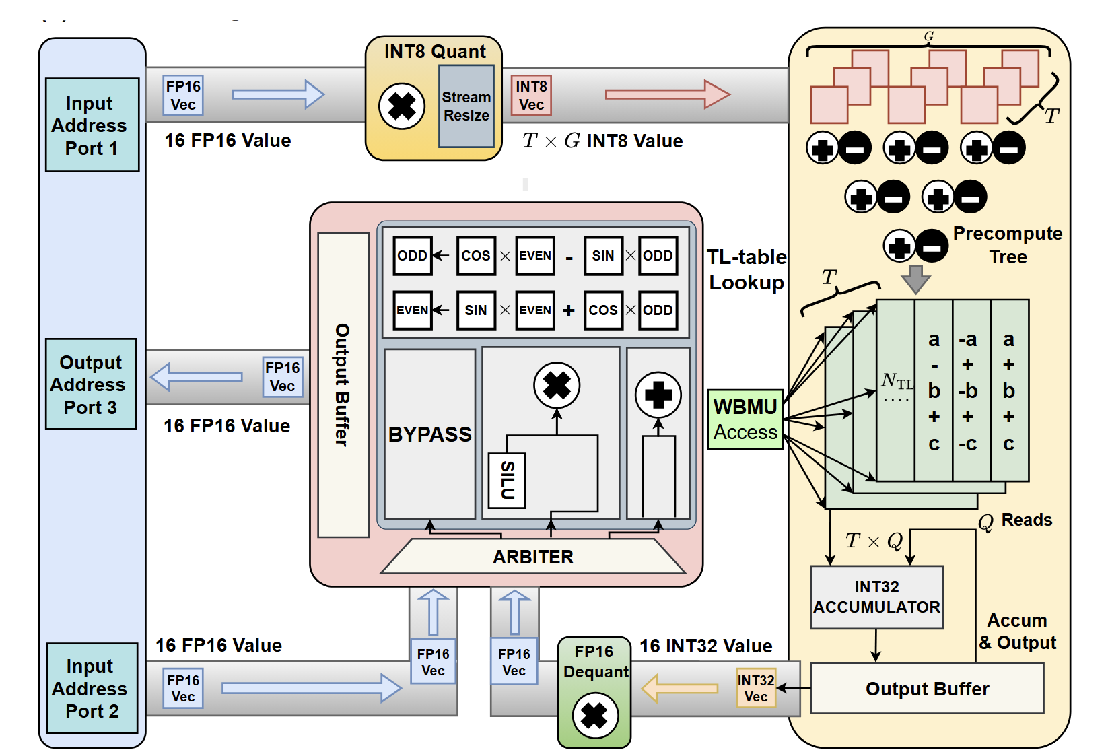
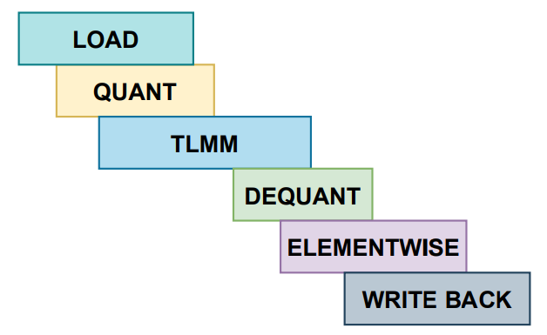
Dataflow Fusion in TLMM-FUSE Unit
Contribution 1
  Challenge:
  Ternary LLM is NOT only about integer operations!
    Quant, Dequant, SILU, Residual Add, RoPE operates under FP16,
    And they are everywhere,
    They can be performance bottlenecks
Our Solution:
Dataflow fusion with function-level pipelining
  Latency hiding and overlapping
Notes:
So, what about the rest of the model? Our TLMM engine is great for integers, but integer operations alone aren't enough to run a full LLM. We still have to deal with FP16 element-wise operations like Quantization, Dequantization, SILU, Residual Adds, and RoPE. If we processed our integer math, saved those results to main memory, and then fetched them back just to do the FP16 math, the memory latency would completely destroy our performance. Instead, we built a function-level pipeline. As you can see in the timing diagram at the bottom, we use streaming fusion to chain these steps together. This lets us overlap the execution phases, hiding the latency of those FP16 operations behind our main compute.

Slide 18
URAM-aware Weight Buffer Management Unit (WBMU)
Contribution 2
Weight Loading and Access in LLMs
TLMM-FUSE
Table-lookup ternary matmul
for QKV + FFN fused with FP DeQ ↔ INT ops ↔ Quant
+ Elemwise (residual/RoPE/...)
URAM-aware Weight Management
Fine-grain buffering +
Analytic Management
Prefill Attention
Reversed + fully fused
minimizes DDR traffic
Decode Attention
On-chip SoftMax score buffer
avoids DDR reloads
WBMU in TeLLMe Accelerator
Notes:
Now that we have a highly efficient compute engine, we run into the classic hardware problem: how do we feed it fast enough? During the autoregressive decoding phase, LLMs are notoriously memory-bound. If our memory access is slow, our fast compute engine just sits there waiting. To solve this, we carefully mapped our data to the FPGA's specific memory resources, as shown on the right. We use BRAMs for intermediate activations and LUTRAMs for those small TL tables we talked about earlier. But for the massive weight matrices, we leverage UltraRAMs. URAMs are deep and wide, giving us 288 kilobits per block, which is perfect for storing our packed ternary weights on-chip.

Slide 19
URAM-aware Weight Buffer Management Unit (WBMU)
Contribution 2
Challenge: BRAM capacity cannot hold one linear layer weight
Our Solution: Utilize URAM; with smart weight buffer management strategy
Our buffer mapping scheme:
Activation, Intermediate Buffer: BRAM
Weight Buffer: URAM
TL table: lutram
36 Kb
4096
BRAM
BRAM
lutram
lutram
lutram
lutram
lutram
lutram
URAM
lutram
lutram
lutram
lutram
lutram
lutram
BRAM
BRAM
64 b
72 bit
BRAM
BRAM
BRAM
BRAM
288 Kb
Notes:
Now that we have a highly efficient compute engine, we run into the classic hardware problem: how do we feed it fast enough? During the autoregressive decoding phase, LLMs are notoriously memory-bound. If our memory access is slow, our fast compute engine just sits there waiting. To solve this, we carefully mapped our data to the FPGA's specific memory resources, as shown on the right. We use BRAMs for intermediate activations and LUTRAMs for those small TL tables we talked about earlier. But for the massive weight matrices, we leverage UltraRAMs. URAMs are deep and wide, giving us 288 kilobits per block, which is perfect for storing our packed ternary weights on-chip.

Slide 20
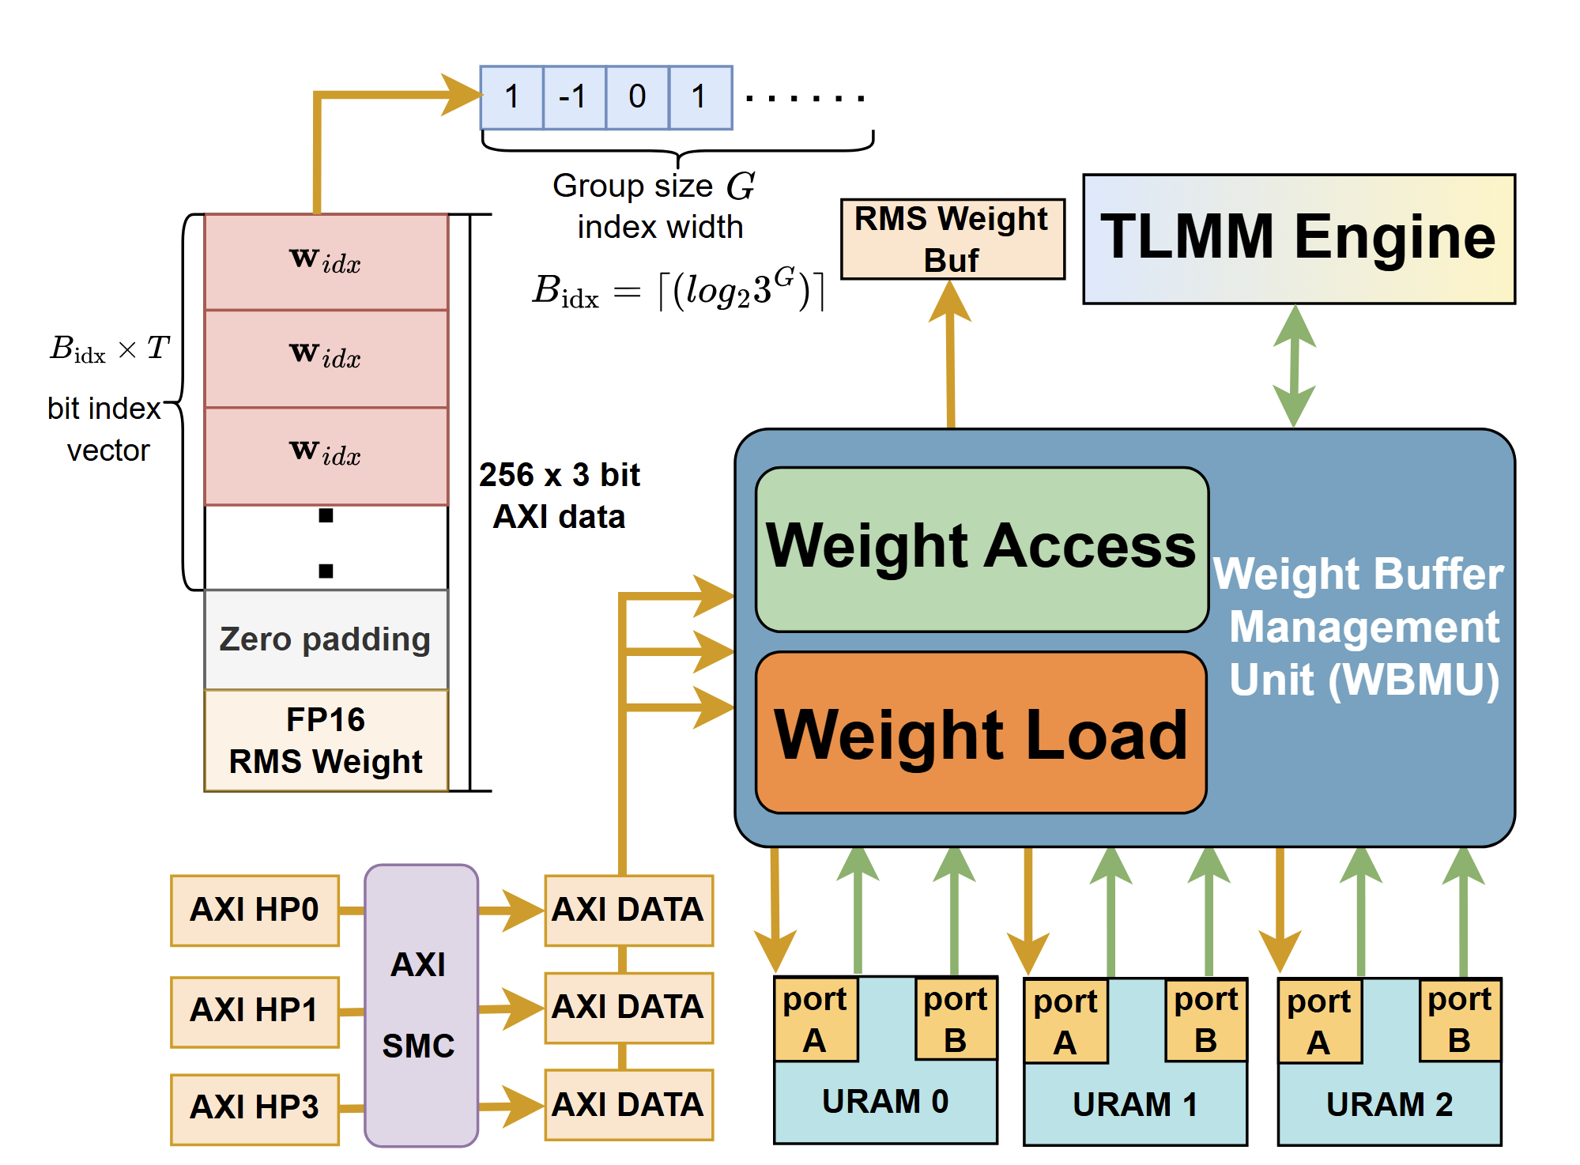
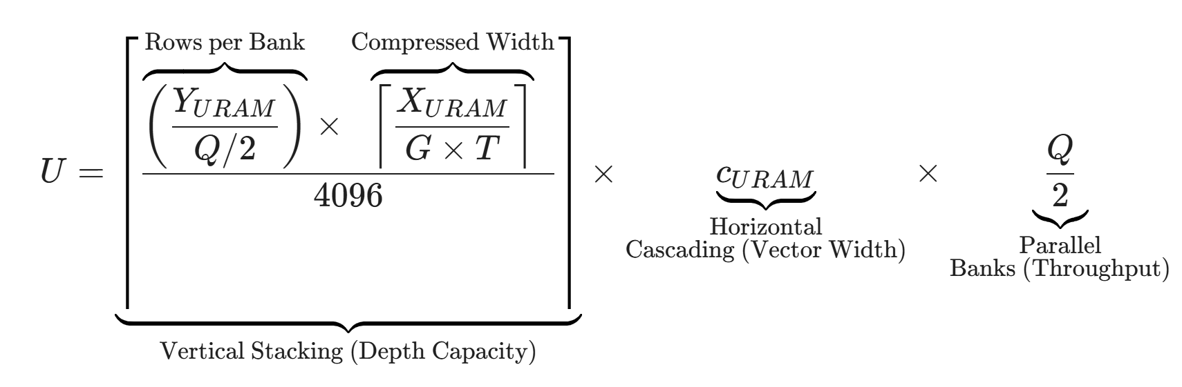
URAM-aware Weight Buffer Management Unit (WBMU)
Contribution 2
BANK 0
BANK 1
BANK 2
Q = 6
URAM
URAM
URAM
URAM
URAM
URAM
URAM
URAM
URAM
URAM
URAM
URAM
(1) Analytical Parameter Selection for URAM
  Calculate the URAM requirement with best utilization based on matrices size and parallelism
Notes:
So, we know URAM is critical for on-chip weight storage, but how do we manage it without wasting space? The Weight Buffer Management Unit handles with Analytical Parameter Selection.
Instead of using trial and error, we use the specific formula you see on the right to calculate exactly how many URAM blocks we need, which we call $U$. It looks complex, but it's just sizing the memory in three dimensions. The $Q/2$ term tells us how many parallel banks we need to ensure fast, simultaneous memory access. The $C_{URAM}$ term handles the width—cascading blocks horizontally to fit our data vectors with maximized utilization. And the large fraction handles the depth—stacking blocks vertically based on the target matrice size because a single URAM only holds 4096 entries.

Slide 21
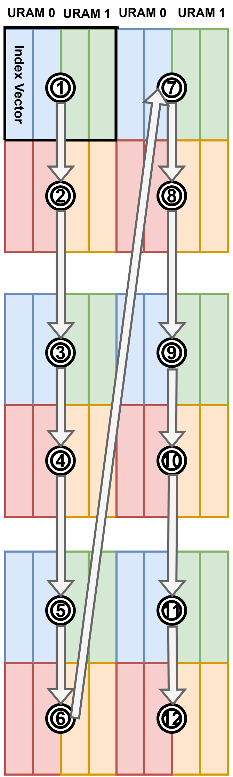
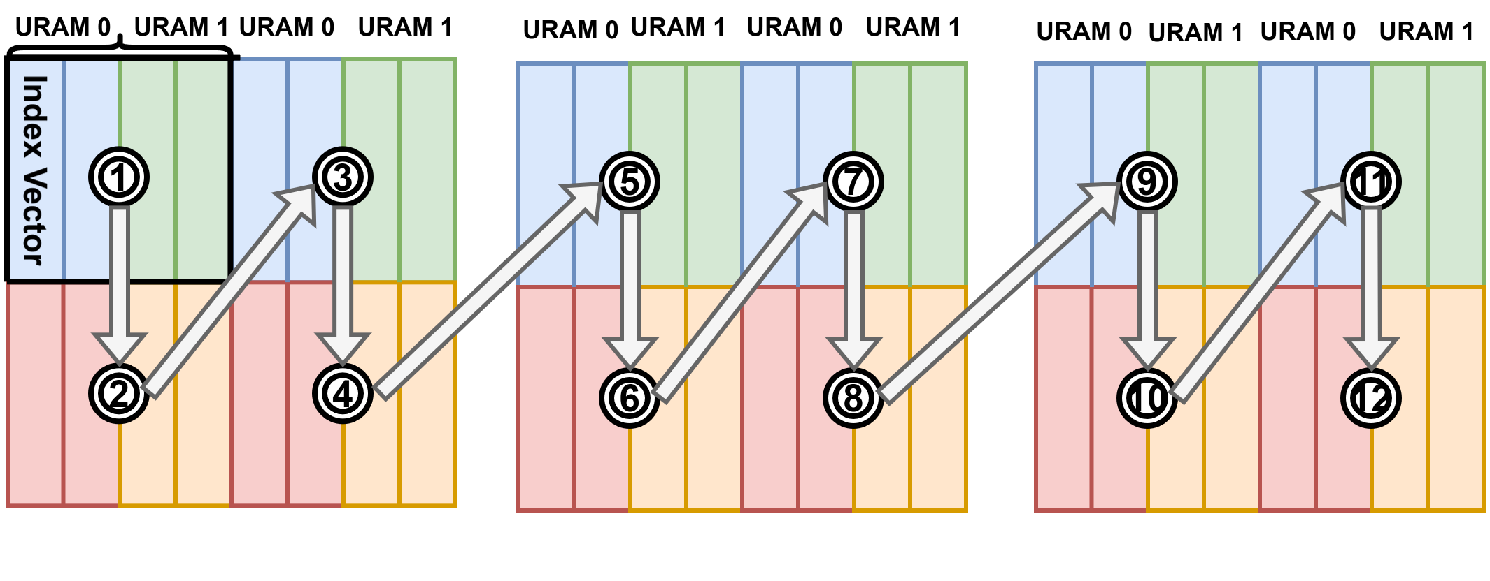
URAM-aware Weight Buffer Management Unit (WBMU)
Contribution 2
(2) Address Mapping for Weight Access
  Fit different weight matrices (Up, Down, qkvo projection)
q,k,v,o projection
Down projection
Up projection
(1) Analytical Parameter Selection for URAM
  Calculate the URAM requirement with best utilization based on matrices size and parallelism
Notes:
Second, we have to deal with the reality of transformer architectures: different layers require different access patterns. For example, the Up and Down projections are actually transposes of each other and has larger size than the qkvo projection. Our address mapping logic, shown on the top right, translates these different traversal pattern for the unified Uram space, so our TLMM engine can seamlessly process Q, K, V, O, and FFN projections.

Slide 22
URAM-aware Weight Buffer Management Unit (WBMU)
Contribution 2
(3) Data Packing and Weight Loading
  Maximize DDR bandwidth utilization
(2) Address Mapping for Weight Access
  Fit different weight matrices (Up, Down, qkvo projection)
q,k,v,o projection
Down projection
Up projection
(1) Analytical Parameter Selection for URAM
  Calculate the URAM requirement with best utilization based on matrices size and parallelism
Notes:
Finally, on the left, we tie it all together with our data packing strategy. To make sure we aren‘t wasting a single cycle of off-chip memory access, we bundle multiple parallel ports to grab 768 bits at a time. By packing multiple weight indices and an FP16 weight into one burst, we maximize our DDR bandwidth and keep our compute pipeline moving fast. But it’s still bottleneck so ddr row buffer hit like Humming bird work is more important

Slide 23
Contribution 3
Separate Customization for Prefill and Decode Attention
Prefill and Decode Attention in LLMs
TLMM-FUSE
Table-lookup ternary matmul
for QKV + FFN fused with FP DeQ ↔ INT ops ↔ Quant
+ Elemwise (residual/RoPE/...)
URAM-aware Weight Management
Fine-grain buffering +
Analytic Management
Prefill Attention
Reversed + fully fused
minimizes DDR traffic
Decode Attention
On-chip SoftMax score buffer
avoids DDR reloads
Separate Prefill and Decode Attention Modules in TeLLMe
Notes:
So far, we have discussed how our TLMM engine and URAM optimizations effectively address the computational and memory bottlenecks of massive linear layers.
But as we all know, especially with longer contexts, the Attention mechanism and KV Cache become the next critical bottleneck in LLM inference. Now let’s see how TeLLMe overcomes this challenge with its dedicated Attention modules

Slide 24
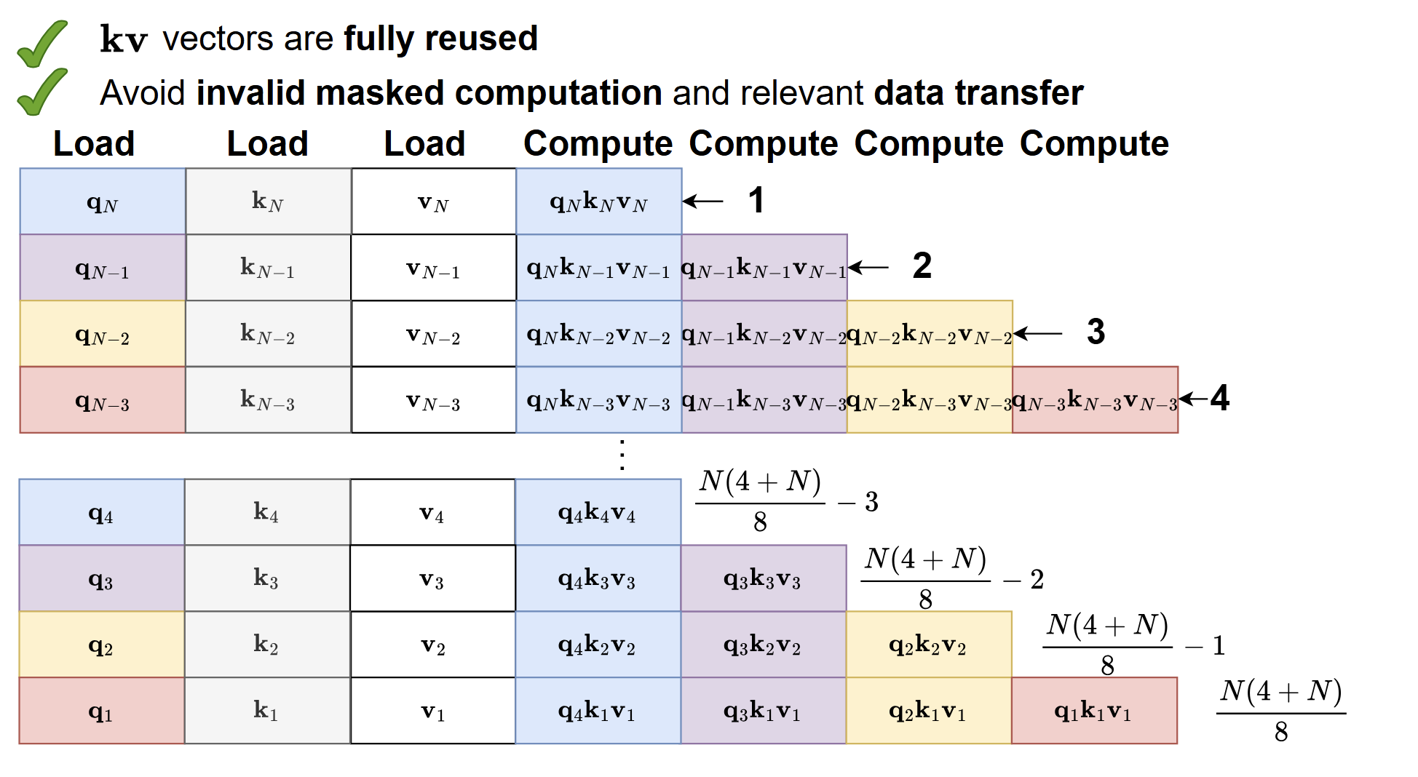
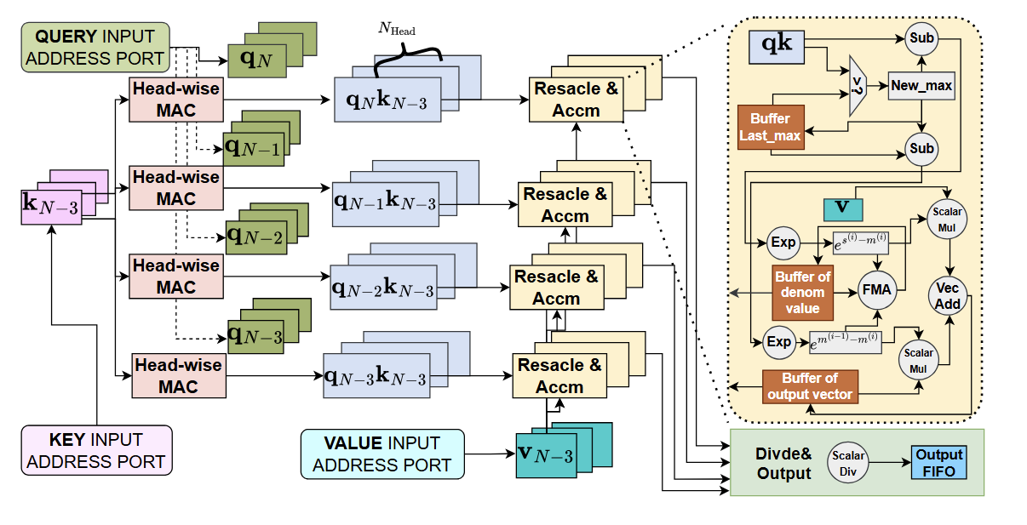
Challenges in designing the Attention Mechanism
Contribution 3
Challenges 1: Prefill and decode attention have different computational patterns.
Our Solution: Dedicated hardware unit and dataflow for prefill and decode, separately
Challenges 2: Constrained memory bandwidth, computation capacity, and on-chip buffer on edge FPGAs.
Our Solution:
Optimized compute scheduling
Operator fusion
Notes:
When implementing this on edge FPGAs, we primarily faced two major challenges.
First, prefill and decode attention have fundamentally different workload characteristics. You can't just use a one-size-fits-all approach. Our solution was to decouple them, implementing dedicated hardware units and dataflows for each stage to ensure optimal efficiency. GEMV vs GEMM, No KV cache assited KV cache assistend
Second, we are working with edge FPGAs, which means severely constrained memory bandwidth, compute capacity, and on-chip buffers. To squeeze out maximum performance despite these severe limitations, we use optimized scheduling and operator fusion to keep data moving smoothly and stay on-chip as much as possible.

Slide 25




Multi-head Attention Mechanism
Background
multi-head
k₁
k₂
q₁
$$×$$
o₁
softmax
q₂
$$×$$
v₁
$$=$$
v₂
o₂
$$\sqrt{d_{k}}$$
Computation graph of the attention mechanism
Notes:
This figure illustrates the computation in the muti-head attention mechanism.
In the prefill stage, it’s basically all tensor operations, including Matrix multiplication and softmax. (next slides)

Slide 26
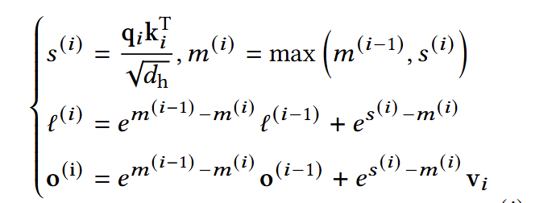
Multi-head Attention Mechanism: With and Without Fusion
No Fusion
Excessive off-chip mem operation
k₁
q₁
v₁
o₁
To DDR
N_heads
concat
N_heads
N_heads
Transpose & Softmax
With Fusion
Fully on BRAM calculation
FA2 [2] kernel fusion
[2] T. Dao, "FlashAttention-2: Faster attention with better parallelism and work partitioning," in Proc. 12th Int. Conf. Learn. Represent. (ICLR), Vienna, Austria, 2024.
Notes:
The original attention computation demands large amount of off-chip memory access to store the intermediate tensor back to DDR. Instead, we use flashattention-like approach to fuse the QK multiplication, softmax, and multiply with V. With operator fusion, all the intermediate values can be buffered on on-chip BRAMs, which greatly reduces the latency

Slide 27
Naïve QK Multiplication Scheduling in Prefill
Load
Compute
q₁
q₂
q₃
q₄
q₅
q₆
k₁
k₂
k₃
k₄
k₅
k₆
Notes:
Besides operator fusion, computation scheduling has a significant impact on performance. Here is one example of the naïve scheduling (next slides)

Slide 28
Naïve Scheduling Requires Higher Memory Bandwidth
Parallelization (p) = 3
Load
Compute
q₁
K_{1,2,3}
q₁ k₁
q₁ k₂
q₁ k₃
q₁
q₂
q₃
q₄
q₅
q₆
k₁
k₂
k₃
k₄
k₅
k₆
Notes:
If we want to parallelize the computation, we need to load multiple vector on-chip, which is bounded by the memory bandwidth on edge FPGA (next slides)

Slide 29


Naïve Scheduling Requires Higher Memory Bandwidth
Parallelization (p) = 3
Load
Compute
q₁
K_{1,2,3}
q₁ k₁
q₁ k₂
q₁ k₃
q₁
q₂
K_{4,5,6}
q₁ k₄
q₁ k₅
q₁ k₆
q₃
q₄
q₅
q₆
k₁
k₂
k₃
k₄
k₅
k₆
Iteration count: $\frac{N2}{p}$
Bandwidth required: $p$
Notes:
(next)

Slide 30
Naïve Scheduling Leads to Unused Computations Due to the Causal Mask
Parallelization (p) = 3
Load
Compute
q₁
K_{1,2,3}
q₁ k₁
q₁ k₂
q₁ k₃
q₁
Causal mask
q₂
K_{4,5,6}
q₁ k₄
q₁ k₅
q₁ k₆
q₃
q₄
q₅
q₆
k₁
k₂
k₃
k₄
k₅
k₆
Iteration count: $\frac{N2}{p}$
Bandwidth required: $p$
Notes:
Also, in the llm inference, there is causal mask the prevent the current token from seeing future tokens. Therefore, the naïve parallelism introduces redundant computation on masked elements

Slide 31
Reversed-order Scheduling & Operator Fusion in Prefill (Ours)
Contribution 3
Load
Compute
Notes:
(next slides)

Slide 32
Reversed-order Scheduling & Operator Fusion in Prefill (Ours)
Contribution 3
Load
Compute
q₁
Causal mask
q₂
q₃
q₄
q₅
q₆
k₁
k₂
k₃
k₄
k₅
k₆
Notes:
To address this problem, we propose a new way of computation scheduling. This animation helps me better explain how our scheduling works. We start from the bottom rightmost unmasked element and calculate backwards. (next slides)

Slide 33
Reversed-order Scheduling & Operator Fusion in Prefill (Ours)
Contribution 3
Iteration :
1
Load
Compute
q₆
k₆
v₆
q₆ k₆ v₆
q₁
Causal mask
q₂
Fused QKV compute
q₃
q₄
q₅
q₆
k₁
k₂
k₃
k₄
k₅
k₆
Notes:
Due to flash-attention-like fusion, we can compute the QKV computation and get the attention output in one iteration

Slide 34
Reversed-order Scheduling & Operator Fusion in Prefill (Ours)
Contribution 3
Iteration :
2
Load
Compute
q₆
k₆
v₆
q₆ k₆ v₆
q₁
Causal mask
q₂
q₅
k₅
v₅
q₆ k₅ v₆
q₅ k₅ v₅
q₃
q₄
q₅
q₆
k₁
k₂
k₃
k₄
k₅
k₆
Notes:
During this optimized reversed-order scheduling, each iteration we only need to load a single token (vector) on-board.

Slide 35
Reversed-order Scheduling & Operator Fusion in Prefill (Ours)
Contribution 3
Iteration :
4
Load
Compute
q₆
k₆
v₆
q₆ k₆ v₆
q₁
Causal mask
q₂
q₅
k₅
v₅
q₆ k₅ v₅
q₅ k₅ v₅
q₃
q₄
k₄
v₄
q₆ k₄ v₄
q₅ k₄ v₄
q₄ k₄ v₄
q₄
q₅
k₃
v₃
q₆ k₃ v₃
q₅ k₃ v₃
q₄ k₃ v₃
q₆
k₁
k₂
k₃
k₄
k₅
k₆
Notes:
After a few steps of warm-up, we can achieve the full parallelism

Slide 36
Reversed-order Scheduling & Operator Fusion in Prefill (Ours)
Contribution 3
Iteration :
6
Load
Compute
q₆
k₆
v₆
q₆ k₆ v₆
q₁
Causal mask
q₂
q₅
k₅
v₅
q₆ k₅ v₅
q₅ k₅ v₅
q₃
q₄
k₄
v₄
q₆ k₄ v₄
q₅ k₄ v₄
q₄ k₄ v₄
q₄
q₅
k₃
v₃
q₆ k₃ v₃
q₅ k₃ v₃
q₄ k₃ v₃
q₆
k₁
k₂
k₃
k₄
k₅
k₆
…

Slide 37
Reversed-order Scheduling & Operator Fusion in Prefill (Ours)
Contribution 3
Iteration :
7
Load
Compute
q₆
k₆
v₆
q₆ k₆ v₆
q₁
Causal mask
q₂
q₅
k₅
v₅
q₆ k₅ v₅
q₅ k₅ v₅
q₃
q₄
k₄
v₄
q₆ k₄ v₄
q₅ k₄ v₄
q₄ k₄ v₄
q₄
q₅
k₃
v₃
q₆ k₃ v₃
q₅ k₃ v₃
q₄ k₃ v₃
q₆
k₁
k₂
k₃
k₄
k₅
k₆
…
q₃
q₃ k₃ v₃
Notes:
After we compute all parallelized rows, we begin the new iterations

Slide 38
Reversed-order Scheduling & Operator Fusion in Prefill (Ours)
Contribution 3
Iteration :
9
Load
Compute
q₆
k₆
v₆
q₆ k₆ v₆
q₁
Causal mask
q₂
q₅
k₅
v₅
q₆ k₅ v₅
q₅ k₅ v₅
q₃
q₄
k₄
v₄
q₆ k₄ v₄
q₅ k₄ v₄
q₄ k₄ v₄
q₄
q₅
k₃
v₃
q₆ k₃ v₃
q₅ k₃ v₃
q₄ k₃ v₃
q₆
k₁
k₂
k₃
k₄
k₅
k₆
…
q₃
q₃ k₃ v₃
…
q₁
k₁
v₁
q₃ k₁ v₁
q₂ k₁ v₁
q₁ k₁ v₁
Fewer iterations & Lower bandwidth required!
Notes:
This optimization brings us fewer iterations and requires much lower bandwidth. This makes LLM deployment on edge FPGA possible

Slide 39
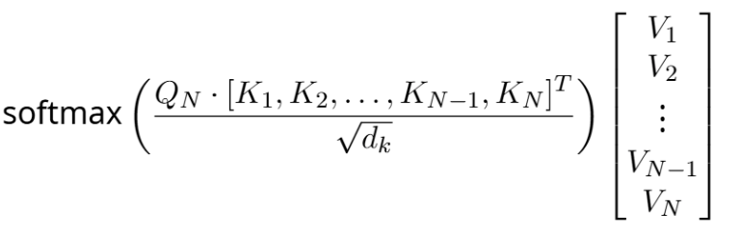
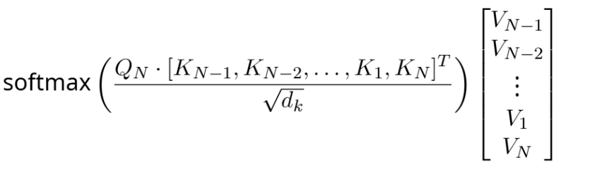

Efficiently Supporting Decode Attention
Contribution 3
q₁
Causal mask
The reversed scheduling changes the order of KV cache.
Does it affect the computation in the decode stage? No
q₂
q₃
q₄
q₅
q₆
k₁
k₂
k₃
k₄
k₅
k₆
$$=$$
prefill attention
k
k cache
v
v cache
q
k₁
k₂
k₃
k₄
k₅
k₆
decode attention
q
Head-wise
MAC
Running Max & Sum
Head-wise
MAC
output
Online SoftMax
Notes:
Our scheduling optimization makes the order of KV cache inverse. Does it affect the computation in the decode stage? No
Once we keep the Key-Value pair, any KV cache order is equivalent in attention computation
For the decode attention, since it is mainly memory bounded, we use a lightweight online softmax to save logic resources without compromising performance.

Slide 40
TeLLMe: Ternary LLM Accelerator on Edge FPGAs
Supports 6 different patterns of computation
TLMM-FUSE
Table-lookup ternary matmul
for QKV + FFN fused with FP DeQ ↔ INT ops ↔ Quant
+ Elemwise (residual/RoPE/...)
URAM-aware Weight Management
Fine-grain buffering +
Analytic Management
TeLLMe Evaluation Results
Prefill Attention
Reversed + fully fused
minimizes DDR traffic
Decode Attention
On-chip SoftMax score buffer
avoids DDR reloads
TLMM-FUSE Unit in TeLLMe Accelerator
Notes:
Moving on to our TLMM-FUSE unit. You might be wondering: why not just use a standard approach for ternary matmul? Well, a straightforward implementation actually introduces significant hardware bottlenecks.
Think about it: our weights only have three states: -1, 0, and 1. In large matrices, these exact same patterns repeat over and over again. A standard 'select and accumulate' architecture isn't smart enough to recognize this; it treats every operation as brand new, wasting precious LUT resources by re-computing identical partial sums.
+2
On top of that, if we try to map this to DSP slices, we are drastically underutilizing our hardware. We are essentially taking complex DSPs built for high-precision math and using them for basic addition and negation—which is a huge architectural waste. That's exactly why we shifted to the Table-Lookup method illustrated on the left side of this slide.“
Straight forward implematation of ternary matmul has according challenge and
Limited States, Repetitive Patterns: With only 3 states (-1, 0, +1), weight patterns repeat frequently across large matrices.
Re-computation: Standard "Select & Accumulate" logic treats every operation as unique, repeatedly burning LUT resources to calculate identical partial sums for these repeating patterns.
DSP Underutilization: Using high-precision DSP slices for simple negation/addition is architecturally inefficient.

Slide 41
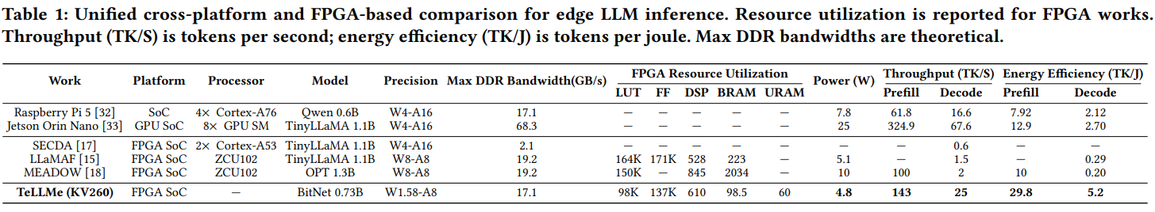
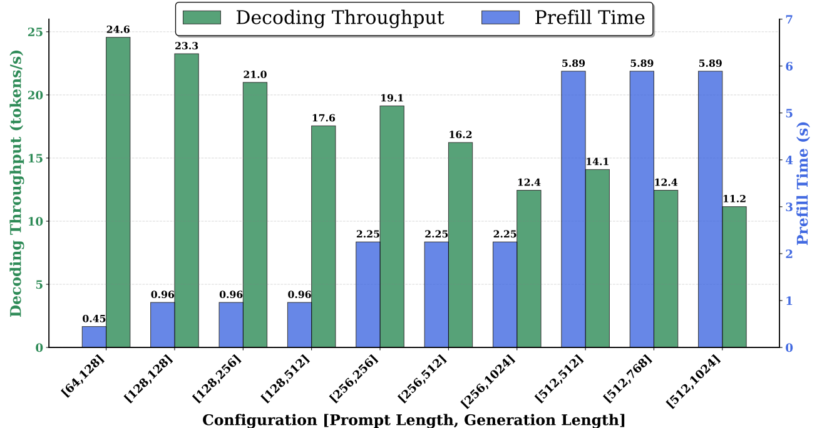
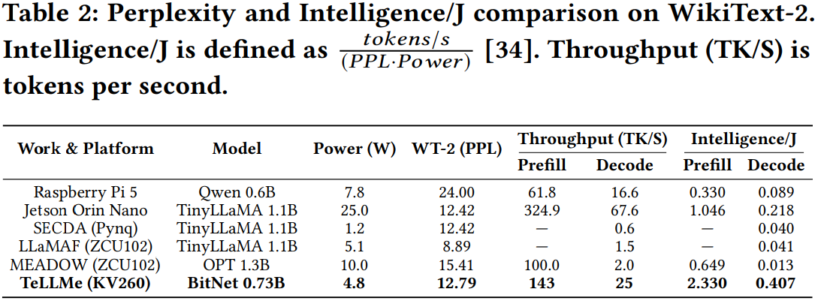
Results 1: Cross-platform Comparison for Edge LLM Inference
Notes:
This slide summarizes our cross-platform inference comparsison results.
As highlighted in Table 1, TeLLMe achieves a throughput of 143 prefill tokens and 25 decoding tokens per second at just. This yields an decode energy efficiency of 5.2 tokens per joule, which is up to 26 times better than prior FPGA accelerators like MEADOW, and significantly more efficient than edge CPUs and GPUs.
To prove we don't sacrifice quality for speed, Table 2 tracks 'Intelligence per Joule', which accounts for model perplexity. TeLLMe achieves the highest score across all evaluated platforms. Finally, the performance chart on the right demonstrates that for standard sequence lengths, TeLLMe consistently delivers responsive, real-time generation speeds

Slide 42
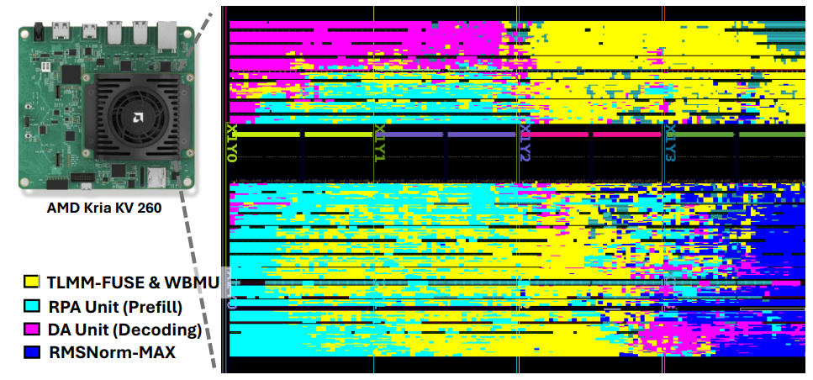
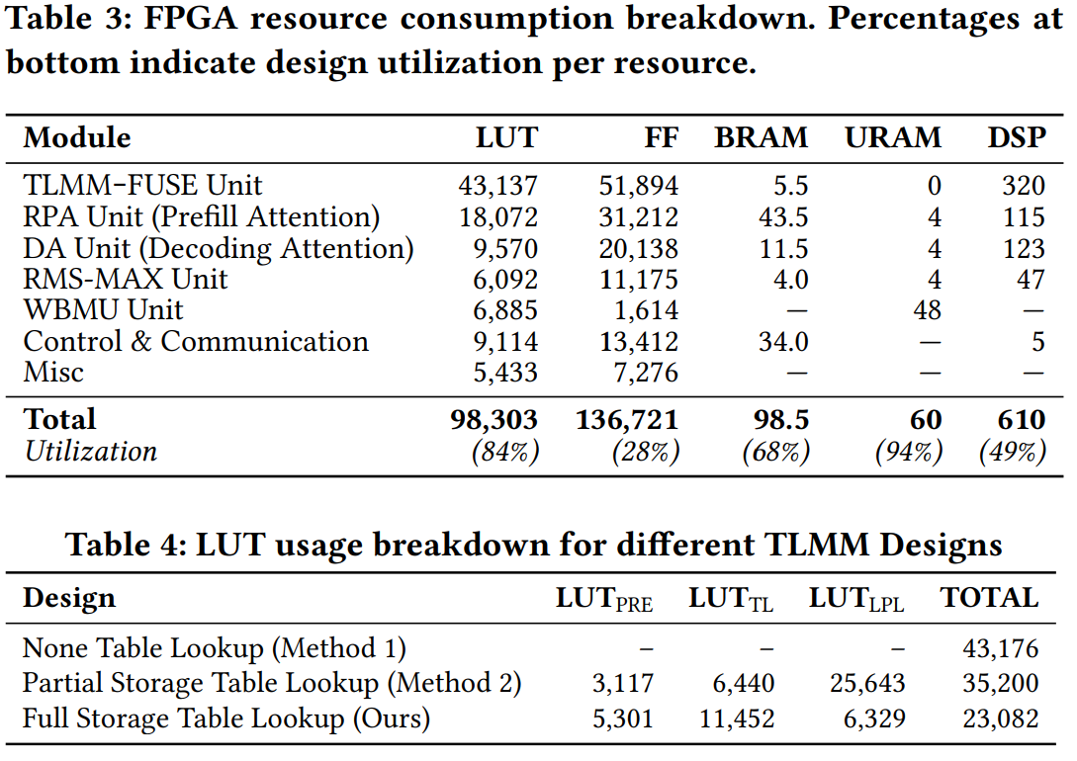
Results 2: FPGA Resource Consumption and Timing Closure
Platform: AMD Kria KV 260
Frequency: 250 MHz
Timing Closure: WNS: 0.009; TNS 0.000; WHS 0.009; THS 0.000.
Notes:
Moving on to resource consumption, here is the exact breakdown for the KV260. For our total utilization, we used 84% of the LUTs, 28% of the FFs, 68% of the BRAMs, 94% of the URAMs, and 49% of the DSPs. The right side displays our generated floorplan. And as highlighted at the bottom, the design routes cleanly and fully meets all timing constraints with zero violations.

Slide 43
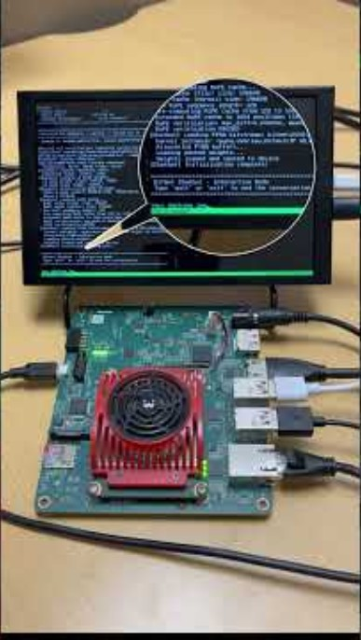
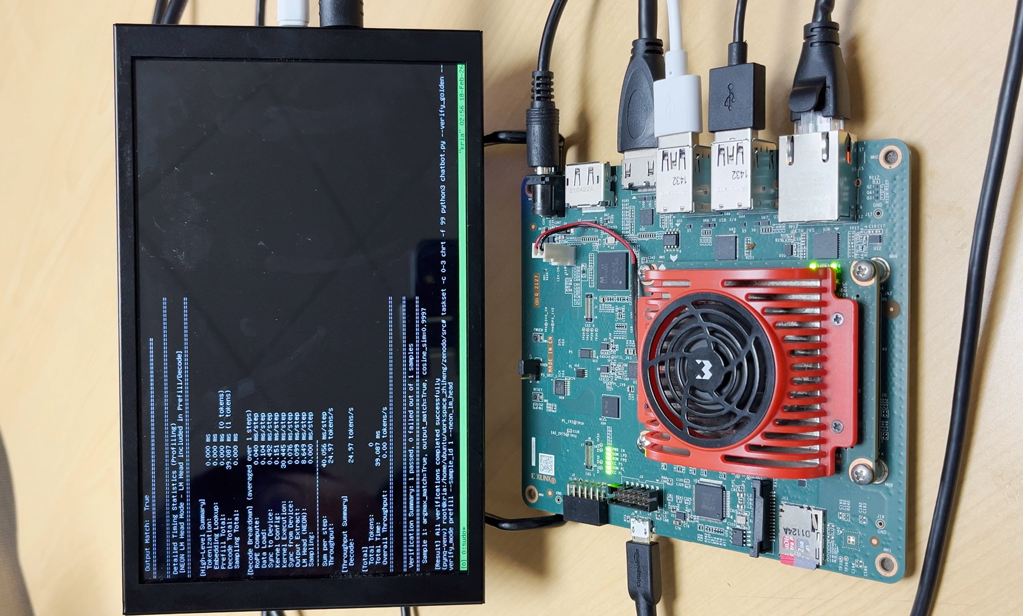
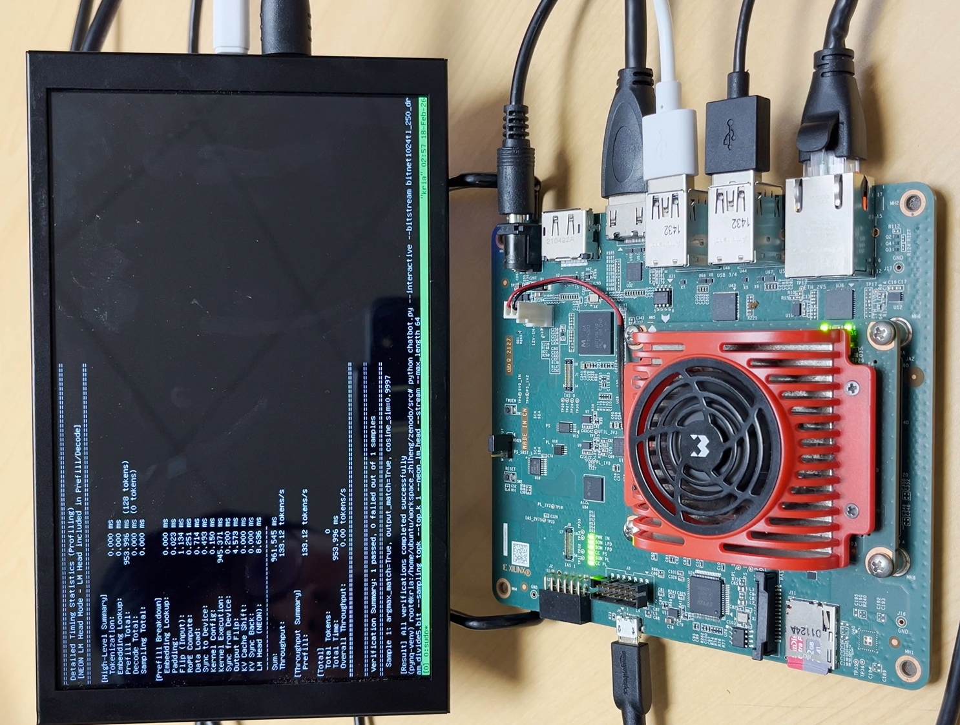
TeLLMe Demo
Decode Throughput at
sequence length step 128:
25 tokens/s
Prefill throughput at
prompt length 128:
133 tokens/s
Open Sourced at https://github.com/UCI-CORSA/TeLLMe_FPGA_2026
Notes:
Finally, we have a demo showing TeLLMe running live on the physical KV260 board. As you can see from the on-board profiling screenshots, the hardware confirms our benchmarked performance. On the right, for a prompt length of 128, we achieve a prefill throughput of 133 tokens per second. On the left, during the autoregressive generation at a sequence length of 128, we maintain a steady decode throughput of 25 tokens per second.
We are also excited to announce that our work is fully open-sourced. You can scan the QR code on the screen or visit the UCI-CORSA GitHub link below to access the code and deploy it yourself.

Slide 44
TeLLMe: Ternary LLM Accelerator on Edge FPGAs
URAM-aware Weight Management
Fine-grain buffering +
Analytic Management
Sequence of Tokens
KV-cache
…
Sequence of Tokens
…
…
Q
Prefill
TLMM-FUSE
Table-lookup ternary matmul
for QKV + FFN fused with FP DeQ ↔ INT ops ↔ Quant
+ Elemwise (residual/RoPE/...)
Decode
New
Prefill Attention
Reversed + fully fused
minimizes DDR traffic
Decode Attention
On-chip SoftMax cache
avoids DDR reloads
Platform: AMD Kria KV 260
< 6 W
Max Soc Power
143 tokens/s
Prefill throughput
25 tokens/s
Decode throughput
Notes:
So, how do we turn these ternary benefits of Lower Computational Complexity and Less Memory Traffic Requirement into actual hardware performance? This slide outlines our four main contributions.
The heart of our design is the TLMM-FUSE unit, which replaces standard multipliers with table lookups and fuses them directly with necessary floating-point operations. We feed this engine using a smart URAM Weight Management system. For the attention layers, we decoupled the architecture: our Prefill Attention Unit uses a reversed and fused design to cut down off-chip traffic, while our Decode Attention Unit caches SoftMax scores on-chip to prevent slow memory reloads.
The bottom line is the performance: running on a standard KV260 board, we hit up to 143 prefill tokens and 25 decoding tokens per second, consuming less than 6 watts of power.

Slide 45
TeLLMe: An Efficient End-to-End Ternary LLM Prefill and Decode Accelerator with Table-Lookup MatMul on Edge FPGAs
FPGA 2026
Thank you!
Ye Qiao*, Zhiheng Chen*, Yifan Zhang, Yian Wang, and Sitao Huang
(* Equal contributions) EECS, University of California, Irvine, USA
Contact: sitaoh@uci.edu
https://github.com/UCI-CORSA/
TeLLMe_FPGA_2026
Acknowledgment: the authors would like to thank the support from NSF (Award No. 2443992) and AMD.
Compiler
Optimizations
Reconfigurable
Scalable
Architectures
Research Lab @UCI

Slide 46
Previous Accelerators Ignore the Difference
KV-cache
Sequence of Tokens
…
…
Q
Sequential token-by-token Generation
For both Prefill and Decoding
Forcing the Prefill phase to follow a Decoding-like execution pattern results in low throughput.
Notes:
If you look at previous FPGA accelerators, you'll notice a common trend: they are almost entirely focused on the decoding pattern. They optimize their hardware to generate one token at a time and constantly check the KV-cache.
The issue arises when these designs try to handle the initial prompt. Many apply this exact same sequential dataflow to the prefill stage.

Slide 47
Results1: Cross-platform and FPGA-based comparison for edge LLM inference
Notes:
This slide summarizes our cross-platform inference comparsison results.
As highlighted in Table 1, TeLLMe achieves a throughput of 143 prefill tokens and 25 decoding tokens per second at just in average 4.8 watts. This yields an energy efficiency of 5.2 tokens per joule, which is up to 26 times better than prior FPGA accelerators like MEADOW, and significantly more efficient than edge CPUs and GPUs.
To prove we don't sacrifice quality for speed, Table 2 tracks 'Intelligence per Joule', which accounts for model perplexity. TeLLMe achieves the highest score across all evaluated platforms. Finally, the performance chart on the right demonstrates that for standard sequence lengths, TeLLMe consistently delivers responsive, real-time generation speeds

Slide 48
TeLLMe: Novelty & Key Contributions
TLMM-FUSE
Table-lookup ternary matmul
for QKV + FFN fused with FP DeQ ↔ INT ops ↔ Quant
+ Elemwise (residual/RoPE/...)
URAM-aware Weight Management
Fine-grain buffering +
Analytic Management
Prefill Attention
Reversed + fully fused
minimizes DDR traffic
Decode Attention
On-chip SoftMax score buffer
avoids DDR reloads
Notes:
Now that we have a highly efficient compute engine, we run into the classic hardware problem: how do we feed it fast enough? During the autoregressive decoding phase, LLMs are notoriously memory-bound. If our memory access is slow, our fast compute engine just sits there waiting. To solve this, we carefully mapped our data to the FPGA's specific memory resources, as shown on the right. We use BRAMs for intermediate activations and LUTRAMs for those small TL tables we talked about earlier. But for the massive weight matrices, we leverage UltraRAMs. URAMs are deep and wide, giving us 288 kilobits per block, which is perfect for storing our packed ternary weights on-chip.

Slide 49
TeLLMe System Architecture
Notes:
Our

Slide 50
TeLLMe System Architecture
Notes:
Our

Slide 51
Conclusion
We presented TeLLMe, the first end-to-end FPGA accelerator for ternary LLMs. TeLLMe accelerates both prefill and decoding stages. We propose to integrate the table-lookup-based matrix multiplication into the TeLLMe accelerator, achieving up to 25 tokens/s generation throughput and up to 143 tokens/s prefill throughput while consuming under 5W power budget and maintaining great model performance. TeLLMe achieves a significant performance and efficiency improvement over existing mobile-edge devices and previous FPGA-based accelerators, enabling energy efficient, low-latency generative AI in the edge environment.

Slide 52
Results1: Cross-platform and FPGA-based comparison for edge LLM inference

Slide 53
Results 2: FPGA resource consumption breakdown

Slide 54
T = 1
Load
Compute
q₆
k₆
v₆
q₆ k₆ v₆
q₆ k₆ v₆
q₆ k₆ v₆
q₁
Causal mask
q₂
q₅
k₆
v₆
q₆ k₆ v₆
q₆ k₆ v₆
q₆ k₆ v₆
q₃
q₆
k₆
v₆
q₆ k₆ v₆
q₆ k₆ v₆
q₆ k₆ v₆
q₄
q₅
q₆
k₆
v₆
q₆ k₆ v₆
q₆ k₆ v₆
q₆ k₆ v₆
q₆
k₁
k₂
k₃
k₄
k₅
k₆

Slide 55
Design Choice of TLMM-FUSE Unit
(a) Design Choice 1: Full Storage
8 6 5
TL Table 1WQR
Input Activation Entries
0
Adder & Subtractor Tree
8 6 5
14 2 13
3 11 1
19 9 7 3
Original Val
8 6 5
14 2 11 1 13 3
19 9 7 3
-8 -6 -5
-14 -2 -13
-3 -11 -1
-19 -9 -7 -3
Negation Unit
Negated Val
1
-1
0
1
-1
1
1
-1
0
TL Table
(1WQR)
Accumulator
5 12 5

Slide 56
Design Choice of TLMM-FUSE Unit
(b) Design Choice 2: Partial Storage
TL Table
8 6 5
14 2 13
3 11 1
19 9 7 3
1
-1
0
1
-1
1
1
-1
0
Negation Unit
TL Table
(1WQR)
Negation Unit
Negation Unit
5 12 5
Target on II= 1 parallel lookup and accumulation
0
-8 -6 -5
-14 -2 -13
-3 -11 -1
-19 -9 -7 -3
V.S.
Negation Unit
14x10 bit LUTRAM
(Sel[5bit]==0) ? 0 : -Input[10bit]
Result will vary for different Q, G, T and target accumulation II
Rough experiment on HLS, further DSE is required

Slide 57
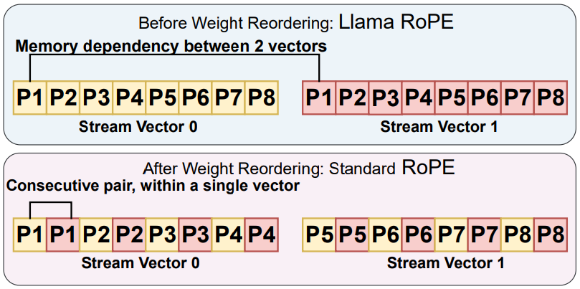
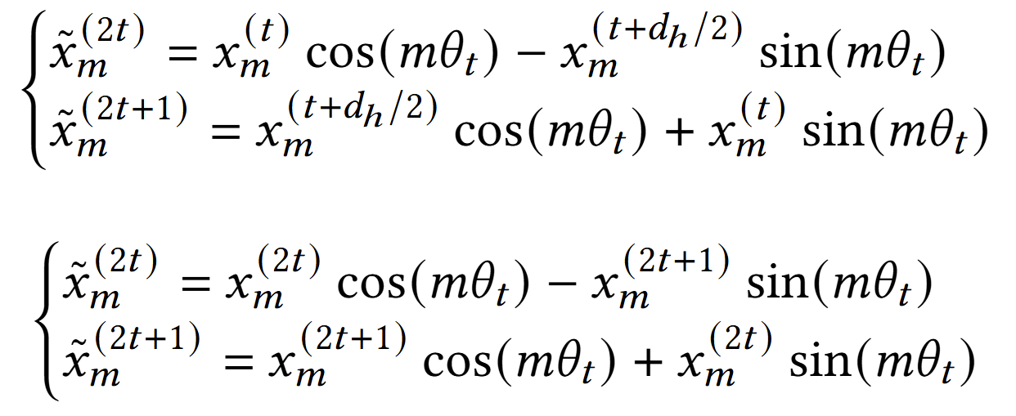
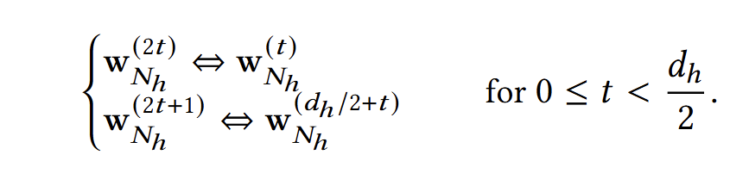
Streaming fusion between FP and INT operation
To better support the stream access pattern:
Weight Reordering
Llama RoPE
Standard RoPE

Slide 58
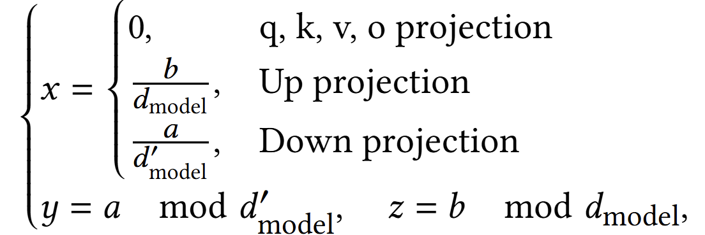
Weight Buffer Management Unit (WBMU) and Data Packing
(2) Address Mapping for Weight Acess
Down projection
q,k,v,o projection
Up projection
(3) Data Packing & Weight Loading
  Multi-Port Access: Activates 3 AXI HP Ports
  Efficient Packing: Packs 5 Weight Index Vectors (140bit) and 1 FP16 RMSNorm weight into a single transfer

Slide 59




Naïve attention computation scheduling in Prefill
Reverse Scheduling (Our Design)
Iteration count: $\frac{N2}{2p} + \frac{N}{2}$
Bandwidth: $1$
Naive scheduling
Iteration count: $\frac{N2}{p}$
Bandwidth: $p$

Slide 60
Naïve attention computation scheduling in Prefill
q₁
Causal mask
q₂
q₃
q₄
q₅
q₆
k₁
k₂
k₃
k₄
k₅
k₆

Slide 61
Weight Buffer Management Unit (WBMU) and Data Packing
(2) Address Mapping for Weight Acess
Down projection
q,k,v,o projection
Up projection
(3) Data Packing & Weight Loading
  Multi-Port Access: Activates 3 AXI HP Ports
  Efficient Packing: Packs 5 Weight Index Vectors (140bit) and 1 FP16 RMSNorm weight into a single transfer

Slide 62
TeLLMe System Architecture

Slide 63
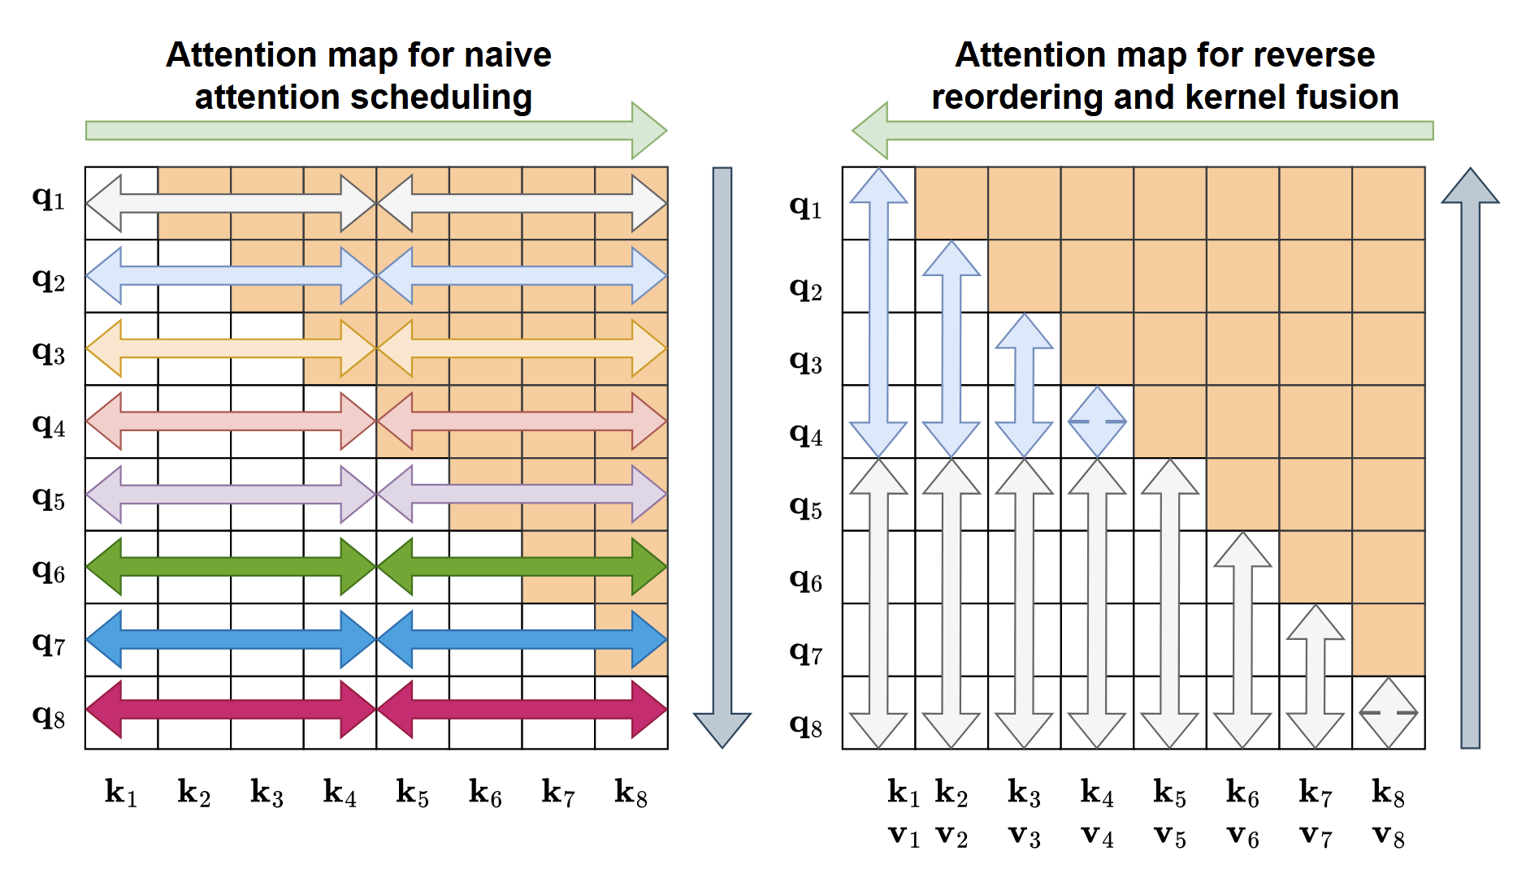
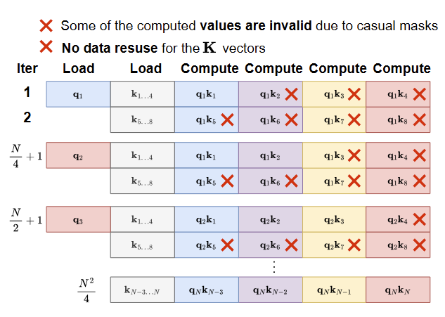
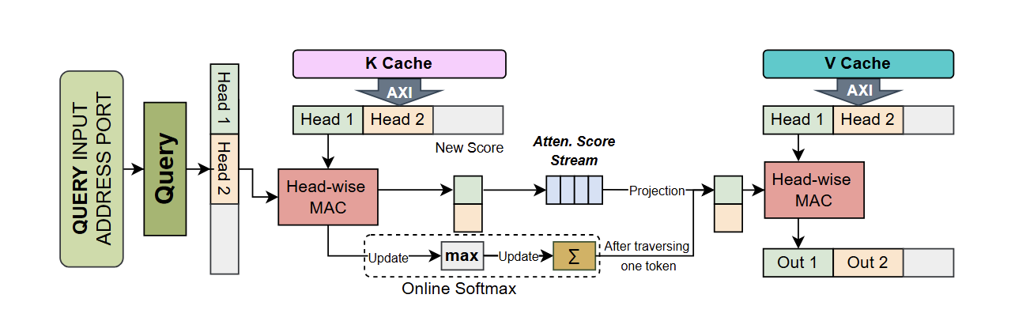
Design of the Attention Mechanism
Overall Challenge: Workload Heterogeneity
  Conflict: The Attention mechanism exhibits different pattern in Prefill and Decode stage.
Prefill Challenge: Naive parallel scheduling saturates off-chip bandwidth, stalling compute units despite high arithmetic demand
Solution: Maximize data reuse via reversed scheduling and flash attention-alike kernel fusion.
Decode Challenge: Throughput is strictly limited by fetching the large, growing KV-cache from off-chip memory for every single token
Solution: Buffer attention scores and eliminates DDR transfer

Slide 64
Reversed Prefill Attention Unit

Slide 65



Computation graph of Attention Mechanism
k₁
k₂
q₁
$$×$$
q₂
softmax
v₁
$$=$$
o₁
v₂
o₂
$$\sqrt{d_{k}}$$

Slide 66



Operator fusion of Q, K, and V
Iteration :
1
Load
Compute
q₆
k₆
v₆
q₆ k₆ v₆
q₁
Causal mask
q₂
q₃
q₄
q₅
q₆
k₁
k₂
k₃
k₄
k₅
k₆
k₁
k₂
q₁
$$×$$
q₂
softmax
v₁
$$=$$
o₁
v₂
o₂
$$\sqrt{d_{k}}$$

Slide 67
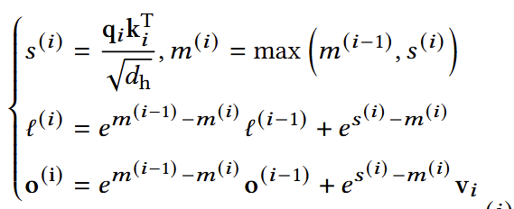
Operator fusion of Q, K, and V
Iteration :
1
Load
Compute
q₆
k₆
v₆
q₆ k₆ v₆
q₁
Causal mask
q₂
q₃
q₄
q₅
q₆
k₁
k₂
k₃
k₄
k₅
k₆

Slide 68
Iteration :
3
Load
Compute
q₆
k₆
v₆
q₆ k₆ v₆
q₁
Causal mask
q₂
q₅
k₅
v₅
q₆ k₅ v₆
q₅ k₅ v₅
q₃
q₄
q₅
q₆
k₁
k₂
k₃
k₄
k₅
k₆

Slide 69
Iteration :
4
Load
Compute
q₆
k₆
v₆
q₆ k₆ v₆
q₁
Causal mask
Warm-up
q₂
q₅
k₅
v₅
q₆ k₅ v₆
q₅ k₅ v₅
q₃
q₄
k₄
v₄
q₆ k₄ v₆
q₅ k₄ v₅
q₄ k₄ v₄
q₄
q₅
q₆
k₁
k₂
k₃
k₄
k₅
k₆

Slide 70
Iteration :
2
Load
Compute
q₆
k₆
v₆
q₆ k₆ v₆
q₁
Causal mask
q₂
q₃
q₄
q₅
q₆
k₁
k₂
k₃
k₄
k₅
k₆

Slide 71
T =
1
Load
Compute
q₁
Causal mask
q₂
q₃
q₄
q₅
q₆
k₁
k₂
k₃
k₄
k₅
k₆

Slide 72
Load
Compute
q₁
K_{1,2,3}
q₁ k₁
q₁ k₂
q₁ k₃
q₁
Causal mask
q₂
K_{4,5,6}
q₁ k₄
q₁ k₅
q₁ k₆
q₃
q₄
Unused blocks due to the causal mask
q₅
q₆
k₁
k₂
k₃
k₄
k₅
k₆

Slide 73


Iteration :
7
Load
Compute
q₆
k₆
v₆
q₆ k₆ v₆
q₁
Causal mask
q₂
q₅
k₅
v₅
q₆ k₅ v₅
q₅ k₅ v₅
q₃
q₄
k₄
v₄
q₆ k₄ v₄
q₅ k₄ v₄
q₄ k₄ v₄
q₄
q₅
k₃
v₃
q₆ k₃ v₃
q₅ k₃ v₃
q₄ k₃ v₃
q₆
k₁
k₂
k₃
k₄
k₅
k₆
…
q₃
q₃ k₃ v₃
Iteration count: $\frac{N2}{2p} + \frac{N}{2}$
…
Bandwidth: $1$

Slide 74
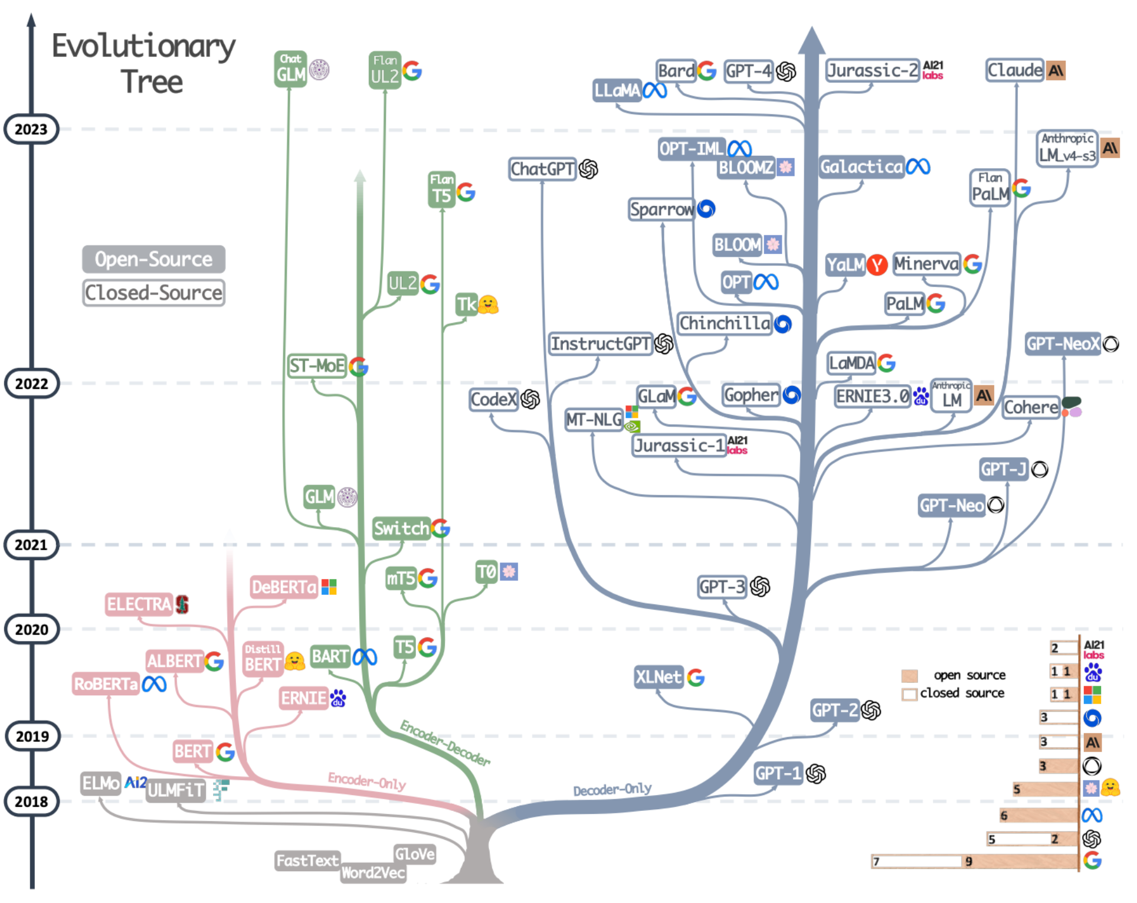
Challenges in Running Transformer at the Edge
Decoder Transformer: fundamental architectures of large language models(LLMs)
Very intensive in computation(prefill) and memory demands(decode), challenging for edge deployment
Grok 4 (July 9, 2025)
500 billion petaFLOP
Source: The Evolution and Breakthrough of Natural Language Processing: The Revolution from Rules to Deep Learning
Source: OurWorldInData.org/artificial-intelligence
Edge devices are pervasive, featuring security, privacy, and latency advantages.
AR/VR
Robots
Autonomous Vehicles
Can we bring real-time end-to-end LLM inference to edge devices?
Yes!
TeLLMe is our answer!

Slide 75
Previous Accelerators Focused on Decoding Pattern
KV-cache
Sequence of Tokens
…
…
Q
Sequential token-by-token prediction
Memory traffic and capacity heavy
Decoding and Prefill
Forcing the Prefill phase to follow a Decoding-like execution pattern results in low throughput.

Slide 76

Previous Accelerators Focused on Decoding Only
Sequence of Tokens
KV-cache
Sequence of Tokens
…
…
…
Q
Process Tokens in Parallel
Compute
Heavy
New
Sequential Token-by-Token Prediction
Memory Traffic and Capacity Heavy
KV-cache
Prefill
Decoding
Yes! TeLLMe
Accelerate Both!!!

Slide 77
TeLLMe: Novelty & Key Contributions
URAM-aware Weight Management
Fine-grain buffering +
Analytic Management
Sequence of Tokens
KV-cache
…
Sequence of Tokens
…
…
Q
TLMM-FUSE
Table-lookup ternary matmul
for QKV + FFN fused with FP DeQ ↔ INT ops ↔ Quant
+ Elemwise (residual/RoPE/...)
Lower Computational Complexity
New
Prefill Attention
Reversed + fully fused
minimizes DDR traffic
Decode Attention
On-chip SoftMax cache
avoids DDR reloads
Less Memory Traffic Requirement
KV-cache
Prefill benefits from Ternary
< 6 W
Soc Power
KV260
Platform
Decoding benefits from Ternary
143 tok/s
Prefill throughput
25 tok/s
Decode throughput

Slide 78
TeLLMe: Novelty & Key Contributions
URAM-aware Weight Management
Fine-grain buffering +
Analytic Management
TLMM-FUSE
Table-lookup ternary matmul
for QKV + FFN fused with FP DeQ ↔ INT ops ↔ Quant
+ Elemwise (residual/RoPE/...)
Prefill Attention
Reversed + fully fused
minimizes DDR traffic
Decode Attention
On-chip SoftMax cache
avoids DDR reloads
< 6 W
Soc Power
KV260
Platform
Up to143 tok/s
Prefill throughput
Up to 25 tok/s
Decode throughput

Slide 79
Naïve QK multiplication scheduling in Prefill Attention
Parallelization (p) = 3
Load
Compute
q₁
K_{1,2,3}
q₁ k₁
q₁ k₂
q₁ k₃
q₁
Causal mask
q₂
K_{4,5,6}
q₁ k₄
q₁ k₅
q₁ k₆
q₃
q₄
q₅
q₆
k₁
k₂
k₃
k₄
k₅
k₆
Iteration count: $\frac{N2}{p}$
Bandwidth required: $p$

Slide 80
TeLLMe System Architecture
Heterogeneous SoC Design (PS + PL)
  PS (Processing System): Handles pre/post-processing and configuration (AXI-Lite).
  PL (Programmable Logic): Implements the high-performance accelerator kernel.
Specialized Dataflow Compute Engines
  RPA (Reversed Prefill Attention): Optimized for compute-bound prefill phase.
  DA (Decoding Attention): Optimized for memory-bound decoding phase.
  TLMM-FUSE: Core linear engine fusing Quant/Dequant, Elementwise Ops, and Ternary MatMul.
  RMS-MAX: Handles normalization and dynamic quantization scaling.

Slide 81
TeLLMe: Novelty & Key Contributions
URAM-aware Weight Management
Fine-grain buffering +
Analytic Management
TLMM-FUSE
Table-lookup ternary matmul
for QKV + FFN fused with FP DeQ ↔ INT ops ↔ Quant
+ Elemwise (residual/RoPE/...)
Prefill Attention
Reversed + fully fused
minimizes DDR traffic
Decode Attention
On-chip SoftMax cache
avoids DDR reloads
< 6 W
Soc Power
KV260
Platform
143 tok/s
Prefill throughput
25 tok/s
Decode throughput

Slide 82
TeLLMe: Novelty & Key Contributions
URAM-aware Weight Management
Fine-grain buffering +
Analytic Management
TLMM-FUSE
Table-lookup ternary matmul
for QKV + FFN fused with FP DeQ ↔ INT ops ↔ Quant
+ Elemwise (residual/RoPE/...)
Prefill Attention
Reversed + fully fused
minimizes DDR traffic
Decode Attention
On-chip SoftMax cache
avoids DDR reloads
< 6 W
Soc Power
KV260
Platform
143 tok/s
Prefill throughput
25 tok/s
Decode throughput

Slide 83
Naïve QK multiplication scheduling in Prefill Attention
Parallelization (p) = 3
Load
Compute
q₁
K_{1,2,3}
q₁ k₁
q₁ k₂
q₁ k₃
q₁
q₂
q₃
q₄
q₅
q₆
k₁
k₂
k₃
k₄
k₅
k₆

Slide 84
TeLLMe: Novelty & Key Contributions
TLMM-FUSE
Table-lookup ternary matmul
for QKV + FFN fused with FP DeQ ↔ INT ops ↔ Quant
+ Elemwise (residual/RoPE/...)
URAM-aware Weight Management
Fine-grain buffering +
Analytic Management
Prefill Attention
Reversed + fully fused
minimizes DDR traffic
Decode Attention
On-chip SoftMax score buffer
avoids DDR reloads

Slide 85
multi-head
k₁
k₂
q₁
$$×$$
q₂
softmax
v₁
$$=$$
o₁
v₂
o₂
$$\sqrt{d_{k}}$$

Slide 86
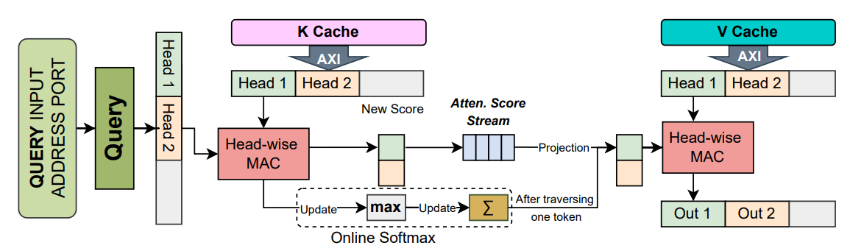
Decode Attention Unit

Slide 87
Prefill and Decode Have Different Computational Patterns
Sequence of Tokens
KV-cache
Sequence of Tokens
…
…
…
Q
Process Tokens in Parallel
Compute
Heavy
New
Sequential Token-by-Token Prediction
Memory Traffic Heavy
KV-cache
Prefill
Compute-bound
Decode
Memory-bound
Notes:
But prefill is completely different—it needs to process the entire prompt in parallel to actually build the KV-cache in the first place. If you force the prefill phase to process token-by-token, you are drastically underutilizing your hardware. It leads to terrible throughput and a frustratingly long wait before the model even starts talking. We realized that to fix this, we needed an architecture that respects the distinct computational needs of both stages.

Slide 88
Previous Accelerators Ignore the Difference
KV-cache
Sequence of Tokens
…
…
Q
Sequential token-by-token Generation
For both Prefill and Decoding
Forcing the Prefill phase to follow a Decoding-like execution pattern results in low throughput.
Notes:
If you look at previous FPGA accelerators, you'll notice a common trend: they are almost entirely focused on the decoding pattern. They optimize their hardware to generate one token at a time and constantly check the KV-cache.
The issue arises when these designs try to handle the initial prompt. Many apply this exact same sequential dataflow to the prefill stage.

Slide 89



TeLLMe: An Efficient End-to-End Ternary LLM Prefill and Decode
Accelerator with Table-Lookup Matmul on Edge FPGAs
Compiler
Optimizations, Reconfigurable and Scalable
Architectures
Research Lab @ UCI
Ye Qiao*, Zhiheng Chen*, Yifan Zhang, Yian Wang, and Sitao Huang
(* Equal contributions)
EECS, University of California, Irvine, USA
Contact: sitaoh@uci.edu
Github Link
Acknowledgment: the authors would like to thank the support from NSF (Award No. 2443992) and AMD.
Notes:
Hi, everyone. My name is Zhiheng Chen. I am a master student from UC Irvine. Today, I am very excited to share our latest research with you. Our paper is titled: 'TeLLMe: An Efficient End-to-End Ternary LLM Prefill and Decode Accelerator with Table-Lookup Matmul on Edge FPGAs'.

