Slide 1




SORCERI: Streaming Overlay Acceleration for Highly Contracted Electron Repulsion Integral Computations in Quantum Chemistry
Philip Stachura, Xin Wu, Christian Plessl, Zhenman Fang

Slide 2
Quantum Mechanics based Molecular Dynamics Simulations
known as ab initio MD
can accurately model reactive
and complex systems
“from fundamentals”

Slide 3
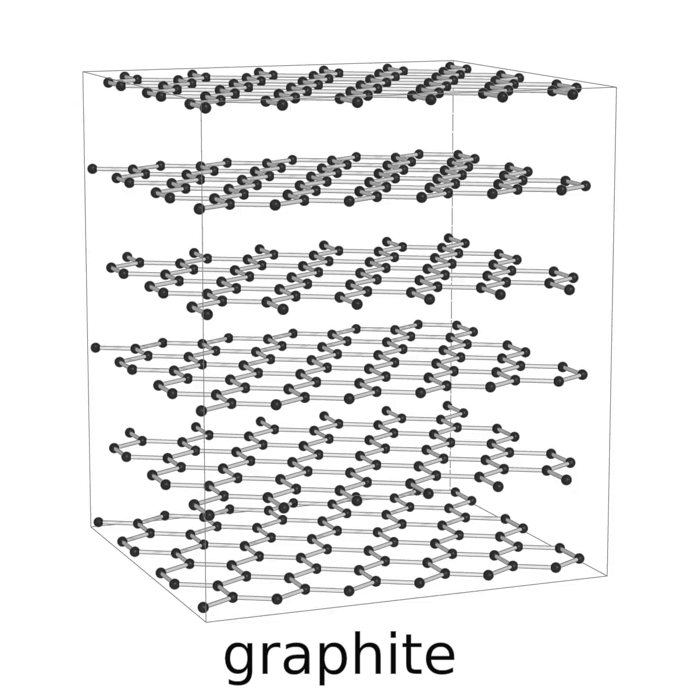
Quantum Mechanics based Molecular Dynamics Simulations
known as ab initio MD
can accurately model reactive
and complex systems
“from fundamentals”

Slide 4
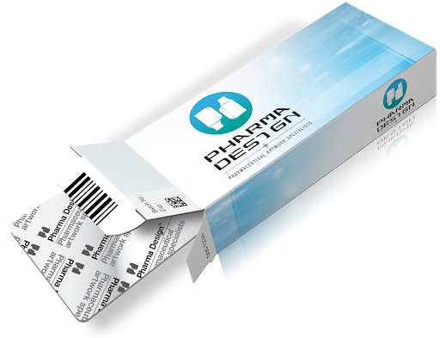
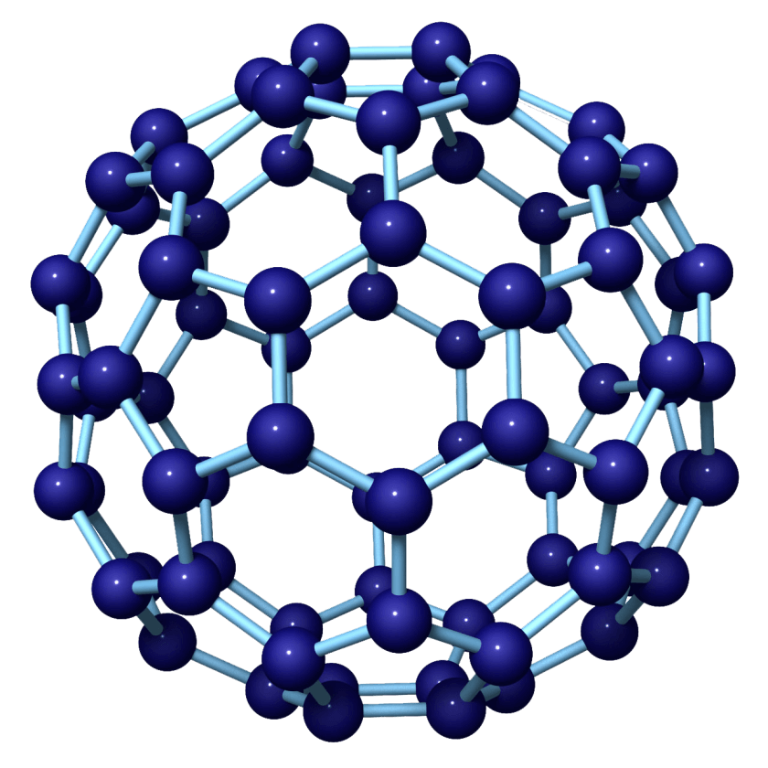
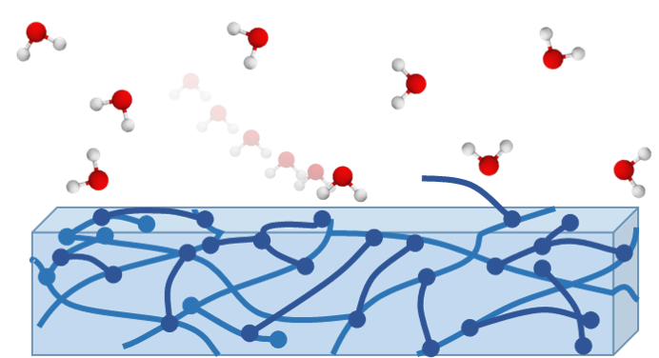
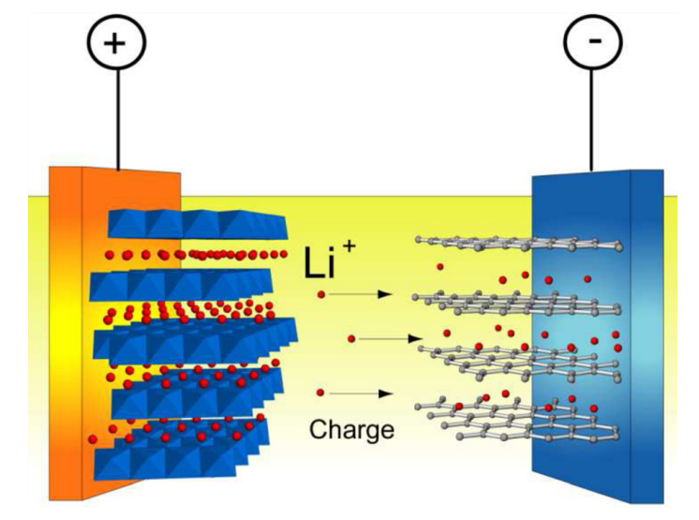
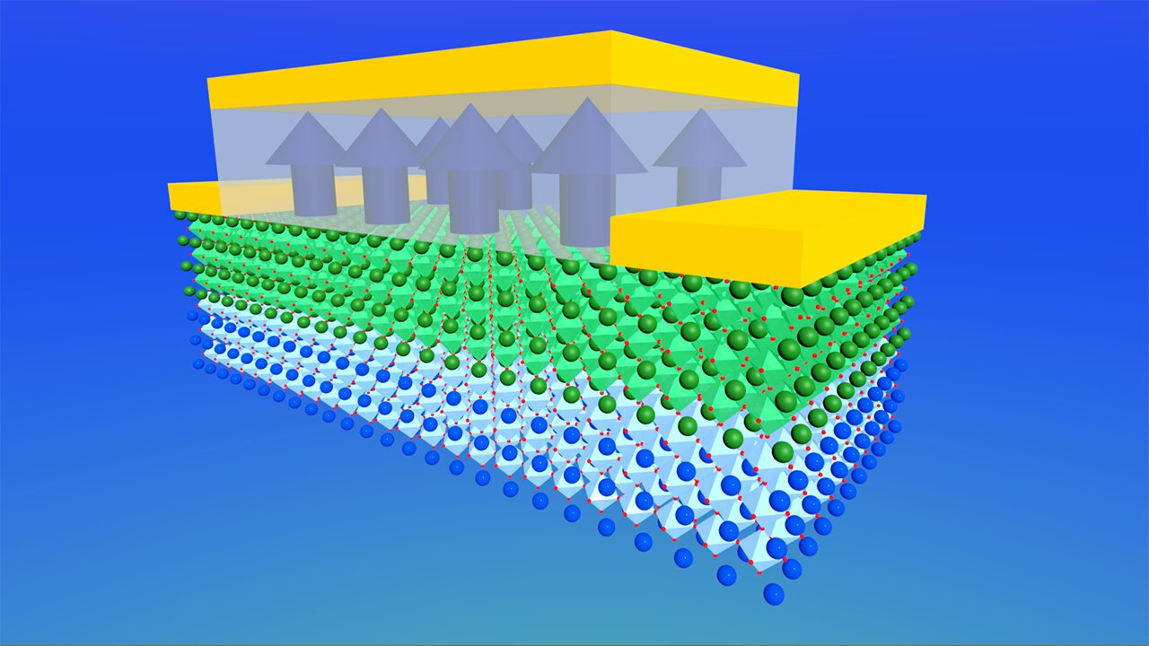
>$3 Trillion Industry
Pharmaceutical design
Nanotechnology
Polymer design
Electro-chemistry (batteries)
Semiconductor design
SOTA rare-earth iron garnet materials simulated on 12000 CPU cores

Slide 5
Electron Repulsion Integral (ERI)
“nightmare of integrals”
– Nobel Lecture for Chemistry

Slide 6
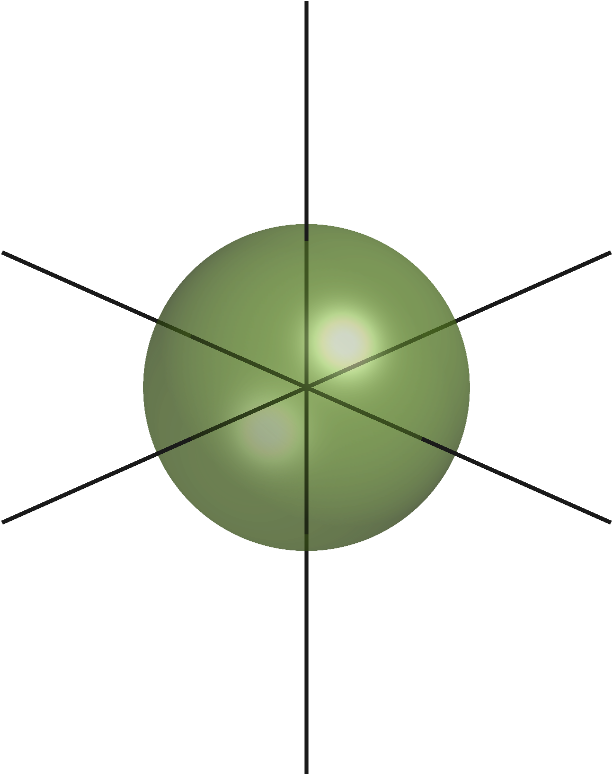


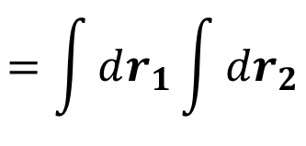



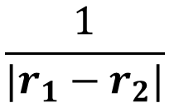

Electron Repulsion Integral (ERI)
$$=\int{dr_{1}}\int{dr_{2}}$$
$$\frac{1}{|r_{1}−r_{2}|}$$
$$\left[ab | cd\right]$$
$$g_{A,a,α}\left(r_{1}\right)g_{B,b,β}\left(r_{1}\right)$$
$$g_{C,c,γ}\left(r_{2}\right)g_{D,d,δ}\left(r_{2}\right)$$
$$a, b, c, d$$
: Atomic orbitals
s-orbital
p-orbital
d-orbital

Slide 7
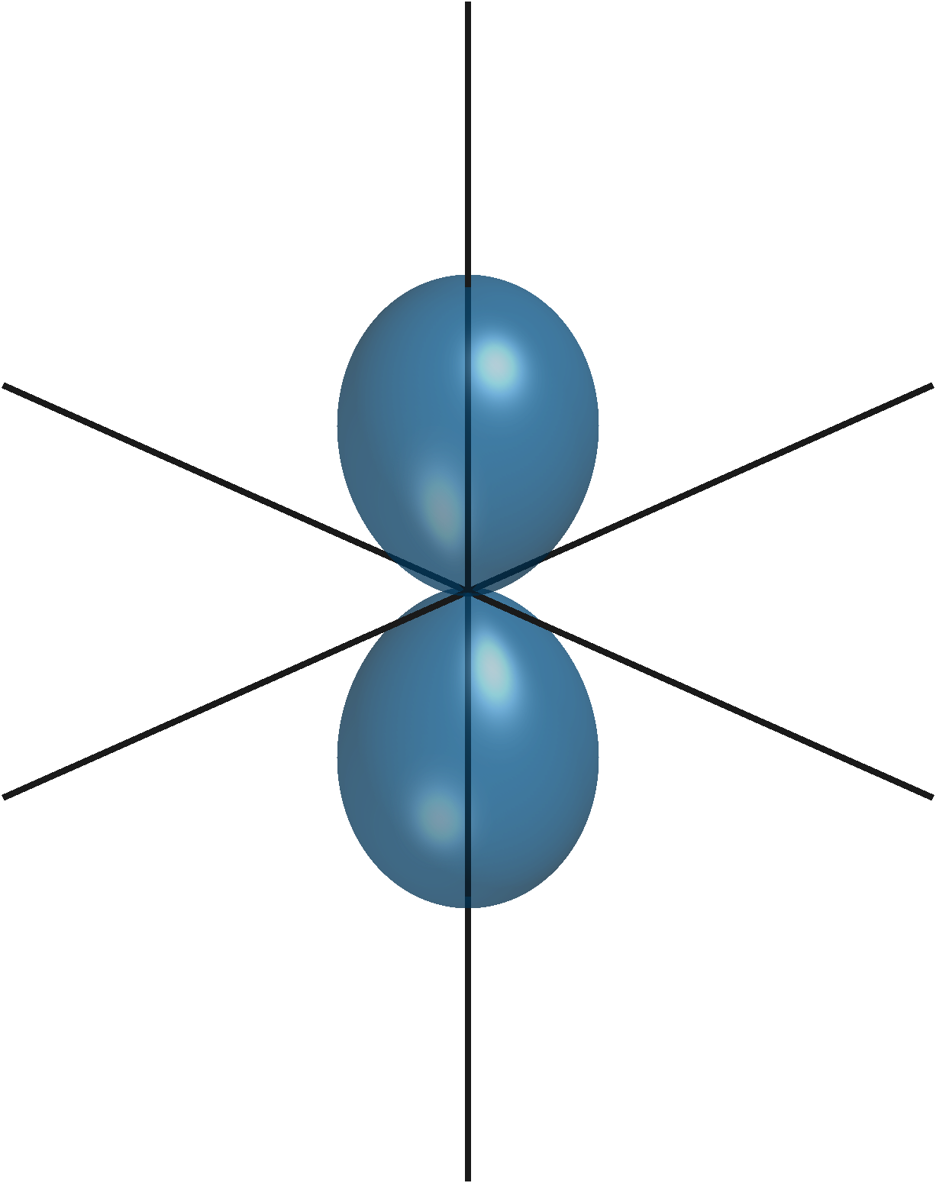
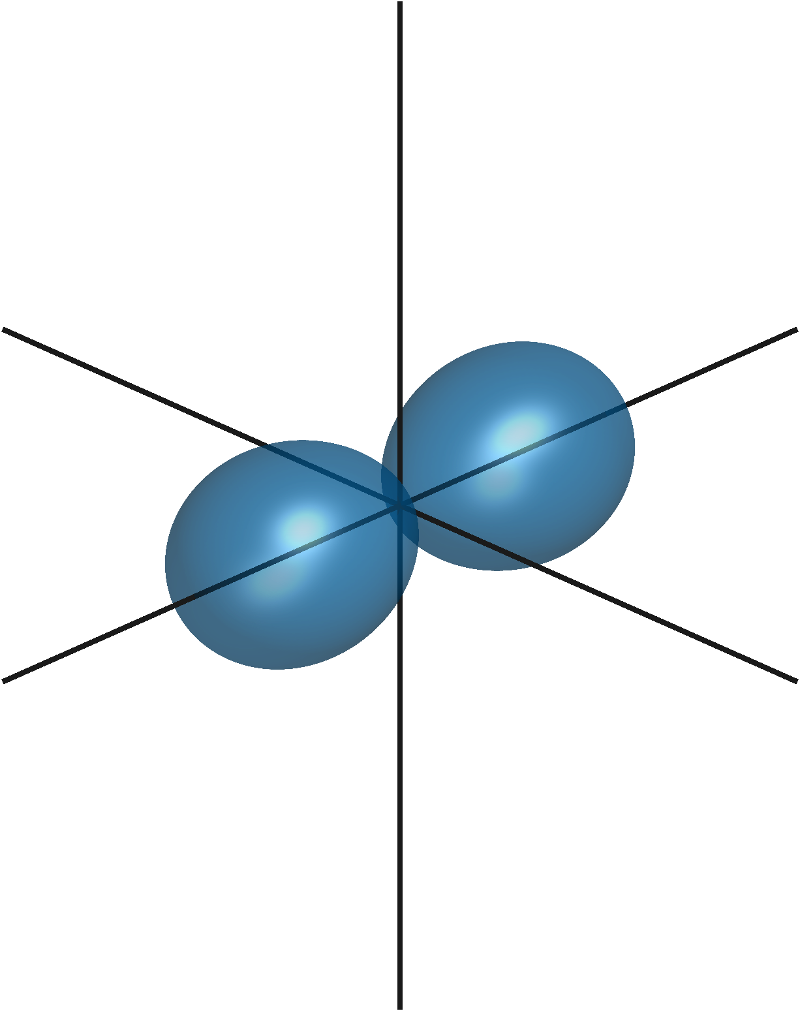
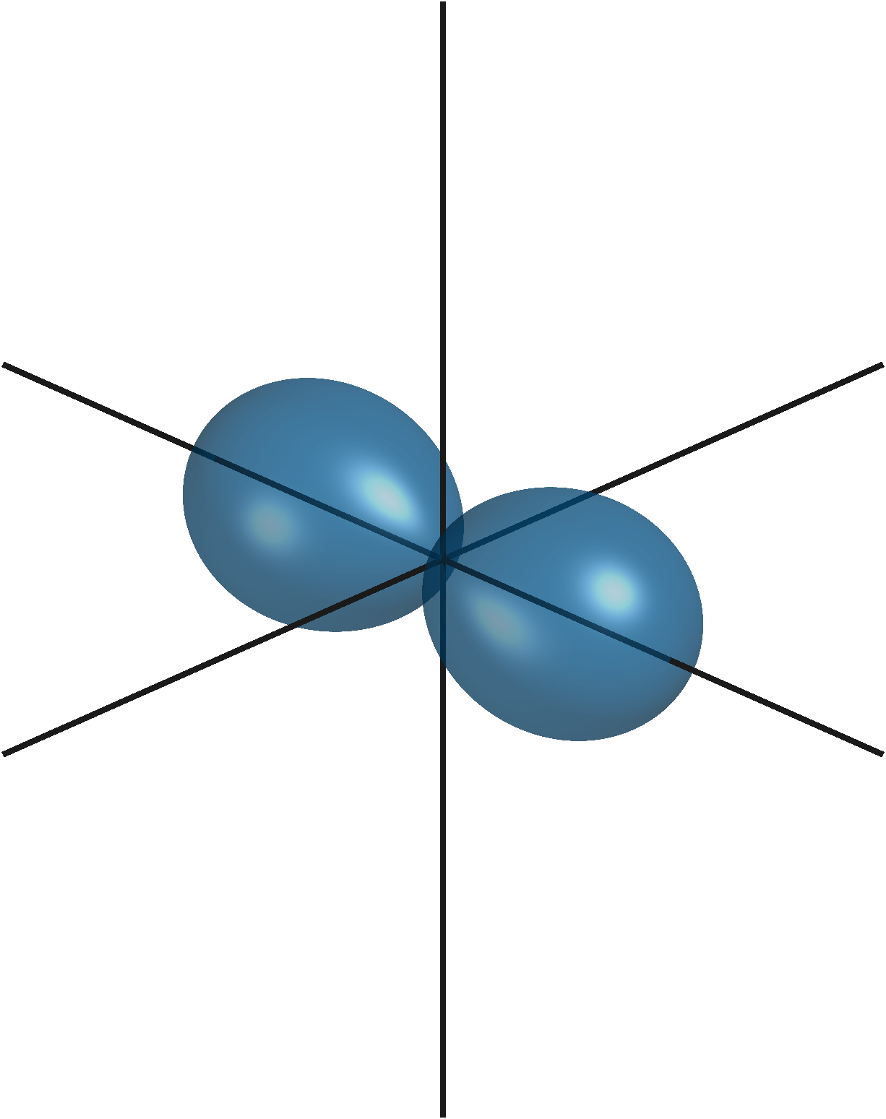
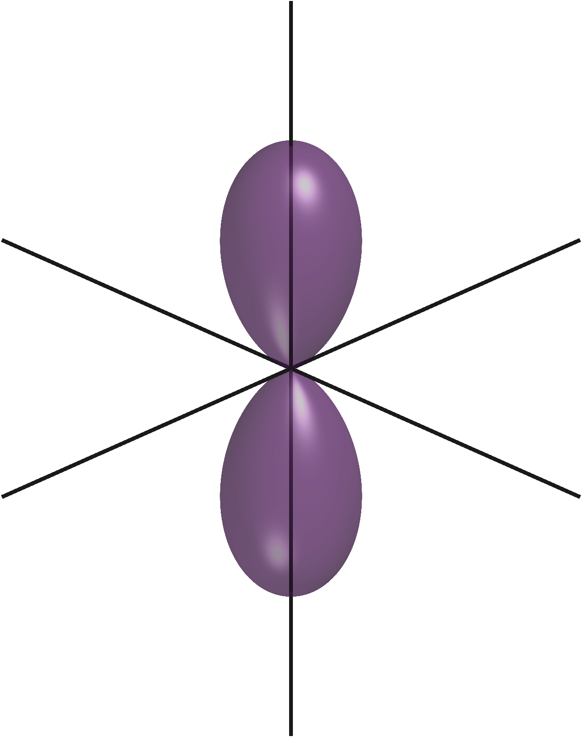
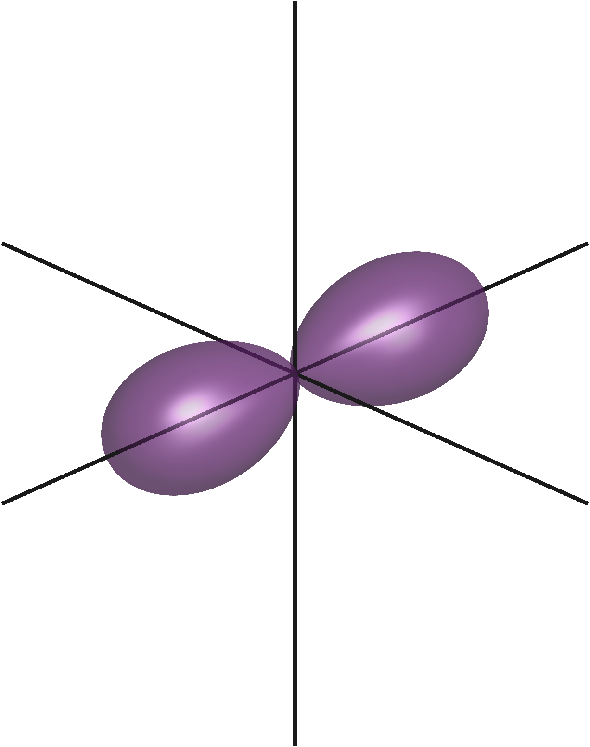
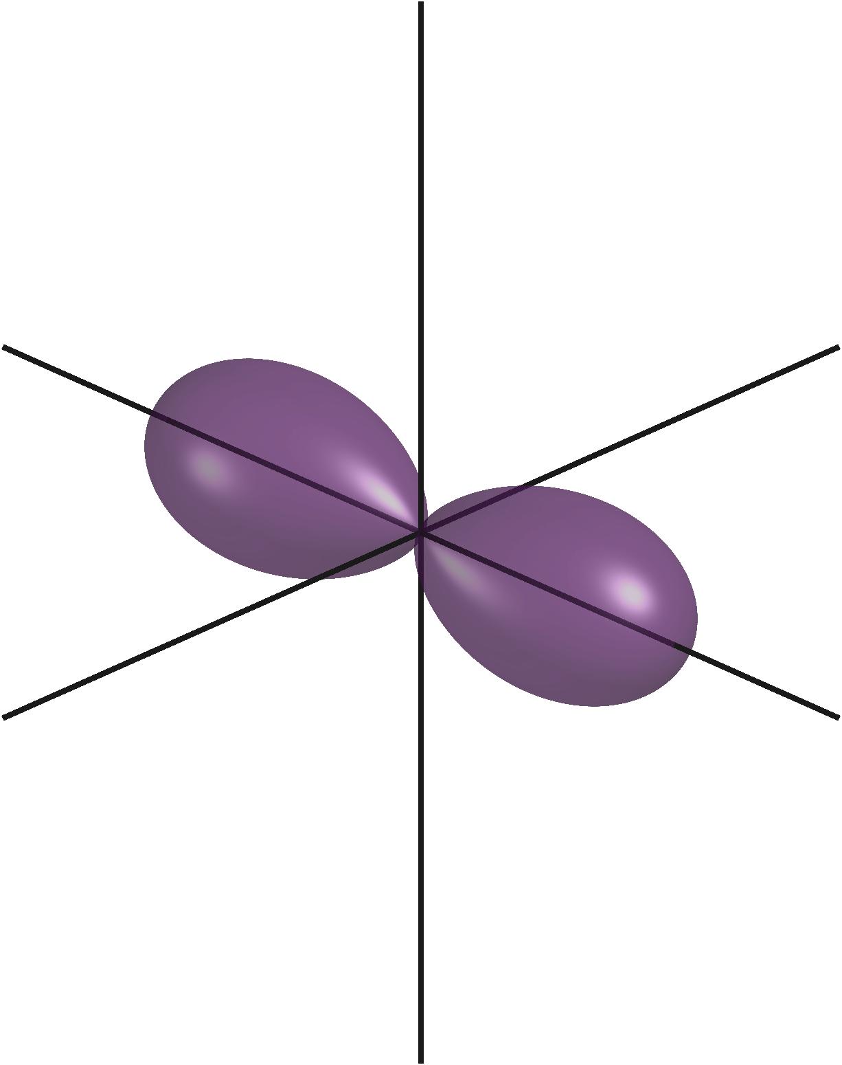
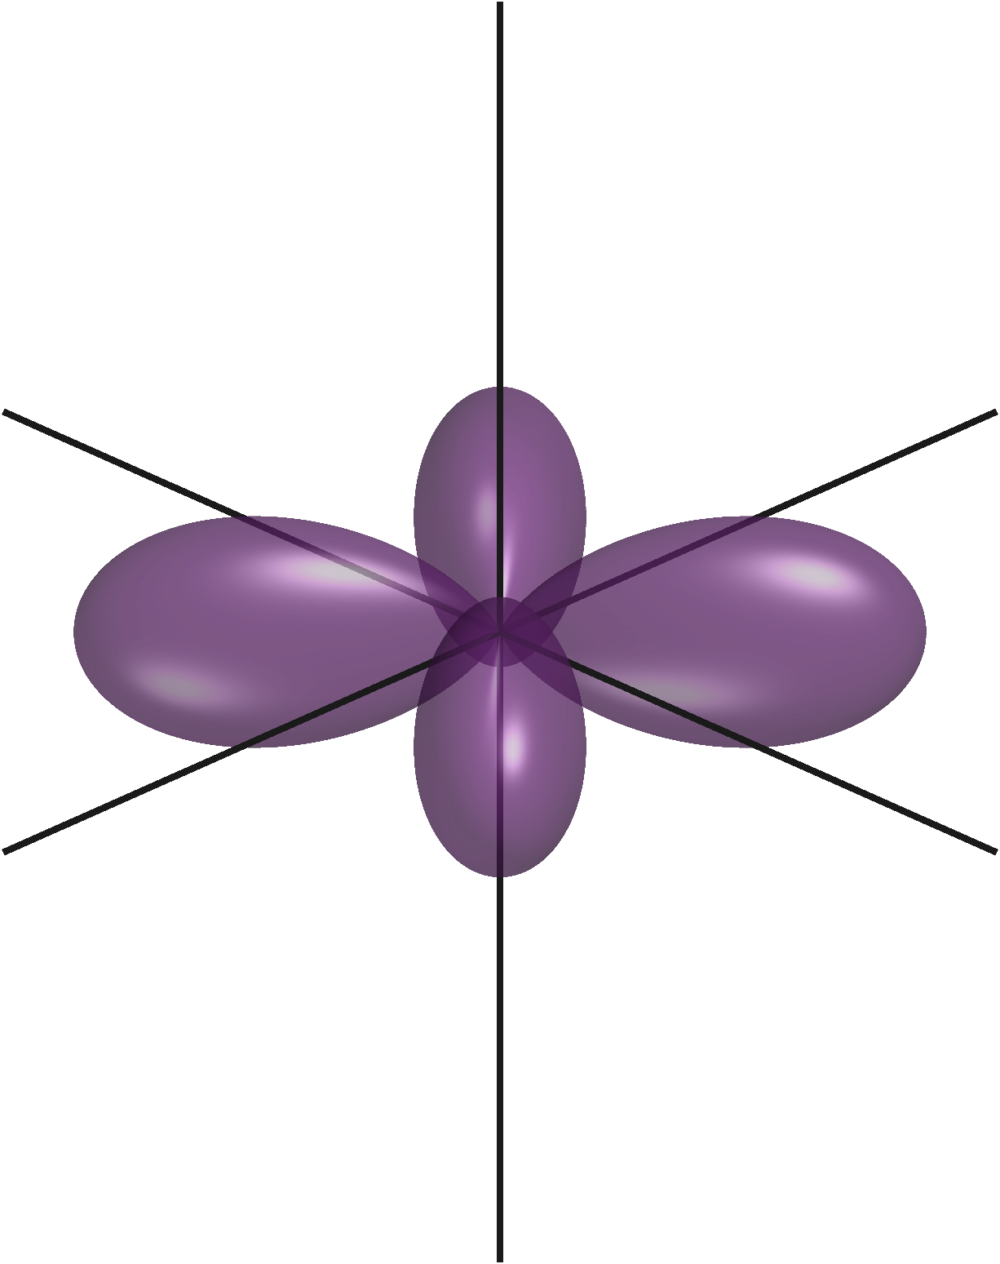
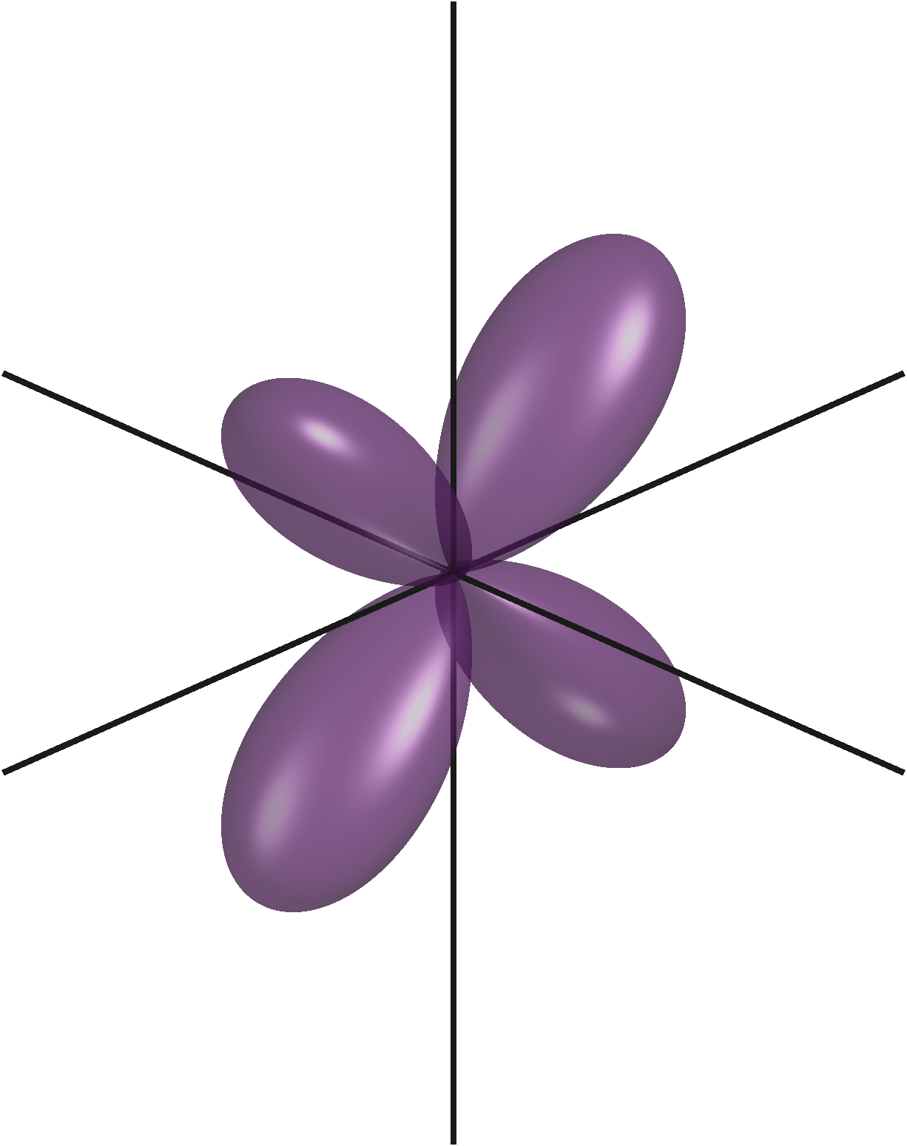
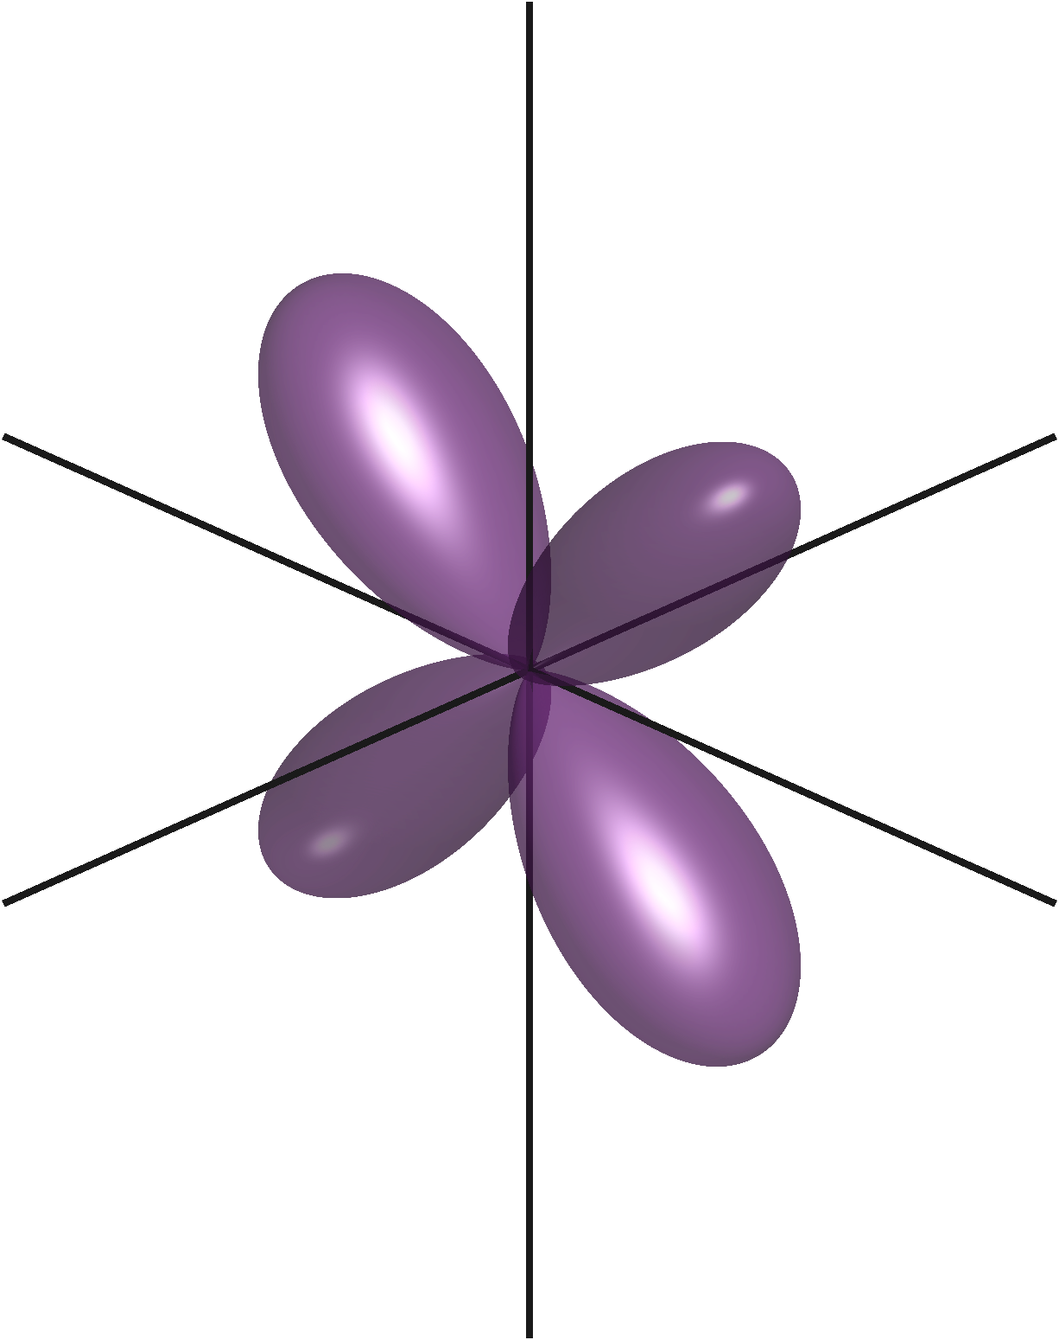
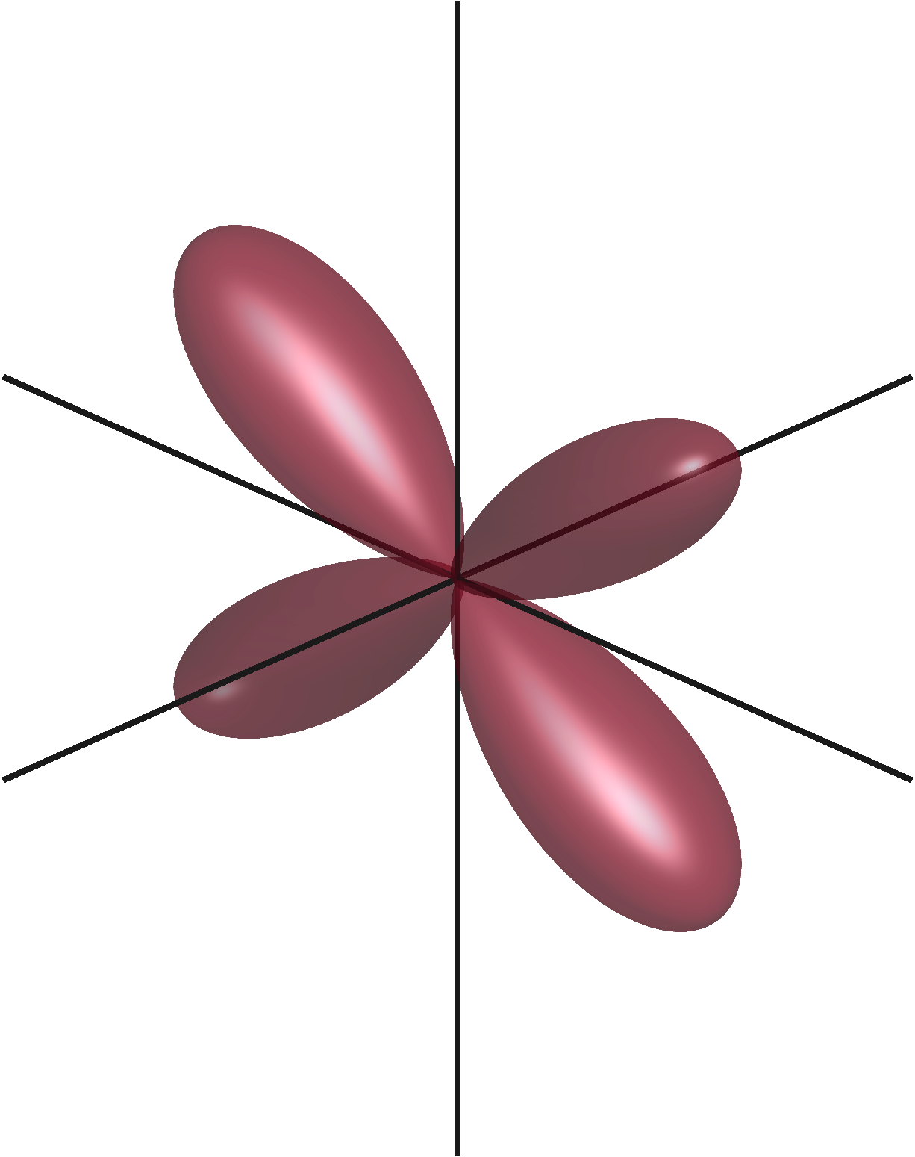
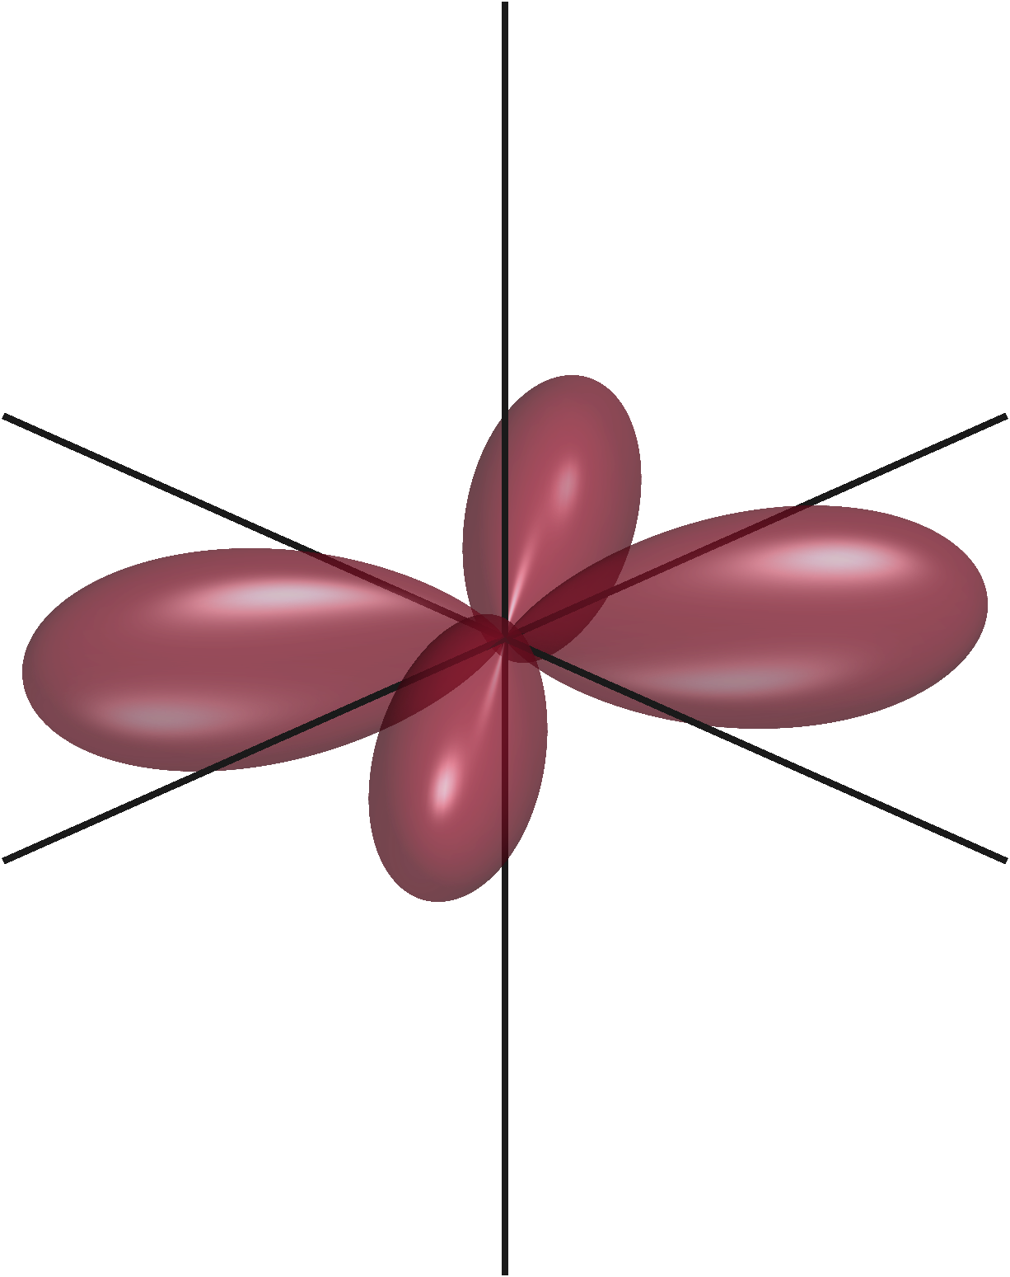
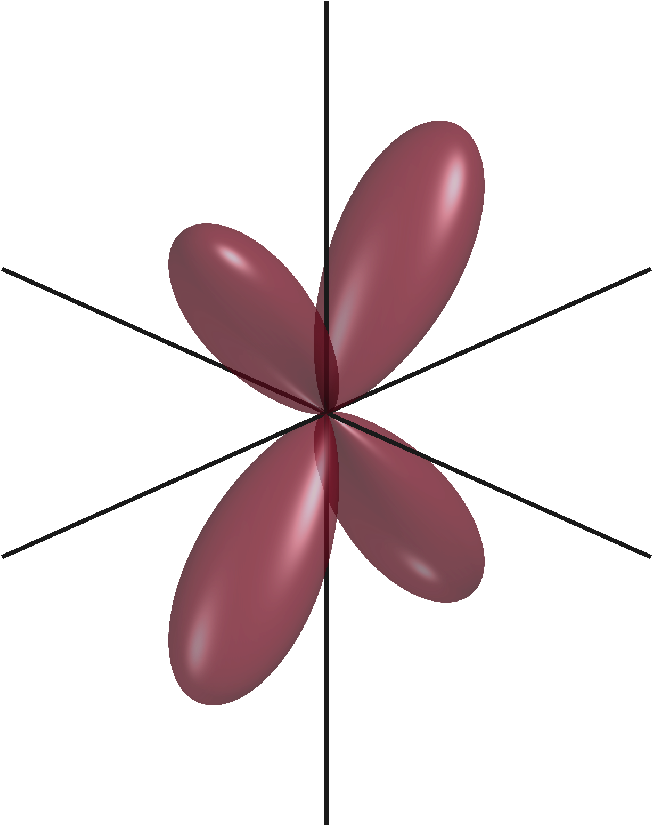
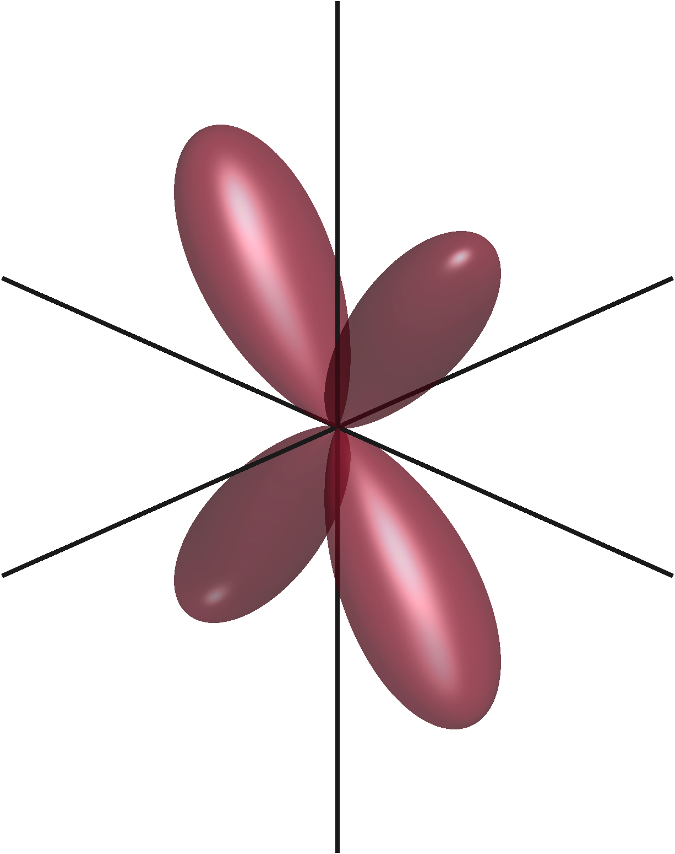
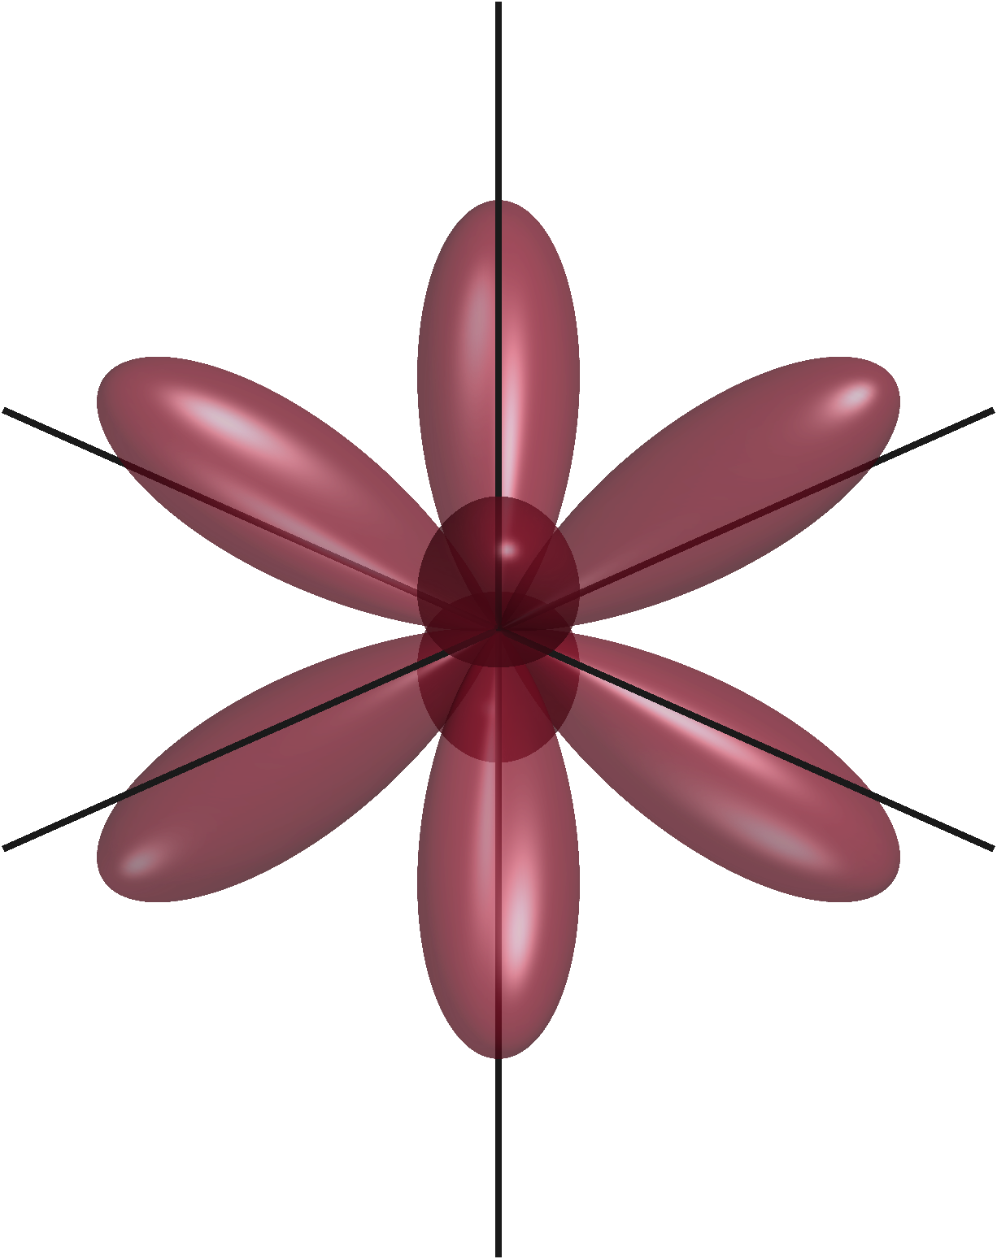
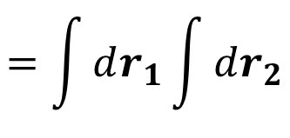


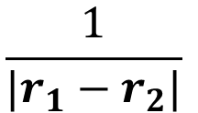

$$=\int{dr_{1}}\int{dr_{2}}$$
$$\frac{1}{|r_{1}−r_{2}|}$$
$$\left[ab | cd\right]$$
$$g_{A,a,α}\left(r_{1}\right)g_{B,b,β}\left(r_{1}\right)$$
$$g_{C,c,γ}\left(r_{2}\right)g_{D,d,δ}\left(r_{2}\right)$$
s-orbital
Cartesian gaussian sub-orbital charge distributions
p-orbital
d-orbital

Slide 8
$$=\int{dr_{1}}\int{dr_{2}}$$
$$\frac{1}{|r_{1}−r_{2}|}$$
$$\left[ab | cd\right]$$
$$g_{A,a,α}\left(r_{1}\right)g_{B,b,β}\left(r_{1}\right)$$
$$g_{C,c,γ}\left(r_{2}\right)g_{D,d,δ}\left(r_{2}\right)$$
s-orbital
Cartesian gaussian sub-orbital charge distributions
=
p-orbital
=
d-orbital
=

Slide 9

s-orbital
$$g_{A,a,α}\left(r_{1}\right)$$
Primitive → 1 GTO
Contracted → Many GTOs
(Gaussian Type Orbital)
In general, one contracted GTO requires ≥ 4 primitive GTOs for accurate results

Slide 10
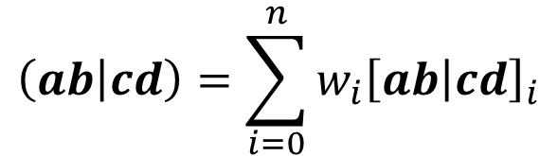


$$=\int{dr_{1}}\int{dr_{2}}$$
$$\frac{1}{|r_{1}−r_{2}|}$$
$$\left[ab | cd\right]$$
$$g_{A,a,α}\left(r_{1}\right)$$
$$g_{B,b,β}\left(r_{1}\right)$$
$$g_{C,c,γ}\left(r_{2}\right)g_{D,d,δ}\left(r_{2}\right)$$
s-orbital
Cartesian gaussian sub-orbital charge distributions
=
p-orbital
$$\left(ab | cd\right)=\sum_{i=0}^{n}{w_{i}{\left[ab | cd\right]}_{i}}$$
=
Contracted
Primitive
d-orbital
=
Scales O(n⁴) where n is the # of electrons
18.7 trillion ERIs per timestep (LiH-HFX-OPT2 benchmark in CP2K [JCP20])
Limits ab initio MD to about only 1000 atoms

Slide 11
Decompose to Primitives
Rys Poly.
Aux. Coeffs
Recurrence Relations
Gaussian Quadrature
Contract
Basis Set
Final ERIs
Decompose to Primitives
Rys Poly.
Aux. Coeffs
Recurrence Relations
Gaussian Quadrature
Contract
Basis Set
Final ERIs
Decompose to Primitives
Rys Poly.
Aux. Coeffs
Recurrence Relations
Gaussian Quadrature
Contract
Basis Set
Final ERIs
Summary of previous work
Primitive ERIs only
Required a unique bitstream for each quartet class
both input and output bottlenecks
Summarize what part of the calculation it did

Slide 12
Calculation Overview

Slide 13
Calculation Overview
Basis Set
Decompose to Primitives
Rys Polynomial
Aux. Coeffs
Recurrence Relations
Gaussian Quadrature
Contraction
Final ERIs

Slide 14












Calculation Overview
Basis Set
$$\left(ab | cd\right)$$
Decompose to Primitives
$$\left[ab | cd\right]$$
$$\left[ab | cd\right]$$
$$\left[ab | cd\right]$$
$$\left[ab | cd\right]$$
$$\left[ab | cd\right]$$
$$\left[ab | cd\right]$$
$$\left[ab | cd\right]$$
$$\left[ab | cd\right]$$
$$\left[ab | cd\right]$$
Rys Polynomial
$$\left[ab | cd\right]$$
$$\left[ab | cd\right]$$
Aux. Coeffs
Recurrence Relations
Gaussian Quadrature
Contraction
Final ERIs

Slide 15
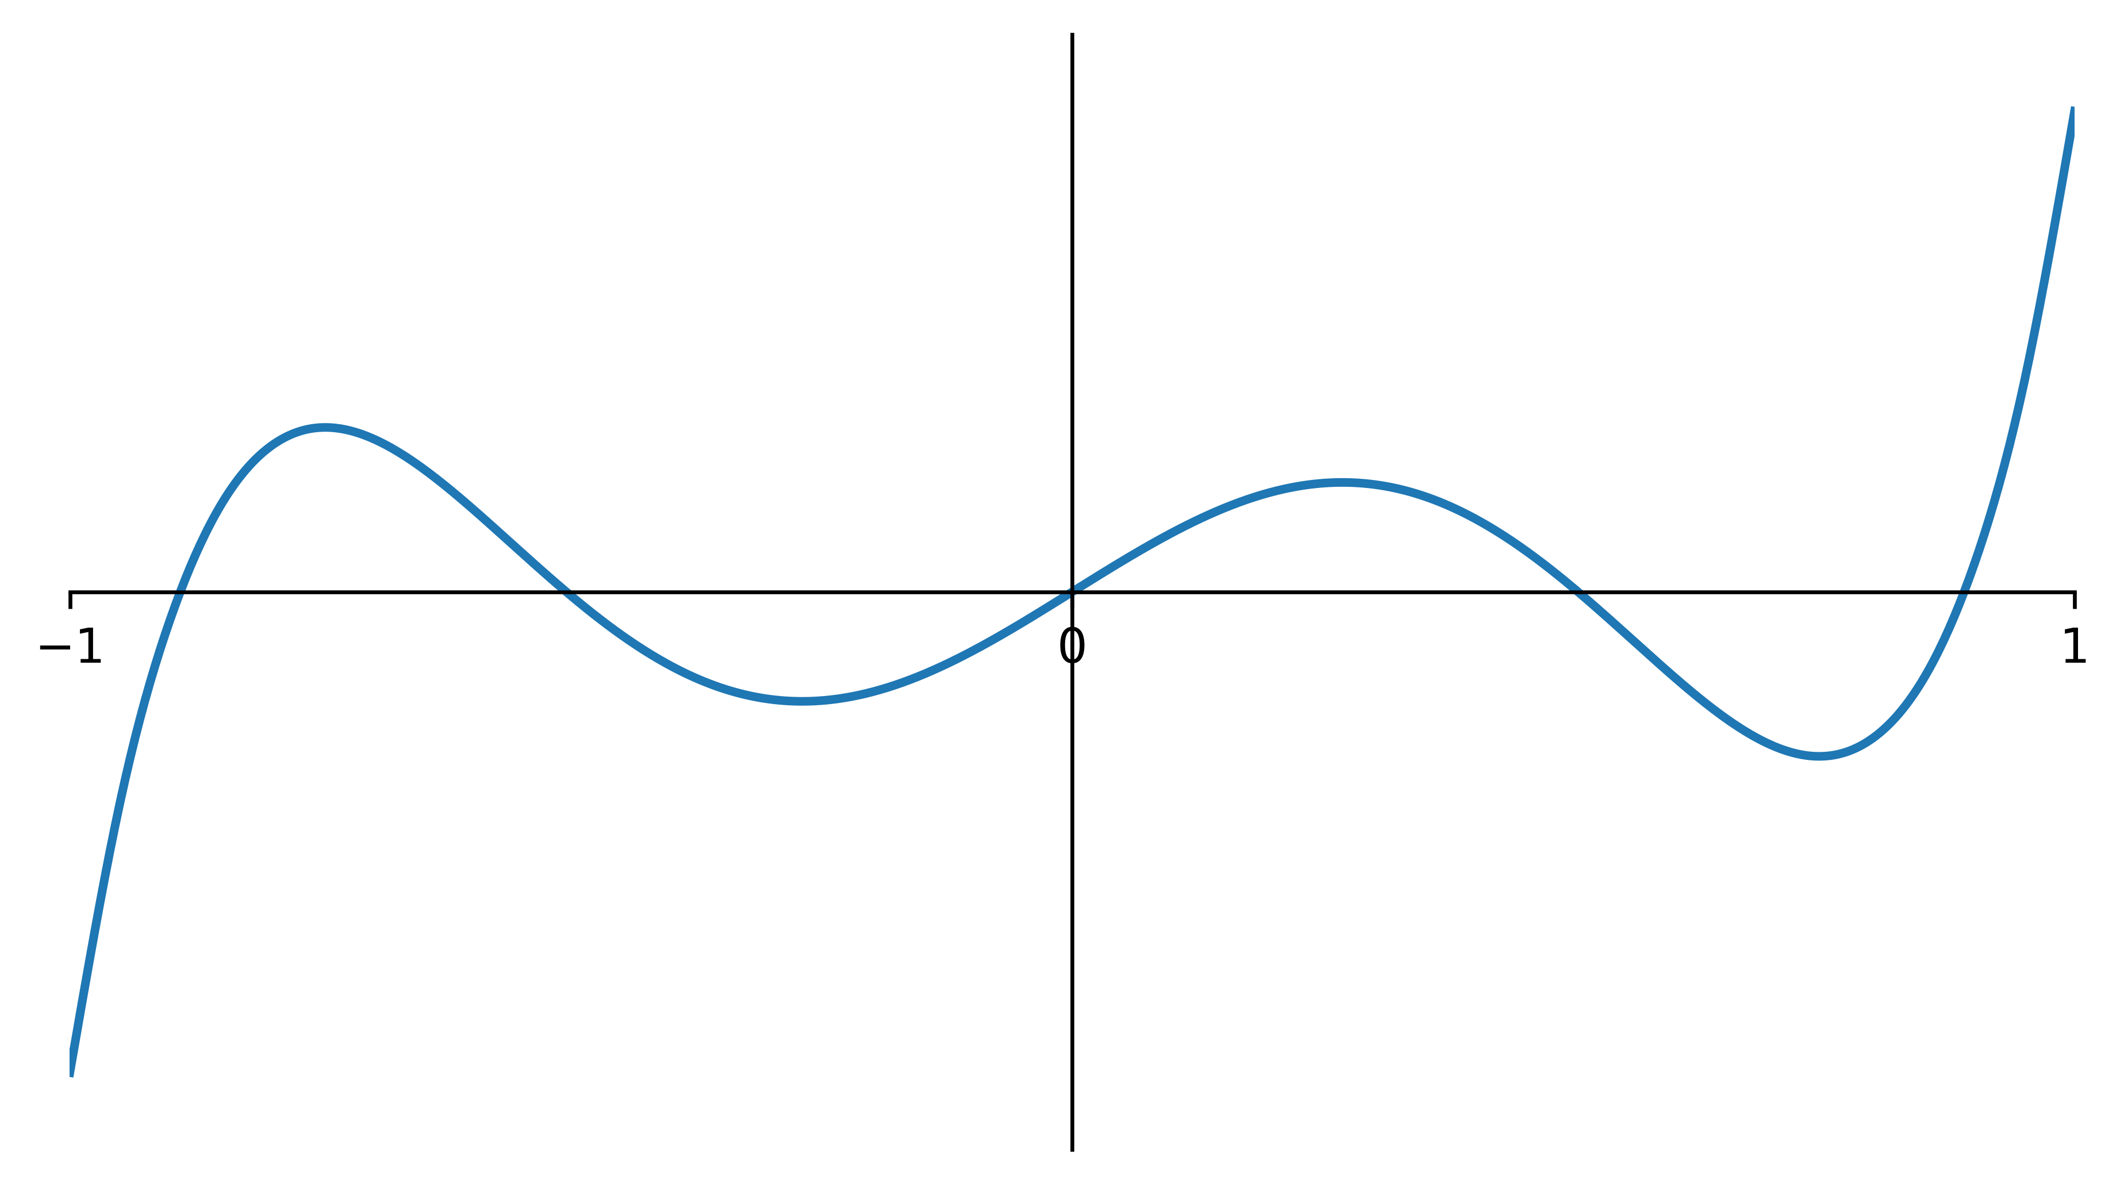
Calculation Overview
Basis Set
Decompose to Primitives
Rys Polynomial
Aux. Coeffs
Recurrence Relations
Gaussian Quadrature
Contraction
Final ERIs

Slide 16
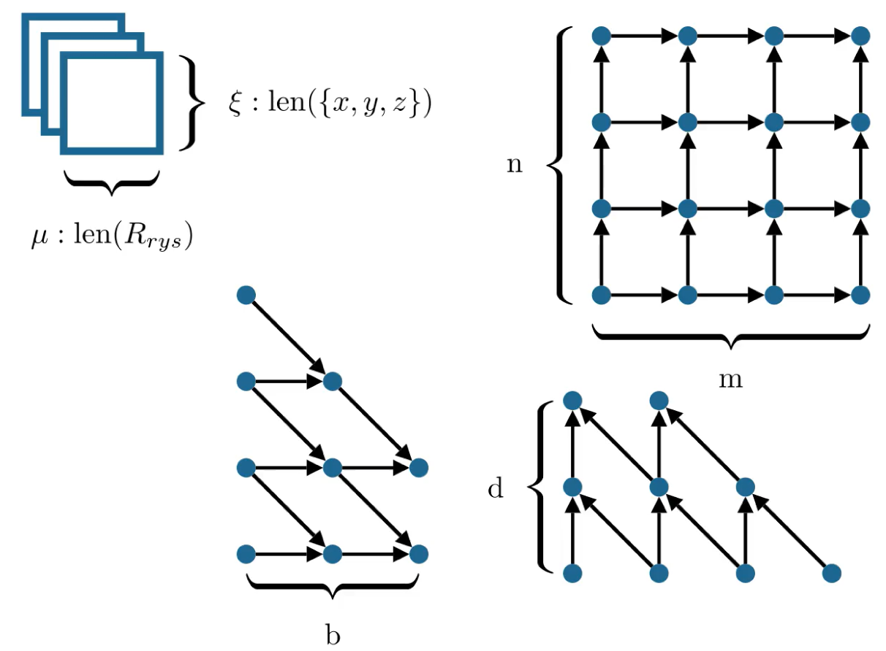
Calculation Overview
Basis Set
Decompose to Primitives
Rys Polynomial
Aux. Coeffs
Recurrence Relations
Gaussian Quadrature
Contraction
Final ERIs

Slide 17
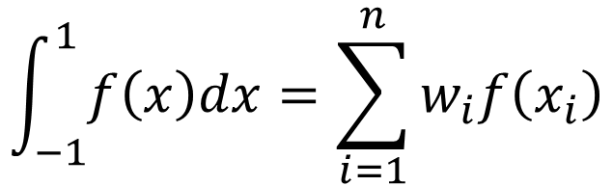
Calculation Overview
Basis Set
Decompose to Primitives
Rys Polynomial
$$\int_{−1}^{1}{f\left(x\right)dx}=\sum_{i=1}^{n}{w_{i}f\left(x_{i}\right)}$$
Aux. Coeffs
Recurrence Relations
Gaussian Quadrature
Contraction
Final ERIs

Slide 18












Calculation Overview
Basis Set
Decompose to Primitives
Rys Polynomial
Aux. Coeffs
Recurrence Relations
Gaussian Quadrature
$$\left[ab | cd\right]$$
$$\left[ab | cd\right]$$
$$\left[ab | cd\right]$$
$$\left[ab | cd\right]$$
$$\left[ab | cd\right]$$
$$\left[ab | cd\right]$$
$$\left[ab | cd\right]$$
$$\left[ab | cd\right]$$
$$\left[ab | cd\right]$$
$$\left[ab | cd\right]$$
$$\left[ab | cd\right]$$
Contraction
Final ERIs
$$\left(ab | cd\right)$$

Slide 19
Prior Work FPGA Design (SERI)

Slide 20
Prior Work FPGA Design (SERI)
Basis Set
Decompose to Primitives
Rys Polynomial
Aux. Coeffs
Recurrence Relations
Gaussian Quadrature
Contraction
Only calculates primitive ERIs
Final ERIs

Slide 21
Prior Work FPGA Design (SERI)
Basis Set
Decompose to Primitives
Pre-calculated on host
Rys Polynomial
Aux. Coeffs
Recurrence Relations
Gaussian Quadrature
Final ERIs

Slide 22
Prior Work FPGA Design (SERI)
Basis Set
Decompose to Primitives
Pre-calculated on host
Rys Polynomial
HBM
Aux. Coeffs
Recurrence Relations
Gaussian Quadrature
HBM
Final ERIs

Slide 23
Prior Work FPGA Design (SERI)
Basis Set
Decompose to Primitives
Pre-calculated on host
Rys Polynomial
FPGA-Host Bandwidth Bottleneck
HBM
Aux. Coeffs
Recurrence Relations
Reduces performance by up to 88%
Gaussian Quadrature
HBM
FPGA-Host Bandwidth Bottleneck
Final ERIs

Slide 24
Prior Work FPGA Design (SERI)
Basis Set
Decompose to Primitives
Rys Polynomial
HBM
Aux. Coeffs
Recurrence Relations
Gaussian Quadrature
HBM
Final ERIs

Slide 25
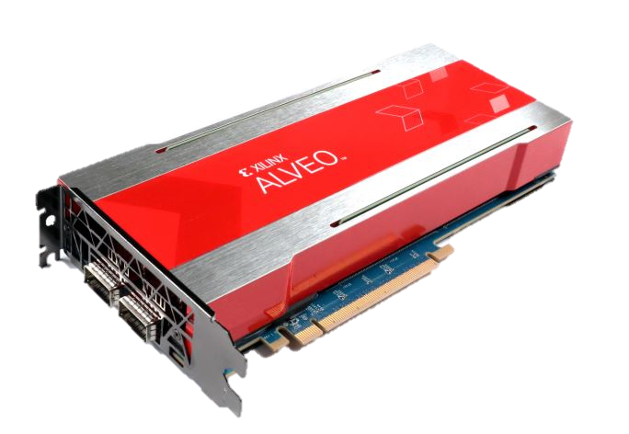

Requires excessive FPGAs → Impractical
[ss|ss]
[ps|ss]
[ps|ps]
[pp|ss]
[pp|ps]
[pp|pp]
[ds|ss]
[ds|ps]
[ds|pp]
[ds|ds]
[dp|ss]
[dp|ps]
[dp|pp]
[dp|ds]
[dp|dp]
[dd|ss]
[dd|ps]
[dd|pp]
[dd|ds]
[dd|dp]
[dd|dd]
Bitstream #1
Bitstream #2
Bitstream #3
Bitstream #4
Bitstream #5
Bitstream #6
Bitstream #7
Bitstream #8
Bitstream #9
Bitstream #10
Bitstream #11
Bitstream #12
OR
Bitstream #13
Bitstream #14
Frequent reconfiguration → Slow
Bitstream #15
Bitstream #16
Bitstream #17
Bitstream #18
Bitstream #19
Bitstream #20
Bitstream #21
Reconfiguring...

Slide 26
Prior Work FPGA Design (SERI)
Basis Set
Decompose to Primitives
Rys Polynomial
Critical Practical Limitations
Host-FPGA Bandwidth Limitations
Quartet Class Specific Kernels
HBM
Aux. Coeffs
Recurrence Relations
Gaussian Quadrature
HBM
Final ERIs

Slide 27
SORCERI – Practical End-to-End
Basis Set
Decompose to Primitives
Rys Polynomial
Aux. Coeffs
Recurrence Relations
Gaussian Quadrature
Contraction
Final ERIs

Slide 28
SORCERI
Basis Set
Decompose to Primitives
Rys Polynomial
Aux. Coeffs
Perform all steps on-chip
Recurrence Relations
Gaussian Quadrature
Contraction
Final ERIs

Slide 29
SORCERI
Basis Set
Decompose to Primitives
Rys Polynomial
Aux. Coeffs
Perform all steps on-chip
Recurrence Relations
Gaussian Quadrature
Contraction
Final ERIs

Slide 30
SORCERI
[ss|ss]
[ps|ss]
[ds|ss]
[pp|ss]
[ps|ps]
[dp|ss]
[ds|ps]
[pp|ps]
[dd|ss]
[ds|ds]
[dp|ps]
[ds|pp]
[pp|pp]
[dd|ps]
[dp|ds]
[dp|pp]
[dd|ds]
[dd|pp]
[dp|dp]
[dd|dp]
[dd|dd]
Bitstream #1
Basis Set
Bitstream #2
Bitstream #3
Decompose to Primitives
Bitstream #4
Bitstream #5
Bitstream #6
Rys Polynomial
Bitstream #7
Bitstream #8
Bitstream #9
Aux. Coeffs
Bitstream #10
Perform all steps on-chip
Bitstream #11
Recurrence Relations
Bitstream #12
Bitstream #13
Bitstream #14
Gaussian Quadrature
Bitstream #15
Bitstream #16
Contraction
Bitstream #17
Bitstream #18
Bitstream #19
Final ERIs
Bitstream #20
Bitstream #21

Slide 31
SORCERI
[ss|ss]
[ps|ss]
[ds|ss]
[pp|ss]
[ps|ps]
[dp|ss]
[ds|ps]
[pp|ps]
[dd|ss]
[ds|ds]
[dp|ps]
[ds|pp]
[pp|pp]
[dd|ps]
[dp|ds]
[dp|pp]
[dd|ds]
[dd|pp]
[dp|dp]
[dd|dp]
[dd|dd]
Bitstream #1
( 𝜇 = 1,2 )
Basis Set
Decompose to Primitives
Rys Polynomial
Bitstream #2
( 𝜇 = 3 )
Aux. Coeffs
Perform all steps on-chip
Overlays
Recurrence Relations
Gaussian Quadrature
Bitstream #3
( 𝜇 = 4,5 )
Contraction
Final ERIs

Slide 32
Creating Overlays

Slide 33
Creating Overlays
All stages must be designed to flexibly consume data
Data must be dynamically processed to maintain high throughput
Compute Module
Parallelism (unroll)
Resource reuse (II)
At runtime we need different effective II’s, depending on input

Slide 34
Creating Overlays
All stages must be designed to flexibly consume data
Data must be dynamically processed to maintain high throughput
Compute Module
Parallelism (unroll)
Resource reuse (II)
At runtime we need different effective II’s, depending on input
This can be difficult, especially for Vitis HLS designs

Slide 35
Strategies for Vitis HLS Designs
How do we achieve?
Runtime flexible effective II
AND
Efficient resource utilization (LUTs, DSPs, FFs)
AND
Good Timing Closure

Slide 36
Strategies Vitis HLS Designs
Core Idea: use free-running pipelines (frp)
Pipeline Style | Usage Constraints | Flushable | Supports Rewind | II>1 Resource Sharing | Timing Closure
stp | none | no | yes | yes | high fanout
flp | few | yes | no | no | standard
frp | a lot | yes | yes | yes | very good

Slide 37
Strategies for Vitis HLS Designs
Core Idea: maximize use of free-running pipelines (frp)
Split steps into free running tasks
Data handling and manipulation should in be free-running pipelines
If complex control logic is needed, implement as separate task and stream instructions into the free-running pipeline tasks
Pipeline Style | Usage Constraints | Flushable | Supports Rewind | II>1 Resource Sharing | Timing Closure
stp | none | no | yes | yes | high fanout
flp | few | yes | no | no | standard
frp | a lot | yes | yes | yes | very good

Slide 38
Rys Polynomial Stage

Slide 39
Rys Polynomial Stage - Challenge
We want to find the zeros of the Rys polynomial
This calculation is too difficult to solve analytically
Requires evaluation of piecewise polynomial approximations
Both the calculations and number of calculations change with the order of the polynomial (μ) and the input (x)
…
μ = 1
μ = 2
μ = 3
…
Range of input x
Range of input x
Range of input x
Unique Code
Unique
Code
Unique Code
Unique Code
Unique Code
Unique Code
Unique Code
Unique Code
Unique Code
Unique Code
Unique Code
Unique Code
Unique Code
Unique Code
Unique
Code
…

Slide 40
Rys Polynomial Stage - Solution
Thankfully, there are some common calculation modules we can extract

Slide 41
Rys Polynomial Stage - Solution
Many high degree Horner polynomial evaluations
Pre-Calculations
Post-Calculations
$$P_{n}\left(x\right)=a_{0}+x\left(a_{1}+x\left(a_{2}+…+x\left(a_{n−1}+xa_{n}\right)\right)\right)$$

Slide 42
Rys Polynomial Stage - Solution
Horner Unit (II=1)
$$P_{n}\left(x\right)=a_{0}+x\left(a_{1}+x\left(a_{2}+…+x\left(a_{n−1}+xa_{n}\right)\right)\right)$$
Horner Unit (II=1)
Pre-Calculations
Post-Calculations
$$P_{n}\left(x\right)=a_{0}+x\left(a_{1}+x\left(a_{2}+…+x\left(a_{n−1}+xa_{n}\right)\right)\right)$$
Horner Unit (II=1)
$$P_{n}\left(x\right)=a_{0}+x\left(a_{1}+x\left(a_{2}+…+x\left(a_{n−1}+xa_{n}\right)\right)\right)$$
free-running pipelines

Slide 43
Rys Polynomial Stage - Solution
Horner Unit (II=1)
$$P_{n}\left(x\right)=a_{0}+x\left(a_{1}+x\left(a_{2}+…+x\left(a_{n−1}+xa_{n}\right)\right)\right)$$
Horner Unit (II=1)
Pre-Calculations
Post-Calculations
$$P_{n}\left(x\right)=a_{0}+x\left(a_{1}+x\left(a_{2}+…+x\left(a_{n−1}+xa_{n}\right)\right)\right)$$
Horner Unit (II=1)
$$P_{n}\left(x\right)=a_{0}+x\left(a_{1}+x\left(a_{2}+…+x\left(a_{n−1}+xa_{n}\right)\right)\right)$$
free-running pipelines

Slide 44
Rys Polynomial Stage - Solution
Horner Unit (II=1)
$$P_{n}\left(x\right)=a_{0}+x\left(a_{1}+x\left(a_{2}+…+x\left(a_{n−1}+xa_{n}\right)\right)\right)$$
Horner Unit (II=1)
Pre-Calculations
Post-Calculations
$$P_{n}\left(x\right)=a_{0}+x\left(a_{1}+x\left(a_{2}+…+x\left(a_{n−1}+xa_{n}\right)\right)\right)$$
Horner Unit (II=1)
$$P_{n}\left(x\right)=a_{0}+x\left(a_{1}+x\left(a_{2}+…+x\left(a_{n−1}+xa_{n}\right)\right)\right)$$
free-running pipelines

Slide 45
Rys Polynomial Stage - Solution
Horner Unit (II=1)
$$P_{n}\left(x\right)=a_{0}+x\left(a_{1}+x\left(a_{2}+…+x\left(a_{n−1}+xa_{n}\right)\right)\right)$$
Horner Unit (II=1)
Pre-Calculations
Post-Calculations
$$P_{n}\left(x\right)=a_{0}+x\left(a_{1}+x\left(a_{2}+…+x\left(a_{n−1}+xa_{n}\right)\right)\right)$$
Horner Unit (II=1)
$$P_{n}\left(x\right)=a_{0}+x\left(a_{1}+x\left(a_{2}+…+x\left(a_{n−1}+xa_{n}\right)\right)\right)$$
free-running pipelines

Slide 46
Rys Polynomial Stage - Solution
Horner Unit (II=1)
$$P_{n}\left(x\right)=a_{0}+x\left(a_{1}+x\left(a_{2}+…+x\left(a_{n−1}+xa_{n}\right)\right)\right)$$
Horner Unit (II=1)
Pre-Calculations
Post-Calculations
$$P_{n}\left(x\right)=a_{0}+x\left(a_{1}+x\left(a_{2}+…+x\left(a_{n−1}+xa_{n}\right)\right)\right)$$
Horner Unit (II=1)
$$P_{n}\left(x\right)=a_{0}+x\left(a_{1}+x\left(a_{2}+…+x\left(a_{n−1}+xa_{n}\right)\right)\right)$$
free-running pipelines

Slide 47
Rys Polynomial Stage - Solution
Horner Unit (II=1)
$$P_{n}\left(x\right)=a_{0}+x\left(a_{1}+x\left(a_{2}+…+x\left(a_{n−1}+xa_{n}\right)\right)\right)$$
Horner Unit (II=1)
Pre-Calculations
Post-Calculations
$$P_{n}\left(x\right)=a_{0}+x\left(a_{1}+x\left(a_{2}+…+x\left(a_{n−1}+xa_{n}\right)\right)\right)$$
Horner Unit (II=1)
$$P_{n}\left(x\right)=a_{0}+x\left(a_{1}+x\left(a_{2}+…+x\left(a_{n−1}+xa_{n}\right)\right)\right)$$
free-running pipelines

Slide 48
Rys Polynomial Stage - Solution
Horner Unit (II=1)
$$P_{n}\left(x\right)=a_{0}+x\left(a_{1}+x\left(a_{2}+…+x\left(a_{n−1}+xa_{n}\right)\right)\right)$$
Horner Unit (II=1)
Pre-Calculations
Post-Calculations
$$P_{n}\left(x\right)=a_{0}+x\left(a_{1}+x\left(a_{2}+…+x\left(a_{n−1}+xa_{n}\right)\right)\right)$$
Horner Unit (II=1)
$$P_{n}\left(x\right)=a_{0}+x\left(a_{1}+x\left(a_{2}+…+x\left(a_{n−1}+xa_{n}\right)\right)\right)$$
free-running pipelines

Slide 49
Rys Polynomial Stage - Solution
Horner Unit (II=1)
$$P_{n}\left(x\right)=a_{0}+x\left(a_{1}+x\left(a_{2}+…+x\left(a_{n−1}+xa_{n}\right)\right)\right)$$
Horner Unit (II=1)
Pre-Calculations
Post-Calculations
$$P_{n}\left(x\right)=a_{0}+x\left(a_{1}+x\left(a_{2}+…+x\left(a_{n−1}+xa_{n}\right)\right)\right)$$
Horner Unit (II=1)
$$P_{n}\left(x\right)=a_{0}+x\left(a_{1}+x\left(a_{2}+…+x\left(a_{n−1}+xa_{n}\right)\right)\right)$$
free-running pipelines

Slide 50
Rys Polynomial Stage - Solution
Horner Unit (II=1)
$$P_{n}\left(x\right)=a_{0}+x\left(a_{1}+x\left(a_{2}+…+x\left(a_{n−1}+xa_{n}\right)\right)\right)$$
Horner Unit (II=1)
Pre-Calculations
Post-Calculations
$$P_{n}\left(x\right)=a_{0}+x\left(a_{1}+x\left(a_{2}+…+x\left(a_{n−1}+xa_{n}\right)\right)\right)$$
Horner Unit (II=1)
$$P_{n}\left(x\right)=a_{0}+x\left(a_{1}+x\left(a_{2}+…+x\left(a_{n−1}+xa_{n}\right)\right)\right)$$
free-running pipelines

Slide 51
Rys Polynomial Stage - Solution
Horner Unit (II=1)
$$P_{n}\left(x\right)=a_{0}+x\left(a_{1}+x\left(a_{2}+…+x\left(a_{n−1}+xa_{n}\right)\right)\right)$$
Horner Unit (II=1)
Pre-Calculations
Post-Calculations
$$P_{n}\left(x\right)=a_{0}+x\left(a_{1}+x\left(a_{2}+…+x\left(a_{n−1}+xa_{n}\right)\right)\right)$$
Horner Unit (II=1)
$$P_{n}\left(x\right)=a_{0}+x\left(a_{1}+x\left(a_{2}+…+x\left(a_{n−1}+xa_{n}\right)\right)\right)$$
free-running pipelines

Slide 52
Rys Polynomial Stage - Solution
Horner Unit (II=1)
$$P_{n}\left(x\right)=a_{0}+x\left(a_{1}+x\left(a_{2}+…+x\left(a_{n−1}+xa_{n}\right)\right)\right)$$
Horner Unit (II=1)
Pre-Calculations
Post-Calculations
$$P_{n}\left(x\right)=a_{0}+x\left(a_{1}+x\left(a_{2}+…+x\left(a_{n−1}+xa_{n}\right)\right)\right)$$
Horner Unit (II=1)
$$P_{n}\left(x\right)=a_{0}+x\left(a_{1}+x\left(a_{2}+…+x\left(a_{n−1}+xa_{n}\right)\right)\right)$$
free-running pipelines

Slide 53
Rys Polynomial Stage - Solution
Horner Unit (II=1)
$$P_{n}\left(x\right)=a_{0}+x\left(a_{1}+x\left(a_{2}+…+x\left(a_{n−1}+xa_{n}\right)\right)\right)$$
Horner Unit (II=1)
Pre-Calculations
Post-Calculations
$$P_{n}\left(x\right)=a_{0}+x\left(a_{1}+x\left(a_{2}+…+x\left(a_{n−1}+xa_{n}\right)\right)\right)$$
Horner Unit (II=1)
$$P_{n}\left(x\right)=a_{0}+x\left(a_{1}+x\left(a_{2}+…+x\left(a_{n−1}+xa_{n}\right)\right)\right)$$
Overall II of the stage can scale based on calculation complexity

Slide 54
Orthogonal Memory Access - Challenge
Some stages such as Recurrence Relations and Gaussian Quadrature, produce and consume data on orthogonal dimensions
We need a way to transpose the data without affecting throughput
Needs to be flexible to varying data dimensions at runtime

Slide 55
Orthogonal Memory Access - Challenge
0,0
0,1
0,2
0,3
0,4
0,5
0,6
0,7
1,0
1,1
1,2
1,3
1,4
1,5
1,6
1,7
2,0
2,1
2,2
2,3
2,4
2,5
2,6
2,7
3,0
3,1
3,2
3,3
3,4
3,5
3,6
3,7
4,0
4,1
4,2
4,3
4,4
4,5
4,6
4,7
5,0
5,1
5,2
5,3
5,4
5,5
5,6
5,7
6,0
6,1
6,2
6,3
6,4
6,5
6,6
6,7
7,0
7,1
7,2
7,3
7,4
7,5
7,6
7,7

Slide 56
Orthogonal Memory Access - Challenge
0,0
0,1
0,2
0,3
0,4
0,5
0,6
0,7
1,0
1,1
1,2
1,3
1,4
1,5
1,6
1,7
2,0
2,1
2,2
2,3
2,4
2,5
2,6
2,7
Column
Writer
(II=1)
Row
Reader
(II=1)
3,0
3,1
3,2
3,3
3,4
3,5
3,6
3,7
4,0
4,1
4,2
4,3
4,4
4,5
4,6
4,7
5,0
5,1
5,2
5,3
5,4
5,5
5,6
5,7
6,0
6,1
6,2
6,3
6,4
6,5
6,6
6,7
7,0
7,1
7,2
7,3
7,4
7,5
7,6
7,7

Slide 57
Orthogonal Memory Access - Challenge
0,0
0,1
0,2
0,3
0,4
0,5
0,6
0,7
1,0
1,1
1,2
1,3
1,4
1,5
1,6
1,7
2,0
2,1
2,2
2,3
2,4
2,5
2,6
2,7
Column
Writer
(II=1)
Row
Reader
(II=1)
3,0
3,1
3,2
3,3
3,4
3,5
3,6
3,7
4,0
4,1
4,2
4,3
4,4
4,5
4,6
4,7
not possible
not possible
5,0
5,1
5,2
5,3
5,4
5,5
5,6
5,7
6,0
6,1
6,2
6,3
6,4
6,5
6,6
6,7
7,0
7,1
7,2
7,3
7,4
7,5
7,6
7,7

Slide 58
Buffer Permutation Stage
0,0
0,1
0,2
0,3
0,4
0,5
0,6
0,7
1,0
1,1
1,2
1,3
1,4
1,5
1,6
1,7
2,0
2,1
2,2
2,3
2,4
2,5
2,6
2,7
3,0
3,1
3,2
3,3
3,4
3,5
3,6
3,7
4,0
4,1
4,2
4,3
4,4
4,5
4,6
4,7
5,0
5,1
5,2
5,3
5,4
5,5
5,6
5,7
6,0
6,1
6,2
6,3
6,4
6,5
6,6
6,7
7,0
7,1
7,2
7,3
7,4
7,5
7,6
7,7

Slide 59
Orthogonal Memory Access - Challenge
0,0
0,1
0,2
0,3
0,4
0,5
0,6
0,7
1,0
1,1
1,2
1,3
1,4
1,5
1,6
1,7
2,0
2,1
2,2
2,3
2,4
2,5
2,6
2,7
Column
Writer
(II=1)
Row
Reader
(II=1)
3,0
3,1
3,2
3,3
3,4
3,5
3,6
3,7
4,0
4,1
4,2
4,3
4,4
4,5
4,6
4,7
5,0
5,1
5,2
5,3
5,4
5,5
5,6
5,7
6,0
6,1
6,2
6,3
6,4
6,5
6,6
6,7
7,0
7,1
7,2
7,3
7,4
7,5
7,6
7,7

Slide 60
Orthogonal Memory Access - Challenge
0,0
0,1
0,2
0,3
0,4
0,5
0,6
0,7
1,0
1,1
1,2
1,3
1,4
1,5
1,6
1,7
0,0
2,0
2,1
2,2
2,3
2,4
2,5
2,6
2,7
1,0
2,0
Column
Writer
(II=1)
Row
Reader
(II=1)
3,0
3,0
3,1
3,2
3,3
3,4
3,5
3,6
3,7
4,0
5,0
6,0
4,0
4,1
4,2
4,3
4,4
4,5
4,6
4,7
7,0
5,0
5,1
5,2
5,3
5,4
5,5
5,6
5,7
6,0
6,1
6,2
6,3
6,4
6,5
6,6
6,7
7,0
7,1
7,2
7,3
7,4
7,5
7,6
7,7

Slide 61
Orthogonal Memory Access - Challenge
0,0
0,2
0,3
0,6
0,7
0,0
0,1
0,4
0,5
1,0
1,2
1,3
1,6
1,7
1,0
1,1
1,4
1,5
2,0
2,2
2,3
2,6
2,7
2,0
2,1
2,4
2,5
Column
Writer
(II=1)
Row
Reader
(II=1)
3,0
3,2
3,3
3,6
3,7
3,0
3,1
3,4
3,5
4,0
4,2
4,3
4,6
4,7
4,0
4,1
4,4
4,5
5,0
5,2
5,3
5,6
5,7
5,0
5,1
5,4
5,5
6,0
6,2
6,3
6,6
6,7
6,0
6,1
6,4
6,5
7,0
7,2
7,3
7,6
7,7
7,0
7,1
7,4
7,5

Slide 62
Orthogonal Memory Access
0,0
0,1
0,2
0,3
0,4
0,5
0,6
0,7
1,0
1,1
1,2
1,3
1,4
1,5
1,6
1,7
2,0
2,1
2,2
2,3
2,4
2,5
2,6
2,7
Column
Writer
(II=1)
Row
Reader
(II=1)
3,0
3,1
3,2
3,3
3,4
3,5
3,6
3,7
4,0
4,1
4,2
4,3
4,4
4,5
4,6
4,7
5,0
5,1
5,2
5,3
5,4
5,5
5,6
5,7
6,0
6,1
6,2
6,3
6,4
6,5
6,6
6,7
7,0
7,1
7,2
7,3
7,4
7,5
7,6
7,7

Slide 63
Orthogonal Memory Access
0,0
0,1
0,2
0,3
0,4
0,5
0,6
0,7
1,0
1,1
1,2
1,3
1,4
1,5
1,6
1,7
0,0
2,0
2,1
2,2
2,3
2,4
2,5
2,6
2,7
1,0
2,0
Column
Writer
(II=1)
Row
Reader
(II=1)
3,0
3,0
3,1
3,2
3,3
3,4
3,5
3,6
3,7
4,0
5,0
6,0
4,0
4,1
4,2
4,3
4,4
4,5
4,6
4,7
7,0
5,0
5,1
5,2
5,3
5,4
5,5
5,6
5,7
6,0
6,1
6,2
6,3
6,4
6,5
6,6
6,7
7,0
7,1
7,2
7,3
7,4
7,5
7,6
7,7

Slide 64
Orthogonal Memory Access
0,0
0,0
0,2
0,3
0,6
0,7
0,1
0,4
0,5
1,0
1,0
1,2
1,3
1,6
1,7
1,1
1,4
1,5
2,0
2,0
2,2
2,3
2,6
2,7
2,1
2,4
2,5
Column
Writer
(II=1)
Row
Reader
(II=1)
3,0
3,0
3,2
3,3
3,6
3,7
3,1
3,4
3,5
4,0
4,0
4,2
4,3
4,6
4,7
4,1
4,4
4,5
5,0
5,0
5,2
5,3
5,6
5,7
5,1
5,4
5,5
6,0
6,0
6,2
6,3
6,6
6,7
6,1
6,4
6,5
7,0
7,0
7,2
7,3
7,6
7,7
7,1
7,4
7,5

Slide 65
Orthogonal Memory Access - Challenge
0,0
0,1
0,2
0,3
0,4
0,5
0,6
0,7
1,0
1,1
1,2
1,3
1,4
1,5
1,6
1,7
2,0
2,1
2,2
2,3
2,4
2,5
2,6
2,7
Column
Writer
(II=1)
Row
Reader
(II=1)
3,0
3,1
3,2
3,3
3,4
3,5
3,6
3,7
4,0
4,1
4,2
4,3
4,4
4,5
4,6
4,7
5,0
5,1
5,2
5,3
5,4
5,5
5,6
5,7
6,0
6,1
6,2
6,3
6,4
6,5
6,6
6,7
7,0
7,1
7,2
7,3
7,4
7,5
7,6
7,7

Slide 66
Orthogonal Memory Access - Challenge
0,0
0,1
0,2
0,3
0,6
0,7
0,0
0,1
0,2
0,3
0,4
0,5
0,6
0,7
0,4
0,5
1,0
1,1
1,2
1,3
1,4
1,5
1,6
1,7
2,0
2,1
2,2
2,3
2,4
2,5
2,6
2,7
Column
Writer
(II=1)
Row
Reader
(II=1)
3,0
3,1
3,2
3,3
3,4
3,5
3,6
3,7
4,0
4,1
4,2
4,3
4,4
4,5
4,6
4,7
5,0
5,1
5,2
5,3
5,4
5,5
5,6
5,7
6,0
6,1
6,2
6,3
6,4
6,5
6,6
6,7
7,0
7,1
7,2
7,3
7,4
7,5
7,6
7,7

Slide 67
Orthogonal Memory Access - Challenge
0,0
0,1
0,2
0,3
0,6
0,7
0,0
0,1
0,2
0,3
0,4
0,5
0,6
0,7
0,4
0,5
1,0
1,1
1,2
1,3
1,4
1,5
1,6
1,7
2,0
2,1
2,2
2,3
2,4
2,5
2,6
2,7
Column
Writer
(II=1)
Row
Reader
(II=1)
3,0
3,1
3,2
3,3
3,4
3,5
3,6
3,7
4,0
4,1
4,2
4,3
4,4
4,5
4,6
4,7
5,0
5,1
5,2
5,3
5,4
5,5
5,6
5,7
6,0
6,1
6,2
6,3
6,4
6,5
6,6
6,7
7,0
7,1
7,2
7,3
7,4
7,5
7,6
7,7

Slide 68
Orthogonal Memory Access - Challenge
0,0
0,1
0,2
0,3
0,4
0,5
0,6
0,7
1,0
1,1
1,2
1,3
1,4
1,5
1,6
1,7
2,0
2,1
2,2
2,3
2,4
2,5
2,6
2,7
Column
Writer
(II=1)
Row
Reader
(II=1)
3,0
3,1
3,2
3,3
3,4
3,5
3,6
3,7
4,0
4,1
4,2
4,3
4,4
4,5
4,6
4,7
not possible
5,0
5,1
5,2
5,3
5,4
5,5
5,6
5,7
6,0
6,1
6,2
6,3
6,4
6,5
6,6
6,7
7,0
7,1
7,2
7,3
7,4
7,5
7,6
7,7

Slide 69
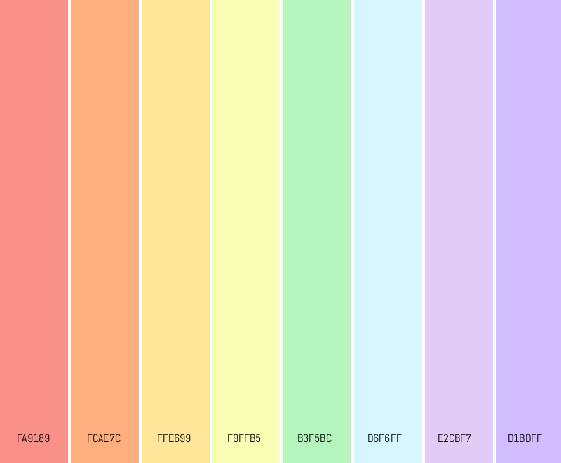
0,0
0,1
0,2
0,3
0,4
0,5
0,6
0,7
1,0
1,1
1,2
1,3
1,4
1,5
1,6
1,7
2,0
2,1
2,2
2,3
2,4
2,5
2,6
2,7
Column
Writer
Row
Reader
3,0
3,1
3,2
3,3
3,4
3,5
3,6
3,7
4,0
4,1
4,2
4,3
4,4
4,5
4,6
4,7
5,0
5,1
5,2
5,3
5,4
5,5
5,6
5,7
6,0
6,1
6,2
6,3
6,4
6,5
6,6
6,7
7,0
7,1
7,2
7,3
7,4
7,5
7,6
7,7

Slide 70
Orthogonal Memory Access - Solution
0,0
0,1
0,2
0,3
0,4
0,5
0,6
0,7
1,0
1,1
1,2
1,3
1,4
1,5
1,6
1,7
2,0
2,1
2,2
2,3
2,4
2,5
2,6
2,7
Column
Writer
(II=1)
Row
Reader
(II=1)
3,0
3,1
3,2
3,3
3,4
3,5
3,6
3,7
4,0
4,1
4,2
4,3
4,4
4,5
4,6
4,7
5,0
5,1
5,2
5,3
5,4
5,5
5,6
5,7
6,0
6,1
6,2
6,3
6,4
6,5
6,6
6,7
7,0
7,1
7,2
7,3
7,4
7,5
7,6
7,7

Slide 71
Orthogonal Memory Access - Solution
0,0
1,0
0,1
2,0
1,1
0,2
Column
Writer
(II=1)
Row
Reader
(II=1)
3,0
2,1
1,2
0,3
4,0
3,1
2,2
1,3
0,4
5,0
4,1
3,2
2,3
1,4
0,5
6,0
5,1
4,2
3,3
2,4
1,5
0,6
7,0
6,1
5,2
4,3
3,4
2,5
1,6
0,7
7,1
6,2
5,3
4,4
3,5
2,6
1,7
7,2
6,3
5,4
4,5
3,6
2,7
7,3
6,4
5,5
4,6
3,7
7,4
6,5
5,6
4,7
7,5
6,6
5,7
7,6
6,7
7,7

Slide 72
7,1
6,2
5,3
4,4
3,5
2,6
1,7
7,2
6,3
5,4
4,5
3,6
2,7
7,3
6,4
5,5
4,6
3,7
7,4
6,5
5,6
4,7
7,5
6,6
5,7
7,6
6,7
7,7
Orthogonal Memory Access - Solution
0,0
1,0
0,1
2,0
1,1
0,2
Column
Writer
(II=1)
Row
Reader
(II=1)
3,0
2,1
1,2
0,3
4,0
3,1
2,2
1,3
0,4
5,0
4,1
3,2
2,3
1,4
0,5
6,0
5,1
4,2
3,3
2,4
1,5
0,6
7,0
6,1
5,2
4,3
3,4
2,5
1,6
0,7

Slide 73
Orthogonal Memory Access - Solution
0,0
7,1
6,2
5,3
4,4
3,5
2,6
1,7
1,0
0,1
7,2
6,3
5,4
4,5
3,6
2,7
2,0
1,1
0,2
7,3
6,4
5,5
4,6
3,7
Column
Writer
(II=1)
Row
Reader
(II=1)
3,0
2,1
1,2
0,3
7,4
6,5
5,6
4,7
4,0
3,1
2,2
1,3
0,4
7,5
6,6
5,7
5,0
4,1
3,2
2,3
1,4
0,5
7,6
6,7
6,0
5,1
4,2
3,3
2,4
1,5
0,6
7,7
7,0
6,1
5,2
4,3
3,4
2,5
1,6
0,7

Slide 74
Orthogonal Memory Access - Solution
0,0
7,1
6,2
5,3
4,4
3,5
2,6
1,7
1,0
0,1
7,2
6,3
5,4
4,5
3,6
2,7
2,0
1,1
0,2
7,3
6,4
5,5
4,6
3,7
Column
Writer
(II=1)
Row
Reader
(II=1)
3,0
2,1
1,2
0,3
7,4
6,5
5,6
4,7
4,0
3,1
2,2
1,3
0,4
7,5
6,6
5,7
Single cycle column access
5,0
4,1
3,2
2,3
1,4
0,5
7,6
6,7
Single cycle row access
6,0
5,1
4,2
3,3
2,4
1,5
0,6
7,7
7,0
6,1
5,2
4,3
3,4
2,5
1,6
0,7

Slide 75
Orthogonal Memory Access - Solution
0,0
7,1
6,2
5,3
4,4
3,5
2,6
1,7
1,0
0,1
7,2
6,3
5,4
4,5
3,6
2,7
2,0
1,1
0,2
7,3
6,4
5,5
4,6
3,7
Column
Writer
(II=1)
Row
Reader
(II=1)
3,0
2,1
1,2
0,3
7,4
6,5
5,6
4,7
4,0
3,1
2,2
1,3
0,4
7,5
6,6
5,7
5,0
4,1
3,2
2,3
1,4
0,5
7,6
6,7
6,0
5,1
4,2
3,3
2,4
1,5
0,6
7,7
7,0
6,1
5,2
4,3
3,4
2,5
1,6
0,7

Slide 76
Orthogonal Memory Access - Solution
0,0
7,1
6,2
5,3
4,4
3,5
2,6
1,7
Load and store time scales perfectly with size
1,0
0,1
7,2
6,3
5,4
4,5
3,6
2,7
2,0
1,1
0,2
7,3
6,4
5,5
4,6
3,7
Column
Writer
(II=1)
Row
Reader
(II=1)
3,0
2,1
1,2
0,3
7,4
6,5
5,6
4,7
4,0
3,1
2,2
1,3
0,4
7,5
6,6
5,7
5,0
4,1
3,2
2,3
1,4
0,5
7,6
6,7
6,0
5,1
4,2
3,3
2,4
1,5
0,6
7,7
7,0
6,1
5,2
4,3
3,4
2,5
1,6
0,7

Slide 77
Orthogonal Memory Access - Solution
0,0
7,1
6,2
5,3
4,4
3,5
2,6
1,7
1,0
0,1
7,2
6,3
5,4
4,5
3,6
2,7
2,0
1,1
0,2
7,3
6,4
5,5
4,6
3,7
Column
Writer
(II=1)
Row
Reader
(II=1)
3,0
2,1
1,2
0,3
7,4
6,5
5,6
4,7
4,0
3,1
2,2
1,3
0,4
7,5
6,6
5,7
5,0
4,1
3,2
2,3
1,4
0,5
7,6
6,7
6,0
5,1
4,2
3,3
2,4
1,5
0,6
7,7
7,0
6,1
5,2
4,3
3,4
2,5
1,6
0,7

Slide 78
Orthogonal Memory Access - Solution
0,0
7,1
6,2
5,3
4,4
3,5
2,6
1,7
1,0
0,1
7,2
6,3
5,4
4,5
3,6
2,7
2,0
1,1
0,2
7,3
6,4
5,5
4,6
3,7
Column
Writer
(II=1)
Row
Reader
(II=1)
3,0
2,1
1,2
0,3
7,4
6,5
5,6
4,7
4,0
3,1
2,2
1,3
0,4
7,5
6,6
5,7
5,0
4,1
3,2
2,3
1,4
0,5
7,6
6,7
6,0
5,1
4,2
3,3
2,4
1,5
0,6
7,7
7,0
6,1
5,2
4,3
3,4
2,5
1,6
0,7

Slide 79
Orthogonal Memory Access - Challenge 2
0,3
0,0
7,1
6,2
5,3
4,4
3,5
2,6
1,7
1,3
1,0
0,1
7,2
6,3
5,4
4,5
3,6
2,7
2,3
2,0
1,1
0,2
7,3
6,4
5,5
4,6
3,7
Column
Writer
(II=1)
Row
Reader
(II=1)
3,3
3,0
2,1
1,2
0,3
7,4
6,5
5,6
4,7
4,3
4,0
3,1
2,2
1,3
0,4
7,5
6,6
5,7
5,3
5,0
4,1
3,2
2,3
1,4
0,5
7,6
6,7
6,3
6,0
5,1
4,2
3,3
2,4
1,5
0,6
7,7
7,3
7,0
6,1
5,2
4,3
3,4
2,5
1,6
0,7

Slide 80
Orthogonal Memory Access - Challenge 2
0,3
0,0
7,1
6,2
5,3
4,4
3,5
2,6
1,7
1,3
1,0
0,1
7,2
6,3
5,4
4,5
3,6
2,7
2,3
2,0
1,1
0,2
7,3
6,4
5,5
4,6
3,7
Column
Writer
(II=1)
Row
Reader
(II=1)
3,3
3,0
2,1
1,2
0,3
7,4
6,5
5,6
4,7
4,3
4,0
3,1
2,2
1,3
0,4
7,5
6,6
5,7
5,3
5,0
4,1
3,2
2,3
1,4
0,5
7,6
6,7
6,3
6,0
5,1
4,2
3,3
2,4
1,5
0,6
7,7
7,3
7,0
6,1
5,2
4,3
3,4
2,5
1,6
0,7

Slide 81
Orthogonal Memory Access - Challenge 2
0,3
0,0
7,1
6,2
5,3
4,4
3,5
2,6
1,7
1,3
1,0
0,1
7,2
6,3
5,4
4,5
3,6
2,7
2,3
2,0
1,1
0,2
7,3
6,4
5,5
4,6
3,7
Column
Writer
(II=1)
Row
Reader
(II=1)
3,3
3,0
2,1
1,2
0,3
7,4
6,5
5,6
4,7
4,3
4,0
3,1
2,2
1,3
0,4
7,5
6,6
5,7
5,3
5,0
4,1
3,2
2,3
1,4
0,5
7,6
6,7
6,3
6,0
5,1
4,2
3,3
2,4
1,5
0,6
7,7
7,3
7,0
6,1
5,2
4,3
3,4
2,5
1,6
0,7

Slide 82
Orthogonal Memory Access - Challenge 2
0,3
0,0
7,1
6,2
5,3
4,4
3,5
2,6
1,7
1,3
1,0
0,1
7,2
6,3
5,4
4,5
3,6
2,7
2,3
2,0
1,1
0,2
7,3
6,4
5,5
4,6
3,7
Column
Writer
(II=1)
Row
Reader
(II=1)
3,3
3,0
2,1
1,2
0,3
7,4
6,5
5,6
4,7
4,3
4,0
3,1
2,2
1,3
0,4
7,5
6,6
5,7
5,3
5,0
4,1
3,2
2,3
1,4
0,5
7,6
6,7
6,3
6,0
5,1
4,2
3,3
2,4
1,5
0,6
7,7
7,3
7,0
6,1
5,2
4,3
3,4
2,5
1,6
0,7

Slide 83
Orthogonal Memory Access - Challenge 2
0,x
0,0
7,1
6,2
5,3
4,4
3,5
2,6
1,7
1,x
1,0
0,1
7,2
6,3
5,4
4,5
3,6
2,7
2,x
2,0
1,1
0,2
7,3
6,4
5,5
4,6
3,7
Column
Writer
(II=1)
Row
Reader
(II=1)
3,x
3,0
2,1
1,2
0,3
7,4
6,5
5,6
4,7
4,x
4,0
3,1
2,2
1,3
0,4
7,5
6,6
5,7
5,x
5,0
4,1
3,2
2,3
1,4
0,5
7,6
6,7
Too congested
High fanout
6,x
6,0
5,1
4,2
3,3
2,4
1,5
0,6
7,7
7,x
7,0
6,1
5,2
4,3
3,4
2,5
1,6
0,7

Slide 84
Orthogonal Memory Access - Challenge 2
0,x
0,0
7,1
6,2
5,3
4,4
3,5
2,6
1,7
1,x
1,0
0,1
7,2
6,3
5,4
4,5
3,6
2,7
2,x
2,0
1,1
0,2
7,3
6,4
5,5
4,6
3,7
Column
Writer
(II=1)
Row
Reader
(II=1)
3,x
3,0
2,1
1,2
0,3
7,4
6,5
5,6
4,7
4,x
4,0
3,1
2,2
1,3
0,4
7,5
6,6
5,7
5,x
5,0
4,1
3,2
2,3
1,4
0,5
7,6
6,7
Too congested
High fanout
6,x
6,0
5,1
4,2
3,3
2,4
1,5
0,6
7,7
7,x
7,0
6,1
5,2
4,3
3,4
2,5
1,6
0,7

Slide 85
Orthogonal Memory Access - Solution 2
0,x
0,0
7,1
6,2
5,3
4,4
3,5
2,6
1,7
1,x
1,0
0,1
7,2
6,3
5,4
4,5
3,6
2,7
2,x
2,0
1,1
0,2
7,3
6,4
5,5
4,6
3,7
Column
Writer
(II=1)
Row
Reader
(II=1)
3,x
3,0
2,1
1,2
0,3
7,4
6,5
5,6
4,7
4,x
4,0
3,1
2,2
1,3
0,4
7,5
6,6
5,7
5,x
5,0
4,1
3,2
2,3
1,4
0,5
7,6
6,7
6,x
6,0
5,1
4,2
3,3
2,4
1,5
0,6
7,7
7,x
7,0
6,1
5,2
4,3
3,4
2,5
1,6
0,7

Slide 86
Orthogonal Memory Access - Solution 2
0,x
0,0
7,1
6,2
5,3
4,4
3,5
2,6
1,7
1,x
1,0
0,1
7,2
6,3
5,4
4,5
3,6
2,7
2,x
2,0
1,1
0,2
7,3
6,4
5,5
4,6
3,7
Column
Writer
(II=1)
Row
Reader
(II=1)
3,x
3,0
2,1
1,2
0,3
7,4
6,5
5,6
4,7
4,x
4,0
3,1
2,2
1,3
0,4
7,5
6,6
5,7
5,x
5,0
4,1
3,2
2,3
1,4
0,5
7,6
6,7
6,x
6,0
5,1
4,2
3,3
2,4
1,5
0,6
7,7
7,x
7,0
6,1
5,2
4,3
3,4
2,5
1,6
0,7

Slide 87
Orthogonal Memory Access - Solution
0,0
7,1
6,2
5,3
4,4
3,5
2,6
1,7
1,0
0,1
7,2
6,3
5,4
4,5
3,6
2,7
Element Rotation
Element Rotation
2,0
1,1
0,2
7,3
6,4
5,5
4,6
3,7
Column
Writer
(II=1)
Row
Reader
(II=1)
3,0
2,1
1,2
0,3
7,4
6,5
5,6
4,7
4,0
3,1
2,2
1,3
0,4
7,5
6,6
5,7
5,0
4,1
3,2
2,3
1,4
0,5
7,6
6,7
6,0
5,1
4,2
3,3
2,4
1,5
0,6
7,7
7,0
6,1
5,2
4,3
3,4
2,5
1,6
0,7

Slide 88
0,0
7,1
6,2
5,3
4,4
3,5
2,6
1,7
1,0
0,1
7,2
6,3
5,4
4,5
3,6
2,7
2,0
1,1
0,2
7,3
6,4
5,5
4,6
3,7
Column
Writer
Row
Reader
3,0
2,1
1,2
0,3
7,4
6,5
5,6
4,7
4,0
3,1
2,2
1,3
0,4
7,5
6,6
5,7
5,0
4,1
3,2
2,3
1,4
0,5
7,6
6,7
6,0
5,1
4,2
3,3
2,4
1,5
0,6
7,7
7,0
6,1
5,2
4,3
3,4
2,5
1,6
0,7

Slide 89
0,0
0,0
0,1
0,2
0,3
0,4
0,5
0,6
0,7
1,0
1,0
1,1
1,2
1,3
1,4
1,5
1,6
1,7
2,0
2,0
2,1
2,2
2,3
2,4
2,5
2,6
2,7
Column
Writer
Row
Reader
3,0
3,0
3,1
3,2
3,3
3,4
3,5
3,6
3,7
4,0
4,0
4,1
4,2
4,3
4,4
4,5
4,6
4,7
5,0
5,0
5,1
5,2
5,3
5,4
5,5
5,6
5,7
6,0
6,0
6,1
6,2
6,3
6,4
6,5
6,6
6,7
7,0
7,0
7,1
7,2
7,3
7,4
7,5
7,6
7,7

Slide 90
Contraction Stage

Slide 91
Contraction Stage - Challenge
We need to accumulate data at an II=1
The U280 does not natively support II=1
floating-point accumulation

Slide 92
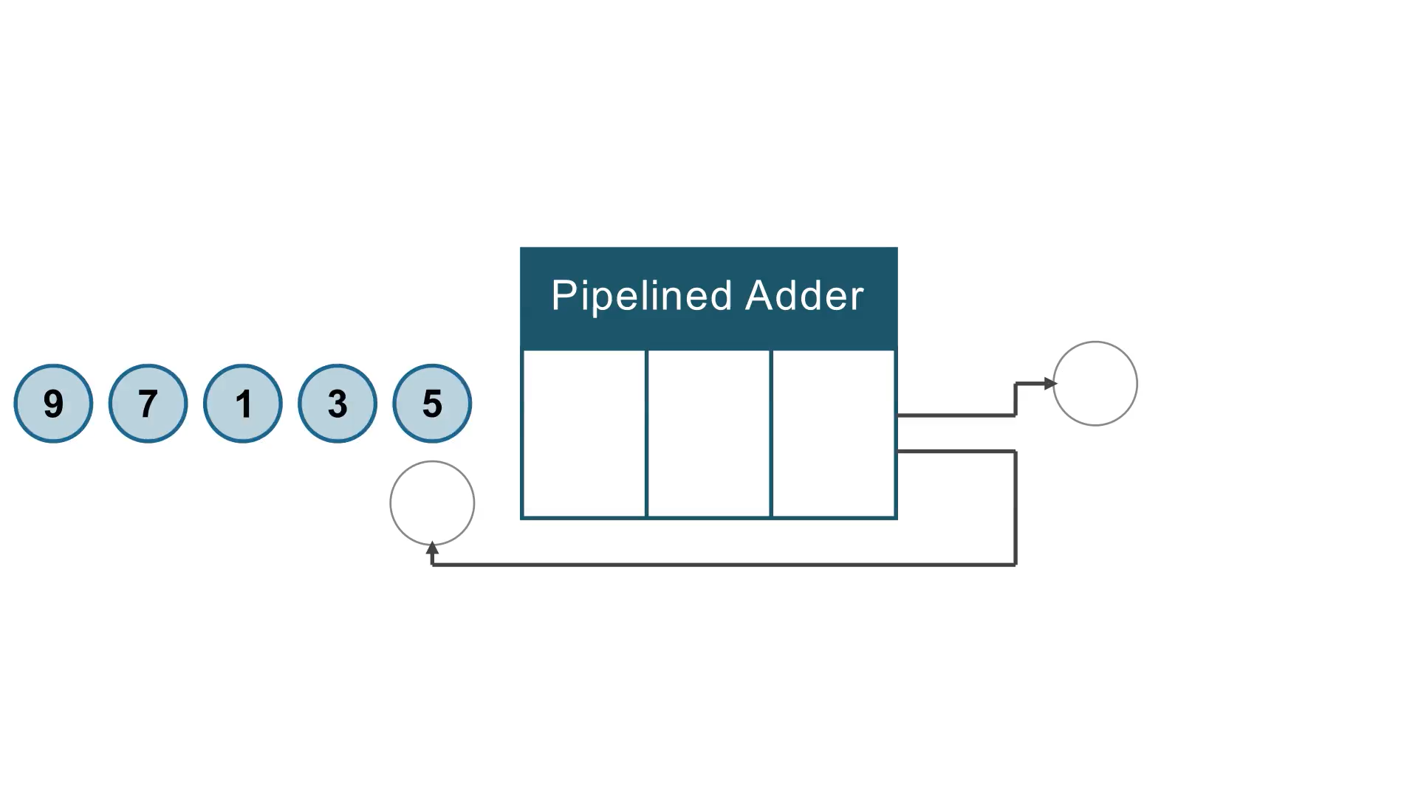
Floating Point Accumulation - Challenge

Slide 93
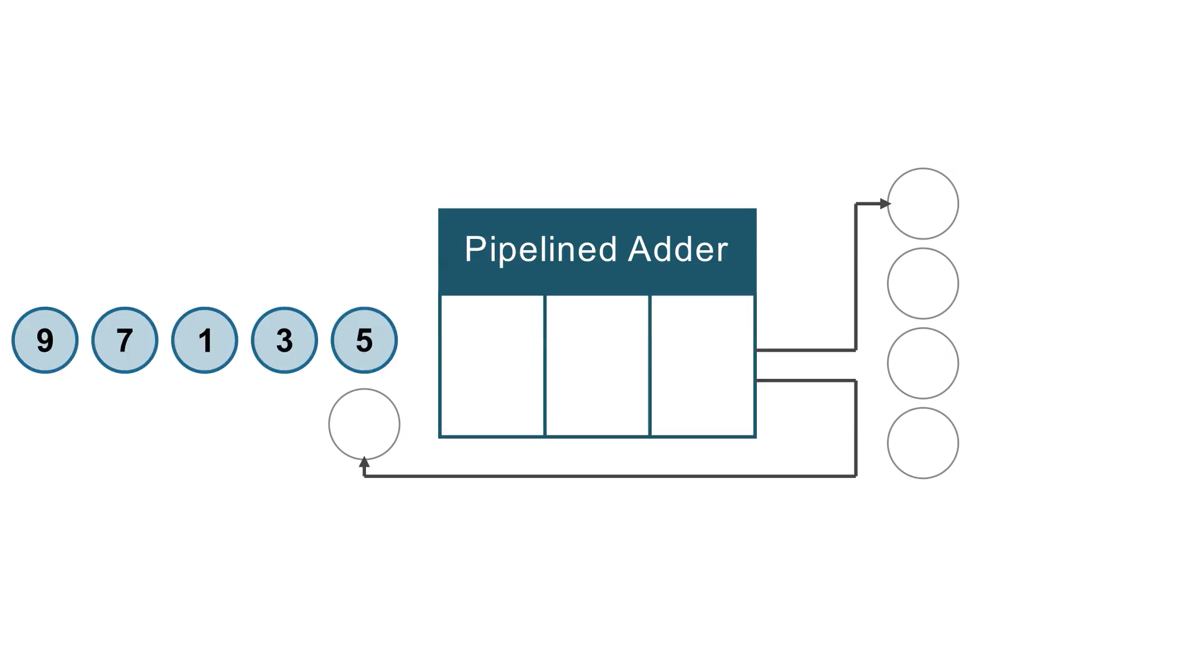
Floating Point Accumulation - Solution

Slide 94
Floating Point Accumulation - Challenge 2
5
5
5
f32
5
5
5
5
5

Slide 95
Floating Point Accumulation - Challenge 2
f32

Slide 96
Floating Point Accumulation - Challenge 2
f32
f32
5
5
5
5
5
5

Slide 97
Floating Point Accumulation - Challenge 2
f32
f32
5
5
5
5
5
5

Slide 98
Floating Point Accumulation - Challenge 2
f32
f32
f32
f32
f32
f32
5
5
5
5
5
5
5
5
5
5
5
5
5
5
5
5
5
5
5
5
5
5
5
5
5
5
5
5
5
5
5
5
5
5
5
5

Slide 99
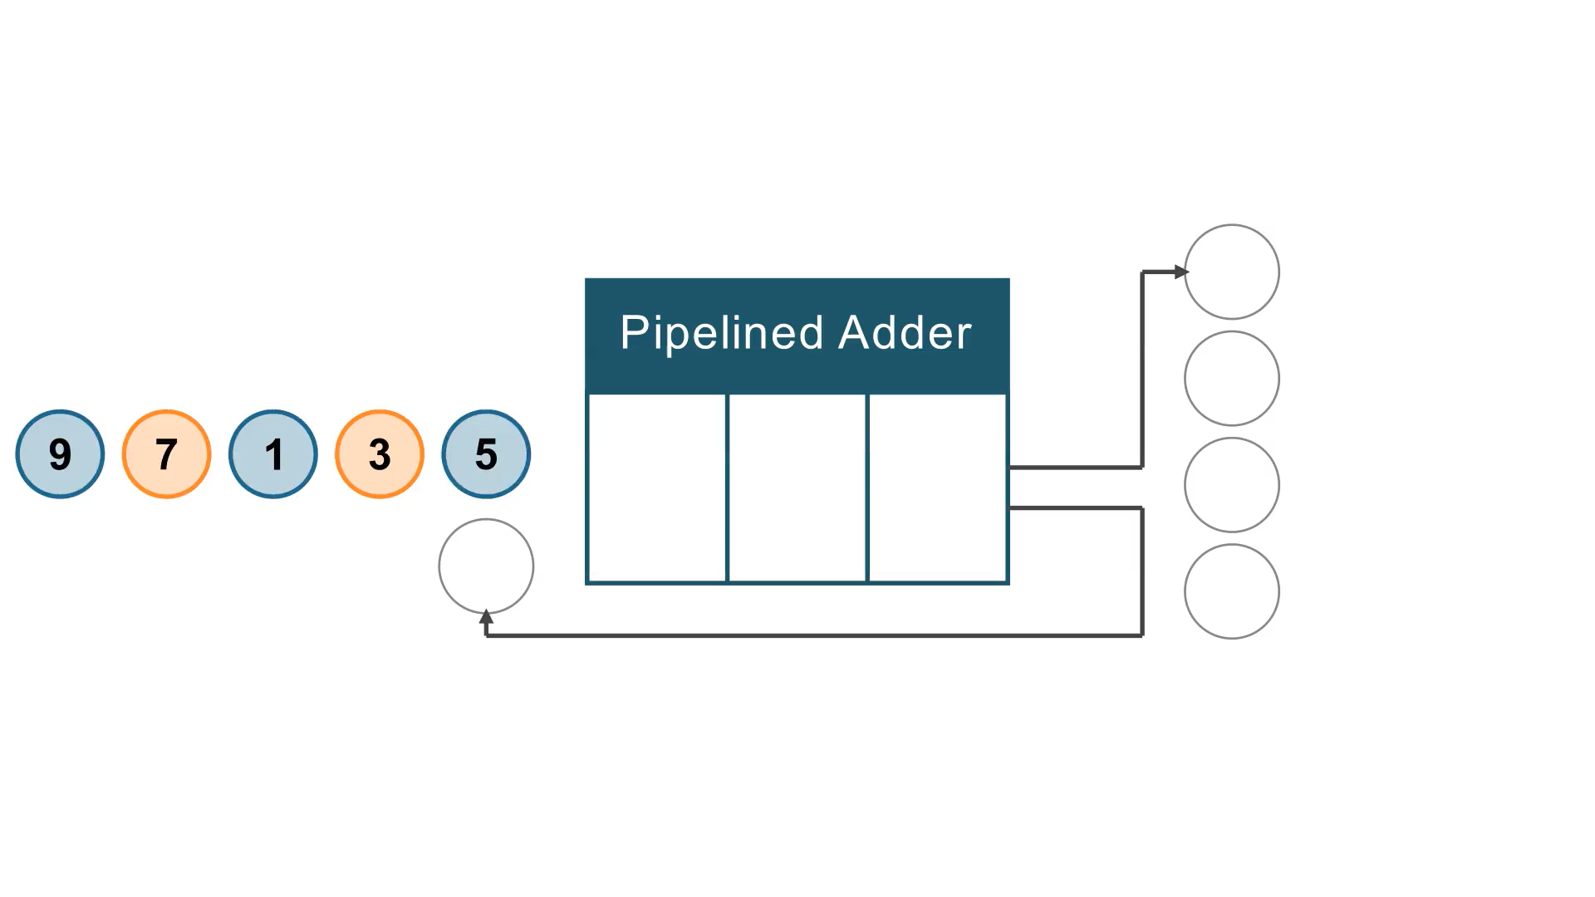
Floating Point Accumulation - Solution 2

Slide 100
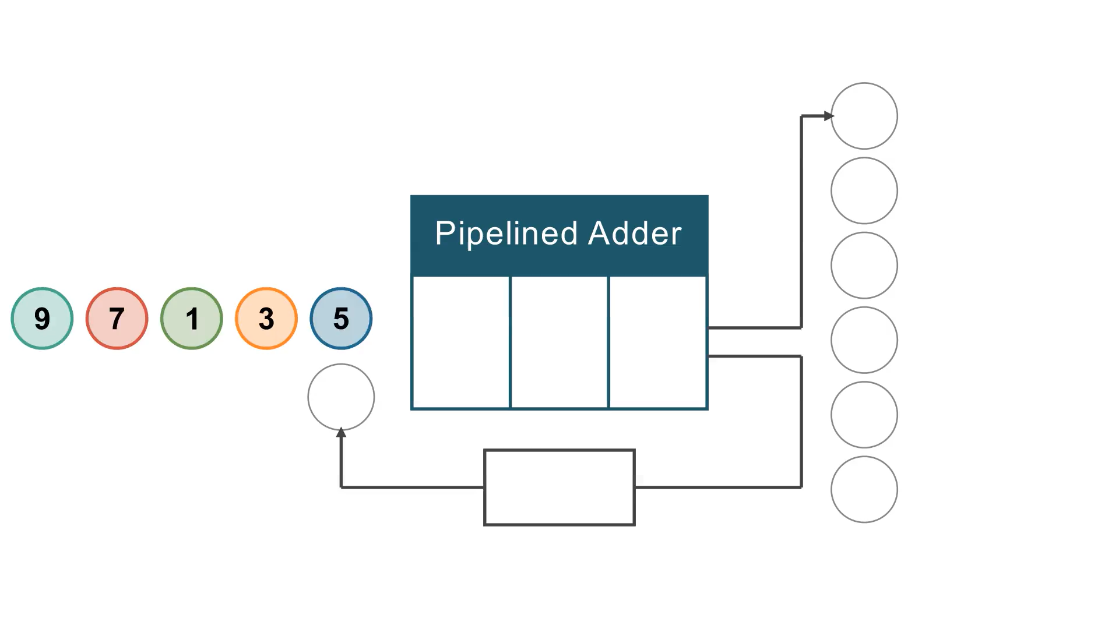
Floating Point Accumulation - Solution 2
Supports flexible accumulation distance at runtime

Slide 101
Floating Point Accumulation

Slide 102
Resource Utilization

Slide 103
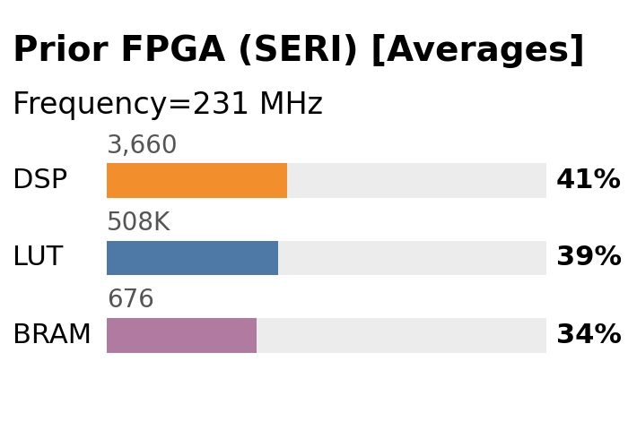
Resource Utilization

Slide 104
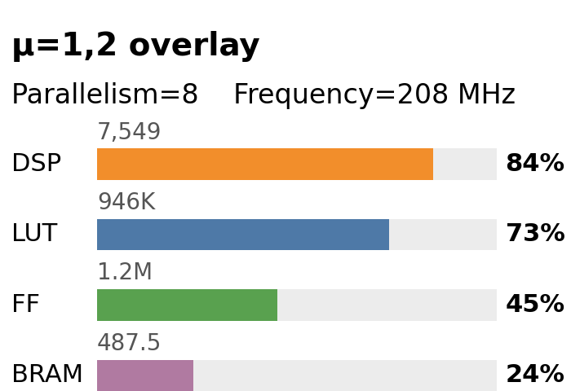
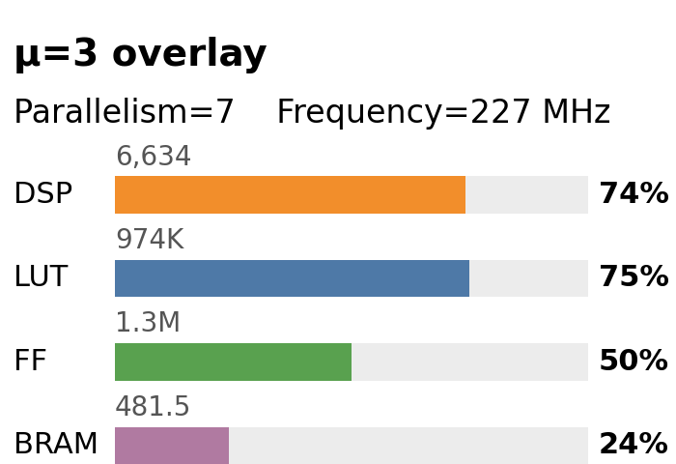
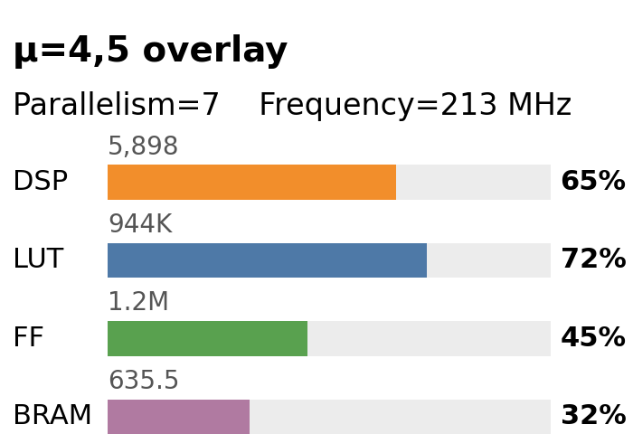
Resource Utilization
SORCERI

Slide 105
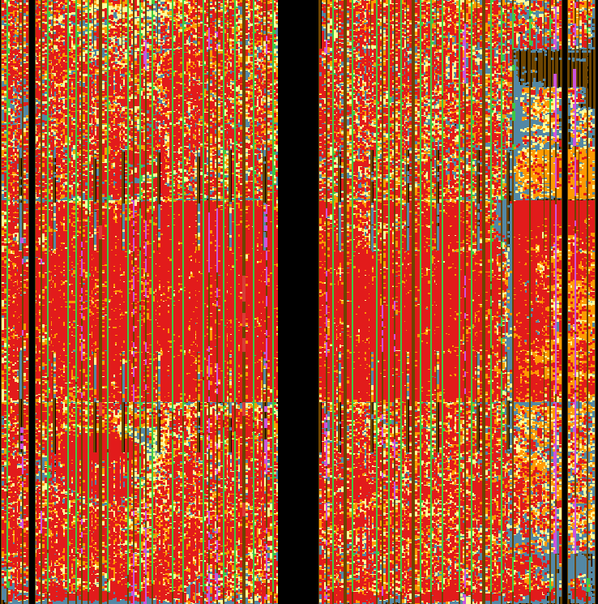
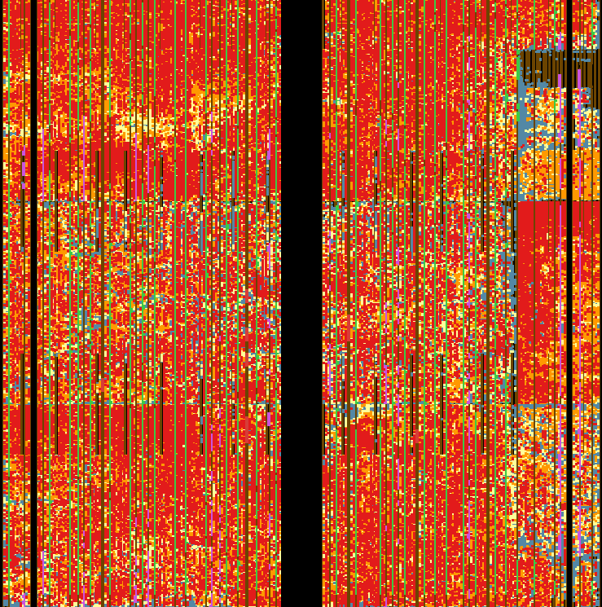
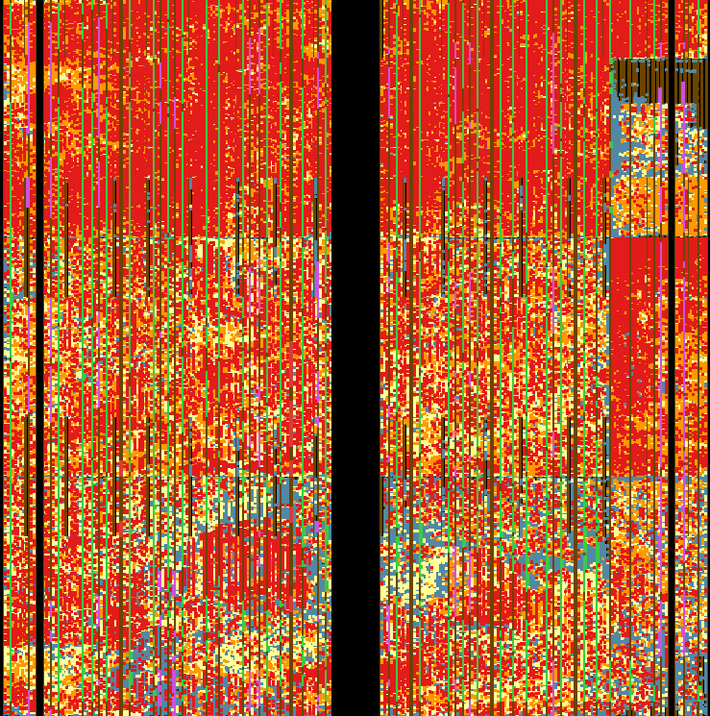
SORCERI
CLB LUT Util:
100%
>87.5%
>75%
>0%

Slide 106
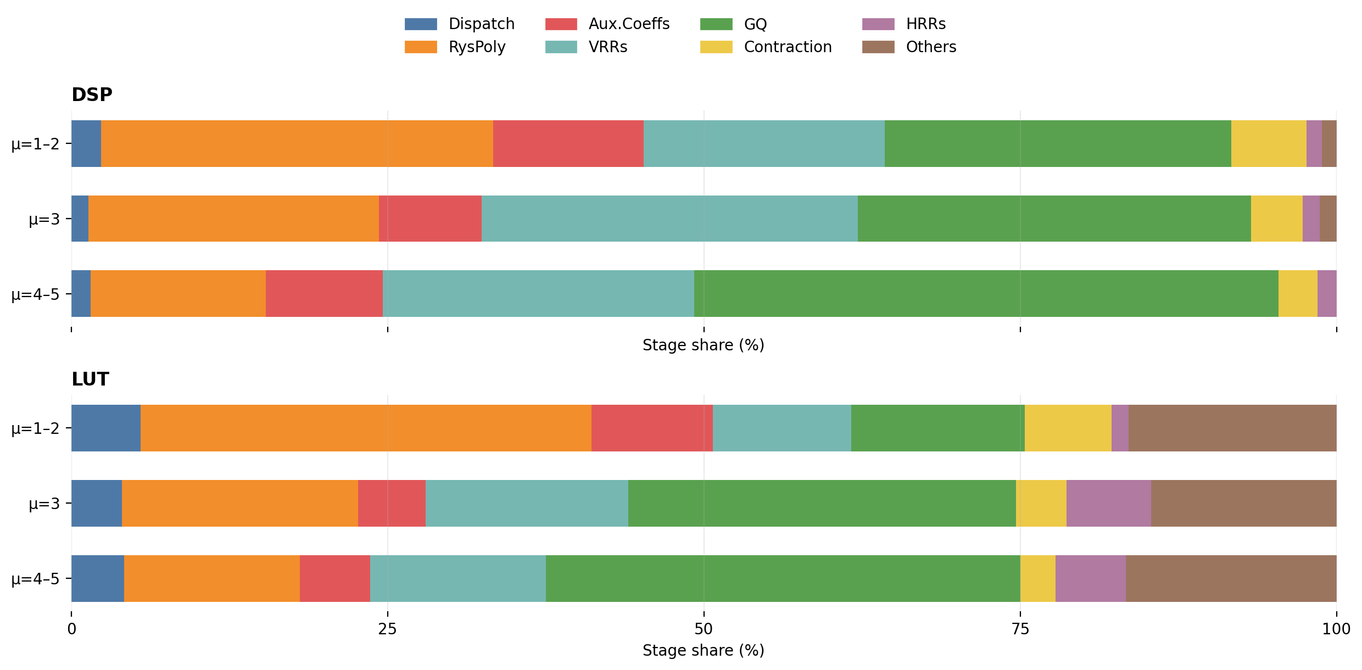
Resource util and breakdown for each overlay

Slide 107
Results - Throughput
FPGA-Host Bandwidth Bottleneck

Slide 108
Results - Throughput
* SERI performance excludes FPGA-Host data transfer

Slide 109
Results - Throughput
* SERI performance excludes FPGA-Host data transfer

Slide 110
Results - Throughput
Speedups: 1.57x 1.50x 0.96x
vs
Prev FPGA
vs
64-core CPU
vs
A40 GPU

Slide 111
Results – Power Efficiency

Slide 112
Results – Power Efficiency
Perf per Watt : 1.16x 5.96x 1.99x
vs
Prev FPGA
vs
64-core CPU
vs
A40 GPU

Slide 113
SORCERI:
Streaming Overlay for Contracted Electron Repulsion Integral Computation
Streaming overlay architecture
Novel Rys polynomial and flexible transpose stages
ERI contraction on-chip
Perf per Watt : 1.16x 5.96x 1.99x
vs
Prev FPGA
vs
64-core CPU
vs
A40 GPU

Slide 114


Acknowledgements

Slide 115
Questions?

Slide 116
Presentation Ended
Backup Slides Begin

