Slide 1


UDP: A Universal DSP Packing Framework for Low-bitwidth MAC Acceleration on FPGAs
Jundong Wu, Zhendong Zheng, Lei Gong*,
Chao Wang, Xuehai Zhou
University of Science and Technology of China, Hefei, China
Suzhou Institute for Advanced Research, USTC, Suzhou, China
2026.2
Notes:
Hello everyone. I’m Jundong Wu from the University of Science and Technology of China (USTC).
Today, I’m excited to present our work： "UDP: A Universal DSP Packing Framework for Low-bitwidth MAC Acceleration on FPGAs."

Slide 2
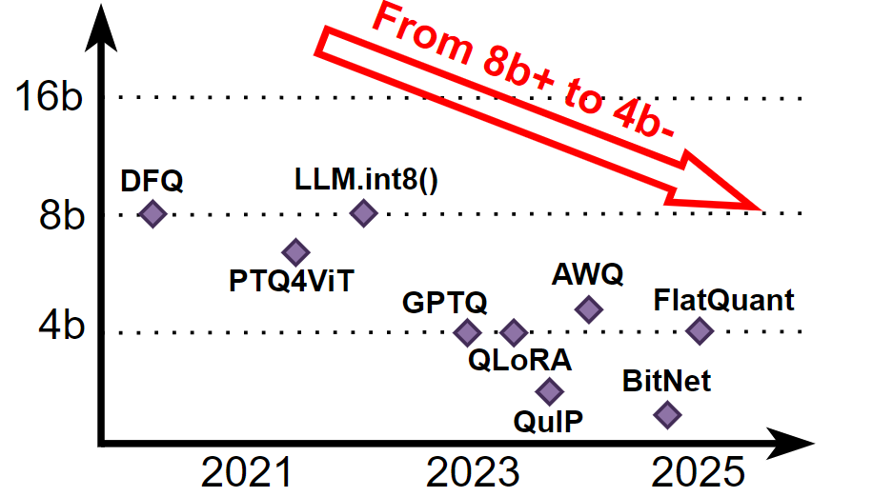
Low-Bitwidth computation demand
  Neural networks are becoming increasingly lightweight
Early CNNs: 1–2 bits
Today LLM:
w ≤ 4 bits, a ≤ 8 bits
BitNet: 1.58-bit ultra-low-precision weight
2026 FPGA
Page 1/5
Notes:
To begin with the background: deep learning models are becoming increasingly lightweight.
For practical on-device LLM deployment, minimizing hardware costs is essential, leading to a steady decline in quantization bit-widths.
We’ve evolved from early CNNs using 1 or 2 bits to modern LLMs that frequently leverage 4-bit weights. Some models, like BitNet from Microsoft, even use 1.58-bit precision.
This trend creates a high demand for low-bitwidth computation.

Slide 3
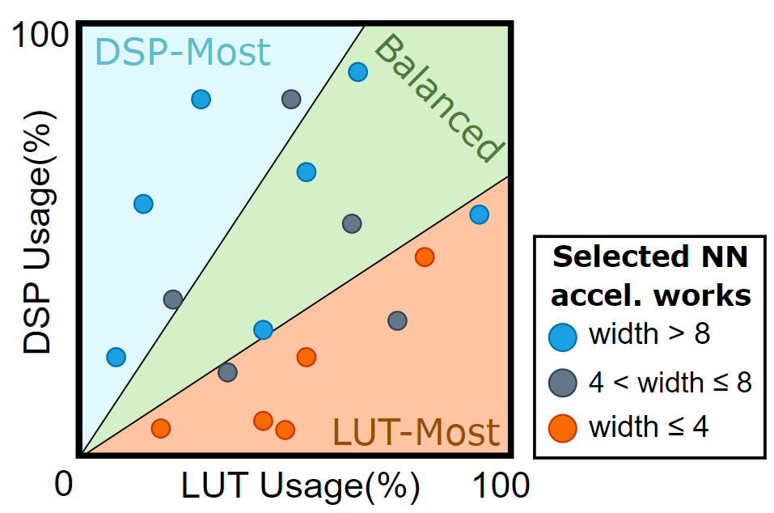
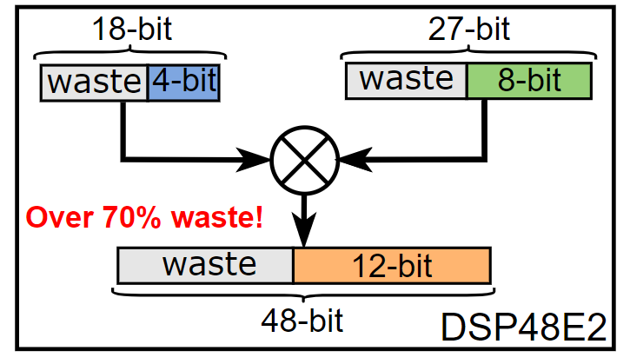
背景介绍：FPGA 上 DSP 的不充分
Bitwidth mismatch & DSP under-utilization
Fixed DSP bitwidths (e.g., DSP48E2) waste capacity when running low-bit ops
Low-bit NN accelerators shift toward LUT-based compute instead of DSPs
2026 FPGA
Page 1/5
Notes:
However, there is a fundamental mismatch between low-bitwidth acceleration and the DSP blocks available on modern devices.
Standard FPGA DSP blocks, like the DSP48E2, are tailored for high-precision math, making them highly inefficient for low-bitwidth tasks.
This mismatch often pushes developers to shift their workloads from DSPs to LUTs—a compromise that typically sacrifices performance and scalability.

Slide 4
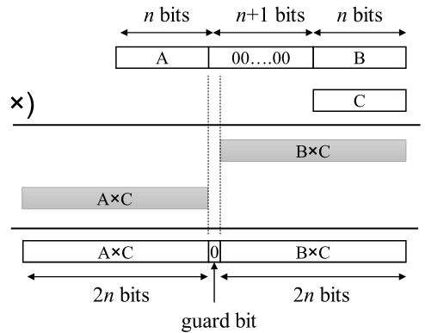
DSP 打包简述
Solution: DSP Packing
  Key idea: enable multiple low-bitwidth MACs in one DSP multiply
(A+B) × C
= (A×C) + (B×C)
2026 FPGA
Page 2/5
S. Lee, D. Kim, D. Nguyen and J. Lee, "Double MAC on a DSP: Boosting the Performance of Convolutional Neural Networks on FPGAs," in IEEE Transactions on Computer-Aided Design of Integrated Circuits and Systems, vol. 38, no. 5, pp. 888-897, May 2019, doi: 10.1109/TCAD.2018.2824280
Notes:
To solve this, researchers use a technique called "DSP Packing." The idea is simple: we "pack" multiple low-bit multiplications into a single DSP module to enhance hardware utilization.
As illustrated here, we pack two multiplications together and let the DSP compute them in a single shot. Conceptually, it can be written as:
(A+B)*C = A*C + B*C
We’re skipping the bit-shifting and concatenation details here. With properly reserved guard bits, we prevent the bit-level overflow, so the packed outputs can be recovered without interference.

Slide 5
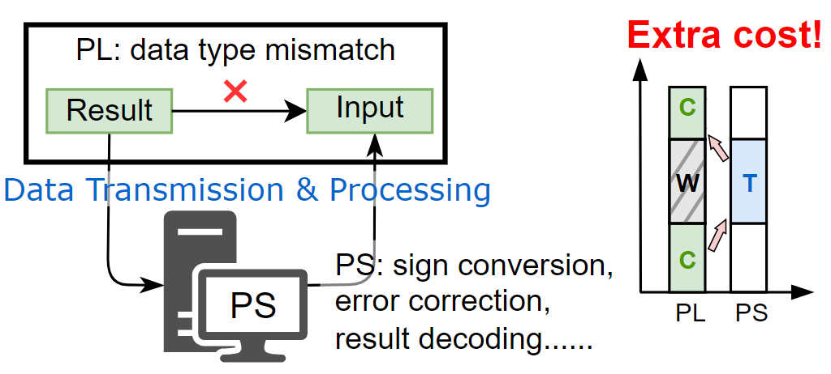
问题概述
Limitation 1: Computational Continuity
          Some solutions rely on host-side processing
          Extra steps such as sign conversion, error correction and result decoding
          Required PL↔PS data transfers
          Root cause: non-invertible packing/mapping
2026 FPGA
Page 2/5
Notes:
However, after analyzing existing packing methods, we found two critical limitations. The first one is the Continuity issue.
As you can see, many existing methods depend heavily on host-side preprocessing—including sign conversion, error recovery, and output decoding.
This creates a serious problem: it leads to frequent data exchanges between the host processor (PS) and the FPGA logic (PL). Every time the data has to go back to the CPU to be 'fixed' or 'decoded,' thus the end-to-end throughput degrades.
The root cause is that the mapping process is not the bijective mapping. Because the accelerator cannot handle the results by itself, the compute pipeline is 'broken.' This is the first gap we aim to bridge with UDP.

Slide 6
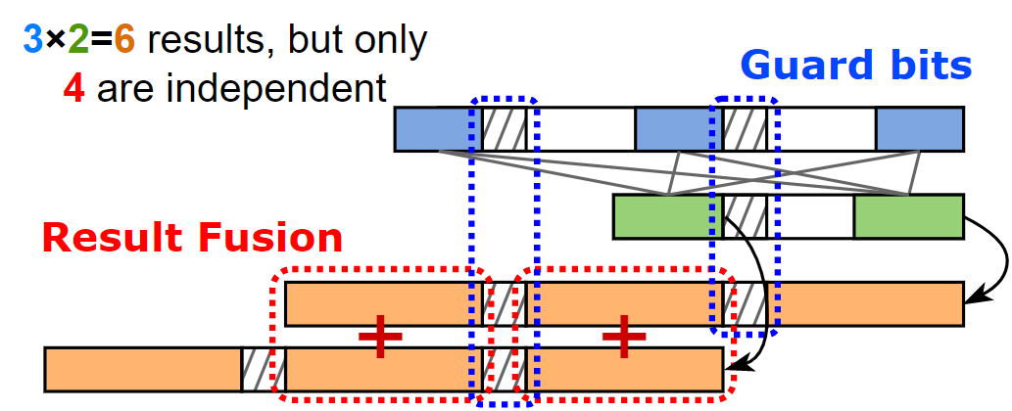
问题概述
Limitation 2: Pattern Generality
          Stacking-based packing relies on guard bits and result fusion
          guard-bit spacing causes resource waste
          Fused (non-independent) results restrict supported operators
2026 FPGA
Page 2/5
Notes:
The second one is the Generality issue, especially when we move from simple models to modern LLMs.
Traditional 'stacking-based' packing works okay for simple convolutions, but it is incompatible for the matrix multiplications used in LLMs for two main reasons:
Resource Waste: To keep the math accurate, these methods add extra guard bits. These bits don't carry any data—they are just there to prevent overflow—which wastes the limited bit capacity of the DSP.
Output Separation: As shown here, out of the six products generated, only the first and last are independent. The middle four are entangled, making them almost impossible to use directly in the next layer of the network.
To bridge these gaps, we propose UDP, a solution designed to restore both computational continuity and pattern generality.

Slide 7
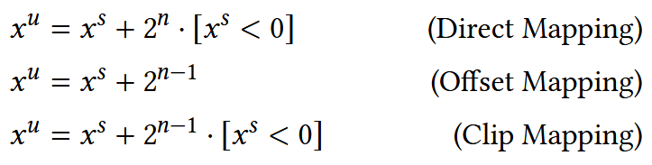
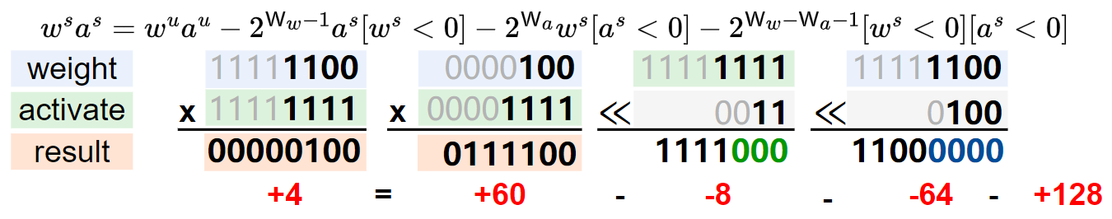
解决方案：映射与打包
UDP: Mapping & Recovery
  Reversible, lossless mapping with optimality guarantee
          Clip mapping: strip sign bits → treat residuals as unsigned values.
          Save 1 bit of DSP capacity
2026 FPGA
Page 3/5
DSP results
Notes:
Now, let’s dive into the core of UDP. To achieve high-efficiency packing, we propose Clip-mapping, which extracts the sign bits and treats the remaining magnitudes as unsigned values.
Crucially, we have provided mathematical proof demonstrating that this approach is optimal. It strikes the perfect balance by minimizing hardware overhead while ensuring zero loss in arithmetic accuracy.
In our specific implementation, we employ a hybrid scheme: we apply Clip-mapping to weights, while using Direct-mapping for activations. This combination allows us to maximize DSP throughput without the typical complexity of sign-extension.

Slide 8
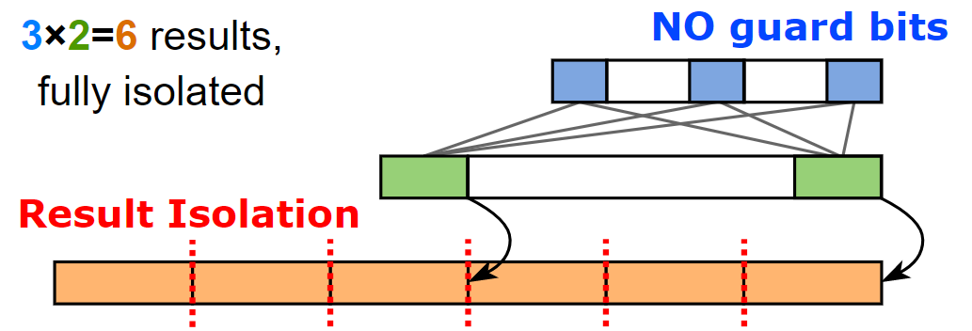

解决方案：映射与打包
UDP: Packing & Unpacking
  Tiling-based packing with broaden applicability
          No guard bits, no overlap
          Carry-safe by construction
          Isolated outputs for general use
2026 FPGA
Page 3/5
Notes:
While stacking-based packing was widely adopted for CNNs, its inherent output overlap makes it ill-suited for the massive matrix multiplications in modern LLMs.
By using clip-mapping to remove extra sign bits, we can pack much more actual data into each DSP module. This allows our tiling-based method to match the high parallelism of stacking-based method, while keeping every result separate and easy to use.
More importantly, we have mathematically eliminated overflow between adjacent results. This ensures complete result isolation, allowing us to entirely remove guard bits and maximize bit-utilization efficiency.

Slide 9
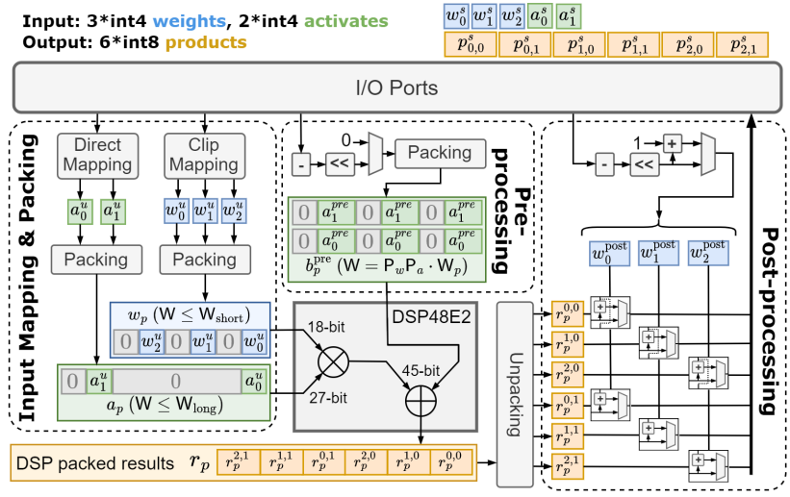
解决方案：映射与打包
UDP: Hardware design
Computes 2×3 = 6 parallel int8 products
Mapping & packing → pre-processing → DSP compute → unpacking & post-processing
Supports multiple compute modes via bit-level integration
2026 FPGA
Page 3/5
Notes:
To address the limitations just described, we propose UDP. The defining feature of our framework is the decoupling of the DSP packing process.
Rather than using a fixed, 'one-size-fits-all' design, we divide the process into two independent stages: the Mapping Stage and the Packing Stage. In our paper, we further subdivide the entire workflow into four functional parts, which allows us to maximize hardware resource reuse across the architecture.
This separation is what makes UDP truly 'Universal.' It gives the framework the flexibility to adapt to various bitwidths and model requirements—all without needing to change any of the underlying hardware logic.

Slide 10
解决方案：映射与打包
UDP: Hardware template
          A layered Chisel template to auto-generate required compute blocks
          Fully parameterized design
          Hierarchical / layered hardware template
          Automatic generation of optimized Verilog code
2026 FPGA
Page 3/5
Notes:
UDP is implemented as a hardware template in Chisel, which can automatically optimize the design based on user parameters and generate synthesizable Verilog. This template offers three main advantages:
Fully parameterized: it supports configurable bitwidths, parallelism, and computation modes.
Flexible and customizable: it can be tailored to different project requirements and target platforms.
Automatic code generation: it produces optimized Verilog code, enabling efficient implementation and acceleration.

Slide 11
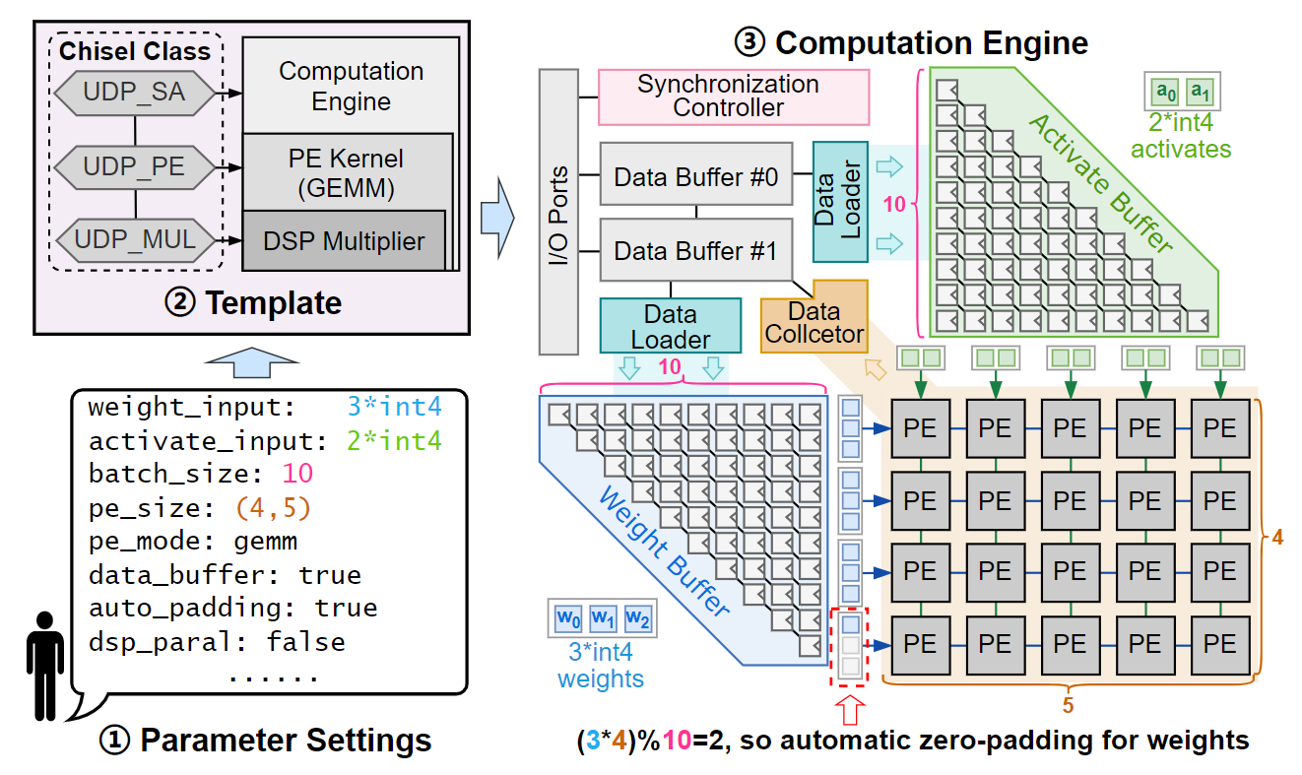
UDP: Hardware template
Notes:
To make UDP practical for real-world use, we developed a hardware-template workflow that simplifies the entire design process into three easy steps.
First, the user defines the parameters. You simply choose the data types and the scale of the array based on your specific workload.
Second, the template takes over. It automatically generates the entire hardware hierarchy. As shown in the figure, this includes the full compute engine, the datapath, and even the data movement modules. This automation saves a significant amount of manual RTL coding effort.
Finally, the generated design is ready for direct deployment onto your target FPGA platform.
What’s more, because we built this template using Chisel, it is incredibly flexible. Its object-oriented nature allows you to adjust interfaces independently, making it very easy to 'plug' UDP into your own existing design workflow without any hassle.

Slide 12
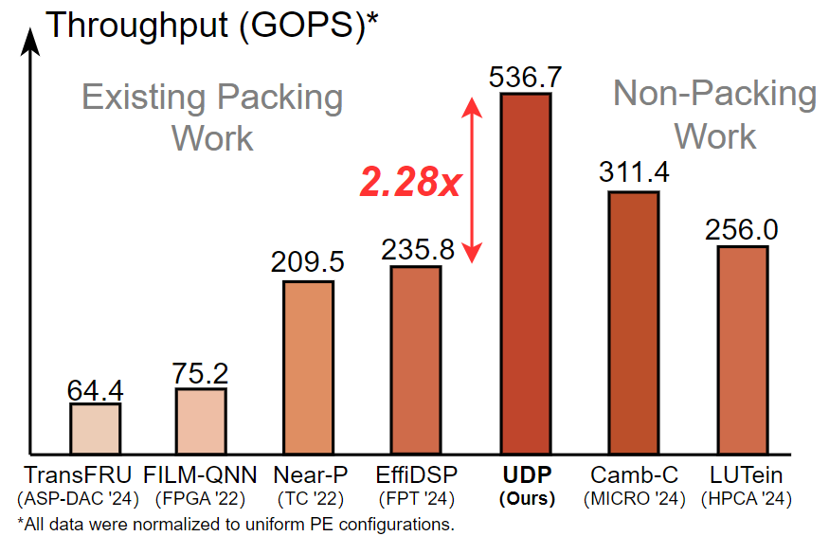
Experimental Results
          With only the compute core replaced, UDP achieves the highest throughput, outperforming prior packing-based designs by up to 2.28x
Notes:
Now, let’s examine how these architectural advantages translate into real-world performance.
As demonstrated in our evaluation, UDP achieves significantly higher throughput within the same hardware constraints. Compared to baseline designs without DSP packing, the performance gains are substantial.
This evidence validates that low-bitwidth acceleration can be efficiently implemented on DSP blocks. Our results demonstrate that DSP-based architectures are not only comparable to traditional LUT-based methods but are, in fact, highly competitive—offering a much more resource-efficient alternative for FPGA-based acceleration.

Slide 13
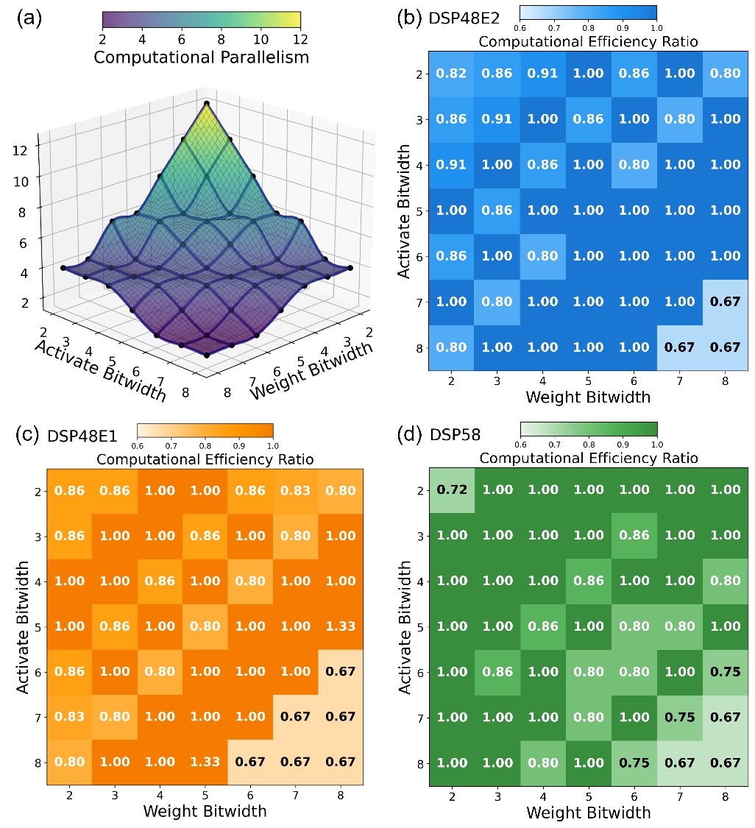
Experimental Results
UDP can be implemented on any hardware that provides MAC support
UDP is theoretically optimal for the majority of configurations
Notes:
UDP is highly versatile and can be deployed on any device supporting MAC operations. Its parameterized design allows it to adapt seamlessly to various hardware environments.
Across DSP48E1, E2, and DSP58, UDP reaches the theoretical parallelism limit in over 66% of cases, and exceeds 80% in most other settings.
This proves that UDP is a robust, high-performance solution that works consistently across multiple generations of FPGA hardware.

Slide 14
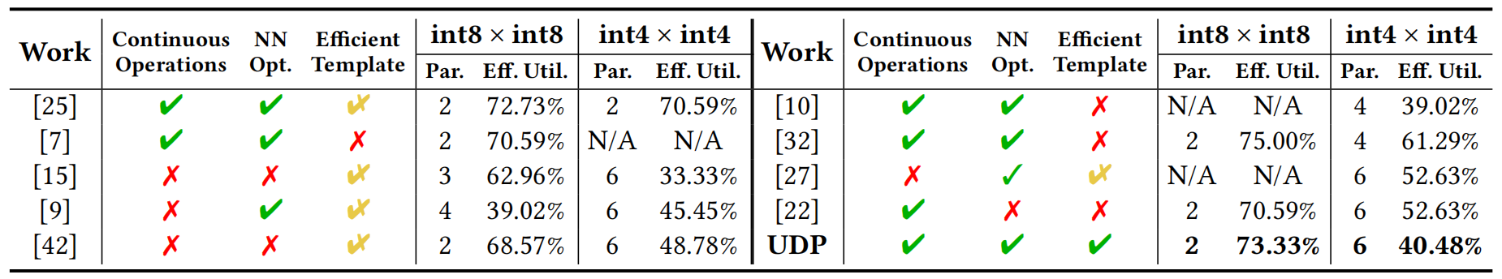
Experimental Results
Comparation against other DSP packing schemes
Notes:
Finally, we compared UDP’s overall performance against other state-of-the-art DSP packing schemes.
The results show that UDP effectively addresses the key limitations found in prior work, particularly the issues with data continuity and limited flexibility. By using our decoupled mapping and packing strategy, UDP achieves high DSP utilization across a very wide range of bitwidths and scenarios.
This demonstrates that our framework is a truly universal and efficient solution for accelerating modern neural networks on FPGAs.

Slide 15
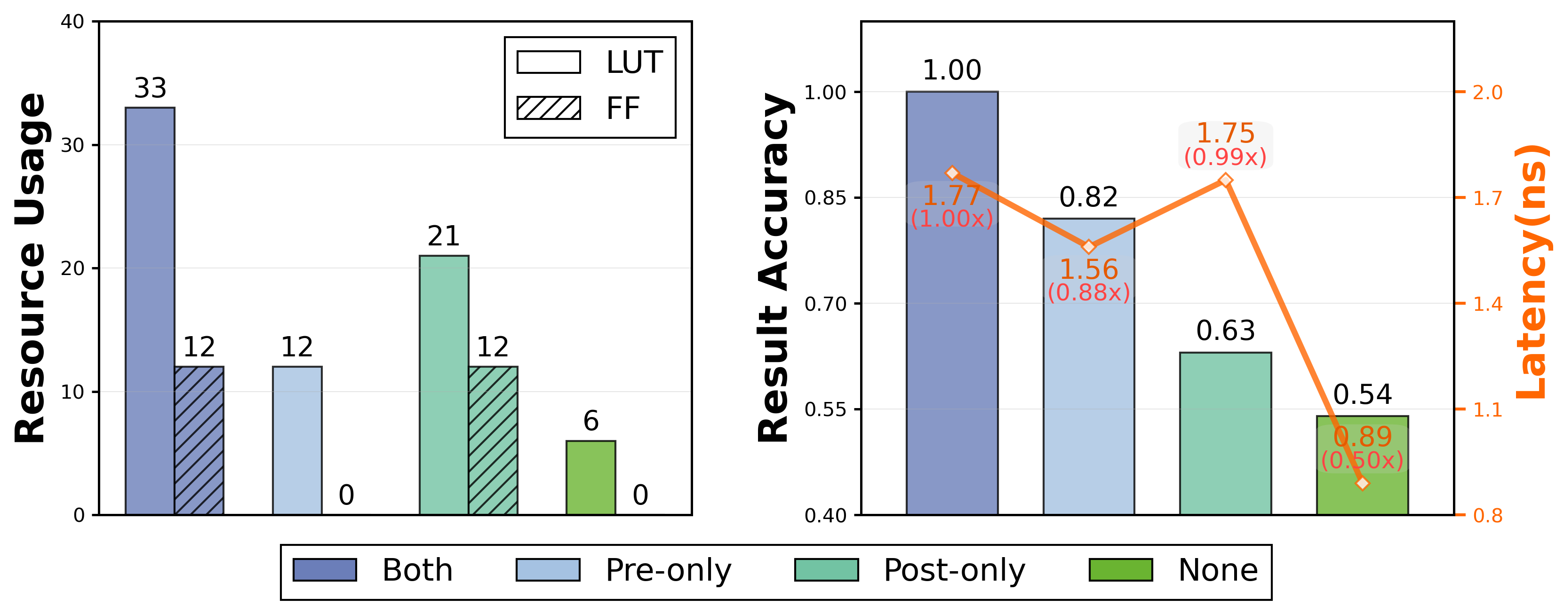
Exploratory Analysis
Different Processing Combinations
We further discuss how the mapping and recovery strategies affect both accuracy and performance
By trading off about 20% accuracy, we can achieve over 60% resource savings
Notes:
Beyond the core framework, we also explored additional design options enabled by UDP.
By applying only partial processing—either pre-processing or post-processing—during the mapping and packing stages, we can significantly lower hardware costs.
r analysis demonstrates that for ultra-constrained environments, UDP supports aggressive optimization. In an extreme scenario aimed at massive resource reduction, we can achieve over 60% savings by trading off approximately 20% accuracy. This flexibility allows users to configure the trade-off to perfectly match the specific accuracy and resource needs of their applications.

Slide 16
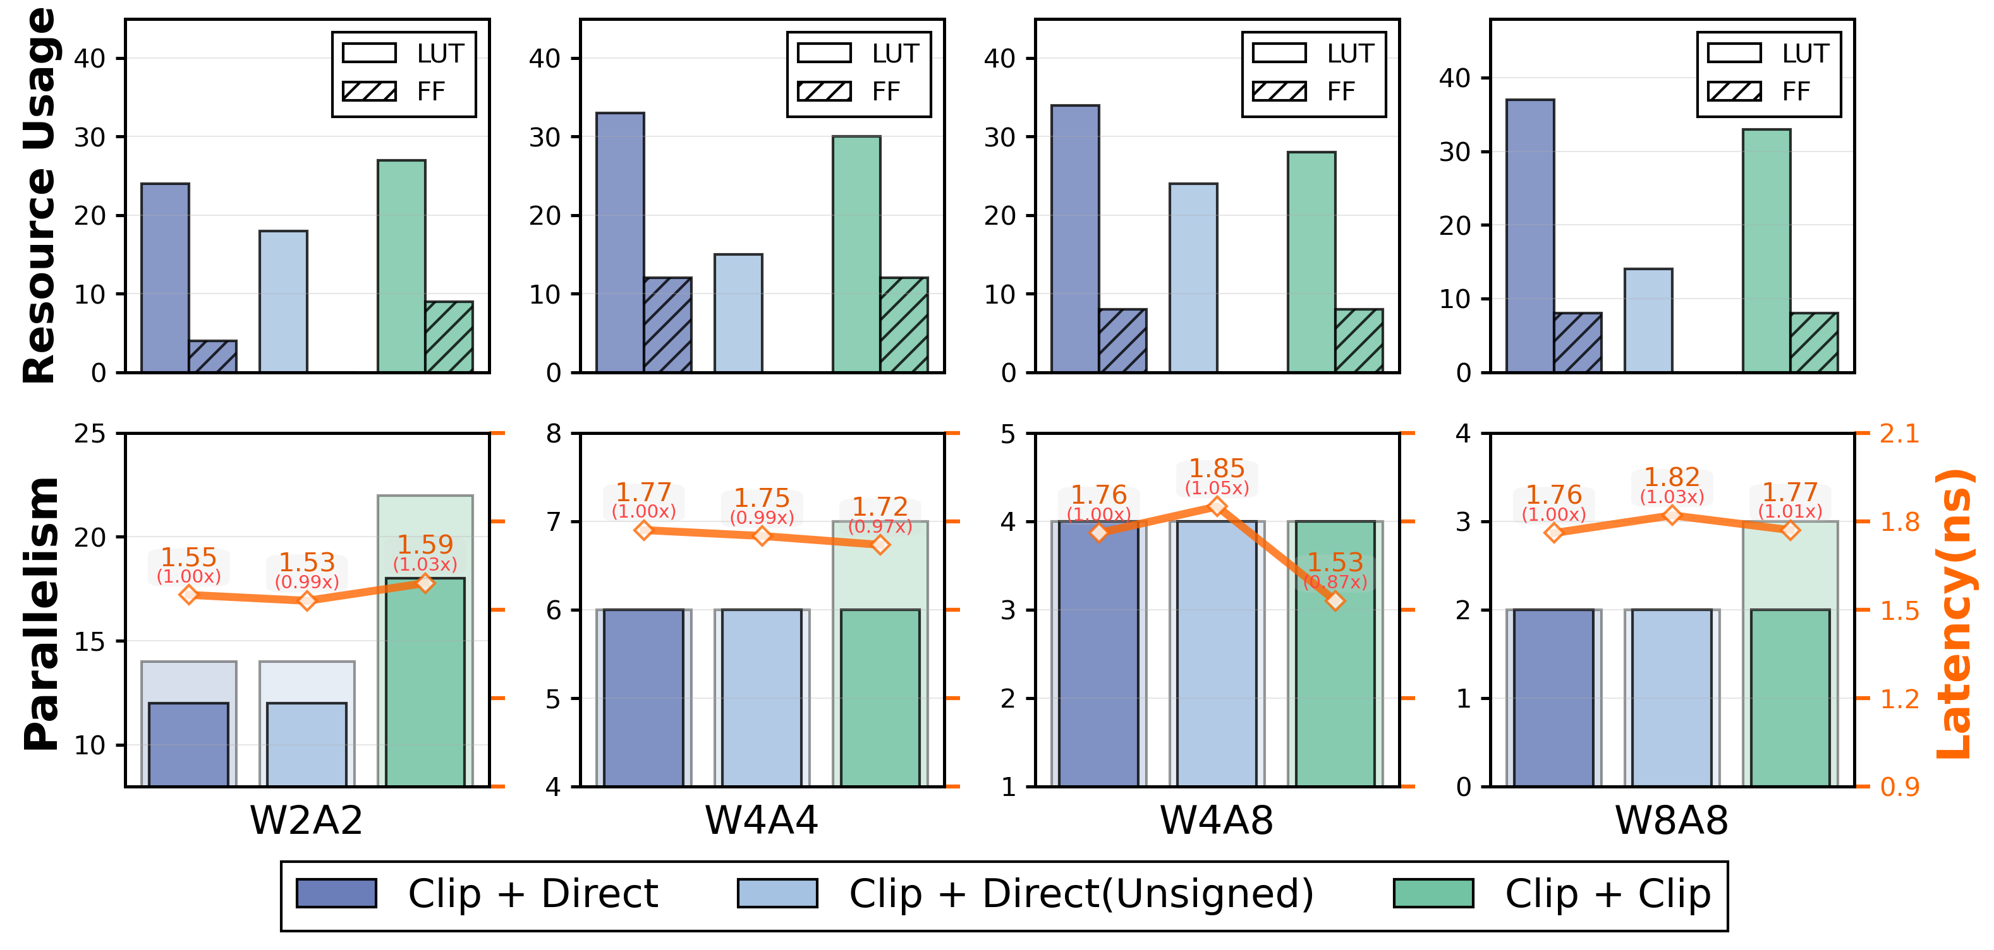
Exploratory Analysis
More Aggressive Clip Mapping
Clip + Direct mapping achieves a strong balance between resource usage and performance
Notes:
Next, let’s look at the mapping strategy. One option is to apply clip mapping to both weights and activations, which can further reduce hardware costs. However, we found that this approach doesn't fully utilize the DSP resources because it introduces too many padding bits, leading to lower packing efficiency.
After careful evaluation, we concluded that combining clipping with direct mapping is our best choice. This combination strikes the perfect balance—it maximizes the efficiency of the DSP while keeping the hardware overhead at a minimum.

Slide 17
问题概述
Conclusion & future work
We propose UDP, a Universal DSP Packing framework
We decouple packing into mapping and packing stages to support arbitrary combinations and continuous computation
We provide a complete Chisel-based hardware template that auto-generates synthesizable HDL from parameters
Future work: extend support to more data types and broader hardware platforms
2026 FPGA
Page 2/5
Notes:
To wrap up, let’s summarize our work today.
We proposed UDP, a Universal DSP Packing framework designed for the era of low-bitwidth neural networks. The key to our approach is decoupling the packing process into independent Mapping and Packing stages. This design not only supports arbitrary bitwidth combinations but also ensures continuous on-chip computation, solving the data bottlenecks found in prior work.
Furthermore, we provide a complete Chisel-based hardware template that automates the entire generation process, making it easy for researchers to deploy efficient accelerators. Our evaluations prove that UDP is highly competitive, often reaching the theoretical limits of parallelism across multiple DSP generations.
In the future, we plan to extend UDP to support even more diverse data types and broader hardware platforms.

Slide 18
问题概述
Acknowledgments
This work was supported in part by National Key R&D Program
of China under Grants 2022YFB4501600 and 2022YFB4501603,
in part by National Natural Science Foundation of China under
Grants 61976200, and 62172380, in part by Anhui Provincial
Natural Science Foundation under Grant 2508085MF141, in part
by Jiangsu Provincial Natural Science Foundation under Grant
BK20251815, in part by Youth Innovation Promotion Association
CAS under Grant Y2021121, in part by USTC Research Funds of
the Double First-Class Initiative under Grant YD2150002005 and
YD2150002011. Lei Gong is the corresponding author.
2026 FPGA
Page 2/5
Notes:
Finally, I would like to thank our funding agencies for their support.

Slide 19
UDP: A Universal DSP Packing Framework for Low-bitwidth MAC Acceleration on FPGAs
Thank you!
Notes:
Thank you for your attention, and I am now happy to take any questions.

