Slide 1


TDM Signal Grouping and Package Pin Assignment for 2.5D Multi-FPGA Systems with Lookahead Placement
Jiarui Wang, Runzhe Tao, Jing Mai, Xun Jiang, Shenghua Wang,
Cuiliu Yang, Haoyu Jie, Kan Huang, Richard Y. Sun, Yibo Lin
Peking University
S2C Inc.
Notes:
Hello, everyone. I’m Xun Jiang from Peking University. I’m going to introduce our work TDM Signal Grouping and Package Pin Assignment for 2.5D Multi-FPGA Systems with Lookahead Placement. This work is collaborated by our partners from Peking University and S2C.

Slide 2
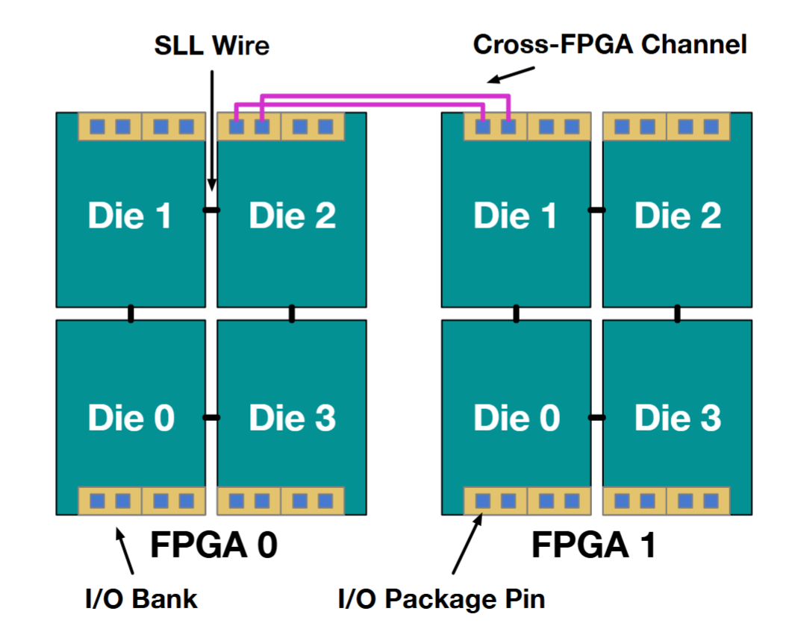
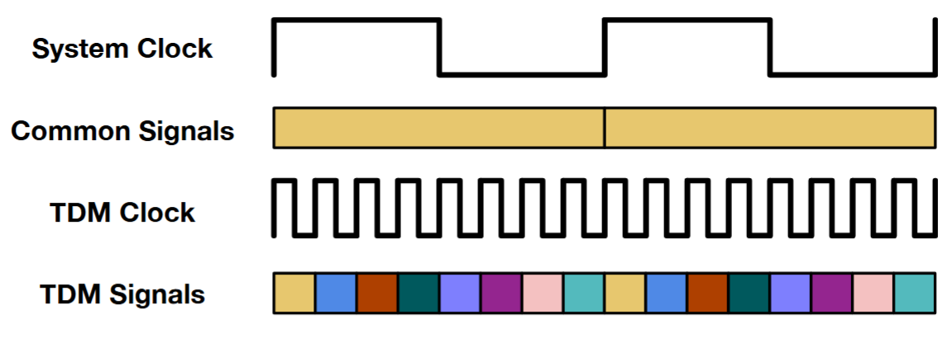
Modern 2.5D Multi-FPGA System (MFS)
TDM Ratio: the maximum number of TDM signals in a channel within one system clock.
A Multi-FPGA System with 2 FPGAs
Cross-FPGA TDM Signals
Notes:
2.5D Multi-FPGA system has been commonly used in modern emulation system. In the left figure, we show an example of a multi-FPGA system with 2 FPGAs. Each FPGA has 4 dies, and different dies within an FPGA are connected by SLL wires. And each FPGA has several I/O banks which contains several I/O package pins. Cross-FPGA signals are transmitted through channels between I/O banks of different FPGAs and each channel connect a pair of package pins. Usually, there are two kinds of signals: common signals and TDM signals. In a system clock period, only one common signal can be transmitted while multiple TDM signals can be transmitted within a system clock period.

Slide 3
Typical Die-Level MFS Emulation Flow
Post-Synthesized Netlist
Logic-Element-Level Placement
Die-Level Design Partition
TDM Signal Grouping & Package Pin Assignment
Logic-Element-Level Routing
Die-Level Routing and TDM Ratio Assignment
Bitstream Generation
System-Level Flow
Logic-Element-Level Flow
Notes:
The CAD flow to use multi-FPGA system for emulation usually contains 2 phases: system-level flow and logic-element-level flow. System-level flow takes post logic synthesized netlist as it inputs. It first partition the design onto each die of each FPGA. Then, die-level routing and TDM ratio assignment is performed to determine the routing paths for die-crossing nets. The final step of the system-level flow is TDM signal grouping and package pin assignment, which is what we do in this work. After the system-level flow, we have the logic-element-level netlist for each FPGA. We then use commercial tools like Vivado to do the placement and routing process and generate the bitstream.

Slide 4
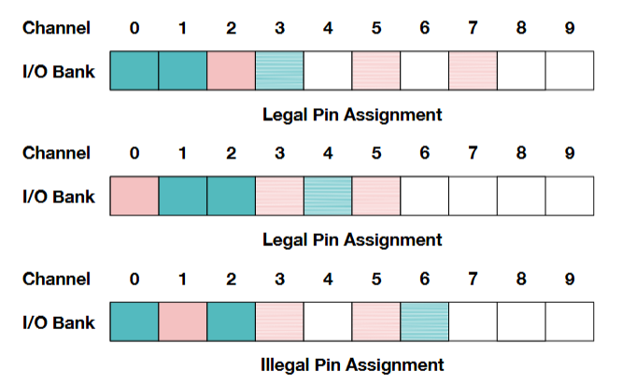
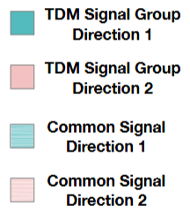
Problem: TDM Signal Grouping & Package Pin Assignment
Input: System-level routing and TDM assignment results.
Output:
  Decide which cross-FPGA TDM signals shall share the same channel.
  Assign the package pin for each cross-FPGA signals/signal groups (SGs).
Target:
  PnR congestion (Primary)
  Delay
Constraint:
  SGs with same direction shall be in adjacent channel.
  TDM maximum capacity.
Notes:
Let’s review the main character of this work: the problem of TDM signal grouping and package pin assignment. As a cross-FPGA channel can be used for several TDM signals, TDM signal grouping is the process to decide which cross-FPGA TDM signals shall share the same channel. The TDM signals with in a TDM signal group shall have the same TDM ratio and direction. Package pin assignment process is the next step to assign a package pin for each cross-FPGA common signal or TDM signal groups. Due to the IP limitation, we shall follow the I/O bank direction rule, which requires assigning TDM signal groups with higher priority than common signals, and TDM signal groups with the same direction shall be assigned to neighbor package pins.

Slide 5
Prior Works
 | [Liao et al. TCAD ’21] | Industrial Tools
Algorithm | MCF & ILP | Heuristic
Design Flow | FPGA-Level Flow | FPGA-Level/Die-Level
FPGA Architecture | 1x4 Dies | 1x4/2x2 Dies
Netlist | Simplified Hypergraph without Logic-Element-Level Netlist | Die-Level/FPGA-Level Logic-Element-Level Netlist
Physical Information | Missing Locations of Package Pins | Ignoring Locations of Package Pins
Notes:
Only a few prior works studies this problem. An article from TCAD in 2021 uses Min cost flow and integer linear programming to do the TDM signal grouping and package pin assignment process. Their work is based on the FPGA-Level design flow, which is not precise enough compared to die-level flow in modern emulation tools. They focus on an FPGA with 1x4 die shape, which is more simple than modern 2x2 shape FPGAs. They use ICCAD 2019 contest benchmark as their netlist, which is a simplified hypergraph without any logic-element-level information. They also ignore the locations of package pins.

Slide 6
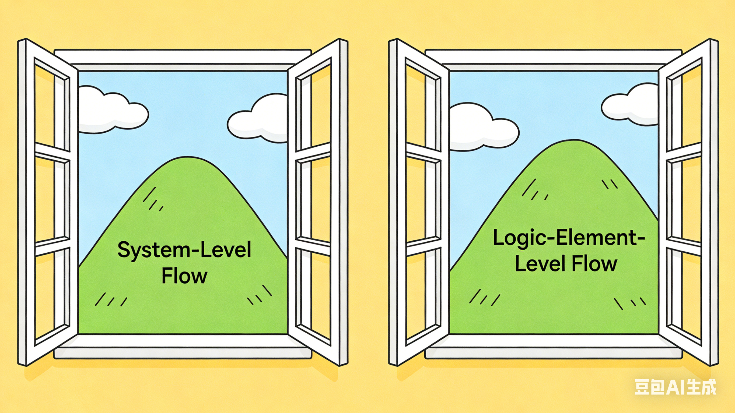
Challenge
Optimizing both system-level & logic-element-level
  Ignoring logic-element-level physical position lead to high PnR congestion.
  Need to lookahead logic-element level when TDM signal grouping and package pin assignment.
Optimizing total die-crossing
Optimizing delay and congestion
Conventional flow: only consider system level
Target flow: consider both levels
Notes:
The challenge of the TDM signal grouping and package pin assignment is that we need to consider both the system-level flow and the logic-element-level flow, as such process is a bridge between system-level flow and logic-element-level flow. However, conventional flow only consider system level but ignore the logic element level, results in high logic element level placement and routing congestion. To address this, we need to lookahead logic-element level in the grouping and assignment process.

Slide 7
Contributions
TDM signal grouping and package pin assignment framework with logic-element-level global placement lookahead.
Notes:
So in this work, we propose a TDM signal grouping and package pin assignment framework with logic-element-level global placement lookahead. We build the netlist for each FPGA before TDM signal grouping and do global placement process for each FPGA. The global placement result is used to guide the grouping and assignment process to reduce the logic-element-level congestion.

Slide 8
Contributions
TDM signal grouping and package pin assignment framework with logic-element-level global placement lookahead.
Speed-boosted global placer for large-scale AMD VP1902 FPGA.
Novel placement-aware TDM signal grouping and package pin assignment algorithms.
Less congestion and delay compared to industrial tool.
Notes:
Detailly, we make the following three contribution in this paper: We build a speed-boosted global placer for modern large-scale AMD VP1902 FPGA devices. We design a series novel placement-aware TDM signal grouping and package pin assignment algorithms. Compared to an industrial tool, our results have less congestion and delay.

Slide 9
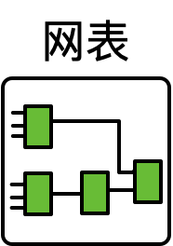
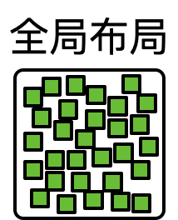
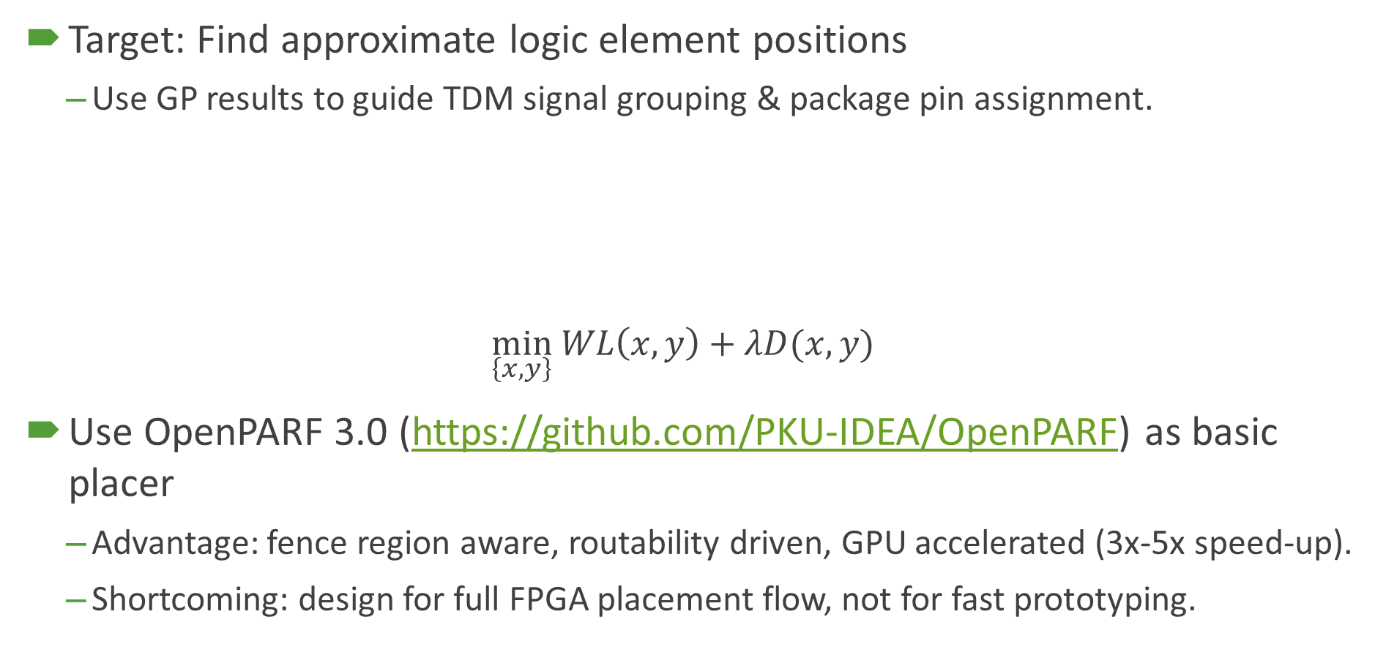
Global Placement Lookahead
Target: Find approximate logic element positions
  Use GP results to guide TDM signal grouping & package pin assignment.
$$\min_{\left\{x,y\right\}} WL\left(x,y\right)+λD(x,y)$$
Use OpenPARF 3.0 (https://github.com/PKU-IDEA/OpenPARF) as basic placer
  Advantage: fence region aware, routability driven, GPU accelerated (3x-5x speed-up).
  Shortcoming: design for full FPGA placement flow, not for fast prototyping.
Netlist
Global Placement
Notes:
Let me first introduce our global placement lookahead algorithm. In the FPGA CAD flow, the target of global placement is to find approximate positions for the logic elements. We use the global placement result to guide our TDM signal grouping and package pin assignment process. We hope those signals with neighboring startpoint and endpoint position can be grouped to the same group and signals can be assigned to neighbor package pins. The global placement process is based on the following target function: minimizing wirelength and density. In this work, we use OpenPARF, the opensource FPGA CAD tool designed by our group and is available on GitHub, as our basic placer. The OpenPARF placer is fence region aware to restrict cells into dies they belong to, and routability driven to optimize congestion. Also, it is GPU accelerated and has potential to quickly generate the result. However, it is originally design for full FPGA placement flow, not for fast prototyping.

Slide 10
Speed-Boosted Global Placer
Challenge: HUGE design scale and FPGA layout
Solution: Speed-boosted global placer
  Adaptive lambda scheduling strategy.
  Shared density-map caching mechanism.
  Optimized data marshalling.
  Placement layout approximation.
 | ISPD ’16 & ’17 Cases On AMD VU095 | MLCAD ’23 Cases On AMD VU3P | Our Cases On AMD VP1902
MAX #Cells | 1M | 711K | 8M
#Tiles | 168x480 | 206x300 | 544x1148
Notes:
Applying OpenPARF to modern large-scale multi-die FPGAs shall face the challenge of the huge design scale and FPGA layout. As shown in this table, compared to the ISPD & MLCAD benchmarks, which are usually used to evaluate the performance of academical global placers, the number of cells and the area of layouts of our VP1902 cases are much larger. To address this problem, we develop a speed-boosted global placer. We use these four strategies: Adaptive lambada scheduling, shared density-map caching, optimized data marshalling and placement layout approximation.

Slide 11
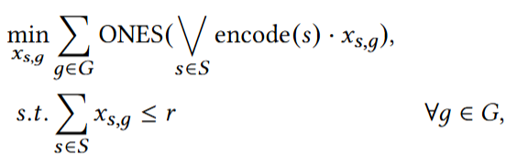
Encoding-Based TDM Signal Grouping (1)
Die 1
Die 2
Signal 1
Encoding method
  Encoding each signal by 0/1 bits.
  Encoding bit ID refers to cross-die boundary.
Problem formulation
2
6
1
3
5
7
0
4
Die 0
Die 3
Signal 2
FPGA 0
FPGA 1
Encoding ID
7 6 5 4 3 2 1 0
Signal 1
0 0 1 0 0 0 0 1
Signal 2
0 0 0 1 0 0 0 1
variable
TDM ratio for signal s
Signal 1 + Signal 2
0 0 1 1 0 0 0 1
The goal of TDM signal grouping is to make signals across the same cross-die boundary into a group.
Notes:
Let me now introduce our TDM signal grouping algorithm. To fastly check the die crossing of a signal or a signal group, we propose a novel signal encoding. Each signal will have an 8-bit binary encoding, and each bit represents whether the signal cross the corresponding die boundary. Take the right figure as an example, signal 1 is encoded as 00100001 and signal 2 is encoded as 00010001. And if we group some signals together, the group’s encoding will be logic OR of each signal’s encoding. The number of die crossing will be the number of 1s in the encoding, and we have the problem formulation as here.
Solve by greedy algorithm：优先选1比较多的signal，然后找hamming distance较小的。
Refine by GP position：在不改变die crossing的情况下，使得一个group输出cell尽可能接近。

Slide 12
Encoding-Based TDM Signal Grouping (2)
Signals in the same group share the same cross-FPGA channel.
The objective correlate with congestion well.
G1.1
G1.1
G2.1
G1.2
G2.1
G1.2
G2.2
G2.2
Signal G1.1
0 0 1 0 0 0 0 1
Signal G1.1
0 0 1 0 0 0 0 1
2
3
Signal G1.2
0 0 1 0 0 0 0 1
Signal G1.2
0 0 0 1 0 0 0 1
Signal G2.1
0 0 0 1 0 0 0 1
Signal G2.1
0 0 1 0 0 0 0 1
2
3
Signal G2.2
0 0 0 1 0 0 0 1
Signal G2.2
0 0 0 1 0 0 0 1
Die Crossing : 4=2(G1)+2(G2)
Die Crossing : 6=3(G1)+3(G2)
Notes:
Let’s see an example of the TDM signal grouping problem. We have four signals with TDM ratio as 2 from the left FPGA to the right one. If we group the result as the left one, the total die crossing will be 4. But if we group as the right one, the total die crossing will be 6. Note that signals in the same group share the same cross-FPGA channel, and the total die crossing correlates with congestion well.
Objective:
Solve by greedy algorithm
Refine by GP position

Slide 13
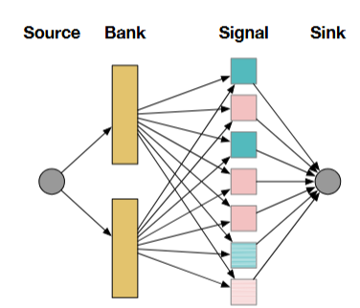
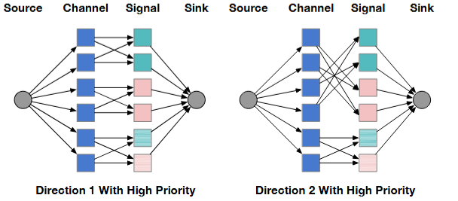
MCF-Based Package Pin Assignment
Target: Assign signals/signal groups to package pins with smaller distance.
Step 1:
  Bank assignment
Edge Weight is calculated by the distance from cells to I/O banks or package pins.
Step 2:
  Pin Assignment
1
1
1
1
1
1
1
1
#channel
Notes:
Our package pin assignment flow is based on min-cost flow to assign the common signals and the TDM signal groups to package pins with smaller distance. The process is divided into 2 steps: Bank assignment and pin assignment. Such a division is to handle the bank direction rule caused by TDM IP. The edge weight of our MCF model is defined by the distance from the startpoint and endpoints of each signal to the I/O banks or the package pins, which is based on our global placement lookahead results.

Slide 14
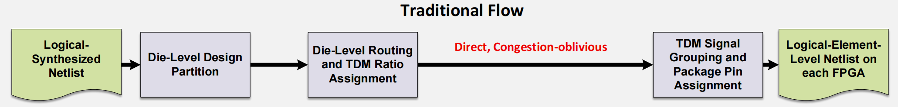
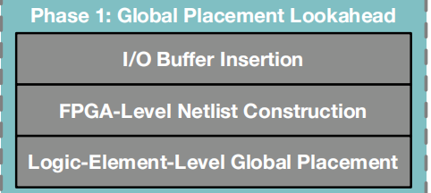
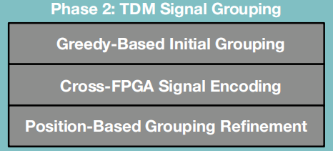
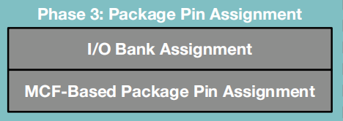
Overall Flow
Our Flow
Notes:
Finally, let’s review the overall flow of our work. We take the die-level partition and routing results, the FPGA placement architecture of our inputs and have global placement lookahead before TDM signal grouping and package pin assignment process, which is new to MFS CAD flow. For those highly congested designs, our global placer can report them in the early design stage and they may be re-partitioned. We then do our encoding-based signal grouping and MCF-based pin assignment process to generate the final results, and these 2 steps are GP results awared.

Slide 15
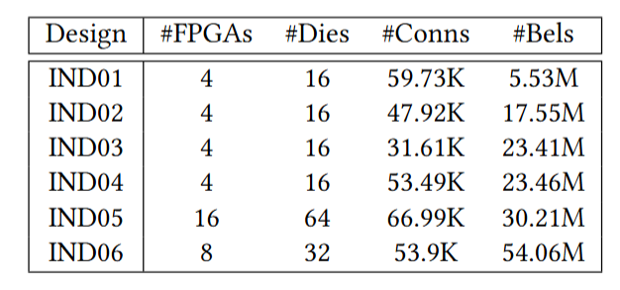
Experimental Setups
2.1 GHz Intel CPU with 512 GB Memory
NVIDIA A40 GPU for Global Placer
6 industrial cases
Target AMD VP1902 FPGA
  Architecture generated by RapidWright
  Use FPGA Interchange Format as input
Evaluated by Vivado 2025.1
Benchmark Statistics
Notes:
Our experiments are done on a 2.1 GHz Intel CPU with 512 GB Memory. We use NVIDIA A40 GPU to accelerate our global placer. We collect 6 industrial cases with at most 54M logic elements. Our works targets at AMD VP1902 FPGA and we use RapidWright and FPGA Interchange Format to generate our inputs. Our results are evaluated by Vivado 2025.1.

Slide 16
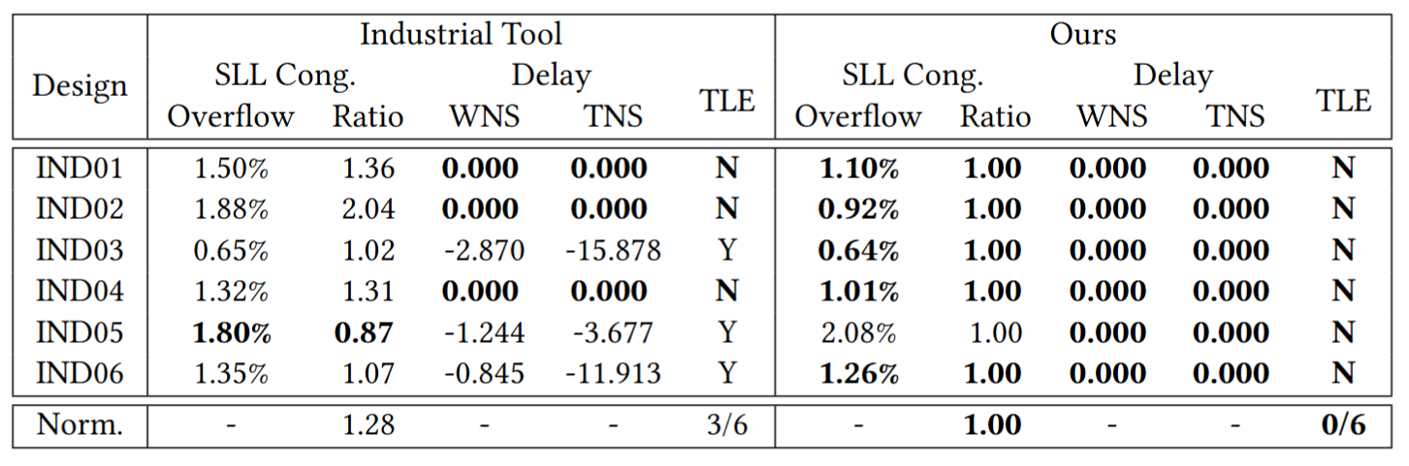
Experimental Results: Industrial Tool VS Ours
28% less congestion
Fix up to 2.87ns WNS
100% successful rate
Notes:
We compared our results with an industrial tool, the results shows that our works can reduce 28% less congestion. We compared the results of the WNS and TNS, it shows that the industrial tool has negative slacks on 3 of 6 cases, and results in failing to generate legal results in a 24-hour limit. Our results have no negative slack and no time limit exceed.

Slide 17
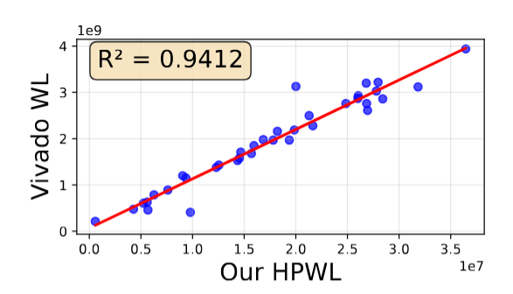
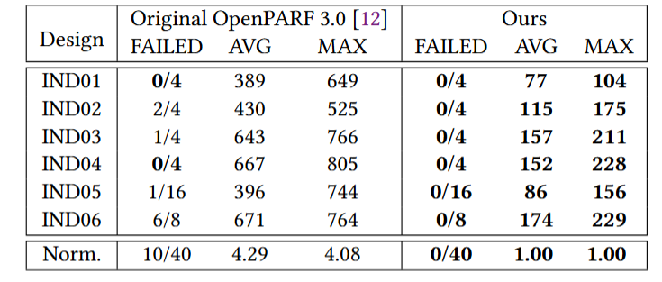
Ablation Study: Global Placer
Highly Correlated WL with Vivado
  0.9412 of R² Value
Highly accelerated placer
  4.29x faster than OpenPARF 3.0
  Placing 8M-cells FPGA-level sub-design within 5 min
Notes:
We also do ablation studies to show the effective of our global placer. We compared the results of HPWL of our placer and the post-placement wirelength of Vivado. It shows that they are highly correlated. We also compared the runtime with the original OpenPARF 3.0, and it shows that our placer is more than 4 times faster than the original OpenPARF 3.0 placer.

Slide 18
Conclusion
TDM signal grouping and package pin assignment framework with logic-element-level global placement lookahead.
Speed-boosted global placer and placement-aware TDM signal grouping and package pin assignment algorithms.
28% less congestion and fix up to 2.878ns WNS compared to industrial tool.
Future Work:
  Design hierarchy aware global placement.
Notes:
Finally, let me conclude our works. In this work, we design a TDM signal grouping and package pin assignment framework with logic-element-level global placement lookahead. We propose Speed-boosted global placer and placement-aware TDM signal grouping and package pin assignment algorithms. We have 28% less congestion and up to 2.878ns WNS compared to industrial tool. In future, we will try to make our global placer design hierarchy aware to make it more robust.

Slide 19
Thanks!
Questions are welcome!
Email: jiaruiwang@pku.edu.cn
Notes:
Thanks for listening. As the first author of this work is injured and cannot come to this conference, for further questions, please contact his email.
FAQ:
PL和Vivado结果Congestion比怎么样？不知道Vivado Post-Placement估计Congestion方法，整体来看，使用的RUDY模型和Vivado相关性还可以
结果是否可能是Repartition优化产生的？和工业工具比较是公平的，使用了相同的partition和routing结果
为什么不和prior work比？那个工作基于的模型over-simplified了，没办法生成vivado输入
Industrial tool是什么，算法是什么？Confidential，由工业界合作伙伴提供，整体算法是启发式优化跨die数目
是否会将工作开源？GP优化会集成进OpenPARF，剩下部分涉及confidential
Placement和vivado比速度怎么样？CPU版本跟vivado差不多，GPU版本快3倍左右，可以Stand alone进行gp，vivado不能单独gp

