Slide 1

vFPGA: Towards Sub-μs Reconfiguration via 3D FPGA and Packaging Co-Design
Nikhil K. Cherukuri*, S. Nag*, P. S. Nalla*, A. K. Kola*, C. S. Gadireddi**, K. Dai*, J. Seo***, Z. Fang*, J. Zhang**, Yu Cao*
*University of Minnesota Twin Cities, **Arizona State University, ***Cornell Tech
International Symposium on Field-Programmable Gate Arrays
FPGA ’26, February 22–24, 2026, Seaside, CA, USA

Slide 2
Outline
Motivation and Architectural Innovation
  The Latency Bottleneck in 2D FPGAs
  vFPGA: A Vertical Memory-on-Logic Architecture
Interconnect-Driven Latency Scaling
  Scaling Latency with Vertical Interconnect (VI) Pitch
  Signal-Link Allocation and Configuration Bit Density
Memory Organization and 3D Integration Challenges
  Memory Partitioning and PR Granularity
  Power Delivery and Clocking
Prototype Implementation and Results
Conclusion
Notes:
1 Title + 1 outline + 14 slides + 1 TY slide

Slide 3
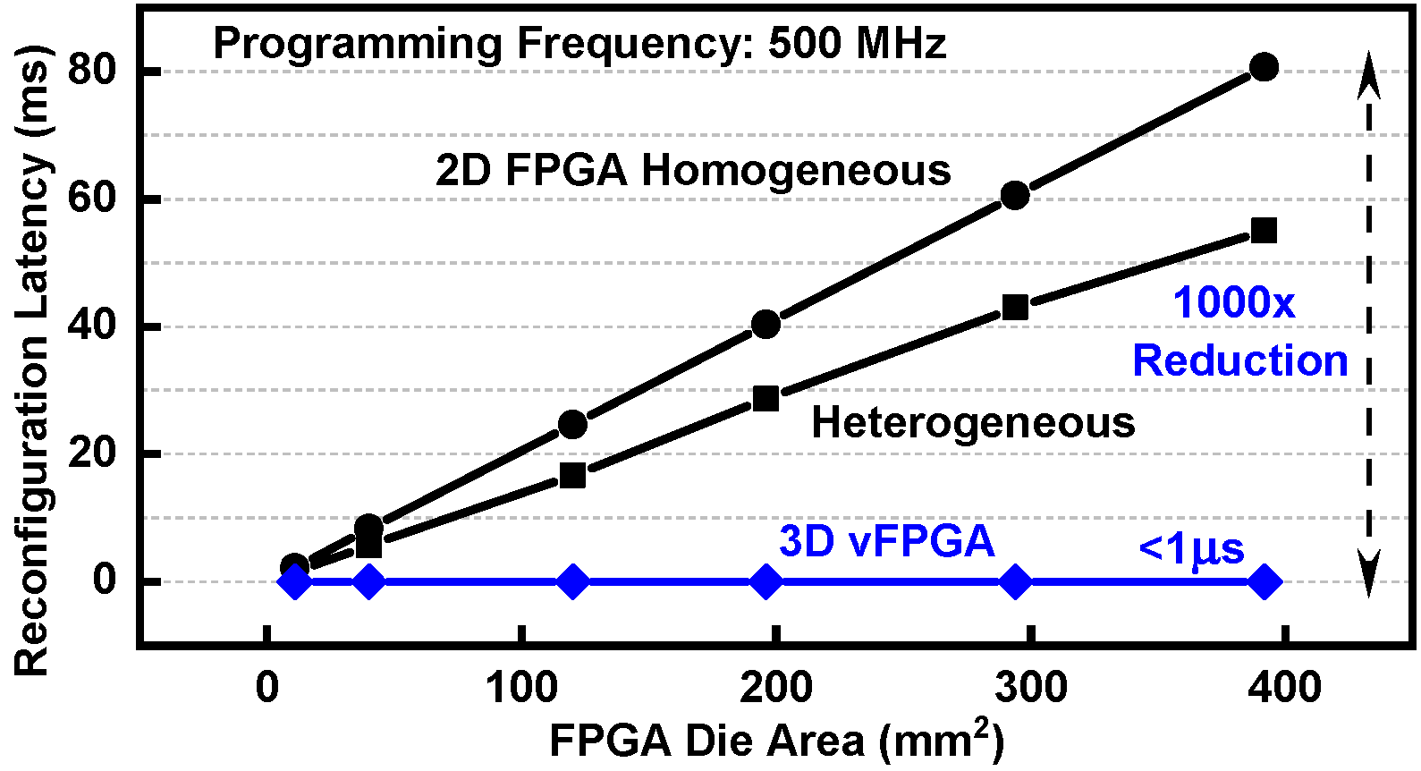
Motivation: The Latency Bottleneck in 2D FPGAs
Global serial scan-chain loads only one-bit per cycle
Reconfiguration latency increases linearly with die area
Millisecond-to-second latencies prevent rapid context switching
Benefits of parallel 2D chains diminish as bitstreams scale
Applications:
  Real-time multi-model AI inference
  Robotics (sense-plan-act paradigm)
  High-Frequency Trading (HFT)
  and latency-critical systems

Slide 4
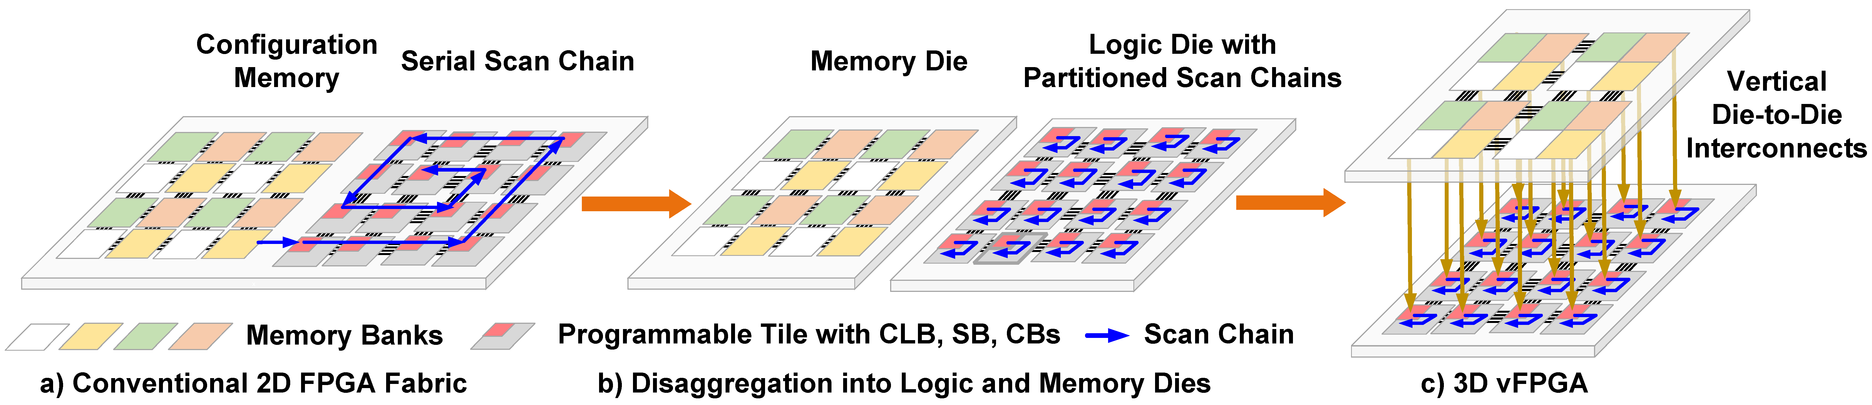
vFPGA: A Vertical Memory-on-Logic Architecture
Disaggregate 2D fabric into stacked logic and memory dies
Partition global scan chain into localized, tile-level chains
Leverage dense face-to-face VIs for parallel programming
Maintain distributed reconfiguration, context and PR control across both dies
Transform serial bitstream loading into high-throughput vertical programming

Slide 5
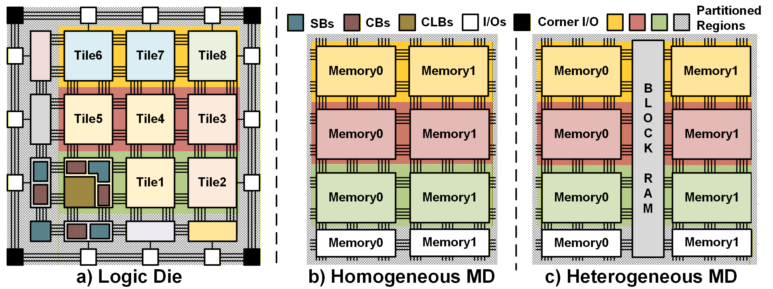
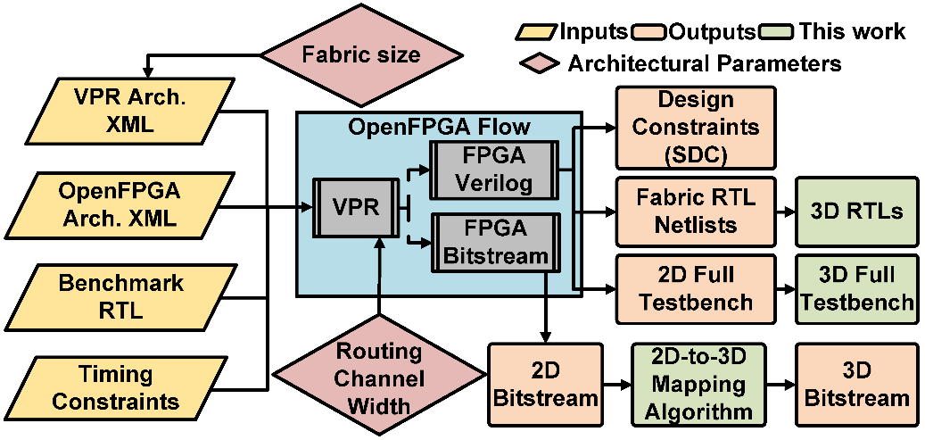
DSE Architecture and OpenFPGA-Based Design Flow
Architecture for DSE
  Baseline island-style 23×23 CLB homogeneous FPGA (1.1M bits)
  Scalable partitioned vertical programming enables area-independent RTR and PR
Design Flow
  Generated 2D fabrics with fixed architectural parameters using OpenFPGA* framework
  Implemented full-chip 3D pseudo-RTLs, testbenches, and 3D bitstream algorithm
OpenFPGA-based design flow
*Tang et al., IEEE Micro, 2020

Slide 6
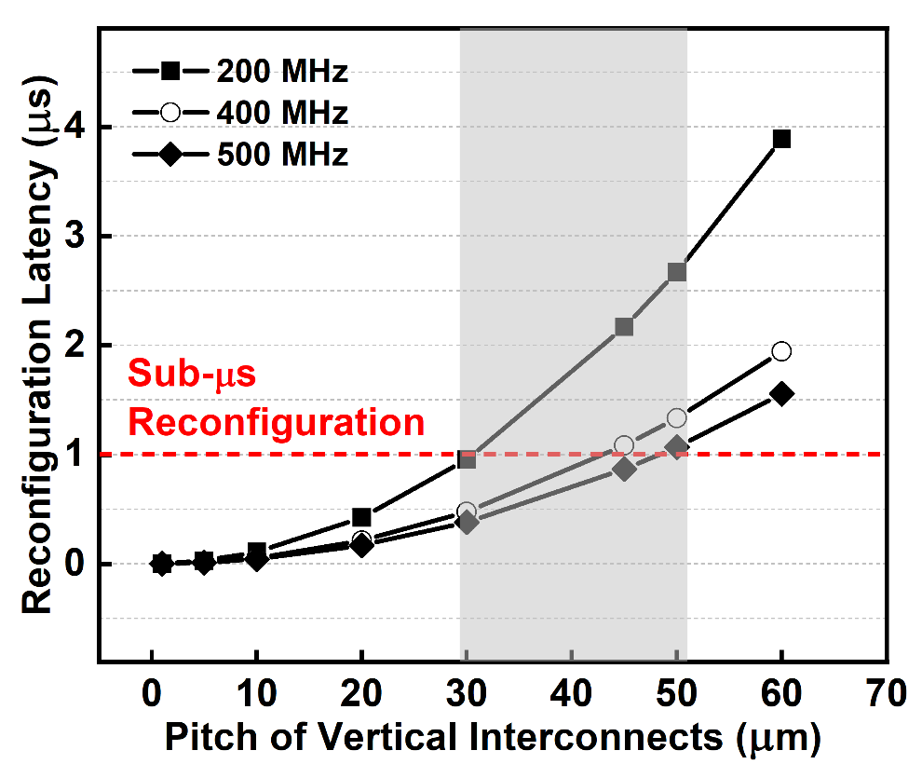
Scaling Latency with Vertical Interconnect Pitch
VI pitch is the dominant architectural parameter governing latency
Reconfiguration latency ∝ (pitch)² (since VI density ∝ 1/(pitch)²)
Sub-µs RTR sustained at pitches ≤30 µm across 200–500 MHz
Hybrid bonding (1–10 μm) enables near single-cycle, sub-10 ns RTR
Practical design point:
45 μm Cu-pillar pitch @ 500 MHz, sub-μs RTR

Slide 7
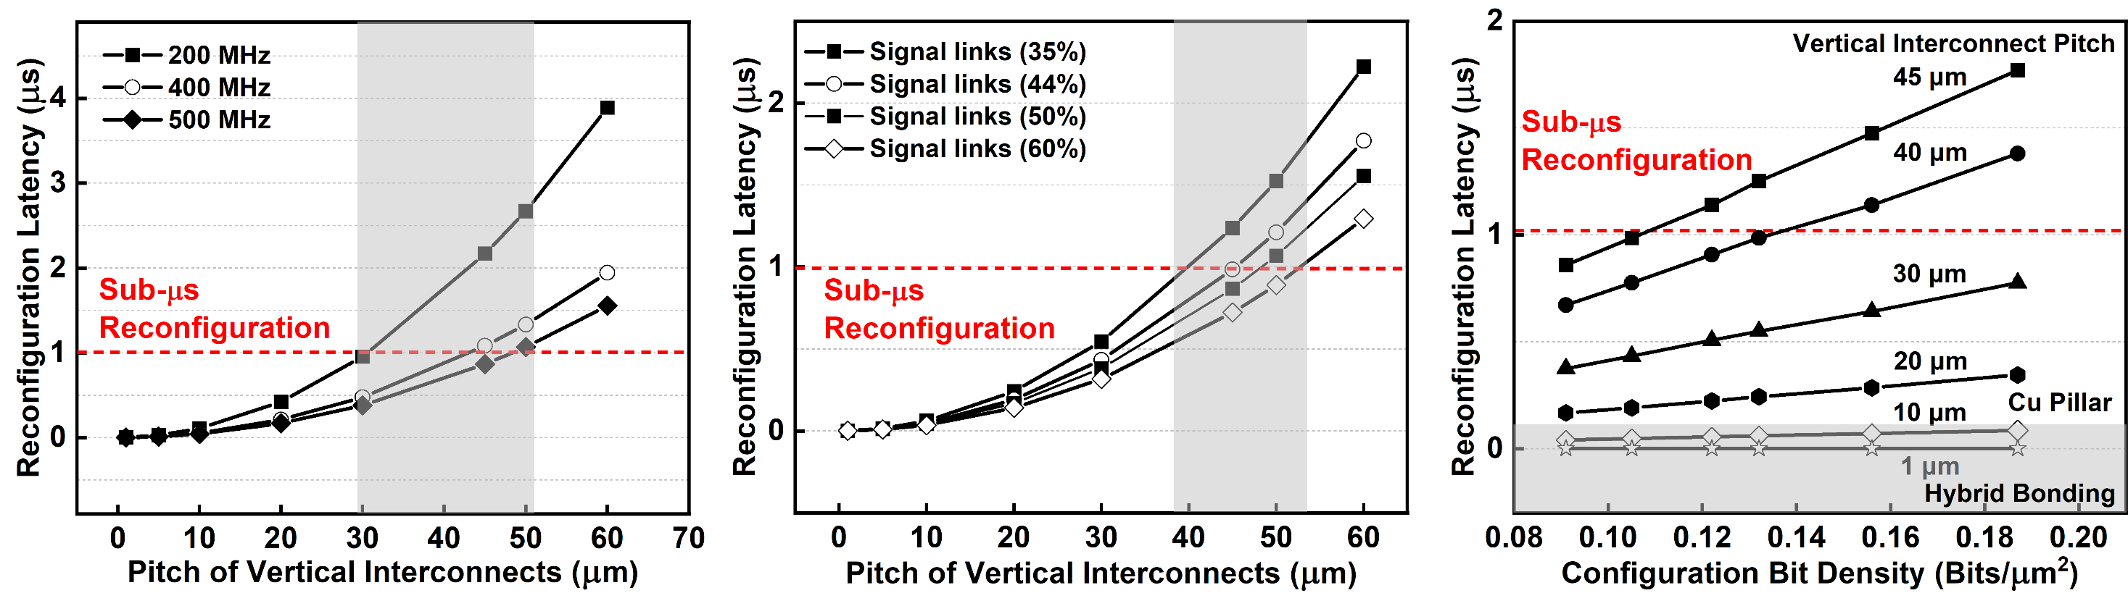
Signal-Link Allocation and Configuration Bit Density
Signal-Link Allocation and Latency Trade-Off
  Higher signal-link ratio increases bandwidth and delays latency scaling to ~45 µm
  VI pitch dominates; sufficient signal provisioning required for sub-µs RTR
Bit Density Scaling and VI Pitch Sensitivity
  Higher bit density amplifies latency at coarse pitches (40–45 µm)
  Fine pitches (≤35 µm) sustain robust sub-µs RTR under high bit density

Slide 8
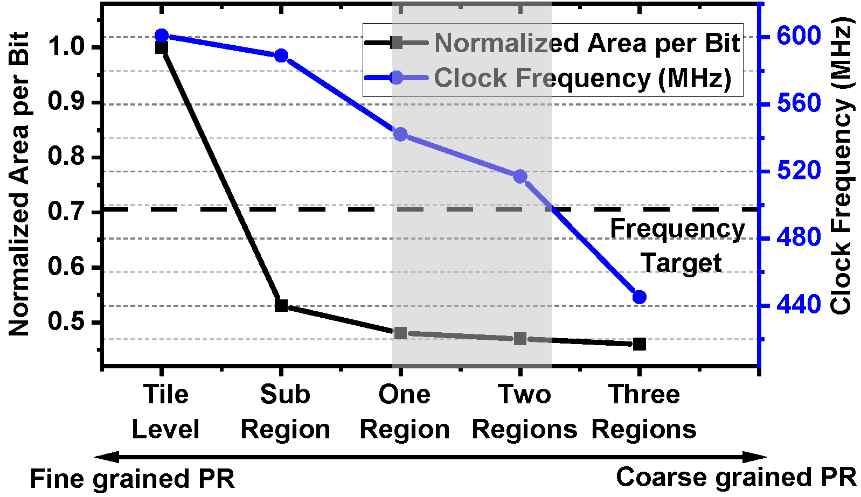
Balancing Multi-Context Storage and PR Granularity
Fine-grained partitions: Smaller banks, higher frequency, higher area overhead
Coarse partitions: Larger banks, better area efficiency, lower frequency
Partitioning granularity directly trades PR flexibility for context capacity
Sub-µs RTR sustained with scalable multi-context capacity
Optimal: 1–2 region banking
@ 30–50 µm VI pitch

Slide 9
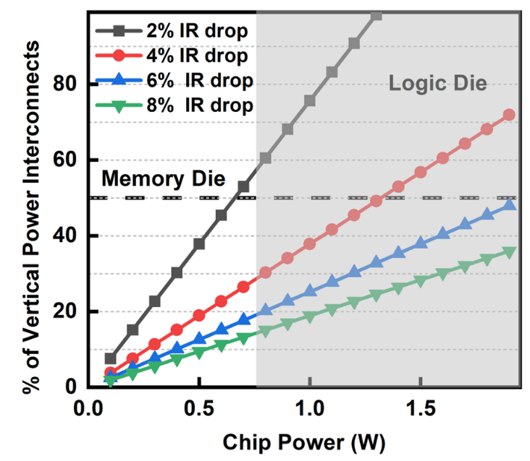
3D Power Delivery Constraints and Architecture
GF22 IR-drop limits (>4%) require 40–60% VIs for power delivery
Lower-power memory-die-on-top minimizes power–signal VI contention
Top die powered via dedicated periphery VIs from reserved bottom-die core rings
  Supplemental VDD/VSS support from bottom-die upper metal PDN stripes
50 % VIs

Slide 10

Inter-Die Source-Synchronous Clocking
Bottom die forwards launch clock to top die and captures returned data
Capture timing compensates worst-case round-trip RC delay
Minimizes inter-die skew impact and preserves timing margins
Bang et al., SLIP, 2015 and Sumbul et al., DATE, 2025

Slide 11
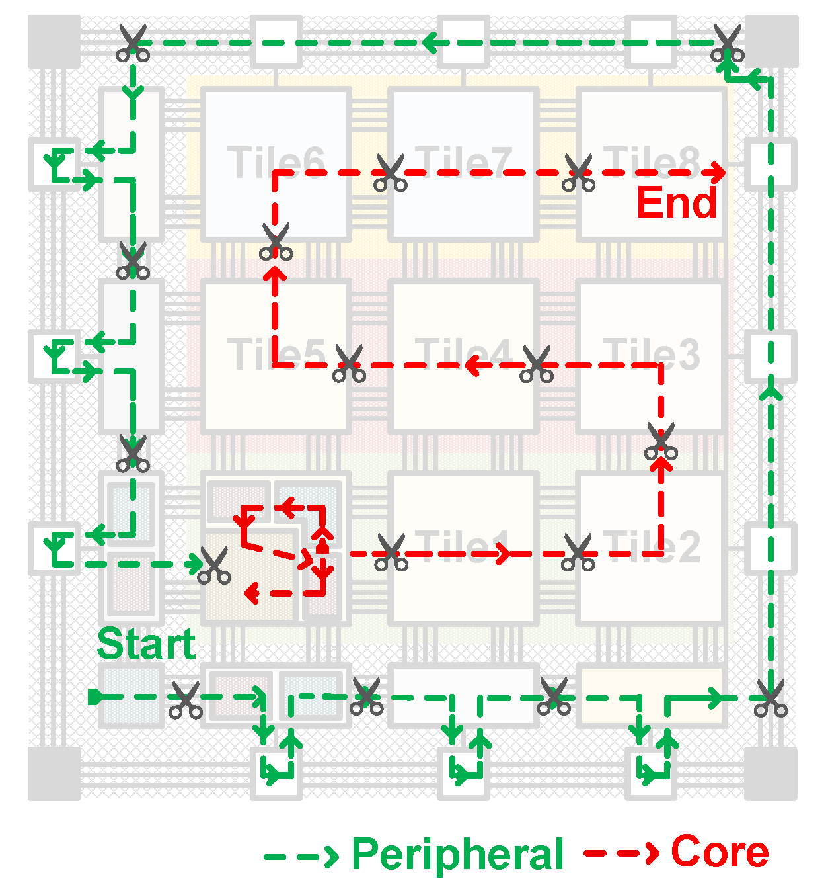
2D-to-3D Bitstream Mapping Methodology
Segmentation: Partition global 2D bitstream into tile-aligned 3D segments
Balanced Allocation: Distribute core/periphery bits evenly across regions
Synchronous Shift: Zero-pad shorter segments for aligned shift cycles
PR Support: Independent programming of partitioned domains
vFPGA Hierarchical Organization (12×8 Fabric)
  273 macros → 77 programmable tiles
  7 scan-partitioned regions (6 core, 1 periphery)
  4 static PR domains aligned with memory partitions
  Core/periphery programming groups

Slide 12
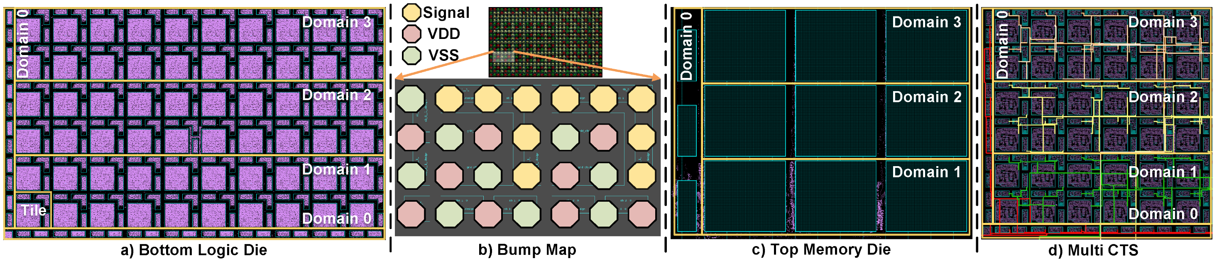
GF22 FD-SOI Prototype Implementation
12 × 8 tileable FPGA fabric
  127.4K reconfiguration bits
45 μm Cu-pillar VI pitch
  43% Signal VIs
27 pre-loaded contexts (ping-pong)
Multi-domain static PR

Slide 13
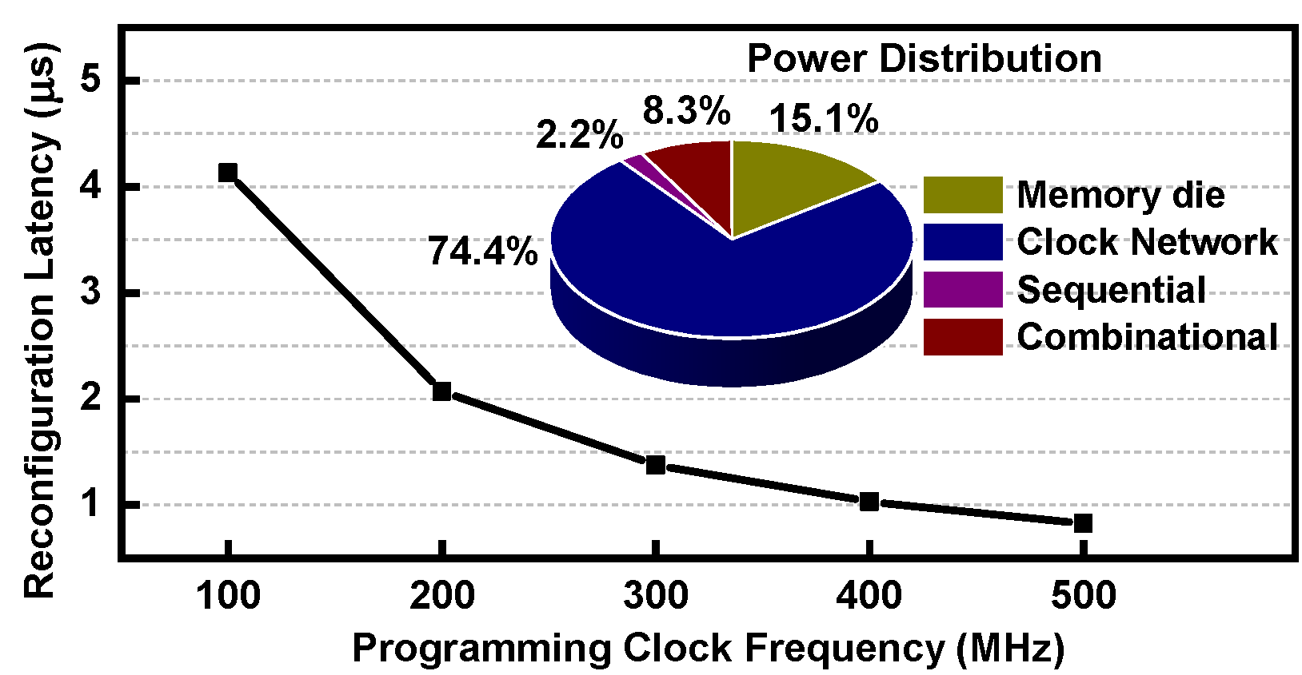
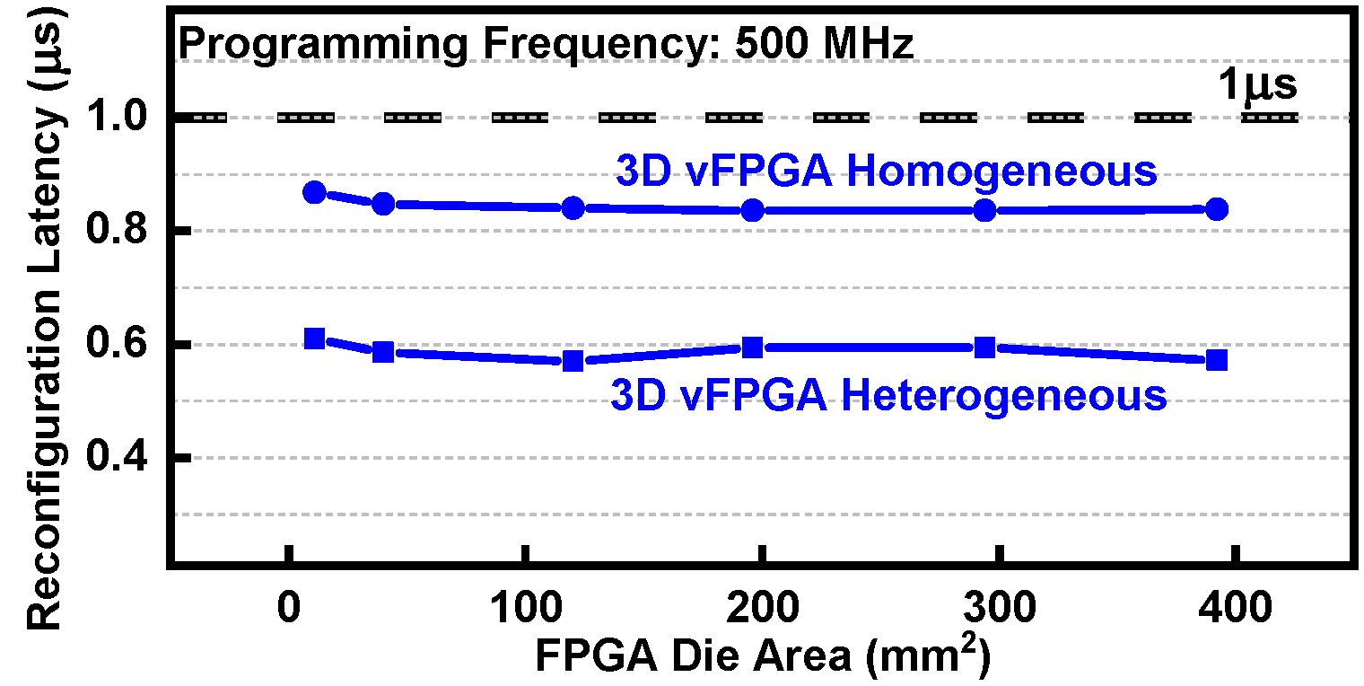
Results: Area-Independent Sub-μs Reconfiguration
0.83 μs RTR @ 500 MHz (45 μm pitch)
  1000× faster than 2D FPGAs
  Latency independent of FPGA area
  10 μm pitch → ~40 ns RTR (projected)
Verified on MAC, multiplier, adder, counter, reconfigurable PE, FIFO designs
Clock network dominates power on logic die

Slide 14
Toward Next-Generation 3D vFPGA
Two-tier GF22 vFPGA tape-out and post-silicon validation
Heterogeneous 3D architecture with SRAM, BRAM, and domain-specific units
Hybrid bonding (≤10 µm pitch) for ultra-high VI density
Dynamic partial reconfiguration across hierarchical PR domains

Slide 15
Conclusion
Architecture and Methodology
  Co-design enables two-tier sub-μs vFPGAs with area-independent scaling
  Scalable 2D-to-3D bitstream mapping
Interconnect-Driven Scaling
  VI density governs latency; quantified signal/power and memory/PR trade-offs
Prototype Implementation
  0.83 μs RTR with 27 pre-loaded contexts in GF22
Forward Outlook
  Path toward sub-10 ns RTR with finer-pitch HBI
  Enables rapid context switching in latency-critical systems
Notes:
0.83 us for reconfiguration of one-domain and same latency for full-chip reconfiguration

Slide 16
Acknowledgments
This work was supported in part by CoCoSys, one of the seven centers sponsored by the Semiconductor Research Corporation (SRC) and DARPA under the Joint University Microelectronics Program 2.0 (JUMP 2.0)

Slide 17
vFPGA: Towards Sub-μs Reconfiguration via 3D FPGA and Packaging Co-Design
Thank You!

