Slide 1
EdgeSort: A Sub-100 ns, Line-Rate
FPGA Streaming Sorter
Greg Stitt, Wesley Piard, Christopher Crary
Department of Electrical and Computer Engineering
University of Florida
FPGA 2026

Slide 2
Introduction
Most prior sorting work focused on maximizing throughput
  Streaming applications constrained by network bandwidth
  New opportunity for low-latency sorting
GPUs are not well-suited for low-latency streaming applications
  Latency dominated by PCIe times, even for infinitely fast throughput
High-Throughput Sort (e.g., GPU)
Stream In
PCIe Write
PCIe Read
Stream Out
Stream In
Stream Out
Latency Increase over Ideal

Slide 3
EdgeSort
We introduce EdgeSort for SmartNIC FPGAs
  Lower throughput than GPUs, but:
    Achieves line-rate sorting at common networking bandwidths
    Minimizes 1) latency to first output, and 2) total added latency over ideal
  Two orders of magnitude lower latency than PCIe accelerators
  ~100 Gbps throughput with < 100 ns of added latency for 128k-element arrays
High-Throughput Sort (e.g., GPU)
Stream In
PCIe Write
PCIe Read
Stream Out
Lower-Throughput Streaming Sort (EdgeSort)
Subsorting
Merging
Orders-of-magnitude latency improvement
Stream In
Stream Out
Latency to First Output
Stream In
Stream Out
Total Added Latency

Slide 4
Architecture Overview
Architecture based on common subsort-merge strategy
8,2
5,3
2,4
6,1
Input Distributor
Scatters inputs to parallel sub-sorts
Parallel sub-sorts
6
5
3
1
8
2
4
2
. . . . . . . . . . . .
Parallel
Tournament
Tree

Slide 5
Architecture Overview
Architecture based on common subsort-merge strategy
Input Distributor
Parallel sub-sorts
6
3
8
4
. . . . . . . . . . . .
5
1
2
2
Parallel
Tournament
Tree
Tree merges sorted sub-arrays faster than input arrival rate, guarantees line-rate
1,2,2

Slide 6
Architecture Overview
Architecture based on common subsort-merge strategy
Input Distributor
Parallel sub-sorts
6
. . . . . . . . . . . .
5
3
8
4
Parallel
Tournament
Tree
Tree merges sorted sub-arrays faster than input arrival rate, guarantees line-rate
3,4,5
1,2,2

Slide 7
Architecture Overview
Architecture based on common subsort-merge strategy
Input Distributor
Parallel sub-sorts
6
8
Parallel
Tournament
Tree
Tree merges sorted sub-arrays faster than input arrival rate, guarantees line-rate
6,8
3,4,5
1,2,2

Slide 8
EdgeSort Architecture
Extends common strategy with optimizations for scalability and latency
a[i..i+P_{in}-1]
Buffers next array while sub-sorts drain
Line-Rate FIFO
P_{FIFO}
Input Distributor
H hybrid sub-sorts of k elements each provide initial sorted burst, then reduce throughput to improve scalability
HSS₀
HSS₁
. . . . . . . . . . . . .
HSS_{H-1}
k
Parallel
Tournament
Tree
Parallel tournament tree provides sufficient (not max) throughput for line-rate to reduce resources and latency
1 to P_{TT} outputs
Output FIFO
Output FIFO coalesces merged outputs into beats of output bus width
b[i..i+P_{out}-1]
For k=1024, each HSS requires 1 BRAM
H=1024: 1M element arrays with 1024 BRAMs, 784k LUTs

Slide 9
Input Distributor
Scatters P_{in} inputs every cycle to H hybrid sub-sorts (HSS)
  Shown for P_{in}=2
Uses a tagged “conveyor”
  Tag specifies ID of HSS to use
  Shift register acts as conveyor
  HSS accepts any element whose tag matches ID
Two tagging methods
  Counter: simple, but not ideal for some distributions
  LFSR: randomizes assignment to improve parallelism in tournament tree
From line-rate FIFO
a₀
a₁
Tag Assignment
Counter/LFSR
. . . . . . . .
Tag == 0
Tag == 1
Tag == 2
Tag == 3
. . . . . . . .
Tag == H-1
HSS₀
HSS₁
HSS₀
HSS₁
HSS_{H-1}
. . . . . . . .
To parallel tournament tree

Slide 10
Hybrid Sub-Sorts (HSS)
Provides sub-sorting with combination of sorting methods
Optimized for throughput demands of tournament tree
  Children of root read from with probability ½
  Grand-children of root read from with probability ¼
  Nodes at depth n read from with probability 1/2^{n}
For tournament tree with T inputs, read probability of each input is 1/T
  Low throughput requirements => can save resources to improve scalability
Heap sort in BRAM is area efficient, meets throughput constraint
  But, can have latency of > 30 cycles for 1024-element RAM
Problem: poor latency when filling tournament tree pipeline

Slide 11
Hybrid Sub-Sorts (HSS)
Solution: use faster sort initially (insertion sort)
  Burst buffer provides initial sorted burst every cycle to quickly fill tree pipeline
    Doesn’t scale to large sizes, but doesn’t need to
Switch to scalable buffer (heap sort) after pipeline filled
End-of-stream buffer to avoid 30+ cycle latency of inserting last array element into heap
  HSS can feed tournament tree immediately after receiving last element
Input FIFO
empty
FIFO Read Logic
rd_en
element
eviction
ready
Burst Buffer
(Insertion Sort)
Scalable Buffer
(Heap Sort)
End-of-Stream Buffer
(Register)
Write Controller
write enables
(for each buffer)
drain
Read Controller
Output FIFO

Slide 12
Parallel Tournament Tree
Tournament tree must output data at least as fast as inputs arrive (required for line rate)
  Previous work has introduced parallel mergers, but require massive resources
  We aren’t maximizing throughput, just achieving enough for line-rate
Introduced a novel parallel tournament tree
  Uses P_{TT} separate sequential trees
  Challenge: need to see deeper than the root of each tree
Tree₀
Tree₁
Tree₂
Tree₃
Tree₀
Tree₁
Tree₂
Tree₃
Tree₀
Tree₁
Tree₂
Tree₃
. . . .
. . . .
1 3 7 9
0 2 4 8
. . . .
. . . .
5 6 7 9
0 2 4 8
. . . .
. . . .
8 8 9 9
0 2 4 8
Can only read 1 element
Can read 3 elements
Can read 4 elements
Ordering Rule:
  Can read from tournament tree i, only if best_{i} <= next_{j}, for all j in 0 to P_{TT-1}
  Guarantees 1 output per cycle, up to P_{TT} outputs every cycle

Slide 13
Parallel Tournament Tree
Lookahead FIFOs
  Provides best and next elements for all trees
Order analyzer verifies ordering rule for each tree
Sorting network
  Odd-even mergesort sorting network
  Sorts P_{TT} elements each cycle
  Elements not read from tree are ignored
Variable-write FIFO
  Accepts between 1 and P_{TT} sorted elements
  Outputs P_{TT} elements
  Uses pipelined barrel shifting
h₀
h₁
h_{H/PTT-1}
h_{H-PTT}
h_{H-PTT+1}
h_{H-1}
. . . . . . . . . . . . . .
. . . . . . . . . . . . . .
Sequential
Tournament
Tree 0
Sequential
Tournament
Tree P_{TT-1}
. . . . . . . . . . . . . .
done₀
done_{PTT-1}
rd_en₀
Lookahead FIFO
Lookahead FIFO
rd_en_{PTT-1}
. . . . . . . . . . . . . .
best₀
next₀
best_{PTT-1}
next_{PTT-1}
Order Analyzer
best₀
valid₀
best₁
valid₁
. . . . . . . . .
best_{PTT-1}
valid_{PTT-1}
Sorting Network
best[i..i+P_{TT} -1]
valid_count
Variable-Write FIFO
b[i..i+P_{TT} -1]

Slide 14
Latency Analysis
h₀
h₁
h_{H/PTT-1}
h_{H-PTT}
h_{H-PTT+1}
h_{H-1}
. . . . . . . . . . . . . .
. . . . . . . . . . . . . .
Sequential
Tournament
Tree 0
Sequential
Tournament
Tree P_{TT-1}
. . . . . . . . . . . . . .
log₂(H) cycles, <= 10
done₀
done_{PTT-1}
rd_en₀
Lookahead FIFO
Lookahead FIFO
rd_en_{PTT-1}
2 cycles
. . . . . . . . . . . . . .
best₀
next₀
best_{PTT-1}
next_{PTT-1}
1+ cycles
Order Analyzer
best₀
valid₀
best₁
valid₁
. . . . . . . . .
best_{PTT-1}
valid_{PTT-1}
log²(P_{TT}) cycles,
1 to 15 for P_{TT} = 1 to 32
Sorting Network
best[i..i+P_{TT} -1]
valid_count
1+ cycles
Variable-Write FIFO
b[i..i+P_{TT} -1]
Total cycles: 15 to 29

Slide 15
Latency Analysis
a[i..i+P_{in}-1]
1+ cycles
Line-Rate FIFO
P_{FIFO}
1+ cycles
Input Distributor
1 cycle during initial burst
HSS₀
HSS₁
. . . . . . . . . . . . .
HSS_{H-1}
k
Parallel
Tournament
Tree
15 to 29 cycles
1 to P_{TT} outputs
1+ cycles
Output FIFO
b[i..i+P_{out}-1]
Total cycles: 19 to 33
15

Slide 16
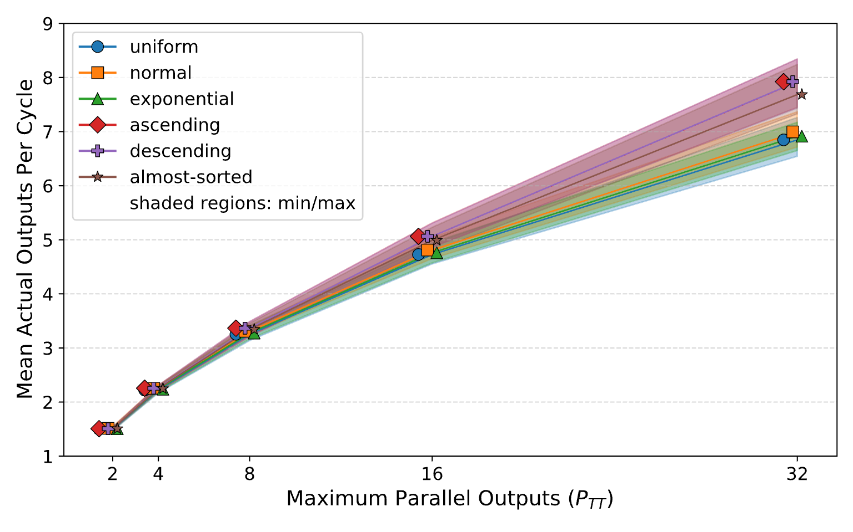
Parallel Tournament Tree
Evaluated parallelism of tree
  Varied max potential parallelism P_{TT}
  Measured mean outputs per cycle
  Tested 6 distributions
  128 inputs (max array size: 128k)
Diminishing returns with larger P_{TT}
  Achieved ~7-8 outputs/cycle at P_{TT}=32
  Similar results across distributions

Slide 17
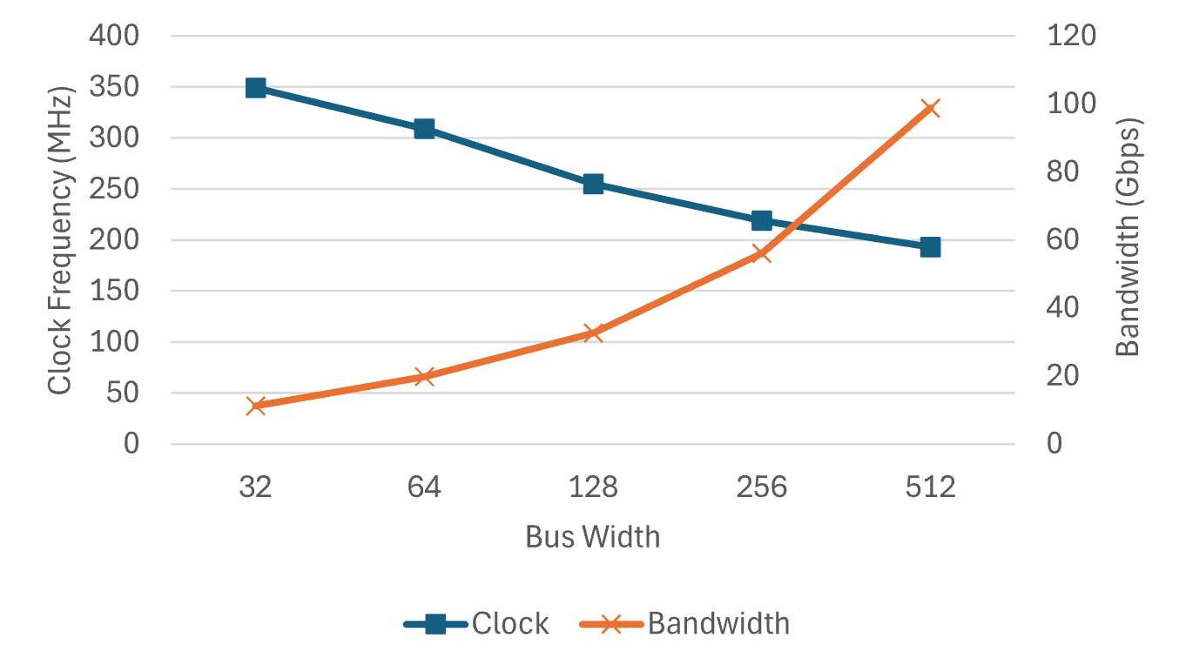
Scalability Experiments
Setup:
  Bus width: 32 to 512
  32-bit key, rest is data
  P_{TT}=2
  Maximum size: 128k elements
  1.7M LUT Versal device
Bandwidth: 11.2 to 98.8 Gbps
  Primarily limited by decrease in clock
Clock: 349 MHz to 193 MHz
  Easy to improve clock at cost of latency
Latency: 74 ns to 134 ns
  Same for latency to first output and total added latency (no gaps)

Slide 18
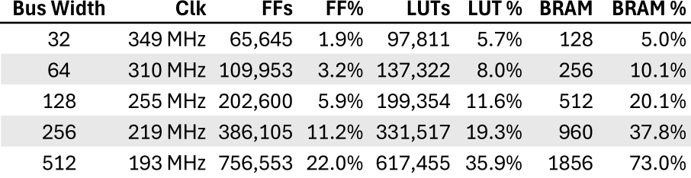
Resource Utilization
P_{TT}=2, maximum size of 128k elements
Evaluated for 1.7M LUT Versal
BRAM bottleneck for wide buses
  Could be improved with UltraRAM
  Other alternatives for low-area, low-P_{TT} data steering in paper

Slide 19
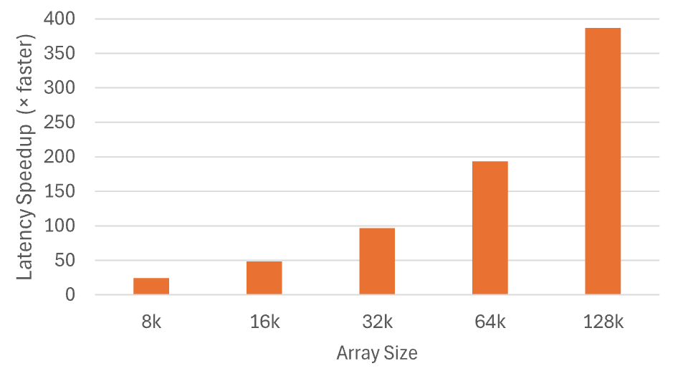
Latency Improvement
Compared EdgeSort latency to PCIe Gen 4 x16 acceleration
  Assumes maximum possible bandwidth (31.5 GB/s) and infinitely fast computation
  Results pessimistic because small PCIe transfers have low bandwidth
EdgeSort achieves > 100x latency improvements for arrays above 32k

Slide 20
Conclusion
We introduced EdgeSort architecture for SmartNIC FPGAs
  Achieved latencies under 100 ns for arrays up to 128k elements
  Line-rate sorting for common bandwidths (up to 98.8 Gbps)
  Showed scalability up to 1M elements
Achieved 1-2 order-of-magnitude latency reductions compared to PCIe accelerators
Hybrid sub-sort and parallel tournament tree designed specifically to reduce latency

