Slide 1
FPGA Fastfood – A High Speed
Systolic Implementation of an Online
Kernel Method
Sean Fox, David Boland and Philip H.W. Leong
School of Electrical and Information Engineering,
The University of Sydney
Notes:
1
This talk is about a computationally inexpensive machine learning algorithm, which we have used to scale up implement

Slide 2
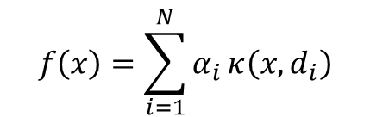
Online Kernel Methods
x_{i}
f(x)
prediction
$$f\left(x\right)=\sum_{i=1}^{N}{α_{i}}κ\left(x,d_{i}\right)$$
d, α
+
∑
Update
Unknowns
Dictionary Entry
y_{i}
-
$$κ\left(x,x′\right) : ℝ^{d} → ℝ^{D}, where D≫d$$
“Kernel Method” →
Dictionary → subset of the input data of length N
Computation and Memory scale O(Nd)
BUT… N scales linearly with the dataset size
Notes:
Our implementation of Fastfood is a type of Online Kernel Method, online meaning that we do training and prediction, and kernel method meaning that the kernel trick is used to extract non-linear relationships inexpensively.

Slide 3

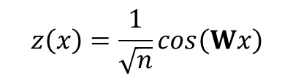
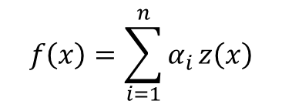
Random Approximation
(Rahimi and Recht, ‘07)
Exact Kernel Methods
  Define z(x):
$$f\left(x\right)=\sum_{i=1}^{N}{α_{i}}κ\left(x,d_{i}\right)$$
Approximates
MV + Non-Linear Activation
(i.e. like Multilayer Perceptron)
W is fixed and random
$$κ\left(x,x′\right)$$
Random Kernel Expansion
1 x d
1 x n
$$f\left(x\right)=\sum_{i=1}^{n}{α_{i}}z\left(x\right)$$
$$z\left(x\right)=\frac{1}{\sqrt{n}}cos\left(Wx\right)$$
z(x)
α
** Only for k(x,x’) = k(x-x’,0)
Input
Output

Slide 4


Fastfood
(Le et al. ‘13)
Computes z(x) efficiently by replacing Wx with combinations of random diagonal matrices and Hadamard transforms
$$z\left(x\right)=\frac{1}{\sqrt{n}}\cos\left(Vx\right), where Vx=\left[Q_{1}x, Q_{2}x, ⋯, Q_{h}x\right]$$
$$Q_{j}x=SHGPHBx$$
** Each Q_{j}x is an independent dxd transform
B, G, S
P
H
Fast Hadamard Transform (dxd)
0 0 1 0
1 0 0 0
0 0 0 1
0 1 0 0
1 1 1 1
1 -1 1 -1
1 1 -1 -1
1 -1 -1 1
Memory = O( 3n )
Time = O( n log d )

Slide 5


Systolic Array Architecture
$$Vx=\left[Q_{1}x, Q_{2}x, ⋯, Q_{h}x\right]$$
Block of b PEs (i.e. $Q_{q}x$)
General PE: 18-bit ALU, RAMs, Control Unit, LFSR
HB₃
HB₄
PE_{b}
inBuff
LFSR
SUM & UPDATE
RAM
+
x
-
HB₂
HB_{h-1}
SWITCH
PE₂
RAM
HB₁
HB_{h}
PE₁
CTRL
Top
HB
PE
Notes:
An interesting aspect of this architecture is the hardware reuse. The same PEs do all the computation in Fastfood. This includes the switching/buffering for the Hadamard transform, and the elementwise stuff,

Slide 6
Results and Conclusion
Impl. | dim. | n | bw | Lat. (cyc) | Fmax (MHz) | Exec (ns) | Th.put (Gb/s)
NORMA (V7, ‘15) | 8 | 200 | 18 | 10 | 127 | 7.87 | 18.3
KNLMS (V7, ‘15) | 8 | 16 | 32 | 207 | 314 | 3.18 | 80.4
CPU (Le et. ‘13) | 1024 | 16.4k | 32 |  |  | 58e4 | 0.06
FASTFOOD (V7) | 1024 | 16.4k | 18 | 1893 | 432 | 23.7e3 | 7.77
FASTFOOD (KU035) | 8192 | 90.1k | 18 | 16930 | 508 | 17.2e3 | 8.57
Supports much larger problems
High speed design
245x speed-up over a CPU
6

