Slide 1
FASTCF: FPGA-based Accelerator for
STochastic-gradient-descent-based Collaborative Filtering
Shijie Zhou, Rajgopal Kannan, Min Yu, Viktor K. Prasanna
FPGA 2018

Slide 2
Outline
Introduction
Optimizations and Accelerator Design
Experimental Results
Impact
Conclusion

Slide 3






Recommender Systems
Information filtering system to predict the interest of users
Everywhere

Slide 4

Collaborative Filtering
Apply machine learning algorithms to predict user’s rating for unrated items
  Bayesian networks
  Clustering
  Matrix factorization
    Stochastic gradient descent (SGD)
      Achieves high prediction accuracy
      Training is computation-intensive

Slide 5







Problem Definition (1)
Input is a partially filled rating matrix $R$
  # of users = # of rows = |$U$|
  # of items = # of columns = |$V$|

Slide 6
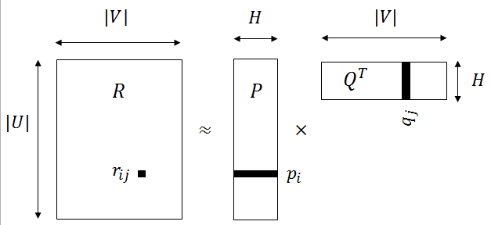

Problem Definition (2)
Output contains two low-rank (i.e., $H$) matrices $P$ and $Q$
  $P×Q^{T}≈R$
  $p_{i}$ : the $i^{th}$ row of $P$ (latent feature vector of user $u_{i}$)
  $q_{j }:$ the $j^{th}$ row of $Q$ (latent feature vector of item $v_{j}$)
  $r_{ij}$: the rating of $v_{j}$ given by $u_{i}$
  $r_{ij}≈$ $p_{i}∙q_{j}$

Slide 7
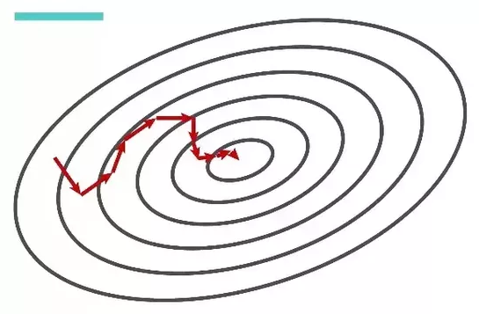
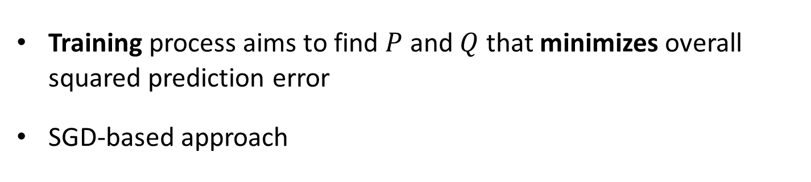

Problem Definition (3)
Training process aims to find $P$ and $Q$ that minimizes overall squared prediction error (i.e., $\sum{(}{r_{ij}^{}−\hat{r_{ij}^{}})}^{2}$)
SGD-based approach
        Randomly initialize each $p_{i}$ and $q_{j}$
        While not done do
          For each known rating $r_{ij}^{}$ do
            ${err}_{ij}= r_{ij}−$ $p_{i}∙q_{j}$
        Update $p_{i}$ and $q_{j}$ based on ${err}_{ij}$
        End for
        End while
        Return $P$ and $Q$
Our focus

Slide 8
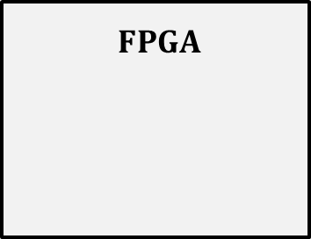

Challenges in Acceleration (1)
Challenge 1
Feature vectors do not fit in on-chip memory of FPGA
How to achieve efficient data reuse?
$External$Memory
$$FPGA$$
P
Q
On-chip RAM

Slide 9









Challenges in Acceleration (2)
Challenge 2
Feature vector dependencies
  Need to incrementally update feature vectors once per rating
$$R$$
$$P$$
$$Q^{T}$$
$$q_{j}$$
$$r_{i^{′}j}$$
$$p_{i^{′}}$$
$$r_{ij}$$
$$p_{i}$$

Slide 10






Challenges in Acceleration (3)
Challenge 3
Parallel processing units access on-chip RAMs
  Concurrent accesses to the same RAM → conflicts
How to reduce access conflicts?
$$FPGA$$
On-chip RAM
P$U_{0}$
P$U_{1}$
P$U_{2}$
P$U_{3}$

Slide 11
Contributions
Novel optimizations to address the three challenges
  Partitioning and communication hiding
    Completely overlap communication with computation
  Parallelism extraction to reduce data dependencies by 28x – 60x
  Scheduling to reduce bank conflicts by 2x – 4x
  Sustain up to 217 GFLOPS for training large real-life datasets
Achieve 13.3x and 12.7x speedup compared with highly optimized multicore and GPU implementations
Generic technique to accelerate SGD-based training

Slide 12
Outline
Introduction
Optimizations and Accelerator Design
Experimental Results
Impact
Conclusion

Slide 13




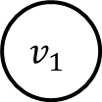
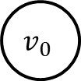


Bipartite Graph Representation
User vertices
Items vertices
1
2 | 5
3.5 | 6
 | 4
$$u_{0}$$
1
2
$$v_{0}$$
$$u_{1}$$
5
3.5
$$u_{2}$$
$$v_{1}$$
6
$$R$$
$$u_{3}$$
4
$$G$$

Slide 14
















Optimization 1 (1)
Graph Partitioning
1
$$u_{0}$$
1
$$u_{0}$$
$$v_{0}$$
$$v_{0}$$
2
$$v_{0}$$
2
$$u_{1}$$
$$u_{1}$$
3.5
5
3.5
5
$$u_{2}$$
$$u_{2}$$
$$v_{1}$$
$$v_{1}$$
$$v_{1}$$
6
$$Subgraph_{0}$$
6
$$Subgraph_{1}$$
$$u_{3}$$
$$u_{3}$$
4
4

Slide 15
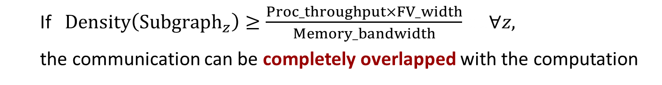












Optimization 1 (2)
Communication Hiding
$$Read FVs$$
$$Compute$$
$$Write FVs$$
$${Subgraph}_{z−1}$$
$$Time$$
$$Read FVs$$
$$Compute$$
$$Write FVs$$
$${Subgraph}_{z}$$
$$Read FVs$$
$$Compute$$
$$Write FVs$$
$${Subgraph}_{z+1}$$
  If $Density\left({Subgraph}_{z}\right)≥\frac{Proc_throughput×FV_width}{Memory_bandwidth}aa∀z,$
  the communication can be completely overlapped with the computation

Slide 16
Optimization 1 (3)
Graph Partitioning and Communication Hiding
Objective: each subgraph should have sufficient edges for the computation to hide the communication
Fast heuristic partitioning approach
  Subset degree of a vertex subset
    number of edges that connect to the vertices in the subset
  Balance subset degrees of distinct vertex subsets
    Sort vertices based on vertex degree
    Greedy assignment of each vertex into the non-full vertex set that has the minimum subset degree

Slide 17

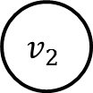




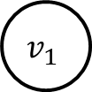





Optimization 2
Parallelism Extraction
Partition the edges of each subgraph into non-overlapping matchings
  Edges in the same matching have no common vertices
$$u_{0}$$
$$v_{0}$$
$$u_{0}$$
$$v_{0}$$
Edge coloring
$$u_{1}$$
$$v_{1}$$
$$u_{1}$$
$$v_{1}$$
$$u_{2}$$
$$v_{2}$$
$$u_{2}$$
$$v_{2}$$

Slide 18
Edge Scheduling
Optimization 3
Partition the edges in each matching into batches
  Sort the edges based on the conflict index (i.e., the number of edges in the matching that have conflict with this edge)
  Assign each edge to the batch where its addition does not increase the conflicts within the batch

Slide 19
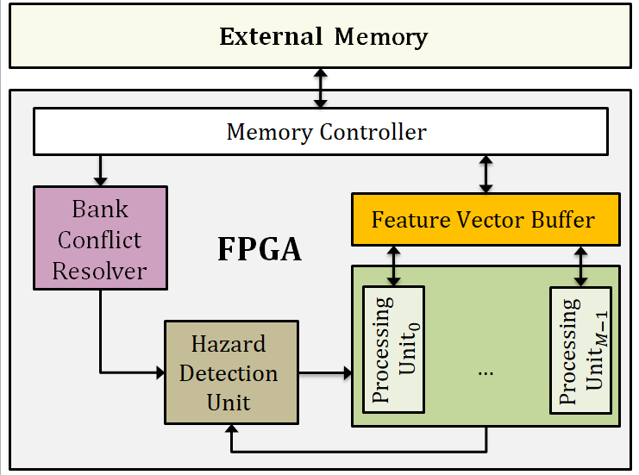
Architecture of FASTCF
Multi-ported RAM based on banking
Resolve bank conflicts to feature vector buffer
Parallel processing units to process distinct edges
Check FV dependencies based on fine-grained locking

Slide 20
Outline
Introduction
Optimizations and Accelerator Design
Experimental Results
Impact
Conclusion

Slide 21
Experimental Setup
Real-life datasets
Virtex UltraScale+ xcvu9pflgb2104 FPGA (for training)
  43 MB of on-chip RAM
Intel Xeon E5-2686 processor (for pre-processing)
  8 cores @ 2.3 GHz
Dataset | # users | # items | # ratings | Description
Libim | 135 K | 168 K | 17,359 K | Dating ratings
Netflix | 480 K | 17 K | 100,480 K | Movie ratings
Yahoo | 1,200 K | 136 K | 460,380 K | Music ratings
Notes:
DDR3 bandwidth 15 GB/s

Slide 22
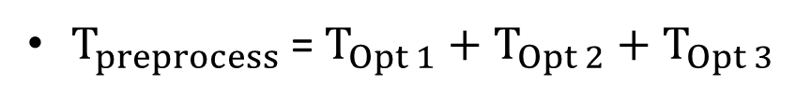
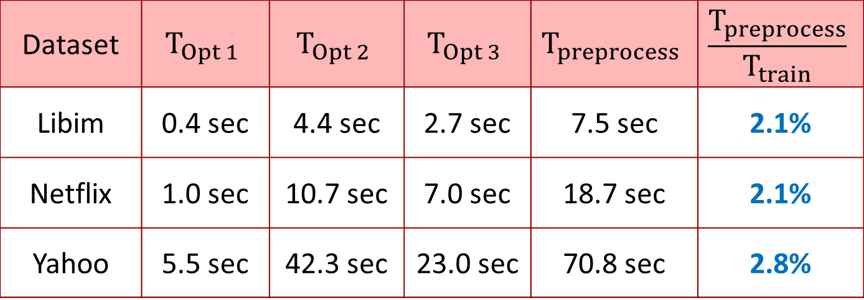
Pre-processing Overhead
$T_{preprocess}$= $T_{Opt 1}$ $+$ $T_{Opt 2}+T_{Opt 3}$
Dataset | $$T_{Opt 1}$$ | $$T_{Opt 2}$$ | $$T_{Opt 3}$$ | $$T_{preprocess}$$ | $$\frac{T_{preprocess}}{T_{train}}$$
Libim | 0.4 sec | 4.4 sec | 2.7 sec | 7.5 sec | 2.1%
Netflix | 1.0 sec | 10.7 sec | 7.0 sec | 18.7 sec | 2.1%
Yahoo | 5.5 sec | 42.3 sec | 23.0 sec | 70.8 sec | 2.8%
Pre-processing overhead can be amortized since the training is iterative

Slide 23
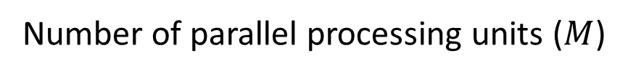
Performance vs. Parallelism
217
163
Throughput (GFLOPS)
93
47
Number of parallel processing units ($M$)

Slide 24
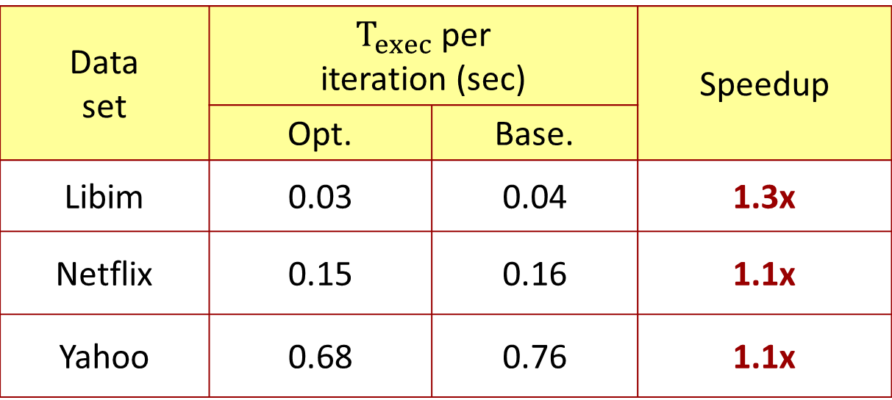
Impact of Optimization 1
Communication Hiding
Optimized design: Opt 1 + Opt 2 + Opt 3
Baseline design: Opt 2 + Opt 3
Data set | $T_{exec}$ per iteration (sec) |  | Speedup
 | Opt. | Base.
Libim | 0.03 | 0.04 | 1.3x
Netflix | 0.15 | 0.16 | 1.1x
Yahoo | 0.68 | 0.76 | 1.1x

Slide 25
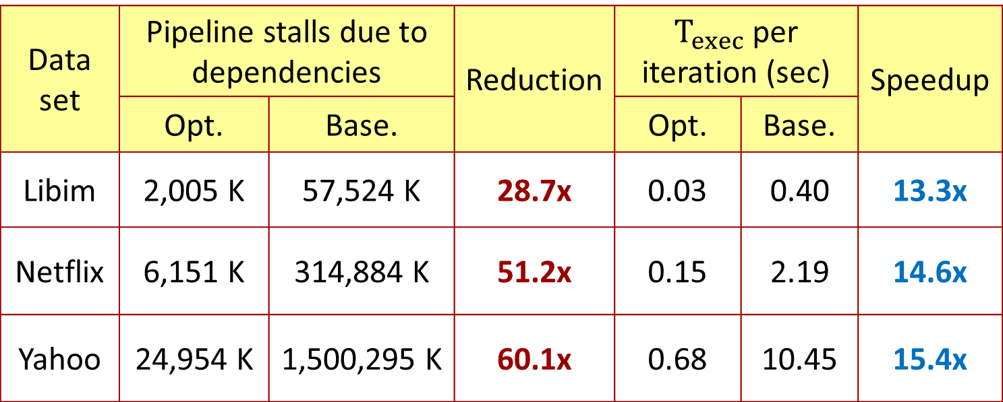
Impact of Optimization 2
Pipeline stall reduction
Optimized design: Opt 1 + Opt 2 + Opt 3
Baseline design: Opt 1 + Opt 3
Data set | Pipeline stalls due to dependencies |  | Reduction | $T_{exec}$ per iteration (sec) |  | Speedup
 | Opt. | Base. |  | Opt. | Base.
Libim | 2,005 K | 57,524 K | 28.7x | 0.03 | 0.40 | 13.3x
Netflix | 6,151 K | 314,884 K | 51.2x | 0.15 | 2.19 | 14.6x
Yahoo | 24,954 K | 1,500,295 K | 60.1x | 0.68 | 10.45 | 15.4x

Slide 26
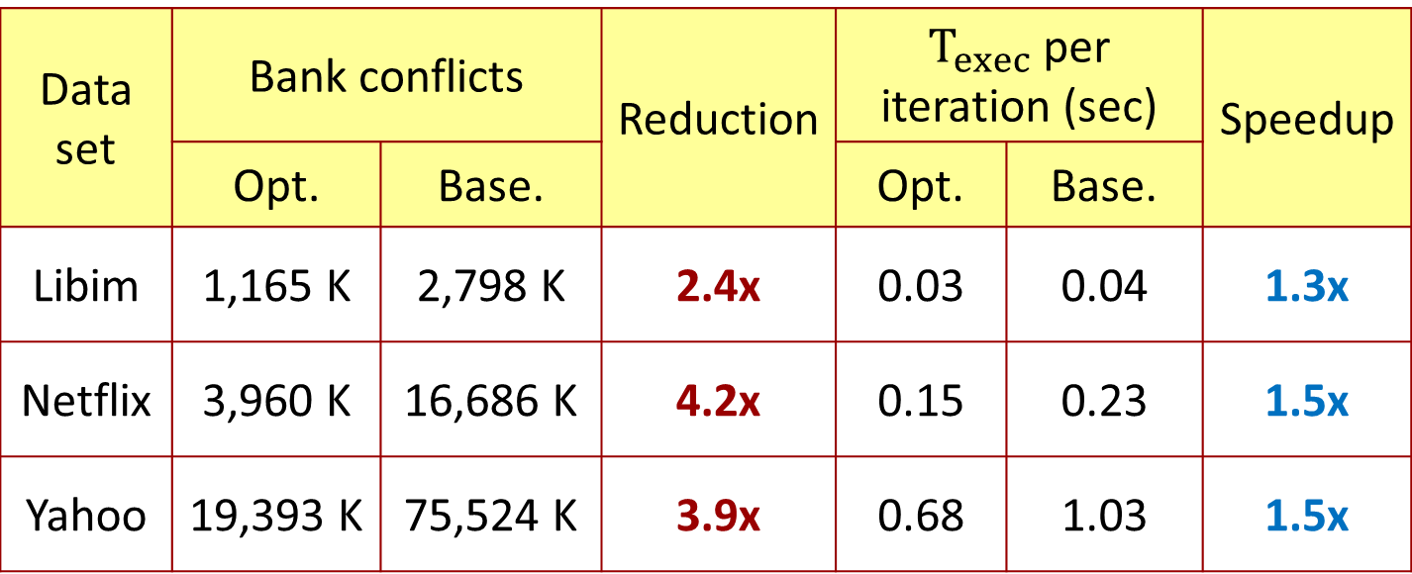
Impact of Optimization 3
Bank conflict reduction
Optimized design: Opt 1 + Opt 2 + Opt 3
Baseline design: Opt 1 + Opt 2
Data set | Bank conflicts |  | Reduction | $T_{exec}$ per iteration (sec) |  | Speedup
 | Opt. | Base. |  | Opt. | Base.
Libim | 1,165 K | 2,798 K | 2.4x | 0.03 | 0.04 | 1.3x
Netflix | 3,960 K | 16,686 K | 4.2x | 0.15 | 0.23 | 1.5x
Yahoo | 19,393 K | 75,524 K | 3.9x | 0.68 | 1.03 | 1.5x

Slide 27
Comparison with State-of-the-art
Up to 13.3x speedup for training the Netflix dataset
Approach | Platform | Processor Power | Exec. Time per Iteration | Speedup
SIGMOD ’14 | 24-core Intel E5-2697 | 130 W | 2.00 sec | 13.3x
This paper | Virtex UltraScale+ | 14 W | 0.15 sec
GPGPU ’15 | 2880-core Tesla K40C GPU | 235 W | 1.90 sec | 12.7x
This paper | Virtex UltraScale+ | 14 W | 0.15 sec

Slide 28
Outline
Introduction
Optimizations and Accelerator Design
Experimental Results
Impact
Conclusion

Slide 29

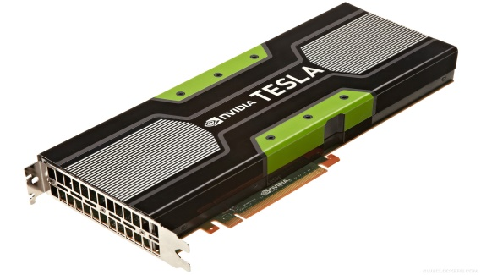
Impact of This Work
Accelerate other data science problems that derive latent features from observations
  Topic modeling/extraction
  Word embedding
Techniques for accelerating SGD-based training algorithms
Generic optimizations applicable to other platforms

Slide 30
Conclusion
Developed FASTCF to accelerate SGD-based CF
Designed three optimizations to
  completely overlap communication with computation
  reduce data dependencies to extract parallelism
  reduce bank conflicts
Achieved a high throughput of up to 217 GFLOPS for training large real-life datasets
Achieved 13.3x and 12.7x speedup compared with state-of-art multicore and GPU implementations

Slide 31
Comments & Questions
Thank you
fpga.usc.edu

