Slide 1
Degree-aware Hybrid Graph Traversal on FPGA-HMC Platform
Jialiang Zhang and Jing Li
University of Wisconsin-Madison

Slide 2
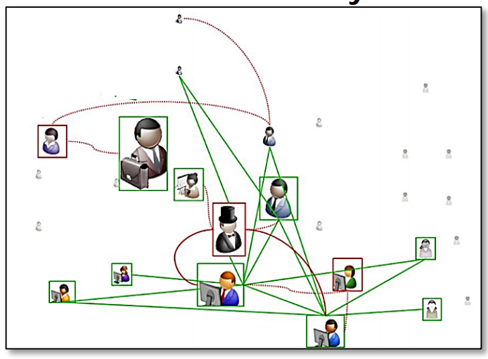
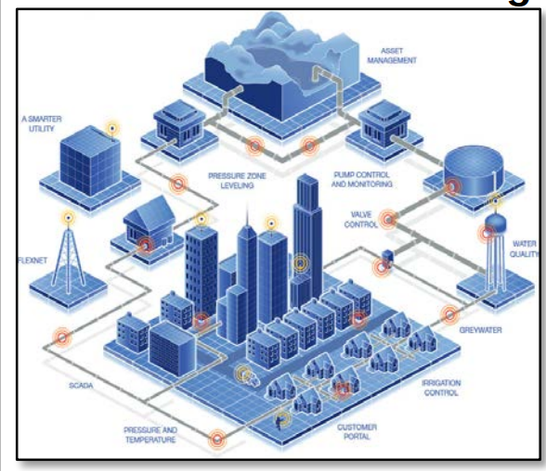
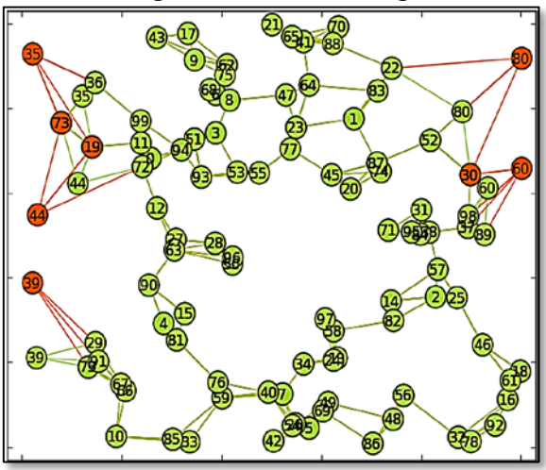
Large-scale graph traversal
Graph traversal is one of the key kernel for big-data applications
  Social Media Analysis
  Cyber security
  IT Infrastructure Monitoring
  And more…
The large-scale graph traversal is challenging
  Lack of locality
  Low parallelism
  High synchronization cost
  Social Media Analysis
Infrastructure Monitoring
  Cyber security
From http://www.darpa.mil/attachments/HIVE_Proposers_Day_PM_Briefing.pdf

Slide 3
Summary of this work
Workload
Analysis
Algorithm
Gain deeper understanding of the state-of-the-art algorithm
Dataset
  Large graphs typically have non-uniformed degree distribution
Optimization
Algorithm
  Associate the vertices index with the access frequency leveraging the degree information for better locality
Hardware
  Efficient data placement policy
  Adjacency list compression
Evaluation
  Experiments on FPGA-HMC platform

Slide 4
Summary of this work
Workload
Analysis
Algorithm
Dataset
Optimization
Algorithm
Hardware
Evaluation

Slide 5
Level-synchronized BFS
Level-synchronized BFS is the most widely used parallel graph traversal algorithm
  Start from one source vertex
  Construct a BFS tree by checking the neighbors of source vertices
  Unvisited neighbors becomes the source vertices in the next level
0
0
Level 1
1
2
3
1
2
3
Level 2
4
5
4
5
Level 3
Level
Synchronized
BFS
6
7
6
7
Level 4

Slide 6
Level-synchronized BFS
Level-synchronized BFS is the most widely used parallel graph traversal algorithm
  Start from one source vertex
  Construct a BFS tree by checking the neighbors of source vertices
  Unvisited neighbors becomes the source vertices in the next level
0
0
Level 1
1
2
3
4
5
Level
Synchronized
BFS
6
7

Slide 7
Level-synchronized BFS
Level-synchronized BFS is the most widely used parallel graph traversal algorithm
  Start from one source vertex
  Construct a BFS tree by checking the neighbors of source vertices
  Unvisited neighbors becomes the source vertices in the next level
0
0
Level 1
1
2
3
1
2
3
Level 2
4
5
Level
Synchronized
BFS
6
7

Slide 8
Level-synchronized BFS
Level-synchronized BFS is the most widely used parallel graph traversal algorithm
  Start from one source vertex
  Construct a BFS tree by checking the neighbors of source vertices
  Unvisited neighbors becomes the source vertices in the next level
0
0
Level 1
1
2
3
1
2
3
Level 2
4
5
4
5
Level 3
Level
Synchronized
BFS
6
7

Slide 9
Level-synchronized BFS
Level-synchronized BFS is the most widely used parallel graph traversal algorithm
  Start from one source vertex
  Construct a BFS tree by checking the neighbors of source vertices
  Unvisited neighbors becomes the source vertices in the next level
0
0
Level 1
1
2
3
1
2
3
Level 2
4
5
4
5
Level 3
Level
Synchronized
BFS
6
7
6
7
Level 4

Slide 10
Hybrid graph traversal
Hybrid graph traversal is the state-of-the-art level synchronized BFS algorithm on CPU[1] for scale-free graph
  In additional to the conventional top-down method, it uses the bottom-up method
0
Visited vertices in previous level
1
2
3
Visited vertices in current level
4
5
Unvisited vertices
6
7

Slide 11
Top-down method
The traditional implementation of the level-synchronized BFS is the top-down method:
  1. Scan vertices in the current level
1
2
3
Visited vertices in
previous level
0
1
2
3
Visited vertices in
current level
4
5
Unvisited vertices
6
7

Slide 12
Top-down method
The traditional implementation of the level-synchronized BFS is the top-down method:
  Scan vertices in the current level
  Check the status of all neighbors
1
2
3
0
1
2
3
0
1
2
3
0
4
4
5
5
1
2
3
4
5
4
5
6
7
6
7

Slide 13
Top-down method
The traditional implementation of the level-synchronized BFS is the top-down method:
  Scan vertices in the current level
  Check the status of all neighbors
  Add unvisited neighbors to next level
1
2
3
0
0
4
5
5
1
2
3
4
4
5
4
5
6
7

Slide 14
Top-down method
The traditional implementation of the level-synchronized BFS is the top-down method:
  Scan vertices in the current level
  Check the status of all neighbors
  Add unvisited neighbors to next level
Problem:
  1.Redundant edge check, when the size of current level is large
1
2
3
0
0
4
5
5
1
2
3
4
4
5
4
5
6
7

Slide 15
Top-down method
The traditional implementation of the level-synchronized BFS is the top-down method:
  Scan vertices in the current level
  Check the status of all neighbors
  Add unvisited neighbors to next level
Problem:
  1. Redundant edge check
  2. Conflict updates
1
2
3
0
0
4
5
5
1
2
3
4
4
5
4
5
6
7

Slide 16
Bottom-up method
To address such problem, bottom-up method [1] is proposed:
  1. Scan the unvisited vertices
4
5
6
7
0
1
2
3
4
5
6
7
[1]Scott Beamer, etal. Direction-optimizing breadth-first search. In Proceedings of the International Conference on High Performance Computing, Networking, Storage and Analysis (SC '12).

Slide 17
Bottom-up method
To address such problem, bottom-up method is proposed:
  Scan the unvisited vertices
  Check if more than one neighbor is in the current level
4
5
6
7
0
1
2
6
2
3
6
7
4
5
5
1
2
3
4
5
6
7

Slide 18
Bottom-up method
To address such problem, bottom-up method is proposed:
  Scan the unvisited vertices
  Check if more than one neighbor is in the current level
  Add the source vertices to the next level
4
5
6
7
0
1
2
6
2
3
6
7
4
5
5
1
2
3
4
5
4
5
6
7

Slide 19
Bottom-up method
To address such problem, bottom-up method is proposed:
  Scan the unvisited vertices
  Check if more than one neighbor is in the current level
  Add the source vertices to the next level
Efficient when the current level is large:
  Early termination to reduce redundant check
  No conflict
Inefficient when the number of unvisited vertices is small
4
5
6
7
0
1
2
3
1
2
4
5
5
4
5
4
5
6
7

Slide 20
Hybrid graph traversal
Hybrid graph traversal is the state-of-the-art level synchronized BFS algorithm on CPU[1] for scale-free graph
  It switches between top-down and bottom-up based on heuristics： the size of current level and the number of unvisited vertices
The objective of hybrid graph traversal is to reduce the redundant edge check
  Edge check doesn’t lead to expanding the BFS tree
    Check the status of visited vertices in top-down method
    Scanning all vertices to find unvisited ones in bottom-up method

Slide 21
Summary of this work
Workload
Analysis
Algorithm
Dataset
Optimization
Algorithm
Hardware
Evaluation

Slide 22
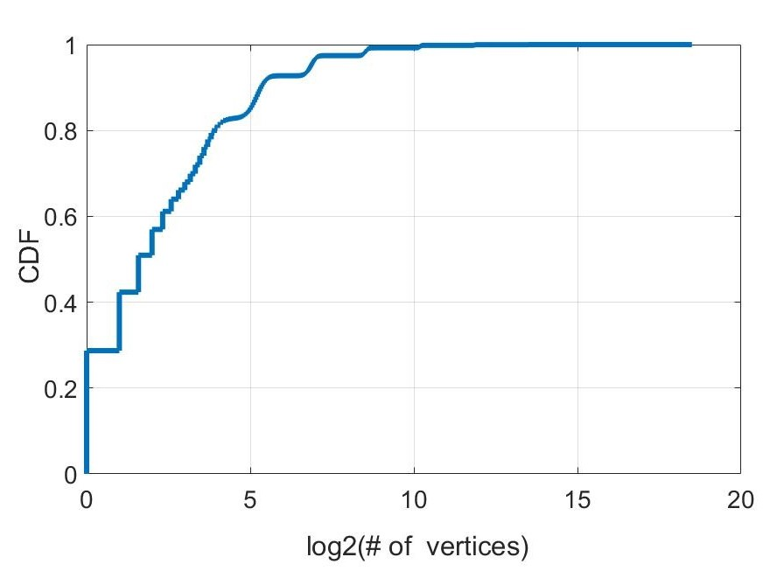
Degree Distribution
Dataset: Kronecker Graph
  Widely used graph dataset for model social network
  Used in GRAPH500 challenge
  1 million vertices; 16 million edges
Only a few “hot vertices” contributes to most of the edge connections
  Popular people in social network
  Hub node in data network
  Controller node in infrastructure network
These “hot vertices” tends to have high access frequency
256 (0.02%) vertices contributes to 97% edge connection
Cumulative distribution of vertex degree

Slide 23
Summary of this work
Workload
Analysis
Algorithm
Dataset
Optimization
Algorithm
Hardware
Evaluation

Slide 24
Degree-aware vertex index sorting.
Sort the vertices based on the degree offline
Assign smaller index to vertices with higher degree
3
1
3
1
1
0
0
3
2
2
Sorting
1
2
3
2
2
2

Slide 25
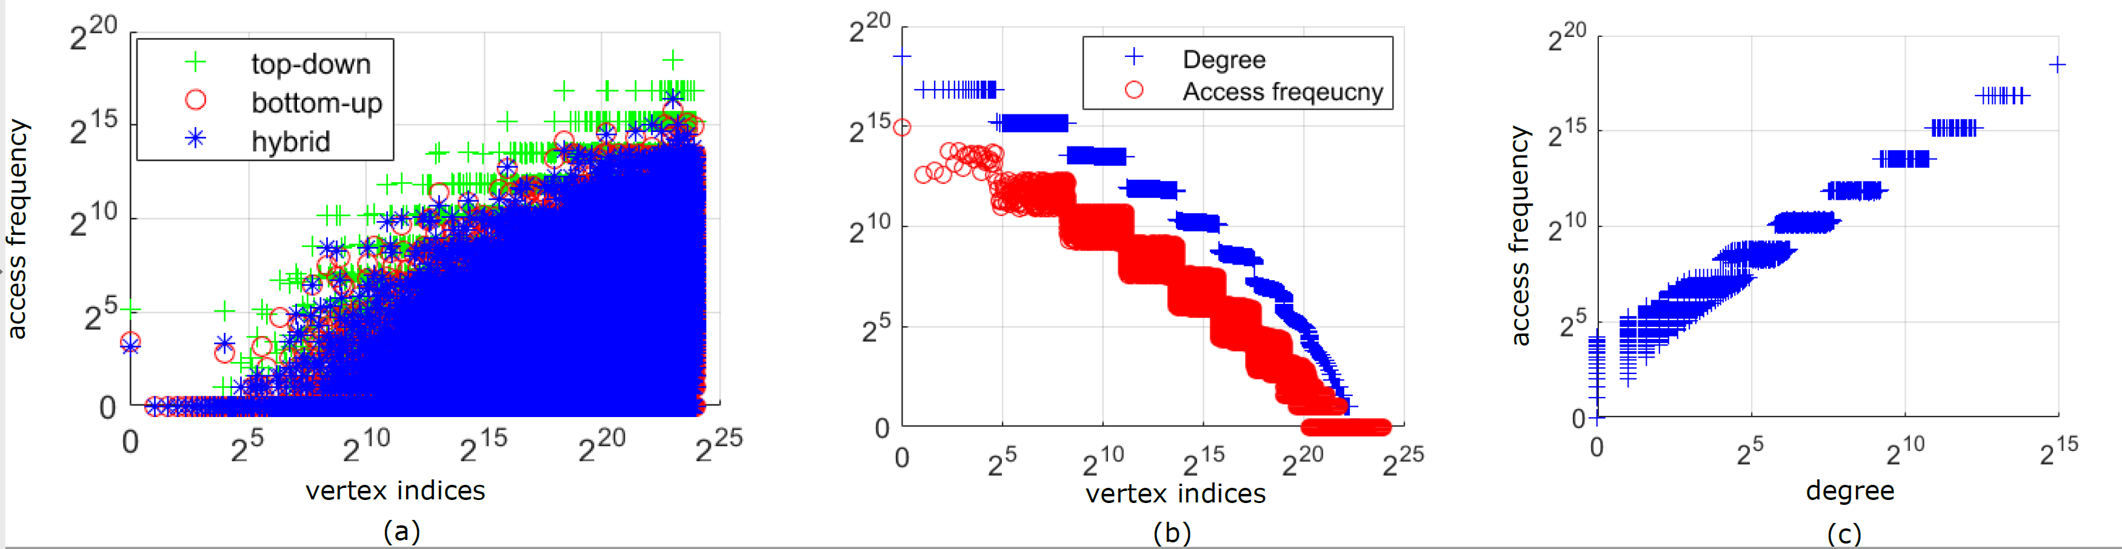
Degree-aware vertex index sorting.
Sort the vertices based on the degree
Assign smaller index to vertices with higher degree
The objective is to associate the access frequency with the indices through degree information
w/o Sorting
w/ Sorting
w/ Sorting

Slide 26
Degree-aware adjacency list reordering
We reorder the adjacency list to terminate the neighbor scanning in bottom-up earlier
  High-degree vertices tends to be visited earlier
  Can be compressed by simple coding scheme
Vertices indices
0
1
2
3
Pointer to adjacency list
0
3
5
7
0
3
adjacency list
2
3
1
2
0
0
1
0
reordering
1
2
Vertices indices
0
1
2
3
Pointer to adjacency list
0
3
0
0
adjacency list
1
2
3
0
2
0
1
0

Slide 27
Summary of this work
Workload
Analysis
Algorithm
Dataset
Optimization
Algorithm
Hardware
Evaluation

Slide 28
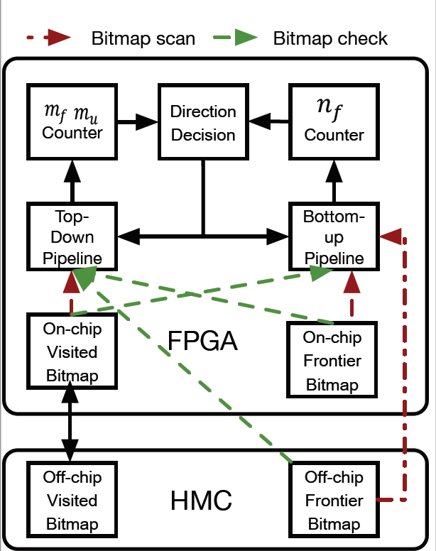
Hardware architecture
Two bitmaps:
  (Non)-visited vertices
  Vertices in the current level
Graph topology (off-chip)
  Vertices list
  Adjacency list
Top-down pipeline:
  Vertices in the current level-> vertices list -> neighbor list -> visited vertices
Bottom-up pipeline:
  Non-visited vertices -> vertices list -> neighbor list -> Vertices in the current levels
V list
&
Adj. list
  HMC

Slide 29
Hardware optimizations
We focus on bottom-up method (contributes to most of the runtime):
  Non-visited vertices bitmap(cheap)
    Streaming read
    Access each bit once per level
  Vertices list and Neighbor list (cheap)
    Streaming read
    Access once during BFS
  Vertices in the current levels (expensive)
    Random access
    Multiple access per level
V list
&
Adj. list

Slide 30
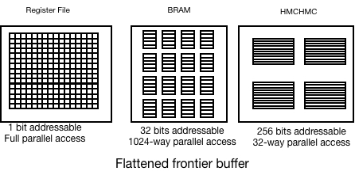
    Degree-aware data placement
We create three different memory to store track the vertices in the current level
  1-Bit addressable register file
  32-bit addressable BRAM
  256-bit addressable HMC
We allocate the memory based on the indices (access frequency)
  Most of the memory access is conflict-free
  Most of the HMC access can be absorbed

Slide 31
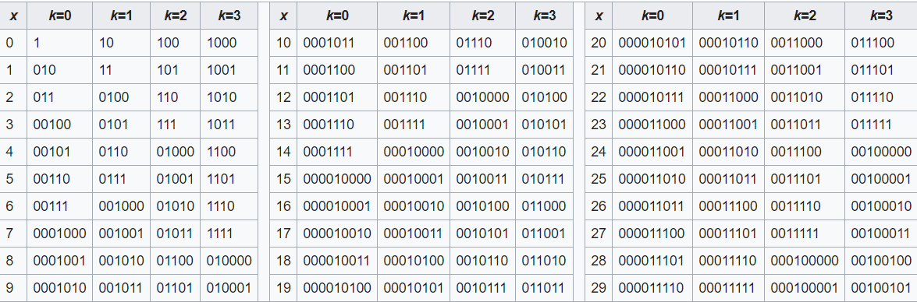
Degree-aware adjacency list compression
The major portion of the HMC traffic is reading the neighbor list:
  Streaming
  Already sorted based on the access frequency
To reduce the HMC throughput, we propose to use exp-golomb coding to compress the adjacency list
  Exp-golomb coding is a variable length coding
  Exp-golomb is prefix coding
  Exp-golomb coding assigns shorter code to smaller indices
  It has lower complexity compared to Huffman-coding
  1bit
  9 bit

Slide 32
Summary of this work
Workload
Analysis
Algorithm
Dataset
Optimization
Algorithm
Hardware
Evaluation

Slide 33
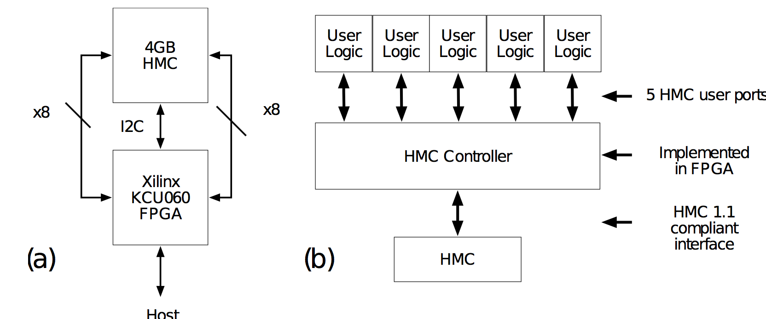
Experimental Setup
Platform: Pico Computing AC510
FPGA: Xilinx Ultra scale KCU060
HMC bandwidth: 30GB/s on both direction
HMC capacity: 4GB
FPGA
HMC

Slide 34
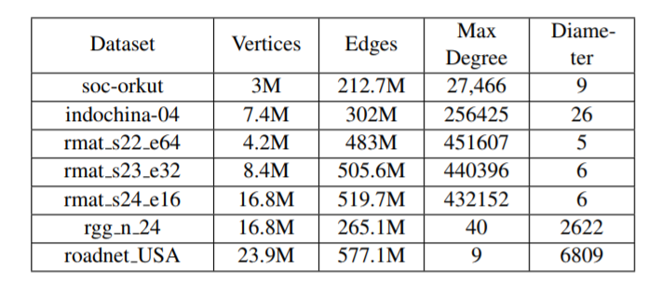
Dataset
  Evaluate on 5 scale-free graph (small diameter):
    2 real-world social network
    3 Graph500 graph
  2 grid-like graph (large diameter)

Slide 35
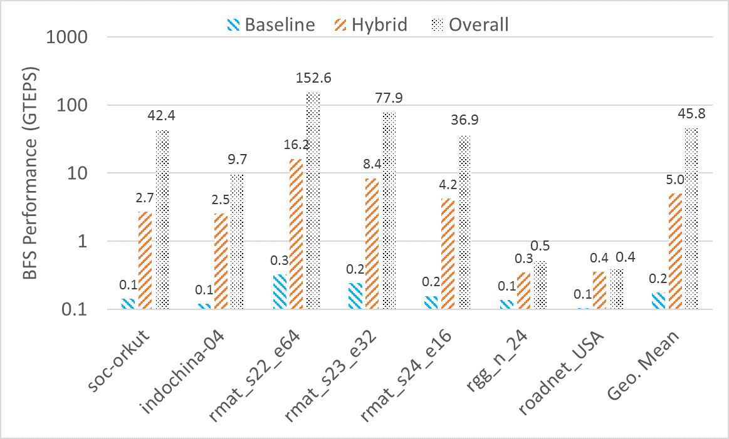
Overall performance
Achieve 229x average throughput gain compared to top-down only implementation
Achieve 9x throughput gain compared to non-optimized hybrid-BFS on FPGA
Achieved a energy efficiency of 1630 MTEPS/W, which is 2x higher than the #1 in green graph 500

Slide 36
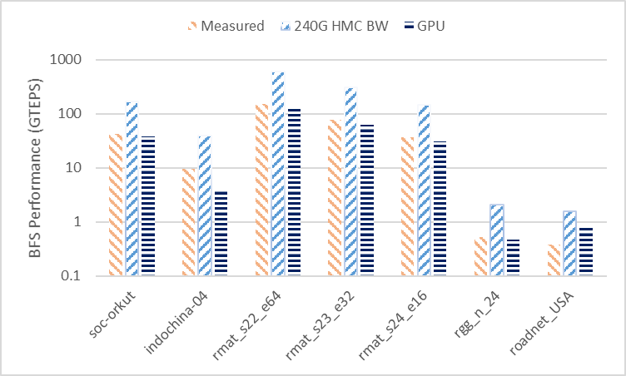
Performance projection
Assume we can use the full bandwidth of HMC (240GB/s)
Achieve 9x average throughput gain compared to our GPU (GTX1060 w/ 240GB/s GDDR5)

Slide 37
Conclusion
Degree distribution in scale-free graph is a useful property for the acceleration of graph traversal
The proposed method associates indices with access frequency through vertices sorting for better locality
Leveraging the improved locality, the proposed method further co-optimizes the SW/HW of the hybrid graph traversal
The experimental result proves the effectiveness of the proposed result.

Slide 38
Thanks!
We especially thank Micron for the donation of the development tool and hardware.

