Slide 1
Graph-Theoretically Optimal Memory Banking for Stencil-Based Computing Kernels
Juan Escobedo and Mingjie Lin
University of Central Florida
ECE Department

Slide 2
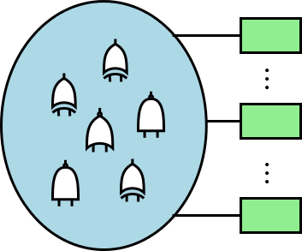
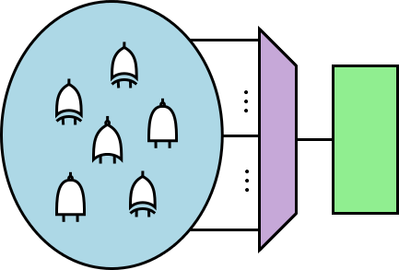

HLS: Memory Access Parallelization is Essential
M B/s
M B/s
M B/s
M B/s
M B/s
M B/s
B1
Bn
Bk
K$⋅$M B/s << BW
Memory
Notes:
One of the major problems is how to circumvent the memory bottleneck problem. In many cases, processing nodes require new data at rates much faster traditional, centralized, memory systems can provide.
If one could divide the data into smaller partition such that every processing node could access the data it needs in parallel without interference of the others would greatly increase throughput since the sequential memory access bottleneck would be alleviated, even without the need for memory with larger bandwidth. Is because of this that the idea of Memory Access Parallelization has proven to be the key to implement efficient memory architectures for arbitrary pieces of code.

Slide 3
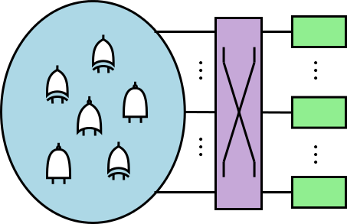
Solutions? Memory Banking
M B/s
M B/s
M B/s
M B/s
M B/s
M B/s
B1
Bn
Bk
Notes:
- One of the most popular solutions is called Memory Banking. The idea is to split data among a set of memory banks without any duplication. These banks will be accessed by each of the processing nodes but the data has been partitioned is such a way that it ensures that no 2 processing nodes require data from the same bank at any given time.

Slide 4
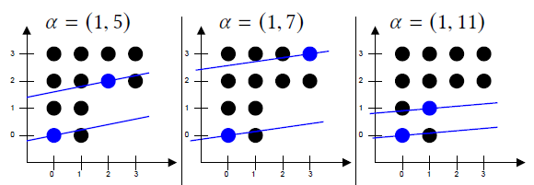
Memory Banking
Extensive research
Representative work includes:
Linear skew/Hyperplanes: [Shapiro1978][Cong’09] [Wang’14][Meng’15]
Find a single hyperplane family to do the banking. Using a simple mapping function making it easy to implement however it might miss some (better) solutions
Notes:
There has been extensive research on the field of Memory Banking.
One of the first, and perhaps most straightforward, approaches is using a single family of hyperplanes to do the partitioning. Memory locations that belong to the same hyperplane are assigned to the same memory bank. This also gives a relatively simple function to determine which bank should be accessed by using linear operations and modulo logic at any given time. Although this method works well in general, it has been proven it might miss some better solutions (smaller partition factor) due to its limited search space.

Slide 5
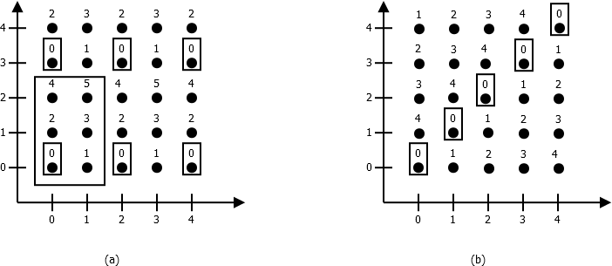


Memory Banking: Representative Work
Lattice based method: [Darte’05][Cilardo’15]
Finds n families of hyperplanes, forming a lattice. They can find (better) solutions unattainable with a single hyperplane family but the method is not formulated to find the optimal banking factor, just reduce conflicts.
B=$\left(\begin{matrix}2 & 0 \\ 0 & 3\end{matrix}\right)$
B=$\left(\begin{matrix}1 & 0 \\ 1 & 6\end{matrix}\right)$
Notes:
Lattice based methods aim to solve this limitation.
The idea is to find n families of hyperplanes, where N is the dimensionality of the problem, such that they form an integer lattice. All points on the same lattice belong to the same bank. To cover the entire data domain, secondary lattices are needed. These secondary lattices are comprised of the same family of hyperplanes plus a constant offset such that no single memory location belongs to more than one lattice. The total number of lattices needed corresponds to the partition factor.
Any solution found by the hyperplane method can also be found using this method
The limitation of [Cilardo, 2015] is that it aims to reduce memory conflicts, and does not address the objective of finding the optimal partition factor directly.

Slide 6
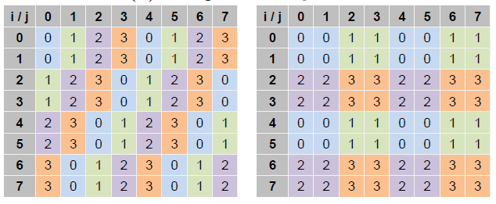
Memory Banking: Representative Work
Trace based method: [Zhou’17]
Finds a bit mask that maps all memory addresses to a reduced space where conflicts have been eliminated via graph coloring.
One of the drawbacks is the time to find the solution is proportional to the problem size even for stencil based kernels.
Because colorability of the graph for a given partition factor is determined with an heuristic coloring algorithm, optimality is not ensured.
Notes:
More recently, a trace based method was introduced by [Zhou, 2017]
It uses a bit mask to map the memory execution trace with the information of what memory locations are access on any given iteration to a small set of masked memory IDs. These masked IDs are then considered as nodes in a graph. When 2 masked IDs appear on the same iteration, they are linked by an edge. If the maximum clique is smaller or equal to the current maximum partition factor then then the graph is colored using a greedy graph coloring algorithm. The algorithm tries all masks for a given partition factor until it fidns one that produces a graph that can be fully colored. If said mask is not found, the partition factor is increased and the process repeats.
One of the drawbacks is that the time it takes to find a solution is proportional to the problem size, even for stencil kernels. And since it uses a heuristic algorithm to do the coloring, it might miss the optimal.

Slide 7
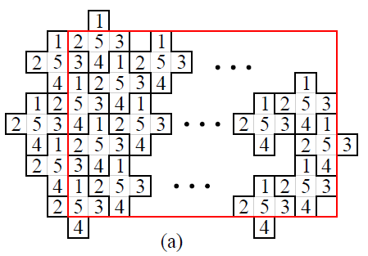
Memory Banking: Representative Work
Tessellation based method: [Escobedo, 2017]
Finds a repeating rectangle with a banking scheme using the optimal partition factor that can be used to cover the entire data domain. However, when the stencil does not tessellate space, no upper limit in the partition factor is given.
Notes:
Another approach explored is the use of the geometrical information of the stencil to come up with a banking scheme that allowed for conflict free memory access.
The idea is to determine whether or not a given stencil tessellates the space. If it does, then it is possible to find a rectangular region that contains a banking scheme that repeats and thus can be sued to cover the entire data domain. Said rectangular region can be stored and easily used as a mapping function.
The limitation is that when the stencil does not tessellate the data space, no upper bound in the partition factor was given.

Slide 8
Open Questions and Problems:
Given a stencil based kernel computation, what is the minimum partition factor required for conflict-free memory accesses?
In practice, we also need to address the problems of:
Given the optimal partition factor for a stencil based kernel, how to obtain a practical banking scheme?
For a given optimal partition factor and banking scheme, how to keep memory overhead as low as possible while maintaining ease of computation?

Slide 9
Key ideas
Use Memory Access Conflict Graph to analytically study memory banking
Find the minimum partition factor through classical optimal coloring
Advantages:
Provide unified mathematical framework to tackle other problems
Allows to rigorously prove optimality
Versatility paves the path for other research directions

Slide 10
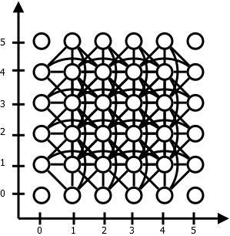
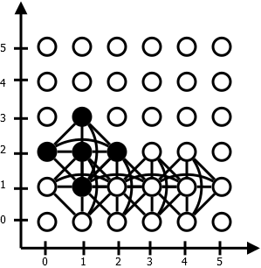
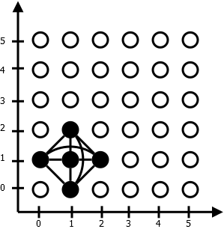
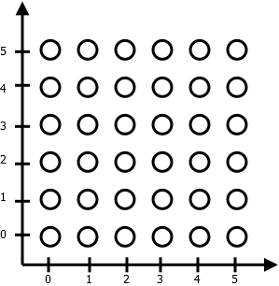
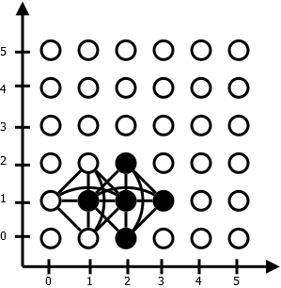
Memory Access Conflict Graph
for i=1:n-1
for j=1:n-1
B(i,j)=foo(A(i,j),A(i+1,j),
A(i+1,j),A(i,j-1),A(i,j+1));
end
end
Notes:
The base of our approach is the memory conflict graph.
Go though the slides to show how it is made.
Coloring this graph optimallu will indeed give us the optimal partition factor and a bank assignment.

Slide 11
Major Challenges
Optimal graph coloring is NP-complete
Even if optimal coloring is feasible, mapping might be too big to be practical
We need a solution that:
Independent of the problem size
Ensures optimality
Easy to compute and store

Slide 12
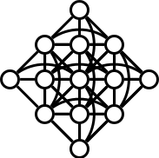
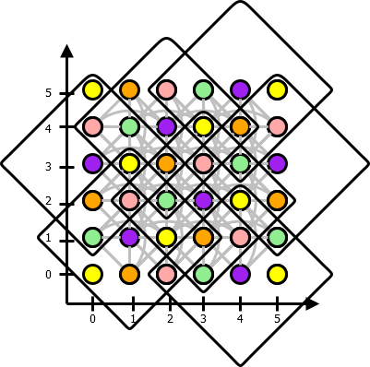
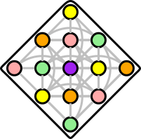
Our Approach
Notes:
Starting from the full memory conflict graph, we find a small induced sub graph (ISG) of it. An induced subgraph is a graph that contains a set of nodes of the original graph and all the edges between the selected nodes.
We then proceed to color this graph optimally
We can then use this coloring (under certain conditions) to color the entire data domain.

Slide 13
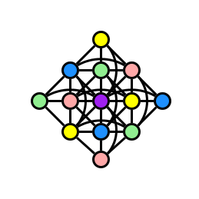
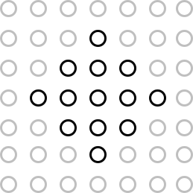
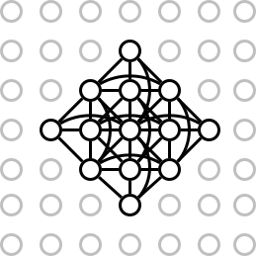
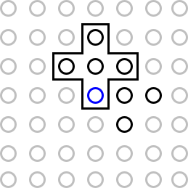
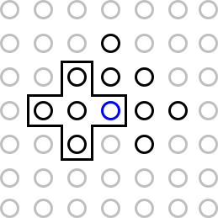
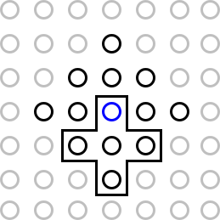
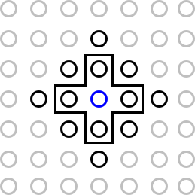
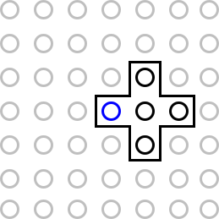

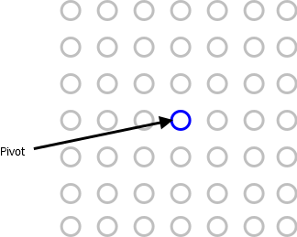
Extended Stencil Graph (ESG)
The ESG is an induced subgraph (ISG) of the conflict graph.
ESG construction:
Notes:
This ISG that will allow us to achieve our goal is what we have called the Extended Stencil Graph (ESG)
Go though construction
Start by considering a single memory location in an infinite plane as a pivot node.
Consider the set of all nodes that belong to a stencil that contains the pivot node.
Include all the edges between the considered nodes, even those of partial stencils (remember this is an ISG)
This is the graph we will color.

Slide 14
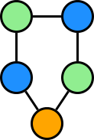
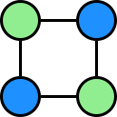
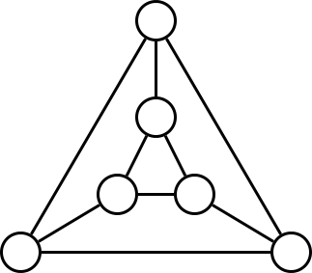
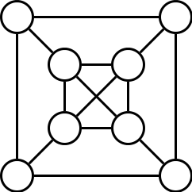

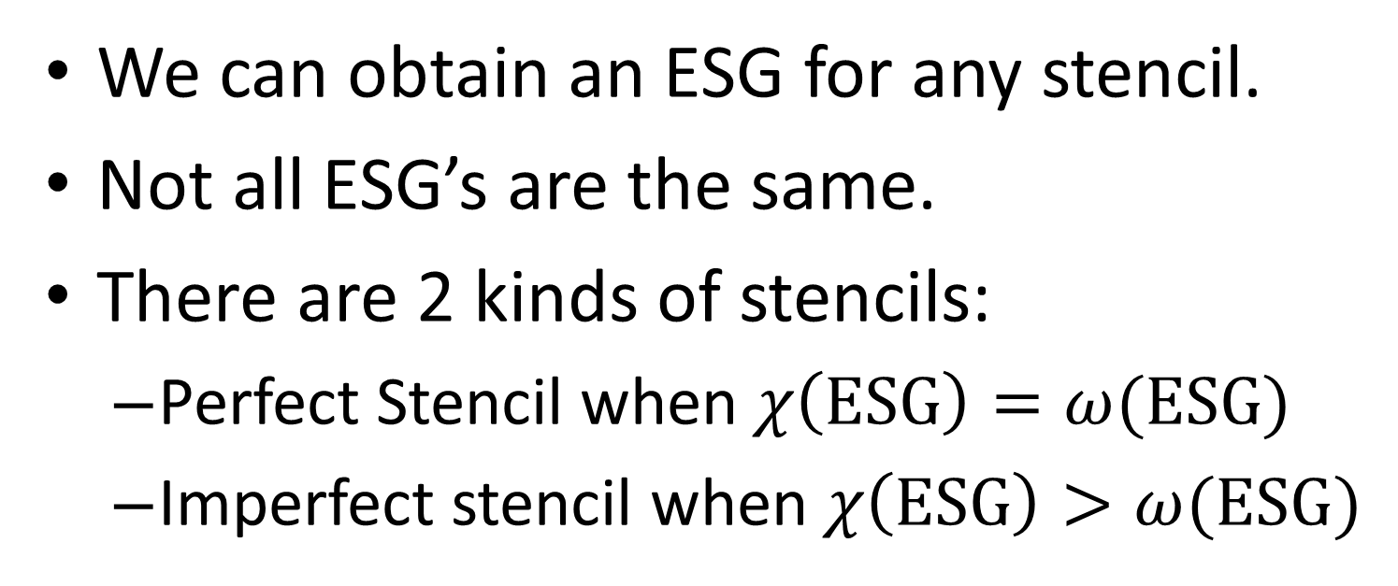



Extended Stencil Graph (ESG)
We can obtain an ESG for any stencil.
Not all ESG’s are the same.
There are 2 kinds of stencils:
Perfect Stencil when $χ\left(\text{ESG}\right)=ω(\text{ESG})$
Imperfect stencil when $χ\left(\text{ESG}\right)>ω(\text{ESG})$
$$χ\left(\text{G}\right)=2$$
$$χ\left(\text{G}\right)=3$$
$$ω\left(\text{G}\right)=3$$
$$ω\left(\text{G}\right)=4$$

Slide 15
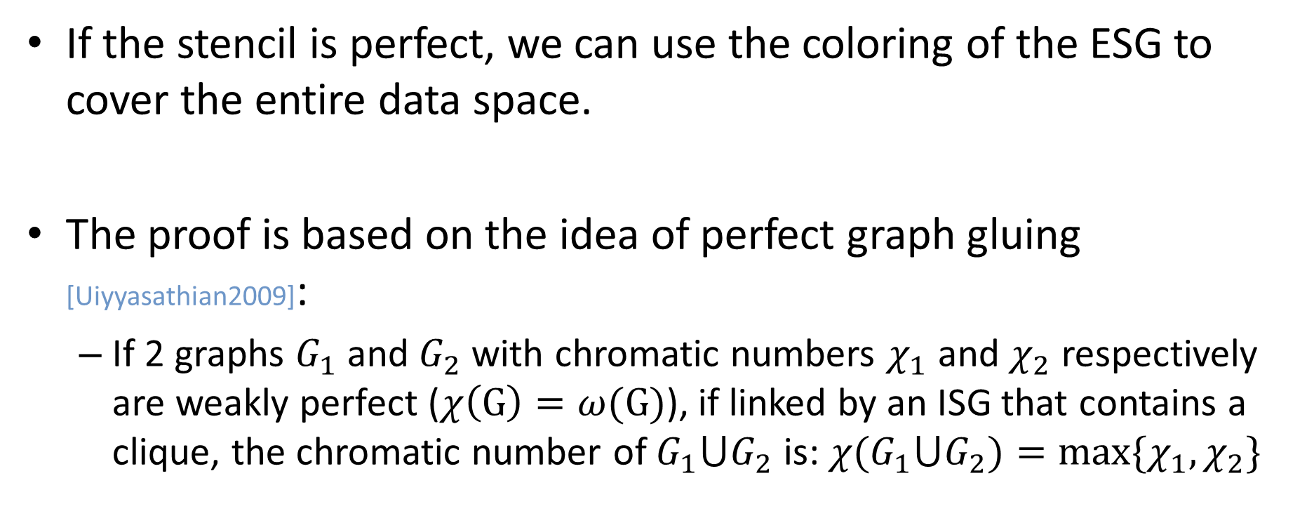
Perfect Stencil
If the stencil is perfect, we can use the coloring of the ESG to cover the entire data space.
The proof is based on the idea of perfect graph gluing [Uiyyasathian2009]:
If 2 graphs $G_{1}$ and $G_{2}$with chromatic numbers $χ_{1}$ and $χ_{2}$ respectively are weakly perfect ($χ\left(\text{G}\right)=ω(\text{G})$), if linked by an ISG that contains a clique, the chromatic number of $G_{1}⋃G_{2}$ is: $χ(G_{1}⋃G_{2})=max⁡\{χ_{1},χ_{2}\}$
Notes:
The chromatic number of the graph is the minimum k for which a graph is k-colorable. In other words, is the smallest number of colors needed to assign a different color to all adjacent nodes in the graph.
The maximum clique is the largest set of nodes that form a clique( all nodes are connected to each other)

Slide 16
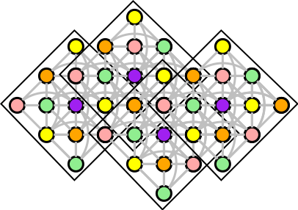
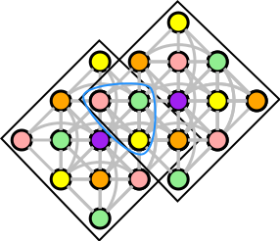
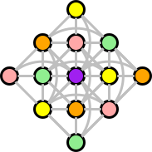
Perfect Stencil ESG
Clique
Notes:
Go through animation.
We can always find a clique to join the graphs such that no memory conflict exists and can extend indefinitely in all directions

Slide 17
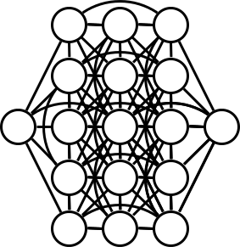
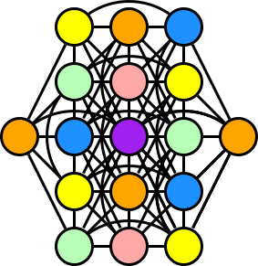
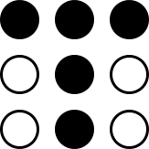

Imperfect stencil
Original stencil
ESG
Colored ESG
$$χ\left(\text{G}\right)=6≠ω\left(\text{G}\right)=5$$
Uh-oh!
Notes:
When the chromatic number does not match the maximum clique, we have the problem that we can’t ensure the graphs can be linked by any clique to obtain a coloring that can cover the entire data domain.

Slide 18
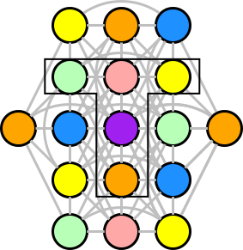
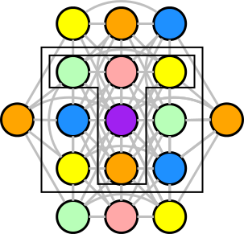
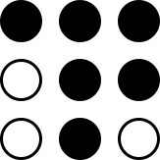
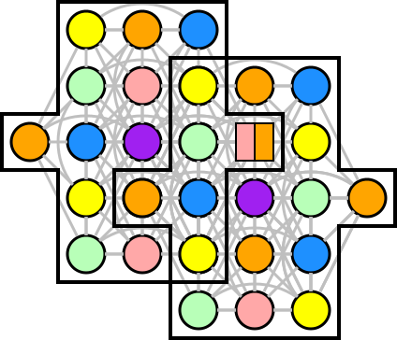
Imperfect stencil
Bank conflict
Candidates
Augmented stencil candidate
$$χ\left(\text{ESG}\right)=6>ω\left(\text{ESG}\right)=5$$
Notes:
As we can see, there is at least one instance where overlapping the optimally colored ESG would assign 2 banks to the same memory location.
So the key is to find a way to augment the original stencil in order to make its ESG perfect.
To achieve this, we consider the original stencil, and its circumscribing square. We then consider all combinations of 1,2, .. N elements in the circumscribing square minus the original tile to augment the number of nodes in the original stencil.
Because the number of candidates and combinations is finite, we can ensure the upper bound of the partition factor to find a usable repeatable coloring is the number of elements in the circumscribing square.

Slide 19
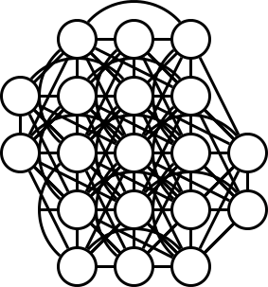
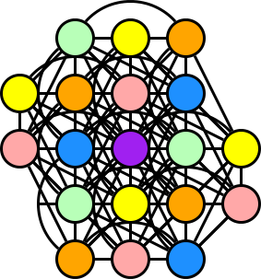





Imperfect stencil
$$\text{Augmented} \text{Stencil}$$
$$\text{ESG} \text{of}$$
$$\text{Augmented} \text{Stencil}$$
$$Colored ESG$$
$$χ\left(\text{G}\right)=6=ω\left(\text{G}\right)=6$$
$$\text{We} \text{are} \text{done}\text{!}$$

Slide 20
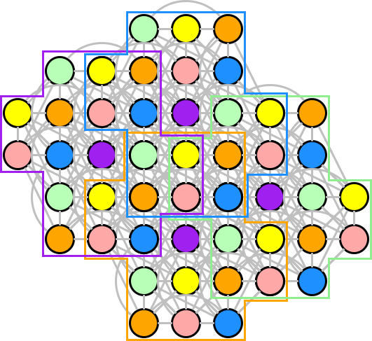
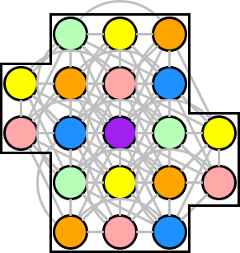
Imperfect stencil

Slide 21
Algorithm flow and Experimental Setup
Matlab
Stencil
Obtain ESG
Optimally color ESG
ESG is WP?
Yes
No
Augment stencil
Obtain bank and offset LUT
Synthesize and implement
Generate Verilog code
Generate HLS C code
Vivado
Vivado HLS
Notes:
In summary, this is the high level view of the entire process

Slide 22
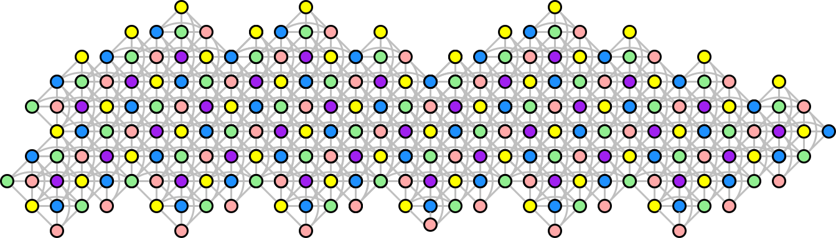
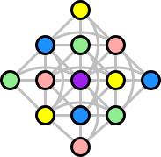
Algorithm Output: Coloring Scheme LUT

Slide 23
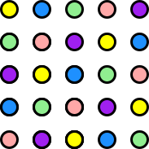
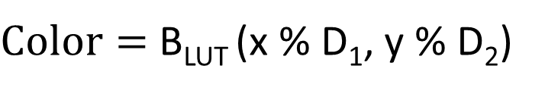
Algorithm Output: Coloring Scheme LUT
D₁=5
N dimensional LUT: B_{LUT}
Given a memory location with address (x,y), the color can determined in real-time as:
In practice, use a counter in mod D_{n} to simplify the logic.
D₂=5
$\text{Color}=$ B_{LUT} (x % D₁, y % D₂)

Slide 24
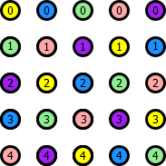
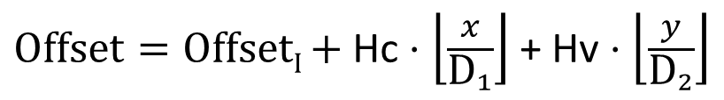

Algorithm Output: Offset LUT
N dimensional LUT: O_{LUT}
Given a memory location with address (x,y), the internal offset can determined in real-time as:
A set of constants:
Hc: Maximum internal offset of all banks inside LUT
Vc: Maximum number of elements of all banks in a row of tiles
Intra bank offset is then calculated as:
In practice, use a counter in mod D_{n} to simplify the logic.
$\text{Offset}\text{I}=$ O_{LUT} (x % D₁, y % D₂)
$\text{Offset}=\text{Offse}\text{t}\text{I} \text{+ }\text{Hc}⋅\left\lfloor \frac{x}{{\text{D}}_{1}}\right\rfloor$ + $\text{H}\text{v}⋅\left\lfloor \frac{y}{{\text{D}}_{2}}\right\rfloor$
Notes:
Notice we have complete freedom to assign these internal offsets inside the tile. This is the key to reduce memory overhead.

Slide 25

Algorithm Output:Sample HLS C Pseudocode
Notes:
The generated C code for vivado HLS contains a few, predefined sections:
Get the bank
Get the intra bank address
Perform the parallel memory access
Route the data to the right output
Update the counters

Slide 26

Performance Results
Tested 6 stencils:
12-point from [Shapiro1978]
Partition factor no worse than state-of-the-art. Improved by 14% for 12-point stencil
DSP utilization reduced by up to 100% over GMP[Wang’14]
Clock period reduced by 14% on average
FF and LUT utilization decreased by 44%
Memory overhead reduced by 30%

Slide 27
Conclusions
We present a graph theoretically method that allows for the automatic calculation of the optimal partition factor for stencil based computations.
It also provides an usable mapping scheme for that partition as a byproduct.
The method also provides an upper bound to the partition factor needed to have mapping scheme that is finite but can cover an arbitrarily large memory space.

Slide 28

Memory Overhead Improvement
$$\text{Overhead}= \sum_{i=0}^{d−1}{(\left(w_{i} \% {{\text{B}}_{\text{LUT}}}_{i}\right)⋅\prod_{∀k≠i}{w_{k}})}$$

