Slide 1
ADAM: Automated Design Analysis and Merging for Speeding up FPGA Development
Ho-Cheung Ng, Shuanglong Liu and Wayne Luk
Department of Computing, Imperial College London, UK
Notes:
Thanks for the introduction George. Good Morning everyone, Today I'm going to talk about my work on ADAM: Automated Design Analysis and Merging for Speeding up FPGA Development.
This work was undertaken during my first year PhD as HiPEDs student at Imperial College London.

Slide 2
Motivation: Multiple Fine-tuned Designs
During optimization, useful to have multiple versions
Experiment on hardware to evaluate correctness or numerical accuracy
Optimize by fine-tuning each version of the design
Only minor differences between each version
Speed up software simulation involving massive data sets
Examples
Explore precision and model resolution for shallow water equations in climate modeling
Explore frequency response by adjusting depth of binomial filter for Gaussian filtering approximation
FPT 2015 and 2016, 75% of designs in the full papers in the application section use less than half of FPGA resources
Notes:
During optimization, it is useful to have multiple versions being experimented on actual hardware to test the functional correctness or to evaluate their numerical accuracy.
In particular, the optimization is performed by fine-tuning each version of the design, and the differences between each version are usually minimal.
Therefore, we want to speed up this optimization and evaluation process compared to SW simulation especially when applications involve massive data sets.
**click**
Essentially, there exist many real-life applications that perform optimization by fine-tuning each version of the design. For example, climate modelling is so much faster on FPGA but it involves an exploration on the precision and model resolution for shallow water equations.
Furthermore, Gaussian filtering can be approximated with the use of binomial filter. The depth of the filter can be adjusted in each version to explore the frequency response. This will be further eaborated in this presentation.
Finally, based on the statistics in FPT 15 and 16, 75% of designs in the application section use less than half of FPGA resources, which means there remains substantial area on chip. As a result we would like to propose the following

Slide 3
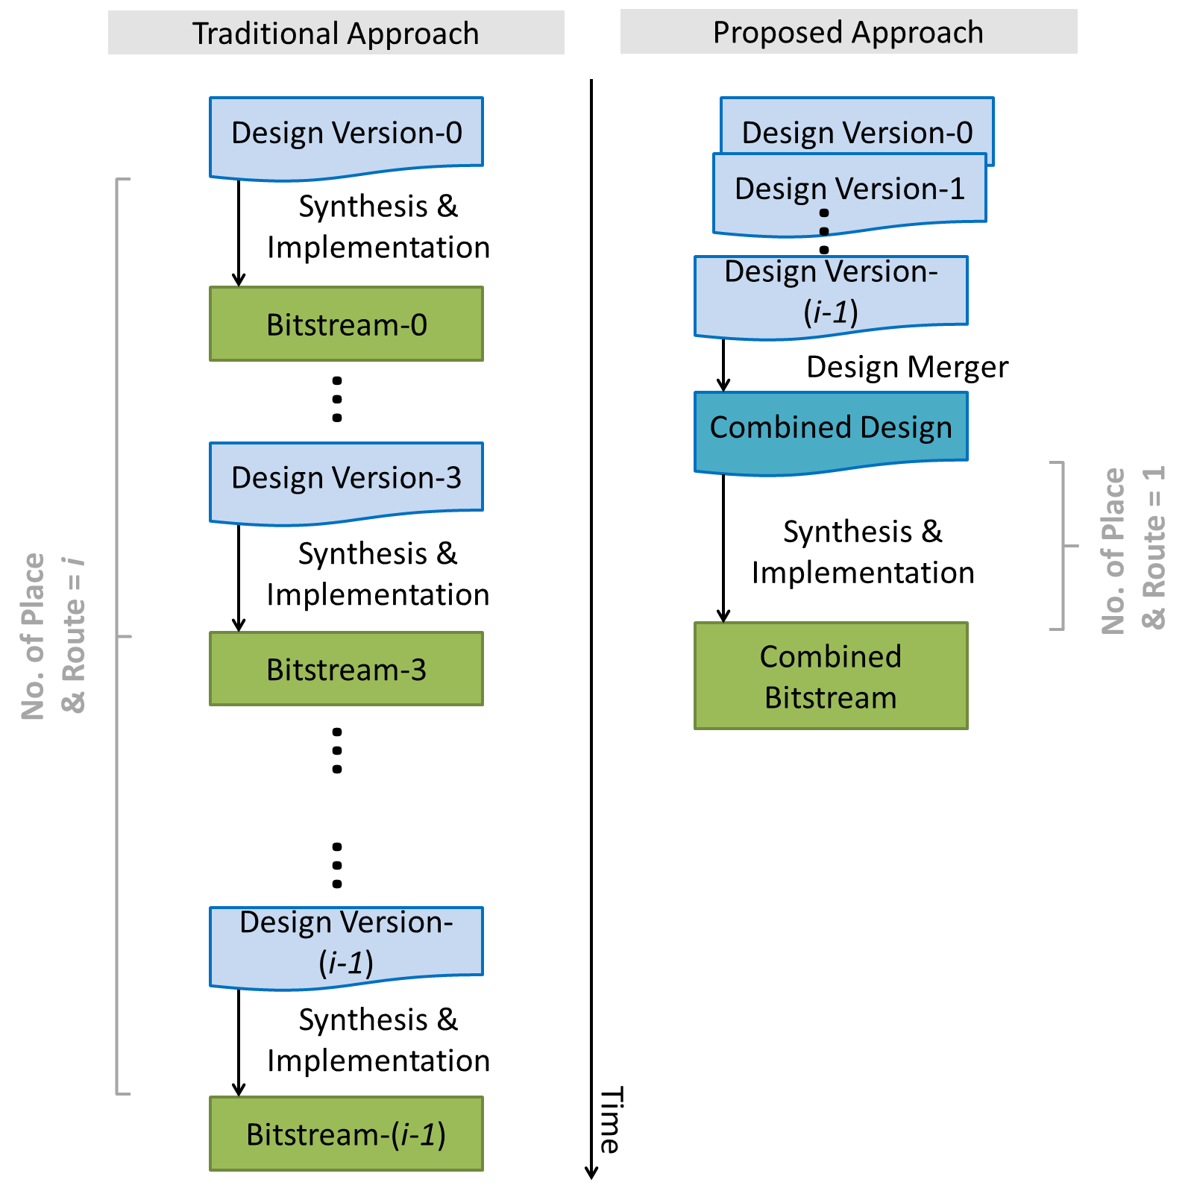
Challenges
Automatic merging of multiple design versions/commits into a single hardware implementation
Identify common computational kernels between versions
Perform merging and generating a final hardware design in linear time
Reduce compilation time significantly
Notes:
We propose the use of an automatic merger that combines multiple versions or commits of a design project into a single hardware implementation,
As you can see on the right hand side of this slide, traditional approach involves compilation of each version repeatedly which can be time-consuming.
The proposed approach, can identify common computational kernels between versions, perform the necessary merging, and generate a final hardware design in linear time. This can reduce the summation of the complication time significantly.
We note that this approach can only work when the derivation of each version is independent of each other, however, this approach is still useful for the scenario where the derivation of each version is dependent on a former one because developers can sometimes predict the possible parameters for the succeeding versions.

Slide 4
Contributions
Novel approximate MCS detection algorithm
Detect common subgraphs in multiple graphs
Linear time complexity
Merge signals with different bitwidths
Prototype tool implementing MCS algorithm
Generates control to enable selection of each version at runtime
Evaluation of approach
Analyze compilation time vs degree of similarity: optimized parameters
Tuning of binomial filters: one hour to 10 minutes
Notes:
The contributions of this work are as follows,
We propose a novel approximate maximum common subgraph algorithm that can detect MCS on multiple graphs in linear time complexity.
It can also merge the signal with different bitwidth.
We also develop a prototype tool to realize this MCS algorithm where the tool can generate appropriate control to enable selection of each version at runtime.
Finally, we provide an analysis of compilation time vs degree of similarity to identify the optimized parameters.

Slide 5
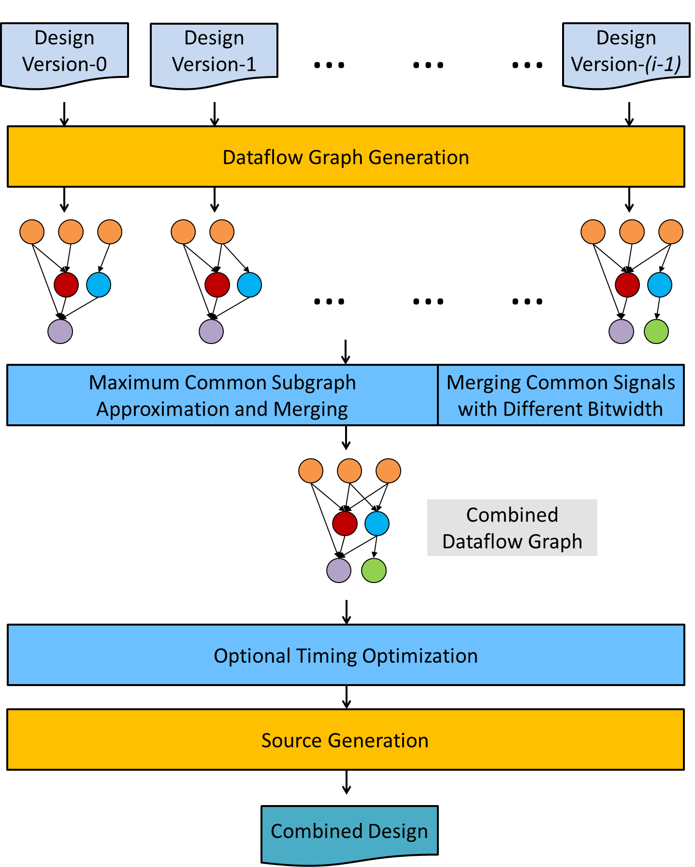
ADAM: Our Approach
ADAM, an Automated Design Analysis and Merging approach
Notes:
The proposed approach is called ADAM, an Automated Design Analysis and Merging approach.
Basically, every version of the same design is parsed in order to generate individual dataflow graphs.
MCS algorithm is launched to identify the equivalent subgraph.
Common nodes are merged, including the nodes of the common signal that is different in bitwidth across different versions of design.
Optional timing optimization is also performed to improve the frequency if the dataflow graph is direct acyclic.

Slide 6
ADAM: Maximum Common Subgraph (MCS) detection
Rutgers et al [37]: find MCS set between two dataflow graphs G_{a} and G_{b}.
Best-first search algorithm with multiple rounds of search
Each round of search:
A vertex v_{a} is heuristically chosen to find a vertex v_{b}, forming mapping M_{ab}
Heuristic:
Selection of v_{b} depends on similarities of v_{a} and v_{b} neighbours
Vertices in V_{a} with fewer possible mapping candidates in V_{b}: handled first
When a round of search completes, vertex v_{a} will not be selected again
[37] J. H. Rutgers et al. 2010. An Approximate Maximum Common Subgraph Algorithm for Large Digital Circuits. In 13th Euromicro Conference on Digital System Design: Architectures, Methods and Tools. 699–705.
Notes:
As we know, maximum common subgraph algorithm is an NP complete problem.
Therefore an approximate algorithm is used to minimize the merging time.
Rutgers et al propose an approximate algorithm to determine the set of MCS between two dataflow graphs G_{a} and G_{b}
It uses a best-first search algorithm where in each round of search, a vertex v_{a} is heuristically chosen to find a vertex v_{b} so as to form a mapping M_{ab}
The detail of the heuristic is as follows, and these details can be found in their paper.

Slide 7
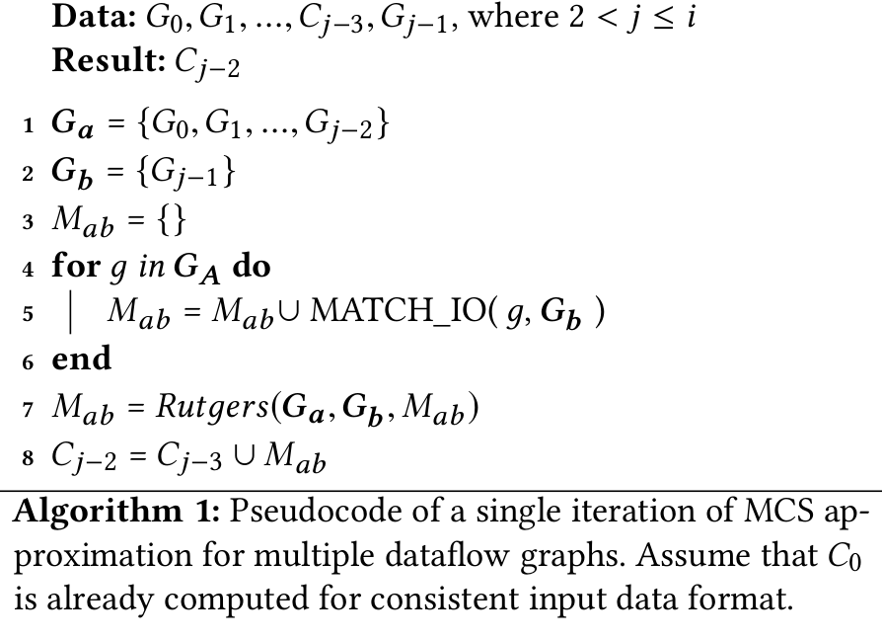
ADAM: MCS Algorithm for Multiple Graphs
Rutgers(G_{a}, G_{b}, M_{ab}) launched iteratively
Until a final set of MCS C_{i-2} for each version
Number of versions i is small
The overall time complexity equals to O(i²n) = O(n) where n = number of nodes
Notes:
Since Rutgers is limited to two dataflow graphs only, and it is difficult and challenging to extend it so as to support MCS search over multiple dataflow graphs.
We propose an algorithm that can achieve this purpose and it executes Rutgers iteratively,
Algorithm 1 shows a single iteration of the corresponding algorithm.
The time complexity of this iterative algorithm is O(i²n), where i is the number of version and n is the number of nodes. The overall time complexity equals to O(n) approximately bcos i normally is small.
To provide a better illustration, we use an example to demonstrate this algorithm.

Slide 8
ADAM: MCS Algorithm for Multiple Graphs
4 Versions, i = 4
2nd iterations, j = 2
G₀
G₁
G₂
G₃
G_{a}
G_{b}
Notes:
Given i=4 and j=2, it means that we have 4 designs and it is in the second iteration. Imagine the first iteration is done already, which gave us the MCS for G0 and G1.
G3 will not be used in this iteration. The nodes are the same if they are in the same color.
(**click**) To execute this algorithm, we group the first 2 graphs as Ga to form one big dataflow with multiple unconnected subgraphs.
(**click**)The last graph, which is G2, is considered to be Gb
(**click**).
Then Rutgers is launched to match Ga and Gb and it gives us the MCS between Ga and Gb. This doesn’t mean the second iteration is finished, but let’s take a look at the third iteration.

Slide 9
ADAM: MCS Algorithm for Multiple Graphs
4 Versions, i = 4
3rd iterations, j = 3
G₀
G₁
G₂
G₃
G_{a}
G_{b}
Notes:
We have j=3 this time.
(**click**) We group the first 3 graphs as Ga to form one big dataflow graph with multiple unconnected subgraphs.
(**click**) The last graph, which is G4, is considered to be Gb.
(**click**) Then Rutgers is launched to match Ga and Gb and it gives us the MCS between Ga and Gb. You now can notice that in this setting only one node in Ga can be mapped to Gb, however in reality many nodes can be mapped to Gb, because Ga is originally composed of multiple dataflow graphs.
(**click**) Therefore, the newly formed result must be joined with the previous result to complete a round of search, since it will relate to all the vertices that have been mapped in the previous iteration.

Slide 10
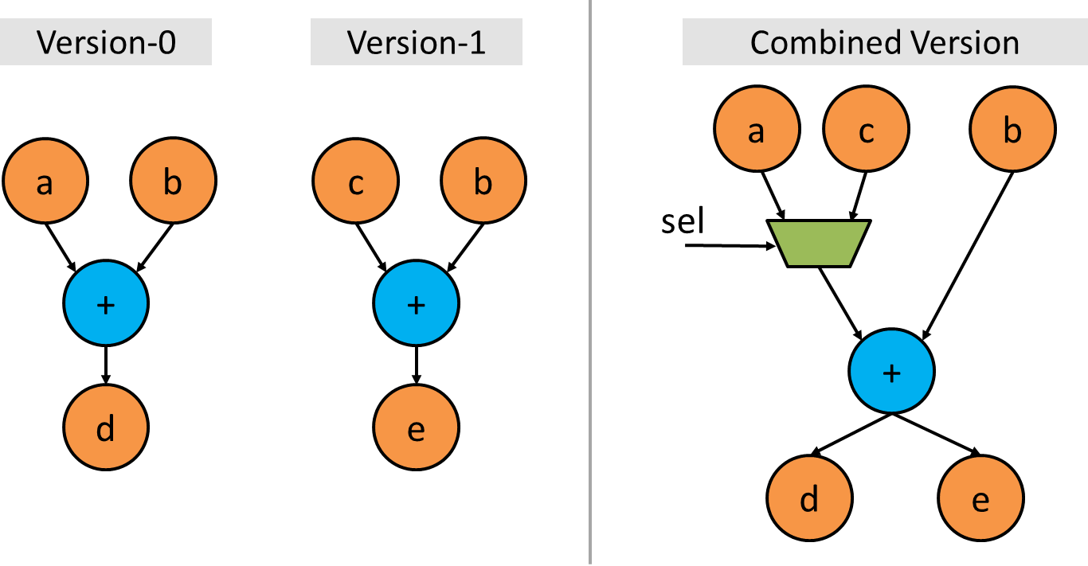
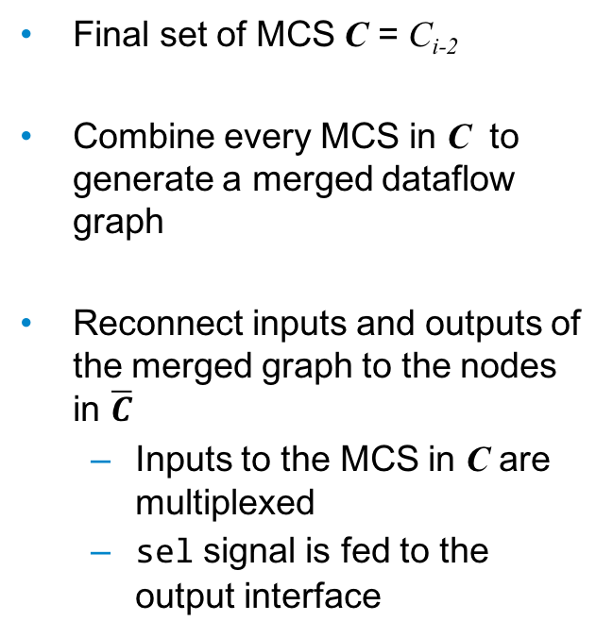
ADAM: Final Dataflow Graph Generation
Final set of MCS C = C_{i-2}
Combine every MCS in C to generate a merged dataflow graph
Reconnect inputs and outputs of the merged graph to the nodes in $\overline{C}$
Inputs to the MCS in C are multiplexed
sel signal is fed to the output interface
Notes:
Once we get the final set of MCS between every dataflow graphs, we combine them to generate the final dataflow graph.
Let’s take a look at the example on the right.
The addition node and the variable B are the same in both version 0 and 1, and they form the MCS. Once the MCS is merged, the inputs and outputs of the merged graph have to be connected to the nodes outside the MCS. This is achieved by multiplexing the inputs to the MCS. A select signal is fed to the output to enable the correct selection of the design version at runtime.

Slide 11
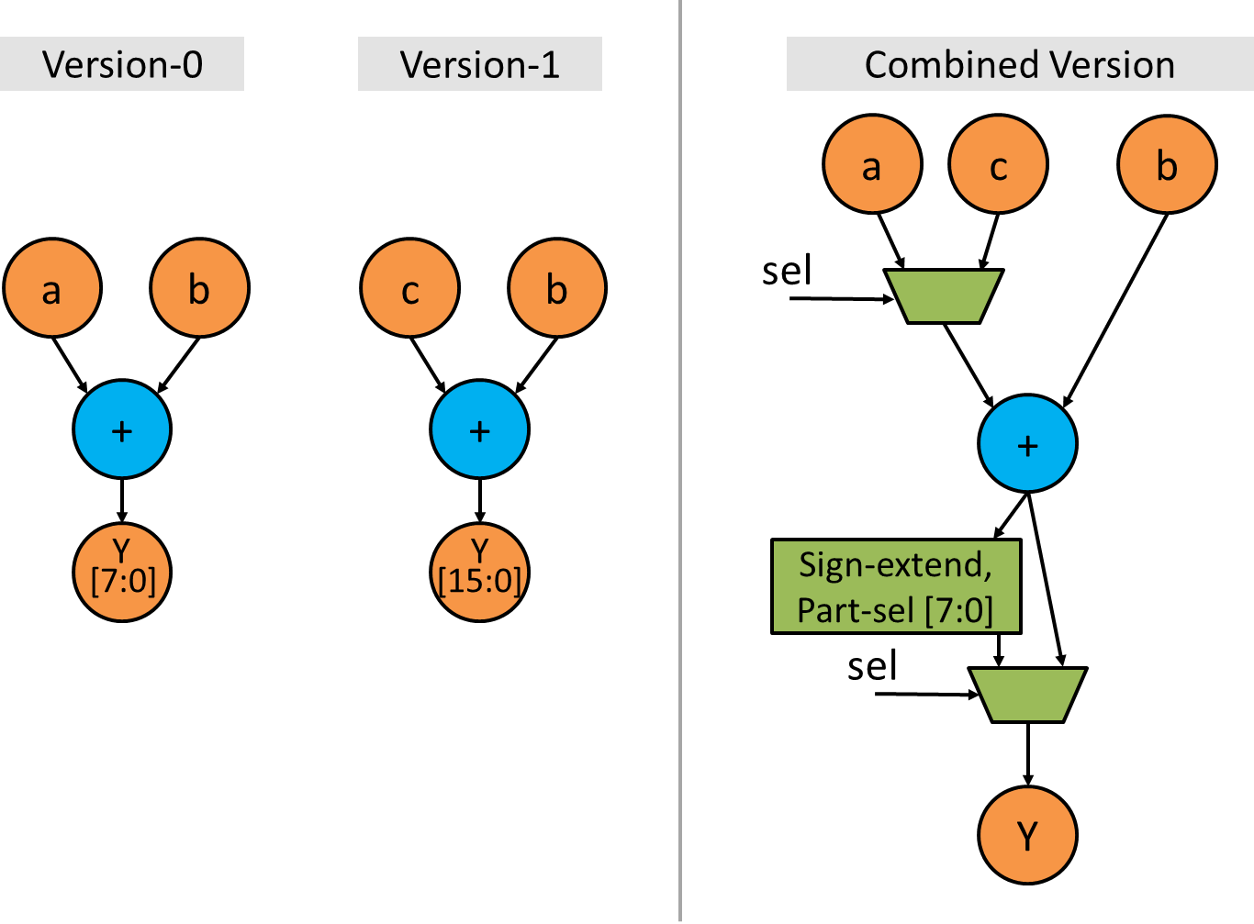
ADAM: Merging Common Signals with Different Bitwidths
Maximum bitwidth of every common signal is first obtained
Update assignment nodes
Appending multiplexers
Partially-selecting and sign/zero-extending the MSB bit
May not be optimal
Future work: multiplexing vs operator savings
Notes:
Apart from merging the identical vertices, we are interested in merging common signals with different bitwidth to see if we can further minimizing the area cost.
Let’s take a look at the example on the right.
The signals Y are common in both design versions, yet they are of different bitwidth. To merge the signal, we first identify the maximum bitwidth of that signal, which is 16 is this case. Then we update the corresponding assignment node by appending multiplexers. One of the input of the mux is sign or zero extended and the lower bits are partially selected to imitate the effect of 8 bit.
We note that this scheme may not be optimal, and we will look at multiplexing cost vs operator savings in the future work.

Slide 12
Prototype tool and benchmarks
Automatic merger prototyped with Pyverilog [41].
Open-source toolkit that provides RTL design analysis and code generation of Verilog HDL
Incorporates multiple libraries such as parser, dataflow analyzer and Verilog code generator
Parser and dataflow analyser: generate dataflow graph for each version of Verilog-based design
MCS is approximated and combined iteratively in linear time complexity
Search for and merge common signals with different bitwidth during iterative MCS detection
[41] S. Takamaeda-Yamazaki. 2015. Pyverilog: A Python-Based Hardware Design Processing Toolkit for Verilog HDL. In Applied Reconfigurable Computing: 11th International Symposium (ARC). 451–460.
Notes:
To understand the implications of the proposed framework, we prototype the automatic merger with Pyverilog.
Basically, it is an Open-source toolkit that provides RTL design analysis and code generation of Verilog. It incorporates multiple libraries such as parser, dataflow analyzer and Verilog code generator.
*click*
In our prototype, the parser and dataflow analyser are used to generate dataflow graph for each version of Verilog-based design.
Then, MCS is approximated and combined iteratively in linear time complexity.
Finally, searching and merging common signals with different bitwidth are also performed during the above iterative MCS detection process.

Slide 13
Benchmarks from VTR
Several parameterizable Verilog designs selected from VTR Benchmarks
bgm, LU8PEEng and array of diffeq1 (8x8)
Introduce discrepancy between versions by modifying macros or the bitwidth of all signals
Changing the corresponding macros eliminate certain parts of the original circuit, the resulting dataflow graphs vary across versions
Generated hardware and original hardware
Synthesized and implemented onto Xilinx Artix-7 AC701 Evaluation Platform using Vivado 2016.3
Run on HP EliteDesk 800 G2 Tower PC with
Intel i7-6700 3.40GHz CPU and 32GB RAM
Notes:
In our first benchmark, we select several Verilog designs from VTR Benchmarks where the parameters can be adjusted.
These designs include bgm, LU operations and an array of differential equation. We populate the FPGA with multiple differential equation modules bcos we want to have the FPGA resources occupied substantially.
We introduce discrepancy between versions by modifying macros or the bitwidth of all the signals.
As changing the corresponding macros eliminate certain parts of the original circuit, the resulting dataflow graphs vary across versions. This allows us to exercise the MCS algorithm proposed.
The SW and HW that we use in this benchmark are displayed in the bottom of this slide.

Slide 14
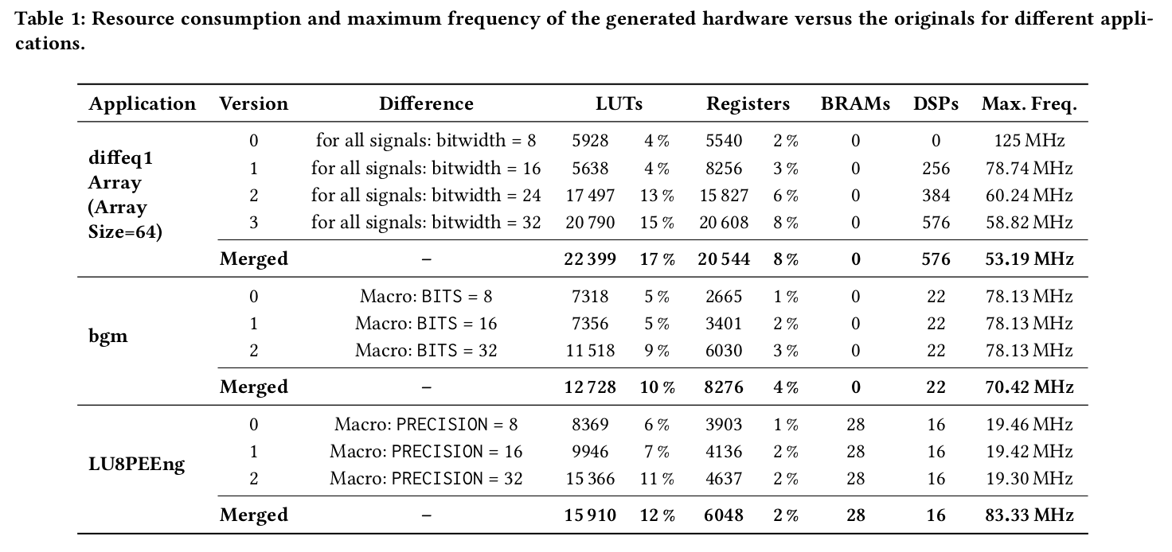
Benchmarks from VTR
Resources consumed are increased only by around 2% with reference to Artix-7 AC701 FPGA (smallest FPGA in 7-series).
The maximum frequencies in diffeq1 and bgm are reduced by 10 to 12%.
Maximum frequency supported by the merged hardware in LU8PEEng is improved by around 4 times.
Insertion of registers for zero-extension increases the number of driving gates during versioning, reducing fan-out.
Notes:
This table tells us the experimental results. It looks a bit complicated but the most important columns are Verison and Difference, and also the area cost.
“”click””
To begin with, the resources consumed are increased only by 2% based on Artix-7 AC701 FPGA, which is one of the smallest FPGA in the 7-series.
“”click””
The maximum frequencies in differental equation and bgm are reduced by 10 to 12%, which are considered to be moderate given the functionality that it provides.
“”click””
Finally, the maximum frequency supported by the merged HW for LU operation is surprisingly increased by around 4 times.
This is mainly due to the insertion of registers for zero-extension when different versions are merged, which increases the number of driving gates and reduces the fan-out.
More detail about this can be found in our paper, and
We note such an improvement comes from fan-out optimization which is orthogonal to the dataflow graph merging proposed.

Slide 15
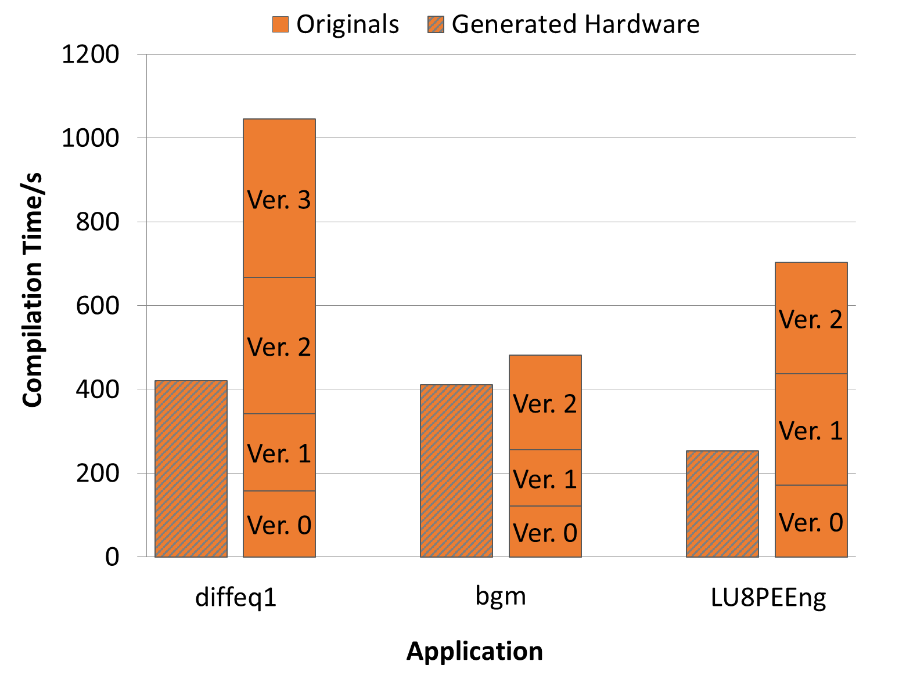
Benchmarks from VTR
Notes:
Apart from the resource consumption and maximum frequency, we also have to look at the reduction in compilation time which is the main purpose of this work.
In this diagram, the x-axis represents different applications and y-axis refers to the complication time in seconds.
The compilation time of the generated HW is compared to the summation of the compilation time of the originals.
And we could always see that there is certain improvement.
Yet, the improvement in terms of compilation time in bgm is less significant.
This is likely due to a bug in the final code generation in Pyverilog.
Pyverilog generates a nested if-else structure whether a ’’elseif” statement is encountered.
Therefore, this complicates the generated hardware for bgm which consists of 5246 elif statement for each original version.

Slide 16
Case study: binomial filters
Binomial filters: efficient structures based on binomial coefficients to realize Gaussian filtering
Many variations
Analysis of the accuracy and frequency response in hardware is useful
Provide accurate results
Faster than software simulation
Notes:
Apart from using the designs from VTR suite, we also provide a case study on one of the applications mentioned before,
And that is binomial filter.
Basically, it is an efficient structure based on binomial coefficients to realize Gaussian filtering,
And there are so many variations.
To understand which variation will be the best for a particular use case, an analysis of the accuracy and frequency response in hardware will be useful
Bcos it provides accurate results and is faster than SW simulation.

Slide 17
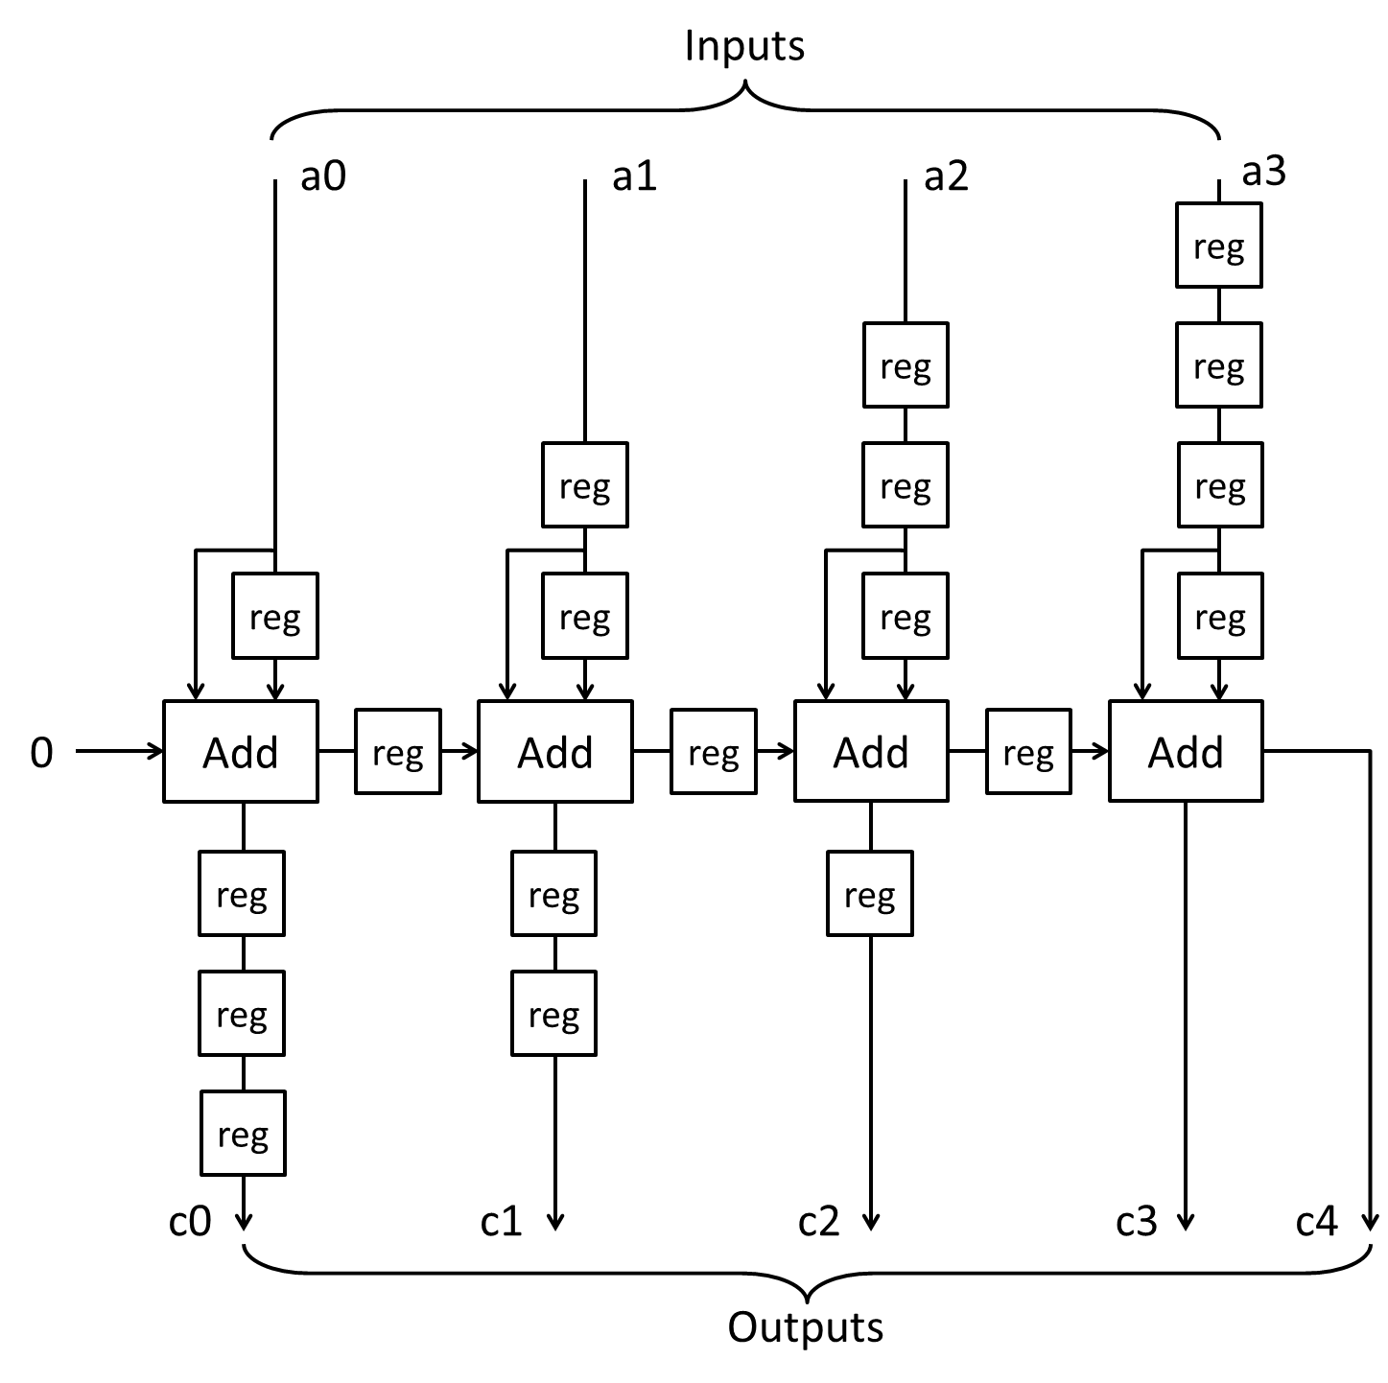
Case study: binomial filters
Structure is derived from the polynomial (1 – z ⁻¹) ^{n}
Such a cascade is arranged in a pipeline where the depth = n
Quality of the approximation to Gaussian filter depends on n
Lager n, smaller error
A fully-pipelined binomial filter where n = 4.
Notes:
In this case study, we select the structure that is based on this polynomial.
And it is an cascade of adder and it is arranged in a pipeline with depth equals to n. And it is shown on the right hand side.
The quality of the approximation depends on n where a larger n can contribute to a smaller error.

Slide 18
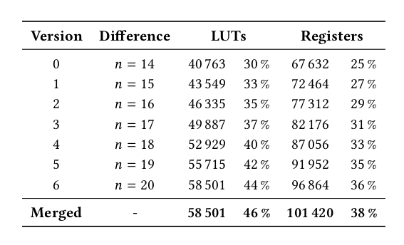
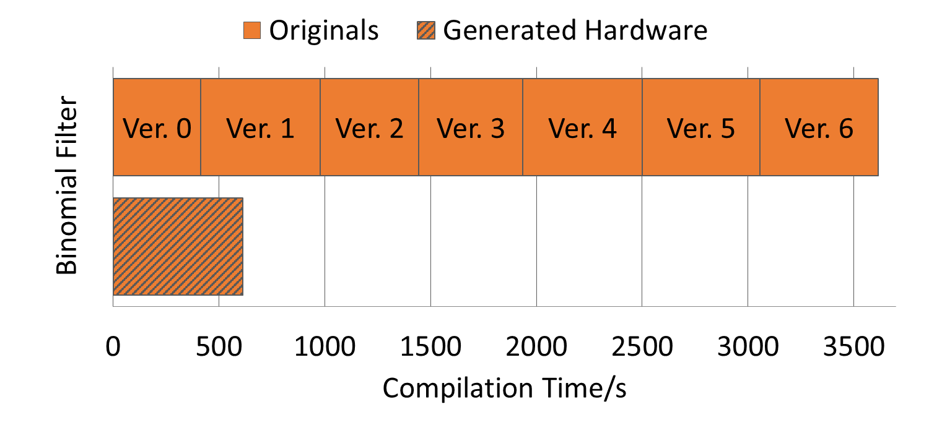
Case study: Binomial Filters
Resources consumed are increased only by around 2% with reference to Artix-7 AC701 FPGA (smallest FPGA in 7-series).
Speedup in compilation time is around 5.9 times when compared to the combined compilation time of all the originals (from 1 h reduced to 10 min).
Depth of the filters n is varied in each version
FPGA is populated with 32 filters
Target frequency: fixed at 100 MHz
Notes:
In particular, it is common for the user to vary n in each version to understand the behaviour and the relative accuracy against the user inputs.
Therefore, the depth of the filter is varied in each version, and the target freq is set as 100 Mhz.
""click""
As we can see from the table, the resources consumed are increased only by around 2% with reference to the same FPGA.
""click""
Also, the bar chart tells us that the compilation time can be reduced by 5.9 times when compared to the combined compilation time of all the originals. The complication time is basically reduced from an hour to just 10 minutes.

Slide 19
Evaluation
Relationship between compilation time and degree of similarity is explored by
Varying the number of design versions and
Its resource consumption on FPGA
The FPGA is populated with multiple diffeq1 module
So that 30%, 40% and 50% of the FPGA slices are initially occupied by each unmerged design version
Differences are introduced by changing the signal names
Notes:
As the above experiment is based on the architecture of the applications provided by VTR Benchmarks and binomial filters, the variations or the degree of similarity between versions cannot be adjusted randomly.
Therefore in our final evaluation, we study the Relationship between compilation time and degree of similarity by Varying the number of design versions and
Its resource consumption on FPGA.
To do this, we populate the FPGA with multiple differental equation module so that so that 30%, 40% and 50% of the FPGA slices are initially occupied by each unmerged design version .
The differences are introduced by changing the signal names to make them unique.

Slide 20
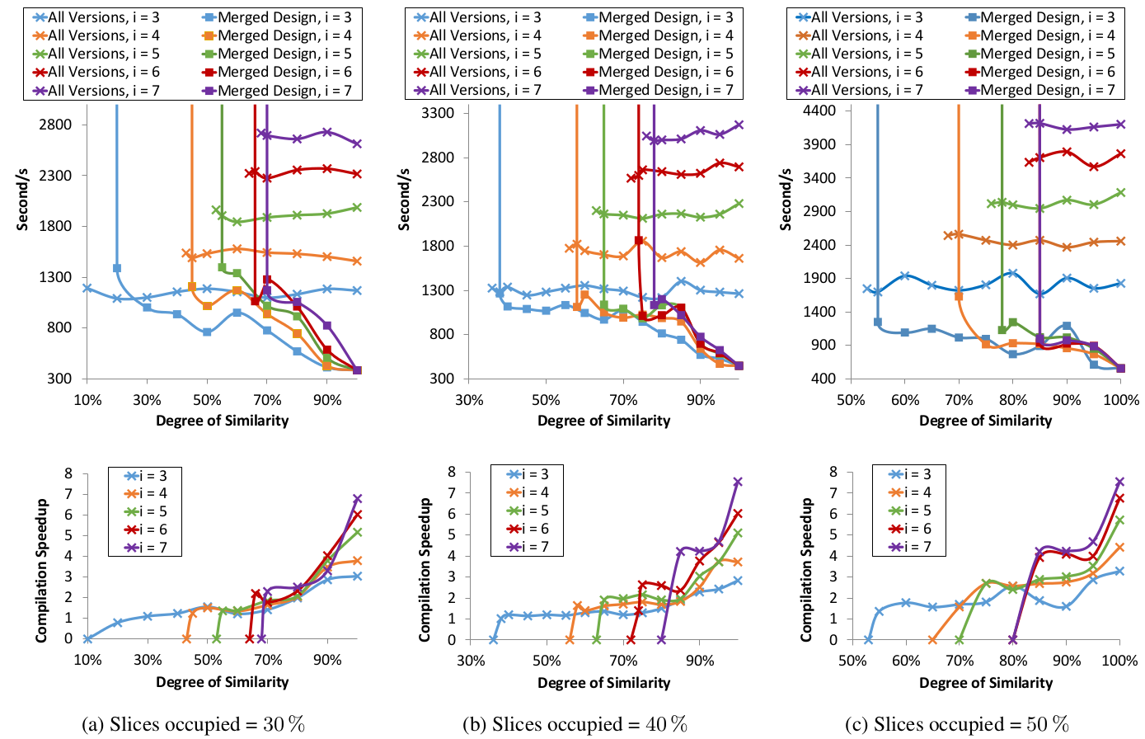
Evaluation
Compilation time of generated HW is independent of the version counts
At least 3 times faster, 85% in common
5 times faster, 95% in common.
degree of similarity: defined as the proportion of computational hardware that is common between versions.
Notes:
The degree of similarity is defined as the proportion of computational hardware that is common between versions. We do not use the syntax of dataflow graph in this definition bcos different vertices can represent different HW resources.
As you can see, there are two graphs where the one on the left is represented in terms of compilation time.
The one on right is essentially representing the same thing but the y-axis is now the compilation speedup between the merged HW and the summation of the originals.
This two graphs present the results when the slices occupied is around 30%.
From the graphs, we can see that the compilation time of generated HW is almost independent of the version counts
The speedup is around 3 times when the similarity is around 85%.
Further improvement can be achieved when the similarity is around 95%.

Slide 21
Evaluation
Compilation time of generated HW is independent of the version counts
At least 3 times faster, 85% in common
5 times faster, 95% in common
degree of similarity: defined as the proportion of computational hardware that is common between versions.
Notes:
Finally, we find that similar behavior can also be observed when the slices occupied are 40 and 50%

Slide 22
Summary: ADAM
Automatic merging of multiple designs into a single implementation
Perform merging and generate a final hardware design in linear time
Compilation time for binomial filters:
1 hour to 10 minutes
Future Work
More benchmarks: e.g. climate modelling, genomics, machine learning
Integrate with design automation flow
Domain-specific and platform-specific optimization
Trade-off between compute and interconnect resources sharing
Notes:
To conclude, we propose ADAM that can support automatic merging of multiple designs into a single implementation
It performs merging and generates a final hardware design in linear time
The Compilation time for case study of binomial filters is reduced from an hr to 10 minutes.
In the future, we plan to include more benchmarks such as climate modelling, genomics and machine learning
We also want to have it integrated with the design automation flow
Domain-specific and platform-specific optimization will also be performed
And Trade-off between compute and interconnect resources sharing will be studied.
Thank you for listening to my presentation, and I am more than happy to answer your questions.

