Slide 1
A Scalable Approach to Exact Resource-Constrained Scheduling Based on a Joint SDC and SAT Formulation
Steve Dai, Gai Liu, Zhiru Zhang
Electrical and Computer Engineering, Cornell University

Slide 2
High-Level Synthesis (HLS)
Promising tool to reduce the development time for FPGA-targeted hardware designs
Raises the level of design abstraction from hardware to software
Tackles increased design complexity and stringent design constraints
Software Compilation
Scheduling
Binding
RTL Generation
C/C++/
SystemC
Verilog/
VHDL
Adding timing information
High-level
Software
Cycle-accurate
Hardware
Untimed
Timed

Slide 3
Scheduling is Important
Timing influences the quality of the resulting hardware
Enable micro-architectural tradeoffs from a single design source
Untimed | Combinational for Latency | Sequential for Area | Pipelined for Throughput
in1
in2
in3
in4
in1
in2
in3
in4
in1
in2
in3
in4
in
+
1
2
3
4
+
+
+
REG
+
1
2
3
+
+
out1
out1
+
Control-Data Flow Graph (CDFG)
1
2
+
+
out1
out

Slide 4
HLS Scheduling with Constraints
Determines the clock cycle at which each operation should be executed subject to constraints
Dependence
Cycle time
Relative timing
Resource-constrained scheduling
Minimizes latency given a limited number of functional units
Considers resource constraints in addition to other constraints
NP-hard problem

Slide 5
Tension between Scalability and Quality
High
scalability
(greedy
decisions)
List scheduling
(e.g., [Parker et al., DAC’86])
Optimal quality
Fast runtime
?
Faster
SDC
(e.g., [Cong & Zhang, DAC’06])
Force-directed
[Paulin & Knight, TCAD’89]
Slow
runtime
ILP
Low
quality
High quality
(global optimization)
Better QoR

Slide 6
SDC-Based Scheduling
SDC = System of difference constraints
ld
ld
ld
3ns
s_{i} : schedule variable for operation i
v₁
v₂
v₀
Dependence constraints
<v₀ , v₄ > : s₀ – s₄ ≤ 0
<v₁ , v₃ > : s₁ – s₃ ≤ 0
<v₂ , v₃ > : s₂ – s₃ ≤ 0
<v₃ , v₄ > : s₃ – s₄ ≤ 0
<v₄ , v₅ > : s₄ – s₅ ≤ 0
Cycle time constraints
v₂ → v₅ : s₂ – s₅ ≤ -1
v₁ → v₅ : s₁ – s₅ ≤ -1
+
1ns
v₃
+
1ns
Timing constraints
v₄
v₅
st
1ns
Target cycle time: 5ns
Delay estimates
Add (+) 1ns
Load (ld) 3ns
Store (st) 1ns
[J. Cong & Z. Zhang, DAC, 2006] [Z. Zhang & B. Liu, ICCAD, 2013]

Slide 7
SDC is Efficient
Difference constraints in a constraint graph
Feasible (integer) schedule from single-source shortest path
Detect infeasibility by the presence of negative cycle
Dependence constraints
<v₀ , v₄ > : s₀ – s₄ ≤ 0
<v₁ , v₃ > : s₁ – s₃ ≤ 0
<v₂ , v₃ > : s₂ – s₃ ≤ 0
<v₃ , v₄ > : s₃ – s₄ ≤ 0
<v₄ , v₅ > : s₄ – s₅ ≤ 0
Cycle time constraints
v₂ → v₅ : s₂ – s₅ ≤ -1
v₁ → v₅ : s₁ – s₅ ≤ -1
3
s₀
2
s₂
0
Feasible
schedule
2
s₁
-1
0
-1
0
s₃
3
0
s₄
s₅
0
src
3
3
3
-1
v₄ → v₃ : s₄ – s₃ ≤ -1
Negative cycle = Certificate of infeasibility
[J. Cong & Z. Zhang, DAC, 2006] [Z. Zhang & B. Liu, ICCAD, 2013]

Slide 8
Resource Constraints in SDC
Cannot be represented exactly in integer difference form
Must be heuristically transformed into difference constraints
ld
v₁
ld
v₂
ld
3ns
v₀
+
1ns
Resource constraints
➔ Heuristic partial orderings
v₀ → v₂ : s₀ – s₂ ≤ -1
OR
v₁ → v₀ : s₁ – s₀ ≤ -1
v₂ → v₀ : s₂ – s₀ ≤ -1
v₃
+
1ns
3 cycle latency
v₄
v₅
st
1ns
2 cycle latency
Resource constraint
Two read ports
Need to enumerate for best latency
For scalability, SDC heuristically imposes one ordering
without guarantee of optimality
[J. Cong & Z. Zhang, DAC, 2006] [Z. Zhang & B. Liu, ICCAD, 2013]

Slide 9
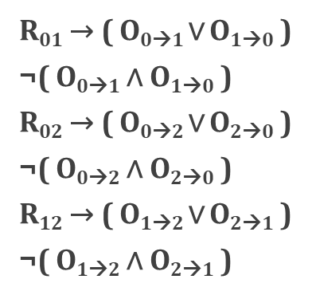
SDS: Exact Scheduling with SDC and SAT
Satisfiability (SAT): Is there an assignment of the (Boolean) variables that satisfies a Boolean formula?
Partial orderings
Difference constraints
s₀ – s₄ ≤ 0
s₁ – s₃ ≤ 0
s₂ – s₃ ≤ 0
s₃ – s₄ ≤ 0
s₄ – s₅ ≤ 0
s₂ – s₅ ≤ -1
s₁ – s₅ ≤ -1
SAT
SDC
Resource Constraints
Timing Constraints
Conflict clauses
Infeasibility
Conflict based search
Graph based
feasibility checking
~1M variables
>1M clauses
Conflict-driven learning
Polynomial time
Still NP-hard, but optimal scheduling

Slide 10
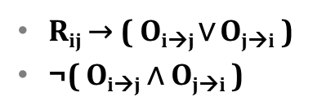
Resource Constraints in SAT
Boolean variables
B_{ik} Binding: i bound to resource k
R_{ij} Sharing: i shares resource with j
O_{i→j} Partial ordering: i scheduled in an earlier cycle than j
SAT clauses for resource constraints
Partial ordering constraint: If i and j share the same resource, they must be scheduled in different cycles

Slide 11
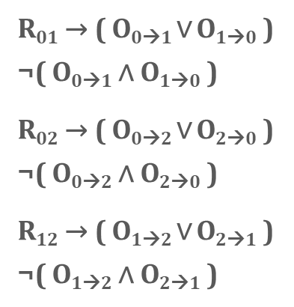
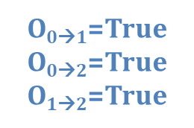

Conflict-Driven Learning
Is latency = 2 cycles feasible?
Partial orderings
Difference constraints
Negative cycle
sum = -1
s₀
1
-1
-1
propose
s₂
-1
s₁
-1
-1
conflict
s₃
s₄
s₅
Conflict clauses
Infeasibility
What SAT learns from SDC:
Any ordering involving operation 0 before 2 should no longer be attempted

Slide 12
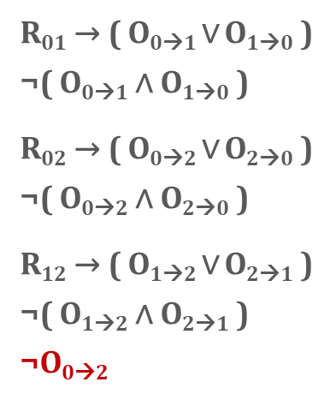
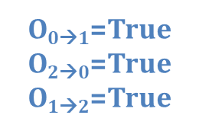

Conflict-Driven Learning
Is latency = 2 cycles feasible?
Negative cycle
sum = -2
s₀
-1
1
propose
-1
s₂
-1
s₁
-1
-1
conflict
s₃
s₄
s₅

Slide 13
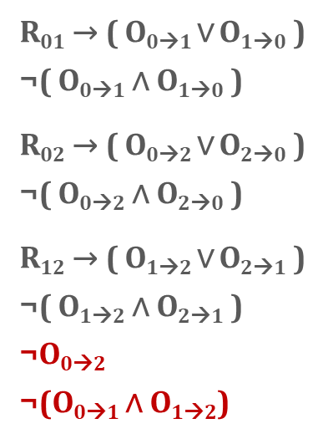
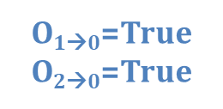
Conflict-Driven Learning
Is latency = 2 cycles feasible?
No negative cycle
s₀
1
-1
propose
-1
s₂
s₁
-1
-1
No conflict
s₃
s₄
s₅
Any ordering satisfying these conflicts are infeasible
Feasible! Returns schedule.

Slide 14




Fast Conflict-Driven Learning
Generate short conflicts
Shorter conflict ➔ more pruning ➔ faster convergence
Negative cycle = irreducibly inconsistent set of constraints
Keeps conflicts short
Becomes consistent if any constraint is removed from the set
Resource-aware lower bounding [Rim & Jain, TCAD 1997]
Complements negative cycle for conflict generation
Can generate even shorter conflicts in certain cases

Slide 15
Fast Incremental Learning
Not necessary to process entire graph each time
With incremental SDC, add edges only up until the constraint graph becomes infeasible
Incremental SDC [Ramalingam et al., Algorithmica 1999]
Start with a feasible solution
Add or tighten an edge
O(|Δe|+ |Δv|log|Δv|)
Update only affected subgraph
Delete or relax an edge
O(1)
Current solution remains feasible
0
0
1
s₀
0
-1
s₂
0
s₁
-1
-1
s₃
1
s₄
s₅
1
1

Slide 16
Fast Incremental Learning
Incremental resource constraints
Start with no resource constraints
Add resource constraints only as needed to deal with contention
Significantly reduce search space
R₀₁ → ( O_{0→1} ∨ O_{1→0} )
¬( O_{0→1} ∧ O_{1→0} )
R₁₂ → ( O_{1→2} ∨ O_{2→1} )
¬( O_{1→2} ∧ O_{2→1} )
s₀
R₀₁ → ( O_{0→1} ∨ O_{1→0} )
¬( O_{0→1} ∧ O_{1→0} )
R₀₂ → ( O_{0→2} ∨ O_{2→0} )
¬( O_{0→2} ∧ O_{2→0} )
R₁₂ → ( O_{1→2} ∨ O_{2→1} )
¬( O_{1→2} ∧ O_{2→1} )
R₀₁ → ( O_{0→1} ∨ O_{1→0} )
¬( O_{0→1} ∧ O_{1→0} )
R₀₂ → ( O_{0→2} ∨ O_{2→0} )
¬( O_{0→2} ∧ O_{2→0} )
R₀₁ → ( O_{0→1} ∨ O_{1→0} )
¬( O_{0→1} ∧ O_{1→0} )
R₀₂ → ( O_{0→2} ∨ O_{2→0} )
¬( O_{0→2} ∧ O_{2→0} )
R₁₂ → ( O_{1→2} ∨ O_{2→1} )
¬( O_{1→2} ∧ O_{2→1} )
R₀₁ → ( O_{0→1} ∨ O_{1→0} )
¬( O_{0→1} ∧ O_{1→0} )
R₀₂ → ( O_{0→2} ∨ O_{2→0} )
¬( O_{0→2} ∧ O_{2→0} )
s₂
SAT
SDC
s₁
Resource Constraints
Timing Constraints
s₃
s₄
s₅

Slide 17
From Feasibility to Optimality
SAT is a decision problem
How to optimize for latency?
Binary search over feasible latency range
Automatically establish “tight” upper and lower bounds
Lower
Bound
Upper
Bound
latency
Resource-aware
Lower Bounding
[Rim & Jain, TCAD 1997]
SDC
[Cong & Zhang,
DAC 2006]
SDS handles constraints exactly and achieves optimal solution like ILP

Slide 18

Implementation
C Compiler (LLVM)
C Program
Optimized
LLVM IR
Allocation
Target H/W
Characterization
SDS
Constraints
Scheduling
User constrains
Timing
Resource
Schedule
Binding
C++
Lingeling SAT
LegUp HLS Flow
http://legup.eecg.utoronto.ca
RTL Generation
Synthesizable Verilog

Slide 19
Quality of Results
Dataflow benchmarks
Contain a large portion of resource-constrained operations
Stress-test scheduler’s resource handling capability
Resource Constraints: 2 multipliers and 2 memory ports. Latency in cycles.
Benchmark | #Ops | SDS Latency | ILP Latency | SDC Latency
ARAI | 44 | 8 | 8 | 9
PR | 52 | 12 | 12 | 14
WANG | 54 | 12 | 12 | 14
LEE | 58 | 12 | 12 | 14
MCM | 74 | 15 | 15 | 16
DIR | 76 | 14 | 14 | 15
HONDA | 105 | 27 | 27 | 33
CHEM | 349 | 85 | Timeout | 89
U5ML | 857 | 261 | 261 | 264
Timeout after 300 seconds.

Slide 20
Runtime Results
Resource Constraints: 2 multipliers and 2 memory ports.
Runtimes in seconds.
Benchmark | # Operations | SDS Scheduling | Default ILP Scheduling
 |  |  | CPLEX | CBC
ARAI | 44 | 0.01 | 0.12 | 1.18
PR | 52 | 0.01 | 0.86 | 3.70
WANG | 54 | 0.01 | 0.86 | 12.2
LEE | 58 | 0.01 | 0.26 | 2.88
MCM | 74 | 0.34 | 6.19 | 24.6
DIR | 76 | 0.01 | 1.51 | 11.5
HONDA | 105 | 0.02 | 9.06 | 104
CHEM | 349 | 1.42 | TO | TO
U5ML | 857 | 0.01 | 20.8 | TO
SDS Speedup over
12x
86x
86x
26x
18x
151x
453x
Timeout
2080x
118x
370x
1220x
288x
72x
1150x
5200x
Timeout
Timeout
Timeout after 300 seconds.

Slide 21
Runtime Results
The solver remains scalable for more resources
Runtimes in seconds.
Benchmark | # Operations | SDS Scheduling
 |  | 1 mult 1 port | 2 mults 2 ports | 3 mults 3 ports | 4 mults 4 ports | 6 mults 6 ports
ARAI | 44 | 0.01 | 0.01 | 0.01 | 0.01 | 0.01
PR | 52 | 0.01 | 0.01 | 0.01 | 0.01 | 0.02
WANG | 54 | 0.01 | 0.01 | 0.01 | 0.01 | 0.02
LEE | 58 | 0.01 | 0.01 | 0.01 | 0.01 | 0.02
MCM | 74 | 0.05 | 0.34 | 0.01 | 0.13 | 0.07
DIR | 76 | 0.02 | 0.01 | 0.01 | 0.01 | 0.01
HONDA | 105 | 0.01 | 0.03 | 0.04 | 0.09 | 0.24
CHEM | 349 | 1.49 | 1.42 | 1.10 | 2.92 | 4.33
U5ML | 857 | 0.01 | 0.01 | 0.01 | 0.01 | 0.01

Slide 22
Additional Results
CHStone benchmarks
Target Intel Cyclone V FPGA at 10ns
Both SDC and SDS can schedule within 50ms
Benchmark | #Ops | SDC-Based Scheduling |  |  | SDS Scheduling
 |  | CP | ALM | #Control Steps | CP | ALM | #Control Steps
ADPCM | 850 | 12.0 | 5599 | 95 | 11.3 | 5680 | 86
AES | 812 | 10.4 | 5313 | 174 | 10.5 | 5506 | 167
BLOWFISH | 687 | 7.5 | 2209 | 110 | 7.8 | 2402 | 106
DFMUL | 279 | 9.4 | 1112 | 7 | 9.6 | 1126 | 6
DFADD | 361 | 7.3 | 1439 | 8 | 7.4 | 1442 | 8
DFSIN | 1067 | 10.2 | 8584 | 78 | 9.6 | 8541 | 78
GSM | 966 | 10.2 | 3256 | 7 | 10.6 | 3233 | 7
MIPS | 346 | 11.7 | 1036 | 5 | 11.8 | 1029 | 5
MOTION | 284 | 8.4 | 5577 | 11 | 9.0 | 5729 | 11

Slide 23
Take-Away Points
Combine SDC and SAT with conflict-driven learning to enable fast yet exact resource-constrained scheduling
Broader applications
Not specific to HLS
Resource-constrained scheduling in other fields
Wide range of constrained scheduling problems
High Scalability
SDC
SDS
Low Scalability
Low Quality
High Quality

Slide 24
Take-Away Points
Inspired by SMT (Satisfiability Modulo Theory)
Leverage problem-specific knowledge to improve efficiency
Use SAT solver only as a black box
Explore benefits of tightly integrating SDC with SAT in a more SMT-like approach
SDS⁺⁺
SAT
SAT
SDC
Thank you! Questions?

