Slide 1

Dynamically Scheduled
High-level Synthesis
Lana Josipović, Radhika Ghosal, Paolo Ienne
École Polytechnique Fédérale de Lausanne (EPFL)
February 2018

Slide 2
High-level Synthesis and Static Scheduling
High-level synthesis (HLS) is the future of reconfigurable computing
  Design circuits from high-level programming languages
Classic HLS relies on static schedules
  Each operation executes at a cycle fixed at synthesis time
Scheduling dictated by compile-time information
  Maximum parallelism in regular applications
  Limited parallelism when information unavailable at compile time (i.e., latency, memory or control dependencies)

Slide 3
The Limitations of Static Scheduling
for (i=0; i<N; i++) {
hist[x[i]] = hist[x[i]] + weight[i];
}
1: x[0]=5 → ld hist[5]; st hist[5];
2: x[1]=4 → ld hist[4]; st hist[4];
3: x[2]=4 → ld hist[4]; st hist[4];

Slide 4
The Limitations of Static Scheduling
for (i=0; i<N; i++) {
hist[x[i]] = hist[x[i]] + weight[i];
}
1: x[0]=5 → ld hist[5]; st hist[5];
2: x[1]=4 → ld hist[4]; st hist[4];
3: x[2]=4 → ld hist[4]; st hist[4];
RAW

Slide 5
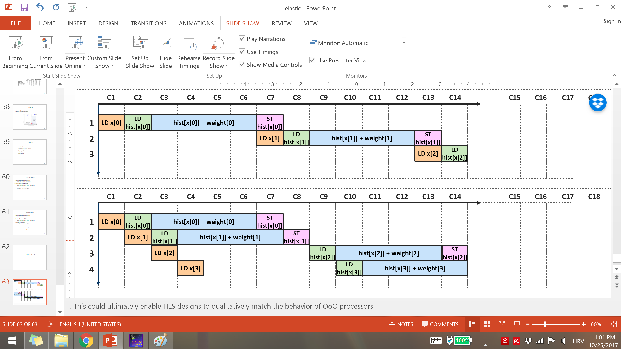
The Limitations of Static Scheduling
for (i=0; i<N; i++) {
hist[x[i]] = hist[x[i]] + weight[i];
}
1: x[0]=5 → ld hist[5]; st hist[5];
2: x[1]=4 → ld hist[4]; st hist[4];
3: x[2]=4 → ld hist[4]; st hist[4];
RAW
Static scheduling (any HLS tool)
  Inferior when memory accesses cannot be disambiguated at compile time

Slide 6
The Limitations of Static Scheduling
for (i=0; i<N; i++) {
hist[x[i]] = hist[x[i]] + weight[i];
}
1: x[0]=5 → ld hist[5]; st hist[5];
2: x[1]=4 → ld hist[4]; st hist[4];
3: x[2]=4 → ld hist[4]; st hist[4];
RAW
Static scheduling (any HLS tool)
  Inferior when memory accesses cannot be disambiguated at compile time
Dynamic scheduling
  Maximum parallelism: Only serialize memory accesses on actual dependencies

Slide 7
Towards Dynamic Scheduling
Overcoming the conservatism of statically scheduled HLS
  Dynamically selecting the schedule at runtime¹
  Application-specific dynamic hazard detection²
  Pipelining particular classes of irregular loops³
¹ Liu et al. Offline synthesis of online dependence testing: Parametric loop pipelining for HLS. FCCM ’15.
² Dai et al. Dynamic hazard resolution for pipelining irregular loops in high-level synthesis. FPGA ‘17.
³ Tan et al. ElasticFlow: A complexity-effective approach for pipelining irregular loop nests. ICCAD ‘15.

Slide 8
Towards Dynamic Scheduling
Overcoming the conservatism of statically scheduled HLS
  Dynamically selecting the schedule at runtime¹
  Application-specific dynamic hazard detection²
  Pipelining particular classes of irregular loops³
    Some dynamic behavior, but still based on static scheduling
¹ Liu et al. Offline synthesis of online dependence testing: Parametric loop pipelining for HLS. FCCM ’15.
² Dai et al. Dynamic hazard resolution for pipelining irregular loops in high-level synthesis. FPGA ‘17.
³ Tan et al. ElasticFlow: A complexity-effective approach for pipelining irregular loop nests. ICCAD ‘15.

Slide 9
Dynamically Scheduled Circuits
  Efforts in the asynchronous domain ¹
  Structures of asynchronous handshake components
  Each operation executes as soon as all of its inputs arrive
  Dataflow, latency-insensitive, elastic ^{2, 3, 4}
  Synchronous methodologies for achieving dynamic scheduling
¹ Budiu et al. Dataflow: A complement to superscalar. ISPASS ’05.
² Carloni et al. Theory of latency-insensitive design. TCAD '01.
³ Cortadella et al. Synthesis of synchronous elastic architectures. DAC '06.
⁴ Vijayaraghavan et al. Bounded dataflow networks and latency-insensitive circuits. MEMOCODE '09.

Slide 10
Dynamically Scheduled Circuits
  Efforts in the asynchronous domain ¹
  Structures of asynchronous handshake components
  Each operation executes as soon as all of its inputs arrive
  Dataflow, latency-insensitive, elastic ^{2, 3, 4}
  Synchronous methodologies for achieving dynamic scheduling
    How to create dynamically scheduled circuits from high-level programs?
¹ Budiu et al. Dataflow: A complement to superscalar. ISPASS ’05.
² Carloni et al. Theory of latency-insensitive design. TCAD '01.
³ Cortadella et al. Synthesis of synchronous elastic architectures. DAC '06.
⁴ Vijayaraghavan et al. Bounded dataflow networks and latency-insensitive circuits. MEMOCODE '09.

Slide 11
Outline
Introduction
Background: elastic circuits
Synthesizing elastic circuits
Evaluation
Conclusion

Slide 12
Elastic Circuits¹
  Every component communicates via a pair of handshake signals
valid
Component 1
ready
Component 2
data
¹ Cortadella et al. Synthesis of synchronous elastic architectures. DAC '06.

Slide 13
Elastic Components¹
Buff
FIFO
Fork
  Elastic buffer
  Elastic FIFO
  Fork
Join
Branch
Merge
  Join
  Branch
  Merge
¹ Cortadella et al. Synthesis of synchronous elastic architectures. DAC '06.

Slide 14
Elastic Components¹
Buff
FIFO
Fork
  Elastic buffer
  Elastic FIFO
  Fork
Join
Branch
Merge
  Join
  Branch
  Merge
¹ Cortadella et al. Synthesis of synchronous elastic architectures. DAC '06.

Slide 15
Elastic Components¹
Buff
FIFO
Fork
  Elastic buffer
  Elastic FIFO
  Fork
Join
Branch
Merge
  Join
  Branch
  Merge
¹ Cortadella et al. Synthesis of synchronous elastic architectures. DAC '06.

Slide 16
Elastic Components¹
Buff
FIFO
Fork
  Elastic buffer
  Elastic FIFO
  Fork
Join
Branch
Merge
  Join
  Branch
  Merge
¹ Cortadella et al. Synthesis of synchronous elastic architectures. DAC '06.

Slide 17
Elastic Components¹
Buff
FIFO
Fork
  Elastic buffer
  Elastic FIFO
  Fork
Join
Branch
Merge
  Join
  Branch
  Merge
¹ Cortadella et al. Synthesis of synchronous elastic architectures. DAC '06.

Slide 18
Elastic Components¹
Buff
FIFO
Fork
  Elastic buffer
  Elastic FIFO
  Fork
Join
Branch
Merge
  Join
  Branch
  Merge
¹ Cortadella et al. Synthesis of synchronous elastic architectures. DAC '06.

Slide 19
Elastic Components
  data
Memory subsystem
  address
+
−
LD
  Load ports
  data
LD
  address
  data
ST
  address
>
=
  Store ports
  data
  address
ST
  Functional units
  Memory interface

Slide 20
Outline
Introduction
Background: elastic circuits
Synthesizing elastic circuits
Evaluation
Conclusion

Slide 21
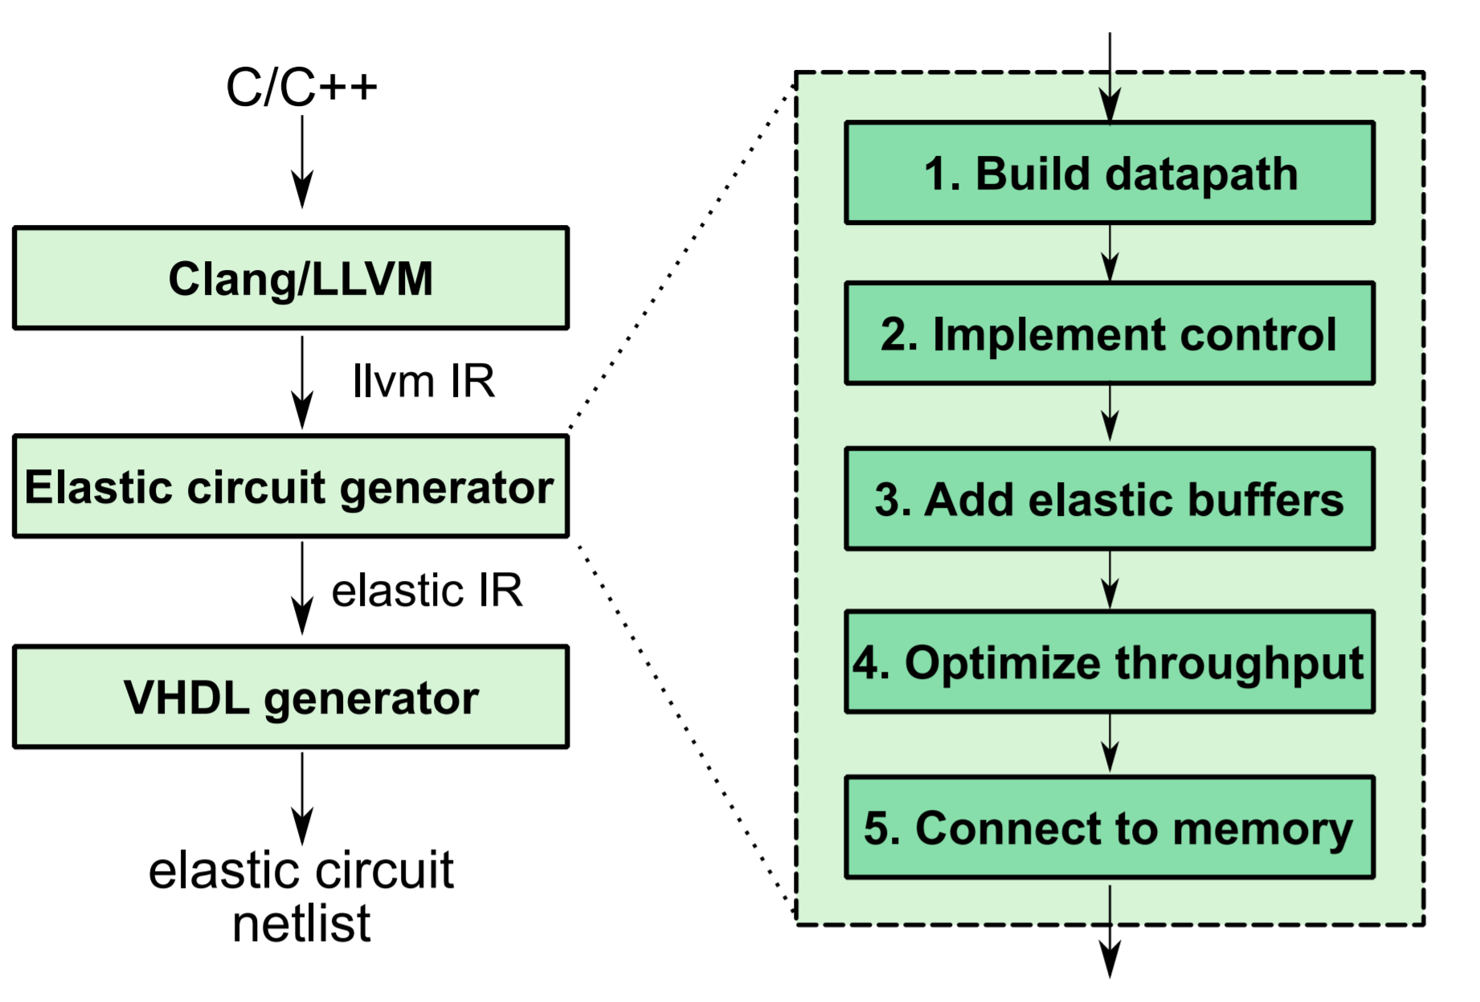
Synthesizing Elastic Circuits

Slide 22
Synthesizing Elastic Circuits
  From C to intermediate graph representation
  LLVM compiler framework
Basic block
for (i=0; i<N; i++) {
hist[x[i]] = hist[x[i]] + weight[i];
}

Slide 23
Synthesizing Elastic Circuits
  Constructing the datapath
i
1
for (i=0; i<N; i++) {
hist[x[i]] = hist[x[i]] + weight[i];
}
LD x[i]
+
LD weight[i]
N
LD hist[x[i]]
<
  Each operator corresponds to a functional unit
+
ST hist[x[i]]

Slide 24
Synthesizing Elastic Circuits
  Implementing control flow
Start: i=0
Mg
1
for (i=0; i<N; i++) {
hist[x[i]] = hist[x[i]] + weight[i];
}
LD x[i]
+
LD weight[i]
N
LD hist[x[i]]
<
  Merge for each variable entering the BB
+
ST hist[x[i]]

Slide 25
Synthesizing Elastic Circuits
  Implementing control flow
Start: i=0
Mg
1
for (i=0; i<N; i++) {
hist[x[i]] = hist[x[i]] + weight[i];
}
LD x[i]
+
LD weight[i]
N
LD hist[x[i]]
<
  Branch for each variable exiting the BB
+
Br
ST hist[x[i]]
Exit: i=N

Slide 26
Synthesizing Elastic Circuits
  Inserting Forks
Start: i=0
Mg
Fork
1
for (i=0; i<N; i++) {
hist[x[i]] = hist[x[i]] + weight[i];
}
LD x[i]
+
Fork
LD weight[i]
Fork
N
LD hist[x[i]]
<
  Fork after every node with multiple successors
+
Br
ST hist[x[i]]
Exit: i=N

Slide 27
Adding Elastic Buffers
  Elastic buffers and circuit functionality
LD hist[x]
LD weight[i]
+

Slide 28
Adding Elastic Buffers
  Elastic buffers and circuit functionality
LD hist[x]
LD weight[i]
Buff
+

Slide 29
Adding Elastic Buffers
  Elastic buffers and circuit functionality
LD hist[x]
LD weight[i]
  Buffer insertion does not affect circuit functionality
Buff
+

Slide 30
Adding Elastic Buffers
  Elastic buffers and circuit functionality
LD hist[x]
LD weight[i]
  Buffer insertion does not affect circuit functionality
Buff
+
  Elastic buffers and avoiding deadlock
  r=0
Mg
  v=1
1
+
Br

Slide 31
Adding Elastic Buffers
  Elastic buffers and circuit functionality
LD hist[x]
LD weight[i]
  Buffer insertion does not affect circuit functionality
Buff
+
  Elastic buffers and avoiding deadlock
Mg
Buff
  Each combinational loop in the circuit needs to contain at least one buffer
1
+
Br

Slide 32
Adding Elastic Buffers
Start: i=0
Mg
Fork
1
LD x[i]
+
Fork
LD weight[i]
Fork
N
LD hist[x[i]]
<
+
Br
St hist[x[i]]
Exit: i=N

Slide 33
Adding Elastic Buffers
Start: i=0
Mg
Fork
1
+
  2 Combinational loops
LD x[i]
Fork
LD weight[i]
Fork
N
LD hist[x[i]]
<
+
Br
ST hist[x[i]]
Exit: i=N

Slide 34
Adding Elastic Buffers
Start: i=0
Mg
Buff
Fork
1
LD x[i]
+
Fork
LD weight[i]
Fork
N
LD hist[x[i]]
<
+
Br
ST hist[x[i]]
Exit: i=N

Slide 35
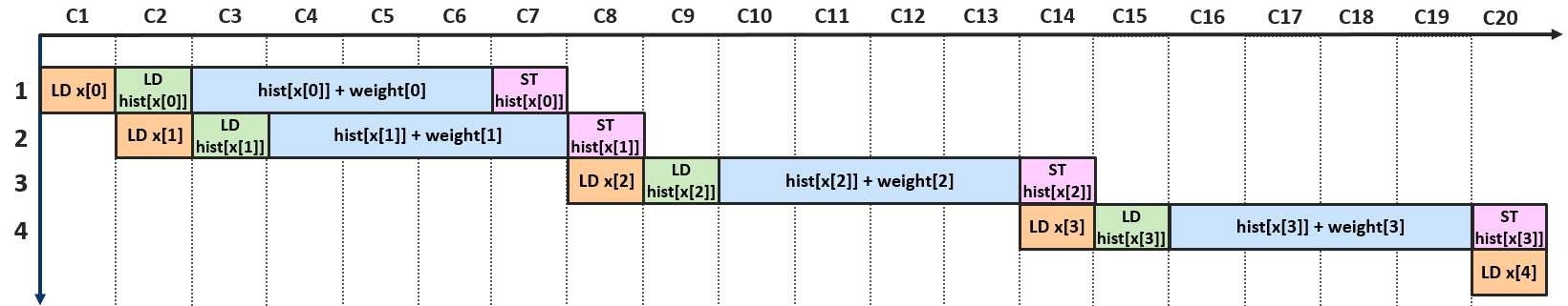
Adding Elastic Buffers
  Backpressure from slow paths prevents pipelining

Slide 36
Increasing Throughput
Start: i=0
Mg
Buff
Fork
1
LD x[i]
+
Fork
LD weight[i]
Fork
N
LD hist[x[i]]
<
+
Br
ST hist[x[i]]
Exit: i=N

Slide 37
Increasing Throughput
Start: i=0
Mg
Buff
Fork
1
  Insert FIFOs into slower paths
LD x[i]
FIFO
+
Fork
LD weight[i]
Fork
N
FIFO
LD hist[x[i]]
<
+
Br
ST hist[x[i]]
Exit: i=N

Slide 38
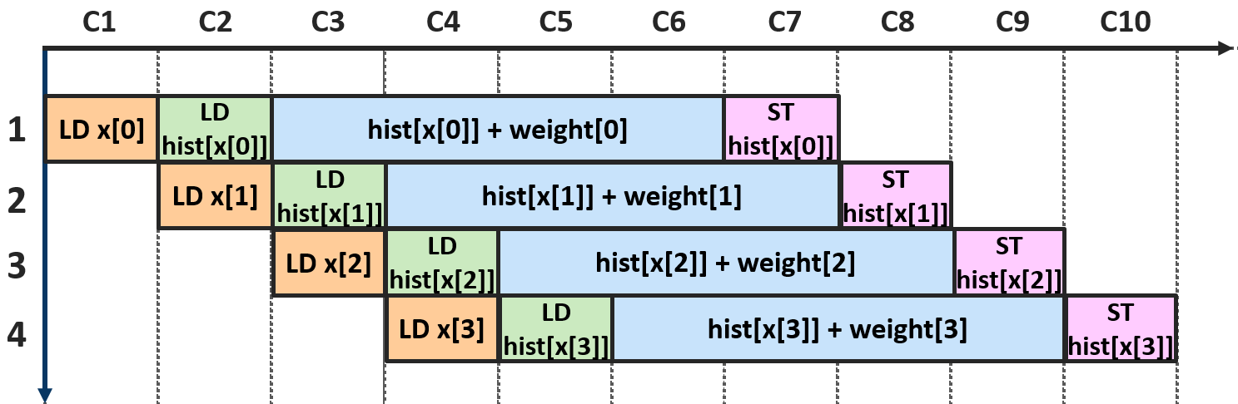
Increasing Throughput
Start: i=0
Mg
Buff
Fork
1
LD x[i]
FIFO
+
Fork
LD weight[i]
Fork
N
FIFO
LD hist[x[i]]
<
+
Br
ST hist[x[i]]
Exit: i=N

Slide 39
Increasing Throughput
  Sending multiple values to the next BB
x
i
y
Join
Branch
Huang et al. Elastic CGRAs. FPGA ‘13.

Slide 40
Increasing Throughput
  Sending multiple values to the next BB
x
i
y
Join
Branch
  Pipelining only with modulo scheduling
Huang et al. Elastic CGRAs. FPGA ‘13.

Slide 41
Increasing Throughput
  Sending multiple values to the next BB
x
i
x
y
i
y
Join
Fork
Branch
Branch
Branch
Branch
  Pipelining only with modulo scheduling

Slide 42
Increasing Throughput
  Sending multiple values to the next BB
x
i
x
y
i
y
Join
Fork
Branch
Branch
Branch
Branch
  Pipelining only with modulo scheduling
  Pipelining without modulo scheduling

Slide 43
Increasing Throughput
Start: i=0
Mg
Buff
Fork
1
LD x[i]
FIFO
+
Fork
LD weight[i]
Fork
N
FIFO
LD hist[x[i]]
<
+
Br
ST hist[x[i]]
Exit: i=N

Slide 44
Increasing Throughput
Start: i=0
Mg
Buff
Fork
1
LD x[i]
FIFO
+
Fork
LD weight[i]
Fork
N
RAW dependency
not honored!
FIFO
LD hist[x[i]]
<
+
  What about memory?
Br
ST hist[x[i]]
Exit: i=N

Slide 45
Connecting to Memory
  Load-store queue (LSQ)
    Needs information on the original program order of the memory accesses¹
    Send tokens to the LSQ in order of basic block execution
¹ Josipović et al. An out-of-order load-store queue for spatial computing. CASES ‘17.

Slide 46
Connecting to Memory
  Load-store queue (LSQ)
    Needs information on the original program order of the memory accesses¹
    Send tokens to the LSQ in order of basic block execution
  BB1 is starting
BB1: LD, ST
  LSQ
LD x
LD weight
LD hist
ST hist
  Memory
¹ Josipović et al. An out-of-order load-store queue for spatial computing. CASES ‘17.

Slide 47
Connecting to Memory
  Load-store queue (LSQ)
    Needs information on the original program order of the memory accesses¹
    Send tokens to the LSQ in order of basic block execution
  BB1 is starting
BB1: LD, ST
  LSQ
LD x
LD weight
LD hist
ST hist
LD hist
ST hist
  Memory
¹ Josipović et al. An out-of-order load-store queue for spatial computing. CASES ‘17.

Slide 48
Connecting to Memory
  Load-store queue (LSQ)
    Needs information on the original program order of the memory accesses¹
    Send tokens to the LSQ in order of basic block execution
  BB1 is starting
BB1: LD, ST
  LSQ
LD x
LD weight
LD hist
ST hist
LD hist
ST hist
LD hist
  Memory
ST hist
¹ Josipović et al. An out-of-order load-store queue for spatial computing. CASES ‘17.

Slide 49
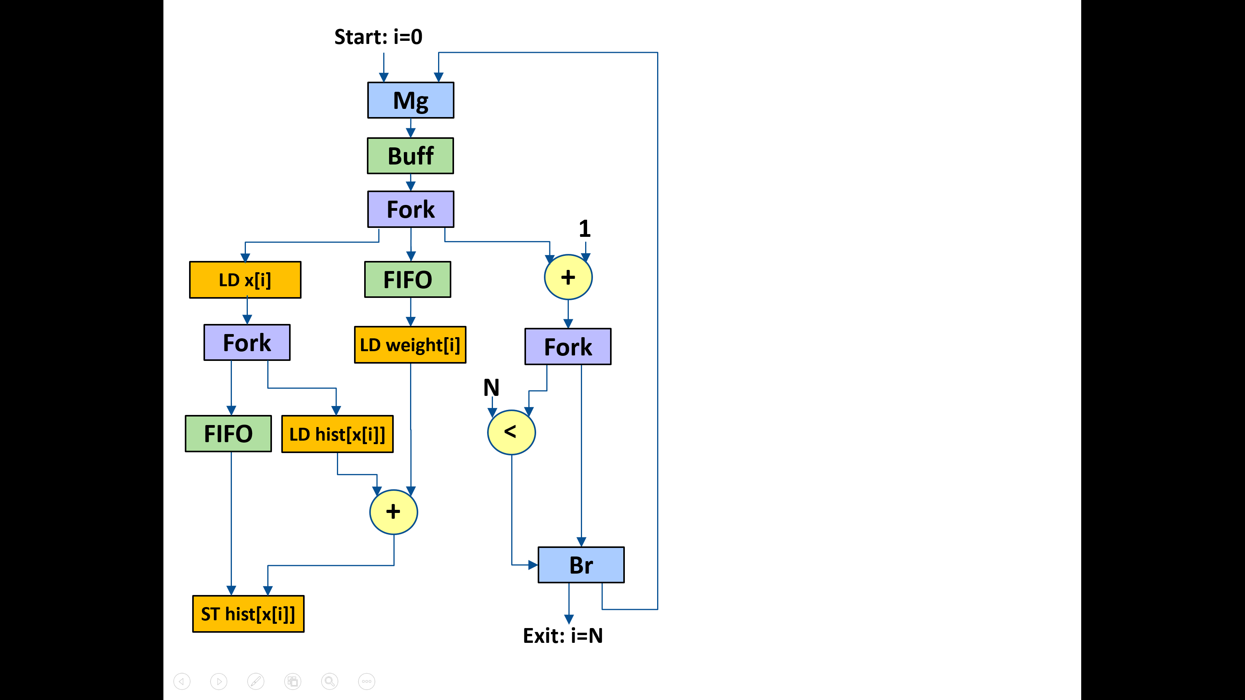
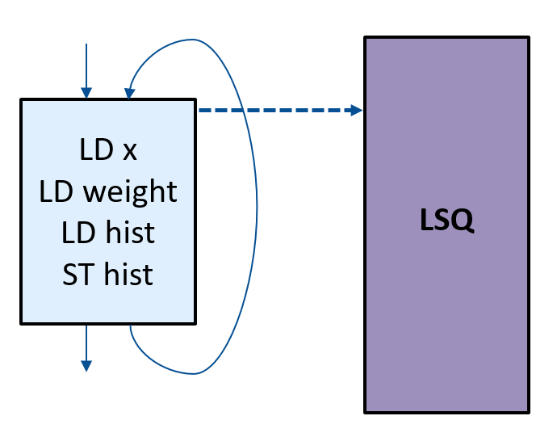
Connecting to Memory
Dynamically scheduled circuit

Slide 50
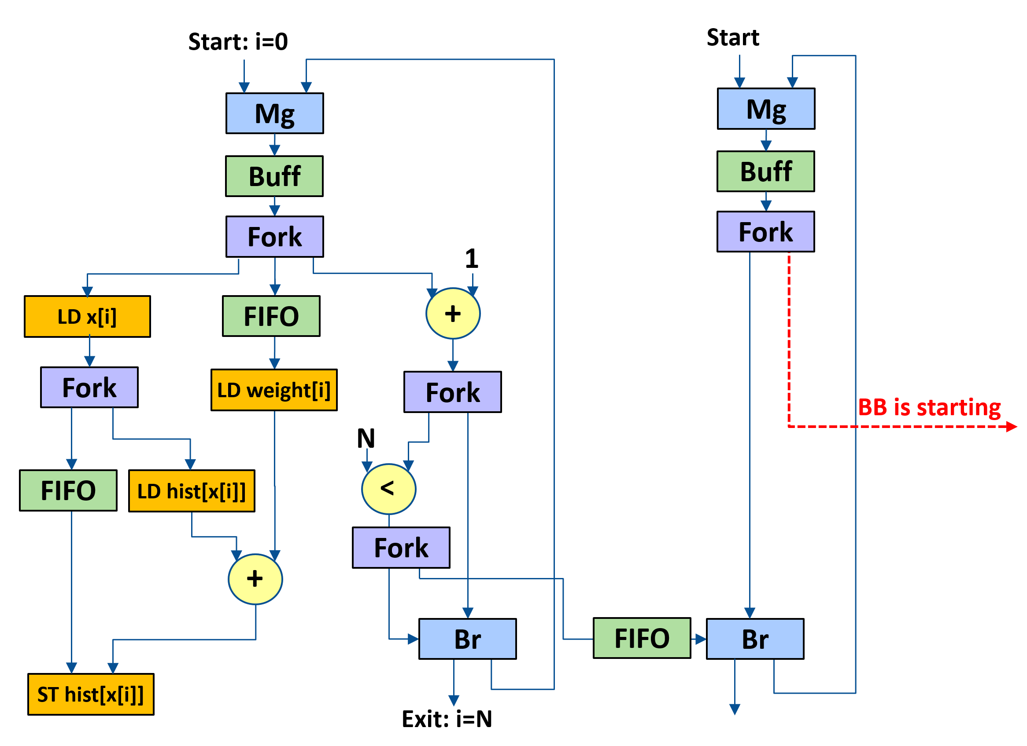
Connecting to Memory
Fork
Dynamically scheduled circuit
Interface to the LSQ

Slide 51
Connecting to Memory
Fork
Dynamically scheduled circuit
Interface to the LSQ

Slide 52
Outline
Introduction
Background: elastic circuits
Synthesizing elastic circuits
Evaluation
Conclusion

Slide 53
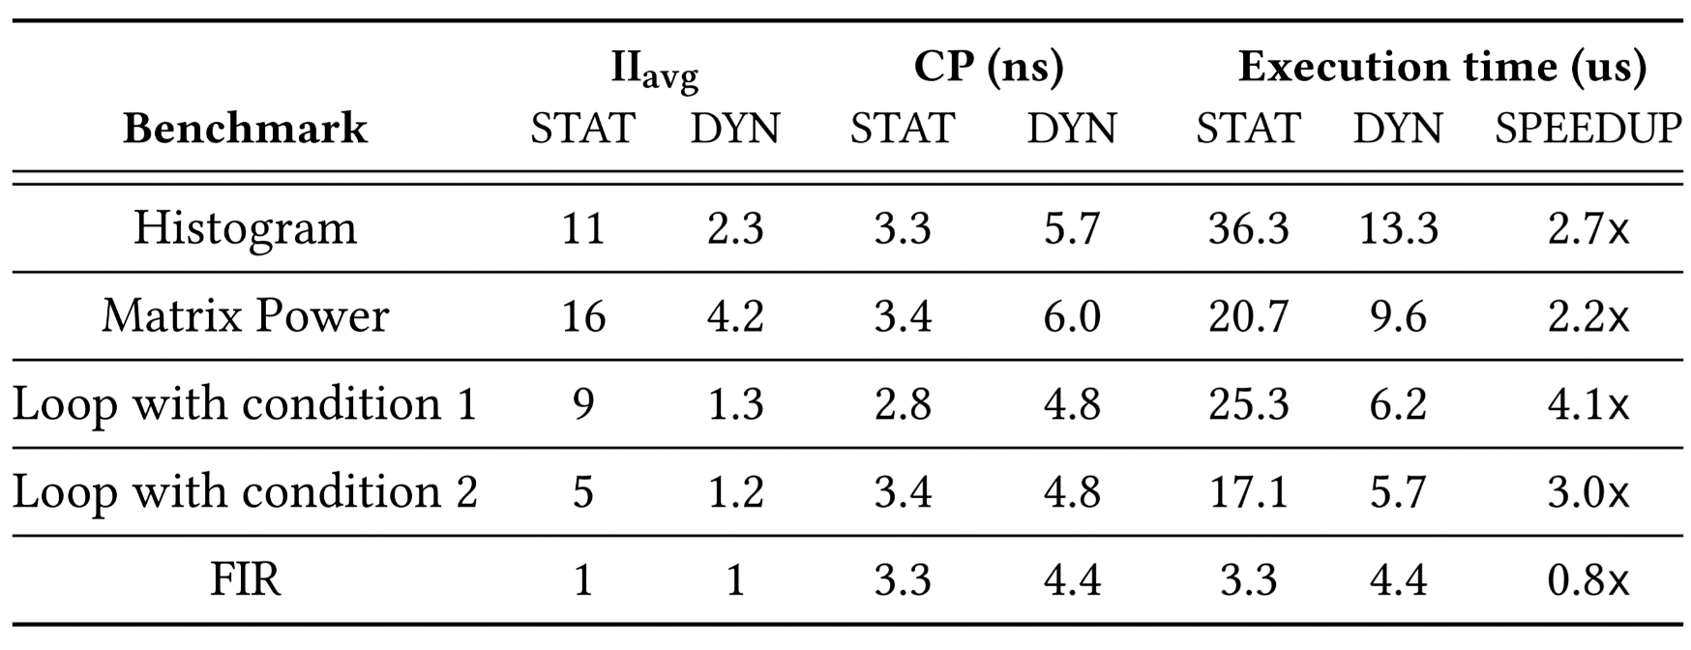
Results
  Elastic designs dynamically resolve memory and control dependencies and produce high-throughput pipelines

Slide 54
Results
  Elastic designs dynamically resolve memory and control dependencies and produce high-throughput pipelines

Slide 55
Results
  Elastic designs dynamically resolve memory and control dependencies and produce high-throughput pipelines

Slide 56
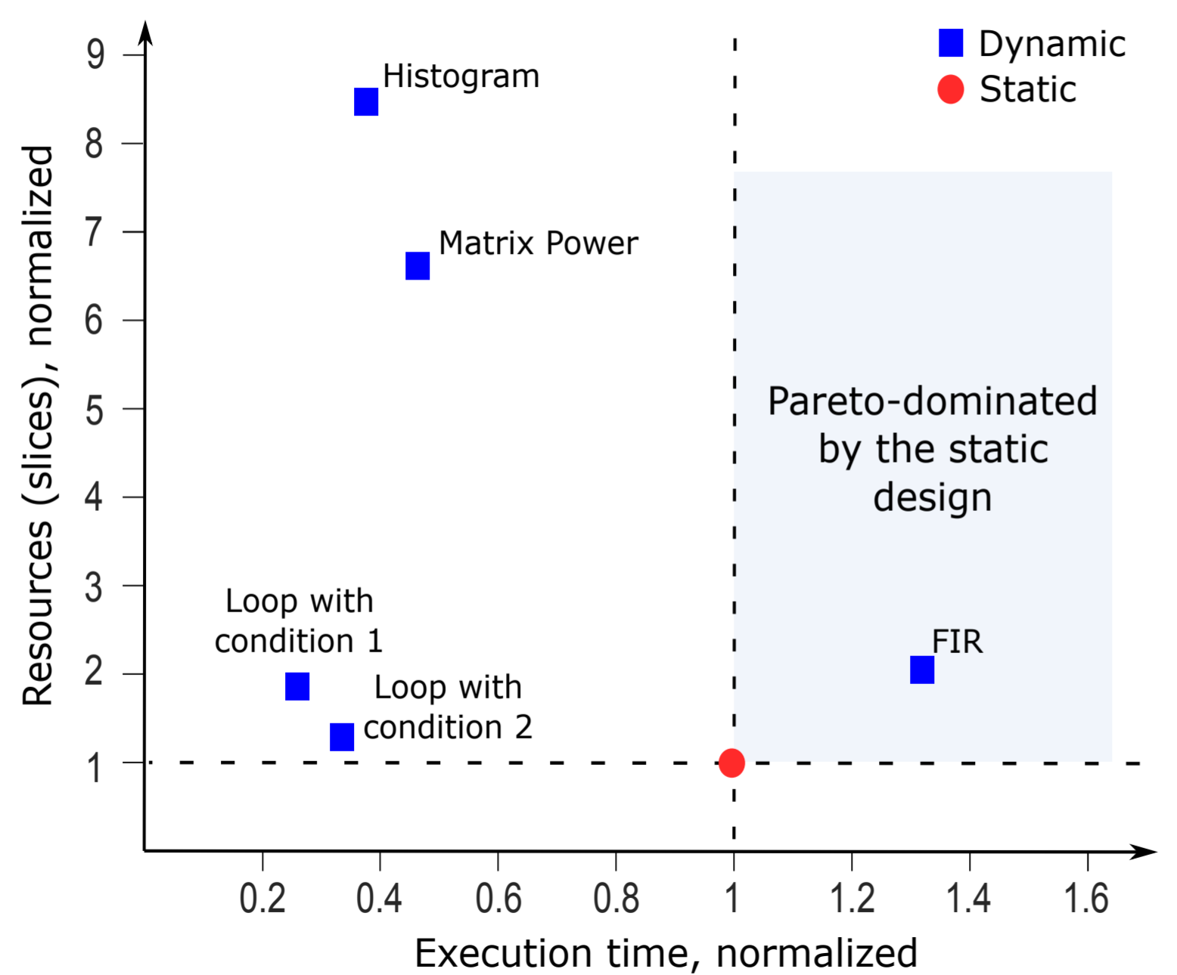
Results

Slide 57
Results
Dynamically scheduled HLS is valuable for emerging FPGA applications

Slide 58
Thank you!

