Slide 1
A Framework for Generating High Throughput CNN Implementations on FPGAs
Hanqing Zeng, Ren Chen, Chi Zhang and Viktor Prasanna
University of Southern California
fpga.usc.edu
Feb. 26, 2018
FPGA 18, Monterey, CA

Slide 2
Outline
Background & overview
Algorithmic optimizations
Hardware mapping methodology
Automatic design generation
Experimental results
Conclusion

Slide 3
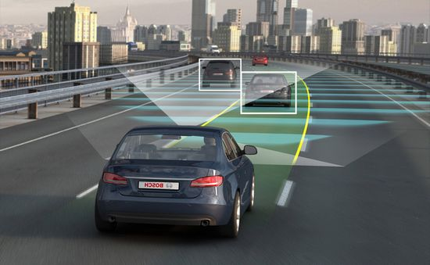
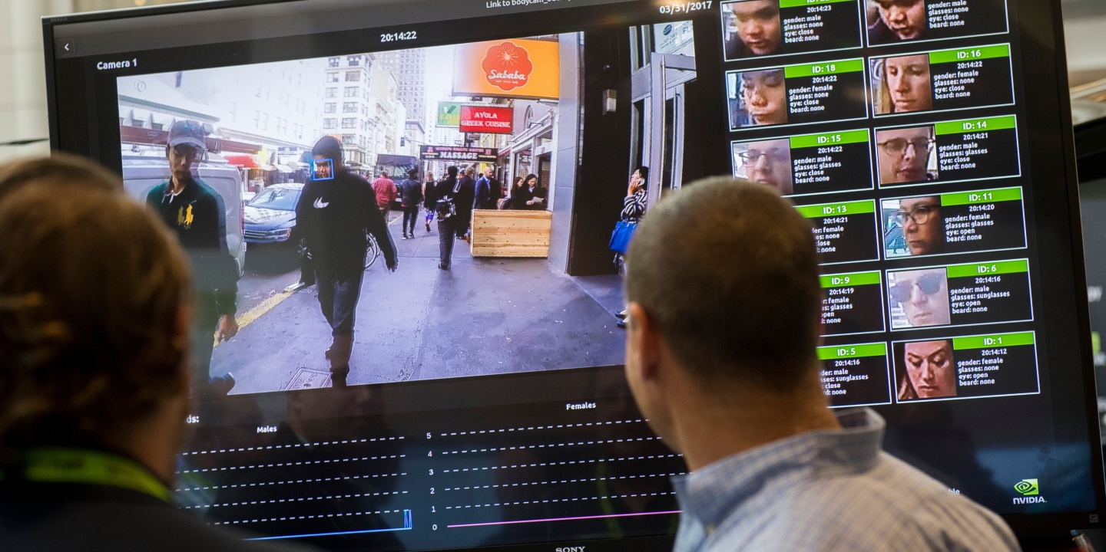

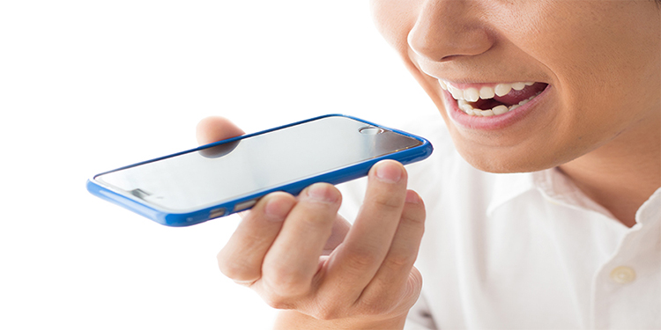
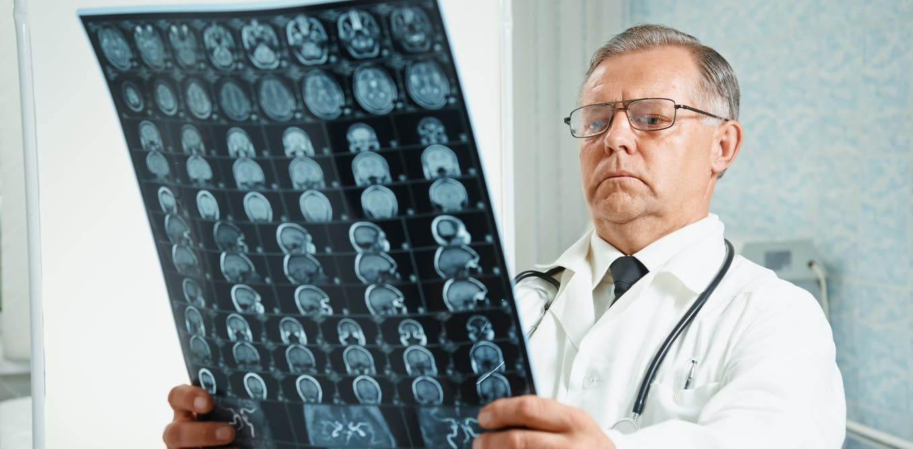
Convolutional Neural Networks
Latency driven workloads
Throughput driven workloads
Autonomous driving
Security & Surveillance
Natural language processing
Medical imaging diagnosis
Notes:
CNNs have been applied to many applications.
In some cases, for example, autonomous driving and NLP, you really expect the CNN to have real-time response. So these are latency driven workload.
In other cases, for example, CNNs are used to analyze huge volume of videos or images for security and medical diagnosis, then throughput is the key metric.
In this work, we focus on throughput optimization.

Slide 4
Framework Overview
Suggestions for optimizing next generation DL chips
Throughput-optimized accelerator
Target FPGA specification
Hardware Mapping
Auto Design Generation
CNN model parameters
Algorithmic Optimization
Data layout
Input
Shape of 2D images
Output
Notes:
First of all, the framework has an algo module. It takes as input CNN model params and shape of 2D input images, and generates a data layout which can be very efficiently processed by hardware accelerators.
Then the Hardware mapping module needs to know about the spec of the target FPGA, in order to generate the throughput optimized accelerator. Notice that hardware mapping does not depend on the CNN parameters. In fact, the mapping module will provide feedback to the algorithmic optimization modules so that the data layout can best fit the FPGA.
Lastly, the mapping module from the high level can provide suggestions for designing next generation DL chips.

Slide 5
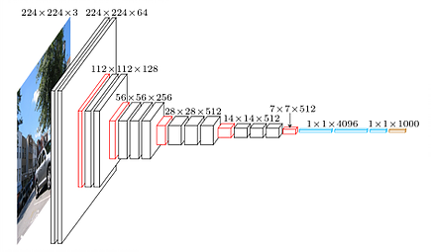
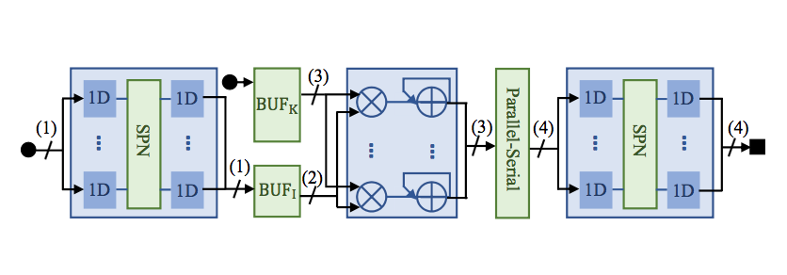
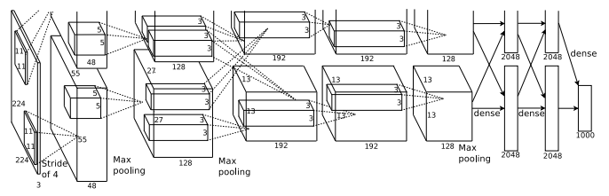
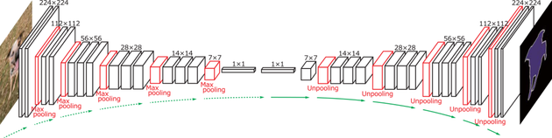
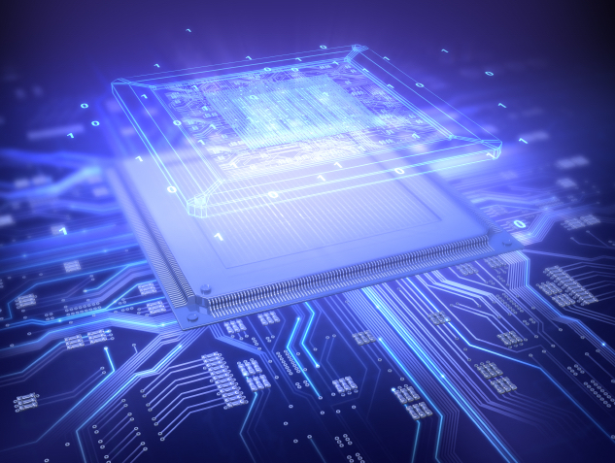


Various CNN Models
AlexNet
VGG16
Generic high throughput accelerator
No need to reconfigure for a specific CNN
Accelerator design
FCN-16s
...
Framework
Various image sizes
Segmentation
Corresponding data layout
Target FPGA
...
Classification
...
Notes:
Let’s see a more concrete example.
Suppose we want to use a fixed FPGA to accel many different kinds of CNNs. The framework synthesize an accelerator design onto the device.
After that, the application specific CNNs come into picture. These can be drastically different networks. The input image data also come. They can be small images, or large images.
However, the hardware is already configured. Then how do we optimize a specific workload? The framework will adjust the data layout to be fed to hardware so that high throughput can always be sustained.
In summary, the accelerator is generic.

Slide 6





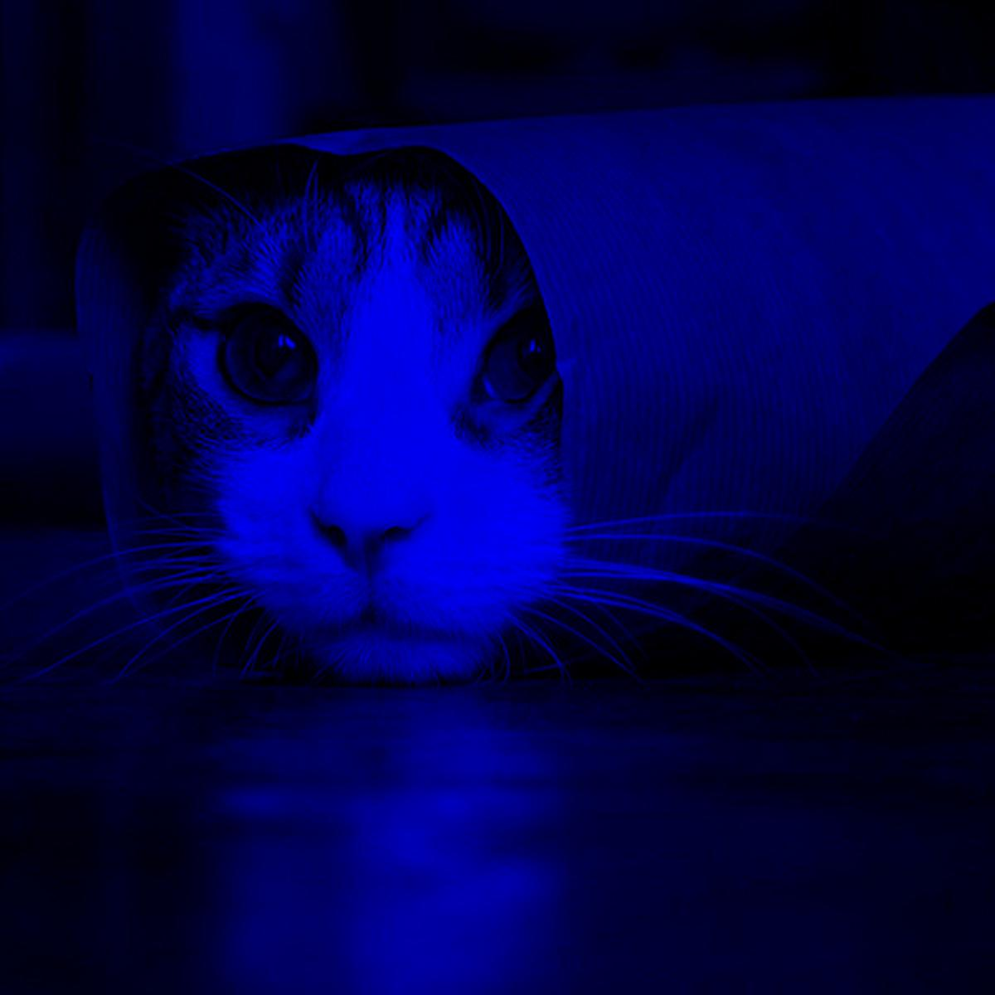




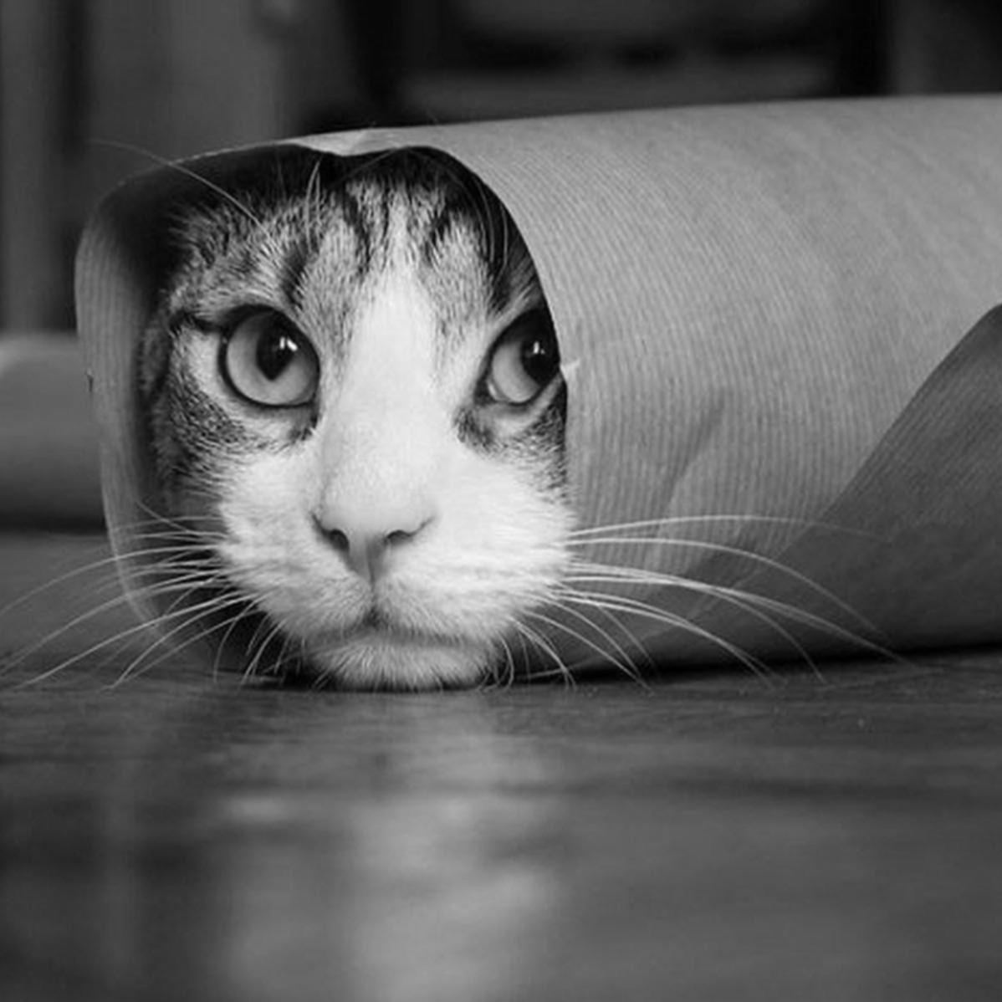
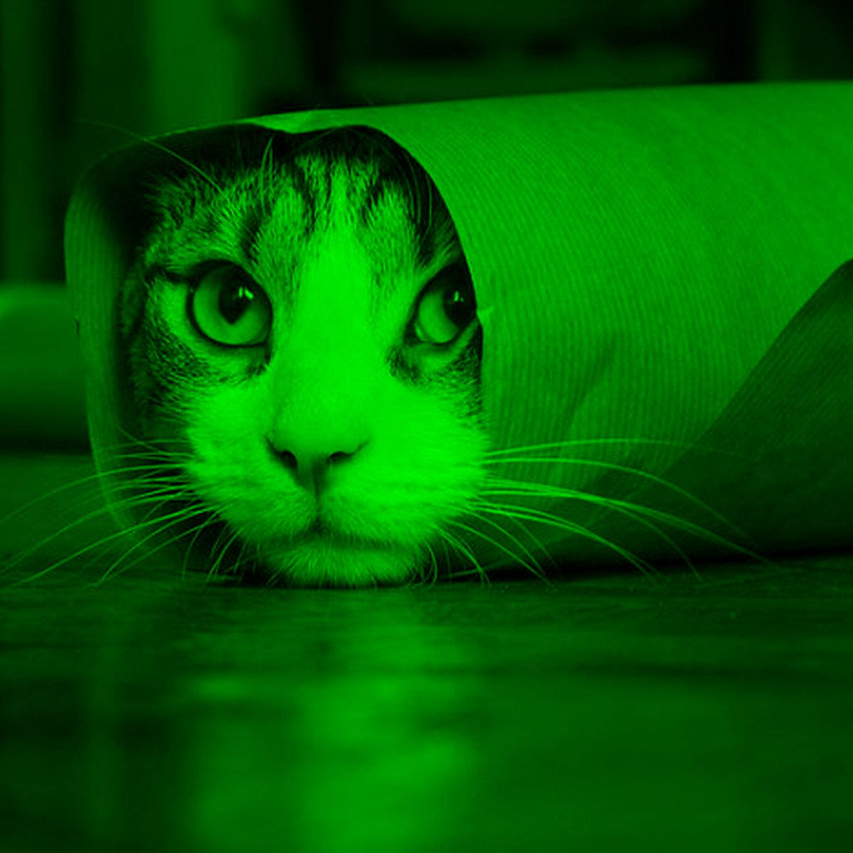



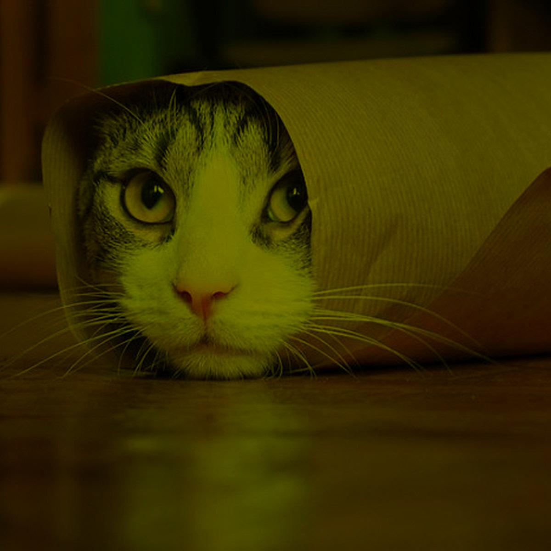
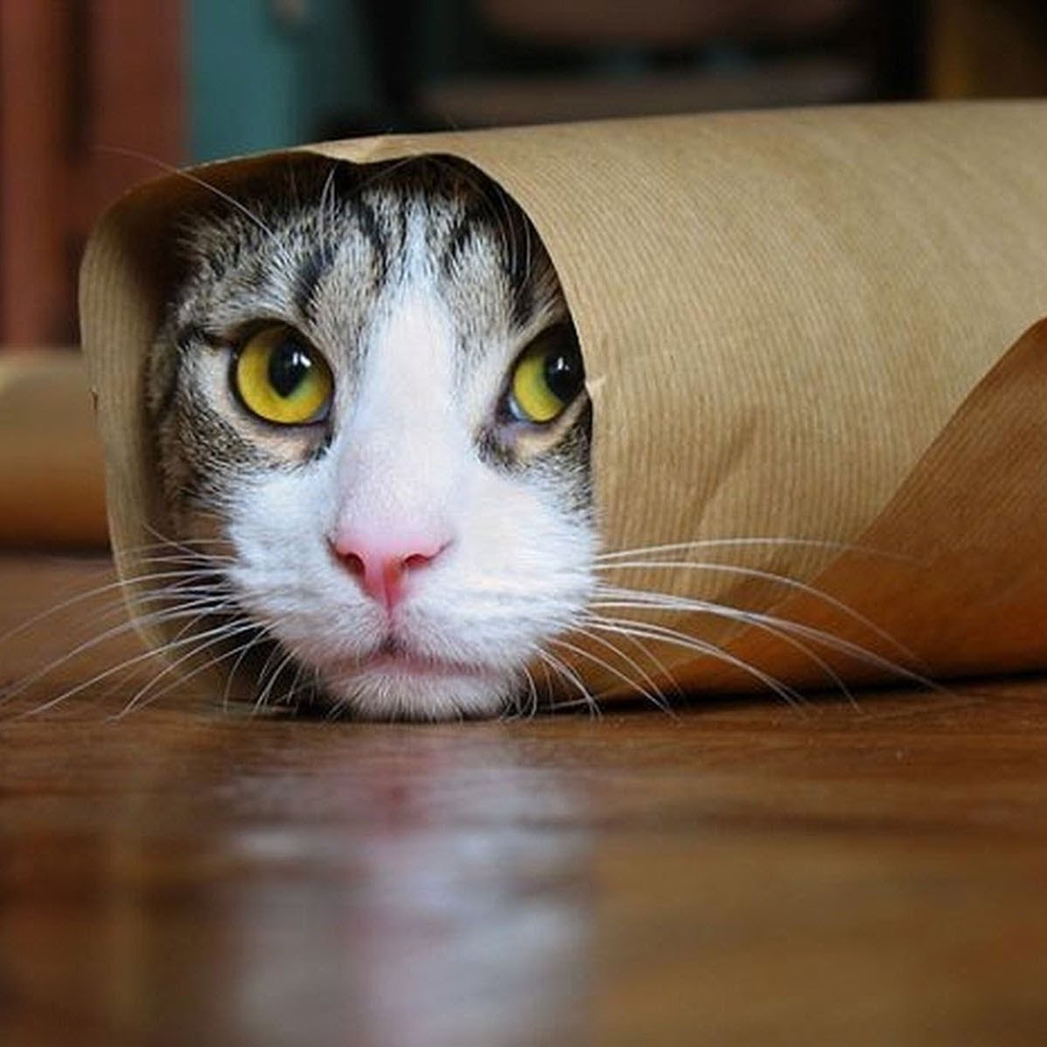


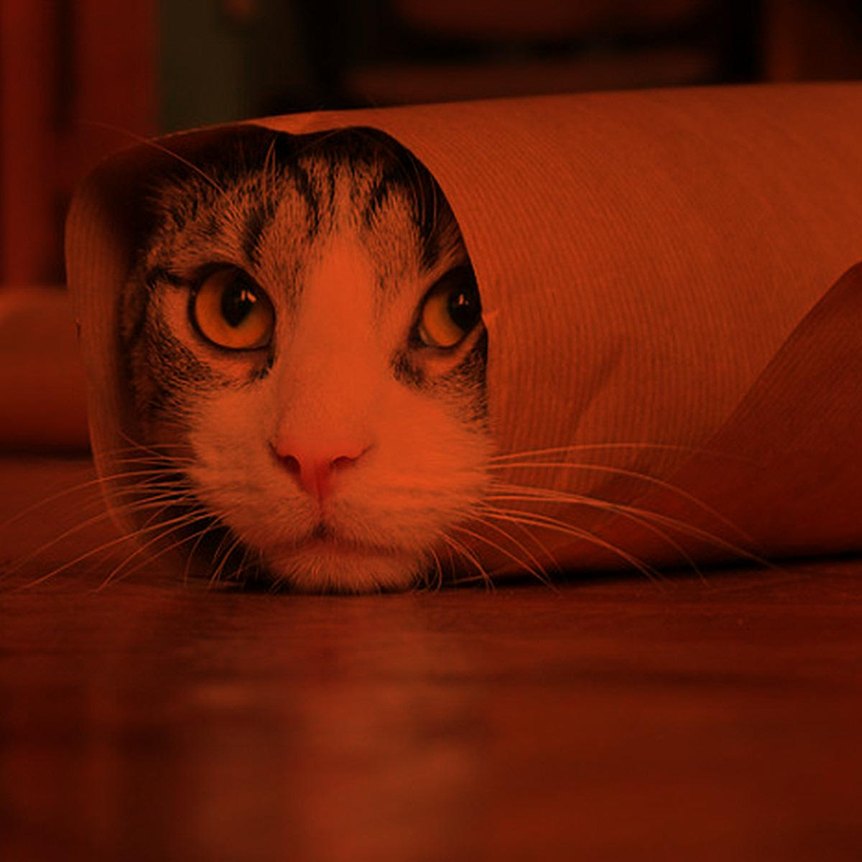
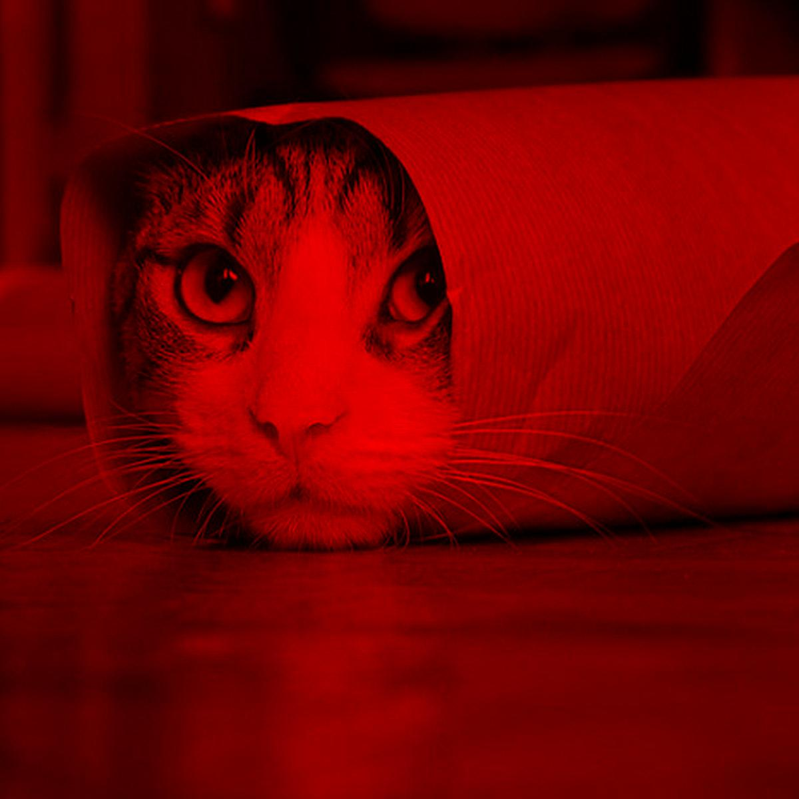




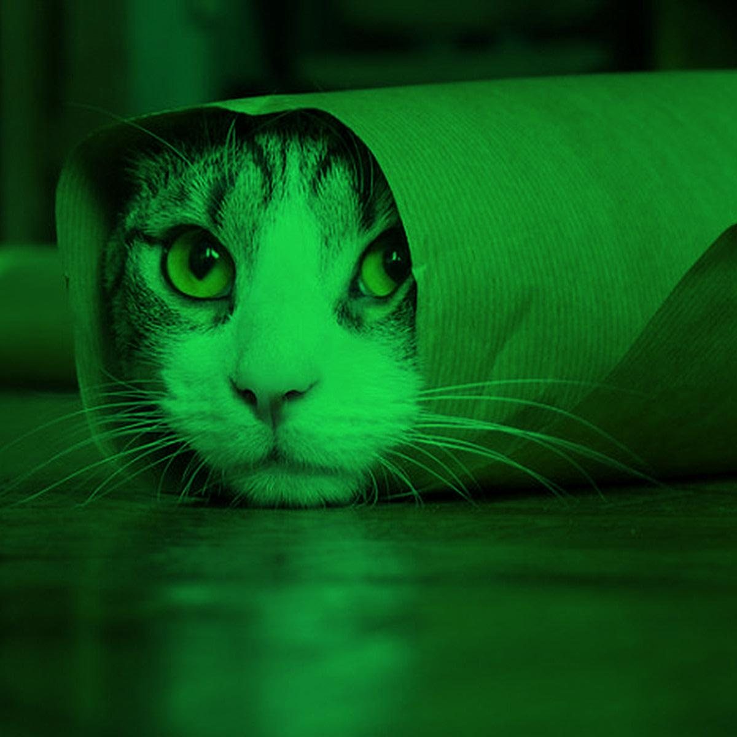
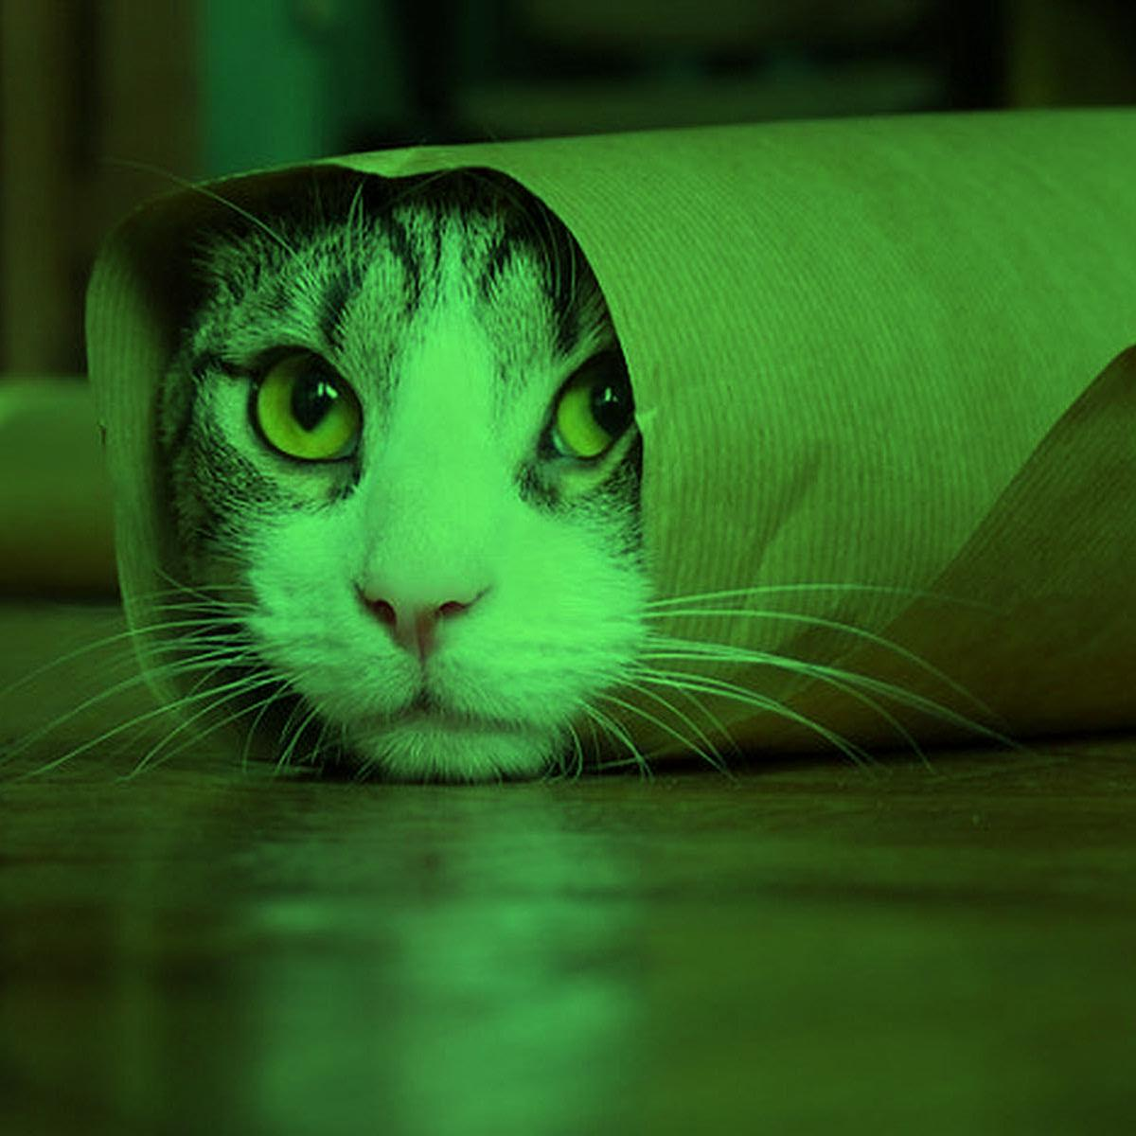


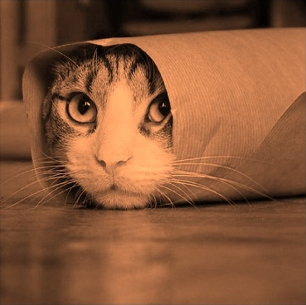
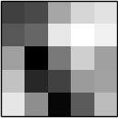

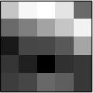

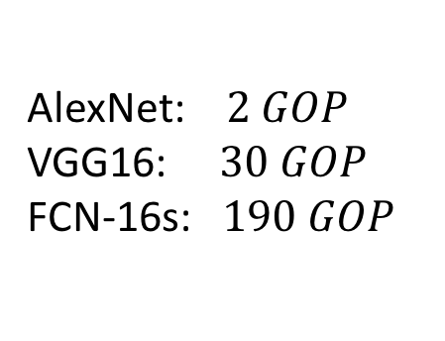
Challenges in Designing a Generic Accelerator
Computation complexity
Variation in CNN model parameters
Variation in input image sizes
Image size
AlexNet: $2 GOP$
VGG16: $30 GOP$
FCN-16s: $190 GOP$
Input channels
Output channels
Input
Output
Output
Input
Kernel filters
Output
Input
Kernel filters
Kernel window size
Kernel filters
Notes:
3.5 min

Slide 7
Outline
Background & overview
Algorithmic optimizations
Hardware mapping methodology
Automatic code generation
Experimental results
Conclusion

Slide 8
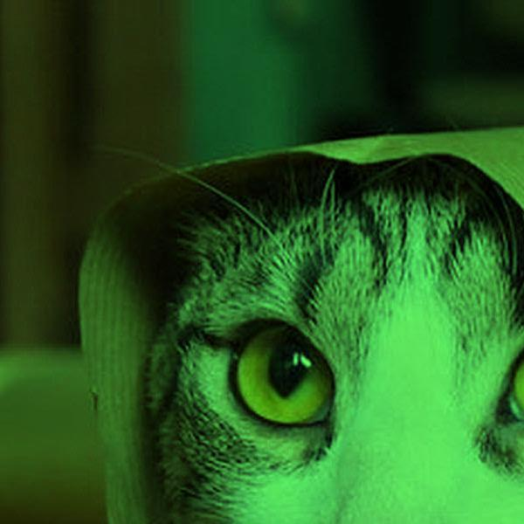
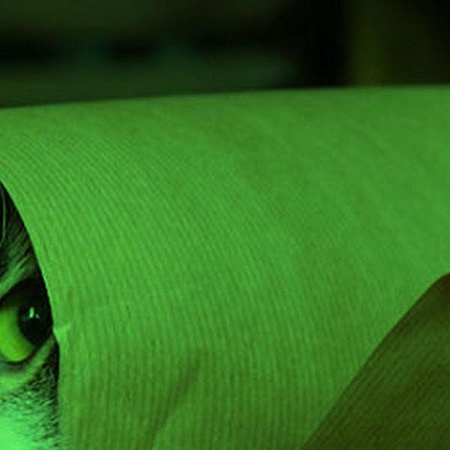
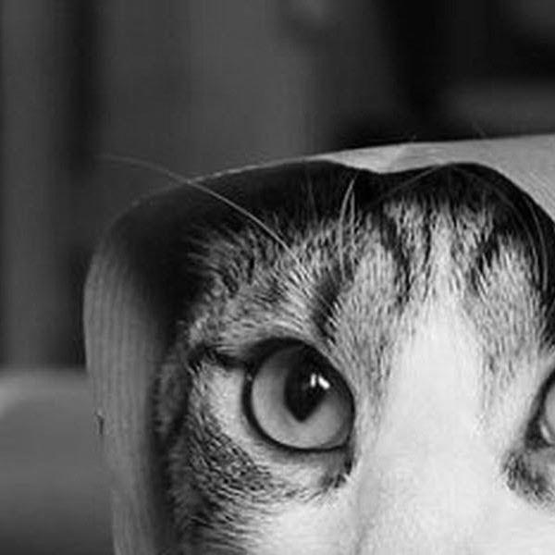

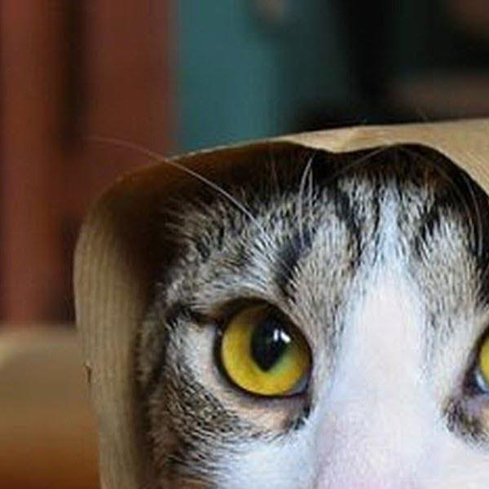


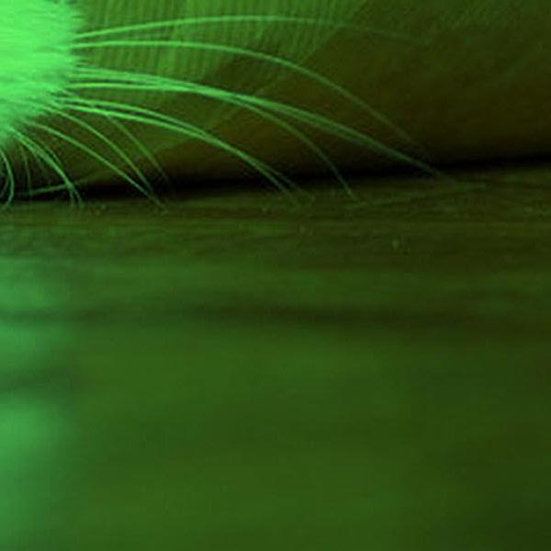

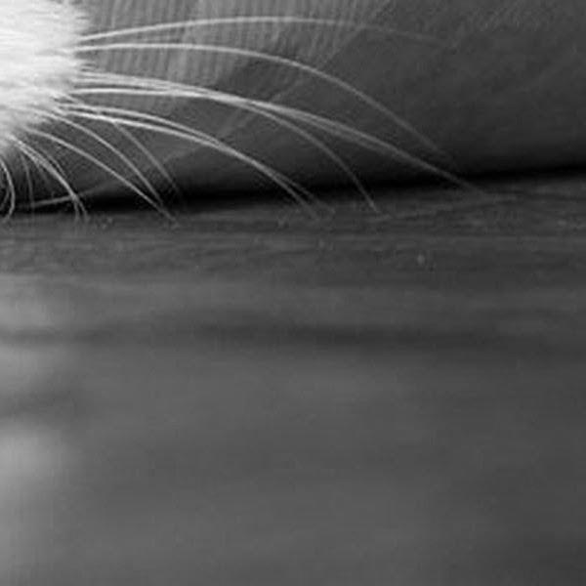

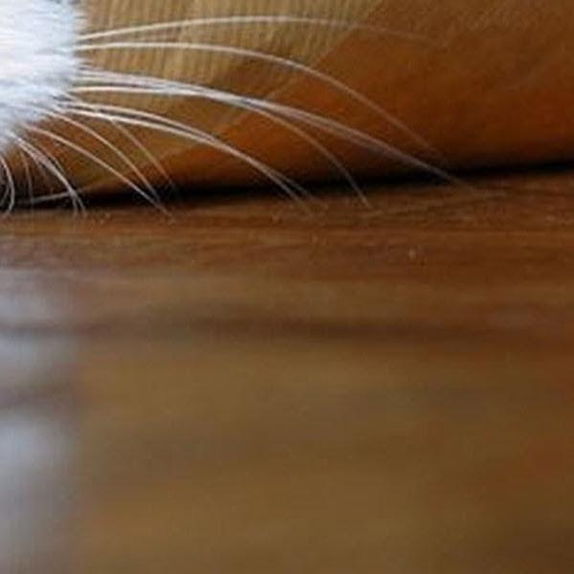


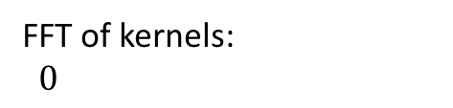
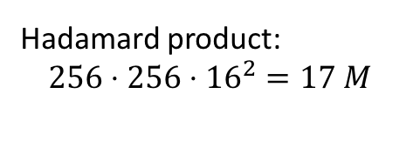

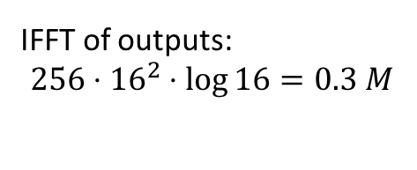

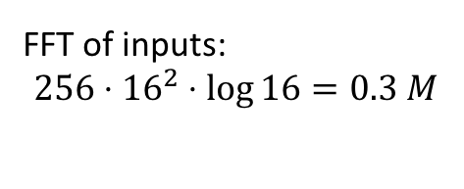
Frequency Domain Convolution with Overlap-and-Add
FFT of inputs:
$$256⋅{16}^{2}⋅\log{16}=0.3 M$$
FFT of kernels:
$0$
$$ℱ$$
Hadamard product:
$$256⋅256⋅{16}^{2}=17 M$$
IFFT of outputs:
$$256⋅{16}^{2}⋅\log{16}=0.3 M$$
$$ℱ$$
$$ℱ$$
Notes:
Our framework is based on frequency domain convolution. Let’s first review how to perform frequency domain convolution with a known technique called overlap-and-add.
The motivation of overlap-add is that we want to use a fixed size FFT architecture in hardware to handle images of various sizes. How do we do it?
We first partition the images based on the FFT size. Then we do some paddings and send the images to frequency domain, by Fourier transform. As an example, suppose we have 256 input channels, and our FFT size is 16 point, then the number of operations required here is 0.3 million.
Of course, we also need to send the kernel filters to frequency domain. Notice that we don’t need to perform any operations in this step, since kernels are fixed during inferencing, and we can pre-store the frequency domain representation of kernel filters.
Next step is that we take kernels and images and perform hadamard product on them. Hadamard product is basically elementwise multiplication. we require 17 M operations in our example.
Finally, we take the matrices back to time domain, and combine the partitions into a complete image. When combining the images, the partitions need certain amounts of overlap. That’s why we call this technique Overlap-and-Add.

Slide 9

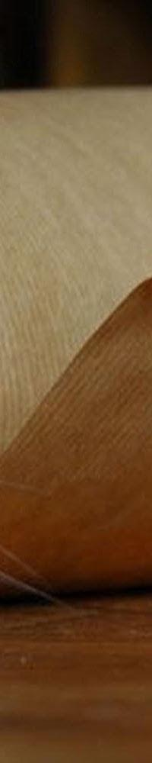
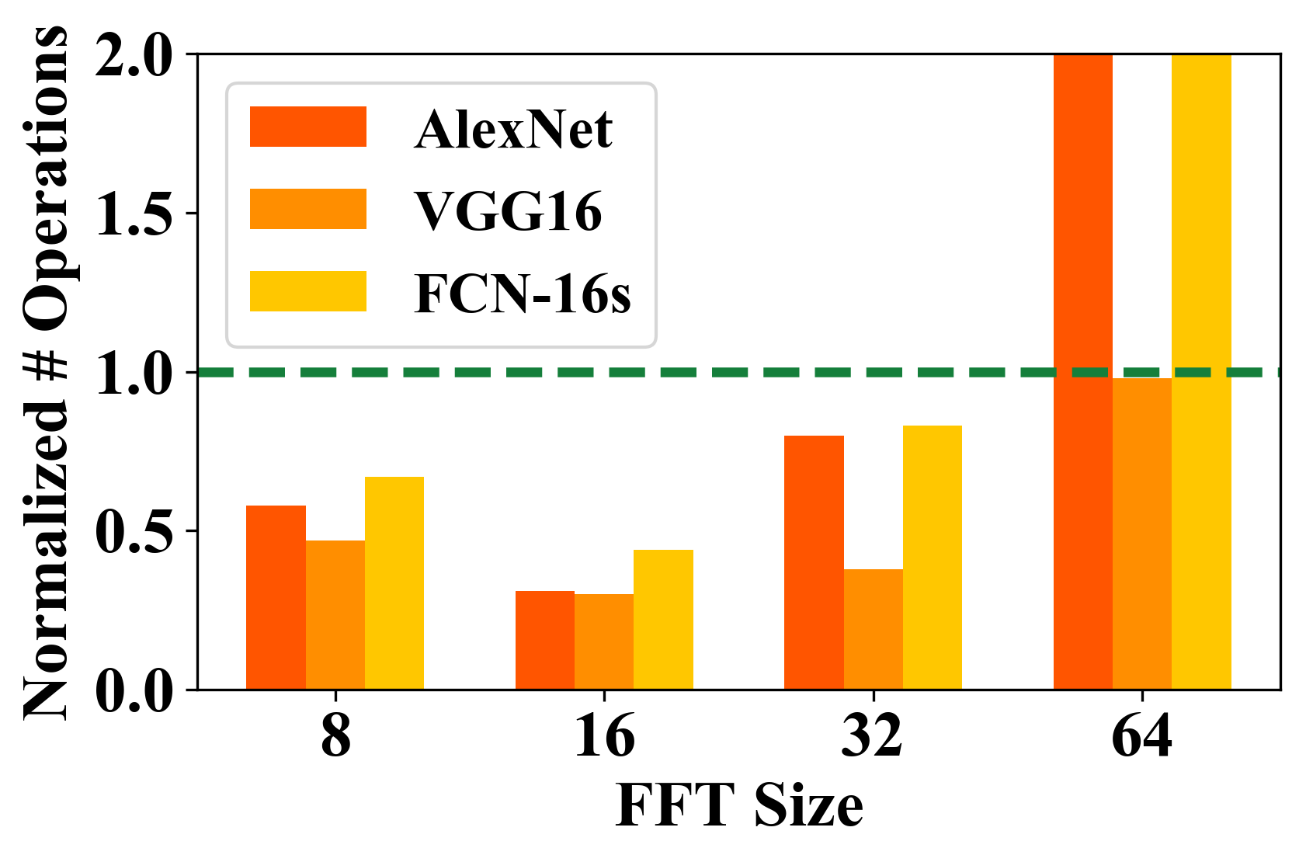


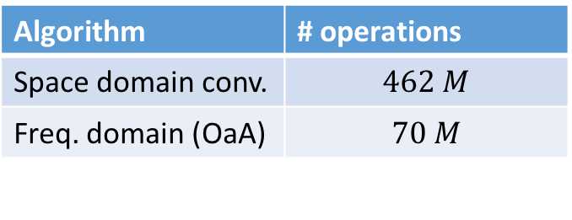
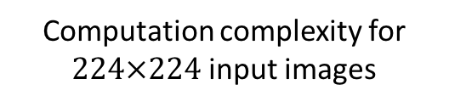
Limitation of Overlap-and-Add (OaA)
☑ Computation complexity
☑ Variation in kernel window size
✘ Variation in image sizes
✘ Flexibility in hardware design
Algorithm | # operations
Space domain conv. | $$462 M$$
Freq. domain (OaA) | $$70 M$$
Computation complexity for $224×224$ input images
e
Wasted computation on padding!
Space Conv.
Notes:
This known technique seems very good.
Because of frequency domain convolution, we save a lot of computation compared with space domain convolution. And OaA can be applied to kernels of various sizes as long as the FFT size is larger than the kernel size.
But OaA is not very robust when dealing with images of various sizes.
For example, here we have a l

Slide 10
Optimization 1: Concatenate-and-Pad
☑ Variation in image sizes
☑ Flexibility in hardware design
e
e
e
e
e
Reducing wasted computation of OaA
e
e
e
e

Slide 11
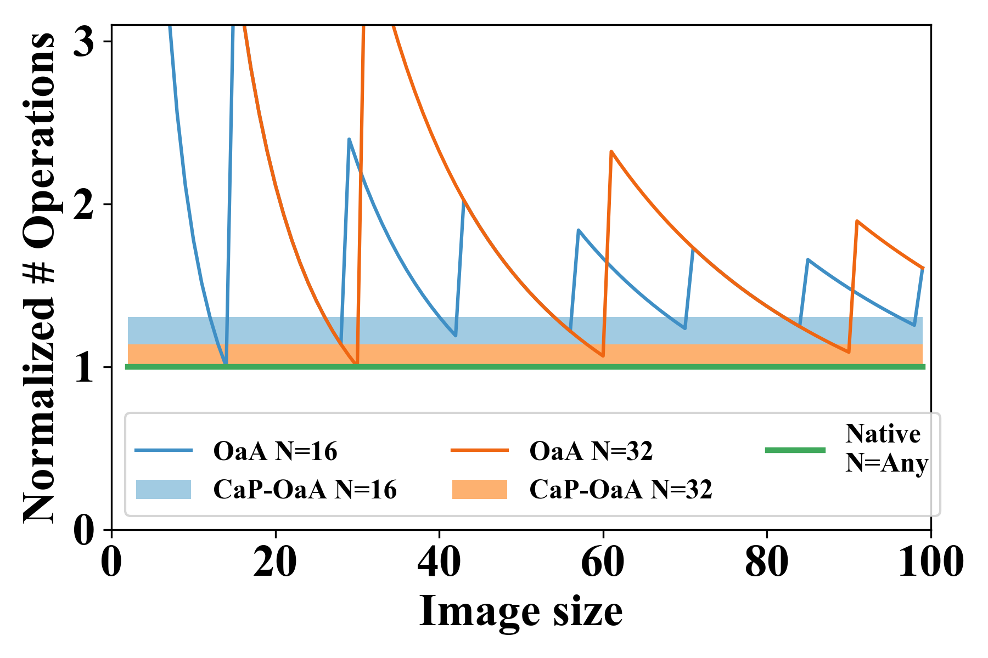
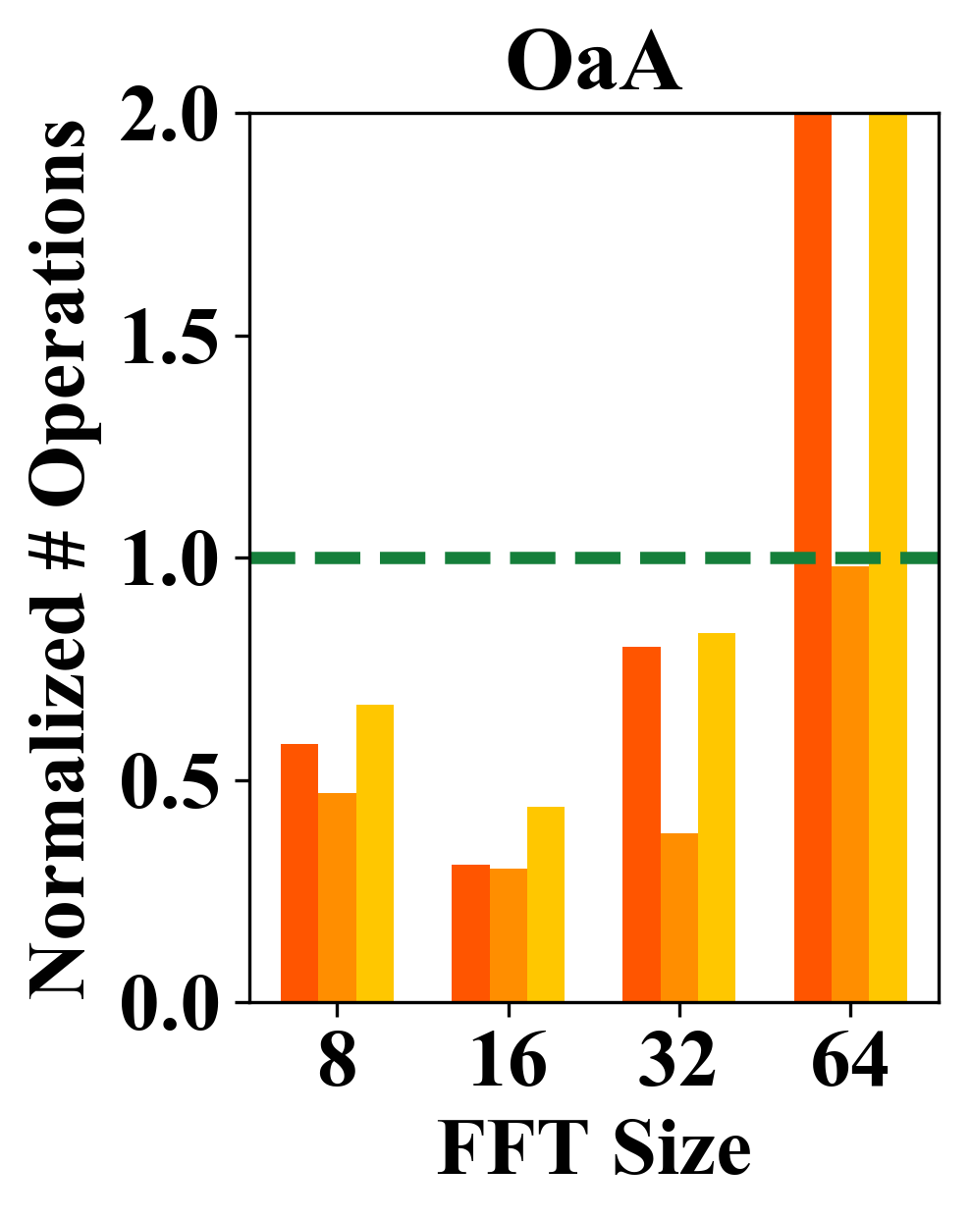
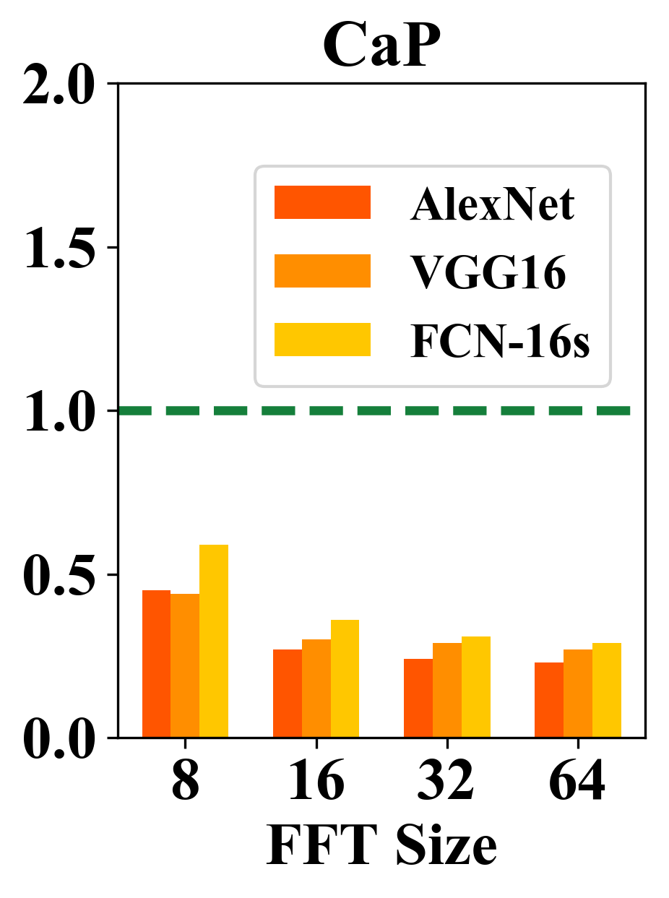
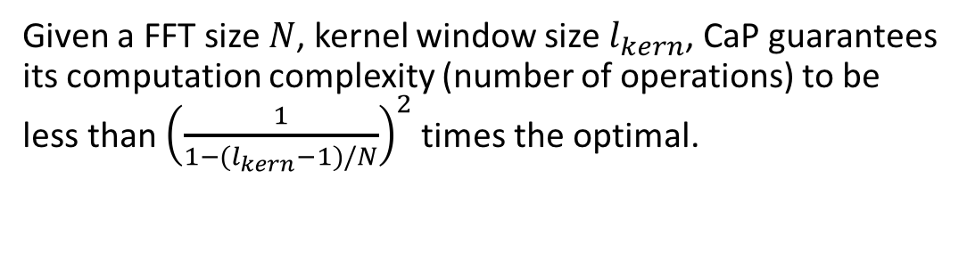
Computation Complexity of CaP
30%
14%
Given a FFT size $N$, kernel window size $l_{kern}$, CaP guarantees its computation complexity (number of operations) to be less than ${\left(\frac{1}{1−(l_{kern}−1)/N}\right)}^{2}$ times the optimal.

Slide 12
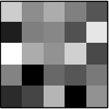
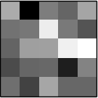
Optimization 2: Freq. Domain Loop Tiling
☑ Variation in number of input channels
☑ Variation in number of output channels
Data reuse scheme in batch inferencing
  Kernel oriented
Loop tiling on kernels
  Partition the input/output channels
  Kernel tiles fits on-chip memory

Slide 13
Summary of Algorithmic Optimizations
CNN model parameters
Shape of 2D images
Freq. domain convolution
☑ Comp. complexity
Overlap-and-Add
☑ Various kernel window sizes
Concatenate-and-Pad
☑ Various input image sizes
Freq. domain loop tiling
☑ Various input channels
☑ Various output channels
Concatenate-and-Pad
Frequency domain loop tiling
FFT size based on hardware spec?
Overlap-and-Add
Data layout for frequency domain convolution

Slide 14
Outline
Background & overview
Algorithmic optimizations
Hardware mapping methodology
Automatic design generation
Experimental results
Conclusion

Slide 15
Hardware Mapping Overview
Suggestion to next generation DL chips
Optimal generic accelerator:
Communication capacity?
Computation capacity?
FPGA spec.
Hardware Mapping
Throughput-optimized accelerator
Auto Design Generation
Define optimal data layout:
Partition images (FFT size)?
Partition kernels (tiling size)?
CNN model
Algorithmic Optimization
Data layout
Suggestions for optimizing next gen DL chip:
How much DSP?
How large on-chip buffer?
How fast external BW?
Shape of 2D images

Slide 16


Accelerator Architecture
From external memory
To external memory
1D
1D
Parallel-Serial
1D
1D
…
SPN
…
…
SPN
…
…
…
1D
1D
1D
1D
2D FFT
MAC array
2D IFFT
 | Communication |  | Computation
 | External mem traffic | On-chip data reuse | Complexity | DSP consumption
FFT size ↑ | ↑ | ↓ | ↓ | ↓
FFT size ↓ | ↓ | ↑ | ↑ | ↑

Slide 17




Device Coefficient
Categorize the target FPGA by
  DSP resources $L$
  On-chip memory size $M$
  External memory bandwidth $B$
High level abstraction
Device coefficient
  $K=B∙M^{\frac{1}{2}}∙L^{−1}$
  Balance communication & computation
FPGA
$$L$$
$$M$$
$$B$$
DRAM
Notes:
For CNN workloads

Slide 18
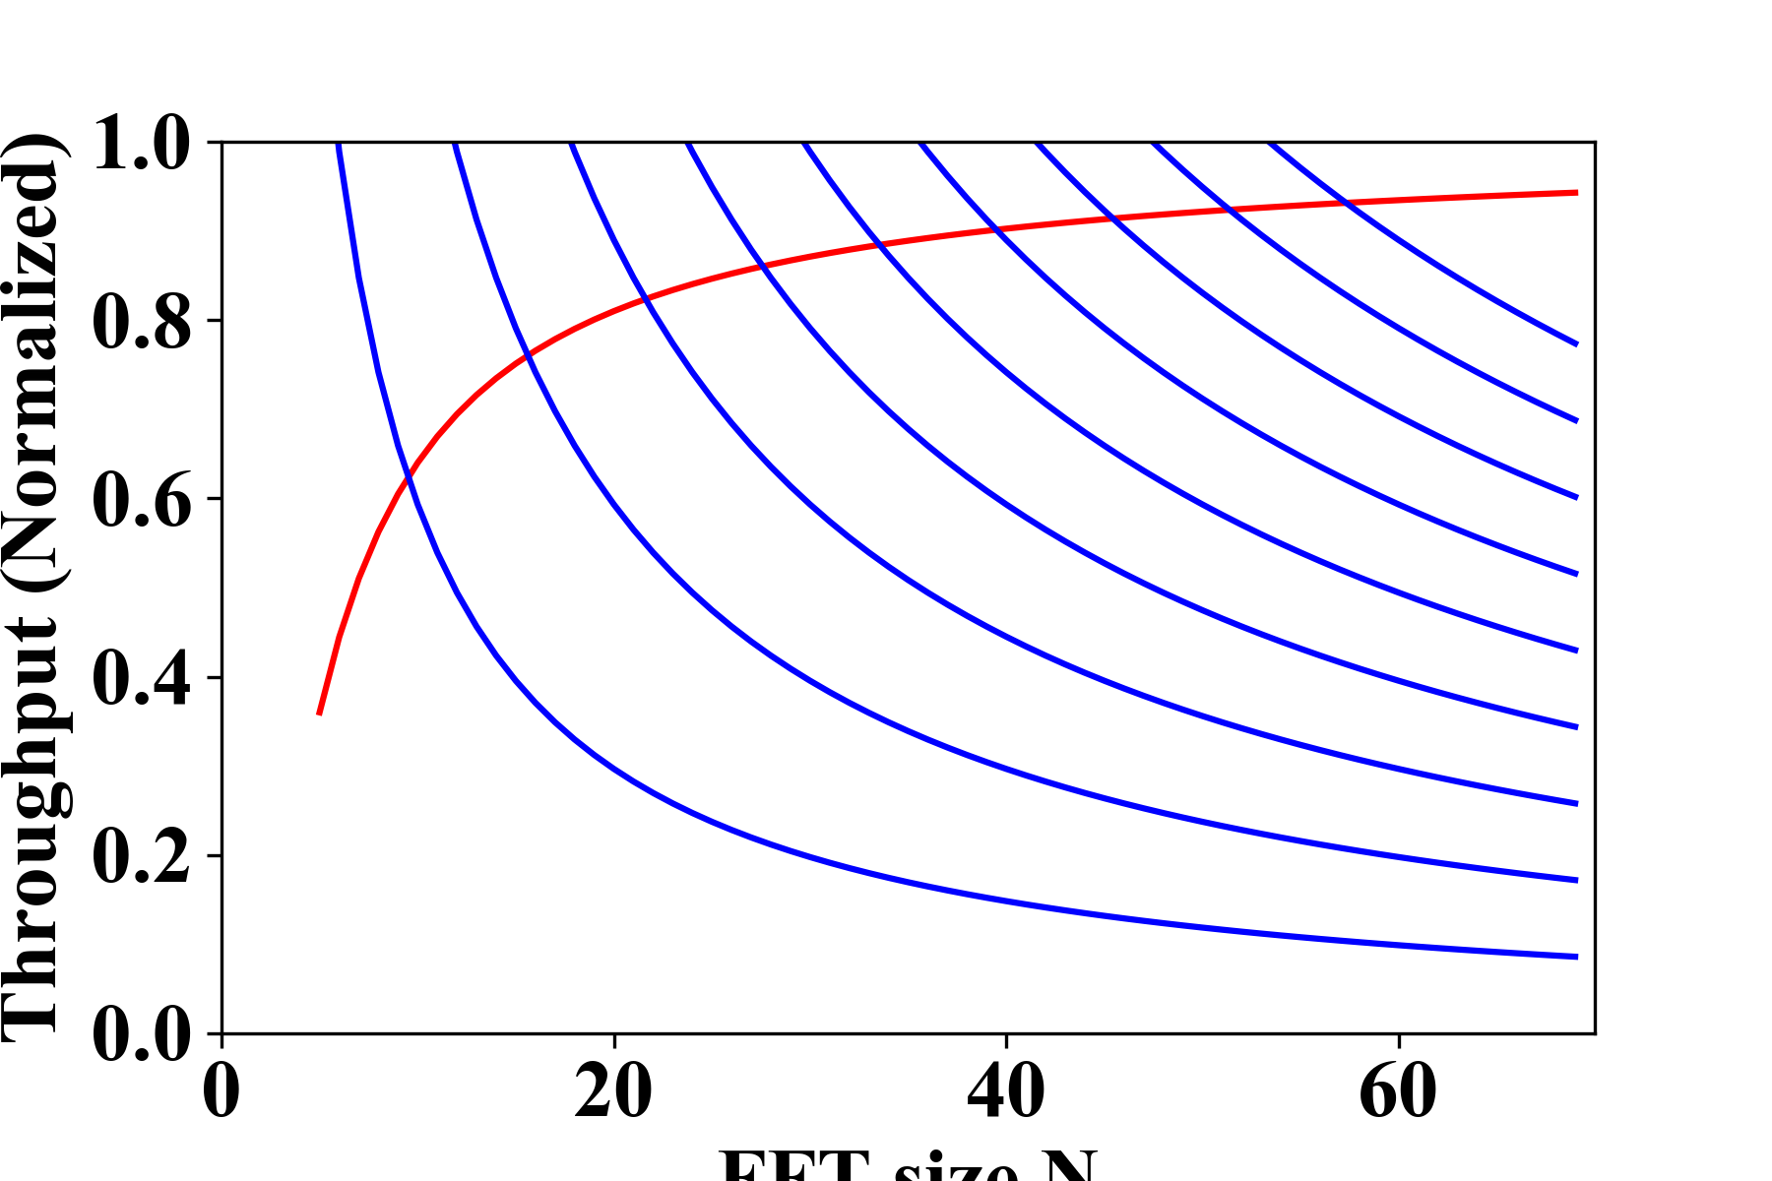
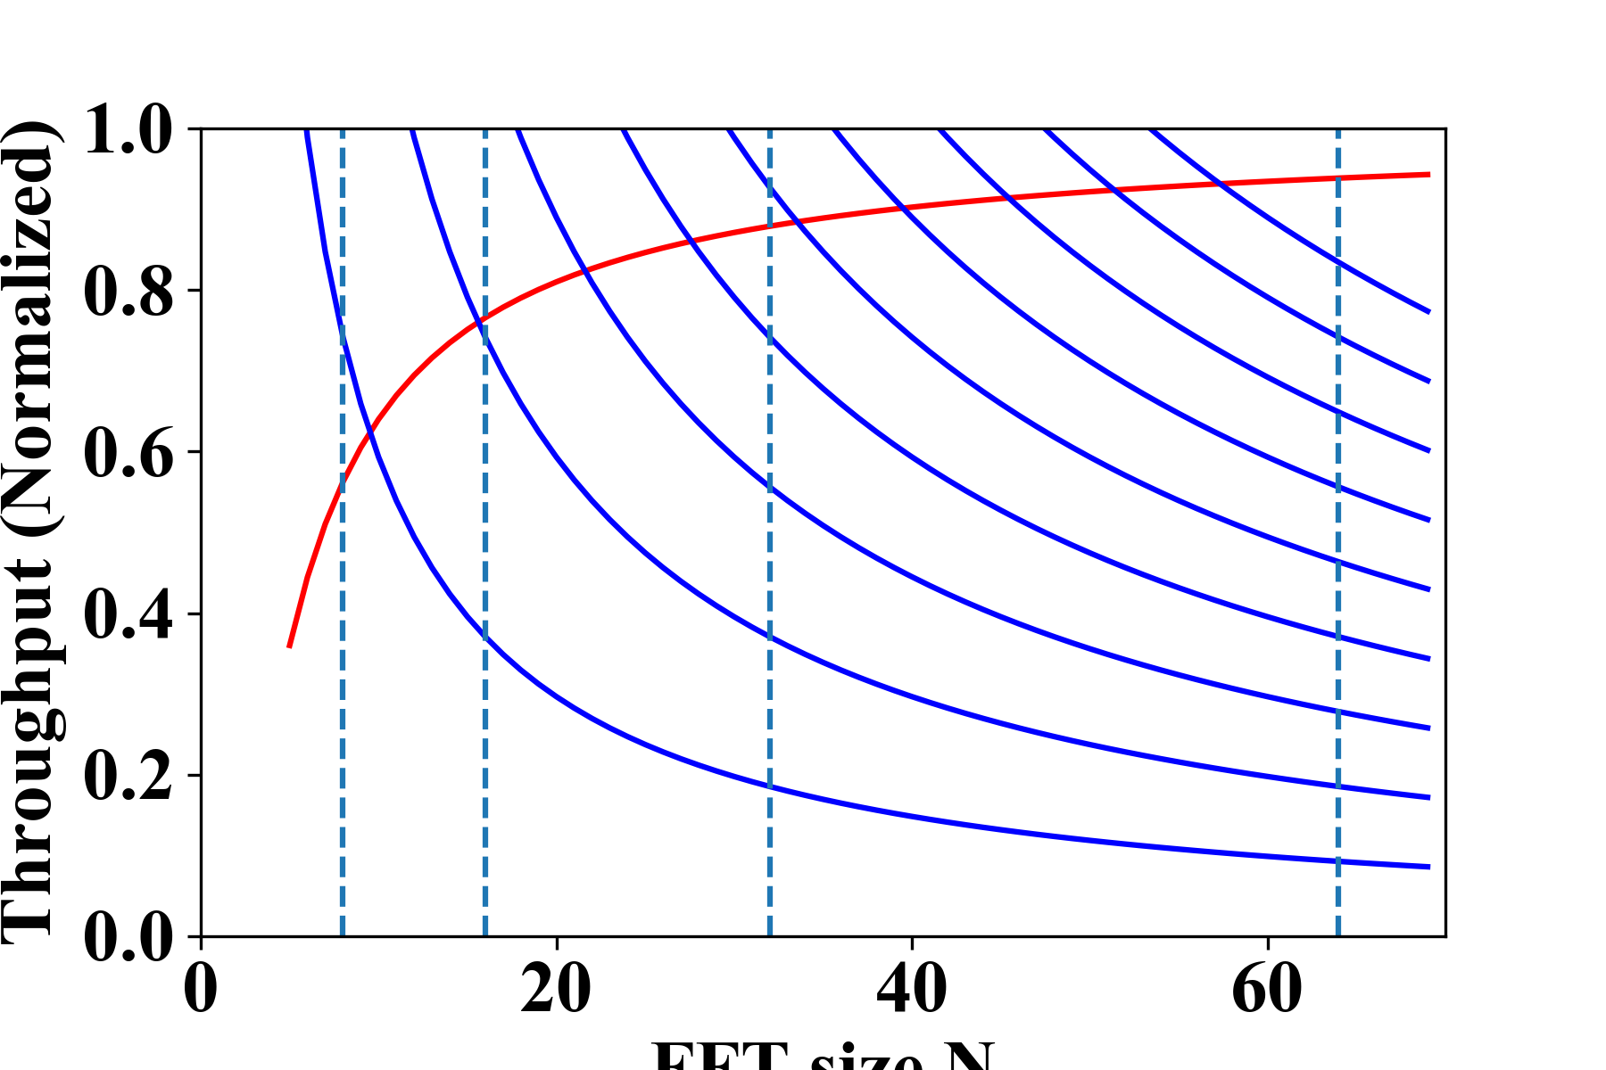





Performance Analysis
Communication bound
Computation bound
$$K=2.25$$
Throughput (Normalized)
Throughput (Normalized)
$$K_{Stratix−V}=1.0$$
$$K=0.25$$
FFT Size
FFT Size
$16$-point FFT
$64$-point FFT

Slide 19
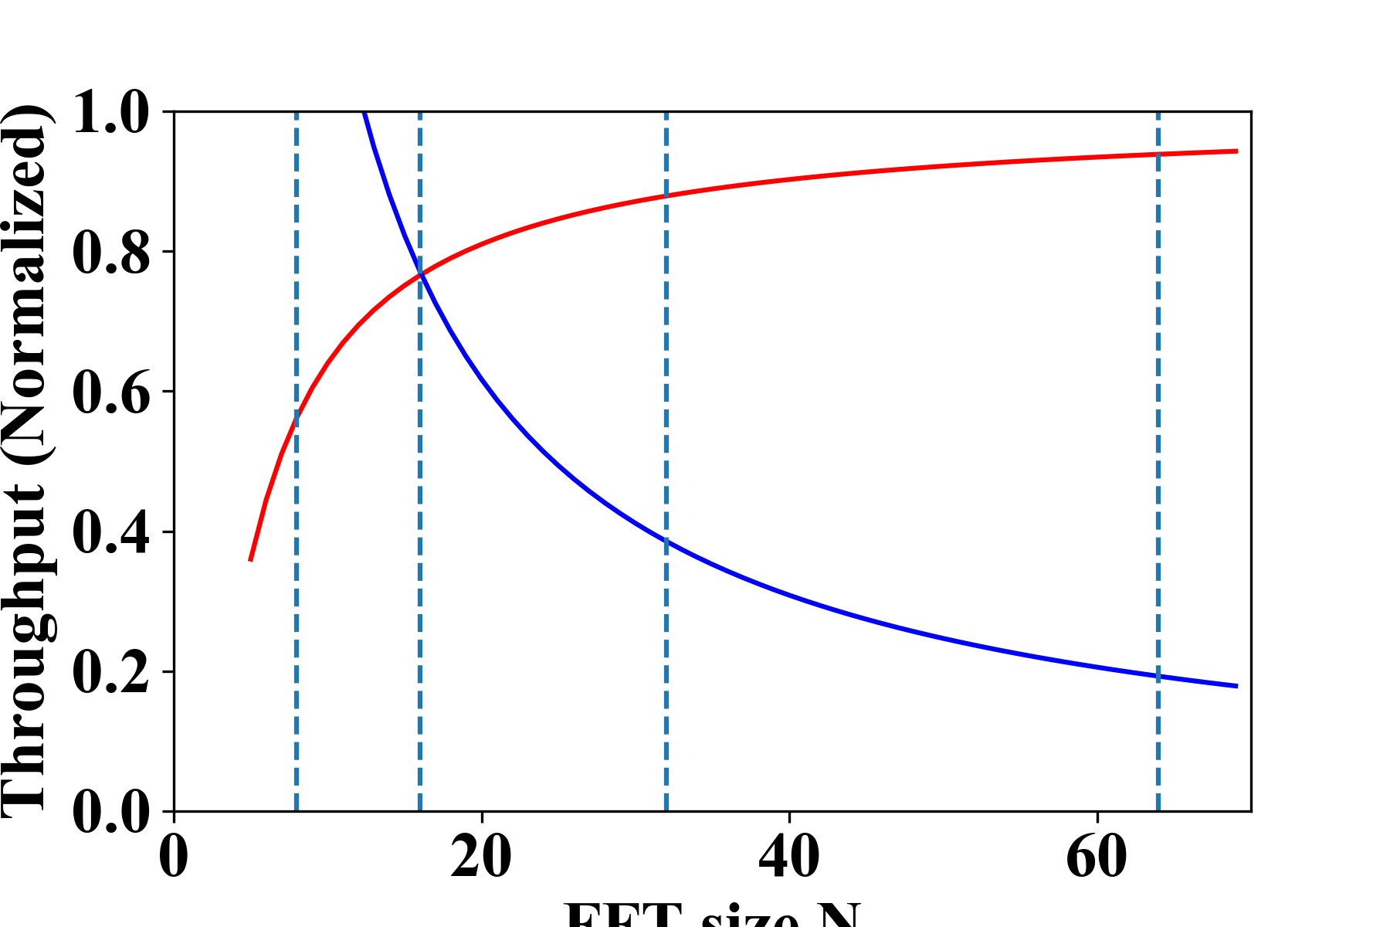
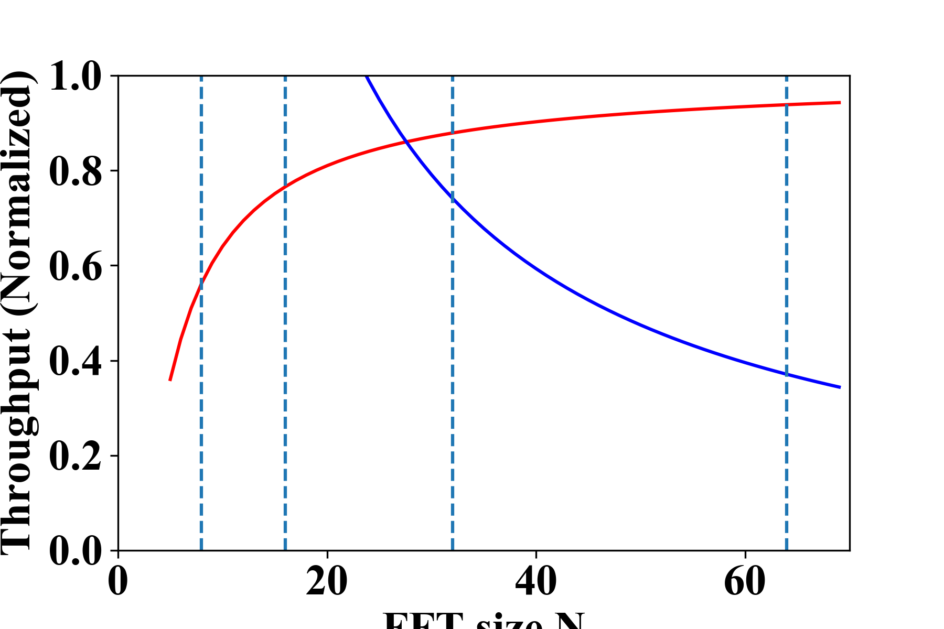
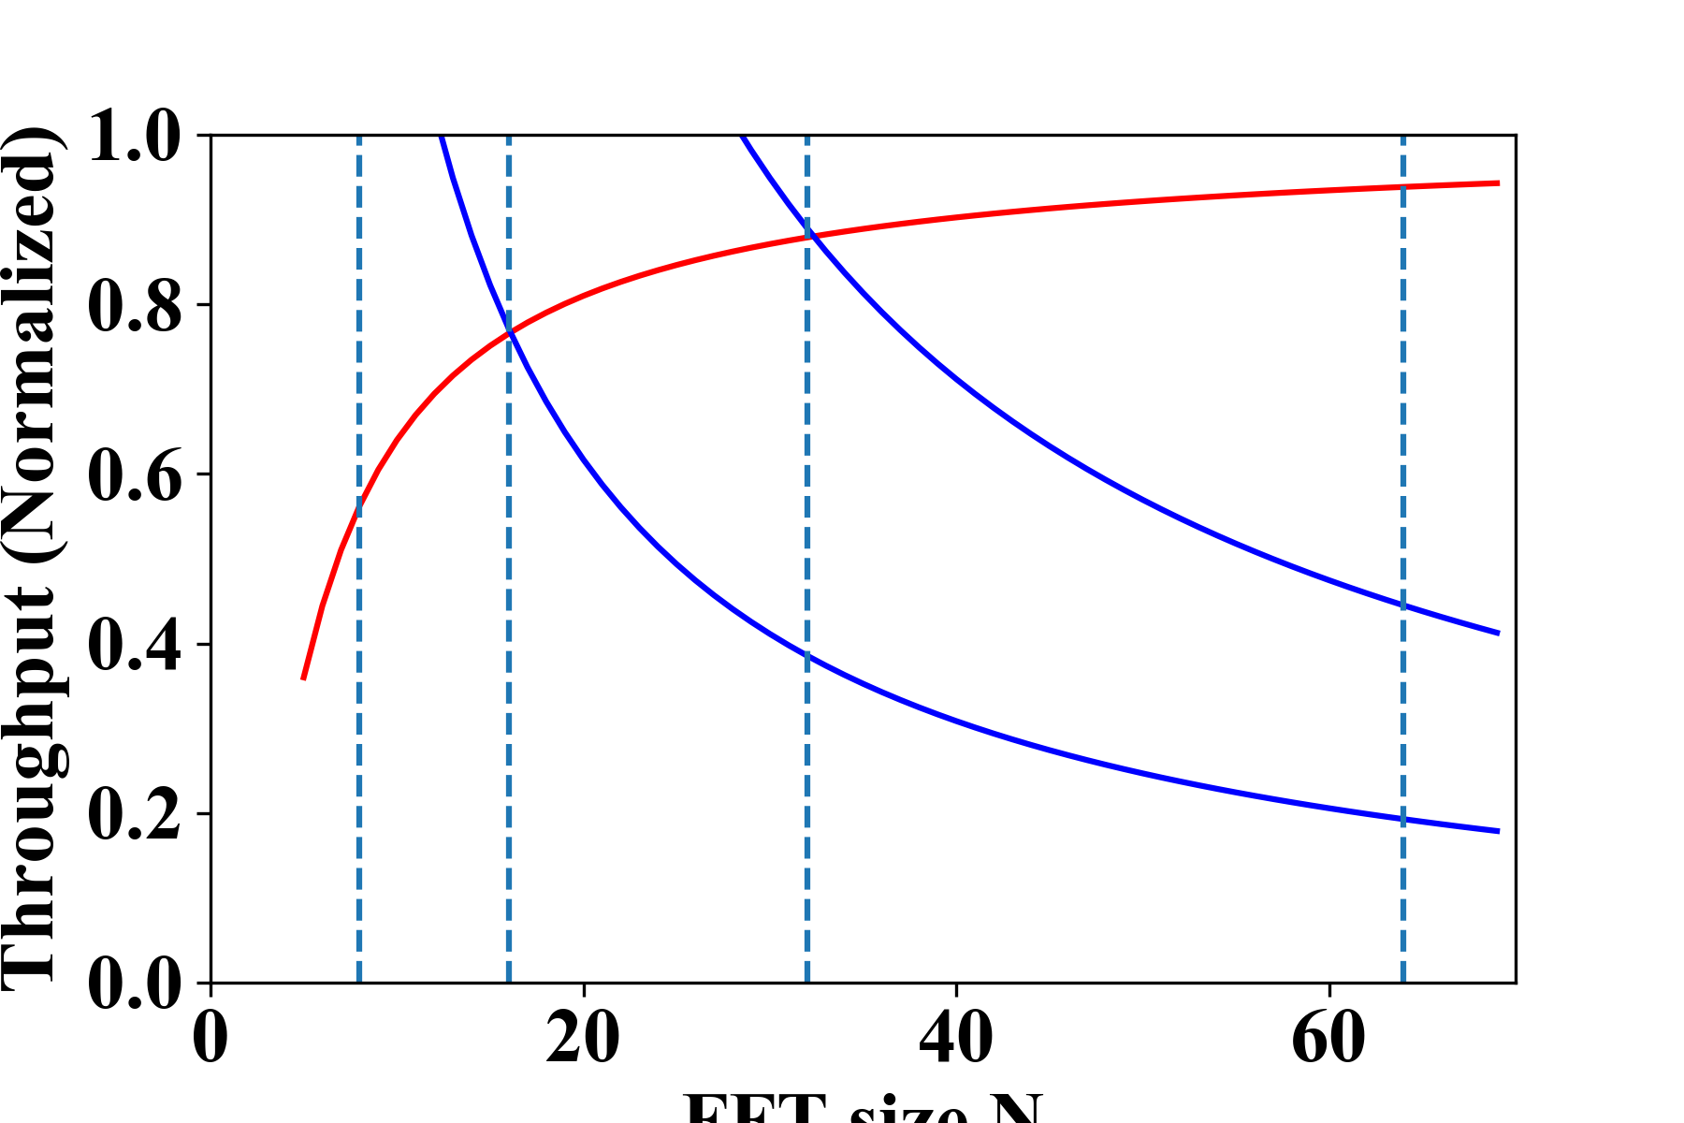

Design Space Exploration
Stratix-V:
$K=1.0$
Next generation of Deep Learning chips:
$K=0.5$
$K=1.5$
…
Throughput (Normalized)
Throughput (Normalized)
Throughput (Normalized)
FFT Size
FFT Size
FFT Size

Slide 20
Outline
Background & overview
Algorithmic optimizations
Hardware mapping methodology
Automatic design generation
Experimental results
Conclusion

Slide 21

Automatic Design Generation
Time to generate a complete design: $<1s$

Slide 22
Outline
Background & overview
Algorithmic optimizations
Hardware mapping methodology
Automatic design generation
Experimental results
Conclusion

Slide 23



Reduction in Computation Complexity
AlexNet
VGG16
FCN-16s
3.7x
2.3x

Slide 24


Use of Device Coefficient
Optimal design point for Stratix-V:
FFT of $16$ point
Tiling size of $64$

Slide 25
Comparison with State-of-the-Art
AlexNet Results
 | FPL 16 | FPL 16 | FPGA 17 | Our work
FPGA | Virtex-7 VC709 | Stratix-V GXA7 | Stratix-V GXA7 | Stratix-V GXA7
Frequency (MHz) | 156 | 100 | 200 | 200
Precision | 16b fixed | 8-16b fixed | 32b float | 16b fixed
DSP | 2144 (60%) | 256 (100%) | 224 (88%) | 256 (100%)
On-chip RAM | 956 (65%) | 1152 (61%) | 1208 (64%) | 1377 (73%)
Throughput (GOPS) | 565.9 | 134.1 | 83.0 | 780.6
5.8x

Slide 26
Comparison with State-of-the-Art
VGG16 Results
 | FPGA 16 | FPGA 17 | FPGA 17 | FPGA 17 | Our work
FPGA | Zynq XC7Z045 | Arria-10 GX1150 | Arria-10 GX1150 | Stratix-V GXA7 | Stratix-V GXA7
Frequency (MHz) | 150 | 150 | 385 | 200 | 200
Precision | 16b fixed | 8-16b fixed | 8-16b fixed | 32b float | 16b fixed
DSP | 780 (89%) | 1518 (100%) | 1378 (91%) | 224 (88%) | 256 (100%)
On-chip RAM | 486 (87%) | 1900 (70%) | 1450 (53%) | 1208 (64%) | 1377 (73%)
Throughput (GOPS) | 137.0 | 645.3 | 1790 | 123.5 | 669.1
4.9x
FCN Results
550 GOPS (First work to accelerate FCN)

Slide 27
Conclusion
Algorithmic optimizations
  Concatenate-and-Pad: Computation complexity reduction
  CaP + OaA + Tiling: Leading to a generic accelerator design
Hardware mapping methodology
  Device coefficient: Simple and precise design space exploration
  Device coefficient: Optimizing of next generation DL chips
Performance improvements in throughput
  AlexNet: 5.8x; VGG16: 4.9x

Slide 28
Thank You!
fpga.usc.edu

