Slide 1

A Customizable Matrix Multiplication Framework for the Intel HARPv2 Xeon+FPGA Platform - A Deep Learning Case Study
Duncan J.M. Moss, Srivatsan Krishnan, Eriko Nurvitadhi, Piotr Ratuszniak, Chris Johnson, Jaewoong Sim, Asit Mishra, Debbie Marr, Suchit Subhaschandra and Philip H.W. Leong
Notes:
Thanks for the introduction Peter. Good Afternoon everyone, Today I'm going to talk about my work on an FPGA framework for accelerating matrix multiplication on the Xeon+FPGA HARPv2 platform.
This work was undertaken during my internship Intel, collabroating with Intel Lab.
The framework is open source and can be found on the Intel github.
The framework uses a BLAS interface to abstract away hardware details so that users can benefit from the FPGA without knowledge of any of the underlying details.

Slide 2
Outline
Motivation
Design
Neural Network
Results
Conclusion
Notes:
First, I am going to touch on our motivation, specifically, why we undertook this work.
Next, I will describe the basic hardware and software framework, including our API and hardware template.
I will then present a few extensions to our framework, that provides extra support for any matrix size and any neural network configuration.
Specifically, This will contain a brief look at a few of our memory management techniques and deep learning optimisations.
Finally, a few of the key results will conclude the talk.

Slide 3
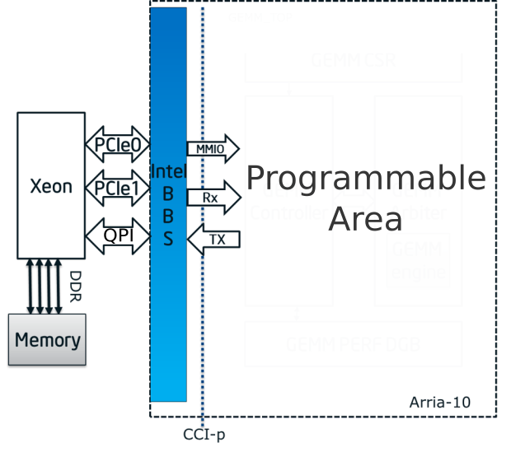
Problem
Xeon+FPGA
Simple, software-based interface
Extensions to efficiently support Machine Learning
Notes:
The problem we set out to solve was to multiply two arbitarity size matricies A and B, utilising all of the computation resources avaiale.
Our initial FPGA implementation performs the A times B matrix operation, with option transposition, and then applies the scaling alpha.
The C matrix accumulation and beta scaling is handled by the CPU.
We wanted to ensure that it could handle many different workloads operating at different precisions, achieving near peak performance for any matrix size and area utilisation.
For those of you unfamiliar with the Xeon+FPGA HARPv2 platform, it is a 14 core Boardwell Xeon CPU integrated with an Arria 10 FPGA on the same package.
They communicate through 2 PCI links and a Cache Coherent memory interface.
One aspect of the framework important to us was to ensure that users called the accelerator with a familiar software-based interface, which could be easily integrated into existing applications.
We further extended this framework to support machine learning and specifically deep learning by adding additional functionality.

Slide 4
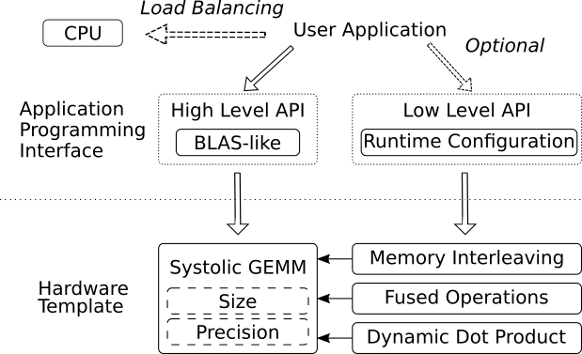
Framework
Notes:
The framework consists of an API, which in its simplest form is a straightforward BLAS function call, and a hardware template, which parameterised the hardware design.

Slide 5
Framework
Notes:
On the other hand, the low level API is a C++ template base interface and gives the user control over the various runtime optimisations and options, such as precision, buffering and optional neural network functionality.

Slide 6
Framework
Notes:
The hardware template is a parameterised Systolic matrix multiplier, with size and precision configurable at compile time.
We extended the hardware template with memory interleaving, fused operations and dynamic dot product modules which are described later in this talk.

Slide 7
Framework
Notes:
Additionally, The framework support heterogenous execution of a single matrix multiplication, with automatic loading balancing between FPGA and CPU.
Currently the optimal split is staticly set, at 55% for the FPGA and 45% for the CPU, the results for this are addressed later in the talk.

Slide 8
Outline
Motivation
Design
Neural Network
Results
Conclusion
Notes:
Next I will talk about the hardware template.

Slide 9
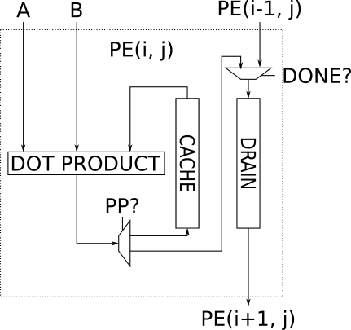
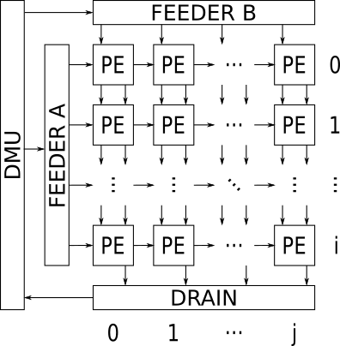
Hardware Template
FP32, INT16, INT8, INT4, Ternary, Binary
Notes:
The hardware template is a systolic array of processing elements, with matrix blocks coming from feeder A for the row, and feeder B for the columns.
Matrix blocks continuously brought into the feeders, only draining the systolic array until a complete block of C has been computed.
As opposed to a traditional multiply-accumulate based systolic array, each of our processing element performs one dot product every cycle, .
The dot product is designed as a parallel array of multipliers connected to an adder tree that is fully pipelined, .
Furthmore, it can be configured at compile to support different precision, such as Single Precision Floating Point, Fixed Point 16 & 8 & 4 bits, included Tenery and Binary computation.
Every cycle, the processing elements operates by taking vectors from each block within a feeder until the entire block has been pocessed.
Within each processing element, a cache is used to store intermediate results for the current C block, only transferring to the drain when the block is completed.
The processing element is design so that draining can be performed while the next block is being computed, ensuring that the dot product produces a result every cycle.

Slide 10
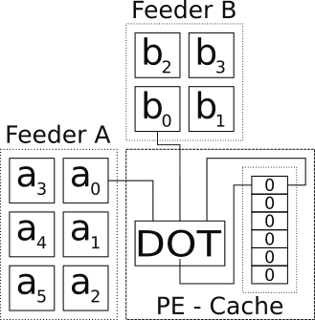
Feeder Blocks
Notes:
Inside the systolic array, Feeder A and Feeder B are large memories that corresponded to multiple blocks of the A and B matrices respectively.
These feeders are double buffered to reduces stalls due to data starvation.
As shown in the slide, the top portion of Feeder A and the left portion of Feeder B are connected to the top left processing element.
Each element in Feeder A and B represents a portion of the rows and columns of the matricies A and B respectivily.
A processing element takes its input from either the feeders or adjacent processing elements and multiplies these two blocks, by interleaving the input vectors.
In this initial implementation a static indexing scheme was used to determine which input vectors are read out from the feeders.
The host processor is responsible for supplying the feeders in the appropriate order to multiply the two input matrices, producing the final result.

Slide 11
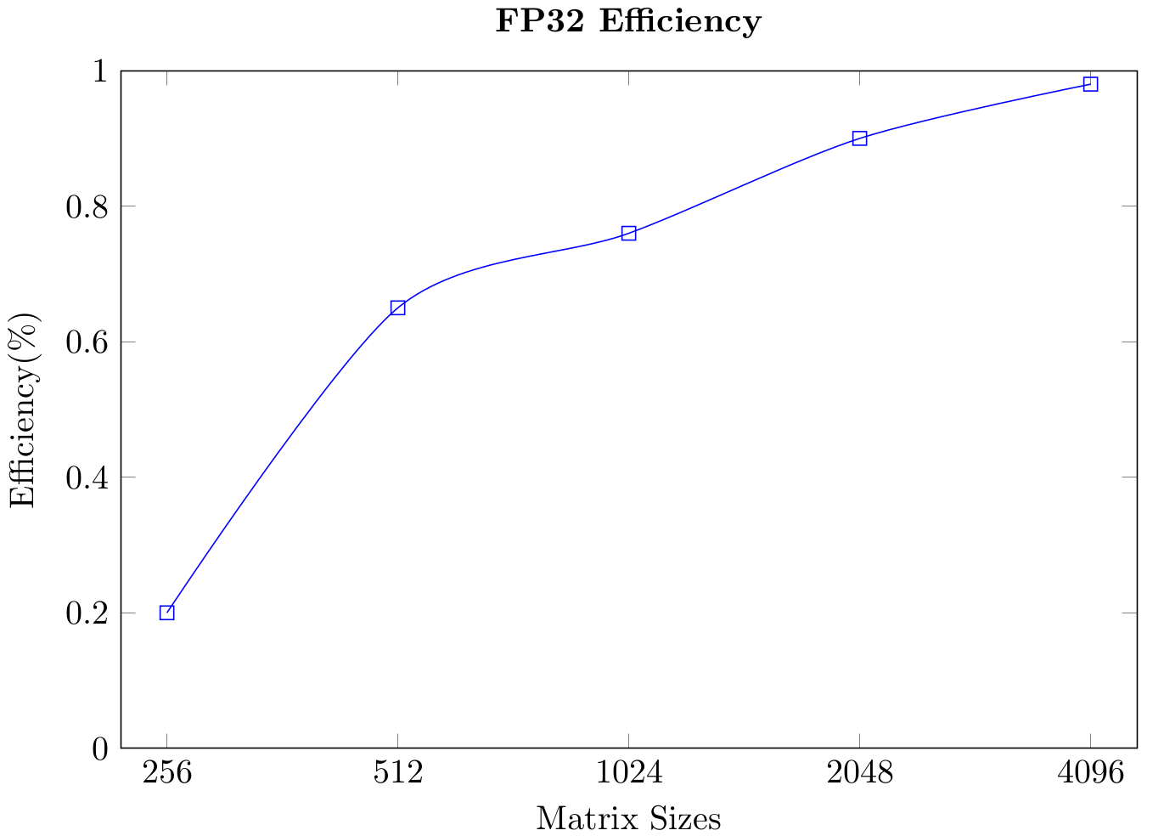
Evaluation of Initial Implementation
Notes:
We took our initial implementation and evaluated its performance against a range of different matrix sizes.
In this graph the x axis corresponds to the matrix size and the y axis is the percentage of peak available performance, which we will call efficiency.

Slide 12
Evaluation of Initial Implementation
Notes:
While we were happy with the results at the larger matrix sizes, we observed a significant decrease in performance for the smaller sizes, outlined in red.

Slide 13
The Goal
Notes:
Our goal moving on to the second stage of the design was to improve the efficiency of these smaller matrix sizes.

Slide 14
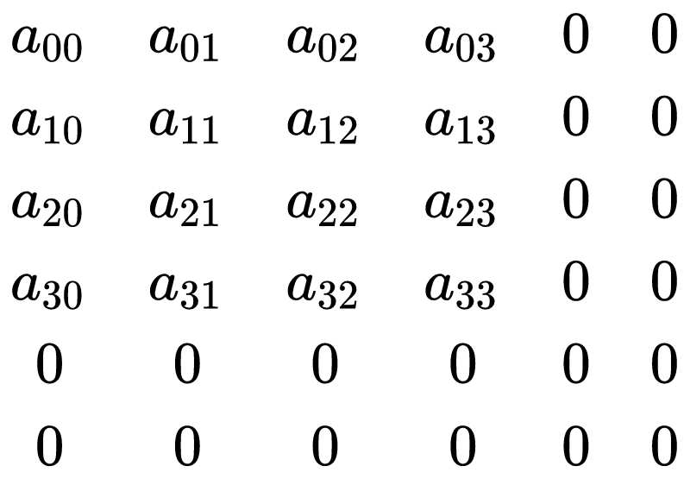
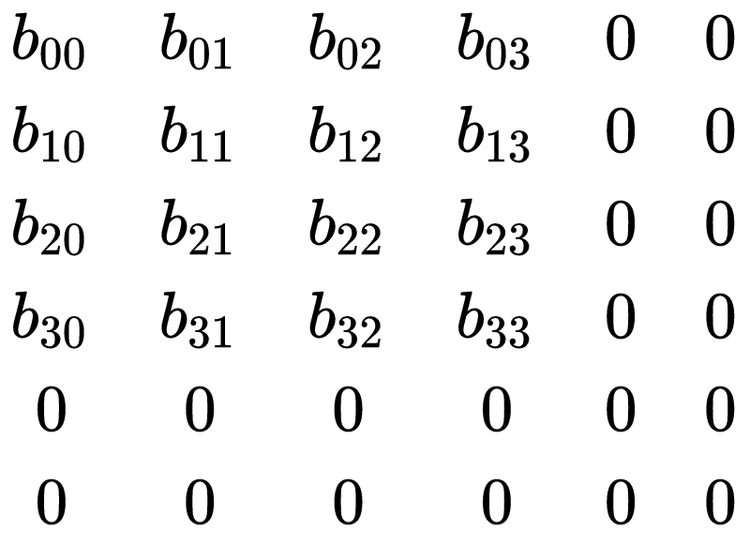

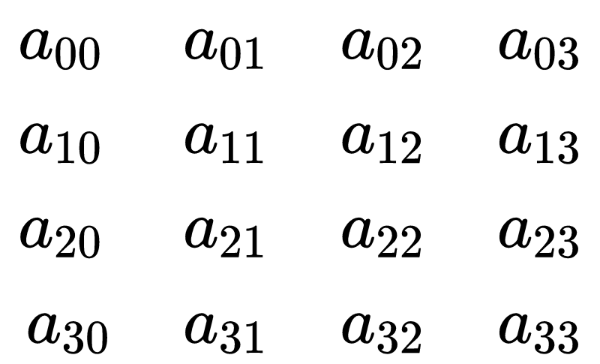
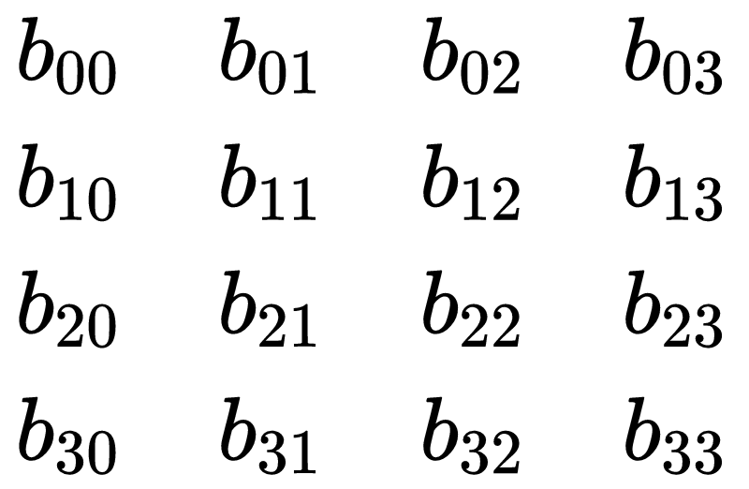
Memory Interleaving
Inefficient with
Static Partitioning
Fewer Computations
Increase Bandwidth
Notes:
So we looked at why the framework performed well at the larger matrics and why it performed poorly at the smaller size.
In short, we found that our static partioning methodology of the different matrix blocks was padding zeros in blocks that didn't fit nicely into our feeder.
Since the Xeon+FPGA support partial reconfiguration, which is a runtime routine for dynamic loading bitstreams, we considered offering several bitstream with different static partiting schemes.
However this solution was insufficient for applications that made use of multiple matrix multiplication in quick succession since we couldn’t make use of our double buffers.
Instead, we wanted to make sure that regards of the matrix size, the user would achieve the best possible performance given the computation and bandwidth limitations of the system.
Our solution was to develop a dynamic indexing scheme for loading matrix blocks in the feeders and serving these blocks to the processing elements.
This slide show a simple example where the blocking sizes were modified at runtime to ensure that computations involving zero padded blocks are avoided.
This resulted in fewer computations performed on the FPGA at cost of increased bandwidth.
More details on this process can be found in the paper.

Slide 15
Outline
Motivation
Design
Neural Network
Results
Conclusion
Notes:
I will now cover some of the neural network specific details.

Slide 16
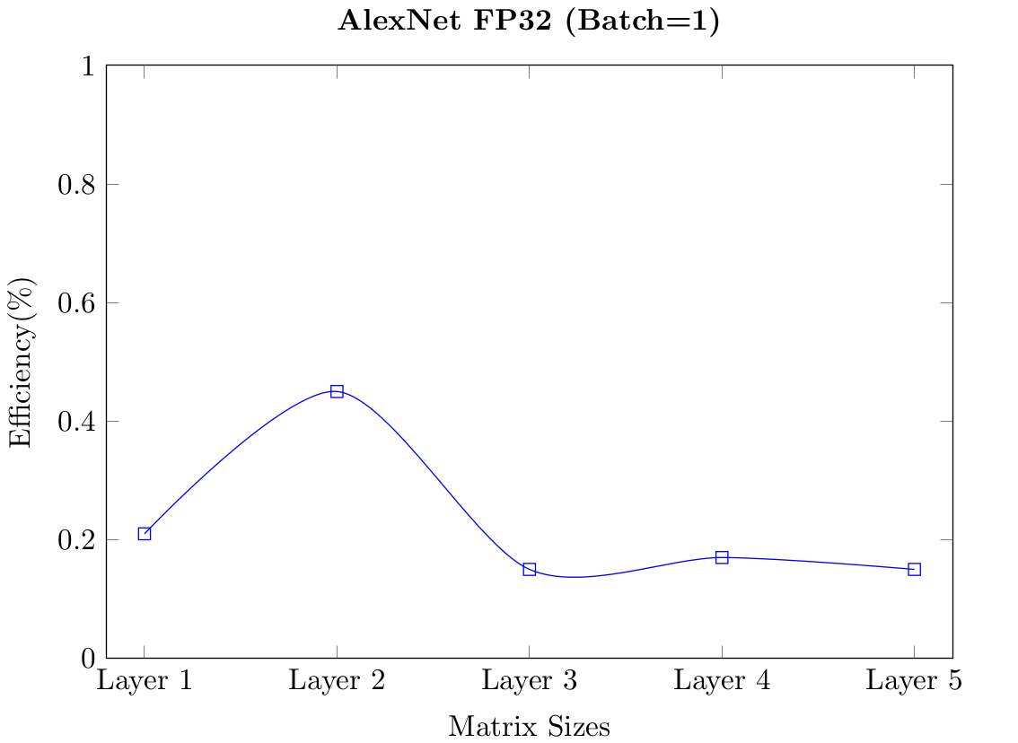
Network Computation - Batch = 1
Notes:
Having improved the performance of the matrix multiplication, we focused on our deep learning workloads.
On CPUs and GPU, larger batch sizes are used in deep learning inference to maximise efficiency, however this is a the cost of latency.
We wanted to make sure that users who wanted to use a small batch size would still achieve high efficiency.
The graph here shows the efficiency on the y axis for the first five layer of a batch 1 case for a single precision floating point implementation of AlexNet.
We saw that despite our previous memory optimisations, for the batch 1 case the efficiency was significantly lower than what we expected, especially for layers 3 to 5.

Slide 17
Neural Network Goal
Notes:
Again, the goal was identify the issue and raise the performance over the entire network.

Slide 18
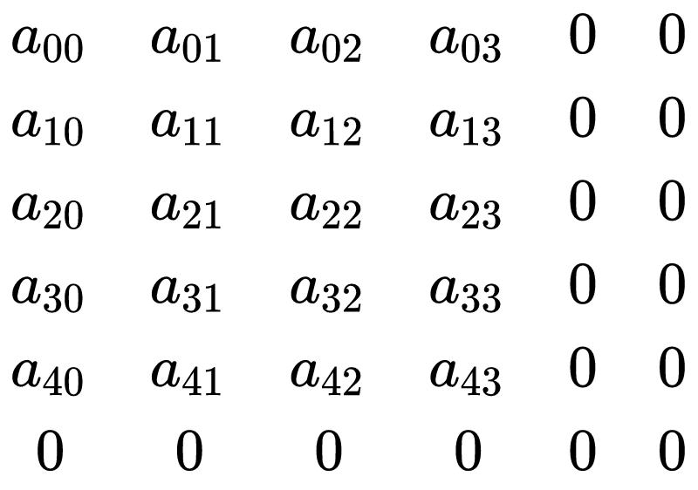
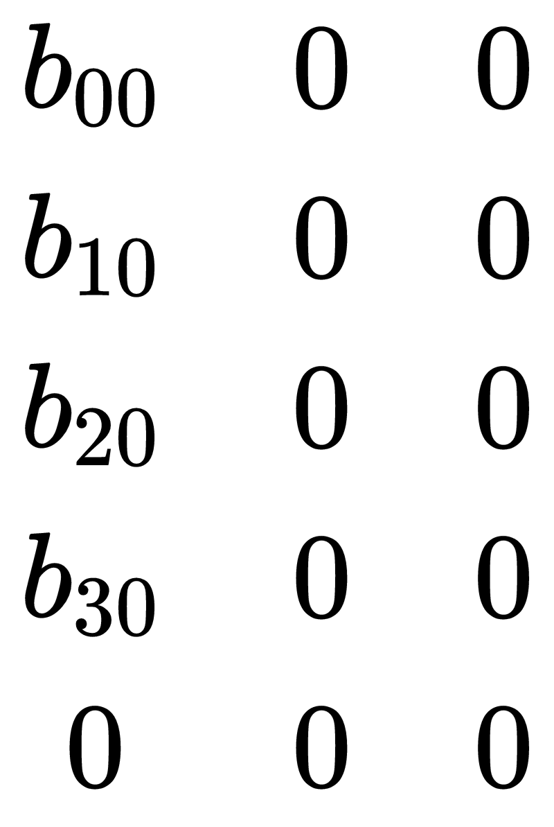
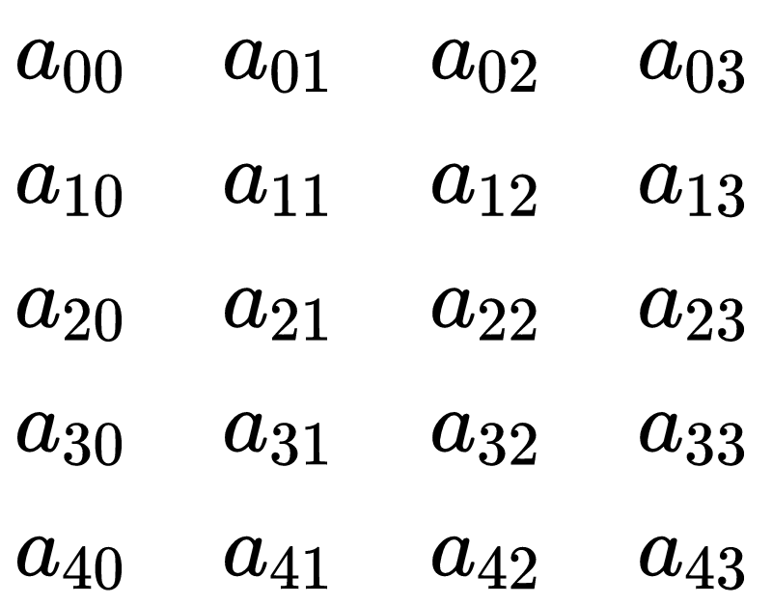
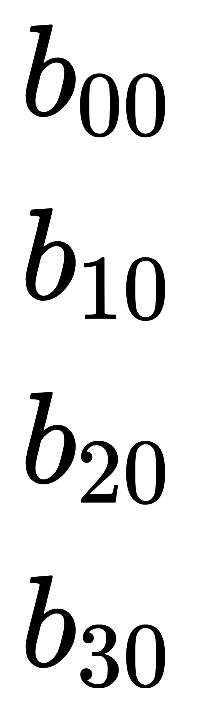
Memory Sharing between Feeder A and Feeder B
Inefficient with
Static Partitioning
Minimising Bandwidth
Increase Maximum block size restriction
Notes:
The main limitation of the runtime memory interleaving scheme was a restriction on the maximum matrix block size.
To alleviate this, we allowed the feeders to trade memory allocated to their particular blocks between each other.
In essence, this increases the maximum block size for the corresponding matrix, resulting in an decrease in the required bandwidth.
In the slide we can see that for the B matrix, the block size has been decreased down to 1 x 2 element rectangle, whereas the A matrix block size has been increased to 2 x 5 element rectangle.
While this example seems small, in the case of the lower batch sizes, the A matrix is orders of magnitude of larger than the B matrix.
By allowing the A matrix to extends its blocks past its previous limit, more computation can be performed per block resulting in a decreased in the transfer bandwidth and improving efficiency.

Slide 19
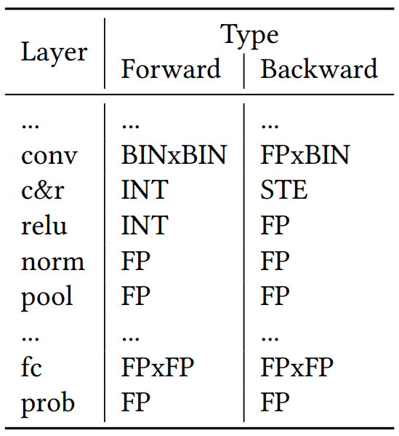
Case Study Training a Binarised Neural Network
Notes:
Having foucsed and optimised the most compute intensive parts of neural networks, the convlution and fully connected layers, we took a more holistic approach to the over network implatations, identifying areas in which we could obtain small gains.
We decided to focus on binarised neural networks because their implementations offer promising results on FPGA technology.
This table shows a breaking down of the operations required for training a binarised neural network and the precision required.
Examining the table, the computation for both the forward and backwards are combinations of binary, integer and floating point operations.
Specifically the convlution layer, shown in the first line, can be performed in binary precision for inference, however in the backwards pass we needed to employ a high precision dot product.
Other auxilary layers such clipping and rounding, relu, batch normalisation and pooling were performed at either integer or floating point precision.
During the backward pass, the clipping and rounding operation is replaced by the strait through esimator, effectively bypassing the operation.
We noticed that performance could be improved by support two precision within each processing element and that Auxilary neural network layers operations could be supported as data was transferred out of the FPGA.
To perform this, we introduce two optimisations: the dynamic dot product and a post processing module for fusing the auxilary layer operations.

Slide 20
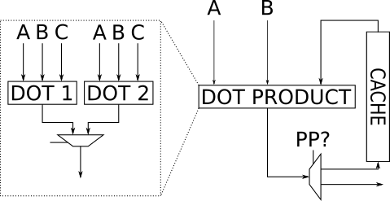
Optimisation: Dynamic Dot Product
Notes:
The dynamic dot product implements two dot product of different precisions in each processing element.
In this initial implementation we are presenting here, each dot product does not share DSP resources, and as a result will limit the array size.
We use this module to implement specifically a binary dot product and floating point dot product since the binary dot product uses logic resources exclusively.
The desired dot product is selectable at runtime, and controlled by a global flag propagated to each processing element.

Slide 21
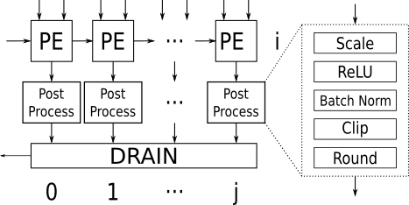
Optimisation: Fused Operations
Notes:
The post processing module implements a series a range of different modules.
Each module is selectable at compile time and bypass-able at runtime if the computation doesn’t need to be performed.
Same hardware template can be used for multiplie layer configurations, as well as allowing for other matrix multiplication to be performed if desired.
The end result is a single bitstream, able to operated a two precision, configurable to perform a range of different post processing operations, all controlled by simple templated API.

Slide 22
Outline
Motivation
Design
Neural Network
Results
Conclusion
Notes:
I will now present some key result related to our performance and memory optimsiations.

Slide 23
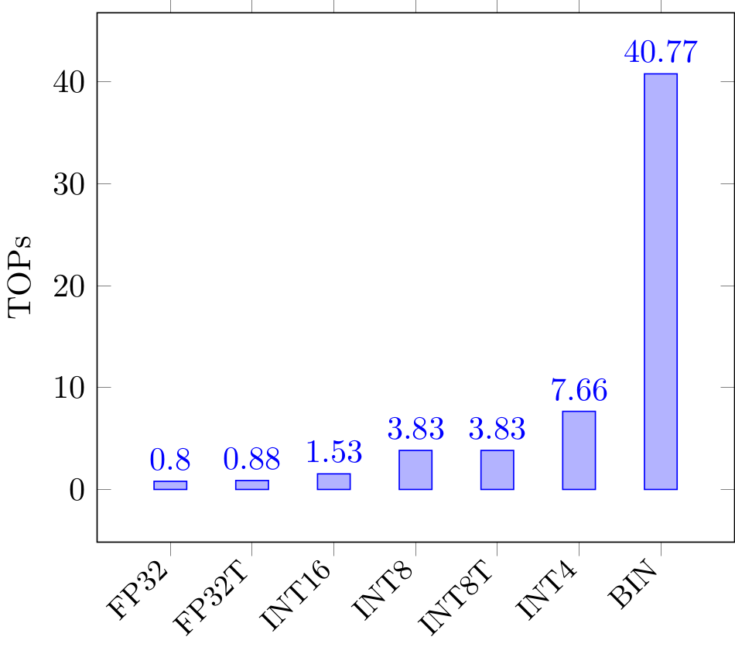
Measured Peak Performance
Notes:
The x axis represents the different precision supported by the hardware template and the y axis denotes the measured peak Tera operations per second for the arria 10.
Note while the floating point performance seems relatively small compared to the binary performance, it with 20% of the Arria 10s theoretical peak performance for the HARPv2 platform.
We can see a near linear increase in from FP32 to INT4 as the dot product size is doubled as the precision in halved.
However in the case of binary, the dot product module is a good fit of the FPGA architecture allowing for a larger systolic array which results in a significant performance boost.

Slide 24
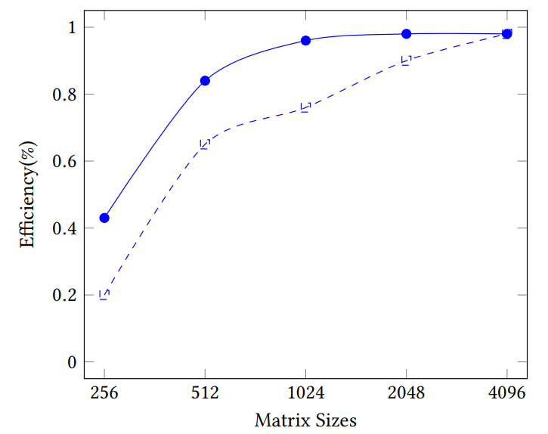
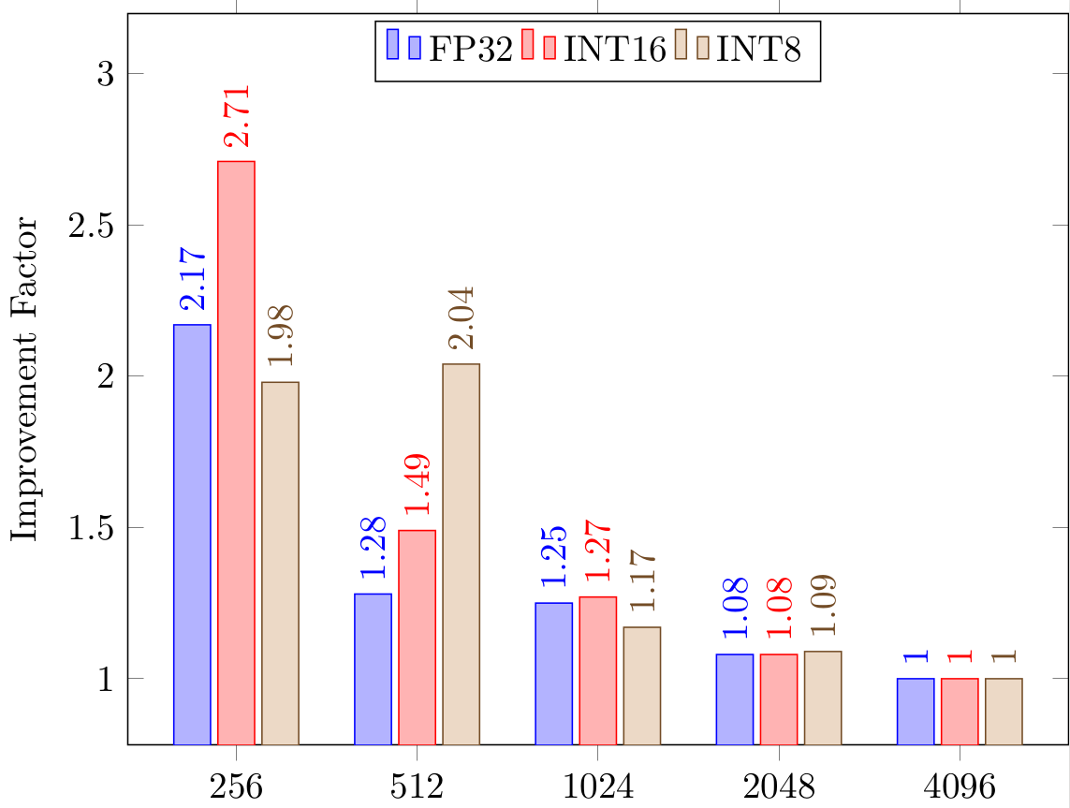
GEMM Memory Interleaving Results
Notes:
This shows the performance benefits of our run time memory interleaving scheme.
For the left hand graph, the x axis represents the different matrix sizes and the y axis is the efficiency.
Comparing the dotted blue line, which denotes our static partitioning scheme, to the solid blue line, our memory interleaving scheme, we see a significant increase in performance, achieving up to a 2x improved for memory interleaving.
The graph on the right show the improvement factor for different precisions at different matrix sizes.
As indicated by blue bar at matrix size 256, all three precisions show at leave a 2x improvement over the static interleaving scheme.
As the matrix sizes increase, the improvement is less pronounced as the near peak efficiency.

Slide 25
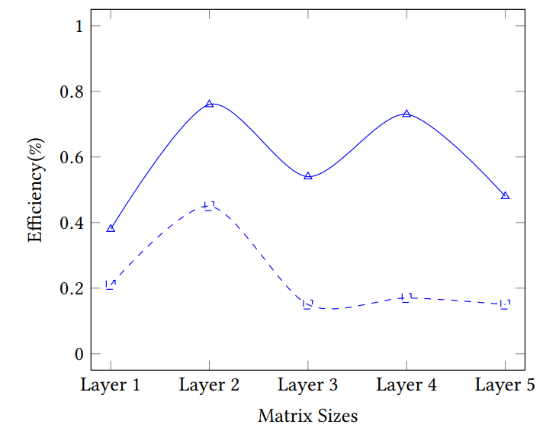
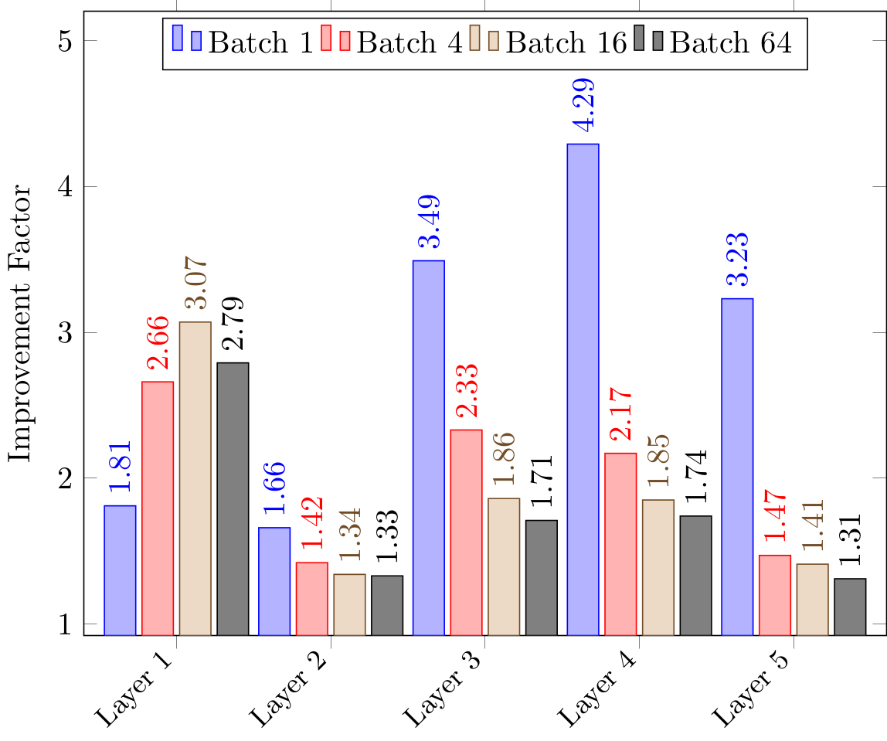
Neural Network Memory Interleaving Results
Notes:
Moving on to the neural network performance, the graph on the left show the efficiency on the x axis vs the first 5 layers of AlexNet.
Again we see that the dotted blue line has moved up, improving the compute efficiency of each layer.
Specifically for layers 3 to 5, we observed up to a 4.3x improving making the batch 1 case significantly more compute efficient.
Again, similar to the previous slide, the graph on the right shows this trend of a range of different batch sizes.
While the batch 1 case sees the most improvement, we can still observe significant gains for all layers with the minimum improvement at 1.3x for batch 64 were it achieves near peak efficiency.

Slide 26
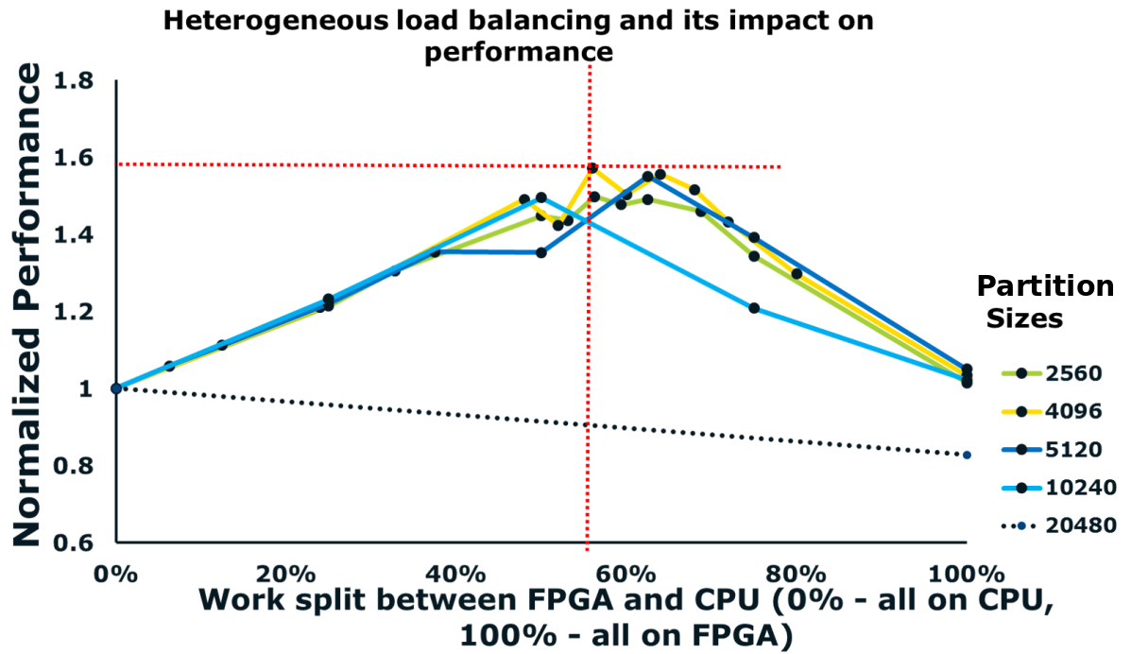
Heterogeneous Load Balancing
Notes:
Although I haven’t covered this in detai,l our framework support heterogenous load balancing over the CPU and FPGA.
This slide presents the result for a large matrix multiplication partitioned across the FPGA and the 14 core broadwell CPU.
The y axis is the normalised performance in regards to the measured peak CPU.
The x axis show the current work split between the FPGA and the CPU, where 0% denotes all work is performed on the CPU and 100% all work performed on the FPGA.
Each line denotes different partition sizes and as shown in the graph, size 4096 performs the best, achieving a 1.6x improvement over a CPU only implementation, with a work split of 55% on the FPGA and 45% on the CPU.
However as shown in the graph they are other viable partitioning sizes.

Slide 27
Outline
Motivation
Design
Neural Network
Results
Conclusion

Slide 28
Conclusion
Described an efficient matrix multiplication framework for the Xeon+FPGA
Users can accelerate their applications simply via a BLAS-like function call in software.
Choose parameters to suit problem.
Optimisations:
Runtime Memory Interleaving
Dynamic Dot Product
Fused Operations
Open Source
Notes:
In conclusion, I described a flexible and high performance matrix multiplication framework for the Xeon+FPGA.
Through the use of a BLAS-like interface, users does not requrie knowlodge of the underlying hardware to take advantage of the system.
I focused on a few key optimisations, specifically,
- how we partition block dynamically to support Any Matrix size and any network configuration
- A module to support mutliple precisions, allowing for potentially both inference and training of binarised neural networks
- and a fexilable post processing module capabile of accelerating auxilary neural network layer and miniised host overhead.
The architecture and implementation are open source and we invite you to utilise our framework to accelerate your matrix multiplication and deep learning needs, for access please email me.

Slide 29
Thank you!
duncan.moss@sydney.edu.au

Slide 30
Optimisation: Dynamic Dot Product & Fused Operations

Slide 31
Overview
FPGA
CPU
FPGA + CPU
CPU
Notes:
Red done by the FPGA.
Green done by the CPU.
The hardware template also supports heterogeneous load balancing.
At runtime the workload is partitioned across both the FPGA and CPU.
In the case of a GEMM, the A and B matrices are divided into sub blocks and the computation is balanced across the two compute engines.
This is useful for particularly large workloads in which the majority of the work is taken by the GEMM function.

Slide 32
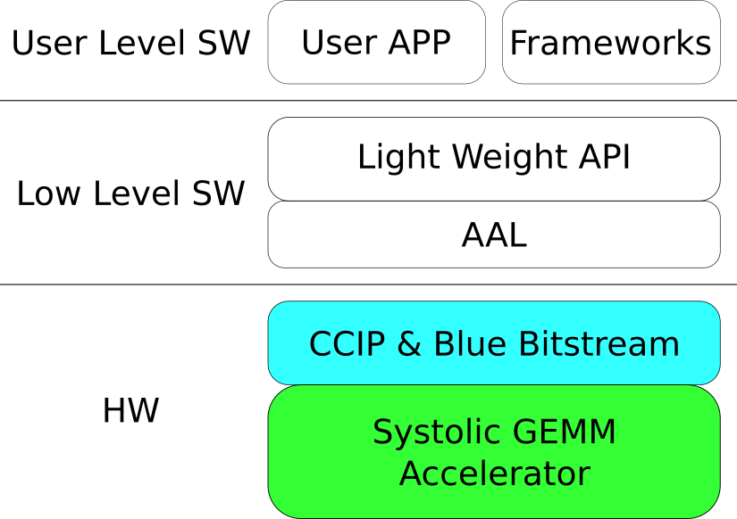
Notes:
The API exposes various configurable parameters to the user-level software.
Applications running using our framework leverage the Intel HARPv2 user mode runtime and kernel driver to set these parameters.
Intel HARPv2 comes with its own driver stack called Intel Accelerator Abstraction Layer (Intel AAL).
The integration of runtime software with the hardware accelerator template is shown in the slide.
The hardware template and API chooses between the different memory links, the default setting performs bandwidth balancing between all three.
There are three key components in the integration.
The AAL layer provides the necessary runtime services and API to access the FPGA device.
The framework's API is built on top of the AAL user-mode API's and services.
At a very high level, AAL services can be briefly classified into two categories.
The AAL user-mode runtime are interfaces that abstract the FPGA hardware via a service oriented model.
The AAL kernel-mode driver includes interfaces for allocation of Direct Memory Access (DMA) buffers with shared addressing between the hardware accelerator template and the users application. It provides interfaces to access Memory Mapped IO (MMIO) registers in the hardware template. It also provides interfaces to perform partial reconfiguration on the FPGA device.
The AAL kernel mode driver utilizes Intel Blue Bitstream to enumerate the device and perform partial reconfiguration.
Intel BBS is the infrastructure shell component in the FPGA.
It abstracts the UPI (Cache Coherent Xeon Link) and the PCIe links to provide a simple load-store like interface called the Cache Coherent Interface (CCI) to the user's accelerator.
Intel BBS also handles partial reconfiguration and contains the AAL kernel visible MMIO registers.
The AAL kernel driver uses the configuration registers for FPGA device enumeration and initialization.

Slide 33
Hardware Template Parameters
Parameters | Options
Systolic Array Size | (Logic, DSP & Memory Limited)
Precision
Accumulator Width | Arbitarity. for Fixed Point

Slide 34
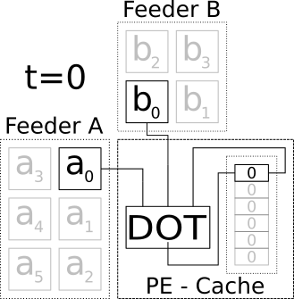
Hardware Template
Notes:
Say we consider this processing element. Every cycle a value is going to be servered from the A and B feeder, and the previous value propogated along its respective rows and columns.
To perform the matrix multiplication, the points are A and B are either incremented or left as they are.
For the sake of simplicity I’m going to assume that the DOT product module is fully combinatorial and produces its output within a cycle. In reality the module is pipelined to ensure a high clock frequency however the pipeline depth doesn’t significantly affect the control and can be ignored for this example.
or example...

Slide 35
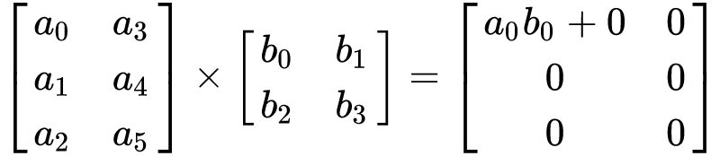
Hardware Template
Notes:
At T = 0, a0 and b0

Slide 36
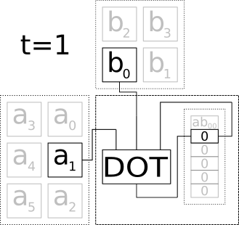
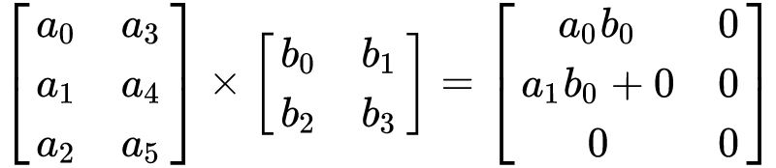
Hardware Template
Notes:
At T = 0, a0 and b0

Slide 37
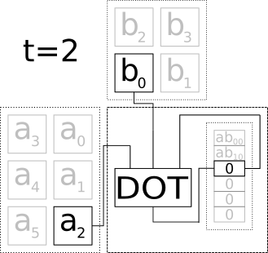
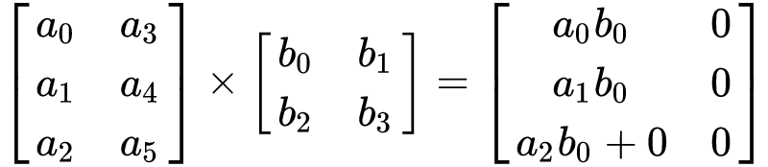
Hardware Template
Notes:
At T = 0, a0 and b0

Slide 38
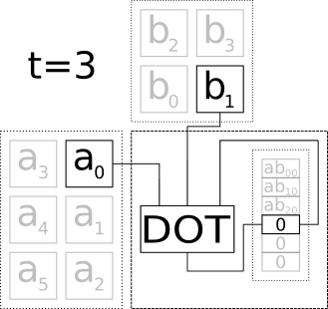
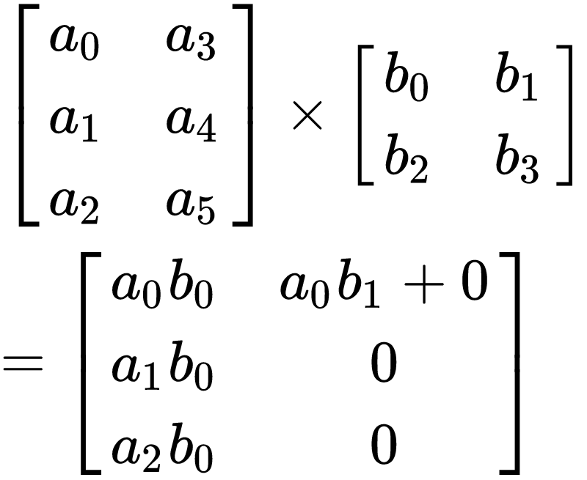
Hardware Template
Notes:
At T = 0, a0 and b0

Slide 39
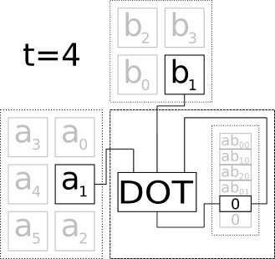
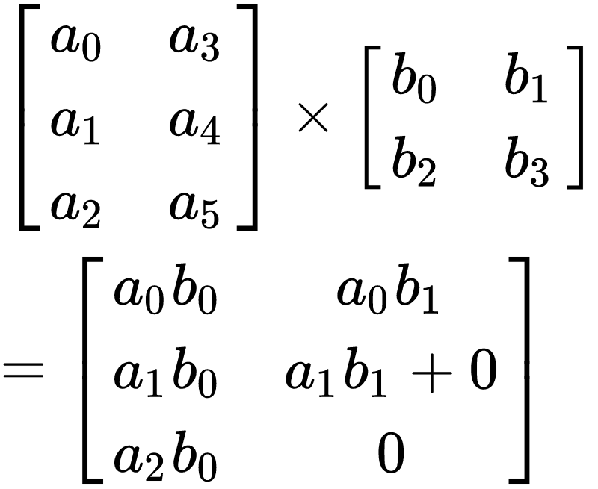
Hardware Template
Notes:
At T = 0, a0 and b0

Slide 40
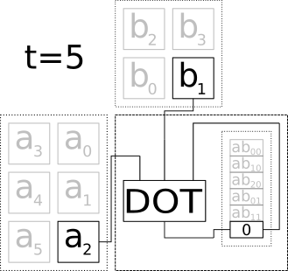
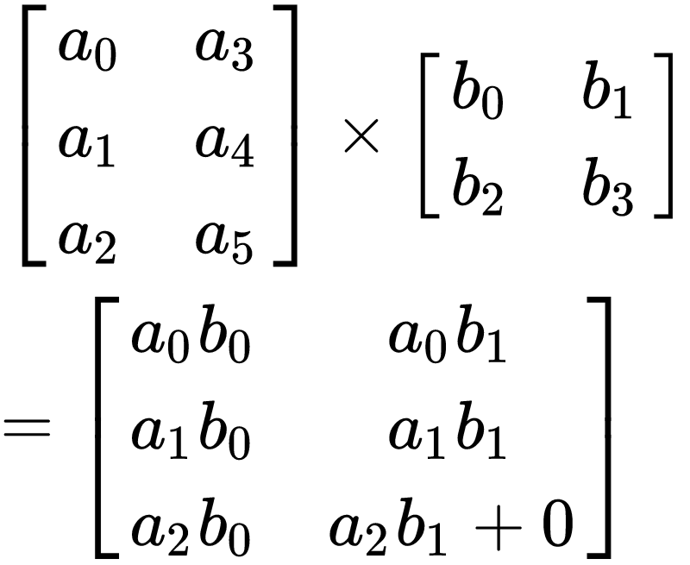
Hardware Template
Notes:
At T = 0, a0 and b0

Slide 41
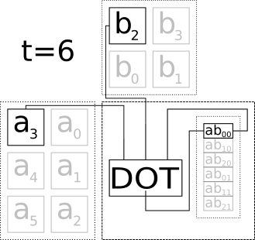
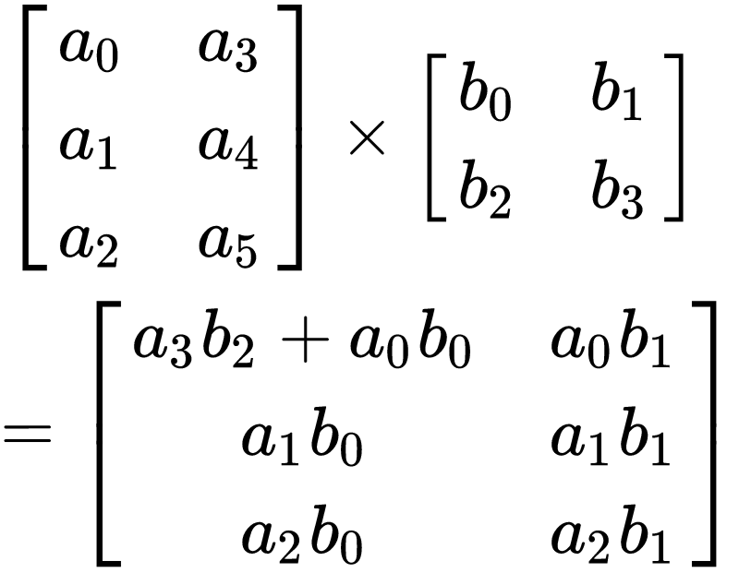
Hardware Template
Notes:
At T = 0, a0 and b0

Slide 42
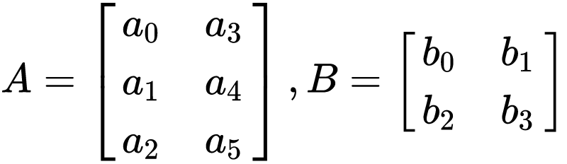
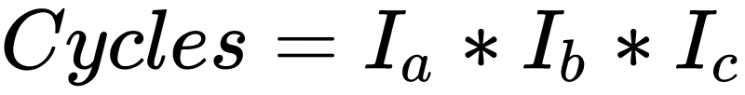
Hardware Template
Notes:
At T = 0, a0 and b0

Slide 43
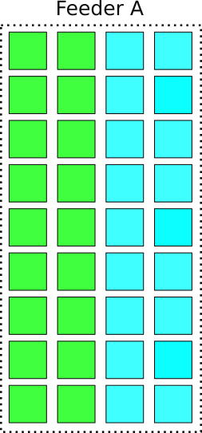
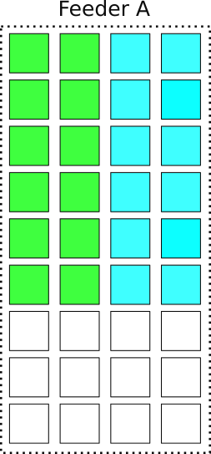
Hardware Template - Runtime Interleaving
Feeders
Feeders
Notes:
The blue and the green squares represented subblocks of

Slide 44
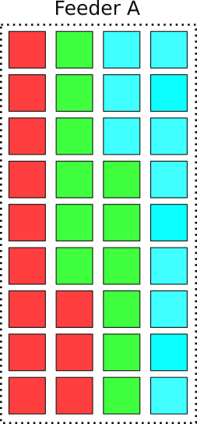
Hardware Template - Runtime Interleaving
Feeders
Feeders
Notes:
This worked well, but unfortunetly when both the CPU and FPGA were making significant memory requests…
Automatic buffer adjusting...

Slide 45
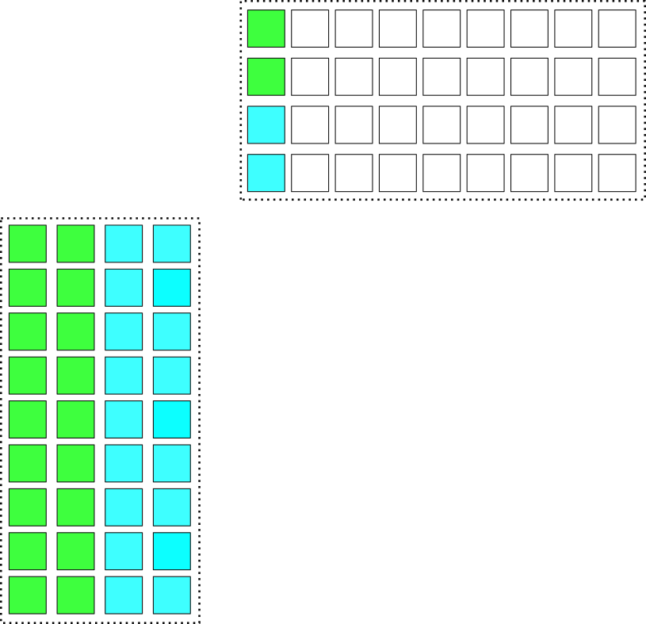
Hardware Template - Any Size, Any Network
Unbalanced Matrix Sizes
Notes:
Up until this point we have a few benchmarks that we were comparing against, the neural networks I mentioned eariler with the standard batch size, etc.
We then looked at these two graphs…
Two problems we came across: zeros in the memories, and degration of CPU bandwidth

Slide 46
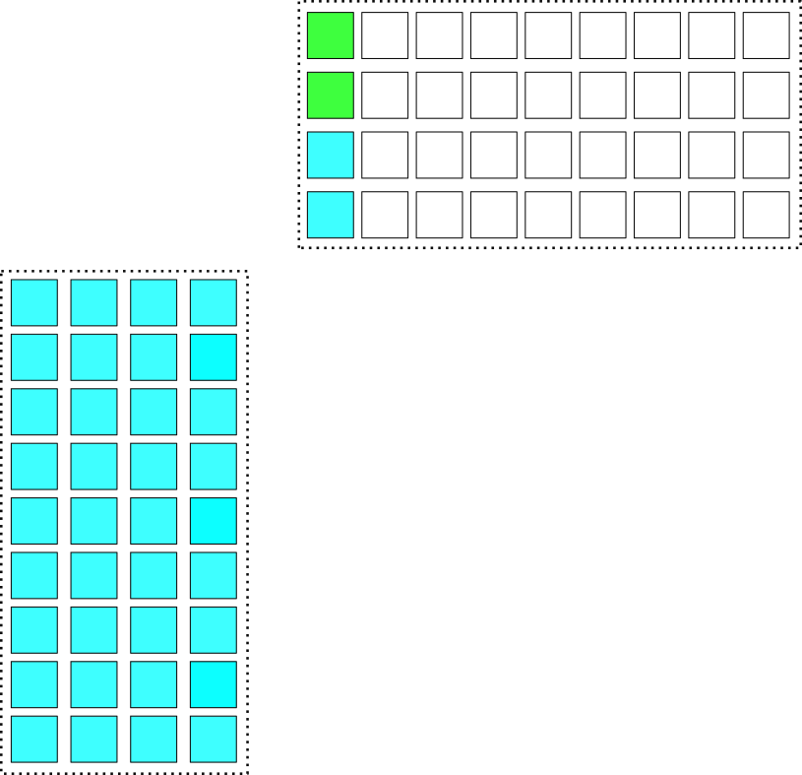
Hardware Template - Any Size, Any Network
Notes:
Up until this point we have a few benchmarks that we were comparing against, the neural networks I mentioned eariler with the standard batch size, etc.
We then looked at these two graphs…
Two problems we came across: zeros in the memories, and degration of CPU bandwidth

Slide 47
Framework - API Extension
Parameters | Type | Options
Systolic Array | C | Logic & Memory Limited
Precision | C | FP32, INT16, INT8, INT4, Ternary, Binary
Accumulator Width | C | Logic & Memory Limited
Interleaving | C & R | Memory Limited
Fused Ops | C & R | Scaling, Batch Norm, Clip, Rounding, ReLU

Slide 48
Framework - API Extension
template<typename T1, typename T2>
void fpga_gemm<T1,T2>::fpga_gemm( trans a, trans b,
int m, int n, int k, float alpha, T1* a, int lda,
T2* b, int ldb, float beta, T1* c, int ldc
int i_a_lead_interleave, int i_b_lead_interleave, int i_feeder_interleave, GEMM_MODE i_mode);
void gemm(trans a, trans b, int m, int n, int k, float alpha, float* a, int lda, float* b, int ldb, float beta, float* c, int ldc);
int config_afu_sgemm(const char *pathname) {
gemmAAL<int, int> hardware_template;
hardware_template.setHW(true);
return hardware_template.configSGEMM(pathname); }
Notes:
The low-level functions are templated to support different precisions and modes.
Depending upon the precision, the number of elements packed into cacheline also changes.
The low level API is shown above. "a\_rows" and "b\_cols" refers to the number of rows and columns in A and B matrices respectively. The
"common" parameter refers to the common dimension in both the matrices.
"i\_alpha" and "i\_beta" refer to the scaling parameters and "i\_mode" refers to the mode in which the hardware accelerator template is set.
"i\_a\_lead\_interleave", "i\_b\_lead\_interleave" and "i\_feeder\_interleave" are the interleaving parameters.
These parameters can be used by the runtime to control the memory interleaving and improve the compute efficiency.
Internally, the application API uses the AAL user mode runtime to access and initialize the FPGA device.
Switching the precision during runtime is supported by the dynamic configuration API.

Slide 49
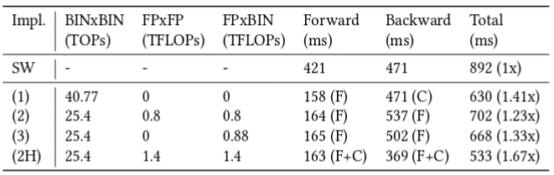
Results - Dynamic Dot Product

