Slide 1
A Full-System VM-HDL Co-Simulation Framework for Servers with PCIe-Connected FPGAs
Shenghsun Cho, Mrunal Patel, Han Chen,
Michael Ferdman, Peter Milder

Slide 2


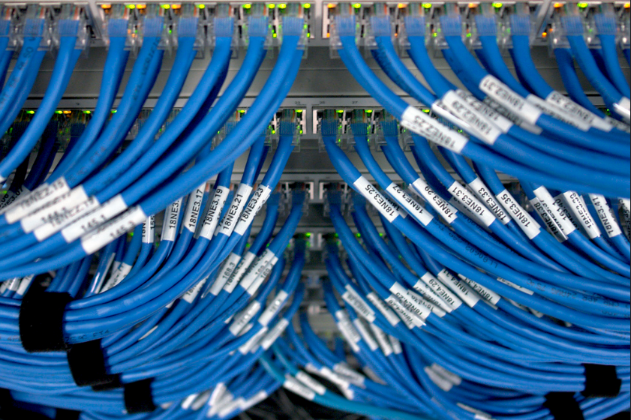
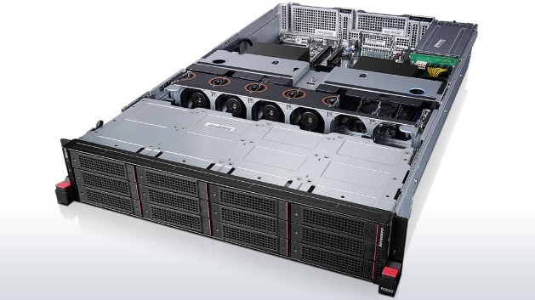
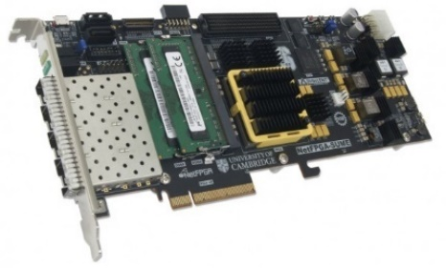

FPGAs in Cloud Creates Debug Challenges
FPGAs now run rapid changing server workloads
Involve HW, SW, and OS at the same time
Directly interact with real-world network
Impossible to debug with testbenches
Forces developers to debug on the target systems
PCIe
FPGA
Network

Slide 3
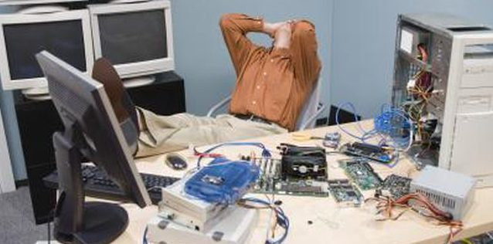
Debugging on Target Systems is Difficult
Long debug iteration time
Time-consuming FPGA synthesis and P&R
Poor visibility for identifying bugs
Limited hardware probes
OS hang and reboot without useful information

Slide 4
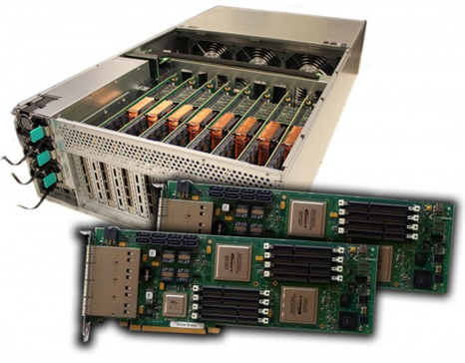

Our VM-HDL Co-Simulation Framework
Run the same HW, SW, and OS as the target systems
Provides network capability for HDL simulation
Reduces debug iteration time
Provides full visibility
VM
HDL
Co-Simulation
Target System

Slide 5
Outline
Overview
FPGA Debugging Challenges
Our VM-HDL Co-Simulation Framework
Case Studies
Conclusions

Slide 6

Long Debug Iteration Time
Synthesis, place and route can take many hours
Not much help from multi cores/machines
Timing violations force re-running the whole process

Slide 7

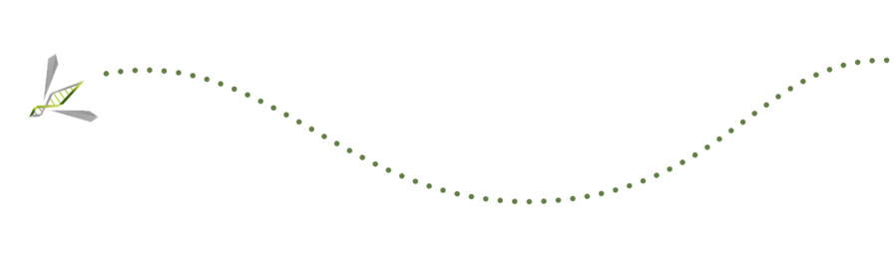
Poor Visibility for Debugging
Very limited FPGA probes and waveform buffer
Requires FPGA P&R to add or change probes
OS reboots without providing enough information

Slide 8

State Of The Art
Systems are too complex for testbenches
HW-SW Co-Sim cannot handle OS and network
Existing full-system simulation is targeting SoC ASICs
Used in early stage evaluation with high-level models

Slide 9
Outline
Overview
FPGA Debugging Challenges
Our VM-HDL Co-Simulation Framework
Case Studies
Conclusions

Slide 10
Our VM-HDL Co-Simulation Framework

Slide 11
Our VM-HDL Co-Simulation Framework
Virtual Machine
Host
HDL Simulator
FPGA
Software
Hardware Design
Unchanged
Components
Operating System
Co-Sim
Components
PCIe Block
Emulated Hardware
FPGA PCIe
Simulation Bridge
Host Hardware
PCIe Link
FPGA
Pseudo Device
Inter-Process Queue

Slide 12
Our VM-HDL Co-Simulation Framework
Virtual Machine
HDL Simulator
Software
Hardware Design
Operating System
PCIe Block
Emulated Hardware
FPGA PCIe
Simulation Bridge
Host Hardware
PCIe Link
FPGA
Pseudo Device
Inter-Process Queue
Attach GDB
Save Waveform
Full visibility and no modification to HW, SW, and OS

Slide 13
Network Support
Virtual Machine
Virtual Machine
HDL Simulator
HDL Simulator
Software
Hardware Design
Operating System
Emulated Hardware
FPGA PCIe Simulation Bridge
Emulated Hardware
PCIe Link
FPGA
Pseudo Device
PCIe Queue
NIC Tap
NIC Queue
FPGA NIC
Simulation Bridge

Slide 14
Network Support
Virtual Machine
Virtual Machine
HDL Simulator
HDL Simulator
Software
Hardware Design
Operating System
Inbound
Packets
Emulated Hardware
FPGA PCIe Simulation Bridge
Emulated Hardware
PCIe Link
FPGA
Pseudo Device
PCIe Queue
NIC Tap
NIC Queue
FPGA NIC
Simulation Bridge

Slide 15
Network Support
Virtual Machine
Virtual Machine
HDL Simulator
HDL Simulator
Software
Hardware Design
Operating System
Outbound
Packets
Emulated Hardware
FPGA PCIe Simulation Bridge
Emulated Hardware
PCIe Link
FPGA
Pseudo Device
PCIe Queue
NIC Tap
NIC Queue
FPGA NIC
Simulation Bridge

Slide 16
Outline
Overview
FPGA Debugging Challenges
The VM-HDL Co-Simulation Framework
Case Studies
Conclusions

Slide 17
Evaluation Setup
Target system
Dual-Socket Xeon server with Xilinx Virtex 7 XC7V690 FPGA
Co-Simulation
QEMU VM with KVM support
VCS HDL simulator
ZeroMQ inter-process communication library
OS and software
Ubuntu 16.04 with Kernel 4.4.0
Software and driver to utilize FPGA designs

Slide 18
Case Study: Sorting Offload
Compare iteration time of a target system and Co-Sim
11% FPGA LUT utilization after place and route
Host
FPGA
Software
Hardware Design
DMA
result
Sorting Engine
Operating System
Device Driver
input
Host Hardware
PCIe
PCIe Block

Slide 19
Debug Iteration Time Comparison
 | Target System (minutes:seconds) | Co-Simulation (minutes:seconds)
Compilation | - | 1m:10s
Synthesis | 18m:03s | -
Place and Route | 35m:40s | -
Reboot | 2m:33s | 0m:25s
Execution | ≈0m:00s | 0m:03s
Total | 56m:16s | 1m:38s

Slide 20
Hardware Probe Change Comparison
Hardware | First Time | Add Probes | Change Probes
Synthesis | 17m:48s | - | -
P&R | 39m:16s | 42m:22s | 58m:52s
Reboot | 1m:26s | 1m:26s | 1m:26s
Execution | ≈0m:00s | ≈0m:00s | ≈0m:00s
Total | 58m:30s | 43m:48s | 60m:18s
Co-Simulation
Simulation | 1m:33s
Total | 1m:33s | 0m:00s | 0m:00s
(unit: minutes:seconds)

Slide 21
Case Study: Network Interface Card
Confirm the functionality of the NIC bridge in Co-Sim
Co-Sim sustains 15KB/sec connections to public network
Host
FPGA
Software
Hardware Design
Ethernet Block
DMA
Inbound Packet
Operating System
Device Driver
Outbound Packet
Host Hardware
PCIe
PCIe Block

Slide 22
Conclusions
Debugging FPGAs in datacenters is difficult
Long debug iteration time
Poor visibility
Our VM-HDL Co-Sim framework solves these problems
Same HW, SW, and OS in simulation and target systems
Provides network capability to HDL simulation
Significantly reduces the debug iteration time
Full visibility for identifying bugs
Source/Demo can be downloaded at:
http://compas.cs.stonybrook.edu/projects/fpgacloud/vm-hdl-cosim/

