Slide 1
Routing Magic: Performing Computations Using Routing Networks and Voting Logic on Unary Encoded Data
Soheil Mohajer; Zhiheng Wang; Kia Bazargan
Monday February 26, 2018

Slide 2
Agenda
Introduction and Background
Overview of Architecture
  Examples
Experimental Result
Hardware Comparison
Notes:
where?
What our methods is though example?
Compare to the previous result

Slide 3
Computation Methods
Binary Computation
Unary Computation
101₂ = 2² + 2⁰=5
11011100_{u} = 5/8
a₁ a₂ a₃ a₄ a₅ a₆ a₇ a₈
c₁ c₂ c₃ c₄ c₅ c₆ c₇ c₈
b₁ b₂ b₃ b₄ b₅ b₆ b₇ b₈
AND
a x b = c
a x b = c
Notes:
Binary: coding is compact and the hardware is big, exponential difference in the length

Slide 4
Stochastic Computation
Example of Multiplication of two numbers
Serial Configuration:
Long clock cycle latency
Small area
111000
110000 (= 2/6)
Correlation Problem
=> hard to parallelize
110000
Notes:
Our work is an evolution of the stochastic computing idea
Suppose we have two independent random sources that generate x and y
Walk though with 2bit example of the multiplication, just with and gate we done the multiplication
Also walk though the bottom example, input streams are exactly the same, output is y not x*y, if we want to implement this in parallel, we need a lot of uncorrelated random bits, which hard

Slide 5
Agenda
Introduction and Background
Overview of Architecture
  Examples
Experimental Result
Hardware Comparison

Slide 6
Overview of Architecture
Thermometer
Encoder
Scaling
Network
Alternator
Logic
Decoder
1
2
3
4
5
6
7
8
9
10
11
12
13
14
15
16
+
Binary
Input
Binary
Output

Slide 7
Overview of Architecture
Thermometer
Encoder
Scaling
Network
Alternator
Logic
Decoder
1
2
3
4
5
6
7
8
9
10
11
12
13
14
15
16
Thermal Encoder
a₂a₁
Binary
Input
Binary
Output
+
Column Decoder
a₄a₃
16 | 15 | 14 | 13
12 | 11 | 10 | 9
8 | 7 | 6 | 5
4 | 3 | 2 | 1
16
15
14
13
12
11
10
9
8
7
6
5
4
3
2
1
Row Decoder
0 0 1 0
a₄a₃a₂a₁
Binary
Input

Slide 8
Overview of Architecture
Thermometer
Encoder
Scaling
Network
Alternator
Logic
Decoder
1
2
3
4
5
6
7
8
9
10
11
12
13
14
15
16
Thermal Encoder
a₂a₁
Binary
Input
Binary
Output
+
Column Decoder
a₄a₃
16 | 15 | 14 | 13
12 | 11 | 10 | 9
8 | 7 | 6 | 5
4 | 3 | 2 | 1
16
15
14
13
12
11
10
9
8
7
6
5
4
3
2
1
Row Decoder
0 1 1 0
a₄a₃a₂a₁
Binary
Input
Notes:
Flip the number

Slide 9
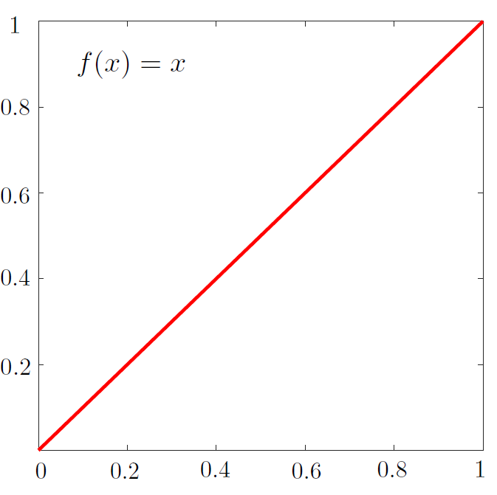
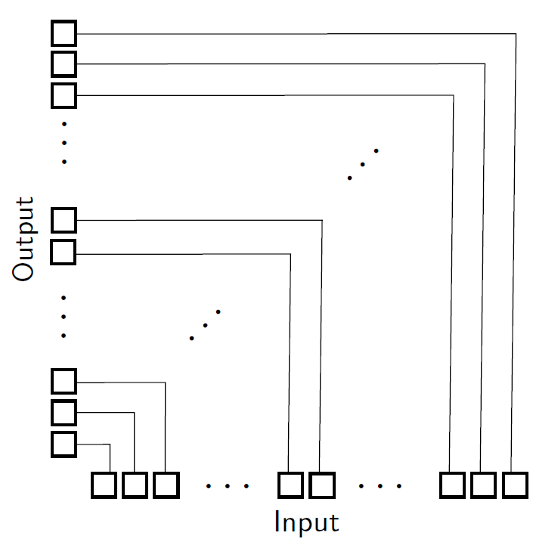
Unit Slope Function
1
2
3
4
5
6
7
8
9
10
11
12
13
14
15
16
Binary
Input
Binary
Output
+
Function Plot
Scaling Network
Alternator Logic

Slide 10
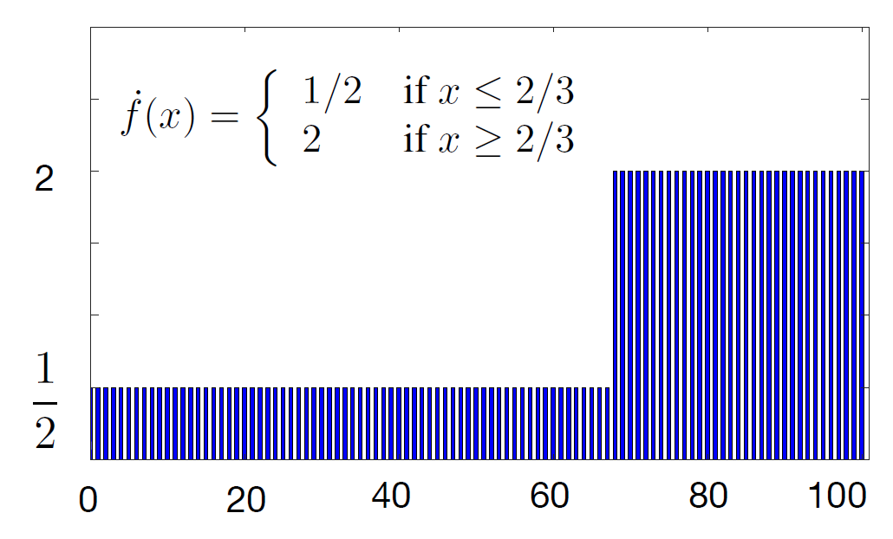
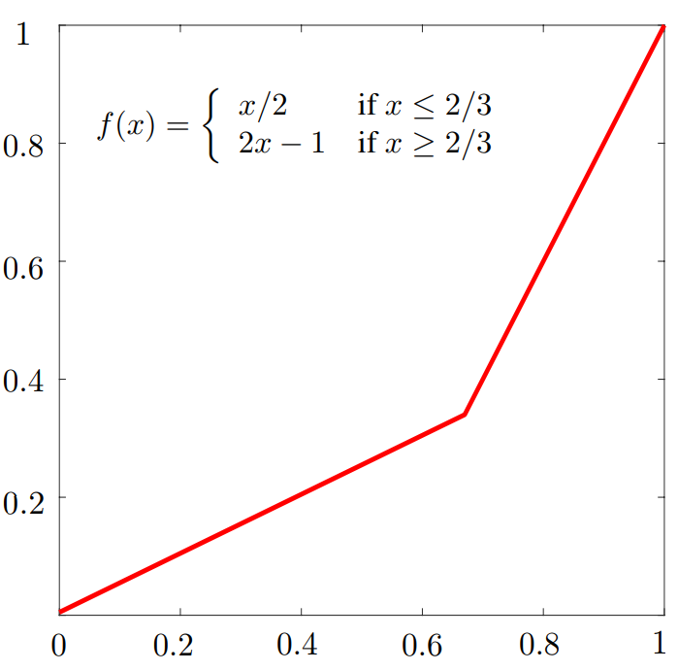
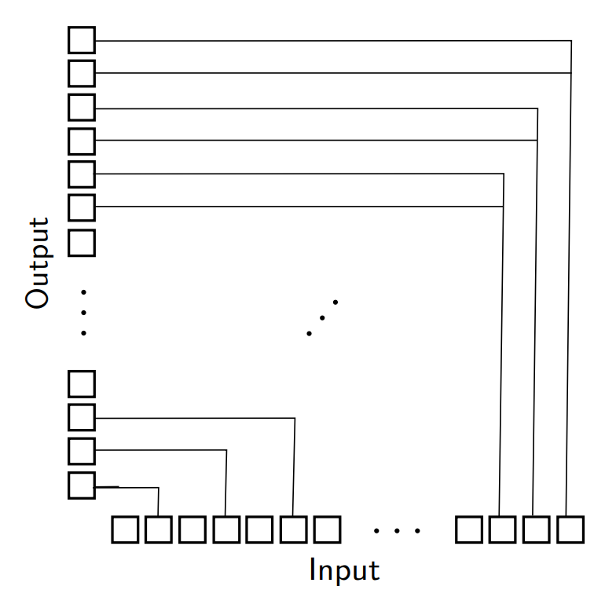
Piece-wise Linear Function
Function Plot
Scaling Network

Slide 11
Piece-wise Linear Function
Function Plot
Scaling Network

Slide 12
Piece-wise Linear Function
Function Plot
Scaling Network
Notes:
Add more slides to show the step of the function itself

Slide 13
Piece-wise Linear Function
Function Plot
Scaling Network
Notes:
Add more slides to show the step of the function itself

Slide 14
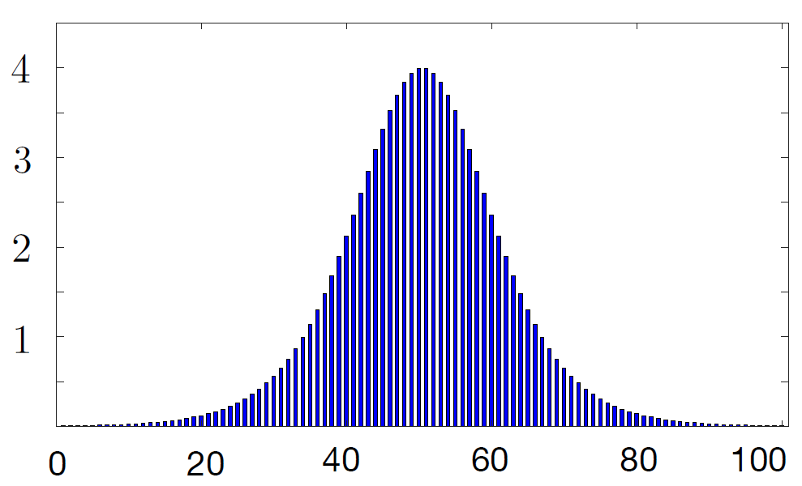
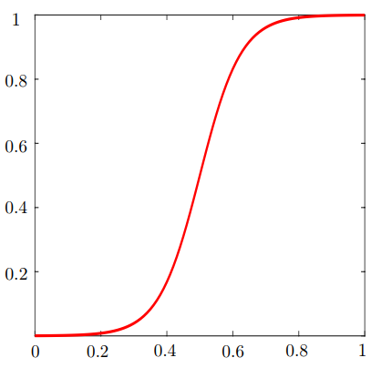
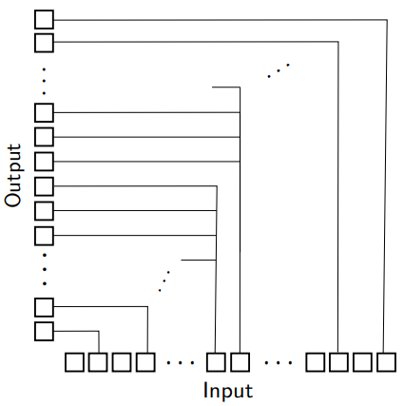
Monotonically Increase Function
Function Plot
Scaling Network

Slide 15
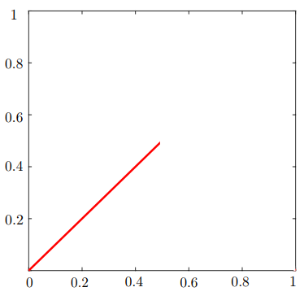
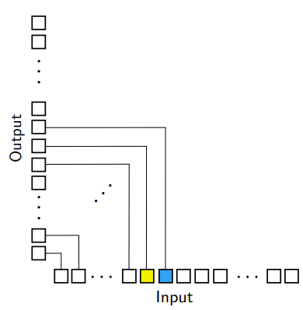
General Oscillating Function
Increasing part of the function
Scaling Network
Notes:
Remind they our themal code increment from the left, with additional x increase, y has to increase

Slide 16
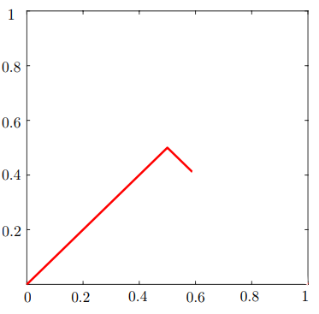
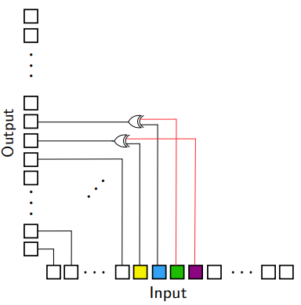
General Oscillating Function
First deduction of the function
Scaling Network
Notes:
Now with additional x, y has to decrease, the additional x has to undo the effect of the previous bits, the green is undoing the blue one by using the XOR gate

Slide 17
General Oscillating Function
First deduction of the function
Scaling Network

Slide 18
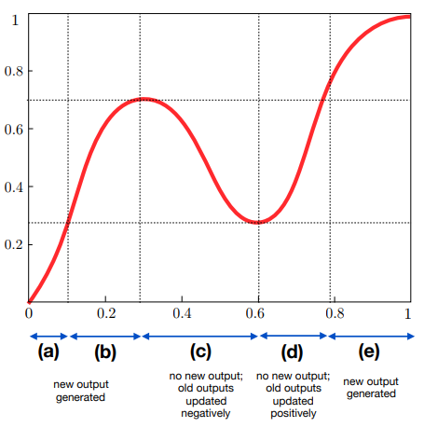
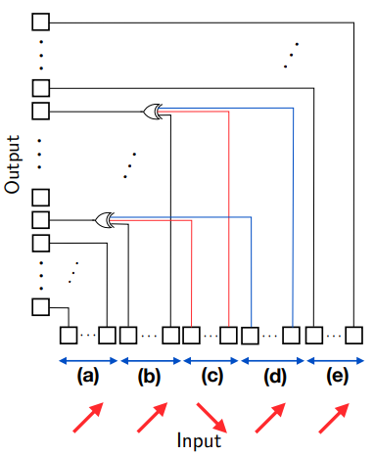
General Oscillating Function
Function Plot
Scaling Network
0.5
0.5
Notes:
Focus on the blue line, the y at this point when the black is turned on for the first time, and remains on until the red has turned on. The red point has to undo the effect of black one, which can be done by using a two inputs xor gate. The blue line has to turn on again when the blue point has turned on. Three inputs xor gate would do that.
Please remember this slide because I will use this concept in the 3d figure.

Slide 19
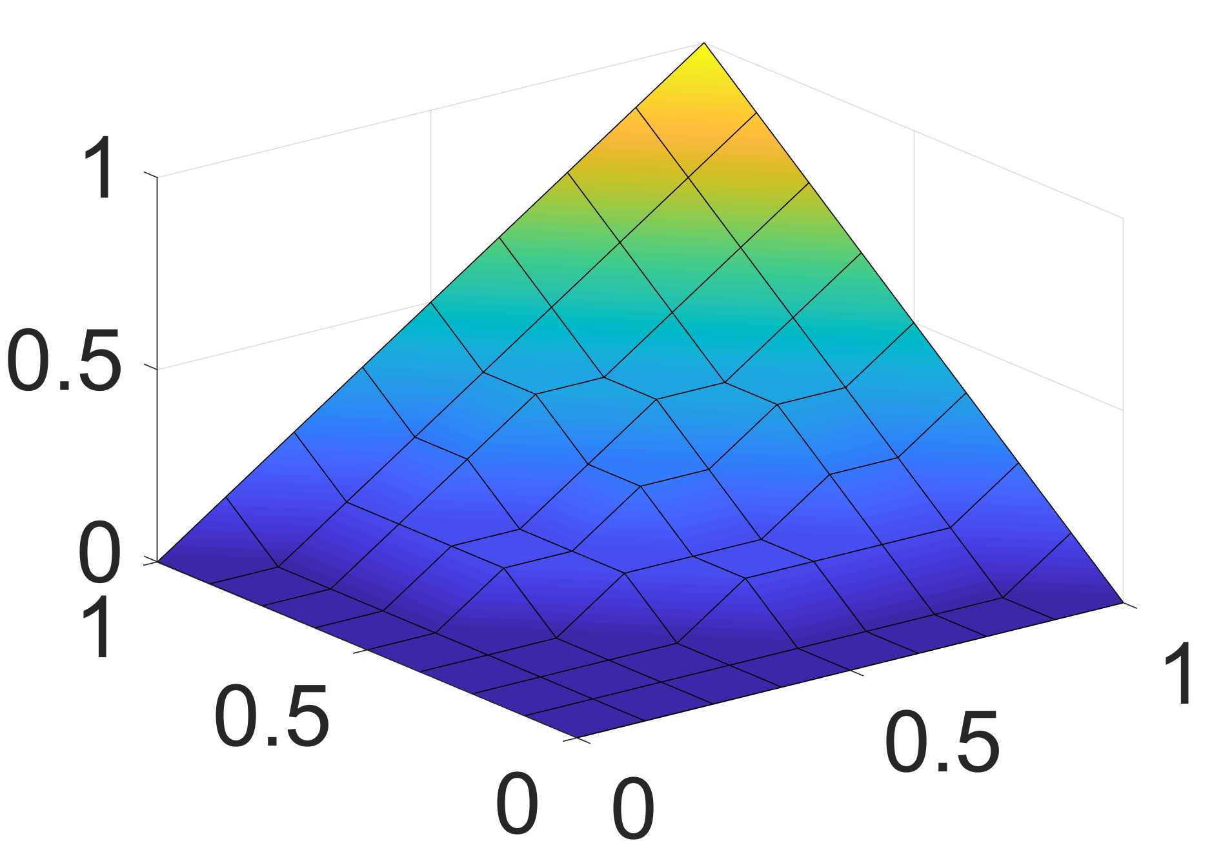
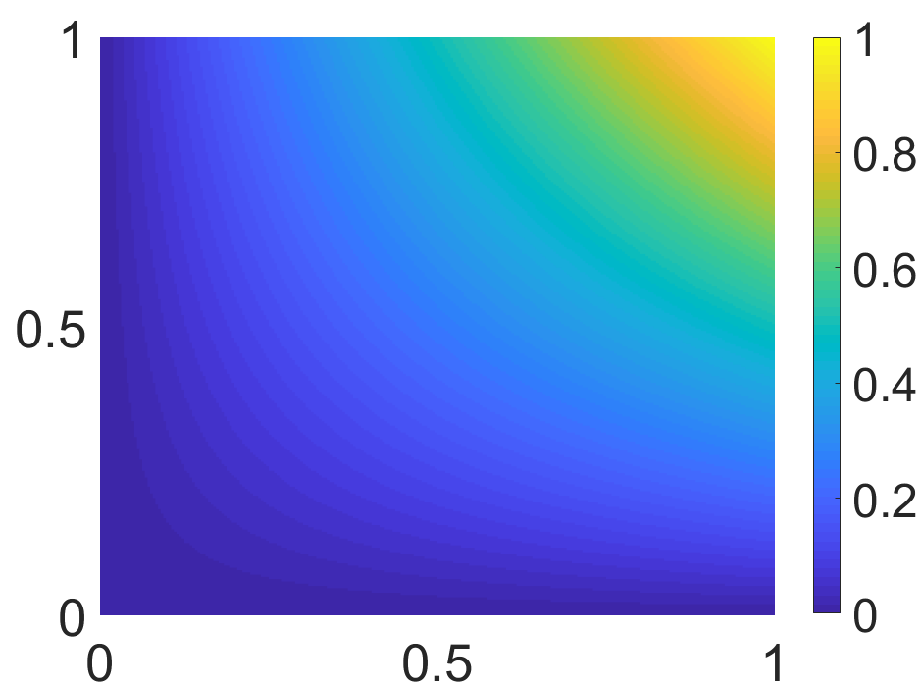

Multivariate Function
$$Z=X×Y$$
Monotonically Increasing Function
Z
Y
X
X
Y

Slide 20
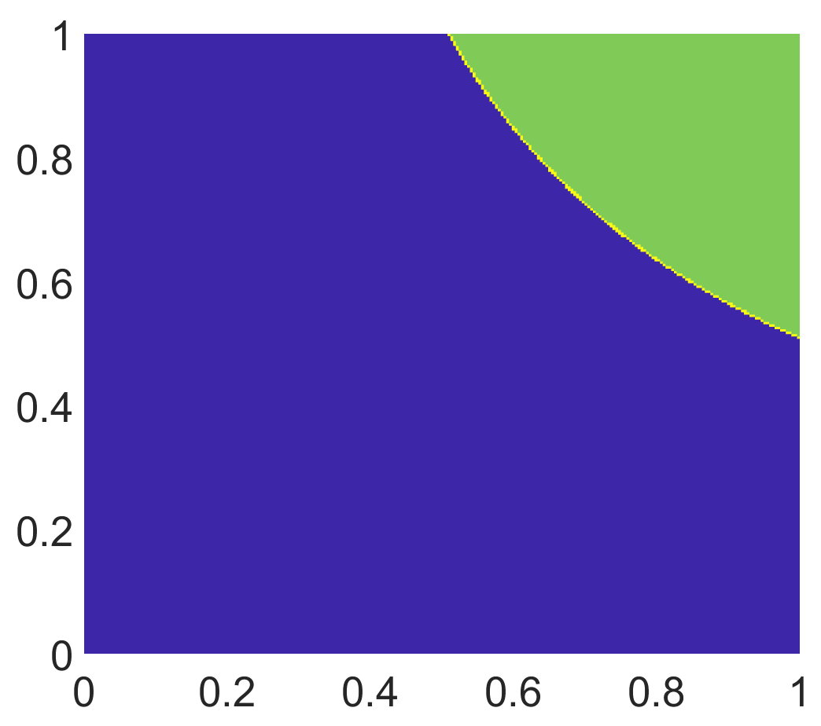
Multivariate Function
$$Z=X×Y$$
Monotonically Increasing Function
Z = 0.5
Z
Y
X
Y
X
Notes:
Focus on the yellow dot, assume the x is fixed at 0.6, the only time I have to turn on the output line is when the y hit yellow point. If I and 0.6 form x and 0.8 from y, I can tell I have reached the yellow dot , similarly for all of the boundary points we need to use the sum of product to specify the function

Slide 21
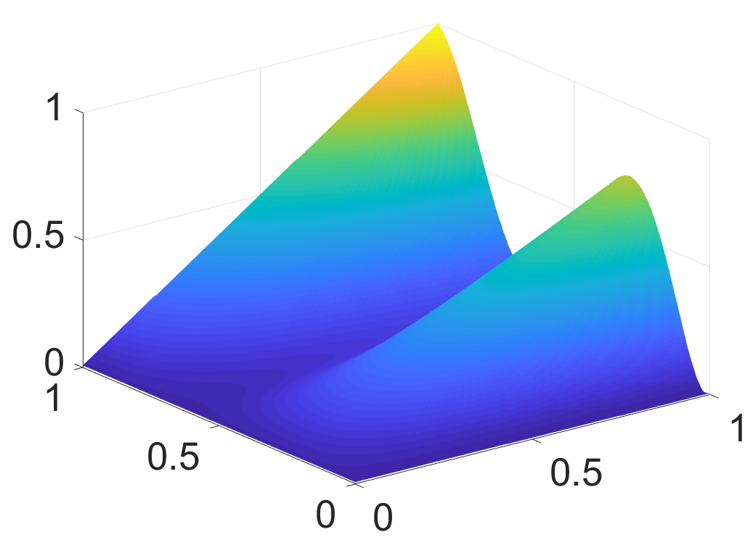
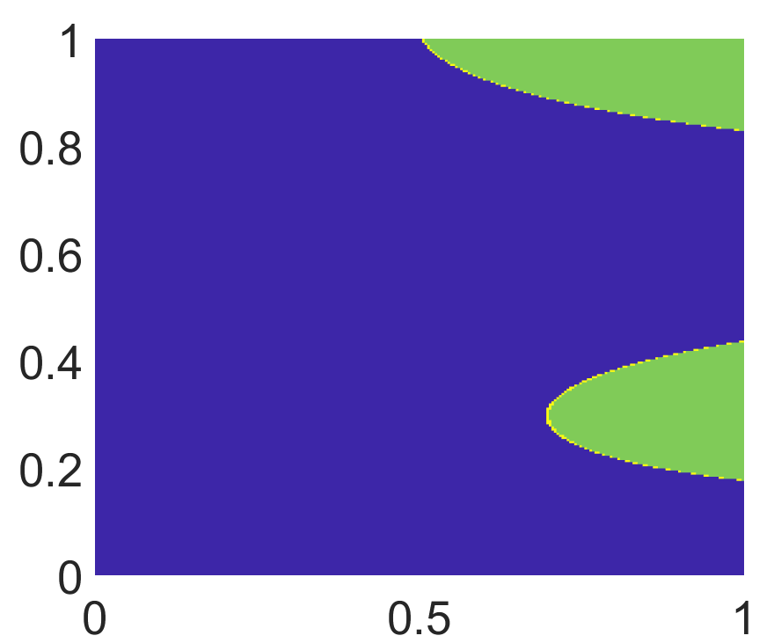

Multivariate Function
$$Z=f(X,Y)$$
Oscillating Function
Z = 0.5
Z
Y
X
Y
X
Notes:
Tie to the previous xor slide

Slide 22
Agenda
Introduction and Background
Overview of Architecture
  Examples
Experimental Result
Hardware Comparison

Slide 23
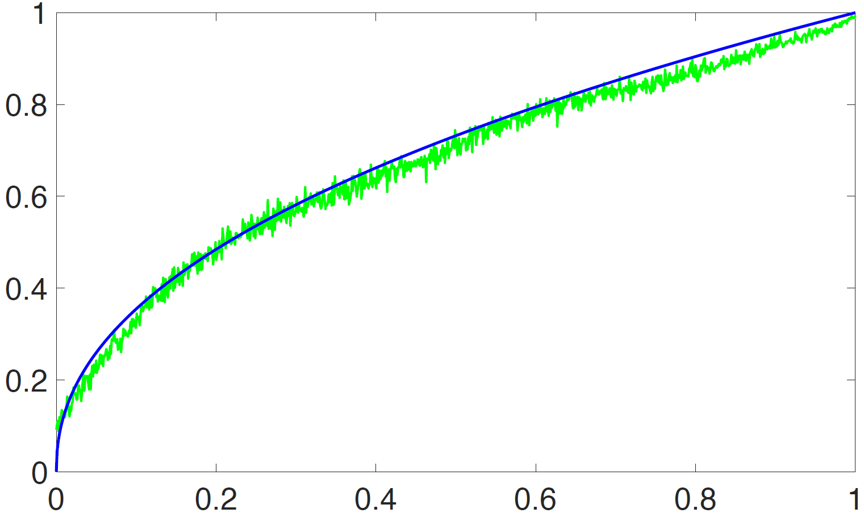
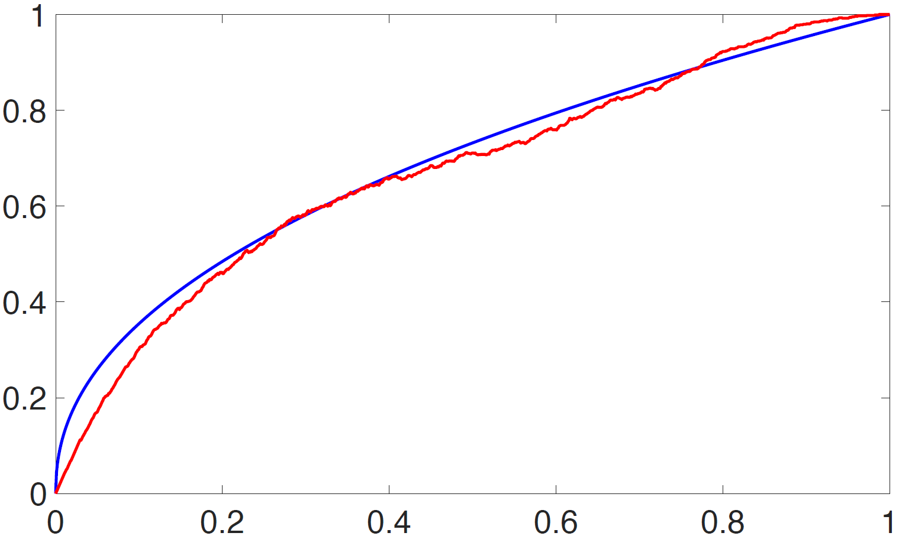
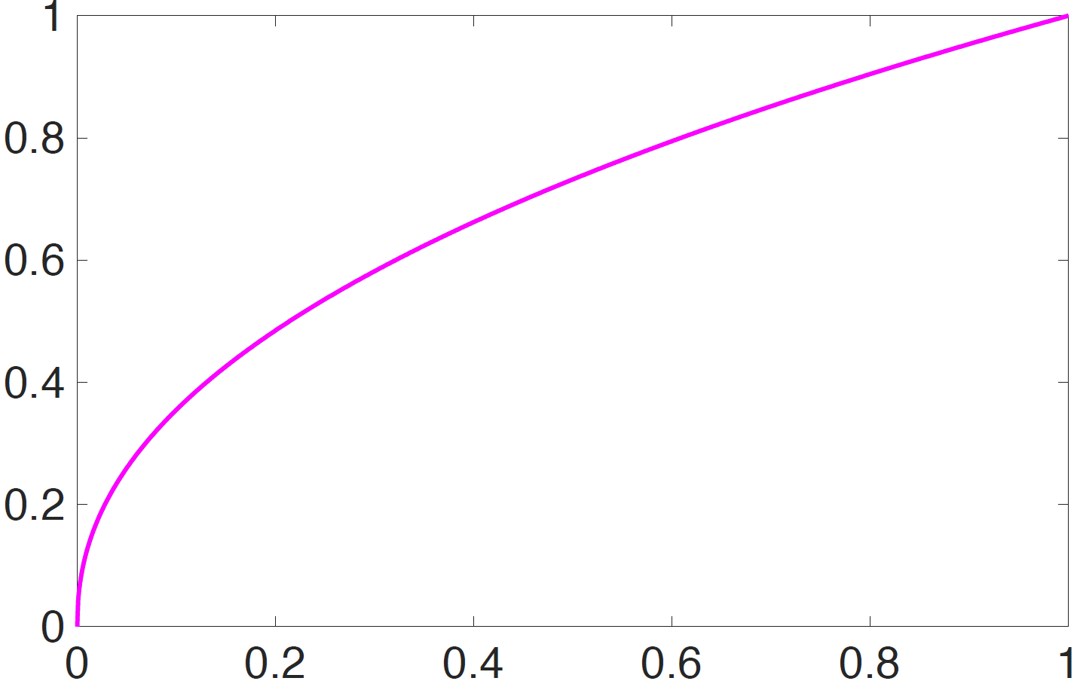
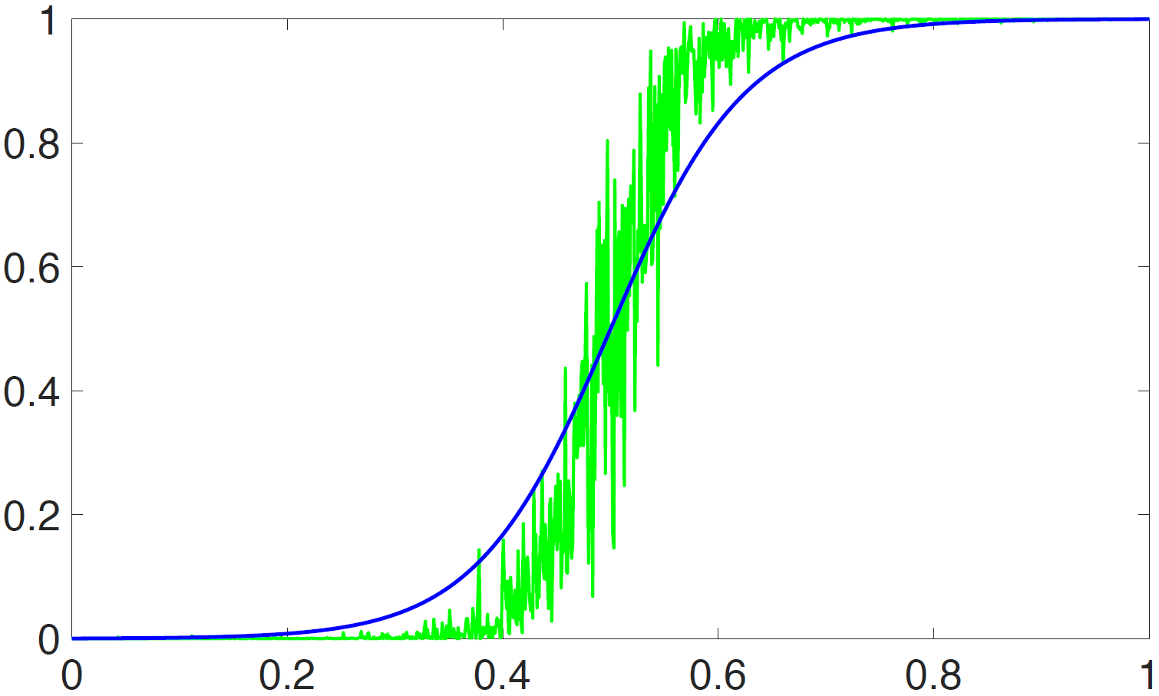
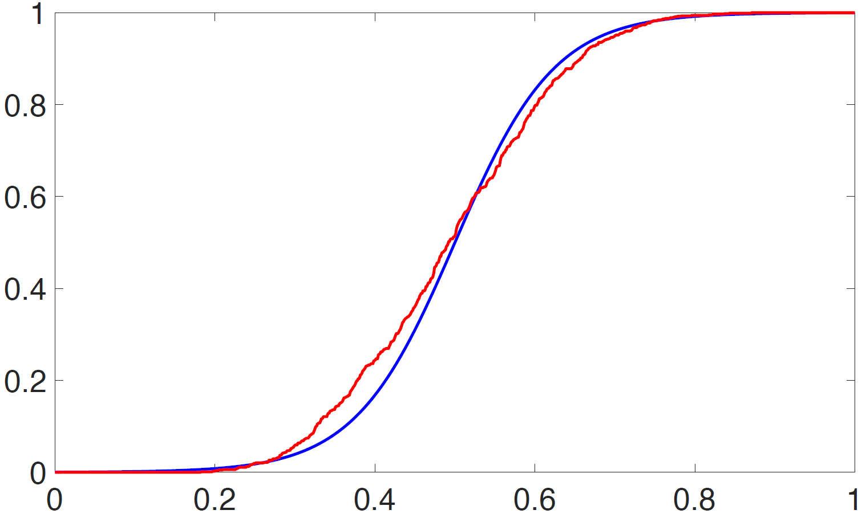
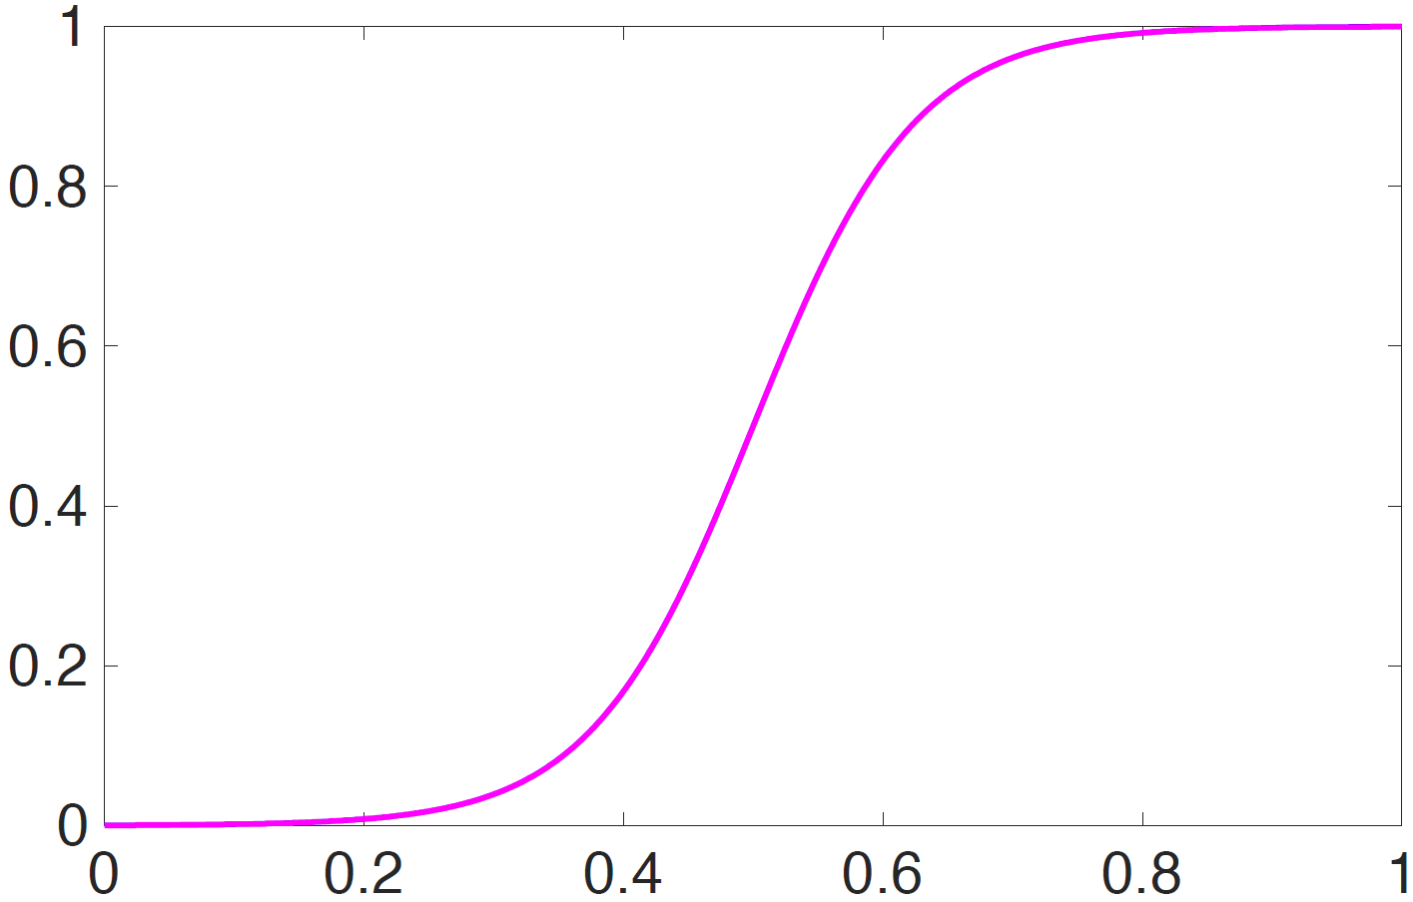
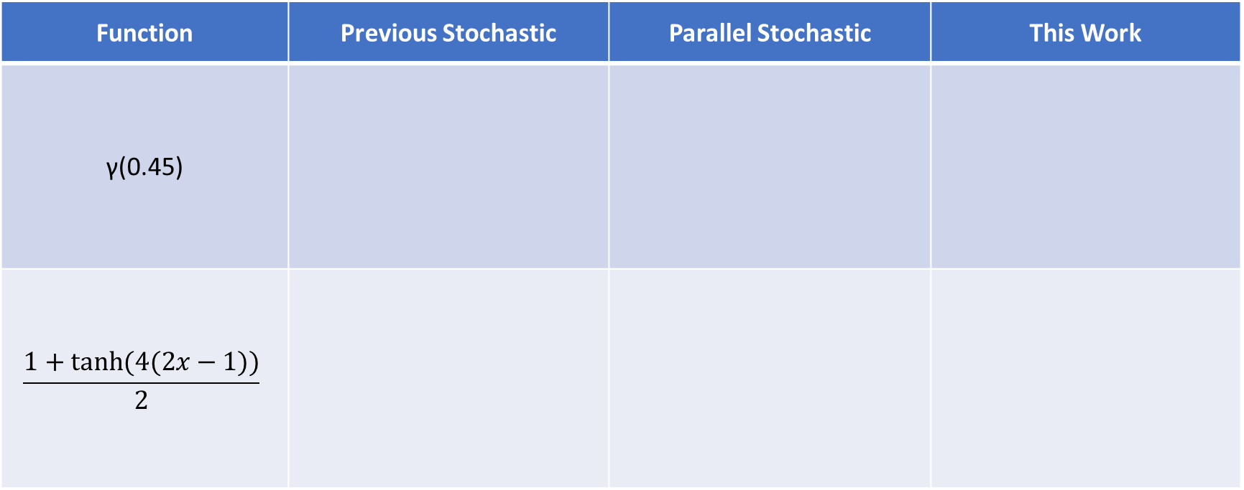
Experimental Results: Accuracy
Different Functions
Function | Previous Stochastic | Parallel Stochastic | This Work
γ(0.45)
$$\frac{1+tanh⁡(4(2x−1))}{2}$$

Slide 24






Experimental Result: Image Processing
Gamma Correction
Edge Detection
Original
Gamma(0.25)
Original
Edge Display
Function | LUT | Delay (ns) | AxD
Conv Edge Detection | 1218 | 145.6 | 177k
This Work | 8240 | 5.73 | 47k
Conv Median F | 421 | 15.45 | 6.5k
This Work | 1723 | 5.76 | 11.8k
Gamma(0.45)
Gamma(0.75)
Notes:
The details of the implementation are in the paper, the reason that our method works well with the edge detection but not the median is that in the median we have to convert too many number to the unary and the encoder takes a lot of resources

Slide 25
Agenda
Introduction and Background
Overview of Architecture
  Examples
Experimental Result
Hardware Comparison

Slide 26
Area Comparison
N/A
Notes:
Conventional binary implementation
The area report for the stochastic is just one bit, but we need to do it over 1024 time for the 10 bit computation

Slide 27
Delay Comparison
N/A

Slide 28
Area Delay Product Comparison
Average: 8% of Conv
N/A
Notes:
Average comparision

Slide 29
Thank you!

Slide 30
Area Comparison

Slide 31
Delay Comparison

Slide 32
Why FPGA?

