Slide 1
ParaDRo: A Parallel Deterministic Router Based on Spatial Partitioning and Scheduling
Chin Hau Hoo, Akash Kumar
Notes:
There are two parts to the title, I will explain each individually

Slide 2
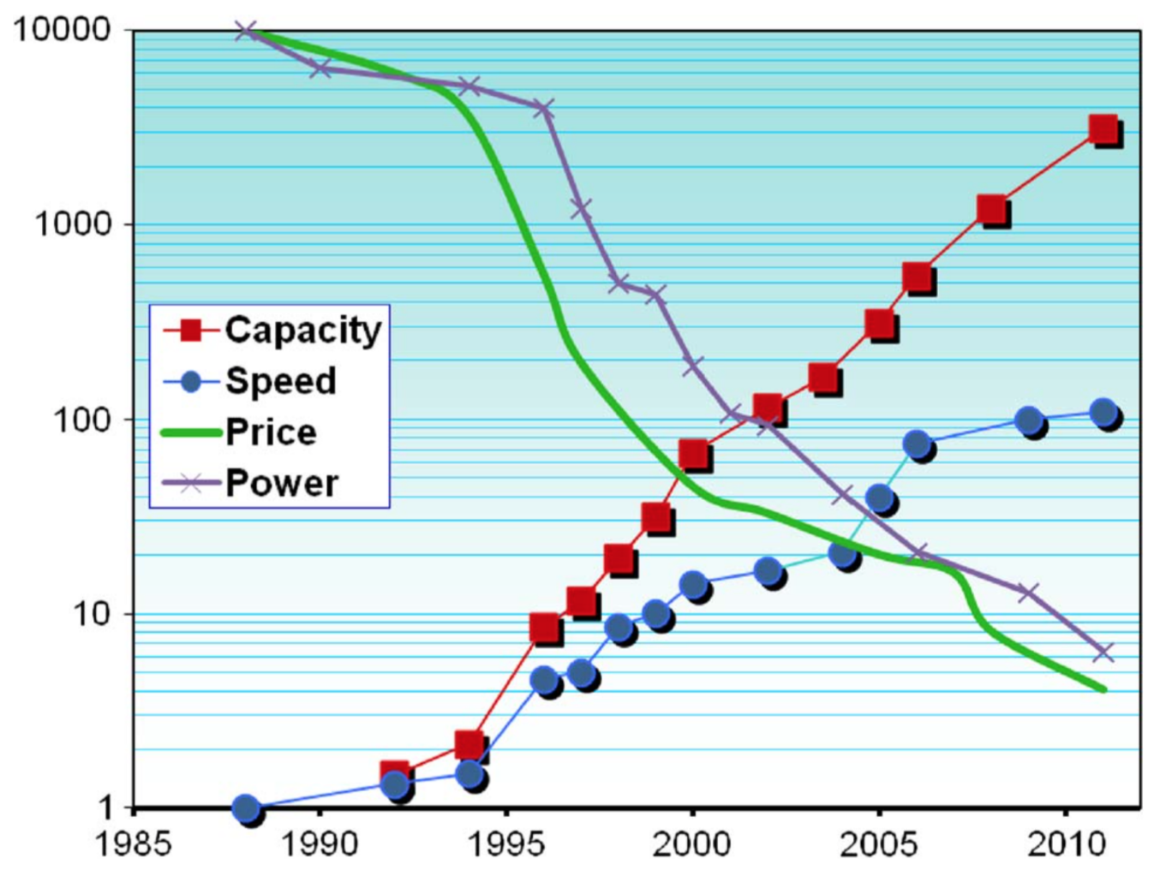
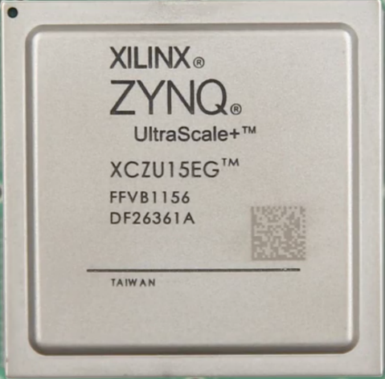
Moore’s law driving FPGA advancement
Xilinx XC2064
64 LUTs
Xilinx Zynq Ultrascale+
500,000+ LUTs
Notes:
This first FPGA has X number of LUTs
So what is an f

Slide 3
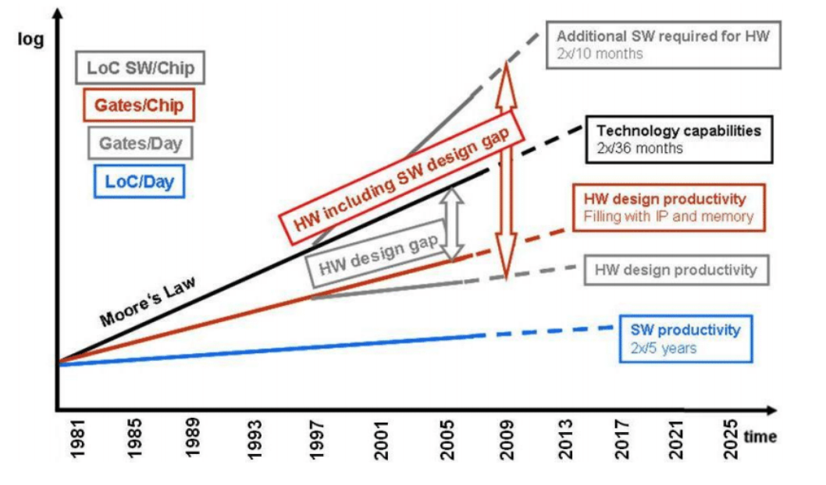
What is the problem?
Notes:
In other words, the capacity of fpga is growing faster than the ability of design tools to effectively utilize it

Slide 4
Why?
End of Dennard’s scaling
Increasing the clock speed of processor is no longer a viable solution to reduce execution time
“Power wall”

Slide 5
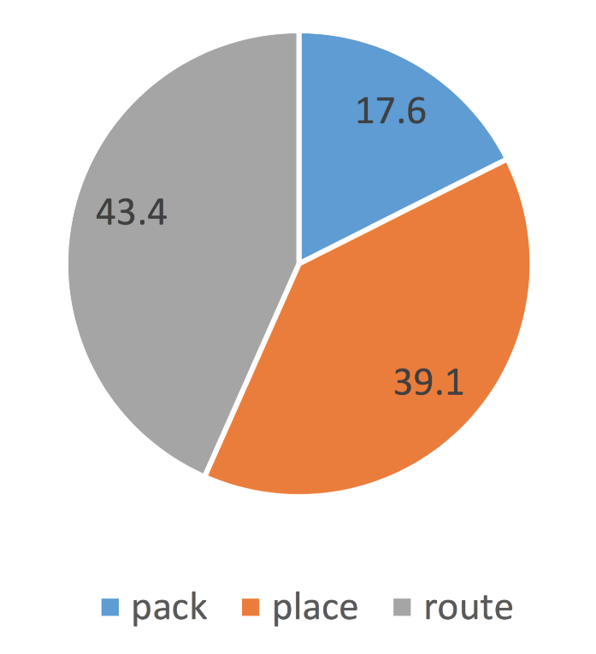
FPGA design flow
HDL
Logic synthesis
Percentage of execution time in various stages
Technology mapping
Packing
Placement
Routing
Bitstream generation
Notes:
To better understand the design productivity gap, let’s look at a typical fpga design flow. Therefore, in this talk we are focusing on routing.
Data is obtained using the 8 benchmarks in slide 29

Slide 6
Pathfinder
Initialize
CLB
CLB
Has nets to route?
No
Yes
Rip up net
Update history congestion costs
Route net
Update present congestion costs
CLB
CLB
Yes
Congested?
Output pin
No
Input pin
Done
Notes:
So what is the algorithm to perform routing in fpgas? Pathfinder
The figure on the left shows an example arch of fpga
Pathfinder builds a graph to model the the routing resources in this fpga during initialization

Slide 7
Pathfinder
Initialize
CLB
CLB
Has nets to route?
No
Yes
Rip up net
Update history congestion costs
Route net
Update present congestion costs
CLB
CLB
Yes
Congested?
Output pin
No
Input pin
Done

Slide 8
Pathfinder
Initialize
CLB
CLB
Has nets to route?
No
Yes
Rip up net
Update history congestion costs
Route net
Update present congestion costs
CLB
CLB
Yes
Congested?
Output pin
No
Input pin
Done

Slide 9
Pathfinder
Initialize
CLB
CLB
Has nets to route?
No
Yes
Rip up net
Update history congestion costs
Route net
Update present congestion costs
CLB
CLB
Yes
Congested?
Output pin
No
Input pin
Done

Slide 10
Pathfinder
Initialize
CLB
CLB
Has nets to route?
No
Yes
Rip up net
Update history congestion costs
Route net
Update present congestion costs
CLB
CLB
Yes
Congested?
Output pin
No
Input pin
Done
Notes:
Path finder is similar to Dijktra’s algorithm except that the cost is updated dynamically

Slide 11
Pathfinder
Initialize
CLB
CLB
Has nets to route?
No
Net 1 source
Yes
Rip up net
Net 2 source
Update history congestion costs
Route net
Update present congestion costs
CLB
Net 1 sink
CLB
Yes
Congested?
Net 2 sink
Output pin
No
Input pin
Done

Slide 12
Pathfinder
Initialize
CLB
CLB
Has nets to route?
No
Net 1 source
Yes
Rip up net
Net 2 source
Update history congestion costs
Route net
Update present congestion costs
CLB
Net 1 sink
CLB
Yes
Congested?
Net 2 sink
Output pin
No
Input pin
Done

Slide 13
Pathfinder
Initialize
CLB
CLB
Has nets to route?
No
Net 1 source
Yes
Rip up net
Net 2 source
Update history congestion costs
Route net
Update present congestion costs
CLB
Net 1 sink
CLB
Yes
Congested?
Net 2 sink
Output pin
No
Input pin
Done

Slide 14
Observations
Pathfinder is largely sequential
Route of a net depends on the routes taken by nets routed before it
Is it possible to create a scalable and deterministic parallel FPGA router?
Notes:
No free lunch
Complex trade off between speedup, quality of result, and determinism

Slide 15
Existing deterministic routers
 | Platform | Method | Speedup
Gort, 2010 (Coarse) | Shared memory | Net partitioning | Moderate
Gort, 2010 (Fine) | Shared memory | Parallel maze expansion | Low
Gort, 2010 (Hybrid) | Shared + Distributed memory | Net partitioning + Parallel maze expansion | Moderate
Gort, 2012 | Distributed memory | Net partitioning | Moderate
Gort, 2012 (Enhanced) | Distributed memory | Net partitioning + Conditional net rerouting | High
Shen, 2015 | Distributed memory | Net partitioning | Moderate
Shen, 2017 | GPU | Net partitioning + Parallel maze expansion | Very high
ParaDRo | Shared memory | Net partitioning + Scheduling | High
Notes:
Net partitioning is used in almost all approaches to ensure determinism

Slide 16
Algorithm overview
Initialization
  Recursive bi-partitioning
    Pre-processing
    Finding the optimal cut-line
  Multi-sink net decomposition and virtual net generation
  Overlap graph coloring and task graph generation
Routing virtual nets in the task graph associated with each node in the bi-partitioning tree

Slide 17
Recursive bi-partitioning
A
start=0, end=3
E
start=5, end=7
P0
Nets: C, D
start=0, end=2
B
F
start=5, end=8
C
start=3, end=5
P1
Nets: A, B
P2
Nets: E, F
D
start=4, end=6
FPGA Columns
0
1
2
3
4
5
6
7
8

Slide 18
Recursive bi-partitioning
– Pre-processing
A
start=0, end=3
E
nets_start
start=5, end=7
0
1
2
3
4
5
6
7
8
start=0, end=2
B
F
start=5, end=8
C
start=3, end=5
A
C
D
E
D
B
F
start=4, end=6
FPGA Columns
0
1
2
3
4
5
6
7
8

Slide 19
Recursive bi-partitioning
– Pre-processing
A
start=0, end=3
E
nets_end
start=5, end=7
0
1
2
3
4
5
6
7
8
start=0, end=2
B
F
start=5, end=8
C
start=3, end=5
B
A
C
D
E
F
D
start=4, end=6
FPGA Columns
0
1
2
3
4
5
6
7
8

Slide 20
Recursive bi-partitioning
– Pre-processing
total_workload_after
0
1
2
3
4
5
6
7
8
0
0
0
0
0
0
0
0
0
2
0
0
0
0
0
0
0
0
A
start=0, end=3
E
start=5, end=7
3
0
0
0
0
0
0
0
0
B
3
0
0
2
0
0
0
0
0
start=0, end=2
F
start=5, end=8
3
0
0
2
1
0
0
0
0
C
start=3, end=5
D
3
0
0
2
1
1
0
0
0
start=4, end=6
3
0
0
2
1
3
0
0
0
FPGA Columns
0
1
2
3
4
5
6
7
8
Prefix sum from the last element
9
6
6
6
4
3
0
0
0

Slide 21
Recursive bi-partitioning
– Pre-processing
total_workload_before
0
1
2
3
4
5
6
7
8
0
0
0
0
0
0
0
0
0
0
0
0
2
0
0
0
0
0
A
start=0, end=3
E
start=5, end=7
0
0
1
2
0
0
0
0
0
B
0
0
1
2
0
2
0
0
0
start=0, end=2
F
start=5, end=8
0
0
1
2
0
2
1
0
0
C
start=3, end=5
D
0
0
1
2
0
2
1
1
0
start=4, end=6
0
0
1
2
0
2
1
1
2
FPGA Columns
0
1
2
3
4
5
6
7
8
Prefix sum from the first element
0
0
1
3
3
5
6
7
9

Slide 22
Recursive bi-partitioning
- Finding the optimal cut-line
total_workload_before
Absolute workload diff
0
1
2
3
4
5
6
7
8
Cutline
0
1
2
3
4
5
6
7
8
9
0
0
1
3
3
5
6
7
9
9
6
6
5
1
0
5
6
7
9
total_workload_after
Min diff
Min diff
Min diff
Min diff
0
1
2
3
4
5
6
7
8
Min diff
9
6
6
6
4
3
0
0
0
P0
Nets: C, D
nets_end
nets_start
0
1
2
3
4
5
6
7
8
0
1
2
3
4
5
6
7
8
P1
Nets: A, B
P2
Nets: E, F
B
A
C
D
E
F
A
C
D
E
B
F

Slide 23
Problem when routing
Net C and D are overlapping!
Thread 0
Thread 1
C
P0
Nets: C, D
Idle
D
A
E
P1
Nets: A, B
P2
Nets: E, F
B
F

Slide 24
Multi-sink net decomposition and virtual net generation
C1
C2
Less overlap between virtual nets
D1
C
C1
C2
OR
D
D
C1
C2
D1
Notes:
When we break

Slide 25
Overlap graph coloring and task graph generation
C1
C2
C1
C1
C1
C2
D1
C2
D1
C2
D1
D1
Overlap graph
Graph coloring to identify parallelism
Conversion to directed task graph to minimize idle time
Notes:
Graph coloring to identify parallelism

Slide 26
Overlap graph coloring and task graph generation
C1
C2
C1
C1
C3
C1
C3
C3
C2
D1
C2
D1
C2
D1
D1
C3
Graph coloring to identify parallelism
Conversion to directed task graph to minimize idle time
Overlap graph
Notes:
Graph coloring to identify parallelism

Slide 27
Routing the nets with scheduling
With scheduling
Without scheduling
Thread 0
Thread 1
Thread 0
Thread 1
C2
D
C
C1
P0
Nets: C1, C2, C3, D
Idle
C3
A
E
D
VS
P1
Nets: A, B
P2
Nets: E, F
B
F
A
E
B
F

Slide 28
Ensuring convergence
When the number of congested nets drops below a predefined threshold, ParaDro only reroutes congested nets
When rerouting only congested nets, the bounding boxes of virtual nets are expanded back to their original size
C1
C2
C1
C2
D
D

Slide 29
Experimental Setup
Dual Intel® Xeon® E5-2680 v3 + 128 GB RAM
RHEL 6.8 + Linux kernel 2.6.32
gcc 7 with -O3 flag
Benchmark | Total nets | Minimum channel width
stereovision1 | 10,797 | 104
LU8PEEng | 15,990 | 114
stereovision2 | 34,501 | 154
LU32PEEng | 53,199 | 174
neuron | 54,056 | 206
stereo_vision | 61,883 | 228
segmentation | 125,592 | 292
denoise | 257,425 | 310

Slide 30
Speedup of different ParaDRo variants
Par: parallelism within a node as well
Extra: bipartition each internal node
once more in orthogonal direction
Notes:
Seq – no parallelism within the partition node
Par – parallelize the nodes within the partition e.g. C and D
Extra – orthogonal cuts in all the nodes, except the last level of the tree. Since the number of leaves is the same as the number of threads.

Slide 31
Critical path delay

Slide 32
Impact on total wirelength
Notes:
Two factors – Restrictive bounding box and our ParaDRo partitioning

Slide 33
Impact of enforcing sequential equivalence on speedup

Slide 34
Speedup comparison with existing deterministic works
18.7
(par extra)
Notes:
Gort Enhanced – only in first iteration it routes all nets.. From the second iteration only congested routes are routed.
Largest benchmark was Stereo-vision with 40K LUTs, may give convergence issues with larger benchmarks
Shen uses Bellman-Ford, easier to parallelize than Dijkstra but it is not work-optimal

Slide 35
Impact of ‘Determinism’
Notes:
ParaFRo: FPL 2016
ParaDiMe: FCCM 2017

Slide 36
Conclusions
Presented a deterministic parallel router - ParaDRo
Uses recursive bi-partitioning to group the nets into nodes that can be routed in parallel
Graph coloring and task scheduling are employed within the node to exploit further parallelism
Determinism affects speed-up significantly

Slide 37
Thank you!

Slide 38

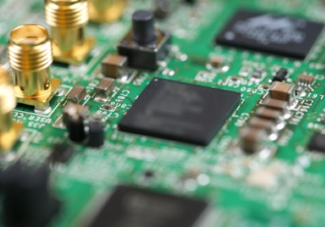
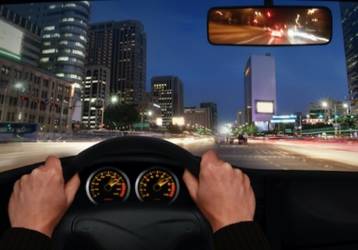




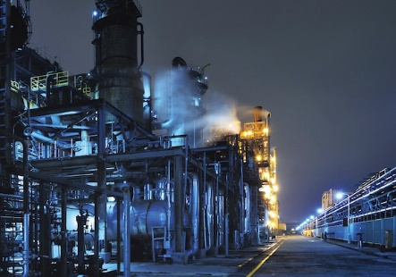

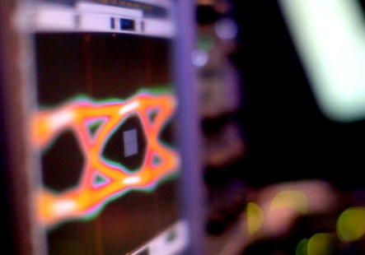
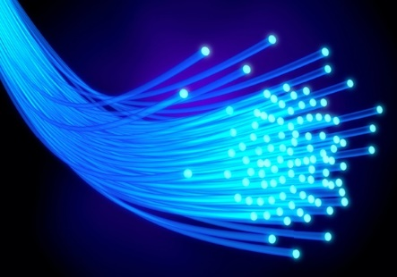

Where are FPGAs used?
Aerospace
Prototyping
Automotive
Broadcast
Consumer Electronics
Data Center
HPC
Industrial
Medical
Test & Measurement
Wired Comms
Wireless Comms
Notes:
So where are fpp

Slide 39










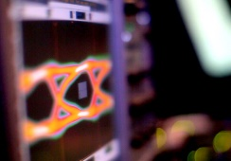


Design tools
Implement applications on FPGAs
Aerospace
Prototyping
Automotive
Broadcast
Consumer Electronics
Data Center
HPC
Industrial
Medical
Test & Measurement
Wired Comms
Wireless Comms
Verilog-to-Routing (VTR)
Evaluate new FPGA architectures
Notes:
Design tools is the bridge between fpga and their applications

