Slide 1
Architecture and Circuit Design of An All-Spintronic FPGA Device
Stephen M. Williams and Mingjie Lin
University of Central Florida
ECE Department
Notes:
Hello everyone, my name is Stephen Williams and today I’m going to talk about the Design of an all-spintronic FPGA and the benefits/challenges associated with it.

Slide 2
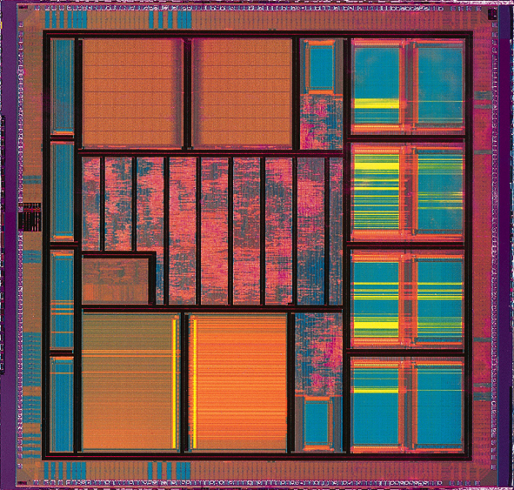
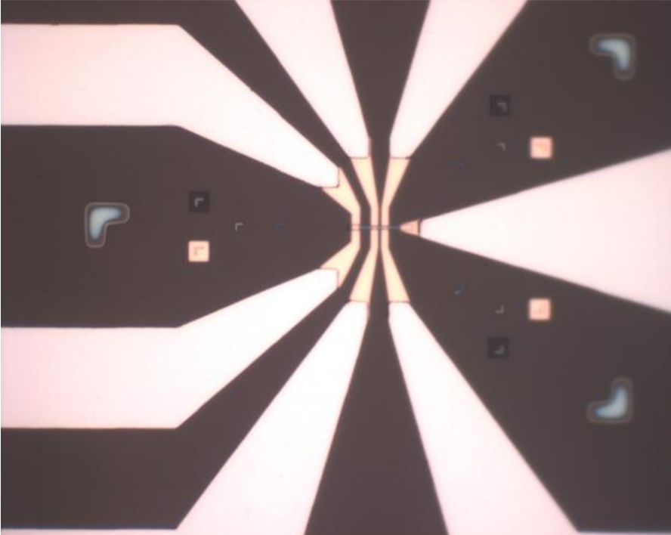
Computing: Charge vs. Spin
CMOS
Spintronics
Boolean algebra
Charge encoded information
Voltage-mode computation
Boolean algebra
Spin encoded information
Current-mode computation
Notes:
Digital circuit design has long been dominated by conventional charge based devices based on voltage mode computation. Great results have been achieved, but we can’t help but wonder, is this the only way? Emerging device technology known as spintronics has recently been gaining traction as an alternative to CMOS technology.

Slide 3
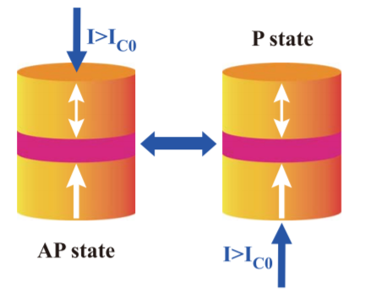
Spintronic Devices: What? How? Why?
CMOS-based electronics ignore the spin-property of electrons and rely on charge-based functionality.
Nano-magnetic devices which use the spin-state of an electron to convey information can open the doors to exciting new ways to process and store information.
-
e
Information encoded in
electron rotational direction
and up/down orientation
Using spin-polarized current, we
Can manipulate electron spin
In a material to control its state
Notes:
These new devices called spintronics represent informational states based on the spin direction of a group of electrons in a material. This spin-state can be manipulated by an external magnetic field, but new more efficient techniques can achieve this using spin-polarized current applied through the material. These devices have the potential to fundamentally change how we encode and process information.

Slide 4
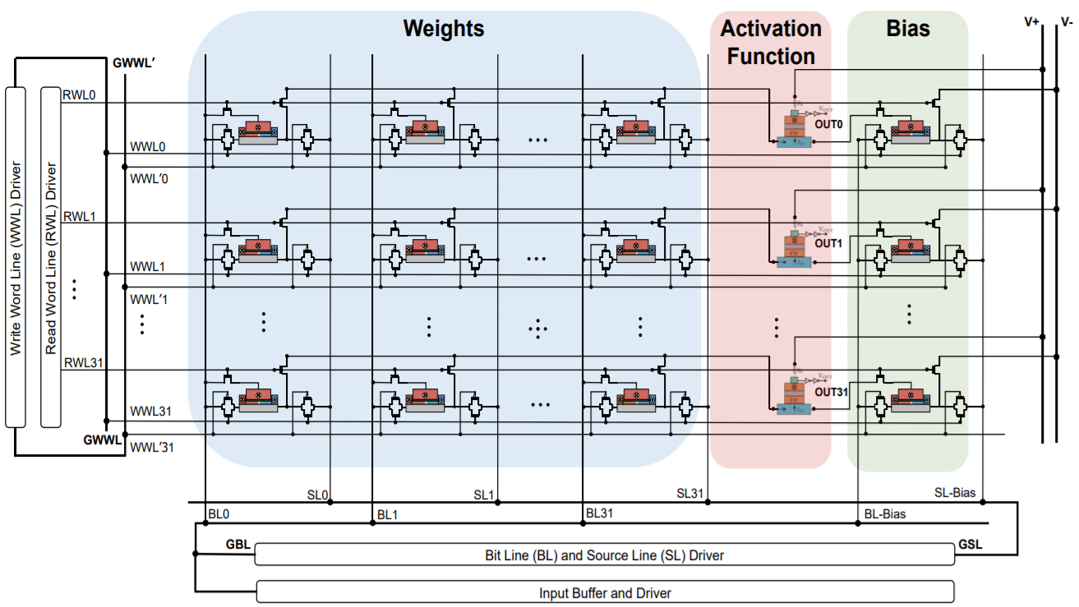
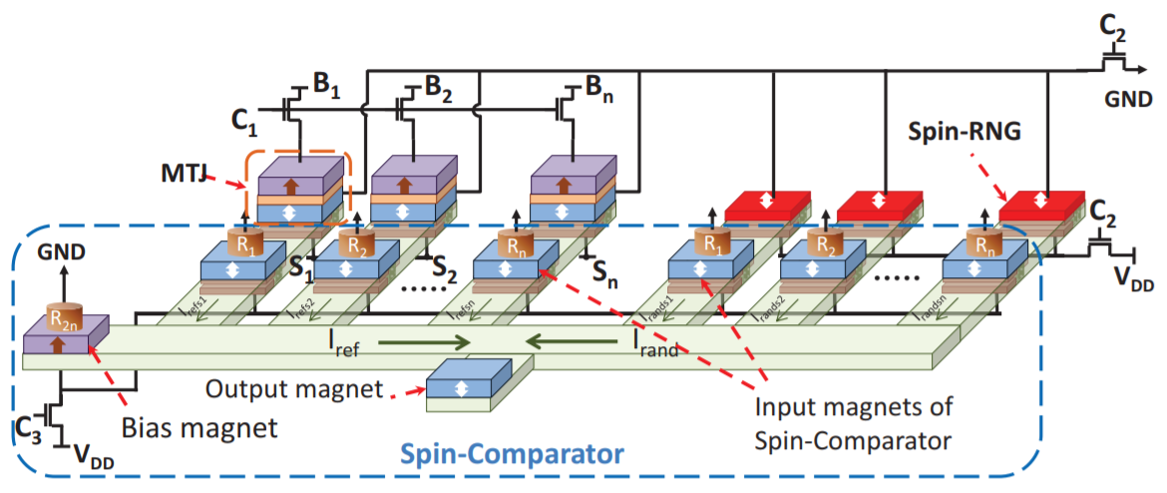
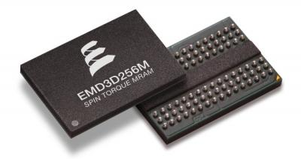
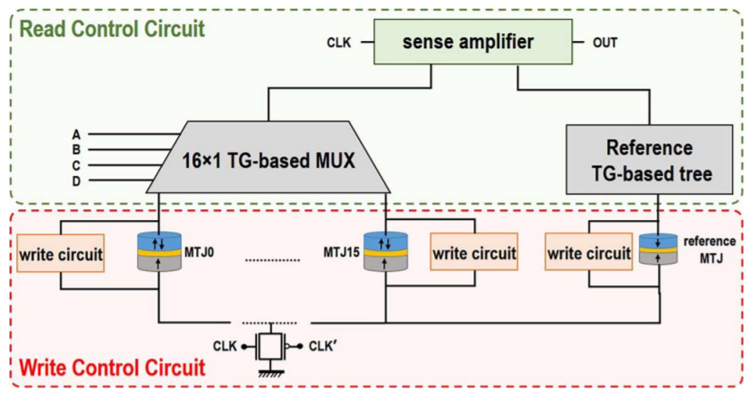
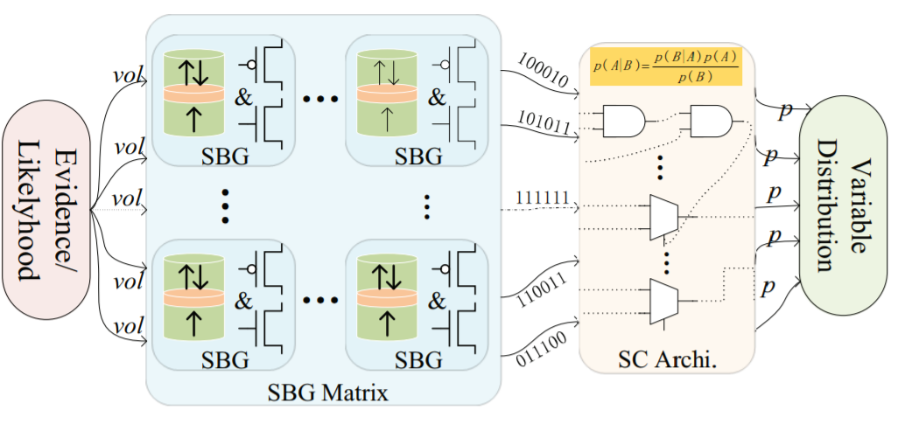
Spintronic Devices are Widely Studied
Boltzmann Machine [Zand, 17]
Stochastic Logic [Venkatesan, 15]
Magnetic RAM
Bayesian Inference [Jia, 17]
Spin-CMOS LUT [Zand, 16]
Notes:
Spintronic circuit and architecture design has been a hot topic in the research community, spanning from analog brain-inspired computing, to probabilistic logic, and even hybrid Spin-CMOS logic. Not only that, but it is also seeing applications in industry for non-volatile DRAM.

Slide 5
Spintronics for FPGA Design
Motivation
FPGAs are becoming more important in computing applications.
Architecture of FPGA is regular and mature, making it a perfect target for exploratory design.
Moore’s Law still alive, but it is struggling with post-5nm advances.
Challenges
Energy consumption and area usage remain critical constraints with room for improvement.
Reliable operation in radiation rich environments not guaranteed.
Solution
Spintronic devices can be densely integrated and operate at extremely low sub-100mV voltage supplies.
Spintronics have been shown to be resilient to radiation known to upset CMOS.
We’re not advocating abandonment of CMOS, just the need to explore the alternatives.
Notes:
We choose to look at FPGA design due to its growing importance in computation applications. The regularity of FPGA architecture makes it a nice choice from an implementation stand point. While CMOS FPGAs have great performance, the post-5nm future has a lot of uncertainty. It’s unclear how we will continue to improve energy consumption and continue to increase FPGA logic density.
Spintronic devices are known to be able to achieve high density, with the cost of a device being not much more than a via. Their structure also lends well to vertical integration, which may be critical in the future. They also bring some benefits not easily achieved with CMOS designs, namely radiation tolerance and non-volatility.
I want to emphasize that we aren’t claiming CMOS to be a dead end, just that there is a need to explore other options.

Slide 6
Previous work in Spintronic FPGA Design
We’re not the first, our work is built on the strong foundations set by others before us.
Previous work borrows lookup table (LUT) concept used in CMOS FPGAs.
[Zand, 17], [Suzuki, 15], [Goncalves, 13]
Room for improvement in previous work
Doesn’t fully harness benefit of spin device for both logic and storage.
Relies on intricate spin-CMOS integration at the logic block level.
We push in a new direction, an architecture customized for the strengths of spintronic devices.
Notes:
Many others before us have tried their hand at spintronic-fpga design. However, nearly all of the previous work relies on either on the LUT FPGA architecture or fine grained hybrid spin-CMOS circuits.
We firmly believe that there is room for improvement and that an FPGA architecture needs to developed which can capitalize on the strengths of spintronic devices. Not just aid CMOS LUTs with things like non-volatile SRAM bits.
Our work is unique in that we design an FPGA from the ground up to work in harmony with the natural properties of spintronic device technology.

Slide 7
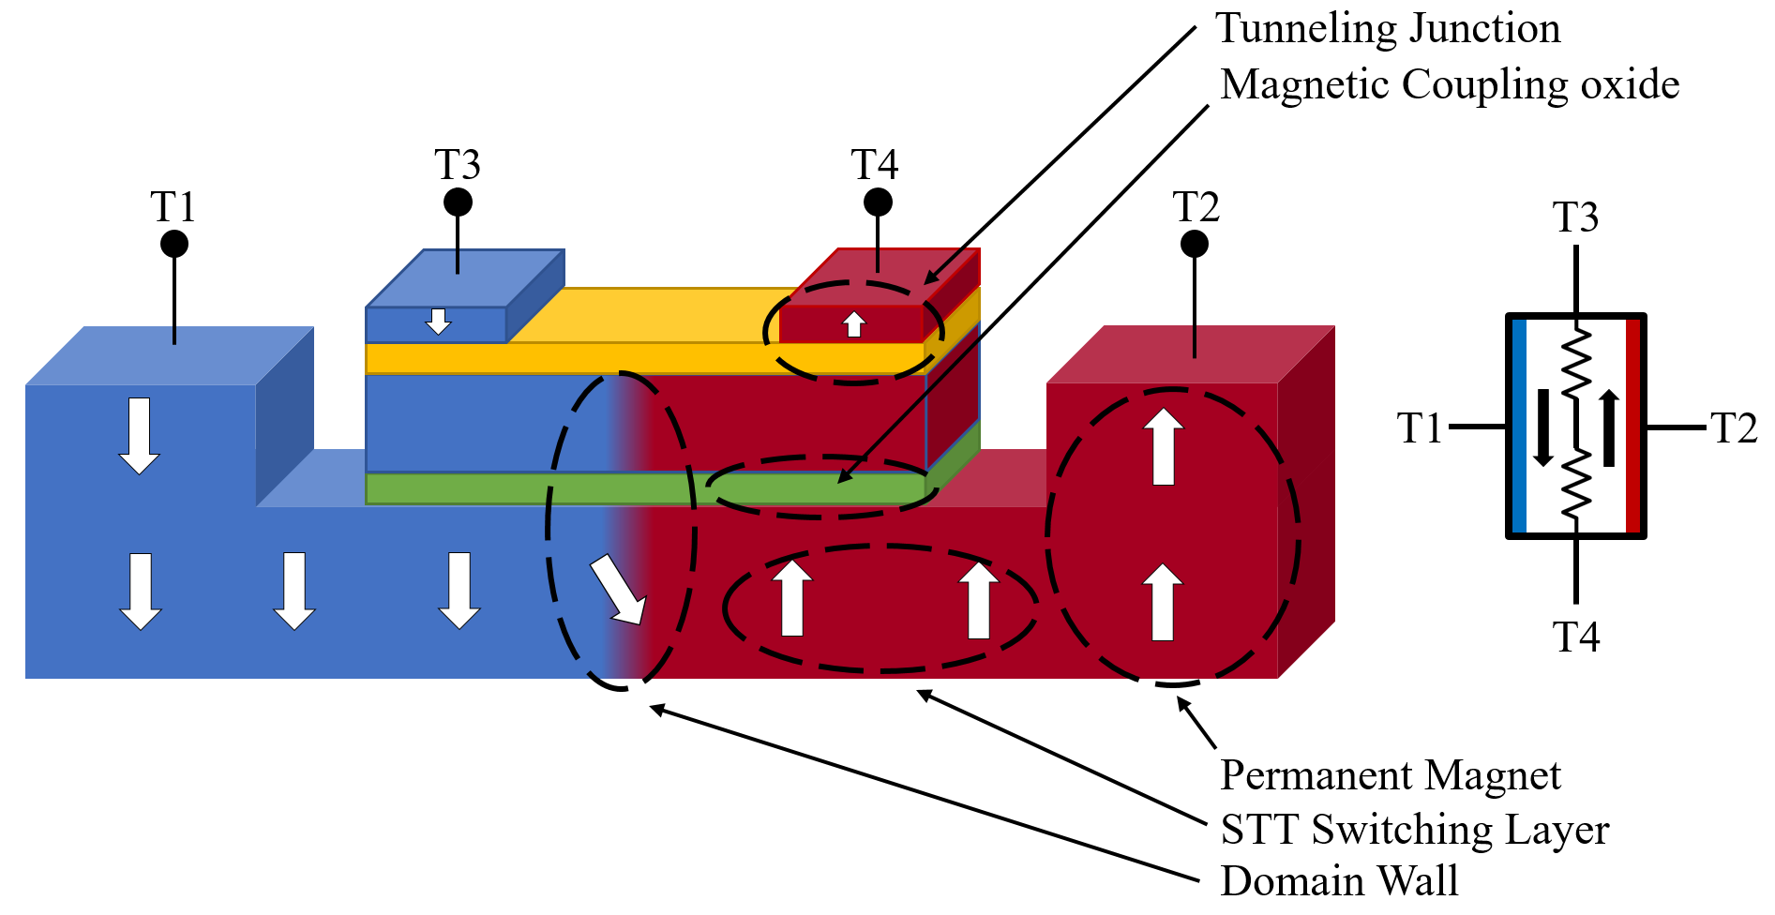
Recent Spintronic Device, the mCell
Based on domain-wall motion in a magnetic nanowire.
Domain-wall position determines device state.
Decoupled read and write path allows for optimized all spin logic without the need for access CMOS transistors.
[Morris, 12]
Notes:
The mCell is a recent spintronic device developed at Carnegie Mellon which utilizes domain-wall motion to manipulate the device state. By injecting current through the lower layer between T1 and T2, we can change the resistive state between terminals T3 and T4.
Most previous spintronic devices have a shared write and read path, which requires CMOS isolation transistors and separate read and write phases. This all adds unneccesary area and delay overheads. The mCell is unique in that it has a write path between T1 and T2 and a read path between T3 and T4, allowing for simultaneous read/write operations.

Slide 8
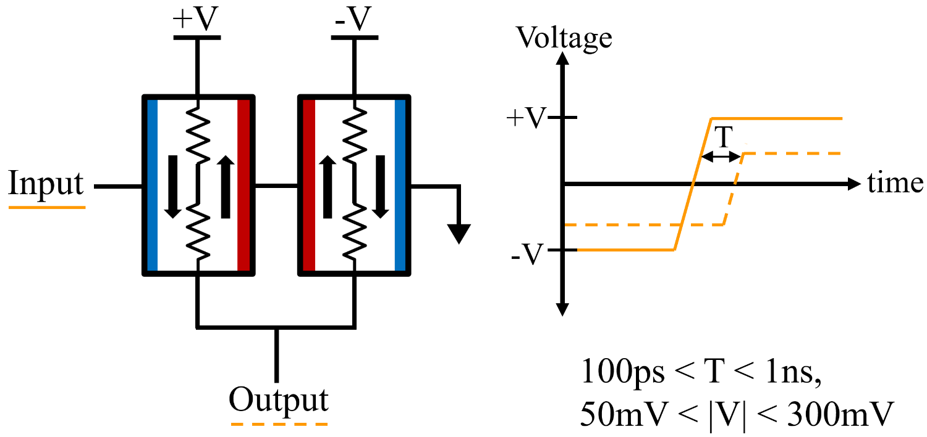
Buffer Design with mCell
Input
Output
Operates at low 50mV terminal voltage.
Gain can be achieved by increasing supply voltage.
Current-mode operation.
Notes:
Here we show basic circuit design using the mCell. Two mCells can easily form a buffer when connected as shown. If the voltage supply polarity is reversed the circuit performs and inversion operation. The device output is set based on the direction of the write current. Multiple inputs can be applied and the circuit will set its output based on a summation of the input currents. This is equivalent to performing a majority evaluation of the input currents.
This circuit can operate as low as +/- 50mV and future device engineering advancements are likely to reduce that even further. The decoupled read and write paths allow us to have gain by increasing the voltage supply for a given buffering stage.

Slide 9
Choosing an architecture for spin-FPGA
LUT-based FPGA works well for CMOS technology, but may not be the best choice for spintronics.
Using spintronics as a drop in replacement for CMOS leads to inefficient designs. Due to lack of a good spintronic mux design.
Current-mode devices such as the mCell are naturally suited to majority logic.
An ideal spin-FPGA would utilize some form of majority logic. Majority logic also provides some basic reconfigurability as seen below.
Input1
Majority Gate
(AND)
Bias ‘0’
Input2
Output
Input1
Majority Gate
‘0’
Input2
Output
Input3
Input1
Majority Gate
(OR)
Input2
Output
Bias ‘1’
‘1’
Notes:
Now that we’ve given a brief overview of the mCell and a basic circuit design using it, we need to discuss how to choose an architecture for it.
As previously mentioned, mCell circuits can implement a majority operation at their input. A good spintronic FPGA design would take advantage of this. The LUT-based architecture requires a fast-efficient mux and it’s unclear if a spin-mux can be made efficiently
Taking a look at a 3-input majority gate we can derive some basic logical flexibility. If we consider if as a two input device with the 3rd input being a bias, we can obtain a AND gate by setting the bias to be 0 or a OR gate by setting the bias equal to 1. This will play a key role in our spintronic FPGA.

Slide 10
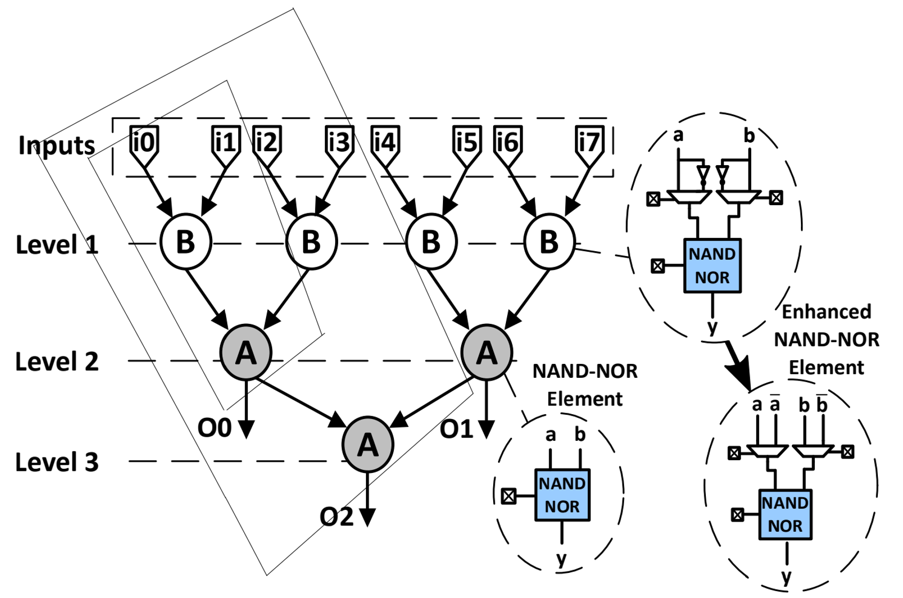
NAND-NOR Reconfigurable Logic
[Huang, 17] proposed using NAND-NOR logic for FPGA design.
NAND-NOR logic tree with programmable inverters to realize logic functions.
NAND-NOR logic can be directly implemented using majority logic, leading to an efficient spintronic implementation.
Notes:
Last year a group proposed using what they call “NAND-NOR logic” as a basis for a CMOS FPGA. NAND-NOR logic is based on a binary tree of nodes which can implement either a NAND function or a NOR function. The basic NAND-NOR element used a single SRAM bit to choose between the two functions, while the “enhanced NAND-NOR element adds a programmable inverter to each input. This allows the NAND-NOR tree to be able to implement a wide range of logic functions.
Something to note is that the NAND-NOR tree has multiple outputs allowing for reused of internal logic, reducing area overhead from logic replication.
We chose this as our target architecture due to the direct mapping from spintronic devices to majority logic and the direct mapping from majority logic to NAND-NOR logic.

Slide 11
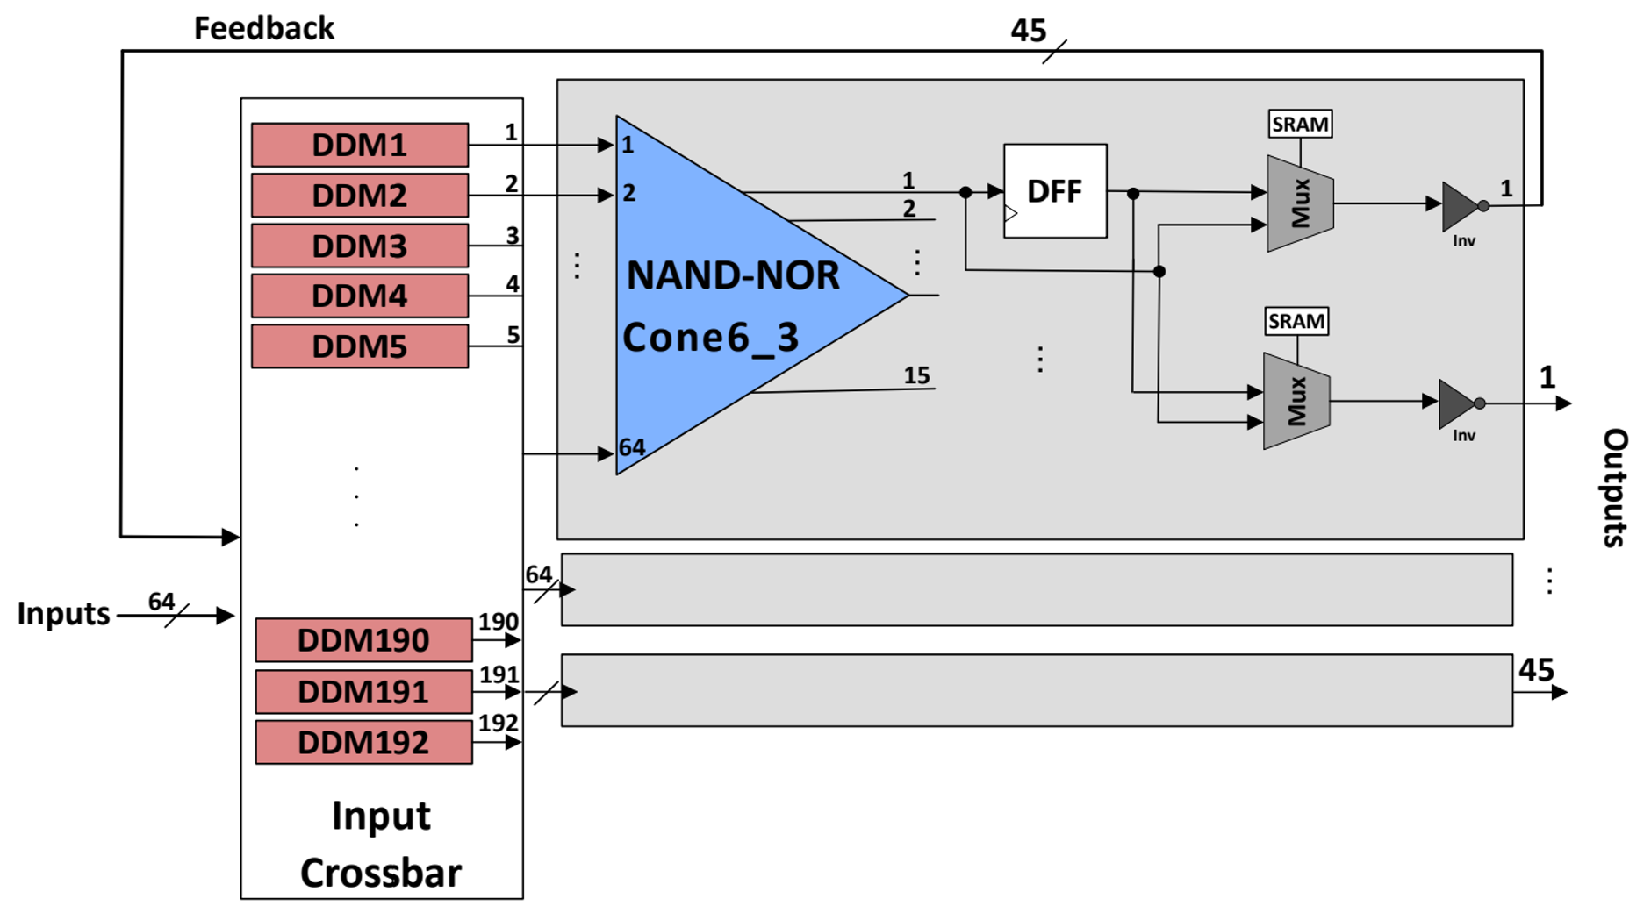
Overall View of NAND-NOR Logic
Input
Interconnect
Logic
Cone
Logic
Registration
Notes:
Shown here is the overall logic block with its input interconnect. The input interconnect is composed of 192 multiplexors feeding three 6-level NAND-NOR cones. Each NAND-NOR cone provides 15 output registers for various internal nodes.

Slide 12
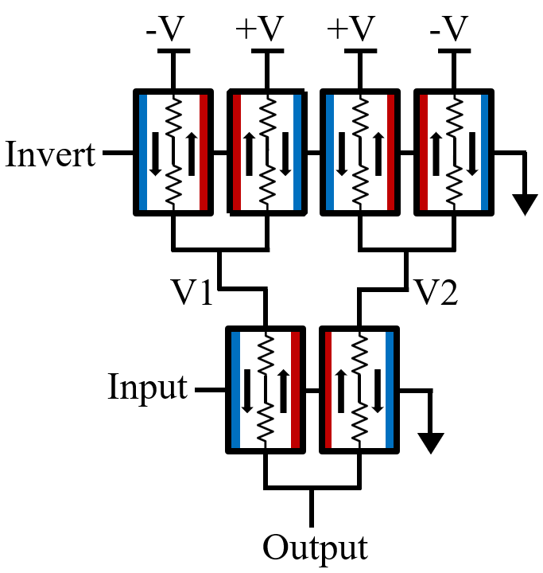
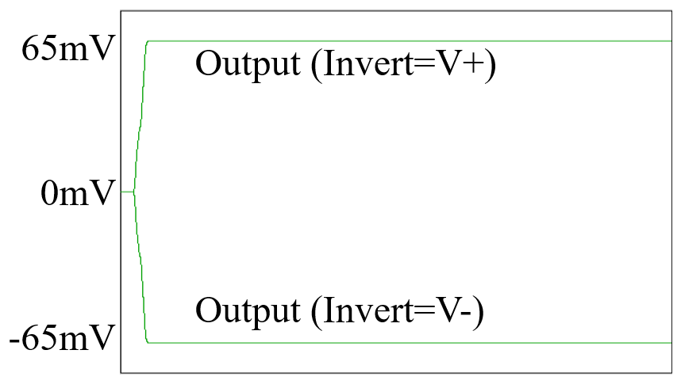
Programmable Spintronic Inverter
Invert
Input
S0
Output
S1
Symmetric delay between inverted and non-inverted operation.
Asserting Invert signal reverses supply polarity for the logic gate.
Upper four mCells act as non-volatile configuration bit.
Notes:
Now we begin the design of our NAND-NOR FPGA. First up is the programmable inverter. We achieve this functionality with 6 mCells, the lower two mCells drive the output and the top four mCells act as a configuration bit which can invert the output driver voltage supply based on the “invert signal”.
Since the critical path remains the same for both the inverted and non-inverted case, the programmable inverter has equal delay in both modes..something not easily achieved with cmos. The configuration bit is non-volatile and once set, the invert signal is no longer needed. The symmetric delay is critical as one issue with the CMOS NAND-NOR design is delay variance based on the configuration leading to increased complexity in timing analysis.

Slide 13
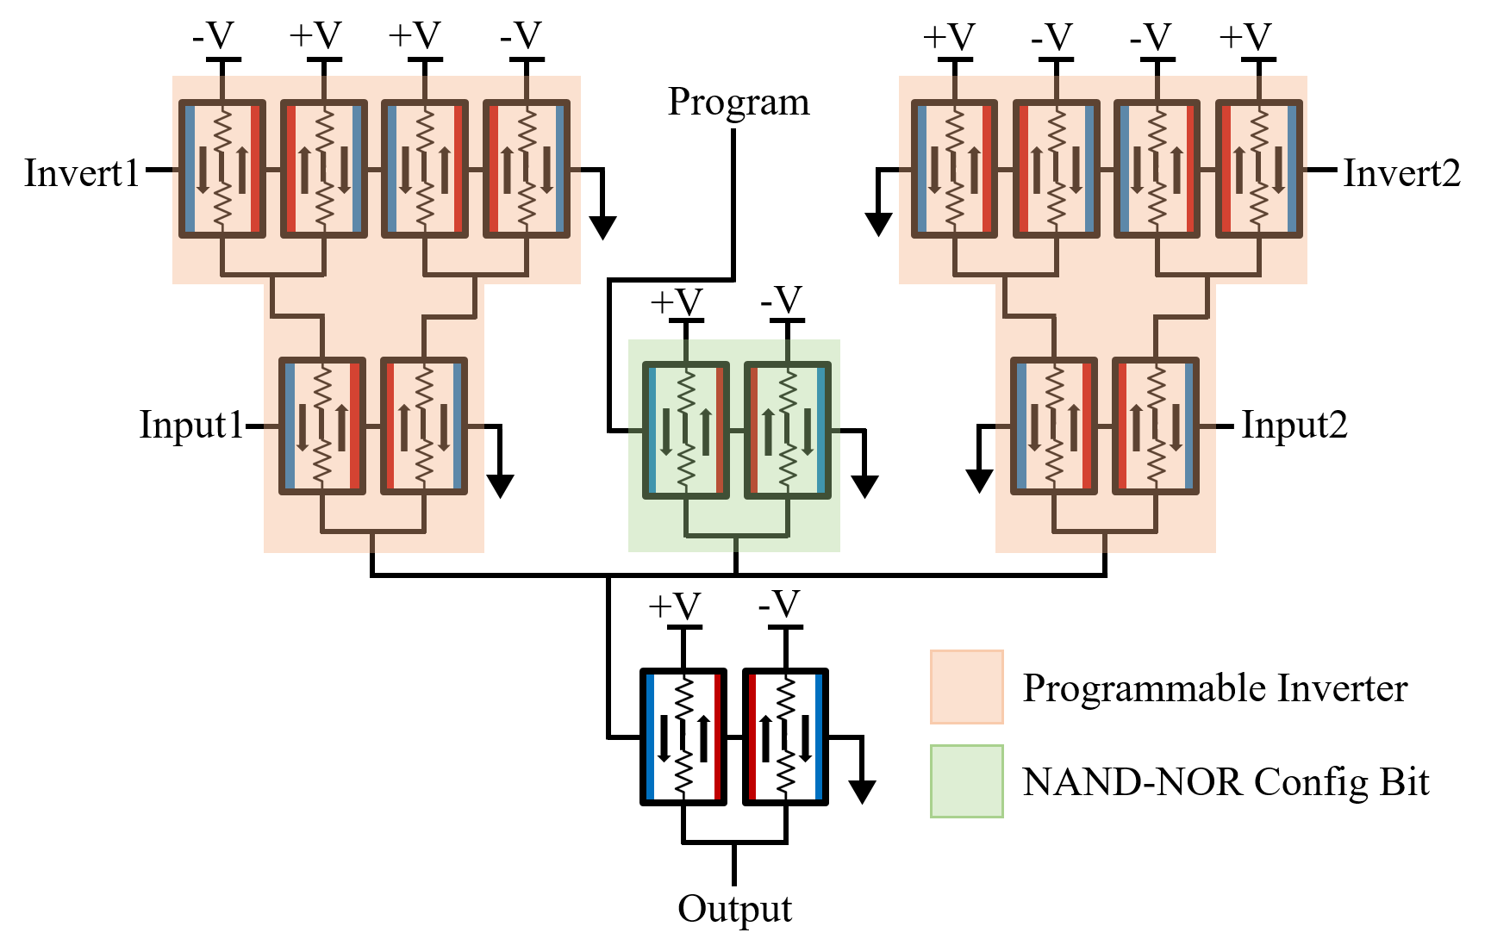
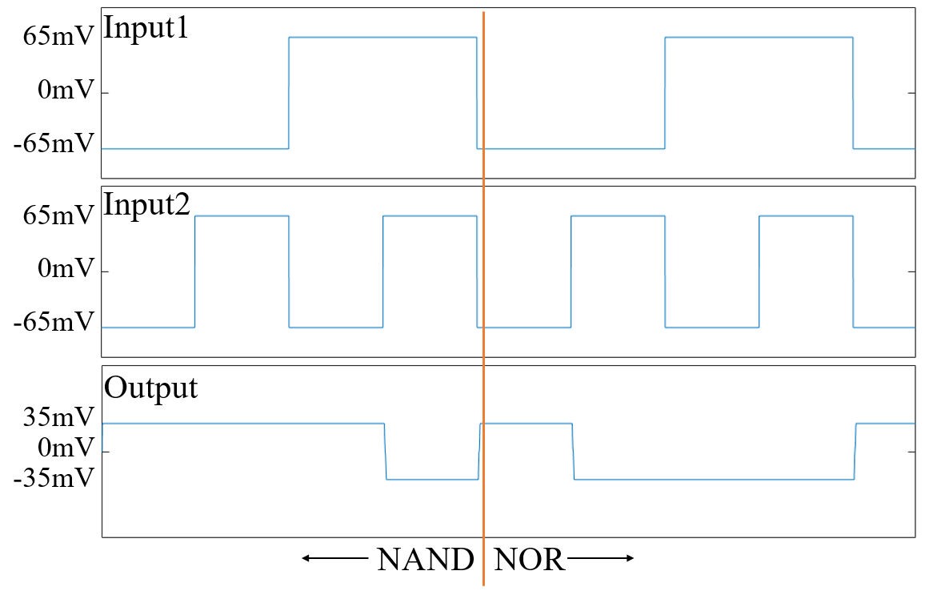
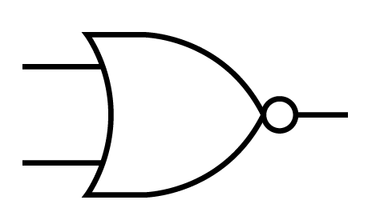
Enhanced NAND-NOR Element
Input1
S0
S1
S0
Output
S1
Input2
S0
S1
Three input majority gate with bias bit, allows for switchable NAND-NOR gate. Each input has a programmable inverter.
Notes:
Next we need to design the NAND-NOR element itself. It is essentially two programmable input inverters driving an output buffer with a bias bit shown in green. The bias bit is set high or low based on the “program” signal, allowing for NAND and NOR functions to be realized.

Slide 14
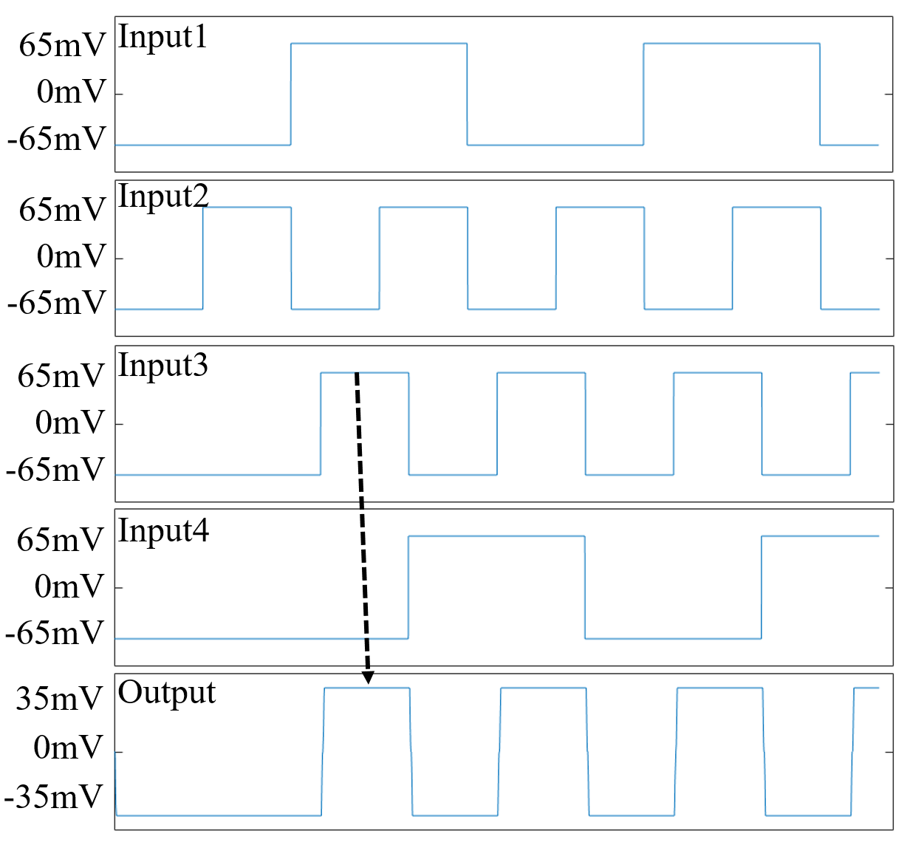
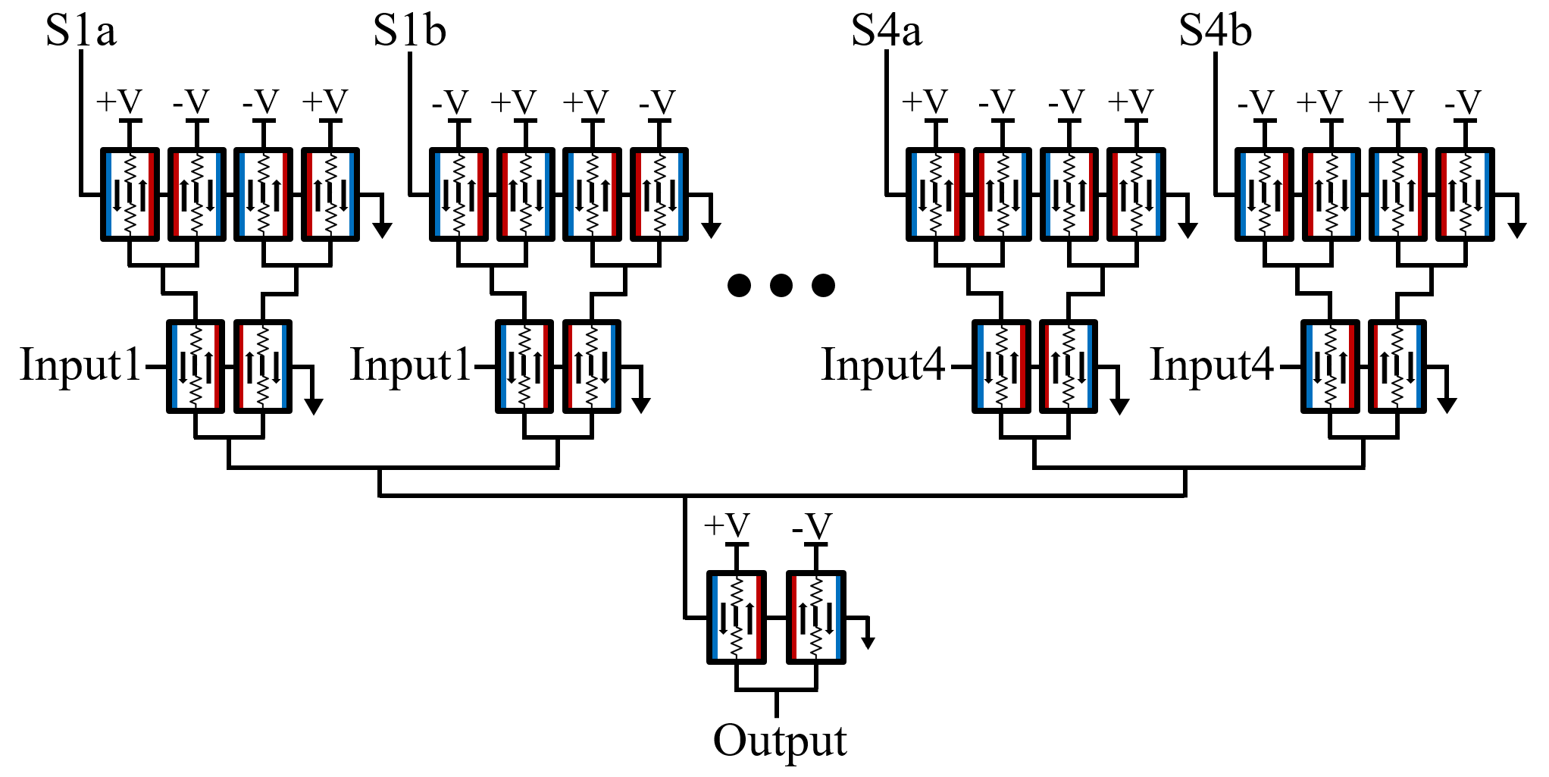
Spintronic Mux-Based Interconnect
Input1
S0
S1
Input2
S0
S1
S0
S1
Output
Input3
S2
S0
S1
S3
Input4
S0
S1
Use a pair of programmable inverters to enable/disable a signal path.
Can also act as programmable inversion layer, removing all programmable inverters from the inner NAND-NOR cone.
Notes:
Now onto the input interconnect. Our design uses a pair of programmable input inverters for each input signal. When the pair is set to opposite states the signal is effectively cancelled out, this allows us to select any of the input signals. The chosen signal can also be inverted by setting its pair of programmable inverters in the inversion mode. This allows us to move all the programmable inverters to the interconnect layer greatly simplifying the NAND-NOR cone to just 4 mCells per tree node.
Multiple input signals can be selected as once allowing the input interconnect to perform basic logic functions, though this functionality was not explored in our current work.

Slide 15
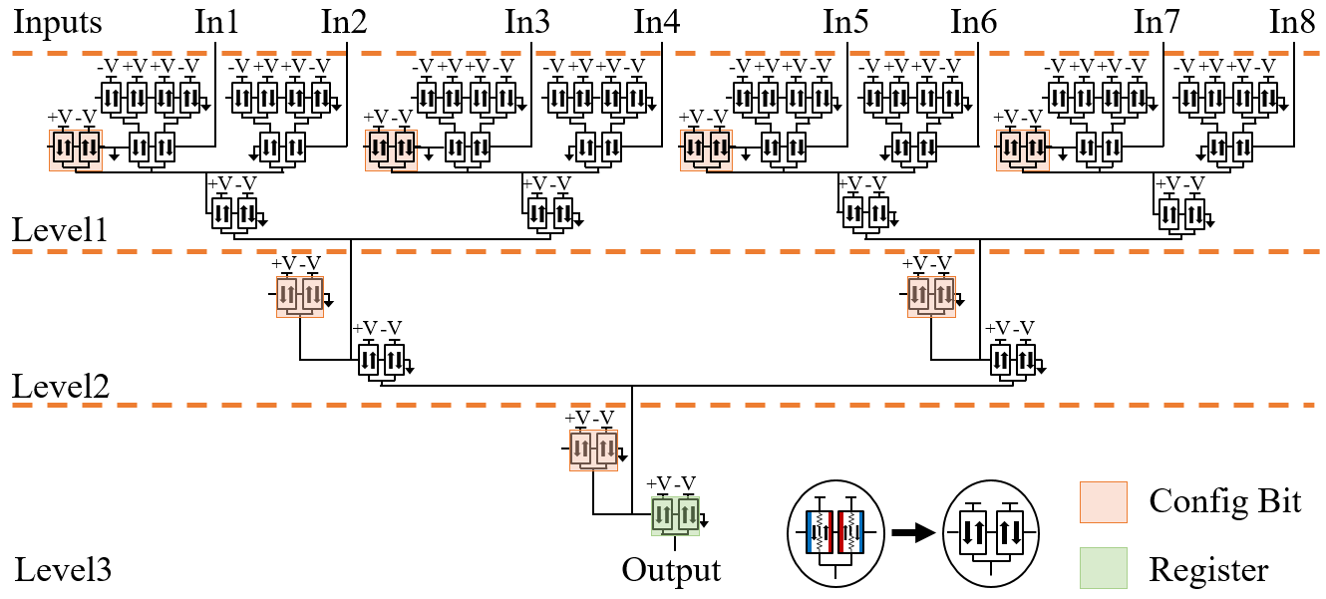
Spin NAND-NOR Cone
Notes:
Here is the full NAND-NOR cone. Shown in blue in the programmable input inverter, as mentioned earlier these can all be moved to the input interconnect which allows for a extremely compact NAND-NOR tree. Shown in yellow is the basic NAND-NOR element, composed of a configuration bias bit and the output majority gate. The non-volatile property of the mCells allows us to easily implement logic registration as needed for minimal overhead.

Slide 16
Leakage Current Challenges
We’ve covered the major aspects of the design.
But there remains a key challenge.
mCell current-mode logic leaks current.
Leakage from 65mV supply is very small, but in large-scale FPGAs with millions of logic elements, it is an issue.
Can be solved with an integrated CMOS layer under the spin-FPGA layer.
Notes:
Now I want to discuss the biggest challenge associated with our spintronic-FPGA, current leakage. Due to the low resistance of about 2kohms for a device in the off state, the mCells circuit will leak current from its 65mV supply. While this current is very small, for FPGAs with millions of logic elements this is clearly a problem.
The developers of the mCell showed that this can be effectively solved with an external CMOS power management die or with a CMOS layer integrated underneath the mCell spintronic FPGA.

Slide 17
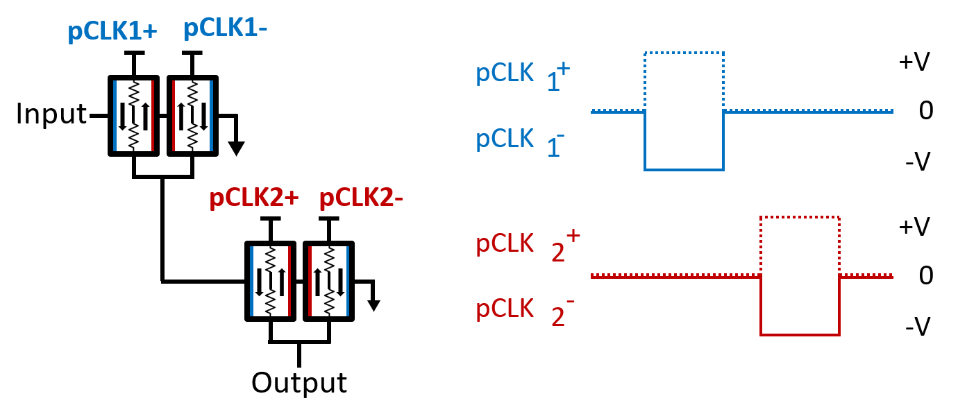
Power Strobing to Reduce Leakage
Should only power mCell gate when ready to perform computation.
This can be achieved by replacing the power supply with a clock signal.
Serves double purpose, power and clock distribution in one metal wire.
Notes:
The way this power management technique works is that the power rail of an mCell circuit is strobed when it is ready to perform an operation. That way the mCell only passes current when it is actively working.
This strobing can be managed with a few extra CMOS devices.

Slide 18
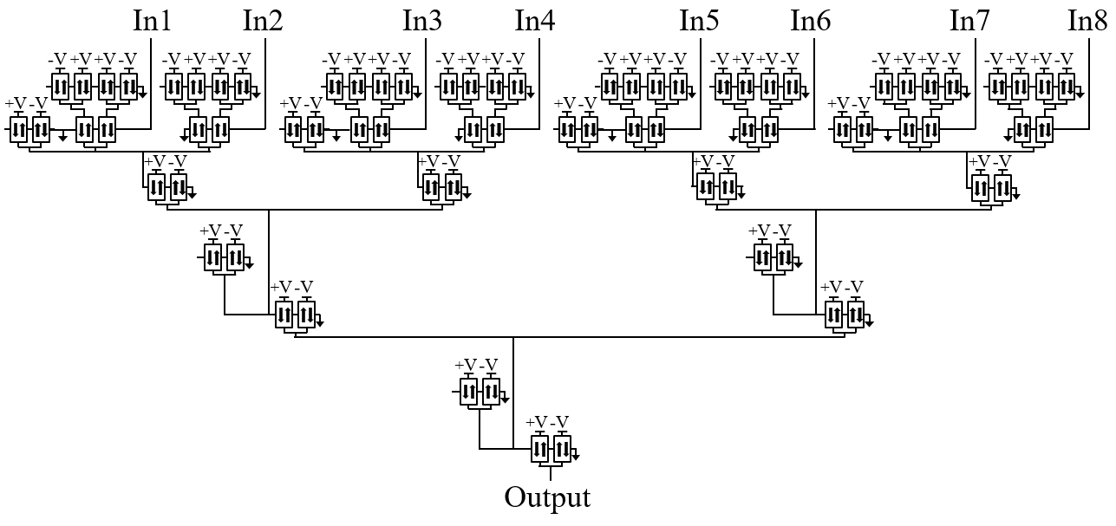
Power Strobing to Reduce Leakage
Power Domain 1
Power Domain 2
Power Domain 3
Notes:
To give an example of power strobing with a larger circuit, the same concept is applied to a NAND-NOR cone. The design is divided into slices called power domains. Defining the power domains is a trade off between complexity of the power strobing circuit and the amount of energy saved.

Slide 19
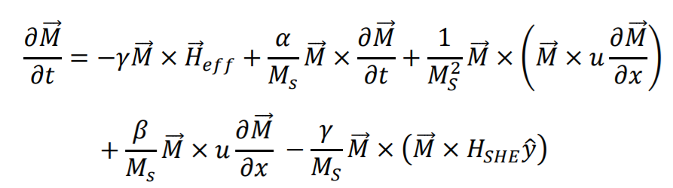
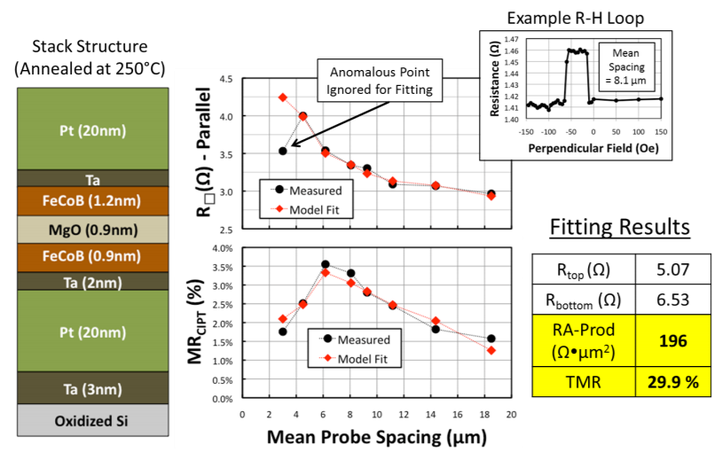
Simulation Model
Micromagnetic
Theory
Accurate mCell Model
Real Device
Behavior
Verilog-A mCell model from Carnegie Mellon.
Fitted to match real device behavior.
Validated with parasitic layout simulation of 1.5 million mCell FFT block.
Used in conjunction with Hspice to simulate circuits in this work.
Notes:
To validate functionality and measure performance, it is critical to use an accurate model. We use a VerilogA mCell model developed at Carnegie melon which takes into account both micromagnetic theory and real device behavior to provide an accurate model. This is simulated in Hspice for all the circuits shown here.

Slide 20
Results
Our mCell-FPGA improves upon previous CMOS design
17.3% 6-level cone delay reduction.
59.1% reduction in delay variance between configurations.
47.4% reduction in device count.
56.7% in energy consumption.
Compared against a Stratix IV style CMOS LUT Architecture
26% delay reduction, 64% LUT/Cone count reduction in MCNC benchmark suite.
13% delay reduction, 55% LUT/Cone count reduction VTR benchmark suite.
Notes:
Now onto the results. Compared to the CMOS 6-level NAND-NOR cone, we reduce cone delay, delay variance, device count, energy. Compared to an architecture based on the Stratix IV, in MCNC we improve delay and area, and in VTR we improve delay and area.

Slide 21
Conclusion and Future Work
Without being able to fabricate an mCell FPGA, results are a rough estimate.
Previous work based on 40nm CMOS.
Likely less competitive in delay vs. state of the art CMOS.
That view neglects unique aspect brought by mCell-FPGA.
Non-volatile data-path and configuration memory.
Inherent logic registration in mCell circuits.
Radiation tolerance.
mCell-FPGA may not compete in all applications.
Where it is competitive, there isn’t a good alternative in CMOS.
Future Work
Explore CMOS support circuits such as power-strobing circuits.
Design of FPGA IO, PLL, SERDES.
Notes:
Without having the ability to fabricate a real mCell FPGA, our results provide only a rough estimate. Not only that, but previous CMOS work was based on outdated 40nm CMOS technology. We admit that against state of the art CMOS, the mCell FPGA will likely be slower. But that view is neglects to take into account all the new benefits that can be gained from a spintronic-FPGA such as low cost registers, radiation tolerance, device density, and non-volatility of the entire FPGA fabric..both logic and configuration memory.
While a spin-FPGA may not compete with CMOS in applications, there are definitely applications with can utilize the advantages of the spintronic-FPGA.
Our next steps are to fully design things such as the CMOS power management circuit and the other peripheral blocks found in FPGAs.

