Slide 1


Neuromorphic Processor Project
DeltaRNN
A Power-efficient Recurrent Neural Network Accelerator
Chang Gao 高唱
Daniel Neil, Enea Ceolini, Shih-Chii Liu, Tobi Delbruck
Institute of Neuroinformatics, University of Zurich and ETH Zurich

Slide 2
Outline
Introduction
Delta Network Algorithm
Hardware Architecture
Results
Demo
1

Slide 3
Outline
Introduction
Delta Network Algorithm
Hardware Architecture
Results
Demo
1

Slide 4
Outline
Introduction
Delta Network Algorithm
Hardware Architecture
Results
Demo
1

Slide 5
Outline
Introduction
Delta Network Algorithm
Hardware Architecture
Results
Demo
1

Slide 6
Outline
Introduction
Delta Network Algorithm
Hardware Architecture
Results
Demo
1

Slide 7
Outline
Introduction
Delta Network Algorithm
Hardware Architecture
Results
Demo
1

Slide 8

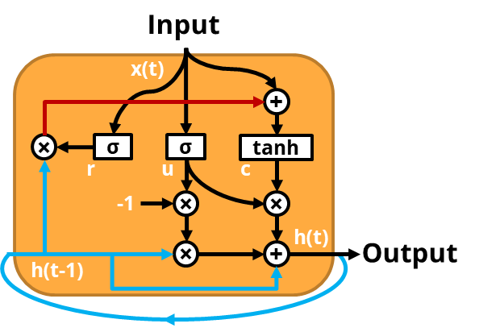




Introduction
Recurrent Neural Networks (RNNs) are fully-connected networks with complex neurons that have multiple memory states, which has a long history of handling tasks with temporal sequences.
Gated-Recurrent Unit
Input
Layer
Hidden
Layer
Output
Layer
2

Slide 9
Introduction
Why does a power efficient neural network accelerator matter?
Reduced Network Bandwidth Requirement
Lower Latency
Robustness to Network Failure
Better Privacy
3

Slide 10
Introduction
How to achieve high power efficiency?
Do less computations without hurting prediction accuracy
$$r\left(t\right)=σ\left[W_{xr}x\left(t\right)+W_{hr}h\left(t−1\right)+b_{r}\right]$$
$$u\left(t\right)=σ\left[W_{xu}x\left(t\right)+W_{hu}h\left(t−1\right)+b_{u}\right]$$
$$c\left(t\right)=\tanh\left[W_{xc}x\left(t\right)+r\left(t\right)⨀W_{hc}h\left(t−1\right)+b_{c}\right]$$
$$h\left(t\right)=\left[1−u\left(t\right)\right]⨀h\left(t−1\right)+u\left(t\right)⨀c\left(t\right)$$
4

Slide 11




Introduction
How to achieve high power efficiency?
Most arithmetic operations are
Matrix Vector Multiplication (MxV)
$$y=Wx$$
$$x$$
×
$$y$$
$$W$$
=
$$r\left(t\right)=σ\left[W_{xr}x\left(t\right)+W_{hr}h\left(t−1\right)+b_{r}\right]$$
$$u\left(t\right)=σ\left[W_{xu}x\left(t\right)+W_{hu}h\left(t−1\right)+b_{u}\right]$$
$$c\left(t\right)=\tanh\left[W_{xc}x\left(t\right)+r\left(t\right)⨀W_{hc}h\left(t−1\right)+b_{c}\right]$$
$$h\left(t\right)=\left[1−u\left(t\right)\right]⨀h\left(t−1\right)+u\left(t\right)⨀c\left(t\right)$$
5

Slide 12
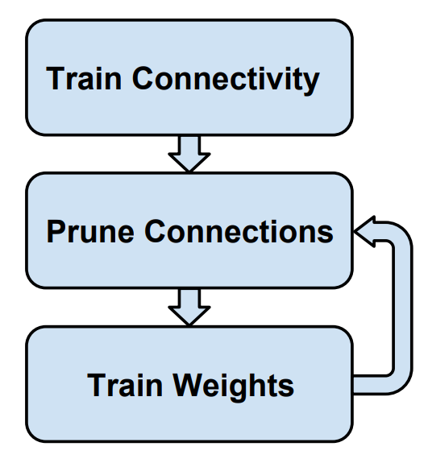
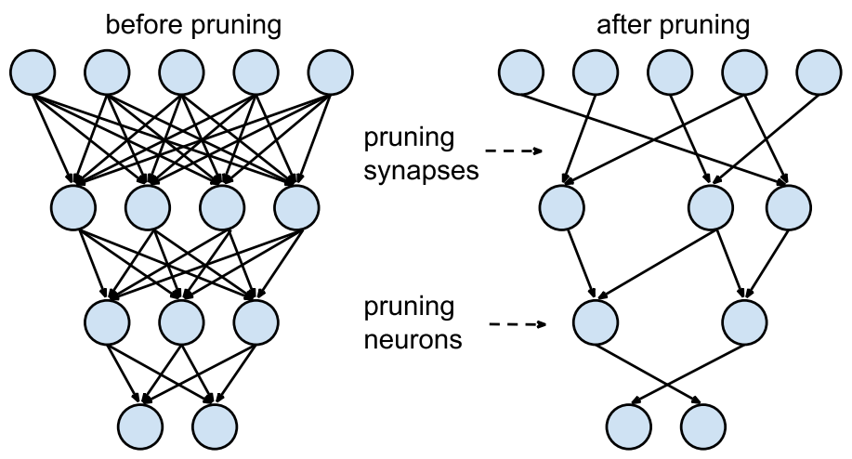
Introduction
Option 1 - Reduce redundancy of weights
Weight Compression
×
0
0
0
0
0
0
0
0
0
0
0
0
0
0
0
0
0
0
0
Sparse Matrix Vector Multiplication
6
Han et al. Learning both Weights and Connections for Efficient Neural Networks, NIPS’15

Slide 13
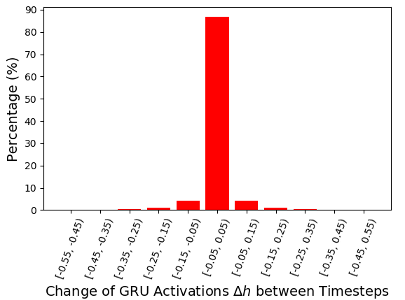




Introduction
Option 2 - Reduce redundancy of states in time
High temporal autocorrelation in neuron states
State Compression
$$y=Wx$$
$$x$$
×
$$y$$
$$W$$
=
$$r\left(t\right)=σ\left[W_{xr}x\left(t\right)+W_{hr}h\left(t−1\right)+b_{r}\right]$$
$$u\left(t\right)=σ\left[W_{xu}x\left(t\right)+W_{hu}h\left(t−1\right)+b_{u}\right]$$
$$c\left(t\right)=\tanh\left[W_{xc}x\left(t\right)+r\left(t\right)⨀W_{hc}h\left(t−1\right)+b_{c}\right]$$
$$h\left(t\right)=\left[1−u\left(t\right)\right]⨀h\left(t−1\right)+u\left(t\right)⨀c\left(t\right)$$
7

Slide 14


Introduction
Option 2 - Reduce redundancy of states in time
High temporal autocorrelation in neuron states
State Compression
$$y=WΔx$$
$$Δx$$
0
3
0
0
6
×
$$y$$
$$W$$
=
$$r\left(t\right)=σ\left[W_{xr}x\left(t\right)+W_{hr}h\left(t−1\right)+b_{r}\right]$$
$$u\left(t\right)=σ\left[W_{xu}x\left(t\right)+W_{hu}h\left(t−1\right)+b_{u}\right]$$
$$c\left(t\right)=\tanh\left[W_{xc}x\left(t\right)+r\left(t\right)⨀W_{hc}h\left(t−1\right)+b_{c}\right]$$
$$h\left(t\right)=\left[1−u\left(t\right)\right]⨀h\left(t−1\right)+u\left(t\right)⨀c\left(t\right)$$
8

Slide 15









Delta Network Algorithm
Calculate matrix-vector multiplication using delta updates
GRU Formulations:
$$r\left(t\right)=σ\left[W_{xr}x\left(t\right)+W_{hr}h\left(t−1\right)+b_{r}\right]$$
$$x\left(t−1\right)$$
9
5
4
3
7
$$u\left(t\right)=σ\left[W_{xu}x\left(t\right)+W_{hu}h\left(t−1\right)+b_{u}\right]$$
-
$$c\left(t\right)=\tanh\left[W_{xc}x\left(t\right)+r\left(t\right)⨀W_{hc}h\left(t−1\right)+b_{c}\right]$$
$$x\left(t\right)$$
9
2
4
3
1
$$h\left(t\right)=\left[1−u\left(t\right)\right]⨀h\left(t−1\right)+u\left(t\right)⨀c\left(t\right)$$
=
$$Δx\left(t\right)$$
0
3
0
0
6
×
$$y$$
Delta Network GRU Formulations:
$M_{r}\left(t\right)=$ $W_{xr}Δx\left(t\right)+W_{hr}Δh\left(t−1\right)+M_{r}\left(t−1\right)$
$M_{u}\left(t\right)=$ $W_{xu}Δx\left(t\right)+W_{hu}Δh\left(t−1\right)+M_{u}\left(t−1\right)$
$$W$$
=
$$M_{cx}\left(t\right)=W_{xc}Δx\left(t\right)+M_{cx}\left(t−1\right)$$
$$M_{ch}\left(t\right)=W_{hc}Δh\left(t−1\right)+M_{ch}\left(t−1\right)$$
$$r\left(t\right)=σ\left[M_{r}\left(t\right)\right]$$
$$u\left(t\right)=σ\left[M_{u}\left(t\right)\right]$$
Dense Matrix Sparse Vector Multiplication
$$c\left(t\right)=\tanh\left[M_{cx}\left(t\right)+r\left(t\right)⨀M_{ch}\left(t\right)\right]$$
$$h\left(t\right)=\left[1−u\left(t\right)\right]⨀h\left(t−1\right)+u\left(t\right)⨀c\left(t\right)$$
$$M_{r}\left(0\right)=b_{r}$$
$$M_{u}\left(0\right)=b_{u}$$
$$M_{cx}\left(0\right)=b_{c}$$
$$M_{ch}\left(0\right)=0$$
9

Slide 16


Delta Network Algorithm
Calculate matrix-vector multiplication using delta updates
$$Θ$$
$$Θ$$
10

Slide 17
Delta Network Algorithm
Calculate matrix-vector multiplication using delta updates
$$Θ$$
$$Θ$$
Activated
Not activated
11

Slide 18


Delta Network Algorithm
Calculate matrix-vector multiplication using delta updates
$$Θ$$
$$Θ$$
Activated
Not activated
12

Slide 19
Delta Network Algorithm
Calculate matrix-vector multiplication using delta updates
$$Θ$$
$$Θ$$
Activated
Not activated
13

Slide 20
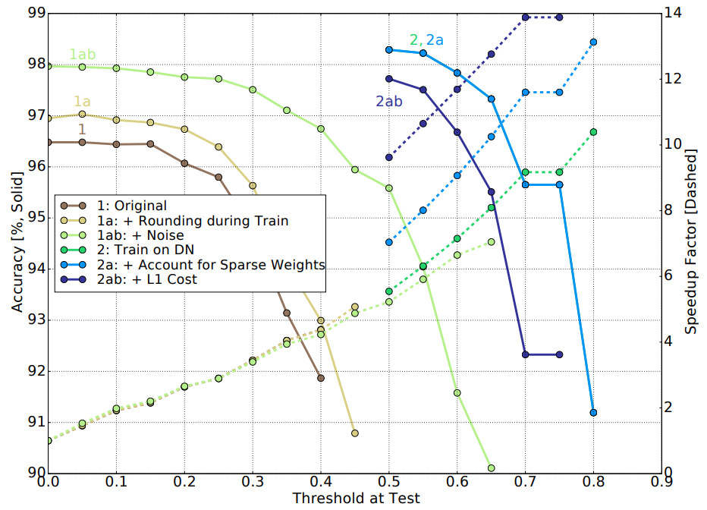
Delta Network Algorithm
Test Accuracy Result on TIDIGITS
> 98%
Test accuracy results from standard GRUs run as delta networks after training (curves 1, 1a, and 1ab) and those trained as delta networks (curves 2, 2a, and 2ab) under different constraints on the TIDIGITS dataset. The delta networks are trained for Θ = 0.5, and the average of five runs is shown.
14
Daniel Neil, et al. 2017. Delta Networks for Optimized Recurrent Network Computation. ICML ’17.

Slide 21
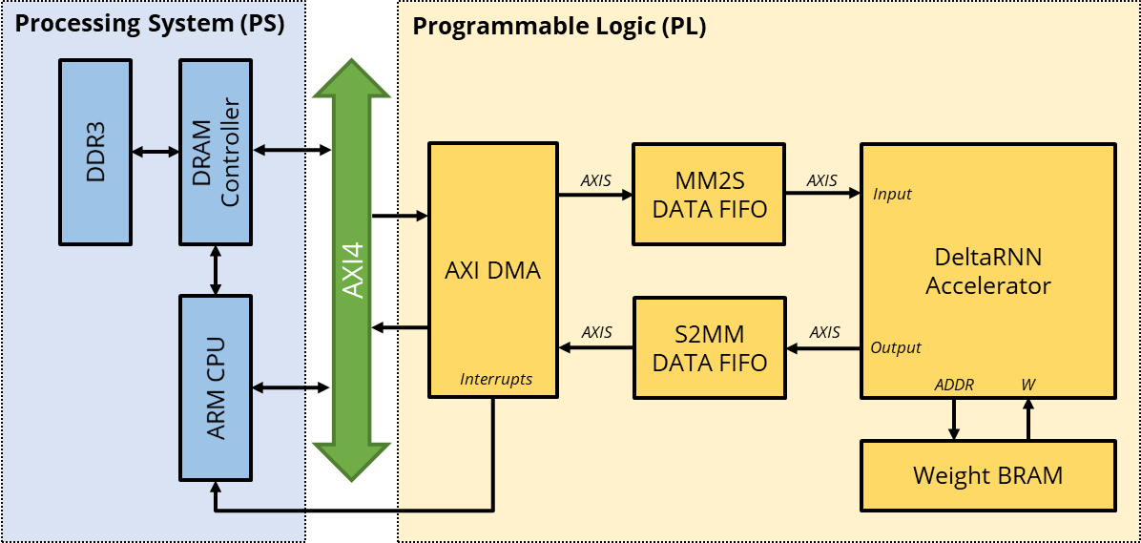
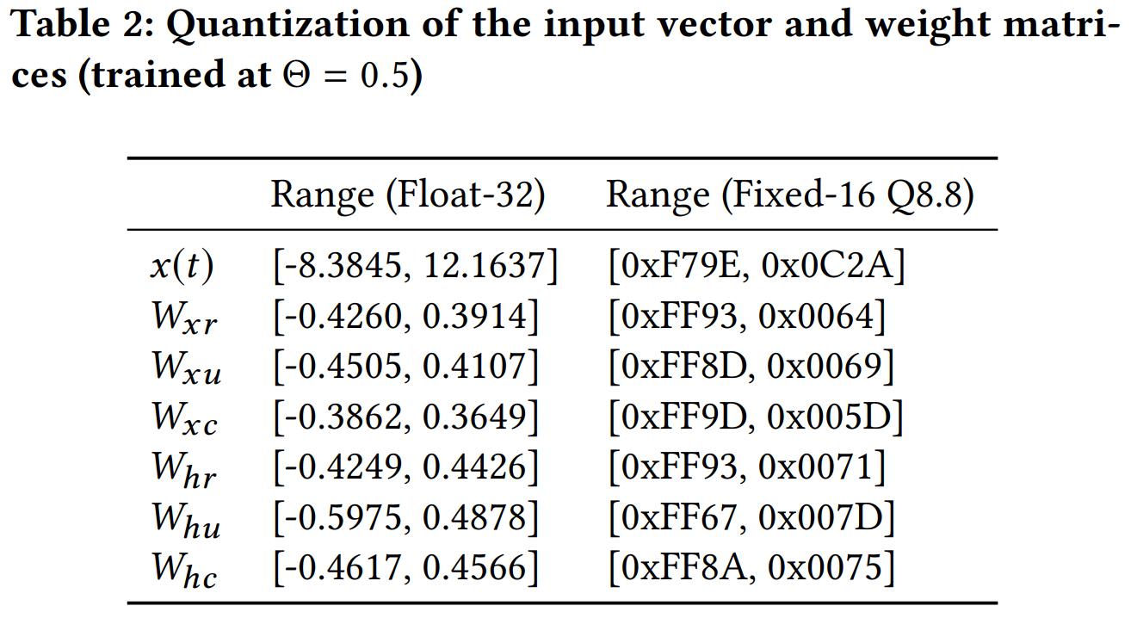
Accelerator Architecture
Top-Level Overview
15

Slide 22
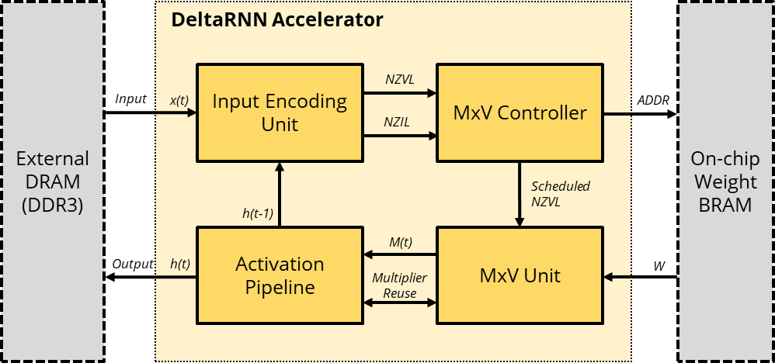






Accelerator Architecture
DeltaRNN Accelerator
$M_{r}\left(t\right)=$ $W_{xr}Δx\left(t\right)+W_{hr}Δh\left(t−1\right)+M_{r}\left(t−1\right)$
$M_{u}\left(t\right)=$ $W_{xu}Δx\left(t\right)+W_{hu}Δh\left(t−1\right)+M_{u}\left(t−1\right)$
$$M_{cx}\left(t\right)=W_{xc}Δx\left(t\right)+M_{cx}\left(t−1\right)$$
$$M_{ch}\left(t\right)=W_{hc}Δh\left(t−1\right)+M_{ch}\left(t−1\right)$$
$$r\left(t\right)=σ\left[M_{r}\left(t\right)\right]$$
$$u\left(t\right)=σ\left[M_{u}\left(t\right)\right]$$
$$c\left(t\right)=\tanh\left[M_{cx}\left(t\right)+r\left(t\right)⨀M_{ch}\left(t\right)\right]$$
$$h\left(t\right)=\left[1−u\left(t\right)\right]⨀h\left(t−1\right)+u\left(t\right)⨀c\left(t\right)$$
$$M_{r}\left(0\right)=b_{r}$$
$$M_{u}\left(0\right)=b_{u}$$
$$M_{cx}\left(0\right)=b_{c}$$
$$M_{ch}\left(0\right)=0$$
16

Slide 23
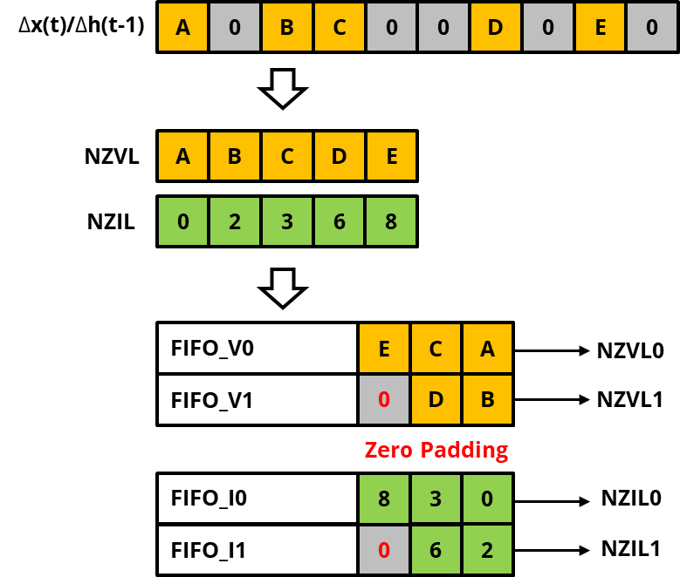
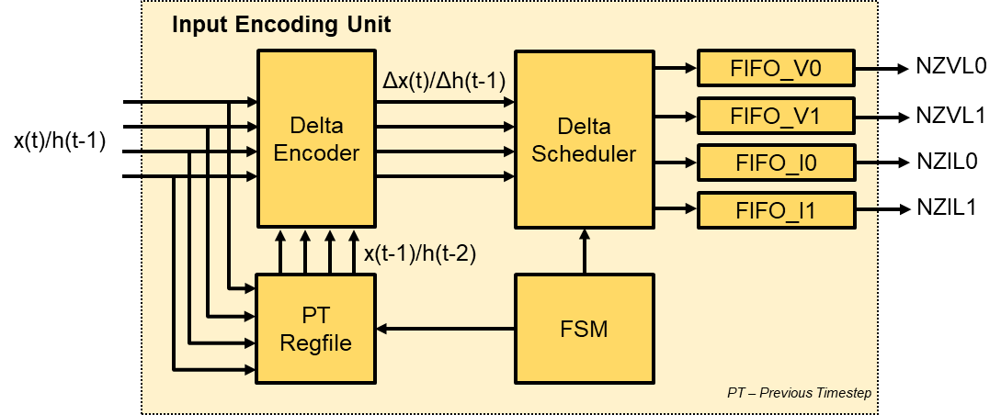






Accelerator Architecture
Input Encoding Unit
Non-zero Value List (NZVL)
Non-zero Index List (NZIL)
$M_{r}\left(t\right)=$ $W_{xr}Δx\left(t\right)+W_{hr}Δh\left(t−1\right)+M_{r}\left(t−1\right)$
$M_{u}\left(t\right)=$ $W_{xu}Δx\left(t\right)+W_{hu}Δh\left(t−1\right)+M_{u}\left(t−1\right)$
$$M_{cx}\left(t\right)=W_{xc}Δx\left(t\right)+M_{cx}\left(t−1\right)$$
$$M_{ch}\left(t\right)=W_{hc}Δh\left(t−1\right)+M_{ch}\left(t−1\right)$$
$$r\left(t\right)=σ\left[M_{r}\left(t\right)\right]$$
$$u\left(t\right)=σ\left[M_{u}\left(t\right)\right]$$
$$c\left(t\right)=\tanh\left[M_{cx}\left(t\right)+r\left(t\right)⨀M_{ch}\left(t\right)\right]$$
$$h\left(t\right)=\left[1−u\left(t\right)\right]⨀h\left(t−1\right)+u\left(t\right)⨀c\left(t\right)$$
$$M_{r}\left(0\right)=b_{r}$$
$$M_{u}\left(0\right)=b_{u}$$
$$M_{cx}\left(0\right)=b_{c}$$
$$M_{ch}\left(0\right)=0$$
17

Slide 24
Accelerator Architecture
Input Encoding Block
Non-zero Value List (NZVL)
Non-zero Index List (NZIL)
18

Slide 25
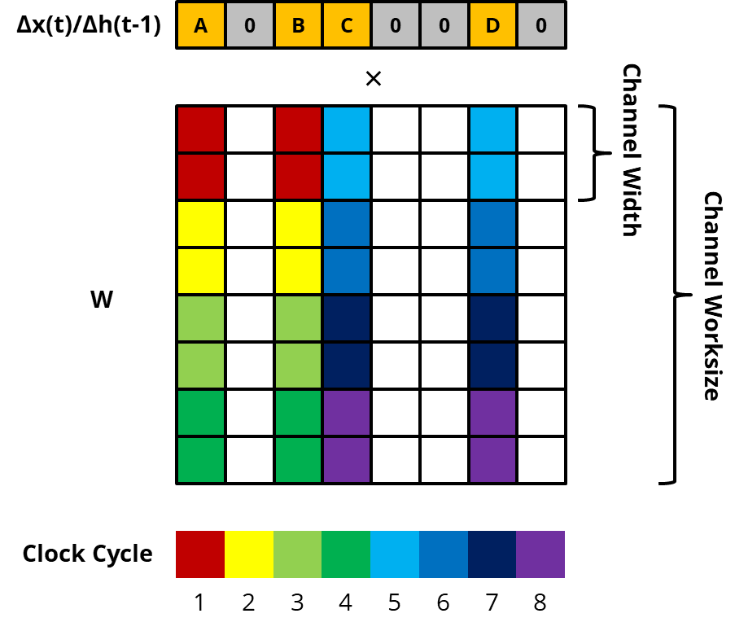
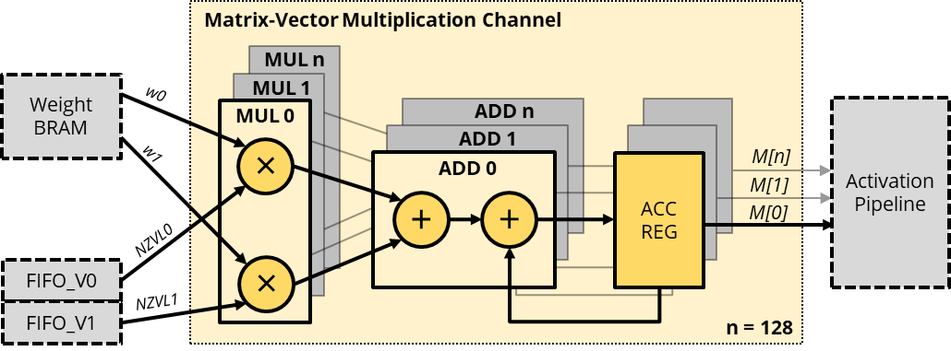
Accelerator Architecture
Matrix-Vector Multiplication Unit
$M_{r}\left(t\right)=$ $W_{xr}Δx\left(t\right)+W_{hr}Δh\left(t−1\right)+M_{r}\left(t−1\right)$
$M_{u}\left(t\right)=$ $W_{xu}Δx\left(t\right)+W_{hu}Δh\left(t−1\right)+M_{u}\left(t−1\right)$
$$M_{cx}\left(t\right)=W_{xc}Δx\left(t\right)+M_{cx}\left(t−1\right)$$
$$M_{ch}\left(t\right)=W_{hc}Δh\left(t−1\right)+M_{ch}\left(t−1\right)$$
$$r\left(t\right)=σ\left[M_{r}\left(t\right)\right]$$
$$u\left(t\right)=σ\left[M_{u}\left(t\right)\right]$$
$$c\left(t\right)=\tanh\left[M_{cx}\left(t\right)+r\left(t\right)⨀M_{ch}\left(t\right)\right]$$
$$h\left(t\right)=\left[1−u\left(t\right)\right]⨀h\left(t−1\right)+u\left(t\right)⨀c\left(t\right)$$
$$M_{r}\left(0\right)=b_{r}$$
$$M_{u}\left(0\right)=b_{u}$$
$$M_{cx}\left(0\right)=b_{c}$$
$$M_{ch}\left(0\right)=0$$
19

Slide 26
Accelerator Architecture
Activation Pipeline
$M_{r}\left(t\right)=$ $W_{xr}Δx\left(t\right)+W_{hr}Δh\left(t−1\right)+M_{r}\left(t−1\right)$
$M_{u}\left(t\right)=$ $W_{xu}Δx\left(t\right)+W_{hu}Δh\left(t−1\right)+M_{u}\left(t−1\right)$
$$M_{cx}\left(t\right)=W_{xc}Δx\left(t\right)+M_{cx}\left(t−1\right)$$
$$M_{ch}\left(t\right)=W_{hc}Δh\left(t−1\right)+M_{ch}\left(t−1\right)$$
$$r\left(t\right)=σ\left[M_{r}\left(t\right)\right]$$
$$u\left(t\right)=σ\left[M_{u}\left(t\right)\right]$$
$$c\left(t\right)=\tanh\left[M_{cx}\left(t\right)+r\left(t\right)⨀M_{ch}\left(t\right)\right]$$
$$h\left(t\right)=\left[1−u\left(t\right)\right]⨀h\left(t−1\right)+u\left(t\right)⨀c\left(t\right)$$
$$M_{r}\left(0\right)=b_{r}$$
$$M_{u}\left(0\right)=b_{u}$$
$$M_{cx}\left(0\right)=b_{c}$$
$$M_{ch}\left(0\right)=0$$
20

Slide 27
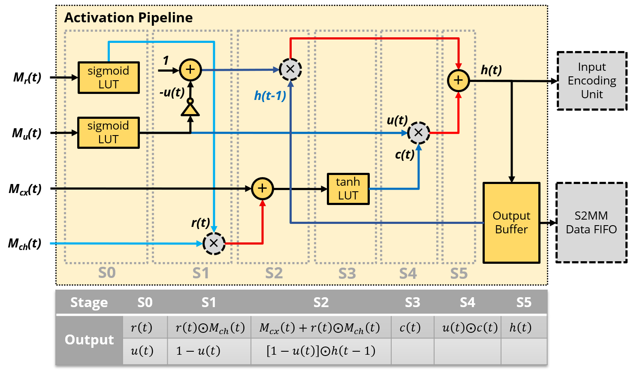
Accelerator Architecture
Activation Pipeline
21

Slide 28
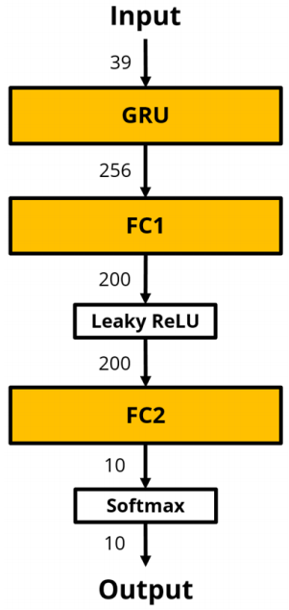
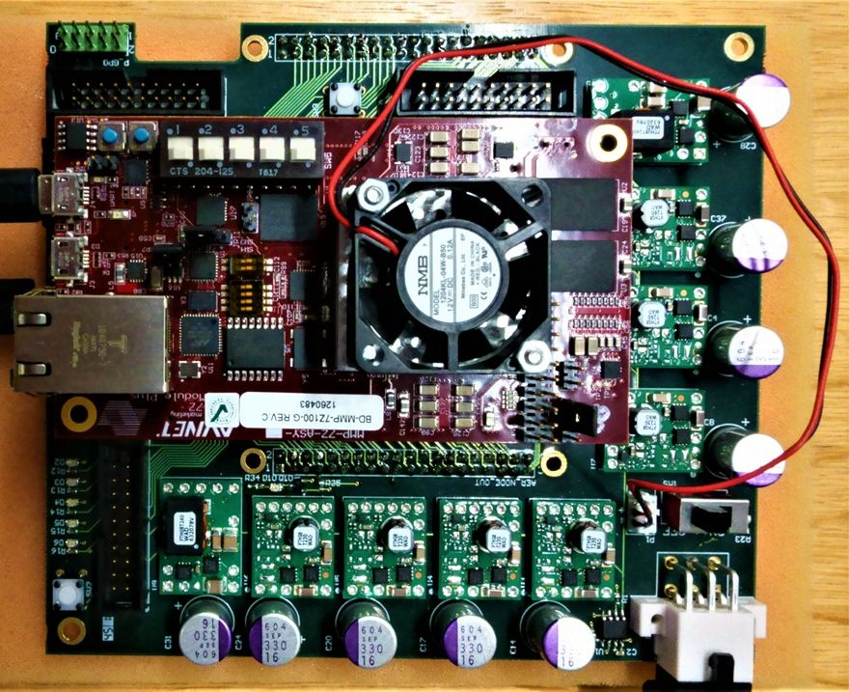
Results
Experimental Setup
Zynq 7100 FPGA runs at 125 MHz
Single-layer GRU with 256 neurons
TIDIGITS Dataset (50% Train, 50% Test)
Trained at delta threshold = 0.5 (0x80)
22

Slide 29
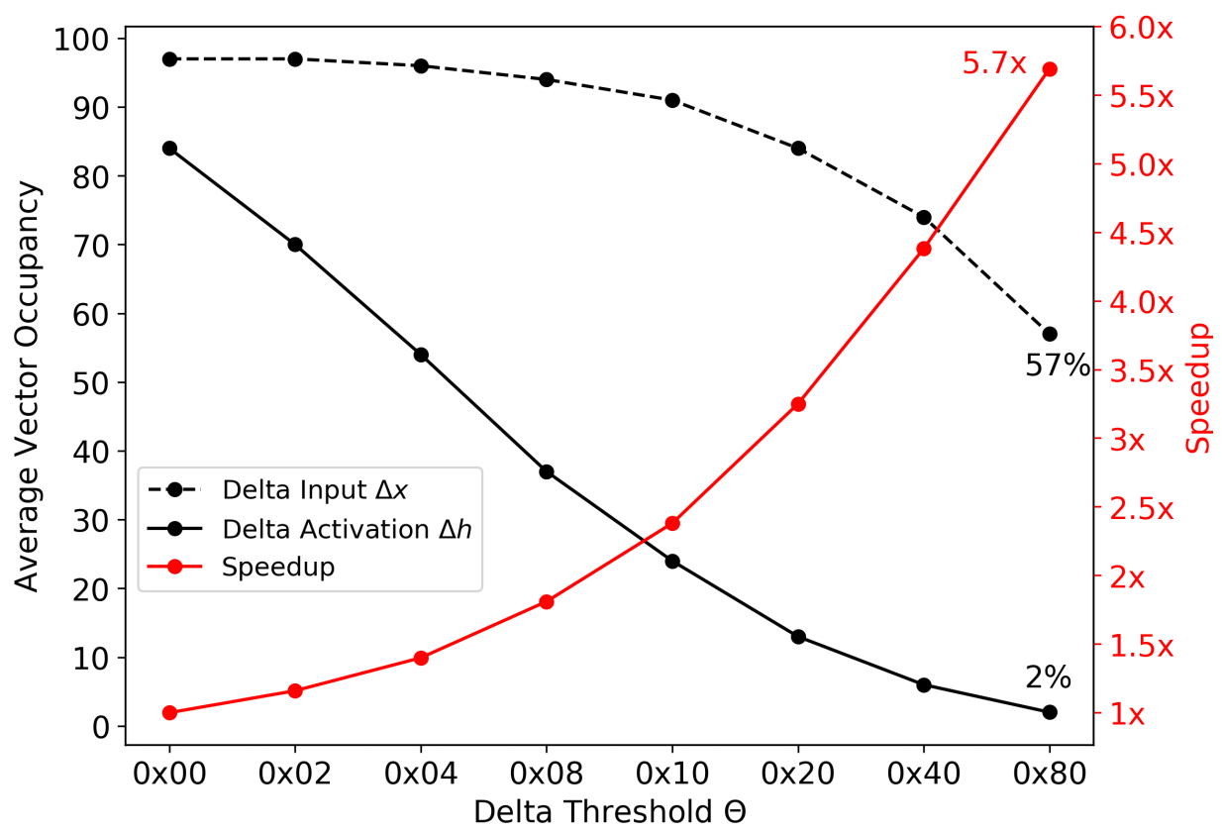
Results
Effective Throughput & Speedup
Delta Threshold | Time [ms] | Effective Throughput [GOp/s]
0x00 | 26.43 | 210.37
0x02 | 22.77 | 244.18
0x04 | 18.89 | 294.34
0x08 | 14.61 | 380.56
0x10 | 11.12 | 500.00
0x20 | 8.14 | 683.05
0x40 | 6.04 | 920.53
0x80 | 4.64 | 1198.28
23

Slide 30
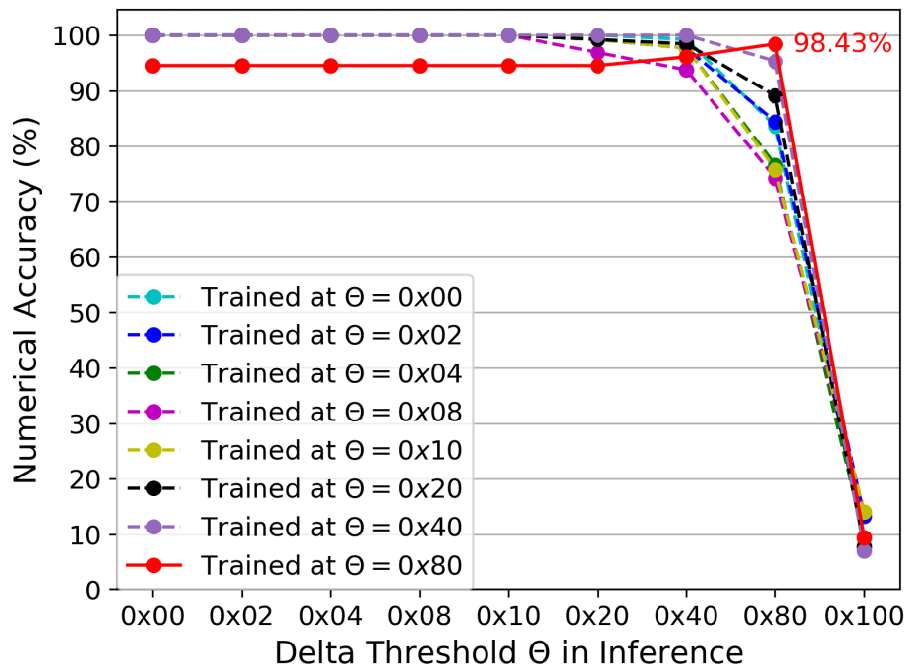
Results
Numerical Accuracy
Numerical accuracy (compared to CPU results) of classification results obtained by DRNN running test RNN models trained at diﬀerent delta thresholds
24

Slide 31
Results
Comparison to prior work and CPU, GPU
 | DeltaRNN* | ESE[1] | FP-DNN[2] | Intel i7-8700K* | GTX 1080 Ti*
FPGA Model | Xilinx Zynq-7100 | Xilinx XCKU060 | Altera GSMD5 | - | -
Precision | Fixed16 | Fixed16/12 | Fixed16 | Float32 | Float32
Frequency [MHz] | 125 MHz | 200 MHz | 150 MHz | - | -
Effective Throughput [G(FL)Op/s] | 1198 | 2520 | 315.85 | 18.78 | 123.34
Power [W] | 7.3 | 41 | 25 | 35.6 | 95.9
Power Efficiency [G(FL)Op/s/W] | 164.11 (310x) | 61.46 (116x) | 12.63 (24x) | 0.53 (1x) | 1.29 (2.4x)
* Test on the same task
25
[1] Han et al., “ESE: Efficient Speech Recognition Engine with Sparse LSTM on FPGA”, FPGA’17
[2] Y. Guan et al., "FP-DNN: An Automated Framework for Mapping Deep Neural Networks onto FPGAs with RTL-HLS Hybrid Templates“, FCCM ’17

Slide 32
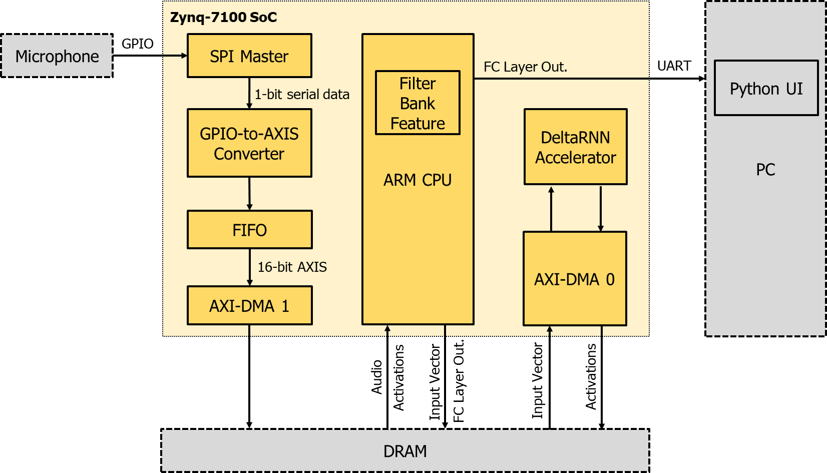
Demo
Digit recognition
26

Slide 33
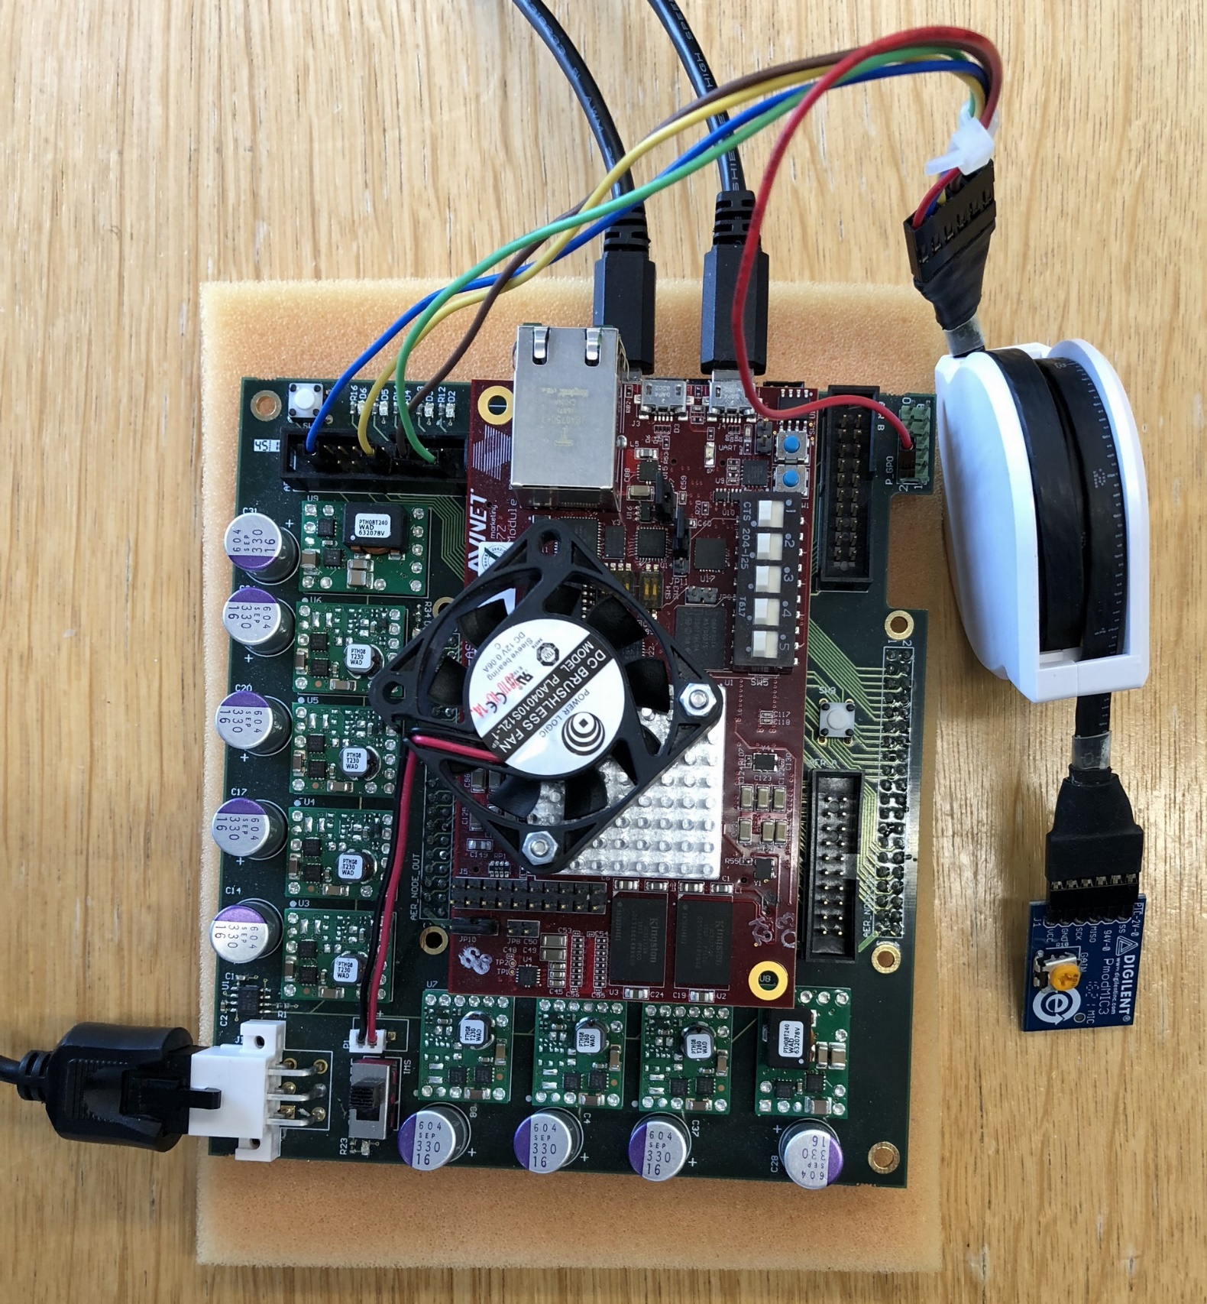
Demo
Digit recognition
Setup
Microphone: Pmod MIC3 12-bit Digital Microphone
Sample Rate: 20 kHz
Input Vector Size: 40
Hidden Layer Size: 256
Frame Size = 25 ms
Frame Stride = 10 ms
Frame per second = 100
DeltaRNN Frequency = 1 MHz
Measured Power
Zynq Board Power = 2.8 W (28 mJ/frame)
Xilinx Power Analyzer Results
DeltaRNN Power = 30 mW (Core + BRAM)
Processing System Power = 1.58 W
Static Power = 0.3 W
Total On-Chip Power = 1.92 W
27

Slide 34
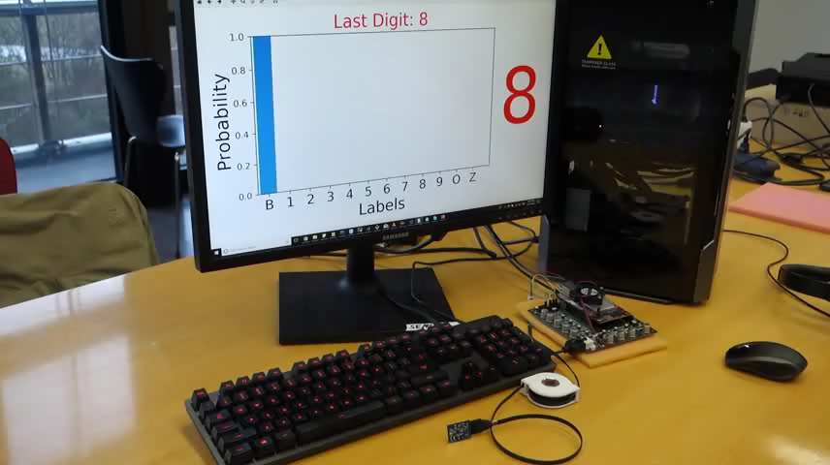
Demo
Digit recognition
28

Slide 35
Thank you!

