Slide 1
C-LSTM: Enabling Efficient LSTM using Structured Compression Techniques on FPGAs
Shuo Wang¹, Zhe Li², Caiwen Ding², Bo Yuan³, Qinru Qiu², Yanzhi Wang², and Yun Liang¹
¹CECA, Peking University, China
2Syracuse University, USA
3City University of New York, USA

Slide 2
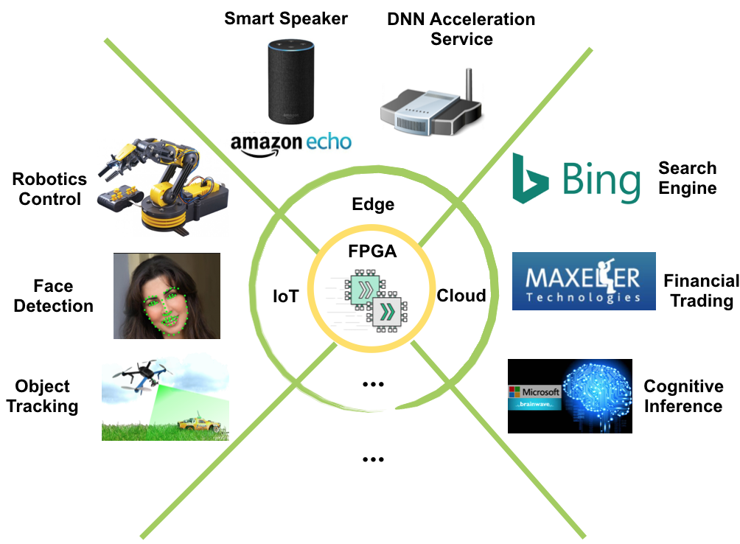
FPGA Accelerated DNNs

Slide 3


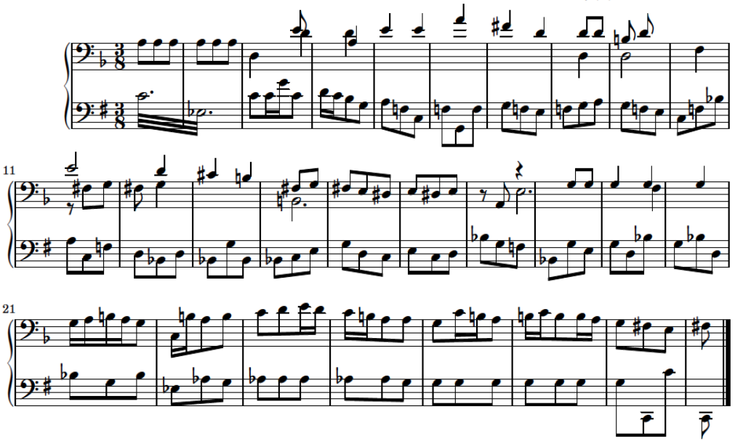
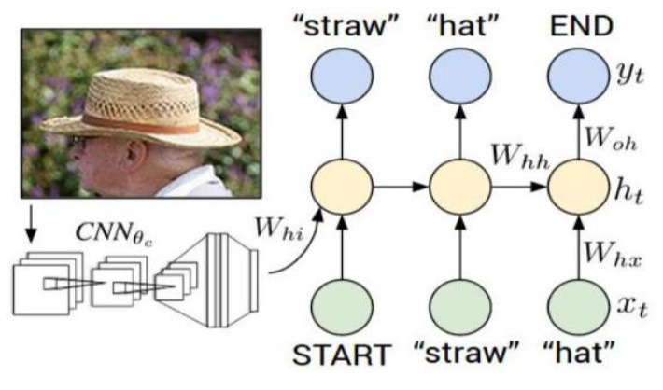
RNNs
Machine Translation
Voice Control
Music Composition
Image Caption

Slide 4
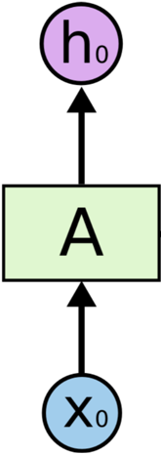


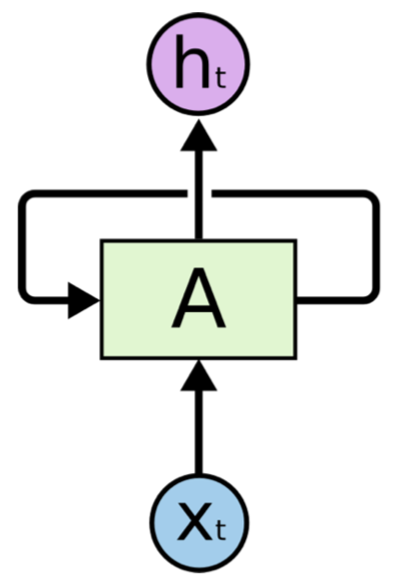
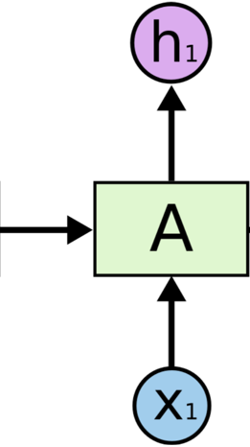
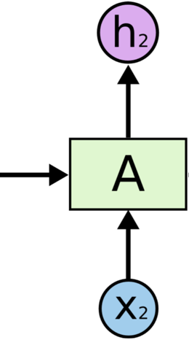
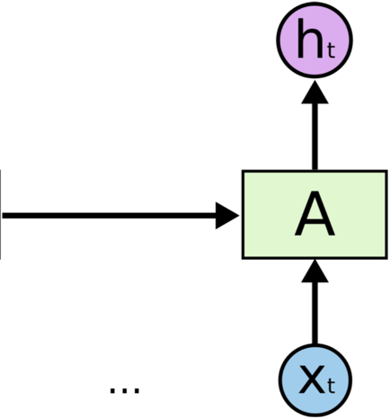




Architecture of RNNs
Overview
  RNNs use loops to preserve and learn information overtime
A: neural network
Xt: input
ht: output
=
  short-term information is easily to be preserved
  long-term information is difficult to be taken into account of

Slide 5
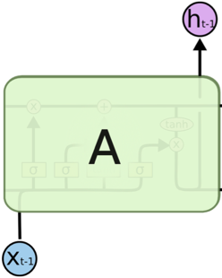
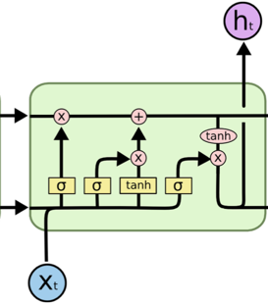
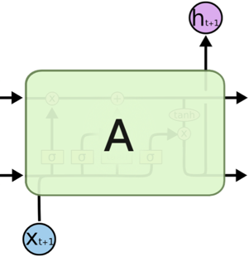
LSTM based RNNs
LSTM
  Long Short Term Memory neural network, capable of learning both
  long-term and short-term dependencies
…
…
  cell state is added to preserve the long-term information

Slide 6
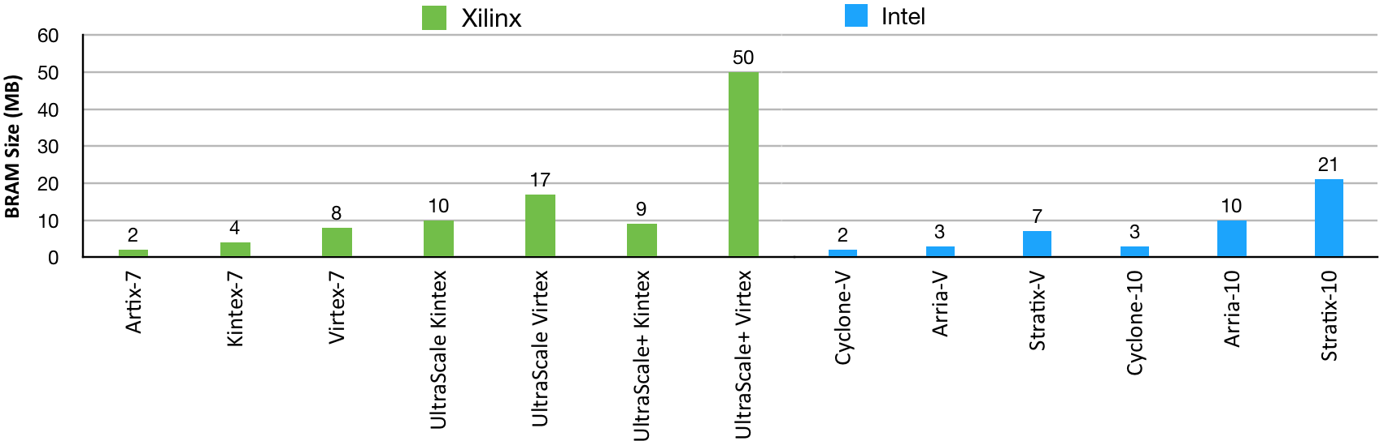
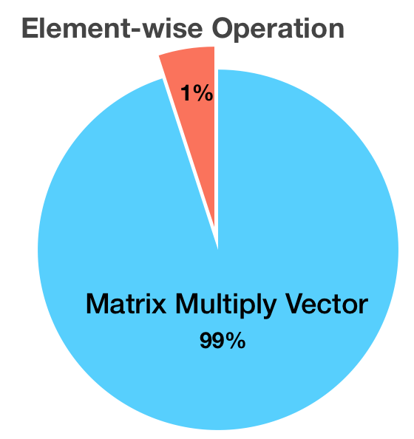
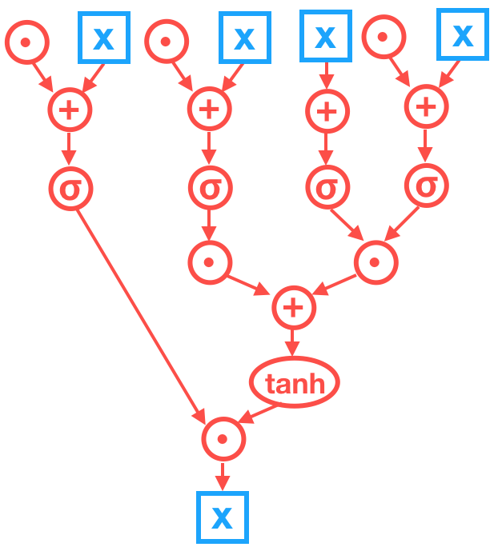
Google LSTM
Large Model Size
Google LSTM Model Size (32MB)
Skewed Computation Intensity
complicated
data dependency

Slide 7
C-LSTM Framework
LSTM Architecture Specification
Structured Compression
Software
Level
√
Model Training
Hardware Optimization
Hardware
Level
Automatic Synthesis Toolchain
Optimized FPGA Implementation

Slide 8
Compression Techniques Overview
Deep Compression
ICLR’16
Parameter
Pruning
Structured Sparsity
NIPS’16
Less is More
ECCV’16
ESE
FPGA’17
Limited Precision
ICML’15
Model
Compression
Techniques
Quantization
Binary Connect
NIPS’15
Binary Net
CoRR’16
Our Work: C-LSTM
FPGA’18
Circulant Matrix
ICCV’15
Structured
Matrix
Deep Fried
ICCV’15
Structured Transform
NIPS’15

Slide 9
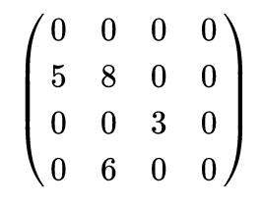
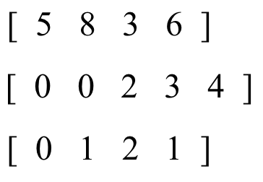

Parameter Pruning
Partition Workload
Data
Sparse
Matrix
CSR
Format
Indices
Unbalanced Workload
  0 : 2 : 1 : 1
=
Extra Storage Footprint
  indices
Hardware
Unfriendly!
Irregular Memory Access
  random access is slow

Slide 10

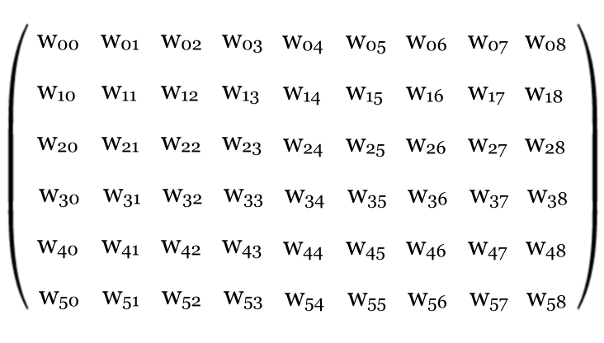
Structured Matrix
Circulant Matrix
4 x 4 Original Matrix
4 x 4 Circulant Matrix
1 x 4 Dense Vector
w00
w01
w02
w03
w00
w01
w02
w03
w10
w11
w12
w13
Circulant
Projection
w03
w00
w01
w02
Compress
w00
w01
w02
w03
w20
w21
w22
w23
w02
w03
w00
w01
w30
w31
w32
w33
w01
w02
w03
w00
Block-Circulant Matrix
6 x 9 Original Matrix
2 x 9 Dense Matrix
Structured
Compress
w00
w01
w02
w03
w04
w05
w03
w04
w05
w30
w31
w32
w33
w34
w35
w33
w34
w35

Slide 11
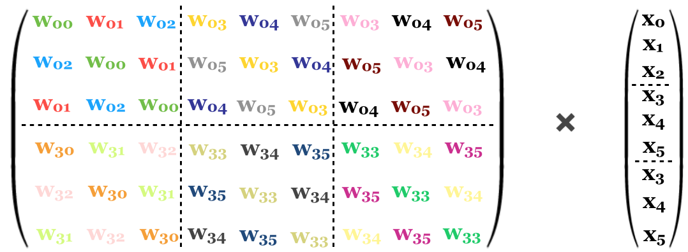
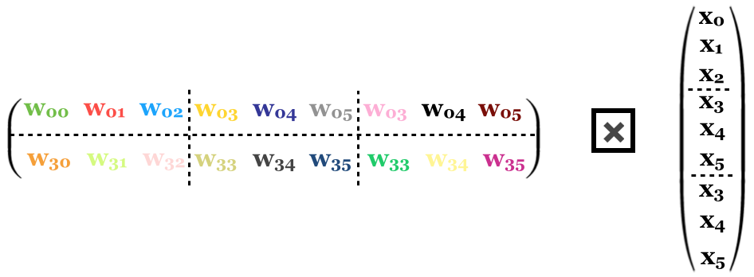
Circulant Convolution
Circulant Matrix
Input Vector
Matrix
Multiply
Vector
Compress
Circulant Dense Matrix
Circulant
Convolution

Slide 12
Circulant Convolution Acceleration
x0
y0
x1
x2
y1
w00
w01
w02
w03
w04
w05
w03
w04
w05
x3
y2
×
x4
=
w30
w31
w32
w33
w34
w35
w33
w34
w35
x5
y3
x3
x4
y4
x5
y5
Fast Fourier Transformation
FFT
y0
FFT-Accelerated
Circulant
Convolution
x0
y1
x1
IFFT
∑
x2
y2
x3
FFT
y3
x4
x5
y4
x3
y5
x4
x5

Slide 13

Circulant Convolution Complexity Analysis
m x n Matrix
m/k x n Dense Circulant Matrix
Structured
Compress
w00
w01
w02
w03
w04
w05
w03
w04
w05
w30
w31
w32
w33
w34
w35
w33
w34
w35
k x k Circulant Sub-Matrix
Storage Complexity
  reduced from O(m·n) to O(m·n/k)
Hardware
Friendly!
Computational Complexity
  reduced from O(m·n) to O(m·n·logk/k)

Slide 14
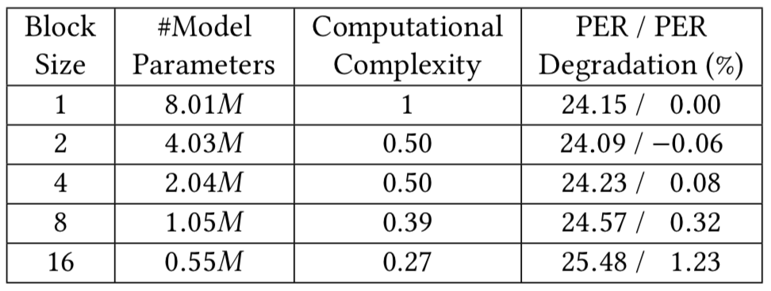
Model Training
Varying Circulant Matrix Block Size k
  trade-offs between compression ratio and accuracy
Output Corresponding Inference Models
  block size = 8
  block size = 16

Slide 15
C-LSTM Hardware Level
Hardware Optimization & Implementation
  Circulant Convolution
  Activation Functions
  Scheduling & Pipelining
Automatic Synthesis Toolchain
  Operator Scheduling
  C/C++ Operator Templates
  Code Generator
  Synthesis Backend

Slide 16
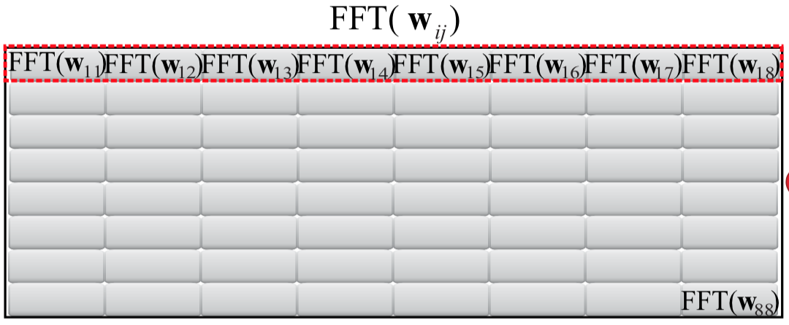
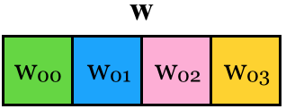


Circulant Convolution
Local Memory Promotion
FFT
promoted to on-chip
BRAMs of FPGA
IFFT
FFT
Redundancy Elimination
FFT accelerated circulant convolution
  outputs of FFT is mirrored, and about half of the outputs could
  be eliminated

Slide 17
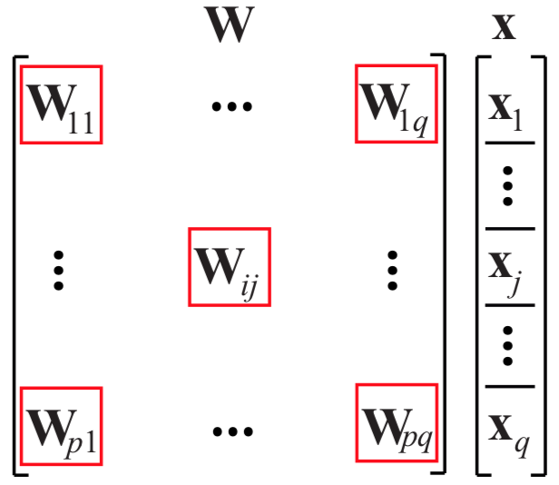
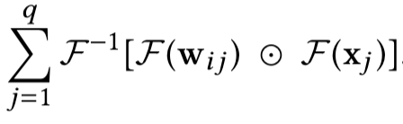
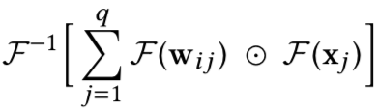
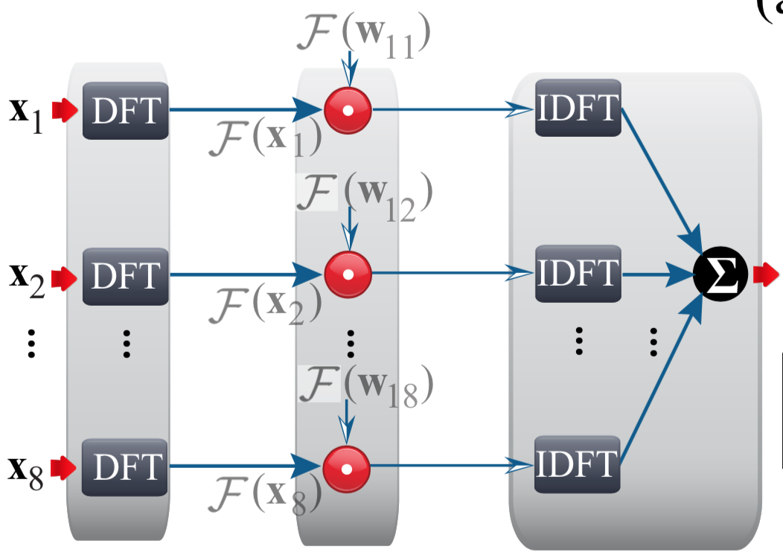
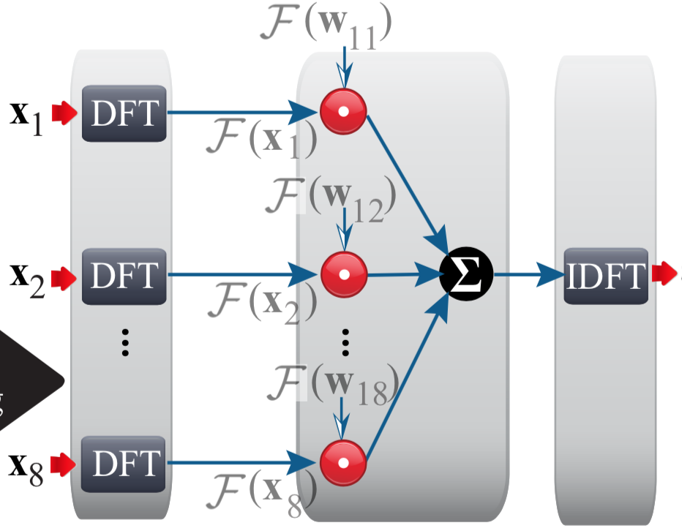
Circulant Convolution
FFT/IFFT Decoupling
decouple
block circulant convolution
coupled form
decoupled form
decouple

Slide 18
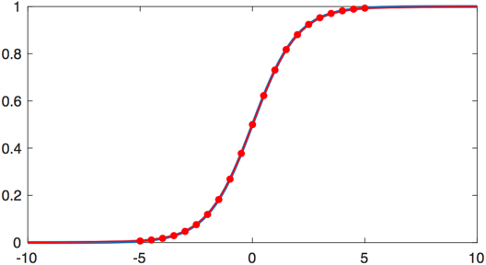
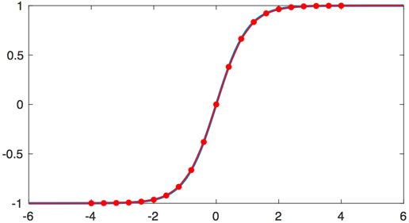
Activation Functions
Piece-wise linearization
sigmoid
y = sigmoid(x)
22 segments
< 1% error rate
x
tanh
y = tanh(x)
x

Slide 19
LSTM Pipelining
Putting It All Together
Parallelization
Degree
Throughput
(Tuples / Clock Cycle)
X 10.5
x
x
x
x
8 / 8 = 1
·
·
·
+
+
+
+
circulant
convolution
operators
σ
σ
σ
σ
element-wise
operators
X 8
8 / 1 = 8
·
·
+
the resources are wasted
tanh
·
X 8
x
8 / 8 = 1

Slide 20
Operator Scheduler
Coarse & Fine-grained Pipeline
  step 1: partition LSTM module
  into 3 stages
x
x
x
x
double buffers
  step 2: build fine-grained pipeline
  for each stage (II = 1)
·
·
·
+
+
+
+
  step 3: add double buffers for each
  concatenated stage pair
σ
σ
σ
σ
·
·
double
buffers
+
  step 4: adjust the parallelism degree
  to maximize throughout under the
  resource constraint
tanh
·
double buffers
x

Slide 21
Scheduling Result
Execution Timeline
stage 1
stage 2
stage 3
stage 1
x
x
x
x
time
input 1
double buffers
input 2
input 1
·
·
·
input 3
input 2
input 1
+
+
+
+
input 4
input 3
input 2
σ
σ
σ
σ
stage 2
input 5
input 4
input 3
·
·
double
buffers
+
.
.
.
.
.
.
.
.
.
tanh
·
double buffers
stage 3
x

Slide 22
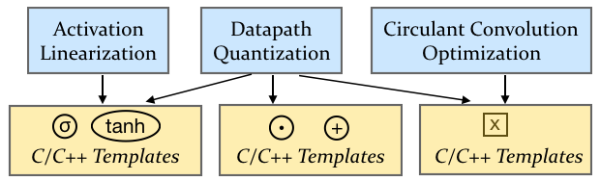
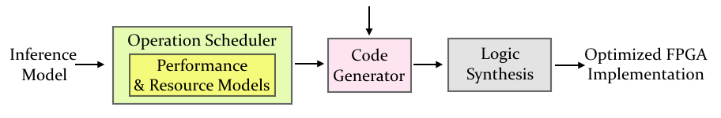
Synthesis Backend

Slide 23
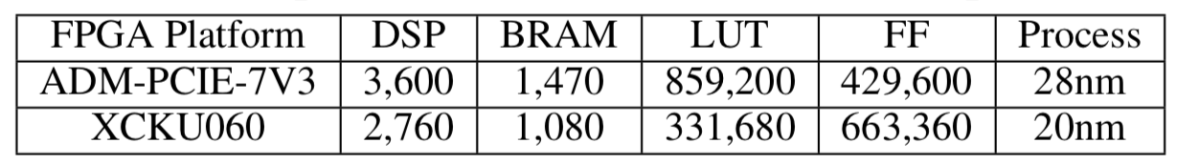
Experimental Setup
Comparison Baseline
  ESE (FPGA’17)
LSTM Architecture
  Google LSTM
Benchmark Suite
  TIMIT
FPGA Platforms
Software Tools
  SDAccel 2017.1

Slide 24
Experimental Results
Performance
  throughput (frames per second)
up to 21.2X
throughput speedup
  execution latency
up to 7.0X
latency reduction

Slide 25
Experimental Results
Energy Efficiency (frames per second / watt)
up to 33.5 X energy
efficiency speedup
PER Degradation
comparable
PER degradation

Slide 26
Conclusion
Circulant Matrix Compression
  reduces both storage and computational complexity
  accuracy degradation is small and acceptable
  compressed circulant matrix is dense and hardware friendly
LSTM Inference Engine Created by C-LSTM
  > 10X throughput speedup
  > 4X latency reduction
  > 19X energy speedup
  < 1.3% accuracy degradation

Slide 27
Thank you !

