Slide 1
Network-on-Chip Programmable Platform in Versal™ ACAP Architecture
Ian Swarbrick, Dinesh Gaitonde, Sagheer Ahmad, Brian Gaide, Ygal Arbel
Xilinx Silicon Architecture Team

Slide 2
Agenda
Versal Devices and Motivation for Hardened NoC
Overview of Versal NoC
Timing Closure Benefits
Routing
Conclusions

Slide 3
Versal Device
Versal – Xilinx 7nm Generation Devices
Adaptive Compute Acceleration Platform (ACAP) devices
Device-wide hardened NoC
Each physical link has full-duplex paths
128 bit data @ 1 GHz at mid-speed grades.
All resource address mapped
Configurable address map
Note: not an actual device

Slide 4
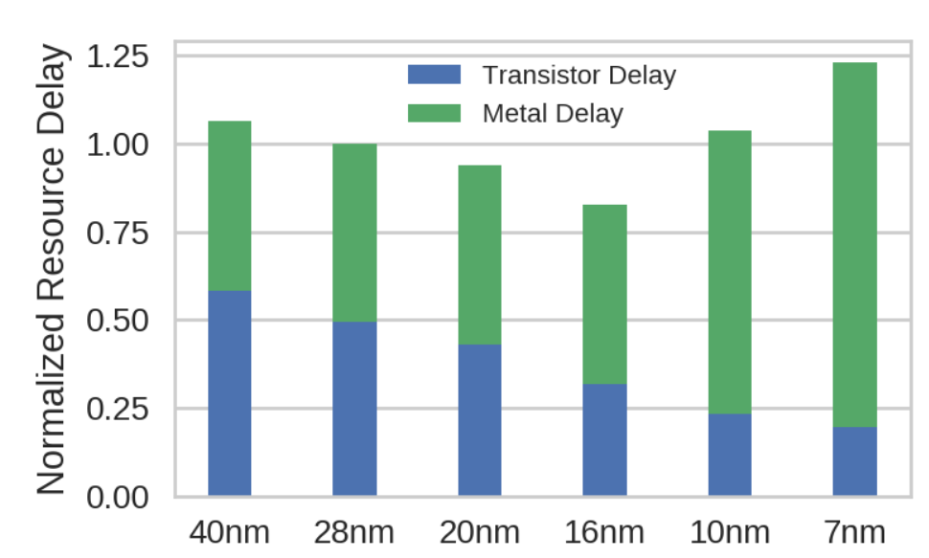
Motivation for Hardened NoC
Need for efficient data movement
Data movement common across all applications.
Wires not scaling with logic.
Data movement needs to keep up with memory.
~100 GB/sec DDR
Hundreds of GBs/sec with HBM
Increasing wire delays make timing closure harder.
Move towards Platform with fabric
All fabric ports and hard IP are globally addressable from anywhere on the device.
Independent from fabric and available without loading any fabric bitstream.

Slide 5
Overview of Versal NoC

Slide 6
Hardened NoC – Packetized Interconnect
Packetize, transport, de-packetize
Virtual Channels provide independent non-blocking flow control

Slide 7
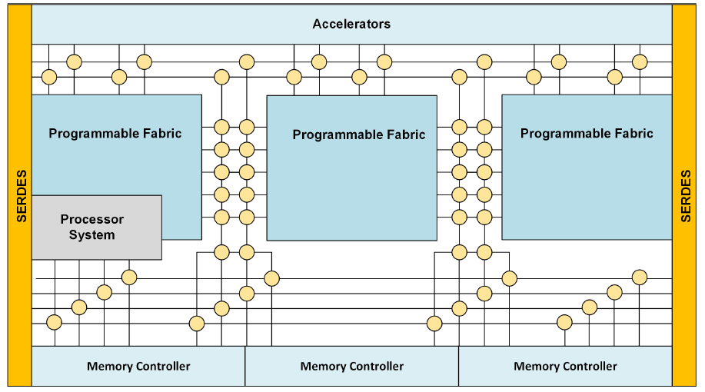
NoC Topology
HNoC – 4 or 2 Physical Lanes
64 GBytes/sec at in each direction 1GHz
VNoC – 2 Physical Lanes
32 GBytes/sec in each direction at 1GHz
Each NoC lane (physical channel) is 2 full-duplex links.
16 GBytes/sec raw bandwidth (@ 1GHz)
HNoCs connect up/down to hard IPs
VNoCs connect horizontally to fabric
Note: not an actual device

Slide 8
NoC Scaling
Horizontal Scaling
Bigger devices need more NoC resources
Wider devices have more IO on the top and bottom of the device
One VNoC column per DDR channel
More fabric -> NoC connects is device width grows.
More vertical bandwidth as device width grows.
Taller devices have more fabric
Each half-FSR (fabric sub-region) in VNoC has one ingress and one egress NoC path.
More fabric/NoC connections as device height grows.
MC
MC
MC
Vertical Scaling
MC
MC

Slide 9
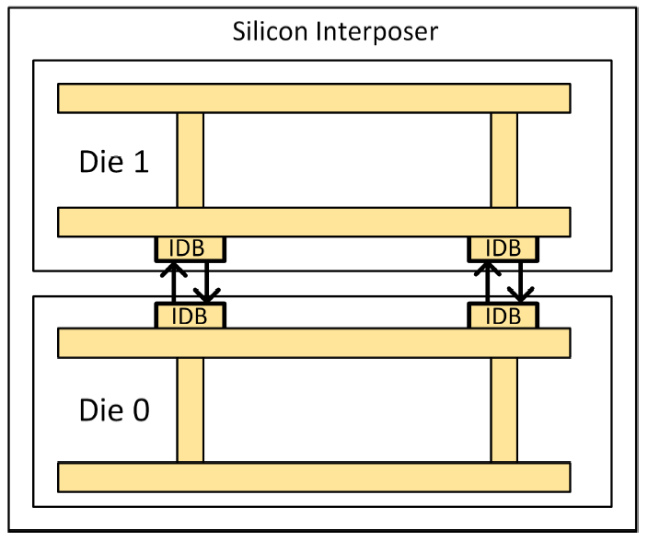
NoC for Multi-Die Devices
NoC extends across SSIT (Stacked Silicon Interconnect Technology) devices
VNoC physical channels continue across devices
Source synchronous, single data rate links across interposer

Slide 10
NoC Quality-of-Service
Routes through network are programmable
Each route is assigned to a traffic class
Classes separated using virtual channels
Traffic classes can be:
Low latency (reads): prioritize traffic to give low latency without compromising other QoS constraints.
ISOC: Bounded latency.
Best Effort: given whatever service is available.
Other mechanisms provide traffic shaping
Ingress rate control
Weighted arbitration at every NoC switch.

Slide 11
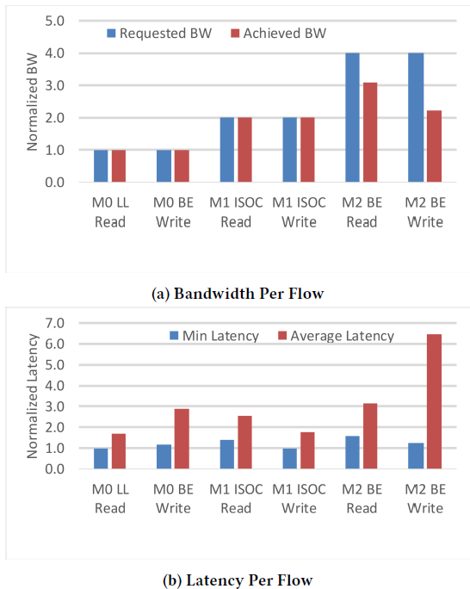
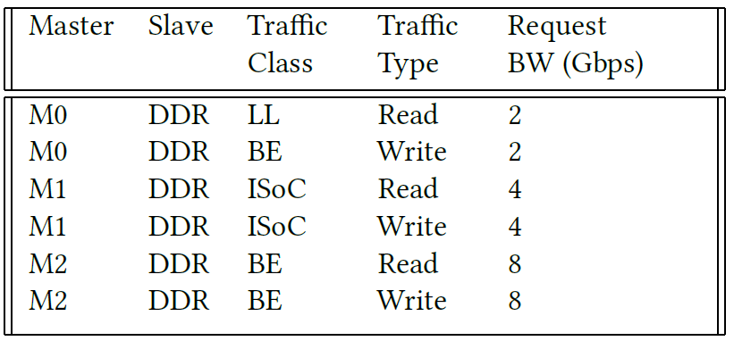
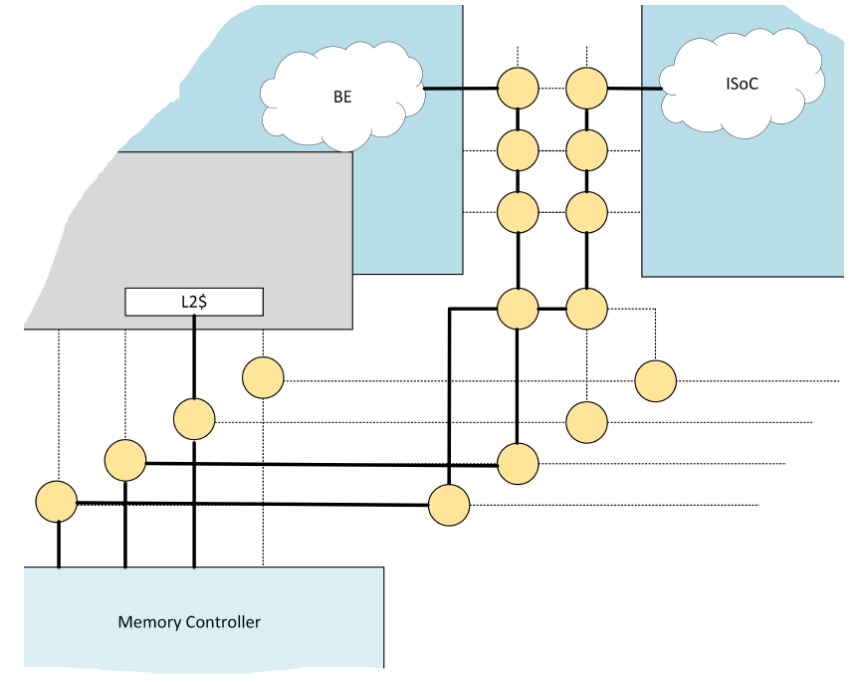
QoS Example
(GB/sec)
Notes:
Ask, compiler flow, simulation.

Slide 12
NoC Timing Closure Benefits

Slide 13
Timing Closure
Fabric timing closure requires iteration
Hardened NoC interfaces and modular design simplify the process

Slide 14
NoC Routing

Slide 15
NoC Routing
Versal NoC has distributed routing tables
QoS managed per-connection
Dynamically re-programmable for partial reconfiguration
Tools take user QoS constraints and configure paths
Routes created in a deadlock-free manner

Slide 16
NoC Compiler
Compiler takes in user traffic and design constraints (including NoC topology)
Produces routing assignments that
Meet QoS specification
Are deadlock free

Slide 17
Hardened NoC Example
4 DDR Memories interleaved
16 Fabric masters
External bandwidth from PCIe
Local processor control traffic also
~150 GBytes/sec aggregate bandwidth
NoC compiler runs in minutes
No fabric resources consumed for routing/address/switching or DDR

Slide 18
Conclusions

Slide 19
Versal NoC - Conclusions
Hardened NoC that scales across Versal product family
Eases timing closure and increases design productivity
Flexible QoS
Programmable route and bandwidth assignments
A core infrastructure piece of the Versal ACAP platform

