Slide 1
System View Inc.

Slide 2
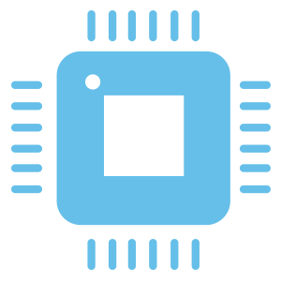
Problem
Embedded Systems
Getting Increasingly Complex
System Design Span Multiple Chips (CPUs, GPUs, FPGAs, DSPs ….)
Difficult to Integrate, No Visibility
No Universal Tool Exists for Integration
Notes:
Continued push towards higher integration
2) FPGAs see the variety of Systems . FPGAs are not alone in system. ,. FPGAs are used for I/O s . Horizontal tool support
3) Interfaces difficult to bring-up & debug. 2 Cavium + 56 FPGA
4) Multi-level failure software (thread-locking) , hardware (fifo overflow), data corruption .. Don’t know what is going on
4) What-if requires massive changes
5) Project failed due to long integration time.

Slide 3
Solution: Visual System Integrator
Rapid, visual application development:
Describe Hardware platform.
Develop Application (Import C/C++/RTL blocks connect them)
Automatic code generation for the complete system (Software/Hardware projects, drivers, DMAs)
Get unprecedented Transaction level visibility at runtime
Focus on your application, not the platform & firmware!
Notes:
Why Visual ? Natural people draw diagrams to describe their systems . NI (Labview) & Mathworks (Simulink)
Increases ease of use & raise the abstraction without loosing I/O advantage / differentiation . Raising to much can cause questions
Enable both FPGA skilled & Software skilled
System level visibility important, chip level debug available hard to correlate events from across the system (light weight monitoring), no jtag
5) Components come-in out of order. Two benefits our tool used in portions only , increases adoption

Slide 4
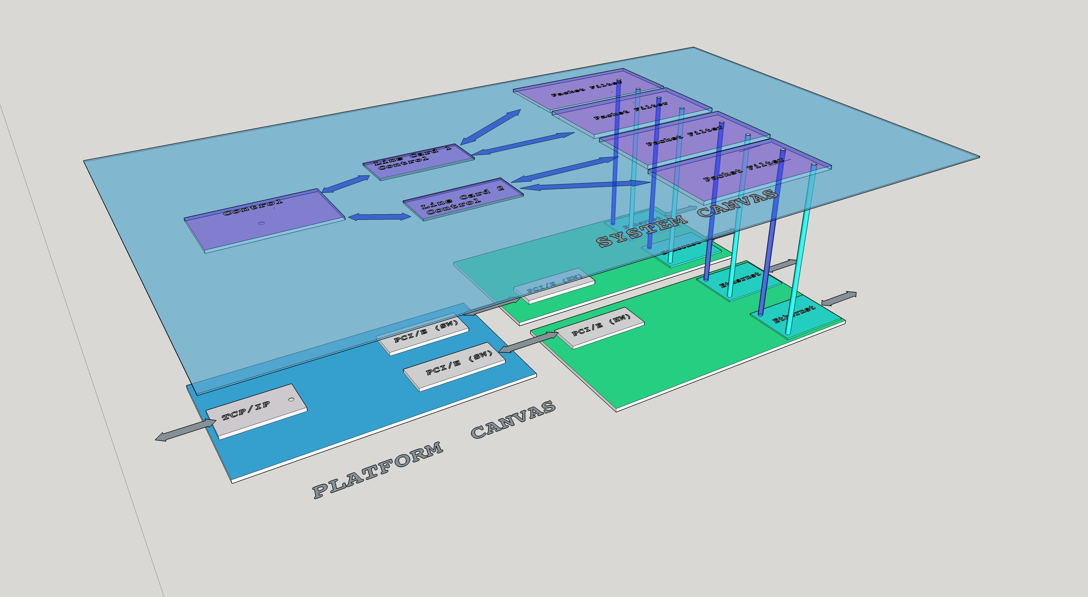
Design Visualization : Platform & System Layers
Platform Layer
Board level Physical Hardware
Express connections & transport between Physical entities
Application / System Layer
Easily add logical blocks
Import C/C++/Java or Python code
Connect blocks to express dataflow
Notes:
Why Visual ? Natural people draw diagrams to describe their systems . NI (Labview) & Mathworks (Simulink)
Increases ease of use & raise the abstraction without loosing I/O advantage / differentiation . Raising to much can cause questions
Enable both FPGA skilled & Software skilled
System level visibility important, chip level debug available hard to correlate events from across the system (light weight monitoring), no jtag
5) Components come-in out of order. Two benefits our tool used in portions only , increases adoption

Slide 5
Visual System Integrator: Work Flow
Describe
Hardware
Platform
(Import Existing)
Software Projects
Eclipse, Qt, VC++ , …
Compile
Platform
Runtime , Drivers &
OS Configurations …
Platform
Meta data
Compile Generate System
FPGA
Projects
Import
Platform
Develop
Application
System

Slide 6
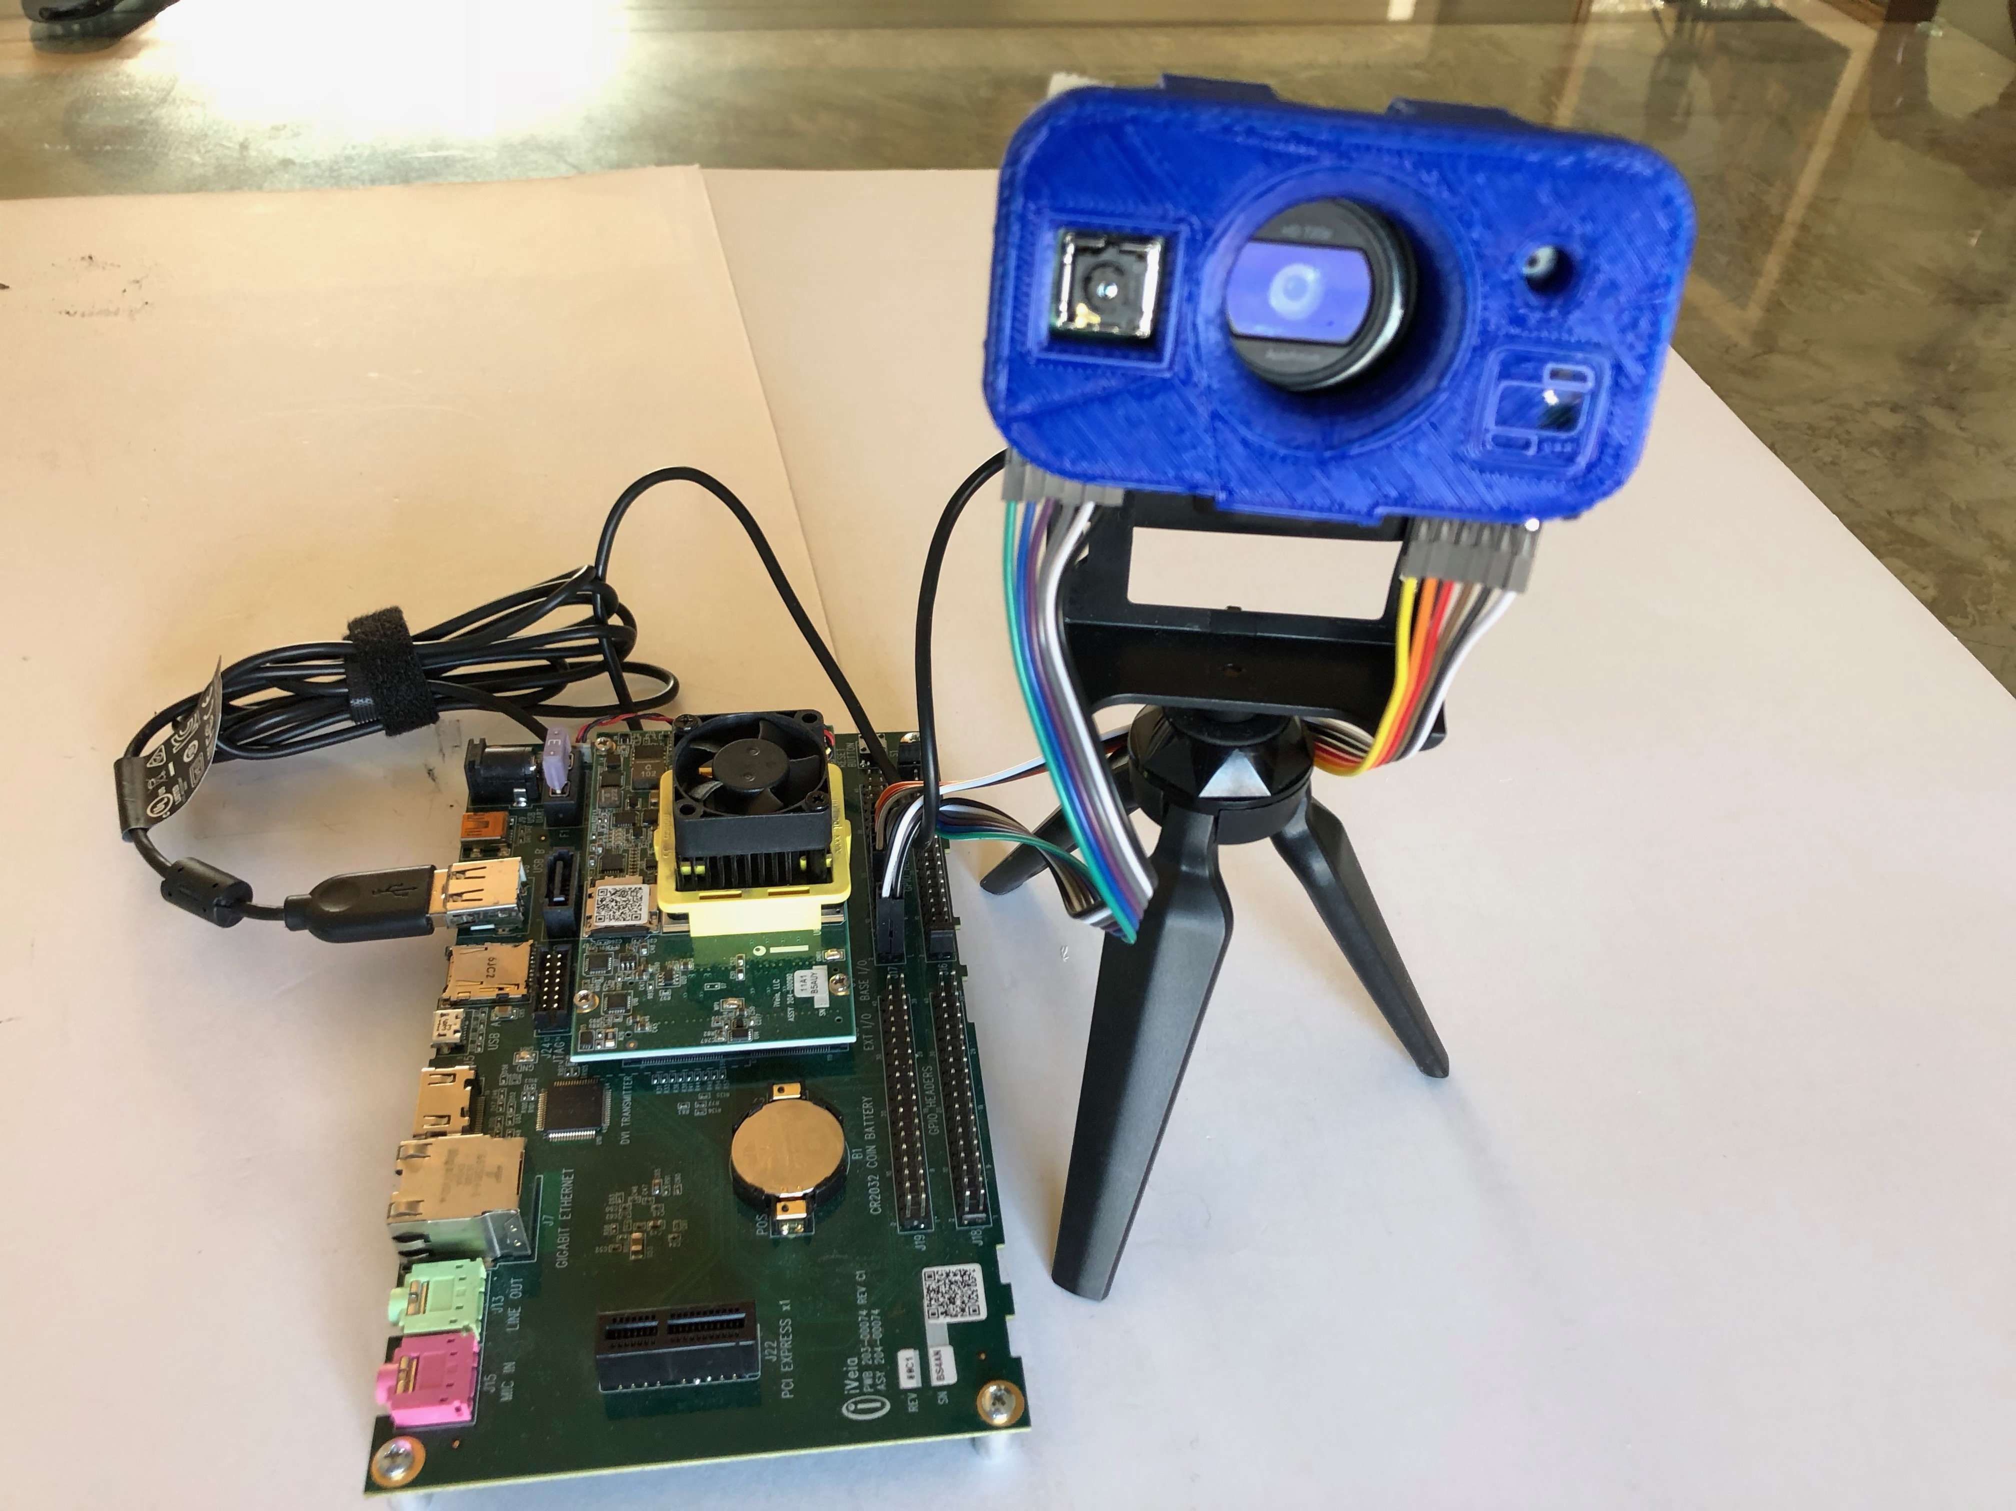
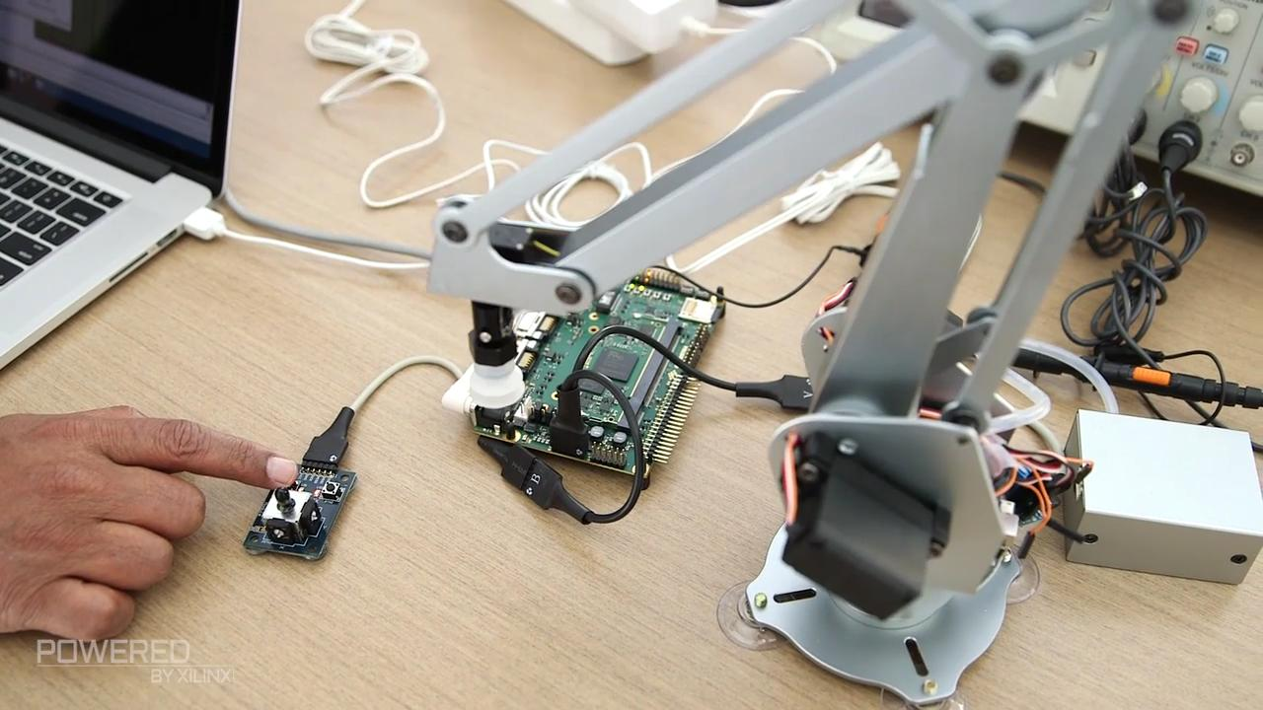
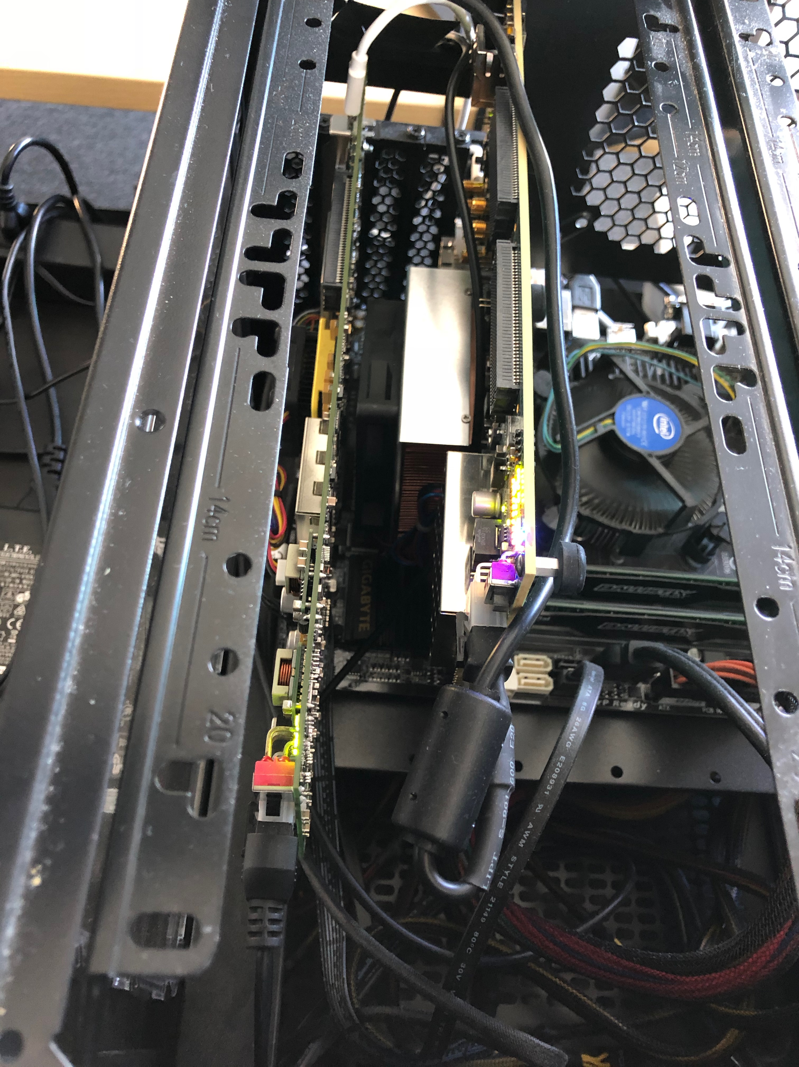
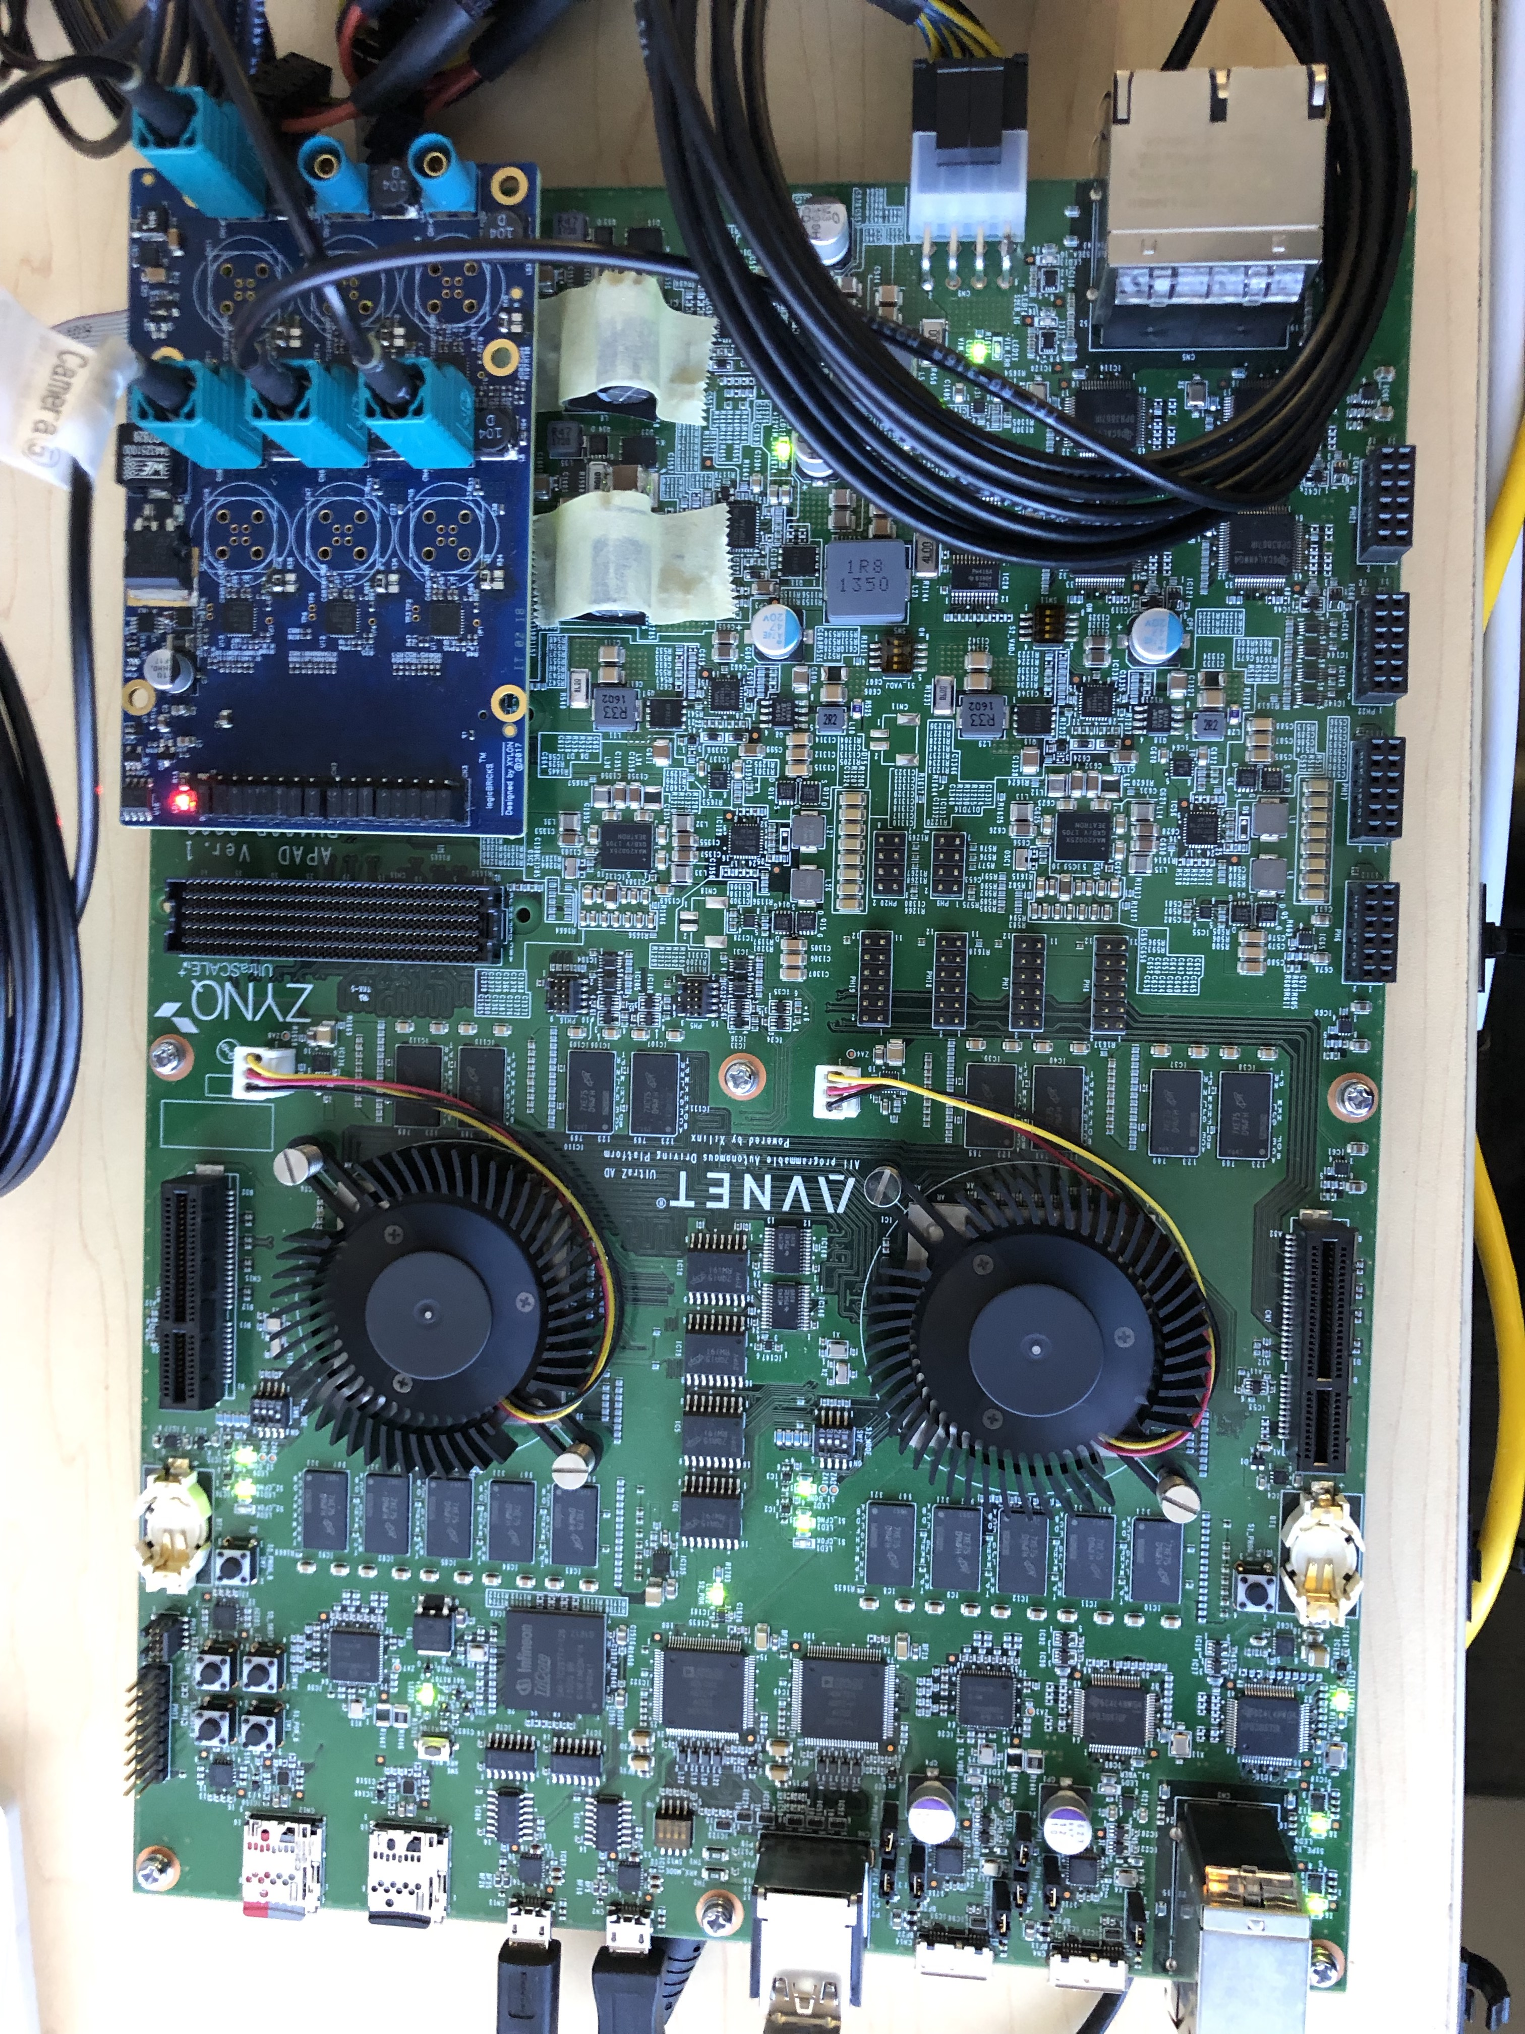
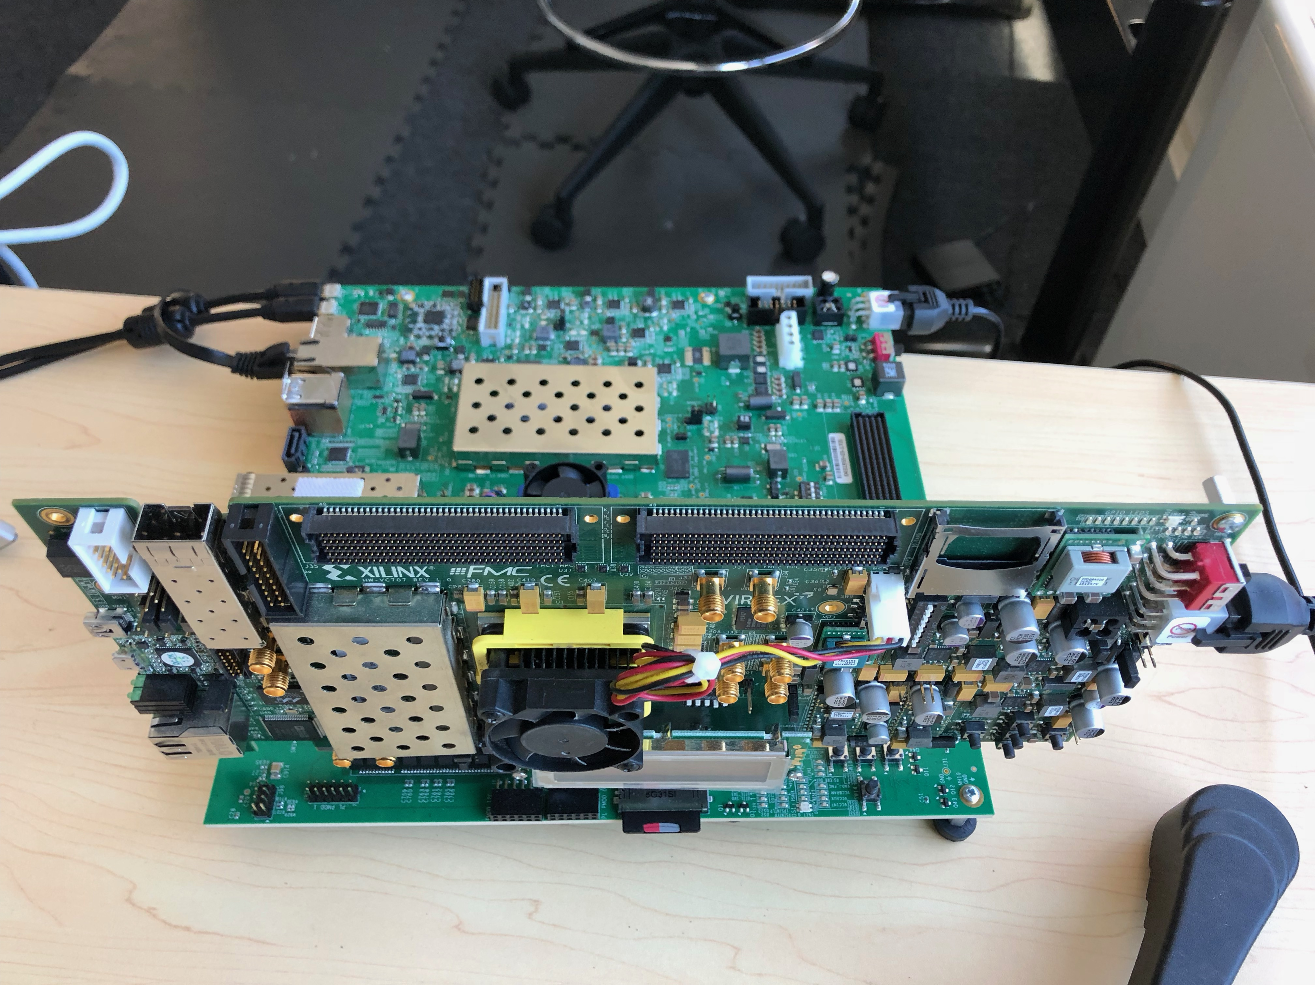
VSI Built Systems

Slide 7
Load On Demand (Partial Reconfig)
Time multiplex hardware Resource [R5, FPGA Fabric … ]
Dynamically change the behavior of a system
Radar : Transmit, Receive or Communication
Deep Learning: Reconfigure between Training vs Evaluation
Self Driving Car: Adapt to different driving /weather conditions
Snow, Rain, Highway, City etc

Slide 8
Load On Demand
Load on Demand using Data-Flow
Gear
Spindle
Forward
Camera Display
Forward Camera
Processing
G1
Rear
Camera
Display
Rear Camera
Processing
G1

Slide 9
Load On Demand
Load on Demand using Data-Flow
A
B
Fixed
Gear
Spindle
Forward
Camera
Display
vsi::runtime
Forward Camera
Processing
G1
Rear
Camera
Display
Rear Camera
Processing
G1

Slide 10
Load On Demand
Action | Time in uS (10e-6 Seconds)
Config Block Setup | 210 uS
Decouple Logic from Active | 123 uS
Load Partial Bitstream (~1.2Mbytes) | 19845 uS
Recouple Logic to Active | 138 uS
Restore Config block setup | 77 us
Total | 20393 uS (.02 S)

Slide 11
Application Development : Example
Import Platform
Develop Application
DSP
Function
User C/C++ Code
TCP
SERVER
Synthesizable
C/C++ Function
Synthesizable
C/C++ Function
Software
Library
X86
C/C++
Functions
FPGA
FPGA
Library

Slide 12
System Level Verification: Transport
Simulator
CPU
Emulator
Embedded
CPU
Shared
Memory
Transaction Based
(DPI over TCP/IP)
Transaction Based
(Transactor)
PCI/e
AXI (Zynq)
FPGA
TCP/IP
CPU (X86)
FPGA
Aurora
Pin Muxing
PCI/e

Slide 13
System Level Verification
Simulator
RTL
CPU
Emulator
Embedded
CPU
Synthesizable
C/C++
RTL
C/C++
C/C++
Java
Python
Synthesizable
C/C++
Synthesizable
C/C++
FPGA
Synthesizable
C/C++
CPU (X86)
FPGA
C/C++
Java
Python
RTL
Synthesizable
C/C++
Synthesizable
C/C++
RTL

Slide 14
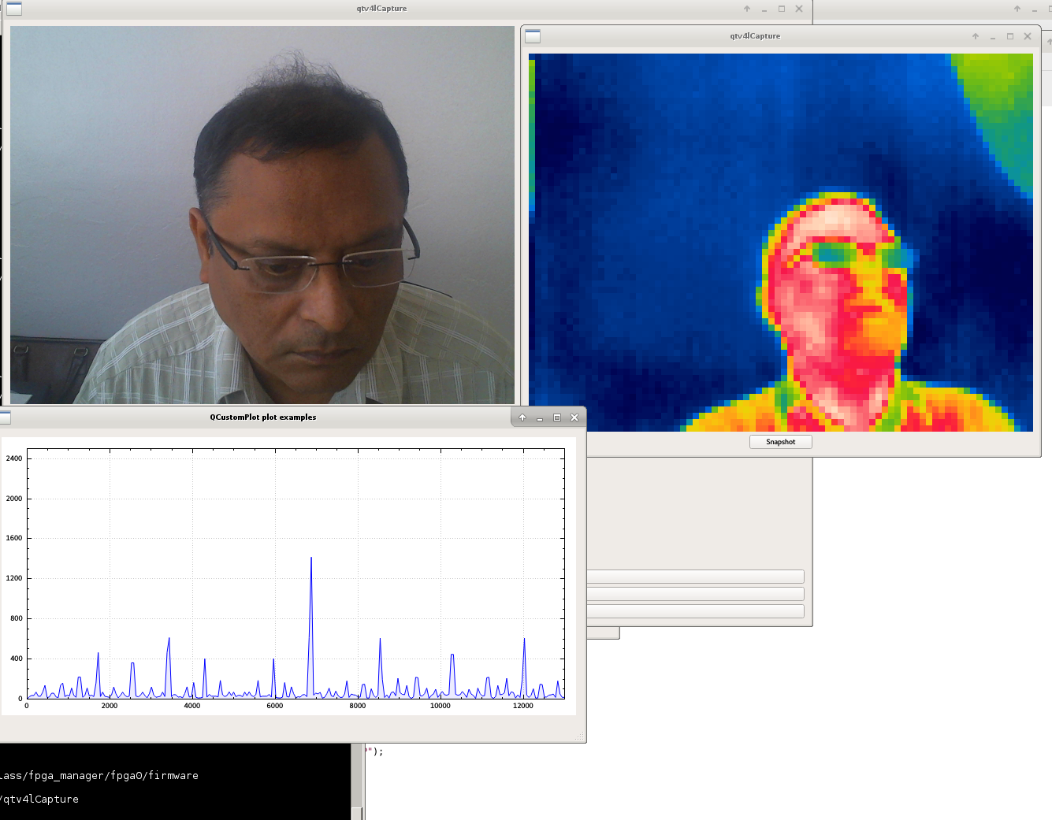
Rapid Application Development using Visual System Integrator
Real Time tracking of Optical & Thermal images
Display
FFT
Capture Microphone
Samples
Quad SPI
SPI
FFT
Display
Thermal Image
xf::MinMax
Thermal
Image Capture
SPI
Display
Webcam Image
CPU (ARM64)
FPGA
Capture ROI
xf::MeanShift
Track ROI
USB
Capture V4L
Xilinx: UltraScale MPSoC: Iveia Captiva

