Slide 1
Temporal Thermal Covert Channels in Cloud FPGAs
Shanquan Tian and Jakub Szefer
Yale University
International Symposium on Field-Programmable Gate Arrays (FPGA)
February 26, 2018
Notes:
Hello everyone, today I am going to give a report about temporal thermal covert channels in Cloud FPGAs.

Slide 2
Temporal Thermal Covert Channel in FPGAs
Cloud FPGAs leverage temporal sharing of the FPGA resources among users, which can lead to covert channels and information leakage.
To transmit information, simple on-off keying (OOK) is used.
The sender and receiver share or can access the same set of FPGAs.
High Temperature = 1 and Low Temperature = 0
Notes:
One of the security problem is the possibility to transmit data through leftover heat. Assuming two users use the same FPGAs on Cloud, first it is Alice then it is Bob, we can build a temporal covert channel to transmit data from Alice to Bob.
Here is the protocol, first, w… blue means the FPGAs are of the same temperature to environment. Then, heating period, …. Red means the some FPGAs are hot, typically it is 10 degree Celsius more than environment. Alice left, and it is Bob’s turn. FPGAs are cooling down as time goes by, but Bob can still detect the difference if the idle time is not short. Here is the measuring period, or sensing period, ….Yellow means the FPGAs are warmer than environment. So, how to implement sensors and heaters on Cloud FPGAs?

Slide 3
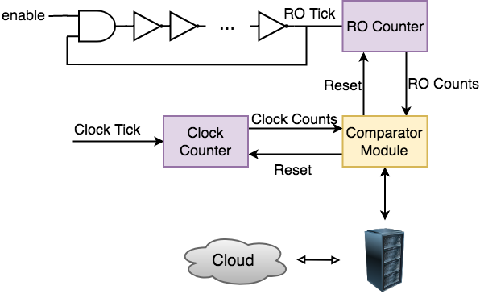
Ring Oscillator Temperature Sensor
Ring Oscillator (RO) is a temperature-to-frequency transducer suitable for thermal monitoring on FPGAs.^{[1]}
Comparing RO counts (affected by temperature) to reference clock counts (not affected by temperature) allows one to measure relative RO frequency.
[1] Eduardo Boemo and Sergio López-Buedo. 1997. Thermal monitoring on FPGAs using ring-oscillators. In International Workshop on Field Programmable Logic and Applications. Springer, 69–78.
Notes:
We use Ring Oscillator as thermal sensors on Cloud FPGAs. This figure shows how RO sensor runs on Cloud FPGAs. I think I have explained it last year, the only difference is that it runs on Cloud FPGAs but not local ones in our lab.

Slide 4
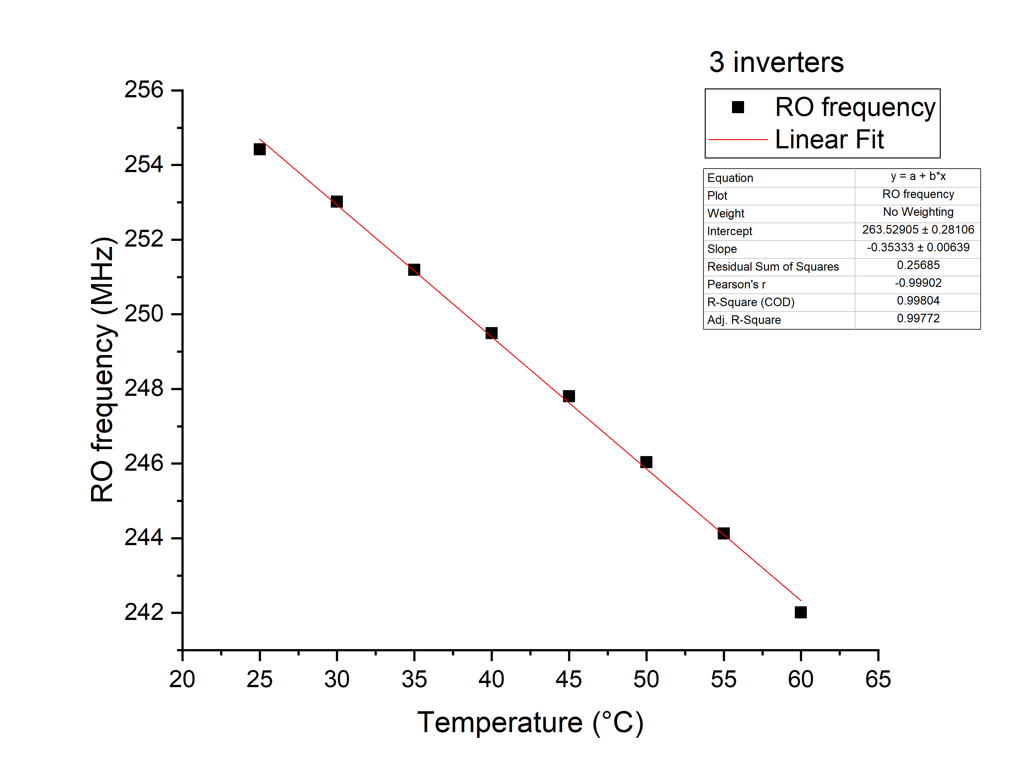
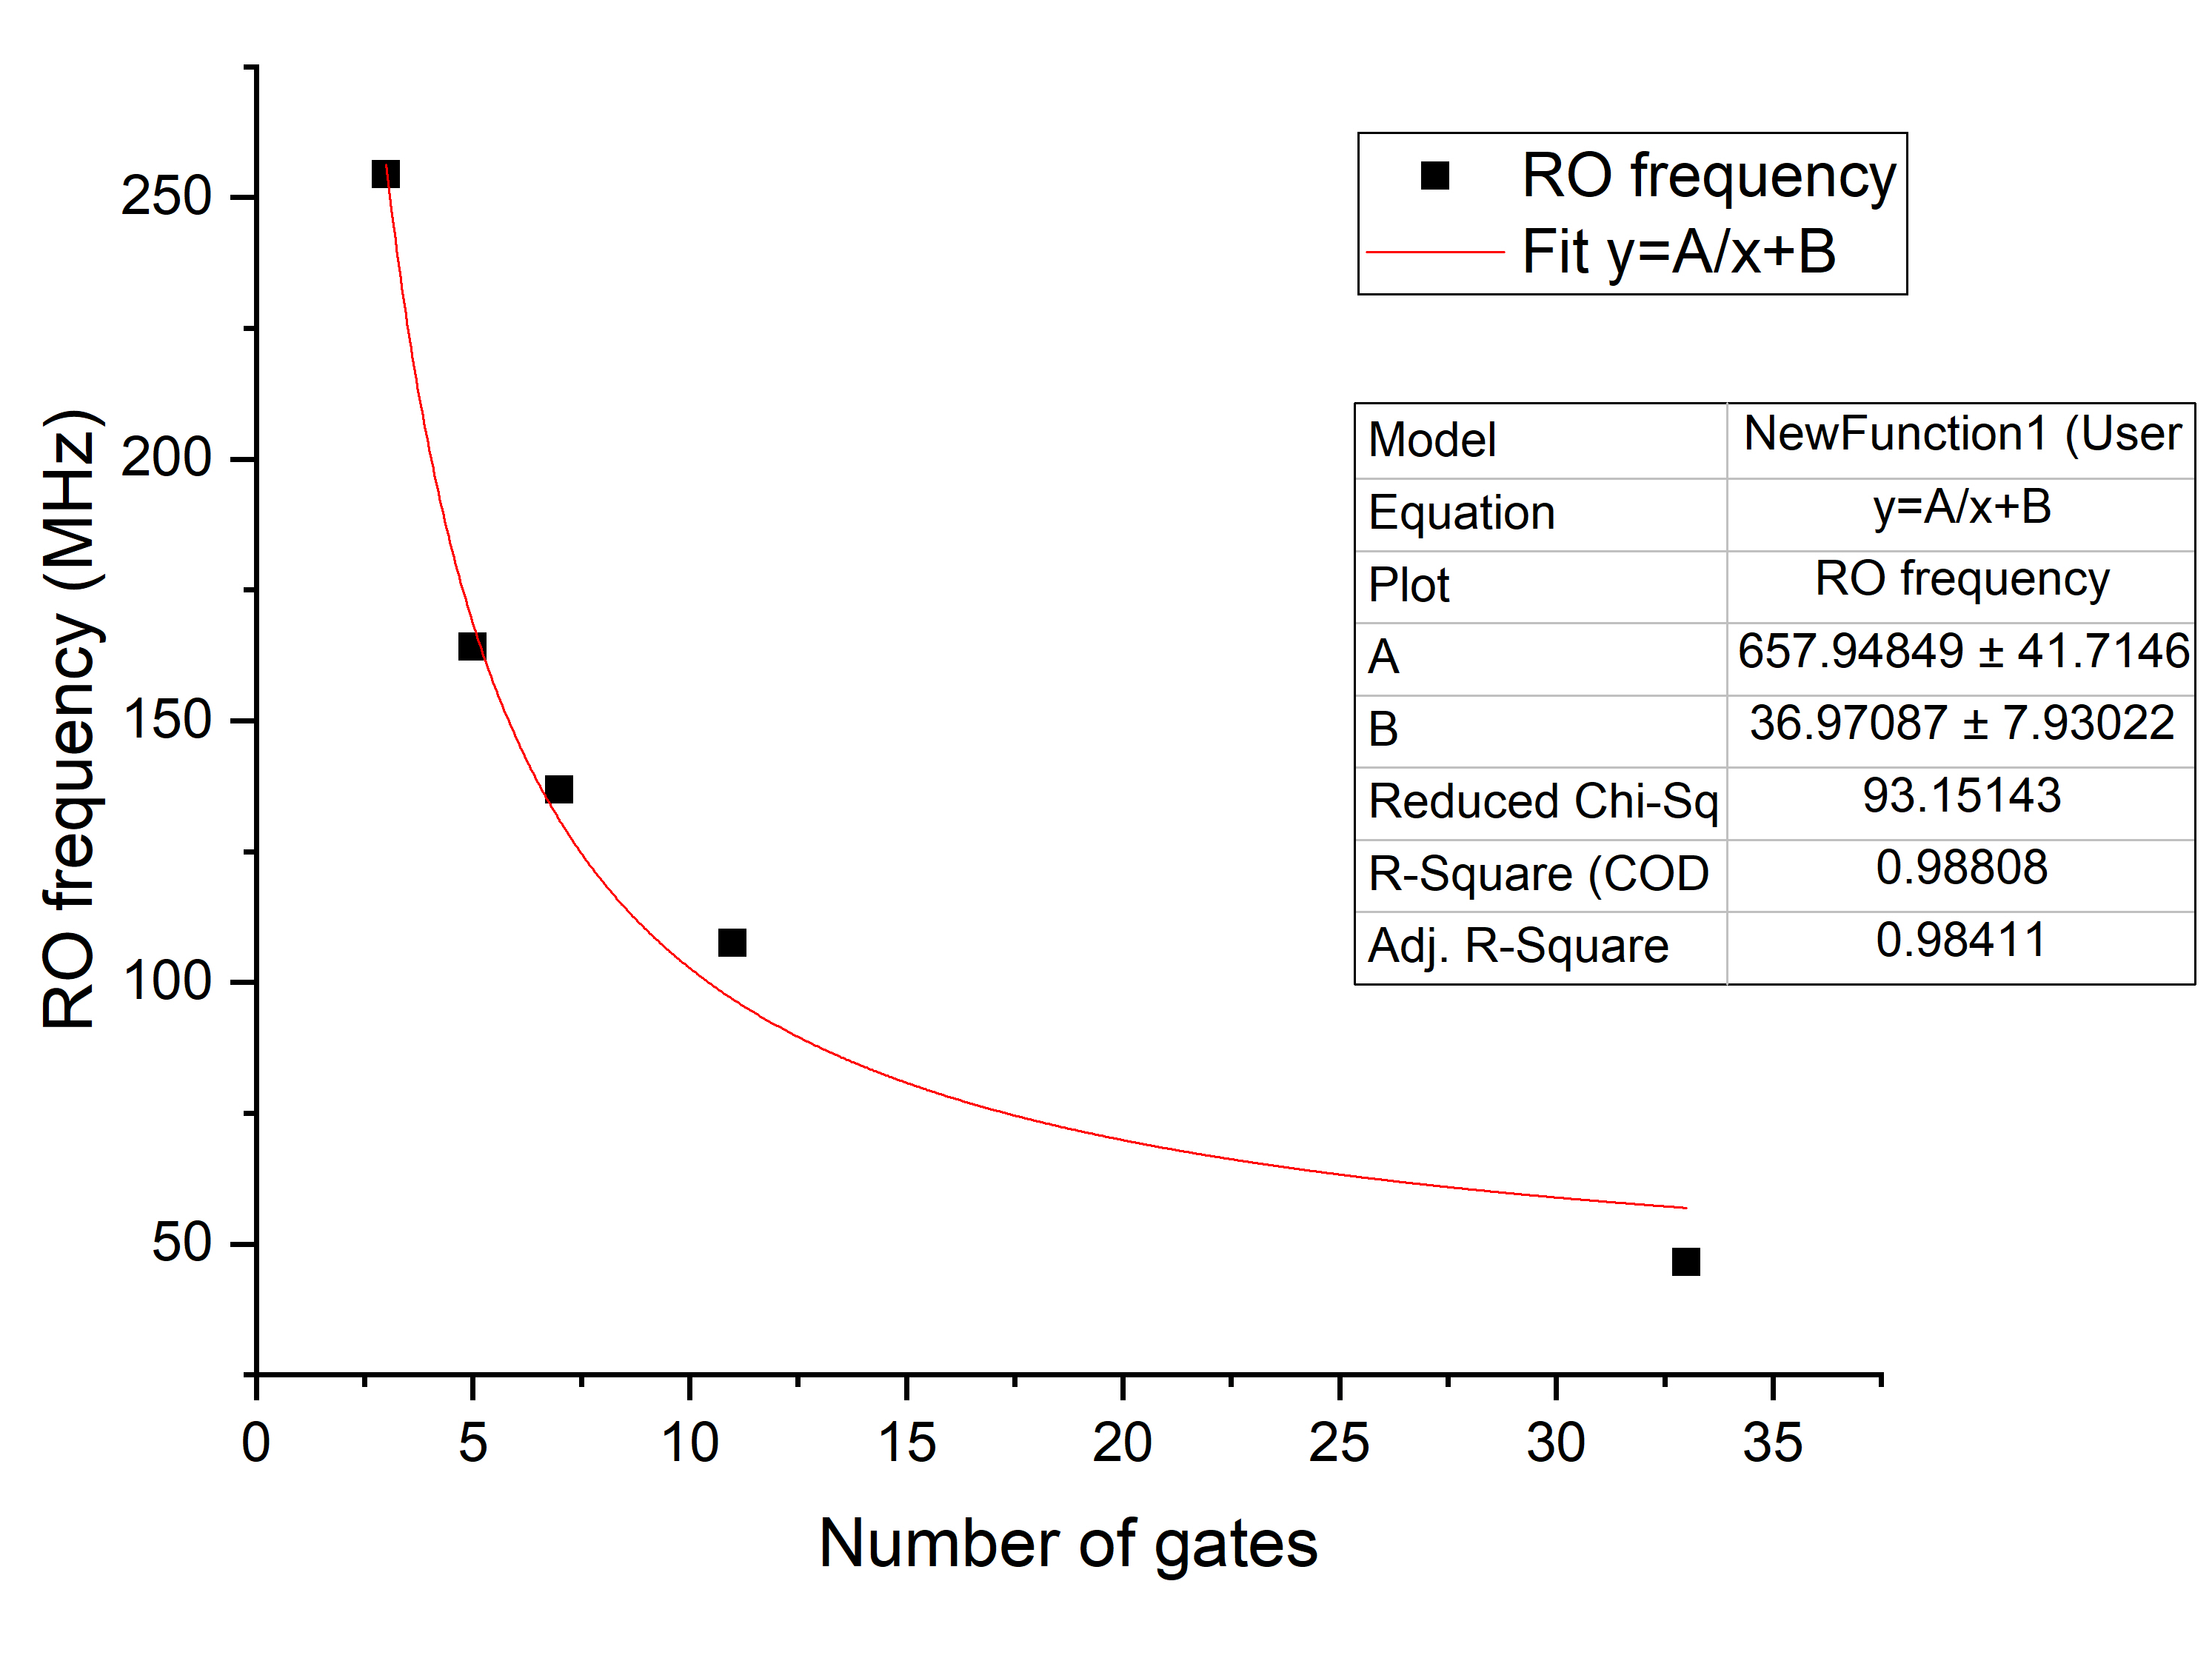
Ring Oscillator Temperature Sensor
The frequency of RO sensor (t: average delay, N: num. of gates):
$f=\frac{1}{2tN}$
The average delay increases as temperature increases:
$$f∝T and f ∝N^{−1}$$
Notes:
F is proportional to Temperature. Measuring RO counts and we can get the relative temperature.

Slide 5
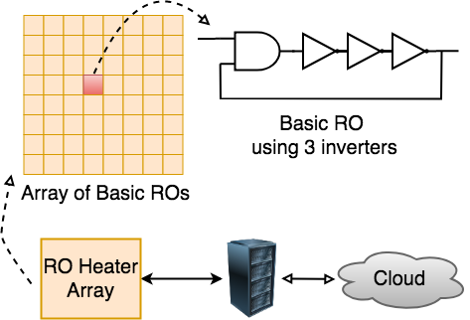
Ring Oscillator Heater
Array of free-running RO with 3 inverters each. ^{[2]}
Dynamic power is proportional to frequency and number of switching elements. An RO with 3 inverters gives the highest power density by allowing most number of ROs to fit in an unit area.
[2] Andreas Agne, Hendrik Hangmann, Markus Happe, Marco Platzner, and Chris- tian Plessl. 2014. Seven recipes for setting your FPGA on fire–a cookbook on heat generators. Microprocessors and Microsystems 38, 8 (2014), 911–919.
Notes:
We also built RO heater on Cloud FPGAs. It is the flip of gates on FPGAs that consumes the most part of energy. So, we built an array of basic very small RO, with 3 inverters each. We tested three sizes of heaters, using up to 7 thousand , 20 thousand, 40 thousand ALMs to influence the temperature.

Slide 6
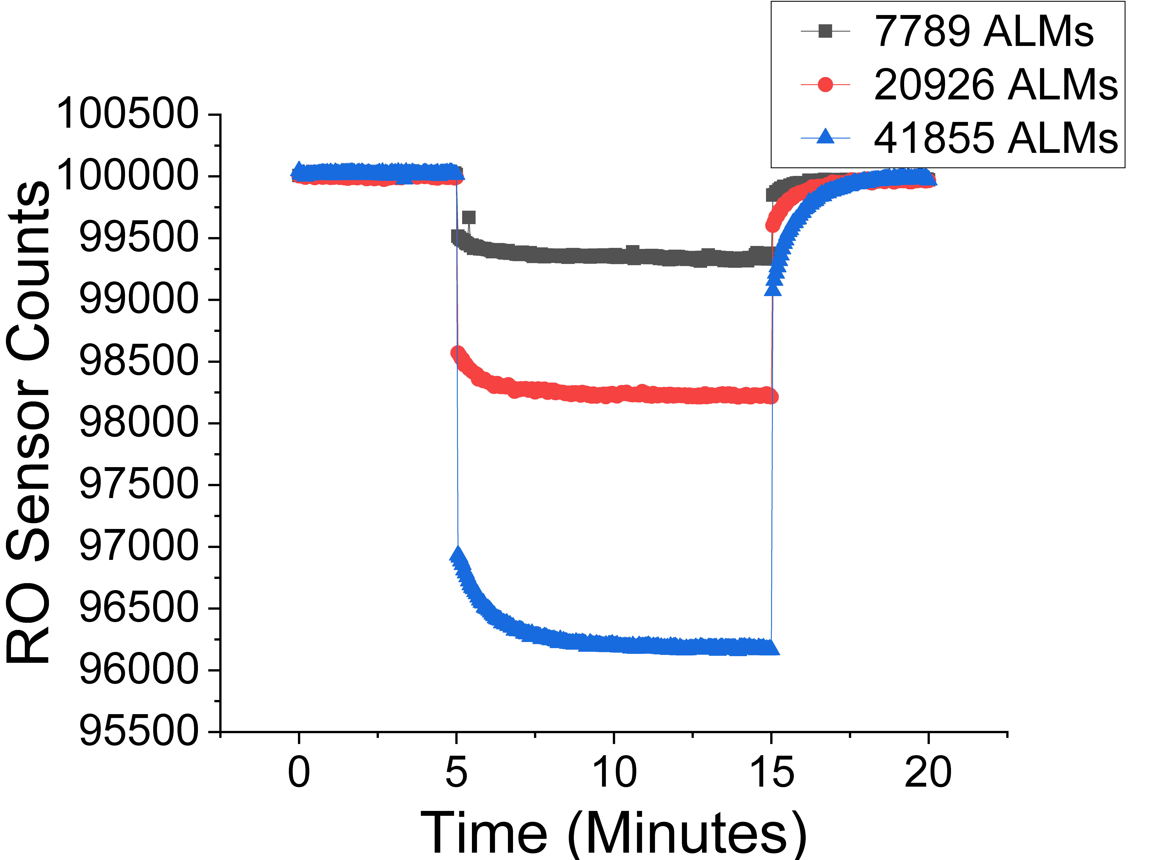
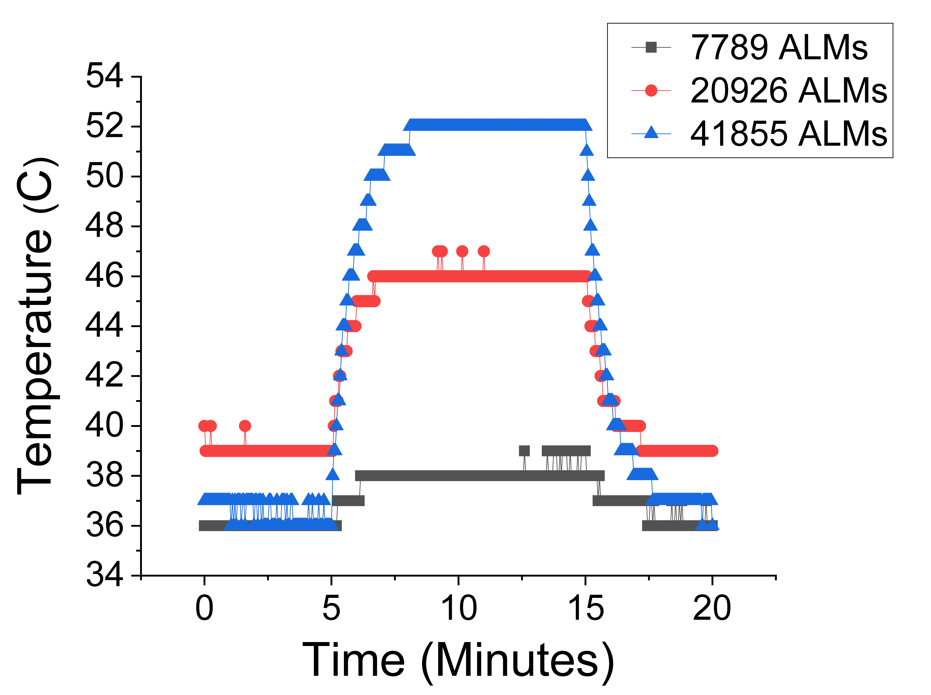
Heating and Cooling Evaluation on Cloud FPGAs
Heater was turned on at 5 minutes, turned off at 15 minutes.
The initial sharp drop/increase of the RO sensor counts in the figures is due to the FPGA supply voltage change as the large heater array turns on or off.
The remaining, more gradual frequency change after that is due to the thermal processes.
Notes:
After building these projects on FPGAs, we did experiments on Cloud FPGAs.

Slide 7
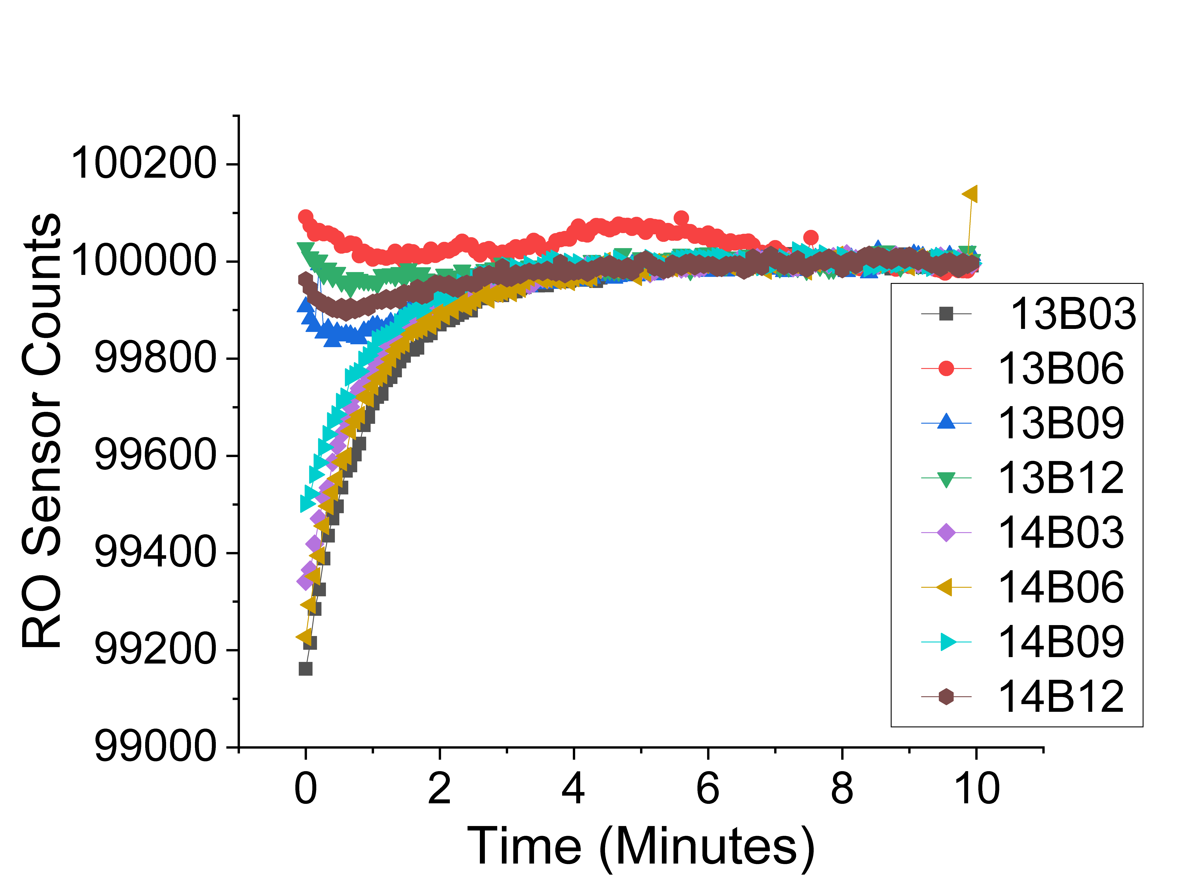
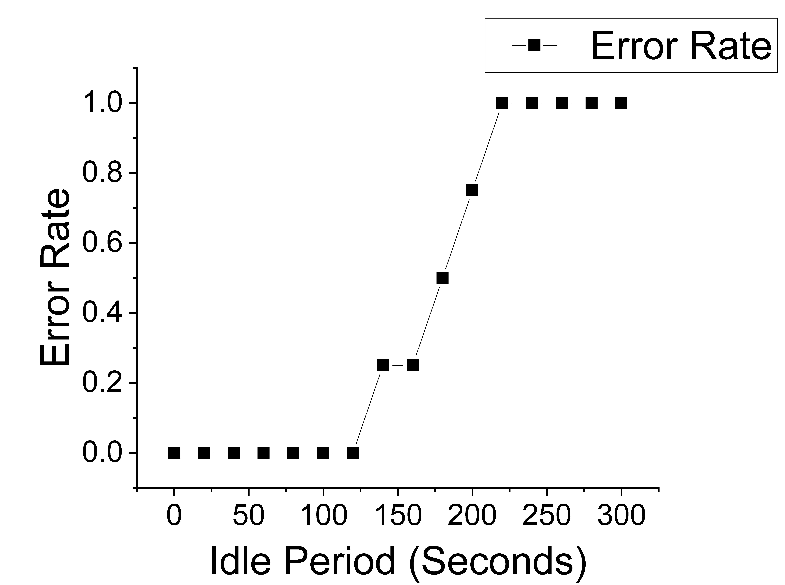
Temporal Thermal Covert Channel Evaluation
Covert channel experiment transmitting 8 bits 8’b10001110
8 FPGAs in TACC were used in parallel.
Error rate increased with idle time.
Notes:
So we could build our temporal thermal covert channels. In this experiment, 8 FPGAs in Texas Advanced Computing Center (TACC) was used to transmit 8 bits.
Not surprisingly, the error rate increased with idle time, which is after Alice stops but before Bob starts.

Slide 8
Bandwidth Evaluation
Bandwidth for $N$ FPGAs:
$$Bandwidth= \frac{H\left(1/2+e/2\right)−(1/2)×H(e)}{\left(t_{r}+t_{w}+t_{h}\right)+t_{i}+(t_{r}+t_{s})}×N$$
𝐻 is binary entropy function^{[3]} where $H\left(x\right)=−x\log_{2}x−\left(1−x\right)\log_{2}\left( 1−x\right).$
[3] Thomas M Cover and Joy A Thomas. 2006. Elements of information theory 2nd edition. Willey-Interscience: NJ (2006), 187–188.
Notes:
We can also calculate the bandwidth of Temporal Thermal Covert Channel.
where $t_{w}$is the waiting time required for sender to wait for the FPGA to cool off, $t_{h}$is the heating time, $t_{i}$is the idle time between when the sender and receiver are using the FPGAs, $t_{s}$is the sensing time, $t_{r}$is the reconfiguration time for every new project on FPGA, and $e$ is the error rate. $H$is binary entropy function where $H\left(x\right)=−x\log_{2}x−\left(1−x\right)\log_{2}\left( 1−x\right)$ [3].

Slide 9
Conclusion
Demonstration of a new covert channel: the temporal thermal covert channels in cloud FPGAs.
Evaluation of Ring Oscillator (RO) sensors and RO heaters in cloud FPGAs.
Analysis of possible channel bandwidths including noise and use of multiple FPGAs.

