Slide 1

Improving Performance of Graph Processing on FPGA-DRAM Platform by Two-level Vertex Caching
Zhiyuan Shao, Ruoshi Li, Diqing Hu, Xiaofei Liao, and Hai Jin
School of Computer Science and Technology
Huazhong University of Science and Technology

Slide 2
Outline
Background and Motivation
Our Solution: FabGraph
Tech. details
Evaluation
Conclusion and Future Work

Slide 3
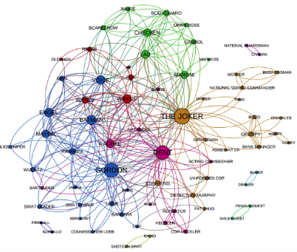
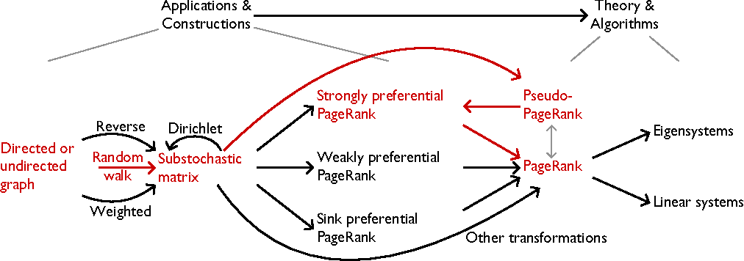
Large-scale Graph Processing
Extensively used in various domains
High memory-accessing/computing ratio

Slide 4
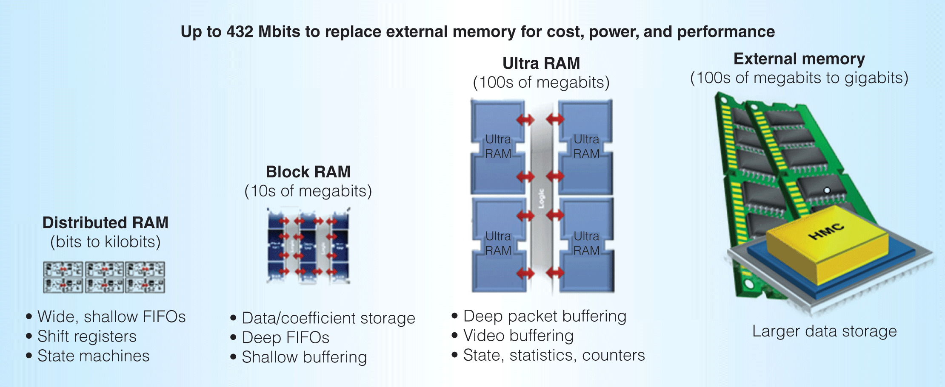
FPGA Memory Hierarchy

Slide 5
ForeGraph (state-of-art system)
Graph representation
  2-Dimensional grid
  irregular→ regular

Slide 6
ForeGraph (state-of-art system)

Slide 7
ForeGraph (state-of-art system)
Problems
  Frequent pipeline stalls caused by vertex data exchanging with DRAM
  Edge inflation problem (11% to 34%)

Slide 8
Outline
Background and Motivation
Our Solution: FabGraph
Tech. details
Evaluation
Conclusion and Future Work

Slide 9
System overview (FabGraph)
Basic idea
  2-level vertex caching
With it, we can…
  Reduce data transmissions between DRAM and FPGA
  Overlap communication with computation
  Eliminate/reduce pipeline stalls
  Solve the edge inflation problem

Slide 10
Outline
Background and Motivation
Our Solution: FabGraph
Tech. details
  L2 cache data replacement
  Communication/Computation overlapping
  Space allocation for two cache levels
  Enhanced pipelines
Evaluation
Conclusion and Future Work

Slide 11
L2 cache data replacement
Hilbert order-like replacement
 | ForeGraph | FabGraph
 |  | S_{L2} < Q | S_{L2} ≥ Q
Read | Q+Q²/K | Q²/S_{L2}-(Q-S_{L2})/2 | 0
Write | Q²/K | Q²/S_{L2}-(Q-S_{L2})/2 | 0
Now we have: Q=8, S_{L2}=K=4
(ForeGraph) Read: 24 /Write: 16 (vertex intervals)
(FabGraph) Read: 14 /Write: 14 (vertex intervals)

Slide 12
Communication/Computation overlapping

Slide 13
Communication/Computation overlapping (Cont’d)
Overlapping factor:
α=T_{actual}/T_{theory}
α=1: perfect overlapping
α>1: imperfect overlapping

Slide 14
Space allocation for two cache levels
Case 1: boards with BRAM+URAM (URAM is larger than BRAM)
  Use BRAM as the L1 cache
  Use URAM as the L2 cache

Slide 15
Space allocation for two cache levels
(Cont’d)
Case 2: boards with BRAM only
  Allocate BRAM space for both L1 and L2 cache
Assume Q = 74, M_{bram} = 64, |E| = 69M, α = 1, BW_{dram} = 19.2GB/s, F_{pipe} (enhanced) = 150MHz
Assume Q = 74, |E| = 69M, BW_{dram} = 19.2GB/s, α = 1, and F_{pipe}(enhanced) = 150MHz

Slide 16
Enhanced pipelines

Slide 17
Outline
Background and Motivation
Our Solution: FabGraph
Tech. details
Evaluation
Conclusion and Future Work

Slide 18
Evaluation Setup
Platform
  Xilinx Virtex UltraScale VCU110 (16.61MB BRAM)
  Xilinx Virtex UltraScale+ VCU118 (9.48MB BRAM + 33.75MB URAM)
  Xilinx Vivado 2017.4 (simulation)
  DRAM peak bandwidth: 19.2GB/s (DRAMSim2)
Datasets
Graphs | #vertices | #edges | Q
Com-Youtube (YT) | 1.13 million | 2.99 million | 18
SOC-Pokec (PK) | 1.63 million | 30.62 million | 26
Wiki-Talk (WK) | 2.39 million | 5.02 million | 38
Soc-LiveJournal (LJ) | 4.85 million | 68.99 million | 74

Slide 19
Evaluation on VCU110
Resource utilization
Algorithm | Graph | BRAM | SL1 (MB) | SL2 (MB) | #pipelines | LUT | FF | Fpipe (MHz) | Fbram (MHz)
BFS | YT | 88.6% | 12 | 3.25 | 48 | 34.71% | 19.19% | 200 | 200
 | PK
 | WK
 | LJ | 77.4% | 8.1 | 4.77 | 32(enhanced) | 23.87% | 12.79% | 150 | 300
PageRank | YT | 93.4% | 11.02 | 4.53 | 22(enhanced) | 28.42% | 25.45%
 | PK | 90.5% | 12.02 | 3.01 | 24(enhanced) | 31.02% | 27.76%
 | WK | 86.5% | 8.01 | 6.5 | 16(enhanced) | 31.02% | 27.67%
 | LJ | 93.4% | 11.02 | 4.53 | 22(enhanced) | 28.42% | 25.45%

Slide 20
Evaluation on VCU110 (Cont’d)
Performance
Algorithm | Graph | Runtimes (seconds) | Speedup over ForeGraph | α (overlapping factor)
BFS | YT | 0.0032 | 3.1x | 1.0
 | PK | 0.0253 | - | 1.0
 | WK | 0.0154 | 1.2x | 1.8
 | LJ | 0.168 | 2.7x | 1.0
PageRank | YT | 0.0116 | 2.5x | 1.28
 | PK | 0.0971 | - | 1.0
 | WK | 0.0515 | 1.0x | 2.41
 | LJ | 0.276 | 2.1x | 1.0

Slide 21
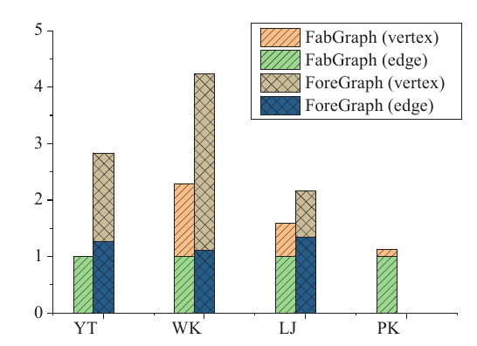
Evaluation on VCU110 (Cont’d)
Reduction on DRAM/FPGA data transmission amount

Slide 22
Evaluation on VCU118
Performance
Resource utilization
Algorithm | Graph | Runtime (seconds) | Speedups over ForeGraph | α | Speedup over VCU110
BFS | YT | 0.0032 | 3.1x | 1.0 | 1.0x
 | PK | 0.0253 | - | 1.0 | 1.0x
 | WK | 0.0205 | 1.1x | 2.41 | 0.66x
 | LJ | 0.168 | 2.7x | 1.0 | 1.0x
PageRank | YT | 0.0101 | 3.0x | 1.064 | 1.2x
 | PK | 0.0972 | - | 1.0 | 1.0x
 | WK | 0.0434 | 1.2x | 2.71 | 1.2x
 | LJ | 0.219 | 2.6x | 1.0 | 1.3x
 | BFS | PageRank
#pipelines | 32(enhanced) | 18(enhanced)
LUT | 22.85% | 12.72%
FF | 15.48% | 14.10%
BRAM | 85.92% | 95.0%
URAM | 11.88% | 59.38%
Fpipe (MHZ) | 150 | 150
Fbram (MHz) | 300 | 300

Slide 23
Outline
Background and Motivation
Our Solution: FabGraph
Tech. details
Evaluation
Conclusion and Future Work

Slide 24
Conclusion
Two-level vertex caching mechanism is effective in improving the performance of graph processing on FPGA-DRAM platforms
Two-level vertex caching mechanism can even help FPGA boards configured with small BRAM but large URAM to achieve better performance than expensive FPGA boards with large BRAM

Slide 25
Future works
Performance Scaling
  Vertical scaling – FPGA-HBM2 platform
  Better horizontal scaling

Slide 26
Thanks!

