Slide 1


F5-HD: Fast Flexible FPGA-based Framework for Hyperdimensional Computing
Sahand Salamat, Mohsen Imani, Behnam Khaleghi,
Tajana Šimunić Rosing
System Energy Efficiency Lab
University of California San Diego

Slide 2
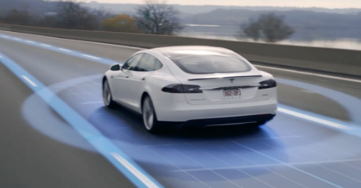




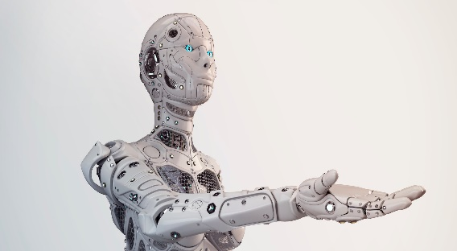


Machine Learning is Changing Our Life
Self Driving Cars
Healthcare
Smart Robots
Finance
Gaming

Slide 3


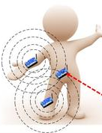
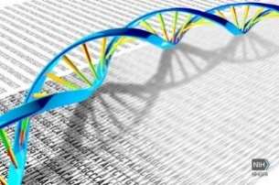
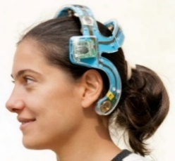

Hyperdimensional (HD) Computing
Image Classification
HyperDimensional
Computing
General and scalable
Robust to noise
Light weight
High Dimensional Data
Activity Recognition
Encode
Regression
...
Clustering
[1] Kanerva, Pentti. "Hyperdimensional computing: An introduction to computing in distributed representation with high-dimensional random vectors." Cognitive Computation 1.2 (2009): 139-159.
[2] Imani, Mohsen, et al. "Exploring hyperdimensional associative memory." 2017 IEEE International Symposium on High Performance Computer Architecture (HPCA). IEEE, 2017.

Slide 4




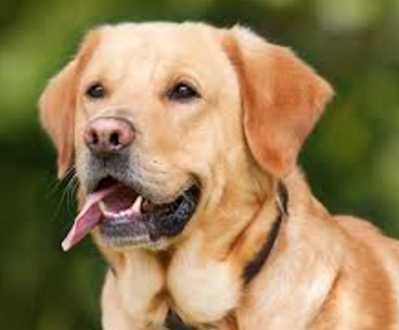
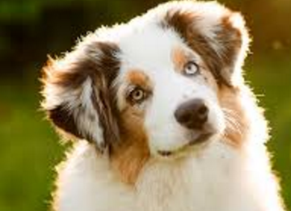
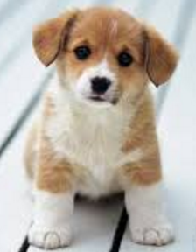

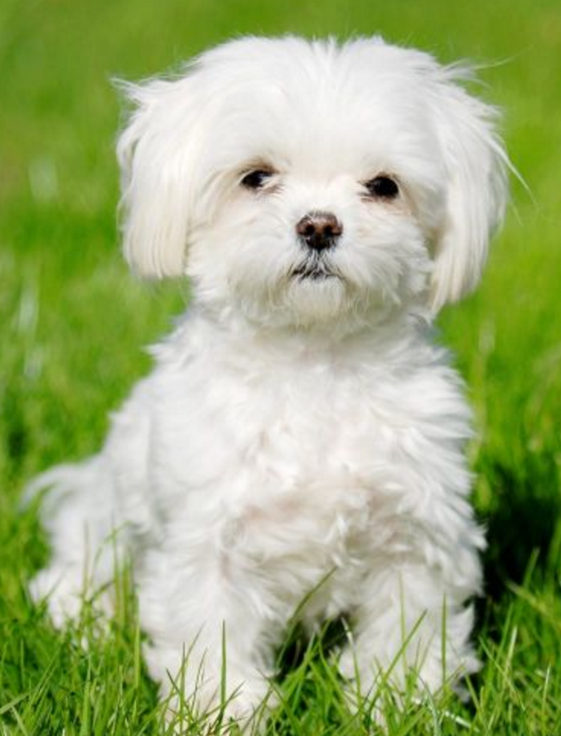
HD Computing
Training
Retraining
. . .
Cat hypervector
Cat hypervector
×
Encoding
-1 +1 -1 -1 +1 . . . +1
-1 +1 -1 -1 +1 . . . +1
+
+
+
+
-
+
+
+
+
-1 -1 +1 -1 -1 . . . +1
+
Encoding
Dog hypervector
. . .
-1 -1 +1 -1 -1 . . . +1
Dog hypervector
Similarity Check
Inference
Encoding
+1 +1 +1 -1 -1 . . . +1
Encoded hypervector

Slide 5
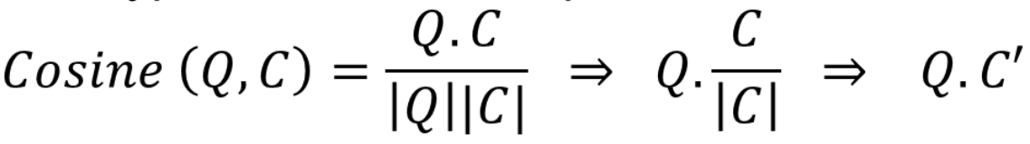
HD dataflow
    Similarity Check
      Hamming Distance for binary model
      Cosine similarity for non-binary model

Slide 6
HD Acceleration
HD → thousands of bit-level additions, multiplication and accumulation
  These operations can be parallelized in dimension level
FPGAs can provide huge parallelism
FPGA design requires extensive hardware expertise
FPGAs have long design cycles
  Application-specific template-based design
  Several template-based FPGA implementation for neural networks [Micro’16][FCCM’17][FPGA’18]
  No FPGA implementation framework for HD!
[1] Sharma, Hardik, et al. "From high-level deep neural models to FPGAs." The 49th Annual IEEE/ACM International Symposium on Microarchitecture. IEEE Press, 2016
[2] Guan, Yijin, et al. "FP-DNN: An automated framework for mapping deep neural networks onto FPGAs with RTL-HLS hybrid templates." 2017 IEEE 25th Annual International Symposium on Field-Programmable Custom Computing Machines (FCCM). IEEE, 2017.
[3] Shen, Junzhong, et al. "Towards a uniform template-based architecture for accelerating 2d and 3d cnns on fpga." Proceedings of the 2018 ACM/SIGDA International Symposium on Field-Programmable Gate Arrays. ACM, 2018.

Slide 7
-HD
F5
F5-HD: Fast Flexible FPGA-based Framework for Refreshing Hyperdimensional Computing
First automated framework for FPGA-based acceleration of HD computing
  Input : <20 lines of C++ code
  Output: >2000 lines of Verilog HDL code
Supports training, retraining, and inference of HD
Kintex, Virtex, Spartan FPGA families
Supports different Precisions
  Fixed-point
  Power of two
  Binary

Slide 8
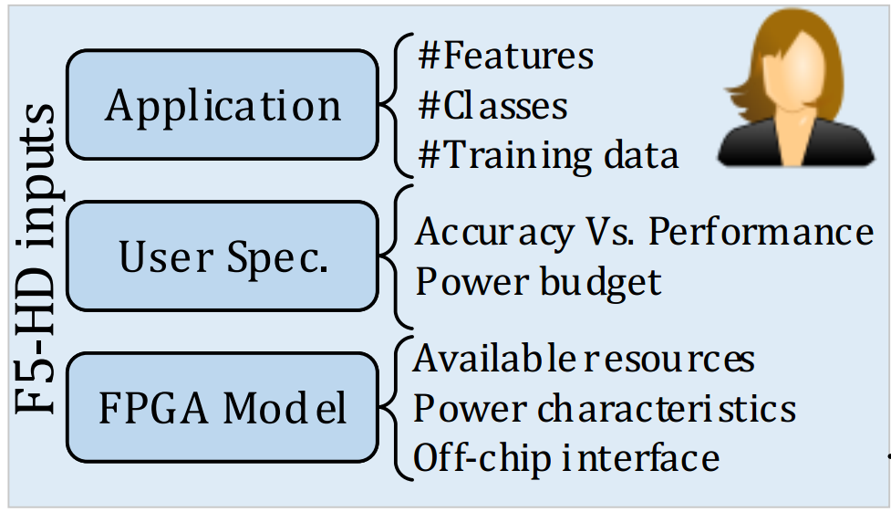
F5-HD Overview
Model Specification
Design Analyzer
Model Generator
Scheduler
F5-HD

Slide 9
Baseline Encoding
HV₀ :
b
b
b
b
b
b
999
998
997
2
1
0
Base Hypervectors
HV₁ :
b
b
b
b
b
b
999
998
997
2
1
0
S=3
HV₀
b
b
b
b
b
b
999
998
997
2
1
0
P (HV₁)
b
b
b
997
b
b
b
999
998
2
1
0
F= 4
P ² (HV₀)
b
b
b
b
b
b
999
998
997
2
1
0
P ³ (HV₀)
b
b
b
b
b
b
999
998
997
2
1
0
{b₂,b₁,b₀} Encoded HV =
b₂HV₀+b₁HV₁+b₀HV₀+b₉₉₉HV₀
b₁HV₀+b₀HV₁+b₉₉₉HV₀+b₉₉₈HV₀
b₀HV₀+b₉₉₉HV₁+b₉₉₈HV₀+b₉₉₇HV₀
b₉₉₇,b₉₉₈,b₉₉₉,b₀,b₁,b₂ of base HVs are needed

Slide 10
F5-HD Encoding
HV₀ :
b
b
b₃
b
b
b
999
998
2
1
0
HV₁ :
b
b
b₃
b
b
b
999
998
2
1
0
S=3
HV₀
b
b
b₃
b
b
b
999
998
2
1
0
P (HV₁)
b
b₃
b
b
b
b
999
998
2
1
0
F= 4
P ² (HV₀)
b
b
b₃
b
b
b
999
998
2
1
0
P ³ (HV₀)
b
b
b₃
b
b
b
999
998
2
1
0
{b₂,b₁,b₀} Encoded HV =
b₂HV₃+b₁HV₂+b₀HV₁+b₀HV₀
b₁HV₀+b₀HV₁+b₂HV₀+b₃HV₀
b₀HV₀+b₁HV₁+b₂HV₀+b₃HV₀
b₀,b₁,b₂,b₃ of base HVs are needed
$2/3$ memory bandwidth

Slide 11
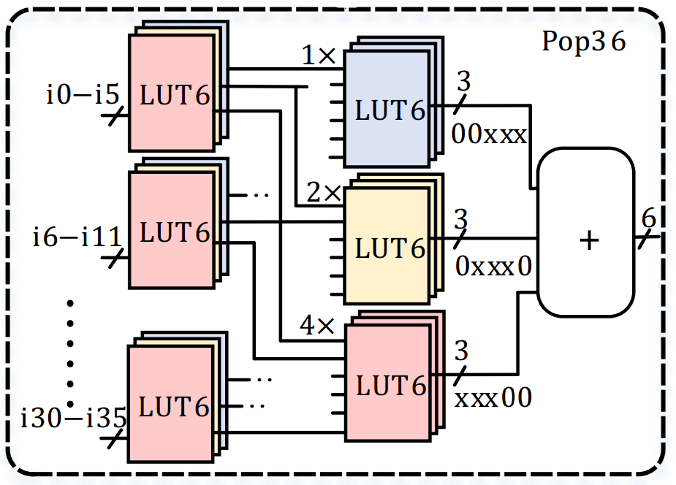
F5-HD Encoder Architecture
b
b
b
b
b
b
999
998
997
2
1
0
+
+
+
Hand
+
-
optimized
+
+
#Features
b
b
b
b
b
b
+
Templates
999
998
997
2
1
0
+
b₁
b₀
Encoding
HD Model
+
+
+
+
PU
PE
b
b
b
b
b
b
999
998
997
2
1
0
Design Analyzer
Instead of using adders F5-HD uses LUTs
Model Generator
+
Scheduler
+
36 bits
+
+
+
+

Slide 12
F5-HD Architecture
Hand
-
optimized
Templates
Encoding
HD Model
PU
PE
Design Analyzer
Model Generator
Scheduler

Slide 13
F5-HD Processing Unit/Engine
Processing Unit
  Finding similarity between input and a class
Processing Engine
  Multiplication and Accumulation
Hand
-
optimized
Templates
Encoding
HD Model
PU
PE
Design Analyzer
Model Generator
Scheduler

Slide 14
F5-HD Steps: Design Analyzer
Design Analyzer
  Selects the model precision
  Create a power model as a function of parallelization
  maximize the resource utilization with respect to the user’s power budget
  Calculating the parallelization factor
Hand
-
optimized
Templates
Encoding
HD Model
PU
PE
Design Analyzer
Model Generator
Scheduler

Slide 15
F5-HD steps
Model Generator
  Instantiates hand-optimized template modules
  Generates memory interface and Verilog HDL code
Scheduler
  Adds scheduling and controlling signals
Hand
-
optimized
Templates
Encoding
HD Model
HD.v
PU
PE
HD.cpp
module HD (clk, rst, out);
…
MemInterface (…);
InputBuffer (…);
HDEncoder (…);
Training_Retraining (…);
HDModel (…);
AssociativeSearch (…);
Scheduler (…);
Controller (…);
endmodule
module PU(…);
…
endmodule
…
Design Analyzer
Void main () {
//Application
NumInFeatures=700;
NumClasses=5;
NumTrainingData=50000;
…
//User Spec.
PowerBudget=5;
HDModel=“binary”;
//FPGA Spec
FPGA=“XC7k325T ”;
FPGAPowerModel=“p.model”;
…
}
Model Generator
Scheduler
F5-HD

Slide 16
Experimental Setup
F5-HD
  Including user interface and code generation has been implemented in C++ on CPU
  Hand-optimized templates implemented in Verilog HDL
  Generates synthesizable Verilog implementation
  Supports Kintex, Virtex, and Spartan FPGA families
Results are compared to
  Intel i7 7600 CPU and AMD R9 390 GPU
Datasets:
  Speech Recognition (ISOLET) [31]
  Activity Recognition (UCIHAR) [32]
  Physical Activity Monitoring (PAMAP) [33]
  Face Detection [34]

Slide 17
Experimental Results
F5-HD reduces the design time significantly
  Writing FPGA implementation takes >100 days (>2000 lines of code) [FPL’16]
  Preparing F5-HD input takes < 1 hour (<20 lines of code)
F5-HD is 5.1x faster than HLS implemented hardware
*10 ³
Kapre, Nachiket, and Samuel Bayliss. "Survey of domain-specific languages for FPGA computing." 2016 26th International Conference on Field Programmable Logic and Applications (FPL). IEEE, 2016.

Slide 18
Experimental Results: Encoding
F5-HD encoder
  For 64 features: 1.5× higher throughput
  For 512 features: 1.9× higher throughput

Slide 19

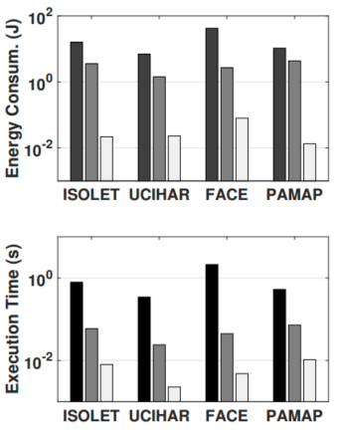
Experimental Results: Training
F5-HD vs GPU:
  87× more energy efficient
  8× faster
F5-HD vs CPU:
  548x more energy efficient
  148x faster

Slide 20
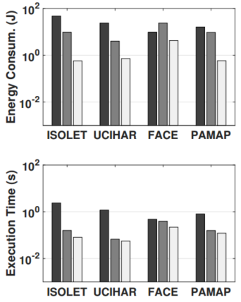
Experimental Results: Retraining
F5-HD vs GPU:
  7.6× more energy efficient
  1.6× faster
F5-HD vs CPU:
  70x more energy efficient
  10x faster

Slide 21
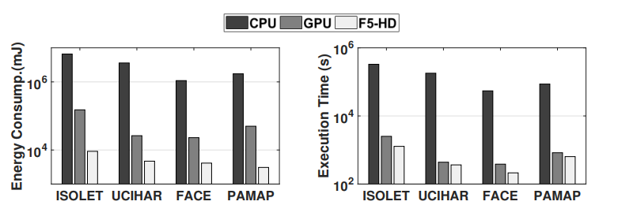
Experimental Results: Inference
Energy and execution time improvement during inference
  2X, 260X faster than GPU, and CPU
  12X, 620X more energy efficient than GPU and CPU

Slide 22
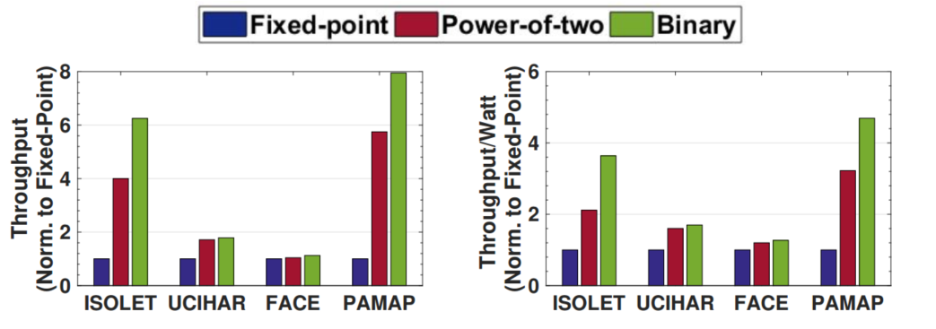
Experimental Results: HD precision
Binary HD is 4.3x faster but 20.4% less accurate than fixed-point model
Power of two model is 3.1x faster but 5.8% less accurate than fixed point model
Accuracy | ISOLET | UCIHAR | PAMAP | FACE
Binary HD | 88.1% | 77.4% | 85.7% | 48.5%
Power-of-two HD | 90.3% | 88.0% | 90.8% | 89.6%
Fixed-point HD | 95.5% | 94.6% | 94.5% | 96.9%

Slide 23
Conclusion
F5-HD: an automated framework for FPGA-based acceleration of HD computing
F5-HD reduces the design time from 3 months to less than an hour
F5-HD supports:
  Fixed-point, power of two and binary models
  Training, retraining, and inference of HD
  Xilinx FPGAs
F5-HD is:
  ~5x faster than HLS tool implementation
  ~87x more energy efficient and ~8x faster during training than GPU
  12x more energy efficient and 2x faster during inference than GPU

