Slide 1
NetFPGA
Workflow for Line-Rate
Packet Processing
FPGA 2019
Stephen Ibanez, Gordon Brebner, Nick McKeown, Noa Zilberman
Notes:
My name is Stephen Ibanez, and today I’ll present the P4->NetFPGA workflow, which is something that we put together to try and make it easy for anyone to deploy their P4 programs on real hardware, specifically, the NetFPGA SUME board.
This is joint work with Gordon Brebner, Nick McKeown, and Noa Zilberman
Many other people have contributed and been involved as well

Slide 2
Agenda
What is P4?
P4 Language Intro
Xilinx SDNet Overview
NetFPGA Overview
P4→NetFPGA Workflow Overview
P4→NetFPGA Use cases

Slide 3
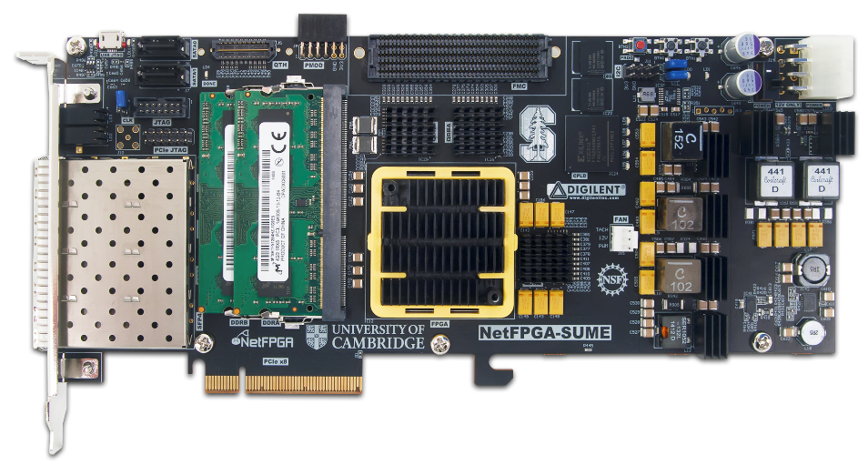
What is P4?
ASICs
CPUs
NPUs
FPGAs
High-speed packet
processing in
network core
Software hypervisor
switching
(Open Vswitch)
Smart NICs
Smart NICs
Research prototypes
Teaching networking
Need experts from many different domains to build a network
P4 Motivation:
  Give networking experts control over the network
Approach:
  Identify abstractions & primitives common to packet processing
Notes:
So what is P4?
There are many different types of devices that are used for performing packet processing and they all fill a niche role in the networking ecosystem.
ASICs from companies like Broadcom, Juniper, and Arista are used for performing high speed packet processing in the core of the network.
General purpose CPUs are used for building software switches like Open Vswitch, which switches packets between virtual machines
NPU based Smart NICs are sometimes used to connect hosts to the network
And FPGAs have a special role in the networking world. They are commonly found on Smart NICs as well, and because of their flexibility and accessibility to the academic community, they are often used to build research prototypes as well as teach network systems, while providing students with hands-on experience working with real hardware.
Our networks are often composed of a collection of these devices. And it’s really hard, if not impossible, to find someone that is an expert in building packet processing systems on all of these devices, and is also a networking expert.
Which means, in order to build a network, we need to have experts from many different domains all on the same page, with the same end goals in mind.
Unfortunately, that’s really hard to coordinate in real life situations.
The goal of P4 is to give networking experts control over the entire network. As a network operator, I don’t really want to let some ASIC designer decide what features I can support in my network. I want to have full control over every component.
The way that P4 does this is by taking a step back. It says, well all of these devices are used for performing packet processing. So maybe we can identify some abstractions and primitives that are common to all packet processing systems. Capture those in a domain specific language, and then build compilers to translate those packet processing programs into configurations for each of these types of devices.
So what are the abstractions common to packet processing?

Slide 4
Packet Processing Abstractions
PISA: Protocol-Independent Switch Architecture
Programmable Match-Action Pipeline
Programmable
Parser
Programmable
Deparser
Memory
ALU
Match+ActionStage (Unit)
Notes:
The packet processing abstractions are defined by a high-level packet processing architecture called the Protocol-Independent Switch Architecture or PISA
PISA consists of a programmable parser. The programmer expresses their parsing logic as a state machine which accepts incoming packets and extracts some header fields of interest.
Those parsed packets are then processed by a programmable match-action pipeline.
The match-action pipeline consists of some number of stages of match-action processing.
Each stage of match-action processing contains some memory to store tables as well as some compute to perform actions, which might modify header fields, add header fields, remove header fields, read/write device state, etc.
So the programmer configures these match-action tables to implement their custom packet processing logic.
The programmable deparser reassembles the final header fields back into a well formed packet.

Slide 5
PISA in Action
Packet is parsed into individual headers (parsed representation)
Headers and intermediate results can be used for matching and actions
Headers can be modified, added or removed
Packet is deparsed (serialized)
Programmable Match-Action Pipeline
Programmable
Parser
Programmable
Deparser
Match+ActionStage (Unit)

Slide 6
P4 Architectures
Custom
Define how the P4 programmable elements are composed
Define how to interact with non-programmable elements
P4 programs are written for a specific architecture

Slide 7
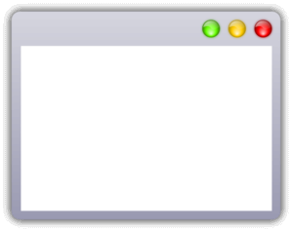


P4 Approach
P4 Programs
SimpleSumeSwitch
SWArch
ASICArch
Architecture
Community Developed
IR
IR
IR
Vendor Developed
Target
FPGAs
Software
switches
Programmable
switch ASICs
Notes:
For folks familiar with object oriented design, you can think of the architecture as a kind of abstract base class that has some pure virtual P4 methods that the P4 programmer must implement

Slide 8
P4 Goal
Portable Switch Architecture (PSA)
Community
Developed
IR
Vendor
Developed
Software
switches
FPGAs
Programmable
switch ASICs

Slide 9
Programming a P4 Target
User supplied
Control Plane
P4 Program
P4 Compiler
Add/remove
table entries
Extern
control
Packet-in/out
RUNTIME
CPU port
P4 Architecture
Model
Data Plane
Target-specific configuration binary
Tables
Extern
objects
Load
Target
Vendor supplied

Slide 10
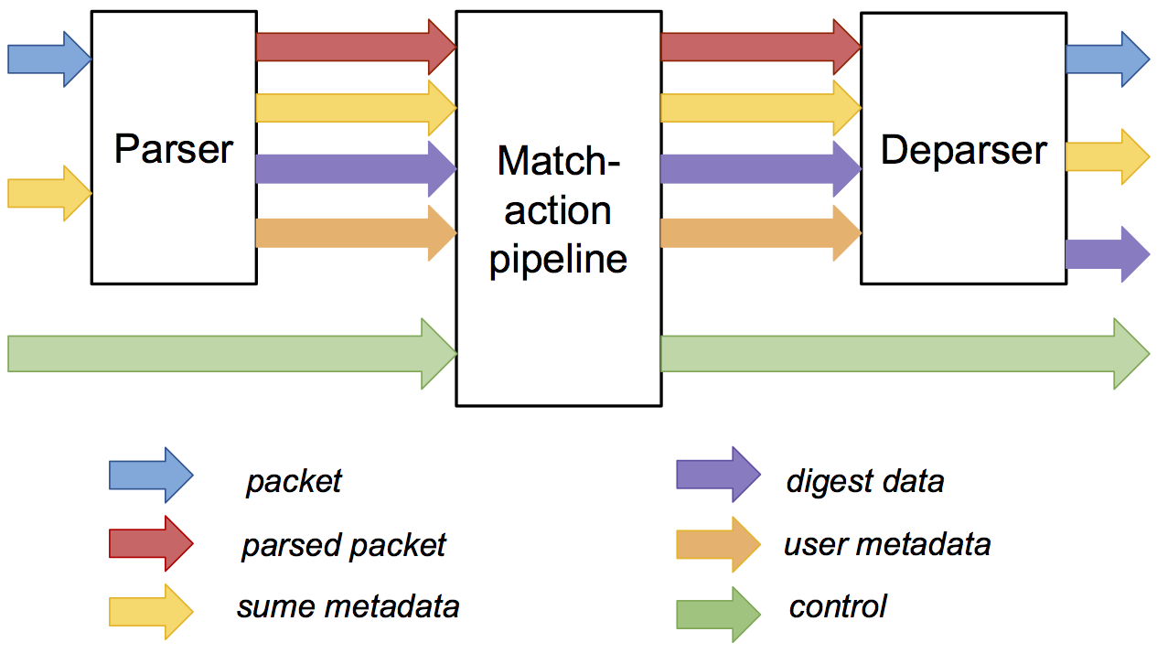
SimpleSumeSwitch Architecture Model for SUME Target
tdata
tdata
tuser
tuser
AXI
Lite
AXI
Lite
P4 used to describe parser, match-action pipeline, and deparser
Notes:
For the P4->NetFPGA workflow we defined the so called SimpleSumeSwitch architecture, which consists of a P4 programmable parser, match-action-pipeline, and deparser, along with some specific metadata busses.
I'll define the format of the sume_metadata bus on the next slide.
The format of the digest_data bus can be configured by the P4 programmer, and it can be sent to the control-plane if desired.
The user_metadata bus can use used to share information between the P4 programmable elements.
And their is an AXI Lite control interface for the match-action pipeline, which is used to add & remove table entries.
Unlike the Portable Switch Architecture, which needs to be comprehensive enough to implement commodity switches, the goal here was to design something that is simple too understand and is flexible enough to be used as an effective prototyping tool.

Slide 11
Standard Metadata in SimpleSumeSwitch Architecture
/* standard sume switch metadata */
struct sume_metadata_t {
bit<16> dma_q_size;
bit<16> nf3_q_size;
bit<16> nf2_q_size;
bit<16> nf1_q_size;
bit<16> nf0_q_size;
// send digest_data to CPU
bit<8> send_dig_to_cpu;
// ports are one-hot encoded
bit<8> dst_port;
bit<8> src_port;
// pkt len is measured in bytes
bit<16> pkt_len;
}
src_port/dst_port – one-hot encoded, easy to do multicast
*_q_size – size of each output queue, measured in terms of 32-byte words, when packet starts being processed by the P4 program
send_dig_to_cpu – to send digest_data to control-plane
Notes:
Here's the format of the sume_metadata bus. By reading and writing fields of this bus, the P4 program can interact with the rest of the architecture.
The src_port field is set by the architecture and it indicates the port on which the packet arrived
The dst_port field can be set by the P4 program to tell the architecture which port or ports to send the packet out of. These fields are one-hot encoded so it's easy to do multicast
The *_q_size fields indicate the size of each queue when the packet starts being processed by the P4 program
If the send_dig_to_cpu field is set by the P4 program then the architecture will send the digest_data to the control-plane, which is useful if you are trying to do MAC learning or implement a router or something like this

Slide 12
P4 Program Template (SimpleSumeSwitch)
#include <core.p4>
#include <sume_switch.p4>
/* HEADERS and METADATA */
struct user_data { ... }
struct digest_data { ... }
struct headers {
ethernet_t ethernet;
ipv4_t ipv4;
}
/* PARSER */
parser MyParser(packet_in packet,
out headers hdr,
out user_data_t user,
out digest_data_t digest,
inout sume_metadata_t smeta) {
...
}
/* MATCH-ACTION PROCESSING */
control MyIngress(inout headers hdr,
inout user_data_t user,
inout digest_data_t digest,
inout sume_metadata_t smeta) {
...
}
/* DEPARSER */
control MyDeparser(packet_out packet,
in headers hdr,
in user_data_t user,
inout digest_data_t digest,
inout sume_metadata_t smeta) {
...
}
/* SWITCH */
SimpleSumeSwitch(
MyParser(),
MyIngress(),
MyDeparser()
) main;
Notes:
Lets take a look at a generic template P4 program for the SimpleSumeSwitch

Slide 13
P4 Types (Basic and Header Types)
header ethernet_t {
bit<48> dstAddr;
bit<48> srcAddr;
bit<16> type;
}
header ipv4_t {
bit<4> version;
bit<4> ihl;
bit<8> diffserv;
bit<16> totalLen;
bit<16> identification;
bit<3> flags;
bit<13> fragOffset;
bit<8> ttl;
bit<8> protocol;
bit<16> hdrChecksum;
bit<32> srcAddr;
bit<32> dstAddr;
}
struct headers {
ethernet_t ethernet;
ipv4_t ipv4;
}
Basic Types
bit<n>: Unsigned integer (bitstring) of size n
bit is the same as bit<1>
int<n>: Signed integer of size n (>=2)
varbit<n>: Variable-length bitstring
Header Types: Ordered collection of members
    Byte-aligned
    Can contain bit<n>, int<n>, and varbit<n>
    Can be valid or invalid
    Provides several operations to test and set validity bit: isValid(), setValid(), and setInvalid()
Notes:
Here are some of the basic types that are supported in P4 programs

Slide 14
P4 Parsing
parser MyParser(packet_in packet,
out headers hdr,
out user_data_t user,
out digest_data_t digest,
inout sume_metadata_t smeta) {
state start {
packet.extract(hdr.ethernet);
transition select(hdr.ethernet.type) {
0x800 : parse_ipv4;
default : accept;
}
}
state parse_ipv4 {
packet.extract(hdr.ipv4);
transition accept;
}
}
Map packets into headers and metadata
State machine
Three predefined states:
  start
  accept
  reject
User defined states
Loops are OK

Slide 15
P4 Match-Action Processing
control MyIngress(inout headers hdr,
inout user_data_t user,
inout digest_data_t digest,
inout sume_metadata_t smeta) {
action set_dst_port(bit<8> port) {
smeta.dst_port = port;
}
table forward {
key = { smeta.src_port : exact; }
actions = { set_dst_port; }
size = 1024;
default_action = set_dst_port(0);
}
apply {
if (hdr.ipv4.isValid()) {
forward.apply();
}
else {
smeta.dst_port = 0;
}
}
}
Declare tables and actions
Similar to C functions
No loops
Functionality specified by code in apply statement
Table entries populated by control-plane
forward table entries:
Key | Action Name | Action Data
1 | set_dst_port | 2
2 | set_dst_port | 1

Slide 16
P4 Deparsing
control MyDeparser(packet_out packet,
in headers hdr,
in user_data_t user,
inout digest_data_t digest,
inout sume_metadata_t smeta) {
apply {
// insert valid headers into packet
packet.emit(hdr.ethernet);
packet.emit(hdr.ipv4);
}
}
Assembles the headers back into a well-formed packet
Header is only emitted if it valid

Slide 17
P4 Externs
// special SUME hash function
extern void sume_hash(in bit<64> data, out bit<8> result);
control MyIngress(inout headers hdr,
inout user_data_t user,
inout digest_data_t digest,
inout sume_metadata_t smeta) {
apply {
bit<8> flowID;
sume_hash(hdr.ip.src++hdr.ip.dst, flowID);
...
}
}
Black boxes for P4 programs
Functionality is not described in P4
Used to perform device/vendor specific functionality
Can be stateless of stateful
Can be accessed by the control-plane
Set of supported externs is defined by architecture

Slide 18
Xilinx SDNet Compiler
P4 to PX frontend
Produces:
  JSON design info
  HDL module
  Verification environment
Configuration:
  Throughput (1 – 400 Gbps)
  Latency
  Resources
Notes:
Now that you're all experts in writing P4 programs I can tell you a bit about the Xilinx SDNet compiler which is really the center piece of the P4->NetFPGA workflow
The version of the SDNet compiler that is currently available will consume a P4 program that is written for one of it's supported architectures and will translate that into a corresponding PX program.
PX is another domain specific language for expressing packet processing that was developed within Xilinx Labs and it actually pre-dates P4
PX has a lot of overlap with P4 in terms of goals and functionality
So in the first instance of the workflow, the P4 program is translated into a PX program. And in the process it produces a JSON file that indicates all sorts of useful information about the P4 program, such as the tables, actions, and externs that are used
The PX program is passed into the SDNet compiler along with options to configure our target throughput, latency, and resource utilization
The SDNet compiler then produces an HDL module that implements the functionality of our original P4 program.
It also produces a useful verification environment, which includes a SystemVerilog testbench, a C++ model of the PX program, and C drivers to add & remove table entries
Now we can write our P4 programs and convert them into HDL. So now we just need some hardware to run it on. That is where the NetFPGA platform comes in.

Slide 19
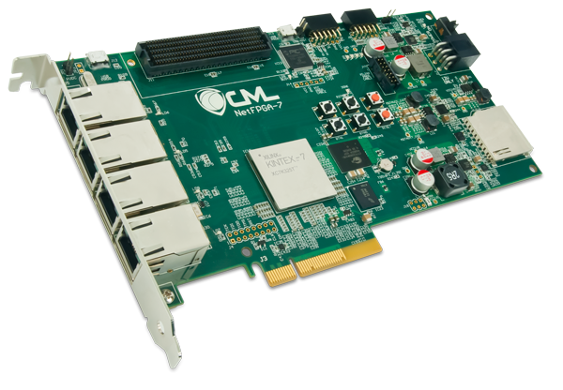
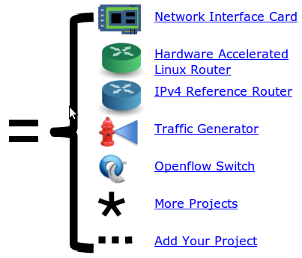
NetFPGA = Networked FPGA
A line-rate, flexible, open networking platform for teaching and research
Notes:
NetFPGA is a project that has been around for a couple of decades so it has a well established community of developers
It was originally started at Stanford University and is now mainly maintained at the University of Cambridge
NetFPGA is a line-rate, flexible, open source networking platform designed for teaching and research
The project won the SOSR software systems award this year.
The platform can be used for a number of different applications including a NIC, router, traffic generator, and more
There is a family of boards NetFPGA boards. The original was a 4x1G board, then there was an initial 4x10G board, and now the latest is the NetFPGA SUME board

Slide 20
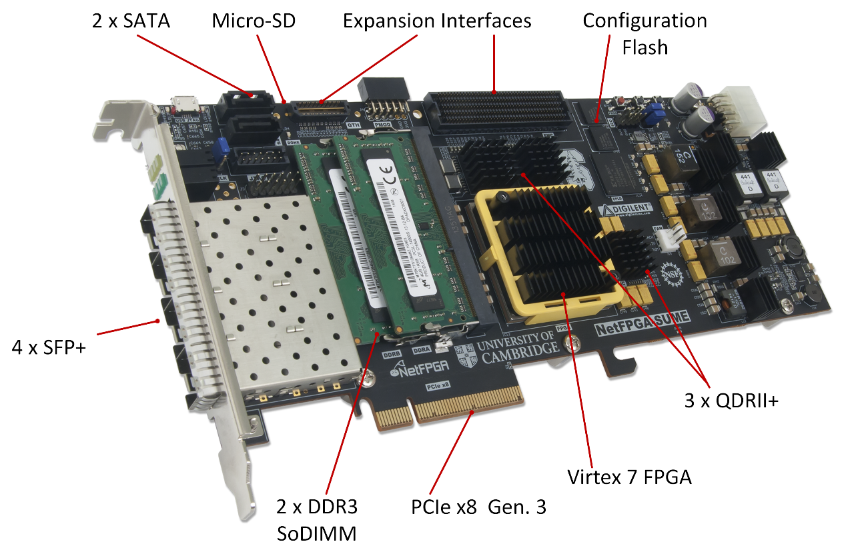
NetFPGA-SUME
Notes:
The SUME board is decorated with a Xilinx Virtex-7 FPGA
It has 4 10G SFP+ interfaces, a PCIe Gen 3 host adapter, 27 MB of SRAM, 8GB of DRAM, and a bunch of other peripherals
This is the board that we target for the P4->NetFPGA workflow

Slide 21
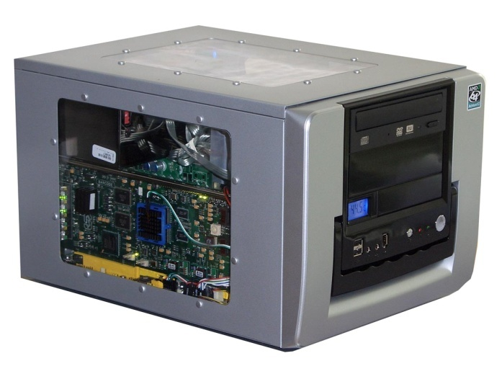

NetFPGA board
Networking Software running on a standard PC
CPU
Memory
PCI-Express
PC with NetFPGA
10GbE
A hardware accelerator built with FPGA driving 1/10/ 100Gb/s network links
FPGA
10GbE
10GbE
Memory
10GbE
Notes:
The SUME board can be used standalone, but it is often installed in a Linux host machine
By doing so, a software control-plane can run on the Linux host and interact with the hardware accelerated packet processing logic on the SUME board via the PCI Express interface.

Slide 22
NetFPGA Reference Design
Five stages
  Input port
  Input arbitration
  Forwarding decision and packet modification
  Output queuing
  Output port
256-bit data bus
200 MHz
10GE
RxQ
10GE
RxQ
10GE
RxQ
10GE
RxQ
DMA
Input Arbiter
Output Port Lookup
Output Queues
10GE
Tx
10GE
Tx
10GE
Tx
10GE
Tx
DMA
Notes:
Here is the canonical NetFPGA reference design. It consists of 5 stages …
Over 2000 boards deployed, used in classroom for about 15 years
Limited success because students need to be familiar with hardware design and working with FPGAs
There are a lot of students that are interested in building network systems, but the don’t have the necessary pre-requisite background to use the NetFPGA
With this in mind, we developed the P4->NetFPGA workflow

Slide 23

NetFPGA
Overview
Notes:
By allowing students to program the NetFPGA using P4, rather than Verilog, instructors can given their students hands-on experience working with real hardware, while allowing them to focus on learning networking concepts rather than the minutiae involved in FPGA design
Similarly, networking researchers can rapidly prototype new systems without being bogged down by hardware development
Let me now provide an overview of the P4->NetFPGA workflow

Slide 24
General Process for Programming a P4 Target
P4→NetFPGA tools
Control Plane
P4 Program
P4 Compiler
Add/remove
table entries
Extern
control
Packet-in/out
RUNTIME
CPU port
P4 Architecture
Model
Data Plane
Target-specific configuration binary
Tables
Extern
objects
Load
Target
SimpleSumeSwitch
Architecture
NetFPGA SUME
Notes:
First, let’s revisit the general process for programming a P4 target so that I can point out the various components
The Target is the NetFPGA SUME board
The P4 Architecture Model is the SimpleSumeSwitch which I described at the beginning of this talk
And the P4->NetFPGA tools provide both the P4 compiler as well as the runtime control mechanism that allows the control-plane to interact with the packet processing data-plane

Slide 25
P4→NetFPGA Compilation Overview
NetFPGA Reference Design
P4 Program
10GE
RxQ
10GE
RxQ
10GE
RxQ
10GE
RxQ
DMA
Xilinx SDNet Tools
Input Arbiter
Output Port Lookup
SimpleSumeSwitch Architecture
SimpleSume
Switch
Output Queues
10GE
Tx
10GE
Tx
10GE
Tx
10GE
Tx
DMA
25

Slide 26
P4→NetFPGA Extern Function library
HDL modules invoked within P4 programs
Stateless – reinitialized for each packet
Stateful – keep state between packets
  Cannot pipeline stateful operations
  Stateful operation: x = x + 1
x should be 2,
not 1!
x = 0
x = 1
Need atomic
read-modify-write operations
tmp
pkt.tmp = x
tmp
= 0
pkt.tmp ++
tmp
= 1
x = pkt.tmp
tmp
tmp
= 0
tmp
= 1
Slide Credit: Anirudh Sivaraman

Slide 27
P4→NetFPGA Extern Function library
Stateful Atoms[1]
Stateless Externs
Add your own!
Atom | Description
R/W | Read or write state
RAW | Read, add to, or overwrite state
PRAW | Predicated version of RAW
ifElseRAW | Two RAWs, one each for when predicate is true or false
Sub | IfElseRAW with stateful subtraction capability
Atom | Description
IP Checksum | Given an IP header, compute IP checksum
LRC | Longitudinal redundancy check, simple hash function
timestamp | Generate timestamp (granularity of 5 ns)
[1] Sivaraman, et al. "Packet transactions" ACM SIGCOMM Conference, 2016.

Slide 28
P4→NetFPGA Simulations
Python Scapy based script to generate test packets and metadata
Two stages of simulations:
  Testbench produced by SDNet compiler
  Full NetFPGA pipeline simulation

Slide 29
API & Interactive CLI Tool Generation
Both Python API and C API
  Manipulate tables and externs in P4 pipeline
  Used to implement control-plane
CLI tool
  Useful debugging feature
  Query various compile-time information
  Interact directly with tables and externs at run time

Slide 30
P4→NetFPGA Workflow
Write P4 program
Write externs
Write python gen_testdata.py script
Compile to Verilog / generate API & CLI tools
Run simulations
Build bitstream
Check implementation results
Test the hardware
All of your effort will go here
fail
pass

Slide 31
P4→NetFPGA Online Tutorials[1]
Step-by-step guide
Solutions available
Three assignments:
  Switch as calculator
  TCP flow monitor
  In-band Network Telemetry (INT)
[1] https://github.com/NetFPGA/P4-NetFPGA-public/wiki/Tutorial-Assignments

Slide 32
P4→NetFPGA Community
150 different institutions
Mailing list: cl-netfpga-sume-beta@lists.cam.ac.uk

Slide 33
NetFPGA
In Practice

Slide 34
Research Prototypes
P4 Infrastructure
  Programmable packet scheduling
  Programmable data-plane verification
Data-plane Programs
  Proactive congestion control
  Stateless load-aware load balancing
  Firewall for 5G mobile networks
  Heavy hitter detection
  IP packet fuzzer
Networking-Offload Applications
  Network accelerated consensus
  Network-accelerated sorting
  In-Network key-value cache
  In-Network compression
  Named data networking
And more …
Notes:
The research prototypes that have been produced by the community so far can be roughly categorized into three groups
The P4 Infrastructure projects are about building new architectures to enable additional sorts of programmability or functionality
The Data-Plane programs are P4 implementations of typical networking applications such as congestion control, load balancing, and firewalls
The Networking-Offload applications are things that you wouldn't normally consider to be a networking application like consensus protocols, or sorting, or caching, or compression, but they have been offloaded onto the network because of the additional programmability that is available
Let me briefly highlight a couple of the projects that I've been involved in

Slide 35
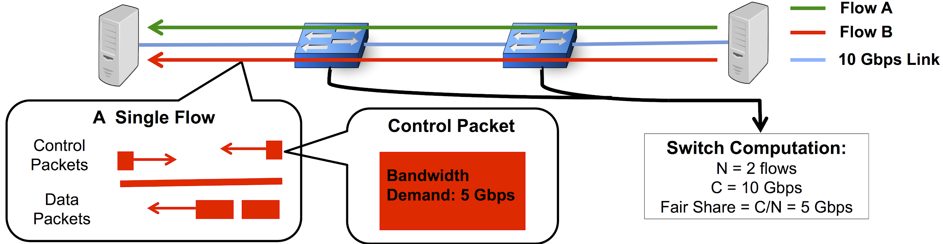
Proactive Congestion Control
Status Quo:
  End hosts react to congestion signals from the network and adjust flow rates
Proactive approach:
  Let the network decide how to allocate bandwidth to flows
Notes:
Proactive congestion control is a new technique for an old problem
Typical approaches to congestion control are reactive in the sense that they first measure congestion signals from the network, such as packet drops, ECN marks, and queue sizes and then they reactively adjust their sending rates
Proactive techniques on the other hand attempt to use explicit information about the flows and the topology to compute optimal sending rates before congestion even occurs in the first place.

Slide 36
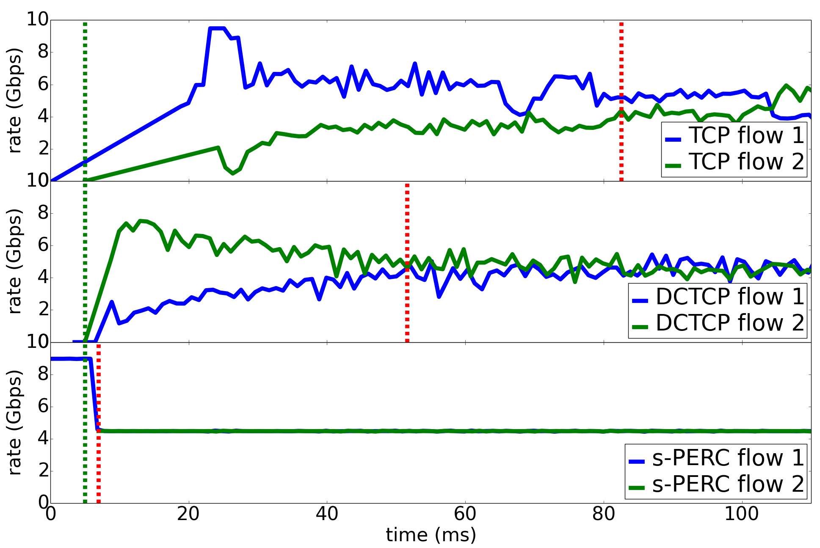
Proactive Congestion Control
10 Gbps
Proactive techniques converge quickly
Faster convergence leads to lower flow completion times
Reactive
Proactive
proactive
proactive

Slide 37
Programmable Packet Scheduling
Push-In-First-Out (PIFO) Model:
Programmable rank computation
Packets always dequeued from the head
4
8
7
6
3
0
Fixed PIFO
Clear separation of fixed and programmable logic
Can implement virtually every scheduling policy that we care about today
[1] A. Sivaraman, et al. "Programmable packet scheduling at line rate." ACM SIGCOMM 2016

Slide 38
Programmable Packet Scheduling
10GE
RxQ
10GE
RxQ
10GE
RxQ
10GE
RxQ
DMA
HDL designers can update architecture as desired
Input Arbiter
Schedules packets based on priority computed in P4 program
Compute packet priority
Output Port Lookup
SimpleSume
Switch
Packet Buffer
PIFO Scheduler
Output Queues
10GE
Tx
10GE
Tx
10GE
Tx
10GE
Tx
DMA

Slide 39
Teaching Network Systems
CS344 at Stanford:
  Build an internet router on NetFPGA SUME (teams of 2)
  Data-plane in P4, control-plane routing protocol on Linux host
  Interoperability testing (6 weeks)
  Open-ended design challenge (4 weeks)
  P4→NetFPGA replaced Verilog course
Fork it on GitHub [1]
[1] https://github.com/p4lang/education/wiki/courses#build-an-internet-router-cs344
Notes:
In addition to building research prototypes, the P4->NetFPGA workflow is also great for teaching network system design
Last year, I taught a class at Stanford called CS344 in which students work in teams of 2 to build a fully functioning internet router on the NetFPGA SUME board
Students implement the data-plane in P4 and the control-plane in Python on the Linux host

Slide 40
Looking Forward
P4Runtime support
Improved latency & resource utilization
Facilitate customized architectures
Controller
P4Runtime
PX
HDL

Slide 41

Get the Tools!
Docs: https://github.com/NetFPGA/P4-NetFPGA-public/wiki
Request P4->NetFPGA tools and licenses from XUP [1]
NetFPGA SUME Board
  (Academic users) Special price request [2]
  (Industry users) Purchase from Digilent [3]
[1] https://www.xilinx.com/support/university/donation-program.html
[2] https://netfpga.wufoo.com/forms/netfpga-special-pricing-request/
[3] http://store.digilentinc.com/netfpga-sume-virtex-7-fpga-development-board/

Slide 42
Backup Slides

Slide 43
Benefits of Data Plane Programmability
C
  Control and Customization. Make the device behave exactly as you want
R
  Reliability. Reduce the risk by removing unused features
E
  Efficiency. Reduce energy consumption and expand scale by doing only what you need
A
  Add new features on your schedule
T
  Telemetry. Be able to see inside the Data Plane
E
  Exclusivity and Differentiation. No need to share your IP with the chip vendor
Notes:
Why is it good and so important?
First of all, you will be able to make the device behave exactly as you want. Most of the time fixed function devices are designed around standard behaviors, because that’s what allows them to sell to most users. But any time you need to go outside of clearly prescribed behaviors (and, believe me, it happens a lot), it might be very difficult to do. When you write your own data plane program, you are free to do anything.
Second, you will be able to easily add new features at any time and without waiting for a new chip to be designed. How powerful is that? Imagine that you had to wait for a new CPU every time you wanted to write a new application!
And, by the way, if you have some ”secret sauce” you can keep it to yourself, because there is no need to explain anything to the chip vendor (who is most interested in the features that can be mande available to everyone).
Fourth, it is important to remember that high-speed ASICs, even programmable ones, have fixed, finite amount of resources. If a data plane program has to do a lot of things you do not need (which typically happens with a universal, “one-size-fits-all” programs), these resources, both silicon and energy are wasted on the things you don’t need. When you write your program, you can use generic resources, available on a programmable device only for the processing you need. If processing is simple, you can save energy or reduce latency as well.
Fifth, it might be a subtle point, but when you remove unused protocols, you are improving the overall reliability of the system, since you leave fewer holes in it.
And last, but not least, I will also show you that it is very easy to expose (and export the internal state of your data plane program outside. And this opens great opportunities in network telemetry and diagnostics that were simply unthinkable before.

Slide 44
In-band Network Telemetry (INT)
“I visited: switch 1 @ 780ns,
switch 9 @ 1.3us,
switch 12 @ 2.4us
1
Which path did my packet take?
# | Rule
1
2
3
…
75 | 192.168.0 /24
…
“In switch 1, I followed rules 75 and 250.In switch 9, rules 3 and 80”
2
Which rules did my packet follow?
INT Slides courtesy of Nick McKeown

Slide 45
In-band Network Telemetry (INT)
“Delay: 100ns, 200ns, 19740ns”
3
How long did my packet queue at each switch?
Queue
4
Who did my packet share the queue with?
Time
INT Slides courtesy of Nick McKeown

Slide 46
In-band Network Telemetry (INT)
1
Which path did my packet take?
2
Which rules did my packet follow?
3
How long did my packet queue at each switch?
4
Who did my packet share the queue with?
INT Slides courtesy of Nick McKeown

