Slide 1

LANMC: LSTM-Assisted Non-Rigid Motion Correction
on FPGA for Calcium Image Stabilization
Zhe Chen¹, Hugh T. Blair², Jason Cong¹
¹Computer Science Department, ²Department of Psychology, UCLA
zhechen@ucla.edu

Slide 2
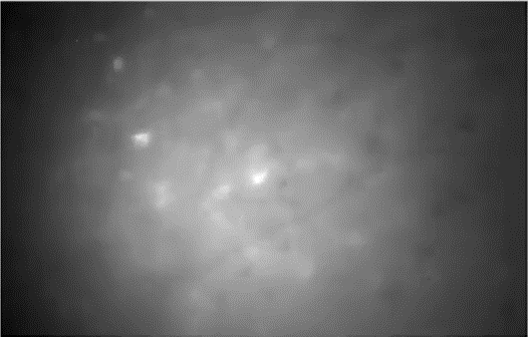
Research Background
Miniscope Calcium Imaging [1] Monitoring neuron activities at large scale in vivo.
Challenge
Non-uniform motion artifacts
Costly and Low Efficient Algorithm
Motivation
Real-Time Non-Rigid motion correction for calcium imaging IN DEMAND.
[1] Denise J. Cai, Daniel Aharoni et al., Nature, 2016
Notes:
Miniscope Calcium Imaging [1] Monitoring neuron activities at large scale in vivo.

Slide 3
Conventional Non-Rigid Motion Correction Method
Processing Steps
2D Contrast Filter
Remove the bulk of background
Filter size: Cell diameter in image
Piecewise Rigid Motion Correction
Divide overlapping patches
Cross correlation based on FFT/IFFT
Local Maximum -> Motion Vector
Algorithm Inefficiency:
The operation needs to be repeated for each single patch.
It causes algorithm to be costly and inefficient for real-time application.

Slide 4
Proposed Method based on LSTM Inference
METHOD: Use long short-term memory (LSTM) inference to predict motion at overlap patches
Offline Training
NoRMCorre -> Get training target
Online Inference
Rigid motion correction + LSTM Inference
95% operation is saved by using 5-node LSTM
Accuracy Evaluation:

Slide 5
Implementation: Folding Architecture
Leverage the central symmetry of the filter kernel with Folding
I₀
I₁
I₂
I₃
I₄
C₀
C₁
C₂
C₁
C₀
Save >80% LUT, FF and >60% DSP compared to design w/o folding
Performance Evaluation
 | Frequency (MHz) | Runtime (ms)
Zynq-7045 | 100 | 3.73
Zynq-7045 | 300 | 1.25
CPU w/ 4T | 1.2-1.5 GHz | 134.6
CPU w/ 8T | 1.2-1.5 GHz | 89.7
CPU w/ 16T | 1.2-1.5 GHz | 61.9
At 300 MHz, FPGA achieves >40x speedup over the CPU

Slide 6
Implementation: Reuse FFT/IFFT and LSTM
Unroll and Pipeline FFT/IFFT Operation
Unroll and Pipeline LSTM Inference Acceleration
Reuse FFT/IFFT IP for H/V Transformation
Vivado HLS
Reuse LSTM for H/V Direction and All Patches

Slide 7
Performance Evaluation
Processing Latency
Energy Efficiency
compared to Xeon E52620 CPU
Low power high efficient Ultra96 board
Consistent speedup of acceleration kernels
Simplify algorithm by LSTM inference
82x Speedup
Close to 4 orders Gain
Conclusion
FPGA design realizes real-time non-rigid motion correction for calcium image.
Low latency and high energy efficiency suitable for closed-loop feedback stimulation.

Slide 8



Thank you!
Acknowledgments

