Slide 1
HopliteBuf: FPGA NoCs with Provably Stall-Free FIFOs
Tushar Garg
tushar.garg@uwaterloo.ca

Slide 2
Context and Motivation
NoCs efficiently integrate large subsystems.

Slide 3
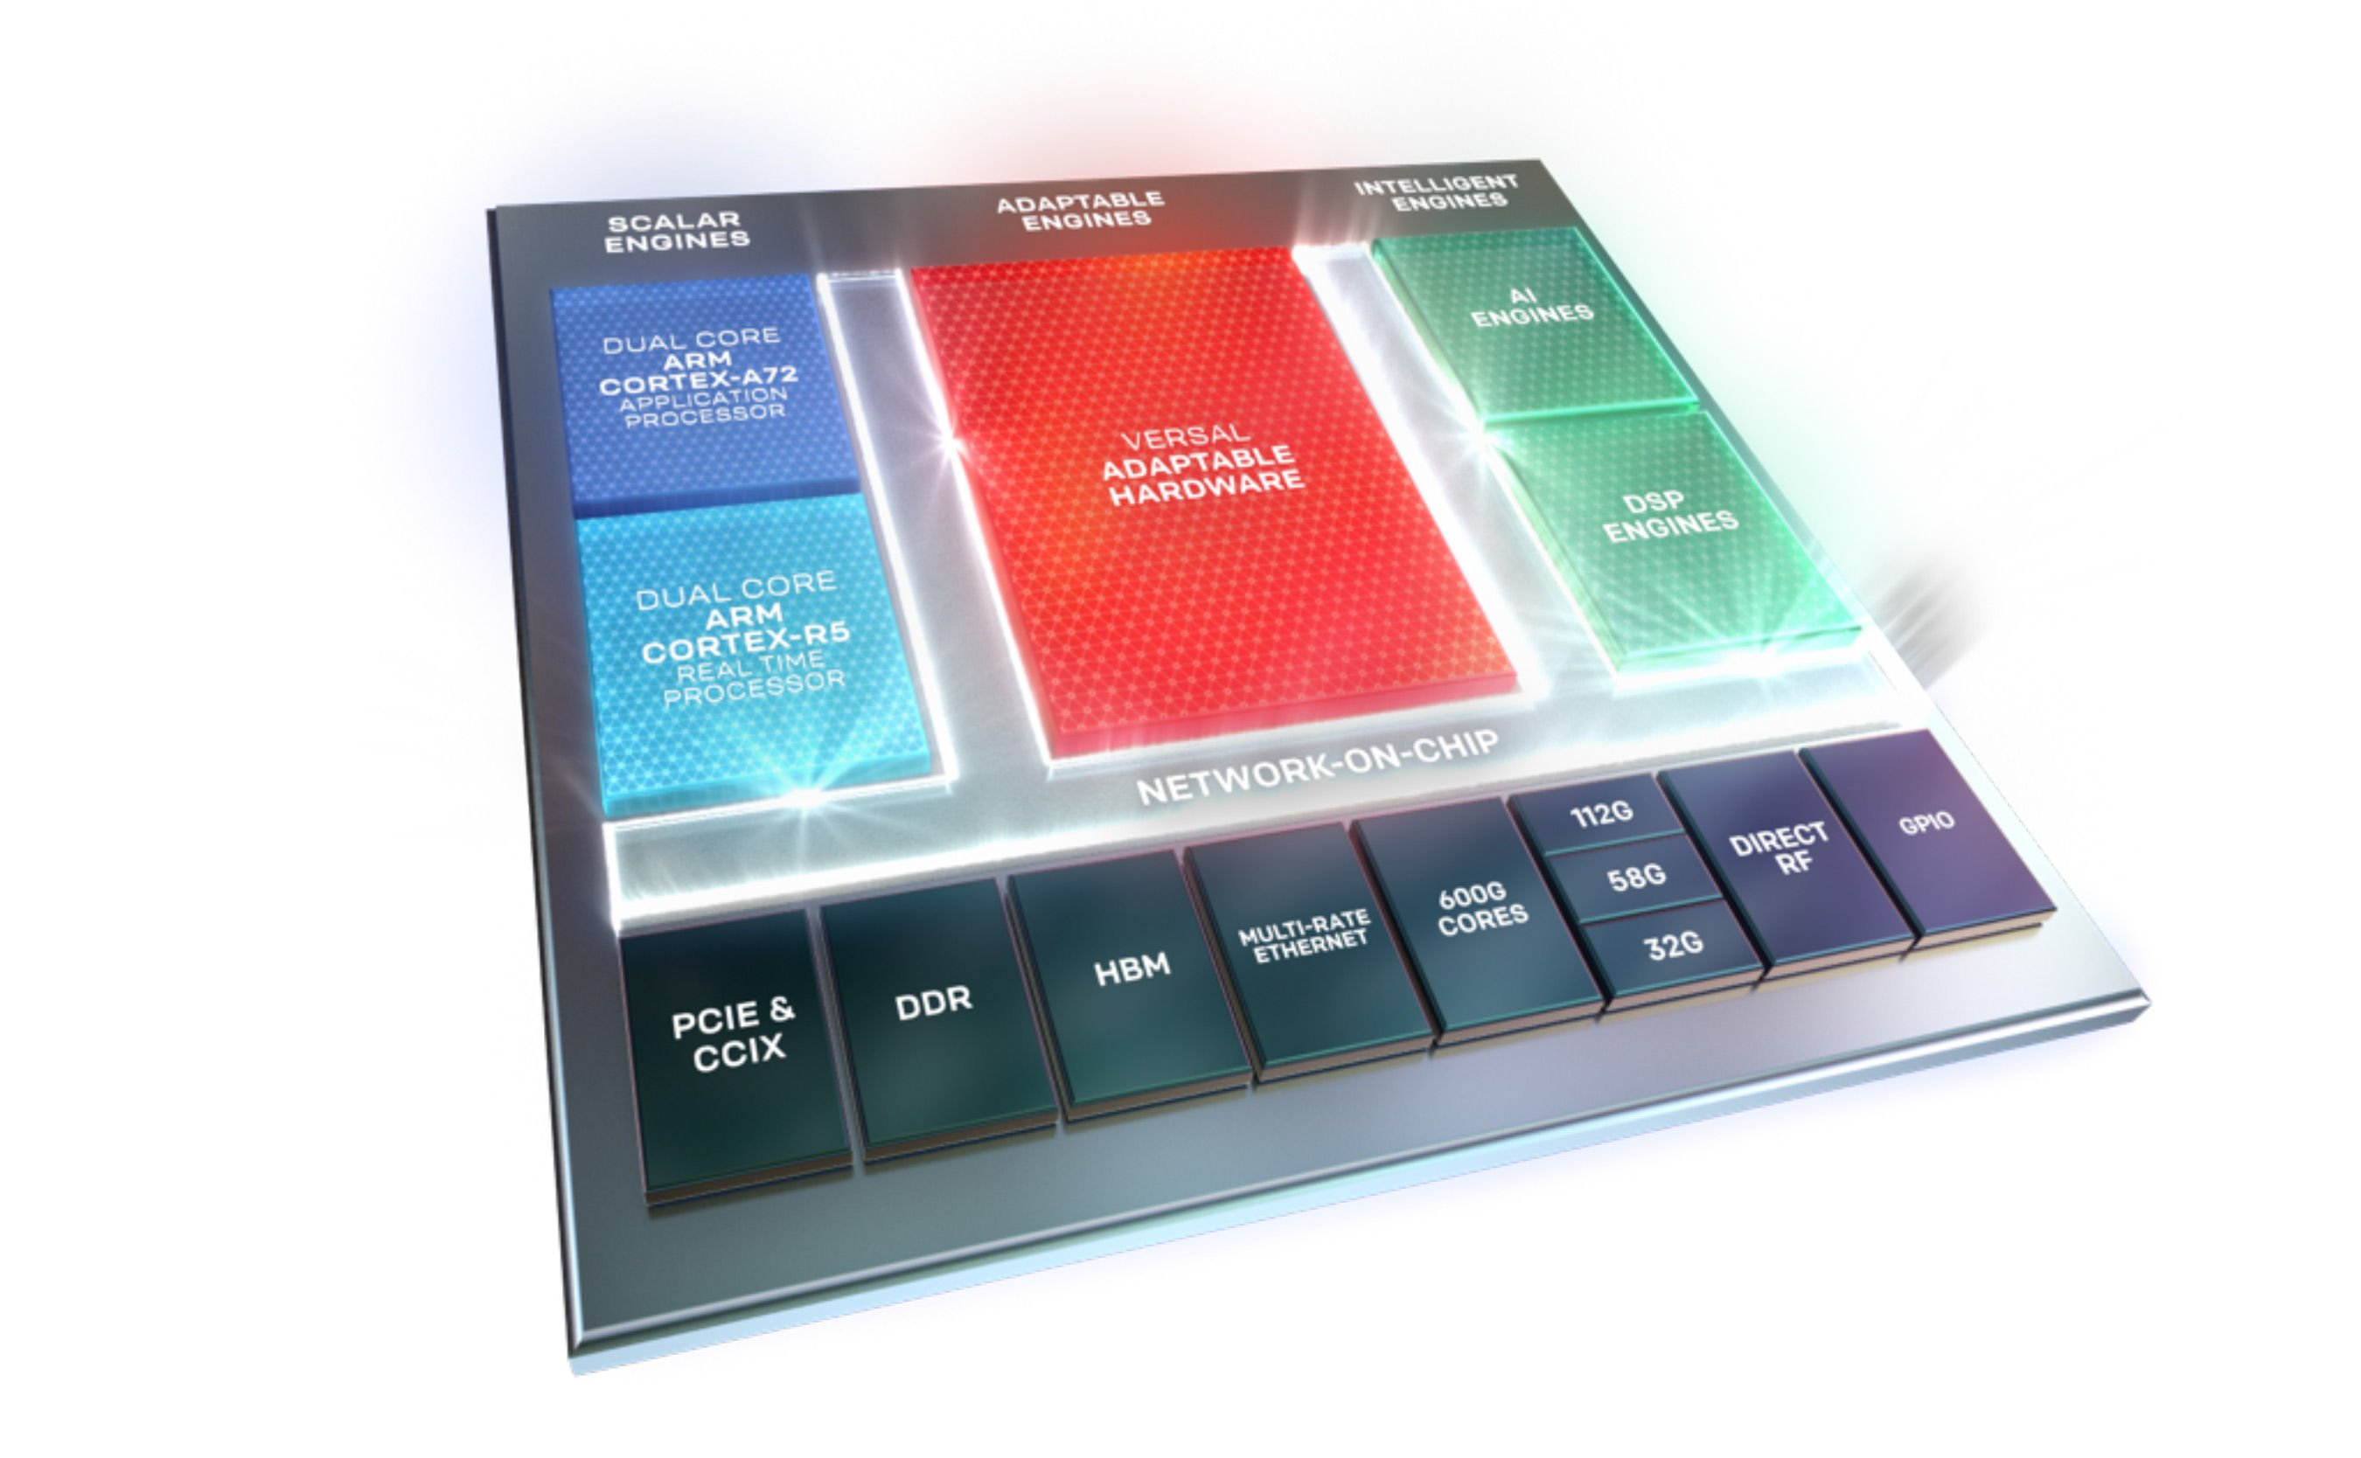
Context and Motivation
NoCs efficiently integrate large subsystems.
Image source: Xilinx

Slide 4
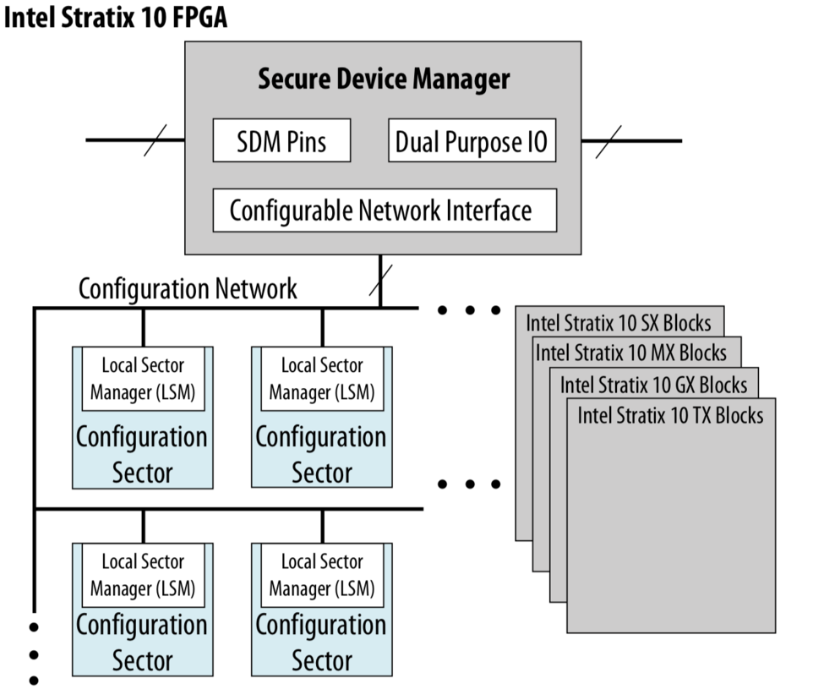
Context and Motivation
NoCs efficiently integrate large subsystems.
Image source: Xilinx
Image source: Intel

Slide 5
Context and Motivation
Key Idea: We need tools to make better use of NoCs

Slide 6
Context and Motivation
Key Idea: We need tools to make better use of NoCs
Can I route my communication requirements?

Slide 7
Context and Motivation
Key Idea: We need tools to make better use of NoCs
Can I route my communication requirements?
How much is it going to cost?

Slide 8
Context and Motivation
Key Idea: We need tools to make better use of NoCs
Can I route my communication requirements?
How much is it going to cost?
Would I have BW left on switches?

Slide 9
Problem
Hoplite, HopliteRT – are small and fast. less than 100 LUTs/router, 400-500 Mhz.

Slide 10
Problem
Hoplite, HopliteRT – are small and fast. less than 100 LUTs/router, 400-500 Mhz. BUT,
deflection penalties

Slide 11
Problem
Hoplite, HopliteRT – are small and fast. less than 100 LUTs/router, 400-500 Mhz. BUT,
deflection penalties
out-of-order delivery

Slide 12
Problem
Hoplite, HopliteRT – are small and fast. less than 100 LUTs/router, 400-500 Mhz. BUT,
deflection penalties
out-of-order delivery
low-throughput

Slide 13
Claim
FPGA-overlay NoCs with regulated traffic can be built by using:

Slide 14
Claim
FPGA-overlay NoCs with regulated traffic can be built by using:
small stall-free buffers

Slide 15
Claim
FPGA-overlay NoCs with regulated traffic can be built by using:
small stall-free buffers
offline tool to statically compute the buffer sizes

Slide 16
Claim
FPGA-overlay NoCs with regulated traffic can be built by using:
small stall-free buffers
offline tool to statically compute the buffer sizes
no-backpressure

Slide 17
Claim
FPGA-overlay NoCs with regulated traffic can be built by using:
small stall-free buffers
offline tool to statically compute the buffer sizes
no-backpressure
eliminate deflections

Slide 18
Claim
FPGA-overlay NoCs with regulated traffic can be built by using:
small stall-free buffers
offline tool to statically compute the buffer sizes
no-backpressure
eliminate deflections
in-order delivery

Slide 19
Claim
1.2-2x lower latency than Hoplite(RT)
10% higher injection rate than Hoplite(RT)
30-60% more flow set support than Hoplite(RT)
1.2-1.5x more cost than Hoplite(RT)

Slide 20
Hoplite
32b payload
LUT | FF
60 | 100
Jan Gray, N. Kapre. Hoplite: A Deflection-Routed Directional Torus NoC for FPGA. FPL 2015

Slide 21
Hoplite
SW
SW
SW
SW
0,0
0,1
0,2
0,3
SW
SW
SW
SW
1,0
1,1
1,2
1,3
SW
SW
SW
SW
2,0
2,1
2,2
2,3
SW
SW
SW
SW
3,0
3,1
3,2
3,3

Slide 22
Hoplite
SW
SW
SW
SW
0,0
0,1
0,2
0,3
SW
SW
SW
SW
1,0
1,1
1,2
1,3
SW
SW
SW
SW
2,0
2,1
2,2
2,3
SW
SW
SW
SW
3,0
3,1
3,2
3,3

Slide 23
Hoplite
SW
SW
SW
SW
0,0
0,1
0,2
0,3
SW
SW
SW
SW
1,0
1,1
1,2
1,3
SW
SW
SW
SW
2,0
2,1
2,2
2,3
SW
SW
SW
SW
3,0
3,1
3,2
3,3

Slide 24
Hoplite
SW
SW
SW
SW
0,0
0,1
0,2
0,3
SW
SW
SW
SW
1,0
1,1
1,2
1,3
SW
SW
SW
SW
2,0
2,1
2,2
2,3
SW
SW
SW
SW
3,0
3,1
3,2
3,3

Slide 25
Hoplite
SW
SW
SW
SW
0,0
0,1
0,2
0,3
SW
SW
SW
SW
1,0
1,1
1,2
1,3
SW
SW
SW
SW
2,0
2,1
2,2
2,3
SW
SW
SW
SW
3,0
3,1
3,2
3,3

Slide 26
HopliteRT
32b payload
LUT | FF
60 | 100
S. Wasly, R. Pellizzoni, N. Kapre. HopliteRT: An Efficient FPGA NoC for real-time applications. FPT 2017

Slide 27
HopliteRT
SW
SW
SW
SW
0,0
0,1
0,2
0,3
SW
SW
SW
SW
1,0
1,1
1,2
1,3
SW
SW
SW
SW
2,0
2,1
2,2
2,3
SW
SW
SW
SW
3,0
3,1
3,2
3,3

Slide 28
HopliteRT
SW
SW
SW
SW
0,0
0,1
0,2
0,3
SW
SW
SW
SW
1,0
1,1
1,2
1,3
SW
SW
SW
SW
2,0
2,1
2,2
2,3
SW
SW
SW
SW
3,0
3,1
3,2
3,3

Slide 29
HopliteRT
SW
SW
SW
SW
0,0
0,1
0,2
0,3
SW
SW
SW
SW
1,0
1,1
1,2
1,3
SW
SW
SW
SW
2,0
2,1
2,2
2,3
SW
SW
SW
SW
3,0
3,1
3,2
3,3

Slide 30
HopliteRT
SW
SW
SW
SW
0,0
0,1
0,2
0,3
SW
SW
SW
SW
1,0
1,1
1,2
1,3
SW
SW
SW
SW
2,0
2,1
2,2
2,3
SW
SW
SW
SW
3,0
3,1
3,2
3,3

Slide 31
HopliteBuf (W→S)
32b payload + 32 FIFO
LUT | FF
110 | 100

Slide 32
HopliteBuf (W→S)
SW
SW
SW
0,0
0,1
0,2
0,3
SW
SW
SW
SW
1,0
1,1
1,2
1,3
SW
SW
SW
SW
2,0
2,1
2,2
2,3
SW
SW
SW
SW
3,0
3,1
3,2
3,3

Slide 33
HopliteBuf (W→S)
SW
SW
SW
0,0
0,1
0,2
0,3
SW
SW
SW
SW
1,0
1,1
1,2
1,3
SW
SW
SW
SW
2,0
2,1
2,2
2,3
SW
SW
SW
SW
3,0
3,1
3,2
3,3

Slide 34
 | Hoplite | HopliteRT | HopliteBuf
 |  |  | W→S | W→S+N
Livelock freedom | ✗ | ✓ | ✓
In-order delivery | ✗ | ✗ | ✓
Latency | ✗✗ | ✗ | ✓
Cost | ✓ | ✓ | ✗
Traffic Regulation | ✗ | ✓ | ✓

Slide 35
 | Hoplite | HopliteRT | HopliteBuf
 |  |  | W→S | W→S+N
Livelock freedom | ✗ | ✓ | ✓
In-order delivery | ✗ | ✗ | ✓
Latency | ✗✗ | ✗ | ✓
Cost | ✓ | ✓ | ✗
Traffic Regulation | ✗ | ✓ | ✓
Circular Dependency |  |  | ✓

Slide 36
Outline
Network Calculus
Circular dependencies in W→S
HopliteBuf W→S+N
Evaluation and Conclusion

Slide 37
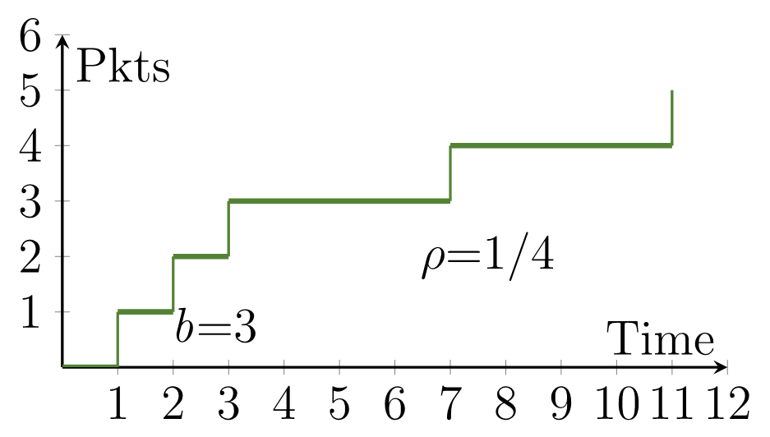
Network Calculus
PE
Reg
SW

Slide 38
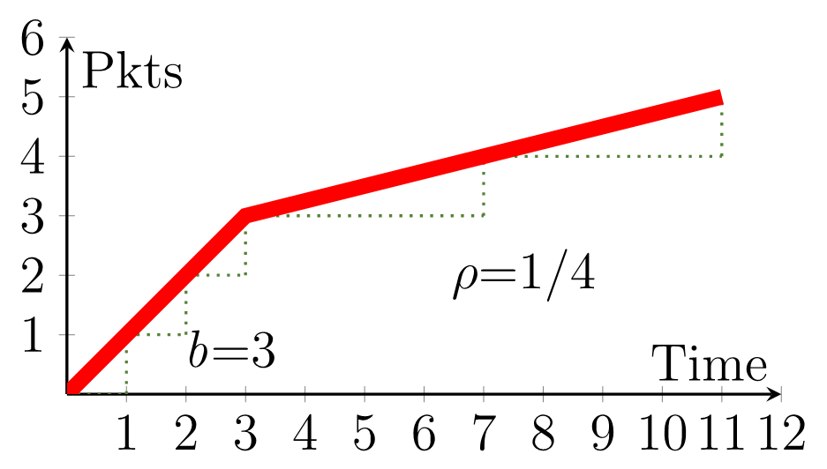
Network Calculus
PE
Reg
SW

Slide 39
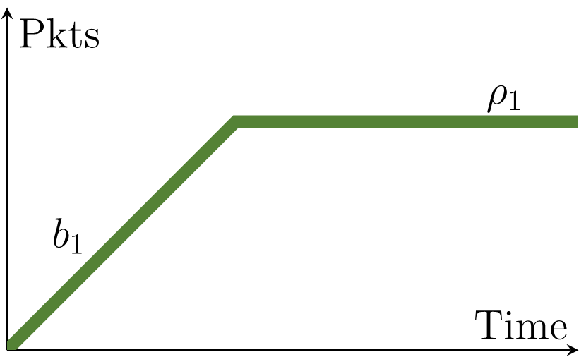
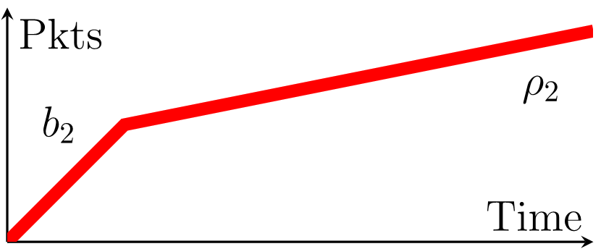
Network Calculus
North injects packets at (b₁, ρ₁)
West injects packets at (b₂, ρ₂)
N
W
S

Slide 40
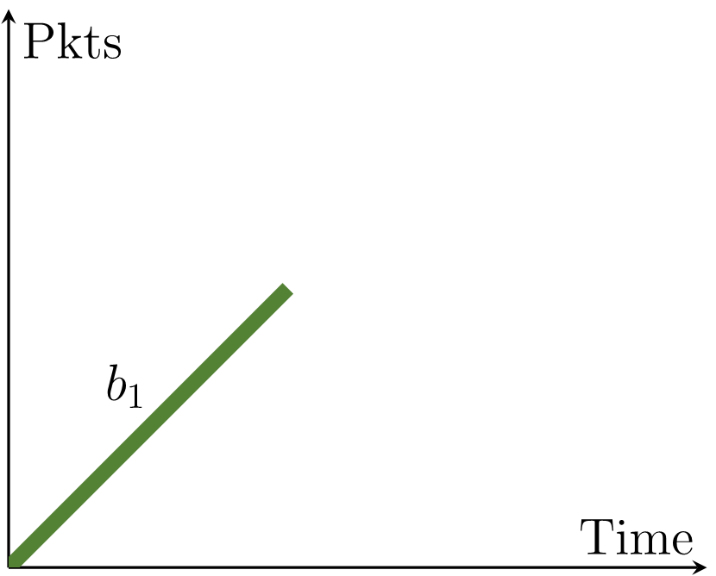
Network Calculus
North injects packets at (b₁, ρ₁)
West injects packets at (b₂, ρ₂)
North obstructs buffer reading
N
W
S

Slide 41
Network Calculus
North injects packets at (b₁, ρ₁)
West injects packets at (b₂, ρ₂)
North obstructs buffer reading
Buffer fills at rate ρ₂
N
W
Buffer size depends on b₁,ρ₁ and b₂,ρ₂
S

Slide 42
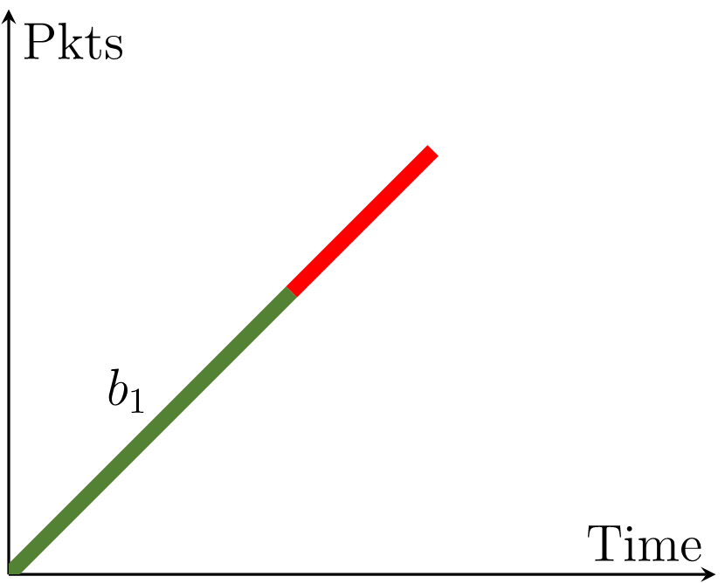
Network Calculus
North injects packets at (b₁, ρ₁)
West injects packets at (b₂, ρ₂)
North obstructs buffer reading
Buffer fills at rate ρ₂
Buffer is read at rate b
N
W
b
Buffer size depends on b₁,ρ₁ and b₂,ρ₂
b
S

Slide 43
Network Calculus
North injects packets at (b₁, ρ₁)
West injects packets at (b₂, ρ₂)
North obstructs buffer reading
Buffer fills at rate ρ₂
Buffer is read at rate b
N
W
b
Buffer size depends on b₁,ρ₁ and b₂,ρ₂
Output burst size increases
b
S

Slide 44
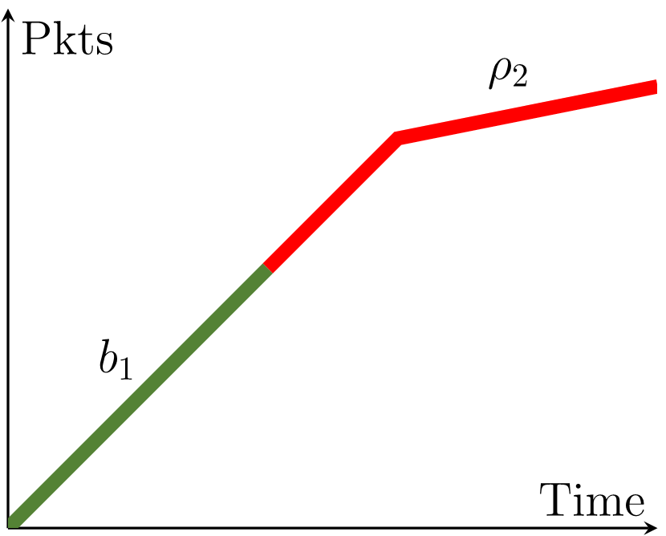
Network Calculus
North injects packets at (b₁, ρ₁)
West injects packets at (b₂, ρ₂)
North obstructs buffer reading
Buffer fills at rate ρ₂
Buffer is read at rate b
N
W
b
Buffer size depends on b₁,ρ₁ and b₂,ρ₂
Output burst size increases
b
S

Slide 45
Circular Dependency W→S
SW
A
0,0
SW
B
1,0
SW
C
2,0

Slide 46
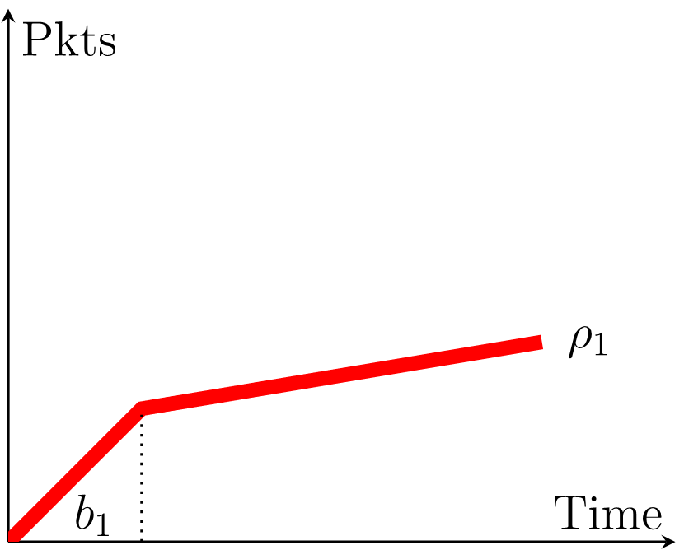
Circular Dependency W→S
SW
A
0,0
SW
B
1,0
SW
C
2,0

Slide 47
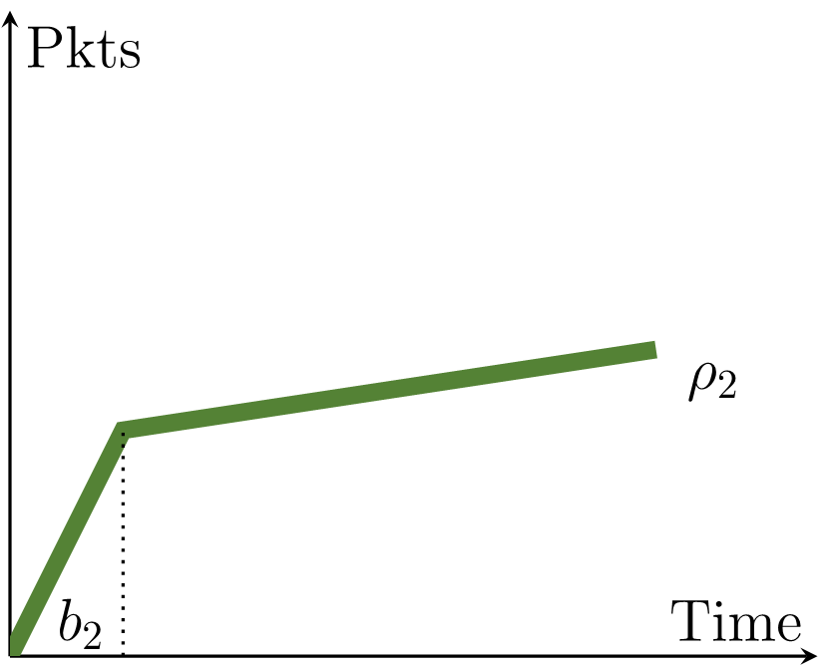
Circular Dependency W→S
SW
A
0,0
SW
B
1,0
SW
C
2,0

Slide 48
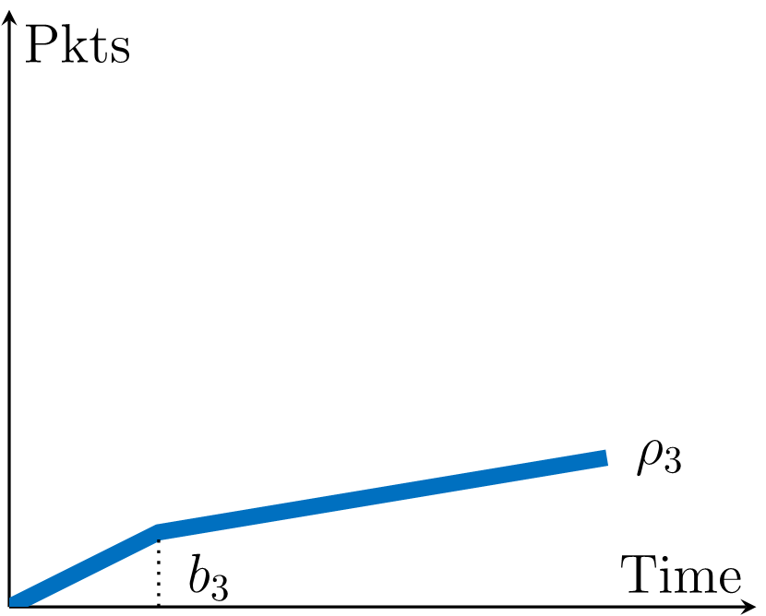
Circular Dependency W→S
SW
A
0,0
SW
B
1,0
SW
C
2,0

Slide 49
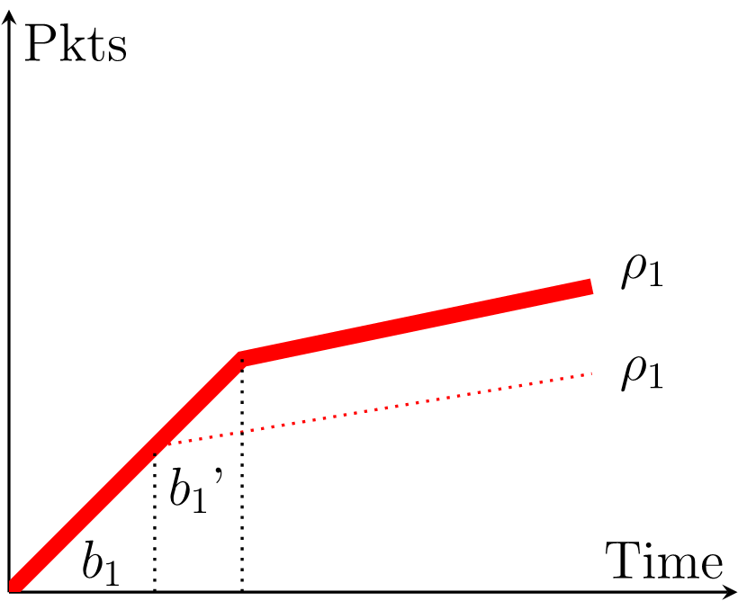
Circular Dependency W→S
SW
A
0,0
SW
B
1,0
SW
C
2,0

Slide 50
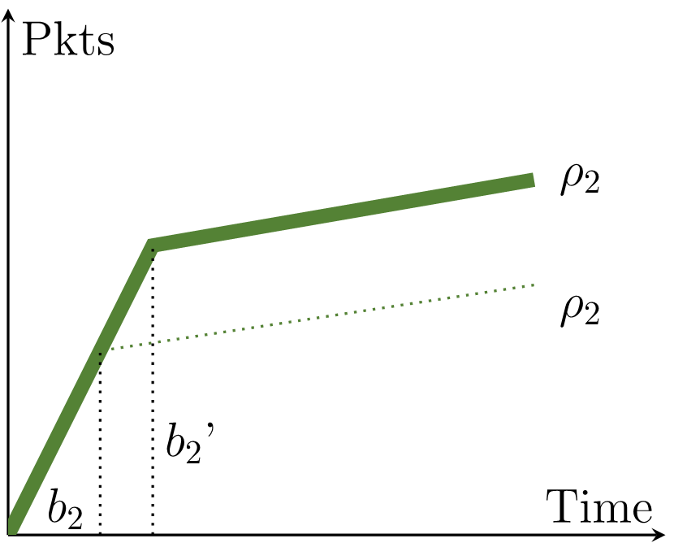
Circular Dependency W→S
SW
A
0,0
SW
B
1,0
SW
C
2,0

Slide 51
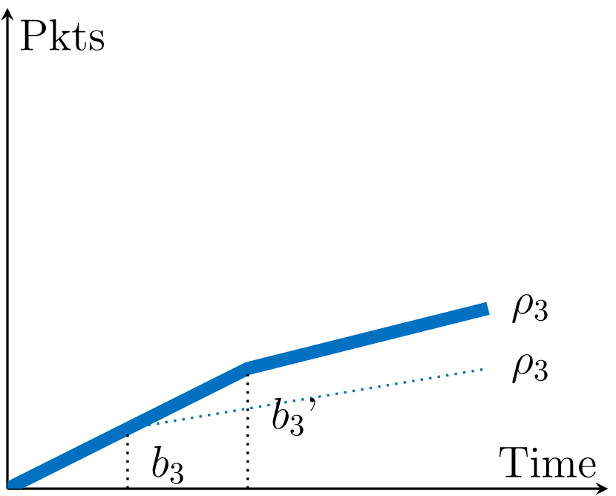
Circular Dependency W→S
SW
A
0,0
SW
B
1,0
SW
C
2,0

Slide 52
Circular Dependency W→S
SW
A
0,0
SW
B
1,0
SW
C
2,0

Slide 53
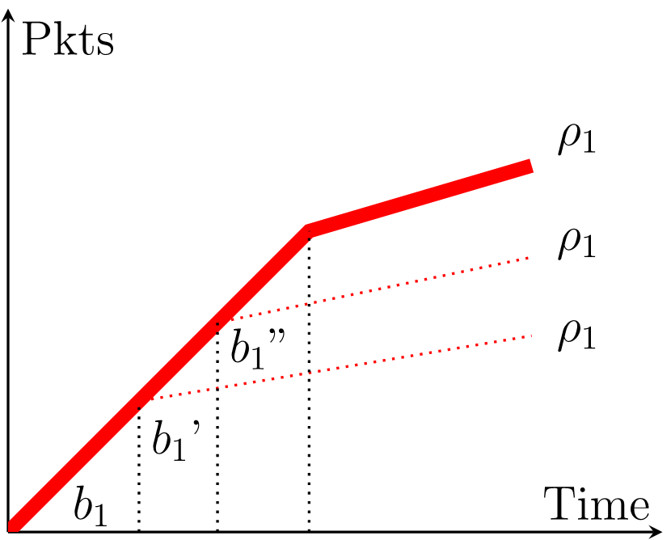
Circular Dependency W→S
SW
A
0,0
SW
B
1,0
SW
C
2,0

Slide 54
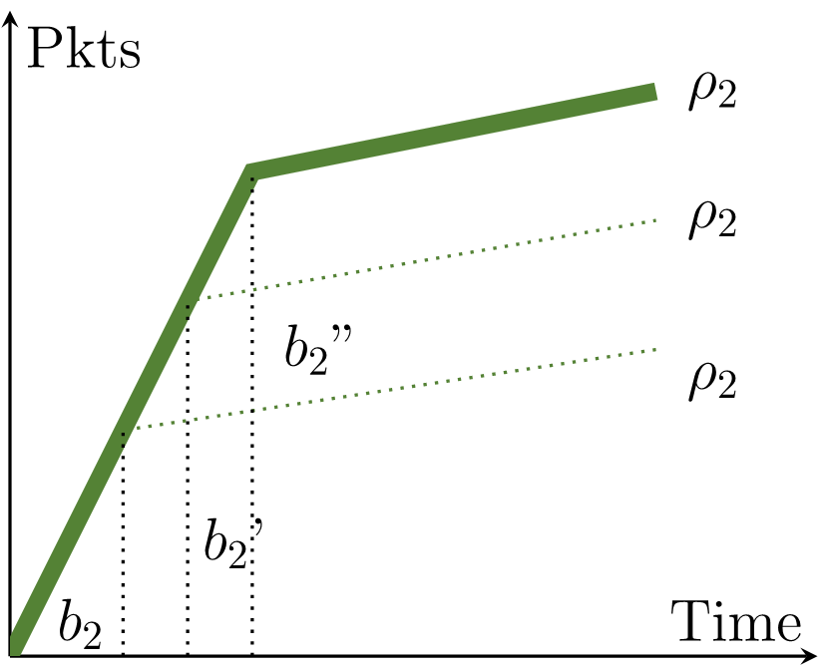
Circular Dependency W→S
SW
A
0,0
SW
B
1,0
SW
C
2,0

Slide 55
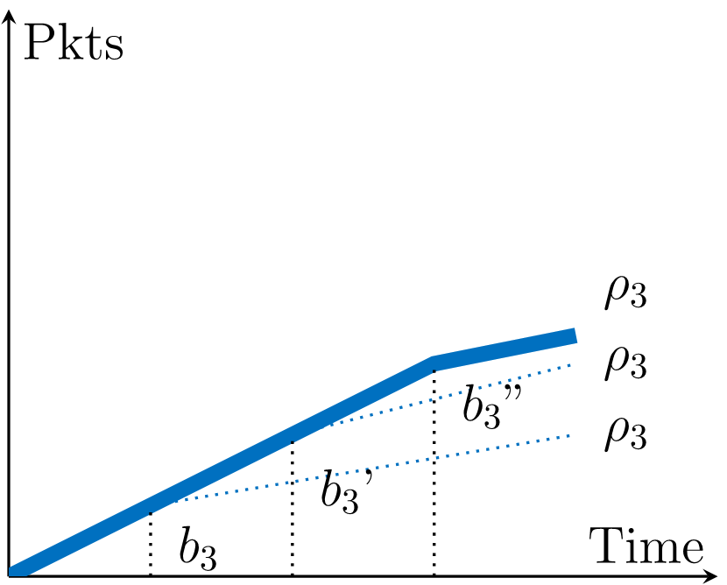
Circular Dependency W→S
SW
A
0,0
SW
B
1,0
SW
C
2,0

Slide 56
Circular Dependency W→S
Circular dependencies are bad
reduce provable network utilization by 50% ^{[1]}
¹Amari, Mifdaoui. Worst-case timing analysis of ring networks with cyclic dependencies using network calculus. RTCSA 2017

Slide 57
Circular Dependency W→S
Circular dependencies are bad
reduce provable network utilization by 50% ^{[1]}
Analysis may converge
worst case occupancy bounds are pessimistic
¹Amari, Mifdaoui. Worst-case timing analysis of ring networks with cyclic dependencies using network calculus. RTCSA 2017

Slide 58
Circular Dependency W→S
Circular dependencies are bad
reduce provable network utilization by 50% ^{[1]}
Analysis may converge
worst case occupancy bounds are pessimistic
Analysis may NOT converge
no bounds exist – infinite buffer
¹Amari, Mifdaoui. Worst-case timing analysis of ring networks with cyclic dependencies using network calculus. RTCSA 2017

Slide 59
HopliteBuf (W→S+N)

Slide 60
HopliteBuf (W→S+N)
SW
SW
SW
SW
0,0
0,1
0,2
0,3
SW
SW
SW
SW
1,0
1,1
1,2
1,3
SW
SW
SW
SW
2,0
2,1
2,2
2,3
SW
SW
SW
SW
3,0
3,1
3,2
3,3

Slide 61
HopliteBuf (W→S+N)
SW
SW
SW
0,0
0,1
0,2
0,3
SW
SW
SW
SW
1,0
1,1
1,2
1,3
SW
SW
SW
SW
2,0
2,1
2,2
2,3
SW
SW
SW
SW
3,0
3,1
3,2
3,3

Slide 62
HopliteBuf (W→S+N)
SW
SW
SW
0,0
0,1
0,2
0,3
SW
SW
SW
SW
1,0
1,1
1,2
1,3
SW
SW
SW
SW
2,0
2,1
2,2
2,3
SW
SW
SW
SW
3,0
3,1
3,2
3,3

Slide 63
HopliteBuf (W→S+N)
SW
A
0,0
SW
B
1,0
SW
C
2,0

Slide 64
HopliteBuf (W→S+N)
SW
A
0,0
SW
B
1,0
SW
C
2,0

Slide 65
HopliteBuf (W→S+N)
SW
A
0,0
SW
B
1,0
SW
C
2,0

Slide 66
HopliteBuf (W→S+N)
SW
A
0,0
SW
B
1,0
SW
C
2,0

Slide 67
HopliteBuf (W→S+N)
SW
A
0,0
SW
B
1,0
SW
C
2,0

Slide 68
HopliteBuf (W→S+N)
SW
A
0,0
SW
B
1,0
SW
C
2,0

Slide 69
HopliteBuf (W→S+N)
SW
A
0,0
SW
B
1,0
SW
C
2,0

Slide 70
HopliteBuf (W→S+N)
SW
A
0,0
SW
B
X
X
1,0
SW
C
X
2,0

Slide 71
 | Hoplite | HopliteRT | HopliteBuf
 |  |  | W→S | W→S+N
Livelock freedom | ✗ | ✓ | ✓ | ✓
In-order delivery | ✗ | ✗ | ✓ | ✓
Latency | ✗✗ | ✗ | ✓ | ✓✓
Cost | ✓ | ✓ | ✗ | ✗✗
Traffic Regulation | ✗ | ✓ | ✓ | ✓
Circular Dependency |  |  | ✓ | ✗

Slide 72
Evaluation
System size: 5x5
FIFO size: 128 – reasonable to implement in LUT/MLAB
Traffic pattern:
Random – 100 synthetic flow sets
ALL to ONE – DRAM

Slide 73
Evaluation
System size: 5x5
FIFO size: 128 – reasonable to implement in LUT/MLAB
Traffic pattern:
Random – 100 synthetic flow sets
ALL to ONE – DRAM
Infeasible cases:
HopliteRT – Link utilization > 100%
HopliteBuf – Or, FIFO occupancy > 128
What metrics do we measure?
Feasibility, FIFO occupancy

Slide 74
Feasibility

Slide 75
Feasibility

Slide 76
Feasibility

Slide 77
Feasibility

Slide 78
Feasibility
30-60% better than Hop(RT) 5-20% better than W→S

Slide 79
Worst-Case FIFO Size

Slide 80
Worst-Case FIFO Size

Slide 81
Worst-Case FIFO Size

Slide 82
Summary
We present HopliteBuf
Stall free buffered NoC
Static analysis tool

Slide 83
Summary
We present HopliteBuf
Stall free buffered NoC
Static analysis tool
W→S: Circular Dependency

Slide 84
Summary
We present HopliteBuf
Stall free buffered NoC
Static analysis tool
W→S: Circular Dependency
W→S+N: Accurate Analysis

Slide 85
Summary
We present HopliteBuf
Stall-free buffered NoC
Static analysis tool
W→S: Circular Dependency
W→S+N: Accurate Analysis
Key Results
1.2-2x lower latency than Hoplite(RT),
10% higher injection rate than Hoplite(RT),
30-60% more flow set support than Hoplite(RT),
1.2-1.5x more cost than Hoplite(RT)
Open source repo:
git.uwaterloo.ca/watcag-public/hoplitebuf-bounds

