Slide 1
Multi-Commodity Flow-Based Spreading in a Commercial Analytic Placer
Nima Karimpour Darav
Andrew Kennings
Kristofer Vorwerk
Arun Kundu
Physical & Logical Design Group

Slide 2
Outline
Background
Motivation
Implementation Details
Experimental Results
Conclusions

Slide 3
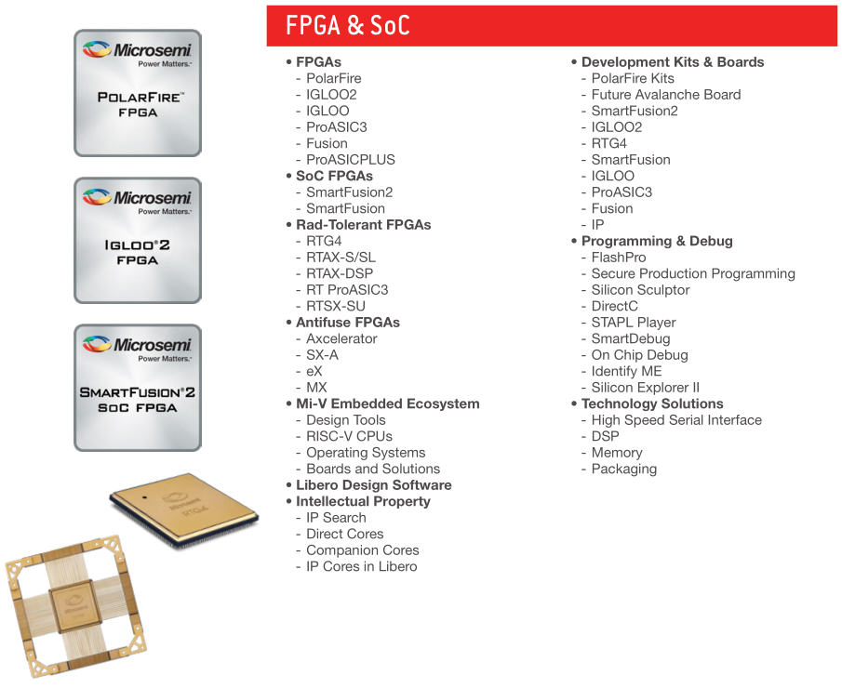
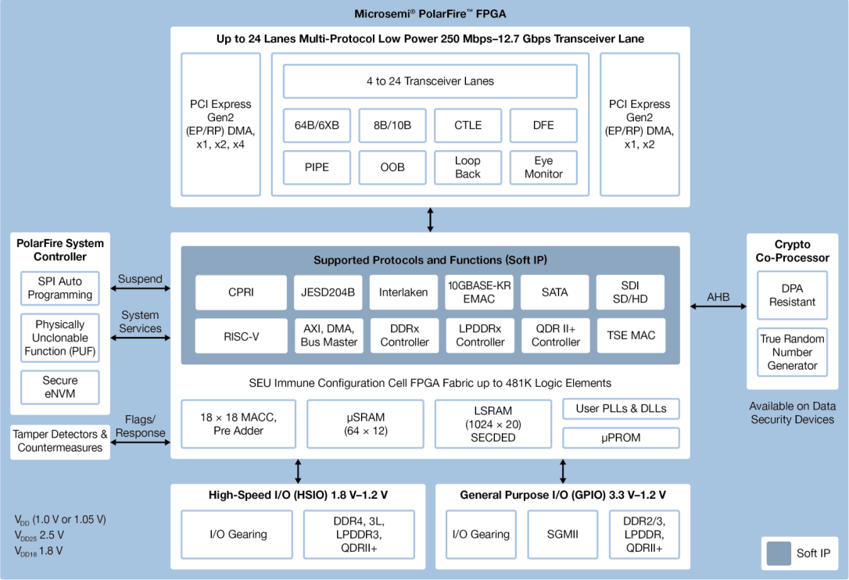
Background
Our FPGA hardware & software products are becoming increasingly complex:
2004: ProASIC^{PLUS}
2006: IGLOO
2010: SmartFusion
2012: SmartFusion2
2015: RTG4
2017: PolarFire
Increasing demand for both high-performance …
High-speed SERDES, DDR4, AXI buses.
FIR filters, CNNs, DSP-intensive tasks.
… and “group-based” design patterns:
Software region constraints.
Fixed cells (“obstacles”).
Tight timing budgets, and sophisticated timing constraints.

Slide 4
Motivation (1 of 2)
Circuit
Clustering
Analytic Placer
Timing, power, routability objectives.
Lower-bound (LB) Placement
Cluster Placement
Goal of UB:
preserve the LB objectives by not perturbing placement.
Upper-bound (UB) Spreading
Can Stop?
Detailed Improvement
The closer the UB to Full Legalization, the better the accuracy of timing predictions & decisions.
Full Legalization
Done

Slide 5
Motivation (2 of 2)
Our UB strategy is based on network flow.
A grid can be imposed over the placement area.
Cells can be snapped into their nearest grid “bin”.
The bins are analogous, in many ways, to nodes in a flow problem.
The concept of flow can be used to push over-capacitated cells into under-capacitated sites.
Our approach
Max movement
Avg Movement
Complex regions
Cell order
Different cell types
Less perturbation of LB
Better timing
Better HPWL
Robust
Handling complex regions
No deadlock
Scalable
Efficient runtime
Not limited to architecture

Slide 6
High-Level Overview of the Spreading Algorithm (Part 1)
Circuit + Architecture
The structure of our approach is similar to Edmonds-Karp.
Comment
Construct Flow Network
Assign cells to closest compatible bin
Identify the overflowed bins
Overflowed bins remain?
No
Yes
Establish limit on amount of movement
End
For each bin, calculate the set of augmenting paths for the bin using BFS, then sort by cost
Next
bin
All
bins
explored
For each path, move cells along path

Slide 7
Step 1: Build the Flow Network (1 of 6)
Architecture Grid
URAM Site
DSP Site
LSRAM Site
LUT & Carry Site
DSP Grid
LUT (and Carries) Grid
URAM Grid
LSRAM Grid

Slide 8
Step 1: Build the Flow Network (2 of 6)
URAM Site
DSP Site
LSRAM Site
LUT & Carry Site
DSP Grid
DSP Flow Network
URAM Grid
zoom-in …
URAM Flow Network
LSRAM Grid
LSRAM Flow Network
4-direction connections

Slide 9
Step 1: Build the Flow Network (3 of 6)
Architecture Grid
URAM Site
DSP Site
LSRAM Site
LUT & Carry Site
DSP Flow Network
URAM Flow Network
LSRAM Flow Network
LUT (and Carry) Network
Fused Flow Network

Slide 10
Step 1: Build the Flow Network (4 of 6)
Distinct grids lend themselves to a convenient problem separation.
This may be the case for some FPGA architectures…
URAM Site
DSP Site
LSRAM Site
LUT & Carry Site
In Microsemi’s FPGA products, non-carry LUTs can occupy locations within the URAM, DSP, and LSRAM sites, if those sites are unused.
This is referred to as using “shadow logic”.
Good for logic utilization.
Let’s see how this is supported…
LUT (and Carry) Grid
LUT (and Carry) Network

Slide 11
Step 1: Build the Flow Network (5 of 6)
This required us to support a notion of “compatibility” to model cell-to-site legality.
The LUTs need to be connected to the nearest URAM, LSRAM, and DSP sites because of the ability to occupy shadow locations.
URAM Flow Nodes
LSRAM Flow Nodes
DSP Flow Nodes
LUT Flow Node
Fused Flow Network
Notes:
Emphasizes multi-commodity nature of this problem.

Slide 12
Step 1: Build the Flow Network (6 of 6)
Region1
Region constraints impact “compatibility”.
Region2
URAM Flow Nodes
LSRAM Flow Nodes
DSP Flow Nodes
The regions require different connections vs. previous slide.
LUT Flow Node
Fused Flow Network

Slide 13
High-Level Overview of the Spreading Algorithm (Part 2)
Circuit + Architecture
Supply Nodes
These are the over-capacitated (overfilled) grid sites.
We want to push flow through these sites toward empty bins.
Construct Flow Network
Assign cells to closest compatible bin
Identify the overflowed bins
Overflowed bins remain?
No
Yes
Establish limit on amount of movement
End
For each bin, calculate the set of augmenting paths for the bin using BFS, then sort by cost
Next
bin
All
bins
explored
For each path, move cells along path
Notes:
In practice, the quality of the final solution is mostly independent of the order of resolving overflowed bins because cell movements are limited
by Ψ ; however, sorting overflowed bins Λ in order of ascending supply values has been shown to reduce runtime. This is because resolving slightly-overflowed bins first provides more candidate paths for highly-overflowed bins later.

Slide 14
Step 2: Find Augmenting Paths (1 of 4)
Each augmenting path is a queue of bins whose first element is the overflowed bin.
While traversing bins using the BFS, partial paths are costed and saved into the queue.
The BFS is repeated until the queue of potential path choices is emptied or the total demand provided by the identified paths can sink the source bin.
URAM Flow Nodes
LSRAM Flow Nodes
DSP Flow Nodes
LUT & Carry Flow Nodes
First Level Search

Slide 15
Step 2: Find Augmenting Paths (2 of 4)
A valid augmenting path starts with the supply node and ends with a sink node.
C1
C2
C3
Suppose that these are carry chain LUTs which are in overfilled LUT locations.
In Microsemi’s FPGA, these cells can only be placed in (non-shadow) LUT locations.
C4
C5
Valid Path

Slide 16
Step 2: Find Augmenting Paths (3 of 4)
A valid augmenting path starts with the supply node and ends with a sink node.
For adding a node into the end of path (compatibility conditions):
There must be at least one object in the source node with the same color as the destination node.
C1
C2
C3
C4
C5
A bin is compatible with an object iff
the object is not in a region constraint, or the region-color of the object is included in the region-color vector of the bin; and,
the object can be legally placed into the bin of the corresponding type.
Invalid Path

Slide 17
Step 2: Find Augmenting Paths (4 of 4)
A valid augmenting path starts with the supply node and ends with a sink node.
For adding a node into the end of path (compatibility conditions):
There must be at least one object in the source node with the same color as the destination node.
There must be at least one object from the source node to the destination node that must :
Not violate the max movement constraint.
Be allowed to be placed at the destination node.
C1
C2
C3
C4
C5
Non-carry LUT; can go into DSP shadow location.
Valid Path

Slide 18
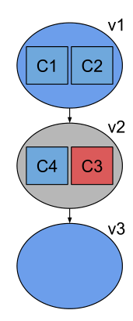
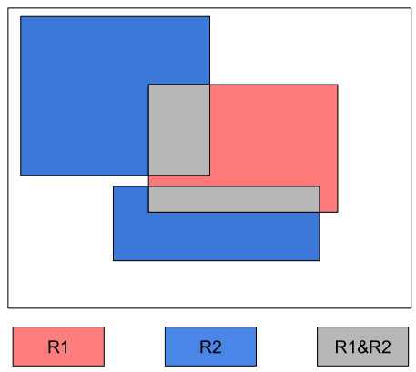
Step 3: Move the Cells (1 of 3)
For a given augmenting path:
Source Bin
Sink Bin
Notes:
In this figure, v1 and v2 are overflowed bins with 2 objects each, while v3 is a sink bin.
Bins v1 and v3 are overlapping with region R2 while v2 is overlapping with both regions R1 and R2.

Slide 19
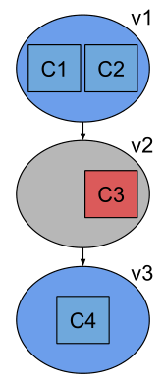
Step 3: Move the Cells (2 of 3)
For a given augmenting path:
Loop until there are no bins left unexplored in the path…
Pop & examine the last bin from the path.
Choose the cell, in the bin, which is closest to & compatible with the sink.
Move the cell.
Update sink to the current bin.
Sink Bin
Notes:
First, the closest object to bin v3 is moved to sink bin v3 such that the object must be compatible with the target bin v3.
c3 is not compatible with bin v3 because c3 is assigned to Red region while v3 is overlapping with only the Blue region.

Slide 20
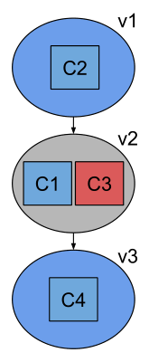
Step 3: Move the Cells (3 of 3)
For a given augmenting path:
Loop until there are no bins left unexplored in the path…
Pop & examine the last bin from the path.
Choose the cell, in the bin, which is closest to & compatible with the sink.
Move the cell.
Update sink to the current bin.
No newly-overflowed bins are created.
Notes:
Then, the closest compatible object to bin v2 is moved to v2.
No new overflowed bin is introduced and the source bin (v1) in the augmentation path is no longer overflowed. The location of each logical cluster is updated based on the location (centre of gravity) of its representing object (or objects). Hence, the solution
provided is well-spread as clusters represented by single objects are fully-legalized, while minor overlaps are permitted for clusters represented by multiple objects.

Slide 21
Experimental Results (1 of 5)
Conducted on a suite with:
557 designs which we have used internally for benchmarking for many years.
A variety of sizes and design utilizations.
A variety of timing constraints.
Each design was placed into the smallest available PolarFire die which could fit it.
Each design was run with 5 different starting seeds, and averages reported here.
The placer was set to optimize the timing as best as it could (i.e., don’t stop early).
Timing is estimated using the pre-routing timing estimator embedded in the placer.
Results are compared after analytic placement, to our previous well-tuned approach based on geometric spreading.

Slide 22
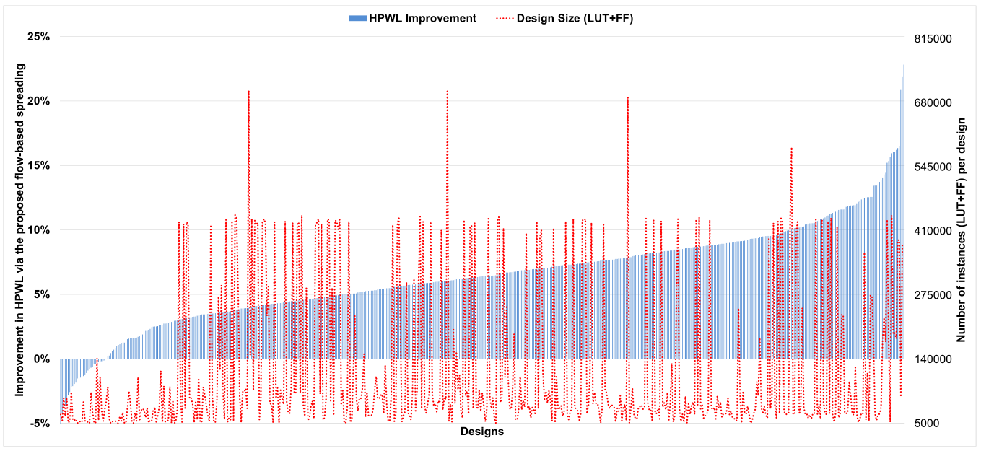
Experimental Results (2 of 5)

Slide 23
Experimental Results (3 of 5)

Slide 24
Experimental Results (4 of 5)

Slide 25
Experimental Results (5 of 5)

Slide 26
Conclusions
Our approach
6.4% reduction in HPWL
Limits on max movement
Handles complex regions
389ps, or ~6 LUT, improvement in delay
Comparable Runtime to Geometric Approaches
Multi-commodity cell types
Generic approach, useful for other architectures

Slide 27
Questions?

