Slide 1
Best Paper Award
4 nominations
Best paper committee:
Brad Hutchings (BYU)
Ilya Ganusov (Intel)
Carl Ebeling (UW)
Dinesh Gaitonde (Xilinx)
$500 award

Slide 2
Best Paper Award Nominees
Multi-Commodity Flow-Based Spreading in a Commercial Analytic Placer
Nima Karimpour Darav(2), Andrew Kennings(1), Kristofer Vorwerk(2), Arun Kundu(2)
University of Waterloo(1), Microsemi Corporation(2)
Substream-Centric Maximum Matchings on FPGA
Maciej Besta, Marc Fischer, Tal Ben-Nun, Johannes De Fine Licht, Torsten Hoefler
ETH Zurich
HopliteBuf: FPGA NoCs with Provably Stall-Free FIFOs
Tushar Garg, Saud Wasly, Rodolfo Pellizzoni, Nachiket Kapre
University of Waterloo
HeteroCL: A Multi-Paradigm Programming Infrastructure for Software-Defined Reconfigurable Computing
Yi-Hsiang Lai(1), Yuze Chi(2), Yuwei Hu(1), Jie Wang(2), Cody Hao Yu(2, 3), Yuan Zhou(1), Jason Cong(2), Zhiru Zhang(1)
Cornell University(1), University of California, Los Angeles(2), Falcon Computing Solutions, Inc.(3)

Slide 3
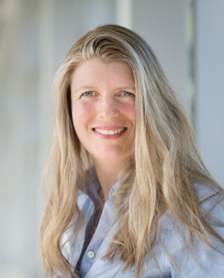
FPGA 2020
February 2020, Monterey-ish, California
General Chair:
Stephen Neuendorffer Xilinx
Program Chair: Lesley Shannon Simon Fraser University

Slide 4
FPGA 2019
Thank you for coming!

