Slide 1



FASED: FPGA-Accelerated
Simulation and Evaluation of DRAM
David Biancolin, Sagar Karandikar, Donggyu Kim, Jack Koenig, Andrew Waterman, Jonathan Bachrach, Krste Asanović

Slide 2
Part 1: On Using FPGAs to Simulate ASICs
An introduction to FireSim, FASED’s simulation environment

Slide 3
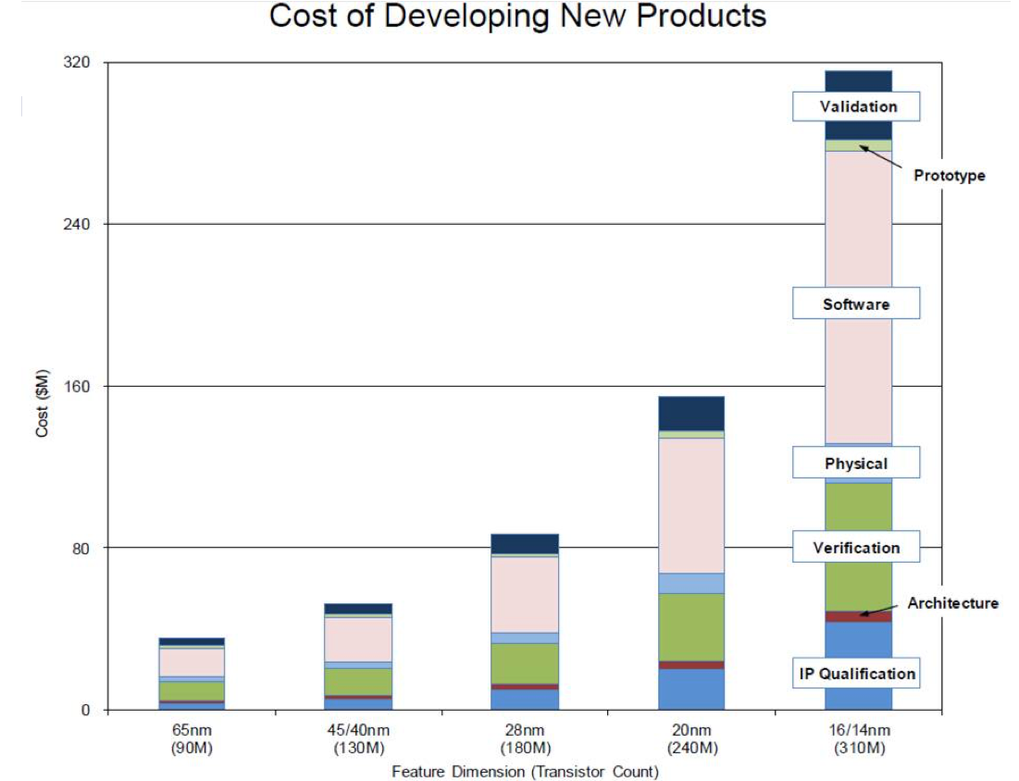
Moore’s Law ($) Has Ended but the NRE Remains
Our group wants to make building custom silicon more accessible:
Chisel & FIRRTL to make HW design more productive
RISC-V to make it easier to architect much of the SoC
How about validation, verification and software?
Source: IBS

Slide 4
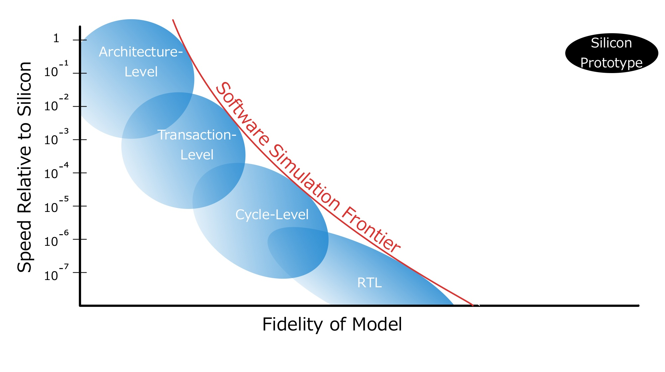
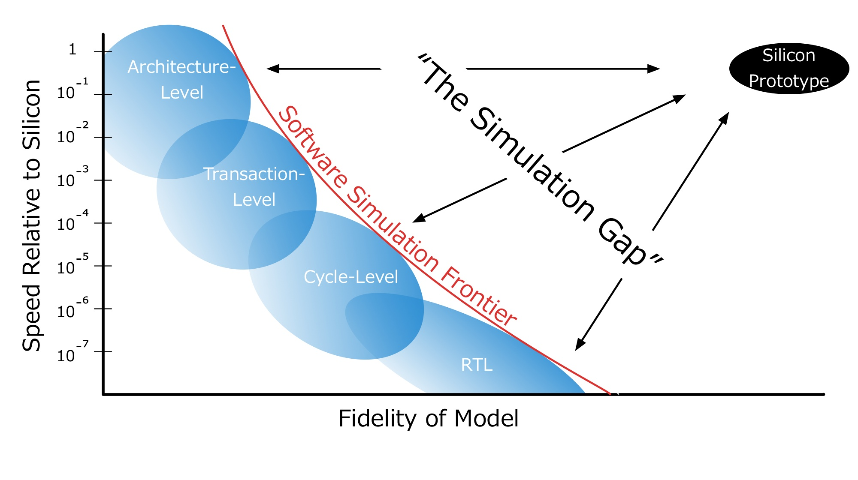
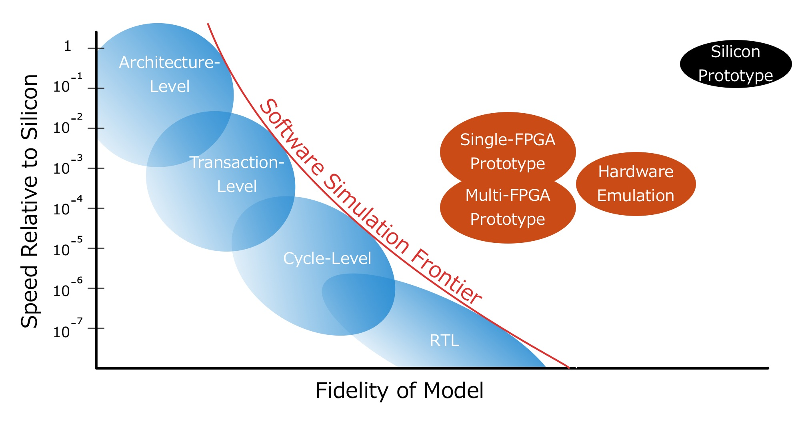

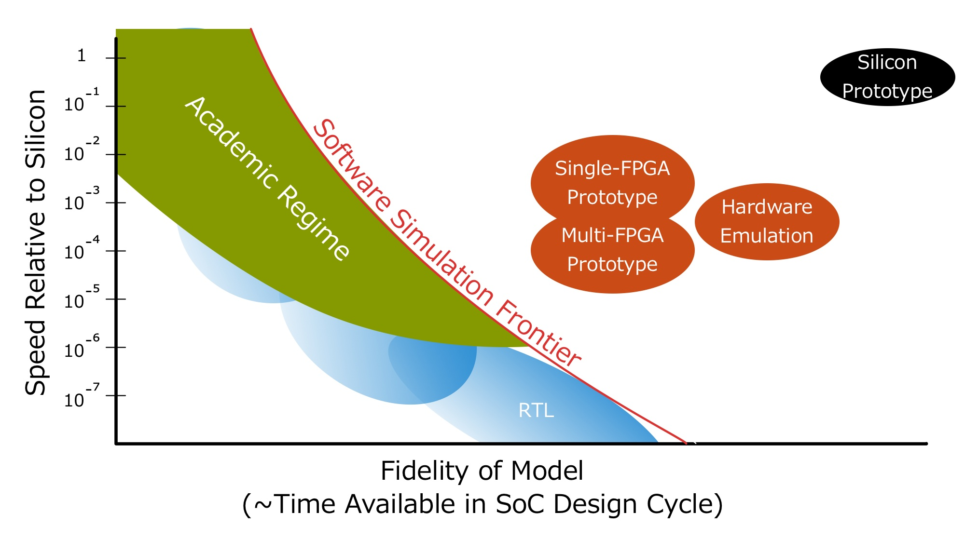
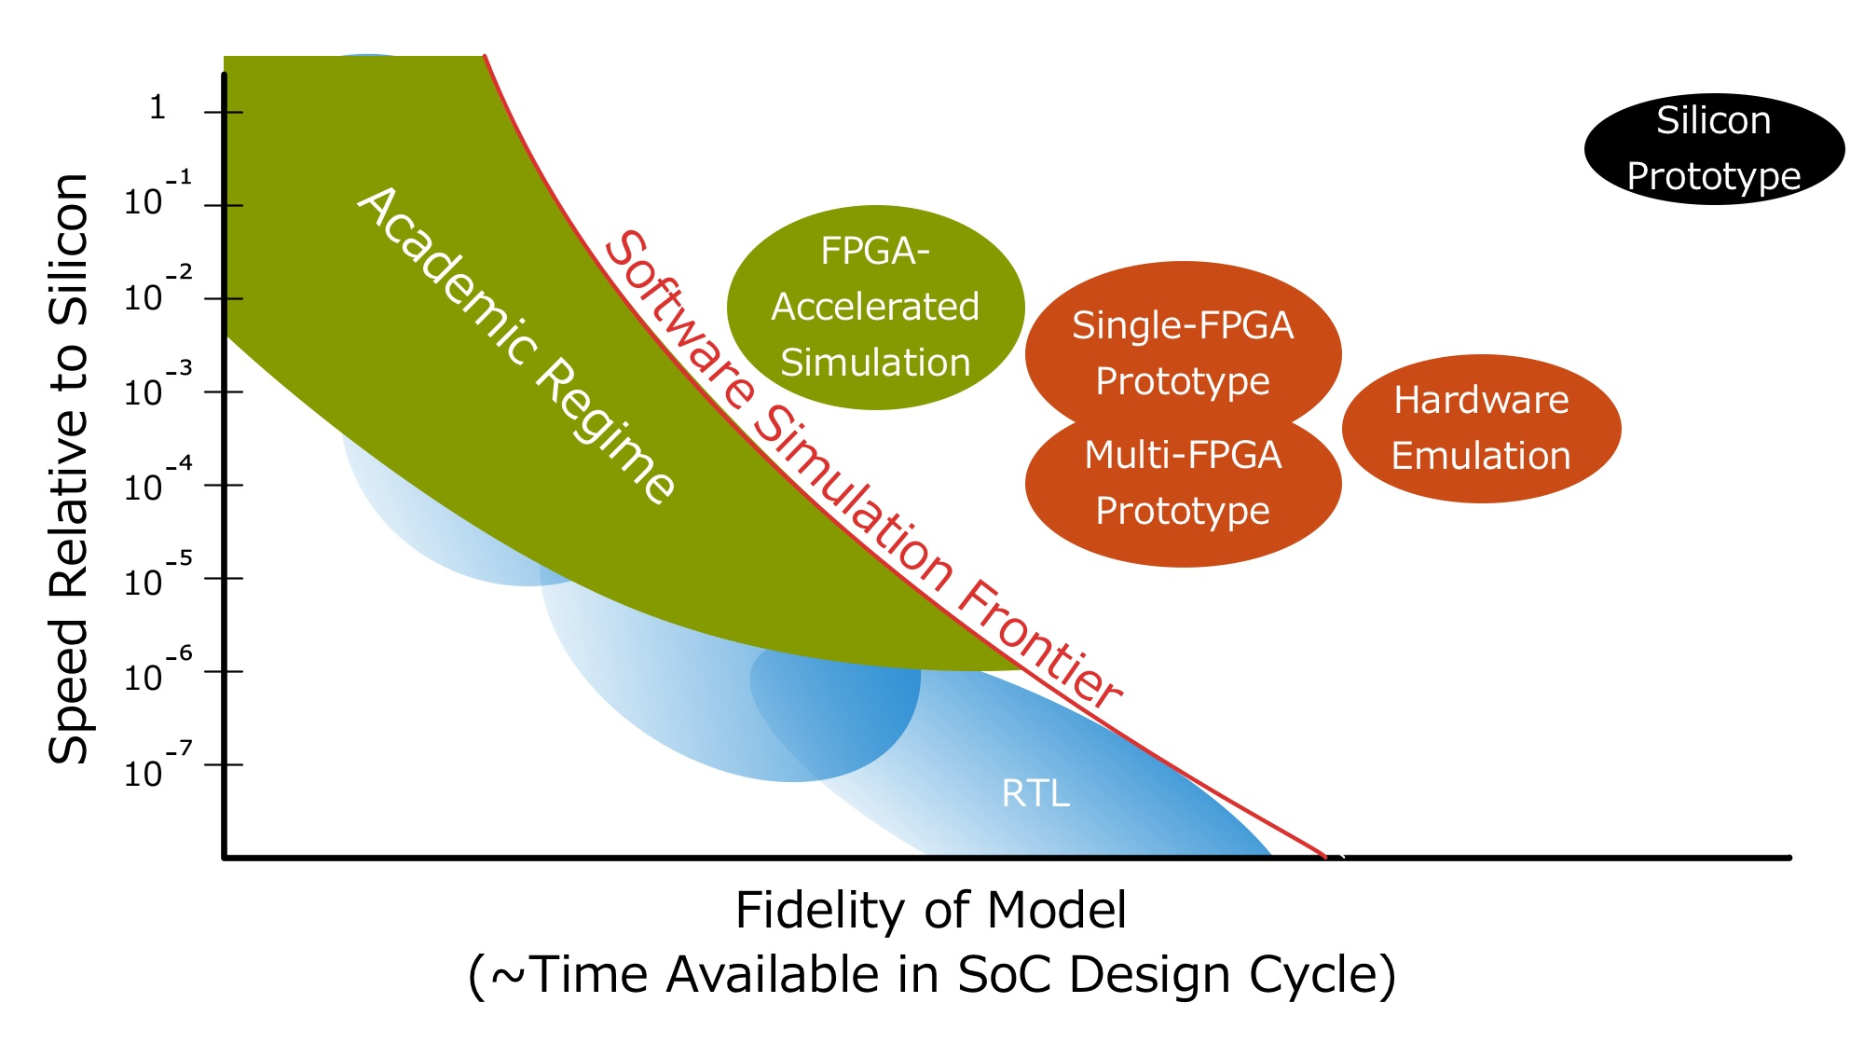


Slide 5
FPGA-Accelerated Simulation
vs.
FPGA Prototyping
We’re not just synthesizing a design into LUTs.

Slide 6
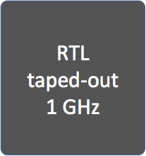

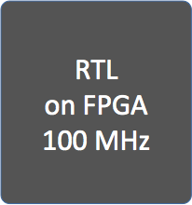

Some Limitations of Conventional FPGA Prototypes
Non-determinism & I/O modeling challenges: I/O, DRAM timing models dependent on variable, host-FPGA DRAM & I/O timing
100 cycles
10 cycles!
Resource limited: Need multiple FPGAs to prototype non-trivial systems
Usability: Difficult to build, modify, debug
Notes:
Show number of cycles to clarify timing mismatch

Slide 7
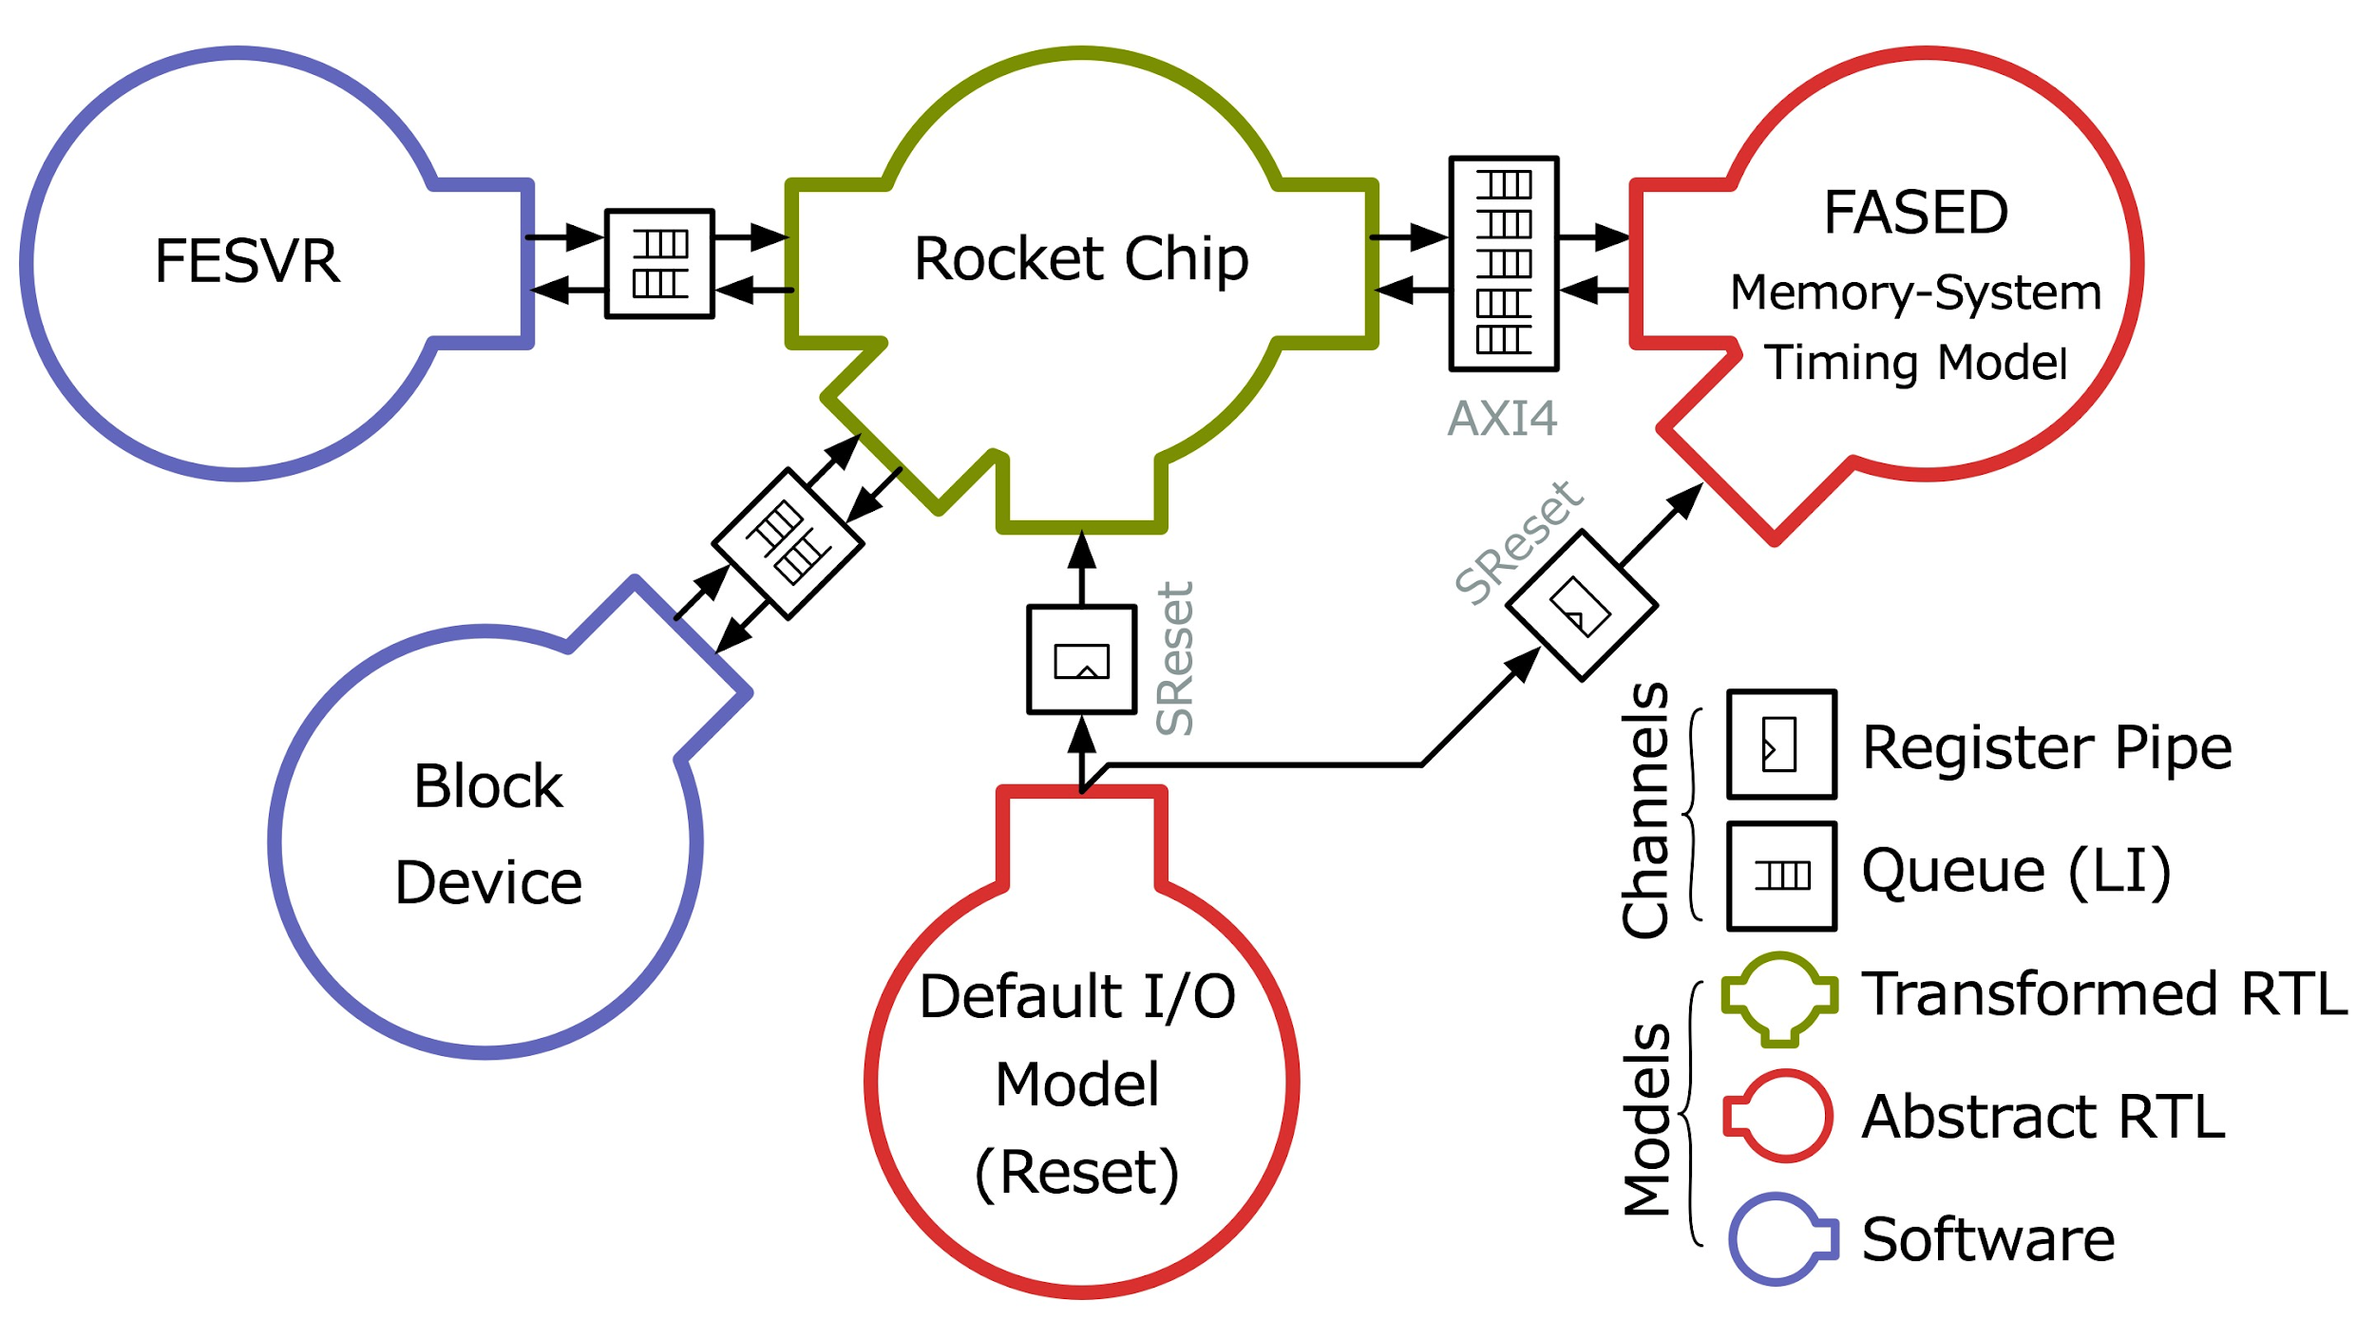
Discrete-Event Simulation using FPGAs (RAMP)
Separate target from host
Represent target as a dataflow graph. Closed system.
3 constituents:
  Models
  Channels
  Tokens
Decoupled RTL models can be abstract, highly optimized for FPGA

Slide 8
How Is FireSim Different from RAMP?
1. Don’t hand-write abstract FPGA-hosted models.
Generate bit-exact models from RTL that would be taped out
Write target-RTL as generators (in Chisel)
Apply host-decoupling as compiler transformation
2. Don’t build custom FPGA host-platforms, use someone else’s!
Technology Changes:
Availability of open IP: Rocket-Chip, BOOM, etc...
FPGAs in the cloud (AWS F1, Catapult)
Continued FPGA capacity scaling
Notes:
Table: RAMP vs. MIDAS
MIDAS is the core technology to simulate RTL in FireSim

Slide 9
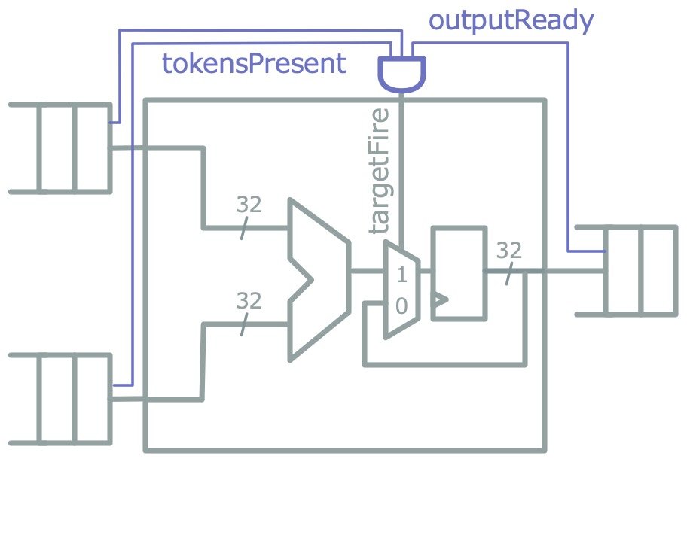
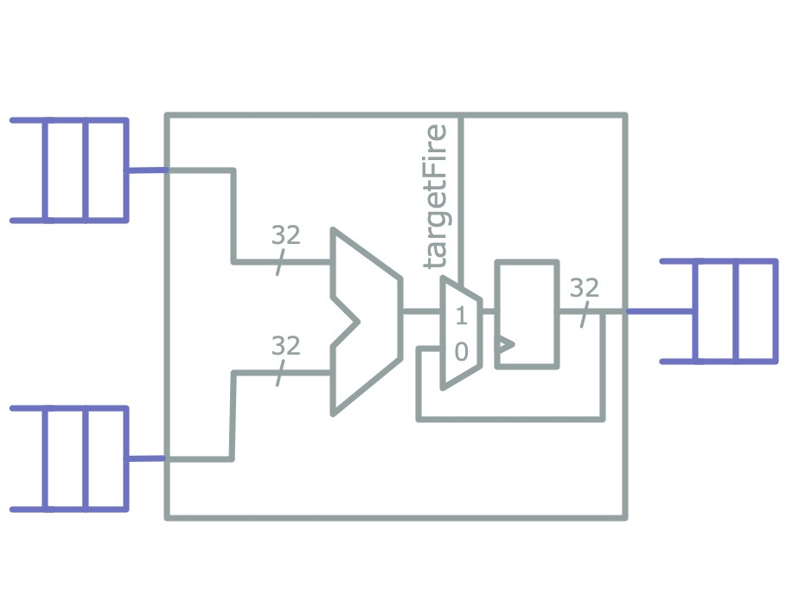
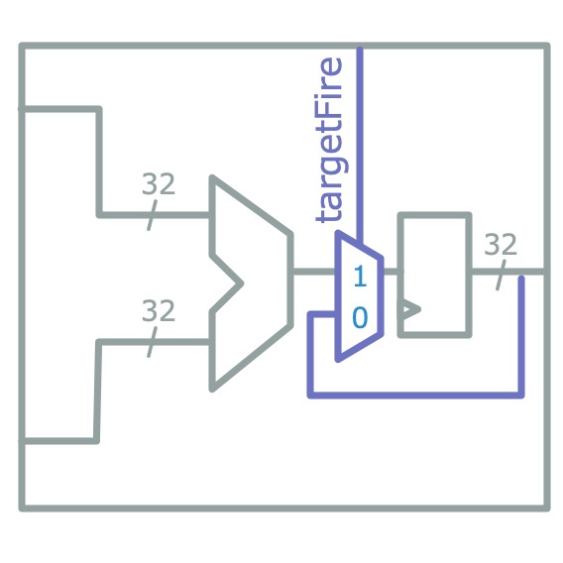
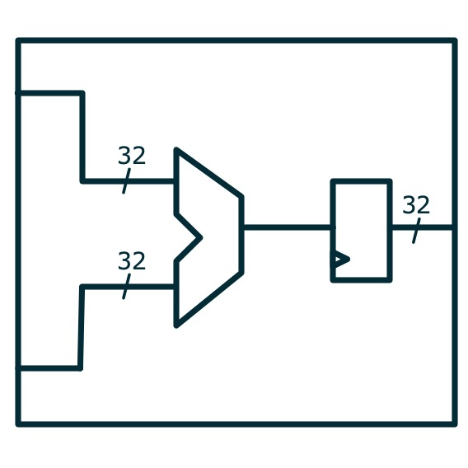
Host-Decoupling (FAME1) Transform on FIRRTL
Luca Carloni et. al, Theory of Latency Insensitive Design

Slide 10
Part 2: FASED – Modeling Memory Systems in FireSim

Slide 11
Outer-Memory Systems are Difficult to Model
Can’t model in fabric; too much state
Can’t model in software; too low latency (10s of ns)
→ Need an FPGA-hosted model that reuses host-FPGA DRAM
How about transforming source-RTL?
Difficult to spoof different memory standards at the PHY boundary
Relatively small CAS latency
How about large last-level caches?
→ Model timing at controller interface (AXI4)
Notes:
1m

Slide 13
Anatomy of a FASED Instance
Split timing and functional model¹
Timing-models written as target-time RTL
Functional model appears as single-cycle CAM
Reuse FAME transform to apply host-decoupling
Configuration port bound to memory-mapped registers for runtime reconfiguration
¹Joel Emer et al, ASIM: A Performance Model Framework

Slide 14
Example Execution:
Single-Cycle Memory System
Cycle Counts
Target: 0
Host: 0
V
V
Legend
V
Token w/ Transaction
Token w/o Transaction
H
Host Transaction

Slide 15
Example Execution:
Single-Cycle Memory System
Cycle Counts
Target: 1
Host: 1
H
Cycle Counts
Target: 1*
Host: 1 → 2
V
STALL
Legend
V
Token w/ Transaction
V
Token w/o Transaction
Miss!
H
Host Transaction

Slide 16
Example Execution:
Single-Cycle Memory System
Cycle Counts
Target: 1
Host: 42
Cycle Counts
Target: 1*
Host: 42 → 43
STALL
Legend
V
Token w/ Transaction
V
Token w/o Transaction
Miss!
H
H
Host Transaction

Slide 17
Example Execution:
Single-Cycle Memory System
Cycle Counts
Target: 1 → 2
Host: 43 → 44
Cycle Counts
Target: 1
Host: 43
Legend
V
Token w/ Transaction
V
Token w/o Transaction
H
Hit!
V
H
Host Transaction

Slide 18
Target Latency > Host Latency
→ Few or No Stalls
Good simulation performance modeling DRAM.
Notes:
10s

Slide 19
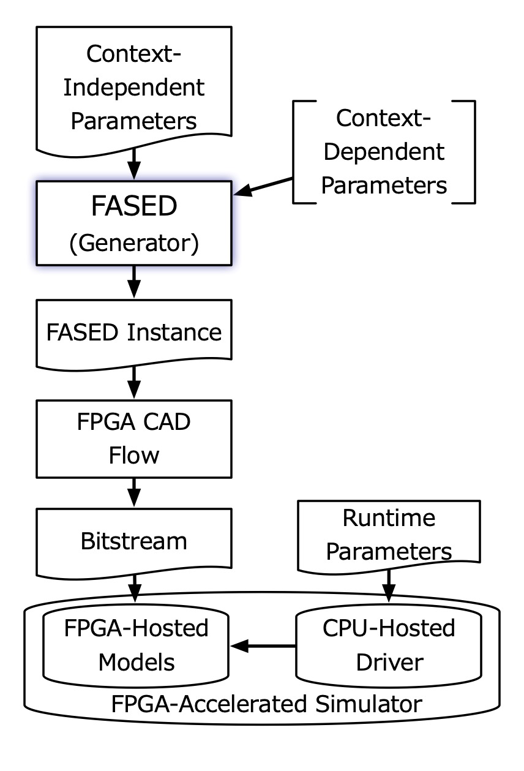
Two-Phase Configuration
A model is configured over two phases:
At generation time, a particular hardware instance is generated
An instance can model a space of different memory systems.
At runtime, the instance is programmed with final timing parameters
A point in that space is picked at runtime.

Slide 20
Timing Models
Notes:
10s

Slide 21
DDR3 Timing Models
FASED has two types of DRAM timing models:
First come, first served (FCFS)
First-ready FCFS¹
Shared run-time configuration parameters:
memory organization
address assignment
page policy
DRAM timings
Model fidelity comparable to DRAMSim2 (just missing power down modes)
¹Scott Rixner et al. Memory Access Scheduling
Notes:
1m

Slide 22
Composable Last-Level Cache Model
DRAM-side, writeback cache
models only tags, not data
runtime configurable settings:
  block size
  # sets, ways
  # of MSHRs
Composable with any DRAM timing model
writeback and refill traffic accurately modeled

Slide 23
Validation
For LLC and generic timing models:
Wrote golden models
Used synthetic stimulus generators
Ran core-side validation tests¹
For DDR3 models:
In RTL simulation, emit DRAM command trace
Pass DRAM command trace to Micron DDR3 model
Same approach used by all academic SW cycle-accurate DRAM simulators.
¹CCBench, https://github.com/ucb-bar/ccbench
Notes:
1m

Slide 24
Adding New Timing Models
Easy to add a new timing model. Need:
Target-side: AXI-4 port & reset
Functional model request-response port
Configuration & instrumentation port
How?
Can write Chisel; extend an existing class
Can write Verilog or use HLS
  We’ll insert a clock-gating element in front
Use an existing DRAM controller
  With some modification to speak to functional model

Slide 25
Other Compelling Features
Notes:
10s

Slide 26
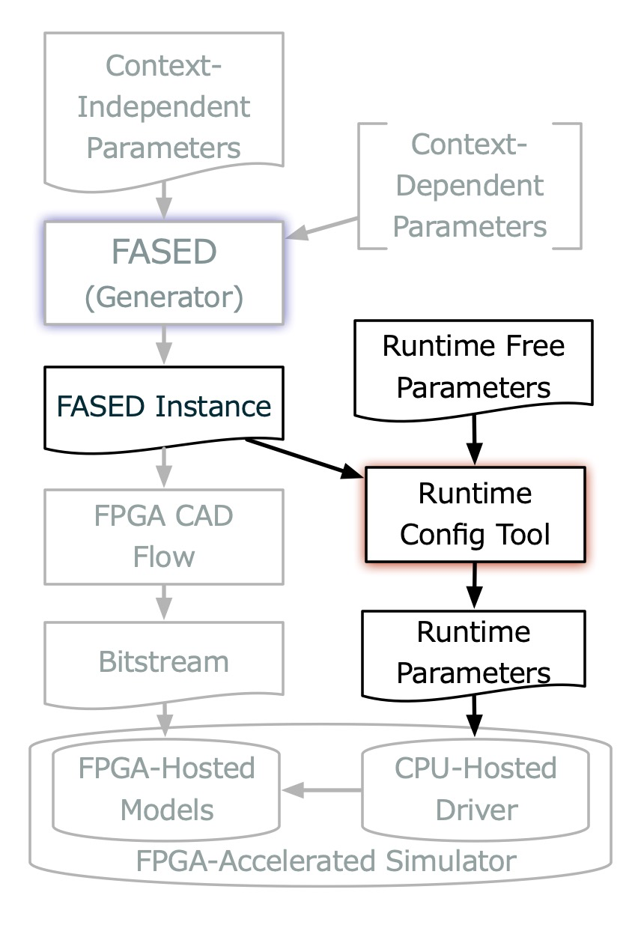
Legalizing Runtime Configurations
Timing model runtime parameters are low-level, easy to mess up
DDR3-2133
Quad rank
Stripe cachelines
Don’t want to provide many configs
Don’t want to look up datasheets
tCAS = 14
tRFC = 260
tFAW = 25

Slide 27
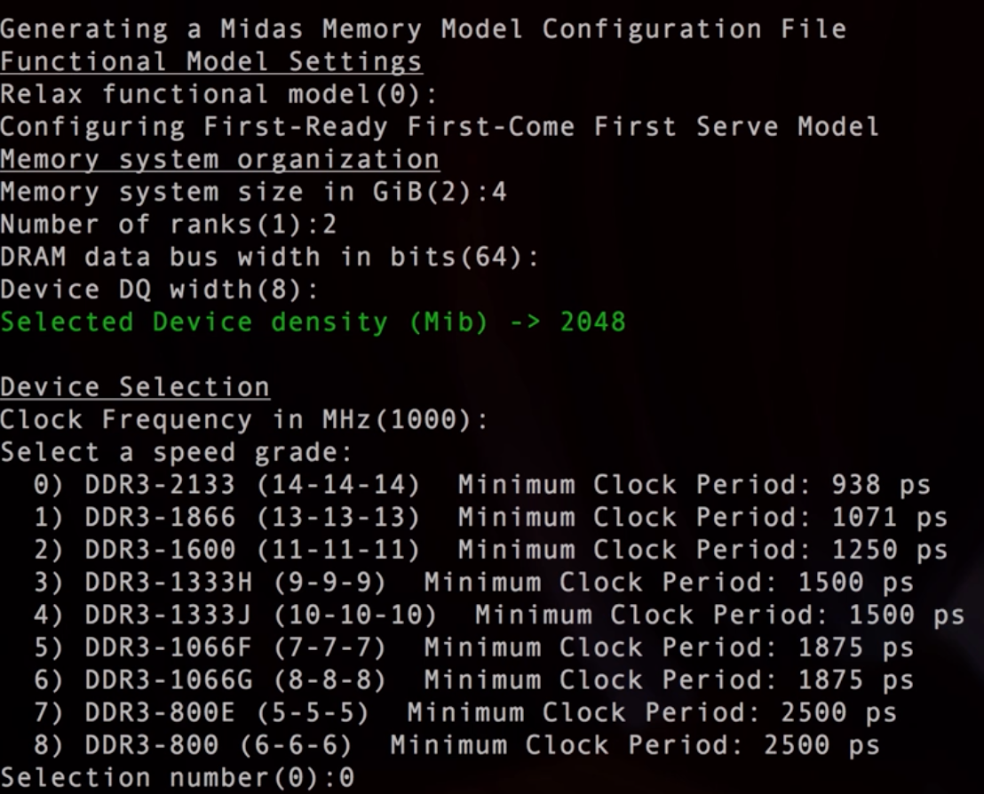

Slide 28
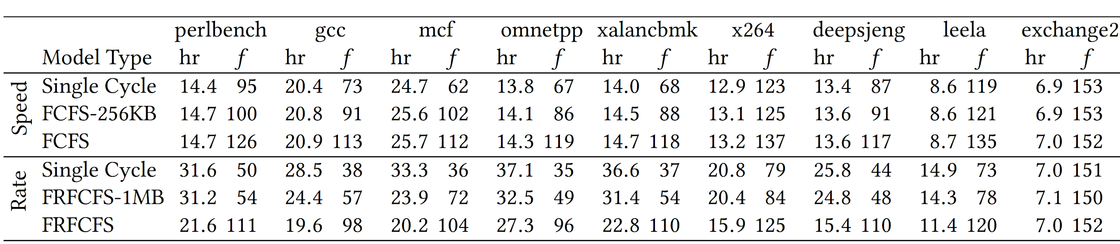
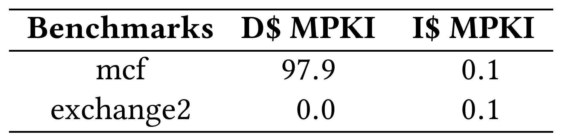
Simulator Performance
FASED instances are fast!
Can run at the FPGA host frequency
Only need to stall when when host-DRAM latency > desired target latency
From SPEC2017 intspeed w/ reference inputs, Rocket, RV64GC, 16 KiB L1 I & D$
V9UP, 160 MHz host frequency

Slide 29
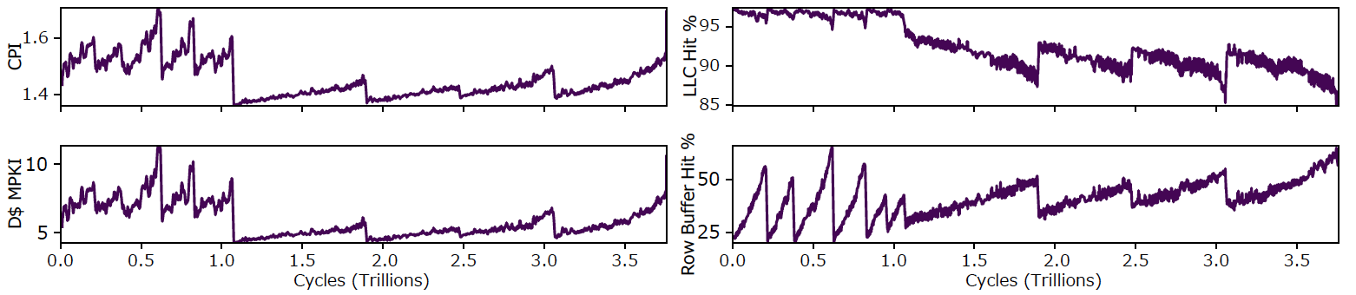
Non-Invasive Instrumentation
Timing models expose rich instrumentation ports
Automatically bound to memory map
Can be polled without perturbing simulation behavior
SPEC2017 Intspeed - Leela. Single-core Rocket. FASED: DDR3-2133 QR, FCFS + 256 KiB LLC

Slide 30
Conclusion
FASED fills an important hole in how we model memory systems in FPGA-accelerated simulators.
Instances are fast (>100 MHz)
Detailed, comparable to DRAMSim2
Highly reconfigurable
Check out FireSim as a platform for evaluating your next custom-hardware / accelerator project.
Notes:
1m

Slide 31
Questions?
FireSim’s GitHub: https://github.com/firesim/firesim
FireSim’s Webpage: https://fires.im/
FireSim’s Doc: https://docs.fires.im/
Acknowledgements:
The information, data, or work presented herein was funded in part by the Advanced Research Projects Agency-Energy (ARPA-E), U.S. Department of Energy, under Award Number DE-AR0000849. Research was partially funded by ADEPT Lab industrial sponsor Intel, and ADEPT Lab affiliates Google, Huawei, Siemens, SK Hynix, and Seagate. The views and opinions of authors expressed herein do not necessarily state or reflect those of the United States Government or any agency thereof.

Slide 32
Old/Backup Slides

Slide 33
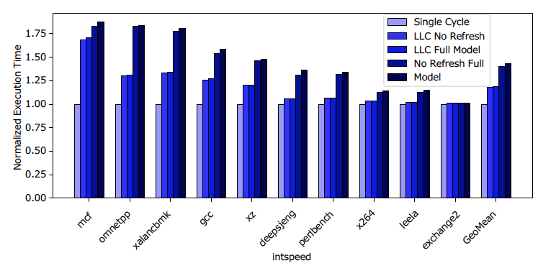
Sweeping Model Fidelity under SPEC2017 intspeed

Slide 34
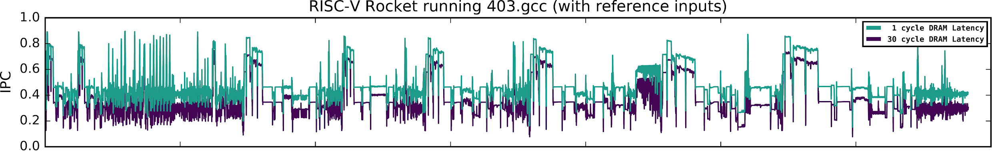
Modeling Ideal Memory Systems
MIDAS can model single-cycle memory systems
Target executes fewer cycles
Every target-memory request stalls target-time
Rocket RV64GC, 16 KiB L1 I$ & D$, 4-way, 64B-line. No L2.
Notes:
20s

Slide 35
So Just How Fast Is It vs Software?
Simulator | Random - Rate (MHz) | Strided - Rate (MHz)
Ramulator | 0.87 | 1.65
DRAMsim2 | 0.32 | 0.47
USIMM | 0.35 | 0.55
This Work | 150 MHz | 150 MHz
Simulator | Random - Rate (MHz) | Strided - Rate (MHz)
Ramulator | 0.87 | 1.65
DRAMsim2 | 0.32 | 0.47
USIMM | 0.35 | 0.55
Timing models
only.
100x faster than DRAMsim2
DDR3-1600, Single Rank, 11-11-11, row-interleaved, FR-FCFS, open-row policy, 100M requests, 9:1 R:W ratio (Source: Ramulator, 2015)
Notes:
20s

Slide 36
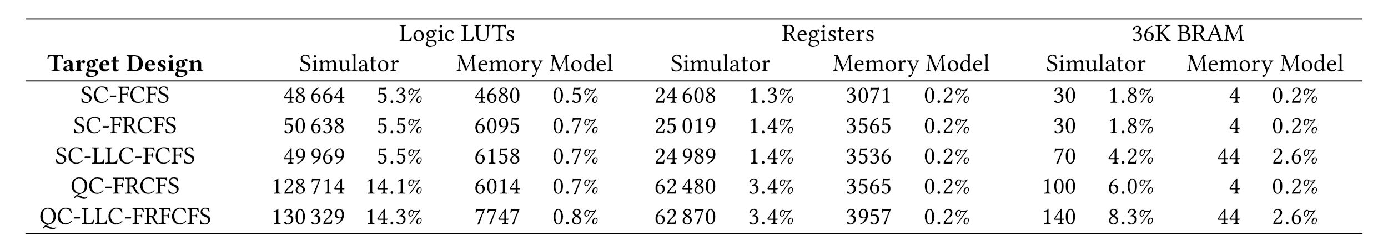
Simulator vs FASED Instance Resource Utilization

Slide 37
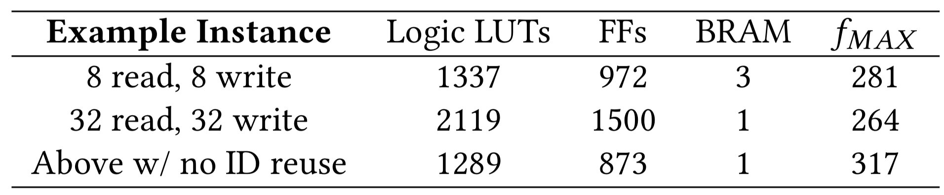
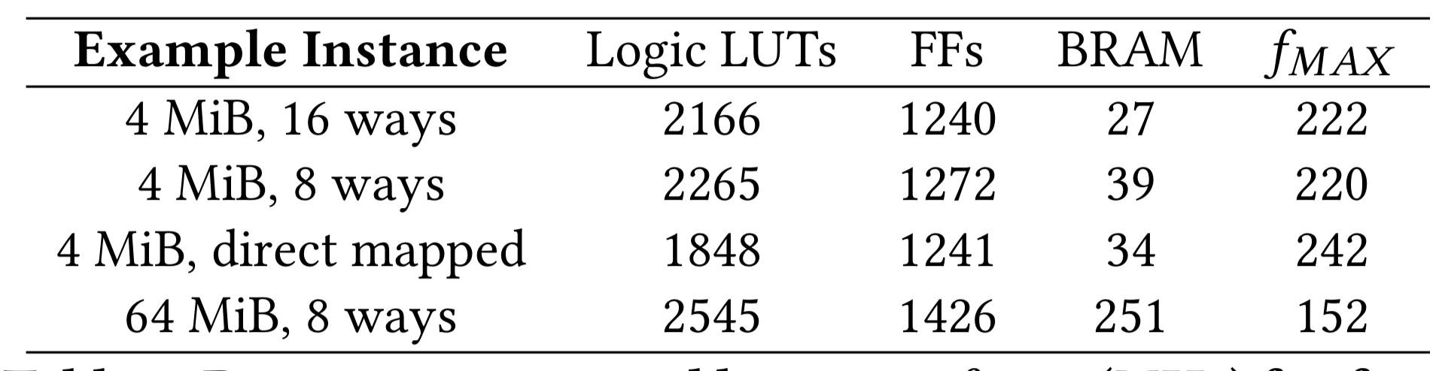
Resource Utilization & Fmax by Timing Model Class
Latency Bandwidth Pipes
LLC + LBP Instances

Slide 38
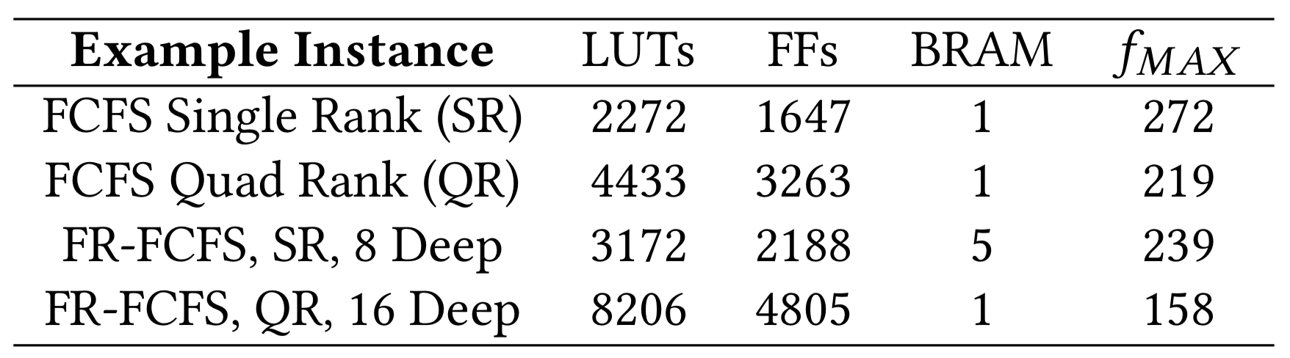
DRAM Model Utilizations

Slide 39
Generic Timing Model Classes
Don’t model DRAM specifically.
Latency-bandwidth pipe
  programmable read, write latencies
  programmable number of outstanding read and write requests
  bandwidth bound via Little’s Law
Bank-conflict model
  latency = base + max(0, tCP − t∆),
  where, tCP = conflict penalty, t∆ = time since last bank request
  programmable bank address assignment
Notes:
1m

Slide 40
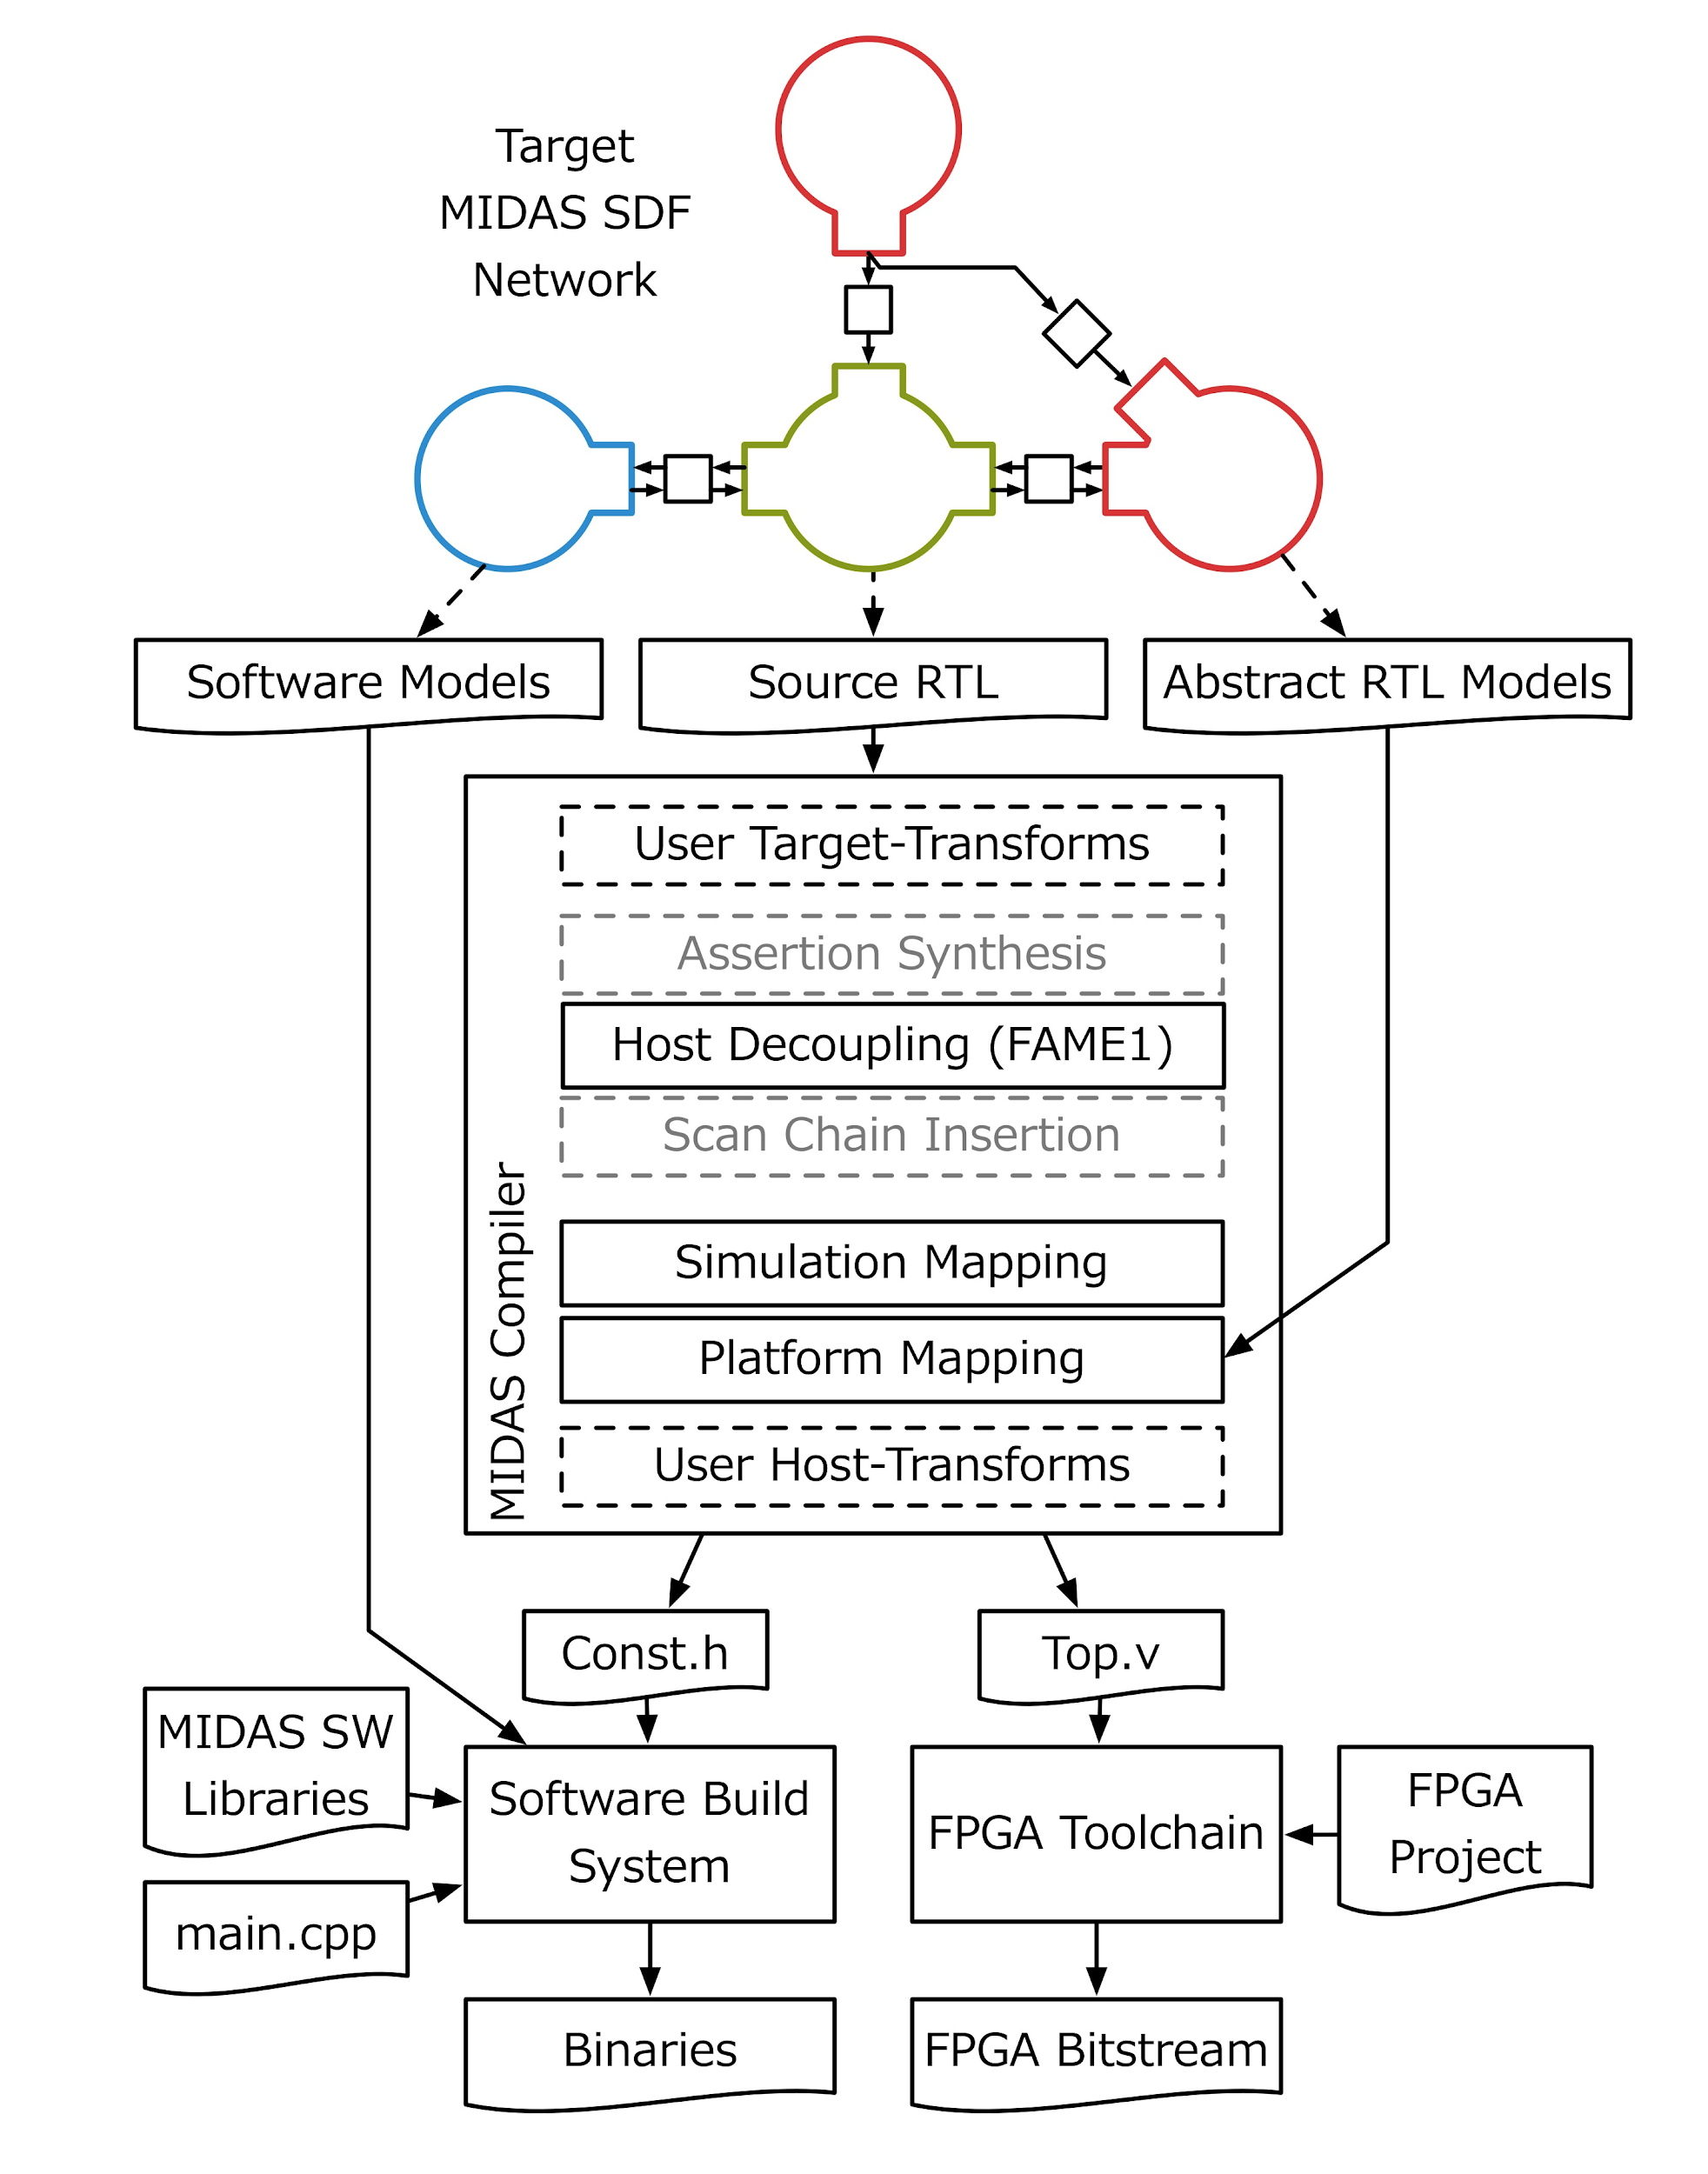
MIDAS 1.0 Flow
Inputs:
FIRRTL to be transformed
MIDAS configuration
Instrument target to improve debuggability
Convert source RTL into an FPGA-hostable model
Generate abstract RTL models, bind components to FPGA-host resources
Generate a wrapper module with simulation (token) channels.
Define a master, link in SW models
Compile verilog into a static FPGA-host shim
Notes:
Example: 32 bit unsigned integer adder, latency = 1

Slide 41
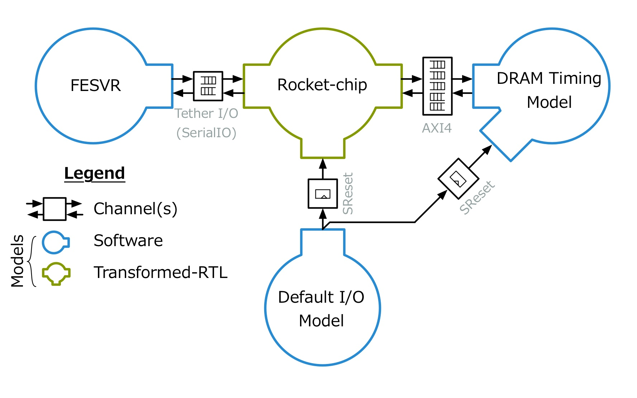
An Example Rocket Chip SoC Target
A channel modeling latency-insensitive interconnect
Assists the core during boot.
A channel modeling a pipelined wire
Notes:
Example: 32 bit unsigned integer adder, latency = 1

Slide 42
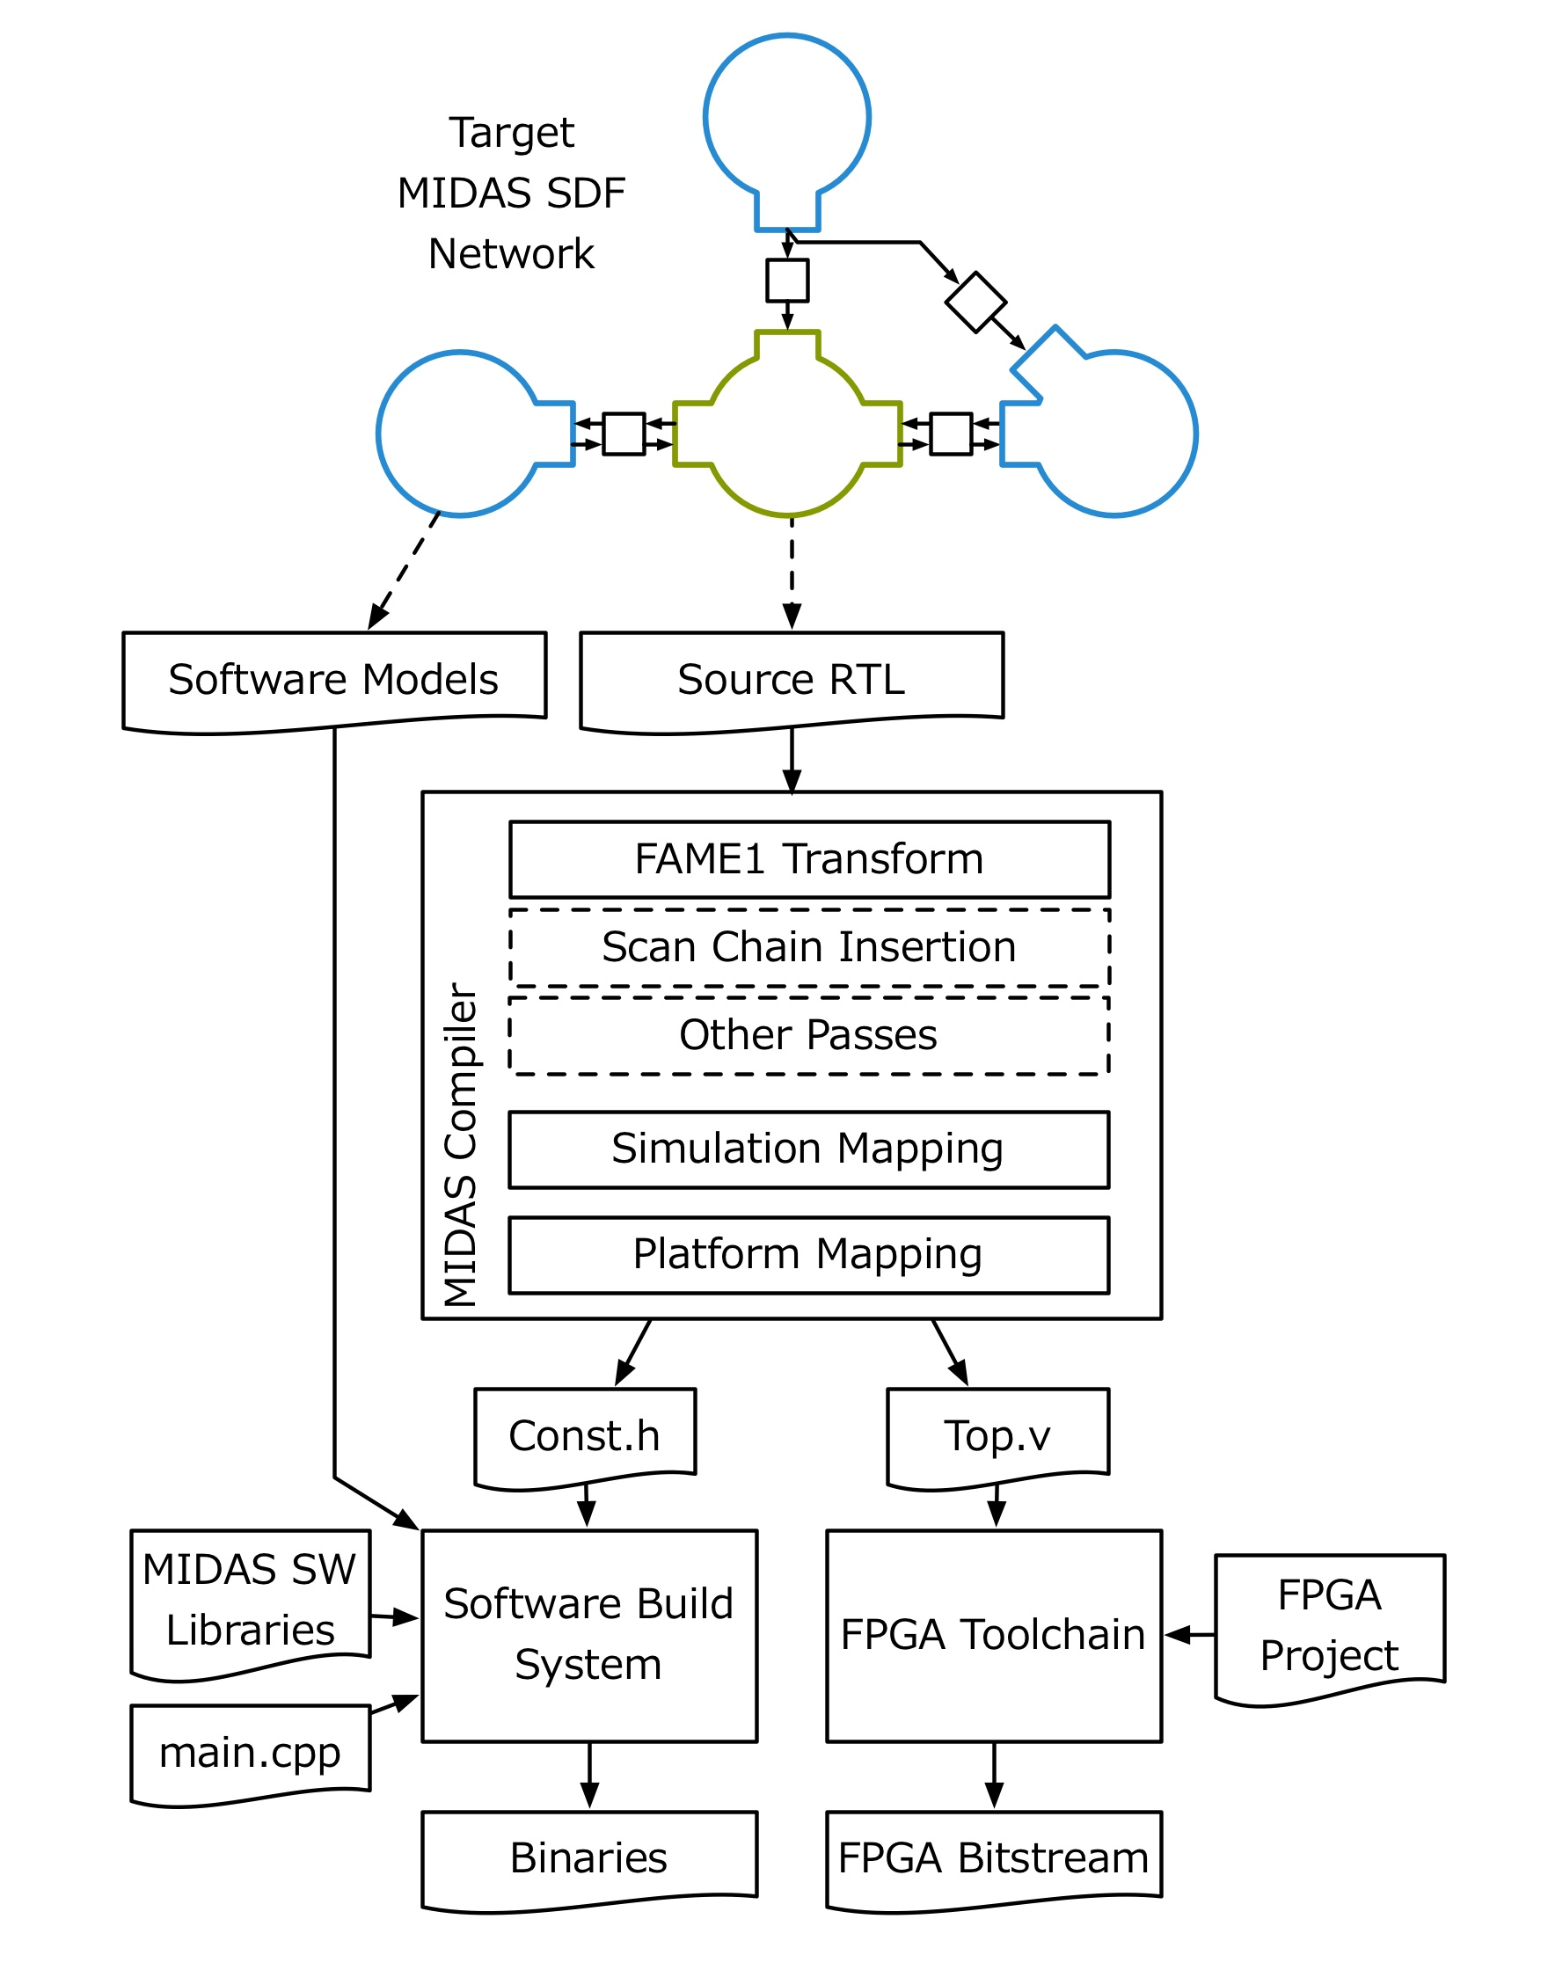
The MIDAS Flow
Convert source RTL into an FPGA-hostable model
Instrument models to improve debuggability and support Strober energy modeling
Stitch together FPGA-hosted models, implement channels, generate simulation interconnect
Connect simulation components to FPGA-host resources (DRAM, off-chip communication)
Compile verilog into a static FPGA-host shim
Define a master, link in SW models
Notes:
Example: 32 bit unsigned integer adder, latency = 1

Slide 43
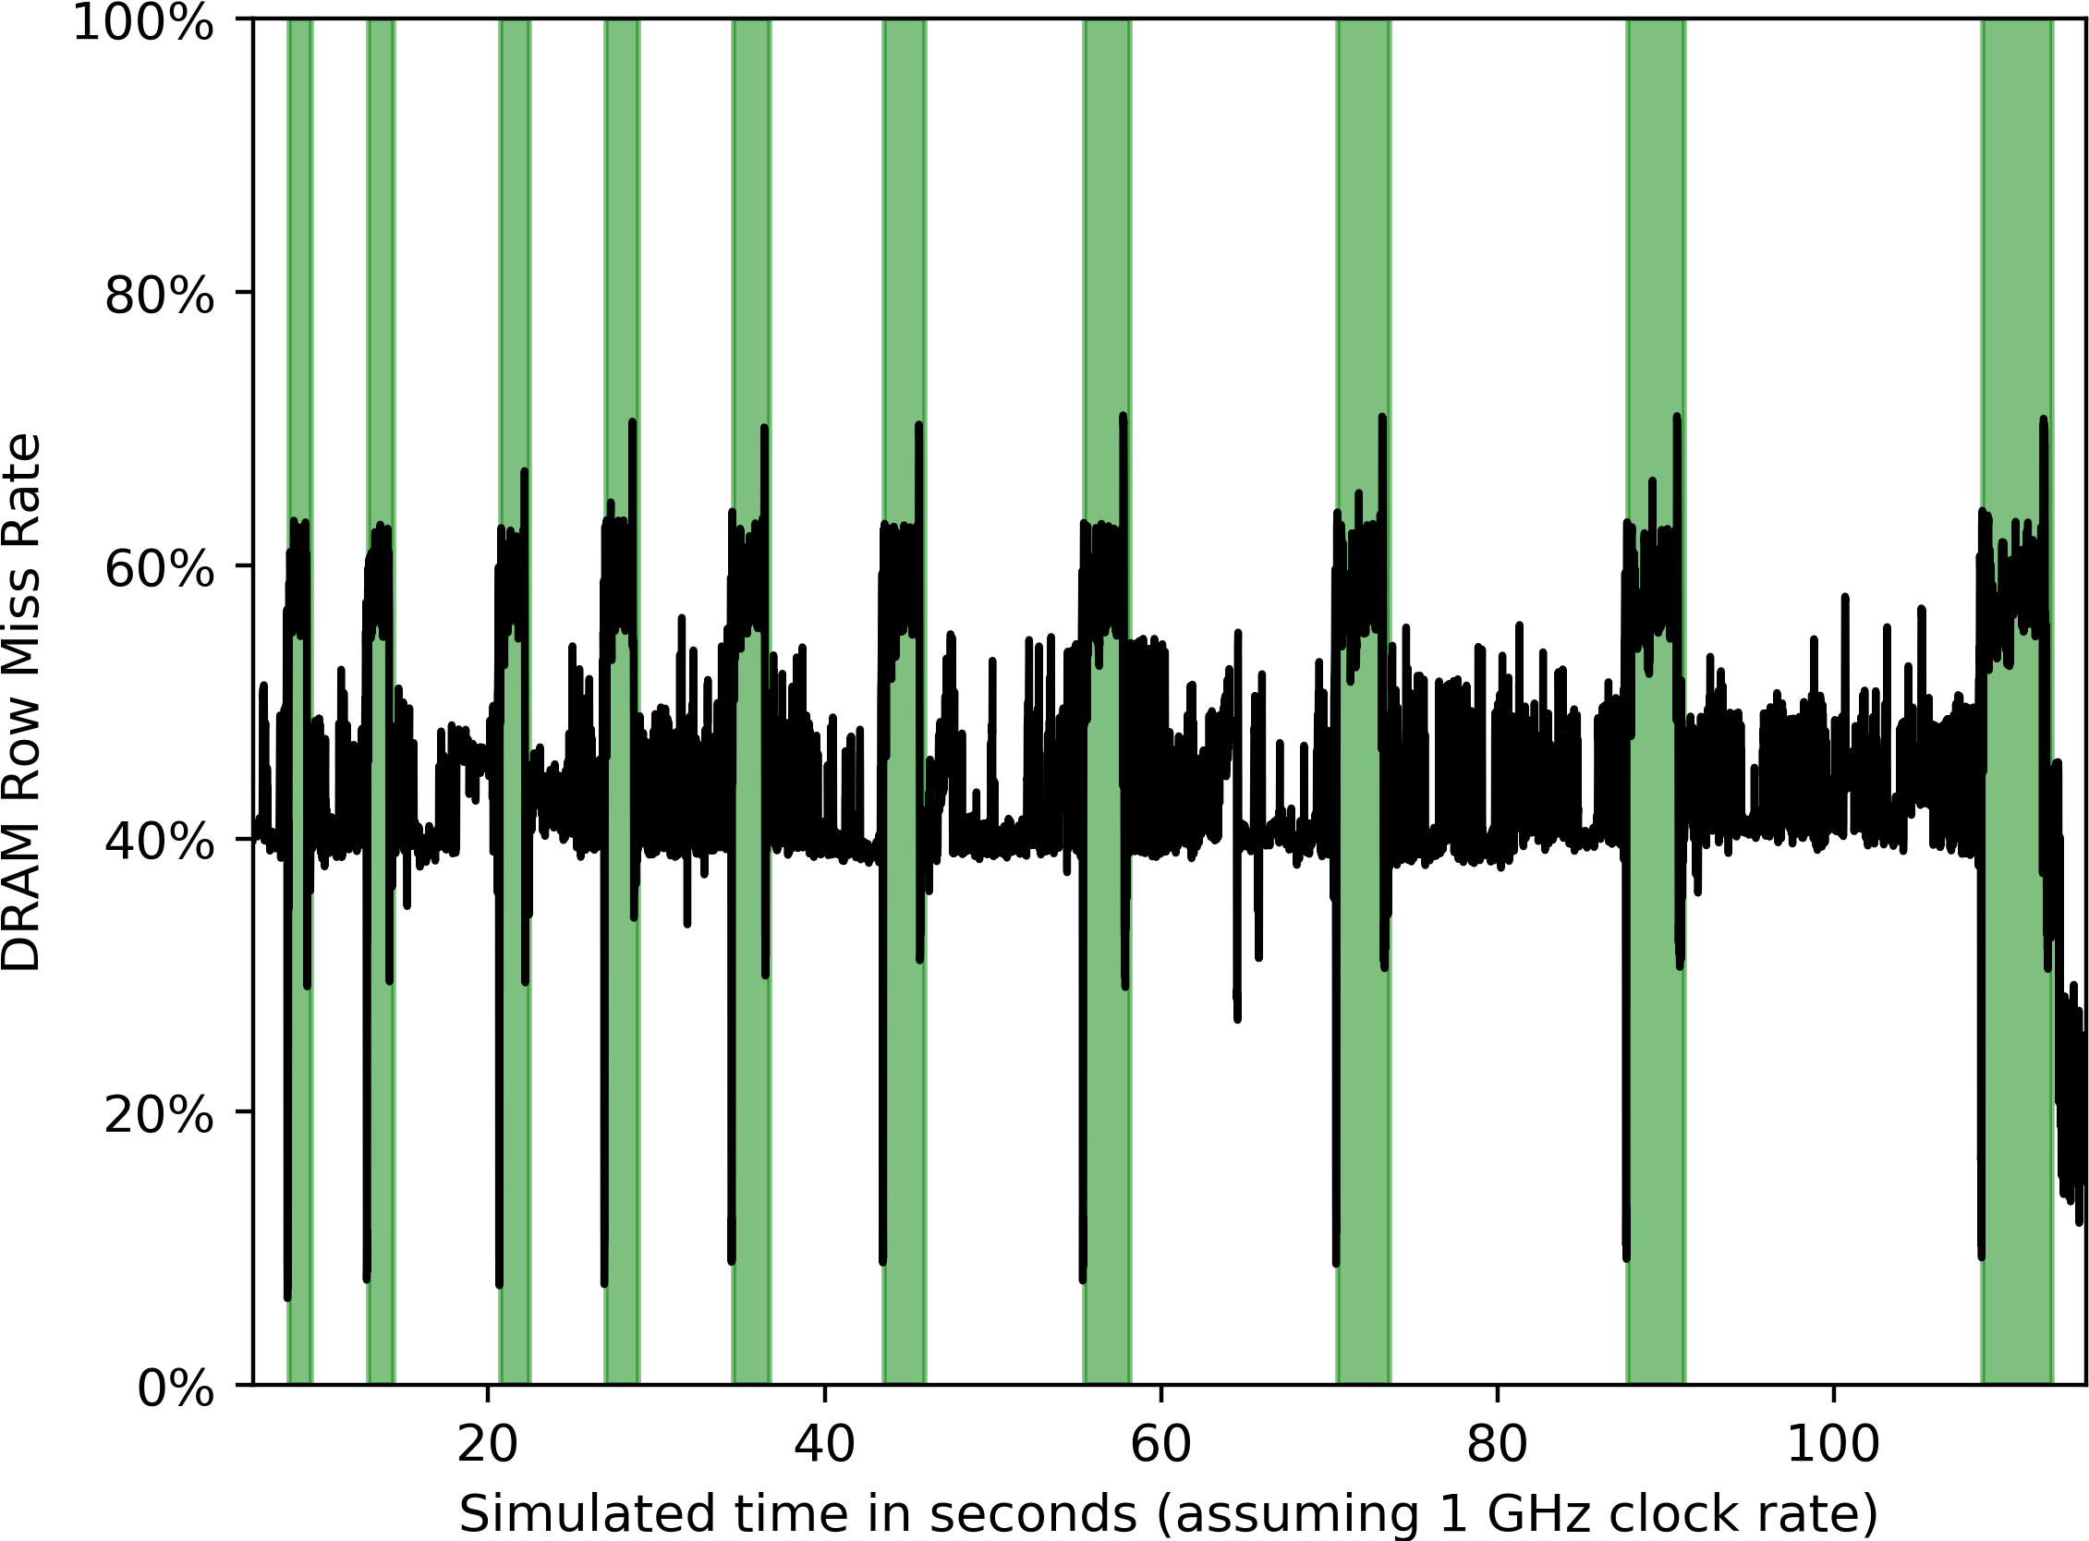
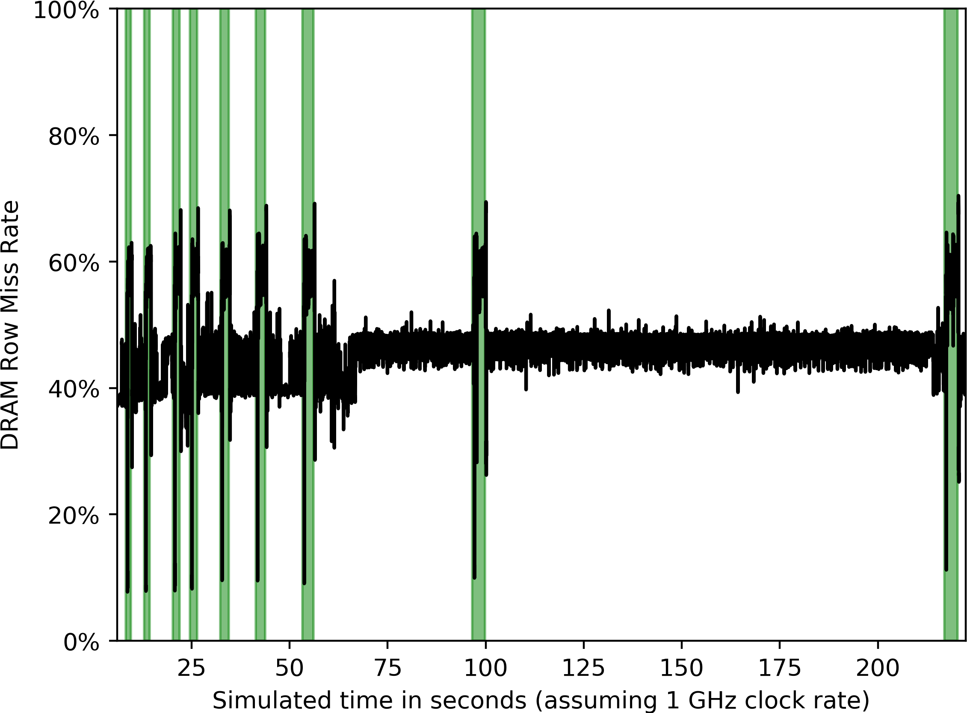
Non-invasive collection of memory system statistics
Dacapo - pmd
Dacapo - avrora
Garbage Collection Events
Notes:
20 sec

Slide 44
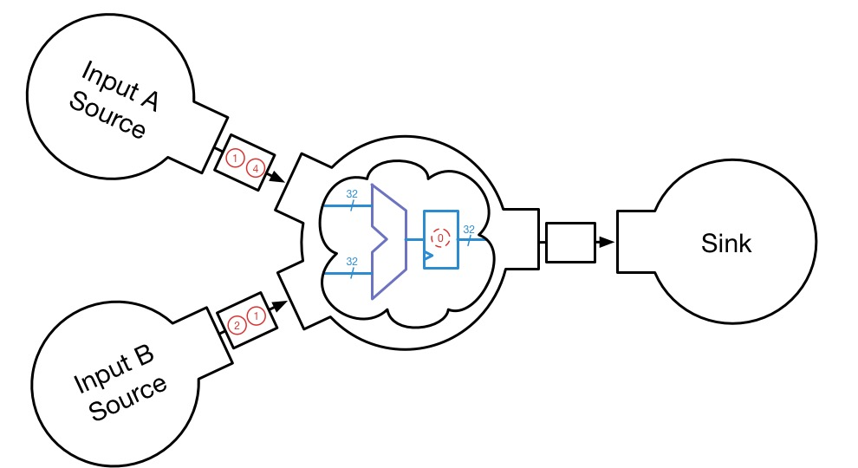
MIDAS Target-level Abstractions
Specify the target and its environment as a synchronous dataflow network:
Example: 32 bit unsigned adder, latency = 1
Notes:
A target is composed of:
Models, Channels, that act on Tokens.
Example: 32 bit unsigned integer adder, latency = 1

Slide 45
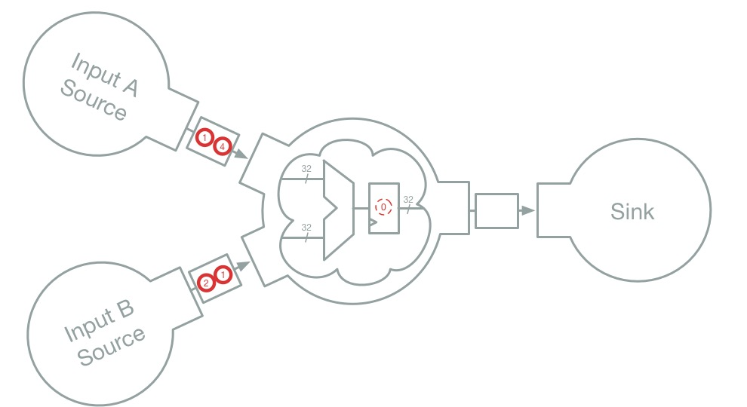
MIDAS Target-level Abstractions - Tokens
Primitive unit of data: Type = Chisel type of interface. One token = one target cycle
Notes:
Tokens represent the values on the wires of a target interface once they have settled for that clock cycle.

Slide 46
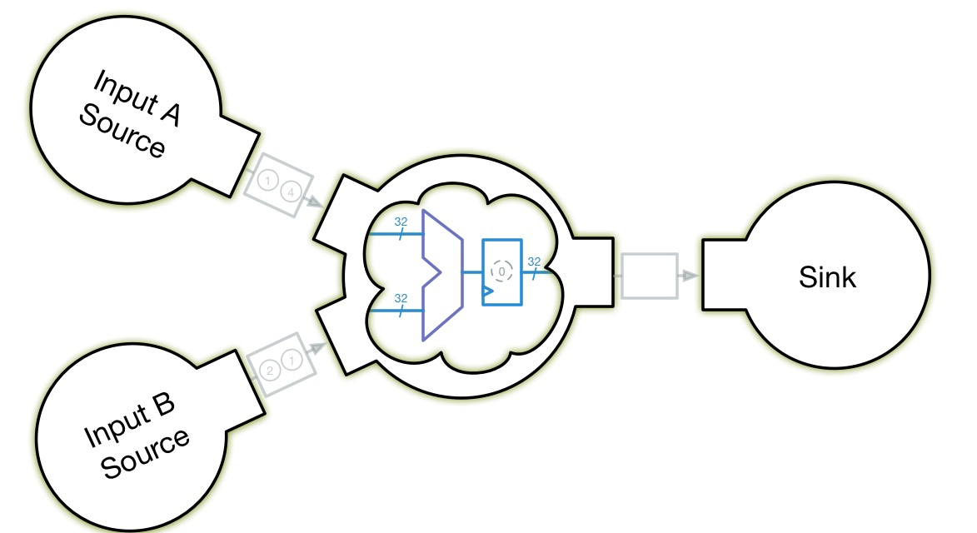
MIDAS Target-level Abstractions - Models
Workhorses of the simulation: consume input tokens => mutate state, create output tokens.
Notes:
Bound to a single clock domain

Slide 47
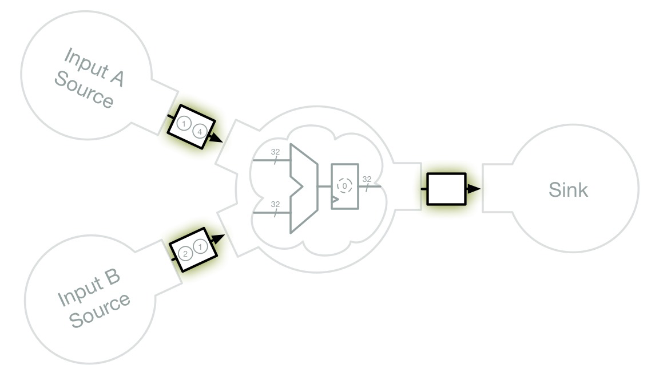
MIDAS Target-level Abstractions - Channels
Transport tokens between models. Cross clock domains & model target channel timing
Notes:
Present boundaries along which partition design over host
Notes:
Example: 32 bit unsigned integer adder, latency = 1

Slide 48
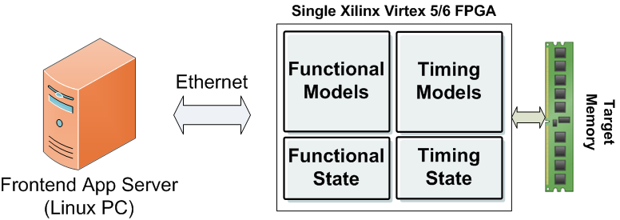
RAMP Gold (ISCA’10, DAC’10)
Accelerate multi-core simulation on FPGA
Features
  Target design: 64-core 32-bit SPARC V8
  FAME7 simulator: decoupled, abstract, multi-threaded
  Functional + timing models on FPGA
  36,000 lines of System Verilog + IPs
  Peak simulation rate: 100MHz / 64-core
  Host platform: Xilinx Virtex-5 board($750)
Notes:
mention that it’s not generated from RTL, custom

Slide 49
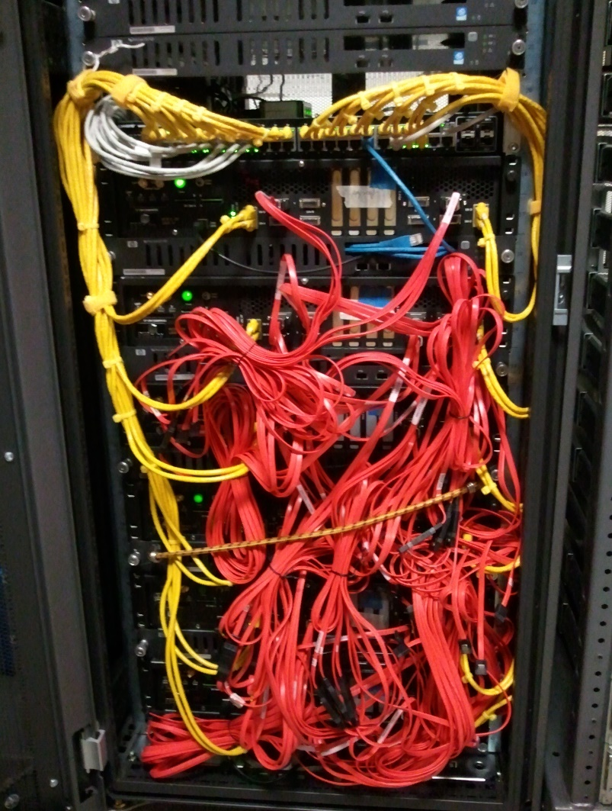
DIABLO: Datacenter-In-A-Box at LOw-cost
(ASPLOS ’15)
Build a “wind tunnel” for datacenter designs using FPGAs
1000x faster than software simulator
  Run in parallel at 1/1000th real time vs. 1/1,000,000th real time
6 BEE3 boards total 24 Xilinx Virtex5 FPGAs
  Full-custom FPGA implementation with many reliability features
  Memory: 384 GB (128 MB/node), peak bandwidth 180 GB/s
  Connected with SERDES @ 2.5 Gbps
  Active power: ~1.2 kWatt
Simulation capacity
  3,072 simulated servers in 96 simulated racks, 96 simulated switches
  8.4 Billion instructions / second

Slide 50
Why not DIABLO-2?
Target design
  ISA: SPARC
  What about RISC-V implementations(e.g. rocket-chip)?
Huge development effort
  Manual RTL implemention for core + switch models
  Who? Zhangxi graduated long time ago
Expensive custom multi-FPGA boards for large designs
  More host memory capacity to model more and larger servers
  Should we buy expensive boards for large scale simulation?

Slide 51
FireSim: New Generation Datacenter Simulator
Large-scale datacenter simulator with various HW & SW models
  Easy to replace processor, memory, storage, networking models through MIDAS APIs
  Hardware models: Automatically transformed via FIRRTL passes
  Software models: Flexibly plugged with handy APIs
Want FireSim to become the standard simulation framework for future datacenters
  Catapult at TACC open to industry and academics
  Plan to release FireSim VM Images
Goal: Starting FireSim Simulation Cluster on Catapult as easy as launching a Spark Cluster on EC2/Azure

Slide 52
Addressing the Lessons Learned from DIABLO
Target design
  Rocket-chip + BOOM
Reduce development effort
  Automatically generate FAME5 simulators from target RTL
  * FAME5: Decoupled + Multi-threaded
  * Same RTL for simulation and tapeout
  Automatically instantiate abstract RTL models with Chisel
  e.g. DRAM timing models
  Use software models whenever possible
  e.g. Network switch models
Low-cost host platform
  Rent servers with FPGAs in the cloud
  Chisel -> Altera FPGA flow

Slide 53
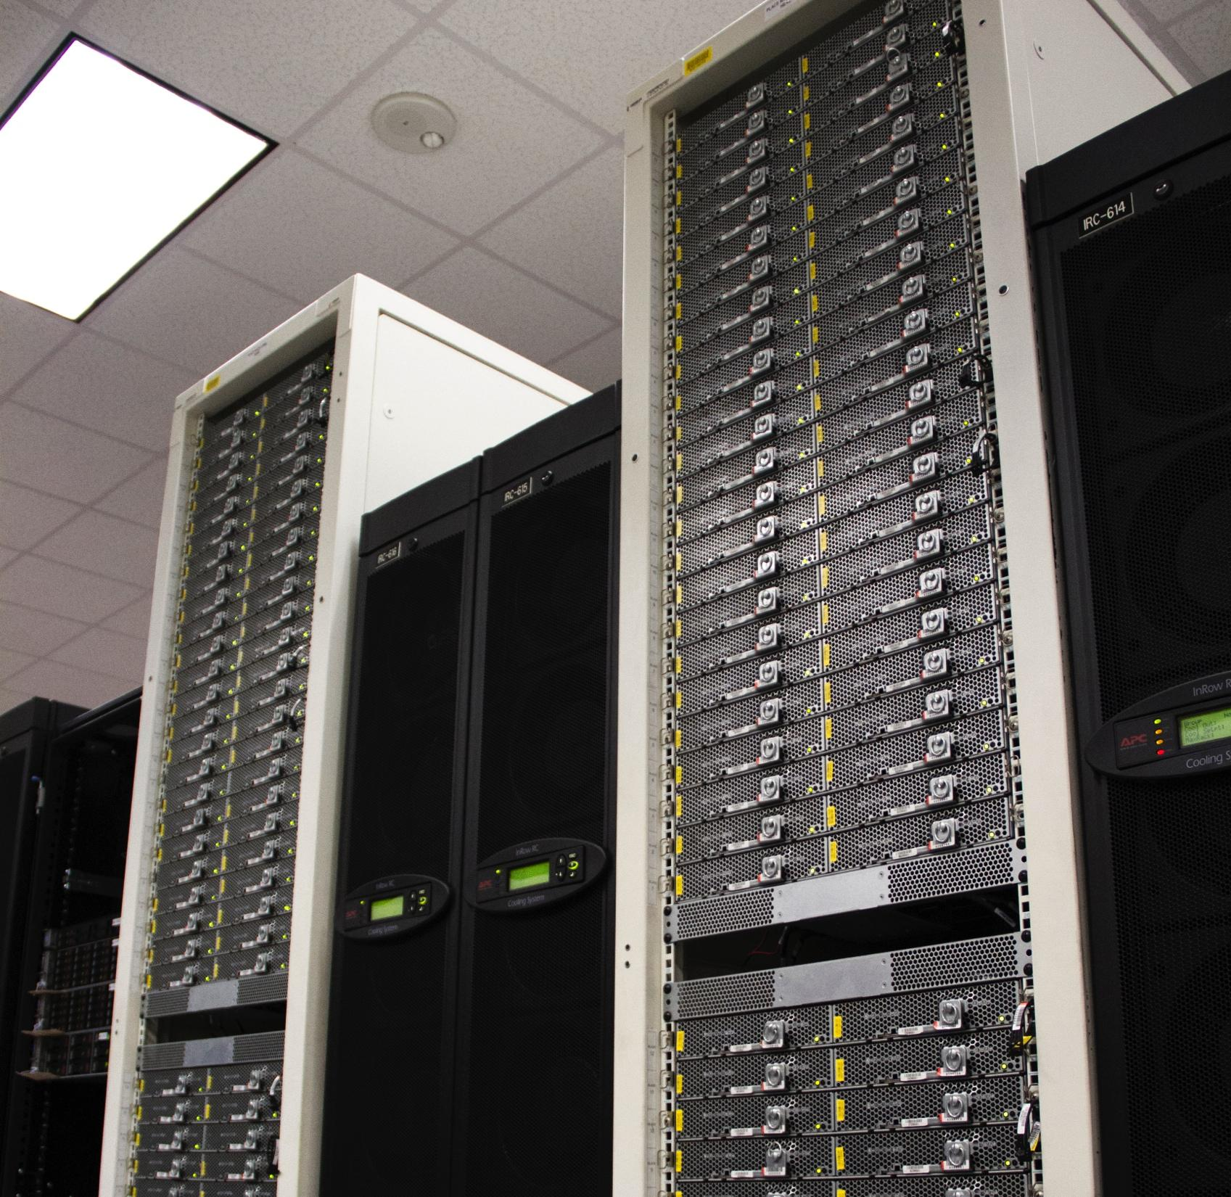
FireSim Host Platform: Catapult
Updated version of Microsoft Catapult system from ISCA 2014, deployed at TACC
Total of 432 Nodes, each with:
  2x 8-core Xeon @ 2.1 GHz
  64GB DRAM
  4x 2TB HDD, 2x 480GB SSDs
  Altera Stratix V FPGAs via PCIe Gen3 x8
  High-speed FPGA-to-FPGA serial interconnect within pods of 48 nodes
We have access to at least 96 Nodes
Catapult @ TACC
tacc.utexas.edu/systems/catapult

Slide 54
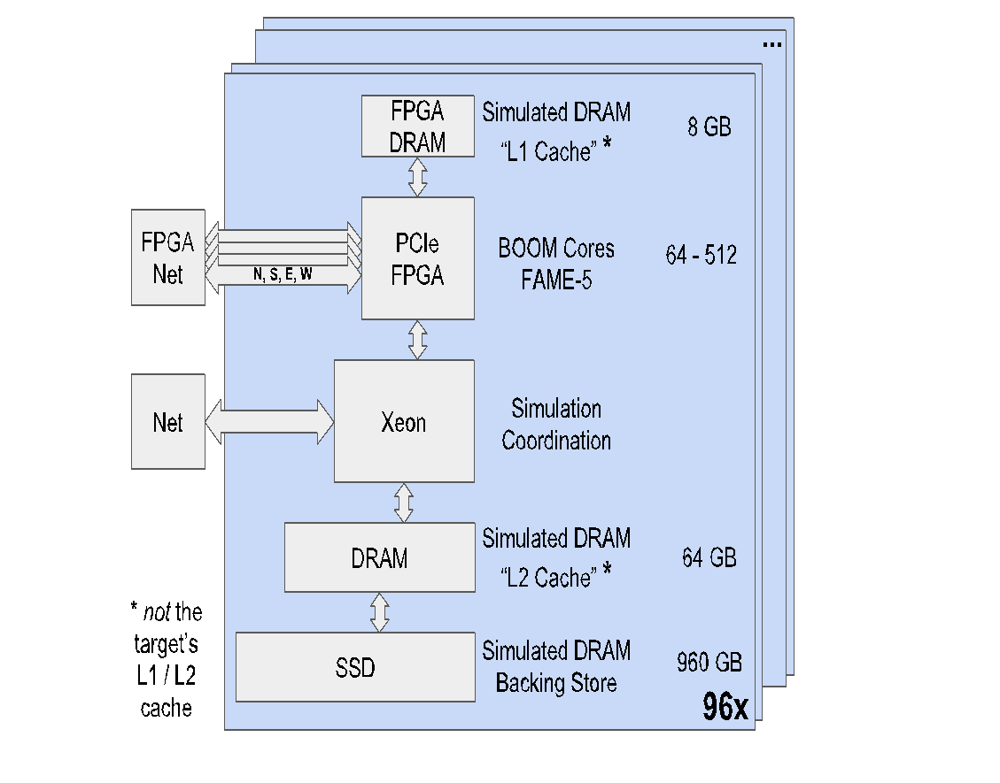
FireSim: Mapping FireBox to Catapult

Slide 55
FireSim Simulation Scale
Simulated Components | 96 Catapult Nodes | 432 Catapult Nodes
CPUs* | 6,144 - 49,152 | 27,648 - 221,184
Memory | 92,160 GB | 414,720 GB
Flash | 786,432 GB | 3,538,944 GB
*CPU count with 64 to 512 BOOM Cores / Catapult Node

Slide 56
FireSim Milestones
V0: One target CPU (rocket) per Catapult node, software-simulated network on Xeons using standard interconnect <- WIP
V1: Target CPUs multiplexed on FPGA for large simulated core counts
V2: Move parts of network models to FPGA:
  Develop photonic-optimized NIC, switch RTL
Tapeouts along the way that apply what we’ve learned with FireSim experiments
  Using the same RTL that plugs into simulation

Slide 57
FireSim Summary
MIDAS is a general simulation framework with HW & SW models hosted on various platforms
FireSim is our proposal for simulating FireBox in order to enable datacenter research and prototyping
Implementation | Flexibility | Accuracy | Efficiency | Scalability
µarch SW Simulator | ✔ | X | X | X
RTL Simulator | ✔ | ✔ | X | X
FAME Simulator | X | ✔ | ✔ | ✔
MIDAS/ FireSim Goal | ✔ | ✔ | ✔ | ✔

Slide 58
Ack/Resp
KV Store Server
KV Store Client
Put/Get
Catapult Node 0
Catapult Node 1
FPGA
FPGA
Rocket-Chip “1 GHz”
SimpleNIC “64 Gbps”
Rocket-Chip “1 GHz”
SimpleNIC “64 Gbps”
PCIe
PCIe
CPU
CPU
FPGA Driver
DRAMSim
SimpleNIC Switch Port 0
FPGA Driver
DRAMSim
SimpleNIC Switch Port 1
Ethernet

Slide 59
KV Store Server
KV Store Client
SoC 0
SoC 1
1 GHz Rocket-Chip
64 Gbps SimpleNIC
1 GHz Rocket-Chip
64 Gbps SimpleNIC
SimpleNIC Transport
SimpleNIC Switch
Port 0 Port 1
Notes:
used in paper -> edit, save as pdf to replace

