Slide 1
Math Doesn’t Have to be Hard: Logic Block Architectures to Enhance Low-Precision Multiply-Accumulate on FPGAs
Andrew Boutros^{1,2}, Mohamed Eldafrawy¹, Sadegh Yazdanshenas¹ & Vaughn Betz^{1,2}
¹Department of Electrical and Computer Engineering, University of Toronto, Toronto, ON, Canada
²Vector Institute, Toronto, ON, Canada
February 25, 2019
Notes:
Since FPGAs were introduced in 1980s, researchers and FPGA vendors have been trying to answer one question which was the driving force for all FPGA architectural enhancements over the past 35 years.

Slide 2
Mohamed Eldafrawy

Slide 3
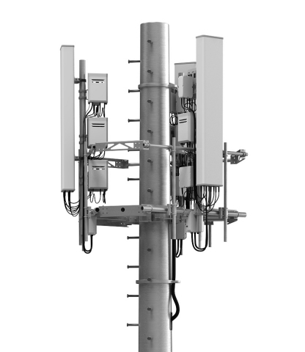
Can FPGAs do better?
in deep learning?
Base station: https://www.businesswire.com
Network switch: https://www.techpartz.com
Autonomous car: https://news.psu.edu
Notes:
This question is CAN FPGAS DO BETTER?
- For every new chip, FPGA architects are coming up with ideas to improve the performance, power efficiency and area efficiency of FPGAs.
- This has led to introducing memory blocks, DSP blocks, sophisticated routing architectures and most recently Networks on chip!
- FPGAs are getting more complex and heterogeneous trying to adapt to wide range of applications while preserving their general purpose nature.
- In this study we have asked ourselves the same questions. CAN FPGAS DO BETTER? But this time in deep learning.

Slide 4
Deep Learning: Accuracy vs. Compute
Multiply-
Accumulate
Notes:
Deep learning, have gained a lot of attention in the recent years.
Being able to solve complex problems such as image classification and speech recognition have encourage a huge amount of research both on the algorithm development side and the hardware acceleration side.
A key metric in deep learning is the network’s accuracy. Researchers are always publishing state-of-the-art deep learning models that are able to achieve higher accuracies than their predecessors.
However, accuracy doesn’t come for free. Highly accurate models tend to have high computational cost. Requiring hardware platforms that can that can provide high performance and power efficiency.
And power efficiency is very important, specially, when it comes to devices with tight power budgets like smartphones.

Slide 5
Efficient Inference: Low-Precision DNNs
One way of reducing computations: Low-precision
Lowering the precision of weights/activations:
Reduce memory bandwidth
Reduce computational energy
Reduce multiply-accumulate area
What about accuracy?
Notes:
One way of decreasing the computational complexity of deep neural networks is to reducing the precision of their weights and activations.
So, what are the actual gains of doing so.
First this reduces the memory bandwidth requirements of the hardware, reduce the multiply-accumulate area and the computational energy
However, the main reason for increasing computational complexity is to increase network’s accuracy. So, an important question is: how is accuracy affected by lowering precision?!!!

Slide 6
Deep Learning: Best Precision?
Lowering precision can degrade accuracy
But network re-engineering can recover accuracy
Most hardware-efficient precision?
No single answer
Depends on accuracy target, application, model …
Precision from 4 – 9 bits is pareto-optimal for many target accuracies^{1,2}
J. Fowers et al., “A Configurable Cloud-Scale DNN Processor for Real-Time AI” in ISCA 2018
M. Bott et al., “FINN-R: An End-to-End Deep-Learning Framework for Fast Exploration of Quantized Neural Networks” in TRETS 2018
Notes:
Decreasing precision can actually degrade accuracy which is in some applications not tolerable.
Recent work, shows that going from single-precision floating point to 16-bit fixed point can degrade the top-1 accuracy of the network on the image net dataset by 0.5%
However, some techniques could be used to recover this accuracy loss. For instance, increasing layer sizes or using block floating point with small mantissa instead of fixed point
So, what is the most hardware-efficient precision?
Well, there is no single answer, it depends on the accuracy target, application, and model being used.
However, recent work has shown that precisions form 4 – 9 bits is pareto-optimal for many target accuracies

Slide 7
Low-Precision on FPGAs
logic blocks
DSP blocks
FPGAs naturally adapt to precision variation
Reconfigurable
Variable bit-width data paths
DSPs are good for large multiplies (Ex: 18-bit)
Fast, compact and reasonably numerous
Are DSPs as good for low-precision multiplies?
24x more 4-bit multiplies using logic blocks
Can logic blocks do even better at low-precision?
24x more 4-bit
multiplies
Notes:
The good news is that FPGAs naturally adapt to precision variation. Since, they are reconfigurable and have variable bit-width data paths.
Multiplies and multiply accumulates are mostly carried out using DSP blocks. And currently DSP blocks have limited precisions available
The smallest precision available in Stratix-10 DSP block is 18x18. At this bit width, multipliers are more efficiently implemented using DSPs. An 18x18 multiplier will need 150 ALMs to be implemented using soft logic. In addition, they will never be as fast as the DSPs at this bit width.
But are DSPs as good for low-precision multiplies?
Well at this precision, you can implement 24x more 4-bit multiplies using logic blocks than DSPs. While also at this size there is no difference in speed.
Results on Arria 10 fastest speed grade:
18x18 multiplication: 11520x (DSP multipliers @ 548 MHz) vs. 17834x (logic block multipliers @ 257 MHz) LB:DSP → 1.55x
4x4 multiplication: 11520x (DSP multipliers @ 548 MHz) vs. 280000x (logic block multipliers @ 617 MHz) LB: DSP → 24.3x

Slide 8
Logic Block Multipliers
Notes:
Logic blocks are highly flexible and are the most ubiquitous recourse on an FPGA. But how efficient are they when it comes to multipliers implementation?
First we need to know how are the multiplier currently mapped to the state of the art logic block architectures.
Then we can look for potential rooms for improvement.

Slide 9
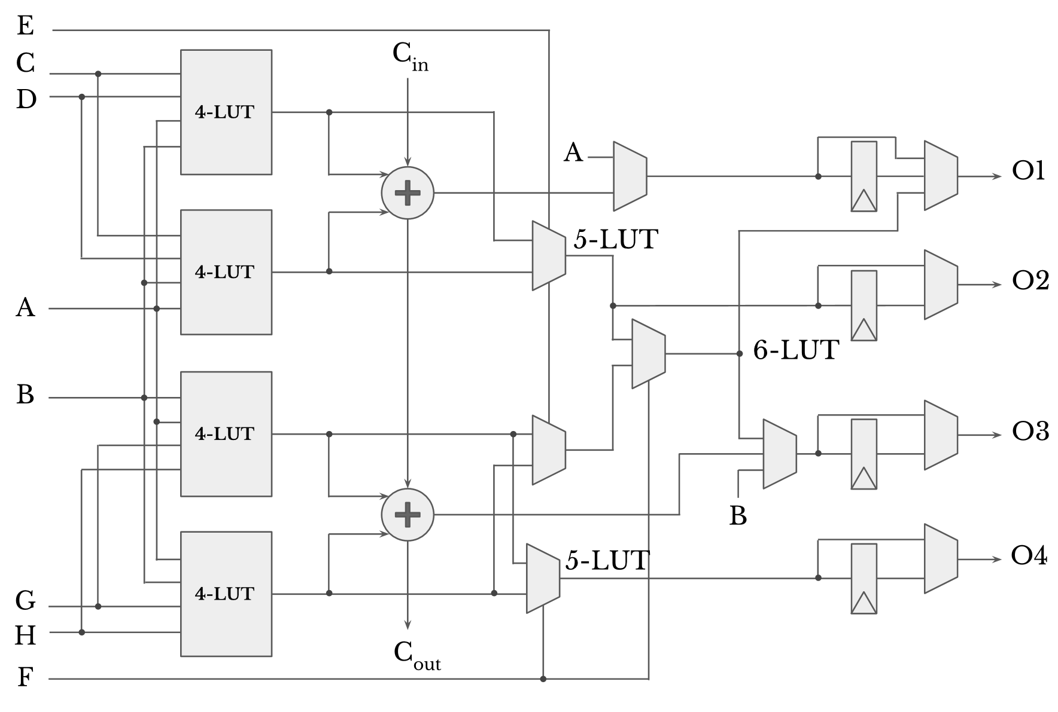
Baseline: Stratix 10-like Logic Block
Architecture specs:
8 distinct inputs
6-input fracturable LUT
Used as 6-LUT or two 5-LUTs
2 bits of arithmetic
4 optionally registered outputs
Notes:
The baseline state-of-the-art logic block architecture we are using for this study in the startix-10 architecture. Here we are showing a stratix-10like logic block. This logic block has 8 distinct inputs, a 6-input fracturable LUT that can be used a one 6-input LUT or two 5-input LUTs or smaller having a maximum of 8 distinct inputs. In addition, the LUT Is used as 4-input LUTs when in arithmetic mode providing two bits of addition per ALM. Finally, the ALM has for outputs which can be optionally registered.

Slide 10
Multiplication Operation
Multiplication Steps:
Partial products generation (LUTs)
Partial products reduction (Adders)
Notes:
Let’s have a look at the steps needed to perform a multiplication operation and see how this going to be mapped to an FPGA. First partial products are generated which is an AND operation between two bits, one from each operand. Then those partial products are added together to generate the final products. This addition is done one 1 or more steps depending on the multiplication size.

Slide 11
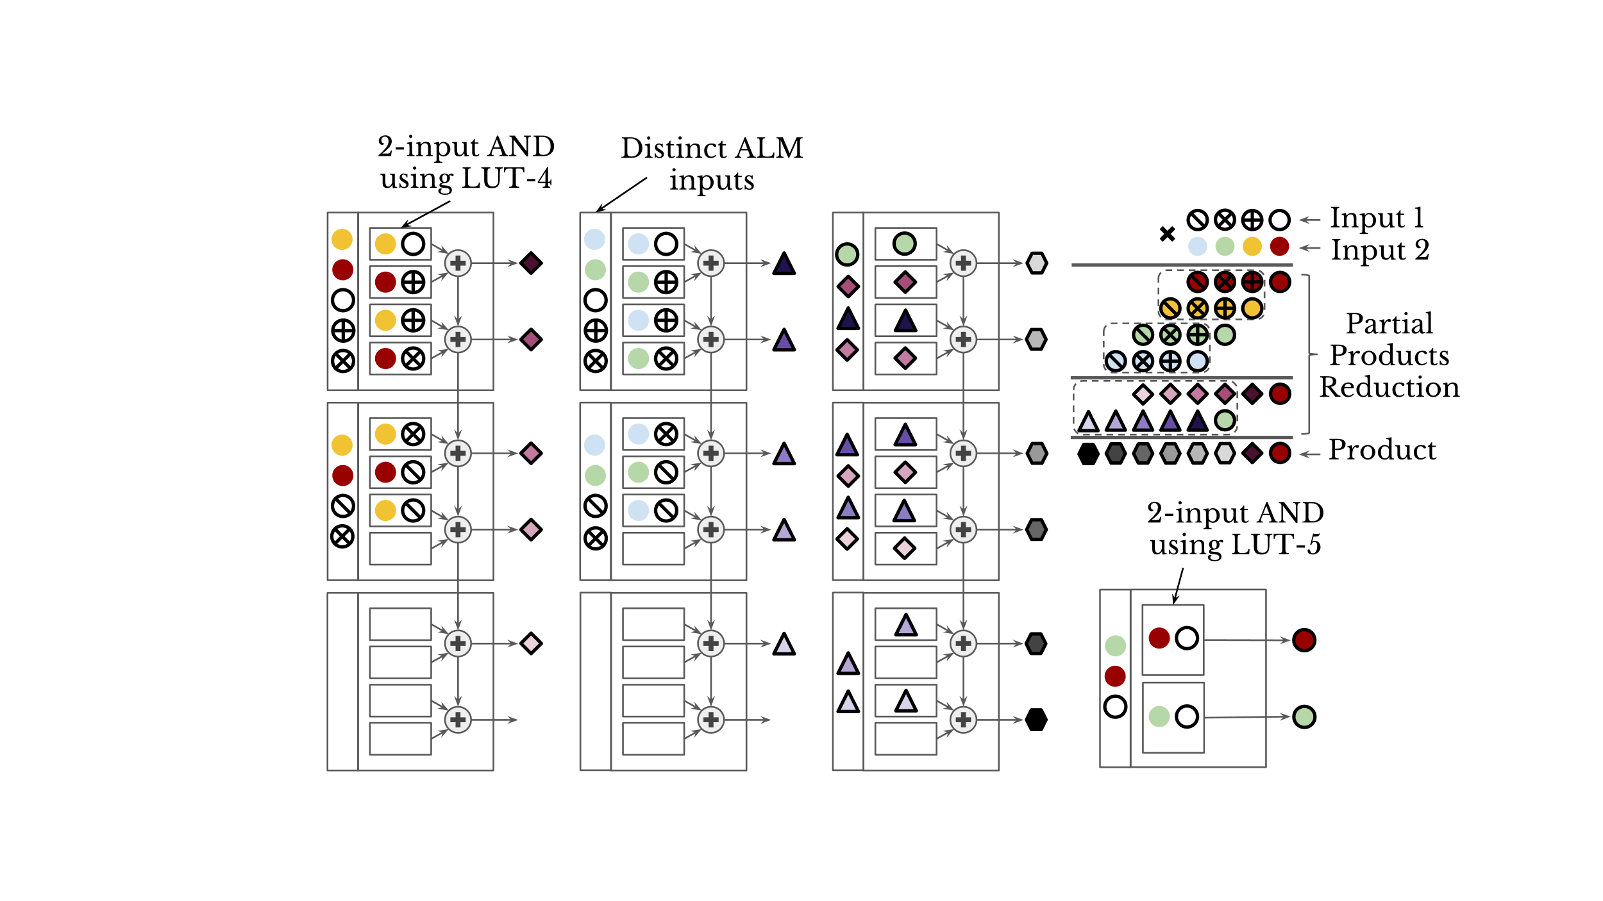
Stratix-10: Unsigned 4-bit Multiplier Mapping
ALM Count: 10
Geomean: 25.0 ALMs
(4-bit to 9-bit multipliers)
Notes:
This animation will show how a 4-bit unsigned multiplier is mapped to the stratix-10 logic block. An unsigned multiplier is chosen for easier illustration. However, for signed multiplier its almost the same mapping. First the partial products are generated using the 4-input LUTs are directly added together using the adder chain in front of the LUTs. Then the outputs are added again together to produce the final product. As shown, 10 ALMs are needed to map this multiplier. Since we are concerned with low-precisions. We studied the mapping of 4-bit to 9-bit multiplications which have a geometric average of 25 ALMs

Slide 12
Stratix-10: Perfect Resource Utilization?
2
1
Observations:
LUTs used as buffers for adder inputs
4-LUT implementing 2-input AND
Notes:
First we can see that in some ALMs the LUTs are being used to pass inputs to the FAs which underutilizes the LUTs.
Second, for partial product generation 4-LUTs are underutilized as they are used as 2-LUTs.
Third, Some ALMs are only used to generate the Cout signal which wastes the ALM resources.

Slide 13
Proposed Architectures
Notes:
Given the observations we have mentioned in the previous slide. We are going to propose architecture changes that can solve one or more the causes for the under utilization observed.

Slide 14
Design Constraints
Backward compatibility (functionality)
Low added cost (area/delay)
Same routing architecture (routing interfaces)
Notes:
The new logic block design should be backward compatible meaning it should be able to support all the operations the baseline architecture is capable of implementing
The new design should have low area and delay overhead for general applications. Meaning these modifications shouldn’t negatively affect the general purpose nature of the FGPA.
Further, we also added another constraints; which is preserving the current I/O interfaces of the LAB and the ALM. This constraints makes it easy to measure the actual influence of our changes.

Slide 15
Extra Carry Chain Architecture
1
Problem:
LUTs used as buffers for adder inputs
Solution:
Add a second level of carry chains
Gains:
Shorter critical path
Better ALM utilization
Notes:
We first propose the extra carry chain architecture which is trying to tackle the first observation we found when we looked at the under utilization cause by the current architecture.

Slide 16
Extra CC: Unsigned 4-bit Multiplier Mapping
1
ALM count: 7 (vs. 10)
Geomean: 17.3 (vs. 25) ALMs
(4-bit to 9-bit multipliers)

Slide 17
4-bit Adder Architecture
2
Problem:
4-LUTs used as 2-input LUT
Solutions:
Fracture 4-LUTs into 3-LUTs
Gains:
Fit more adders per ALM
Better ALM utilization
Notes:
The result is better alm utilization. Now we generate 8 partial products using the 8 LUTs per ALM instead of 4 and we are able to add those partial products together using the 4 adders we have per ALM

Slide 18
4b Adder: Unsigned 4-bit Multiplier Mapping
2
ALM count: 7 (vs. 10)
Geomean: 15.8 (vs. 25) ALMs
(4-bit to 9-bit multiplier)

Slide 19
Shadow Multiplier Architecture
3
How to increase area efficiency even more?
Idea: Add a low-precision shadow multiplier per LAB
Shares inputs with ALMs
Steals out ports from ALMs
Did we lose flexibility?!
Notes:
Did we just lose flexibility by adding a hard multiplier.

Slide 20
SM: Mapping Larger Multiplies
3
How to map larger multiplies?
Using soft logic only
Using other SMs & soft logic
soft adder
5-bit multiplication using one 4-bit SM and ALMs
soft adder
8-bit multiplication using four 4-bit SMs and ALMs
Notes:
For multiplies larger than the hard multiplier size, the rest of the multiplication could be implemented in two ways. Either using soft logic to generate the remaining partial product and then add them with the output of the multiplier. The other option is to other hard multipliers to generate the remaining partial products and add them together. Finally the outputs of both multiplier should be added together to generate the final product as shown in this figure. In our results, we always choose the mapping that results in the smallest number of used ALMs
Using this architecture to implement multiplier we have three scenarios: 1) multiplier implemented is smaller than or equal to the size of the hard multiplier available; the ALMs used are the ones the hard multiplier is stealing outputs from. 2) multiplier width is a multiple of the actual hard multiplier size; multiple hard multipliers can be combined to implement the multiplication and their outputs should be added using an adder reduction tree. 3) all other cases; part of the multiplication will be carried out by the hard multiplier will the other parts will be carried out using soft logic and the output of both will also be added together using an adder reduction tree.

Slide 21
SM: Unsigned Multipliers Mapping
3
ALM Usage:
Output stealing
Partial products
Adder tree
Notes:
To evaluate the ALM usage of this architecture when implementing multipliers. We need to know first how are the ALMs used when mapping multiplies to this architecture. As we show before the hard multiplier shares LAB output port with other ALMs which means that when this hard multiplier is used those ALMs are unusable. Second some times we need ALMs to add products together and maybe need them to create partial products too.

Slide 22
Detailed Evaluation

Slide 23
What to Evaluate?
Quantify gains:
Increase in MAC densities
Reduction in MAC delays
Calculate cost:
Increase in FPGA tile area (logic + routing)
Increase in representative critical path delay
Notes:
First, those changes should provide reasonable efficiency gains to be worthwhile.
Second, Tile area and representative critical path delay of the FPGA shouldn’t increase significantly.
We want to ensure that applying those changes to the logic block architecture won’t negatively impact the general purpose nature of the FPGAs.

Slide 24
Methodology
Transistor sizing: COFFE
Modified COFFE to support:
Stratix 10
Extra Carry Chain
4-bit Adder
Shadow Multipliers: Standard cell flow
Hand mapping multipliers/MACs (4-9 bits):
ALM counts
Critical path delays

Slide 25
Recap: Proposed Architectures
1
Extra Carry Chain
2
4-bit Adder
3
Shadow Multiplier

Slide 26
Multiply-Accumulate Gains (Geomean)
Notes:
Since we in most of the DNN accelerators we are expecting a deeply pipelined design, we care about the number of PE or MAC that could fit on-chip and not as much about their respective speed. Despite that all our designs show an improvement in the MAC speed vs the baseline except for one design which slightly degraded.

Slide 27
General Application: Area and Delay Cost
Notes:
- For the extra carry chain and the 4b Adder architecture we have around 3% increase in tile area which is mainly due to the added adders in both architectures.
However, for the shadow multiplier architectures the increase in tile area is mainly due to the hard multiplier area
Most architectures experience low delay overhead, however, large shadow multiplier architectures experience more overhead due to the increase in wirelength caused by the respective increase in tile area.

Slide 28
Combine Two Architectures?
4
Compact
Multiplies
Compact
Additions
Shadow Multiplier
4-bit Adder
Notes:
The shadow multiplier architecture is heavily dependent on adders.
Why not combine the 4-bit Adder architecture with the shadow multiplier architecture.
We can then get compact multiplier and compact additions in case of implementing multiplies larger than the hard multiplier available

Slide 29
MAC Gain and Area Cost
4
1.5x

Slide 30
Summary & Future Work
Low-precision can increase DNN efficiency
FPGA logic blocks can implement efficient MACs
Extra CC: 1.5x MAC density for only +2.6% tile area
4b Adder: 1.6x MAC density for only +2.9% tile area
SM: up to 4.1x MAC density for up to +14.8% tile area
SM + 4b Adder: up to 6.1x MAC density for up to +16.7% tile area
Future work: Evaluate proposed architectures on full applications
Notes:
Results show that the extra carry chain architecture could increase the MAC density by 1.5x while having insignificant impact on area and delay.
Modified COFFE to support state-of-the-art Stratix 10 LB architecture
Proposed three logic block architectures that can increase the MAC density on the FPGA’s soft logic
Showed that architecture changes with low costs can lead to significant gains in reducing MAC areas.

Slide 31
Questions?

Slide 33
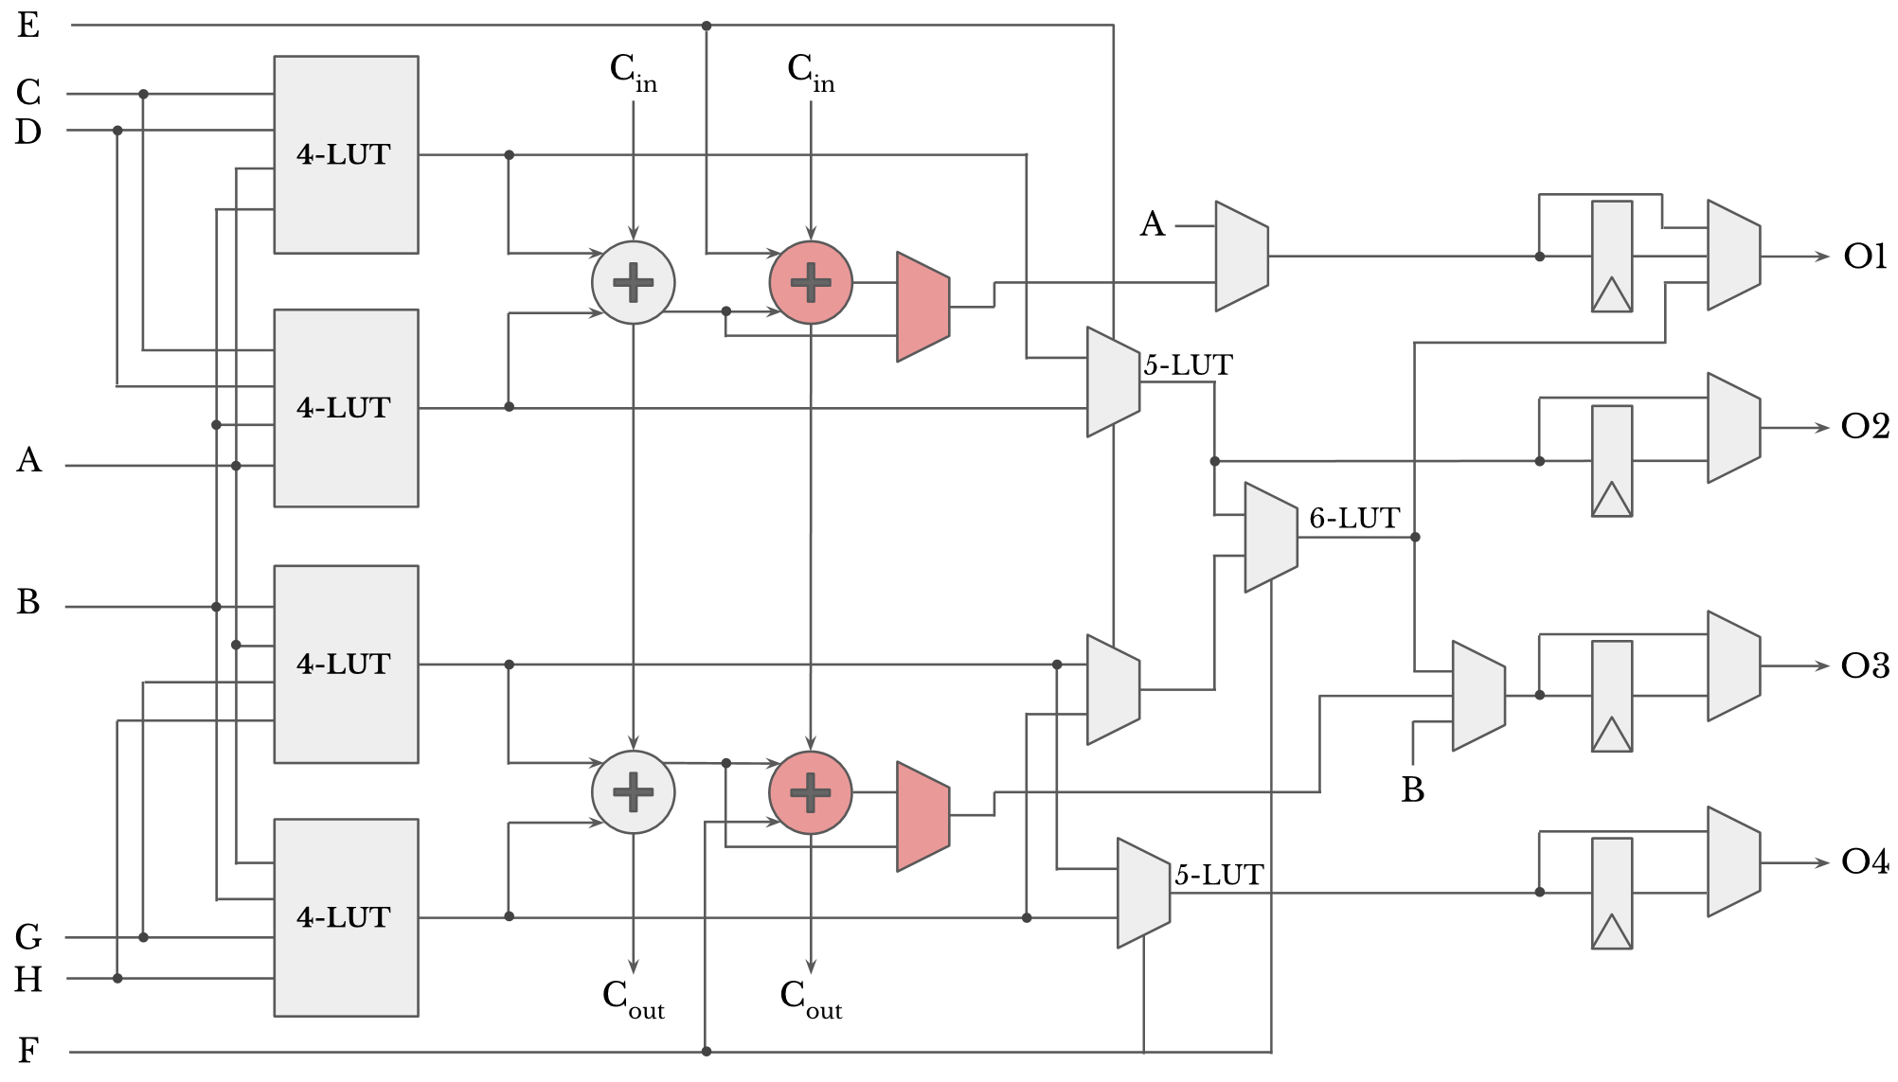
Extra Carry Chain Architecture
1
Notes:
We first propose the extra carry chain architecture which is trying to tackle the first observation we found when we looked at the under utilization cause by the current architecture.

Slide 34
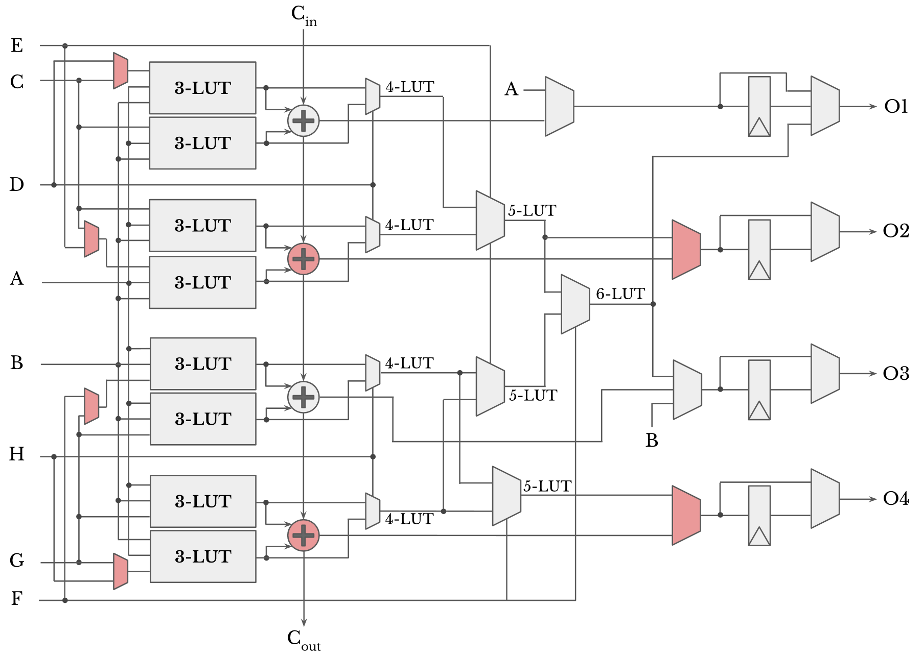
4-bit Adder Architecture
2
Notes:
The result is better alm utilization. Now we generate 8 partial products using the 8 LUTs per ALM instead of 4 and we are able to add those partial products together using the 4 adders we have per ALM

Slide 35
Low-Precision on FPGAs
Simplified FPGA Layout
FPGAs naturally adapt to precision variation
Reconfigurable
Variable bit-width data paths
But current DSP blocks: limited precisions available
More flexible DSPs: added 9- & 4-bit modes¹
What about 5- to 8-bits precisions?
Number of DSPs on chip?!
More flexible and more numerous MACs?
DSPs < 5%
of total logic
Logic Blocks
A. Boutros et al., “Embracing Diversity: Enhanced DSP Blocks for Low-Precision Deep Learning on FPGAs” in FPL 2018
Notes:
The good news is that FPGAs naturally adapt to precision variation. Since, they are reconfigurable and have variable bit-width data paths.
Multiplies and multiply accumulates are mostly carried out sing DSP blocks. And currently DSP blocks have limited precisions available
Recent work done in our groups have explored adding 9- & 4- bit precisions achieving reasonable gains at low cost.
However, what about other precision meaning 5- to 8-bit multipliers. Still only certain precisions can achieve high efficiency this way
In addition, the number of DSPs per chip is limited as seen in this FPGA layout figure. Where DSPs are the dark blue columns.
How do we achieve more flexibility and be able to implement more MACs on chip. What about logic blocks?

