Slide 1
Substream-Centric Maximum Matchings on FPGA
Maciej Besta, Marc Fischer, Tal Ben-Nun, Johannes de Fine Licht, Torsten Hoefler

Slide 2
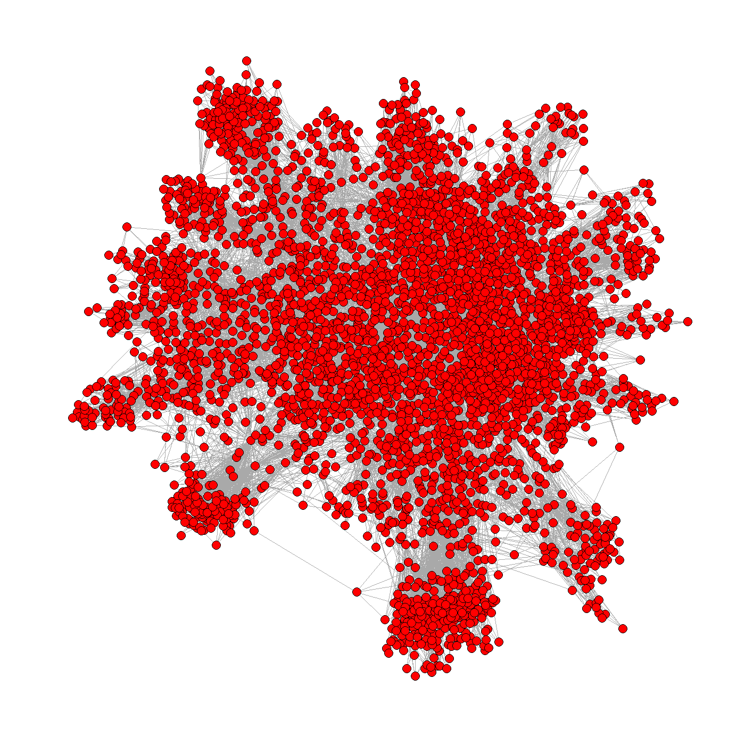
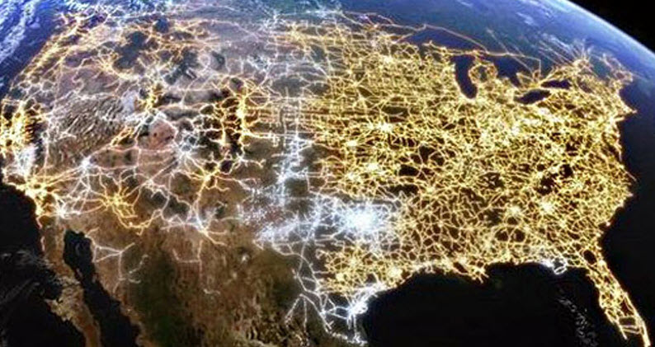
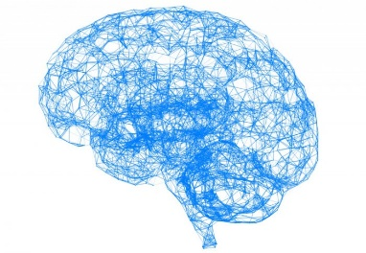
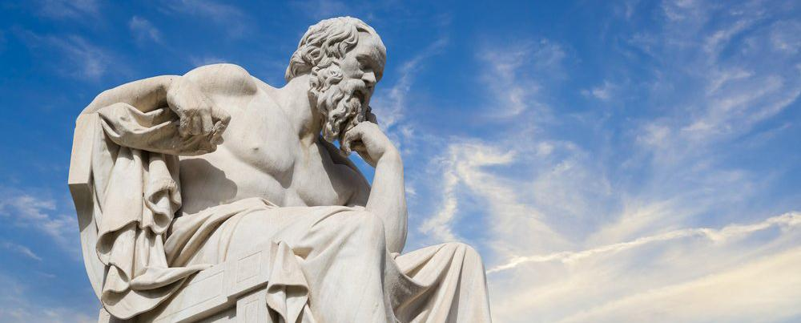
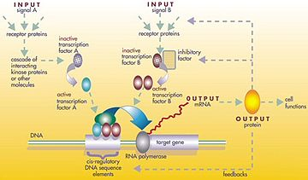
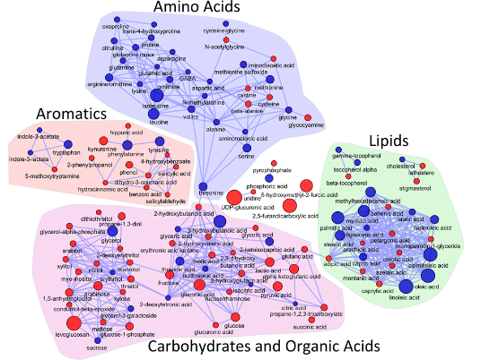
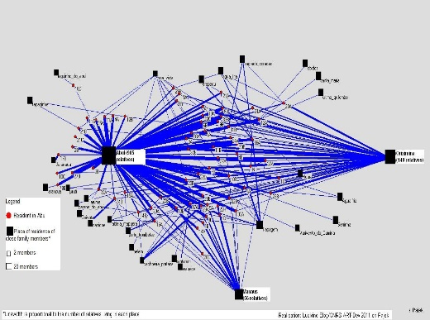
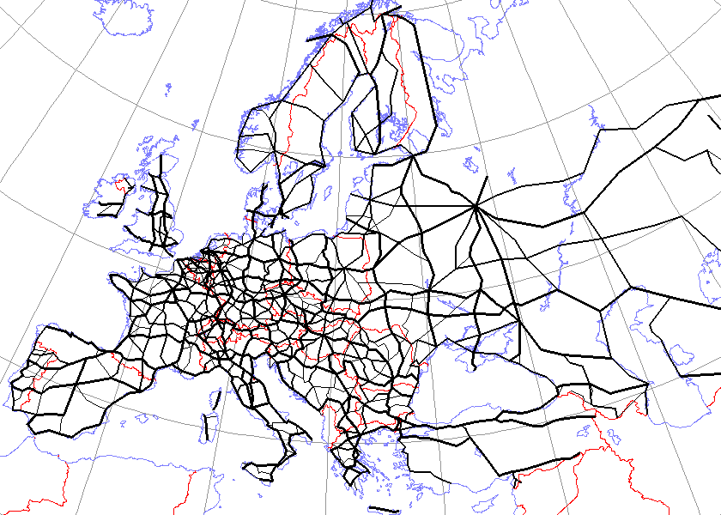
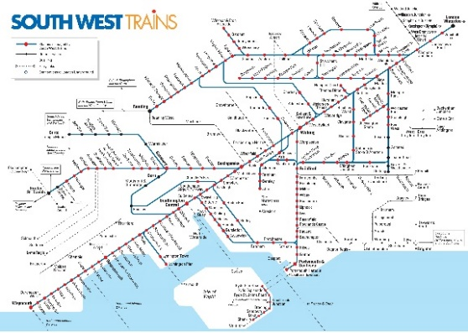
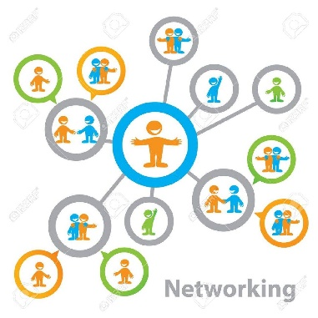
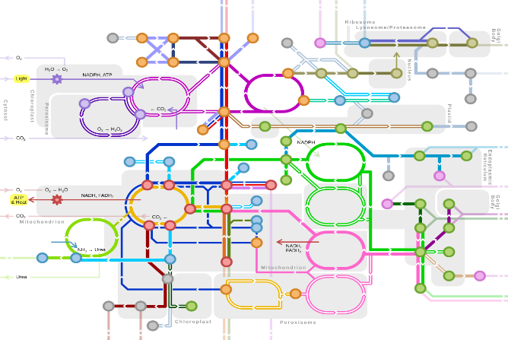
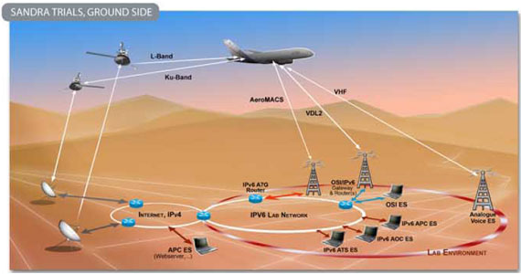
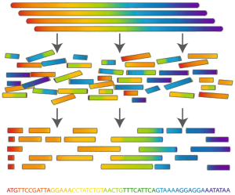
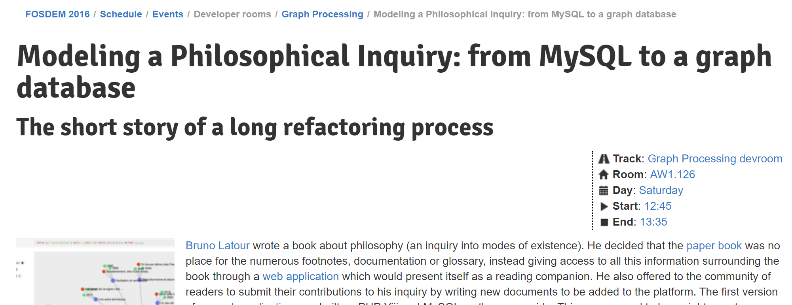
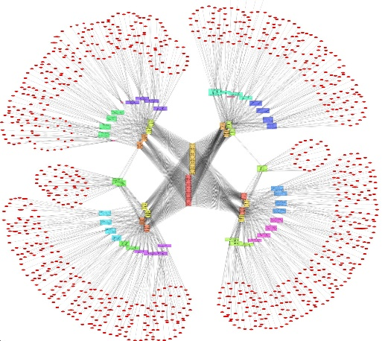
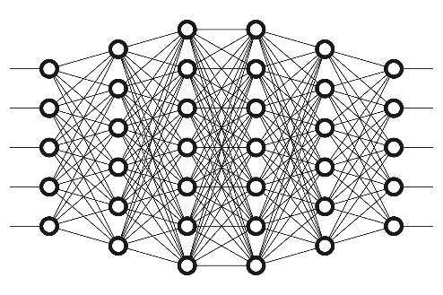
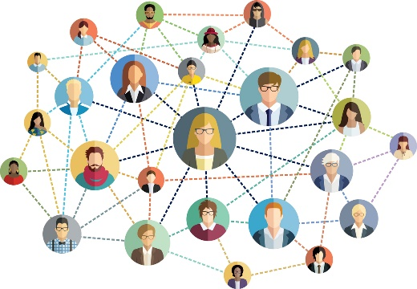
Large graphs…
Useful model
Engineering networks
Why do we care?
...even philosophy ☺
Physics, chemistry
Biological networks
Machine learning
Social networks
Communication networks

Slide 3
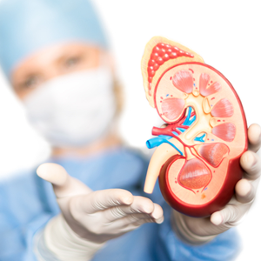
Large graphs…
Matching: A set of edges such that no two edges share a common vertex
“We live in a system of approximations” — Ralph Waldo Emerson
One particularly important problem
In all cases, approximations („reasonably” accurate) are useful
Maximum Weighted Matching (MWM): A matching such that the sum of the edge weights is maximized
Many, many others...
Traveling Salesman Problem
10
10
5
Scheduling
5
10
10
Why do we care?
2-approximation: here, we have a
2-approximation (30/15 = 2)
5
5
[Quantum] error correcting codes
5
5
10
Approximate MWMs are crucial to many problems
10
Transplant matching
Weight = 30
Weight = 15

Slide 4
Research Questions
Which programming paradigm to use for (approximate) MWM
(and other graph problems)?
How to design a high-performance MWM algorithm (as dictated by the used paradigm)?
What is the HW FPGA design that ensures high performance?
What is the ultimate performance, power consumption, and the related tradeoffs?

Slide 5
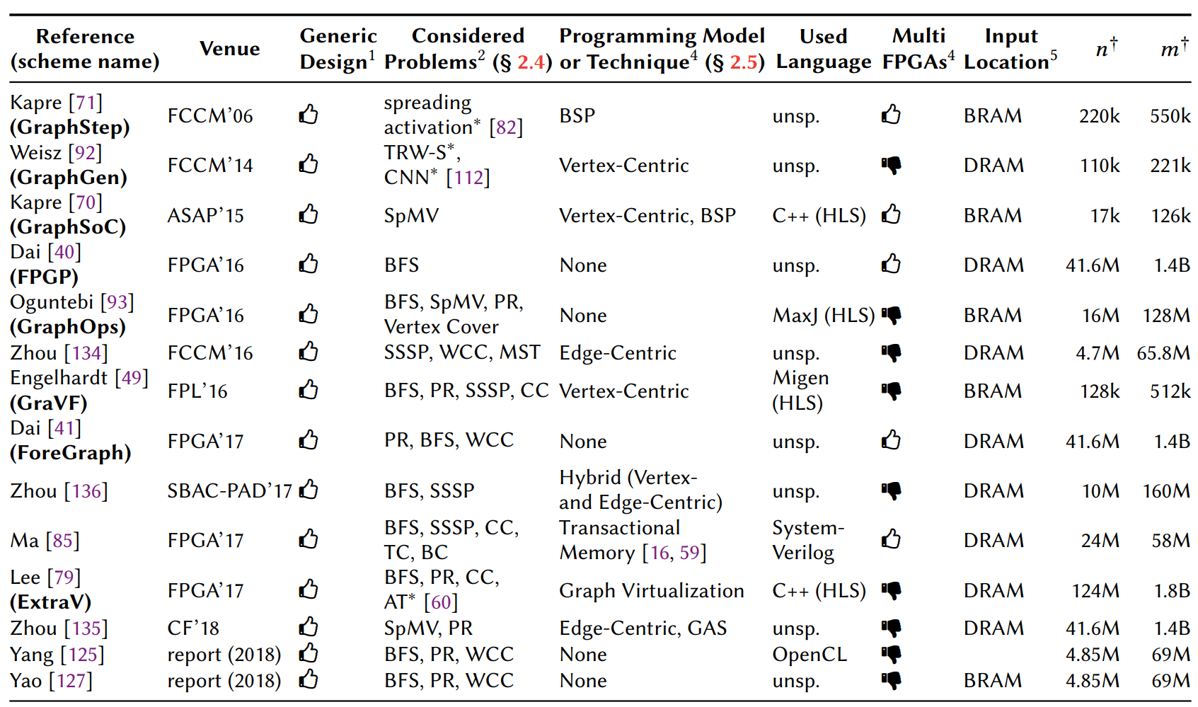
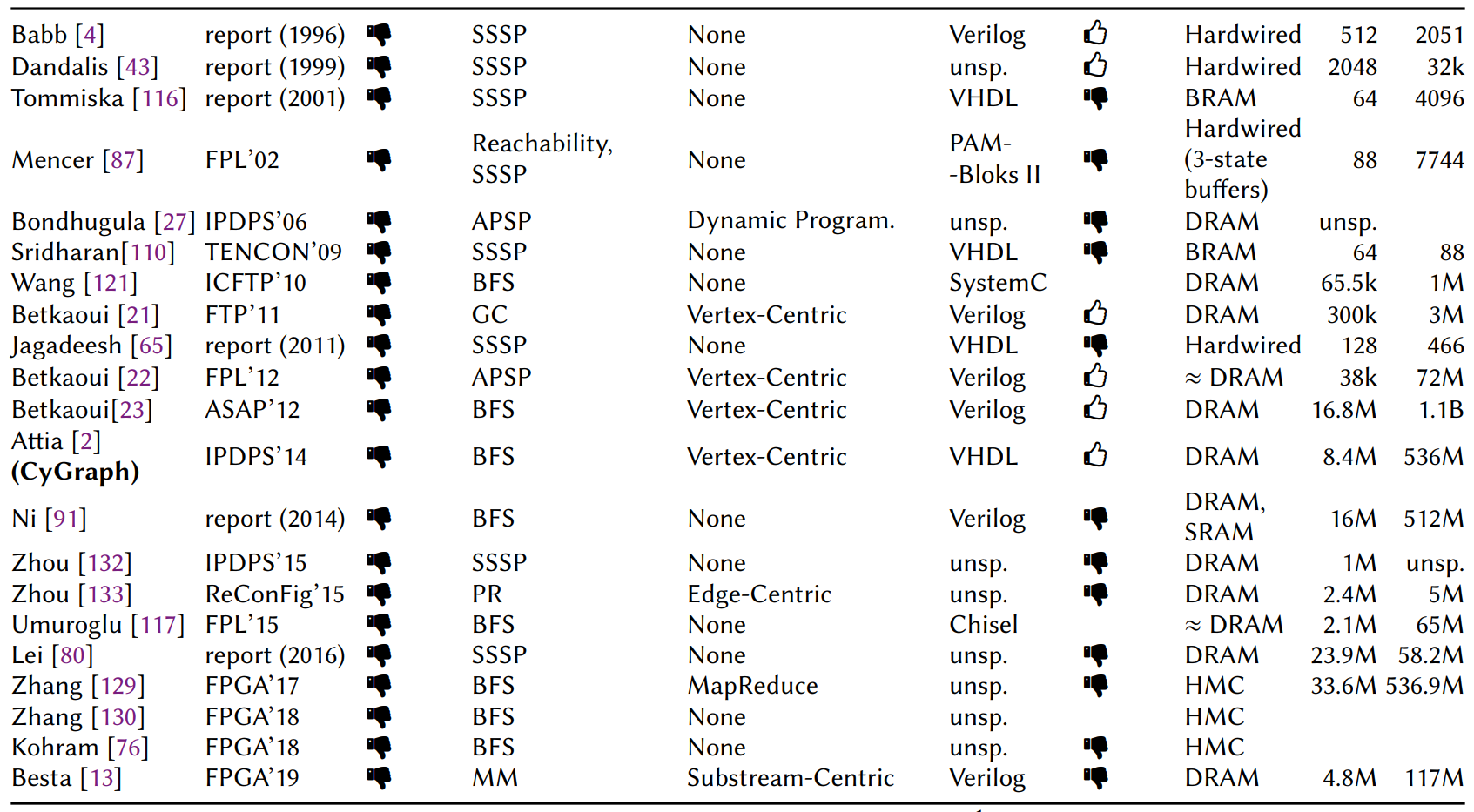
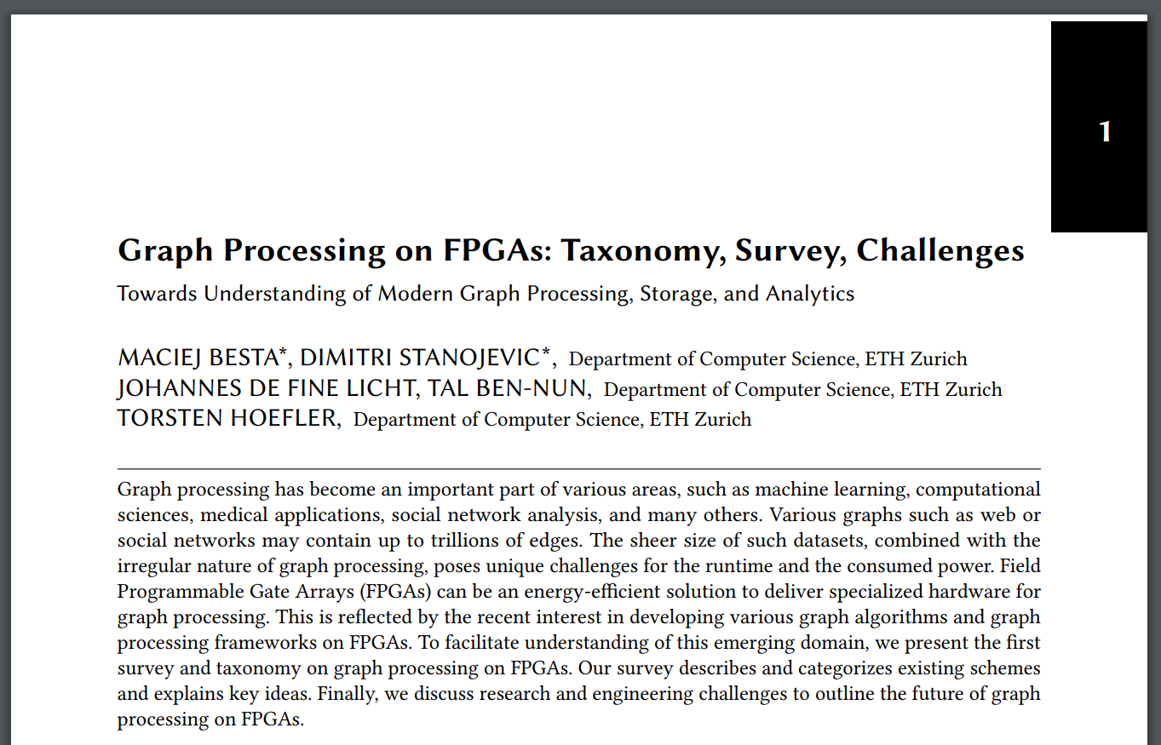
What programming paradigm and why?
Selected parts are in the FPGA paper, the rest is in…
Part 1: Seeking “the best paradigm”, we conducted a detailed analysis of graph processing on FPGAs
http://spcl.inf.ethz.ch/Publications/.pdf/graphs-fpgas-survey.pdf
(submitted to arXiv, will appear tonight)
Key techniques, paradigms, challenges, features, …
~15 FPGA graph processing frameworks
~25 FPGA accelerators for specific algorithms

Slide 6
“(...) implementing graph algorithms efﬁciently on Pregel-like systems (...) can be surprisingly difﬁcult and require careful optimizations.” [1]
+ other issues
What programming paradigm and why?
To be able to utilize pipelining well, we really want to use streaming (aka edge-centric)
[1] S. Salihoglu and J. Widom, “Optimizing graph algorithms on Pregel-like systems”. VLDB. 2014.
Vertex-centric, Gather-Apply-Scatter, ... ?

Slide 7
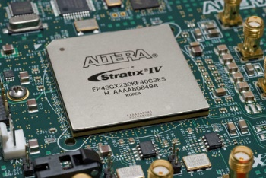
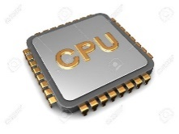
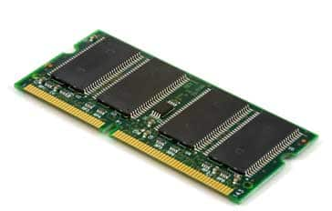
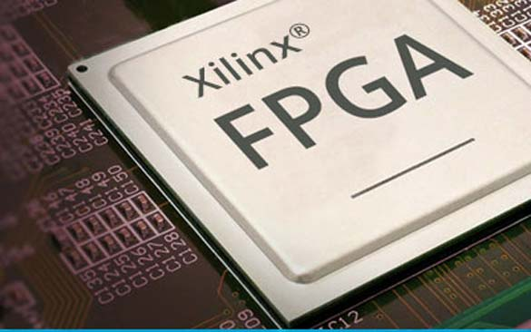
Use some form of streaming (aka edge-centric); we can use pipelining efficiently (“streaming ≈ pipelining”)
…How to minimize the number of “passes” over edges? This can get really bad in the “traditional” edge-centric approach (e.g., BFS needs D passes; D = diameter [1]).
What programming paradigm and why?
…Processing edges is sequential – how to incorporate parallelism?
Issues…
DRAM
Streaming all edges in and out is one “pass”. Repeat it a certain (algorithm-dependent) number of times
Some processing unit (CPU, GPU, FPGA, …, for a moment we don’t care)
[1] A. Roy et al. X-stream: Edge-Centric Graph Processing using Streaming Partitions. SOSP. 2013.

Slide 8
Substream-Centric Graph Processing
It enhances edge-centric streaming approaches
Use some form of streaming (aka edge-centric); we can use pipelining efficiently (“streaming ≈ pipelining”)
What programming paradigm and why?
Part 2: A new paradigm for processing graphs
Also, it enables (tunable) approximation and a (tunable) number of passes
Part 2: Substream-Centric: A new paradigm for processing graphs
Process “substreams” independently
…Processing edges is sequential – how to incorporate parallelism?
Divide the input stream of edges according to some (algorithm-specific) pattern
Substreams (pipelines) are processed in parallel, in a simple way (independently, except for merging)
DRAM
…
How to express MWM in this paradigm?
Weighted edges
Merge substreams

Slide 9
Research Questions
Use substream-centric processing (exposes parallelism, enables easy pipelining, supports approximation)
Which programming paradigm to use for (approximate) MWM
(and many other problems)?
How to design a high-performance MWM algorithm (as dictated by the used paradigm)?
What is the HW FPGA design that ensures high performance?
What is the ultimate performance, power consumption, and the related tradeoffs?

Slide 10
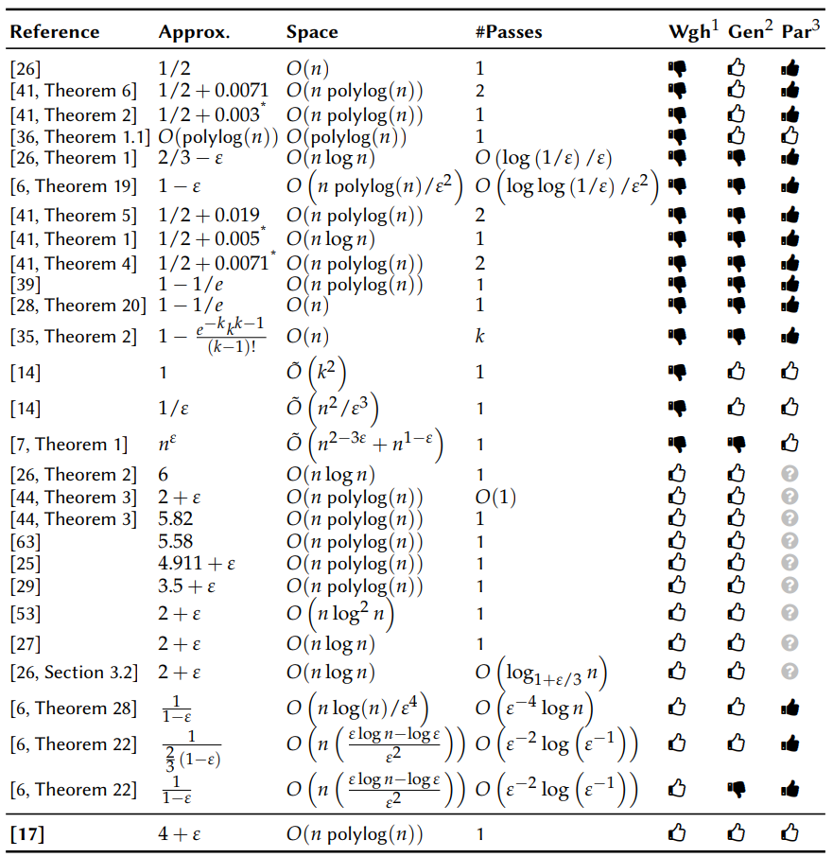
Expose parallelism (match substream-centric)
Part 3: Analysis of models and algorithms for streaming graph processing
Most important
goals:
Minimize #passes
Maximize accuracy
Part 3: Analysis of models and algorithms for streaming graph processing
Minimize local space
~30 algorithms for streaming (approximate) MWM
Idea: let’s check the (rich) world of streaming theory and see if there is anything out there that we could use ☺
No worries, no need to analyze it here, all the details are in the paper ☺
Crouch and Stubbs [1]

Slide 11
Substream-Centric Graph Processing
+ Crouch and Stubbs MWM [1]
Edges are streamed only once!
Compute unweighted matchings separately
How to minimize the number of “passes”?
Select edges with weights:
A parameter that controls accuracy
The algorithm is (4+ε)-approximation, but we’ll show in practice it does not matter much
Greedy merge of matchings into the final MWM
$${≥\left(1+ε\right)}^{0}$$
$${≥\left(1+ε\right)}^{i}$$
DRAM
Substream 0
…
Substream i
$${≥\left(1+ε\right)}^{L−1}$$
Substream L-1
[1] M. Crouch and D. M. Stubbs. Improved streaming Algorithms for weighted Matching, via unweighted Matching. LIPIcs-Leibniz Informatics. 2014.

Slide 12
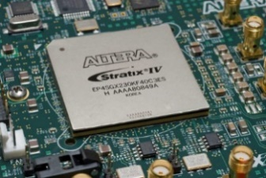
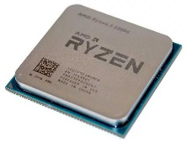
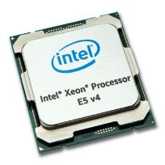
Substream-Centric Graph Processing
+ Crouch and Stubbs MWM [1]
FPGA
Time: O(m)
Work: O(Lm)
Edges are streamed only once!
Use a hybrid CPU-FPGA setting!
How to minimize the number of “passes”?
The algorithm is (4+ε)-approximation, but we’ll show in practice it does not matter much
Part 4: Mapping the algorithm to the „right” hardware configuration
Pipelines – it fits FPGA well!
CPU
Time: O(Ln)
Work: O(Ln)
DRAM
Substream 0
…
Substream i
Inherently sequential – it fits CPU well
Substream L-1
[1] M. Crouch and D. M. Stubbs. Improved streaming Algorithms for weighted Matching, via unweighted Matching. LIPIcs-Leibniz Informatics. 2014.

Slide 13
Substream-Centric Graph Processing
+ Crouch and Stubbs MWM [1]
FPGA
Time: O(m)
Work: O(Lm)
Edges are streamed only once!
Use a hybrid CPU-FPGA setting!
How to minimize the number of “passes”?
The algorithm is (4+ε)-approximation, but we’ll show in practice it does not matter much
Part 5: Implementing all of this on the FPGA-CPU platform
CPU
Time: O(Ln)
Work: O(Ln)
DRAM
Substream 0
…
Substream i
Substream L-1
[1] M. Crouch and D. M. Stubbs. Improved streaming Algorithms for weighted Matching, via unweighted Matching. LIPIcs-Leibniz Informatics. 2014.

Slide 14
Substream-Centric Graph Processing
+ Crouch and Stubbs MWM [1]
FPGA
Time: O(m)
Work: O(Lm)
Edges are streamed only once!
Use a hybrid CPU-FPGA setting!
How to minimize the number of “passes”?
The algorithm is (4+ε)-approximation, but we’ll show in practice it does not matter much
CPU
Time: O(Ln)
Work: O(Ln)
DRAM
Substream 0
…
Substream i
Substream L-1
[1] M. Crouch and D. M. Stubbs. Improved streaming Algorithms for weighted Matching, via unweighted Matching. LIPIcs-Leibniz Informatics. 2014.

Slide 15
Substream-Centric MWM: FPGA optimizations
(related mostly to matching bits)
Blocking
Vectorization
Prefetching
They are often used in graph processing schemes on FPGAs; we apply them as well.
Pipelining

Slide 16
Substream-Centric MWM: FPGA optimizations
Blocking
All the details are in the paper. Let’s focus on the key FPGA design ideas and optimizations
Vectorization
They are often used in graph processing schemes on FPGAs; we apply them as well.
Pipelining
Prefetching

Slide 17
Substream-Centric MWM: FPGA optimizations
Blocking
Edge reordering on the fly (more details in a bit)
All the details are in the paper. Let’s focus on the key FPGA design ideas and optimizations
Vectorization
Blocking (more details in a bit)
Parallel substreams
They are often used in graph processing schemes on FPGAs; we apply them as well.
Pipelining
Prefetching

Slide 18
Substream-Centric MWM: FPGA optimizations Blocking
Introduce a (tunable) „blocking parameter” K
An edge between vertices 0 and 2
Column IDs correspond to vertex IDs
An edge between vertices 0 and 1
K = 3
K determines how many stalls are allowed
0
1
2
3
4
5
0
$$\left[\begin{matrix}0 & 1 & 1 & 1 & 0 & 1 \\ 1 & 0 & 1 & 0 & 1 & 0 \\ 1 & 1 & 0 & 1 & 0 & 1 \\ 1 & 0 & 1 & 0 & 1 & 0 \\ \begin{aligned}0 \\ 1\end{aligned} & \begin{aligned}1 \\ 0\end{aligned} & \begin{aligned}0 \\ 1\end{aligned} & \begin{aligned}1 \\ 0\end{aligned} & \begin{aligned}0 \\ 1\end{aligned} & \begin{aligned}1 \\ 0\end{aligned}\end{matrix}\right]$$
1
depends on
2
depends on
Stalling between every row needed...
Row IDs correspond to vertex IDs
3
depends on
4
depends on
5
Adjacency Matrix
depends on
Notes:
Lets take a closer look at the vectorization. Remember how we were able to compute a maximal matching by a simple bit array. In this example shown here, we compute 5 maximal matchings in parallel.
So first of all, we load an edge from main memory to the FPGA. Assume we are therefore given some edge e with vertices u, v, and edge weight w.
We then load two vectors from main memory to the FPGA. A vector tells us if u or v is already a part of a matching. If we would compute only one matching, the vector would have 1 entry, as seen at the beginning. But since we compute 5 maximal matchings at once, we need 5 entries per vertex. The values we have chosen here are just for demonstration.
We now need to decide, if this edge is part of a substream. This decision is made by comparing the edge’s weight to constant values, which depend on epsilon. Overall, we need to compute L many integer comparisons.
We then decide, if we can add an edge to a maximal matching. This is done element-wise, by considering the loaded vector and the decision, if the edge is part of the substream. We can add the edge to the matching, if the according entries in the loaded vector are 0, and e is part of the substream. Otherwise, the edge is not added. In this example here, we cannot add the edge to the matching, since there is already an incident edge to vertex u.
Finally, we update the vectors and write them back to main memory, and add the edge to the appropriate matchings.

Slide 19
Substream-Centric MWM: FPGA optimizations Blocking
Introduce a (tunable) „blocking parameter” K
K = 3
K determines how many stalls are allowed
$$\left[\begin{matrix}0 & 1 & 1 & 1 & 0 & 1 \\ 1 & 0 & 1 & 0 & 1 & 0 \\ 1 & 1 & 0 & 1 & 0 & 1 \\ 1 & 0 & 1 & 0 & 1 & 0 \\ \begin{aligned}0 \\ 1\end{aligned} & \begin{aligned}1 \\ 0\end{aligned} & \begin{aligned}0 \\ 1\end{aligned} & \begin{aligned}1 \\ 0\end{aligned} & \begin{aligned}0 \\ 1\end{aligned} & \begin{aligned}1 \\ 0\end{aligned}\end{matrix}\right]$$
Portions of rows are ordered „lexicographically” (i.e., no strict ordering that enforces a stall is required)
K is tunable: it controls the tradeoff between the amount of the used FPGA resources and the performance
depends on
Algorithm still (provably) correct
Adjacency Matrix
Notes:
Lets take a closer look at the vectorization. Remember how we were able to compute a maximal matching by a simple bit array. In this example shown here, we compute 5 maximal matchings in parallel.
So first of all, we load an edge from main memory to the FPGA. Assume we are therefore given some edge e with vertices u, v, and edge weight w.
We then load two vectors from main memory to the FPGA. A vector tells us if u or v is already a part of a matching. If we would compute only one matching, the vector would have 1 entry, as seen at the beginning. But since we compute 5 maximal matchings at once, we need 5 entries per vertex. The values we have chosen here are just for demonstration.
We now need to decide, if this edge is part of a substream. This decision is made by comparing the edge’s weight to constant values, which depend on epsilon. Overall, we need to compute L many integer comparisons.
We then decide, if we can add an edge to a maximal matching. This is done element-wise, by considering the loaded vector and the decision, if the edge is part of the substream. We can add the edge to the matching, if the according entries in the loaded vector are 0, and e is part of the substream. Otherwise, the edge is not added. In this example here, we cannot add the edge to the matching, since there is already an incident edge to vertex u.
Finally, we update the vectors and write them back to main memory, and add the edge to the appropriate matchings.

Slide 20
Research Questions
Use substream-centric processing (exposes parallelism, enables easy pipelining, supports approximation)
Which programming paradigm to use for (approximate) MWM
(and many other problems)?
How to design a high-performance MWM algorithm (as dictated by the used paradigm)?
Combine the MWM algorithm by Crouch and Stubbs with a hybrid CPU-FPGA setting
What is the HW FPGA design that ensures high performance?
The proper use of blocking, vectorization, pipelining, prefetching
What is the ultimate performance, power consumption, and the related tradeoffs?

Slide 21
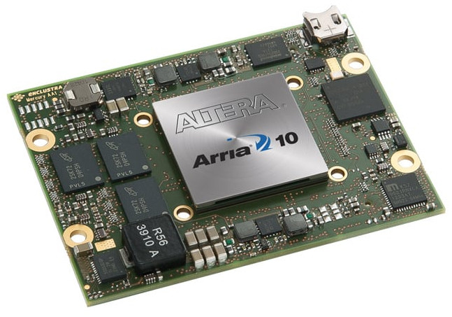
Performance Analysis
Types of machines
CPU: Intel Broadwell
Xeon E5-2680 v4 @3.3 GHz
14 Cores (28 Threads)
Part 6: Evaluation
Altera Arria 10 @200MHz
Notes:
The Interlagos processor is viewed by the Linux operating system in /proc/cpuinfo as having 16 "processors" per chip. These "processors" are the schedualable integer cores

Slide 22
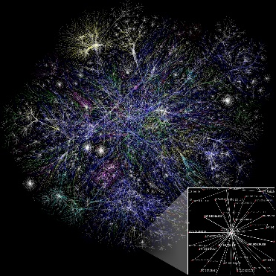
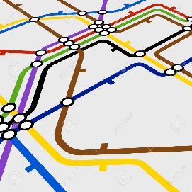
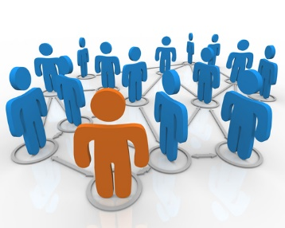
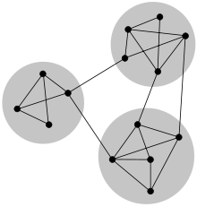
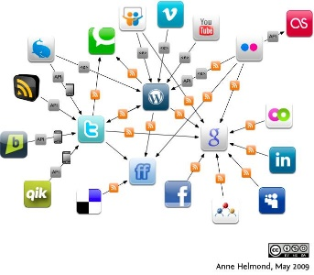
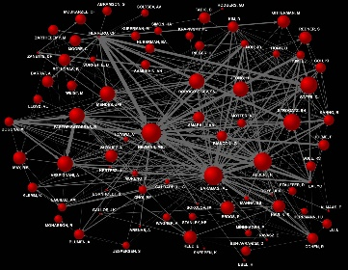
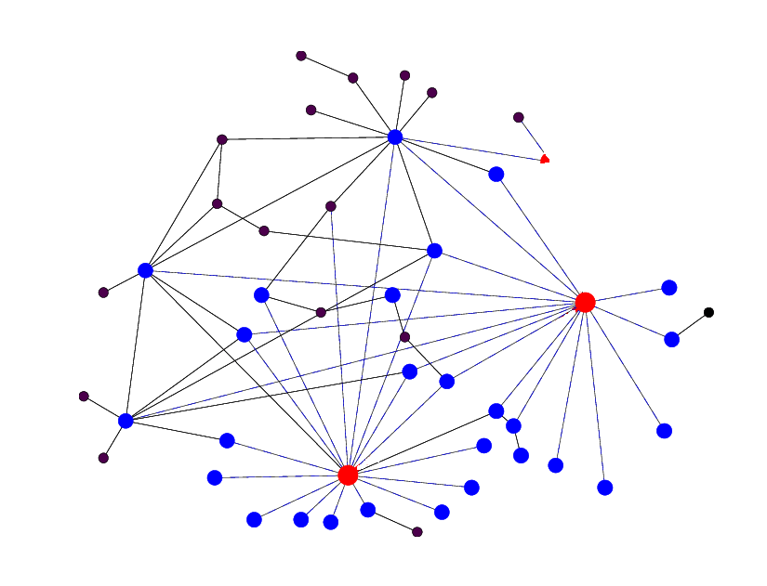
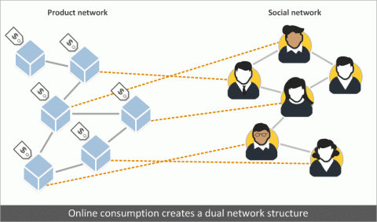
Performance Analysis
Types of graphs
Real-world graphs (SNAP [2], KONECT [3], DIMACS [4])
Synthetic graphs
Road networks
Social networks
Kronecker [1]
Web graphs
Purchase networks
Communication graphs
Citation graphs
[2] SNAP. https://snap.stanford.edu
[3] KONECT. https://konect.cc
[1] J. Leskovec et al. Kronecker Graphs: An Approach to Modeling Networks. J. Mach. Learn. Research. 2010.
[4] DIMACS Challenge

Slide 23
Performance Analysis
Algorithms
CPU implementations of the original Crouch scheme, (4+ε)-approximation
State-of-the-art MWM algorithm, space-optimal, time-optimal (O(m)), (2+ε)-approximation
Our FPGA design, (4+ε)-approximation
We test both CPU and hybrid (FPGA+CPU) platforms
[1] M. Crouch and D. M. Stubbs. Improved streaming Algorithms for weighted Matching, via unweighted Matching. LIPIcs-Leibniz Informatics. 2014.
[2] M. Ghaffari. Space-optimal semi-streaming for(2+ε)-approximatematching. arXiv:1701.03730, 2017.

Slide 24
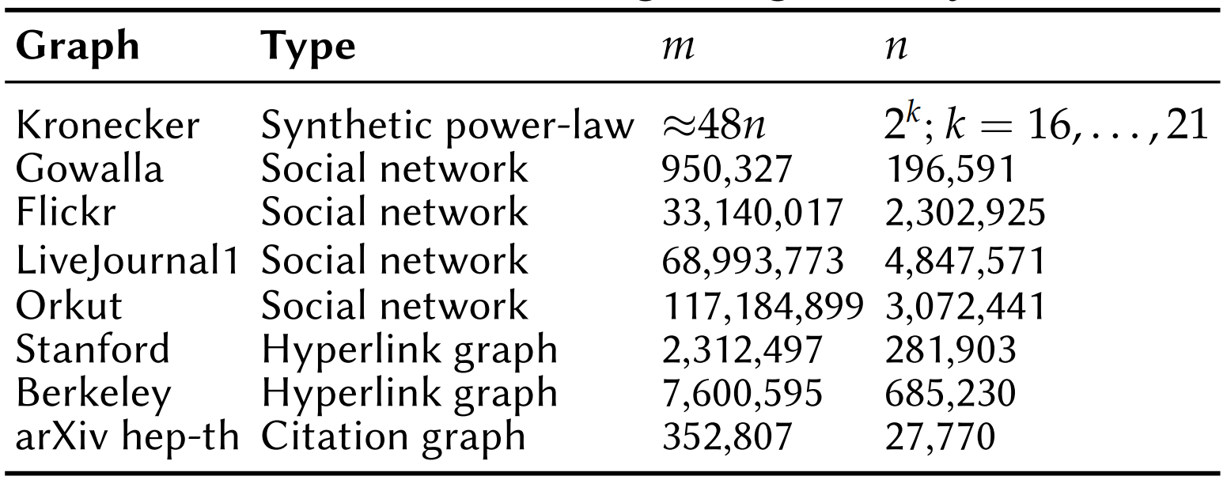
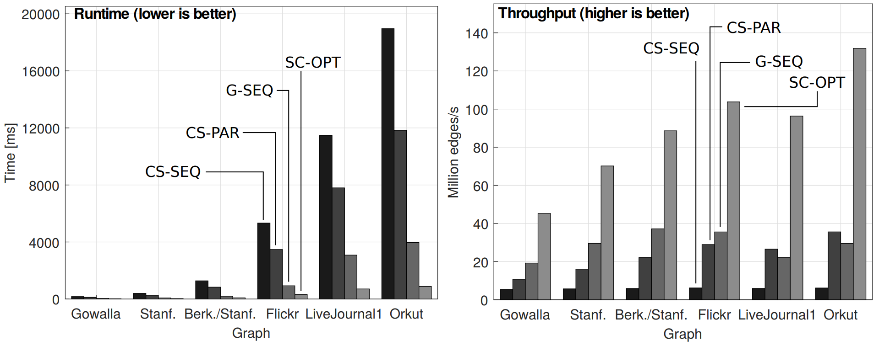
Parameters:
Blocking size (K) = 32, #Substreams (L) = 64
#Threads = 4, ε = 0.1
Performance Analysis
Various Graphs
SC-OPT secures highest performance
Hybrid
Hybrid
CPU
CPU

Slide 25
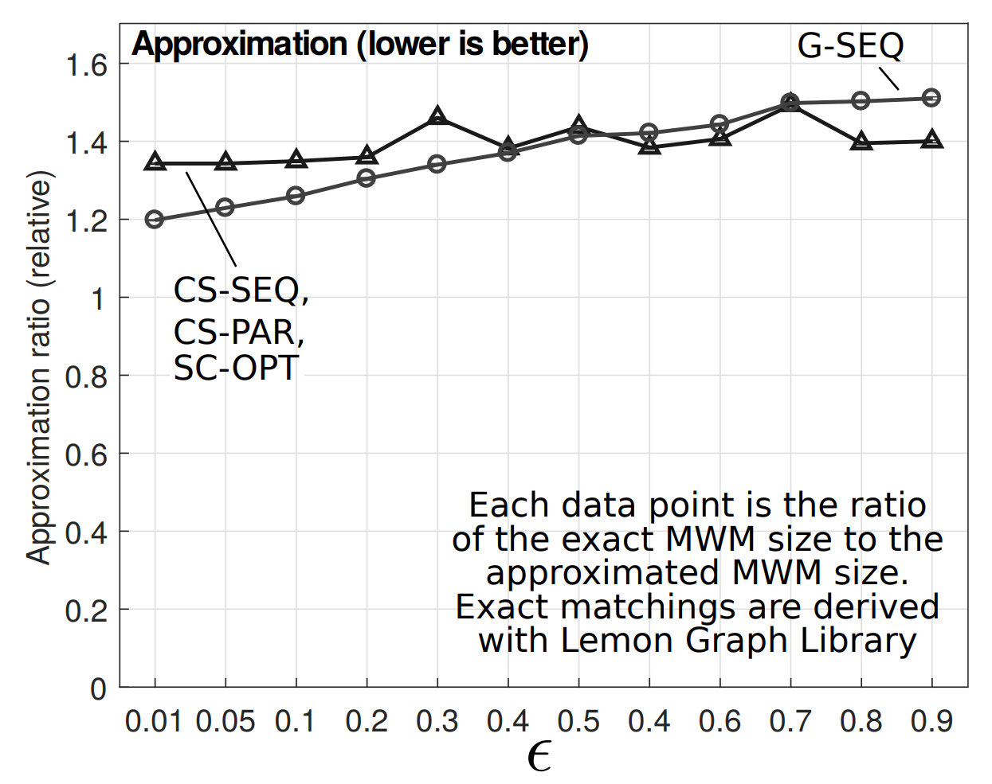
Performance Analysis
Approximation (Accuracy)
Parameters:
#Substreams (L) = 128, Blocking size (K) = 32, #threads = 4, #edges = 8M (Kronecker)
SC-OPT is comparable to the (2+ε)-approximation by Ghaffari et al.

Slide 26
Parameters:
L: #Substreams (pipelines),
K: Blocking size,
T: #CPU threads
Performance Analysis
Energy Consumption, Resource Utilization
SC-OPT (Hybrid) is ~8x more power-efficient than the CPU implementation
Blocking needs more resources (but is tunable!)

Slide 27
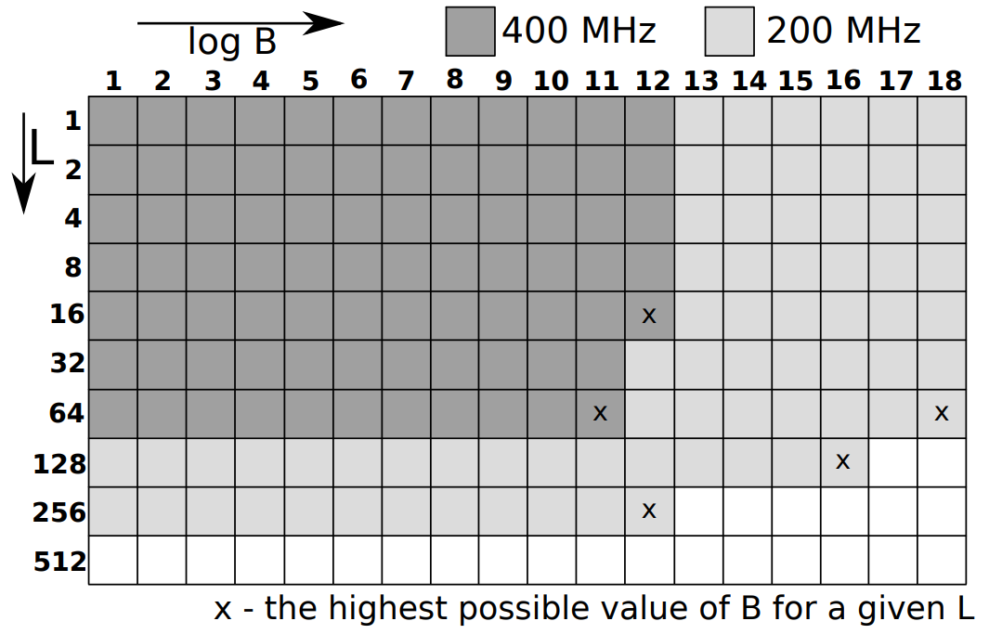
Performance Analysis
Design Space Exploration
B – BRAM size allocated for matching data structures,
L – number of substreams (pipelines)
BRAM signal propagation limits the frequency
Addition complexity grows linearly with L

Slide 28
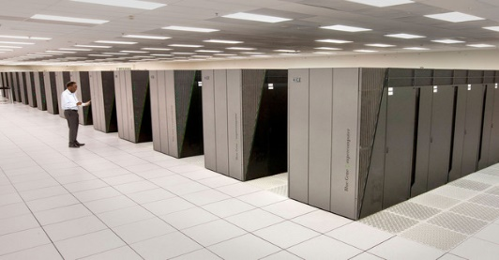
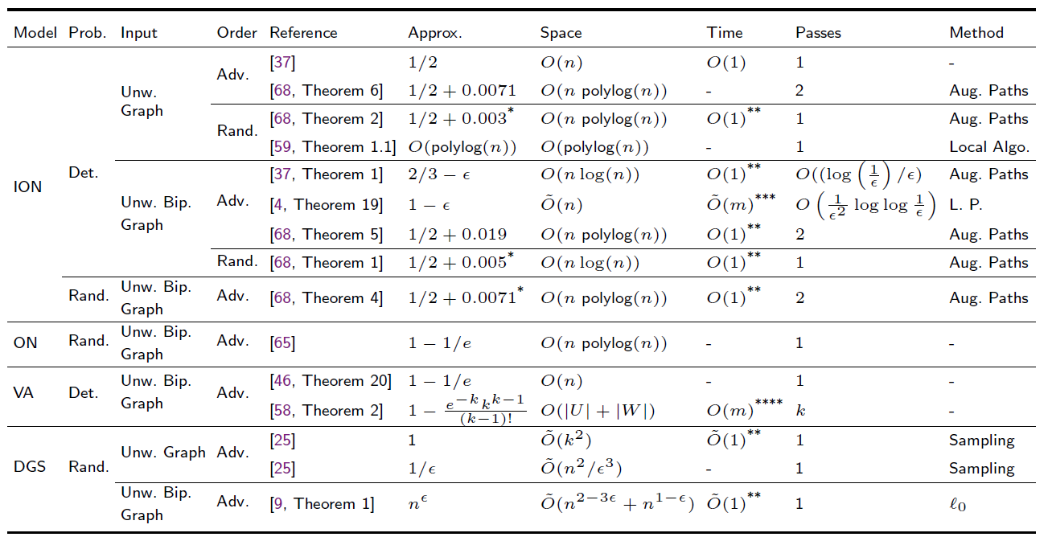
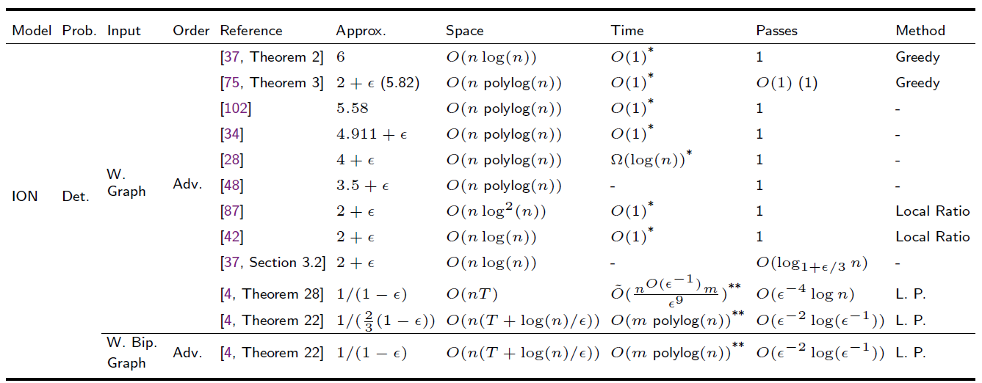
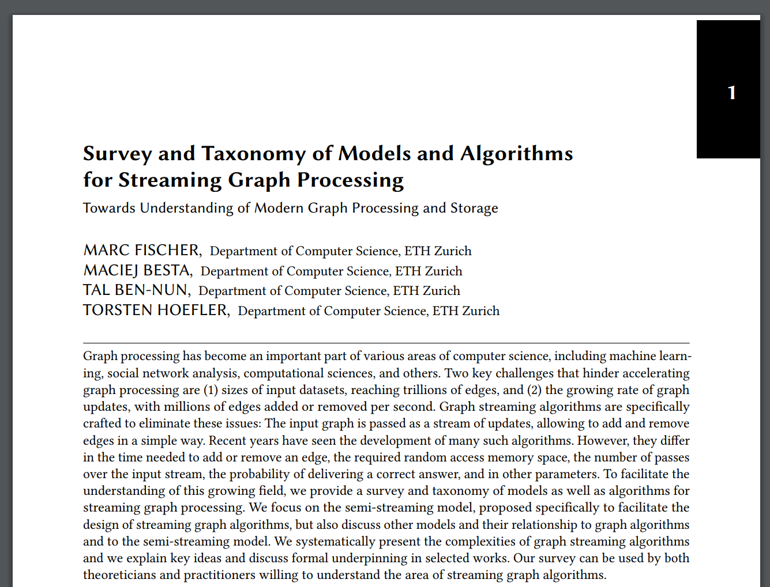
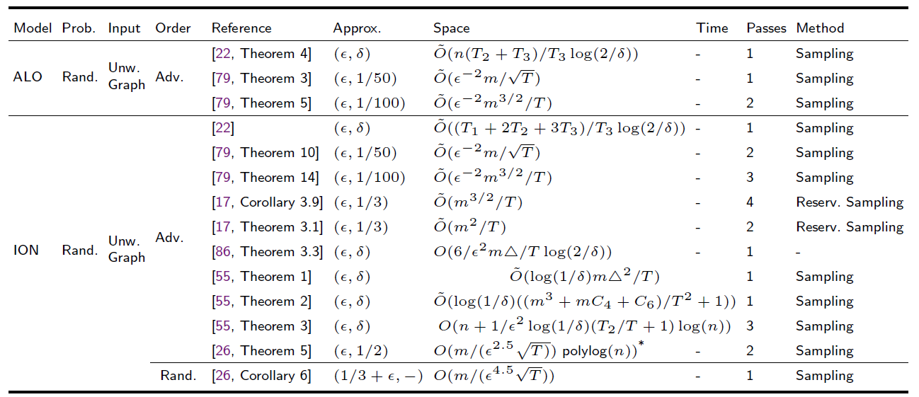
Other Algorithms, Problems, Analyses
Bipartiteness
Work in progress on the distributed setting ☺
Triangle counting
Connected components
Motif counting
In addition to MWM, we also analyzed more graph problems
Minimum spanning trees
Random walks
Colorings
Spanners
Connectivity
Sparsification
Triangle counting
Densest subgraphs
K-edge connectivity
To enable rigorous reasoning, we analyzed ~15 models for streaming graph processing (and selected the best for FPGAs)
K-vertex connectivity
Cash-register
Simple streaming
W-Stream
Semi-streaming
Annotated streaming
MapReduce
Vertex-arrival
Online
MUD
Adjacency-list
Graph Sketching
Insert-only
Sliding window
Dynamic
StreamSort
Turnstile
http://spcl.inf.ethz.ch/Publications/.pdf/graphs-fpgas-survey.pdf
(submitted to arXiv, will appear tonight)
Again, the most relevant parts are in the FPGA paper, the rest in this survey (ready in ~1-2 months)
Notes:
- Where is the promised case study?

Slide 29
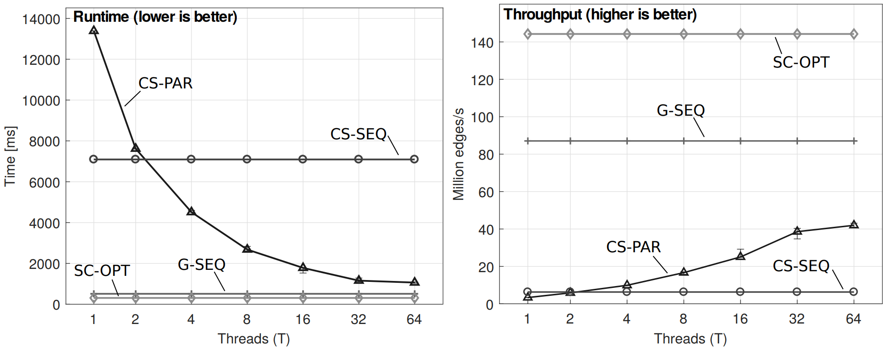
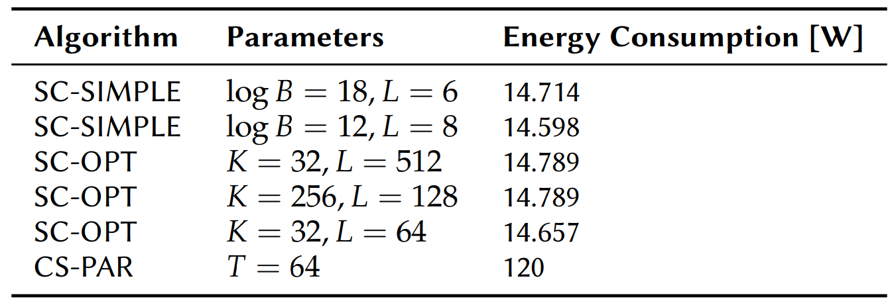
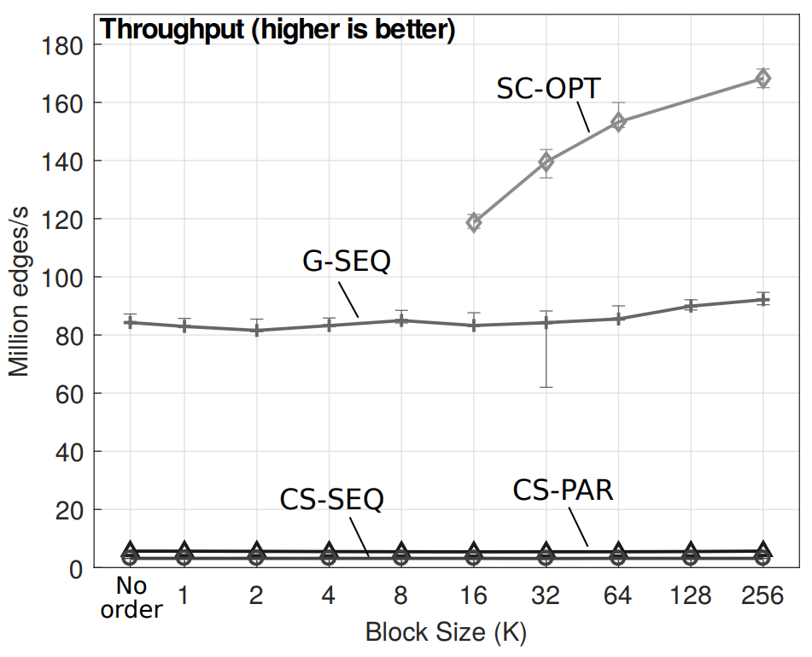
Website & code: http://spcl.inf.ethz.ch/Research/Parallel_Programming/Substream-Centric
Generic FPGA design, code available
Substream-Centric graph processing paradigm, exposes parallelism, enables easy pipelining, supports approximation
Generalizability to other graph problems and settings
Theory-inspired MWM approximate algorithm
on a hybrid CPU-FPGA setting
Detailed domain analysis,
identification of Semi-Streaming Model as FPGA best-fit, 2 surveys
Thank you
for your attention
Notes:
- Where is the promised case study?

Slide 30
BACKUP & EXTENTED SLIDES
Notes:
- Where is the promised case study?

Slide 31
Large graphs…
Let’s use FPGAs for Maximum Matchings...
Problems?
Data-driven
Low power efficiency!
Irregular
120 Watts
250 Watts
Communication- and synchronization-heavy
Graph Problem | CPU (MTEPS/Watt) [1] | FPGA (MTEPS/Watt) [2]
SSSP | 1.9 | 30.2
CC | 0.5 | 48.1
MST | 0.6 | 44.3
[1] A. Roy et al. X-stream: Edge-Centric Graph Processing using Streaming Partitions. ACM Symposium on Operating Syst. 2013.
[2] S. Zhou et al. High-throughput and Energy-efficient Graph Processing on FPGA. FCCM. 2016.

Slide 32
Large graphs…
120 Watts
Data-driven
Irregular
250 Watts
Communication- and synchronization-heavy

Slide 33
Large graphs…
Useful model
Engineering networks
Why do we care?
...even philosophy ☺
Most reliable grid network?
Shortest network path?
Gene alignment?
Physics, chemistry
Biological networks
Machine learning
Least expensive computer network?
Best phone connection?
Social networks
Disease spread channels?
Communication networks
Most relevant protein?
Collaborator experience?
Brain structure?
Terrorism prevention?
Most efficient road network?
Shortest
path?

Slide 34
Part 1: To understand the domain well, we conducted a detailed analysis of graph processing on FPGAs
What programming paradigm and why?
Selected MWM-related parts are in the FPGA paper, the rest is in…
What are the most promising techniques?
Part 1: To understand the domain well, we conducted a detailed analysis of graph processing on FPGAs
Key techniques, challenges, features, …
https://arxiv.org/abs/...
7 paradigms
~15 FPGA graph processing frameworks
~25 FPGA accelerators for specific algorithms

Slide 35
…when in DRAM, accessing & pipelining become complex
It was designed with the “batch” analytics in mind.
Well...
What programming paradigm and why?
Assumes the whole input graph is accessible…
“(...) implementing graph algorithms efﬁciently on Pregel-like systems (...) can be surprisingly difﬁcult and require careful optimizations.” [1]
…when in BRAM, size is severely limited
Vertex-Centric (aka Pregel-like) approach is complex for problems such as matchings, spanning trees, etc.
Vertex-centric, Gather-Apply-Scatter, ... ?
[1] S. Salihoglu and J. Widom, “Optimizing graph algorithms on Pregel-like systems”. VLDB. 2014.

Slide 36
It was designed with the “batch” analytics in mind.
It assumes the whole input is accesible. When in DRAM, accessing & pipelining becomes complex.
To be able to utilize pipelining well, we really want to use streaming (aka the edge-centric paradigm)
What programming paradigm and why?
“(...) implementing graph algorithms efﬁciently on Pregel-like systems (...) can be surprisingly difﬁcult and require careful optimizations.” [1]
Vertex-Centric (aka Pregel-like) approach is complex for problems such as matchings, spanning trees, etc.
Vertex-centric, Gather-Apply-Scatter, ... ?
[1] S. Salihoglu and J. Widom, “Optimizing graph algorithms on Pregel-like systems”. VLDB. 2014.

Slide 37
…when in DRAM, accessing & parallelization become complex
Can be used but it was designed with the “batch” analytics in mind
Well...
What programming paradigm and why?
Assumes the whole input graph is accessible…
…when in BRAM, size is severely limited
KONECT graph datasets
Vertex-centric, Gather-Apply-Scatter, ... ?
Huge
Webgraph datasets

Slide 38
Use some form of streaming (aka edge-centric)
How to implement efficiently on an FPGA?
How to minimize the number of “passes” over edges? (This can get really bad in the “traditional” edge-centric approach, e.g., BFS normally needs O(m+n) work, while in the edge-centric approach it takes O(D m) work (D passes [1]),
What programming paradigm and why?
Processing edges is sequential – how to incorporate parallelism?
m: #edges in a graph
n: #vertices in a graph
D: graph’s diameter
(usually ~5-15)
Some processing unit (CPU, GPU, FPGA, …)
Repeat certain (algorithm-dependent) number of times
DRAM
[1] A. Roy et al. X-stream: Edge-Centric Graph Processing using Streaming Partitions. SOSP. 2013.

Slide 39
Hundreds of papers and schemes, how to select a “streaming model” or an algorithm to use? ☹
We investigated the vast majority of cases, and… guess what happened ☺
We analyzed…
Which one to select?
~15 models for streaming graph processing
~30 algorithms for streaming (approximate) MWM
It is almost ready (may take ~1 month more) – if you want to check it out earlier, let us know!
Any interesting idea to use
in the context of FPGAs and substream-centric processing?

Slide 40
Part 3: Analysis of models and algorithms for streaming graph processing
Part 3: Analysis of models and algorithms for streaming graph processing
Which one to select?
Using a model enables rigorous analysis of the algorithm behavior
Why even should we care?
~15 models for streaming graph processing
Limiting oneself to a particular model helps to select the best algorithm or technique (within that model)
Selecting a right model enables more realistic predictions about the algorithm behavior on given hardware

Slide 41
MUD
MapReduce
Insert-only
Semi-streaming
Adjacency-list
To understand the models (and related caveats) well, we developed a formal taxonomy of the analyzed models with the aim of guiding future graph streaming designs (check the report for details ☺ )
Simple streaming
Vertex-arrival
Graph Sketching
Which one to select?
~15 models for streaming graph processing
Dynamic
Online
StreamSort
W-Stream
Sliding window
Cash-register
Annotated streaming
Turnstile

Slide 42
[1] J. Feigenbaum et al. On graph problems in a semi-streaming model. Theoretical CS, 2005
Covers a general streaming setting (= works for substream-centric)
Semi-streaming [1]
Why semi-streaming, and what does it mean?
Assumes O(n log^{c} n) local space that can be used for processing an edge → fits well FPGA BRAM constraints!
Offers (potentially powerful) MWM algorithms

Slide 43
Research Questions
Use substream-centric processing (exposes parallelism)
Which programming paradigm to use for (approximate) MWM?
For enabling theoretical analysis and rigor in the context of FPGAs (small local space), use the semi-streaming model
How to design a high-performance MWM algorithm (as dictated by the used paradigm)?
What is the HW FPGA design that ensures high performance?
What is the ultimate performance, power consumption, and the related tradeoffs?

Slide 44
Expose parallelism (match substream-centric)
Part 3 continued : Analysis of models and algorithms for streaming graph processing
Our
goals:
Minimize #passes
Accept general (not just bipartite) graphs
Maximize accuracy
Accept weighted graphs
Part 3 continued: Analysis of models and algorithms for streaming graph processing
Part 3 continued: Analysis of models and algorithms for streaming graph processing
~30 algorithms for streaming (approximate) MWM (in the semi-streaming model)
Minimize local space
Any interesting idea to use
in the context of FPGAs and substream-centric processing?
More specifically...

Slide 45
Research Questions
Use substream-centric processing (exposes parallelism)
Which programming paradigm to use for (approximate) MWM
(and many other problems)?
For enabling theoretical analysis and rigor in the context of FPGAs (small local space), use the semi-streaming model
How to design a high-performance MWM algorithm (as dictated by the used paradigm)?
Use the MWM algorithm by Crouch and Stubbs in the substream-centric paradigm in a hybrid CPU-FPGA setting
What is the HW FPGA design that ensures high performance?
What is the ultimate performance, power consumption, and the related tradeoffs?

Slide 46
Substream-Centric MWM: FPGA optimizations
Blocking / Tiling
Vectorization
No, we will not analyze this now ☺ All the details are in the paper. Let’s focus on the key FPGA design ideas and optimizations
They are often used in graph processing schemes on FPGAs; we apply them as well.
Pipelining
Prefetching

Slide 47
The Space of Substream-Centric
$$T_{L,i}$$
Design B
Design A
Locality vs fairness (for writers)
Accuracy
$$T_{R}$$
Amount of FPGA resources
$$T_{DC}$$
Notes:
Writers don’t run wildly: we structure them inside small MCS queues
Ask patrick about the exact semantics of b|x|y. Can it be NOT exact?
T_L,i ? Think about it...

Slide 48
Research Questions
Use substream-centric processing (exposes parallelism)
Which programming paradigm to use for (approximate) MWM?
For enabling theoretical analysis and rigor in the context of FPGAs (small local space), use the semi-streaming model
How to design a high-performance MWM algorithm (as dictated by the used paradigm)?
Use the MWM algorithm by Crouch and Stubbs in the substream-centric paradigm in a hybrid CPU-FPGA setting
The proper use of blocking, vectorization, and others (pipelining, prefetching)
What is the HW FPGA design that ensures high performance?
What is the ultimate performance, power consumption, and the related tradeoffs?

Slide 49
Performance Analysis
Various Graphs
Parameters:
Blocking size = 32, #Substreams = 64
#Threads = 4, ε = 0.1
SC-OPT secures highest performance
Hybrid
Hybrid
CPU
CPU

Slide 50
Performance Analysis
Various Thread (CPU) Counts
Blocking size = 32, #Substreams = 64
#edges = 16M (Kronecker), ε = 0.1
SC-OPT secures highest performance for all considered numbers of threads

Slide 51
Performance Analysis
Various blocking size (K) and #substreams (L)
SC-OPT secures highest performance for all considered values of parameters
Blocking size (K) = 32, #threads = 4,
#edges = 16M (Kronecker), ε = 0.1
#Substreams (L) = 128, #threads = 4,
#edges = 16M (Kronecker), ε = 0.1

Slide 52
Performance Analysis
Approximation
SC-OPT is comparable to the (2+ε)-approximation by Ghaffari et al.
#Substreams (L) = 128, Blocking size (K) = 32, #threads = 4, #edges = 8M (Kronecker)
Blocking size (K) = 32, #threads = 4,
#Substreams (L) = 128 , ε = 0.1

Slide 53
Other Algorithms, Problems, Analyses
Work in progress on the distributed setting ☺
Triangle counting
Connected components
Well, not enough time to present ☺
Minimum spanning trees
Random walks
Motif counting
In addition to MWM, we also analyzed many more graph problems
Connectivity
Triangle counting
Spanners
Colorings
K-edge connectivity
Densest subgraphs
Preliminary substream-centric designs and results
K-vertex connectivity
Bipartiteness
☺ https://arxiv.org/abs/...
Again, the most relevant parts are in the FPGA paper, the rest in this survey (ready in ~1-2 months)
Cut sparsification
Spectral sparsification
Notes:
- Where is the promised case study?

Slide 54
Substream-Centric MWM: FPGA design

Slide 55
Matching Bits: Key Data Structures for Maintaining Information on Matchings
An incoming edge...
e = (u, v, weight)
Vertices + matchings (correctness)
Edges + matchings (more performance)
Vertex u is a part of a matching in substreams 0, 2
(L = 5)
For the current edge, is...
1
0
1
0
0
0
0
0
0
0
Vertex v is not a part of any matching
(L = 5)
1
0
1
0
0
weight ${≥\left(1+ε\right)}^{0}$ ?
L „row” bit vectors (one
per substream)
...
weight ${≥\left(1+ε\right)}^{1}$ ?
L bits (one per substream)
weight ${≥\left(1+ε\right)}^{2}$ ?
v-th vector
weight ${≥\left(1+ε\right)}^{3}$ ?
weight ${≥\left(1+ε\right)}^{4}$ ?
u-th vector
n „column” bit vectors (one per vertex)
Notes:
Lets take a closer look at the vectorization. Remember how we were able to compute a maximal matching by a simple bit array. In this example shown here, we compute 5 maximal matchings in parallel.
So first of all, we load an edge from main memory to the FPGA. Assume we are therefore given some edge e with vertices u, v, and edge weight w.
We then load two vectors from main memory to the FPGA. A vector tells us if u or v is already a part of a matching. If we would compute only one matching, the vector would have 1 entry, as seen at the beginning. But since we compute 5 maximal matchings at once, we need 5 entries per vertex. The values we have chosen here are just for demonstration.
We now need to decide, if this edge is part of a substream. This decision is made by comparing the edge’s weight to constant values, which depend on epsilon. Overall, we need to compute L many integer comparisons.
We then decide, if we can add an edge to a maximal matching. This is done element-wise, by considering the loaded vector and the decision, if the edge is part of the substream. We can add the edge to the matching, if the according entries in the loaded vector are 0, and e is part of the substream. Otherwise, the edge is not added. In this example here, we cannot add the edge to the matching, since there is already an incident edge to vertex u.
Finally, we update the vectors and write them back to main memory, and add the edge to the appropriate matchings.

Slide 56
Performance Analysis
Various #substreams (L)
Hybrid
Parameters:
Blocking size (K) = 32, #threads = 4,
#edges = 16M (Kronecker), ε = 0.1
SC-OPT secures highest performance for all considered values of parameters
CPU
#Substreams (pipelines)

Slide 57
Large graphs…
120 Watts
250 Watts
Communication- and synchronization-heavy

