Slide 1

Stop Crying Over Your Cache Miss Rate:
Handling Efficiently Thousands of Outstanding Misses in FPGAs
Mikhail Asiatici and Paolo Ienne
Processor Architecture Laboratory (LAP)
School of Computer and Communication Sciences
EPFL
February 26, 2019

Slide 2

Motivation
FPGA
Memory
200 MHz
800 MHz DDR
Accelerator
Memory-level parallelism
32
Arbiter
Memory Controller
DDR3-1600 Memory
Blocking
Cache
<<
0.8 GB/s
Non-Blocking
Cache
…
512
64
32
12.8 GB/s
12.8 GB/s
Reuse
0.8 GB/s
Accelerator
<<
0.8 GB/s
Data blocks stored in cache, hoping for future reuse
Notes:
FPGAs rely on massive datapath parallelism (1) to provide acceleration despite the frequency gap (2) with CPUs and GPUs. However, such parallelism is wasted if the memory system is unable to feed it. This is a problem whenever irregular accesses to external memory are common (3), and applications that do so often end up being memory bound. Let’s see why is it so and what we can do about it in the most general case.
Suppose we want to use a DDR3-1600 that operates at 800 MHz DDR (4). At 64 bits/transfer, it can provide up to 12.8 GB/s of bw (5). To expose the full bandwidth to the slower FPGA clock domain, the memory controller (6) will have a very wide memory interface – in this case, 512 bits (7). Now, if accelerators operate on narrow data (8), and their access patterns are not mutually correlated, or we can’t afford design effort figuring out how we can correlate them or make use of bursts, then sharing this memory channel efficiently is not trivial.
The simplest way to do so is by using an arbiter (9) that time-multiplexes this memory channel. While this allows us to maximize memory-level parallelism, fully pipelining memory access, we will never use more than 32 bits per cycle (10), that is, 1/16th of the bandwidth (11).
Another possibility would be to use a simple blocking cache (12). The cache would store data blocks, hoping for future reuse (13). However, whenever a miss occurs (14), the memory channel is stalled until the missing cache line returns from memory. If the memory has a 50-cycle latency, this means that there will have at most one transfer every 50 cycles (15). Therefore, unless the hit rate is very high, the bandwidth utilization will not be better than with an arbiter, possibly even worse.
A non-blocking cache (16) would do a better job. It is a cache, so it allows reuse of stored blocks (17), but misses will not prevent subsequent hits to be served, and it can tolerate a certain number of outstanding misses, which improves MLP (18). It looks like the ideal solution, right? The key is the number of outstanding misses that can be tolerated. Traditional non-blocking caches can tolerate a few tens of misses; however, if the hit rate is low and the memory latency is long, then even the non-blocking cache may stall too early, making it not too different from a blocking cache.
In this presentation, we will show that the mechanism used by non-blocking caches to keep track of outstanding misses not only increases MLP but also improves reuse (20) and that, if temporal locality is low, trading some or all the area used by the cache to keep track of more outstanding misses can increase performance (21).

Slide 3
Motivation
Memory-level parallelism
Non-Blocking
Cache
Reuse
If hit rate is low, tracking more outstanding misses can be more cost-effective than enlarging the cache
Reuse

Slide 4
Outline
Background on Non-Blocking Caches
Efficient MSHR and Subentry Storage
Detailed Architecture
Experimental Setup
Results
Conclusions
Notes:
We’ll see how the implementation of standard non-blocking caches provides reuse of in-flight cache lines, then…

Slide 5
Non-Blocking Caches
MSHR = Miss Status Holding Register
Cache array
0x100C
0x1004
tag
data
MSHR array
0x123
0x1F2D5D08706718799CD58F2F566
0xCA8
0xE9C0F7A7697CBA7CDC1A7934E34
tag
subentries
0x100
0x36C2156B751D4EBB940316495CB
0x100
4
C
miss
0xEBB9
0x100
0x156B
0x100: 0x36C2156B751D4EBB940316495CB
Primary miss
allocate MSHR
allocate subentry
send memory request
Secondary miss
allocate subentry
MSHRs provide reuse without having to store the cache line → same result, smaller area
More MSHRs can be better than a larger cache
External memory
Notes:
When a non-blocking cache has a miss, instead of stalling like a blocking cache, it stores the miss information in an MSHR…
Stress that this is the standard non-blocking cache implementation
Explain that cache provides reuse for future, MSHRs while the cache line is in flight. If MSHR lifetime is long enough (long memory latency),

Slide 6
Outline
Background on Non-Blocking Caches
Efficient MSHR and Subentry Storage
Detailed Architecture
Experimental Setup
Results
Conclusions

Slide 7
How To Implement 1000s of MSHRs?
MSHR array
tag
subentries
One MSHR tracks one in-flight cache line
MSHR tags need to be looked up
  On a miss: primary or secondary miss?
  On a response: retrieve subentries
Traditionally: MSHRs are searched fully associatively [1, 2]
  Scales poorly, especially on FPGAs
Set-associative structure?
=
=
=
=
=
=
=
=
[1] David Kroft “Lockup-free instruction fetch/prefetch cache organization” ISCA 1981
[2] K. I. Farkas and N. P. Jouppi “Complexity/Performance Tradeoffs with Non-blocking Loads” ISCA 1994
Notes:
Explain why fully associative scales poorly (area and delay for comparators and parallel lookup)

Slide 8
Storing MSHRs in a Set-Associative Structure
0x24
2
Use abundant BRAM efficiently
0x46
0x10
0x59
0x87

Slide 9

Storing MSHRs in a Set-Associative Structure
0xA3
4
Use abundant BRAM efficiently
Collisions?
  Stall until deallocation of colliding entry
→ Low load factor
(25% avg, 40% peak with 4 ways)
Solution: cuckoo hashing
0x46
0x24
0x10
0x59
0x87
Notes:
Say that 25% and 40% come from our measurements

Slide 10

Cuckoo Hashing
0x244
0x591
0x463
0x463
Use abundant BRAM efficiently
Collisions can often be resolved immediately
  With a queue [3], during idle cycles
High load factor
  3 hash tables: > 80% average
  4 hash tables : > 90% average
h₀
h_{d-1}
0x463
0x100
0x879
[3] A. Kirsch and M. Mitzenmacher “Using a queue to de-amortize cuckoo hashing in hardware” AACCCC 2007

Slide 11
Efficient Subentry Storage
tag
subentries
0x100
4
C
One subentry tracks one outstanding miss
Traditionally: fixed number of subentry slots per MSHR
  Stall when an MSHR runs out of subentries [2]
  Difficult tradeoff between load factor and stall probability
Decoupled MSHR and subentry storage
  Both in BRAM
Subentry slots are allocated in chunks (rows)
  Each MSHR initially gets one row of subentry slots
  MSHRs that need more subentries get additional rows, stored as linked lists
  Higher utilization and fewer stalls than static allocation
tag
subentries
[2] K. I. Farkas and N. P. Jouppi “Complexity/Performance Tradeoffs with Non-blocking Loads” ISCA 1994

Slide 12
Outline
Background on Non-Blocking Caches
Efficient MSHR and Subentry Storage
Detailed Architecture
Experimental Setup
Results
Conclusions

Slide 13
MSHR-Rich Memory System
General Architecture
tag
subentries
N_{b}
N_{i}
Notes:
Say “it’s like a multibanked cache”

Slide 14
Miss Handling
ID
Address
56 0x7362
miss

Slide 15
Miss Handling
Pointer to first row of subentries
56 0x732
0x736
51
Notes:
Say that I skip MSHR buffer for time reasons and rather spend more words on the subentry buffer

Slide 16
Subentry Buffer
tag
ptr
ID
ID
ptr
0x736
51
25 3
56 2
offset
offset
Head row from MSHR buffer
ID
Offset
51
56 2
Subentry
buffer
rdaddr
wraddr
One read, one write per request: insertion pipelined without stall
(dual-port BRAM)
wrdata
rddata
51
25 3
Free row queue (FRQ)
Update logic
Response
generator
25 3
56 2

Slide 17

Subentry Buffer
tag
ptr
ID
ID
ptr
ID
ID
ptr
0x736
51
25 3
56 2
103
13 0
offset
offset
offset
offset
51
13 0
Subentry
buffer
rdaddr
wraddr
wrdata
Stall needed to insert extra row
rddata
51
25 3
56 2
Free row queue (FRQ)
Update logic
Response
generator
103
103
25 3
56 2
103
103
13 0

Slide 18
Subentry Buffer
tag
ptr
ID
ID
ptr
ID
ID
ptr
0x736
51
25 3
56 2
103
13 0
offset
offset
offset
offset
Last row cache
51
A9 2
Subentry
buffer
rdaddr
Linked list traversal: stall…
…only sometimes, thanks to last row cache
wraddr
wrdata
rddata
25 3
56 2
13 0
103
103
Free row queue (FRQ)
Update logic
Response
generator

Slide 19
Subentry Buffer
tag
ptr
ID
ID
ptr
ID
ID
ptr
0x736
51
25 3
56 2
103
13 0
offset
offset
offset
offset
Last row cache
Data from memory
51
1AF6
60B3
2834
2834
C57D
C57D
Subentry
buffer
rdaddr
wraddr
wrdata
rddata
51
25
56 2
25 3
56
103
103
Free row queue (FRQ)
Update logic
Response
generator

Slide 20
Subentry Buffer
ID
ID
ptr
13 0
offset
offset
Last row cache
103
1AF6
60B3
2834
2834
C57D
C57D
Stall requests only when
allocating new row
iterating through linked list, unless last row cache hits
a response returns
Overhead is usually negligible
Subentry
buffer
rdaddr
wraddr
wrdata
rddata
13 0
Free row queue (FRQ)
Update logic
Response
generator

Slide 21
Outline
Background on Non-Blocking Caches
Efficient MSHR and Subentry Storage
Detailed Architecture
Experimental Setup
Results
Conclusions

Slide 22
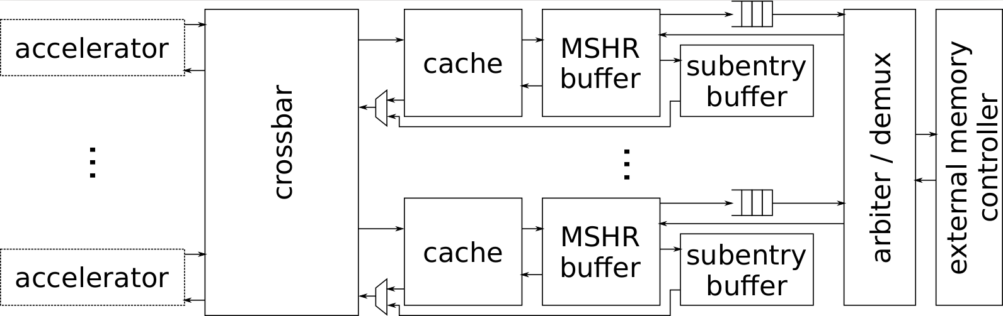
Experimental Setup
Memory controller written in Chisel 3
  4 accelerators, 4 banks
Vivado 2017.4
ZC706 board
  XC7Z045 Zynq-7000 FPGA with 437k FFs, 219k LUTs, 1090 18kib BRAMs (2.39 MB of on-chip memory)
  1 GB of DDR3 on processing system (PS) side – 3.5 GB/s max bandwidth
  1 GB of DDR3 on programmable logic (PL) side – 12.0 GB/s max bandwidth
f = 200 MHz
  To be able to fully utilize DDR3 bandwidth

Slide 23
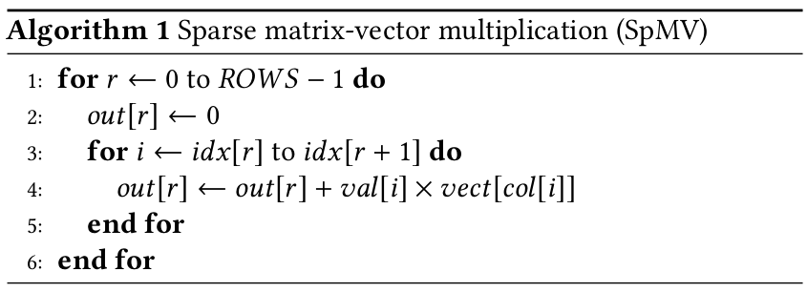
Compressed Sparse Row SpMV Accelerators
This work is not about optimized SpMV!
  We aim for a generic architectural solution
Why SpMV?
  Representative of latency-tolerant, bandwidth-bound applications with various degrees of locality
  Important kernel in many applications [5]
  Several sparse graph algorithms can be mapped to it [6]
[5] A. Ashari et al. “Fast Sparse Matrix-Vector Multiplication on GPUs for graph applications” SC 2014
[6] J. Kepner and J. Gilbert “Graph Algorithms in the Language of Linear Algebra” SIAM 2011
Notes:
Don’t say: “change access pattern by changing sparsity”; rather say “by taking matrices from different domains, we can evaluate very different access patterns”

Slide 24
Benchmark Matrices
Higher → poorer temporal locality
matrix | non-zero elements | rows | vector size | stack distance percentiles 75% 90% 95%
dblp-2010 | 1.62M | 326k | 1.24 MB | 2 | 348 | 4.68k
pds-80 | 928k | 129k | 1.66 MB | 26.3k | 26.6k | 26.6k
amazon-2008 | 5.16M | 735k | 2.81 MB | 6 | 6.63k | 19.3k
flickr | 9.84M | 821k | 3.13 MB | 3.29k | 8.26k | 14.5k
eu-2005 | 19.2M | 863k | 3.29 MB | 5 | 26 | 69
webbase_1M | 3.10M | 1.00M | 3.81 MB | 2 | 19 | 323
rail4284 | 11.3M | 4.28k | 4.18 MB | 0 | 13.3k | 35.4k
youtube | 5.97M | 1.13M | 4.33 MB | 5.8k | 20.6k | 32.6k
in-2004 | 16.9M | 1.38M | 5.28 MB | 0 | 4 | 11
ljournal | 79.0M | 5.36M | 20.5 MB | 19.3k | 120k | 184k
mawi1234 | 38.0M | 18.6M | 70.8 MB | 20.9k | 176k | 609k
road_usa | 57.7M | 23.9M | 91.4 MB | 31 | 601 | 158k
> total BRAM size
https://sparse.tamu.edu/

Slide 25
Outline
Background on Non-Blocking Caches
Efficient MSHR and Subentry Storage
Detailed Architecture
Experimental Setup
Results
Conclusions

Slide 26
Area – Fixed Infrastructure
 | Slices
Baseline with 4 banks | 11.0k
Our system with 4 banks | 10.0k
Baseline: cache with 16 associative MSHRs + 8 subentries per bank
  Blocking cache & no cache perform significantly worse
MSHR-rich: -10% slices
  MSHRs & subentries: FFs → BRAM
  < 1 % variation depending on MSHRs and subentries
(4 accelerators + MIG: 11.9k)
What about BRAMs?
Notes:
All data from 16a on lappc14
Accelerators + DMAs + MIG + ROBs: 11452
Associative MHA (FPGAMSHR – ROBs): 10987
MSHR-rich (FPGAMSHR – ROBs): 9984

Slide 27
BRAMs vs Runtime
Area (BRAMs)
Runtime (cycles/multiply-accumulate)

Slide 28
BRAMs vs Runtime

Slide 29
BRAMs vs Runtime

Slide 30
BRAMs vs Runtime

Slide 31
BRAMs vs Runtime

Slide 32
BRAMs vs Runtime
3% faster, 3.4x fewer BRAMs
6% faster, 2x fewer BRAMs
6% faster, 2x fewer BRAMs
1% faster, 3.2x fewer BRAMs
Same performance, 5.5x fewer BRAMs
90% of Pareto-optimal points are MSHR-rich
25% are MSHR-rich with no cache!
25% faster, 24x fewer BRAMs
7% faster, 2x fewer BRAMs
Same performance, 3.9x fewer BRAMs
6% faster, 2.4x fewer BRAMs

Slide 33
Outline
Background on Non-Blocking Caches
Efficient MSHR and Subentry Storage
Detailed Architecture
Experimental Setup
Results
Conclusions

Slide 34

Conclusions
Traditionally: avoid irregular external memory accesses, whatever it takes
  Increase local buffering → area/power
  Application-specific data reorganization/algorithmic transformations → design effort
Latency-insensitive and bandwidth-bound? Repurpose some local buffering to better miss handling!
  Most Pareto-optimal points are MSHR-rich, across all benchmarks
  Generic and fully dynamic solution: no design effort required

Slide 35
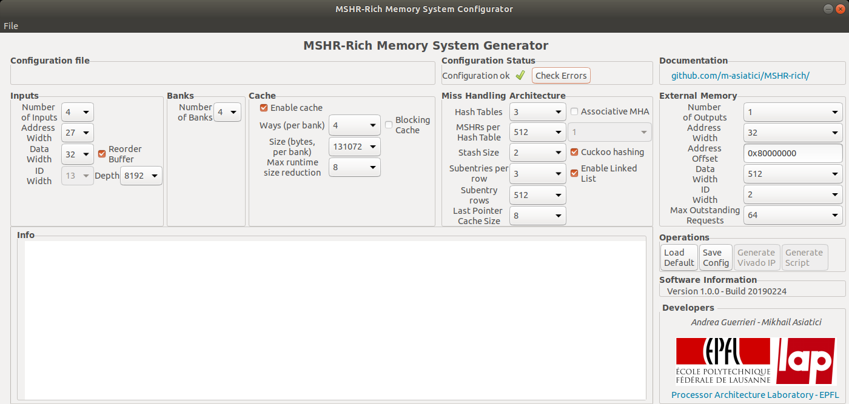
Thank you!
  https://github.com/m-asiatici/MSHR-rich

Slide 36
Backup

Slide 37
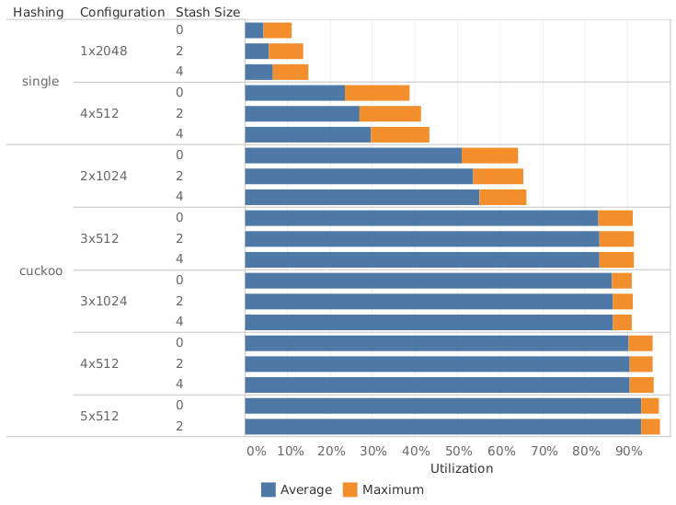
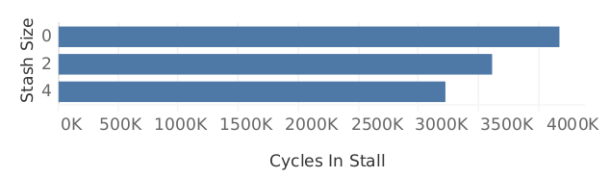
Benefits of Cuckoo Hashing
Achievable MSHR buffer load factor with uniformly distributed benchmark, 3x4096 subentry slots, 2048 MSHRs or closest possible value

Slide 38
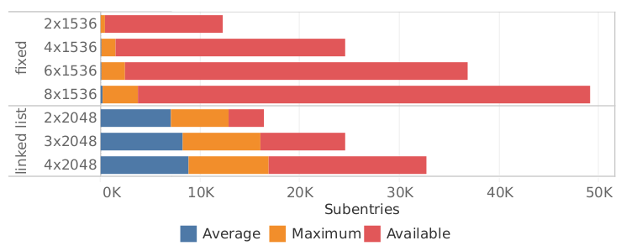
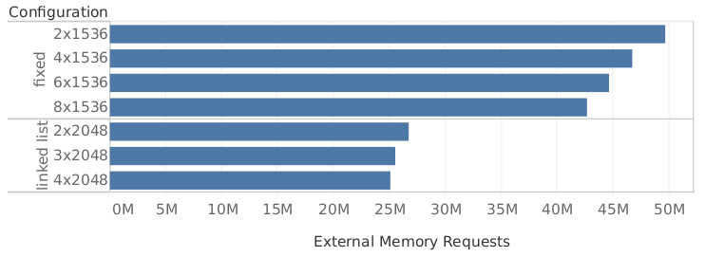
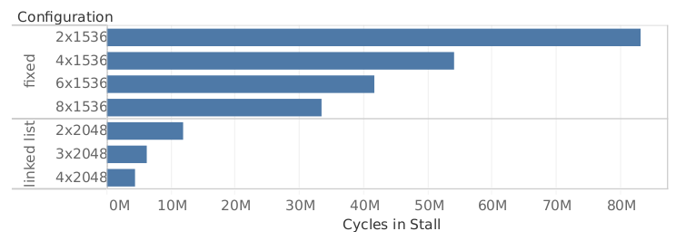
Benefits of Subentry Linked Lists
Subentry slots utilization
External memory requests
Subentry-related stall cycles
All data refers to ljournal with 3x512 MSHRs/bank

Slide 39
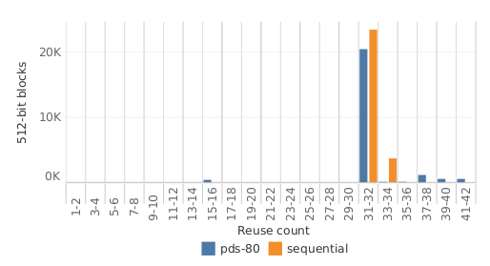
Irregular, Data-Dependent Access Patterns:
Can We Do Something About Them?
Case study: SpMV with pds-80 from SuiteSparse [1]
  Assume matrix and vector values are 32-bit scalars
  928k NZ elements
  129k rows, 435k columns → 1.66 MB of memory accessed irregularly
Spatial locality: histogram of reuses of 512-bit blocks
pds-80 as it is has essentially same reuse
opportunities as if it was scanned sequentially
…but, hit rate with a 256 kB, 4-way associative cache
is only 66%! Why??
[1] https://sparse.tamu.edu/

Slide 40
Reuse with Blocking Cache
Four cache lines, LRU, fully-associative:
M
M
M
time
+1 cache line:
M
speedup
M
Eviction limits reuse window
  Mitigated by adding cache lines
Longer memory latency → more wasted cycles
time

Slide 41
Reuse with Non-Blocking Cache
Four cache lines, LRU, fully-associative:
M
M
M
Four cache lines, LRU, fully-associative, one MSHRs:
speedup
time
M
M
M
M
time
MSHRs widen reuse window
Fewer stalls, wasted cycles less sensitive to memory latency
In terms of reuse, if memory has long latency, or if it can’t keep up with requests, 1 MSHR ≈ 1 more cache line
  1 cache line = 100s of bits
  1 MSHR = 10s of bits
→ Adding MSHRs can be more cost-effective than enlarging the cache, if hit rate is low

Slide 42
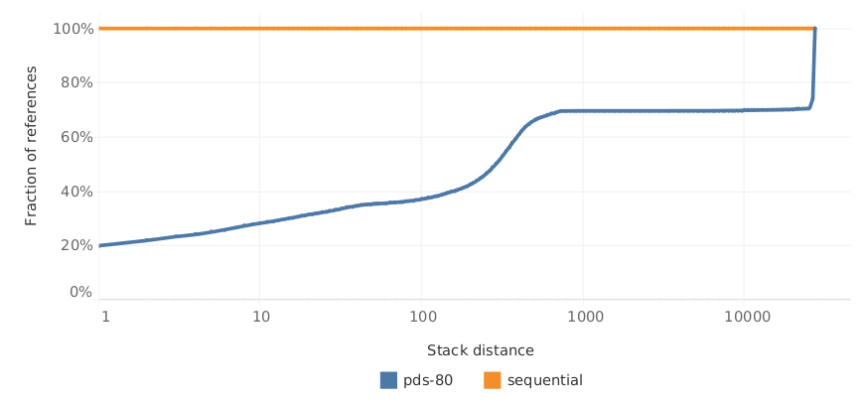
Stack Distance
Stack distance: #different blocks referenced between to references to the same block
{746, 1947, 293, 5130, 293, 746}
S = 1
S = 3
Temporal locality: cumulative histogram of stack distances of reuses
Fully associative, LRU cache
Realistic cache
Always a miss
Can be a hit
Always a hit
4,096
(256 kB cache)

Slide 43
Harnessing Locality With High Stack Distance
Cost of shifting the boundary by one: one cache line (512 bit)
  Is there any cheaper way to obtain data reuse, in a general case?
Always a miss
Can be a hit
4,096
(256 kB cache)

Slide 44
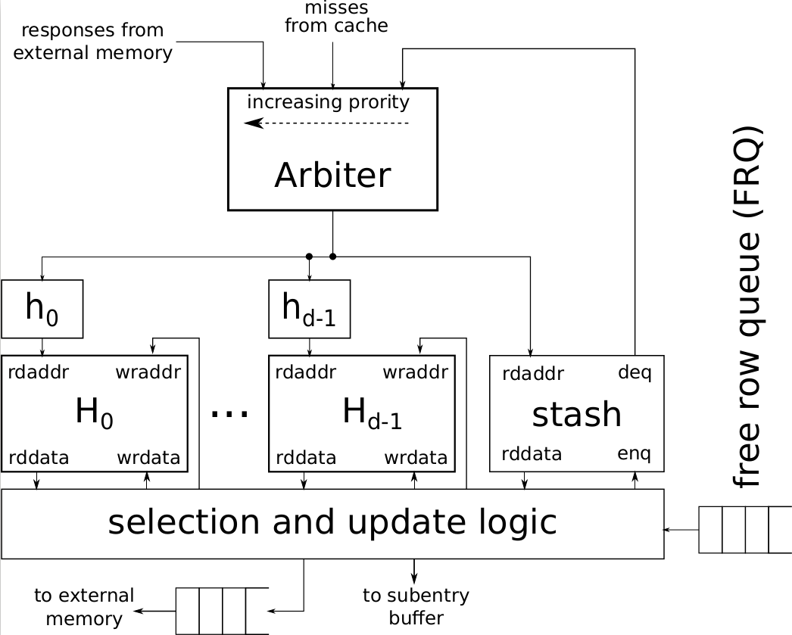
MSHR Buffer
Request pipeline must be stalled only when:
  Stash is full
  A response returns
Higher reuse → fewer stalls due to responses

Slide 45
Memory-Bound Applications
FPGAs rely on massive datapath parallelism to overcome frequency gap with CPUs and GPUs
Wasted if memory system is unable to feed it
Not a problem if:
  Dataset is small enough to fit into on-chip RAM
  High computational intensity
  Accesses are sequential → efficient burst reads
  Accesses are regular → scratchpads
  Accesses have spatial and temporal locality → caches
  Access pattern is known at compile-time → data reorganization, memory banking

Slide 46
Irregular, Data-Dependent Access Patterns
What if
  Access pattern has poor locality, is irregular and data-dependent (e.g. sparse linear algebra and graph analytics)?
  Design effort for an application-specific solution is not an option?
Maximize MLP: emit enough outstanding memory requests to fully exploit memory latency
Still, throughput limited to one memory operation per cycle per channel
If accelerators have narrow data ports, memory bandwidth can be significantly underutilized

