Slide 1
Accelerating Graph Analytics By Co-Optimizing Storage and Access on an FPGA-HMC Platform
Soroosh Khoram, Jialiang Zhang, Maxwell Strange, Jing Li
khoram@wisc.edu, jialiang.zhang@ece.wisc.edu, mbstrange@wisc.edu, jli@ece.wisc.edu
Department of Electrical and Computer Engineering
University of Wisconsin-Madison

Slide 2
Agenda
Motivation and Background
Workload Characterization
Proposed Algorithm
Hardware Implementation
Evaluation
Conclusion

Slide 3
Agenda
Motivation and Background
Workload Characterization
Proposed Algorithm
Hardware Implementation
Evaluation
Conclusion

Slide 4
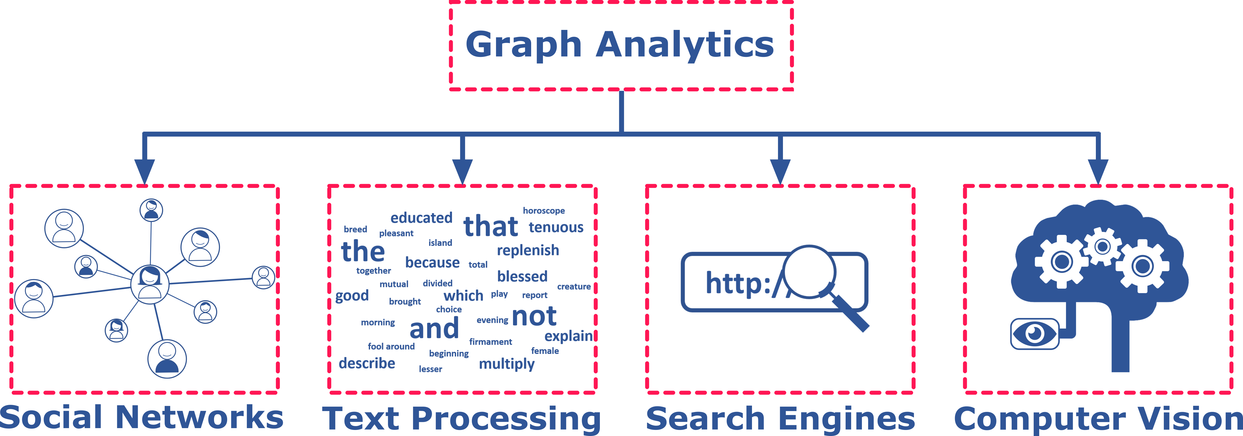
Motivation

Slide 5
Motivation

Slide 6
Graph Analytics Challenges
Large graph workloads present key challenges for processing systems
Abundant memory
accesses
Poor locality
Memory-bound

Slide 7
Graph Analytics Challenges
Large graph workloads present key challenges for processing systems
Abundant memory
accesses
Poor locality
Memory-bound

Slide 8
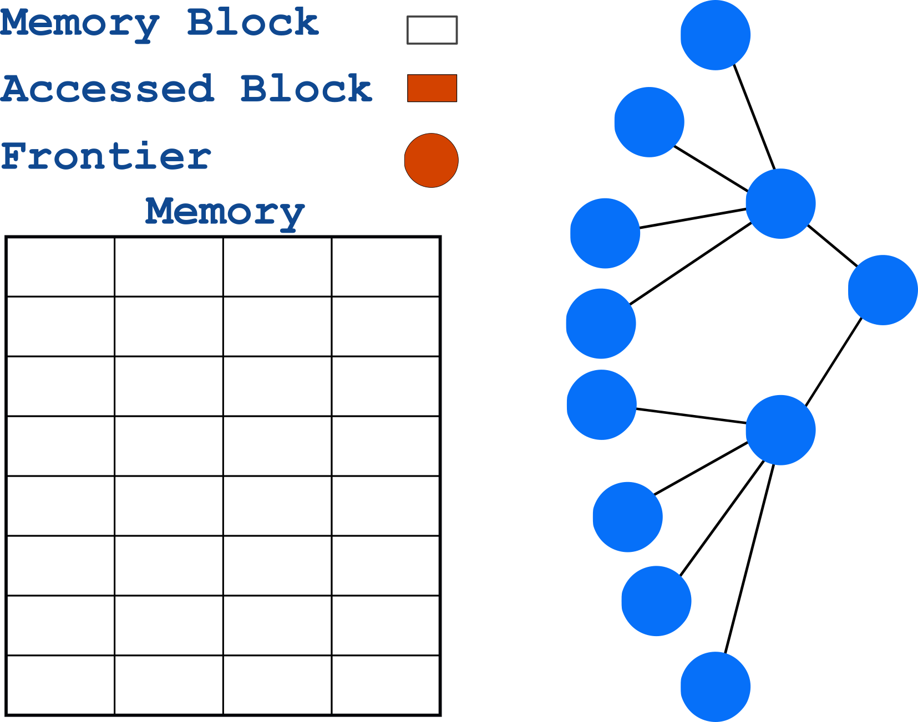
Breadth First Search
A ubiquitous building block for state-of-the-art graph analytics
Makes frequent random memory accesses.
4
5
2
6
4
1
5
7
6
2
8
7
1
3
8
9
9
3
10
10
11
11

Slide 9
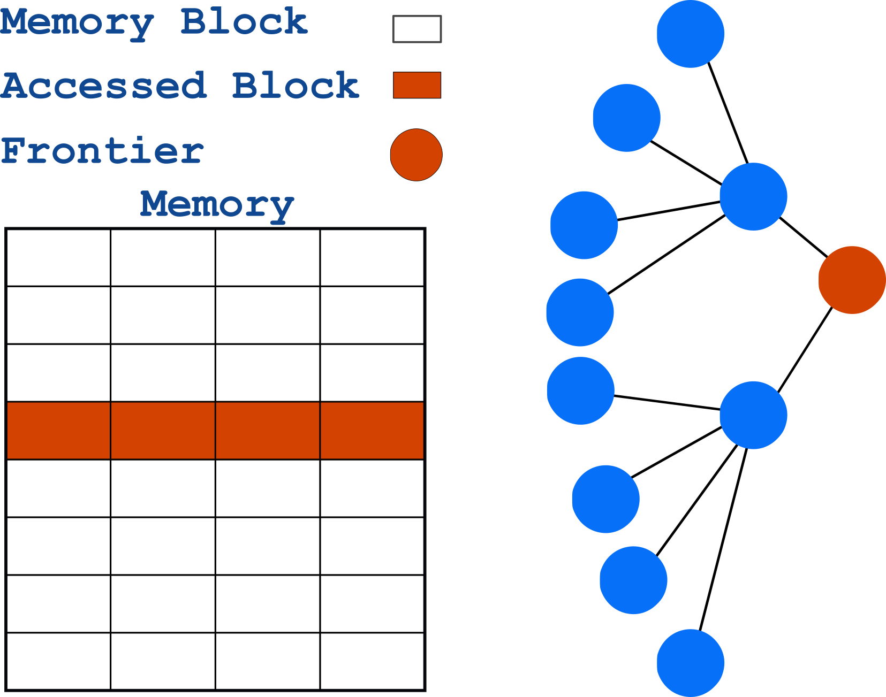
Breadth First Search
A ubiquitous building block for state-of-the-art graph analytics
Makes frequent random memory accesses.
4
5
2
6
4
1
5
7
6
2
8
7
1
3
8
9
9
3
10
10
11
11

Slide 10
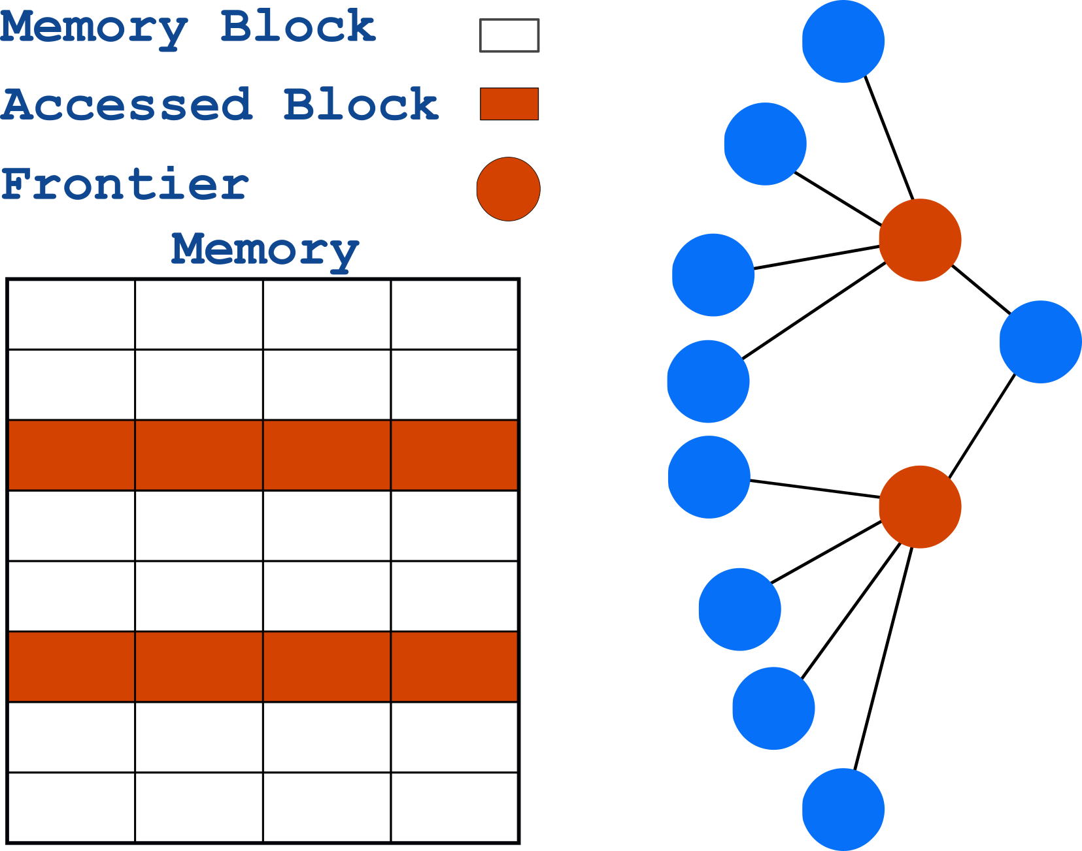
Breadth First Search
A ubiquitous building block for state-of-the-art graph analytics
Makes frequent random memory accesses.
4
5
2
6
4
1
5
7
6
2
8
7
1
3
8
9
9
3
10
10
11
11

Slide 11
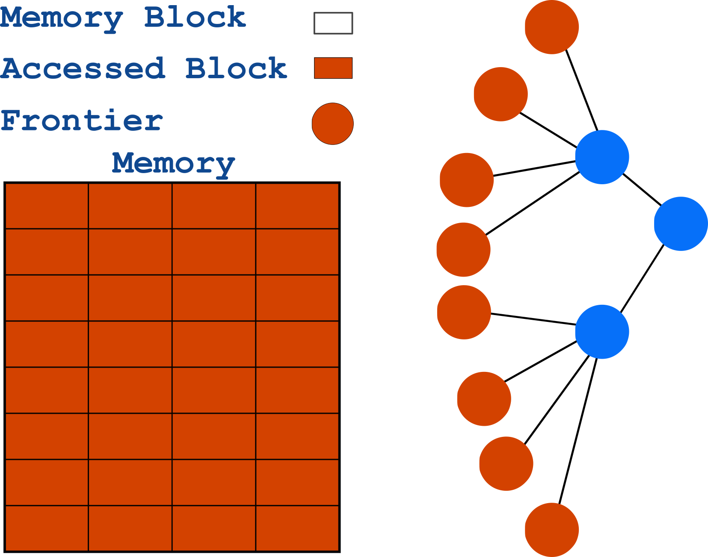
Breadth First Search
A ubiquitous building block for state-of-the-art graph analytics
Makes frequent random memory accesses.
4
5
2
6
4
1
5
7
6
2
8
7
1
3
8
9
9
3
10
10
11
11

Slide 12
Previous Work
Previously we improved BFS by:
Reducing unnecessary memory accesses
Optimizing access granularity to memory
Using Hybrid Memory Cube
Zhang et al. Boosting the Performance of FPGA-based Graph Processor using Hybrid Memory Cube: A Case for Breadth First Search, FPGA’17

Slide 13
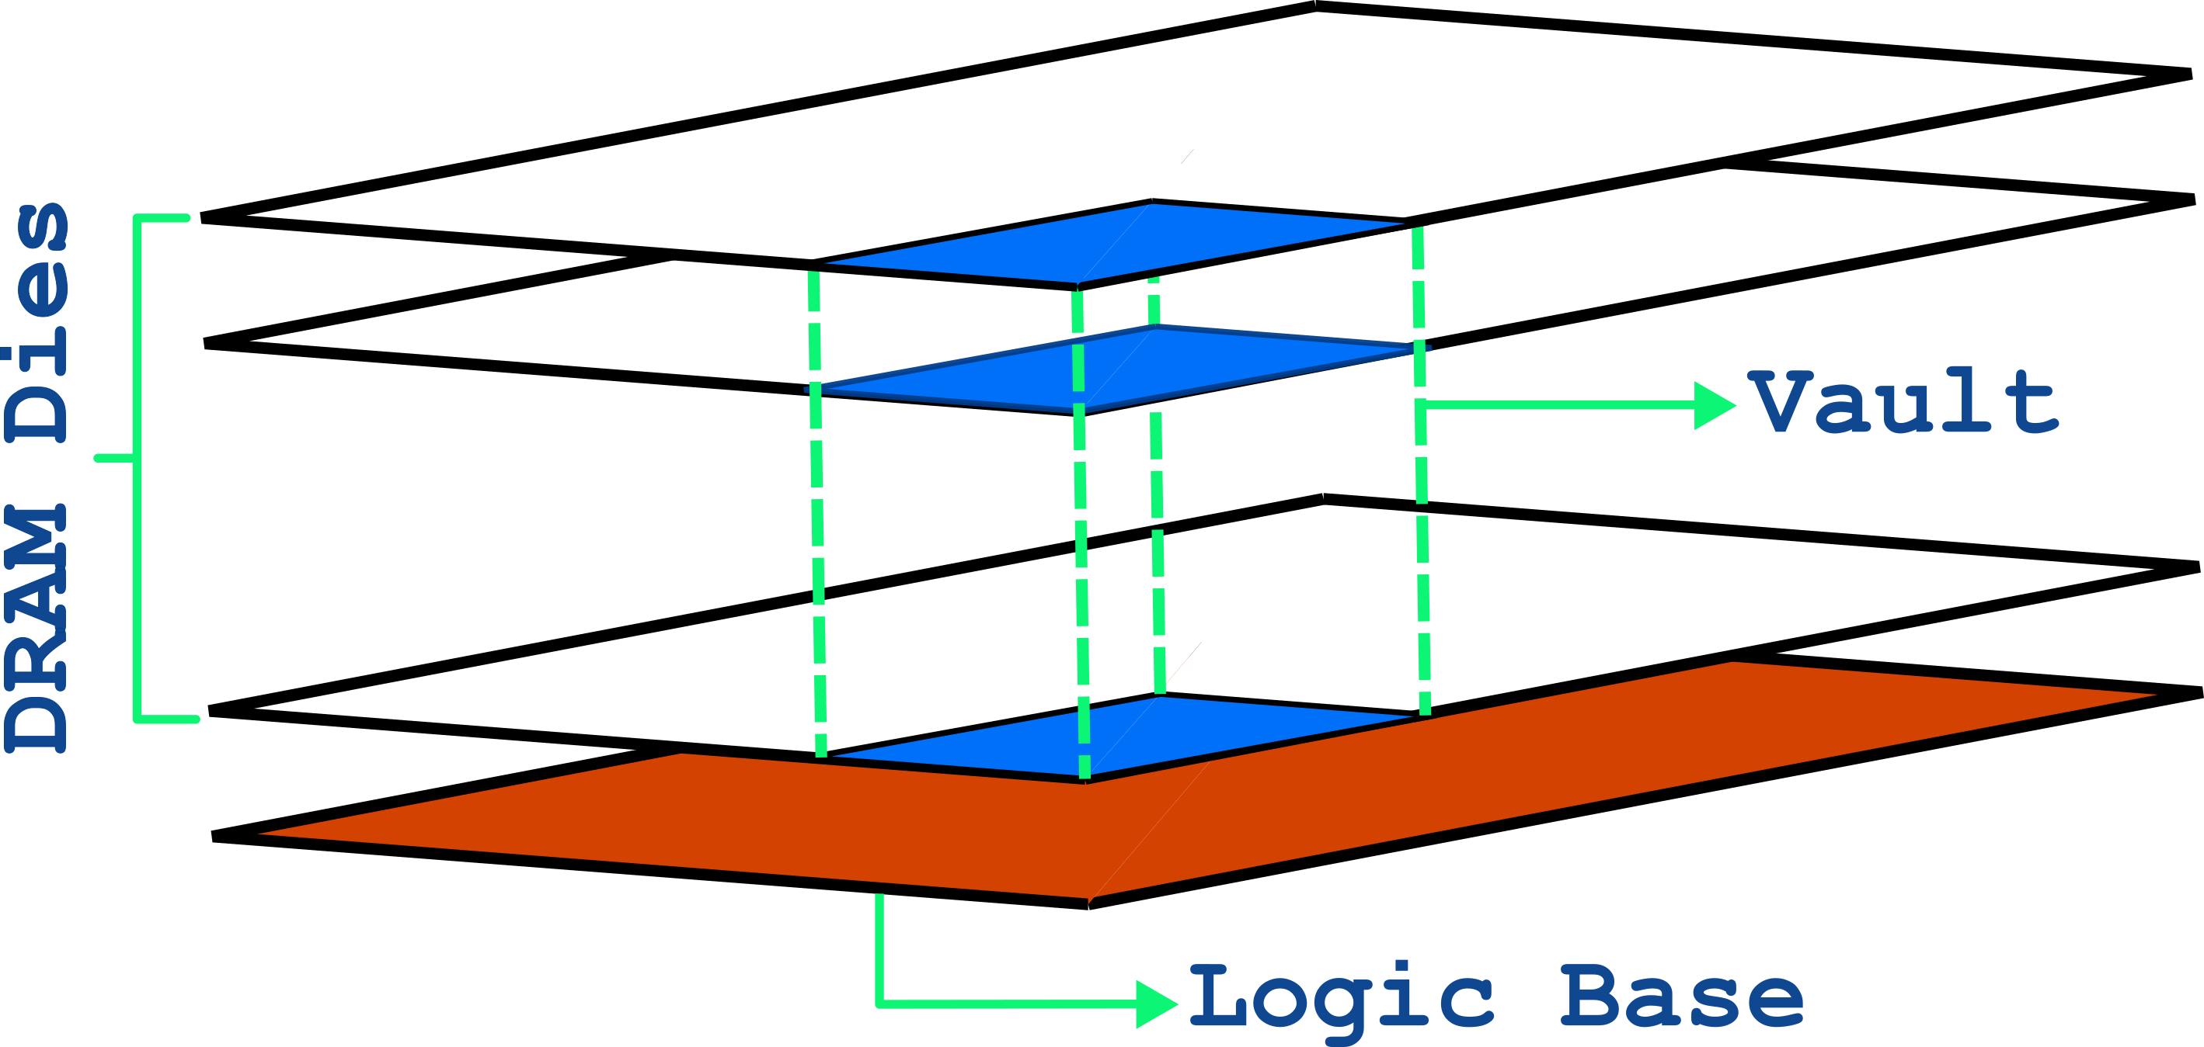
Hybrid Memory Cube
HMC is excellent for graph analytics and provides:
High-speed, parallel random access
Small access granularity
Near-data processing

Slide 14
Agenda
Motivation and Background
Workload Characterization
Proposed Algorithm
Hardware Implementation
Evaluation
Conclusion

Slide 15
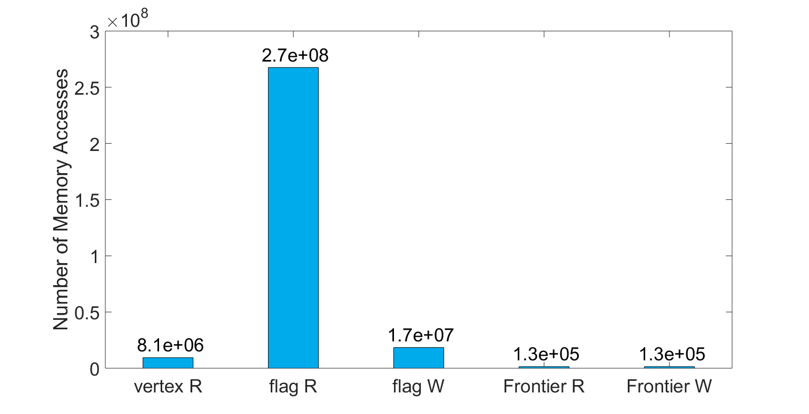
Workload Characterization
BFS is a memory-bound algorithm
Flag reads (flag R) make up the vast majority of the accesses
Flag reads are random and low-efficiency

Slide 16
Agenda
Motivation and Background
Workload Characterization
Proposed Algorithm
Hardware Implementation
Evaluation
Conclusion

Slide 17
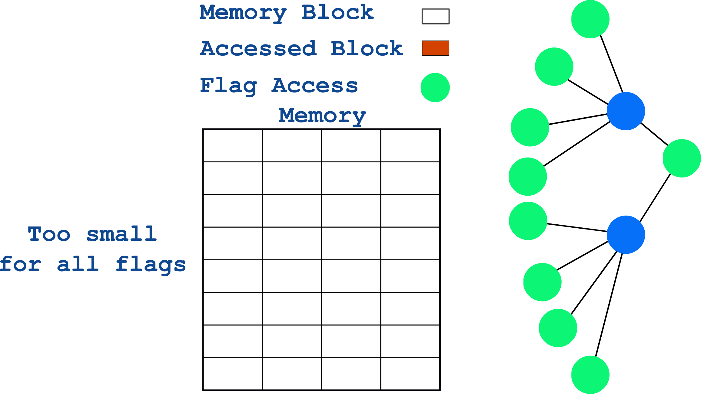
Motivation
All vertices with flag reads might not fit together
This set can change depending on source vertex
4
5
2
6
1
7
8
3
9
10
11

Slide 18
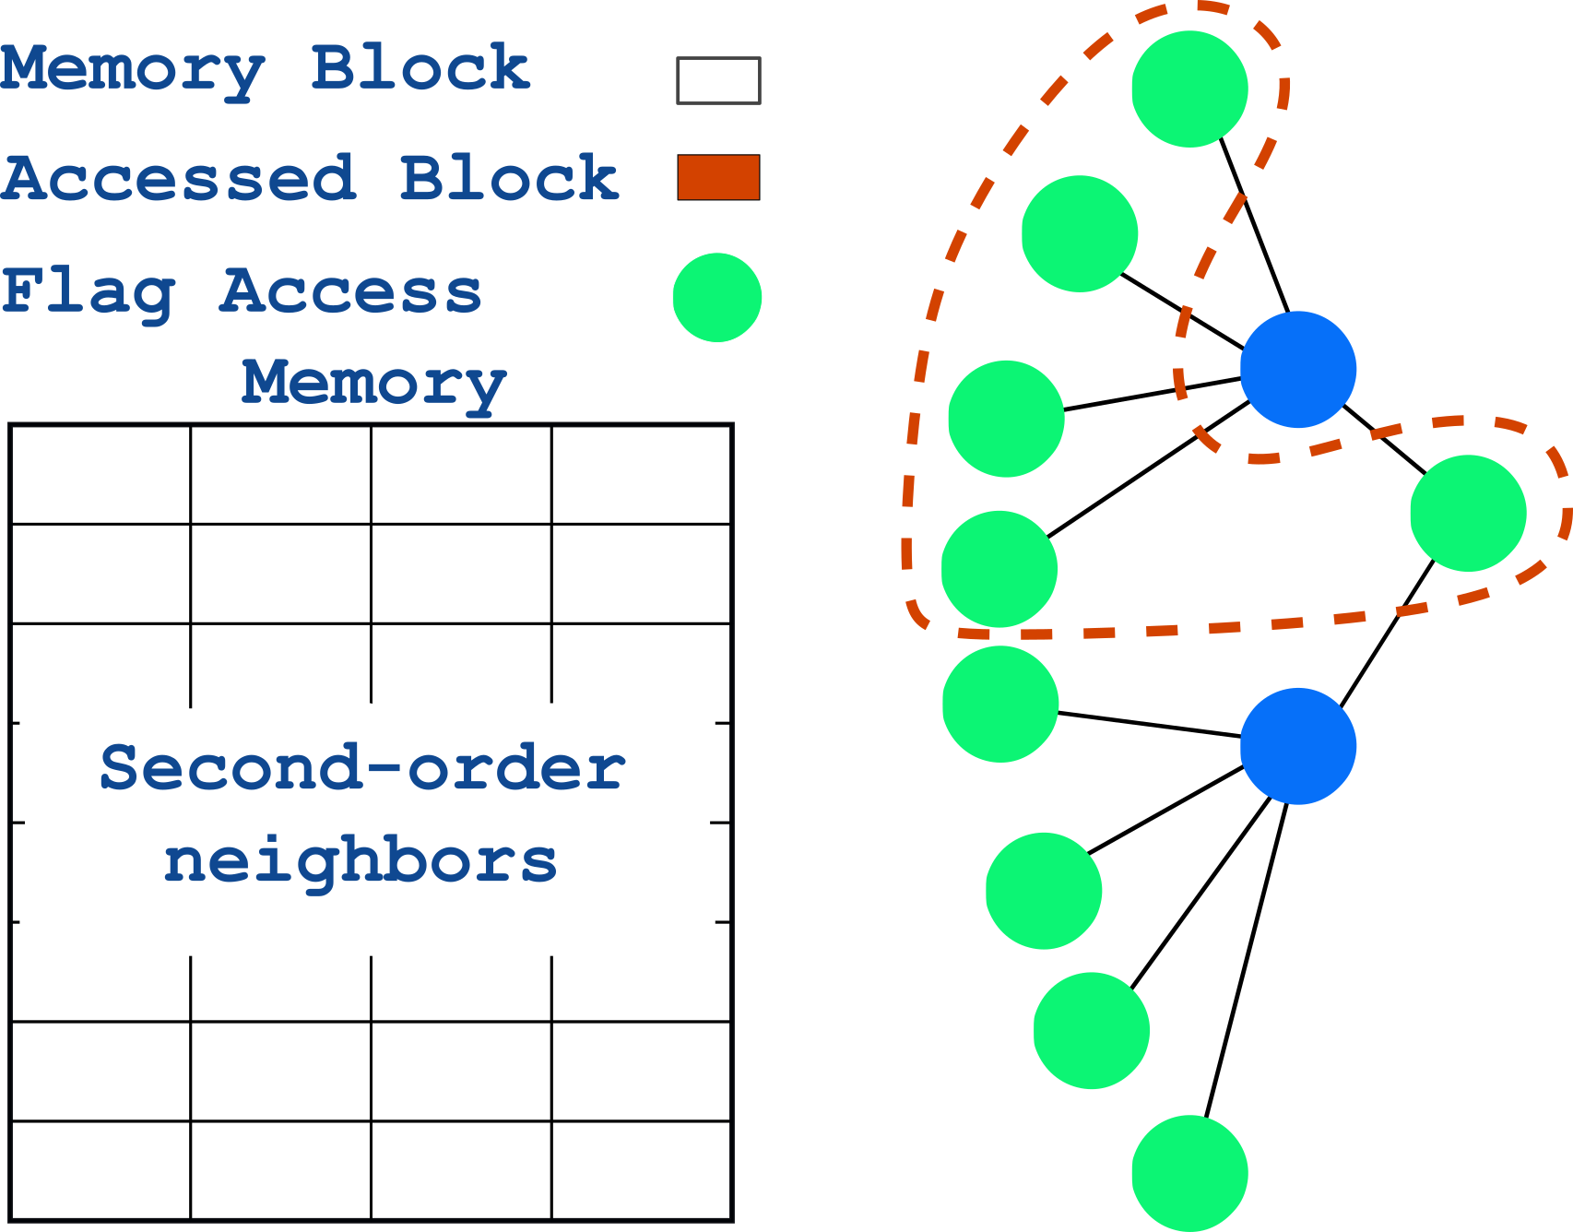
Key Insight
Flag reads happen to second-order neighbors simultaneously
4
5
2
6
1
7
8
3
9
10
11

Slide 19
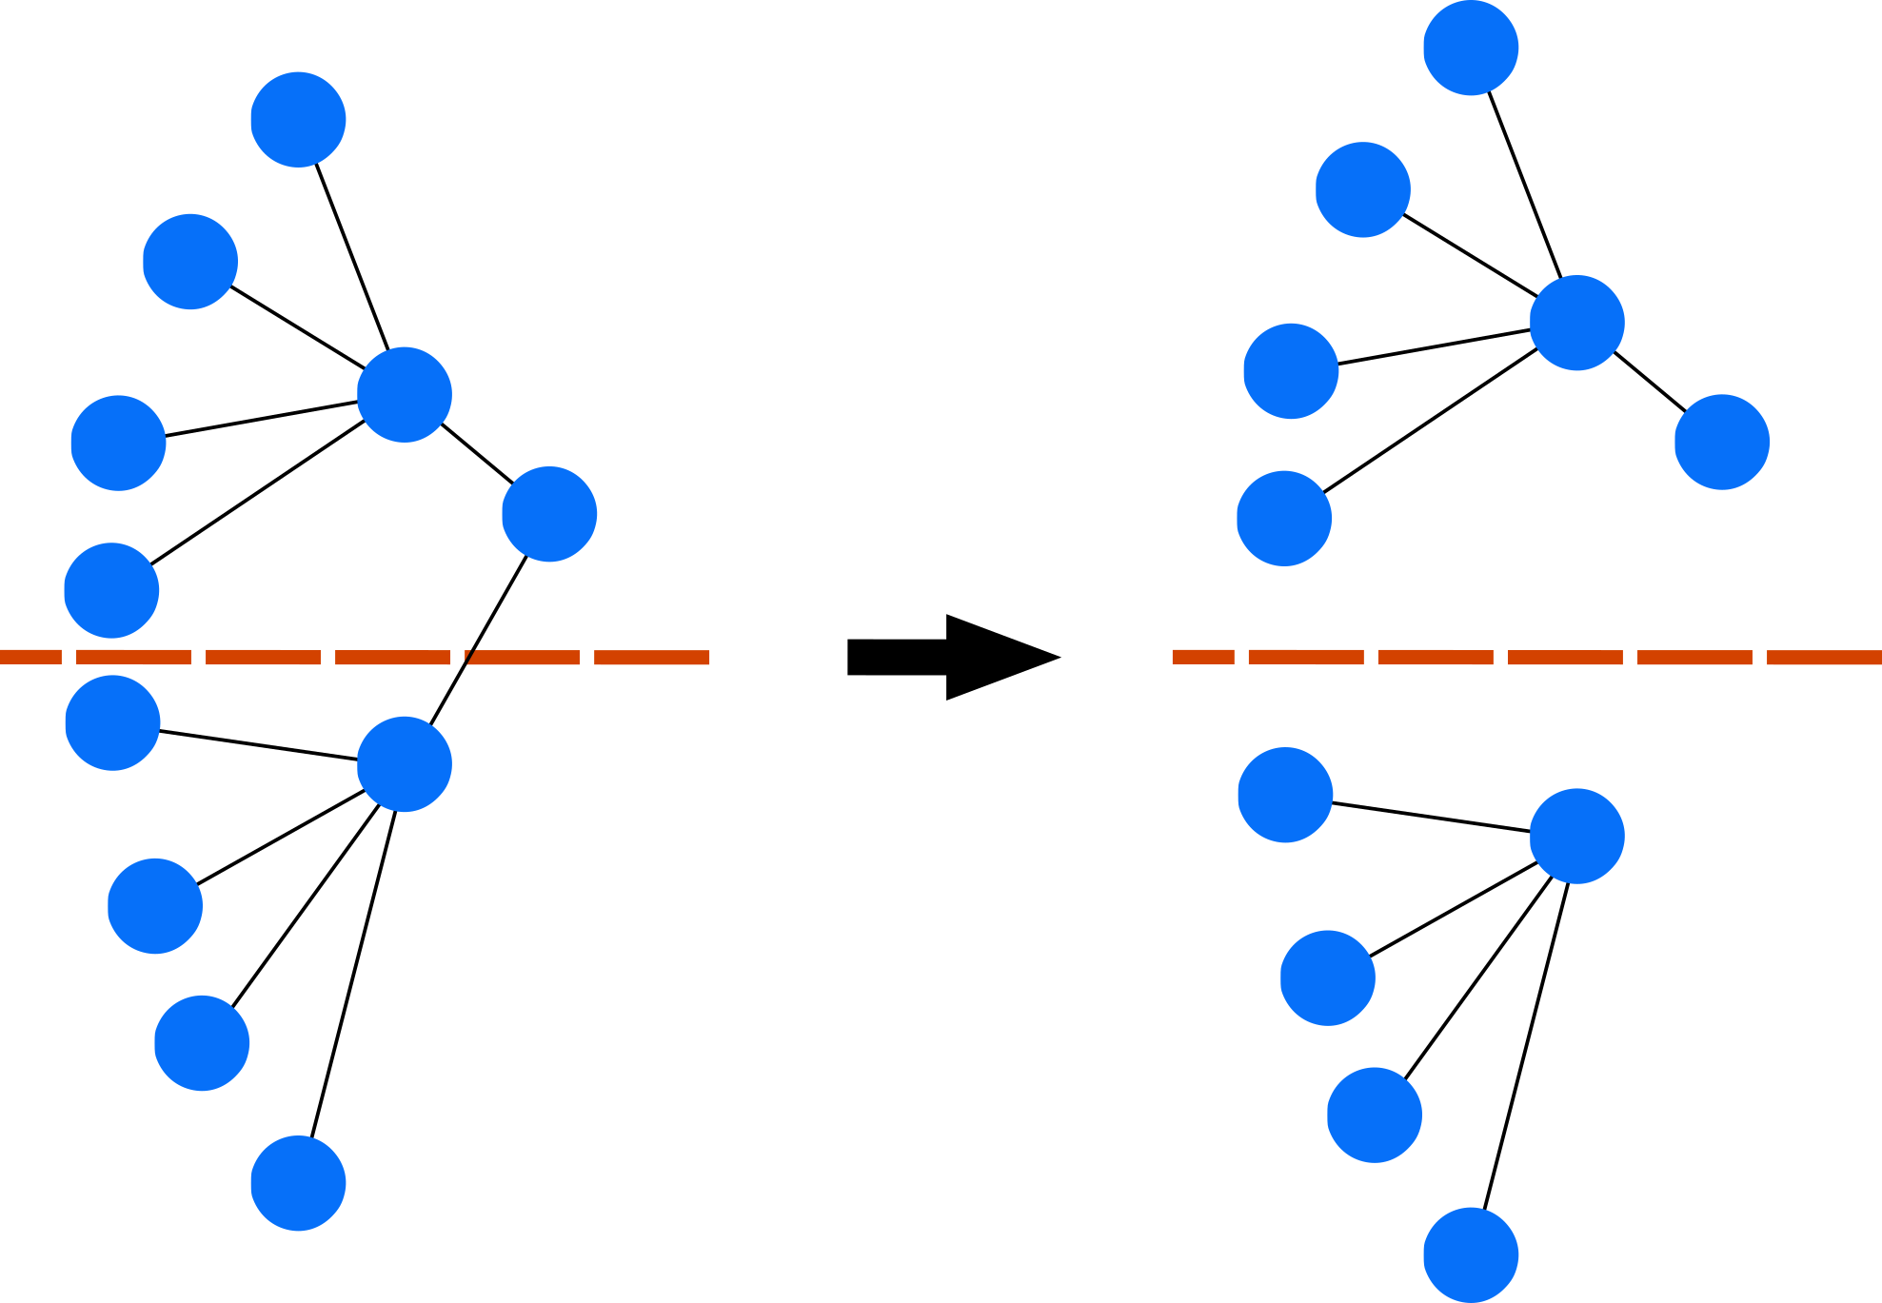
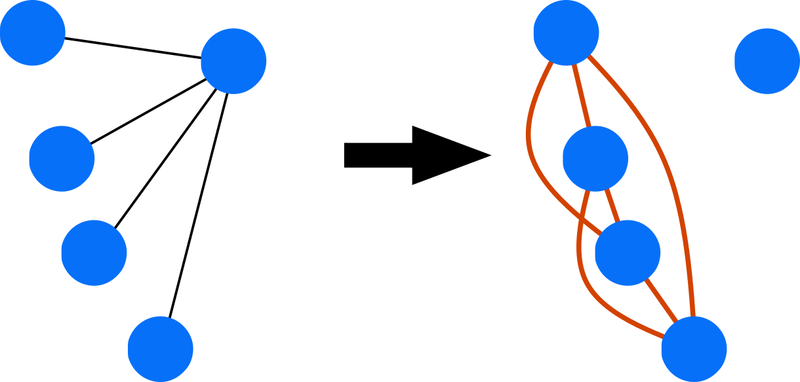
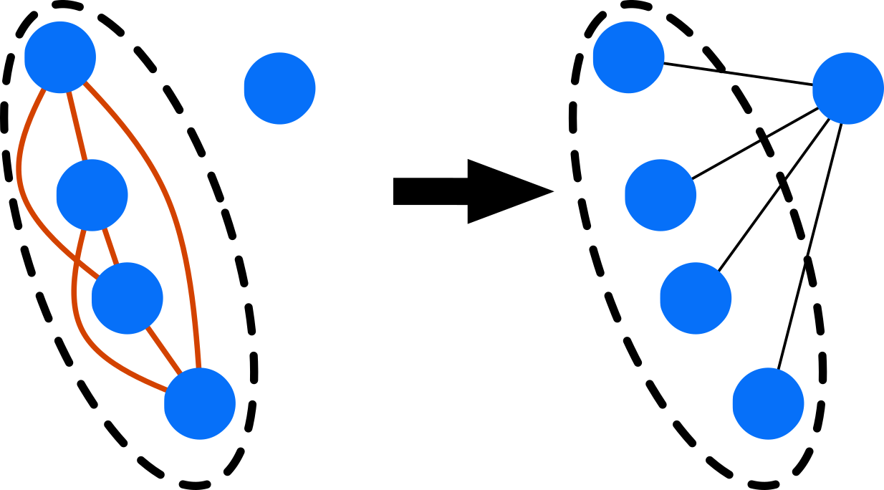
Algorithm Overview
Our clustering algorithm has three steps:
Divide large graphs into subgraphs
Generate Second-order neighbors subgraph (SONS)
Cluster the SONS
SONS
Step 1
Step 2
Step 3

Slide 20
Algorithm Overview
Our clustering algorithm has three steps:
Divide large graphs into subgraphs
Generate Second-order neighbors subgraph (SONS)
Cluster the SONS
SONS
Step 1
Step 2
Step 3

Slide 21
Step 1
Processing full graph is expensive and unnecessary
We used Markov algorithm for its robustness but it can be replaced with any other method.

Slide 22
Step 2
Generate second-order neighbors subgraph:
The same vertices
Connects second-order neighbors in the original subgraph
Reveals groups of second-order neighbors

Slide 23
Step 3
Group vertices of SONS into clusters to be stored in the same memory block.
We use a modified version of the RNSC clustering algorithm for this purpose.

Slide 24
Agenda
Motivation and Background
Workload Characterization
Proposed Algorithm
Hardware Implementation
Evaluation
Conclusion

Slide 25
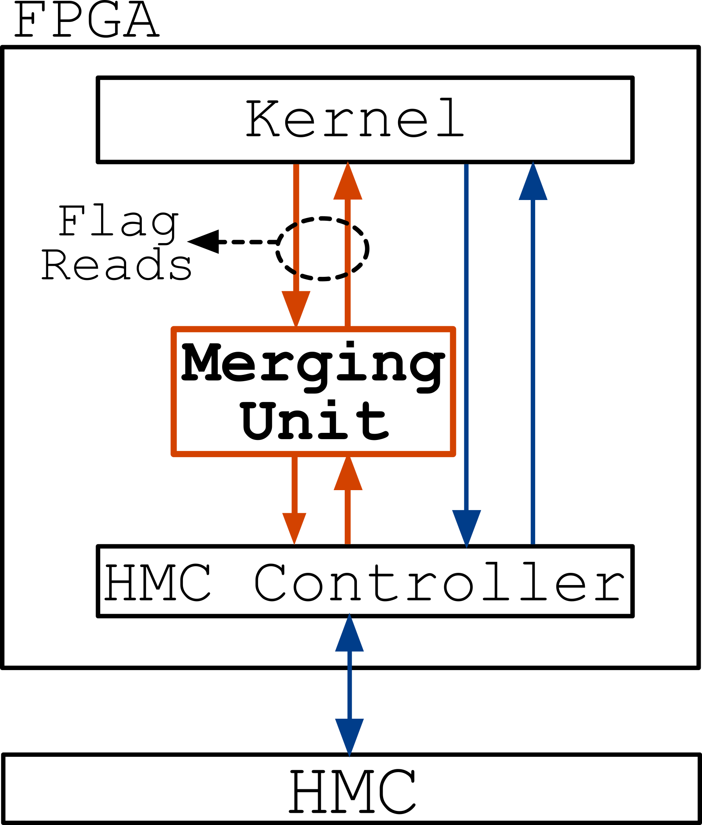
Hardware Overview
Redirect flag reads to a merging unit that merges duplicate requests
It also caches the results for future requests

Slide 26
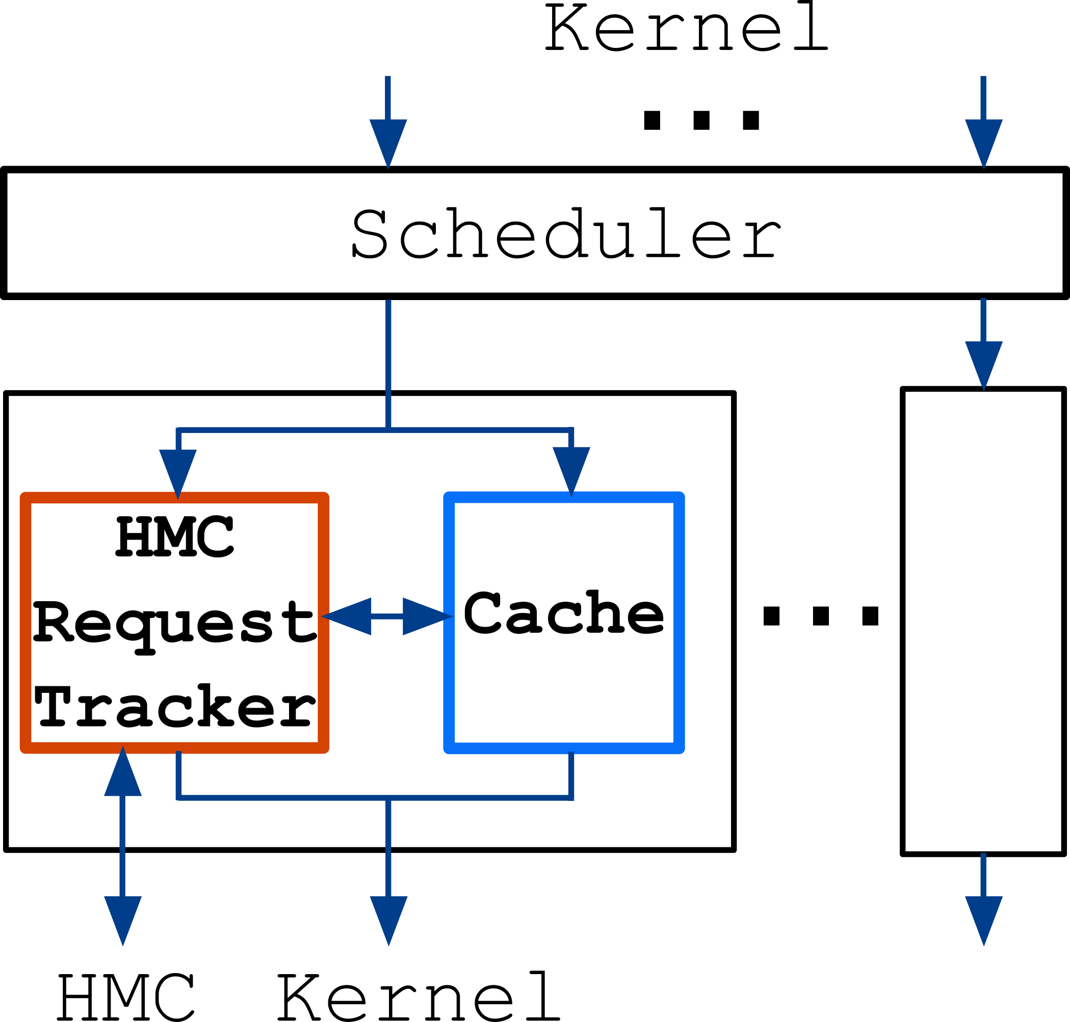
Merging Unit
Scheduler redirects requests to their corresponding cache
Cache stores flag read results
Request tracker records requests waiting response

Slide 27
Agenda
Motivation and Background
Workload Characterization
Proposed Algorithm
Hardware Implementation
Evaluation
Conclusion

Slide 28
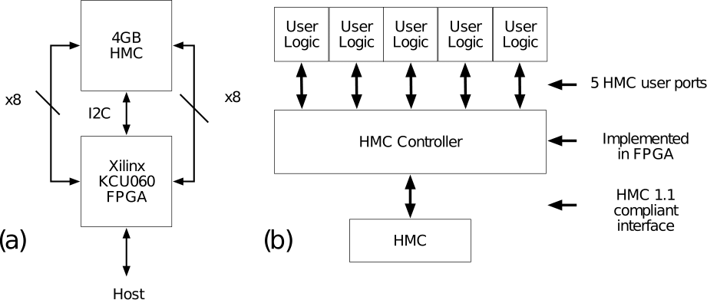
Setup
We use Xilinx KCU060 connected to a 4GB HMC
We use five parallel kernels

Slide 29
Benchmarks
We used 10 graphs from the University of Florida Sparse Matrix Collection
Number of vertices from 450,000 to 1,700,000
Edge factors between 3 and 28

Slide 30
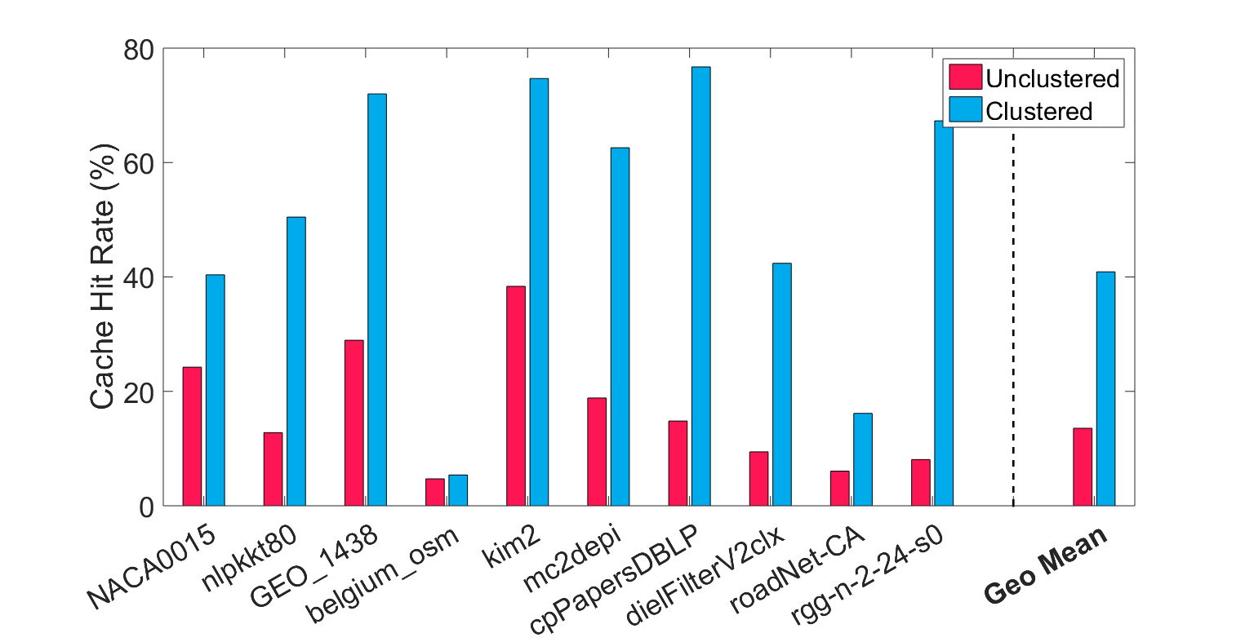
Evaluation Results
Compare cache hit between clustered and unclustered graphs
Clustering improves cache hit by 3x on average

Slide 31
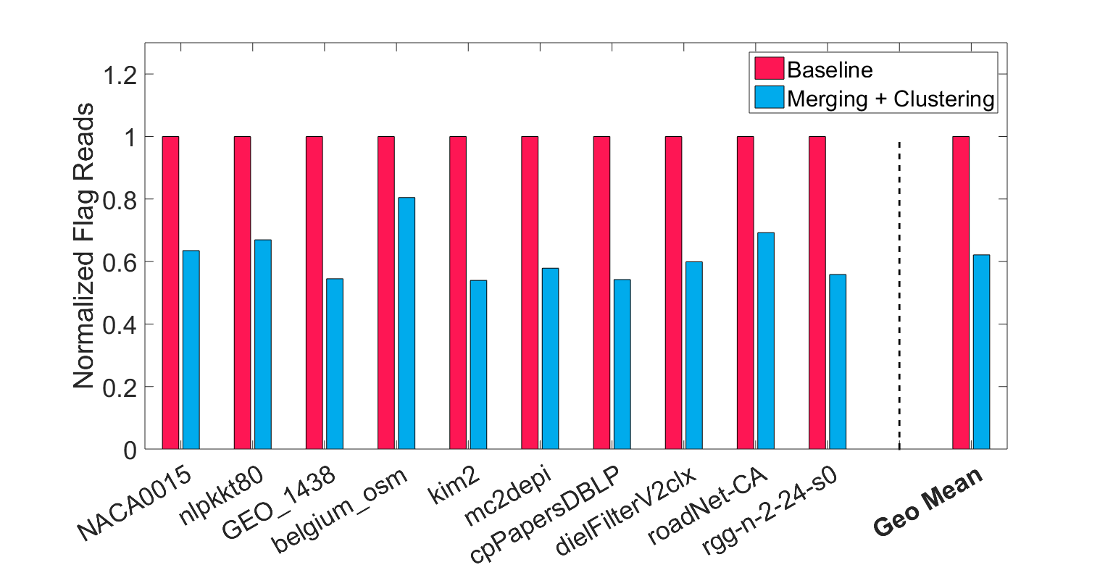
Evaluation Results
Compare flag reads from the HMC between clustered and unclustered
Flag reads are reduced to 61% on average

Slide 32
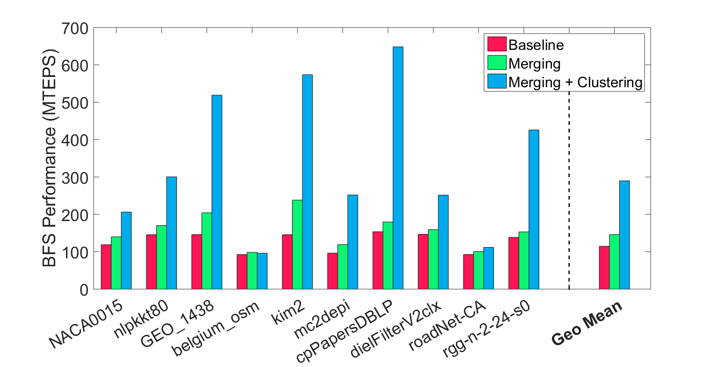
Evaluation Results
Merging alone (green bar) has little effect on performance
Merging + clustering (blue bar) improves performance by 2.8x on average

Slide 33
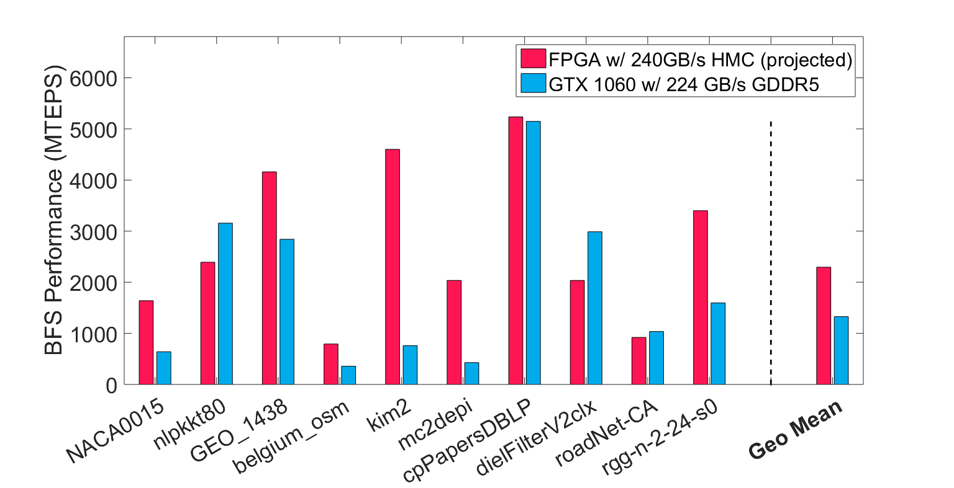
Evaluation Results
We produce competitive results compared to state-of-the-art GPU
Overall 1.7x improvement
Results projected based on bandwidth

Slide 34
Agenda
Motivation and Background
Workload Characterization
Proposed Algorithm
Hardware Implementation
Evaluation
Conclusion

Slide 35
Conclusion
Improved graph traversal performance through software-hardware codesign
Improved locality from the software
Designed request merging support from the hardware
BFS performance improved by 2.8x
Provided competitive performance to state-of-the-art of GPU

Slide 36
Thank You!
Notes:
36
36
36

