Slide 1
Liquid Silicon: A Data-Centric Reconfigurable Architecture Enabled by RRAM Technology
Yue Zha and Jing Li
Department of Electrical and Computer Engineering
University of Wisconsin-Madison
Feb 26, 2018

Slide 2
Outline
Motivation
Background
Hardware Architecture
Circuit Implementation
CAD Tool Set
Evaluation

Slide 3

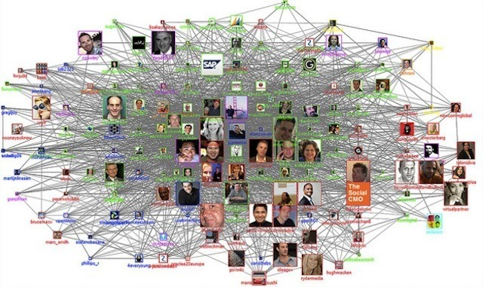



Motivation
Datacenter/Cloud
Graph Analysis
Machine Learning
Terabyte Sort
Cybersecurity
Bioinformatics

Slide 4
Motivation
Data-intensive
Datacenter/Cloud
Limited on-chip storage (BRAM)
Graph Analysis
No support on native search function
Machine Learning
Large routing overhead
Large Problem Size
Search-intensive
Terabyte Sort
Cybersecurity
Bioinformatics

Slide 5
Motivation
Liquid Silicon – a Softer FPGA architecture
Reconfigurable
Logic
Mode
Configurable
Logic Block
Routing
Mode
Connection Block
Switch
Block
Memory
Mode
BRAM
UltraRAM
2D array of Tiles
Search
Mode
?
Hard blocks
in FPGA
One For All

Slide 6
Motivation
Liquid Silicon – a Softer FPGA architecture
Compute Intensive
Search Intensive
Data Intensive
Logic
Mode
Memory
Mode
CLB
Complement FPGA in search/data-intensive applications
BRAM
Search
Mode
Fixed resource partition

Slide 7
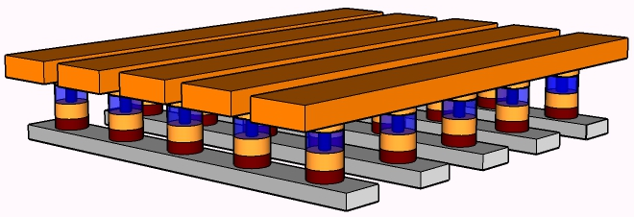
Background
Resistive Random-Access Memory (RRAM)
Ultra-dense crossbar
Programmable
Diode
RRAM
Low
Resistance
State
High
Resistance
State
1D1R cell
Mohammad, et al. (2016). State of the art of metal oxide memristor devices. Nanotechnology Reviews, 5(3), 311-329.

Slide 8
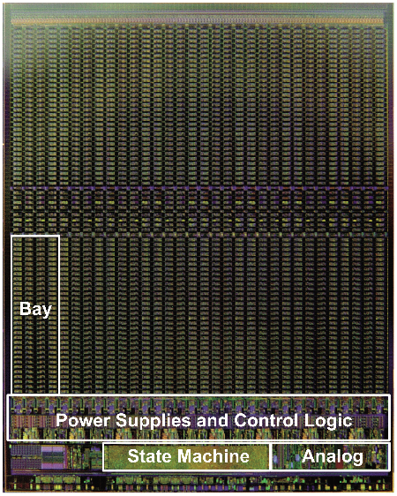
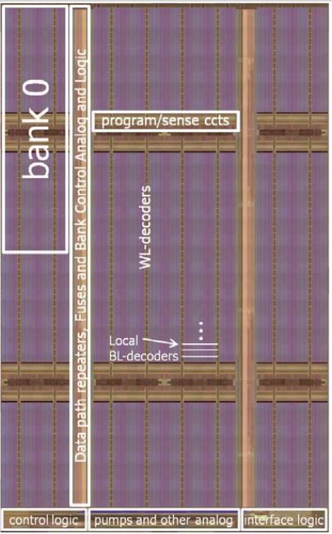
Background
Resistive Random-Access Memory (RRAM)
Liu, T., Yan, T., Scheuerlein, R., et al. (2013). A 130.7 mm2 2-Layer 32 Gb ReRAM Memory Device in 24 nm Technology. Proceedings of International Solid State Circuits
Conference (pp. 210–211).
Fackenthal, Richard, et al. "19.7 A 16Gb ReRAM with 200MB/s write and 1GB/s read in 27nm technology." 2014 IEEE International Solid-State Circuits Conference Digest of
Technical Papers (ISSCC). IEEE, 2014.

Slide 9
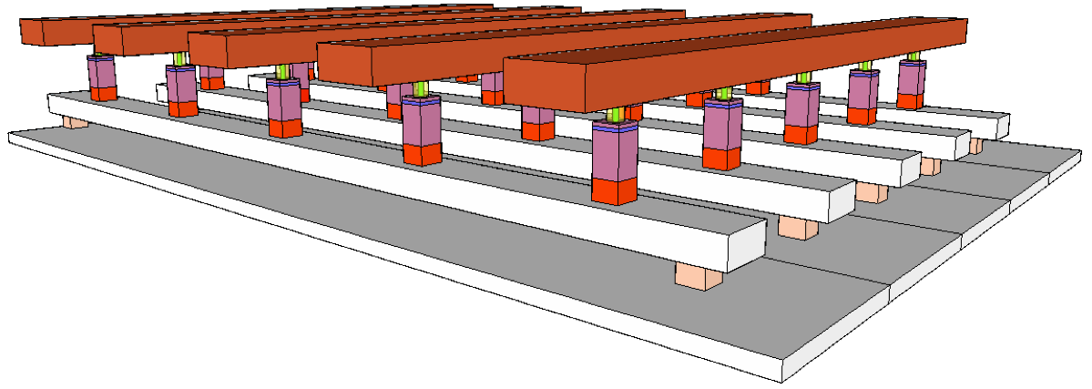
Hardware Architecture
Liquid Silicon – an RRAM-based reconfigurable architecture
2D array of Tiles
Crossbar
Connection
Node
Reconfigurable
Search
Mode
Logic
Mode
Connection Node
Routing
Mode
Memory
Mode
Notes:
L-Si is one attempt to explore the potential of RRAM technology beyond storage.

Slide 10
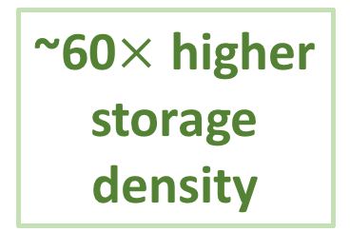
Hardware Architecture – Search Mode
Compare search key with stored words in parallel
2 Cells
~60$×$ higher
storage
density
Search Key
Stored Word #0
Stored Word #1
Match
Vector
16 Transistors
Stored Word #2
Stored Word #3
One Tile
SRAM
SRAM
CMOS-based design
Notes:
Our cad tool will optimize the orientation to improve the mapping quality

Slide 11


Hardware Architecture – Search Mode
Compare search key with stored words in parallel
Higher Update Cost
2 Cells
Better
Scalability
N$×$2^{W} bits
for N W-bit words
~60$×$ higher
storage
density
N$×$W bits
Search key as
memory address
Stored Word #0
Stored Word #1
BRAM
16 Transistors
Stored Word #2
Match
Vector
Stored Word #3
One Tile
Store match vector
SRAM
SRAM
FPGA-based design
CMOS-based design
Notes:
Our cad tool will optimize the orientation to improve the mapping quality

Slide 12
Hardware Architecture – Search Mode
Two adjacent cells are encoded to store one bit
Connection node detects the leakage current
Stored Word #0
Search ‘0’
Search ‘1’
Search ‘1’
0
1
1
0
1
0
Mismatch
Stored Word #1
Stored Word #2
Stored Word #3
L
H
H
L
H
H
Store bit ‘1’
Store bit ‘0’
Store bit ‘X’
(Wildcard)
Turn on diodes

Slide 13
Hardware Architecture – Search Mode
Two adjacent cells are encoded to store one bit
Connection node detects the leakage current
Stored Word #0
Search ‘1’
Search ‘0’
Search ‘1’
1
0
0
1
1
0
Match
Stored Word #1
Stored Word #2
Stored Word #3
L
H
H
L
H
H
Store bit ‘1’
Store bit ‘0’
Store bit ‘X’
(Wildcard)
Turn on diodes

Slide 14
Hardware Architecture – Logic Mode
One tile implements a group of N-input Sum-of-Products
Shallower Logic Depth
Less Interconnections
Logic Input
Logic Input
N-Input
M-Output
Sum-of-Products
6-Input LUT
6-Input LUT
Logic
Output
Logic
Output
6-Input LUT
N >> 6
Coarse-grained logic
implementation
Fine-grained logic
implementation
One Tile
FPGA

Slide 15




Hardware Architecture – Logic Mode
One tile implements a group of N-input Sum-of-Products
  Program RRAM cells into LRS to connect logic inputs
F = A+B+D
F = ABD
$$A$$
$$B$$
$$C$$
$$D$$
0
1
False
0
1
L
L
H
L
One Tile
Turn on diodes

Slide 16
Hardware Architecture – Logic Mode
One tile implements a group of N-input Sum-of-Products
  Program RRAM cells into LRS to connect logic inputs
F = ABD
$$A$$
$$B$$
$$C$$
$$D$$
0
1
True
1
1
L
L
H
L
One Tile
Turn on diodes

Slide 17



Hardware Architecture – Routing Mode
A special case of logic mode
  F = C
Co-exist with logic mode in the same tile
F = ABD
$$A$$
$$B$$
$$C$$
$$D$$
Route Signal C
H
H
L
H
Route C
One Tile

Slide 18
Hardware Architecture – Routing Mode
A special case of logic mode
  F = C
Co-exist with logic mode in the same tile
Logic
F = ABD
Flexible
Partition
Route Signal C
Routing
SB
CLB
CB
Fixed partition
in FPGA
One Tile
Resources used for logic
Resources used for routing

Slide 19
Hardware Architecture – Memory Mode
Four adjacent tiles to implement a memory block
Logic Mode
(e.g. Decoding Circuits)
Memory
Array

Slide 20
Hardware Architecture – Memory Mode
Provided several flexibilities
  Flexible position/capacity
  Flexible logic aspect ratio
BRAMs in fixed columns
Tile configured
in Memory mode
FPGA

Slide 21
Circuit Implementation
Key building blocks of connection nodes
Configurable
Dynamic
Inverter
Skippable
DFF/NOT
Voltage
Driver
S/A
Configuration
Memory

Slide 22
Circuit Implementation – S/A
Two-stage sensing scheme
Low power consumption – limited precharge voltage
WL/BL
Configurable
Dynamic
Inverter
Skippable
DFF/NOT
Voltage
Driver
S/A
Configuration
Memory

Slide 23
Circuit Implementation – Dynamic Inverter
Implement a multi-input dynamic NOR gate
V_{dd}
V_{dd}
Sensing
Clock
Out
Sensing
Clock
Sensing
Clock
V_{dd}
IN₀
Controlled by
configuration
memory
Input
IN₁
Configurable
Dynamic
Inverter
Skippable
DFF/NOT
Voltage
Driver
S/A
Configuration
Memory

Slide 24













Circuit Implementation – Dynamic Inverter
Improve resources utilization
  Sum-Of-Products
  The input of the OR function is rarely used by other functions
$$A$$
$$B$$
$$C$$
$$D$$
$$F_{1}$$
$$F_{2}$$
$$F_{3}$$
$$F_{4}$$
$$F_{1}=ABD$$
G$=F_{1}+F_{2}+F_{3}+F_{4}$
$$F_{2}=AD$$
$$F_{3}=BC$$
Cannot map other
logic functions
$$F_{4}=ACD$$
High Utilization
Low Utilization
Program RRAM into LRS

Slide 25
Circuit Implementation – Voltage Driver
Low Voltage Domain
Provides voltage for
Search/Logic/Routing Modes
High Voltage Domain
Provides voltage for
programming RRAM in
Memory Mode
Configurable
Dynamic
Inverter
Skippable
DFF/NOT
Voltage
Driver
S/A

Slide 26
Circuit Implementation - Configuration
Memory
3D2R Cell
Non-volatile
Organized in Crossbar
Configurable
Dynamic
Inverter
Skippable
DFF/NOT
Voltage
Driver
S/A
Configuration
Memory

Slide 27
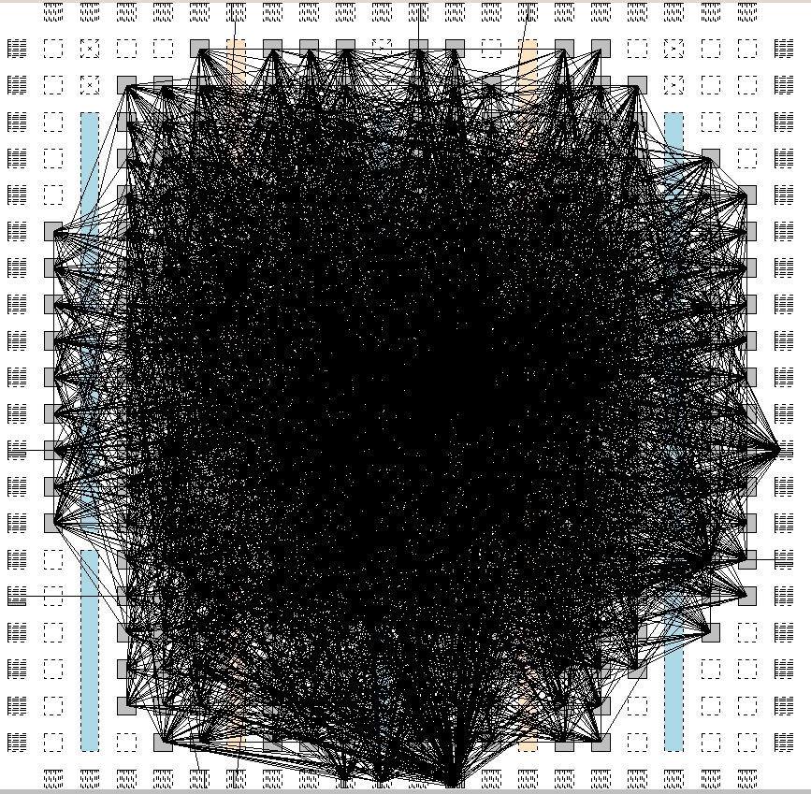
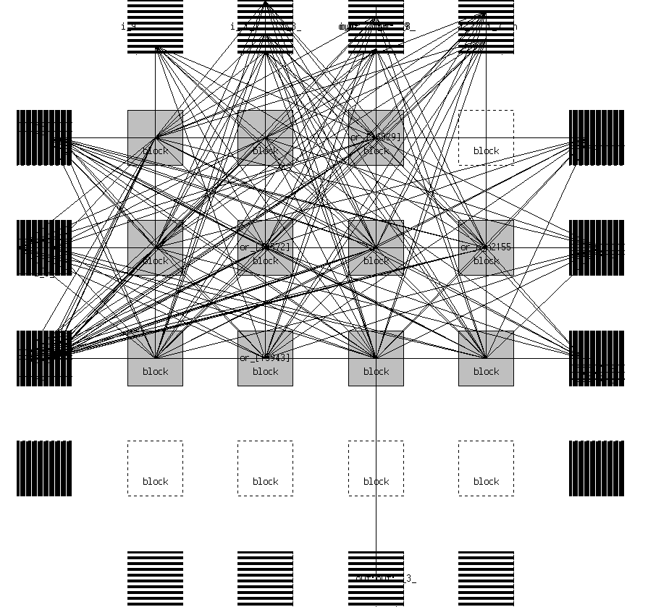
CAD Tool Set
Adapted from VTR project¹
Use our custom place & route tool²
  Partition the hardware resources between four modes
FPGA
Less Routing Overhead
Liquid
Silicon
¹Luu, Jason, et al. "VTR 7.0: Next generation architecture and CAD system for FPGAs.” TRETS 7.2 (2014): 6.
²Zha, Yue, and Jing Li. "Reconfigurable in-memory computing with resistive memory crossbar." ICCAD. ACM, 2016.

Slide 28
CAD Tool Set
Adapted from VTR project¹
Use our custom place & route tool²
  Optimally partition the hardware resources among four modes
FPGA
Flexible Memory
Liquid
Silicon
¹Luu, Jason, et al. "VTR 7.0: Next generation architecture and CAD system for FPGAs.” TRETS 7.2 (2014): 6.
²Zha, Yue, and Jing Li. "Reconfigurable in-memory computing with resistive memory crossbar." ICCAD. ACM, 2016.

Slide 29
Evaluation - Setup
Complete the physical design of Liquid Silicon
  Obtain the tile area
Connection nodes are fully buried under the RRAM crossbar
The physical design of one tile

Slide 30
Evaluation - Setup
HSPICE simulation to obtain the delay and power
  R_{off}/R_{on} = 150kΩ/1kΩ
  Simulate different input/store patterns, PVT variation
Our CAD Tool is used to map applications onto Liquid Silicon
VTR is used to map applications onto FPGAs

Slide 31
Evaluation - Setup
Four architectures include in the comparison
FPGA
SRAM-based FPGA
(baseline)
RRAM-based FPGA
Architectural
Comparison
SRAM
RRAM
SRAM-based
Liquid Silicon
RRAM-based
Liquid Silicon
(proposed)
Technology
Comparison
Liquid Silicon

Slide 32
Evaluation – Logic Only
Evaluate the Logic/Routing modes
MCNC benchmark set
Area reduces 62%
Delay reduces 27%
Energy efficiency improves 31%
Better performance compared with SRAM-based FPGA

Slide 33
Evaluation – Logic Only
Evaluate the Logic/Routing modes
MCNC benchmark set
Area reduces 26%
Delay reduces 37%
Energy efficiency improves 15%
Compare with RRAM-based FPGA
Improvement from architecture

Slide 34
Evaluation – Logic Only
Evaluate the Logic/Routing modes
MCNC benchmark set
Routing area reduces 64%
Routing delay reduces 17%
Less routing overhead from
coarse-grained logic implementation
flexible resource partition

Slide 35
Evaluation – Memory Evaluation
Evaluate the Memory/Logic/Routing Modes
Benchmarks from VTR project
Large-Memory
Utilize > 30% resources for memory
Small-Memory
Utilize < 30% resources for memory

Slide 36
Evaluation – Memory Evaluation
Evaluate the Memory/Logic/Routing Modes
Benchmarks from VTR project
  Area reduce by 64%
  Delay decrease by 29%
  Energy efficiency improve by 65%
Large-Memory
Small-Memory
Better Performance
Larger Memory, Better Performance

Slide 37
Evaluation – Search Evaluation
Packet classification – Networking Domain
Packet classification¹
  Reduces area by 99%
  Reduces power by 94%
  Improves throughput by 30%
Search key as
memory address
BRAM
Match
Vector
Programmable devices in UADP from Cisco
Software Defined Network
Store match vector
FPGA-based Design
¹W. Jiang. 2013. Scalable Ternary Content Addressable Memory implementation using FPGAs. In ANCS. 71–82
Notes:
CISCO

Slide 38
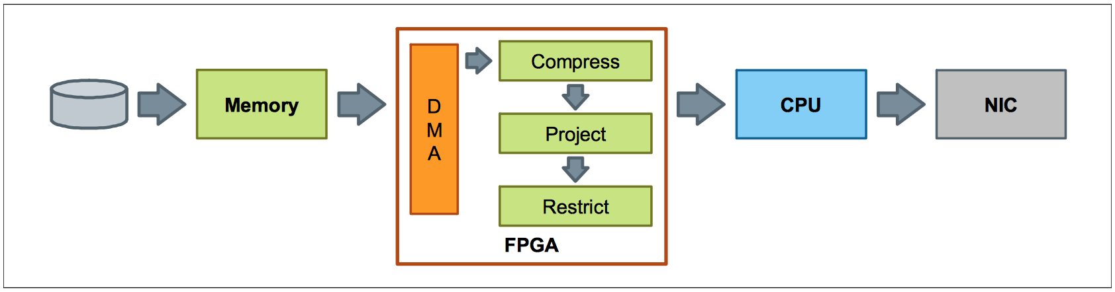
Evaluation – Search Evaluation
Join operation – Big Data Analysis
  Compare with hashing-based implementation
  Reduce the requirement on storage by 24%
  Improve the frequency by 50%
FPGAs in IBM’s Netezza
Francisco, P. (2014). Ibm puredata system for analytics architecture. IBM Redbooks, 1-16.

Slide 39
Summary
Liquid Silicon – a Softer FPGA architecture
  Complement FPGA in data-/search-intensive applications
Provide circuit implementation and custom CAD tool
Improvement is not only from the advanced NVM technology
Liquid
Silicon
Data-/Search-Intensive
Large Problem Size

Slide 40
Thank you!
This work is conducted under
DARPA Young Faculty award program
Notes:
Darpa logo

