Slide 1
Synchronization Constraints for
Interconnect Synthesis
Alex Rodionov & Jonathan Rose
University of Toronto
Notes:
This paper is about making hardware design easier and more productive by adding a new feature to existing system-building tools that lets the designer specify global cycle-level synchronization.

Slide 2
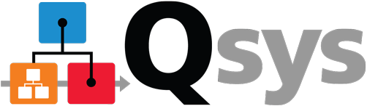






System-Building Tools (Input)
Func.
Module
Standard
Interface
Func.
Module
Logical/Desired Connections
Func.
Module
Notes:
Sys-building: often FPGA vendor-provided tools that let you design hardware structurally but at a higher level than HDL.

Slide 3
System-Building Tools (Output)
System
Func.
Module
Physical
Interconnect
Func.
Module
Func.
Module
Notes:
Auto-gen of I/C: this is where the productivity gain

Slide 4
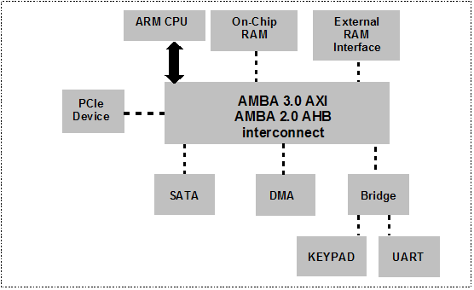
System-Building Tools: Limitations
Were designed for: connecting a CPU with IP cores
latency-
insensitive
Synopsys
Latency-insensitivity: makes latency a hidden implementation detail
Limits ability to globally synchronize
Notes:
System-building tools were designed around connecting CPUs to peripheral IP cores
Evolved use of LSI: Don’t know how long xmis takes, but valid signal at end will tell you
As a designer, latency of tool-generated interconnect is hidden from you, I/C can be swapped with a different implementation without changing cores
Guarantees correctness for xmis between one source and sink
But as soon as global synch, you have a problem

Slide 5
Cycle-Accurate Global Synchronization
cycles
cycles
automatic
manual
Notes:
Example system: 4 modules ABCD, B/C fixed latencies of 2/4, D needs both inputs to arrive simul.
Nontraditional use, more DSP-like app.
If we build with a sys-building tool, we don’t build the I/C and the latency is unknown. Must jump through hoops.
-
Put FIFOs in front of D, call new module D prime. Works but sub-optimal.
-
If we had built the system by hand, we could have solved this with registers. Here’s one solution., 2 256-bit registers.
Here’s an even cheaper one, uses only 18 regs
-
The problem: to get better hardware, we have to ditch automation and manually: # regs, best place to put them, build and keep updated as design changes.
Goal of paper: we want to live in a world where the bottom result can be chosen, and built for us automatically.

Slide 6
New Required Design Inputs
1) Internal links: annotate latency through a module
2) Synchronization Constraints: desired data arrival relationships between chains
cycles
chain1
2
=
chain2
4
cycles
CONSTRAINT: chain1 – chain2 = 0
Notes:
In order for a hyp. tool to be able to do this, two additional pieces of information need to be known from the designer:
- The fixed latencies of modules, we call internal links
- The desired data arrival relationships themselves, which we call *synchronization constraints*
Constraints relate the end-to-end latencies of multi-hop paths called chains
In our sample system, the desire to have D’s inputs arrive simultaneously is spelled out by the following constraint:

Slide 7
Synchronization Constraints
General Form:
Possible Uses:
  Simultaneous arrival of data
  Staggering the arrival of data
  Bounding total maximum round-trip latency
chain1
chain2
…
chainN
(integer constant)
+
–
+
–
+
–
<
≤
=
≥
>
Notes:
In general, a single synch constraint can relate the latency of MANY chains with an integer constant, using eq/ineq op

Slide 8
Constraint-Enabled Flow
Inputs:
  Modules + Logical connectivity
  Internal links
  Chains + Synchronization Constraints
Generate:
  Interconnect for the system
  Delays inserted on generated interconnect
While also:
  Satisfying sync. constraints (correctness)
  Minimizing total area usage (area optimization)
2
4
new
Notes:
Once a tool has these new inputs, the output is the same: generate the system and its interconnect.
Except now, it will also insert delays to satisfy the user’s constraints, and put them in places that minimize total area usage.

Slide 9


Solving Constraints
Can be formulated as Integer Linear Programming problem
  Unknowns: delay on each generated connection
  Constraints: derived from user’s sync. constraints
  Optimization Goal: minimize total area =
∑(bit width) * (# of delay stages)
generated
interconnect
Implement solved delay as registers or memory
Similar to scheduling in HLS tools
Notes:
To do [that], the tool needs to figure out how much delay to insert on each generated piece of interconnect.

Slide 10
Example Implementation and Results
Our own system-building tool called GENIE
Previously introduced at FPGA 2015
Goals: Design productivity through increased automation and optimization capability for interconnect synthesis
Notes:
The ideas we presented could theoretically be applied to any system-building tool.
To test them out, we modified our own tool GENIE, to accept and use synchronization constraints.
Goal of GENIE is to make a system-building tool to be used in use cases that were impractical or impossible before, through new automation and optimization abilities

Slide 11
Design Example: Image Classifier CNN
CNN: A pipeline comprising different kinds of layers
We implement only a Convolutional layer
Fundamental operation: Volume Dot Product between
kernel and image volumes to generate 1 output voxel
(filter)
(feature map)
Notes:
As an example of such a use case, we used our modified GENIE to build a convolutional neural network used for image classification. The goal here will not be to necessarily innovate on CNN architectures, but to show a realistic and useful design example for synchronization constraints.
Without going into much detail…
Kernel and Image

Slide 12
Our CNN Architecture
Kernel, Image, Outputs stored off-chip
Kernel, Image cached on-chip
Compute Array performs many dot products in parallel
DDR3
Iterator
CTRL
Image Bufs
Kernel Bufs
Output Write
Iterator
Compute
Array
Notes:
Here’s a diagram of our hardware system.
Volumes live in off-chip memory, cached in on-chip buffers
Compute array does dot products
Will be focusing on the design of the compute array

Slide 13
Compute Array
Image iterators
Image buffers
Kernel Iterator
+ Buffers
Notes:
Consists of dot product units, and the blocks that feed them. All blocks are hand-coded Verilog, GENIE connects them together, including making those crossbars, which are part of the I/C and have their own latency.
During one pass of computation: the controller gives a launch signal, that’s received by the iterators, which generate addresses to read the image buffers. The image data is read, and broadcast to the columns of the array. Each column contains the same data.
Similarly, the kernel buffers (which have iterators built-in), receive the launch signal and broadcast kernel data across a row.
For the design to work correctly, each DPU must receive matching kernel and image data simultaneously, and achieving this is the challenge.

Slide 14
Implementation 1: Unpipelined Broadcast
A realistic first design attempt
Kernel and Image data is broadcast combinationally
No new synch. constraint features needed
Notes:
Going to tell a design story and build 3 iteratively better versions of this array, all using GENIE. Only the final version will use synchronization constraints.
First version is what someone would make as their first implementation that works but doesn’t care for the best performance. Broadcasts combinationally. Synchronization is easy, doesn’t need to use synchronization constraints.

Slide 15
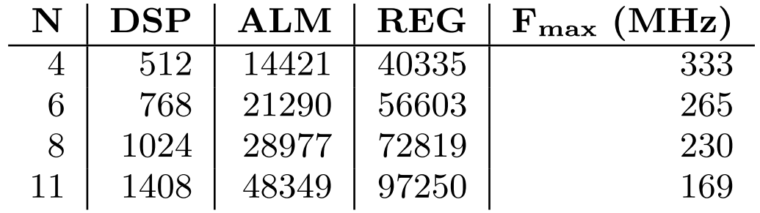
Implementation 1: Unpipelined Broadcast
Built with GENIE, synthesized with Quartus Prime 16.0
Vary compute array size (N), up to 93% of DSPs used
Measure: total system area, frequency
system total
More DPUs
Lower Fmax
Notes:
Synthesized with Quartus 16 for the largest Arria 10 device
No synchronization constraints
No pipelining of the broadcast
N = # of DPU columns (we can parameterize), at 11 uses 91% of the DSPs
Total system area dsp, ALM and registers
Fmax, takeaway: it drops significantly as we fill up the chip, almost by 50%
Can we do better?

Slide 16
Implementation 2: Pipelined Broadcast
Manually pipeline broadcast distribution
This breaks synchronized delivery of image+kernel
Insert FIFOs at each DPU to resynchronize
Notes:
Second implementation: pipeline the broadcast to hopefully improve frequency
GENIE has a feature that lets us micromanage its job of making interconnect and ask it to manually insert registers via topology customization.
This pattern of registers is still regular enough to be relatively easy to add through scripting.
Breaks synchronization off the main diagonal.
To fix this in the easiest possible way: add FIFOs to resynchronize. Not optimal, but it requires the least thinking in case we decide to pipeline differently later. Realistic solution that doesn’t use synch constraints.

Slide 17
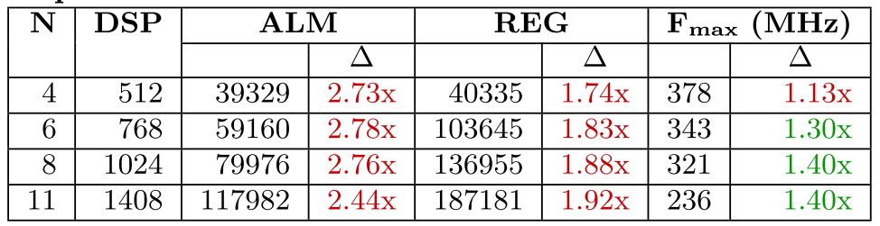
Implementation 2: Pipelined Broadcast
1.13x
Change: Pipelined vs. Unpipelined
Frequency has increased up to 40%
… but at a cost of 144-178% more ALMs
Can we do better?
Notes:
Still the same trends

Slide 18
Implementation 3: Synch. Constraints
We’d like to keep the pipeline registers for Fmax
Achieve synchronization without inserting FIFOs
3
chains
internal
links
2
constraints
3
Notes:
… or thinking too hard.
Third implementation does this using sync constraints.
Here’s the whole array. Here’s just one DPU and all the paths that feed it.
Define a chain for each possible kernel and image path, and make constraints that force them to be equal.
Repeat for every DPU. All scriptable in a nice loop.
Also tell GENIE the internal latencies of the blocks.

Slide 19
Implementation 3: Synch. Constraints
common
4-cycle difference
Increasing # regs
(get turned into RAM)
pipeline of
1-bit LAUNCH
signal
Notes:
It’s interesting to see what GENIE actually inserted to satisfy our constraints.
First, registers in white are the same as in the FIFO version: manually requested for PERFORMANCE.
GENIE knows about those registers, the latency of its own generated interconnect, and the latency of our functional blocks, and can compensate for all of them.
Here’s the registers in yellow that were automatically added by GENIE to solve the constraints.
There’a s common baseline latency discrepancy between all kernel and all image paths, taking interconnect into account, of 4 clock cycles, and we can see the optimizer has neatly factored them out of all paths as 4 1-bit registers.
To compensate for the pipelining added each row, each kernel buffer must start generating data in a staggered fashion, and this is efficiently accomplished automatically by staggering the 1-bit launch signal.
Because of the crossbar, the same trick for delaying the launch signal couldn’t be applied to the image buffers. Instead, the fat 256-bit data buses had to be delayed to compensate for pipelining in the horizontal dir. The number of registers has to increase as you go rightward. Fortunately, thanks to the optimization we mentioned, the longer runs of 256-bit registers are turned into LUTRAMs, saving area.

Slide 20
Comparison: Clock Frequency
-1%
+13%
+30%
0%
+44%
+1%
+47%
+5%
47% more fmax than unpipelined
5% more fmax than FIFO-based
Notes:
Instead of absolute numbers: jump straight into a relative comparison between all three implementations.
We’re looking at achieved clock frequency on the Y axis, and the size of the compute array on the X axis
The numbers above the bars compare the blue synch. Constraint implementation against the other two
What we see is that the synch. constraint implementation keeps, and even slightly improves on, the gains from the second fifo+pipelined implementation.
It hasn’t given us anything compelling in terms of frequency over it. The real gain will be in the area used to achieve it.

Slide 21
Comparison: Area
43% fewer ALMs
-43%
-44%
-45%
+43%
-45%
+55%
+51%
+54%
43% more area, for 47% more Fmax
→ Better trade-off!
Notes:
Here we plot the total system ALM usage. ALMs represent distributed RAM, logic, and register usage.
The payoff is that the carefully orchestrated delays inserted to satisfy the synch. use 43-45% less total system area than using FIFOs.
The largest array uses 43% more area than the baseline unpipelined design. We had a 47% fmax gain in the previous slide, so we’re getting 47% more fmax for 43% more area, which is a much better tradeoff than the comparable 170% area increase of the FIFO version over unpipelined.

Slide 22
Conclusion
Introduced a new kind of timing constraint for tools to use
Augmented our own tool GENIE to use them
Built a Conv. Neural Network to demonstrate usefulness
Get GENIE at:
http://www.eecg.toronto.edu/~jayar/software/GENIE/
Notes:
We introduced a new kind of constraint that tools can use. Unlike traditional timing constraints, that bound combinational delay between registers, synchronization constraints bound the number of clock cycles across chains that can have many registers.
We modified GENIE to accept new constraints and use them to optimize interconnect.
We built a CNN using the modified GENIE. Not set out to build the best CNN, or to prove that registers are better than FIFOs, but to show that a high-quality result can now be more easily and automatically achieved with these new design inputs.

Slide 23
Additional GENIE Optimizations
Systolic Retiming:
Reg Chain to Mem:
RAM
R/W Logic
Notes:
GENIE does to additional things after solving the constraints and inserting registers:
The S’es are routing and distribution primitives added by GENIE, so when fanout

Slide 24
Implementation 3: Synch. Constraints

Slide 25

FPGA Design Ecosystem
High Level
Synthesis
System Level
RTL Languages
Physical
Logical
Notes:
In FPGA design space, many ways of specifying hardware.
The tools we focus on are the “system level design” tools.
-> modules
-> interfaces
-> logical links
-> builds interconnect = productivity advantage

